Slide 1
ASBMR 2021 RARE BONE DISEASE HIGHLIGHTS
Please use COR2ED template throughout – this programme is not part of a CONNECT group
Dr. Kassim Javaid
Nuffield Centre of Orthopaedics, University of Oxford, Oxford, UK
Dr. Zulf Mughal
Manchester University NHS Foundation Trust, Manchester, UK
Prof. Oliver Semler
Children´s Hospital, Department of Rare Skeletal Diseases in Childhood
University Hospital Cologne, Germany
Assoc. Prof. Marelise Eekhoff
Amsterdam University Medical Centers, VUMC, The Netherlands
Dr. Eric Rush
Children’s Mercy, Kansas City, MO, USA
November 2021
This content is supported by an Independent Educational Grant from Ipsen, Kyowa Kirin & Ultragenyx
The programme is therefore independent; the content is not influenced by the supporter and is under the sole responsibility of the experts.
START COURSE >

Slide 2

glossary pop-up
Notes:
GU CONNECT
Revised proposal…removed EU Masterclass and Newsletter translations
Virtual meetings at ASCO GU and ESMO
EKS around ESMO time
Repurposing of US masterclass content into 2-3 standard e-learnings or 1 x fully interactive e-learning with MOC points attached?
Extension of podcasts – aiming for a real series
Feedback from experts in the GU CONNECT meeting was that the Radiopharmaceuticals podcast would be of more value after the VISION trial reports (possible after ASCO 2021)
Suggested content to cover Radium-223, Lutetium, potential cross-resistance)
Other suggestions for podcasts include: Best of 2020 or Update from Podcast with short episodes on different tumour types
PARPi – Interview style podcast between Tia Higano and Elena Castro

Slide 3
Learning objectives
This e-learning course are:
To highlight the latest research in rare bone diseases from the ASBMR 2021 annual meeting
To translate the latest research in rare bone diseases into the context of daily clinical practice
To raise awareness of rare bone diseases with global health care professionals to help improve early diagnosis and referral to centres of excellence
Notes:
GU CONNECT
Revised proposal…removed EU Masterclass and Newsletter translations
Virtual meetings at ASCO GU and ESMO
EKS around ESMO time
Repurposing of US masterclass content into 2-3 standard e-learnings or 1 x fully interactive e-learning with MOC points attached?
Extension of podcasts – aiming for a real series
Feedback from experts in the GU CONNECT meeting was that the Radiopharmaceuticals podcast would be of more value after the VISION trial reports (possible after ASCO 2021)
Suggested content to cover Radium-223, Lutetium, potential cross-resistance)
Other suggestions for podcasts include: Best of 2020 or Update from Podcast with short episodes on different tumour types
PARPi – Interview style podcast between Tia Higano and Elena Castro

Slide 4
ASBMR 2021 Rare Bone disease highlights
Watch the x minute video…
Vimeo Link
Note: podcast 3x, approx 20mins
Notes:
GU CONNECT
Revised proposal…removed EU Masterclass and Newsletter translations
Virtual meetings at ASCO GU and ESMO
EKS around ESMO time
Repurposing of US masterclass content into 2-3 standard e-learnings or 1 x fully interactive e-learning with MOC points attached?
Extension of podcasts – aiming for a real series
Feedback from experts in the GU CONNECT meeting was that the Radiopharmaceuticals podcast would be of more value after the VISION trial reports (possible after ASCO 2021)
Suggested content to cover Radium-223, Lutetium, potential cross-resistance)
Other suggestions for podcasts include: Best of 2020 or Update from Podcast with short episodes on different tumour types
PARPi – Interview style podcast between Tia Higano and Elena Castro

Slide 5

ASBMR 2021 Rare Bone disease highlights
Review the accompanying slides using the link below before taking the assessment quiz…
Screen shot of slide(s)
Notes:
GU CONNECT
Revised proposal…removed EU Masterclass and Newsletter translations
Virtual meetings at ASCO GU and ESMO
EKS around ESMO time
Repurposing of US masterclass content into 2-3 standard e-learnings or 1 x fully interactive e-learning with MOC points attached?
Extension of podcasts – aiming for a real series
Feedback from experts in the GU CONNECT meeting was that the Radiopharmaceuticals podcast would be of more value after the VISION trial reports (possible after ASCO 2021)
Suggested content to cover Radium-223, Lutetium, potential cross-resistance)
Other suggestions for podcasts include: Best of 2020 or Update from Podcast with short episodes on different tumour types
PARPi – Interview style podcast between Tia Higano and Elena Castro

Slide 6
Assessment Quiz
1 question for every 5 minutes of learning
You may wish to brief Multiple Choice Questions into the e-learning agency as an accompanying word document for inclusion in the SCORM file
You will be able to obtain your certificate and CME credit allocation by achieving a pass mark of ≥ 80%
Notes:
GU CONNECT
Revised proposal…removed EU Masterclass and Newsletter translations
Virtual meetings at ASCO GU and ESMO
EKS around ESMO time
Repurposing of US masterclass content into 2-3 standard e-learnings or 1 x fully interactive e-learning with MOC points attached?
Extension of podcasts – aiming for a real series
Feedback from experts in the GU CONNECT meeting was that the Radiopharmaceuticals podcast would be of more value after the VISION trial reports (possible after ASCO 2021)
Suggested content to cover Radium-223, Lutetium, potential cross-resistance)
Other suggestions for podcasts include: Best of 2020 or Update from Podcast with short episodes on different tumour types
PARPi – Interview style podcast between Tia Higano and Elena Castro

Slide 7
QUESTION 1
ASTEROID was a phase 2b dose-finding study investigating the effects of setrusumab in patients with which rare bone disease?
Select the correct answer
Fibrodysplasia Ossificans Progressive
Osteogenesis Imperfecta
Autosomal dominant hypocalcaemia type 1
X-Linked Hypophosphataemia

Slide 8
Question 1:
ASTEROID was a phase 2b dose-finding study investigating the effects of setrusumab in patients with which rare bone disease?
CORRECT
B. Osteogenesis Imperfecta
Correct. The ASTEROID study investigated the effects of setrusumab in patients with osteogenesis imperfecta
INCORRECT
A. Fibrodysplasia Ossificans Progressive
Incorrect. The ASTEROID study investigated the effects of setrusumab in patients with osteogenesis imperfecta
C. Autosomal dominant hypocalcaemia type 1
Incorrect. The ASTEROID study investigated the effects of setrusumab in patients with osteogenesis imperfecta
D. X-Linked Hypophosphataemia
Incorrect. The ASTEROID study investigated the effects of setrusumab in patients with osteogenesis imperfecta

Slide 9
QUESTION 2
Which statement is correct regarding the treatment burosumab?
Select the correct answer
It is a human antibody against FGF23
It is an antagonist of CaSR
It is a pan-anti-TGF-β-antibody
It is a human monoclonal antibody that inhibits sclerostin

Slide 10
Question 2
Which statement is correct regarding the treatment burosumab?
CORRECT
A. It is a human antibody against FGF23
Correct. Burosumab is a recombinant fully human monoclonal antibody against FGF23
INCORRECT
B. It is an antagonist of CaSR
Incorrect. Burosumab is a recombinant fully human monoclonal antibody against FGF23
C. It is a pan-anti-TGF-β-antibody
Incorrect. Burosumab is a recombinant fully human monoclonal antibody against FGF23
D. It is a human monoclonal antibody that inhibits sclerostin
Incorrect. Burosumab is a recombinant fully human monoclonal antibody against FGF23

Slide 11
QUESTION 3
Based on data presented at ASBMR 2021, which genetic test should be considered as a routine part of clinical practice in the future workup of unclear rickets?
Select the correct answer
ENPP-1
ACVR1
PHEX
COL1A1

Slide 12
Question 3
Based on data presented at ASBMR 2021, which genetic test should be considered as a routine part of clinical practice in the future workup of unclear rickets?
CORRECT
A. ENPP-1
Correct. Data presented by Rutsch et al at ASBMR 2021 suggest ENPP1 Deficiency should be considered as differential diagnosis in cases of rickets-like symptoms without alterations of vitamin D or phosphate levels. Therefore, genetic testing for ENPP1-deficiency should therefore be used as a routine part of clinical practice in the future in the workup of unclear rickets
INCORRECT
B. ACVR1
Incorrect. Data presented by Rutsch et al, at ASBMR 2021 suggest ENPP1 deficiency should be considered as differential diagnosis in cases of rickets-like symptoms without alterations of vitamin D or phosphate levels. Therefore, genetic testing for ENPP1-deficiency should therefore be used as a routine part of clinical practice in the future in the workup of unclear rickets
C. PHEX
Incorrect. Data presented by Rutsch et al, at ASBMR 2021 suggest ENPP1 deficiency should be considered as differential diagnosis in cases of rickets-like symptoms without alterations of vitamin D or phosphate levels. Therefore, genetic testing for ENPP1-deficiency should therefore be used as a routine part of clinical practice in the future in the workup of unclear rickets
D. COL1A1
Incorrect. Data presented by Rutsch et al, at ASBMR 2021 suggest ENPP1 deficiency should be considered as differential diagnosis in cases of rickets-like symptoms without alterations of vitamin D or phosphate levels. Therefore, genetic testing for ENPP1-deficiency should therefore be used as a routine part of clinical practice in the future in the workup of unclear rickets

Slide 13
QUESTION 4
Which treatment was investigated in the MOVE trial for the treatment of Fibrodysplasia Ossificans Progressive (FOP)?
Select the correct answer
Burosumab
Setrusumab
Palovarotene
Encaleret

Slide 14
Question 4
Which treatment was investigated in the MOVE trial for the treatment of Fibrodysplasia Ossificans Progressive (FOP)?
CORRECT
C. Palovarotene
Correct. The MOVE trial (NCT03312634) was an efficacy and safety study of palovarotene for the treatment of Fibrodysplasia Ossificans Progressive
INCORRECT
A. Burosumab
Incorrect. The MOVE trial (NCT03312634) was an efficacy and safety study of palovarotene for the treatment of Fibrodysplasia Ossificans Progressive
B. Setrusumab
Incorrect. The MOVE trial (NCT03312634) was an efficacy and safety study of palovarotene for the treatment of Fibrodysplasia Ossificans Progressive
D. Encaleret
Incorrect. The MOVE trial (NCT03312634) was an efficacy and safety study of palovarotene for the treatment of Fibrodysplasia Ossificans Progressive

Slide 15
QUESTION 5
In the XLH Disease Monitoring Program (XLH-DMP), which indicators of psychological burden were greater for adults with X-linked hypophosphatemia compared to children?
Select the correct answer
Depression
Anxiety
Insomnia
All of the above

Slide 16
Question 5
In the XLH Disease Monitoring Program (XLH-DMP), which indicators of psychological burden were greater for adults with X-linked hypophosphatemia compared to children?
CORRECT
D. All of the above
Correct. In the XLH-DMP study there was a higher prevalence of depression (14.8% vs 0.7%), anxiety (12.1% vs 4.5%) and insomnia (7.7% vs 1.0%) in adults with XLH than in children
INCORRECT
Depression
Incorrect. In the XLH-DMP study there was a higher prevalence of depression (14.8% vs 0.7%), anxiety (12.1% vs 4.5%) and insomnia (7.7% vs 1.0%) in adults with XLH than in children
B. Anxiety
Incorrect. In the XLH-DMP study there was a higher prevalence of depression (14.8% vs 0.7%), anxiety (12.1% vs 4.5%) and insomnia (7.7% vs 1.0%) in adults with XLH than in children
C. Insomnia
Incorrect. In the XLH-DMP study there was a higher prevalence of depression (14.8% vs 0.7%), anxiety (12.1% vs 4.5%) and insomnia (7.7% vs 1.0%) in adults with XLH than in children

Slide 17
QUESTION 6
In the study presented by Zhou et al, at ASBMR 2021, approximately 50% of atypical femur fracture patients had clinically suspected monogenic bone disorders, what proportion of these were genetically confirmed?
Select the correct answer
1/4
1/3
1/2
2/3

Slide 18
Question 6
In the study presented by Zhou et al, at ASBMR 2021, approximately 50% of atypical femur fracture patients had clinically suspected monogenic bone disorders, what proportion of these were genetically confirmed?
CORRECT
B. 1/3
Correct. 1/3 were genetically confirmed, supporting the hypothesis of a genetic cause of AFF
INCORRECT
A. 1/4
Incorrect. 1/3 were genetically confirmed, supporting the hypothesis of a genetic cause of AFF
C. 1/2
Incorrect. 1/3 were genetically confirmed, supporting the hypothesis of a genetic cause of AFF
D. 2/3
Incorrect. 1/3 were genetically confirmed, supporting the hypothesis of a genetic cause of AFF

Slide 19
Assessment quiz results
Congratulations!
Congratulations on passing the assessment quiz.
Please return to the course homepage to get the certificate. Your CME credit Dashboard will then be updated.
Notes:
GU CONNECT
Revised proposal…removed EU Masterclass and Newsletter translations
Virtual meetings at ASCO GU and ESMO
EKS around ESMO time
Repurposing of US masterclass content into 2-3 standard e-learnings or 1 x fully interactive e-learning with MOC points attached?
Extension of podcasts – aiming for a real series
Feedback from experts in the GU CONNECT meeting was that the Radiopharmaceuticals podcast would be of more value after the VISION trial reports (possible after ASCO 2021)
Suggested content to cover Radium-223, Lutetium, potential cross-resistance)
Other suggestions for podcasts include: Best of 2020 or Update from Podcast with short episodes on different tumour types
PARPi – Interview style podcast between Tia Higano and Elena Castro

Slide 20
Assessment quiz results
You didn’t pass this time!
Please retry the assessment quiz or return to the course to learn more.
Notes:
GU CONNECT
Revised proposal…removed EU Masterclass and Newsletter translations
Virtual meetings at ASCO GU and ESMO
EKS around ESMO time
Repurposing of US masterclass content into 2-3 standard e-learnings or 1 x fully interactive e-learning with MOC points attached?
Extension of podcasts – aiming for a real series
Feedback from experts in the GU CONNECT meeting was that the Radiopharmaceuticals podcast would be of more value after the VISION trial reports (possible after ASCO 2021)
Suggested content to cover Radium-223, Lutetium, potential cross-resistance)
Other suggestions for podcasts include: Best of 2020 or Update from Podcast with short episodes on different tumour types
PARPi – Interview style podcast between Tia Higano and Elena Castro

Slide 21
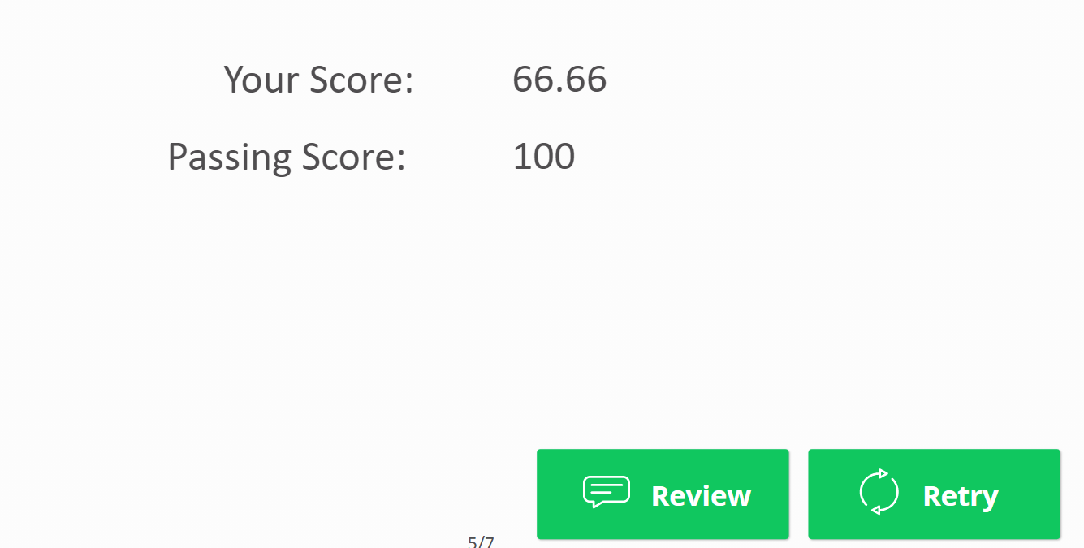
Assessment quiz results

Slide 22
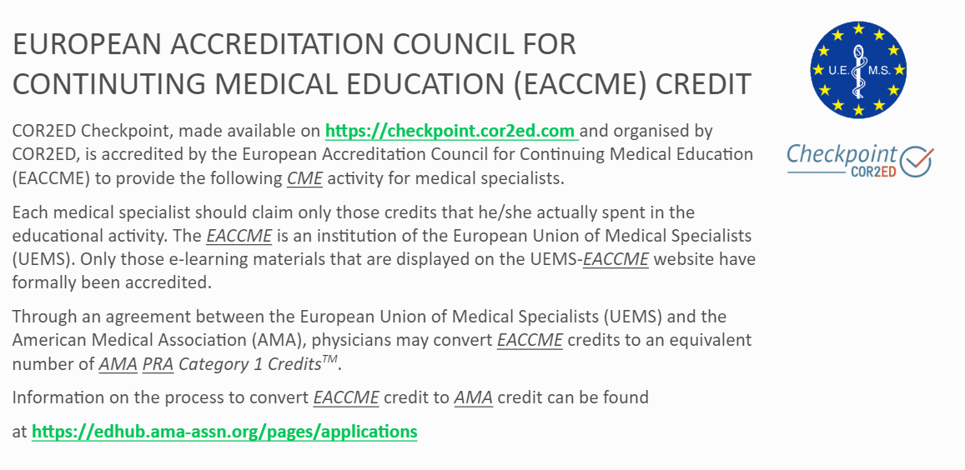

Slide 23
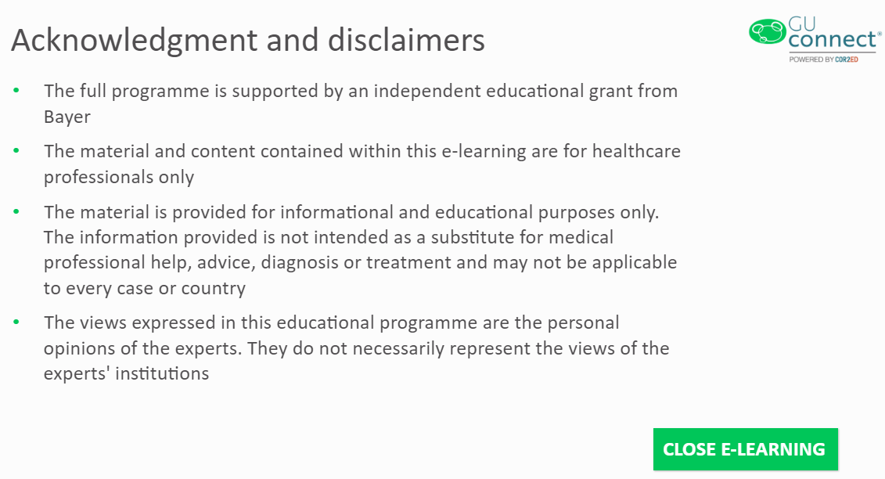
Ipsen, Kyowa Kirin and Ultragenyx
For details of expert disclosures please return to the Scientific Committee information accessible via the course home page
Notes:
GU CONNECT
Revised proposal…removed EU Masterclass and Newsletter translations
Virtual meetings at ASCO GU and ESMO
EKS around ESMO time
Repurposing of US masterclass content into 2-3 standard e-learnings or 1 x fully interactive e-learning with MOC points attached?
Extension of podcasts – aiming for a real series
Feedback from experts in the GU CONNECT meeting was that the Radiopharmaceuticals podcast would be of more value after the VISION trial reports (possible after ASCO 2021)
Suggested content to cover Radium-223, Lutetium, potential cross-resistance)
Other suggestions for podcasts include: Best of 2020 or Update from Podcast with short episodes on different tumour types
PARPi – Interview style podcast between Tia Higano and Elena Castro

