Slide 2
Response to Immunotherapy in Hepatocellular Carcinoma:
Real-World Experience and Treatment Sequencing with NASH/NAFLD Risk Factors
Sammy Saab, MD, MPH, AGAF, FACG, FAASLD
Medical Director, Pfleger Liver Institute
Medical Director, Adult Liver Transplant Program
Chief, Transplant Hepatology
Head, Outcomes Research in Hepatology
Professor of Medicine and Surgery and
Adjunct Professor of Nursing
David Geffen School of Medicine, UCLA
NASH, nonalcoholic steatohepatitis; NAFLD, nonalcoholic fatty liver disease

Slide 3
DISCLAIMER
Please note: Views expressed within this presentation are the personal opinions of the expert.
They do not necessarily represent the views of the expert’s academic institution or the rest of
HCC CONNECT group.
This content is supported by an independent educational grant from Bayer.
Disclosures: Prof Sammy Saab has received honoraria from the following: Eisai, Exelixis.

Slide 4
Aims
Review the emerging role of fatty liver as a cause of chronic liver disease and
hepatocellular carcinoma
Understand the role of immunotherapy for the treatment of hepatocellular carcinoma and its potential limitations to efficacy in varied patient populations
Be familiar with sequential therapy for hepatocellular carcinoma

Slide 5
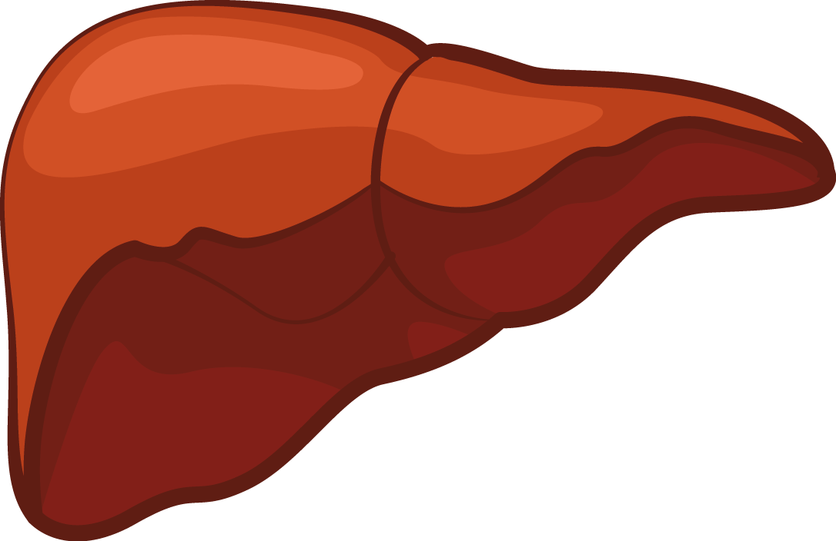
Worldwide Prevalence of NAFLD
Europe
23.7%
Asia
27.4%
North America
24.1%
In T2DM
68.0%
In T2DM
52.0-57.9%
Worldwide prevalence
of NAFLD is 25%
In T2DM (US)
51.8%
Middle East
31.8%
In T2DM
67.3%
Worldwide prevalence of
NAFLD among people
with T2DM is 55.5%
South America
30.5%
Africa
13.5%
In T2DM
56.8%
In T2DM
30.4%
Prevalence of NASH in general population is between 1.5-6.5%
Prevalence of NASH among T2DM is 37.3% (24.7-50.0%)
NAFLD, nonalcoholic fatty liver disease; T2DM, type 2 diabetes mellitus
Younossi Z, et al. Nat Rev Gastroenterol Hepatol. 2018;15(1):11-20

Slide 6
Natural history of NAFLD
Fibrosis progression rate in
NASH: 1 stage per 7 years
20% of patients are fast progressors:
To cirrhosis in 10 years
NAFLD
60-80 million
Americans
NASH
15-20 million
20-30%
over 3 years
20% stage 3
over 2 years
30-40% of patients
with cirrhosis die
from liver disease
Fibrosis
13-16 million
Stage 1-3
Cirrhosis
1-2 million
1.5-2% per year
20% over
2 years
HCC
(Hepatocellular
carcinoma)
Liver failure
Liver death
Risk of death in NASH
1 – Cardiovascular disease
2 – Cancer
3 – Liver
Liver transplant
Multiple sources: 40+ studies
HCC, hepatocellular carcinoma; NASH, nonalcoholic steatohepatitis; NAFLD, nonalcoholic fatty liver disease
Loomba R, et al. Cell. 2021;184(10):2537-64

Slide 7
Prevalence of HCC in Waitlisted Candidates by Etiology
14
12
NASH
10
8
HCC prevalence relative to 2002 level
ALD+CHC
6
CHC
4
ALD
2
CHB
0
2002
2004
2006
2008
2010
2012
2014
2016
Dotted lines represent linear trends
ALD, alcoholic liver disease; CHB, chronic hepatitis B; CHC, chronic hepatitis C; HCC, hepatocellular carcinoma; NASH, nonalcoholic steatohepatitis
Younossi Z, et al. Clin Gastroenterol Hepatol. 2019;17(4):748-55

Slide 8
Barcelona clinic liver cancer (BCLC) staging and treatment strategy in 2022
HCC
Based on tumour burden, liver function and physical status
Refined by AFP, ALBI score,
Child-Pugh, MELD
Very early stage (0)
Single ≤2 cm
Preserved liver function*, PS 0
Early stage (A)
Single, or ≤3 cm nodules each ≤3 cm
Preserved liver function*, PS 0
Intermediate stage (B)
Multinodular
Preserved liver function*, PS 0
Advanced stage (C)
Portal invasion and/or extrahepatic spread
Preserved liver function, PS 1-2
Terminal stage (D)
Any tumour burden
End-stage liver function, PS 3-4
Prognosis
To decide individualised
treatment approach
Potential candidate
for liver
transplantation
Single
≤3 nodules,
each ≤3 cm
Extended
liver transplant
criteria
(size, AFP)
Well-defined
nodules, preserved
portal flow,
selective access
Diffuse, infiltrative, extensive
bilobar liver involvement
Patient characterisation
No
Yes
Portal pressure
bilirubin
Normal
Increased^
Contraindications
to LT
Yes^
No
1st Treatment option
Ablation
Resection
Ablation
Transplant
TACE
Systemic treatment
BSC
Expected survival
>5 years
>2.5 years
>2 years
3 months
Treatment stage migration
Primes lower priority
options due to non-liver
related clinical profile
(Age, comorbidities, patient
values and availability)
Not feasible or failure
Successful
downstaging
1st Line
Atezolizumab-bevacizumab/durvalumab-tremelimumab
If not feasible sorafenib or lenvatinib or durvalumab
Clinical decision-making
Not
feasible
or failure
2nd Line
Regorafenib
(sorafenib-tolerant)
Cabozantinib
Ramucirumab
(AFP ≥400 ng/ml)
Not
feasible
Clinical trials
TACE
Radioembolisation (only for single lesion ≤8 cm)
Post sorafenib
Post atezolizumab-bevacizumab
Post durvalumab-tremelimumab
Post lenvatinib or durvalumab
Not feasible
Alternative
sequences may
be considered
but they have not
been proved
* Except for those with tumour burden acceptable for transplant
^ Resection may be considered for single peripheral HCC with adequate remnant liver volume
3rd Line
Cabozantinib
Not
feasible
AFP, alpha-fetoprotein; ALBI, albumin–bilirubin; BSC, best supportive care; HCC, hepatocellular carcinoma; LT, liver transplantation; MELD, model for end-stage liver disease; PS, performance status; TACE, transarterial chemoembolisation
Reig M, et al. J Hepatol. 2022;76(3):681-93

Slide 9
A Multidisciplinary Team Is Important to Determine Course of Therapy for Patients with HCC
Patient
with
HCC
Hepatology
Hepatobiliary and transplant surgery
Diagnostic radiology
Medical oncology
Radiation oncology
Palliative care
Primary care provider
Pathology
Interventional
radiology
HCC, hepatocellular carcinoma

Slide 10
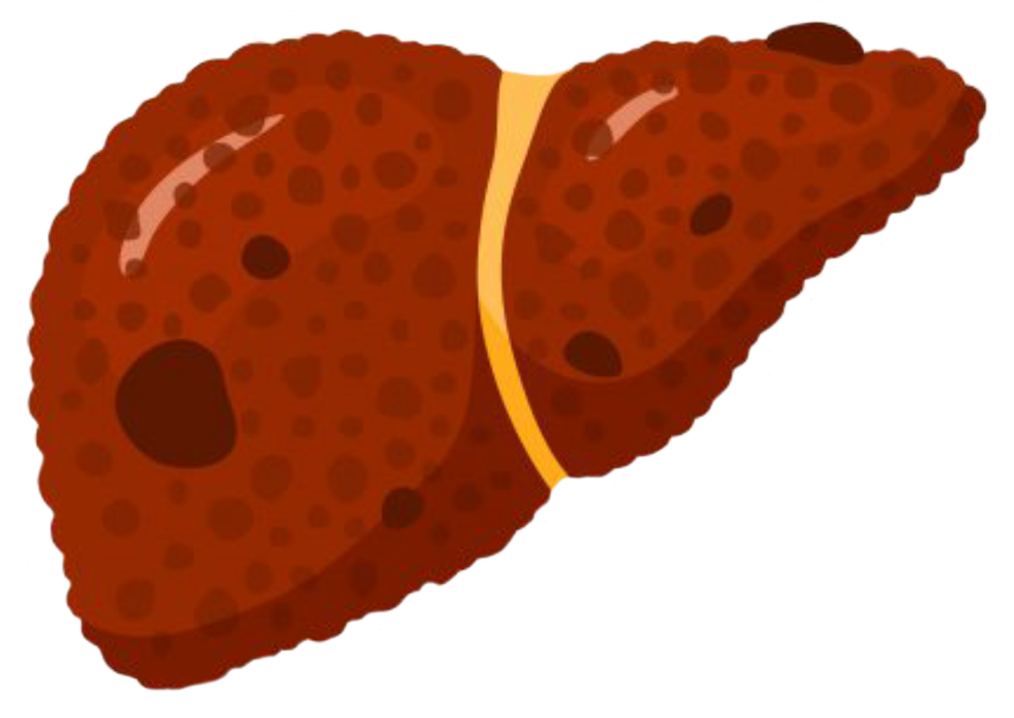
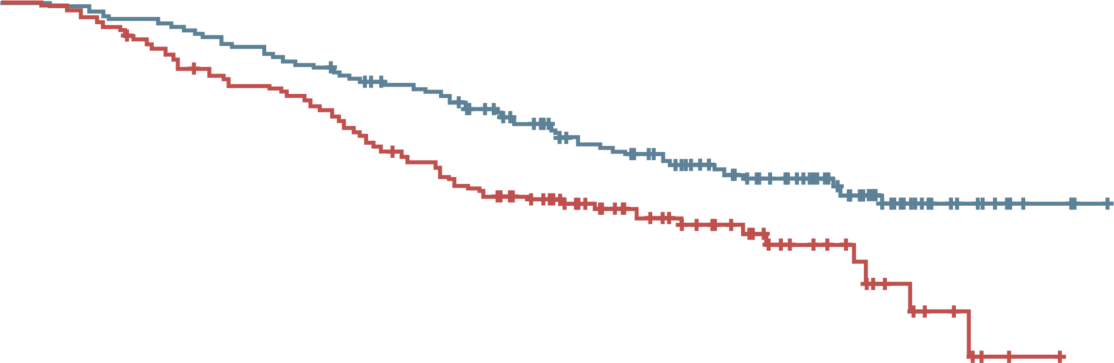
Atezolizumab + Bevacizumab as First-Line Therapy for HCC
PHASE 3, OPEN-LABEL, MULTICENTRE, RANDOMISED TRIAL
100
Overall survival
80
Atezolizumab + bevacizumab
(N=336)
60
Survival (%)
501
Patients with locally advanced hepatocellular carcinoma
(metastatic or unresectable,
or both)
40
HR for death, 0.58;
95% CI, 0.42-0.79; p<0.001
Sorafenib
(N=165)
20
0
0
2
4
6
8
10
12
14
16
Months
Atezolizumab + bevacizumab
Sorafenib
Median
progression-free
survival
6.8 months
4.3 months
HR for disease progression or death, 0.59; 95% CI, 0.47-0.76; p<0.001
Atezolizumab + bevacizumab
Sorafenib
Overall survival
at 12 months
67.2%
(95% CI, 61.3-73.1)
54.6%
(95% CI, 45.2-64.0)
CI, confidence interval; HCC, hepatocellular carcinoma; HR, hazard ratio
Finn R, et al. N Engl J Med. 2020; 382(20):1894-1905

Slide 11
Lack of Immunotherapy Response in Patients with NON-VIRAL Advanced HCC vs control
Meta-analysis of three large randomised controlled phase 3 trials of immunotherapies in patients with advanced HCC
  CheckMate-459: nivolumab versus sorafenib in first line
  IMbrave150: atezolizumab plus bevacizumab versus sorafenib in first line
  KEYNOTE-240: pembrolizumab versus placebo in second line
Immunotherapy improved survival in the overall population (HR 0.77; 95% CI 0.63-0.94)
Survival was superior to the control arm in patients with HBV-related HCC (n=574; p=0.0008) and HCV-related HCC (n=345; p=0.04)
Survival was not superior to control arm in patients with non-viral HCC (n=737; p=0.39)
CI, confidence interval; HBV, hepatitis B virus; HCC, hepatocellular carcinoma; HCV, hepatitis C virus; HR, hazard ratio
Pfister D, et al. Nature. 2021;592(7854):450-6

Slide 12

in Patients with Advanced HCC Treated with Immunotherapy, Survival may be Related to Underlying Liver Disease
Study | HR (95% CI) | HR ± 95% CI | Immunotherapy n | Control n | Weight
CheckMate-459 IMbrave150 KEYNOTE-240 Subtotal | 0.95 (0.74, 1.22) 0.91 (0.52, 1.59) 0.88 (0.64, 1.21) 0.92 (0.77, 1.11) |  | 168 100 163 431 | 168 53 85 306 | 22.7% 9.3% 18.6% 50.6%
CheckMate-459 IMbrave150 KEYNOTE-240 Subtotal | 0.74 (0.58, 0.94) 0.48 (0.33, 0.70) 0.70 (0.42, 1.17) 0.64 (0.48, 0.84) |  | 203 236 115 554 | 203 112 50 365 | 23.1% 15.7% 10.7% 49.4%
Test for subgroup differences: 𝜒² = 4.58, d.f. = 1 (p=0.03), I² = 78.2%
Total | 0.77 (0.63, 0.94) |  | 985 | 671 | 100.0%
Meta-analysis of 1,656 patients
  Overall improved survival with immunotherapy
Separate meta-analyses were subsequently performed for each of the three etiologies: non-viral (NASH and alcohol intake), HCV and HBV
  Survival was superior to the control arm in patients with HBV-related HCC (n=574; p=0.0008) and HCV-related HCC (n=345; p=0.04)
  Survival not superior to control arm in patients with non-viral HCC (n=737; p=0.39)
Non-viral
HCC
Viral
HCC
0.2
0.5
1.0
2.0
Favours immunotherapy
Favours control
Study | HR (95% CI) | HR ± 95% CI | Immunotherapy n | Control n | Weight
CheckMate-459 IMbrave150 KEYNOTE-240 Subtotal | 0.95 (0.74, 1.22) 0.91 (0.52, 1.59) 0.88 (0.64, 1.21) 0.92 (0.77, 1.11) |  | 168 100 163 431 | 168 53 85 306 | 55.1% 11.0% 33.9% 100.0%
CheckMate-459 IMbrave150 KEYNOTE-240 Subtotal | 0.71 (0.50, 1.01) 0.43 (0.21, 0.87) 0.96 (0.48, 1.92) 0.68 (0.48, 0.97) |  | 87 72 43 202 | 86 36 21 143 | 56.6% 21.4% 22.0% 100.0%
CheckMate-459 IMbrave150 KEYNOTE-240 Subtotal | 0.77 (0.56, 1.06) 0.51 (0.32, 0.81) 0.57 (0.35, 0.93) 0.64 (0.49, 0.83) |  | 116 164 72 352 | 117 76 29 222 | 48.9% 26.5% 24.5% 100.0%
Non-viral
HCC
HCV-
HCC
HBV-
HCC
0.1
1.0
10.0
CI, confidence interval; d.f., degrees of freedom; HBV, hepatitis B virus; HCC, hepatocellular carcinoma; HCV, hepatitis C virus; HR, hazard ratio; NASH, nonalcoholic steatohepatitis
Pfister D, et al. Nature. 2021;592(7854):450-6
Favours immunotherapy
Favours control

Slide 13
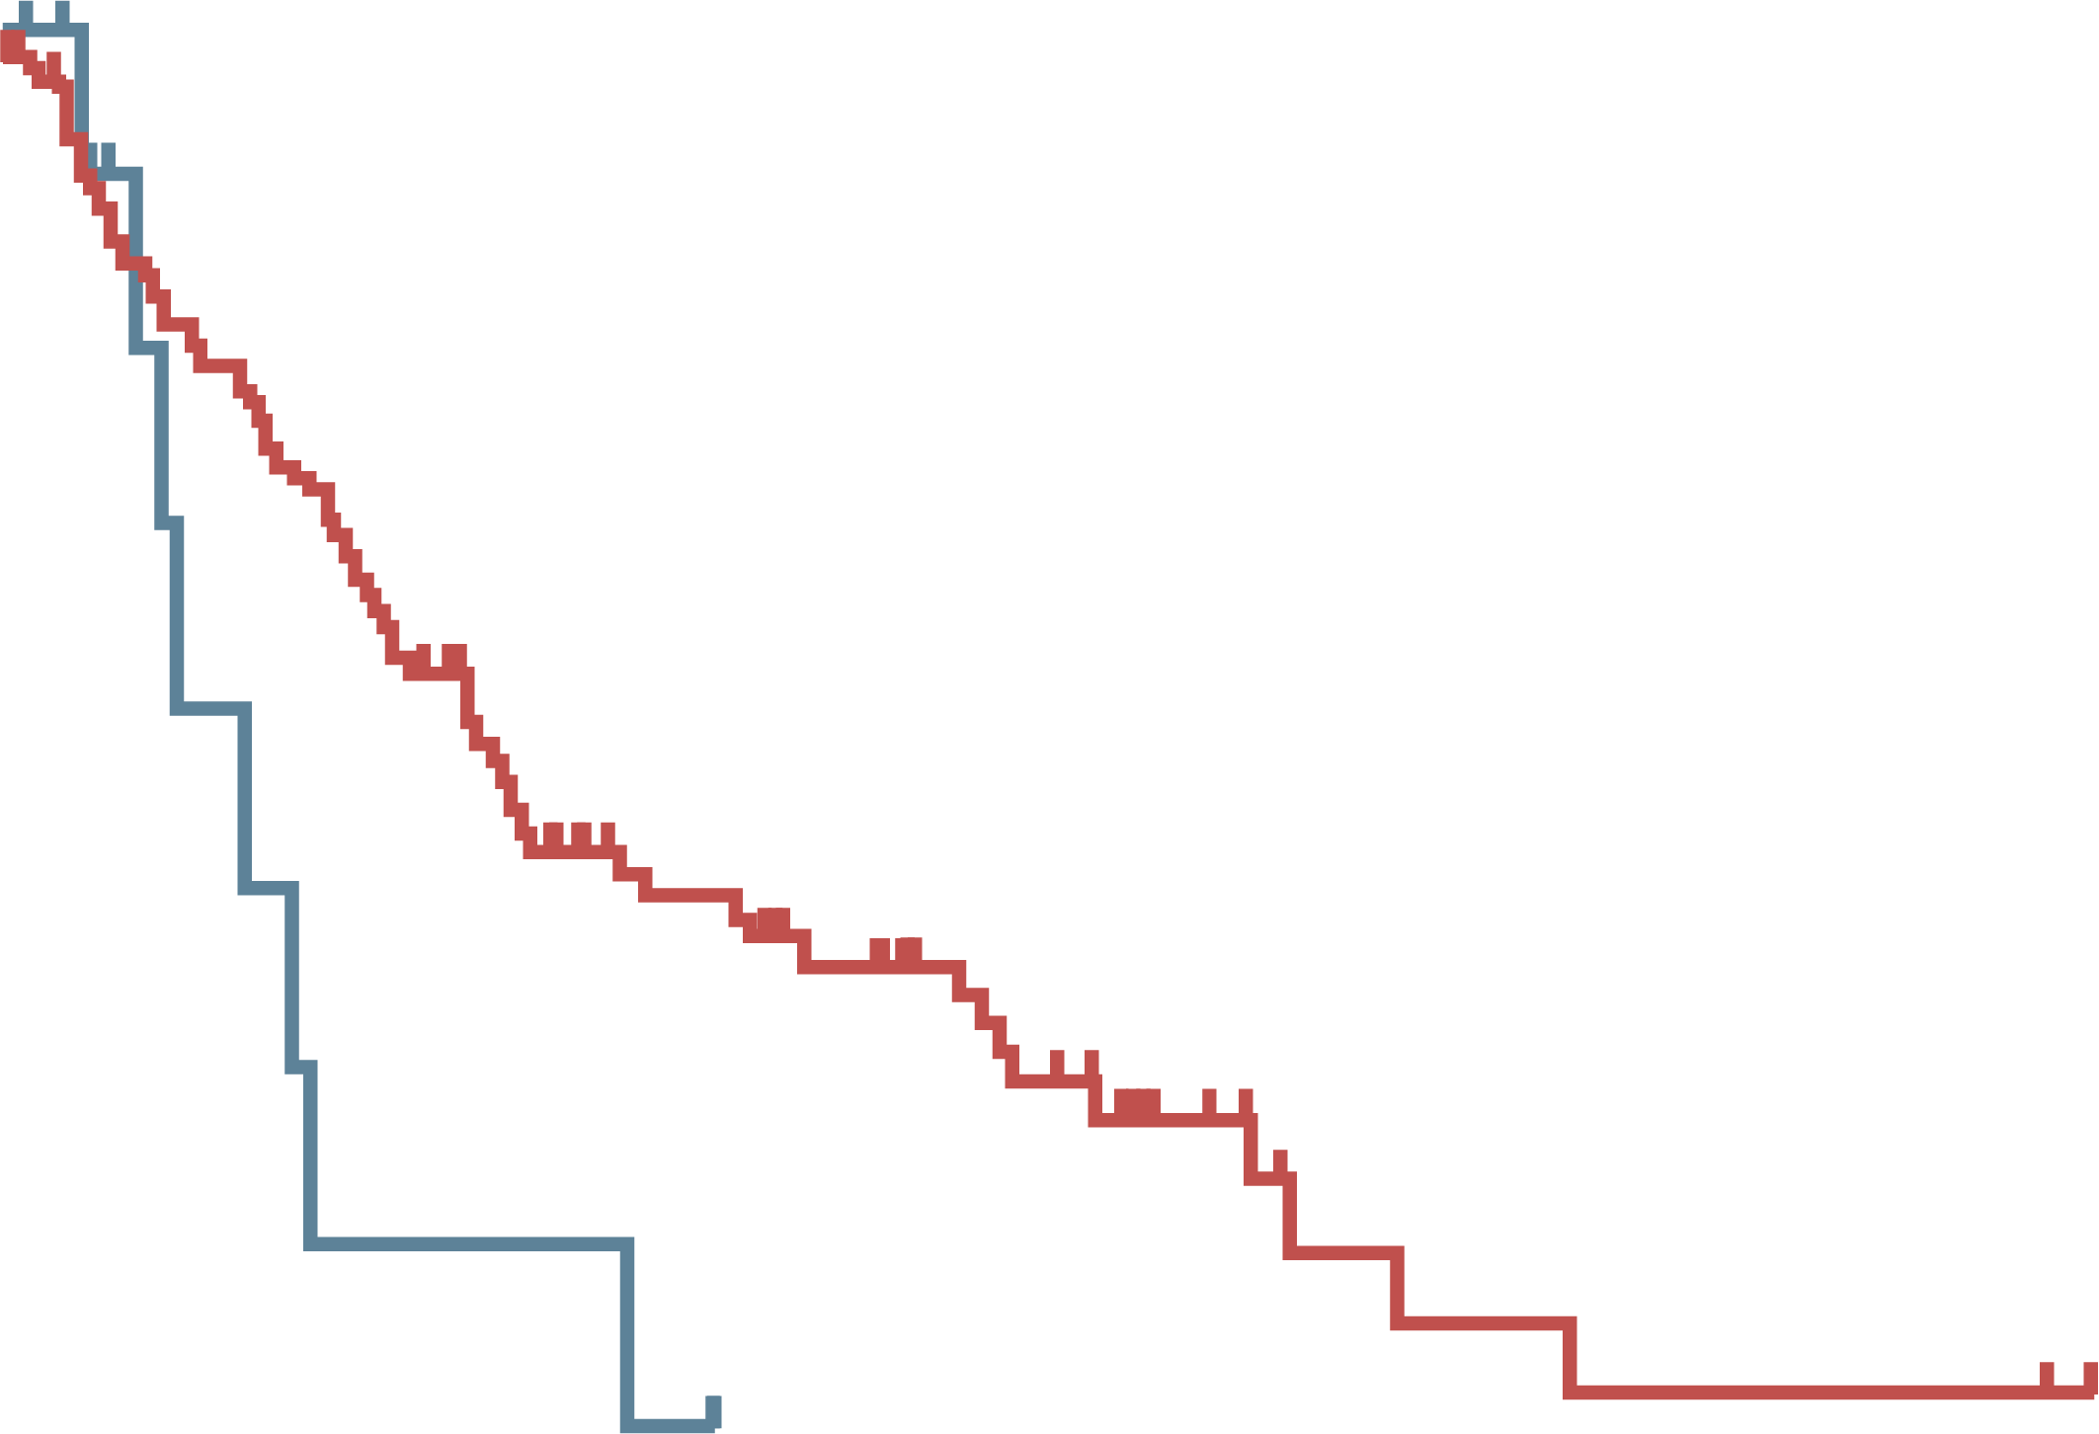
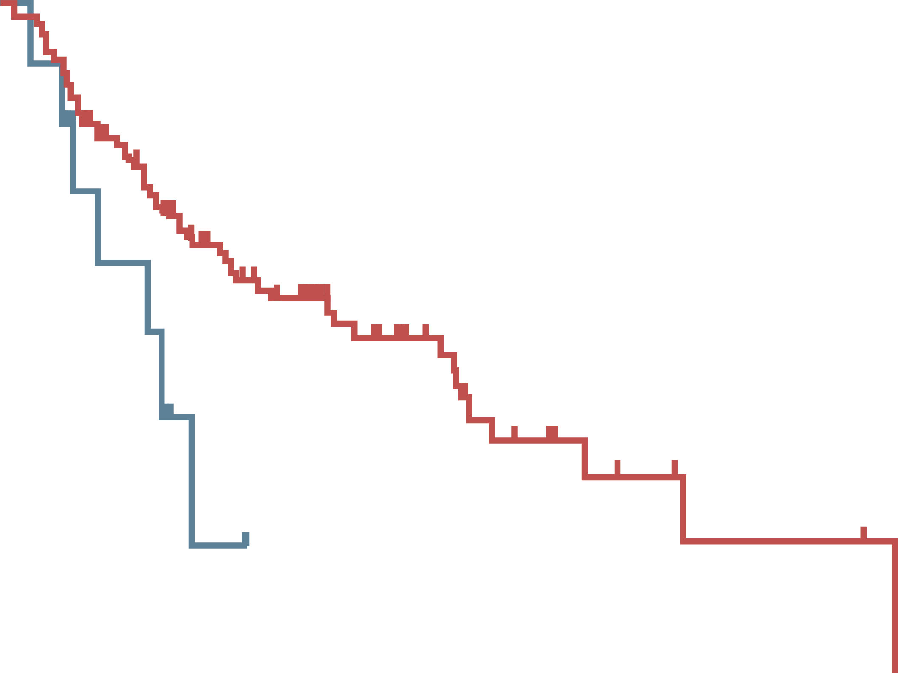
NAFLD is associated with a worse outcome in HCC patients treated with PD-L1‒targeted immunotherapy
Test cohort: 130 patients with advanced HCC
NAFLD associated with less frequent MVI (23% vs 49%)
Immunotherapy more often used as 1L (46% vs 23%) with NAFLD
Analysis corrected for CP score, MVI, performance status, and AFP
Validation cohort: 118 patients with advanced HCC
100
NAFLD: median 5.4 (95% CI 1.8-9.0) months
Other aetiologies: median 11.0
(95% CI 7.5-14.5) months
p=0.023
100
NAFLD: median 8.8 (95% CI 3.6-12.4) months
Other aetiologies: median 17.7
(95% CI 8.8-26.5) months
p=0.034
50
50
Overall survival (%)
Overall survival (%)
0
0
0
12
24
36
48
0
12
24
36
48
Months
Months
1L, first line; AFP, alpha-fetoprotein; CI, confidence interval; CP, Child-Pugh; HCC, hepatocellular carcinoma; MVI, macrovascular tumour invasion; NAFLD, nonalcoholic fatty liver disease; PD-L1, programmed death-ligand 1
Pfister D, et al. Nature. 2021;592(7854):450-6

Slide 14
Real-World Data: Response to Immunotherapy in HCC Patients with NASH at UCSD
Patient characteristics & responses
Characteristic | HCC with NASH cirrhosis | HCC without NASH cirrhosis | p value
Number of patients | 15 | 64
Median age (years) | 68 | 65.5
Male gender | 8 (53.3%) | 47 (73.4%) | 0.210
Hispanic ethnicity | 10 (66.7%) | 17 (26.6%) | 0.006
Immunotherapy agent
Atezolizumab | 8 (53.3%) | 27 (42.2%) | 0.566
Nivolumab | 6 (40%) | 32 (50%) | 0.572
Pembrolizumab | 1 (6.7%) | 5 (7.8%) | 1
Best response | HCC with NASH cirrhosis | HCC without NASH cirrhosis | p value
Disease progression | 7/15 (46.7%) | 7/64 (10.9%) | RR: 4.27; p=0.004
Disease control (stable, partial, or complete response) | 8/15 (53.3%) | 57/64 (89.1%) | RR: 1.67; p=0.004
HCC, hepatocellular carcinoma; NASH, nonalcoholic steatohepatitis; RR, risk ratio; UCSD, University of California, San Diego
Chang J, et al. ASCO GI 2022. Abstract #389. Poster presentation

Slide 15
Real-World Data: Response to Immunotherapy in HCC Patients with NASH at Mount Sinai
Patient characteristics
Characteristic | Total | Nonviral HCC | Viral HCC
Number of patients | 349
Median age (years) | 63
Male gender | 84%
Cirrhosis | 86%
Nivolumab | 87% (79% as first line)
Disease etiology |  | 103 (47% NASH) | 246
Median overall survival |  | 11.4 (95% CI 9.3-17.7) months | 19.3 (95% CI 14.2-26.6) months
Hazard ratio (adjusted for CP class and stage) for viral HCC treated with ICI was 0.81
(95% CI 0.583-1.127); p=0.21
Conclusion: Trend (not statistically significant) towards improved OS in patients in viral HCC compared with patients with non-viral HCC
CI, confidence interval; CP, Child-Pugh; HCC, hepatocellular carcinoma; ICI, immune checkpoint inhibitor; NASH, nonalcoholic steatohepatitis, OS, overall survival
Wu L, et al. ASCO GI 2022. Abstract #396. Poster presentation

Slide 16
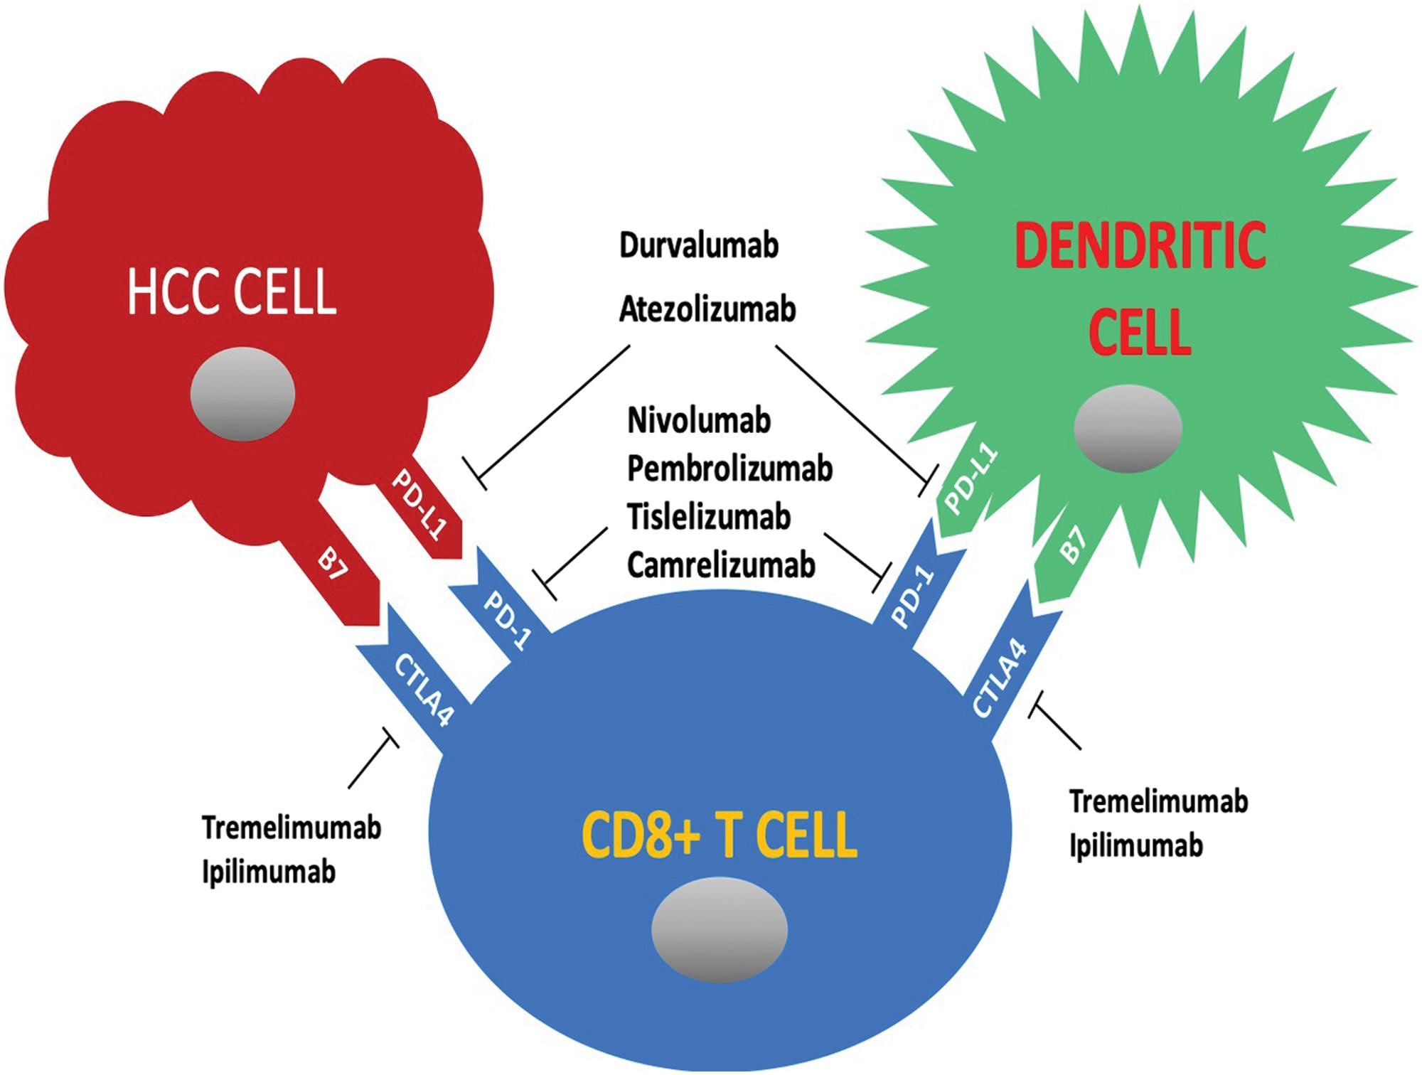
Mechanism of action of checkpoint inhibitors under investigation for HCC treatment
HCC tumour cells can up-regulate expression of PD-1, which binds PD-L1, and stimulates peripheral T-cell depletion. They can also activate CTLA-4, found on the surface of T-cells and leading to down-regulation of T-cells. Ipilimumab and tremelimumab bind to and inactivate CTLA-4, preventing its activation. PD-1‒PD-L1 binding may be prevented by therapeutically blocking either PD-1 (nivolumab, pembrolizumab, tislelizumab, and camrelizumab) or PD-L1 (durvalumab and atezolizumab)
CTLA-4, cytotoxic T-lymphocyte-associated protein 4; HCC, hepatocellular carcinoma; PD-1, programmed cell death 1; PD-L1, programmed death-ligand 1
Ghavimi S, et al. J Clin Transl Hepatol. 2020;8(2):168-76

Slide 17
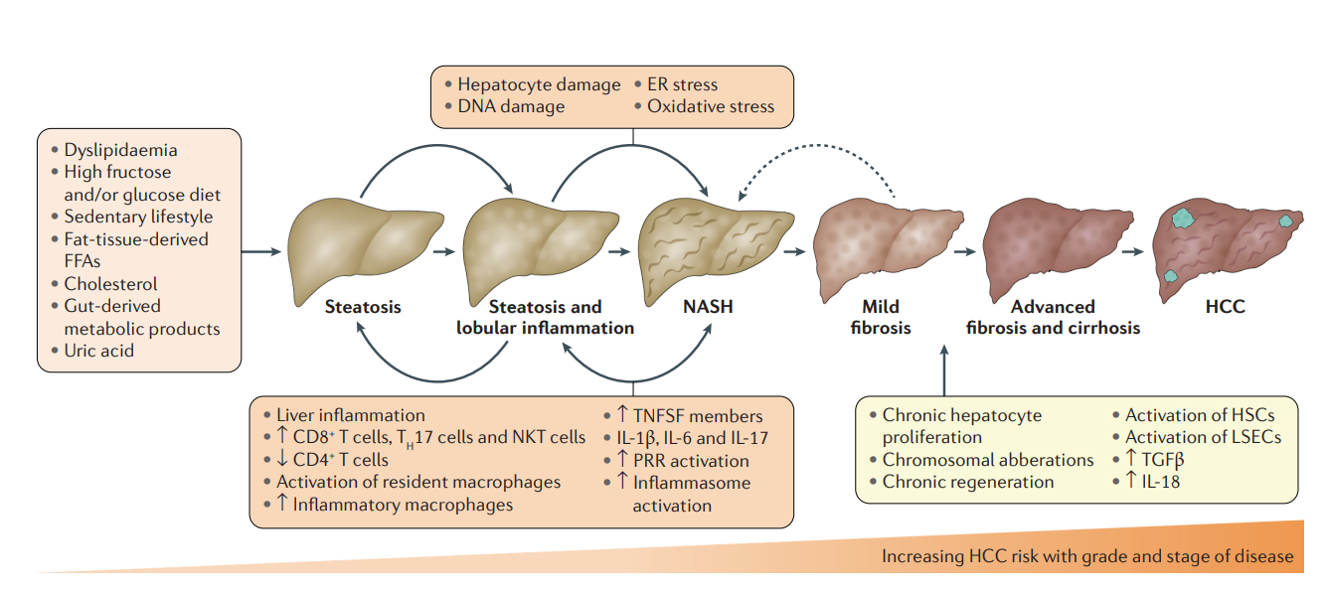
Proposed Mechanism to Explain Potential Differing Responses to Immunotherapy in HCC
NASH-induced HCC might be less responsive to immunotherapy, probably due to aberrant CD8+PD-1+ T-cell activation in NASH-affected livers
In preclinical models of NASH-induced HCC, therapeutic immunotherapy targeted at PD-1 expanded activated CD8⁺PD-1⁺ T cells within tumours but did not lead to tumour regression, which indicates that tumour immune surveillance was impaired
ER, endoplasmic reticulum; FFA, free fatty acid; HCC, hepatocellular carcinoma; HSC, hepatic stellate cell; IL, interleukin; LSEC, liver sinusoidal endothelial cell; NASH, nonalcoholic steatohepatitis; NKT cell, natural killer T-cell; PD-1, programmed cell death 1; PRR, pattern recognition receptor; TGF, transforming growth factor; TNFSF, tumour necrosis factor superfamily
Anstee QM, et al. Nat Rev Gastroenterol Hepatol. 2019;16(7):411-28; Pfister D, et al. Nature. 2021;592(7854):450-6

Slide 18
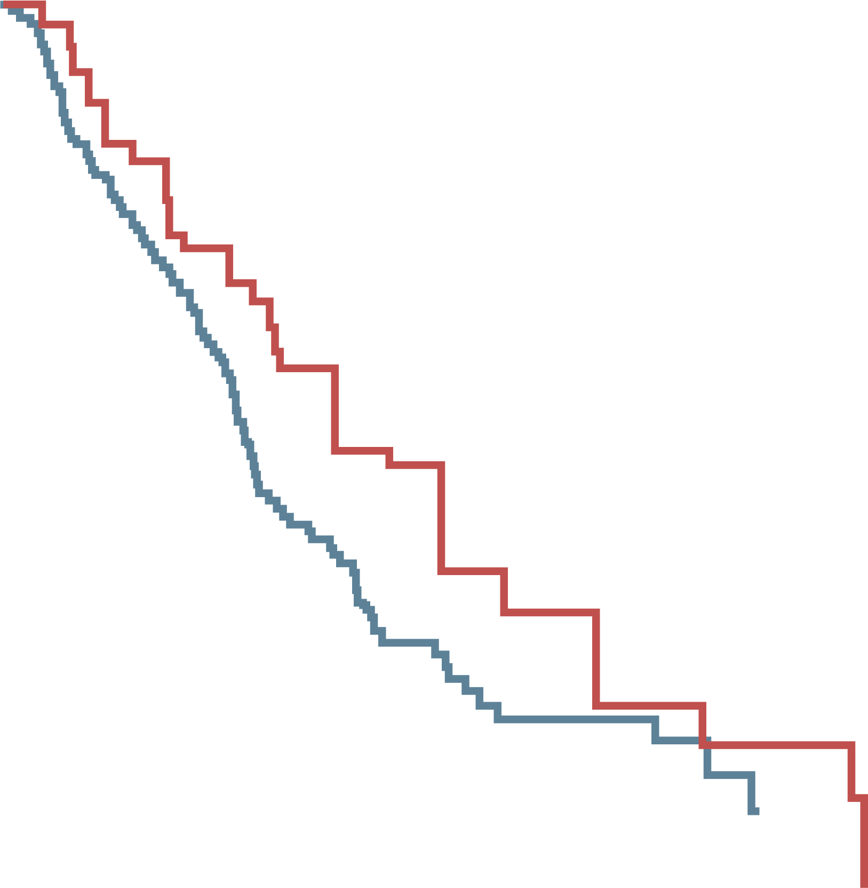
Overall Survival OF Virus/Alcohol versus NAFLD/NASH Patient Groups treated with sorafenib
Characteristic | All patients | Virus/alcohol | NAFLD/NASH | p
N | 180 | 143 | 37
Age (years) | 72 (36-91) | 71 (36-91) | 76 (61-87) | 0.006
Sex (female/male) | 31/149 | 27/116 | 4/33 | 0.246
Etiology (virus/alcohol/ NAFLD + NASH) | 124/19/37 | 124/19/0 | 0/0/37 | <0.001
Tumour size (mm) | 31 (10-190) | 32 (10-190) | 27.5 (10-150) | 0.445
BCLC stage (A/B/C) | 3/80/97 | 2/62/79 | 1/18/18 | 0.696
Macrovascular invasion (none/ major Vp(−)/major Vp(+)) | 147/16/17 | 116/14/13 | 31/2/4 | 0.566
Extrahepatic spread (yes/no) | 79/101 | 63/80 | 16/21 | 0.929
AFP (ng/ml) | 77.2 (0.9-470,335) | 101.4 (0.9-177,630) | 27.7 (0.9-470,335) | 0.208
DCP (mAU/ml) | 278 (3.9-89,928) | 278 (3.9-54,583) | 285 (13-89,928) | 0.762
Data are expressed as median (range), or number
100
Virus + alcohol
NAFLD + NASH
80
Virus + alcohol median OS 16.7 months
NAFLD + NASH median OS 22.7 months
60
Overall survival (rate)
40
p=0.002
20
0
0
500
1000
1500
2000
Time (days)
No. at risk
Virus + alcohol
NAFLD + NASH
143
37
60
22
17
9
3
3
0
0
Conclusion: Sorafenib treatment improved the overall survival of patients with NAFLD or NASH-related HCC versus patients with viral/alcohol causes of liver disease
AFP, alpha-fetoprotein; BCLC, Barcelona Clinic Liver Cancer; DCP, des-γ-carboxy prothrombin; HCC, hepatocellular carcinoma; NAFLD, nonalcoholic fatty liver disease; NASH, nonalcoholic steatohepatitis; OS, overall survival; Vp, vascular invasion
Shimose S, et al. Cancer Med. 2021;10(23):8530-41

Slide 19
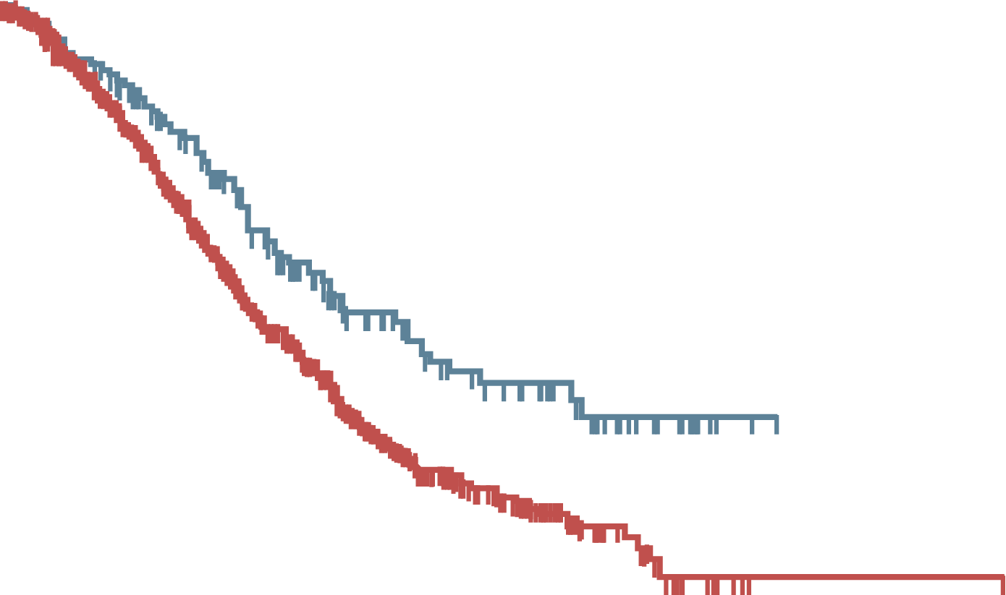
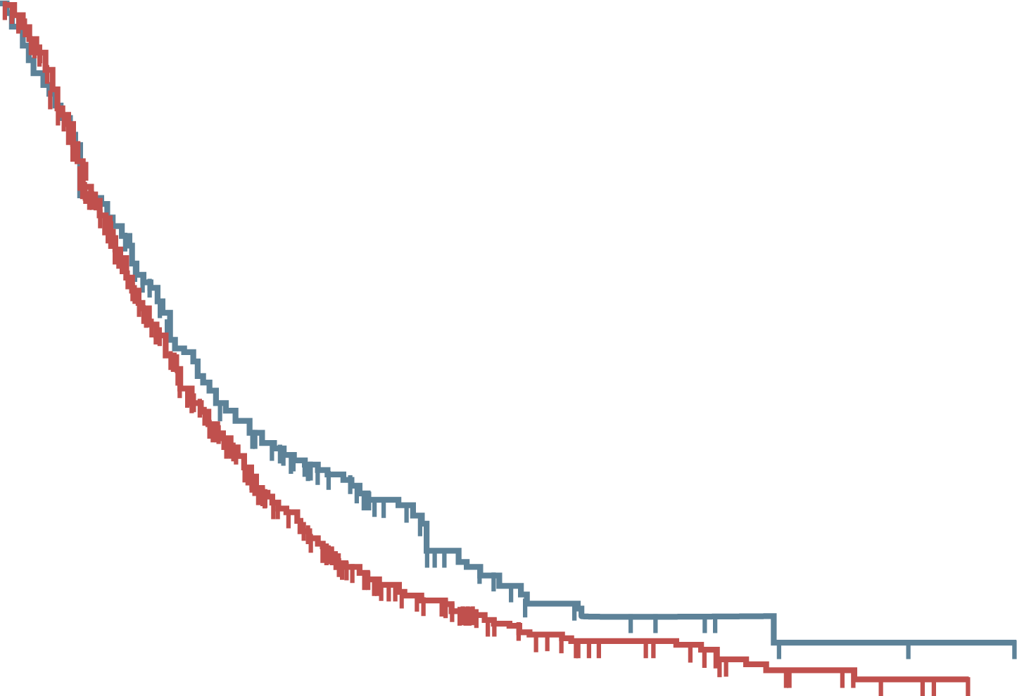
Kaplan–Meier Survival Curves for HCC Patients Treated with Lenvatinib, according to Liver Disease Etiology
Parameters | All Population | NASH correlate | No NASH correlate | p value
Age (years), median (range) | 75 (25-91) | 76 (45-91) | 73 (25-89) | 0.41
Gender Female Male | 21.7 78.3 | 25.4 74.6 | 20.8 79.2 | 0.13
ECOG PS 0 >0 | 82.0 18.0 | 81.8 18.2 | 82.0 18.0 | 0.92
Child-Turcotte- Pugh score A B | 88.2 11.8 | 88.1 11.9 | 88.2 11.8 | 1.00 1.00
BCLC stage B C | 44.2 55.8 | 42.8 57.2 | 44.6 55.4 | 0.66
AFP <400 >400 | 68.8 31.2 | 78.8 21.2 | 66.6 33.4 | 0.0002
Subsequent therapy TACE Immunotherapy Sorafenib Other treatments No treatment |  | 22.6 3.1 23.3 3.8 47.2 | 18.1 6.8 18.1 4.8 52.2 | 0.13
Overall survival
Progression-free survival
100
No NASH correlate
NASH correlate
100
No NASH correlate
NASH correlate
90
90
80
80
70
70
60
60
50
50
Survival probability (%)
Survival probability (%)
40
40
30
30
20
20
10
10
0
0
No. at risk
No NASH
NASH
0
10
20
30
40
50
No. at risk
No NASH
NASH
0
10
20
30
40
995
236
437
125
106
39
17
11
1
0
0
0
995
236
190
65
29
10
7
2
0
0
Conclusion: Overall survival with lenvatinib greater in patients with NASH and HCC than in patients with non-NASH and HCC. Progression-free survival similar between both groups
AFP, alpha-fetoprotein; BCLC, Barcelona Clinic Liver Cancer; ECOG PS, Eastern Cooperative Oncology Group performance status; HCC, hepatocellular carcinoma; NASH, nonalcoholic steatohepatitis; TACE, transarterial chemoembolisation
Rimini M, et al. ESMO Open. 2021;6(6):100330

Slide 20
Real-World Effectiveness of Lenvatinib for HCC in Patients with NASH
 | Lenvatinib for HCC
 | NASH Cohort (n=67) | First Line (n=32) | Second or Later Line (n=35)
PFS rate, %
3 mo | 89 | 90 | 88
6 mo | 75 | 77 | 74
12 mo | 57 | 43 | 69
OS rate, %
3 mo | 99 | 100 | 97
6 mo | 92 | 93 | 91
12 mo | 61 | 66 | 58
Conclusion: Clinical outcomes with lenvatinib for uHCC and NASH similar to outcomes of overall cohort of 397 patients
NASH, nonalcoholic steatohepatitis; mo, months; OS, overall survival; PFS, progression-free survival; (u)HCC, (unresectable) hepatocellular carcinoma
Singal AG, et al. Future Oncol. 2021;17(21):2759-68; Singal et al. Clin Gastroenter Hepatol. 2021. DOI:10.1016/j.cgh.2021.11.020

Slide 21
National Comprehensive Cancer Network (NCCN) Proposed Sequence for the Treatment of HCC
FIRST-LINE SYSTEMIC THERAPY
Preferred regimens | Other Recommended Regimens | Useful in Certain Circumstances
Atezolizumab + bevacizumab (Child-Pugh Class A only) (category 1) | Sorafenib (Child-Pugh Class A) [category 1] or B7) Lenvatinib (Child-Pugh Class A only) (category 1) | Nivolumab (if ineligible for tyrosine kinase inhibitors or other anti-angiogenic agents) (Child-Pugh Class A or B) (category 2B) FOLFOX (category 2B)
Subsequent-Line Therapy if Disease Progression | Other Recommended Regimens
Options Regorafenib (Child-Pugh Class A only) (category 1) Cabozantinib (Child-Pugh Class A only) (category 1) Ramucirumab (AFP ≥400 ng/mL only) (category 1) Lenvatinib (Child-Pugh Class A only) Sorafenib (Child-Pugh Class A or B7) | Nivolumab (Child-Pugh Class A or B) Nivolumab + ipilimumab (Child-Pugh Class A only) Pembrolizumab (Child-Pugh Class A only) (category 2B)
AFP, alpha-fetoprotein; FOLFOX, fluorouracil, leucovorin, and oxaliplatin; HCC, hepatocellular carcinoma
Benson AB, et al. J Natl Compr Canc Netw. 2021;19(5):541-65

Slide 22
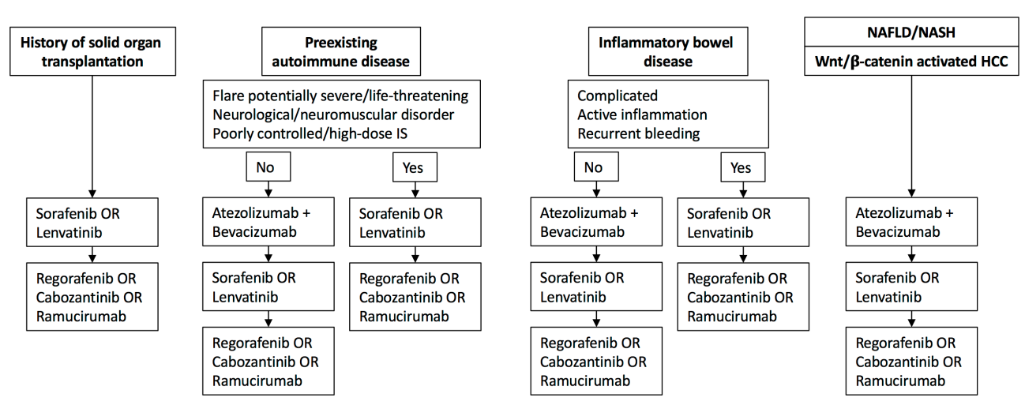
Proposed Treatment Algorithms for Special Populations
HCC, hepatocellular carcinoma; IS, immunosuppression; NAFLD, nonalcoholic fatty liver disease; NASH, nonalcoholic steatohepatitis
Pinter M, et al. Gut. 2021;70(1):204-14

Slide 23
Conclusions
A major consequence of the epidemic of NASH is the increasing incidence of HCC
Multidisciplinary teams are helpful to determine treatment paradigms in patients with HCC
Although survival in patients with HCC is substantially improved with immunotherapy, the benefits may not be equally realised by all patients
Clinicians must be prepared for sequential therapy in patients treated for HCC, particularly those with underlying NAFLD
HCC, hepatocellular carcinoma; NAFLD, nonalcoholic fatty liver disease; NASH, nonalcoholic steatohepatitis

Slide 24




REACH HCC CONNECT VIA
TWITTER, LINKEDIN, VIMEO & EMAIL
OR VISIT THE GROUP’S WEBSITE https://hccconnect.cor2ed.com/
Follow us on Twitter
@hccconnectinfo
Follow the
HCC CONNECT
group on LinkedIn
Watch us on the
Vimeo Channel
HCC CONNECT
Email
froukje.sosef
@cor2ed.com

