Slide 2
Meeting summary asbmr 2021, hybrid MEETING
Professor Dr. Oliver Semler, MD
Children´s Hospital, Department of Rare Skeletal Diseases in Childhood
University Hospital Cologne, Germany
RARE BONE DISEASE HIGHLIGHTS FROM DAY 2
OCTOBER 2021

Slide 3
Disclaimer and disclosures
Please note: The views expressed within this presentation are the personal opinions of the authors and do not necessarily represent the views of the author’s academic institution.
This content is supported by an independent educational grant from Ipsen, Kyowa Kirin and Ultragenyx.
Professor Dr Oliver Semler, MD has no disclosures to declare.

Slide 4
ENPP1

Slide 5
ENPP1: Background
Ectonucleotide pyrophosphatase/phosphodiesterase 1 (ENPP1) is a membrane-bound glycoprotein that regulates bone mineralisation by hydrolysing extracellular nucleotide triphosphates to
produce pyrophosphate
ENPP1-deficiency results in either lethal arterial calcifications (Generalised Arterial Calcification of Infancy, GACI), phosphate wasting rickets, early onset osteoporosis, or progressive spinal rigidity
and a 50% lethality during infancy
Patients with moderate phenotypes can present with rickets-like appearance on x-rays
ENPP1, ectonucleotide pyrophosphatase/phosphodiesterase 1
Kato K, et al. Proc Natl Acad Sci USA. 2012;109:16876-81 ; Maulding N, et al. Bone 2021;142:115656; Ferreira C, et al. J Bone Miner Res. 2021. DOI: 10.1002/jbmr.4418; Rutsch F. ASBMR 2021, Abstract #FRI-265 and O’Brien K, et al. ASBMR 2021, Abstract #1037; https://cor2ed.com/podcast-rare-bone-disease-highlights-at-asbmr-2021/

Slide 6



ENPP1-deficient patients present with both skeletal complications and ectopic calcification
Study design
Here we report a cross-sectional, retrospective study of patients with ENPP1-deficiency, characterising the prevalence and onset of skeletal complications to accelerate diagnosis and management
Subgroup analysis 74 patients with ENPP1-deficiency
116 patients with GACI, 11 patients
with ARHR2
127 medical records
19 countries
ARHR2, autosomal recessive hypophosphataemic rickets type 2; ENPP1, ectonucleotide pyrophosphatase/phosphodiesterase 1; GACI, generalised arterial calcification of infancy
Rutsch F, et al. ASBMR 2021, Abstract #FRI-265; https://cor2ed.com/podcast-rare-bone-disease-highlights-at-asbmr-2021/

Slide 7
ENPP1-deficient patients present with both skeletal complications and ectopic calcification
Key findings
46% presented with findings suggestive of rickets or osteomalacia (ie. altered gait, bowed extremities, metaphyseal cupping or short stature)
  25% of patients with skeletal complications did not have a diagnosis of GACI
Rickets may be the first presentation for these patients and a diagnosis of ENPP1-deficiency
should still be considered even if no prior history of calcification or GACI
Currently the treatment of choice in the patients is an enzyme replacement therapy which
prevents calcification of the vessels and may partially restore the skeletal phenotype but this has to be given twice a week
Gene therapy being explored as a therapeutic option
ENPP1 Deficiency should be considered as differential diagnosis in cases of rickets-like symptoms without alterations of vitamin D or phosphate levels
ENPP1, ectonucleotide pyrophosphatase/phosphodiesterase 1; GACI, generalised arterial calcification of infancy
Rutsch F, et al. ASBMR 2021, Abstract #FRI-265; https://cor2ed.com/podcast-rare-bone-disease-highlights-at-asbmr-2021/

Slide 8
Treatment with an AAV vector expressing ENPP1-Fc prevents ectopic tissue calcification and restores bone parameters in ENPP1 deficient mice
Study design
An adeno-virus vector was developed expressing a modified human ENPP1-Fc as a potential treatment for ENPP1-deficiency, AAV-ENPP1
The aim of this research was to develop a one-dose gene therapy to treat ENPP1-deficiency
One dose of AAV-ENPP1
low, medium or high vg/kg
Endpoints:
Plasma PPI levels
Tissue calcium content
Micro-CT analysis of bone
10 weeks
One dose of vehicle
Murine model of ENPP1-deficiency
(mice ~2 weeks old)
AAV, adeno-virus vector; CT, computed tomography; ENPP1, ectonucleotide pyrophosphatase/phosphodiesterase 1; PPI, inorganic pyrophosphate; vg, vector genomes
O’Brien K, et al. ASBMR 2021, Abstract #1037; https://cor2ed.com/podcast-rare-bone-disease-highlights-at-asbmr-2021/

Slide 9
Treatment with an AAV vector expressing ENPP1-Fc prevents ectopic tissue calcification and restores bone parameters in ENPP1 deficient mice
Key findings
Positive response to correct ENPP1-deficiency with this viral treatment
After administration of a single dose of AAV-ENPP1 there was:
  An increase in PPI levels
  Decreased tissue calcification and improved mineralisation of the bones
  An improved rickets-like phenotype
Next steps would be to determine the lowest effective dose and conduct a safety assessment followed by clinical trials
ENPP1, ectonucleotide pyrophosphatase/phosphodiesterase 1; PPI, inorganic pyrophosphate
O’Brien K, et al. ASBMR 2021, Abstract #1037; https://cor2ed.com/podcast-rare-bone-disease-highlights-at-asbmr-2021/

Slide 10
ENPP1: Clinical perspectives
From: dr. semler
Normally a rickets-like X-ray is only conducted due to bowing of long bones or in cases of impaired bone mineralisation defects (vitamin D deficiency or phosphate wasting).
X-rays of metaphyseal areas need to be taken also in cases of ectopic calcification
Data presented at ASBMR show that ENPP1 has to be considered as a differential diagnosis for a rickets-like X-ray to distinguish between ENPP1-deficiency rickets and other hypophosphataemic rickets
Genetic testing for ENPP1-deficiency should therefore be used as a routine part of clinical practice
in the future in the workup of unclear rickets.
ENPP1, Ectonucleotide pyrophosphatase/phosphodiesterase 1
https://cor2ed.com/podcast-rare-bone-disease-highlights-at-asbmr-2021/

Slide 11
fibrodysplasia ossificans progressiva (FOP)

Slide 12
FOP: Background
Fibrodysplasia ossificans progressiva (FOP) is a rare and disabling autosomal dominant disease involving extraskeletal bone formation
Characterised by congenital deformity of the great toes and progressive heterotopic ossification
Heterotopic ossifications occur after painful inflammatory flare-ups that can arise spontaneously or can be triggered by minor trauma. Each flare-up ultimately causes restriction of related-joints, and along with the others eventually leads to immobility
The causative gene of FOP is activin A receptor type 1 (ACVR1), a bone morphogenetic protein-signaling component, which normally acts to inhibit osteoblastogenesis
Currently, there are no curative interventions, and the mainstay of treatment is focused on symptomatic relief using brief courses of high-dose corticosteroids for flare-ups
ACVR1, activin A receptor type 1 ; FOP, fibrodysplasia ossificans progressiva
Kaplan F, et al. Bone 2020; 140:115539; Akyuz G, et al. Curr. Opin. Pediatr 2019;31:716-22; Pignolo R, et al. Front Endocrinol (Lausanne). 2020;10:908; https://cor2ed.com/podcast-rare-bone-disease-highlights-at-asbmr-2021/

Slide 13
Palovarotene for the treatment of FOP in females aged ≥8 and males ≥10 years: data from the phase 3 move trial
Study design
Palovarotene is retinoic acid receptor gamma (RARγ) agonist
MOVE trial (NCT03312634) – an efficacy and safety study of palovarotene for the treatment of FOP
  Compared data from the MOVE trial with data from the Natural History Study (NHS; NCT02322255)
  Data presented for females ≥8 years and males ≥10 years of age
Study population:
FOP pts ≥4 years of age with R206H ACVR1 mutation or other FOP associated with progressive HO
WBCT imaging
assessments
Endpoint:
Change in new HO volume assessed by low-dose WBCT
Palovarotene
5 mg od*
MOVE Part A
MOVE Part B (extension)
Study
month
Baseline
6
12
18
24
30
36
42
48
IA1: 35 patients completed
12 months’ follow-up
IA3: current analysis, all patients completed 18 months’ follow-up;
data cut-off 28 February 2020
IA2: all patients completed
12 months’ follow-up
*Palovarotene dosing adjusted for flare-ups
ACVR1, activin A receptor type 1; FOP, fibrodysplasia ossificans progressive; HO, heterotopic ossifications; IA, interim analysis; od, once daily; RARγ, retinoic acid receptor gamma; WBCT, whole body computed tomography
Pignolo R, et al. ASBMR 2021, Abstract #FRI-264; www.clinicaltrials.gov (NCT03312634); https://cor2ed.com/podcast-rare-bone-disease-highlights-at-asbmr-2021/

Slide 14
Palovarotene for the treatment of FOP in females aged ≥8 and males ≥10 years: data from the phase 3 move trial
Key findings
79 patients aged ≥8/10 years of age with a documented ACVR R206H mutation were enrolled in MOVE
88 subjects aged ≥8/10 years of age were treated in the NHS
Mean annualised new HO volume was 57% lower in treated group after 18-month treatment period (consistent with the results from the
overall MOVE population) versus the NHS
The most common TEAEs were mucocutaneous events associated with retinoic acid
Mucocutaneous treatment-emergent side effects were reported most commonly in the MOVE trial
Premature physeal closure occurred in a number of patients (led to temporary hold of trial). Treatment is therefore limited until after closure of growth plates
ACVR, activin A receptor; FOP, fibrodysplasia ossificans progressive; HO, heterotopic ossifications; NHS, natural history study
Pignolo R, et al. ASBMR 2021, Abstract #FRI-264; https://cor2ed.com/podcast-rare-bone-disease-highlights-at-asbmr-2021/

Slide 15
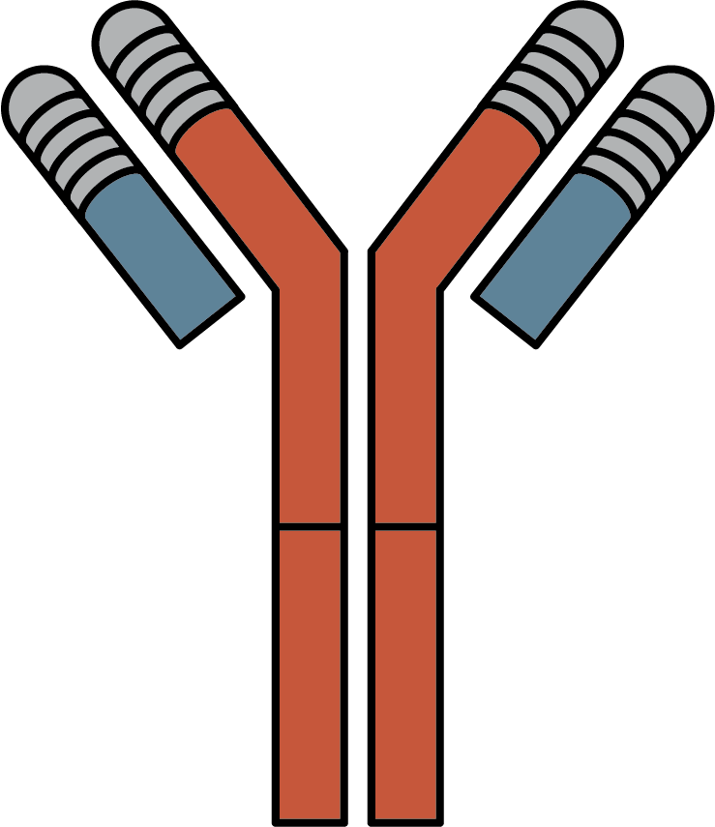
ACVR1 antibodies exacerbate heterotopic ossification in FOP
Study design
Previous results showed that HO in FOP is dependent on activation of FOP-mutant ACVR1 by a ligand, activin A
The dependence on induction by activin A ligand suggested that inhibition of ligand-ACVR1 interaction using ACVR1 antibodies should have the same effect as inhibition of activin A
It was hypothesised that a human antibody to activin A may be a potential therapeutic approach
for FOP
Tamoxifen to initiate FOP
HO volume was measured 3 weeks post initiation
Anti-ACVR1
monoclonal antibody
ACVR1, activin A receptor type 1; CT, computed tomography; FOP, fibrodysplasia ossificans progressive; HO, heterotopic ossifications
Hatsell S, et al. Sci Transl Med. 2015;7(303):303ra137; Wang L, et al. ASBMR 2021, Abstract #1038; https://cor2ed.com/podcast-rare-bone-disease-highlights-at-asbmr-2021/

Slide 16
ACVR1 antibodies exacerbate heterotopic ossification in FOP
Key findings
Increase of HO in the FOP mouse model
  ACVR1 antibodies exacerbated HO in FOP
  Therefore ACVR1 antibodies are definitely not a therapeutic option for FOP patients
ACVR1, activin A receptor type 1; FOP, fibrodysplasia ossificans progressive; HO, heterotopic ossifications
Wang L, et al. ASBMR 2021, Abstract #1038; https://cor2ed.com/podcast-rare-bone-disease-highlights-at-asbmr-2021/

Slide 17
The microbiome contributes to endochondral heterotypic ossification in fop mice by regulating innate immune cell recruitment and polarisation
Study design
Inflammation and innate immune cells contribute to FOP flares and HO
  Inflammatory environmental factors could therefore contribute to disease variability in FOP patients
Aim of this study was to reduce the HO formation by reducing the inflammatory activities in the mice and to determine whether ABX reduction in HO is mediated by changes in monocytes
BM monocytes harvested from GFP control mice
GFP-expressing control mice
Tamoxifen-inducible FOP mice
(3 weeks old)
Tamoxifen + continuous sterile water
8 days
Microbiome ablative cocktail (ABX)
Bilateral hindlimb injury
ABX, ablative antibiotic cocktail; BM, bone marrow; FOP, fibrodysplasia ossificans progressive; GFP, green fluorescent protein; HO, heterotopic ossifications
Pierce J, et al. ASBMR 2021, Abstract #1039; https://cor2ed.com/podcast-rare-bone-disease-highlights-at-asbmr-2021/

Slide 18
The microbiome contributes to endochondral heterotypic ossification in fop mice by regulating innate immune cell recruitment and polarisation
Key findings
Microbiome-ablative ABX reduced HO in ABX-treated FOP mice
Treatment decreased the expression of proinflammatory chemokines and receptors in injured
FOP muscles
Transplanting BM monocytes from control mice restored the HO phenotype in ABX-treated FOP mice
Reducing the inflammatory process in FOP mice seems to have a beneficial therapeutic effect on HO formation
ABX, ablative antibiotic cocktail; BM, bone marrow; FOP, fibrodysplasia ossificans progressive; HO, heterotopic ossifications
Pierce J, et al. ASBMR 2021, Abstract #1039; https://cor2ed.com/podcast-rare-bone-disease-highlights-at-asbmr-2021/

Slide 19
FOP: clinical perspectives
From: dr. semler
A lot of activity and good ideas presented at ASBMR as to how to improve the care of FOP patients
Some approaches have been shown to be more beneficial than others, e.g. palovarotene is one of the most developed and best approaches
Other ways to influence the signalling pathway in the cell need to be further investigated. Initial results suggest regulating inflammation may be beneficial
Very pleased that there is so much research ongoing in the rare bone disease area which is new
Many studies in the pre-clinical stage that have promising data
There is hope that a better treatment can be offered to these patients in the future
FOP, fibrodysplasia ossificans progressive
https://cor2ed.com/podcast-rare-bone-disease-highlights-at-asbmr-2021/

Slide 20




Connect on
LinkedIn @COR2ED
Watch on
Vimeo @COR2ED
Visit us at
cor2ed.com
Follow us on
Twitter @COR2EDMedEd

