Slide 2
How Covid-19 has impacted prostate cancer care
Management of side effects
Janet Forgenie, RN
Uro-Oncology Clinical Nurse Specialist
University College London Hospital, UK
DECEMBER 2020

Slide 3
Disclaimer and disclosures
Please Note: Views expressed within this presentation are the personal opinions of the author. They do not necessarily represent the views of the author’s institute or the rest of the GU Nurse CONNECT group.
This content is supported by an Independent Educational Grant from Bayer.
Disclosures: Janet Forgenie does not have any relevant financial relationships to disclose.

Slide 4
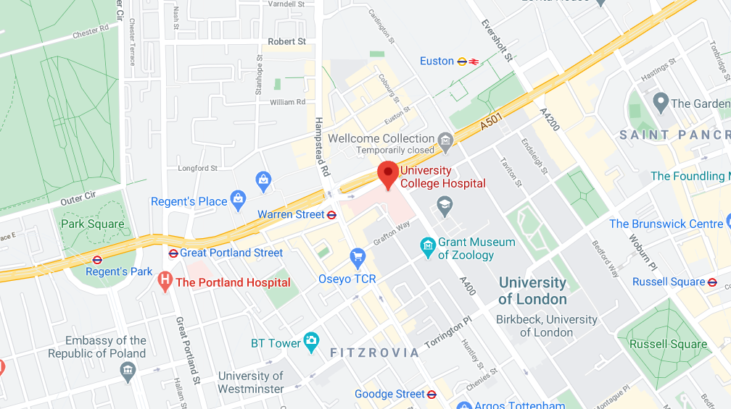
University college London hospital (UCLH)
situation during the Covid-19 pandemic
Challenges of Central London Hospital;
Travel risks during COVID-19
Acute Lockdown (March to July 2020):
Chemo stopped
Trials paused
Staff redeployed to front line
Services reduced
CNS – important role in management of anxiety
Second Wave (Sept 2020 to present) – Recovery:
Chemotherapy restarted
Trials running
Staff currently back in roles
COVID screening
Increased use of enzalutamide
Ongoing Virtual clinics
Virtual MDT
Zoom prostate support group
Zoom educational seminars for ‘Surgical school’, ‘Radiotherapy school’ and a new patient seminar for ‘All option Discussion’ currently being developed
Increase ability to use patient transport
Tx stopped
COVID screening
Virtual clinics
Patients scared to attend hospital for blood tests
Patients not reporting symptoms
Sicker patients with reduce community support
Patients attending clinic with low blood counts/pending MSCC/in pain
CNS, clinical nurse specialist; MDT, multidisciplinary team; MSCC, malignant spinal cord compression; Tx, treatment

Slide 5
The challenge
In the metastatic setting, chemotherapy known to improve the survival of patients may compromise the immune system
Patients scared, anxious and confused about contacting healthcare services during the pandemic. Is it safe?
Medical team
Redeployment
Sickness
Reduced services
Treatments halted/delayed
Trials suspended
Primary care – reduced service
Community support, ie palliative care/district nursing services reduced
Family/social support
Loss of support groups
Isolation
Affects of COVID-19 infection
Male, older population – increase in mortality with COVID-19
This population of patients known for under reporting symptoms
Balancing the benefit of treating patients with prostate cancer against the infection risks associated with COVID-19
Changing the way patients are reviewed in clinics
MDT meetings
Monitoring blood results
Administration of LHRHa
Adapting sequencing of treatment regimes to minimise the risk of COVID-19 infections to patients for a central London Hospital
LHRHa , luteinizing hormone-releasing hormone analogue; MDT, multidisciplinary team

Slide 6
University college London hospital – response
Most prostate cancers are slow growing
Hormones have been used to ‘hold’ disease while patients are waiting for radical treatment
Many prostate cancers are slow growing – monitor less frequently
However, some prostate cancer are aggressive and need close monitoring
Restarting chemotherapy as pandemic is ongoing
Introducing new pathway to incorporate a COVID-19 screen 48 hours prior to chemotherapy
2-day pathway instead on same day treatment and clinic
Hospital transport to avoid public transport through central London
Prostate cancer patients in the CSPC setting not commencing docetaxel
Prostate support group via Zoom
Exercise programme for patients on ADT virtually
Radiotherapy seminar via YouTube
Education seminars
Surgical school
Radiotherapy school
All options for discussion via YouTube
Enzalutamide instead of docetaxel in the newly diagnosed metastatic disease setting (abiraterone if intolerant of enzalutamide)¹
Virtual clinics
Monitoring PSA less frequently
Virtual new patient clinics
CNS follow-up phone calls for newly diagnosed patients
Alternate face-to-face with virtual clinic
Posting medication enzalutamide/abiraterone to reduce necessity for hospital visit
Remote MDT
Working from home for Telephone clinics to aid social distancing for healthcare professionals
Increased referral to CNS-led services to reduce patient numbers in the chemotherapy clinics
ADT, androgen deprivation therapy; CNS, clinical nurse specialist; CSPC, castration sensitive prostate cancer; MDT, multidisciplinary team; NHS, national health service;
PSA, prostate specific antigen
1. https://www.nice.org.uk/guidance/ng161/resources/interim-treatment-change-options-during-the-covid19-pandemic-endorsed-by-nhs-england-pdf-8715724381.Accessed 07-Dec-2020; 2. Personal Communication, Janet Forgenie

Slide 7
Management of side effects
ADT
All patients starting ADT should be initiated on calcium and vitamin D supplements ¹
calcium 1000-1200 mg/day + vit D 400-1000 IU/day
This may be adjusted depending on calcium/vitamin levels
DEXA scan to assess osteopenia:
Normal bone density: 3-yearly DEXA scan
Osteopenia: yearly DEXA scan
Weight bearing exercise should be encouraged
Denosumab, zoledronic acid or alendronate therapy should be considered for femoral neck/total hip or lumber spine T-Score between -1.0 + -2.5 (indicating osteopenia) by DEXA
AND
the FRAX assessment indicates a 10-year probability of hip fracture ≥3% or a 10-year probability of major osteoporotic fracture ≥ 20% ¹
Low Mood – increased risk of depression which may increase the longer patients are on Tx²
Chemotherapy + bad news can also affect mood
Physical activity/exercise helps improve overall well-being
Poor concentration – keeping a diary of symptoms:
What helps and what makes it worse
Use of memory aids
Mental exercises, e.g. crosswords/sudoku
Reduce stress – relaxation techniques
Learning new habits – better diet
Hypertension^{3,4} – ADT is associated with an increased risk of heart failure in men without known cardiovascular disease; it is therefore recommended to lower BP + cholesterol to reduce the risk of death from cardiovascular disease
Life style change: physical activity/weight loss
Stop smoking/reduce alcohol/healthy diet
Hot Flushes⁵ –
Offer medroxyprogesterone (20 mg/day) initially for 10 weeks
Consider cyproterone acetate (50 mg BD for 4 weeks)
Alternatively referral for consideration of acupuncture but no good-quality evidence to support
ADT, androgen deprivation therapy; BD, twice a day; BP, blood pressure; DEXA, dual-energy X-ray absorptiometry; FRAX, fracture risk assessment tool; NCCN, National Comprehensive Cancer Network; NHS, national health service; OD, once daily; Tx, treatment
1. NCCN Guidelines Version 3.2020, Prostate Cancer; 2. Dinh K, et al. J Clin Oncol. 2016;34(16):1905-12; 3. Haque R, et al. Br J Cancer. 2017;117(8):1233-40; 4. Bhatia N, et al. Circulation 2016; 133; 537-541; 5. NICE guideline [NG131] 2019: https://www.nice.org.uk/guidance/ng131/chapter/Recommendations. Accessed 07-Dec-2020

Slide 8
Exercise and its benefits
Advice for patients
Too much rest can lead to loss of body function, muscle weakness and a reduced range of movement.
Therefore more and more cancer centres are looking at ways to encourage cancer patients to become more physically active during and after cancer treatments.
In the past people being treated for a chronic illness, such as cancer, were often told by their doctor to rest and reduce their physical activity. This is good advice if movement causes pain, rapid heart rate, or shortness of breath.
However, new research has shown that exercise is not only safe and possible during cancer treatment, but it can improve how well you function physically and your quality-of-life.¹
Benefits – advice for patients:
Keep or improve your physical abilities
Improve balance, lower risk of falls and broken bones
Keep muscles from wasting due to inactivity
Lower the risk of heart disease
Lessen the risk of osteoporosis
Improve blood flow to your legs and lower the risk of blood clots
Make you less dependent on others for help with normal activities in your daily life
Improve your self-esteem
Lower the risk of being anxious and depressed
Lessen nausea
Improve your ability to keep social contacts
Lessen symptoms of tiredness
Help you control your weight
Improve your quality-of-life
Exercise should be based on what is safe and works for the individual.
It should be something the patient likes doing.
Any exercise plan should take in to account any exercise the patient has previously done, what they can do now, and any physical problems or limits they may have.
Hart N, et al. Current Opinion in Supportive and Palliative Care 2017; 11; 247-257; Cormie P, et al. Prostate Cancer Prostatic Dis 2013; 16, 328–335; Brown M, et al. Pilot Feasibility Stud 2019; 5: 102

Slide 9
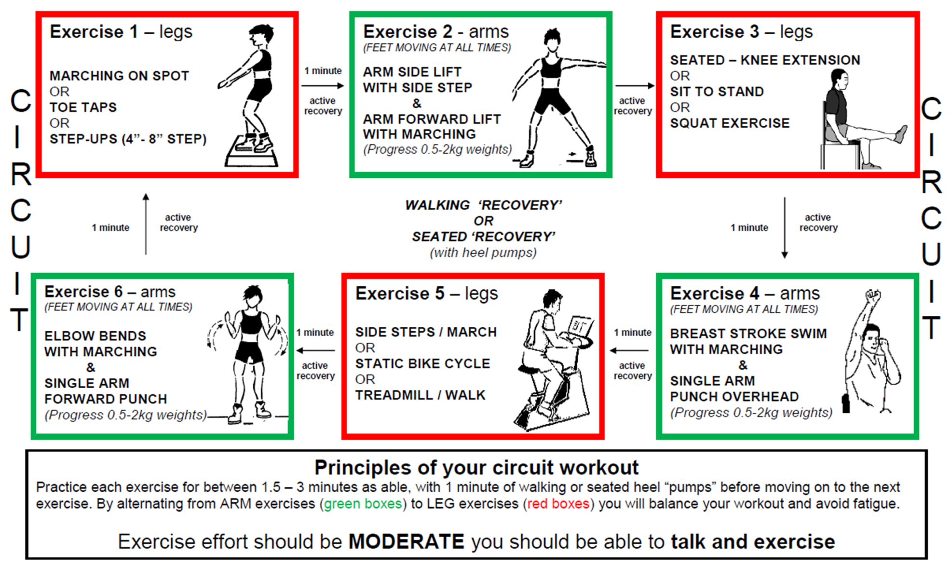
Patient exercise circuit & home programme
C
I
R
C
U
I
T
S
Exercise 2: Arms
(FEET MOVING AT ALL TIMES)
C
I
R
C
U
I
T
S
Exercise 1: Legs
Exercise 3: Legs
Marching on spot
or
Toe taps
or
Step-ups (4”-8” step)
1 minute
Arm side lift
with side step
&
Arm forward lift
with marching
(Progress 0.5-2 kg weights)
Seated – knee extension
or
Sit to stand
or
Squat exercise
active
recovery
active
recovery
1 minute
active
recovery
Walking ‘recovery’ or
Seated ‘recovery’
(with heel pumps)
1 minute
active
recovery
Exercise 6: Arms
(FEET MOVING AT ALL TIMES)
Exercise 5: Legs
Exercise 4: Arms
(FEET MOVING AT ALL TIMES)
1 minute
Side steps / march
or
Static bike cycle
or
Treadmill walk
1 minute
Breast stroke swim
with marching
&
Single arm
punch overhead
(Progress 0.5-2 kg weights)
Elbow bends
with marching
&
Single arm
forward punch
(Progress 0.5-2 kg weights)
active
recovery
active
recovery
Principles of your circuit workout
Practice each exercise for between 1.5-3 minutes as able, with 1 minute of walking or seated heel “pumps” before moving on to the next exercise.
By alternating from ARM exercises (green boxes) to LEG exercises (red boxes) you will balance your workout and avoid fatigue.
Exercise effort should be MODERATE, you should be able to talk and exercise
Pilot exercise programme for prostate cancer patients at University College London Hospitals (Personal communication, Janet Forgenie)
https://www.bug.uk.com/download.php?id=bugbaun2017/J%20Forgenie%202017%20prostate%20presentation.pdf. Accessed 07-Dec-2020

Slide 10
Management of side effects
Chemotherapy
Painful neuropathy – ASCO guidelines recommend duloxetine for treatment of chemotherapy-induced peripheral neuropathy¹
Dose 60 mg OD, discontinue if no response after 2 months
Review at least every 3 months; max dose 120 mg OD (BNF)
Poor appetite – changes in taste or nausea can lead to poor appetite
Check weight monitor for significant weight loss
Refer to dietician for education/support
Short-term, low-dose dexamethasone to boost appetite 2-4mg OD may help⁷
Check nausea is controlled²
Neutropenia³ – this is a medical emergency and requires immediate hospital investigations + treatment.
Significant neutropenia: neutrophil count ≤ 0.5 × 10⁹/L
It can delay chemotherapy/life threatening/increase risk of COVID-19
Indication – Fever/signs of infection/unwell
Nadir time – median time to nadir ~ 7 days, median duration of severe neutropenia is 7 days⁴
Treat as an acute medical emergency and offer empiric antibiotic therapy immediately
History/assessment – FBC/U+E/LFT, including albumin and C-reactive protein lactate and blood cultures
Temp >38 degrees/clinically sepsis
Educate patient and carer in signs and symptoms; local guidance with AOS (Acute oncology service)
Anaemia – low grade is common in patients on ADT⁵, increased risk when on chemo⁶
Signs – Fatigue/SOB/pale
Check FBC
Transfusion – local guidelines
Encourage healthy diet high in protein and iron
ADT, androgen deprivation therapy; ASCO, American Society of Oncology; BNF, British National Formulary; FBC, full blood count; LFT, liver function test; OD, once daily; SOB, shortness of breath; U+E, urea and electrolytes
1. Hershman D, et al. J Clin Oncol. 2014;32(18):1941-67; 2. https://www.cancerresearchuk.org/about-cancer/coping/physically/diet-problems/managing/tips-for-diet-problems?_ga=2.119297737.1774961107.1607382808-1081227050.1607382808. Accessed 07-Dec-2020. 3. https://www.nice.org.uk/guidance/cg151. Accessed -7-Dec-2020; 4. https://www.accessdata.fda.gov/drugsatfda_docs/label/2019/020449s080s082lbl.pdf, accessed 16-Dec-2020; 5. Hicks, B et al. Epidemiology 2017; doi:10.1097/ede.0000000000000678; 6. Groopman J, et al. J Natl Cancer Inst 1999; 91: 1616-34; 7. Dr Ian Back, 2001. Palliative Medicine Handbook 3rd edition: http://lnx.mednemo.it/wp-content/uploads/2007/01/palliative-medicine-handbook-3rd-edition.pdf. Accessed 16-Dec-2020

Slide 11
Take-home message
COVID-19: is it a short-term problem?
Diagnostic:
Biopsy without MRI if locally advanced or highly symptomatic
Staging using CT and/or bone scan
Commence ADT if radiological evidence of metastatic prostate cancer
Biopsy can be postponed
Locally Advanced:
Do not use ADT to postpone RP
Consider long term ADT + EBRT as an alternative to surgery
Start immediate neoadjuvant ADT if symptomatic, followed by EBRT 6–12 months later
Avoid invasive procedures, such as fiducial insertion and or rectal spacers
mCSPC:
Avoid ADT combined with docetaxel based on the risk of neutropenia and frequent hospital visits
Offer systemic treatment: ADT + something (e.g. abiraterone plus prednisone or apalutamide or enzalutamide or docetaxel)
mCRPC:
Treat patients with life-prolonging agents. Base the choice of first-line treatment on the performance status, symptoms, comorbidities, location and extent of disease, patient preference, and on the previous treatment for mCSPC as well as use of medical resources and specific risk during the COVID-19 pandemic
Chemotherapy should be avoided as much as possible
Virtual clinics here to stay
+
Work from home if you can
Keep yourselves your colleagues and your patients safe and well during this COVID-19 pandemic.
Use your resourcefulness to think of new ways of keeping your service running without increasing the risk to patients/staff and carers
ADT, androgen deprivation therapy; CT, computed tomography; EBRT, external beam radiotherapy; mCSPC, metastatic castration sensitive prostate cancer;
MRI, magnetic resonance imaging; RP, radical prostatectomy
Ribal M, et al. Eur Urol. 2020;78(1):21-28

Slide 12




REACH GU NURSES CONNECT VIA
TWITTER, LINKEDIN, VIMEO & EMAIL
OR VISIT THE GROUP’S WEBSITE https://gunursesconnect.info/
Follow us on Twitter
@gunursesconnect
Follow the
GUNURSESCOR2ED
Group on LinkedIn
Watch us on the
Vimeo Channel
GUNURSES CONNECT
Email
sam.brightwell
@cor2ed.com

