Slide 2
Experts knowledge share
TRK fusion-positive sarcomas and lung cancer
Prof. Robin Jones, Prof. Erin Rudzinski and
Prof. Christian Rolfo
19th October 2021

Slide 3
EXPERTS KNOWLEDGE SHARE
THE OBJECTIVE of this meeting is to share Current opinions on how to identify, test and treat TRK fusion-positive SARCOMAS AND Lung CANCER
Your opportunity to discuss and share learnings on a challenging topics within the area of TRK Fusion-positive cancer
A chance to hear the views of Experts and allow them to answer the questions that are important to you
discuss Patient Case Studies and questions that you have sent in advance of this event

Slide 4



Introducing the scientific committee
Prof. Robin Jones
Prof. Erin Rudzinski
Prof. Christian Rolfo
The Royal Marsden Hospital NHS Foundation Trust & Institute of Cancer Research, London, UK
Seattle Children’s Hospital, Seattle, USA
Centre of Thoracic Oncology
Tisch Cancer Institute Icahn School of Medicine at Mount Sinai, New York, USA

Slide 5
Disclaimer
This meeting is based on an independent medical educational grant from Bayer. The programme is therefore independent; the content is not influenced by Bayer and is the sole responsibility of the experts
Please note:
The views expressed within this presentation are the personal opinions of the experts. They do not necessarily represent the views of the experts’ academic institutions or the rest of the faculty

Slide 6
DETECTION OF trk Fusion-positive sarcomas
Prof. Erin Rudzinski, MD
Seattle Children’s Hospital, Seattle, USA

Slide 7
Disclosures
Prof Rudzinski has nothing to disclose.
Notes:
These are my disclosures

Slide 8
NTRK genes
Neurotrophic tropomyosin-receptor kinase genes (NTRK1, NTRK2, NTRK3)
Encode tropomyosin receptor kinase proteins (TRKA, TRKB, TRKC)
Normally expressed in peripheral and central nervous systems in embryonic development
and in adult tissues
Kinase domain activation leads to activation of downstream signalling of MAPK, PI3K and PKC pathways to promote neuron growth, differentiation and survival
MAPK, mitogen-activated protein kinase; NTRK, neurotrophic tyrosine receptor kinase; PI3K, phosphoinositide 3-kinase; PKC, protein kinase Cl; TRK, tropomyosin receptor kinase
Hechtman JF. Mod Pathol. 2021; doi: 10.1038/s41379-021-00913-8 (Online ahead of print)

Slide 9


NTRK fusions
Intra- or inter-chromosomal gene rearrangements lead to the NTRK gene joining with a fusion partner gene
Over 80 different fusion partners identified
This triggers constitutive activation of the TRK protein
This promotes, through MAPK and/or PI3K pathways:
↑ tumour proliferation
↑ survival
↑ invasion
↑ angiogenesis
NTRK fusion
Known dimerization domain
5’ upstream gene partner
3’:
NTRK1
NTRK2
or
NTRK3
NH₂
MPRIP
TPM3
TPR
Tyrosine kinase
domain
Coiled coil
domain
TFG
ARHGEF2
LMNA
SQSTM1
TRIM463
PPL
COOH
TRIM24
PAN3
SQSTM1
TPM4
TFG
MYO5A
Zinc finger
domain
IRF2BP2
Transmembrane
domain
TRAF2
WD
domain
RFWD2
COOH
STRN
EML4
Alternate dimerization mechanism
CD74
QKI
ETV6
NFASC
ETV6
BTBD1
NH₂
BCAN
NACC2
TP53
BCR
CTRC
TLE4
Unknown mechanism
RABGAP1L
CHTOP
AFAP1
IGFBP7
GRIPA1
LRRC71
SSBP2
MRPL24
NH₂
PLEKHA6
PDE4DIP
MIR548F1
SCYL3
DAB21P
VCL
AGBL4
AFAP1
LYN
RBPMS
UBE2R2
HNRNPA2B1
NTRK fusions. Reprinted by permission from Springer Nature 2018
MAPK, mitogen-activated protein kinase; NTRK, neurotrophic tyrosine receptor kinase; PI3K, phosphoinositide 3-kinase; TRK, tropomyosin receptor kinase
Hechtman JF. Mod Pathol. 2021; doi: 10.1038/s41379-021-00913-8 (Online ahead of print)

Slide 10
NTRK fusions in sarcomas
NTRK, neurotrophic tyrosine receptor kinase

Slide 11
Incidence of NTRK fusions in sarcomas
Varies in paediatric and adults tumours
Diagnosis Frequency
Infantile fibrosarcoma 91%
Inflammatory myofibroblastic tumour 18%
Sarcoma (not otherwise specified) 0.68-1.17%
NTRK, neurotrophic tyrosine receptor kinase
Hechtman JF. Mod Pathol. 2021; doi: 10.1038/s41379-021-00913-8 (Online ahead of print)

Slide 12
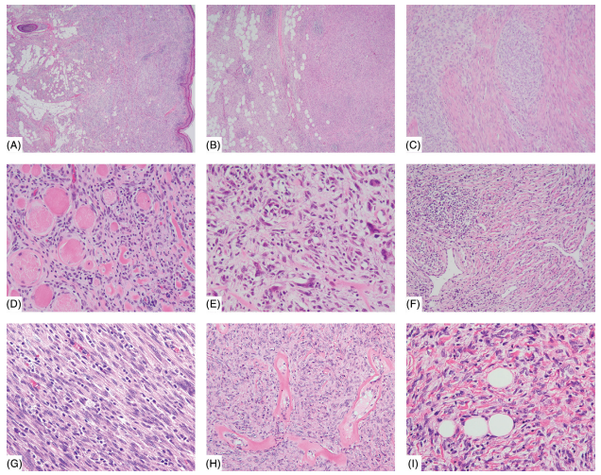
NTRK fusion histology
Lipofibromatosis-like neural tumour
Malignant peripheral nerve sheath tumour-like sarcomas
Infantile fibrosarcoma-like
Inflammatory myofibroblastic
tumour-like
NTRK, neurotrophic tyrosine receptor kinase
Kao YC, et al. Genes Chromosomes Cancer. 2020; 59:575-83

Slide 13
Incidence of NTRK fusions in sarcomas
Varies in paediatric and adults tumours
Diagnosis Frequency
Infantile fibrosarcoma 91%
Inflammatory myofibroblastic tumour 18%
Sarcoma (not otherwise specified) 0.68-1.17%
GIST Anecdotal
Bone sarcomas Anecdotal
GIST, gastrointestinal stromal tumour; NTRK, neurotrophic tyrosine receptor kinase
Hechtman JF. Mod Pathol. 2021; doi: 10.1038/s41379-021-00913-8 (Online ahead of print)
Atiq MA, et al. Mod Pathol. 2021; 34:95-103; Lam SW, et al. Histopathology. 2021; doi: 10.1111/his.14432 (Online ahead of print)

Slide 14
Testing approaches
Immunohistochemistry
panTRK – targets TRKA, TRKB and TRKC
Good screening tool – fast and inexpensive, requires minimal tissue
  Sensitivity of 96-100% for NTRK1/2 fusions
  Sensitivity of 79% for NTRK3 fusions
  Patterns of staining correspond to gene involved
    Cytoplasmic staining not specific for NTRK fusions
Disadvantage is that it requires subsequent molecular verification
NTRK, neurotrophic tyrosine receptor kinase; TRK, tropomyosin receptor kinase
Hechtman JF. Mod Pathol. 2021; doi: 10.1038/s41379-021-00913-8 (Online ahead of print)

Slide 15
Testing approaches
Fluorescent in situ hybridisation (FISH)
ETV6
  Useful in tumours with high prevalence of ETV6-NTRK3 fusions such as infantile fibrosarcoma, mammary analogue secretory carcinoma of salivary gland, secretory breast carcinoma
NTRK1/2/3
Advantages are rapid turn around time (1-3 days), requires relatively little tissue
Disadvantages are potential for false negatives, relatively few places offer NTRK1/2/3
NTRK, neurotrophic tyrosine receptor kinase
Hechtman JF. Mod Pathol. 2021; doi: 10.1038/s41379-021-00913-8 (Online ahead of print)

Slide 16
Testing approaches
RT-PCR
Some common paediatric panels may include ETV6-NTRK3
Advantages include cost, moderate turn around time (1 week), relatively little tissue
Disadvantages include lack of detection of other fusion partners
NTRK, neurotrophic tyrosine receptor kinase; RT-PCR, reverse transcription-polymerase chain reaction
Hechtman JF. Mod Pathol. 2021; doi: 10.1038/s41379-021-00913-8 (Online ahead of print)

Slide 17
Testing approaches
Next generation sequencing (DNA)
Advantages include detection of multiple fusion partners, analyse for other alterations simultaneously
Disadvantages include requirement for moderate amount of tumour tissue, limited coverage of introns (81% sensitivity – best at NTRK1), longer turn around times (2-4 weeks), does not confirm gene fusion is functional
NTRK, neurotrophic tyrosine receptor kinase
Hechtman JF. Mod Pathol. 2021; doi: 10.1038/s41379-021-00913-8 (Online ahead of print)

Slide 18
Testing approaches
Next generation sequencing (RNA)
Advantages include detection of multiple fusion partners, detection is partner agnostic, confirmation that the fusion gene is transcribed, not limited by gene size (introns)
Disadvantages include moderate amount of tumour tissue, subject to RNA degradation in older samples, longer turn around times (2-4 weeks)
Hechtman JF. Mod Pathol. 2021; doi: 10.1038/s41379-021-00913-8 (Online ahead of print)

Slide 19
Testing approaches
other
Whole transcriptome
Hybrid DNA/RNA panels
Nanostring
Marchiò C. Ann Oncol. 2019;30(9):1417-1427. doi: 10.1093/annonc/mdz204
Hechtman JF. Mod Pathol. 2021; doi: 10.1038/s41379-021-00913-8 (Online ahead of print)

Slide 20
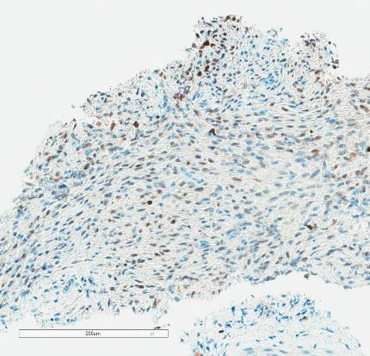
My approach…
panTRK immunohistochemistry
  Nuclear panTRK
  Proceed to ETV6 FISH, RT-PCR
  NGS panel (RNA) for NTRK3
panTRK immunohistochemistry
  Cytoplasmic panTRK
  Sequencing for NTRK1/2 by (DNA or RNA)
    NTRK2 not picked up well by DNA
  FISH, other
Negative panTRK
  Sequencing for multiple tyrosine kinases (RNA)
FISH, fluorescent in situ hybridisation; NGS, next-generation sequencing; NTRK, neurotrophic tyrosine receptor kinase; RT-PCR, reverse transcription-polymerase chain reaction; TRK, tropomyosin receptor kinase

Slide 21
Practical experience
Pearls from my practice
I have only seen nuclear panTRK staining in NTRK3 fused cases
  True even for cases that have failed initial sequencing attempts
Monomorphic spindle cell tumours (in children / young adults) frequently harbour gene rearrangements
  Infantile fibrosarcoma/lipofibromatosis-like neural tumour spectrum of tumours frequently harbour kinase gene alterations, including NTRKs
  Quick to pursue RNA sequencing panels
NTRK, neurotrophic tyrosine receptor kinase; TRK, tropomyosin receptor kinase

Slide 22

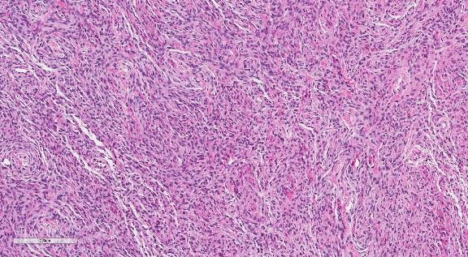
4-month-old male with intradural/ extra-axial mass
Outside hospital sent for NTRK IHC – reported as equivocal → Sequencing eventually came back negative so sent for consultations.
My repeat IHC showed diffuse nuclear panTRK staining → Sent for local RNA sequencing
NTRK, neurotrophic tyrosine receptor kinase

Slide 23
4-month-old male with intradural/ extra-axial mass
KHDRBS1-NTRK3 fusion
NTRK, neurotrophic tyrosine receptor kinase

Slide 24
TRK fusion-positive sarcomas
Clinical Data, Second Generation Therapies
Prof. Robin L Jones
Royal Marsden Hospital
Institute of Cancer Research, London, United Kingdom

Slide 25
Disclosures
Receipt of grants/research support:
  MSD
  GSK
Receipt of consultation fees:
  Adaptimmune, Astex, Athenex, Bayer, Boehringer Ingelheim, Blueprint, Clinigen, Eisai, Epizyme, Daichii, Deciphera, Immune Design, Immunicum, Karma Oncology, Lilly, Merck, Mundipharma, PharmaMar, Springworks, SynOx, Tracon

Slide 26
NTRK fusion-positive tumours
Tropomyosin receptor kinase (TrK)
  3 trans-membrane proteins (Trk A, B + C receptors)
  Encoded by the NTRK1, 2 + 3 genes
  Expressed in human neuronal tissue
    Function as high-affinity receptors for neurotrophins
Oncogenic NTRK gene fusions
  Induce cell proliferation
  Engage downstream signalling pathways
Rare – occur in diverse range of tumours
NTRK, neurotrophic tyrosine receptor kinase; TRK, tropomyosin receptor kinase
Doebele RC, et al. Cancer Discov. 2015;5(10):1049-57; Wilding CP, et al. Curr Opin Oncol 2020;32(4):307-13

Slide 27



TRK receptor signalling
NGF
BDGF
NTF-3
TrKA
TrKB
TrKB
TrKC
TrKC
PIP2
PLC
P
P
GAB1
P
P
SHC
P85
P110
IP3
GRB2
DAG
SOS
P13K
IP3R
RAS
AKT
Ca^{2a}
Ca^{2a}
RAF
Proliferation
PKC
MEK
Differentiation
ERK
Survival
AKT, v-akt murine thymoma viral oncogene homologue; BDGF, brain-derived growth factor; DAG, diacyl-glycerol; ERK, extracellular signal-regulated kinase; GAB1, GRB2-associated-binding protein 1;
GRB2, growth factor receptor-bound protein 2; IP3, inositol trisphosphate; IP3R, IP3 receptor; MEK, mitogen-activated protein kinase; NGF, nerve growth factor; NTF-3, neurotrophin -3; PI3K, phosphatidylinositol-4,5-biphosphate 3-kinase; PIP2, phosphatidylinositol 4,5-biphosphate; PKC, protein kinase C; PLC, phospholipase C; RAF, rapidly accelerated fibrosarcoma kinase; RAS, rat sarcoma kinase; SHC, Src homology 2 domain containing; Trk, tropomyosin receptor kinase
Amatu A, et al. ESMO Open 2016;1:e000023

Slide 28
NTRK fusions in sarcomas
Established role
  Infantile fibrosarcoma with ETV6‑NTRK3 gene fusions¹
  KIT/PDGFRA wild-type GIST²
Unclear which sarcoma subtypes are likely to harbour NTRK gene fusions
  Screening methods are expensive + must be targeted
Tumours with translocations of EWSR1 in Ewing sarcoma or KIT in GIST are unlikely to harbour
NTRK gene fusions
  More research is required to confirm these observations
Emerging tumours with NTRK fusions
  Spindle cell tumours with RAF1, BRAF & NTRK1/2 gene fusions³
  Infantile fibrosarcoma-like with BRAF & NTRK1 gene fusions^{4,5}
  Lipofibromatosis-like neural tumours with NTRK1 gene fusions⁶
  NTRK3 gene fusions positive sarcomas⁶
GIST, gastrointestinal stromal tumour; NTRK, neurotrophic tyrosine receptor kinase; PDGFRA, platelet-derived growth factor receptor alpha
1. Fletcher CDM et al. WHO Classiﬁcation of Tumours of Soft Tissue and Bone. 4th ed. Lyon, France: IARC Press; 2013; 2. Cocco E, et al. Nat Rev Clin Oncol. 2018;15:731-47;
3. Suurmeijer AJH, et al. Genes Chromosomes Cancer. 2018;57:611-21; 4. Kao Y-C, et al. Am J Surg Pathol. 2018;42:28-38;
5. Agaram NP, et al. Am J Surg Pathol. 2016;40:1407-16; 6. Suurmeijer AJH, et al. Genes Chromosomes Cancer. 2019;58:100-10

Slide 29
Frequency of NTRK gene fusions identified in sarcomas
Study | Testing method | Proportion of patients with NTRK fusions identified | NTRK fusion-positive sarcoma subtypes | NTRK genes and fusion partners involved
Agaram et al. | FISH, RNA MPS | 71% (10/14) | Lipofibromatosis-like tumour | 1 TPR-NTRK1 1 TPM3-NTRK1 4 LMNA-NTRK1
Bourgeois et al. | RT-PCR | 91% (10/11) | IFS | ETV6-NTRK3
Bui et al. | Targeted DNA MPS | 0.7% (1/152) | Myopericytoma | NR
Chang et al. | Targeted RNA MPS | 33% (3/9) | IMT | ETV-NTRK3
Chmielecki et al. | Targeted RNA MPS | 1% (4/324) | IFS (n=2), assorted soft tissue sarcoma (n=1), haemangioma (n=1), bone sarcoma (n=1) | SQSTM1-NTRK1 (n=1), other fusion partners NR
Church et al. | FISH | 96% (25/26) | IFS | NTRK3
Croce et al. | Targeted RNA MPS | 54% (7/13) | Uterine and vaginal sarcomas resembling fibrosarcoma | 6 TPM3-NTRK1, 1 EML4-NTRK3
Gatalica et al. | Targeted RNA MPS | 0.4% (2/478) | 1 STS (poorly differentiated sarcoma with possible myofibroblastic differentiation), 1 uterine sarcoma (intermediate to high-grade sarcoma of uterine origin, with myxoid stroma and no specific line of differentiation) | 1 TPM3-NTRK1, 1 SPECC1L-NTRK3
Rosen et al. | Targeted RNA MPS | 1% (11/944) | Sarcoma NOS [9/770 (1%)], uterine sarcoma [2/174 (1%)] | NR
Shi et al. | Targeted DNA MPS | 0.5% (1/186) overall [4% (1/24) in quad-negative tumours] | GIST | ETV6-NTRK3
Solomon et al. | Targeted DNA and/or RNA MPS | 0.7% (13/1915) 18% (3/17) | IFS (n=2), lipofibromatosis-like neural tumour (n=2), uterine sarcoma (n=2), uterine high-grade pleomorphic sarcoma, high-grade spindle cell sarcoma, malignant spindle cell sarcoma, spindle cell sarcoma, angiosarcoma, S-100 positive malignant spindle cell neoplasm, low grade sarcoma (all n=1) IMT | LMNA-NTRK1 (n=4), TPM3-NTRK1 (n=3), ETV6-NTRK3 (n=2), TPR-NTRK1, TPM4-NTRK3, EEF1A1-NTRK3, PEAR1‑NTRK1 (all n=1) ETV6-NTRK3
Stransky et al. | TCGA RNA-seq dataset | 1% (1/103) | Sarcoma | TPM3-NTRK1
Surrey et al. | Targeted RNA MPS | 4% (2/45) | Sarcomas (other) | 1 TFG-NTRK3, 1 RBPMS-NTRK3
Suurmeijer et al. | FISH, targeted RNA MPS | 60% (15/25) | Malignant peripheral nerve sheath tumour-like | 8 LMNA-NTRK1, 3 TPM3-NTRK1, 1 SPECC1L-NTRK2, 1 TPR-NTRK1, 2 NTRK1 with unknown fusion partners
Yamamoto et al. | MPS (TBC), IHC | 5% (2/40) | IMT | ETV6-NTRK3
Zhu et al. | Targeted RNA MPS | 3% (5/184) | Lipofibromatosis-like neural tumour (n=2), IFS (n=1), IMT (n=1), sarcoma NOS (n=1) | 2 ETV6-NTRK3, 2 TPM3-NTRK1, 1 LMNA-NTRK1
FISH, fluorescent in situ hybridisation; GIST, gastrointestinal stromal tumour; IFS, infantile fibrosarcoma; IHC, immunohistochemistry; IMT, inflammatory myofibroblastic tumour; MPS, massive parallel sequencing; NOS, not otherwise specified; NR, not reported; NTRK, neurotrophic tyrosine receptor kinase; RT-PCR, reverse transcription polymerase chain reaction; STS, soft tissue sarcoma; TCGA, The Cancer Genome Atlas
Demetri GD, et al. Ann Oncol. 2020;31(11):1506-17

Slide 30
Recommended algorithm for NTRK gene fusion testing in sarcomas
Tumour sample
Histological diagnosis of sarcoma
Locally advanced and unresectable
or metastatic disease
Localised disease
No routine NTRK testing
NTRK testing priority: +++
Sarcomas with high frequency of NTRK fusions
IFS
IMT
NTRK testing priority: ++
Sarcomas with low frequency of
NTRK fusions
Sarcomas with complex genomics
Wild-type GIST
NTRK testing priority: +
Sarcomas with recurrent gene fusions
KIT, PDGFR, SDH, NF1, or BRAF‑altered GIST
MDM2/CDK4-amplified LPS
FISH
Pan-TRK IHC
Pan-TRK IHCe
NTRK testing for research only
NEGATIVE^{b}
POSITIVE^{c}
POSITIVE
NEGATIVE
ª For patients at high risk of relapse, NTRK gene fusion testing might provide clinically actionable information for later in the disease course
^{b} If histology is typical then confirmation by MPS is recommended
^{c} Treatment may be considered concurrently with confirmatory MPS
^{d} Consider parallel validation by MPS or RT-PCR to confirm that fusion is in-frame
^{e} Avoid IHC screening in cases with myogenic and neural differentiation due the high rate of false positivity
Consider MPS panel including NTRK and non‑NTRK alterations
NEGATIVE
MPS
NEGATIVE
No additional NTRK testing
POSITIVE
POSITIVE^{d}
Consider TRK inhibitor
FISH, fluorescent in situ hybridisation; GIST, gastrointestinal stromal tumour; IFS, infantile fibrosarcoma; IHC, immunohistochemistry; IMT, inflammatory myofibroblastic tumour; LPS, liposarcoma; MPS, massive parallel sequencing; NTRK, neurotrophic tyrosine receptor kinase; RT-PCR, reverse transcription polymerase chain reaction; TRK tropomyosin receptor kinase
Demetri GD, et al. Ann Oncol. 2020;31(11):1506-17

Slide 31
Larotrectinib in sarcomas

Slide 32
Response in sarcoma with LMNA-NTRK1 fusion to larotrectinib
Post-resection
Study baseline
Study cycle 2 day 1
Study cycle 5 day 1
NTRK, neurotrophic tropomyosin receptor kinase
Doebele RC, et al. Cancer Discov. 2015;5(10):1049-57

Slide 33
Larotrectinib in TRK fusion-positive sarcomas
In this subset of patients with sarcoma: ORR = 93% across both adult and paediatric patients with ​NTRK gene fusions
50
93.2
Paediatric patients^{b}
Adult patients
40
30
20
10
0
-10
-20
Maximum change in target lesion size (%)
-30
-40
-50
-60
-70
-80
ORRª (95% CI), % | 93 (82-99)
Best response
CR | 20
PR | 70
sCR | 4
-90
-100
c
c
Investigator response assessments, as of 30 July 2018
ªn=46 patients; includes three unconfirmed PRs pending confirmation; does not include five patients continuing on study and awaiting initial response assessment
^{b}Age <21 years; ^{c}sCR
CI, confidence interval; CR, complete response; ORR, objective response; PR, partial response; sCR, surgical complete response; TRK tropomyosin receptor kinase
Federman N, et al. CTOS. 2018

Slide 34
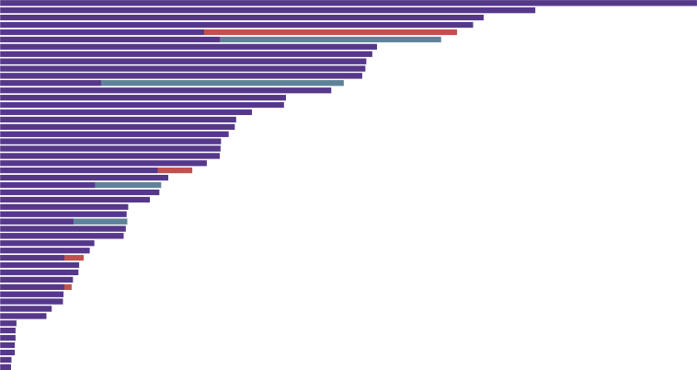
Larotrectinib: Duration of treatment
Dataset | Median duration of treatment
Primary (n=21) | 21.2 months
Supplementary (n=30) | 6.4 months
Integrated (n=51) | 9.4 months
Patients
Treatment after progression
Treatment after surgery
Treatment ongoing
Surgical complete response
Observation post-surgery
Median time to response = 1.8 months
0
5
10
15
20
25
30
35
40
45
Overall treatment duration (months)
Investigator response assessments, as of 30 July 2018
Federman N, et al. CTOS. 2018

Slide 35
TRK-inhibition provides robust responses in patients with NTRK gene fusion-positive sarcoma
EFFICACY OF LAROTRECTINIB IN SARCOMAS HARBOURING TRK FUSIONS:
BEST CHANGE IN TARGET LESIONS
93.2
%
50
40
30
20
10
0
-10
-20
Maximum change in tumour size (%)
-30
-40
-50
-60
-70
-80
-90
STS
IFS
GIST
Bone sarcoma
-100
Data cut-off: Feb 19, 2019
GIST, gastrointestinal stromal tumour; IFS, infantile fibrosarcoma; NTRK, neurotrophic tropomyosin receptor kinase; STS, soft tissue sarcoma; TRK, tropomyosin receptor kinase
Demetri GD, et al. CTOS 2019. Abstract #3254588. Oral presentation

Slide 36
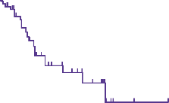
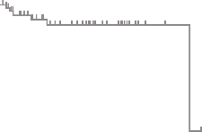
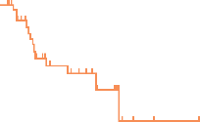
TRK-inhibition provides durable responses in patients with NTRK gene fusion-positive sarcoma
DURATION OF RESPONSE
PROGRESSION-FREE
SURVIVAL
OVERALL SURVIVAL
100
100
100
86%
91%
91%
75
75%
75
67%
75
Progression-free survival (%)
Duration of response (%)
50
Overall survival (%)
50
50
Median: NE
(range 1.6+ to 44.2+ months)
Median follow-up: 15.6 months
Median: 28.3 months
(95% CI 16.8-NE)
Median follow-up: 13.0 months
Median: 44.4 months
(95% CI 44.4-NE)
Median follow-up: 14.1 months
25
25
25
0
0
0
0
6
12
18
24
30
36
42
48
0
6
12
18
24
30
36
42
48
0
6
12
18
24
30
36
42
48
Months from start of response
Months from start of treatment
Months from start of treatment
No. at risk
54
37
22
14
9
2
1
1
0
71
41
25
20
10
3
1
1
0
71
53
36
29
17
8
3
2
0
Data cut-off: Feb 19, 2019
CI, confidence interval; NE, not estimable; NTRK, neurotrophic tropomyosin receptor kinase; TRK, tropomyosin receptor kinase
Demetri GD, et al. CTOS 2019. Abstract #3254588. Oral presentation

Slide 37
Larotrectinib in TRK fusion-positive sarcomas - trial design
Assessed the efficacy and safety of larotrectinib in adult patients with TRK fusion-positive sarcomas
Adult patients aged ≥18 years with sarcomas harbouring an NTRK gene fusion and treated with larotrectinib were identified from three clinical trials:
  NCT02122913
  NCT02576431
  NCT02637687
Patients (N=25)
  Soft tissue sarcoma (n=19)
  Gastrointestinal stromal tumour (n=4)
  Bone sarcoma (n=2)
larotrectinib was administered orally at 100 mg BID (one patient received 150 mg BID)
The primary endpoint was ORR, as assessed by investigators using RECIST v1.1
Data cut-off: 15 July 2019
BID, twice a day; NTRK, neurotrophic tropomyosin receptor kinase; ORR, objective response rate; RECIST, Response Evaluation Criteria in Solid Tumors; TRK, tropomyosin receptor kinase
Kummar S, et al. Connective Tissue Oncology Society (CTOS) Virtual Meeting Eposter 106: 2020

Slide 38
Larotrectinib in TRK fusion-positive sarcomas - Efficacy
 | Soft tissue sarcomas (n=19) | GISTs (n=4) | Bone sarcomas (n=2) | All adult sarcomas (n=25)
ORR, n (%) | 13 (68) | 4 (100) | 1 (50) | 18 (72)
Complete response | 3 (16) | 1 (25) | 0 | 4 (16)
Partial response | 10 (53) | 3 (75) | 1 (50) | 14 (56)
Stable disease | 3 (16) | 0 | 1 (50) | 4 (16)
Progressive disease | 2 (11) | 0 | 0 | 2 (8)
Not determined† | 1 (5) | – | – | 1 (4)
Endpoint | larotrectinib (N=25)
Primary endpoint
ORR, n (%) | 18 (72) (95% CI 51-88)
Secondary endpoints
Time to response, median (range), mo | 1.8 (0.9-3.5)
Duration of treatment, mo | Range, 0.1-51.6 Treatment ongoing in 10 patients (40%) at data cut-off
Median DoR, % | NE (95% CI 7.2-NE) at 22.9 mo (median FU) 64 (95% CI 41-87) at 24 mo
Median PFS, mo | 28.3 (95% CI 6.8-NE) at 22.1 mo
Median OS, % | 44.4 (95% CI 44.4-NE) at 21.4 mo (median FU) 91 (95% CI 80-100) at 24 mo
100
‡
80
60
40
§
20
¶
Maximum change in tumour size (%)
0
-20
-40
-60
-80
-100
Soft tissue sarcoma
GIST
Bone sarcoma
Data cut-off: 15 July 2019.
‡ Patient with malignant peripheral nerve sheath tumour who had progressive disease as best response; § Patient with synovial sarcoma who had progressive disease as best response; ¶ Patient with bone sarcoma with a maximum change in tumour size of 1.1%
CI, confidence interval; DoR, duration of response; FU, follow-up; GIST, gastrointestinal stromal tumour; mo, months; NE, not estimable; ORR, objective response rate; OS, overall survival; PFS, progression-free survival
Kummar S, et al. Connective Tissue Oncology Society (CTOS) Virtual Meeting Eposter 106: 2020

Slide 39
Safety: Adverse Events occurring ≥15% patients¹
AEs were mostly grade 1 or 2, and with 6 months additional follow up compared with the previous analysis,² there were no unexpected safety signals
Grade 3 or 4 treatment-emergent AEs occurred in
11 patients (44%), with none attributed to larotrectinib
Two patients had grade 5 AEs (neurofibrosarcoma and malignant neoplasm progression) and neither were attributed to larotrectinib
Three patients (12%) permanently discontinued treatment due to treatment-emergent AEs
    No patients permanently discontinued treatment due to a larotrectinib-related AE
Preferred term | Treatment-emergent AEs, n (%) |  |  | Treatment-related AEs, n (%)
 | Grade 1 or 2 | Grade 3 | Any Grade | Grade 3 | Any Grade
Constipation | 12 (48) | 0 | 12 (48) | 0 | 5 (20)
Dizziness | 9 (36) | 0 | 9 (36) | 0 | 6 (24)
Abdominal pain | 7 (28) | 1 (4) | 8 (32) | 0 | 1 (4)
Fatigue | 7 (28) | 1 (4) | 8 (32) | 0 | 3 (12)
Nausea | 8 (32) | 0 | 8 (32) | 0 | 4 (16)
ALT increased | 6 (24) | 0 | 6 (24) | 0 | 3 (12)
Anaemia | 4 (16) | 2 (8) | 6 (24) | 0 | 1 (4)
Back pain | 6 (24) | 0 | 6 (24) | - | -
Myalgia | 6 (24) | 0 | 6 (24) | 0 | 5 (20)
Edema peripheral | 6 (24) | 0 | 6 (24) | 0 | 2 (8)
Abdominal distension | 5 (20) | 0 | 5 (20) | 0 | 1 (4)
Diarrhoea | 5 (20) | 0 | 5 (20) | 0 | 1 (4)
Headache | 5 (20) | 0 | 5 (20) | 0 | 3 (12)
Pain in extremity | 5 (20) | 0 | 5 (20) | 0 | 1 (4)
Anxiety | 3 (12) | 1 (4) | 4 (16) | - | -
Musculoskeletal chest pain | 4 (16) | 0 | 4 (16) | - | -
Urinary tract infection | 3 (12) | 1 (4) | 4 (16) | - | -
Vomiting | 4 (16) | 0 | 4 (16) | 0 | 2 (8)
Weight increased | 2 (8) | 2 (8) | 4 (16) | 0 | 2 (8)
AE, adverse event
1. Kummar S, et al. Connective Tissue Oncology Society (CTOS) Virtual Meeting Eposter 106: 2020; 2. Demetri GD, et al. CTOS Abstract #3254588: 2019

Slide 40
entrectinib in sarcomas

Slide 41
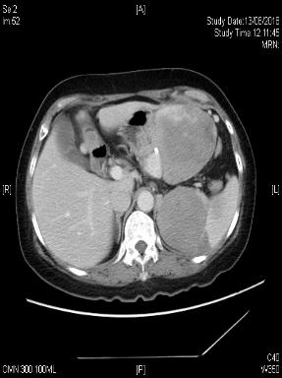
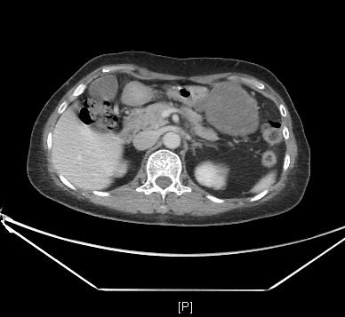
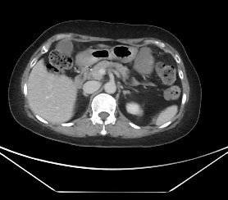
Radiological response in a patient with a high grade sarcoma with histiocytic differentiation (ETV6:NTRK3 exon 14) treated with entrectinib (clinical trial)
Baseline
~ 3 months after treatment
Nadir achieved at ~6 months after treatment
NTRK, neurotrophic tropomyosin receptor kinase

Slide 42
Entrectinib in sarcomas – Trial design
Combined analysis of
  ALKA-372-001
  NCT02097810¹
  NCT02568267²
Sarcoma cohort
  RECIST response rate: 6/12 (50%)
  Six with stable disease
Most treatment related adverse events Grade 1 or 2
  Serious treatment-related adverse events: 30/ 355 (9%) patients
RECIST, Response Evaluation Criteria in Solid Tumors
1.ClinicalTrials.gov (NCT02097810); 2. ClinicalTrials.gov (NCT02568267)
Doebele RC, et al. Lancet Oncol. 2020;21(2):271-282

Slide 43
Second generation TRK inhibitors – ongoing clinical trials
Phase 1/ 2 Loxo-195
  Previously treated with TRK inhibitors
  NCT03215511¹
repotrectinib (TPX-0005)
  Next generation pan-TRK, ROS1 + ALK tyrosine kinase inhibitor
  Phase 1/ 2 in 6 cohorts (NCT03093116²)
  One cohort = pre-treated TRK fusion positive solid tumours
TRK, tropomyosin receptor kinase
1. ClinicalTrials.gov (NCT03215511); 2. ClinicalTrials.gov (NCT03093116)

Slide 44
Mechanisms of Resistance
Acquired resistance^{1,2,3}
More research needed¹
Mutations leading to secondary resistance described^{2,3}
On-target mutations involving NTRK kinase domain²
TRK xDFG mutations confer resistance to type I next-generation TRK inhibitors²
  designed to maintain potency against several kinase domain mutations
Off-target resistance³
  Patients pre-treated TRK inhibitors + in patient-derived models
  Mediated by genomic alterations that converge to activate mitogen-activated protein kinase (MAPK) pathway
MAPK, mitogen-activated protein kinase; NTRK, neurotrophic tropomyosin receptor kinase; TRK, tropomyosin receptor kinase
1. Russo M, et al. Cancer Discov. 2016;6(1):36-44; 2. Cocco E, et al. Cancer Discov. 2021;11(1):126-41; 3. Cocco E, et al. Nat Med. 2019;25(9):1422-7

Slide 45
Conclusions
TRK inhibitors
High response rate with long durability in patients with TRK fusion sarcomas
Favourable safety profile and well tolerated
Importance of identifying NTRK gene fusions in patients with sarcomas
To enable these patients to potentially benefit from TRK-targeted therapy
NTRK, neurotrophic tropomyosin receptor kinase; TRK, tropomyosin receptor kinase

Slide 46
DETECTION OF trk Fusion-positive lung cancers
Prof. Erin Rudzinski, MD
Seattle Children’s Hospital, Seattle, USA

Slide 47
Incidence of gene fusions in lung cancer
Gene | Common alteration | Incidence
ROS1 | Rearrangement | 1-2%
ALK | Rearrangement | 2-7%
BRAF | V600E | 1-2%
NTRK | Rearrangement | 0.2%
MET | Amplification | 0.34%
MET | Exon 14 skipping | 2-3%
EGFR | Common (exon 19, 21) | 30-50%
EGFR | Uncommon (exon 20, G719X, L585R, other) | 12%
RET | Rearrangement | 1-2%
HER2 | Mutations | 2-4%
KRAS | Mutations | 20-30%
NRG1 | Rearrangement | 0.2-0.8%
ALK, anaplastic lymphoma kinase; BRAF, v-raf murine sarcoma viral oncogene homolog B1; EGFR, epidermal growth factor receptor; HER2, human epidermal growth factor receptor 2; KRAS, Kirsten rat sarcoma viral oncogene homolog; MET, hepatocyte growth factor receptor gene; NRG1, neuregulin 1; NTRK, neurotrophic tyrosine receptor kinase; RET, rearranged during transfection; ROS1, c-ros oncogene 1
Melosky B, et al. Lung Cancer. 2021; 160:136-51 (modified)

Slide 48
Incidence of gene fusions in lung cancer
Gene | Common alteration | Incidence
ROS1 | Rearrangement | 1-2%
ALK | Rearrangement | 2-7%
BRAF | V600E | 1-2%
NTRK | Rearrangement | 0.2%
MET | Amplification | 0.34%
MET | Exon 14 skipping | 2-3%
EGFR | Common (exon 19, 21) | 30-50%
EGFR | Uncommon (exon 20, G719X, L585R, other) | 12%
RET | Rearrangement | 1-2%
HER2 | Mutations | 2-4%
KRAS | Mutations | 20-30%
NRG1 | Rearrangement | 0.2-0.8%
ALK, anaplastic lymphoma kinase; BRAF, v-raf murine sarcoma viral oncogene homolog B1; EGFR, epidermal growth factor receptor; HER2, human epidermal growth factor receptor 2; KRAS, Kirsten rat sarcoma viral oncogene homolog; MET, hepatocyte growth factor receptor gene; NRG1, neuregulin 1; NTRK, neurotrophic tyrosine receptor kinase; RET, rearranged during transfection; ROS1, c-ros oncogene 1
Melosky B, et al. Lung Cancer. 2021; 160:136-51 (modified)

Slide 49
Incidence
NTRK fusions occur in NSCLC lung cancer at approximately 0.1-0.3%
  10× more common in tumours with no other oncogenic drivers
  NTRK1 may be more common than NTRK2/3
NTRK fusions mutually exclusive with other oncogenic drivers
  However, may occur as a resistance mechanism to other TKI therapies
Frequency of NTRK fusions among consecutively tested unique patients with NSCLC
Fusion | MGH | MSKCC | Total | Frequency, % (95% CI)
No. of NSCLCs screened | 1,804 | 3,608 | 4,872
NTRK1 | 2 | 4 | 6 | 0.12 (0.5 - 0.27)
NTRK2 | 0 | 1 | 1 | 0.02 (0.00 - 0.11)
NTRK3 | 2 | 2 | 4 | 0.08 (0.02 - 0.21)
All NTRK | 4 | 7 | 11 | 0.23 (0.11 - 0.40)
CI, confidence interval; MGH, Massachusetts General Hospital; MSKCC, Memorial Sloan Kettering Cancer Center; NSCLC, non-small cell lung cancer; NTRK, neurotrophic tyrosine receptor kinase; TKI, tyrosine kinase inhibitor
Harada G, et al. Lung Cancer. 2021; 161:108-13; Farago AF, et al JCO Precis Oncol. 2018; 2018:PO.18.00037

Slide 50
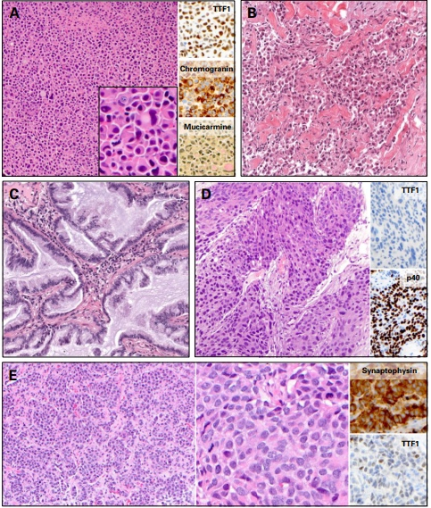
NTRK fusions across tumour types/histologies
Described across a variety
of patient ages (median age range= 48y (range from 25-86) and tumour types/histologies
A: Adenocarcinoma (solid growth pattern, diffuse neuroendocrine differentiation, signet ring cells); B: Adenocarcinoma (poorly-differentiated, solid and single-cell growth patterns); C: Mucinous adenocarcinoma; D: Squamous cell carcinoma; E: Neuroendocrine carcinoma (well-differentiated morphology, increased mitotic activity)
NTRK, neurotrophic tyrosine receptor kinase
Farago AF, et al JCO Precis Oncol. 2018; 2018:PO.18.00037

Slide 51
Testing approaches
Single gene-testing
FISH for NTRK1/2/3
  Advantages are rapid turn around time (1-3 days), requires relatively little tissue
  Disadvantages are potential for false negatives, relatively few places offer NTRK1/2/3
RT-PCR
  Advantages include cost, moderate turn around time (1 week), relatively little tissue
  Disadvantages include lack of detection of other fusion partners
FISH, fluorescent in situ hybridisation; NTRK, neurotrophic tyrosine receptor kinase; RT-PCR, reverse transcription-polymerase chain reaction
Hechtman JF. Mod Pathol. 2021; doi: 10.1038/s41379-021-00913-8 (Online ahead of print)

Slide 52
Testing approaches
Next generation sequencing
DNA-based
  Advantages include analyse variety of gene groups frequently altered in lung cancer including point mutations, amplifications and tumour mutational burden
  Disadvantages include requires moderate amounts of tumour tissue, limited coverage of introns (81% sensitivity – best at NTRK1) and turn around times (2-4 weeks)
RNA-based
  Advantages include confirmation that the fusion gene is transcribed, not limited by gene size (introns), and detection is partner agnostic
  Disadvantages include moderate amounts of tumour tissue, subject to RNA degradation in older samples, turn around times (2-4 weeks)
NTRK, neurotrophic tyrosine receptor kinase
Hechtman JF. Mod Pathol. 2021; doi: 10.1038/s41379-021-00913-8 (Online ahead of print)

Slide 53
Workflows
Multiple published approaches
Depend on institutional resources
qPCR-based analysis:
EGFR only
If DNA poor yield or clinical urgency
DNA-based NGS analysis:
EGFR/KRAS/BRAF/
NRAS/HER2 etc.
All ‘driver negative’
cases by DNA NGS
RNA-based NGS analysis:
ALK/BRAF/MET/ROS1/RET/
NTRK1/NTRK3
Excluded if
inadequate
remaining tissue or
quantity of
extracted RNA
All non-squamous
NSCLC tumours
IHC +/- FISH:
ALK/ROS1
ALK, anaplastic lymphoma kinase; BRAF, v-raf murine sarcoma viral oncogene homolog B1; EGFR, epidermal growth factor receptor; FISH, fluorescent in situ hybridisation; HER2, human epidermal growth factor receptor 2; IHC, immunohistochemistry; KRAS, Kirsten rat sarcoma viral oncogene homolog; MET, hepatocyte growth factor receptor gene; NGS, next-generation sequencing; NSCLC, non-small cell lung cancer; NTRK, neurotrophic tyrosine receptor kinase; qPCR, quantitative polymerase chain reaction; RET, rearranged during transfection; ROS1, c-ros oncogene 1
Moore DA, et al. Lung Cancer. 2021; 161:55-9

Slide 54
Testing approaches
other
Immunohistochemistry
Nanostring

Slide 55
TREATMENT OF trk Fusion-positive lung cancers
Prof. Christian Rolfo, MD
Centre of Thoracic Oncology
Tisch Cancer Institute Icahn School of Medicine at Mount Sinai, New York, USA

Slide 56
Clinical data with larotrectinib and entrectinib in NSCLC, 2nd gen TKIs and mechanisms of resistance
Christian Rolfo, MD, PhD, MBA, Dr.hc
Professor in Medicine
Icahn School of Medicine, Mount Sinai
Associate Director of Clinical Research
Center for Thoracic Oncology
The Tisch Cancer Institute
Mount Sinai, New York, NY, US
Center for Thoracic Oncology
The Tisch Cancer Institute

Slide 57
Disclosures
Research grants | Lung Cancer Research Foundation-Pfizer Grant 2019 NIH U54 grant
Personal financial interests | Speaker: MSD, Roche, Astra Zeneca
 | Advisory board: Inivata, ArcherDx, EMD Serono, Novartis, Boston Pharmaceuticals, Pfizer, Eisai, Blueprint, Mirati, COR2ED, Daiichi Sankyo
Non-financial interests | Research Collaboration: GuardantHealth
Leadership roles | Deputy chair Educational Committee IALSC - President ISLB (International Society of Liquid Biopsy) - Educational Chair: OLA Oncology Latin American Association Scientific Committee Member at ESO (European School of Oncology).
IALSC, International Society for the Study of Lung Cancer; ISLB, International Society of Liquid Biopsy
Christian Rolfo, Center of Thoracic Oncology, The Tisch Cancer Institute, Mount Sinai

Slide 58
FDA approve larotrectinib for NTRK fusion‑positive solid tumors
Novel irreversible HER2 TKIs pyrotinib and poziotinib show promising activity in HER2‑mutated NSCLC
Identification of BRAF mutations in solid tumors
First report of anti-HER2 blockage efficacy in HER2‑mutated NSCLCs
MET exon 14 skipping (METΔex14) mutations reported in NSCLC
NTRK rearrangements reported in NSCLC
LOXO-292 and BLU-667 demonstrate impressive activity in RET-rearranged NSCLC
Discovery of HER2 mutations in solid tumors
Four independent groups report the presence of RET gene fusions in NSCLC
FDA approves dabrafenib-trametinib for BRAF V600E mutated NSCLC
FDA approves entrectinib for NTRK fusion-positive solid tumors, including NSCLC
Discovery of NRG1 translocations
At the 2019 ASCO capmatinib and tepotinib shows impressive activity in MET Δex14 mutations
ASCO, American Society of Clinical Oncology; FDA, Food and Drug Administration; NSCLC, non-small cell lung cancer; NTRK, neurotrophic tyrosine receptor kinase; TKI, tyrosine kinase inhibitor
Adapted from Russo A (Rolfo C), et al. Curr Oncol Rep. 2020;22(5):48
Christian Rolfo, Center of Thoracic Oncology, The Tisch Cancer Institute, Mount Sinai

Slide 59
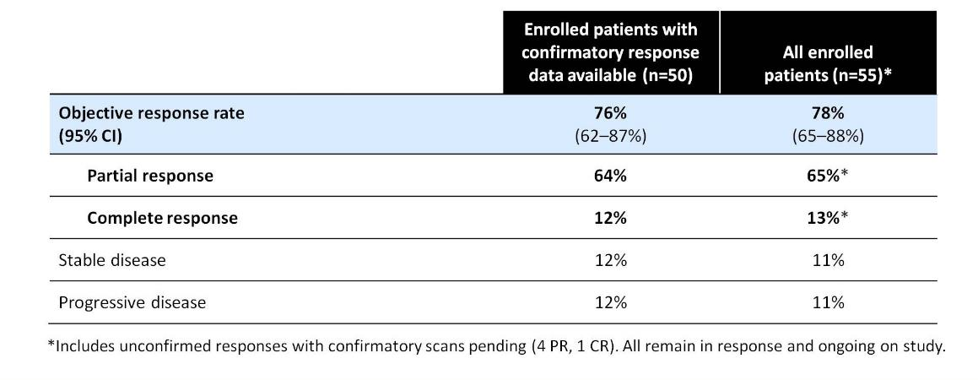
Clinical activity of larotrectinib in patients with TRK fusion cancers
Clinical activity of larotrectinib in patients with TRK fusion cancers
CI, confidence interval; CR, complete response; PR, partial response; TRK, tropomyosin receptor kinase
Presented By David Hyman at 2017 ASCO Annual Meeting
Christian Rolfo, Center of Thoracic Oncology, The Tisch Cancer Institute, Mount Sinai

Slide 60
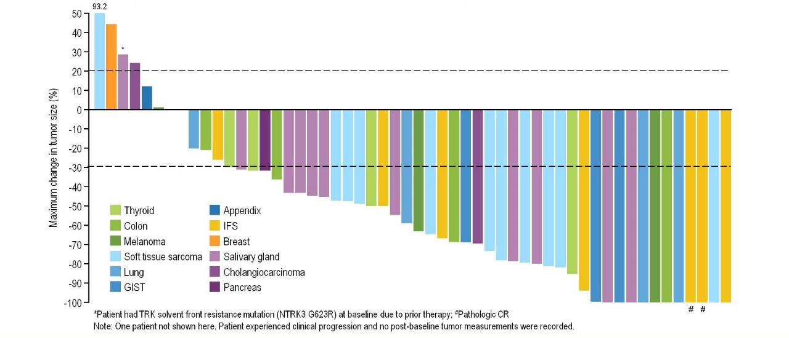
Efficacy regardless of tumor type
Larotrectinib Efficacy regardless of tumor type
GIST, Gastrointestinal stromal tumor; IFS, infantile fibrosarcoma
Presented By David Hyman at 2017 ASCO Annual Meeting
Christian Rolfo, Center of Thoracic Oncology, The Tisch Cancer Institute, Mount Sinai

Slide 61
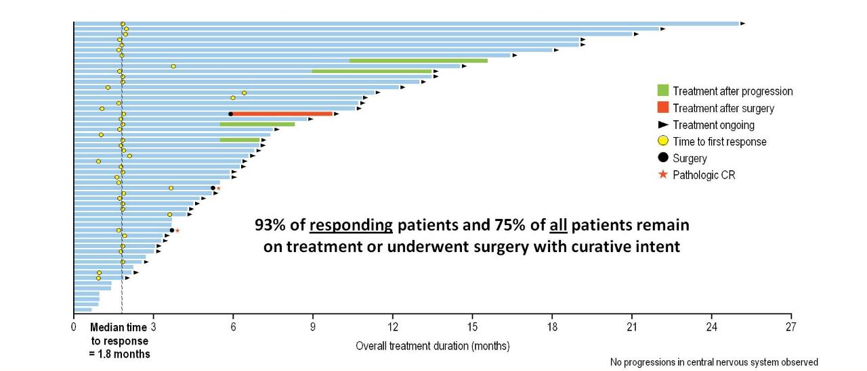
Duration of larotrectinib therapy
Duration of larotrectinib therapy
CR, complete response
Presented By David Hyman at 2017 ASCO Annual Meeting
Christian Rolfo, Center of Thoracic Oncology, The Tisch Cancer Institute, Mount Sinai

Slide 62
Efficacy and safety of larotrectinib in patients with NTRK fusion-positive lung cancer
Study design
Baseline demographics
Baseline demographics
BID, twice daily; CLIA, clinical laboratory improvement amendments; CNS, central nervous system; ECOG, Eastern Cooperative Oncology Group; INV, investigator-assessed; IRC, independent review committee; NTRK, neurotrophic tyrosine receptor kinase; ORR, objective response rate; RECIST, Response Evaluation Criteria in Solid Tumors; TRK, tropomyosin receptor kinase
Drilon A, et al. WCLC 2021. Abstract P53.02. Poster presentation.
Christian Rolfo, Center of Thoracic Oncology, The Tisch Cancer Institute, Mount Sinai

Slide 63
Best response to larotrectinib per IRC in patients with NTRK fusion-positive lung cancer
BID, twice daily; CLIA, clinical laboratory improvement amendments; CNS, central nervous system; ECOG, Eastern Cooperative Oncology Group; INV, investigator-assessed; IRC, independent review committee; NTRK, neurotrophic tyrosine receptor kinase; ORR, objective response rate; RECIST, Response Evaluation Criteria in Solid Tumors; TRK, tropomyosin receptor kinase
Drilon A, et al. WCLC 2021. Abstract P53.02. Poster presentation.

Slide 64
Treatment duration with larotrectinib in patients with NTRK fusion-positive lung cancer
CNS, central nervous system; CR, complete response; IRC, independent review committee;
NTRK, neurotrophic tyrosine receptor kinase; PR, partial response; SD, stable disease
                Drilon A, et al. WCLC 2021. Abstract P53.02. Poster presentation.
Christian Rolfo, Center of Thoracic Oncology, The Tisch Cancer Institute, Mount Sinai

Slide 65
DoR, PFS, and OS with larotrectinib in patients with NTRK fusion-positive lung cancer (per IRC)
DoR
PFS
OS
CI, confidence interval; DoR, duration of response; IRC, independent review committee; NE, not estimable; NTRK, neurotrophic tyrosine receptor kinase; OS, overall survival; PFS, progression-free survival
  Drilon A, et al. WCLC 2021. Abstract P53.02. Poster presentation.
Christian Rolfo, Center of Thoracic Oncology, The Tisch Cancer Institute, Mount Sinai

Slide 66
larotrectinib activity in patients with NTRK fusion-positive lung cancer with CNS metastases
DoR
PFS
OS
CI, confidence interval; CNS, central nervous system; DoR, duration of response; NE, not estimable; NTRK, neurotrophic tyrosine receptor kinase; OS, overall survival; PFS, progression-free survival
Drilon A, et al. WCLC 2021. Abstract P53.02. Poster presentation.
Christian Rolfo, Center of Thoracic Oncology, The Tisch Cancer Institute, Mount Sinai

Slide 67
Safety of larotrectinib in patients with NTRK fusion-positive lung cancer
AE, adverse event; ALT, alanine aminotransferase; AST, aspartate aminotransferase; NTRK, neurotrophic tyrosine receptor kinase; TEAE, treatment-emergent adverse event; TRAE, treatment-related adverse event;
Drilon A, et al. WCLC 2021. Abstract P53.02. Poster presentation.
Christian Rolfo, Center of Thoracic Oncology, The Tisch Cancer Institute, Mount Sinai

Slide 68
Entrectinib
Responses in 48 patients with NTRK fusion-positive solid tumors (six patients without matched pre-therapy or post-therapy scans excluded)
31 of 54 patients had an objective response (57%; 95% CI 43.2-70.8)
7% CR and 50% PR
Median duration of response:
10 months (95% CI 7.1 to NE)
CNS, central nervous system; CR, complete response; CRC, colorectal carcinoma; CUP, cancer of unknown primary; GI, gastrointestinal; MASC, mammary analogue secretory carcinoma; mets, metastases; ND, not determined; NE, not estimable; NSCLC, non-small cell lung cancer; NTRK, neurotrophic tyrosine receptor kinase; ORR, objective response rate; OS, overall survival; PD, progressive disease; PFS, progression-free survival; PR, partial response; SD, stable disease; SLD, sum of longest diameters
Rolfo C. ASCO 2020, Doebele RC, et al. Lancet Oncol. 2020;21:271-82; Bazhenova L, et al. Ann Oncol. 2021;32(suppl_5): S583-S620 (ESMO 2021 poster presentation)
Christian Rolfo, Center of Thoracic Oncology, The Tisch Cancer Institute, Mount Sinai

Slide 69
Response by CNS tumor involvement at baseline
Intracranial responses in six patients with measurable CNS metastases at baseline
CNS, central nervous system
Rolfo C. ASCO 2020, Doebele RC, et al. Lancet Oncol. 2020;21:271-82
Christian Rolfo, Center of Thoracic Oncology, The Tisch Cancer Institute, Mount Sinai

Slide 70
entrectinib in NTRK fusion-positive solid tumors: ESMO 2021 updated analysis
CI, confidence interval; CNS, central nervous system; CR, complete response; CRC, colorectal carcinoma; CUP, cancer of unknown primary; DoR, duration of response; ESMO, European Society for Medical Oncology; GI, gastrointestinal; MASC, mammary analogue secretory carcinoma; ND, not determined; NE, not estimable; NSCLC, non-small cell lung cancer; NTRK, neurotrophic tyrosine receptor kinase; PD, progressive disease; PFS, progression-free survival; PR, primary response; ORR, objective response rate; OS, overall survival; SD, stable disease
              .
Bazhenova L, et al. Ann Oncol. 2021;32(suppl_5): S583-S620 (ESMO 2021 poster presentation)
Christian Rolfo, Center of Thoracic Oncology, The Tisch Cancer Institute, Mount Sinai

Slide 71
CNS activity of entrectinib in NTRK fusion-positive solid tumors
Time to CNS Progression
BICR, blinded independent central review; CI, confidence interval; CNS, central nervous system; CR, complete response; DoR, duration of response; mets, metastases; NE, not estimable; NTRK, neurotrophic tyrosine receptor kinase; ORR, objective response rate; PFS, progression-free survival
71
Bazhenova L, et al. Ann Oncol. 2021;32(suppl_5): S583-S620 (ESMO 2021 poster presentation)
Christian Rolfo, Center of Thoracic Oncology, The Tisch Cancer Institute, Mount Sinai

Slide 72
Safety of entrectinib in NTRK fusion-positive solid tumors:
ESMO 2021 updated analysis
ALT, alanine aminotransferase; AST, aspartate aminotransferase; ESMO, European Society for Medical Oncology; NTRK, neurotrophic tyrosine receptor kinase; TRAE, treatment-related adverse event
Bazhenova L, et al. Ann Oncol. 2021;32(suppl_5): S583-S620 (ESMO 2021 poster presentation).
Christian Rolfo, Center of Thoracic Oncology, The Tisch Cancer Institute, Mount Sinai

Slide 73
Summary of larotrectinib and entrectinib activity in NTRK fusion-positive NSCLC
CI, confidence interval; CNS, central nervous system; CR, complete response; DoR, duration of response; NE, not estimable; NOS, not otherwise specified; NSCLC, non-small cell lung cancer; NTRK, neurotrophic tyrosine receptor kinase; ORR, objective response rate; OS, overall survival; PFS, progression-free survival; PR, partial response
Harada G (Drilon A), et al. Lung Cancer. 2021;161:108-113
Christian Rolfo, Center of Thoracic Oncology, The Tisch Cancer Institute, Mount Sinai

Slide 74
Matching-adjusted indirect comparison for treatment of TRK fusion cancer with larotrectinib versus entrectinib
Comparison of OS Kaplan Meier curves before and after matching
Comparison of PFS Kaplan Meier curves before and after matching
CI, confidence interval; CR, complete response; DoR, duration of response; MAIC, matching-adjusted indirect comparison; NE, not estimable; NR, not reached; ORR, objective response rate; OS, overall survival; PFS, progression-free survival; TRK, tropomyosin receptor kinase
Garcia-Foncillas J, et al. Ann Oncol. 2021;32(suppl_5): S382-S406 (ESMO 2021 poster presentation).
Christian Rolfo, Center of Thoracic Oncology, The Tisch Cancer Institute, Mount Sinai

Slide 75
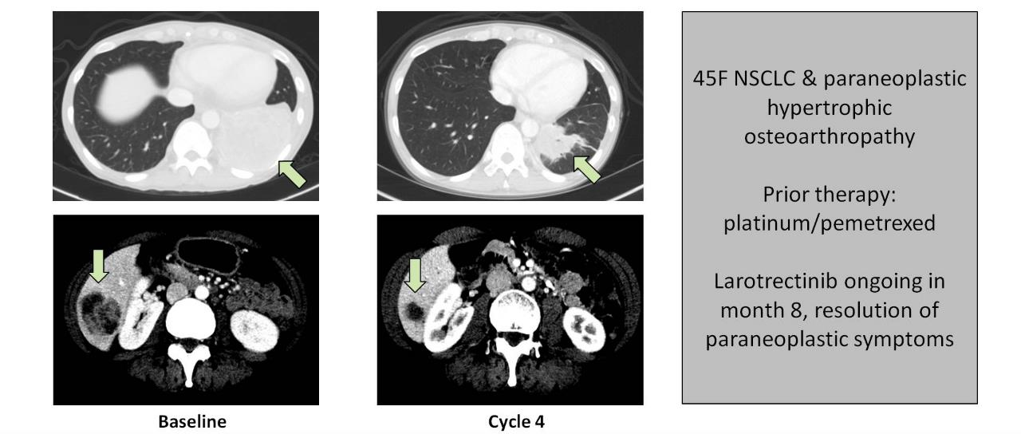
SQSTM1-NTRK1 lung cancer patient
SQSTM1-NTRK1 lung cancer patient case
NSCLC, non-small cell lung cancer; NTRK, neurotrophic tyrosine receptor kinase
Presented By David Hyman at 2017 ASCO Annual Meeting
Christian Rolfo, Center of Thoracic Oncology, The Tisch Cancer Institute, Mount Sinai

Slide 76
Comparison of selected FDA-approved or under clinical development TRK inhibitors
Rolfo C. Lancet Oncol. 2020;21;472-4
Christian Rolfo, Center of Thoracic Oncology, The Tisch Cancer Institute, Mount Sinai

Slide 77
Repotrectinib Preliminary Efficacy
Besse B. et al, OCT 2021

Slide 78
Repotrectinib Preliminary Efficacy
Besse B. et al, OCT 2021

Slide 79
Repotrectinib Preliminary Efficacy

Slide 80
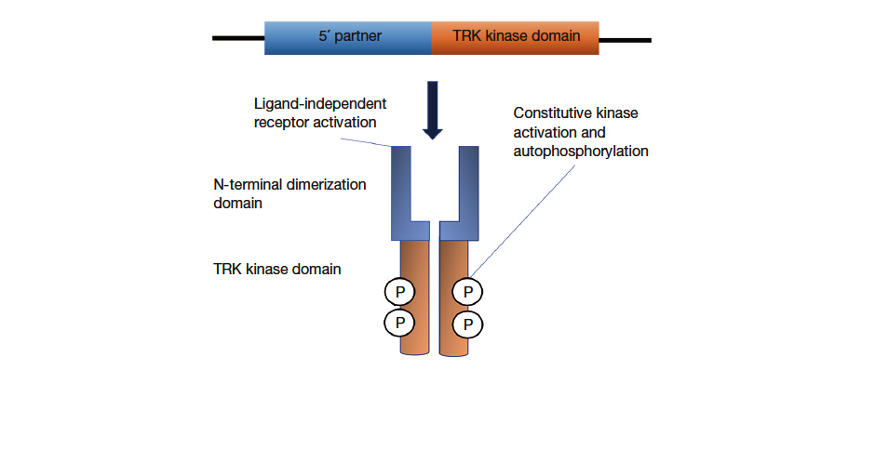
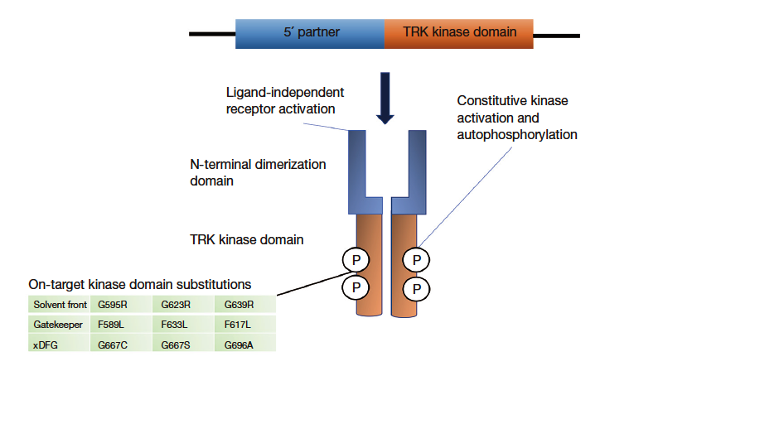
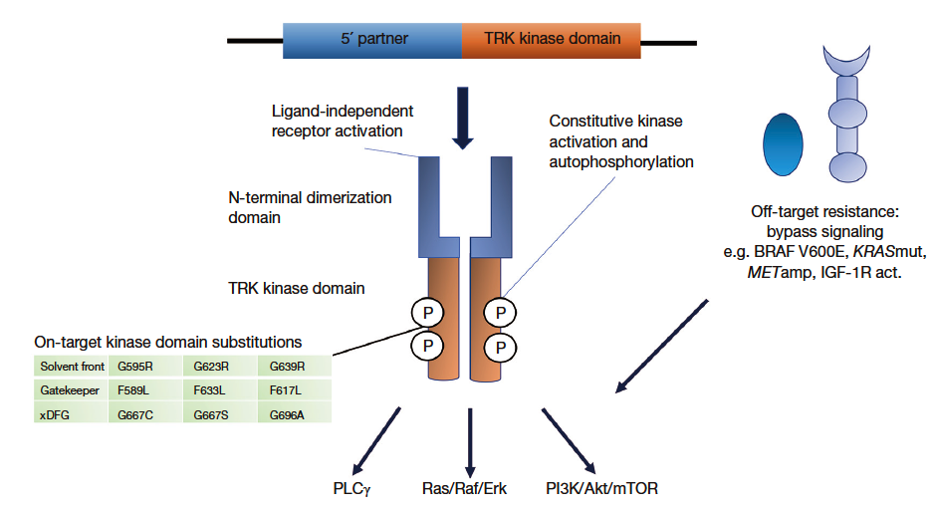
Mechanisms of resistance to TRK inhibitors
IGF-1R act., insulin-like growth factor 1 receptor activation; TRK, tropomyosin receptor kinase
Ekman S. Transl Lung Cancer Res. 2020;9:2535-44
Christian Rolfo, Center of Thoracic Oncology, The Tisch Cancer Institute, Mount Sinai

Slide 81
at least to determine those who will not have a benefit of Immunotherapy!
Please test your patients!
Christian Rolfo, Center of Thoracic Oncology, The Tisch Cancer Institute, Mount Sinai

Slide 82

Christian.Rolfo@mssm.edu
@ChristianRolfo
Thanks
Christian Rolfo, Center of Thoracic Oncology, The Tisch Cancer Institute, Mount Sinai

Slide 83
REACH NTRK CONNECT VIA
TWITTER, LINKEDIN, VIMEO & EMAIL
OR VISIT THE GROUP’S WEBSITE http://www.ntrkconnect.info
Follow us on Twitter
@ntrkconnectinfo
Follow the
NTRK CONNECT
group on LinkedIn
Watch us on the
Vimeo Channel
NTRK CONNECT
Email
froukje.sosef
@cor2ed.com

