Slide 2
MEETING SUMMARY
ESMO 2020, VIRTUAL MEETING
Prof. Gert Attard, MD, PhD, FRCP
University College London Cancer Institute, London, UK
HIGHLIGHTS FROM GU CONNECT
SEPTEMBER 2020

Slide 3
DISCLAIMER AND DISCLOSURES
Please note: The views expressed within this presentation are the personal opinions of the author.
They do not necessarily represent the views of the author’s academic institution or the rest of the
GU CONNECT group.
This content is supported by an Independent Educational Grant from Bayer.
Prof. Gert Attard has received financial support/sponsorship for research support, consultation, or speaker fees from the following companies:
Abbott Laboratories, Astellas Pharma, AstraZeneca, Bayer Healthcare Pharmaceuticals, Essa Pharmaceuticals, Innocrin Pharma, Janssen-Cilag, Millennium Pharmaceuticals, Novartis, Pfizer, Roche/Ventana, Sanofi-Aventis, Takeda, Veridex,
GU, genitourinary

Slide 4
IPATential150: Phase 3 study of ipatasertib plus abiraterone vs placebo plus abiraterone in mCRPC
de Bono J, et al.
ESMO 2020. Abstract #LBA4. Oral presentation
mCRPC, metastatic castration resistant prostate cancer

Slide 5
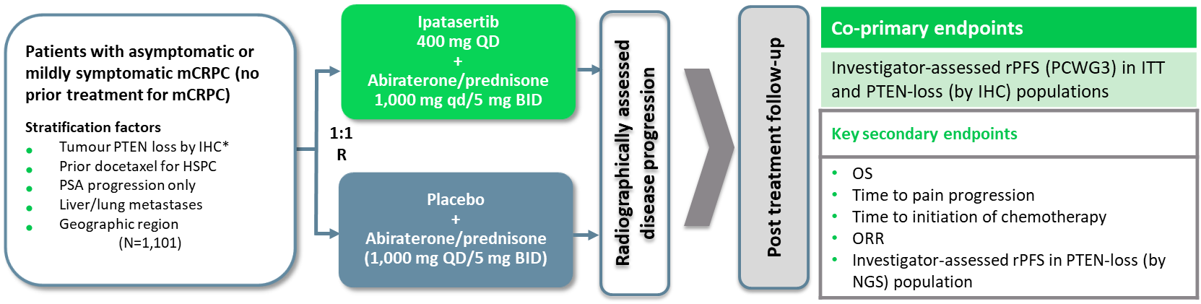
IPATential150: Background and study design
Ipatasertib is an oral adenosine triphosphate-competitive selective inhibitor of AKT1/2/3, which is the central node of the phosphatidylinositol-3-kinase (PI3K)/AKT signalling pathway – a key driver of cancer cell growth and proliferation in prostate cancer^{1,2}
The PI3K/AKT pathway has also been implicated in resistance to anti-androgen therapy as androgen receptor (AR) inhibition is associated with an increase in AKT pathway activation^{2,3}
Approx. 40-60% of patients with metastatic castration-resistant prostate cancer (mCRPC) have lost the AKT phosphatase PTEN. This results in hyperactivation of the PI3K/AKT pathway and is associated with adverse outcomes such as increased tumour grade and stage, earlier biochemical recurrence after radical prostatectomy, metastasis, prostate cancer–specific death, and androgen-independent progression^{4,5}
The IPATential150 trial is investigating dual AR and PI3K/AKT inhibition in patients with previously untreated mCRPC⁶
* PTEN loss defined as minimum of 50% of the specimen’s tumour area with no detectable PTEN staining (by Ventana IHC assay using SP218 antibody)
BID, twice daily; HSPC, hormone-sensitive prostate cancer; IHC, immunohistochemistry; ITT, intention to treat; NGS, next-generation sequencing; ORR, overall response rate; OS, overall survival; PCWG3, Prostate Cancer Working Group 3; PSA, prostate specific antigen; PTEN, phosphatase and tensin homologue; QD, once daily; R, randomisation; rPFS, radiographic progression-free survival; 1. Yang J, et al. Mol Cancer. 2019;18:26; 2. Crumbaker M, et al. Cancers (Basel). 2017;9:34; 3. Wang Y, et al. Current Cancer Drug Targets. 2007;7:591-604;
4. de Bono JS, et al. Clin Cancer Res. 2019;25;928-36; 5. Jamaspishvili T, et al. Nat Rev Urol. 2018;15:222-34; 6. de Bono J, et al. ESMO 2020. Abstract #LBA4. Oral presentation

Slide 6
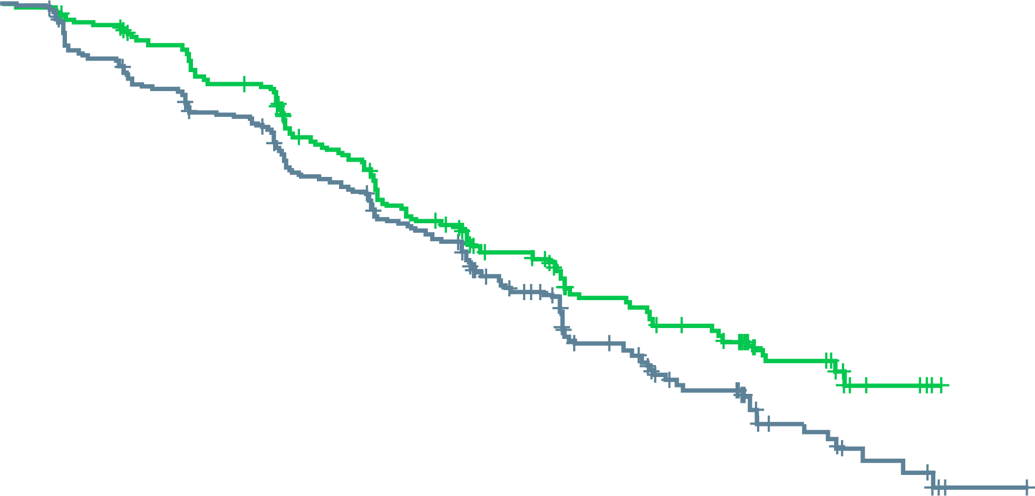
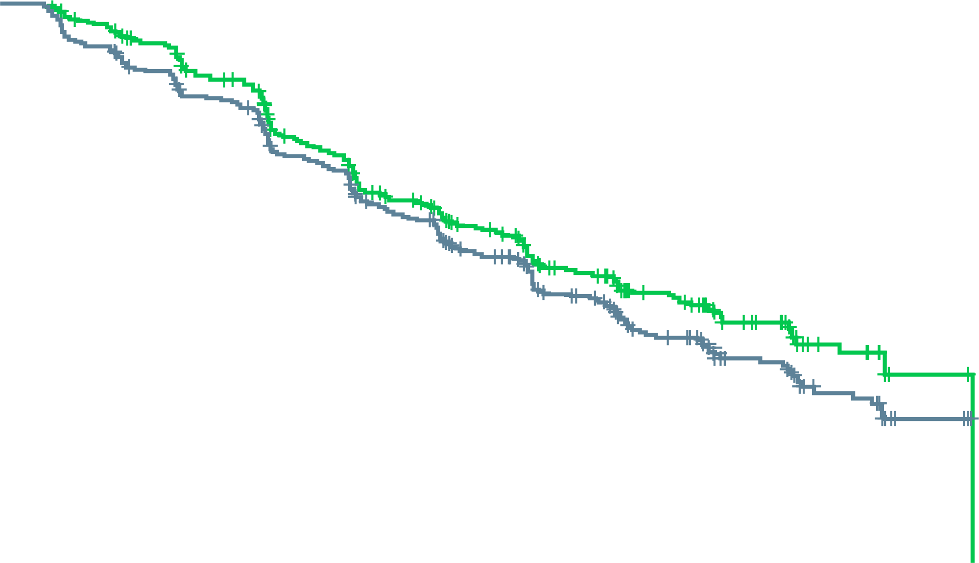
IPATential150: results
Ipatasertib significantly improved radiographic progression-free survival (rPFS) compared to placebo for patients with phosphatase and tensin homologue (PTEN)-loss mCRPC, but not in the intention-to-treat (ITT) population
  This effect was consistent across all pre-specified subgroups
rPFS in the PTEN-loss (by IHC) population
rPFS in the ITT population
 | Pbo + AAP (N=261) | Ipat + AAP (N=260)
Patients with event, n (%) | 154 (59) | 124 (48)
1-year event free (95% CI), % | 63.3 (57.3-69.3) | 64.4 (58.3-70.5)
Stratifiedª HR (95% CI) | 0.77 (0.61-0.98); p=0.0335^{b}
 | Pbo + AAP (N=261) | Ipat + AA (N=260)
Patients with event, n (%) | 306 (55) | 252 (46)
1-year event free (95% CI), % | 63.0 (58.9-67.1) | 65.3 (61.1-69.5)
Stratified HR^{c} (95% CI) | 0.84 (0.71-0.99); p=0.0431^{d}
100
100
80
80
60
Pbo + Ipat
60
Pbo + Ipat
Median follow-up:
19 months
Pbo + AAP
Median follow-up:
19 months
Pbo + AAP
rPFS (%)
Min. follow-up:
14 months
rPFS (%)
Min. follow-up:
14 months
40
40
20
20
Median rPFS,
19.2 months
(95% CI 16.5-22.3)
Median rPFS: 16.5 months
(95% CI 13.9-17.0)
Median rPFS: 18.5 months
(95% CI 16.3-22.1)
Median rPFS: 16.6 months
(95% CI 15.6-19.1)
0
0
0
3
6
9
12
15
18
21
24
27
30
33
0
3
6
9
12
15
18
21
24
27
30
Patients at risk, n
Time (months)
Patients at risk, n
Time (months)
Pbo + AAP
Ipat + AAP
261
260
233
238
206
211
175
182
151
149
105
113
71
72
41
48
22
25
10
12
3
Pbo + AAP
Ipat + AAP
554
547
501
495
443
436
377
368
322
310
237
239
165
158
98
103
60
53
29
26
5
2
Data cut-off date: 16 March 2020; ª Stratified for prior taxane-based therapy and PSA-only progression factor; ^{b} Statistically significant at ɑ = 0.05 level;
^{c} Stratified for prior taxane-based therapy, PSA-only progression factor, and tumour PTEN loss status (by IHC); ^{d} Did not meet statistical significance ɑ = 0.01 level
AAP, abiraterone acetate + prednisone; CI, confidence interval; HR, hazard ratio; IHC, immunohistochemistry; Ipat, ipatasertib;
mCRPC, metastatic castration-resistant prostate cancer; Pbo, placebo; PSA, prostate specific antigen; de Bono J, et al. ESMO 2020. Abstract #LBA4. Oral presentation

Slide 7
IPATential150: results (CONT.)
SECONDARY EFFICACY ENDPOINTS
safety
Secondary endpoints favoured the combination arm
Secondary endpoints (efficacy) | PTEN loss (by IHC) (N=521) |  | ITT (N=1,101)
 | Pbo + AAP | Ipat + AAP | Pbo + AAP | Ipat + AAP
Time to PSA progression, n | 261 | 260 | 554 | 547
Median (95% CI), months | 7.6 (6.4-9.3) | 12.6 (10.2-15.3) | 8.4 (7.4-9.3) | 12.9 (10.3-15.1)
Stratified^{a,b} HR (95% CI) | 0.69 (0.55-0.87); p=0.0013^{c} |  | 0.73 (0.62-0.85); p<0.0001^{c}
PSA response, n/N (%) | 187/261 (72) | 217/260 (84) | 418/554 (76) | 444/546 (81)
p value | 0.0012^{c} |  | 0.0183^{c}
Time to pain progression, n/N (%) | 95/261 (36) | 73/260 (28) | 187/554 (34) | 156/547 (29)
Stratified^{a,b} HR (95% CI) | 0.77 (0.56-1.04) |  | 0.87 (0.70-1.08)
Confirmed ORR, n/N (%) | 37/96 (39) | 60/99 (61) | 98/225 (44) | 122/201 (61)
Difference (95% CI), % | 22 (7-37) |  | 17 (7-27)
 | PTEN loss (by NGS)
rPFS, n | 103 | 105 | – | –
Median (95% CI), months | 14.2 (10.9-18.7) | 19.1 (13.9-NE) | – | –
Stratifiedª HR (95% CI) | 0.65 (0.45-0.95) |  | – | –
Safety, % | Pbo + AAP (N=546) | Ipat + AAP (N=551)
SAEs | 23 | 40
AEs leading to treatment discontinuation | 5 | 21
ª Stratified for prior taxane-based therapy and PSA-only progression factor (PTEN loss [by IHC/NGS]);
^{b} Stratified for prior taxane-based therapy, PSA-only progression factor, and tumour PTEN loss (by IHC) (ITT);
^{c} Descriptive
AAP, abiraterone acetate + prednisone; CI, confidence interval; HR, hazard ratio; IHC, immunohistochemistry; Ipat, ipatasertib; ITT, intention to treat; NE, not evaluable;
NGS, next-generation sequencing; ORR, overall response rate; Pbo, placebo; PSA, prostate specific antigen; rPFS, radiographic progression-free survival; PTEN, phosphatase and tensin homologue
de Bono J, et al. ESMO 2020. Abstract #LBA4. Oral presentation

Slide 8
IPATential150: summary
Ipatasertib plus AAP demonstrated a significantly superior rPFS and anti-tumour activity compared to placebo plus AAP in patients with PTEN-loss mCRPC
  Improvement of rPFS in the ITT population was not statistically significant
The safety profile of ipatasertib plus AAP was in line with known and potential risks observed in clinical studies
While initial data are encouraging, overall survival (OS) benefit and additional secondary endpoints are
not yet mature. The trial will continue until the next planned analysis and data will be shared with health authorities
AAP, abiraterone acetate + prednisone; ITT, intention to treat; mCRPC, metastatic castration-resistant prostate cancer; rPFS, radiographic progression-free survival;
PTEN, phosphatase and tensin homologue
de Bono J, et al. ESMO 2020. Abstract #LBA4. Oral presentation

Slide 9
Final overall survival analysis of PROfound: Olaparib vs physician’s choice of enzalutamide or abiraterone in patients with mCRPC and homologous recombination repair gene alterations
de Bono J, et al.
ESMO 2020. Abstract #610O. Oral presentation by Mateo, J
mCRPC, metastatic castration resistant prostate cancer

Slide 10
PROfound: Background and study design
PROfound was the first randomised prostate cancer trial to use biomarker selection to identify which mCRPC patients may respond to treatment. Olaparib treatment was associated with statistically significant and clinically relevant improvements in BICR rPFS compared to enzalutamide/abiraterone acetate in mCRPC patients with:
    Alterations in BRCA1, BRCA2, and/or ATM (Cohort A)
    Alterations in any of 15 pre-specified genes with a direct/indirect role in homologous recombination repair (HRR)
Final OS data are reported here
Olaparib 300 mg BID
(n=162)
Primary endpoint
rPFS in cohort A (RECIST 1.1 and PCWG3 by BICR)
Key eligibility criteria
mCRPC with disease progression on prior NHA (e.g. abiraterone acetate or enzalutamide)
Alterations in ≥1 of any qualifying gene with a direct or indirect role in HRR
Cohort A
BRCA1, BRCA2, or ATM alteration
(N=245)
Physician’s choice
(n=83)
2:1 randomisation
(Open label)
Upon progression by BICR,
physician’s choice patients were
allowed to cross over to olaparib
Key secondary endpoints
rPFS in cohorts A and B (by BICR) Confirmed radiographic objective response rate in cohort A (by BICR) Time to pain progression in cohort A OS in cohort A
Cohort B
Other alterations
(N=142)
Olaparib 300 mg BID
(n=94)
Physician’s choice
(n=48)
Stratification factors
Previous taxane; measurable disease
Physicians choice: enzalutamide (160 mg QD) or abiraterone (1,000 mg QD + prednisone 5 mg BID)
ATM, ataxia telangiectasia mutated; BICR, blinded independent central review; BID, twice daily; BRCA1/2, breast cancer 1/2; mCRPC, metastatic castration-resistant prostate cancer; NHA, new hormonal agent; OS, overall survival; PCWG3, Prostate Cancer Working Group 3; RECIST, Response Evaluation Criteria In Solid Tumours; rPFS, radiographic progression-free survival; QD, once daily
de Bono J, et al. N Engl J Med. 2020;382:2091-102; Hussain M, et al. Ann Oncol. 2019;30 suppl 5:v881-2; abstract LBA12

Slide 11
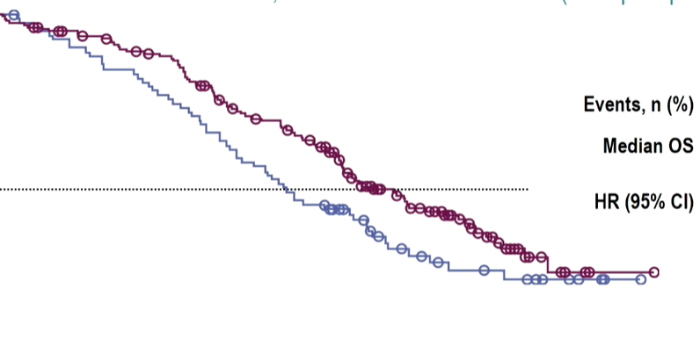
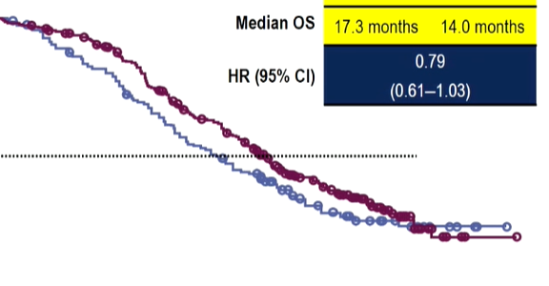
profound: Results
OS in cohort A
OS in overall population
100
Olaparib
100
Olaparib
90
Physician’s choice
90
Physician’s choice
80
80
70
70
60
60
OS (%)
50
OS (%)
50
40
40
30
30
20
20
10
10
0
0
2
4
6
8
10
12
14
16
18
20
22
24
26
28
30
32
34
0
0
2
4
6
8
10
12
14
16
18
20
22
24
26
28
30
32
34
No. at risk
Time since randomisation (months)
No. at risk
Time since randomisation (months)
Olaparib
Physician’s choice
162
83
155
79
150
74
142
69
136
64
124
58
107
50
101
43
91
37
71
27
56
18
44
15
30
11
18
9
6
6
2
3
1
1
0
0
Olaparib
Physician’s choice
256
131
249
125
240
115
228
106
209
96
182
83
157
71
146
63
126
55
96
37
73
27
56
22
39
15
22
11
7
6
2
3
1
1
0
0
 | Cohort A
 | Olaparib (N=162) | Physician’s choice (N=83)
Median OS, months | 19.1 | 14.7
HR (95% CI) | 0.69 (0.50-0.97); p=0.0175
Median follow-up, months | 21.9 | 21.0
 | Overall population
 | Olaparib (N=256) | Physician’s choice (N=131)
Median OS, months | 17.3 | 14.0
HR (95% CI) | 0.79 (0.61-1.03); p=0.0515
Median follow-up, months | 20.7 | 20.5
Patients randomised between April 2017 and November 2018; DCO for final OS: 20 March 2020
Among patients with disease progression in the physician’s choice arm , 67% in cohort A and 66% in the overall population crossed over to olaparib
Longer follow-up yielded no new safety signals
CI, confidence interval; HR, hazard ratio; OS, overall survival
de Bono J, et al. ESMO 2020. Abstract #610O. Oral presentation by Mateo, J

Slide 12
profound: Summary
PROfound is the first phase 3 study to show an OS benefit of a PARP inhibitor
Despite extensive crossover from the control arm, olaparib demonstrated a statistically significant and clinically relevant prolongation of OS compared to enzalutamide/abiraterone in patients with mCRPC with alterations in BRCA1, BRCA2, and/or ATM
Pre-specified sensitivity analysis adjusting for treatment crossover suggests the treatment effect of olaparib will be greater than that observed in the PROfound study
The safety profile of olaparib was consistent with the primary analysis¹
Olaparib is approved by the FDA for patients with mCRPC with alterations in multiple DNA repair genes who have progressed on enzalutamide/abiraterone²
ATM, ataxia telangiectasia mutated; BRCA1/2, breast cancer 1/2; DNA, deoxyribonucleic acid; FDA, US Food and Drug Administration; mCRPC, metastatic castration-resistant prostate cancer; OS, overall survival; ; PARP, Poly (ADP-ribose) polymerase; 1. de Bono J, et al. N Engl J Med. 2020;382:2091-102; 2. US FDA. Available from: https://www.fda.gov/drugs/drug-approvals-and-databases/fda-approves-olaparib-hrr-gene-mutated-metastatic-castration-resistant-prostate-cancer. Last updated May 2020. Accessed September 2020; de Bono J, et al. ESMO 2020 abstract #610O. Oral presentation by Mateo, J

Slide 13
Abiraterone acetate plus prednisolone for HNPC: Long-term results from metastatic patients in STAMPEDE trial
James N, et al.
ESMO 2020. Abstract #611O. Oral presentation
HNPC, hormone-naive prostate cancer

Slide 14
STAMPEDE: Background
In previously reported data from STAMPEDE, abiraterone acetate plus prednisolone (AAP) showed a clear survival advantage in men starting long-term hormone therapy for prostate cancer¹
STAMPEDE included patients with and without metastatic disease (M1). Here we report long-term outcomes in the subset of M1 patients²
STAMPEDE: abiraterone comparisons
Patients: standard of care (SOC) (n=957), SOC + AAP (n=960)
Recruitment: November 2011 to January 2014
Long-term follow up analysis
Database lock: 3 April 2020 (3 years after initial analysis)
1,003 patients had M1 disease at baseline
Median follow-up: 6.1 years
329 control arm events
125 patients still receiving abiraterone acetate
Primary outcome measure: OS
Secondary outcome measures: FFS, PFS, MFS, SREs, toxicity
2006
2007
2008
2009
2010
2011
2012
2013
2014
2015
2016
2017
2018
2019
2020
2021
2022
2023
2024
A
SOC=ADT(+/-RT)
A
B
SOC + zoledronic acid
B
C
SOC + docetaxel
C
D
SOC + celecoxib
D
E
SOC + zoledronic acid + docetaxel
E
F
SOC + zoledronic acid + celecoxib
F
G
SOC + (AA)
G
H
SOC + M1/RT (M1)
H
Trial arm
I
SOC+(E+A)
I
K
SOC + metformin
K
L
SOC + tE2
L
M
SOC + rucaparib (BioMK+)
M
Patients in comparison
Patients not in comparison
2006
2007
2008
2009
2010
2011
2012
2013
2014
2015
2016
2017
2018
2019
2020
2021
2022
2023
2024
A/AA, abiraterone acetate; ADT, androgen deprivation therapy; BioMK+, biomarker positive; E, enzalutamide; FFS, failure-free survival; MFS, metastasis-free survival;
OS, overall survival; PFS, progression-free survival; RT, radiotherapy; SRE, skeletal-related event; tE2, transdermal oestradiol
1. James ND, et al. N Engl J Med. 2017;377:338-51; 2. James N, et al. ESMO 2020. Abstract #611O. Oral presentation

Slide 15
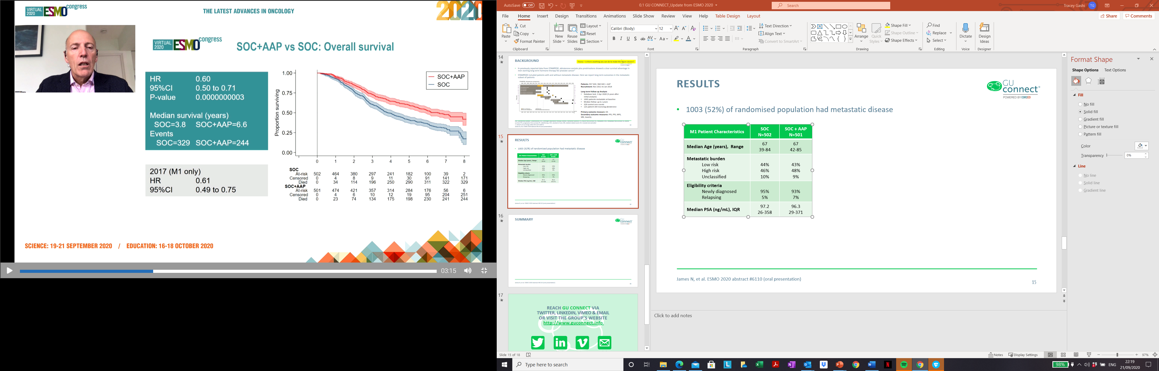
STAMPEDE: RESULTS
1,003 (52%) of randomised population had metastatic disease
OS: SOC + AAP VS SOC
M1 patient characteristics | SOC (N=502) | SOC + AAP (N=501)
Median age (range), years | 67 (39-84) | 67 (42-85)
Metastatic burden,ª %
Low risk | 44 | 43
High risk | 46 | 48
Unclassified | 10 | 9
Eligibility criteria, %
Newly diagnosed | 95 | 93
Relapsing | 5 | 7
Median PSA (IQR), ng/mL | 97.2 (26-358) | 96.3 (29-371)
1.00
 | SOC (N=502) | ISOC + AAP (N=501)
Median survival, years | 3.8 | 6.6
Events, n | 329 | 244
0.75
Proportion surviving
0.50
HR 0.60, 95% CI 0.50-0.71;
p=0.0000000003
2017 (M1 only)
HR 0.61, 95% CI 0.49-0.75
0.25
0.00
0
1
2
3
4
5
6
7
8
SOC, n
At risk
Censored
Died
502
0
0
464
4
34
380
8
114
297
9
196
241
11
250
182
30
290
100
91
311
39
141
322
2
171
329
SOC + AAP, n
At risk
Censored
Died
501
0
0
474
4
23
421
6
74
357
10
134
314
12
175
284
19
198
176
95
230
56
204
241
6
251
244
ª Per LATITUDE risk criteria
AAP, abiraterone acetate + prednisolone; CI, confidence interval; HR, hazard ratio; IQR, interquartile range; M1, metastatic disease; OS, overall survival;
PSA, prostate specific antigen; SOC, standard of care
James ND, et al. N Engl J Med. 2017;377:338-51; James N, et al. ESMO 2020. Abstract #611O. Oral presentation

Slide 16
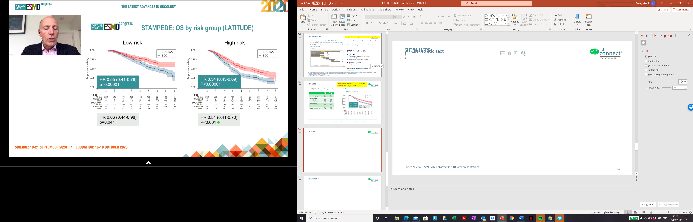
STAMPEDE: RESULTS (CONT.)
OS BY RISK GROUP (LATITUDE)
Low Risk
High Risk
1.00
1.00
0.75
0.75
Proportion surviving
Proportion surviving
0.50
0.50
0.25
HR 0.55, 95% CI 0.41-0.76;
p=0.00001
0.25
HR 0.54, 95% CI 0.43-0.69;
p<0.00001
0.00
0.00
0
1
2
3
4
5
6
7
8
0
1
2
3
4
5
6
7
8
SOC, n
SOC, n
At risk
Censored
Died
222
0
0
213
2
7
191
3
28
165
4
53
146
5
71
109
14
99
62
50
110
29
77
116
1
101
120
At risk
Censored
Died
232
0
0
206
2
24
152
5
75
106
5
121
73
6
153
56
13
163
28
33
171
6
51
175
0
54
178
SOC + AAP, n
SOC + AAP, n
At risk
Censored
Died
214
0
0
211
0
3
192
2
20
172
5
37
161
5
48
149
6
59
95
44
75
31
106
77
5
132
77
At risk
Censored
Died
241
0
0
221
2
18
191
2
48
154
3
84
124
5
112
111
9
121
66
39
136
19
79
143
1
95
145
2018 analysis
HR 0.66 (0.44-0.98)
P=0.041
2018 analysis
HR 0.54 (0.41-0.70)
P<0.001
Toxicity at 4 years post-randomisation was similar between treatment arms, with 16% of patients in each group reporting grade ≥3 toxicity
AAP, abiraterone acetate + prednisolone; CI, confidence interval; HR, hazard ratio; SOC, standard of care
Hoyle AP, et al. Eur Urol 2019;76:719-728; James N, et al. ESMO 2020. Abstract #611O. Oral presentation

Slide 17
STAMPEDE: SUMMARY
The results are unchanged in M1 patients from the initial analysis in 2017
Highly significant OS benefit was observed in M1 patients receiving ADT plus AAP
  Highly significant benefit was also observed for the secondary endpoints of MFS and SREs
OS benefit by LATITUDE risk burden was similar for both low- and high-risk subgroups
  Regulators and payors could consider extending the approval of abiraterone acetate to all patients with mHSPC as opposed to just those in the high-risk subgroup
AAP, abiraterone acetate + prednisolone; ADT, androgen deprivation therapy; M1, metastatic disease; MFS, metastasis-free survival;
mHSPC, metastatic hormone-sensitive prostate cancer; OS, overall survival; SRE, skeletal-related event
James ND, et al. N Engl J Med. 2017;377:338-51; James N, et al. ESMO 2020. Abstract #611O. Oral presentation

Slide 18

REACH GU CONNECT VIA
TWITTER, LINKEDIN, VIMEO, AND EMAIL
OR VISIT THE GROUP’S WEBSITE http://www.guconnect.info
Follow us on Twitter
@guconnectinfo
Follow the
GU CONNECT
group on LinkedIn
Watch us on the
Vimeo Channel
GU CONNECT
Email
elaine.wills@cor2ed.com

