Slide 2
Meeting summary
ASCO GU 2020, San Francisco, USA
Assoc. Prof. Shilpa Gupta
Cleveland Clinic, Ohio, USA
UROTHELIAL CANCER UPDATE

Slide 3
Disclaimer
Please note: The views expressed within this presentation are the personal opinions of the author. They do not necessarily represent the views of the author’s academic institution or the rest of the GU CONNECT group.
This content is supported by an Independent Educational Grant from Bayer.

Slide 4
Study EV-103: Preliminary durability results of enfortumab vedotin plus pembrolizumab for locally advanced or metastatic urothelial carcinoma
Rosenberg JE, et al.
ASCO GU 2020. Abstract #441 (Oral presentation)

Slide 5
introduction
Platinum chemotherapy is the standard of care for patients with metastatic Urothelial Carcinoma (UC) in the first line setting
Gemcitabine/carboplatin is a standard therapy in patients who are cisplatin ineligible but it is poorly tolerated and associated with limited durability and survival.
Enfortumab vedotin is an antibody-drug conjugate comprised of the nectin-4 antibody enfortumab coupled to the microtubule disrupting agent monomethyl auristatin E (MMAE). Nectin-4 is highly expressed in UC
Results from EV-103 were presented at ESMO 2019. EV-103 evaluated enfortumab as a first-line agent in combination with pembrolizumab, and the results from the cisplatin-ineligible (cohort A) demonstrated a 62% objective response rate with 14% of patients achieving a complete response¹
This presentation presents updated durability, progression-free survival and overall survival data for enfortumab vedotin and pembrolizumab in the first-line setting for patients who could not receive cisplatin as first line therapy for locally advanced or metastatic disease
MMAE, monomethyl auristatin E; UC, urothelial carcinoma
1. Hoimes C, et al. Annals of Oncology (2019) 30 (suppl_5): v356-v402. 10.1093/annonc/mdz249;
2. Rosenberg JE, et al. ASCO GU 2020. Abstract #441 (Oral presentation)

Slide 6
EV-103 study design
EV-103 first-line cohorts of enfortumab vedotin
plus Pembrolizumab
Enfortumab vedotin 1.25 mg/kg + pembrolizumab (200 mg) in 1L cisplatin-ineligible la/mUC patients
(N=45)
Patient
Population
Locally Advanced
or
Metastatic Urothelial
Carcinoma
Dose
Escalation¹
enfortumab
vedotin +
pembrolizumab
cisplatin-ineligible
(n=5)
Dose Expansion
Cohort A
enfortumab
vedotin +
pembrolizumab
cisplatin-ineligible
(n=40)
Dosing: Enfortumab vedotin on days 1
and 8 and pembrolizumab on day 1 of
every 3-week cycle
Enfortumab vedotin exposure:
Comparable to enfortumab vedotin
monotherapy on 4-week schedule
(Days 1, 8 and 15)²
Primary endpoints: safety and tolerability
Key secondary endpoints: dose-limiting
toxicities, ORR, DOR, PFS OS
¹ Not included in the current analysis: three 1L patients treated with EV 1 mg/kg + pembrolizumab 200 mg and
two 2L patients treated with EV 1.25 mg/kg + pembrolizumab 200 mg
² Rossenberg et al. J Clin Oncol. 2019;37(29)2592-600.
Data is presented on 45 patients, who have received a median of 9 cycles of therapy (range 1-22)
1L, first-line; 2L, second-line; DOR, duration of response; EV, enfortumab vedotin; mUC, metastatic urothelial carcinoma; ORR, objective response rate; OS, overall survival; PFS, progression-free survival
Rosenberg JE, et al. ASCO GU 2020. Abstract #441 (Oral presentation)

Slide 7
EV-103 baseline data
Enfortumab vedotin 1.25 mg/kg + pembrolizumab in 1L setting 8 Oct 2019 data cut-off | Patients (N=45) n (%)
Male sex, n (%) | 36 (80)
Age, yrs, median (min, max) | 69 (51, 90)
ECOG performance status, n (%) 0 1 2 | 16 (36) 23 (51) 6 (13)
Primary tumor location, n (%) Lower tract Upper tract | 31 (69) 14 (31)
Metastasis sites, n (%) Lymph nodes only Visceral disease Liver | 4 (9) 41 (91) 15 (33)
PD-L1 status by combined positive score,¹ n (%) <10 ≥10 Not evaluable/not available | 19 (42) 14 (31) 12 (27)
¹ Unselected patient population; PD-L1 tested using the 22C3 PharmDx assay from Agilent/Daklo
The majority of patients were men with visceral disease
Patients with low and high PD-L1 status were balanced
1L, first-line; ECOG, Eastern Cooperative Oncology Group; PD-L1, programmed ligand death-1
Rosenberg JE, et al. ASCO GU 2020. Abstract #441 (Oral presentation)

Slide 8
Safety and tolerability
Treatment-related adverse events (TRAE)
TRAEs by preferred term 8 Oct 2019 data cut-off | Patients (N=45) n (%)
 | Any Grade ≥20% of patients | ≥Grade 3 ≥10% of patients
Overall | 43 (96) | 26 (58)
Fatigue | 22 (49) | 4 (9)
Alopecia | 22 (49) | –
Peripheral sensory neuropathy | 22 (49) | 2 (4)
Diarrhea | 20 (44) | 3 (7)
Decreased appetite | 17 (38) | 0
Dysgeusia | 15 (33) | –
Rash maculo-popular | 14 (31) | 4 (9)
Nausea | 13 (29) | 0
Pruritus | 13 (29) | 1 (2)
Anemia | 9 (20) | 3 (7)
Weight decreased | 9 (20) | 0
Lipase increased | 8 (18) | 8 (18)
7 patients (16%) had treatment related SAEs
  1 patient (2%) died due to multiple organ failure
SAE, serious adverse event; TRAE, treatment-related adverse event
Rosenberg JE, et al. ASCO GU 2020. Abstract #441 (Oral presentation)

Slide 9
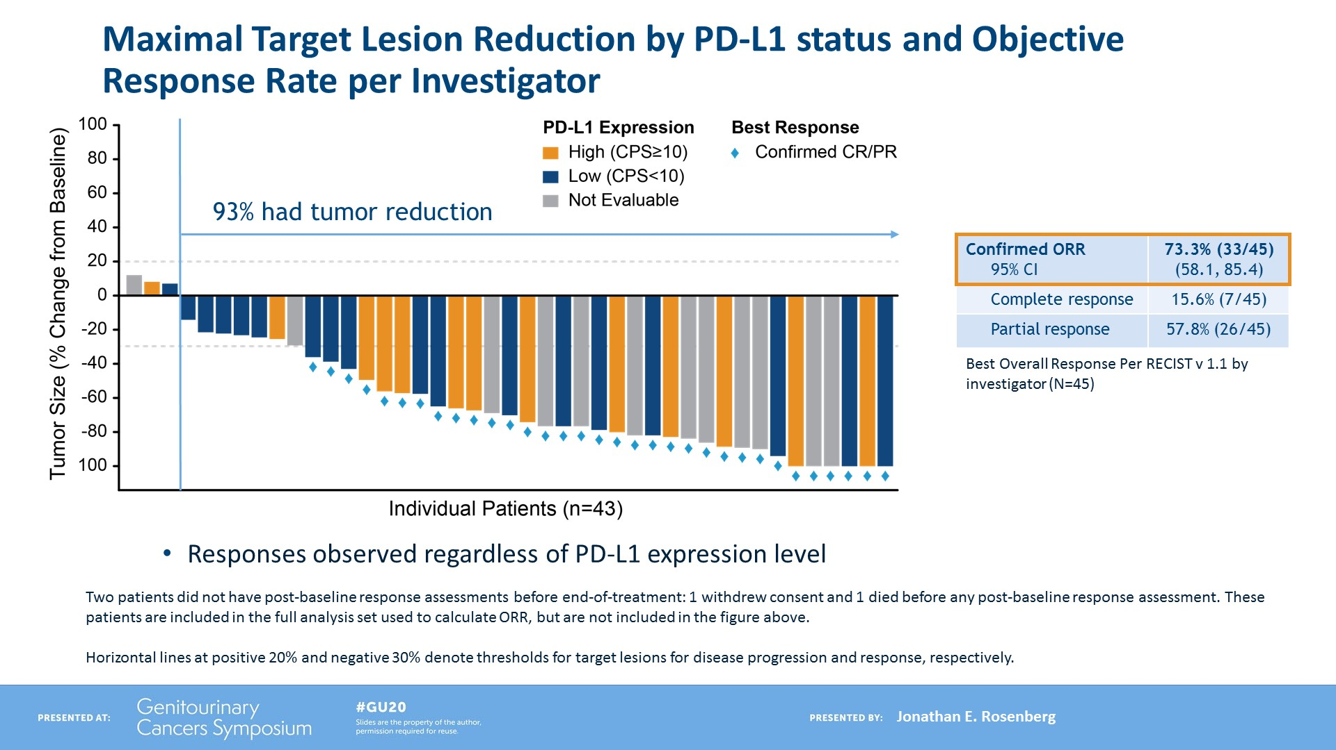
Objective response rate
Maximal target lesion reduction by PD-L1 status
ORR per Investigator
100
PD-L1 Expression
High (CPS ≥10)
Low (CPS <10)
Not evaluable
Best Response
Confirmed CR/PR
Confirmed ORR 95% CI | 73.3% (33/45) (58.1, 85.4)
Complete response | 15.6% (7/45)
Partial response | 57.8% (26/45)
Best Overall Response Per RECIST v 1.1 by investigator (N=45)
80
60
93% had tumour reduction
40
20
Tumour size (% change from baseline)
0
-20
-40
-60
-80
-100
Individual patients (n=43)
Responses observed regardless of PD-L1 expression level
Two patients did not have post-baseline response assessments before end-of-treatment: 1 withdrew consent and 1 died before any post-baseline response assessment.
These patients are included in the full analysis set used to calculate ORR, but are not included in the figure above.
Horizonal lines at positive 20% and negative 30% denote thresholds for target lesions for disease progression and response, respectively.
Median follow-up of 11.5 months
Confirmed investigator-assessed ORR of 73.3% (95% CI: 58.1-85.4)
  Includes 15.6% CR and 93.3% DCR
CI, confidence interval; CPS, combined positive score; CR, complete response; DCR, disease control rate; ORR, objective response rate; PD-L1. Programmed death-ligand 1; PR, partial response; RECIST, Response evaluation criteria in solid tumors
Rosenberg JE, et al. ASCO GU 2020. Abstract #441 (Oral presentation)

Slide 10
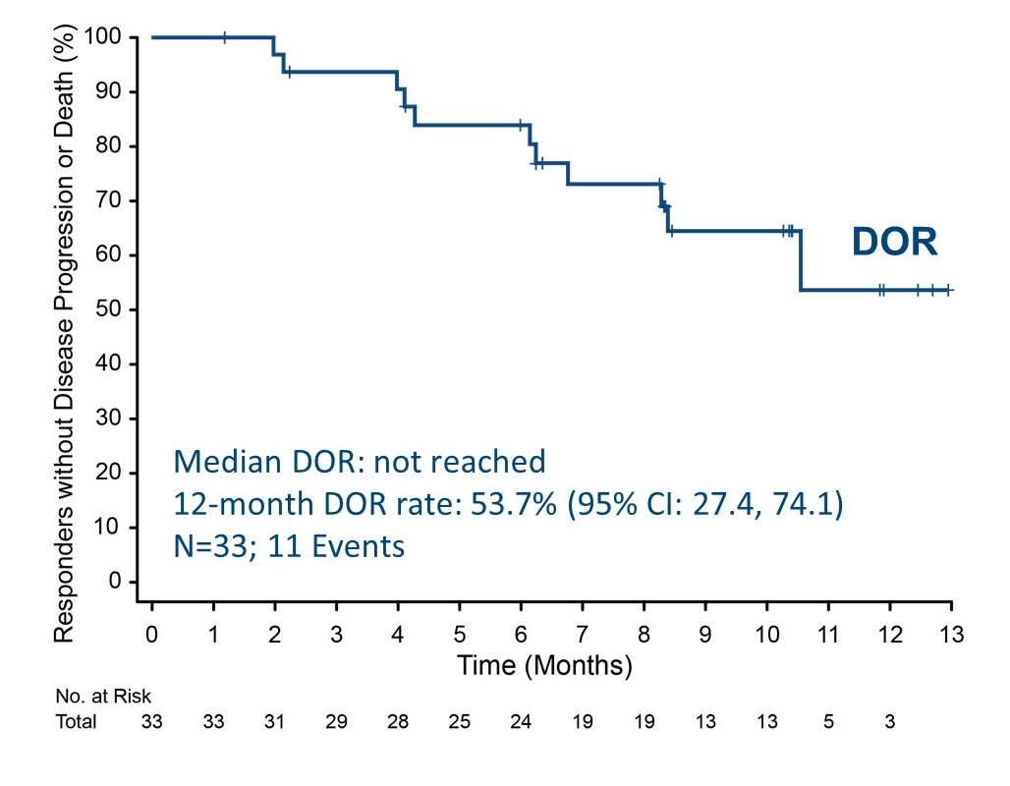
Duration of response
Enfortumab vedotin + pembrolizumab
Median follow up of 10.4 months
  Median DOR not been reached (range: 1.2-12.9+ months)
  Of the 33 responders:
    18 (55%) had an ongoing
    response
    11 (33%) had progressed
    or died
    4 (12%) started new treatment
    prior to PD
CI, confidence interval; DOR, duration of response; PD, progressive disease
Rosenberg JE, et al. ASCO GU 2020. Abstract #441 (Oral presentation)

Slide 11
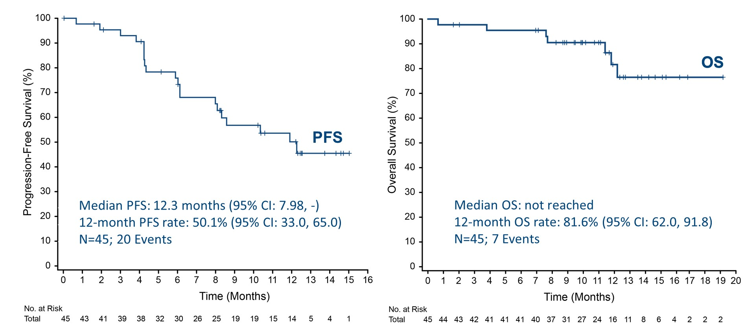
Survival data
Enfortumab vedotin + pembrolizumab
Progression-free survival
Overall survival
CI, confidence interval; OS, overall survival; PFS, progression-free survival
Rosenberg JE, et al. ASCO GU 2020. Abstract #441 (Oral presentation)

Slide 12
conclusions
In first-line cisplatin-ineligible patients, combination therapy with enfortumab vedotin and pembrolizumab shows promising activity
and durability
A high overall response rate was observed, with 88% of patients having responded at first assessment and responses being evident within 2 months (median) of treatment
Combination therapy was associated with a manageable safety profile and no new safety concerns were identified
Further evaluation of the enfortumab vedotin and pembrolizumab combination in metastatic UC and muscle-invasive UC is ongoing
UC, urothelial carcinoma
Rosenberg JE, et al. ASCO GU 2020. Abstract #441 (Oral presentation)

Slide 13
Phase II randomized placebo-controlled neoadjuvant trial of nintedanib or placebo with gemcitabine and cisplatin in locally advanced muscle invasive bladder cancer (NEO-BLADE)
Hussain SA, et al.
ASCO GU 2020. Abstract #438 (Oral presentation)

Slide 14
introduction
Neo-adjuvant chemotherapy (gemcitabine and cisplatin) improves overall survival in patients with MIBC
Nintedanib is a small molecule tyrosine-kinase inhibitor, targeting vascular endothelial growth factor receptor-2, fibroblast growth factor receptor-1 and platelet derived growth factor receptor
The NEO-BLADE study, investigates the toxicity and efficacy effects of adding nintedanib to the usual neo-adjuvant chemotherapy combination of gemcitabine and cisplatin in patients with MIBC
MIBC, muscle invasive bladder cancer
Hussain SA, et al. ASCO GU 2020. Abstract #438 (Oral presentation)

Slide 15
Study design
Randomised, placebo controlled, phase 2 study
120 patients with MITCC, T2-T4 N0M0, GFR >60ml/min
Arm 1:
12 weeks
Gemcitabine,
Cisplatin
& Placebo
Surgery
(Cystectomy)
Follow up
at 3
months after
radical treatment
Follow up at
6 and 12
months after radical treatment and annually for
5 years
Patients are
consented
and randomised
Radical
treatment
options
discussed
Organ Preservation
(Concurrent Chemo
-Radiotherapy or
Radiotherapy alone)
Arm 2:
12 weeks
Gemcitabine,
Cisplatin
& Nintedanib
Patient response assessment; Cycle 3 day 8 +/- 7 days biopsy was
mandated to assess path CR rates. For patients undergoing
cystectomy, cystectomy samples provided pat CR rates. CT scan post
3 cycles provided radiological response
Co-primary endpoint: Pathological CR rate and Overall CRR (pathological & radiological)
Secondary endpoints: PFS, OS and toxicity
CR, complete response; CRR, complete response rate; CT, computerised tomography; GFR, glomerular filtration rate; MITCC, muscle invasive transitional cell carcinoma; OS, overall survival; PFS, progression-free survival
Hussain SA, et al. ASCO GU 2020. Abstract #438 (Oral presentation)

Slide 16
Results
Primary endpoint: pathological/overall CRR
Pathological Complete Response
Pathological CRR
(Evaluable n= 86; ITT n=120)
Nin 51% (21/41); ITT 37% (21/57)
Plb 44% (20/45); ITT 32% (20/63)
OR(CI): 1.31 (0.84, 2.06)
Overall CRR (n=109)*
Nin 40% (22/54); ITT 38% (22/57)
Plb 45% (25/55); ITT 39% (25/63)
OR(CI): 0.90 (0.60, 1.35), p=0.893
Response | Nintedanib | Placebo | Total
CR | 21 (51%) | 20 (44%) | 41
Non-CR | 20 (49%) | 25 (56%) | 45
Radiological Response
Response | Nintedanib | Placebo | Total
CR | 22 (40%) | 25 (45%) | 47
PR | 3 (6%) | 4 (7%) | 7
SD | 25 (46%) | 19 (35%) | 44
PD | 4 (7%) | 7 (13%) | 11
*109 (91%) patients were evaluable for complete response
CI, confidence interval; CR, complete response; CRR, complete response rate; ITT, intention-to-treat; Nin, nintedanib; OR, odds ratio; PD, progressive disease; Plb, placebo; PR, partial response; SD, stable disease
Hussain SA, et al. ASCO GU 2020. Abstract #438 (Oral presentation)

Slide 17
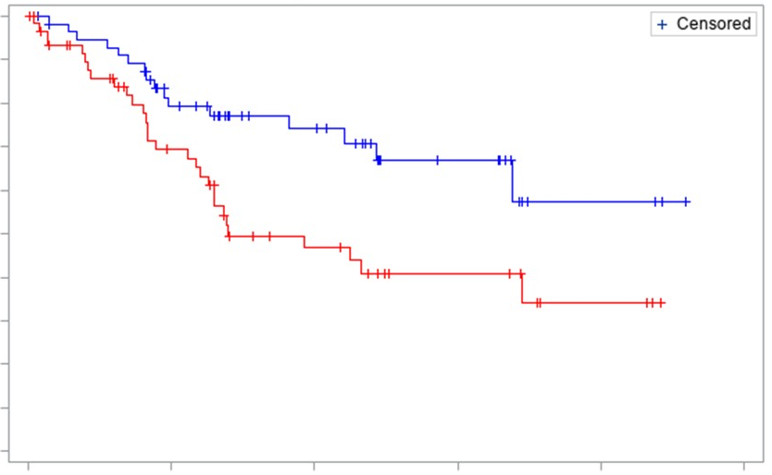
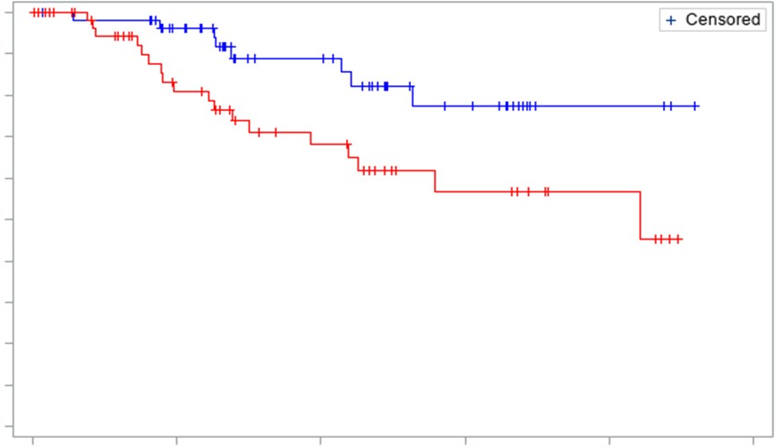
Secondary endpoint results
Progression-free survival
OVERALL survival
1.0
1.0
0.9
0.9
Nintedanib
0.8
0.8
0.7
Nintedanib
0.7
0.6
0.6
Survival probability
Survival probability
0.5
0.5
0.4
Median PFS, months
Plb 16.7 (14.5, NR)
Nin NR (40.6, NR)
HR 0.468
95% CI: 0.254-0.863
P=0.013
0.4
Median OS, months
Plb 50.6 (27.1, NR)
Nin NR (NR, NR)
HR 0.379
95% CI: 0.165-0.874
P=0.018
Placebo
0.3
Placebo
0.3
0.2
0.2
0.1
0.1
0.0
0.0
0
12
24
36
48
60
0
12
24
36
48
60
Time (months)
Time (months)
Nintedanib
57
38
25
13
3
0
Nintedanib
57
46
29
15
3
0
Placebo
63
33
17
9
3
0
Placebo
63
36
23
11
5
0
12-month PFS: Plb 74%, Nin 89%
24-month PFS: Plb 61%; Nin 82%
12-month OS: Plb 83%, Nin 96%
24-month OS: Plb 69%; Nin 89%
CI, confidence interval; HR, hazard ratio; Nin, nintedanib; OS, overall survival; Plb, placebo; PFS, progression free survival
Hussain SA, et al. ASCO GU 2020. Abstract #438 (Oral presentation)

Slide 18
Toxicity
Grade 3+ adverse events | Gemcitabine; Cisplatin & Nintedanib | Gemcitabine; Cisplatin & placebo | Total
Thromboembolic event | 16 (28%) | 13 (21%) | 29
Neutrophil count decreased | 6 (10%) | 1 (2%) | 6
Febrile neutropenia | 2 (4%) | 4 (6%) | 6
Vomiting | 1 (2%) | 3 (5%) | 4
Acute kidney injury | 1 (2%) | 3 (5%) | 4
Skin infection | 2 (4%) | 1 (2%) | 3
Nausea | 1 (2%) | 2 (3%) | 3
Hypotension | 1 (2%) | 2 (3%) | 3
Hyponatremia | 1 (2%) | 2 (3%) | 3
Alanine aminotransferase increased | 3 (5%) | 0 (0%) | 3
Wound infection | 1 (2%) | 1 (2%) | 2
Renal and urinary disorders – Other | 0 (0%) | 2 (3%) | 2
Myocardial infarction | 0 (0%) | 2 (3%) | 2
Fatigue | 1 (2%) | 1 (2%) | 2
111 SAEs observed
  74 grade 3, 11 grade 4, 1 grade 5
  Nintedanib associated with more neutropenia and hypertension
SAE, serious adverse event
Hussain SA, et al. ASCO GU 2020. Abstract #438 (Oral presentation)

Slide 19
conclusion
NEO-BLADE failed to reach its primary endpoint in demonstrating an improvement in CRR between nintedanib and placebo when given
alongside gemcitabine/cisplatin
Secondary endpoints of PFS and OS showed significant benefits for patients treated with nintedanib
The safety data from this trial confirms that triplet therapy can be administered safely
The efficacy signals indicate that the treatment regimen warrants further investigation in a phase 3 trial
CRR, complete response rate; OS, overall survival; PFS, progression-free survival
Hussain SA, et al. ASCO GU 2020. Abstract #438 (Oral presentation)

Slide 20
Results from BLASST-1 (Bladder Cancer Signal Seeking Trial) of nivolumab, gemcitabine, and cisplatin in muscle invasive bladder cancer (MIBC) undergoing cystectomy
Gupta S, et al.
ASCO GU 2020. Abstract #439 (Oral presentation)

Slide 21
introduction
MIBC is a highly aggressive disease with high relapse rates post-cystectomy
Cisplatin-based neoadjuvant chemotherapy (NAC) in MIBC improves survival which correlates with pathologic response
Survival advantage with NAC primarily occurs in patients who achieve pathological downstaging^{1,2}
Anti PD-1/PD-L1 inhibitors have revolutionalised the therapeutic landscape in mUC and neoadjuvant IO-chemo combination has been shown to be active in MIBC³
The phase 2 BLASST-1 study evaluated the efficacy and safety of the PD-1 inhibitor nivolumab plus gem/cis as neoadjuvant therapy for MIBC
Gem/cis, gemcitabine/cisplatin; IO, immuno-oncology; MIBC, muscle invasive bladder cancer; mUC, metastatic urothelial cancer; NAC; neoadjuvant chemotherapy; PD-1, Programmed cell death protein 1; PD-L1, programmed death ligand-1
1. Sonpavde G, et al. Cancer 2009;115:4104-9; 2. Bhindi B, et al. Eur Urol 2017;72(5):660-4; 3. Hoimes C. ESMO 2018. Abstract#LBA33;
4. Gupta S, et al. ASCO GU 2020. Abstract #439 Oral presentation

Slide 22
BLASST-1 Study design
ELIGIBLE PATIENTS
OBJECTIVES
cT2-T4aN≤1MO
Predominantly UC histology
Fit and planned for radical cystectomy
ECOG PS 0-1
Cisplatin-eligible
Cr CI ≥50 ml/min
Primary objective:
Pathologic response = pathological non muscle-invasive rates <pT2N0
Secondary objectives:
Safety
PFS at 2 years
C1D1
GC
C1D8
G+N
C2D1
GC
C2D8
G+N
C3D1
GC
C3D8
G+N
C4D1
GC
C4D8
G+N
TURBT
Cisplatin 70 mg/m2 IV day 1 (or split dose)
Gemcitabine 1000 mg/m2 IV day 1, 8
Nivolumab 360 mg IV day 8
CYSTECTOMY
6-8 weeks
STANDARD
OF CARE
CT/FDG-PET
TISSUE BIOMARKERS
PD-L1
Whole Genome Sequencing
Instrinsic subtypes
Immunological phenotype
CT/FDG-PET
TISSUE (TURBT)
COLLECTION
TISSUE COLLECTION
BLOOD
COLLECTION
41 patients received Gem/Cis + Nivolumab
  38 received 4 cycles, 2 received 2 cycles and 1 received cycle
  40 underwent cystectomy
CrCl, creatinine clearance; CT, computed tomography; ECOG PS, Eastern Cooperative Oncology Group performance status; FDG-PET, fluorodeoxyglucose - positron emission tomography; GC, gemcitabine cisplatin; Gem/Cis, gemcitabine/Cisplatin; G+N, gemcitabine plus nivolumab; IV, intravenous; PD-L1, programmed death ligand-1; PFS, progression-free survival
Gupta S, et al. ASCO GU 2020. Abstract #439 Oral presentation

Slide 23
results
Pathological responses
 | N (%)
PRIMARY ENDPOINT PaR: Pathologic non muscle-invasive rate (<pT2N0) | 27/41 (66)
 | pT0 | 14 | 51.8%
 | pT1 | 2 | 7.4%
 | pTa* | 5 | 18.5%
 | pTis | 6 | 22.2%
pCR: Pathologic complete response (pT0, pTis) | 20/41 (49)
66% of patients achieved a pathologic response
*1 patient with T4N1 disease had a downstaging to pTaN0
There was no correlation between PD-L1 status and pathologic response
  67% of patients with PD-L1 positive tumours achieved a pathologic response
  71% of patients with PD-L1 negative tumours achieved a pathologic response
PaR, pathologic response; pCR, pathologic complete response; PD-L1, programmed death ligand-1
Gupta S, et al. ASCO GU 2020. Abstract #439 Oral presentation

Slide 24
Results – safety
Treatment-related AEs
Drug related AEs | Grade 1-2 | Grade 3-4 | Total
Anemia | 7 (17%) | 2 (7%) | 10 (24%)
Neutropenia | 17 (41%) | 3 (7%) | 20 (48%)
Febrile neutropenia | 0 | 1 (2%) | 1 (2%)
Thrombocytopenia | 12 (29%) | 2 (2%) | 13 (31%)
Fatigue | 25 (60%) | 0 | 25 (60%)
ALT increase | 10 (24%) | 1 (2%) | 11 (26%)
AST increase | 10 (24%) | 0 | 10 (24%)
Rash | 14 (34%) | 0 | 14 (34%)
Diarrhea | 7 (17%) | 0 | 7 (17%)
Nausea | 29 (70%) | 0 | 29 (70%)
Acute kidney injury | 5 (12%) | 1 (2%) | 6 (14%)
The combination was safe with manageable toxicities and no deaths from treatment
Immune-related AEs
Drug related AEs | Grade | Total | Systemic steroids
Rash | 1 | 1 (2%) | No
Hypothyroidism | 1 | 1 (2%)
Inflamed lymph-nodes | 1 | 2 (4%) | No
Guillain Barre Syndrome |  | 1 (2%) | No
AEs, adverse events; ALT, alanine aminotransferase; AST, Aspartate transaminase
Gupta, S et al. ASCO GU 2020. Abstract #439 Oral presentation

Slide 25
conclusion
Neoadjuvant nivolumab + gemcitabine/cisplatin resulted in significant pathological non-muscle invasive rates of 66% (49% pCR)
The combination treatment was safe and effective in patients with MIBC and no added toxicities or deaths were observed
  No cystectomy delays occurred and there were no unexpected surgical complications
PD-L1 status did not correlate with pathologic response
The randomised, phase 3 ENERGIZE study will further investigate the combination treatment in patients with MIBC
MIBC, muscle invasive bladder cancer; pCR, pathologic complete response; PD-L1, programmed death ligand-1
Gupta, S et al. ASCO GU 2020. Abstract #439 Oral presentation

Slide 26

REACH GU CONNECT VIA
TWITTER, LINKEDIN, VIMEO & EMAIL
OR VISIT THE GROUP’S WEBSITE http://www.guconnect.info
Follow us on Twitter
@guconnectinfo
Follow the
GU CONNECT
group on LinkedIn
Watch us on the
Vimeo Channel
GU CONNECT
Email
elaine.wills@cor2ed.com

Slide 27
Dr. Antoine Lacombe
Pharm D, MBA
Phone: +41 79 529 42 79
antoine.lacombe@cor2ed.com
Dr. Froukje Sosef
MD
Phone: +31 6 2324 3636
froukje.sosef@cor2ed.com

