Slide 2
MEETING SUMMARY
ASCO 2020, VIRTUAL MEETING
Sandy Srinivas, MD
Stanford University Medical Center, California, USA
HIGHLIGHTS FROM GU CONNECT
May 2020

Slide 3
DISCLAIMER AND DISCLOSURES
Please note:
The views expressed within this presentation are the personal opinions of the author. They do not necessarily represent the views of the author’s academic institution or the rest of the GU CONNECT group.
This content is supported by an Independent Educational Grant from Bayer.
Dr. Sandy Srinivas has received financial support/sponsorship for research support, consultation or speaker fees from the following companies:
Eisai, Janssen, Bayer, Genentech, Merck

Slide 4
HERO PHASE 3 TRIAL: RESULTS COMPARING RELUGOLIX, AN ORAL GnRH RECEPTOR ANTAGONIST, VERSUS LEUPROLIDE ACETATE FOR ADVANCED PROSTATE CANCER
Shore N, et al.
ASCO 2020. Abstract #5602. Oral presentation

Slide 5
HERO STUDY: BACKGROUND
Androgen deprivation therapy (ADT) is the mainstay of treatment for advanced or metastatic prostate cancer¹
Gonadotropin-releasing hormone (GnRH) agonists, such as leuprolide acetate, are the most commonly used ADT for medical castration. However they cause an initial testosterone surge with a delayed onset of castration and require depot injection²
Relugolix is an oral, GnRH receptor antagonist in development for the treatment of men with advanced prostate cancer^{3,4}
HERO, a global, pivotal, phase 3 trial
Relugolix
360 mg loading dose on Day 1
120 mg orally once daily
N=624
Primary
endpoint
Week 48
Testosterone
recovery
N=184
Men with
advanced
prostate cancer
N=934
Primary endpoint: sustained castration (<50 ng/dL) through 48 weeks
2:1
Leuprolide Acetate
22.5* mg SC injection
every 3 months
N=310
Secondary
endpoints
Castration Day 4, Day 15
Profound castration Day 15
PSA response Day 15
FSH end week 24
*11.25 mg in Japan and Taiwan
ADT, androgen deprivation therapy; FSH, follicle stimulating hormone; GnRH, gonadotropin-releasing hormone; PSA, prostate specific antigen; SC subcutaneous
1. Schröder F, et al. BJU Int 2012; 109(Suppl 6):1-12. 2. Shore N, et al. Prostatic Dis 2013; 16: 7-15; 3. Shore N, et al. ASCO 2020. Abstract #5602. Oral Presentation; 4. Shore N, et al. N Engl J Med 2020. DOI: 10.1056/NEJMoa2004325

Slide 6
HERO STUDY: RESULTS
PRIMARY ENDPOINT
SECONDARY ENDPOINTS
Secondary Endpoints | Relugolix (N=622) % | Leuprolide (N=308) % | P-value
Cumulative probability of testosterone suppression to <50 ng/dL at Day 4 | 56.0 | 0 | <0.001
Cumulative probability of testosterone suppression to <50 ng/dL at Day 15 | 98.7 | 12.0 | <0.001
Proportion of patients with PSA response at Day 15 followed with confirmation at Day 29 | 79.4 | 19.8 | <0.001
Cumulative probability of profound testosterone suppression to <20 ng/dL at Day 15 | 78.4 | 1.0 | <0.001
Mean of FSH level at end of week 24, IU/L | 1.72 | 5.95 | <0.001
90%
Primary endpoint success criterion:
Relugolix lower bound of 95% CI ≥90%
Difference between treatments demonstrated non-inferiority and superiority of relugolix to leuprolide [7.9 %; 95% CI: 4.1-11.8%, p<0.001]
CI, confidence interval; FSH, follicle stimulating hormone; IU, international unit; PSA, prostate specific antigen
Shore N, et al. ASCO 2020. Abstract #5602. Oral Presentation; Shore N, et al. N Engl J Med 2020. DOI: 10.1056/NEJMoa2004325

Slide 7
HERO STUDY: RESULTS
TIME COURSE OF TESTOSTERONE
Testosterone recovery substudy (N=184)
500
Relugolix (N=137)
Leuprolide (N=47)
400
Relugolix (N=622)
Leuprolide (N=308)
300
600
Mean testosterone levels
with 95% CIs (ng/dL)
200
500
100
0
400
0
W49
(End of Treatment)
30 Day
follow-up
60 Day
follow-up
90 Day
follow-up
Mean testosterone
levels with 95% CIs (ng/dL)
300
Study visit
200
100
0
B
W1
W3
W5
W9
W13
W17
W45
W49
W53
Study visit
End of treatment
50 ng/dL = castrate level; 280 ng/dL = lower limit of normal range B, baseline; W week
SAFETY SUMMARY
Safety and tolerability profiles of relugolix and leuprolide were similar
MACE were experienced by 2.9% relugolix group versus 6.2% leuprolide group
CI, confidence interval; MACE, major cardiovascular adverse events
Shore N, et al. ASCO 2020. Abstract #5602. Oral Presentation; Shore N, et al. N Engl J Med 2020. DOI: 10.1056/NEJMoa2004325

Slide 8
HERO STUDY: CONCLUSIONS
Relugolix achieved castration as early as Day 4
Compared to leuprolide, relugolix achieved superiority for:
  Sustained castration rates
  Castration (<50 ng/dL) and profound castration (<20 ng/dL) by Day 15
  PSA response (decrease of >50%) by Day 15
Testosterone recovery within normal range (54% vs 3%) at 90 days
Relugolix treatment was well tolerated
  54% reduction in the risk of MACE with relugolix treatment compared
  with leuprolide
Take home messages:
As an oral agent, relugolix offers an option for men who want to avoid an injection
It offers rapid testosterone recovery and may be best suited for men wanting intermittent ADT as well as men with cardiac co-morbidities
The compliance of taking an oral agent everyday needs to be considered
MACE, major cardiovascular adverse events; PSA, prostate specific antigen
Shore N, et al. ASCO 2020. Abstract #5602. Oral Presentation; Shore N, et al. N Engl J Med 2020. DOI: 10.1056/NEJMoa2004325

Slide 9
TheraP: A RANDOMISED PHASE 2 TRIAL OF ¹⁷⁷LU-PSMA-617 THERANOSTIC VERSUS CABAZITAXEL IN mCRPC PROGRESSING AFTER DOCETAXEL: INITIAL RESULTS (ANZUP PROTOCOL 1603)
Hofman M, et al.
ASCO 2020. Abstract #5500. Oral presentation
mCRPC, metastatic castration resistant prostate cancer

Slide 10
TheraP: OVERVIEW
¹⁷⁷Lu-PSMA-617 (Lu-PSMA) is a radiolabelled small molecule that delivers therapeutic β-radiation to PSMA-expressing tumours
Encouraging efficacy and safety of Lu-PSMA has been observed in prior trials of mCRPC
TheraP is the first randomised study comparing Lu-PSMA to cabazitaxel in men with mCRPC after docetaxel
Eligibility:
Metastatic castration-resistant prostate cancer post docetaxel suitable for cabazitaxel
PSMA + FDG PET/CT:
SUV_{max} >20 at a site of disease
Measurable sites SUV_{max} >10
No discordant FDG+ PSMA-disease
Centrally reviewed
¹⁷⁷Lu-PSMA-617
8.5 GBq i.v. q6 weekly
↓ 0.5 GBq/cycle
Up to 6 cycles
SPECT/CT @ 24 h
Suspend Rx if exceptional response; recommence upon progression
Stratified by:
Disease burden (>20 sites vs ≤20 sites)
Prior enzalutamide or abiraterone
Study site
R
1:1
Cabazitaxel
20 mg/m² i.v. q3 weekly
Up to 10 cycles
Primary endpoint: PSA response (Reduction of
≥50% from baseline)
Key secondary endpoints: PSA PFS, Adverse events
FDG, Fluorodeoxyglucose; LuPSMA, 177Lu-PSMA-617; i.v., intravenous; mCRPC, metastatic castration resistant prostate cancer; PET/CT, Positron emission tomography-computed tomography; PFS, progression free survival; PSA, prostate specific antigen; PSMA, prostate specific membrane antigen; Rx, treatment; SUV, standardised uptake value. Hofman M, et al. ASCO 2020. Abstract #5500. Oral presentation

Slide 11
TheraP: RESULTS
PATIENT CHARACTERISTICS
EFFICACY ENDPOINTS
Key Patient Characteristics | Cabazitaxel N=101 | Lu-PSMA (N=99)
Median Age, years (IQR) | 72 (67-77) | 72 (67-77)
Prior enza/abi | 91% | 91%
Disease burden (>20 sites) | 79% | 77%
Median PSA (IQR) | 110 (64-245) | 94 (44-219)
Median follow-up of 13.3 months (IQR: 9.5-17.7 months)
Efficacy Endpoints (ITT) | Cabazitaxel N=101 | Lu-PSMA (N=98)
PSA50-RR | 37% (27-46) | 66% (56-75)
PSA50-RR, absolute difference (95% CI) | 29% (16-42) P<0.0001
PSA PFS (preliminary)*, HR (95% CI) | 0.69 (0.50-0.95) P=0.02#
*Based on 157 of the required 170 events #p<0.0027 required to trigger rejection of H₀ prior to planned primary analysis
Efficacy results were similar when restricted to per protocol treated men
Abi, abiraterone; CI, confidence interval; enza, enzalutamide; HR, hazard ratio; IQR, inter-quartile range; ITT, intention-to-treat; Lu-PSMA, ¹⁷⁷Lutetium-PSMA-617; PFS, progression free survival; PSA, prostate specific antigen; PSA50-RR, PSA ≥50% response
Hofman M, et al. ASCO 2020. Abstract #5500. Oral presentation

Slide 12
TheraP: RESULTS
SELECTED AEs BY WORSE GRADE
Term | Cabazitaxel (N=85) |  | Lu-PSMA (N=98)
 | G1-2 % | G3-4 % | G1-2 % | G3-4 %
Neutropenia (+/- fever) | 5 | 13 | 6 | 4
Thrombocytopaenia | 4 | 0 | 17 | 11
Dry mouth | 21 | 0 | 59 | 0
Diarrhoea | 52 | 5 | 18 | 1
Dry eye | 4 | 0 | 30 | 0
Dysgeusia | 27 | 0 | 12 | 0
Neuropathy (motor or sensory) | 26 | 1 | 10 | 0
Fatigue | 72 | 4 | 70 | 5
Nausea | 34 | 0 | 39 | 1
Anaemia | 12 | 8 | 18 | 8
Vomiting | 12 | 2 | 12 | 1
TOTAL (all AEs) | 40 | 54 | 53 | 35
Discontinuations for toxicity occurred in 1/98 (1%) Lu-PSMA vs 3/85 (4%) cabazitaxel-treated
There were no Lu-PSMA related deaths; 5 G5 AEs for cabazitaxel and 11 G5 AEs for Lu-PSMA
AE, adverse event; G, grade; Lu-PSMA, 177Lutetium-PSMA-617
Hofman M, et al. ASCO 2020. Abstract #5500. Oral presentation

Slide 13
TheraP: CONCLUSIONS
Lu-PSMA demonstrated a greater PSA50 response compared to cabazitaxel in men with mCRPC after docetaxel
Lu-PSMA may represent a favourable treatment option compared to cabazitaxel in a selected population with high PSMA expression
PFS data is immature at the time of this analysis but initial data is favourable
Improvement in overall survival is yet to be confirmed from this trial and the ongoing VISION trial
Relatively fewer G3-4 AEs were experienced by patients treated with
Lu-PSMA compared to those receiving cabazitaxel
Take home messages:
Data from TheraP should be considered alongside that from the phase 3 VISION trial (NCT 03511664) when available and may be helpful for physicians to sequence therapy once Lu-PSMA is approved
AE, adverse event; Lu-PSMA, ¹⁷⁷Lutetium-PSMA-617; mCRPC, metastatic castration resistant prostate cancer;
PFS, progression free survival; PSA50, PSA ≥ 50% response
Hofman M, et al. ASCO 2020. Abstract #5500. Oral presentation

Slide 14
IMvigor010: PRIMARY ANALYSIS FROM A PHASE 3 RANDOMISED STUDY OF ADJUVANT ATEZOLIZUMAB VERSUS OBSERVATION IN HIGH-RISK MIUC
Hussain M, et al.
ASCO 2020. Abstract #5000. Oral presentation
MIUC, muscle-invasive urothelial carcinoma

Slide 15
IMvigor010: OVERVIEW
Radical cystectomy is the mainstay treatment for muscle-invasive urothelial carcinoma (MIUC) (+/- cisplatin-based neoadjuvant chemotherapy (NAC)) but there is no conclusive evidence to support the use of adjuvant chemotherapy
IMvigor010 investigated the immune checkpoint inhibitor atezolizumab as adjuvant immunotherapy following cystectomy
Key eligibility:
High-risk MIUC
Radical cystectomy/nephro-urecterectomy with LN dissection
No postsurgical radiation of AC or ineligibility for cisplatin AC
ECOG PS 0-2
Tissue sampling for PD-L1 testing
R
A
N
D
O
M
I
S
A
T
I
O
N
1:1
Atezolizumab
1200 mg q3w
No crossover allowed
Disease recurrence/survival follow-up
Observation q3w
Primary endpoint: DFS (ITT)
Key secondary endpoints: OS (ITT)
Exploratory analyses: Biomarkers inc. PD-L1 status
Safety
Baseline Characteristics
In atezolizumab and observation arms, respectively: 48% of patients and 47% had NAC, 7% and 6% had UTUC as primary disease
AC, adjuvant chemotherapy; DFS, disease free survival; ECOG PS, Eastern Cooperative Oncology Group performance status; ITT, intention to treat; LN, lymph nodes; MIUC, muscle invasive urothelial carcinoma; NAC, neoadjuvant chemotherapy; OS, overall survival; PD-L1, programmed death ligand-1; Q3W, every 3 weeks; UTUC, upper tract urothelial carcinoma
Hussain M, et al. ASCO 2020. Abstract #5000. Oral presentation

Slide 16
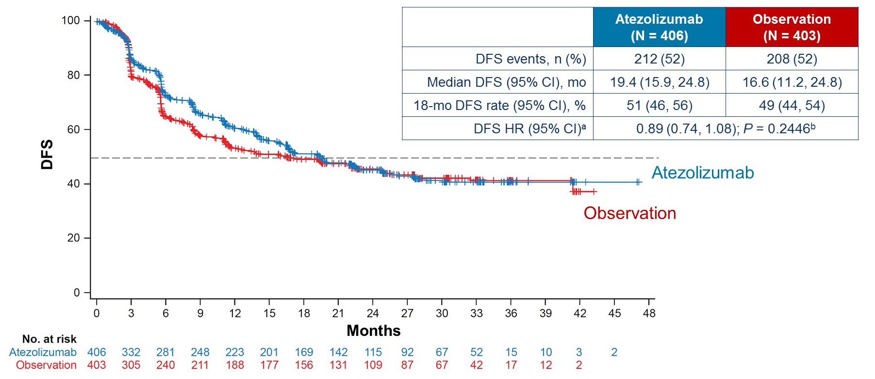
IMvigor010: RESULTS
PRIMARY ENDPOINT: DFS (ITT POPULATION)
 | Atezolizumab (N=406) | Observation (N=403)
DFS events, n (%) | 212 (52) | 208 (52)
Median DFS (95% CI), mo | 19.4 (15.9, 24.8) | 16.6 (11.2, 24.8)
18-mo DFS rate (95% CI), % | 51 (46, 56) | 49 (44, 54)
DFS HR (95% CI)ª | 0.89 (0.74, 1.08); P=0.2446^{b}
Data cutoff: November 30, 2019. Median follow-up: 21.9 months; ªStratified by post-resection tumour stage, nodal status and PD-L1 status;
^{b}2-sided
Baseline prognostic/clinical factors did not influence DFS treatment benefit:
  PD-L1 IC 0/1 (n= 417): HR 0.81 (95% CI, 0.63-1.05)
  PD-L1 IC 2/3 (n= 392): HR 1.01 (95% CI, 0.75-1.35)
CI, confidence interval; DFS, disease free survival; HR, hazard ratio; ITT, intent-to-treat; mo, month; PD-L1, programmed death ligand-1
Hussain M, et al. ASCO 2020. Abstract #5000. Oral presentation

Slide 17
IMvigor010: RESULTS
SECONDARY ENDPOINTS
Interim Overall Survival Analysis | Atezolizumab N=406 | Observation N=403
OS events, n (%) | 118 (29) | 124 (31)
Median OS (95% CI), mo | NR | NR
18-mo OS rate (95% CI), % | 79 (75, 83) | 73 (69, 78)
OS HR (95% CI) | 0.85 (0.66, 1.09)
Safety | Atezolizumab N=390
Treatment-related AE | 276 (71%)
Treatment related grade 3-4 AEs | 63 (16%)
Treatment related grade 5 AE | 1 (<1%)
Treatment related SAE | 41 (11%)
AE leading to discontinuation of atezolizumab | 61 (16%)
Skin and gastrointestinal toxicities most commonly led to treatment
discontinuation
AE, adverse event; CI, confidence interval; HR, hazard ratio; OS, overall survival; SAE, serious adverse event
Hussain M, et al. ASCO 2020. Abstract #5000. Oral presentation

Slide 18
IMvigor010: CONCLUSION
IMvigor010 is the first phase 3 study of a checkpoint inhibitor in MIUC
The primary endpoint of DFS was not met
  No pre-specified subgroups showed a treatment benefit with atezolizumab
  OS follow up is ongoing
Safety profile of atezolizumab was consistent with other studies
  Higher frequency of treatment discontinuations due to AEs was observed
Take home messages:
Based on the data from IMvigor0101, for patients who have had NAC and radical surgery, observation remains the standard of care
Patients with high risk features post surgery who did not receive NAC should receive adjuvant chemotherapy (if they are platinum eligible)
Await results from AMBASSADOR and CHECKMATE 274 trials
AE, adverse event; DFS, disease free survival; MIUC, muscle invasive urothelial carcinoma; NAC, neo-adjuvant chemotherapy; OS, overall survival
Hussain M, et al. ASCO 2020. Abstract #5000. Oral presentation

Slide 19
MAINTENANCE AVELUMAB + BSC VERSUS BSC ALONE AFTER PLATINUM-BASED FIRST-LINE CHEMOTHERAPY IN ADVANCED UC: JAVELIN BLADDER 100 PHASE 3 INTERIM ANALYSIS
Powles T, et al.
ASCO 2020. Abstract #LBA1. Oral presentation
BSC, best supportive care; UC, urothelial carcinoma

Slide 20
JAVELIN 100: OVERVIEW
Platinum chemotherapy (CT) is the standard of care for patients with metastatic urothelial carcinoma (UC) in the 1st line setting however progression-free survival and overall survival benefits are short lived due to emergence of CT resistance
JAVELIN 100 assessed patients with locally advanced or metastatic UC following 1st line chemotherapy, who have not progressed and randomised to either standard of care or avelumab (anti-PD-L1)
All endpoints measured post randomisation (after chemotherapy)
CR, PR, or SD with standard 1st-line chemotherapy
(4-6 cycles)
  Cisplatin + gemcitabine or
  Carboplatin + gemcitabine
Unresectable locally advanced or metastatic UC
Avelumab
10 mg/kg IV Q2W + BSC*
N=350
Primary endpoint
OS
Primary analysis populations
All randomised patients
PD-L1+ population
Secondary endpoints
PFS and objective response per RECIST 1.1
Safety and tolerability
PROs
Treatment-free interval
4-10 weeks
R
1:1
Until PD, unacceptable
toxicity, or withdrawal
N=700
BSC alone*
N=350
Stratification
Best response to 1st-line
chemo (CR or PR vs SD)
Metastatic site (visceral vs non-visceral)
*BSC was administered per local practice based on patient needs and clinical judgement; other systemic anti-tumour therapy was not permitted but palliative local radiotherapy for isolated lesions was acceptable
BSC, best supportive care; CR, complete response; CT, chemotherapy; IV, intravenous; OS, overall survival; PD-L1, programmed death ligand-1; PFS, progression free survival; PR, partial response; PRO, patient reported outcomes; Q2W, every 2 weeks; R, randomisation; RECIST 1.1; Response Evaluation Criteria in Solid Tumours version 1.1; SD, stable disease; UC, urothelial carcinoma
Powles T, et al. ASCO 2020. Abstract #LBA1. Oral presentation

Slide 21
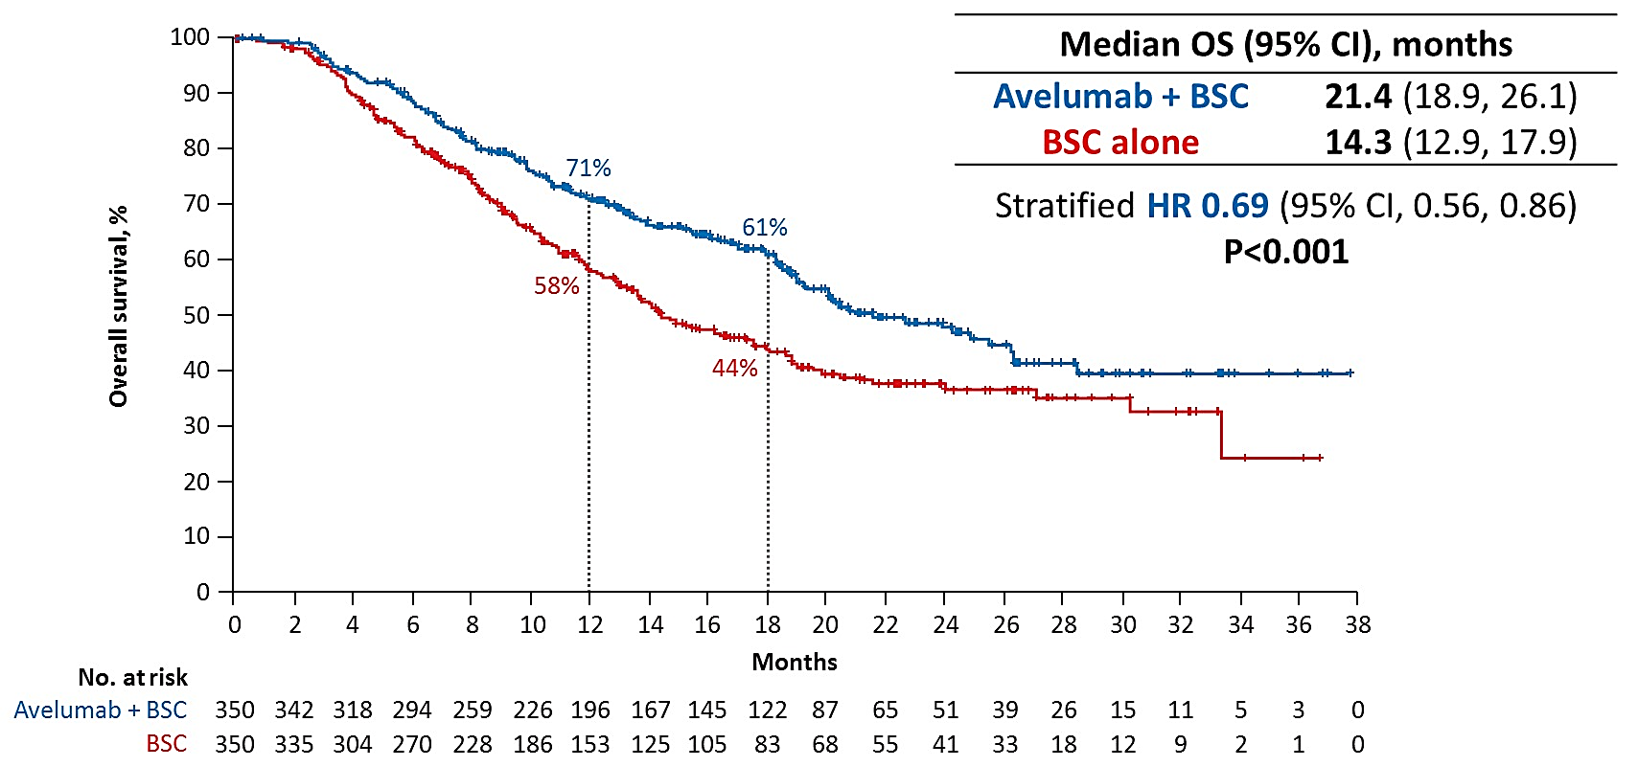
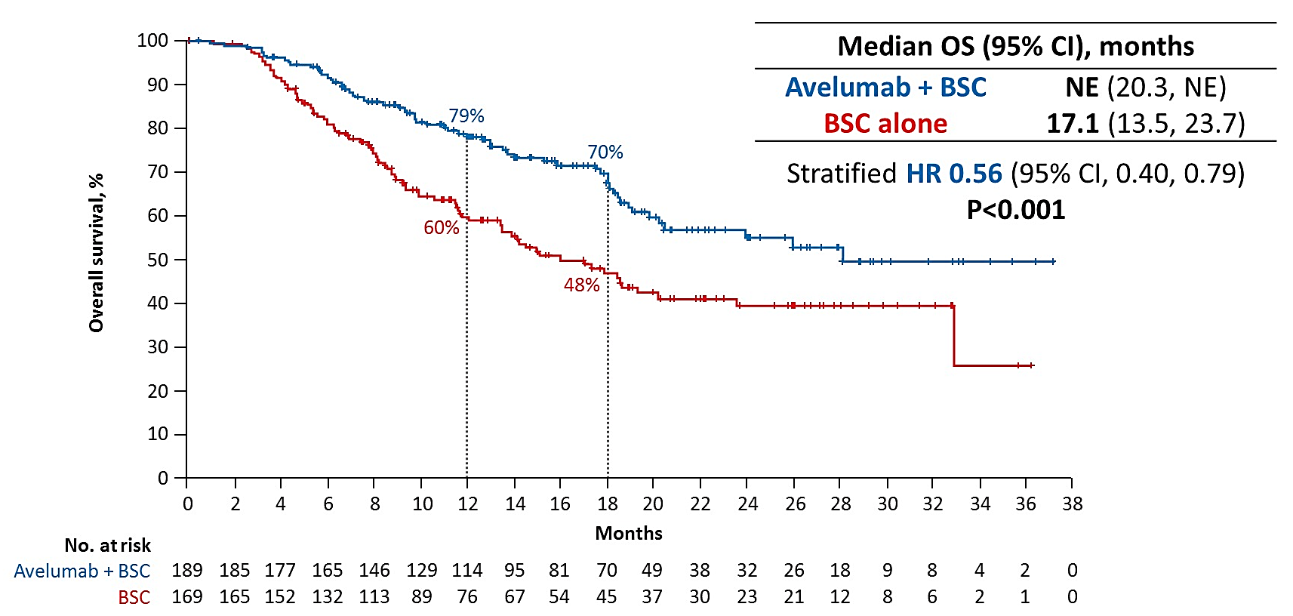
JAVELIN 100: RESULTS
OS IN THE OVERALL POPULATION
OS IN THE PD-L1+ POPULATION
OS was longer with avelumab vs BSC across all pre-specified subgroups
358 patients (51%) had a PD-L1 positive tumour
PD-L1+ status was defined as PD-L1 expression in ≥25% of tumour cells or 100% of tumour-associated immune cells if the percentage of immune cells was >1% or ≤1%, respectively (SP263 assay)
BSC, best supportive care; CI, confidence interval; HR, hazard ratio; OS, overall survival; PD-L1, programmed death ligand-1
Powles T, et al. ASCO 2020. Abstract #LBA1. Oral presentation

Slide 22
JAVELIN 100: RESULTS
SECONDARY ENDPOINTS
PFS by independent radiology review | Avelumab+BCS N=350 | BSC alone N=350
Median PFS - overall population Months (95% CI) | 3.7 (3.5-5.5) | 2.0 (1.9-2.7)
Stratified HR (95% CI), p-value | 0.62 (0.52-0.75) P<0.001
Median PFS – PD-L1+ population Months (95% CI) | 5.7 (3.7-7.4) | 2.1 (1.9-3.5)
Stratified HR (95% CI), p-value | 0.56 (0.43-0.73) P<0.001
 | Avelumab+BCS N=344 |  | BSC alone N=345
 | Any grade | grade ≥ 3 | Any grade | grade ≥ 3
Any TEAE (any grade ≥10%) | 98% | 47.4% | 77.7% | 25.2%
Most frequent grade ≥ 3 AEs (≥5% in either arm)
UTI | 17.2% | 4.4% | 10.4% | 2.6%
Anaemia | 11.3% | 3.8% | 6.7% | 2.9%
Haematuria | 10.5% | 1.7% | 10.7% | 1.4%
Fatigue | 17.7% | 1.7% | 7.0% | 0.6%
Back Pain | 16.0% | 1.2% | 9.9% | 2.3%
TEAEs led to discontinuation of avelumab in 11.9%
Death was attributed to study treatment toxicity in
2 patients (0.6%) in avelumab + BSC arm
No grade 4/5 irAEs occurred
AE, adverse event; BSC, best supportive care; CI, confidence interval; HR, hazard ratio; irAEs, immune response adverse events; PD-L1, programmed death ligand-1; PFS, progression free survival; TEAE, treatment emergent adverse events;
UTI, urinary tract infection
Powles T, et al. ASCO 2020. Abstract #LBA1. Oral presentation

Slide 23
JAVELIN 100: CONCLUSIONS
JAVELIN 100 demonstrated significantly longer OS with first line maintenance avelumab + BSC compared to BSC alone, in both the overall and PD-L1 populations
  OS benefits were seen across all pre-specified subgroups
The safety profile of avelumab was consistent with that observed in previous studies of monotherapy
Avelumab 1st line maintenance in patients with advanced UC whose disease has not progressed with platinum based CT should be considered a new standard of care
Take home messages:
Maintenance avelumab after platinum based CT in patients who achieve a CR, PR, or SD is a new standard of care for patients with front line metastatic urothelial cancer
BSC, best supportive care; CT, chemotherapy; PD-L1, programmed death ligand-1; OS, overall survival;
TEAE, treatment emergent adverse events; UC, urothelial carcinoma
Powles T, et al. ASCO 2020. Abstract #LBA1. Oral presentation

Slide 24
OTHER INTERESTING DATA
OS ANALYSES OF NEXT GENERATION ANDROGEN RECEPTOR INHIBITORS
IN nmCRPC
SPARTAN study. Small E, et al. ASCO 2020. Abs# 5516
ARAMIS study. Fizazi K, et al. ASCO 2020. Abs# 5514
PROSPER study. Sternberg C, et al. ASCO 2020. Abs# 5515
OS, overall survival; nmCRPC, non-metastatic castration resistant prostate cancer

Slide 25
BACKGROUND
nmCRPC is defined as rising PSA despite continuing ADT and no detected metastases¹
nmCRPC patients are high risk for progression and cancer related mortality¹
Next generation androgen receptor inhibitors have previously demonstrated significant improvements in metastasis-free survival in nmCRPC:
Androgen receptor inhibitor | Study
Apalutamide | SPARTAN²
Darolutamide | ARAMIS³
Enzalutamide | PROSPER⁴
Final overall survival results for SPARTAN, ARAMIS and PROSPER are reported here
ADT, androgen deprivation therapy; nmCRPC, non-metastatic castration-resistant prostate cancer; PSA, prostate specific antigen
1. Fizazi K, et al. ASCO 2020. Abstract #5514; 2. Smith, et al. N Engl J Med 2018; 378:1408-18; 3. Fizazi, K et al. N Engl J Med 2019; 380: 1235-1246; 4.Hussain, et al. N Engl J Med 2018; 378: 2465-74

Slide 26
RESULTS
OVERALL SURVIVAL
Apalutamide, darolutamide and enzalutamide demonstrated a significant benefit in OS compared to placebo in patients with nmCRPC
 | SPARTAN¹ |  | ARAMIS² |  | PROSPER³
 | APA + ADT N=806 | PBO + ADT N=401 | DARO + ADT N=955 | PBO + ADT N=554 | ENZA + ADT N=933 | PBO + ADT N=468
Median OS (months) | 73.9 | 59.9 | NR | NR | 67.0 | 56.3
HR, (95% CI), P-value | 0.78 (0.64-0.96) P=0.0161 |  | 0.69 (0.53-0.88) P=0.003 |  | 0.73 (0.61-0.89) P=0.001
NOTE: Due to differences in study design the data presented here is for reference purposes only and cannot be directly compared
SAFETY
The safety profile of apalutamide, darolutamide and enzalutamide at the final study analyses was consistent with that reported for the primary analyses
ADT, androgen deprivation therapy; APA, apalutamide; CI, confidence interval; DARO, darolutamide; ENZA, enzalutamide; HR, hazard ratio; nmCRPC, non-metastatic castration resistant prostate cancer; NR, not reached; OS, overall survival; PBO, placebo
1.Small E, et al. ASCO 2020. Abs# 5516; 2.Fizazi K, et al. ASCO 2020. Abstract #5514; 3. Sternberg C, et al. ASCO 2020. Abs# 5515

Slide 27
CONCLUSIONS
The benefit of the next generation androgen receptor inhibitors previously observed in the primary analysis of the SPARTAN, ARAMIS and PROSPER trials is confirmed in the final OS analyses
OS, overall survival
1.Small E, et al. ASCO 2020. Abs# 5516; 2.Fizazi K, et al. ASCO 2020. Abstract #5514; 3. Sternberg C, et al. ASCO 2020. Abs# 5515

Slide 28

REACH GU CONNECT VIA
TWITTER, LINKEDIN, VIMEO & EMAIL
OR VISIT THE GROUP’S WEBSITE http://www.guconnect.info
Follow us on Twitter
@guconnectinfo
Follow the
GU CONNECT
group on LinkedIn
Watch us on the
Vimeo Channel
GU CONNECT
Email
elaine.wills@cor2ed.com

