Slide 2

The Role of PARPi in Prostate Cancer:
Experts Knowledge Share august 2020
Dr. Neal D. Shore
(Chair)
Carolina Urologic
Research Center
Prof. Andrew J.
Armstrong
Duke University
School of Medicine
Prof. Emmanuel S.
Antonarakis
Johns Hopkins
Medicine

Slide 3
funding
Please note:
The views expressed within this presentation are the personal opinions of the experts. They do not necessarily represent the views of the expert’s academic institution.
AstraZeneca has provided a sponsorship grant towards this independent programme.

Slide 4

Introduction
Dr. Neal D. Shore
(Chair)
Carolina Urologic
Research Center

Slide 5
DISCLOSURE
Dr. Neal D. Shore has the following relevant financial relationships to disclose:
Research/Consulting: AbbVie, Amgen, Astellas, AstraZeneca, Bayer, BMS, Clovis Oncology, Dendreon, Exact Imaging, FerGene, Ferring, Janssen, MDx Health, Merck, Myovant, Nymax, Pfizer, Sanofi, Tolmar
Stock/Patents/Salary: none

Slide 6
educational objectives
Understand the MoA of PARP inhibition and it’s role in the treatment of prostate cancer
Understand the prevalence of DDR mutations in prostate cancer and be able to implement the testing strategies (specifically for somatic mutations) to predict if the prostate tumour is likely
to respond to a PARP inhibitor or other treatment
Recognise the clinical efficacy and safety profile of PARP inhibitors for patients with
prostate cancer
Understand the place of PARP inhibition in the prostate cancer treatment pathway in the context of other non-hormonal agents and the potential for upcoming combination therapies
DDR, DNA damage response; MoA, mechanism of action; PARP, poly ADP ribose polymerase

Slide 7
Advances in prostate cancer therapy:
60 years of progress
2010
  First
  immunotherapy
2005
2017
  High dose radiation reduces recurrence
  New SoC for newly diagnosed advanced PCa
1994
1997
Watchful waiting introduced
Hormone therapy + radiation improves survival
2020
1982
2010
New surgeries help preserve sexual function
2000
1970
Radioactive ‘seeds’ proven effective
1990
2008
1980
1996
  Evidence for targeted therapies
  First drug for PCa resistant to hormone treatment
1970
2012
2020
Approval of PARPi therapy for mCRPC
1982
2004
  New hormone therapy for advanced PCa
Early hormone therapy introduced
1990
  New chemotherapy for hormone-resistance PCa
Laparoscopic surgery introduced
1960
1966
Nobel Prize Huggins,ADT
Cancer Progress Timeline: Prostate Cancer (modified). Available from: https://www.asco.org/research-guidelines/cancer-progress-timeline/prostate-cancer. Accessed, August 2020.
Available from: www.fda.gov/drugs/drug-approvals-and-databases/fda-approves-olaparib-hrr-gene-mutated-metastatic-castration-resistant-prostate-cancer . Accessed, August 2020.
Available from: www.fda.gov/drugs/fda-grants-accelerated-approval-rucaparib-brca-mutated-metastatic-castration-resistant-prostate . Accessed, August 2020.
mCRPC, metastatic; castrate-resistant prostate cancer; PARPi, poly ADP ribose polymerase inhibitor; PCa, prostate cancer; SoC, standard of care

Slide 8
Major prognostic features of prostate cancer
5-year survival is close to 100% in patients with local or regional PCa
Loss of hormone sensitivity and metastasis represent two major negative prognostic events in PCa
New Cancer Diagnosis | 5-year OS range
Local or regional PC¹ | 99-100%
Non-metastatic CRPC | 20-60%
mHSPC | 23.6-51.9%
mCRPC | 10-26%
https://www.cancer.net/cancer-types/prostate-cancer/statistics#:~:text=The%205%2Dyear%20survival%20rate%20for%20most%20men%20with%20local,prostate%20cancer%20combined%20is%2098%25.
https://www.urotoday.com/library-resources/m0-prostate-cancer/111535-treatment-advances-in-non-metastatic-castration-resistant-prostate-cancer.html
Madan RA et al., https://pubmed.ncbi.nlm.nih.gov/18628467/; Carniero et al., https://pubmed.ncbi.nlm.nih.gov/27802009/ Francini et al., https://pubmed.ncbi.nlm.nih.gov/30643173/
Halabi et al., https://pubmed.ncbi.nlm.nih.gov/26951312/
CRPC, castrate-resistant prostate cancer; mCRPC, metastatic CRPC; mHSPC, metastatic hormone-sensitive prostate cancer; OS, overall survival; PCa, prostate cancer

Slide 9

prostate cancer therapy:
Rapid advances
9 life-prolonging approvals since 2010
2010
  First
  immunotherapy
2017
Drug name | Approval | Drug Class | Indication
Sipuleucel-T | April 2010 | Autologous cellular immunotherapy | mCRPC
Cabazitaxel | June 2010 | Chemotherapy | Hormone-refractory metastatic PCa/mCRPC
Abiraterone Acetate | April 2011 | Anti-androgen | mCRPC
Enzalutamide | Aug 2012 | AR inhibitor | mCRPC, nmCRPC, mHSPC
Radium 223 | May 2013 | Radiopharmaceutical | mCRPC bone
Pembrolizumab | May 2017 | Monoclonal antibody | Unresectable/metastatic solid tumours MSI high
Darolutamide | July 2019 | AR inhibitor | Non-metastatic CRPC
Apalutamide | Feb 2018 | Anti-androgen | mHSPC/non-metastatic CRPC
Olaparib | May 2020 | PARPi | HRR gene-mutated mCRPC
  New SoC for newly diagnosed advanced PCa
2020
2010
2012
2020
Approval of PARPi therapy for mCRPC
  New hormone therapy for advanced PCa
All information available at: www.drugs.com
AR, androgen receptor; CRPC, castrate-resistant prostate cancer; HRR, homologous recombination repair; mCRPC, metastatic CRPC; mHSPC, metastatic hormone-sensitive prostate cancer; PARPi, poly ADP ribose polymerase inhibitor; PCa, prostate cancer, SoC, standard of care

Slide 10
PARPi: What do we need to know?
Which mutations confer sensitivity to PARPi?
How common are these mutations in prostate cancer?
How do we identify patients with these mutations?
What is the current role of PARPi in prostate cancer?
PARPi, poly ADP ribose polymerase inhibitor

Slide 11
What is PARP inhibition and how do we identify patients?
Prof. Emmanuel S. Antonarakis, MD
Professor of Oncology and Urology
Johns Hopkins University School of Medicine
Sidney Kimmel Comprehensive Cancer Center
Baltimore, Maryland

Slide 12
DISCLOSURE
Prof. Emmanuel S. Antonarakis has the following relevant financial relationships to disclose:
Research/Consulting: Amgen, Astellas, AstraZeneca, Bayer, BMS, Celgene, Clovis, Dendreon, Eli Lilly, ESSA, Genentech, GSK, Janssen, Johnson & Johnson, Medivation, Merck, Novartis, Qiagen, Sanofi, Tokai
Stock/Patents/Salary: None

Slide 13
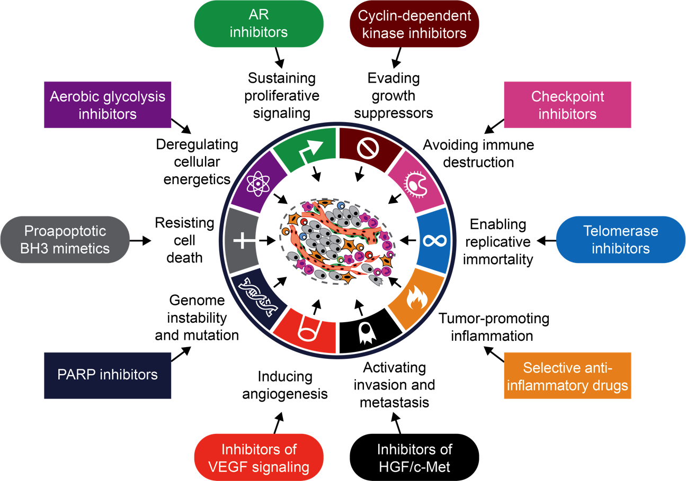
Genomic Instability is a Targetable Hallmark of Cancer
HALLMARKS OF CANCER

Slide 14
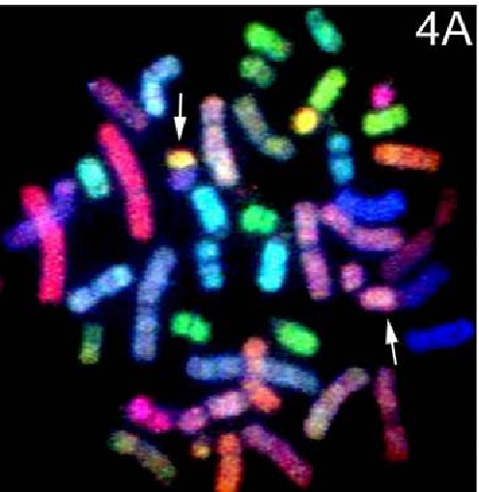

Aberrant DSB repair: genome instability
Spontaneous
(Fork collapse)
DSBs
DSB, double-strand break

Slide 15
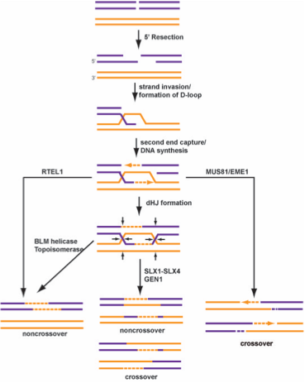
DSB repair: cell cycle
“HR”
M
“NHEJ”
G2
G1
DSB
DSB
S
G0
End joining
DSB resection
REPAIR
BRCA1/53BP1
Strand invasion
“Error prone”
DNA synthesis
REPAIR
“Error free”
53BP1, tumour suppressor p53-binding protein 1; BRCA1, breast cancer type 1 susceptibility protein; DSB, double-strand break; HR, homologous recombination; NHEJ, non-homologous end joining

Slide 16
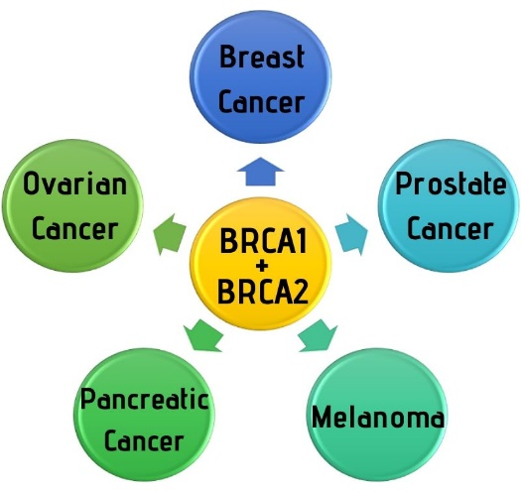
DSB repair defects: cancer predisposition
“HR”
M
“NHEJ”
G2
G1
DSB
DSB
S
G0
DSB, double-strand break; HR, homologous recombination; NHEJ, non-homologous end joining

Slide 17
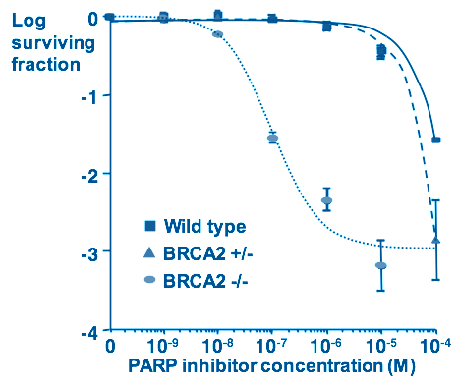
DSB repair defects: therapeutic exploitation in cancer
“HR”
M
“NHEJ”
G2
G1
DSB
DSB
S
G0
PARP inhibitors:
therapeutic exploitation in cancer
Helleday, Jackson, Ashworth
BRCA2, breast cancer type 2 susceptibility protein; DSB, double-strand break; HR, homologous recombination; M, molarity; NHEJ, non-homologous end joining; PARP, poly-ADP ribose polymerase. Bryant HE, et al. Nature 2005; 434:913-917; Farmer H, et al. Nature 2005; 434:917-921

Slide 18
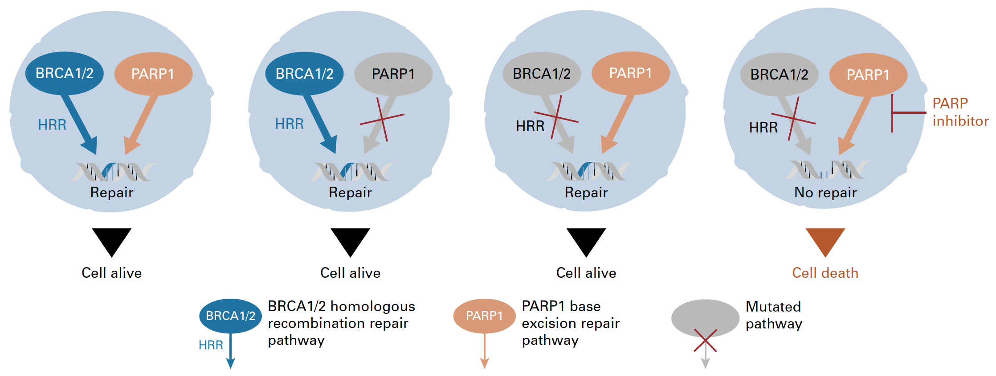

PARP inhibitors:
‘Synthetic Lethality’ in cancer
BRCA: “copy editor”; homologous recombination repair (HRR)
PARP: “spell check”; base excision repair (BER)
BER
BER
BER
BER
BER
PARP is required for single-strand break repair (e.g. via BER)
MOA – inhibiting SSB/BER is synthetic lethal with HRD
BER, base excision repair; BRCA1/2, breast cancer type 1/2 susceptibility protein; HRD, homologous recombination deficiency; HRR, homologous recombination repair; MOA, mode of action; PARP, poly-ADP ribose polymerase; SSB, single-strand break

Slide 19
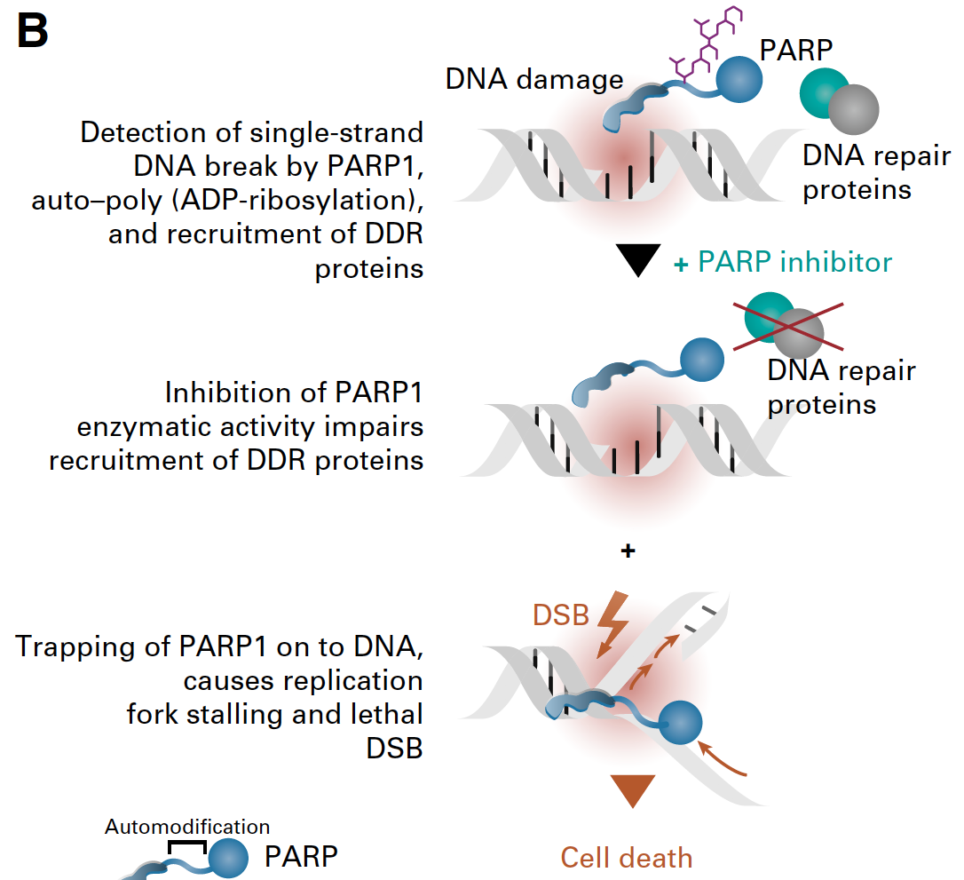
PARP inhibitors: eNZYMATIC INHIBITION & PARP trapping
MOA – trapping PARP is synthetic lethal with HRD
ADP, adenosine diphosphate; DDR, DNA damage response; DSB, double-strand break; HRD, homologous recombination deficiency; MOA, mode of action; PARP, poly-ADP ribose polymerase

Slide 20
DDR Mutations in
Metastatic Prostate Cancer
Prevalence and Screening

Slide 21

Changing treatment patterns in the era of precision medicine
TRADITIONAL MODEL OF DRUG DEVELOPMENT
A
All patients receive
standard treatment
Patients
A
B
B
Clinical trial
PRECISION MEDICINE MODEL
A
B
Choice of treatment
dependent upon biomarker
profile of tumor
Patients
Molecular/biomarker
analysis of tumor
C
D
Goal: analytic validation of biomarker → clinical validation of clinical utility and patient benefits with matched therapy
Key contexts: prior therapy, histology, patient phenotype, comorbidities, costs, toxicities
Fröhlich H, et al. BMC Med. 2018;16(1):150; Redekop WK, Mlasi D. Value Health. 2013;16(6 Suppl):S4-9; Krzyszczyk P, et al. Technology (Singap World Sci). 2018;6:79-100.
Notes:
In precision oncology, we would love to go from the traditional model where patients are treated similarly, to treating patients differently based on presence of a biomarker.

Slide 22
2020 Actionable Pathways, Genotypes and Phenotypes
Metastatic Prostate Cancer
HRD+ CRPC (BRCA1/2, PALB2, others)
MSI^{hi}/dMMR mCRPC
PD-1 based immunotherapy*
CDK12 biallelic loss (tandem duplicator genotype) mCRPC
AR Driven mCRPC
PARPi based therapy,*
IO combinations
AR-variant (e.g. AR-V7) driven CRPC: AR degraders, cofactor inhibitors, taxanes*
Inhibition of enhanced androgen synthesis
AR N-term/DNABD inhibitors, PSMA targeted tx
GR inhibition, PARPi combinations
PD-1 based immunotherapy
AR Independent CRPC (NEPC, Double Negative CRPC)
DLL3 inhibition, combinations
Immunotherapy
Platinum chemotherapy
Immune responsive subsets of mCRPC
Context is critical: pattern of spread, symptoms, prior therapy
*Currently approved therapies for PCa. Armstrong CM, Cao AC. Asian Journal of Urology (2019) 6, 42e49; Antonarakis ES, et al. Prostate Cancer Prostatic Dis. 2016;19(3):231-41; Ponnumasy S, et al. Cancer Res. 2017;77(22):6282-98; Akora VK, et al. Cell. 2013 December 5;155(6):1309-22; Vlachosergios PJ, et al. Curr Oncol Rep. 2017;19(5):32; Khemlina et al. 2015 https://www.sciencedirect.com/science/article/pii/S0305737215001462; Cheng JNCCN 2019https://jnccn.org/view/journals/jnccn/17/5/article-p515.xml

Slide 23
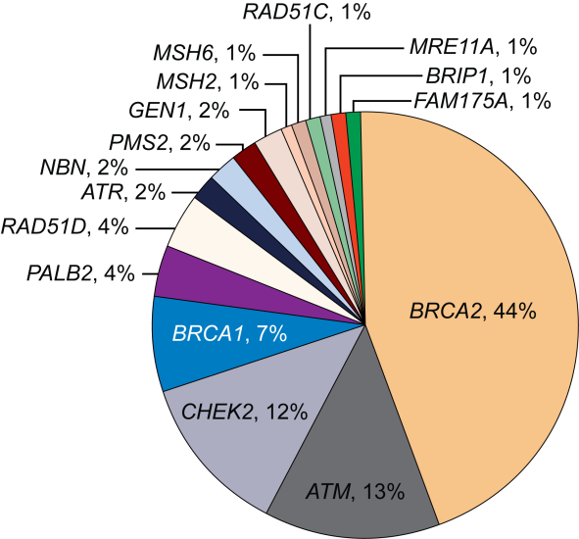
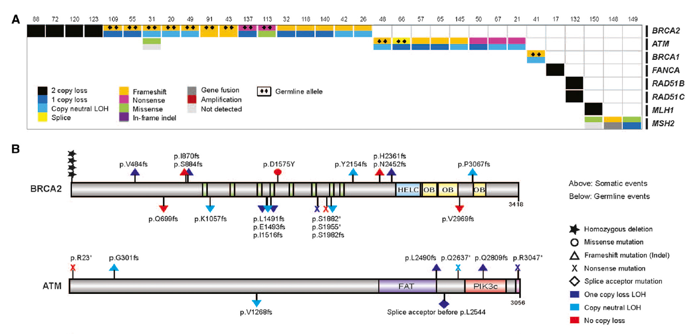
DNA Repair Gene Alterations (Somatic and Germline)
Are Common in Metastatic PCa^{1,2}
Somatic
Germline
23% of metastatic castration-resistant prostate cancers harbor DNA repair alterations
The frequency of DNA repair alterations increases in metastatic disease vs. localized disease
12% of men with metastatic prostate cancer have a germline DNA repair defect
1. Robinson D, et al. Cell. 2015;161:1215-28; 2. Pritchard CC, et al. N Engl J Med. 2016;375:443-53; 3. Antonakaris ES, et al. Eur Urol. 2018;74(2):218-25.

Slide 24
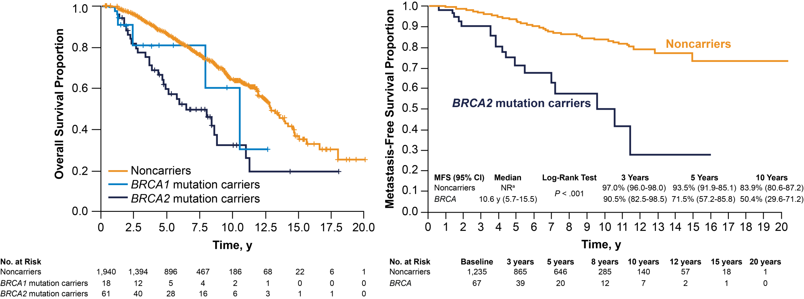
BRCA2 Carriers With PCa Have Worse Prognosis^{1,2}
Noncarriers
ªMedian survival not reached after a median of 64-mo follow-up.
1. Castro E, et al. J Clin Oncol. 2013;31:1748-57; 2. Castro E, et al. Eur Urol. 2015;68:186-93.

Slide 25

Family History Is a Real Risk Factor
A father or brother with prostate cancer doubles a man’s risk of prostate cancer
A mother or sister with breast cancer diagnosed before age 50 significantly increases a woman’s risk of breast cancer
A mother or sister with breast cancer can affect a man’s risk of prostate cancer
Chen et al., Prostate 2008 https://www.ncbi.nlm.nih.gov/pmc/articles/PMC2574825/; Colditz et al., 2012 https://www.ncbi.nlm.nih.gov/pmc/articles/PMC3387322/
Notes:
4907

Slide 26
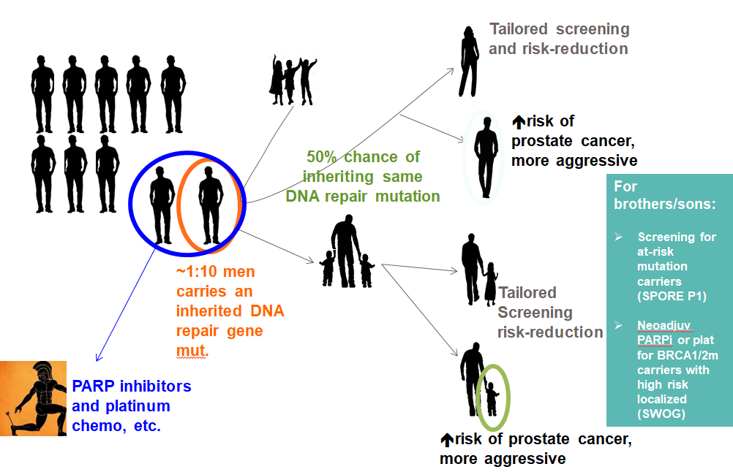
Cascading Impact
Full family history is important to collect during the genetic evaluation
In-person genetic counseling is the gold standard
Patients’ psychosocial needs/preferences should dictate the mode of counseling
~12% of men with prostate cancer carry an inherited DNA repair gene mutation

Slide 27
NCCN (V 2.2020) Guidelines for Genetic Testing
Germline Testing | Somatic Tumor Testing
Germline genetic testing is recommended for patients with prostate cancer and any of the following: High-risk, very high-risk, regional, or metastatic prostate cancer Ashkenazi Jewish ancestry Family history of high-risk germline mutations (eg, BRCA1/2, Lynch mutation) A positive family history of cancer | Recommend evaluating tumor for alterations in homologous recombination DNA repair genes, such as BRCA1, BRCA2, ATM, PALB2, FANCA, RAD51D, CHEK2, and CDK12, in patients with metastatic prostate cancer Can be considered in men with regional prostate cancer Testing for MSI-H or dMMR is recommended in patients with metastatic CRPC, and should be considered in patients with regional or castration-naïve metastatic prostate cancer

Slide 28









How do we test?
Germline
Somatic
Academic/In house

Slide 29
Conclusions
DDR mutations are a therapeutic target in metastatic prostate cancer
PARPi work by the concept of “synthetic lethality”
Both somatic and germline mutations related to DDR are common in metastatic prostate cancer
Somatic and germline testing is recommended for all patients with metastatic prostate cancer and some patients with high-risk regional and locally-advanced prostate cancer

Slide 30

Role of PARPi in advanced prostate cancer
Prof. Andrew J. Armstrong, MD
Professor of Medicine, Surgery,
Pharmacology and Cancer Biology
Director of Research
Duke Cancer Institute’s Center for Prostate
and Urologic Cancers

Slide 31
DISCLOSURE
Prof. Andrew J. Armstrong has the following relevant financial relationships to disclose:
Research/Consulting: Pfizer, Janssen, Astellas, AstraZeneca, Merck, Bayer, Dendreon, BMS, Constellation, Beigene, Genentech/Roche, Clovis consulting and research support (to Duke University for clinical trials/research)
Stock/Patents/Salary: None

Slide 32
Many PARP Inhibitors Are Being Tested¹
Properties of PARP Inhibitors
 | Olaparib¹ | Veliparib¹ | Talazoparib¹ | Niraparib¹ | Rucaparib¹ | Pamiparib²
MW | 434.5 | 244.3 | 380.8 | 320.4 | 323.4 | 298.31
PARP1 IC₅₀ | 5 nM | 1.2 nM | 0.56 nM | 3.8 nM | 0.65 nM | 0.9 nM
PARP2 IC₅₀ | 1 nM | 0.41 nM | 0.15 nM | 2.1 nM | 0.08 nM | 0.5 nM
Trapping | ++ | + | ++++ | +++ | ++ | ++³
1. Carney B et al. Nat Commun. 2018;9:176; 2. Available from: https://www.medchemexpress.com/Pamiparib.html. Accessed, August 2020.
3. Pilie PG, et al. Clin Cancer Res. 2019;25:3759-71.
Pamiparib trapping potential estimated based on description as ‘potent’.
1. Carney B, et al. Nat Commun. 2018;9:176; 2. Available from: https://www.medchemexpress.com/Pamiparib.html. Accessed, August 2020.
3. Pilie PG, et al. Clin Cancer Res. 2019;25:3759-71.

Slide 33
Ongoing Single Agent Clinical Trials of PARPi in mCRPC
PARPi | Clinical Trial No. | Study overview | Setting | Trial status
Olaparib | NCT01682772 | Single arm, phase 2 trial of olaparib, predictive biomarker trial | Advanced castration resistant prostate cancer | Active, not recruiting
Olaparib | NCT02987543 | Randomized phase 3 trial of olaparib vs enzalutamide or abiraterone | mCRPC who have failed prior treatment with a NHA with somatic HRR mutation | Active, not recruiting
Olaparib | NCT03047135 | Single arm phase 2 trial of olaparib | Non-metastatic biochemically-recurrent PCa and a PSADT of ≤6 months and a minimum PSA of 1.0 | Recruiting
Olaparib | NCT03263650 | Randomized phase 2 of olaparib maintenance versus observation | AVPC 6 cycles of cabazitaxel and carboplatin before randomisation | Recruiting
Olaparib | NCT03434158 | Single-arm phase 2 study of olaparib (IMANOL) | mCRPC ≥ 6 cycles of docetaxel with CR/PR (RECIST 1.1) and PCWG3 | Recruiting
Talazoparib | NCT03148795 | Phase 2 single arm study of talazoparib | mCRPC previous taxane-based chemotherapy and progression on ≥ 1 NHA | Active, not recruiting
Rucaparib | NCT02952534 | Single arm phase 2 trail of rucaparib (TRITON2) | mCRPC with evidence of HRR gene deficiency | Active, not recruiting
Rucaparib | NCT02975934 | Phase 3 trial of rucaparib vs physician's choice of abiraterone acetate, enzalutamide, or docetaxel. (TRITON3) | mCRPC with evidence of HRR gene deficiency | Recruiting
Rucaparib | NCT03413995 | Single arm phase 2 trail of rucaparib (TRIUMPH) | mHSPC with germline DDR gene mutations | Recruiting
Rucaparib | NCT03533946 | Single arm phase 2 trail of rucaparib (ROAR) | Hormone-sensitive PCa with ‘BRCAness’ gene defects | Recruiting
Niraparib | NCT02854436 | Single arm phase 2 biomarker/safety/efficacy (Galahad) | mCRPC with progression taxane therapy | Active, not recruiting
Pamiparib | NCT03712930 | Single arm phase 2 trial of pamiparib | mCRPC with HRR deficiency | Active, not recruiting
Humeniuk, Zhang, Armstrong Cancer 2017; Virtanen et al., Genes 2019;10:565; https://clinicaltrials.gov/ct2/show/NCT01682772; https://clinicaltrials.gov/ct2/show/NCT02987543; https://clinicaltrials.gov/ct2/show/NCT03047135; https://clinicaltrials.gov/ct2/show/NCT03263650; https://clinicaltrials.gov/ct2/show/NCT03434158; https://clinicaltrials.gov/ct2/show/NCT03148795; https://clinicaltrials.gov/ct2/show/NCT02952534; https://clinicaltrials.gov/ct2/show/NCT02975934; https://clinicaltrials.gov/ct2/show/NCT03413995; https://clinicaltrials.gov/ct2/show/NCT03533946; https://clinicaltrials.gov/ct2/show/NCT02854436; https://clinicaltrials.gov/ct2/show/NCT03712930

Slide 34
PROfound: Study Design¹
Key Eligibility Criteria
mCRPC with disease progression on prior NHA (abiraterone or enzalutamide)
Alterations in ≥1 of any qualifying gene with a direct or indirect role in HRR
Stratification Factors
Previous taxane
Measureable disease
Cohort A
BRCA1, BRCA2, or ATM
n=245
Olaparib 300 mg BID
n=162
Physician’s choice
n=83
Upon BICR progression, physician’s choice patients were
allowed to cross
over to olaparib
2:1
Open-label
R
Cohort B
Other alterations
n=142
Olaparib 300 mg BID
n=94
Physician’s choice
n=48
Primary endpoint: rPFS in cohort A (RECIST 1.1 and PCWG3 by BICR)
Key secondary endpoints: rPFS (cohorts A+B); confirmed radiographic ORR in cohort A; time to pain progression in cohort A; OS in cohort A
1. de Bono J, et al. N Engl J Med. 2020;382:2091-102.

Slide 35
PROfound: Patient Characteristics¹
Characteristics | Cohort A |  | Cohorts A and B
 | Olaparib (N=162) | Control (N=83) | Olaparib (N=256) | Control (N=131)
Median age at randomization, y (range) | 68 (47-86) | 67 (49-86) | 69 (47-91) | 69 (49-87)
Age ≥65 y at randomization, n (%) | 108 (67) | 60 (72) | 174 (68) | 97 (74)
Metastatic disease at initial diagnosis, n (%) Missing data | 38 (23) 7 (4) | 19 (23) 4 (5) | 66 (26) 11 (4) | 25 (19) 7 (5)
Gleason score ≥8, n/total n (%) | 105/157 (67) | 54/80 (67) | 183/251 (73) | 95/127 (75)
Patients with alterations in a single gene, n (%) BRCA1 BRCA2 ATM CDK12 | 8 (5) 80 (49) 60 (37) N/A | 5 (6) 47 (57) 24 (29) N/A | 8 (3) 81 (32) 62 (24) 61 (24) | 5 (4) 47 (36) 24 (18) 28 (21)
Median PSA at baseline (IQR), mcg/L | 62.2 (21.9-280.4) | 112.9 (34.3-317.1) | 68.2 (24.1-294.4) | 106.5 (37.2-326.6)
Measurable disease at baseline, n (%) | 95 (59) | 46 (55) | 149 (58) | 72 (55)
1. de Bono J, et al. N Engl J Med. 2020;382:2091-102.

Slide 36
PROfound: Patient Characteristics¹ (Cont’d)
Characteristic | Cohort A |  | Cohorts A and B
 | Olaparib (N=162) | Control (N=83) | Olaparib (N=256) | Control (N=131)
Metastases at baseline, n (%) Bone only Visceral: lung or liver Other | 57 (35) 46 (28) 49 (30) | 23 (28) 32 (39) 23 (28) | 86 (34) 68 (27) 88 (34) | 38 (29) 44 (34) 41 (31)
ECOG performance status, n (%) 0 1 2 Missing data | 84 (52) 67 (41) 11 (7) 0 | 34 (41) 46 (55) 3 (4) 0 | 131 (51) 112 (44) 13 (5) 0 | 55 (42) 71 (54) 4 (3) 1 (1)
Previous new hormonal agent, n (%) Enzalutamide only Abiraterone only Enzalutamide and abiraterone | 68 (42) 62 (38) 32 (20) | 40 (48) 29 (35) 14 (17) | 105 (41) 100 (39) 51 (20) | 54 (41) 54 (41) 23 (18)
Previous taxane use, n (%) Docetaxel only Cabazitaxel only Docetaxel and cabazitaxel Paclitaxel only | 106 (65) 74 (46) 2 (1) 29 (18) 1 (<1) | 52 (63) 32 (49) 0 20 (24) 0 | 170 (66) 115 (45) 3 (1) 51 (20) 1 (<1) | 84 (64) 58 (44) 0 26 (20) 0
1. de Bono J, et al. N Engl J Med. 2020;382:2091-102.

Slide 37
PROfound Primary Endpoint: rPFS (Cohort A)^{1,2}
rPFS BY BICR IN PATIENTS WITH ALTERATIONS IN BRCA1, BRCA2, OR ATM (COHORT A)
Olaparib
Physician’s choice
6-mo rate
59.76%
22.63%
 | Olaparib (N=162) | Physician’s Choice (N=83)
Events, % | 106 (65.4) | 68 (81.9)
Median PFS, mo | 7.39 | 3.55
HR (95% Cl) | 0.34 (0.25-0.47) P<.001
12-mo rate
28.11%
9.40%
No. at Risk
Olaparib | 162 | 149 | 126 | 116 | 102 | 101 | 82 | 77 | 56 | 53 | 42 | 37 | 26 | 24 | 18 | 11 | 11 | 3 | 2 | 0 | 0 | 0
Physician’s choice | 83 | 79 | 47 | 44 | 22 | 20 | 13 | 12 | 7 | 6 | 3 | 3 | 3 | 2 | 2 | 1 | 1 | 1 | 1 | 0 | 0 | 0
1. Hussain M, et al. ESMO 2019. Abstract LBA12_PR; 2. de Bono J, et al. N Engl J Med. 2020;382:2091-102.

Slide 38
PROfound: Interim OS^{1,2}
COHORT A
COHORTS A + B
 | Olaparib (N=162) | Physician’s Choice (N=83)
Median OS, mo | 18.5 | 15.1
HR (95% Cl) | 0.64 (0.43-0.97) P = .02
 | Olaparib (N=256) | Physician’s Choice (N=131)
Median OS, mo | 17.51 | 14.26
HR (95% Cl) | 0.67 (0.49-0.93) P = .0063 (nominal)
6-mo rate
91.20%
84.15%
6-mo rate
92.07%
82.92%
12-mo rate
73.07%
56.94%
12-mo rate
66.06%
52.97%
18-mo rate
56.30%
42.13%
18-mo rate
49.18%
35.61%
Probability of Overall Survival
No. at Risk
Olaparib | 162 | 150 | 125 | 76 | 46 | 11 | 0
Physician’s Choice | 83 | 74 | 54 | 34 | 18 | 6 | 0
256 | 240 | 187 | 106 | 58 | 17 | 1
131 | 115 | 79 | 46 | 25 | 6 | 0
Olaparib Physician’s Choice
Of the physician’s choice arm patients who progressed, 80.6% in cohort A and 84.6% in cohort B crossed over to olaparib
1. Hussain M, et al. ESMO 2019. Abstract LBA12_PR; 2. de Bono J, et al. N Engl J Med. 2020;382:2091-102.

Slide 39
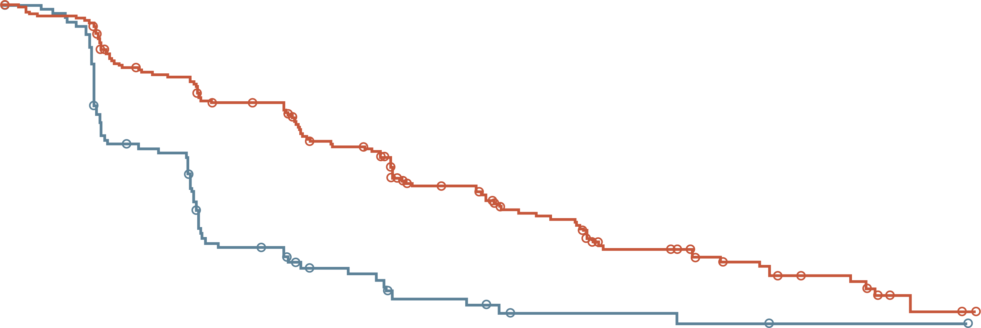
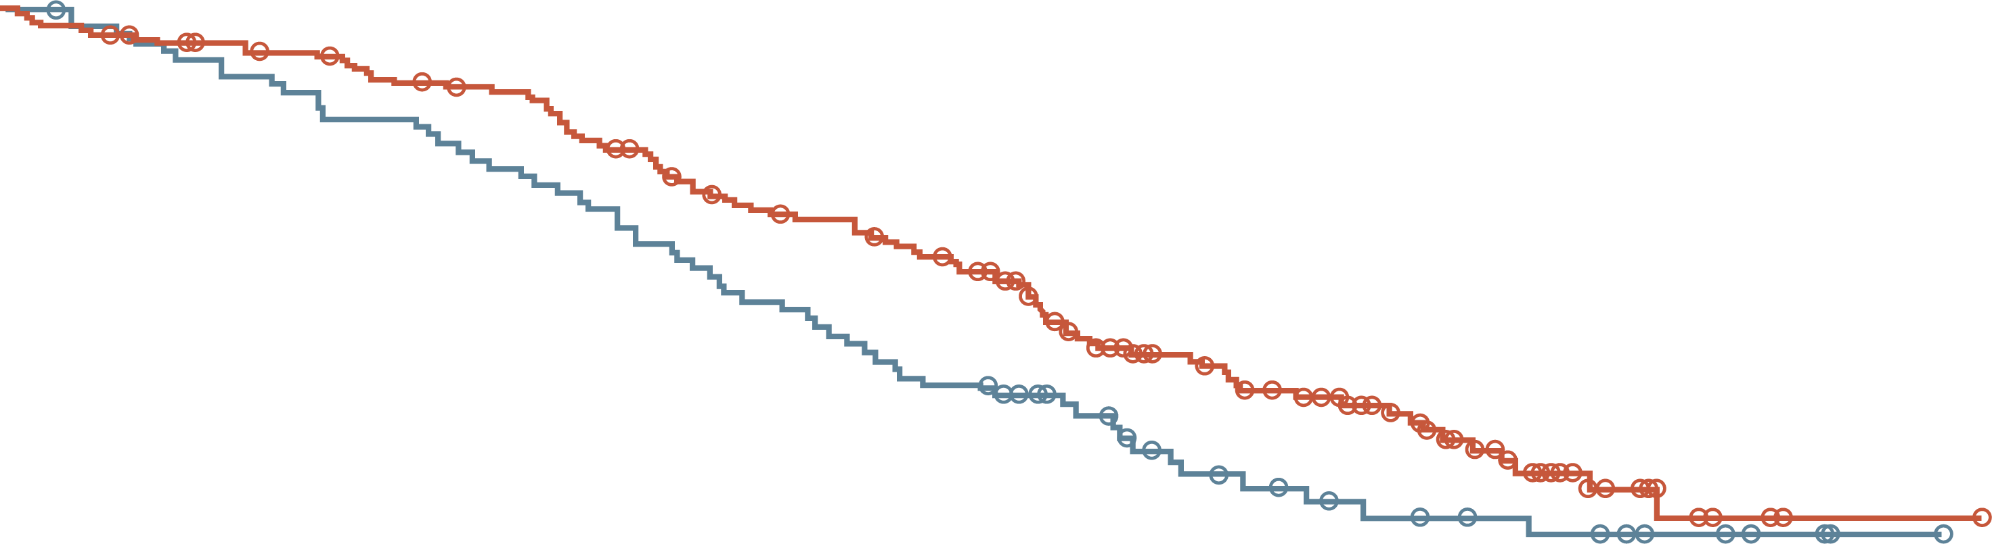
PROfound Outcomes
RADIOLOGICAL OF PFS IN COHORT A
PROBABILITY PD OR DEATH, COHORTS A + B
1.0
Olaparib 300 mg bd (N=162)
Enzalutamide or abiraterone acetate (N=83)
HR 0.34 (95% CI 0.25, 0.47); P < 0.001
Cohorts A and B
Subgroup | Hazard Ratio for Progression or Death (95% CI)
All patients |  | 0.49 (0.38–0.63)
Previous taxane use
Yes |  | 0.39 (0.29–0.53)
No |  | 0.77 (0.50–1.22)
Measurable disease at baseline
Yes |  | 0.41 (0.30–0.56)
No |  | 0.64 (0.43–0.98)
Metastases at baseline
Bone only |  | 0.57 (0.35–0.94)
Visceral |  | 0.42 (0.28–0.64)
Other |  | 0.57 (0.37–0.90)
ECOG score at baseline
0 |  | 0.67 (0.46–1.00)
1 |  | 0.45 (0.32–0.64)
2 |  | 0.31 (0.10–1.13)
Age at randomization
<65 yr |  | 0.53 (0.34–0.85)
≥65 yr |  | 0.52 (0.39–0.70)
Region
Asia |  | 0.67 (0.44–1.04)
Europe |  | 0.48 (0.33–0.71)
North and South America |  | 0.43 (0.26–0.73)
PSA at baseline
≥Median |  | 0.46 (0.33–0.65)
<Median |  | 0.65 (0.44–0.96)
Gene alteration
BRCA1 |  | 0.41 (0.13–1.39)
BRCA2 |  | 0.21 (0.13–0.32)
ATM |  | 1.04–(0.61–1.87)
CDK12 |  | 0.74 (0.44–1.31)
CHEK2 |  | 0.87 (0.23–4.13)
PPP2R2A |  | 6.61 (1.41–46.41)
RAD54L |  | 0.33 (0.05–2.54)
0.9
0.8
0.7
0.6
Probability of radiological
Progression-free survival
0.5
0.4
0.3
0.2
0.1
0.0
0
1
2
3
4
5
6
7
8
9
10
11
12
13
14
15
16
17
18
19
Time from randomization (months)
No. at Risk
Olaparib
E or A
162
83
149
79
126
47
116
44
102
22
101
20
82
13
77
12
56
7
53
6
42
3
37
3
26
3
24
2
18
2
11
1
11
1
3
1
2
1
0
0
OVERALL SURVIVAL IN COHORT A
1.0
Olaparib 300 mg bd (N=162)
Enzalutamide or abiraterone acetate (N=83)
HR 0.69 (95% CI 0.50, 0.97); P = 0.0175
0.9
0.8
0.7
0.6
Probability of
overall survival
0.5
0.4
0.3
0.2
0.1
0.0
0
2
4
6
8
10
12
14
16
18
20
22
24
26
28
30
32
34
Time from randomization (months)
No. at Risk
Olaparib
E or A
162
83
155
79
150
74
142
69
136
64
124
58
107
50
101
43
91
37
71
27
56
18
44
15
30
11
18
9
6
6
2
3
1
1
0
0
0.06
0.25
1.00
4.00
16.00
De Bono et al NEJM 2020; https://www.accessdata.fda.gov/drugsatfda_docs/label/2020/208558s014lbl.pdf
Olaparib Better
Control Better

Slide 40
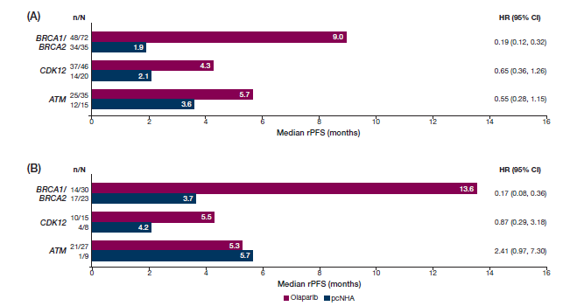
Secondary outcomes
Imaging-based progression-free survival in cohorts a and b
Exploratory Subgroup analyses of rpfs in patients with alterations in brca1/brca2, cdk12 and atm by (A) prior taxane use and (B) no prior taxane use
PRIOR TAXANE USE
NO PRIOR TAXANE USE
De Bono, et al ASCO 2020; abstract 134; Hussain M, et al. ESMO 2019. Abstract LBA12_PR.

Slide 41
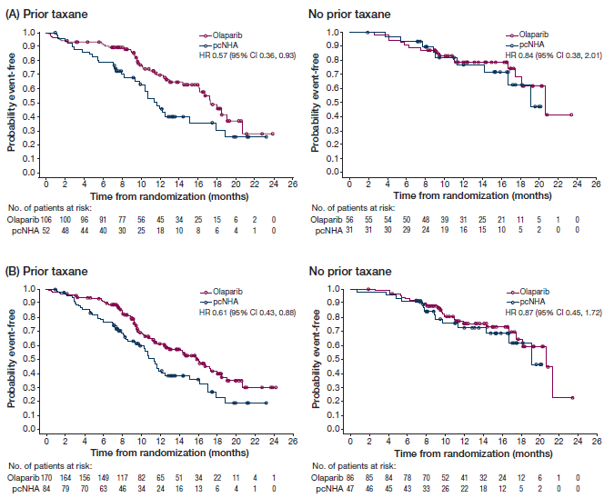
Outcomes in Chemo-naïve mCRPC
Kaplan–Meier estimates of OS in patients in (A) Cohort A and (B) the overall population (Cohorts A+B) by prior taxane status
De Bono, et al ASCO 2020; abstract 134.

Slide 42
PROfound: Exploratory Gene-by-Gene rPFS Analysis^{1,2}
n =
7/15 genes had alteration frequencies too low for descriptive statistics
(<5 patients)¹
97% of patients were randomized based on alterations in 8/15 single genes¹
There is evidence of clinical activity of olaparib in patients with alterations in genes other than BRCA1 or BRCA2¹
Gene-level analysis is complex and exploratory, and comparisons may be confounded by multiple factors¹
BRCA2
81
10.84 (9.17-13.08)
47
3.48 (1.74-3.65)
CDK12
61
5.09 (3.61-5.52)
28
2.20 (1.71-4.83)
ATM
62
5.36 (3.61-6.21)
24
4.70 (1.84-7.26)
BRCA1
8
2.07 (1.38-5.52)
5
1.84 (1.71-3.71)
CHEK2
7
5.59 (1.64-11.99)
5
3.35 (1.38-NR)
PPP2R2A
6
2.69 (1.77-3.91)
Frequency
4
NR
RAD51B
4
10.89 (1.61-14.75)
1
1.77
RAD54L
3
7.20 (3.71-7.39)
2
2.41 (1.81-3.02)
Olaparib
Physician’s choice
1. Available from: https://www.urotoday.com/conference-highlights/esmo-2019/esmo-2019-prostate-cancer/115401-esmo-2019-profound-phase-3-study-of-olaparib-vs-enzalutamide-or-abiraterone-for-metastatic-castration-resistant-prostate-cancer-with-homologous-recombination-repair-gene-alterations.html.
2. Hussain M, et al. ESMO 2019. Abstract LBA12_PR.

Slide 43
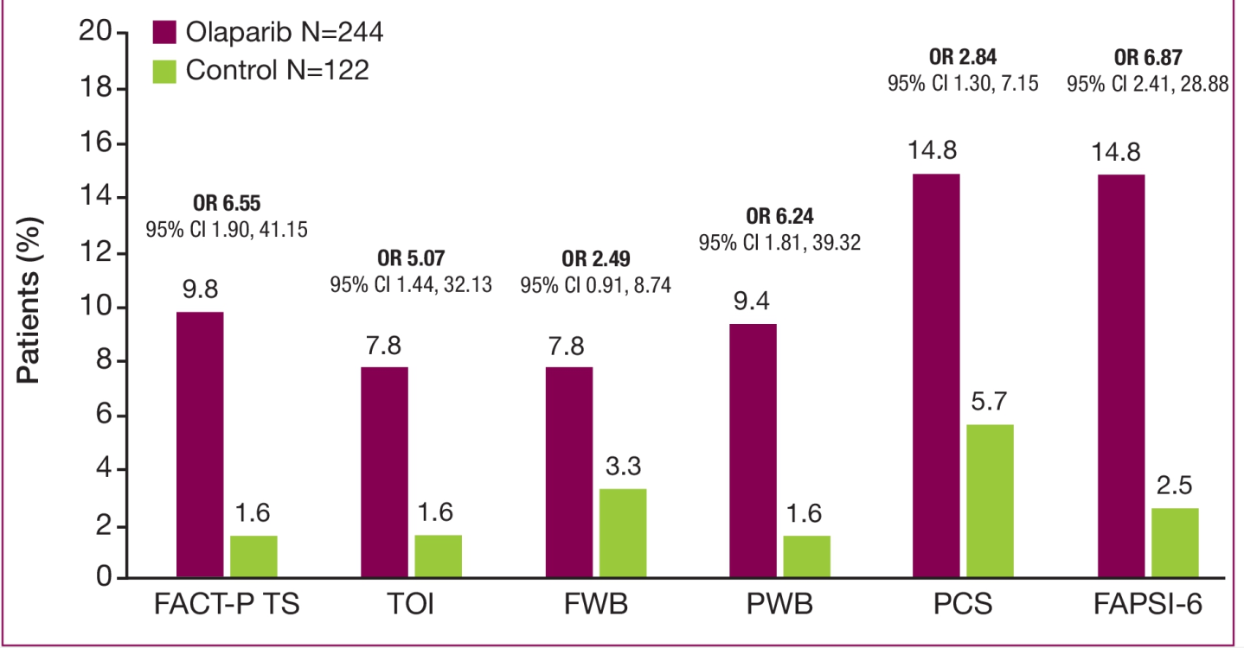
PROfound (Cohorts A+B): HRQoL¹
A higher proportion of patients in the olaparib arm reported improvement in HRQoL
CI, confidence interval; FACT-P TS, Functional Assessment of Cancer Therapy-Prostate; FAPSI-6, FACT Advanced Prostate Symptom Index; FWB, functional wellbeing; HRQoL, health-related qualitdy of life; PCS, prostate cancer subscale; PWB, physical wellbeing; OR, odds ratio; TOI, trial outcome index.
1. Thiery-Vuillemin A, et al. ASCO 2020. Abstract 5539.
Notes:
5539-https://meetinglibrary.asco.org/record/188414/abstract

Slide 44
PROfound Safety¹
Adverse Eventª | Olaparib (N=256) |  | Control (N=130)
 | All Grades (n, %) | Grade ≥3 (n, %) | All Grades (n, %) | Grade ≥3 (n, %)
Any Anemiaª Nausea Fatigue or asthenia Decreased appetite Diarrhea Vomiting Constipation Back pain Peripheral edema Cough Dyspnea Arthralgia Urinary tract infection | 244 (95) 119 (46) 106 (41) 105 (41) 77 (30) 54 (21) 47 (18) 45 (18) 35 (14) 32 (12) 28 (11) 26 (10) 24 (9) 18 (7) | 130 (51) 55 (21) 3 (1) 7 (3) 3 (1) 2 (<1) 6 (2) 0 2 (<1) 0 0 6 (2) 1 (<1) 4 (2) | 114 (88) 20 (15) 25 (19) 42 (32) 23 (18) 9 (7) 16 (12) 19 (15) 15 (12) 10 (8) 3 (2) 4 (3) 14 (11) 15 (12) | 49 (38) 7 (5) 0 7 (5) 1 (<1) 0 1 (<1) 0 2 (2) 0 0 0 0 5 (4)
Interruption of intervention because of adverse event | 115 (45) | N/A | 24 (18) | N/A
Dose reduction because of adverse event | 57 (22) | N/A | 5 (4) | N/A
Discontinuation of intervention because of adverse event | 46 (18) | N/A | 11 (8) | N/A
Death because of adverse event | 10 (4) | N/A | 5 (4) | N/A
ªIncludes anemia, decreased Hb level, decreased red cell count, decreased Hct level, erythropenia, macrocytic anemia, normochromic anemia, normochromic normocytic anemia, and normocytic anemia; anemia reported in 46% of patients, and decreased Hb level reported in <1%.
1. de Bono J, et al. N Engl J Med. 2020;382:2091-102.

Slide 45
Common Side Effects of Olaparib^{1,2}
Anemia
Fatigue
Nausea (vomiting rare)
Decreased appetite
Diarrhea
Thrombocytopenia
Creatinine elevation
Cough and dyspnea
Rare but serious: MDS/AML; pneumonitis; PE/thromboembolism
de Bono J, et al. N Engl J Med. 2020;382:2091-102.
Lynparza 50 mg hard capsules. SmPC. Revised July 2020.

Slide 46
FDA Full Approval: Olaparib for mCRPC
In May 2020, based on data from the PROfound study, the
FDA granted full approval olaparib for the treatment of patients with
deleterious or suspected germline or somatic HRRª gene-mutated mCRPC, who have progressed following prior treatment with
enzalutamide or abiraterone^{1,b}
ªBRCA1, BRCA2, ATM, BARD1, BRIP1, CDK12, CHEK1, CHEK2, FANCL, PALB2, RAD51B, RAD51C, RAD51D, RAD54L.
bSelect patients for therapy based on two FDA-approved companion diagnostic tests: BRACAnalysis CDx and FoundationOne CDx.
1. https://www.fda.gov/drugs/drug-approvals-and-databases/fda-approves-olaparib-hrr-gene-mutated-metastatic-castration-resistant-prostate-cancer.

Slide 47
Rucaparib: TRITON2 and TRITON3 — Study Designs^{1,2}
Next-generation,
AR-signaling directed therapy
Progression
mCRPC
TRITON3
Progression
Taxane-based chemotherapy
Progression
TRITON2
HRR-deficiency is defined by a deleterious alteration in BRCA1, BRCA2, ATM, or 12 other HRR genes (BARD1, BRIP1, CDK12, CHEK2, FANCA, NBN, PALB2, RAD51, RAD51B, RAD51C, RAD51D, RAD54L)
1. Ryan CJ. ASCO 2018; abstract TPS389; 2. Abida W, et al. Annals Onc. 2018:29(Suppl 8):viii271-viii302.

Slide 48
TRITON2: Objective Responses¹
 | DDR Gene
 | BRCA 1/2 (n=57) | ATM (n=21) | CDK12 (n=9) | CHEK2 (n=5) | Other (n=13)
ORR, n (%) [95% CI] | 25 (43.9) [30.7-57.6] | 2 (9.5) [1.2-30.4] | 0 [0.0-33.6] | 0 [0.0-52.2] | 5 (38.5) [13.9-68.4]
CR, n (%) | 3 (5.3) | 0 | 0 | 0 | 1 (7.7)
PR, n (%) | 22 (38.6) | 2 (9.5) | 0 | 0 | 4 (30.8)
SD, n (%) | 26 (45.6) | 10 (47.6) | 5 (55.6) | 3 (60.0) | 6 (46.2)
PD, n (%) | 5 (8.8) | 8 (38.1) | 3 (33.3) | 2 (40.0) | 1 (7.7)
N/E, n (%) | 1 (1.8) | 1 (4.8) | 1 (11.1) | 0 | 1 (7.7)
BEST CHANGE FROM BASELINE IN SUM OF TARGET LESION IN PATIENTS WITH BRCA1/2 ALTERATION (N=56)
100
Confirmed radiographic response
Ongoing on study
80
60
40
20
Change from baseline (%)
0
-20
-40
-80
-100
Status:
Germline
Somatic
U
1. Abida W, et al. ESMO 2019. Abstract 846PD

Slide 49
TRITON2: PSA Responses¹
 | DDR Gene
 | BRCA 1/2 | ATM | CDK12 | CHEK2 | Other
PSA response rate, n/N (%) [95% CI]
All evaluable patients | 51/98 (52.0) [41.7-62.2] | 2/57 (3.5) [0.4-12.1] | 1/14 (7.1) [0.2-33.9] | 1/7 (14.3) [0.4-57.9] | 5/14 (35.7) [12.8-64.9]
With measurable disease | 34/57 (59.6) [45.8-72.4] | 2/21 (9.5) [1.2-30.4] | 1/9 (11.1) [0.3-48.2] | 1/5 (20.0) [0.5-71.6] | 5/13 (38.5) [13.9-68.4]
With no measurable disease | 17/41 (41.5) [26.3-57.9] | 0/36 (0) [0.0-9.7] | 0/5 (0) [0.0-52.2] | 0/2 (0) [0.0-84.2] | 0/1 (0) [0-97.5]
Median time to PSA progression, mo [95% CI] | 6.5 [5.7-7.5] | 3.1 [2.8-3.7] | 3.5 [2.8-4.6] | 5.6 [2.8-NR] | 5.8 [2.8-NR]
BEST CHANGE FROM BASELINE IN PSA PATIENTS WITH BRCA1/2 ALTERATION (N=96)
100
Confirmed PSA response
Ongoing on study
80
60
40
20
Change from baseline (%)
0
-20
-40
-80
-100
Status:
Germline
Somatic
Measurable disease:
Yes
No
U
1. Abida W, et al. ESMO 2019. Abstract 846PD.

Slide 50
TRITON2 primary endpoint
Objective Response rate¹
Response | Investigator-Evaluable Population (n=65) | IRR-Evaluable Population (n=62)
Confirmed ORR, No (%; 95% CI) | 33 (50.8; 38.1 to 63.4) | 27 (43.5; 31.0 to 56.7)
Complete Response | 4 (6.2) | 7 (11.3)
Partial Response | 29 (44.6) | 20 (32.3)
Stable Disease | 25 (38.5) | 28 (45.2)
Progressive Disease | 6 (9.2) | 6 (9.7)
Not evaluable | 1 (1.5) | 1 (1.6)
 | Overall Efficacy Population (n=115)
Confirmed PSA response rate, No. (5;95% CI) | 63 (54.8;45.2 to 64.1)
1. Abida W, et al. Journal of Clinical Oncology 2020 DOI https://doi.org/10.1200/JCO.20.01035

Slide 51
TRITON2: subgroup analysis of Objective Response rate¹
 | ORR in IRR-Evaluable Population |  | PSA Response Rate in Overall Efficacy Population
 |  | ORR, No./No. (%) [95% CI] |  | PSA Response Rate, No./No. (%) [95% CI]
Overall |  | 27/62 (43.5) [31.0 to 56.7] |  | 63/115 (54.8) [45.2 to 64.1]
Gene
BRCA1 |  | 3/9 (33.3) [7.5 to 70.1] |  | 2/13 (15.4) [1.9 to 45.4]
BRCA2 |  | 24/53 (45.3) [31.6 to 59.6] |  | 61/102 (59.8) [49.6 to 69.4]
Germline/somatic status
Germline |  | 9/21 (42.9) [21.8 to 66.0] |  | 27/44 (61.4) [45.5 to 75.6]
Somatic |  | 18/41 (43.9) [28.5 to 60.3] |  | 36/71 (50.7) [38.6 to 62.8]
No. of prior lines of therapy
1 |  | NA |  | 1/1* (100.0) [2.5 to 100.0]
2 |  | 15/32 (46.9) [29.1 to 65.3] |  | 36/61 (59.0) [45.7 to 71.4]
≥3 |  | 12/30 (40.0) [22.7 to 59.4] |  | 26/53 (49.1) [35.1 to 63.2]
Hepatic metastases
Yes |  | 6/13 (46.2) [19.2 to 74.9] |  | 10/14 (71.4) [41.9 to 91.6]
No |  | 21/49 (42.9) [28.8 to 57.8] |  | 53/101 (52.5) [42.3 to 62.5]
Age, years
<65 |  | 7/11 (63.6) [30.8 to 89.1] |  | 15/25 (60.0) [38.7 to 78.9]
65–74 |  | 8/25 (32.0) [14.9 to 53.5] |  | 28/52 (53.8) [39.5 to 67.8]
≥75 |  | 12/26 (46.2) [26.6 to 66.6] |  | 20/38 (52.6) [35.8 to 69.0]
0
20
40
60
80
100
0
20
40
60
80
100
ORR (95% CI)
PSA Response Rate (95% CI)
1. Abida W, et al. Journal of Clinical Oncology 2020 DOI https://doi.org/10.1200/JCO.20.01035

Slide 52
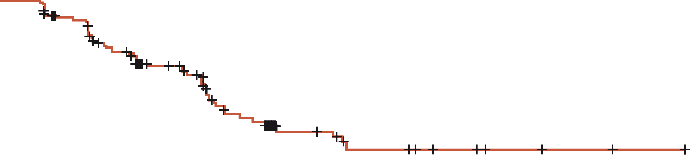
TRITON2: radiographic pfs¹
100
90
Median, months | 95% CI | Range
9.0 | 8.3 to 13.5 | 0.0-27.6+
80
70
60
Radiographic progression-free survival (%)
50
40
30
20
10
0
4
8
12
16
20
24
28
Time (months)
No. at risk:
(events)
115
(0)
80
(21)
53
(34)
17
(50)
9
(53)
4
(53)
3
(53)
0
(53)
1. Abida W, et al. Journal of Clinical Oncology 2020 DOI https://doi.org/10.1200/JCO.20.01035

Slide 53
TRITON2: Response by Non-BRCA DDR Gene Alterations^{1,a}
 | By DDR Gene Group
 | ATM (n=49) | CDK12 (n=15) | CHEK2 (n=12) | Other^{b} (n=14)
Confirmed investigator-assessed objective response^{c} CR PR SD PD NE | 2/19 (10.5) (1.3-33.1) 0/19 (0.0) 2/19 (10.5) 9/19 (47.4) 7/19 (36.8) 1/19 (5.3) | 0/10 (0) (0.0-30.8) 0/10 (0) 0/10 (0) 6/10 (60.0) 3/10 (30.0) 1/10 (10.0) | 1/9 (11.1) (0.3-48.2) 0/9 (0) 1/9 (11.1) 6.9 (66.7) 2/9 (22.2) 0/9 (0) | 4/14 (28.6) (8.4-58.1) 1/14 (7.1) 3/14 (21.4) 8/14 (57.1) 1/14 (7.1) 1/14 (7.1)
6-month clinical benefit rate^{d} | 12/42 (28.6) (15.7-44.6) | 3/15 (20.0) (4.3-48.1) | 3/8 (37.5) (8.5-75.5) | 6/11 (54.5) (23.4-83.3)
12-month clinical benefit rate^{e} | 3/18 (16.7) (3.6-41.4) | 1/14 (7.1) (0.2-33.9) | 0/5 (0) (0.0-52.2) | 3/8 (37.5) (8.5-75.5)
Confirmed PSA response^{f} | 2/49 (4.1) (0.5-14.0) | 1/15 (6.7) (0.2-31.9) | 2/12 (16.7) (2.1-48.4) | 5/14 (35.7) (12.8-64.9)
Median time to PSA progression, mo (95% CI) | 3.1 (2.8-4.6) | 3.2 (2.8-4.6) | 7.4 (2.8-7.4) | 11.0 (3.0-NR)
ªVisit cutoff date: April 29, 2019. Data are n/N (%) (95% CI) unless stated otherwise. ^{b}Includes patients with an alteration in FANCA (n=4), NBN (n=4), BRIP1 (n=2), PALB2 (n=2), RAD51 (n=1), RAD51B (n=1), and/or RAD54L (n=1). ^{c}Per modified RECIST/PCWG3 criteria; includes patients who had measurable disease at baseline per the investigator and
≥16 weeks of follow-up. ^{d}Proportion of patients without radiographic progression per RECIST/PCWG3 criteria who were ongoing with treatment at 6 months. ^{e}Proportion of patients without radiographic progression per RECIST/PCWG3 criteria who were ongoing with treatment at 12 months. ^{f}Defined as ≥50% reduction in PSA from baseline; includes patients who had ≥16 weeks of follow-up.
1. Abida W et al. Clin Cancer Res. 2020 Feb 21 [Epub ahead of print].
Notes:
Abida et al CCR 2020
https://clincancerres.aacrjournals.org/content/early/2020/05/11/1078-0432.CCR-20-0394

Slide 54
Common Side Effects of Rucaparib
Anemia
Fatigue, asthenia
Nausea/vomiting
Decreased appetite
Diarrhea or constipation
Thrombocytopenia
Increased AST/ALT and/or creatinine
Rash
Rare but serious: MDS/AML; fetal teratogenicity
1. Abida W, et al. Clin Cancer Res. 2020 Feb 21 [Epub ahead of print]; 2. Rucabra. SmPC. May 2019.

Slide 55
FDA accelerated Approval: Rucaparib for mCRPC
In May 2020, based on data from the TRITON2 study, the FDA
granted accelerated approval to rucaparib for the treatment of patients with deleterious BRCA1/2 (germline and/or somatic)-associated mCRPC, who have been treated with an androgen receptor-directed therapy and a taxane-based chemotherapy.¹
The TRITON3 study is underway and recruiting patients with
mCRPC and homologous recombination gene deficiency.²
1. https://www.fda.gov/drugs/fda-grants-accelerated-approval-rucaparib-brca-mutated-metastatic-castration-resistant-prostate.
2. https://clinicaltrials.gov/ct2/show/NCT02975934.

Slide 56
TRITON3: Study Design^{1,2}
Key Eligibility Criteria
mCRPC
Deleterious germline or somatic BRCA1, BRCA2, or ATM mutation
Progression on AR-directed therapy in the mCRPC setting
No prior PARPi treatment or chemotherapy for mCRPC
Rucaparib
600 mg BID
2:1
R
Physician’s choice (abiraterone, enzalutamide, or docetaxel)
Primary endpoint: radiographic PFS
1. https://clinicaltrials.gov/ct2/show/NCT02975934; 2. Ryan CJ. ASCO 2018; abstract TPS389

Slide 57
Phase 2 GALAHAD: Niraparib in Previously
Treated mCRPC With Biallelic DDR Mutations^{1,2}
Biomarker evaluation (prescreening)
Screening phase
Treatment phase
(niraparib 300 mg/d)
Follow-up phase
28-d cycle until end
of treatmentª
Every 3 mo after
end of treatment
Key Eligibility Criteria
mCRPC
Biomarker positive for biallelic DRD mutation
Progressed on ≥1 AR-targeted therapy and ≥1 taxane-based chemo
No prior PARP inhibitor or platinum-based chemo
No prior MDS/AML
Primary Endpoint
ORR of soft tissue (visceral or nodal disease), as defined by RECIST 1.1^{b} with
no evidence of bone progression according to PCWG3 criteria in patients with biallelic BRCA mutations²
Secondary endpoints
ORR
CTC response
OS
rPFS
DOR
Safety
Composite response rate, derived from the secondary endpoints and the exploratory endpoint of CTC conversion, was defined as ORR by RESIST 1.1, or conversion CTC from ≥5/7.5 mL to <5/7.5 mL of blood, or ≥50% decline in PSA level.²
ªTreatment continued until disease progression, unacceptable toxicity, or death. ^{b}Investigator assessed.
https://clinicaltrials.gov/ct2/show/NCT02854436. Annals of Oncology (2019) 30 (suppl_5): v851-v934. 10.1093/annonc/mdz394

Slide 58
GALAHAD: Objective responses
Best overall response in biallelic drd patients with measurable disease at baseline
Response, n (%) | Patients with measurable disease (n=51)
 | BRCA (n=29) | Non-BRCAa (n=22)
Complete Response (CR) | 1 (3%) | 0
Partial Response (PR) | 11 (38%) | 2 (9%)
Stable Disease (SD) | 7 (24%) | 10 (45%)
Progressive Disease (PD) | 7 (24%) | 7 (32%)
Maximum change in target lesion diameter
100
BI-BRCA
BI-Non-BRCA
90
80
70
60
50
40
30
20
Maximum change in sum of
target tumour diameters from
baseline (%)
10
0
-10
-20
-30
-40
-50
-60
-70
-80
-90
-100
Smith MR, et al. ESMO 2019; abstract LBA50.
Notes:
58
58

Slide 59
Phase 2 GALAHAD: ORR, PSA Response, CTC response¹
n/N % (95% CI) | All Biallelic DND (N=50)
 | BRCA1/2 (n=29) | Non-BRCA1/2ª (n=21)
Composite RR | 18/29 62.1 (42.3-79.3) | 5/21 23.8 (8.2-47.2)
Objective RR^{b} | 6/16 37.5 (15.2-64.6) | 2/15 13.3 (1.7-40.5)
≥50% decline in PSA | 15/29 51.7 (32.5-70.6) | 1/21 4.8 (0.1-23.8)
CTC conversion (<5/7.5 mL blood) | 12/29 41.4 (23.5-61.1) | 4/21 19.0 (5.5-41.9)
CTC response | 6/29 20.7 (8.0-39.7) | 2/21 9.5 (1.2-30.4)
BRCA1/2
Non-BRCA
100
75
50
25
Maximum change in PSA from baseline (%)
0
-25
-50
-75
-100
ªATM, FANCA, PALB2, CHEK2, BRIP1, or HDAC2 assayed, not all represented in non-BRCA patients. b Investigator-assessed.
1. Smith MR, et al. J Clin Oncol. 2019;37(Suppl7):202.

Slide 60
TALAPRO-1: Talazoparib in mCRPC With DDRm¹
Eligibility criteria
Age ≥18 y
Progressive mCRPC
Measurable soft tissue disease
1-2 previous chemotherapy regimens (≥1 taxane-based regimen) for mCRPC
Progressed on ≥1 NHTª for mCRPC
DDRm^{b} likely to sensitize to PARPi
N = ~100
Talazoparib 1 mg daily
(0.75 mg, if moderate
renal impairment)
Until radiographic progression, unacceptable toxicity, consent withdrawal, or death
Primary endpoint: ORR
Secondary endpoints: Time to OR, DOR, PSA decrease ≥50%, CTC count conversion (to CTC = 0 and <5 per 7.5 mL blood) time to PSA progression, rPFS, OS, safety
ªEnzalutamide/abiraterone acetate. ^{b}DDRm are defined as known/likely pathogenic variants or homozygous deletions in: ATM, ATR, BRCA1/2, CHEK2, FANCA, MLH1, MRE11A, NBN, PALB2, RAD51C.
1. https://meetinglibrary.asco.org/record/188251/abstract.

Slide 61
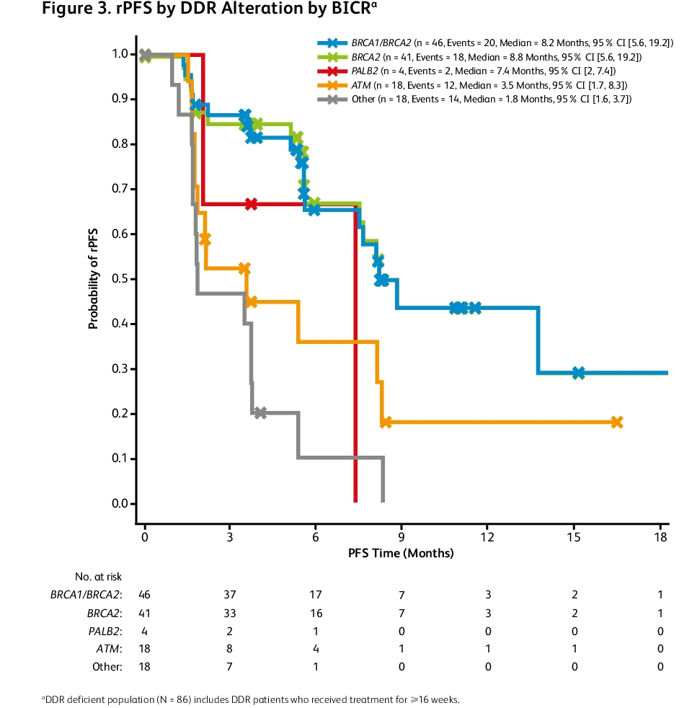
TALAPRO-1: Efficacy¹
% (response/n) | BRCA1/2 (n=46) | BRCA2 (n=41) | PALB2 (n=4) | ATM (n=18) | Other (n=18) | Total (N=86)
Composite Response | 71.7 (33/46) | 75.6 (31/41) | 50.0 (2/4) | 22.2 (4/18) | 11.1 (2/18) | 47.7 (41/86)
ORR | 41.5 (17/41) | 40.5 (15/37) | 33.3 (1/3) | 11.8 (2/17) | 0 (0/14) | 26.7 (20/75)
Confirmed CR | 4.9 (2/41) | 5.4 (2/37) | 0 (0/3) | 5.9 (1/17) | 0 (0/14) | 4.0 (3/75)
Confirmed PR | 36.6 (15/41) | 35.1 (13/37) | 33.3 (1/3) | 5.9 (1/17) | 0 (0/14) | 22.7 (17/75)
SD ≥6 mo | 2.4 (1/41) | 2.7 (1/37) | 0 (0/3) | 11.8 (2/17) | 0 (0/14) | 4.0 (3/75)
PSA decline ≥50% from baseline | 60.9 (28/46) | 63.4 (26/41) | 50.0 (2/4) | 5.6 (1/18) | 5.6 (1/18) | 37.2 (32/86)
CTC conversion ≥5 to <5 | 93.8 (15/16) | 93.8 (15/16) | 0 (0/1) | 50.0 (3/6) | 25.0 (1/4) | 70.4 (19/27)
rPFS BY DDR ALTERATION BY BICRª
In this interim analysis (Dec 2019) of TALAPRO-1, talazoparib monotherapy demonstrated antitumor activity in mCRPC patients with DDR alterations who have previously received taxane therapy and NHT with a confirmed overall ORR of 26.7%. Efficacy was most notable in the subset of patients with mCRPC whose tumors harbored BRCA1/2 alterations, who had a confirmed ORR of 41.5%.
Talazoparib monotherapy was generally well tolerated. No new safety signals were observed in this patient population compared with the known safety profile of talazoparib.
ªDDR-deficient population (N=86) includes DDR patients who received treatment for ≥16 weeks.
1. de Bono J, et al. ASCO 2020. Abstract 5566.
Notes:
https://meetinglibrary.asco.org/record/188251/abstract

Slide 62
TALAPRO-1: Efficacy and Safety Results¹
BEST CHANGE FROM BASELINE IN PSAª
BEST CHANGE FROM BASELINE IN RECISTª
BRCA1 (n=5)
BRCA2 (n=40)
PALB2 (n=3)
ATM (n=16)
Other (n=15)
BRCA1 (n=4)
BRCA2 (n=32)
PALB2 (n=2)
ATM (n=14)
Other (n=10)
300
50
250
200
150
0
Best change from baseline in PSA (%)
Best change from baseline in sum of
diameters fro target lesions (%)
100
50
-50
0
-50
-100
Patients
-100
Patients
ªDDR-deficient population includes DDR patients who received treatments for ≥16 weeks; PSA, n=79 and RECIST, n=62.
1. de Bono J, et al. ASCO 2020. Abstract 5566.

Slide 63
Ongoing Studies of PARP Inhibitor combinations in PC
NCT03732820: Phase 3 Study of olaparib + abiraterone vs abiraterone in mCRPC (PROpel)
NCT03748641: Phase 3 Study of niraparib + abiraterone vs abiraterone in mCRPC (MAGNITUDE)
NCT03395197: Phase 3 Study of talazoparib + Enzalutamide vs Enzalutamide in mCRPC (TALAPRO-2)
NCT 04455750: Phase 3 study of rucaparib + enzalutamide vs enzalutamide in mCRPC (CASPAR)
https://clinicaltrials.gov/ct2/show/NCT03732820; https://clinicaltrials.gov/ct2/show/NCT03748641; https://clinicaltrials.gov/ct2/show/NCT03395197; https://clinicaltrials.gov/ct2/show/NCT04455750

Slide 64
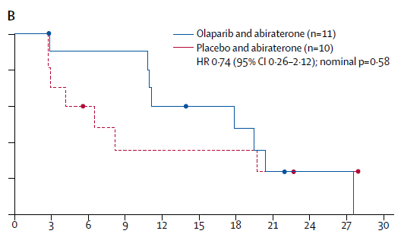
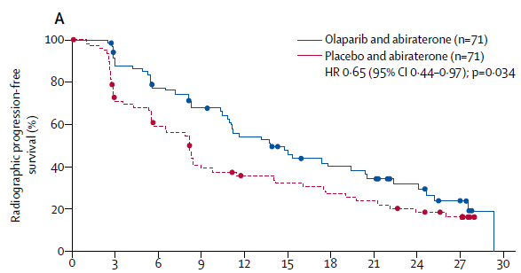
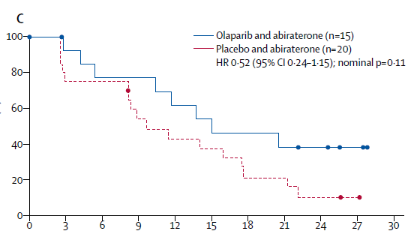
Olaparib + Abiraterone in unselectedª mCRPC
ªPatients unselected based on biomarker criteria.
Clark NW, et al. Lancet Oncol. 2018;19:975-86.
Notes:
64
64

Slide 65
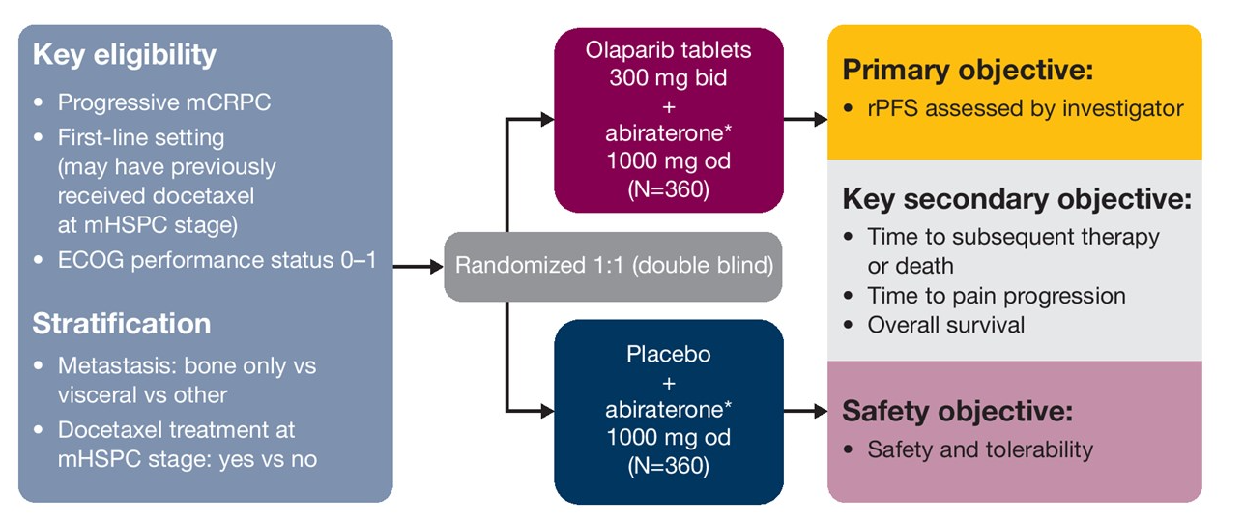
PROpel study: Abiraterone +/- Olaparib
Clark NW, et al. ASCO 2019; abstract TPS340.
Notes:
65
65

Slide 66
TALAPRO-2: Study Design^{1,2}
First-line mCRPC
Stratification Factors
Previous treatment with
any NHT or taxane-based chemotherapy for CSPC
DDR alteration status
Part 1:
Open-label treatment
Determine starting
dose of talazoparib
n=19
Talazoparib 0.5 mg/d + enzalutamide 160 mg/d
Follow Up
Primary endpoint
(part 2):
rPFS
Safety follow-up ~28 d following last dose of study drug treatment
Long-term follow-up every 8-12 weeks
Remain on open-label treatment
Talazoparib 0.5 mg/d + enzalutamide 160 mg/d
Part 2:
Double-blind treatment
n=1,018
1:1 randomization
Remain on blinded treatment
Unselected
DDR
Placebo +
enzalutamide 160 mg/d
1. https://clinicaltrials.gov/ct2/show/NCT03395197.
2. Agarwal N, et al. ASCO 2019; abstract TPS337.

Slide 67
Ongoing Studies of PD-1/PD-L1 Inhibitors in
Combination With PARP Inhibitors in PCa
NCT03338790: Phase 2 Study of Nivolumab in Combination With Rucaparib,
Docetaxel, or Enzalutamide in mCRPC (CheckMate -9KD)
NCT03330405: Phase 2 Study of Avelumab Plus Talazoparib in Locally Advanced or
Metastatic Solid Tumors (JAVELIN PARP Medley)
NCT03834519: Phase 3 Study of Pembrolizumab + Olaparib vs Abiraterone
or Enzalutamide in mCRPC (KEYLYNK-010)
https://clinicaltrials.gov/ct2/show/NCT03338790; https://clinicaltrials.gov/ct2/show/NCT03330405; https://clinicaltrials.gov/ct2/show/NCT03834519

Slide 68
Conclusions
The treatment of men with metastatic prostate cancer has become more complex, now integrating predictive genomic biomarker testing
Two PARPi’s are now approved with olaparib having OS data in mCRPC based on the PROfound study
  Trials are under way for 3 further therapies
Precision medicine approaches using germline and somatic tumor testing are already changing our treatment algorithms and are anticipated to continue to inform decision making and improve outcomes for our patients
Combination therapies and expanded indications represent the next steps for PARPi
  Experts should consider how to plan therapy and communicate with patients in this increasingly complex environment

Slide 69
The Role of PARPi in Prostate Cancer: future perspectives
Dr. Neal D. Shore
(Chair)
Carolina Urologic
Research Center

Slide 70
FDA Approval: Olaparib and rucaparib for mCRPC
In May 2020, based on data from the PROfound study, the FDA approved olaparib for the treatment of patients with deleterious or suspected germline or somatic HRRª gene-mutated mCRPC, who have progressed following prior treatment with enzalutamide or abiraterone^{1,b}
In May 2020, based on data from the TRITON2 study, the FDA granted accelerated approval to rucaparib for the treatment of patients with deleterious BRCA1/2 (germline and/or
somatic)-associated mCRPC, who have been treated with an androgen receptor-directed therapy and a taxane-based chemotherapy²
ªBRCA1, BRCA2, ATM, BARD1, BRIP1, CDK12, CHEK1, CHEK2, FANCL, PALB2, RAD51B, RAD51C, RAD51D, RAD54L.
^{b}Select patients for therapy based on two FDA-approved companion diagnostic tests: BRACAnalysis CDx and FoundationOne CDx.
1. https://www.fda.gov/drugs/drug-approvals-and-databases/fda-approves-olaparib-hrr-gene-mutated-metastatic-castration-resistant-prostate-cancer;
2. https://www.fda.gov/drugs/fda-grants-accelerated-approval-rucaparib-brca-mutated-metastatic-castration-resistant-prostate.

Slide 71
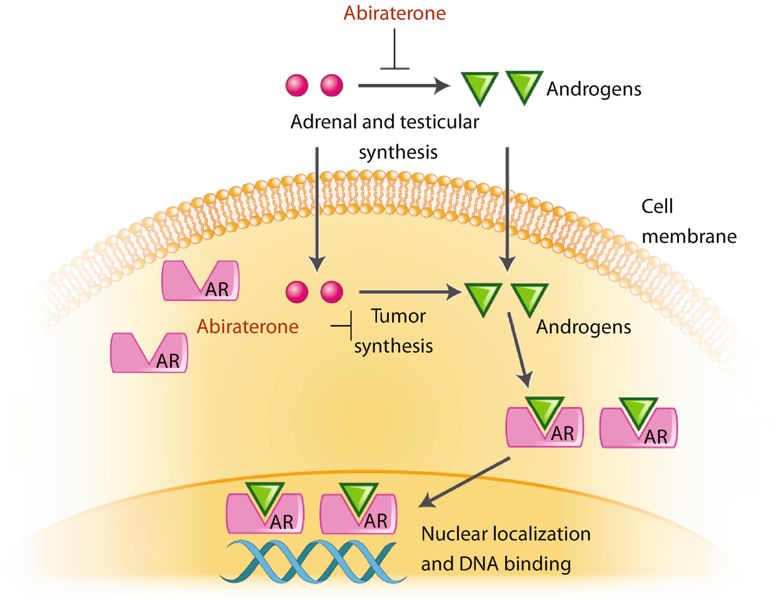
Combining PARPi and HORMONAL TARGETING
The NHA abiraterone, in combination with olaparib, prolonged radiologic progression-free survival in the Phase II PROpel trial vs abiaterone and PBO
  Suggests synergy between hormonal treatments and PARPi
Androgen receptor signalling is a regulator of tumour growth
  AR signalling inhibitors appear to down-regulate DDR gene expression
PARPi
Abiraterone
Expression of DNA repair genes
DNA Repair
Chatterjee P, et al. J Clin Invest. 2019;129(10):4245-60; Clark NW, et al. Lancet Oncol. 2018;19:975-86;
Jividen, et al. BMC Cancer. 2018;18:60; Clarke NW, et al. JCO.2019;37.7_suppl.TPS340.

Slide 72
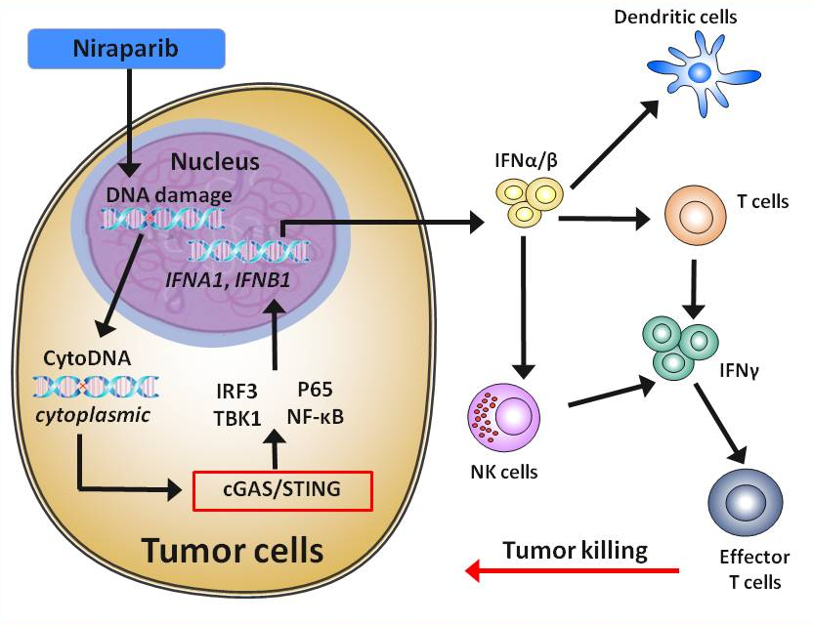
Combining PARPi and Immune checkpoint inhibitors
Unrepaired DNA damage from PARPi leads to presence of cytoplasmic DNA which activates the STING (Stimulator of Interferon Genes) pathway
  Activation of STING
  ↑ expression and release of type 1 IFNs
  ↑ infiltration of effector T cells
Huang J, et al. Biochem Biophys Res Commun. 2015;463:551-6; Jiao S, et al. Clin Cancer Res. 2017;23:3711-20.

Slide 73
Combining PARPi and DNA damaging therapies
Chemotherapy, radiation, radionucleotide etc.
Therapies such as chemotherapy, radiation, and radionucleotides increase DNA damage
  The potential for PARPi trapping increases
  The potential synthetic lethality increases
MoA – DNA damage plus trapping PARP
is synthetic lethal with HRD
Keung MYT, et al. J Clin Med. 2019;8:435.

Slide 74
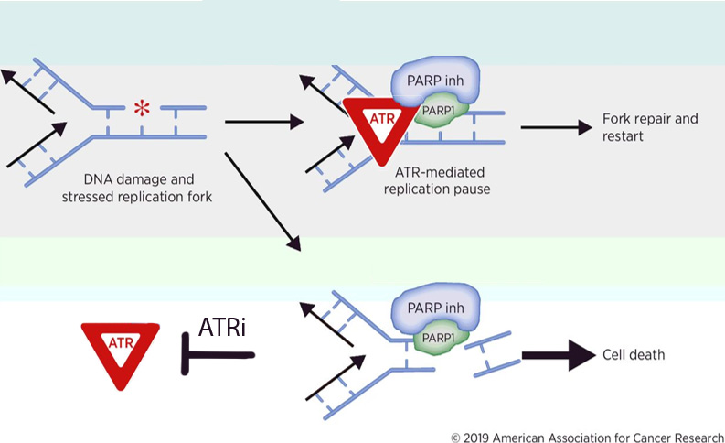
PARPi COMBINATIONS to induce other forms of synthetic lethality
Combined interventions can induce or enhance synthetic lethality by disrupting alternative pathways involved in DNA repair
Such inhibitors of cell signalling pathways include:
  ATR inhibitors (M6620)
  Pi3K pathway inhibitors
  AKT inhibitors (ipatasertib)
  VEGFR inhibitors (cediranib)
  DNA methyltransferase (DNMT) inhibitors
ATR inhibition induced synthetic lethality
Cancers (Basel). 2020 Jun; 12(6): 1607.
Published online 2020 Jun 17. doi: 10.3390/cancers12061607
PMCID: PMC7352566
PMID: 32560564
Overcoming Platinum and PARP-Inhibitor Resistance in Ovarian Cancer
Michelle McMullen, Katherine Karakasis, Ainhoa Madariaga, and Amit M. Oza*
Figure adapted from;
PARP Inhibitors: Extending Benefit Beyond BRCA-Mutant Cancers
Patrick G. Pilié, Carl M. Gay, Lauren A. Byers, Mark J. O'Connor and Timothy A. Yap
DOI: 10.1158/1078-0432.CCR-18-0968 Published July 2019
Notes:
3 new slides
What are the synergistic effects of other drug combinations. Group of mech. DNA damage plus parp inhib.
BRCAness – how do drugs do this
Parp and NADS

Slide 75
Overcoming resistance: ongoing combination trials
Treatment Regimen | Status | Allocation | HRD Selection | Estimated Enrollment | Phase | CTID
PARPi + AR signaling inhibitors
Niraparib and Abiraterone and Prednisolone | Recruiting | Randomized | Yes | 1000 | III | NCT03748641
Olaparib or Olaparib and Abiraterone and Prednisone | Recruiting | Randomized | Yes | 70 | II | NCT03012321
Olaparib and Abiraterone and Prednisolone | Recruiting | Randomized | No | 720 | III | NCT03732820
Rucaparib and Abiraterone, Enzalutamide or Docetaxel | Recruiting | Randomized | Yes | 400 | III | NCT02975934
Niraparib and Apalutamide or Abiraterone and Prednisolone | Active, not recruiting |  | No | 34 | I | NCT02924766
Niraparib and Enzalutamide | Terminated (Suspended by funder) |  | No | 2 | I | NCT02500901
Talazoparib and Enzalutamide | Recruiting | Randomized | Yes† | 872 | III | NCT03395197
Rucaparib and Enzalutamide and Abiraterone | Recruiting | Non-randomized | No | 60 | I | NCT04179396
PARPi + immune checkpoint inhibitors
Talazoparib and Avelumab | Recruiting | Non-Randomized | No | 242 | Ib/II | NCT03330405
Olaparib and Durvalumab | Recruiting |  | Yes | 32 | II | NCT03810105
Niraparib and JNJ-63723283 or Abiraterone and Prednisolone | Recruiting | Non-Randomized | Yes | 150 | Ib-II | NCT0341350
Rucaparib and Nivolumab | Recruiting | Non-Randomized | No | 330 | II | NCT03338790
Rucaparib or Rucaparib and Nivolumab | Recruiting | Randomized | No | 60 | Ib/IIa | NCT03572478
Olaparib and Pembrolizumab | Recruiting | Non-Randomized | No | 400 | I | NCT02861573
Olaparib and Pembrolizumab | Not yet recruiting | Randomized | No | 780 | III | NCT03834519
PARPi + chemotherapy agents
Rucaparib, Docetaxel and carboplatin | Recruiting |  | Yes | 20 | II | NCT03442556
Pamiparib and Temozolomide | Recruiting | Non-randomized | Yes | 150 | I | NCT03150810
PARPi + Radionuclide therapies
Niraparib and Radium Ra 223 Dichloride | Recruiting |  | No | 6 | 1 | NCT03076203
Olaparib and Radium Ra 223 Dichloride | Recruiting | Randomized | No | 112 | II | NCT03317392
Olaparib and 177Lu-PSMA | Recruiting |  | No | 52 | I | NCT03874884
PARPi + surgical procedures
Olaparib and RP | Recruiting |  | Yes | 13 | II | NCT03432897
Olaparib and RP | Recruiting |  | Yes | 15 | II | NCT03570476
PARPi + VEGF RTK inhibitors
Olaparib and Cediranib | Active, not recruiting | Randomized | No | 90 | II | NCT02893917
Adapted from Virtanen V, et al., Genes (Basel). 2019;10(8):565; clinicaltrials.gov

Slide 76
Overcoming resistance: ongoing combination trials
Treatment Regimen | Status | Allocation | HRD Selection | Estimated Enrollment | Phase | CTID
PARPi + AKT inhibitors
Rucaparib and Ipatasertib | Recruiting | Non-Randomized | No | 54 | Ib | NCT03840200
PARPi + androgens
Olaparib and Testosterone Enanthate or Cypionate | Recruiting |  | Yes | 30 | II | NCT03516812
PARPi + ATR inhibitors
Olaparib and AZD6738 | Recruiting | Non-Randomized | No | 47 | II | NCT03787680
PARPi + GnRH antagonists
Olaparib and Degarelix | Recruiting | Randomized | No | 20 | I | NCT02324998
PARPi + nanoparticle conjugate
Olaparib and CRLX101 | Recruiting | Non-randomized | No | 123 | I/II | NCT02769962
Personazlized medicine approach
SMMART therapy | Recruiting |  | No | 52 | I | NCT03878524
PARPi + radiation treatment
Olaparib and RT | Recruiting | Randomized | No | 112 | I/II | NCT03317392
Virtanen V, et al. Genes (Basel). 2019;10(8):565; clinicaltrials.gov

Slide 77
Conclusions
Somatic and germline testing for common DDR mutations are recommended for all patients with metastatic PCa
Multiple PARPi’s have proven efficacy and tolerability in mCRPC
  With olaparib having OS data in mCRPC based on the PROfound study
  Studies into combination therapies with hormonal agents are underway
Combinations with therapies which induce DNA damage or a BRCA-like phenotype may help overcome PARPi resistance
Investigations into PARP inhibitor efficacy in locally advanced PCa may alter the place of PARP inhibition in the treatment pathway

