Slide 1


VON WILLEBRAND DISEASE
Module 1
When to
consider von Willebrand disease?
May 2022
CME credit available
Visit programme home page on:
The programme is supported by an independent educational grant from Takeda.
The programme is therefore independent; the content is not influenced by the
supporter and is under the sole responsibility of the experts.

Slide 2
What will you learn in this micro e-learning programme
about von Willebrand disease?
This micro e-learning programme consists of three modules aiming to increase awareness, knowledge and understanding of the existence, diagnosis, treatment and implications of von Willebrand disease among healthcare professionals outside of haematology.
Upon completion of the three modules, you will:
  be aware of the potential existence of von Willebrand disease in your patient population
  be able to recognise the signs and symptoms of von Willebrand disease
  understand how to search for von Willebrand disease, effectively using the screening tools available and signposting patients towards earlier diagnosis
  be aware of the impact of von Willebrand disease on other care
AFTER MODULE 1 YOU WILL
Current Module
be aware of the potential existence of von Willebrand disease among your patient population
be able to recognise the signs and symptoms of von Willebrand disease
AFTER MODULE 2 YOU WILL
understand you can help diagnose von Willebrand disease
be able to effectively use the screening tools available
understand the next steps to take when suspecting von Willebrand disease
AFTER MODULE 3 YOU WILL
be aware of the impact of von Willebrand disease on provision of general care
understand the key aspects of von Willebrand disease affecting your clinical practice
understand the importance of a multidisciplinary approach in von Willebrand disease care
2

Slide 3
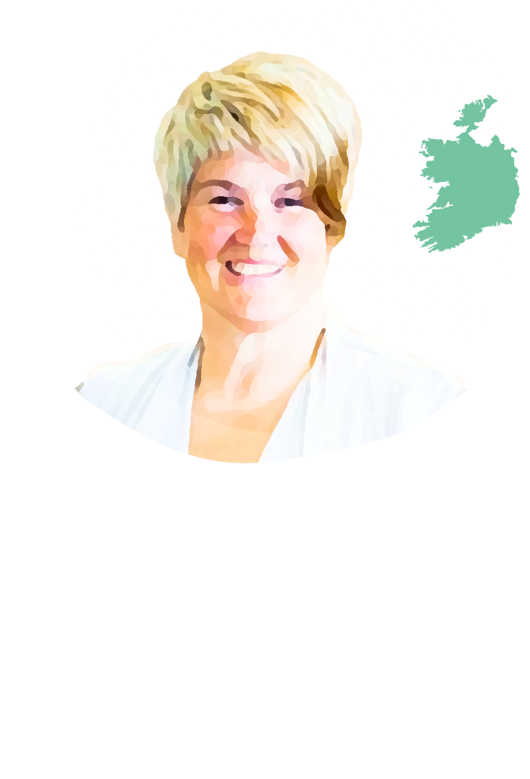
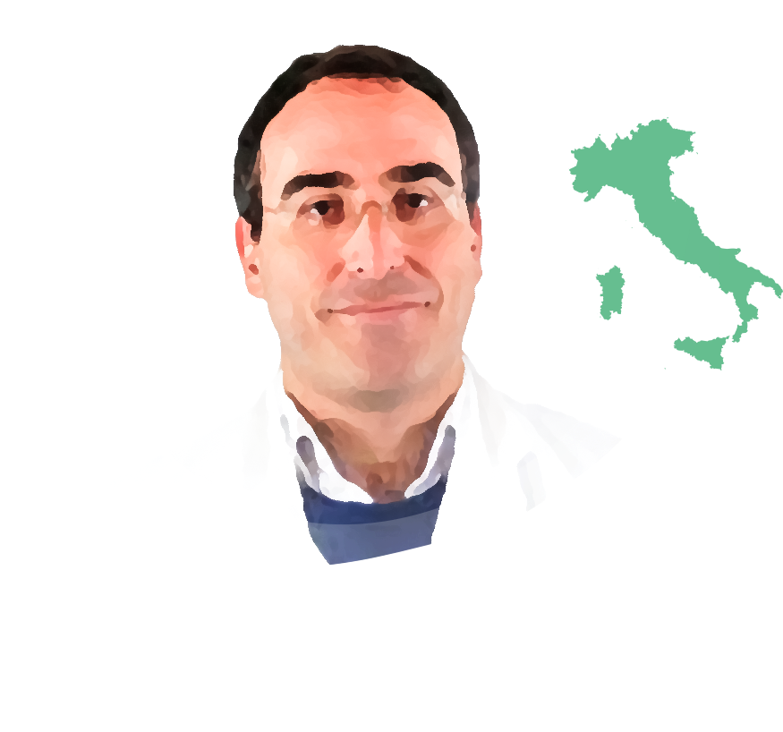
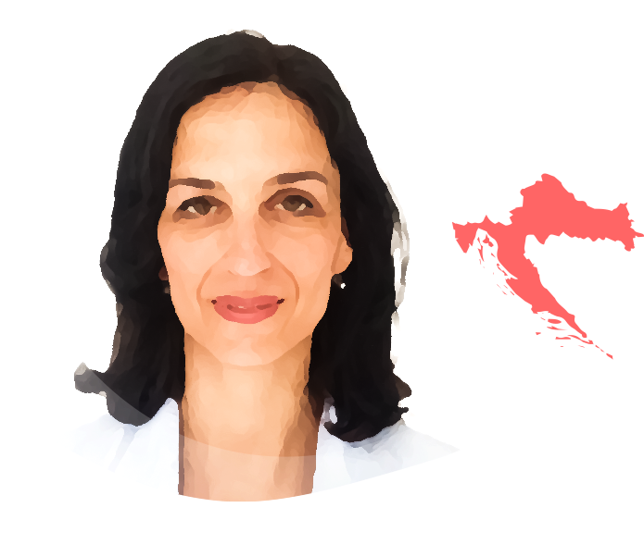

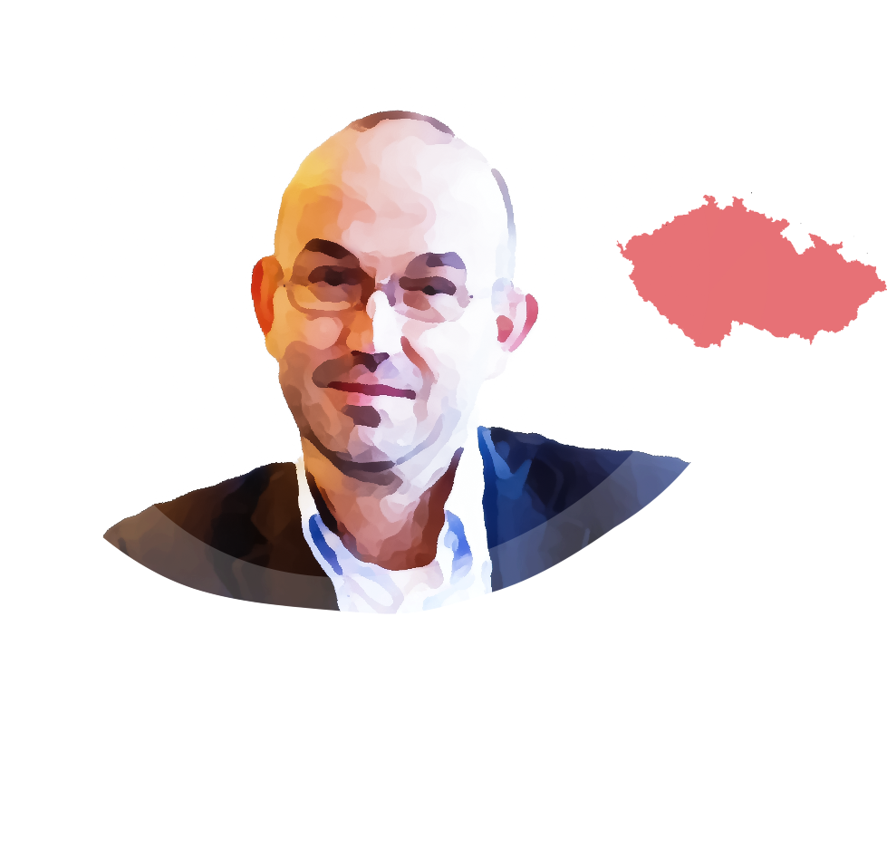
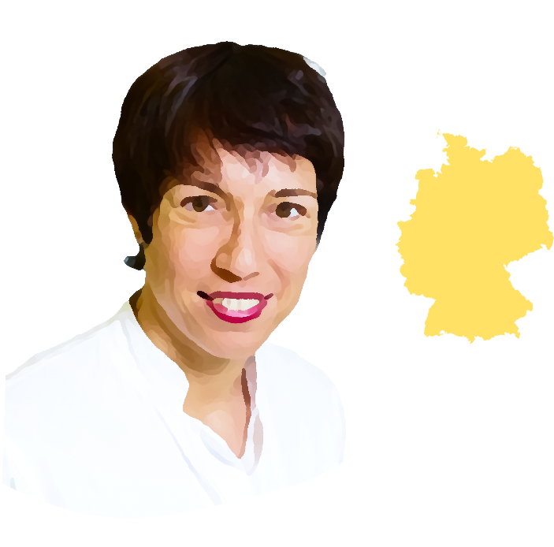
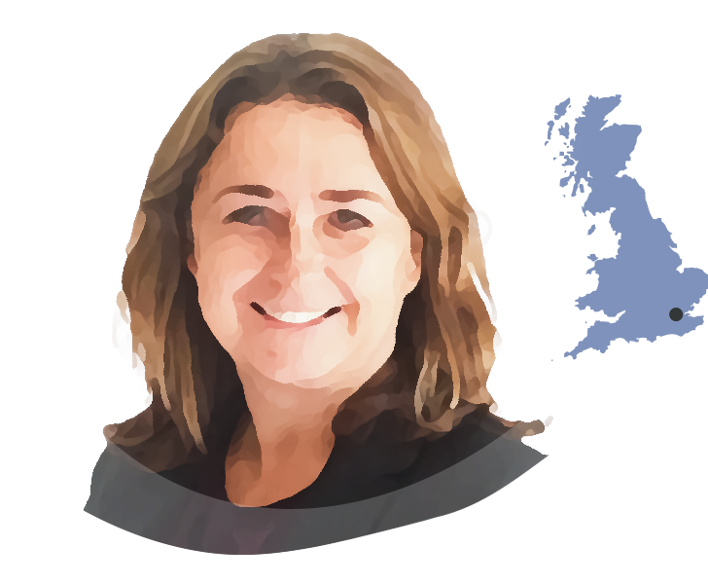
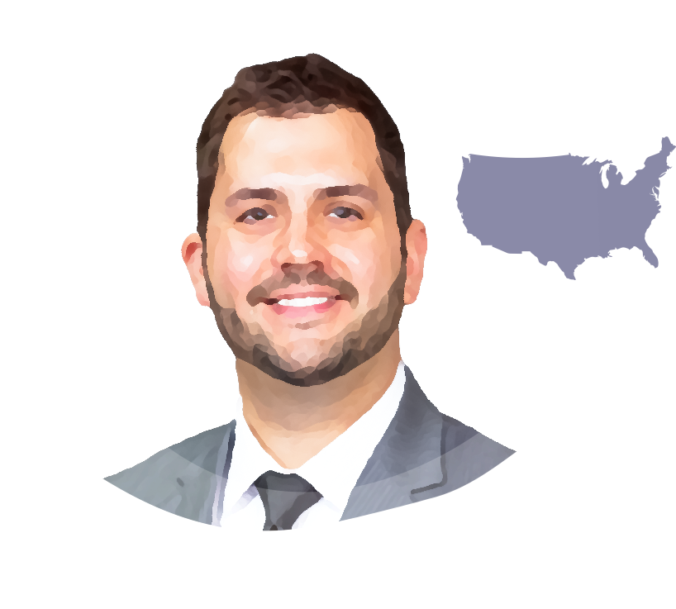
This micro e-learning module has been developed by a
multidisciplinary panel of experts
Dr. Gianluigi Pasta
Dr. Michael A. Mazzeffi
Dr. Alison Dougall
Prof. Ana Boban
IRELAND
ITALY
CROATIA
USA
Dental consultant medically complex patients at Dublin Dental Hospital
Director of doctorate programme in special care dentistry, Trinity College Dublin
Former chair of World Federation of Haemophilia Dental Committee
Medical advisory board member of European Haemophilia Consortium (EHC)
President of International Society for Disability and Oral Health
Orthopaedic consultant at the Haemophilia Centre at Fondazione IRCCS Policlinico San Matteo di Pavia
Chair of the Musculoskeletal Committee of the World Federation of Haemophilia (WFH)
Coordinator of Musculoskeletal Group of Italian Haemophilia Centres Association
Cardiothoracic anaesthesiologist and
intensive care physician
Executive vice chair and director of cardiac intensive care at George Washington University School of Medicine in Washington, DC
Head of Haemophilia Centre at the University Hospital Centre Zagreb
Professor of internal medicine at the School of Medicine of the University of Zagreb, Croatia
Specialist degrees in internal medicine and haematology
Executive committee member of the European Association for Haemophilia and Allied Disorders (EAHAD)
Dr. Med. Rosa Sonja Alesci
Prof. Jan Blatný
CZECH REPUBLIC
Dr. Vickie McDonald
GERMANY
Consultant Haematologist, director of Haemophilia Comprehensive Care Centre and medical director of Paediatrics at University Hospital in Brno
Associate professor of paediatrics at Masaryk University in Brno
Active member of International Society on Thrombosis and Haemostasis (ISTH), Vice president of EAHAD and MAG member of EHC
Paediatric coordinator of the Czech National Haemophilia Programme
Haematology consultant and health economist
Director of the IMD Blood Coagulation Centre in Bad Homburg/Frankfurt/Wiesbaden
Active member of German Society of Haematology and Oncology
Member of medical advisory board German Alliance for Security of Haemophilia
Dr. Jonathan C. Roberts
UK
USA
Consultant Haematologist at the Royal London Hospital, London
Honorary senior lecturer at Queen Mary University of London
National chief investigator for the UK immune thrombocytopenia (ITP) registry
Associate medical director and associate research director at the Bleeding & Clotting Disorders Institute (BCDI)
Assistant professor of Paediatrics and Medicine at the University of Illinois College of Medicine at Peoria in Peoria, IL
Haematologist with BCDI
The views expressed in this slide deck are the personal opinions of the experts.
They do not necessarily represent the views of the experts’ institutions or the rest of the HEMOSTASIS CONNECT group.
3

Slide 4


Von Willebrand disease
at a glance
Von Willebrand disease is the most common inherited bleeding disorder.¹
It is estimated to occur in 1 in 100-1000 people, although tertiary care referrals for von Willebrand disease occur at a much lower frequency (˜1 in 10,000)
von Willebrand disease occurs in men, women, and children
Von Willebrand disease is one of the most overlooked entities in everyday clinical practice.²
The complexity and heterogeneity of the disease and breadth of tests required for a formal diagnosis lead it to be under-diagnosed, over-diagnosed and misdiagnosed
Even if the diagnosis is made, von Willebrand disease is often underestimated.
It has a significant impact on quality of life and on the provision of any kind of other healthcare provided to the patient³
!
It is important not to miss von Willebrand disease
1. Bowman M, et al. J Thromb Haemost. 2010;8:213-6; 2. Colonne CK, et al. J Blood Med. 2021;12:755-68; 3. Sharma R, et al. Blood. 2017;130:2386-91
4

Slide 5

Von Willebrand disease is a disorder of primary haemostasis
Von Willebrand factor (VWF) binds to collagen at sites of vascular injury and mediates platelet adhesion and aggregation
Patients with von Willebrand disease have reduced levels of (functional) VWF, leading to defective platelet adhesion and aggregation
In patients with severe von Willebrand disease, secondary haemostasis can also be affected, as VWF is a carrier of Factor VIII
There are various types of von Willebrand disease
The multifunctional nature of VWF explains the heterogeneity in clinical symptoms and bleeding risk of von Willebrand disease, as well as the diagnostic challenges
Type 1
Quantitative disorder of VWF
Type 2
Qualitative and quantitative disorder of VWF
Various subtypes
Type 3
Absolute lack of VWF
Blood Flow
Blood Flow
Coiled
Inactive VWF
Inactivated
Platelet
Activated
Platelet
Uncoiled
Active VWF
Endothelial Cells
Endothelial Cells
Subendothelial Collagen
VWF, von Willebrand factor
Colonne CK, et al. J Blood Med. 2021;12:755-68; Leebeek FWG, Eikenboom JCJ. N Engl J Med. 2016;375:2067-80
5

Slide 6
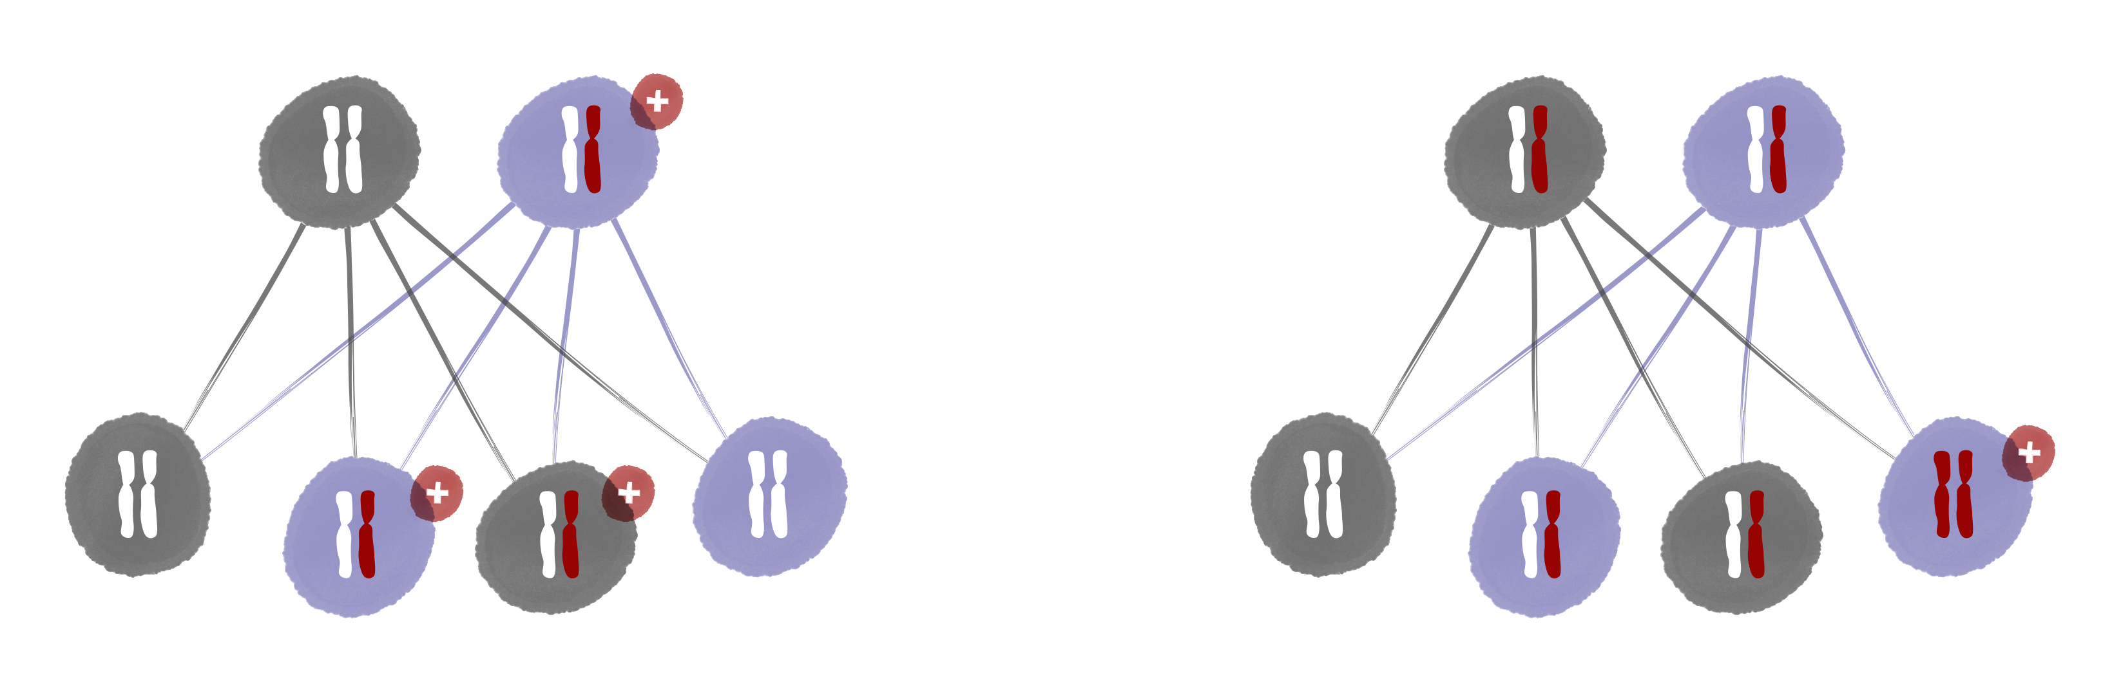
Von Willebrand disease is a hereditary disease that occurs in men and women
von Willebrand disease typically has an AUTOSOMAL DOMINANT pattern of inheritance
Type 3 von Willebrand disease typically has an AUTOSOMAL RECESSIVE pattern of inheritance
Father
Mother
Father
Mother
Unaffected
Affected
Carrier
Carrier
Son
Daughter
Son
Daughter
Unaffected
Daughter
Son
Unaffected
Unaffected
Daughter
Son
Affected
Affected
Affected
Carrier
Carrier
Although a genetic mutation is not commonly found in mild cases of von Willebrand disease, it is still a familial disorder
In rare cases, von Willebrand disease can be acquired later in life
Leebeek FWG, Eikenboom JCJ. N Engl J Med. 2016;375:2067-80; Eikenboom JC. Best Pract Res Clin Haematol. 2001;14:365-79; Mital A. Adv Clin Exp Med. 016;25:1337-44
6

Slide 7



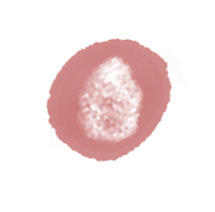












Signs and symptoms von Willebrand disease
General
Paediatric
Gynaecological
Family history of a bleeding disorder
Nosebleeds
Heavy menstrual bleeding, especially since menarche
Notable bruising without injury
Bleeding during teething in small children
Bleeding during ovulation
Prolonged/excessive bleeding,
even from minor wounds
Notable bruising without injury
Primary and late post-partum haemorrhage
Dental
Excessive bleeding from minor wounds
Surgical
Prolonged bleeding following
invasive dental procedures
Joint pain and/or bleeds
ENT
Prolonged bleeding from the gums following deep cleaning
Prolonged and/or severe bleeding after minor or major surgery
Nosebleeds
Recurrent ulcers and pallor of the mucosa associated with anaemia
Severe (potentially life-threatening)
bleeding after tonsillectomy/adenoidectomy
Gastrointestinal
Bleeding of gastrointestinal tract with or without an obvious anatomic lesion in adults
Von Willebrand disease is mainly a disorder of primary haemostasis,
so the bleeding starts quickly, not delayed like in haemophilia
ENT, ear, nose, and throat
This slide is based on the clinical experience of the authors
7

Slide 8


Next steps
when suspecting von Willebrand disease
It is not easy to diagnose von Willebrand disease, as there is a large variability in symptoms and interpretation of laboratory tests is complex.
When suspecting von Willebrand disease, refer the patient to a haematologist for diagnostic laboratory assessment.
Please refer to the other modules of this micro e-learning programme for more information on:
  Module 2: Screening and next steps
  Module 3: A multidisciplinary approach: impact of
  von Willebrand disease on the provision of general care
8

Slide 9




Summary
von Willebrand disease is the most common inherited bleeding disorder, occurring in men, women and children
Signs and symptoms of von Willebrand disease include easy bruising, heavy menstrual bleeding, nosebleeds and prolonged bleeding after surgery
When suspecting von Willebrand disease, refer to a haematologist for diagnostic laboratory assessment
9

Slide 10


Next steps
Please now proceed to the assessment quiz in the e-learning to test your knowledge.
Visit Module 2 of this micro e-learning programme to learn more about:
how you can help diagnose von Willebrand disease
how to effectively use the screening tools available
the next steps to take when suspecting von Willebrand disease
Visit Module 3 of this micro e-learning programme to learn more about:
the impact of von Willebrand disease on provision of general care
the key aspects of von Willebrand disease affecting your clinical practice
the importance of a multidisciplinary approach
Note: you will be able to claim your CME credit after passing at least 2 of the 3 modules
CME credit available
Visit programme home page on:
10

