Slide 2
Gum bleeding and von Willebrand disease
What lies beneath
Dr. Alison Dougall, BChD, MA, MSc, ScD – Dentist
Dublin Dental Hospital and Trinity College Dublin, Ireland
Dr. Rosa Sonja Alesci, MD, PhD – Haematologist
IMD Blood Coagulation Centre Hochtaunus,
Bad Homburg/Frankfurt/Wiesbaden, Germany
JULY 2021

Slide 3
Conflict of interest and funding
This HEMOSTASIS CONNECT programme is supported through independent educational grant from Takeda. The programme is therefore independent, the content is not influenced by the supporters and is under the sole responsibility of the experts.
Please note: The views expressed within this presentation are the personal opinions of the authors.
They do not necessarily represent the views of the author’s academic institution, or the rest of the HEMOSTASIS CONNECT group.
Dr. Rosa Sonja Alesci has received financial support/sponsorship for research support, consultation, or speaker fees from the following companies:
Amgen, Bayer, CSL Behring, Grifols, Novartis, Novo Nordisk, Pfizer, Sobi, Takeda
Dr. Alison Dougall has received financial support/sponsorship for research support, consultation, or speaker fees from the following companies:
Roche Pharmaceuticals

Slide 4
von willebrand disease

Slide 5
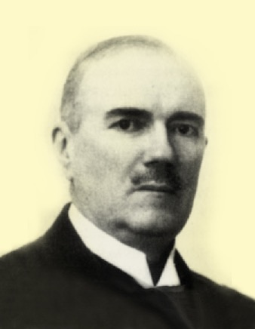
von Willebrand Disease (VWD)
VWD was first described in 1926 by the Finnish professor Erik Adolf von Willebrand
VWD is the most common haemorrhagic disease
  Occurs in 1% of the European population
The diagnosis is not easy
  There is a large variability in symptoms, even between age groups
  Many patients with VWD do not need regular treatment
James AH. Thromb Res. 2009;124 Suppl 1:S7-10; Nilsson IM. Haemophilia. 1999;5 Suppl 2:7-11;
Schneppenheim R, Budde U. Von Willebrand-Syndrom. In: Hämostaseologie für die Praxis. Schattauer 2007
Notes:
5
5

Slide 6
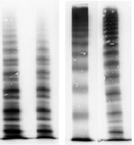

There are different types of VWD
Type 1
Type 2
Type 3
  VWF deficiency
  (quantitative change)
  Multimers normal
  Qualitative changes of VWF, with or without quantitative changes
  Several subtypes
    2A: large and medium-sized multimers decreased, decreased activity
    2B: increased binding to platelets
    2M: binding site defect (collagen, GPIb)
    2N: FVIII-binding defect
  Qualitative and quantitative changes of VWF
The current ‘gold standard’ for classifying VWD is the evaluation of VWF multimers
All types of VWD lead to an increased bleeding tendency
Significant gum bleeding occurs very often in patients with VWD
FVIII, factor VIII; GPIb, glycoprotein Ib; VWD, von Willebrand disease; VWF, von Willebrand factor
Budde U. Haemophilia. 2008;14 Suppl 5:27-38; Schneppenheim R, Budde U. von Willebrand-Syndrom und von Willebrand-Faktor. UniMed 2006
Notes:
6

Slide 7
The Diagnosis of VWD
Clinical aspects
Bleeding symptoms (ranked)
  Easy bruising
  Epistaxis (childhood)
  Menorrhagia
  Bleeding after tooth extraction
  Bleeding of small wounds
  Gum bleeding
  Post operative bleeding
  Post-partum bleeding
  Gastrointestinal bleeding
  Haemarthrosis
  Intracerebral bleeding
Family history!
Lab tests
Ristocetin-Cofactor (VWF:RICO) or Ristocetin activity
VWF antigen levels (VWF:Ag)
aPTT, PT
FVIII, FVIII:C
In vitro bleeding time (PFA-100)
VWF multimer analysis (gel electrophoresis)
To determine subtype:
  Type 2B: ristocetin-induced platelet aggregation (RIPA)
  Type 2M: Collagen binding activity (VWF:CBA)
  Type 2N: FVIII-binding capacity
  Unclear cases/Type 3: Genetic analysis
  Suspicion of an acquired VWD: antibodies
aPTT, activated partial thromboplastin time; FVIII, factor VIII; FVIII:C, factor VIII clotting assay; PFA, platelet function analyser; PT, prothrombin time; VWD, von Willebrand disease; VWF, von Willebrand factor
Federici AB, et al. Haemophilia. 2002;8:607-21
Notes:
7

Slide 8
Most common clinical symptoms
Note that a patient with VWD does not need to show all symptoms
Easy bruising
Menorrhagia
Epistaxis (mostly in childhood)
Mucosal bleedings
Gum bleeding and oozing in the oral cavity
VWD, von Willebrand disease
Federici AB, et al. Haemophilia. 2002;8:607-21; Schneppenheim R, Budde U. von Willebrand-Syndrom und von Willebrand-Faktor. UniMed 2006
Notes:
8
8

Slide 9
Treatment of VWD – DDAVP (desmopressin)
DDAVP (desmopressin) is mostly used for
Type 1 and 2A
It can be used intravenously or nasal
  0.3-0.4 µg/kg in 50-100 ml NaCl, slowly infused in approx. 30-45 minutes
Risks:
  Tachyphylaxis
  Seizures due to hyponatraemia
  Patients should not drink too much (~1.5 L/day)
(Relative) contraindications:
  High blood pressure
  Coronary artery disease
  State after apoplexy
  Age <2 and >70 years
  Migraine
  Renal insufficiency, hydrocephalus
  Disturbed water balance
  Certain medications
NaCl, sodium chloride; VWD, von Willebrand disease
Connell NT, et al. Blood Adv. 2021;5:301-25; Desmopressin (Minrin) SmPC. September 2016
Notes:
9

Slide 10
Treatment of VWD – FVIII-VWF concentrate
Used on demand or as prophylaxis
Useful for
  Surgery
  Severe bleeding (post-trauma , postpartum...)
Dosage and duration depend on type of surgery (goal ≥0.50 IU/mL)
  Mostly dosed at 60-80 IU/kg, ideally 30 minutes before surgery
  Maintenance dose is usually 40-60 IU/kg
  1 unit raises VWF with approx. 1%
Postoperative anticoagulation is recommended in most cases because VWD does not protect against thrombosis
FVIII, factor VIII; VWD, von Willebrand disease; VWF, von Willebrand factor
Connell NT, et al. Blood Adv. 2021;5:301-25
Notes:
10

Slide 11
Gum disease

Slide 12
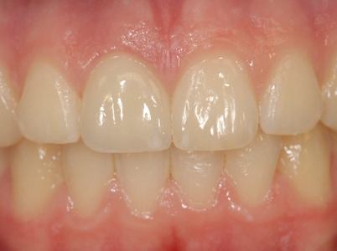
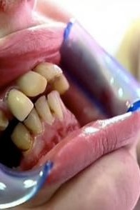
Oral health has a major impact on quality of life and the general health
The value of a healthy mouth
  Confidence and self-esteem
  Prevents pain and infection
  Ability to chew healthy food
  No negative effect on general health
Most oral disease is preventable and risk factors are modifiable

Slide 13
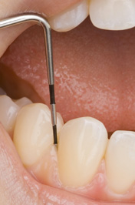
Healthy and diseased gum
Healthy gums are pink, firm and tightly bound to the underlying periosteum
  A probe will advance ~1-2 mm into a small sulcus
Even in VWD or severe thrombocytopenia healthy gums do not bleed when probed
VWD, von Willebrand disease

Slide 14
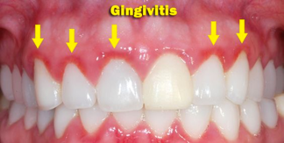
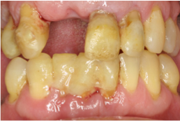
periodontal disease is the underlying problem of gum bleeding
Nearly half of the adults >30 years old in the United States have periodontal disease¹
The early stages of periodontal disease are often symptomless²
  Diagnosis is frequently delayed until symptoms of periodontal breakdown emerge
  Low awareness increases the burden, cost and morbidity
  Severe periodontitis (5-20% of adults) leads to tooth loss and systemic effects
  Risk factors for chronic periodontal disease^{2,3}
Persistent poor oral hygiene
Social determinants
Smoking
Comorbidity: diabetes, RA, immune suppression
Obesity, malnutrition
Poly-pharmacy
Increasing
age
RA, rheumatoid arthritis
1. Eke PI, et al. J Periodontol. 2015;86:611-22; 2. Jin LJ, et al. Adv Dent Res. 2011;23:221-6; 3. Petersen PE and Ogawa H. Periodontol. 2000. 2012;60:15-39

Slide 15
Oral health and von willebrand disease

Slide 16

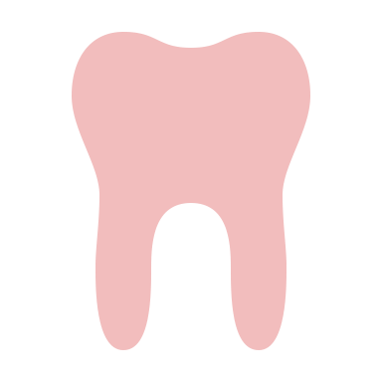

Gum bleeding is a neglected problem in patients with bleeding disorders
Gum bleeding is common, but often ignored in patients with VWD
Both healthcare professionals and patients think the bleeding caused by the VWD itself and it is considered acceptable
Because patients believe gum bleeding is a symptom of their bleeding disorder, their periodontal disease remains untreated
Studies in haemophilia showed patients even stopped brushing their teeth in the presence of gingivitis, as they attributed the gum bleeding to their bleeding disorder
VWD, von Willebrand disease
Carcao MD, et al. Haemophilia. 2010;16:943-8; Gilbert AD and Nuttall NM. Br Dent J. 1999;186:241-4; Hitchings EJ. N Z Dent J. 2011;107:4-11; Noone D, et al. Haemophilia. 2021;27 Issue S2:143. EAHAD 2021. Abstract #ABS221

Slide 17
Gum Bleeding in VWD
Low von Willebrand in Ireland Cohort (LoVIC) study
48% (76/159) of adults with low VWF levels in the LoVIC study experienced oral bleeding
80% (24/30) of patients enrolled in a LoVIC sub study reported oral cavity bleeding
  13% required consultation
  In all patients, a personalised oral hygiene intervention resulted in highly significant reductions in objective bleeding and plaque scores
The current oral cavity bleeding component of the ISTH Bleeding Assessment Tool lacks specificity for bleeding disorders and may reinforce perceptions that bleeding is related to the bleeding disorder rather than gingivitis
ISTH, International Society on Thrombosis and Haemostasis; VWD, von Willebrand disease; VWF, von Willebrand factor
Dougall A, et al. Res Pract Thromb Haemost. 2020;4 (Suppl 1). ISTH 2020. Abstract #PB1595

Slide 18
Gum bleeding is preventable
Gum bleeding is not associated with the bleeding disorder but with plaque biofilm levels
A proper oral hygiene regimen can reduce or eliminate gum bleeding
  Brush the whole mouth systematically twice a day
    Brush the teeth and the gums
    Use a medium or soft brush and fluoridated toothpaste
    Leave toothpaste on the teeth: spit it out but don’t rinse with mouthwash or water
  Chlorhexidine can decrease the bacterial load
    A meta-analysis of 13 randomised controlled trials showed chlorhexidine mouthwash reduces plaque and gingivitis by 33% and 26%, respectively¹
Use motivational interviewing to stimulate patients to maintain a good oral hygiene
  The dental hygienist can play an important role
1. Herrera D. Evid Based Dent. 2013;14:17-8

Slide 19
Practical considerations in Dental care for patients with vwd
Education for patients
Give patients ‘permission’ to brush and floss teeth, as they are often scared to do so
Recommend evidence-based preventive therapeutic agents and interventions
Education for the multidisciplinary team
Paradigm shift regarding perceptions of gum bleeding
Collect data
Oral health related quality of life data are lacking for patients with VWD
This means the voice of the patient is missing
VWD, von Willebrand disease

Slide 20
Dental procedures can safely be performed in patients with VWD
With appropriate measures taken, dental procedures can be safely performed in patients with VWD
  In order to safely provide dental care and improve outcomes, it is crucial for haematologists and dentist to
  work together to risk assess and plan safe effective dental interventions
Systemic and/or local measures should be taken to mitigate the bleeding risk and to treat any bleeding
Systemic measures
Antifibrinolytics: tranexamic acid
One or two 500-mg tablets, three times/day
VWF/FVIII concentrate
DDAVP (desmopressin)
Local measures
during the procedure
Local anaesthetic with adrenaline
Scaffolding agents to stabilise
the clot
Stitches to hold the pack in and stitch the wound
Local measures
after the procedure
Pressure on wound
Do not disturb the clot
Soft diet, no smoking, gentle saltwater rinses, soft toothbrush, no vigorous rinsing
Start at least 4 hours before
Continued for 5 days after
The bleeding should stop after 20-30 minutes
Healing takes at least a week
FVIII, factor VIII; VWD, von Willebrand disease; VWF, von Willebrand factor
Connell NT, et al. Blood Adv. 2021;5:301-25; Srivastava A, et al. Haemophilia. 2020;26 Suppl 6:1-158; Tranexamic acid (Cyklo-f) SmPC. July 2020

Slide 21
Pain medication in patients with VWD
No NSAIDs or aspirin as they influence platelet function
This means many drugs are allowed
For dental surgery, paracetamol and a
COX-2 inhibitor can be used for pain relief
COX-2, cyclooxygenase-2
Srivastava A, et al. Haemophilia. 2020;26 Suppl 6:1-158

Slide 22
Practical aspects of dental procedures in patients with VWD
Multidisciplinary approach is needed for dental procedures, involving the patient, dentist and haematologist
Planning
  In the beginning of the week
  In the morning rather than in the evening
What kind of treatment does the patient need?
  Take your time to explain to patients how to use tranexamic acid
  When using DDAVP (desmopressin), discuss the amount of drinking with patients
  Discuss pain medication with patients
  Who substitutes factor concentrate if needed? And what if a second dose is needed?
Patients should have an emergency card with telephone numbers
VWD, von Willebrand disease

Slide 23
Recommended Further reading
Gingival bleeding in patients with type 1 VWD | VWD was not associated with a more pronounced inflammatory response to the oral biofilm in terms of Gingival Bleeding Index and bleeding on probing
 | Weickert L, et al. Is gingival bleeding a symptom of patients with type 1 von Willebrand disease? A case-control study. J Clin Periodontol. 2014;41:766-71
Dental disease in children with type 3 VWD | 12/17 children (1-17 years old) had undergone dental procedures, which is much higher than in the normal paediatric population. Better preventive dental care needs to be provided to avoid the considerable morbidity and very high burden of dental disease in type 3 VWD
 | Carcao MD, et al. Dental disease in type 3 von Willebrand disease: a neglected problem. Haemophilia. 2010;16:943-8
2019 Cochrane review: antifibrinolytic therapy in patients with haemophilia or VWD undergoing oral surgery or dental extractions | There seems to be a beneficial effect of tranexamic acid in preventing postoperative bleeding in people with haemophilia undergoing dental extraction, but the data are too limited to draw definitive conclusions (two trials in haemophilia and none in VWD)
 | van Galen KP, et al. Antifibrinolytic therapy for preventing oral bleeding in patients with haemophilia or Von Willebrand disease undergoing minor oral surgery or dental extractions. Cochrane Database Syst Rev. 2019;4:CD011385
2020 WFH guidelines on the management of haemophilia | Includes guidance on dental care inpatients with with haemophilia
 | Srivastava A, et al. WFH Guidelines for the Management of Hemophilia, 3rd edition. Haemophilia. 2020;26 Suppl 6:1-158
2021 guidelines on the management of VWD, from the ASH, ISTH, NHF and WFH | Includes guidance on dental procedures in patients with VWD
 | Connell NT, et al. ASH ISTH NHF WFH 2021 guidelines on the management of von Willebrand disease. Blood Adv. 2021;5:301-25
ASH, American Society of Hematology; ISTH, International Society on Thrombosis and Haemostasis; NHF, National Hemophilia Foundation; VWD, von Willebrand disease; WFH, World Federation of Hemophilia

