Slide 2
Antibody-drug conjugates in urothelial cancer and an overview in other genitourinary cancers
Sandy Srinivas, MD
Stanford University Medical Center
California, USA
July 2020

Slide 3
DISCLAIMER AND DISCLOSURES
Please note:
The views expressed within this presentation are the personal opinions of the author. They do not necessarily represent the views of the author’s academic institution or the rest of the GU CONNECT group.
This content is supported by an Independent Educational Grant from Bayer.
Dr. Sandy Srinivas has received financial support/sponsorship for research support, consultation or speaker fees from the following companies:
Eisai, Janssen, Bayer, Genentech, Merck

Slide 4
Antibody-drug conjugates: Background
Antibody Drug Conjugates (ADCs) are an emerging class of targeted anticancer drug delivery agent that confer selective and sustained cytotoxic drug delivery to tumours
ADCs are structured from three main structural units:
  monoclonal antibody against a specific target
  linker molecule
  Payloads: cytotoxic agent or drug
Selection of an appropriate target, a monoclonal antibody, cytotoxic payload, and the manner in which the antibody is linked to the payload are key determinants of the safety and efficacy of ADCs
Sau S, et al. Drug Discovery Today 2017;22:1547-1556

Slide 5
Antibody-Drug Conjugates for
Urothelial cancers

Slide 6
background
Patients with mUC who progress after platinum-based chemotherapy
and immune checkpoint inhibitors have poor outcomes and limited
treatment options
UC is characterised by the expression of multiple cell surface antigens suitable for specific therapeutic targeting with antibody-drug conjugates (ADCs)
Two ADCs in advanced development for advanced urothelial cancer:
  Enfortumab vedotin (recently FDA approved)
  Sacituzumab govitecan (late stage development)
ADC, Antibody drug conjugate; mUC, metastatic urothelial cancer; UC, urothelial cancer
Tagawa S, et al. Journal of Clinical Oncology 2019;37(7_suppl):354; Vlachostergios P, et al. Bladder Cancer 2018;4(3):247-259;
Enfortumab vedotin Prescribing Information Dec 2019

Slide 7
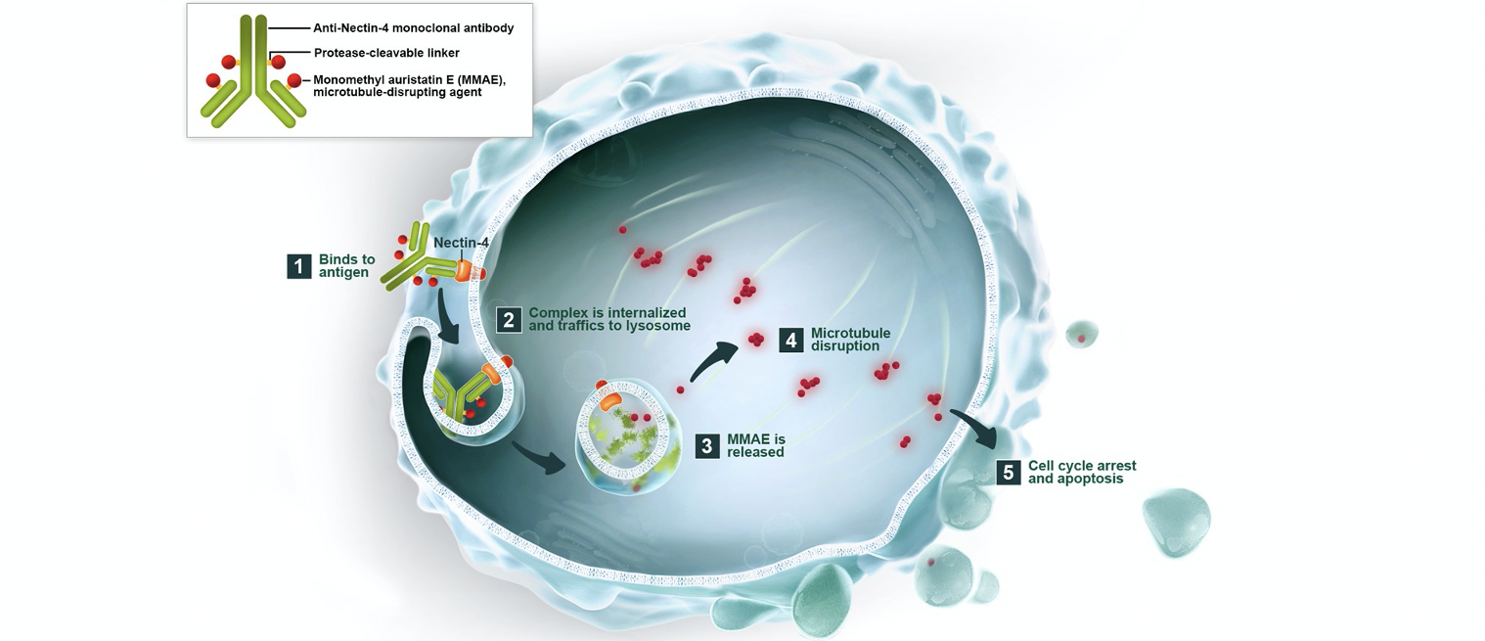
Enfortumab Vedotin
Immuno-drug Conjugate
Antibody target: Nectin-4
Linker: Protease Cleavable
Payload: MMAE - microtubule
disrupting agent
EV-101 phase 1 study – initial assessment of efficacy and safety:
112 patients
ORR: 43%
PFS: 5.4 months
MMAE, monomethyl auristatin E; ORR, objective response rate; PFS, progression free survival
Rosenberg J, et al. Journal of Clinical Oncology 2020;38(10):1041-1049; https://www.seattlegenetics.com/pipeline/enfortumab-vedotin. Accessed 02Jul2020

Slide 8
EV-201 Study Design
Single arm, pivotal phase 2 trial
Cohort 2
Prior PD-1/L1 inhibitor, platinum naïve,
cisplatin ineligible
Enrolment ongoing
Enfortumab vedotin
1.25 mg/kg IV on
days 1, 8, and 15
of each 28-day cycle
Primary endpoint:
ORR per RECIST v1.1
as determined by BICR
Select secondary endpoints:
DOR
PFS
OS
Safety
Screening and enrollment
51 global sites
Previously treated locally advanced or metastatic urothelial cancer
Cohort 1
Prior PD-1/L1 inhibitor and platinum-based therapy
Enrolment completed
July 2018
N=128¹
¹3 patients did not receive enfortumab vedotin treatment: one each due to clinical deterioration, patient decision, and low haemoglobin after enrolment
BICR, blinded independent central review; DOR, duration of response; IV, intravenous; ORR, objective response rate;
OS, overall survival; PD-1/L1, programmed cell death 1/programmed cell death ligand 1; PFS, progression free survival; RECIST, Response Evaluation Criteria in Solid Tumors
Petrylak D, et al. Journal of Clinical Oncology 2019;37(18_suppl):4505; Rosenberg JE, et al. Journal of Clinical Oncology 2019;37(29):2592-2600

Slide 9
EV-201: Cohort 1
Demographics and Disease Characteristics
 | Patients (N=125)
Male sex, n (%) | 88 (70)
Age, years
Median (min, max) | 69 (40,84)
≥75 years, n (%) | 34 (27)
ECOG PS of 1, n (%) | 85 (68)
Primary tumour location, n (%)
Bladder/other | 81 (65)
Upper tract | 44 (35)
Number of prior systemic therapies¹, median (min,max) | 3 (1, 6)
≥2 Bellmunt adverse prognostic factors | 52 (42)
Metastasis sites, n (%)
Lymph nodes only | 13 (10)
Visceral disease | 112 (90)
Liver | 50 (40)
PD-L1 status by combined positive score²
<10 | 78/120 (65)
≥10 | 42/120 (35)
¹Patients with 1 prior therapy had platinum and a PD-1/L1 inhibitor in combination; ²Five patients were not evaluable for PD-L1
ECOG, Eastern Cooperative Oncology Group; PD-L1, programmed cell death ligand 1
Petrylak D, et al. Journal of Clinical Oncology 2019;37(18_suppl):4505; Rosenberg JE, et al. Journal of Clinical Oncology 2019;37(29):2592-2600.

Slide 10
EV-201: Response Rates
EV-201 results highly consistent with phase 1 EV-101 trial in same patient population
COHORT 1 ORR per RECIST v 1.1 assessed by BICR | Patients (N=125)
Confirmed objective response rate, n (%) 95% confidence interval¹ | 55 (44) (35.1, 53.2)
Best overall response per RECIST v. 1.1, n (%)
Complete response | 15 (12)
Partial response | 40 (32)
Stable disease | 35 (28)
Progressive disease | 23 (18)
Not evaluable² | 12 (10)
¹Computed using the Clopper-Pearson method; ²Includes 10 patients who discontinued study prior to post-baseline response assessment, 1 patient who had uninterpretable post-baseline assessment and 1 patient whose post-baseline assessment did not meet the minimum interval requirement for stable disease
BICR, blinded independent central review; RECIST, Response Evaluation Criteria In Solid Tumors
Petrylak D, et al. Journal of Clinical Oncology 2019;37(18_suppl):4505; Rosenberg JE, et al. Journal of Clinical Oncology 2019;37(29):2592-2600

Slide 11
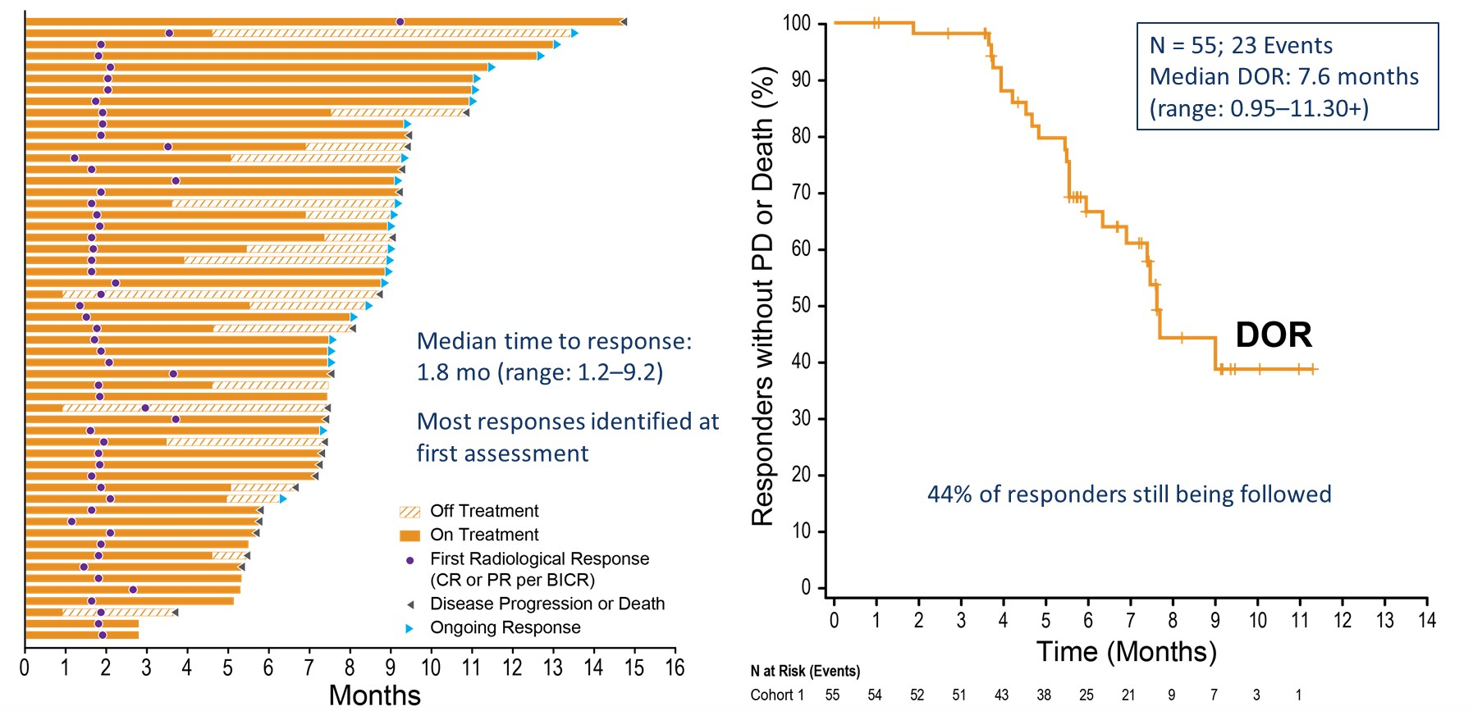
EV-201: Duration of response
Ev-201: cohort 1 duration of response with
enfortumab vedotin
At the time of analysis, 44% of responders had ongoing responses
BICR, blinded independent central review; CR, complete response; DOR, duration of response; PR, partial response
Petrylak D, et al. Journal of Clinical Oncology 2019;37(18_suppl):4505; Rosenberg JE, et al. Journal of Clinical Oncology 2019;37(29):2592-2600

Slide 12
EV-201: Treatment Related
Adverse Events
Cohort 1 Treatment-related AEs by preferred term in ≥20% of patients (any Grade)^{1,2} | Patients (N=125) n (%)
 | Any Grade | ≥Grade 3
Fatigue | 62 (50) | 7 (6)
Alopecia | 61 (49) | 0
Decreased appetite | 55 (44) | 1 (1)
Dysgeusia | 50 (40) | 0
Peripheral sensory neuropathy | 50 (40) | 2 (2)
Nausea | 49 (39) | 3 (2)
Diarrhoea | 40 (32) | 3 (2)
Dry skin | 28 (22) | 0
Weight decreased | 28 (22) | 1 (1)
Rash maculo-popular | 27 (22) | 5 (4)
Most common adverse reactions (≥ 20%) included fatigue, peripheral neuropathy, decreased appetite, rash, alopecia, nausea, dysgeusia, diarrhea, dry eye, pruritus and dry skin³
Recommend holding treatment if blood glucose >250mg/dL³
Permanently discontinue for peripheral neuropathy ≥ grade 3³
AEs, adverse events
1. Petrylak D, et al. Journal of Clinical Oncology 2019;37(18_suppl):4505; 2. Rosenberg JE, et al. Journal of Clinical Oncology 2019;37(29):2592-2600; 3. Enfortumab vedotin prescribing information, Dec 2019

Slide 13
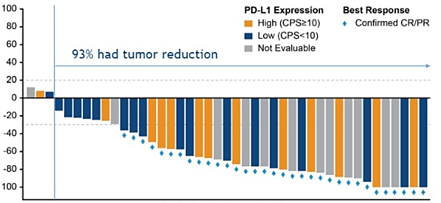
EV-103: EV plus pembrolizumab in first line cisplatin-ineligible mUC patients
Maximal target lesion reduction by PD-L1 status and best response
Objective response rate
Responses observed regardless of PD-L1 expression level
Best overall response by RECIST v 1.1 (Investigator assessed), N=45
Confirmed ORR 95% CI | 73.3% (33/45) (58.1, 85.4)
CR | 15.6% (7/45)
PR | 57.8% (26/45)
93% had tumour reduction
Tumour size (% Change from Baseline)
Individual Patients (n=43)
The horizontal lines at positive 20% and negative 30% denote thresholds for target lesions for disease progression and response, respectively
CI, confidence interval; CPS, combined positive score; CR, complete response; EV, enfortumab vedotin; mUC, metastatic urothelial carcinoma; ORR, objective response rate; PD-L1, Programmed death-ligand 1; PR, partial response; RECIST, Response Evaluation Criteria In Solid Tumors
Rosenberg JE, et al. Journal of Clinical Oncology 2020, 38,suppl 6: abstr 441

Slide 14
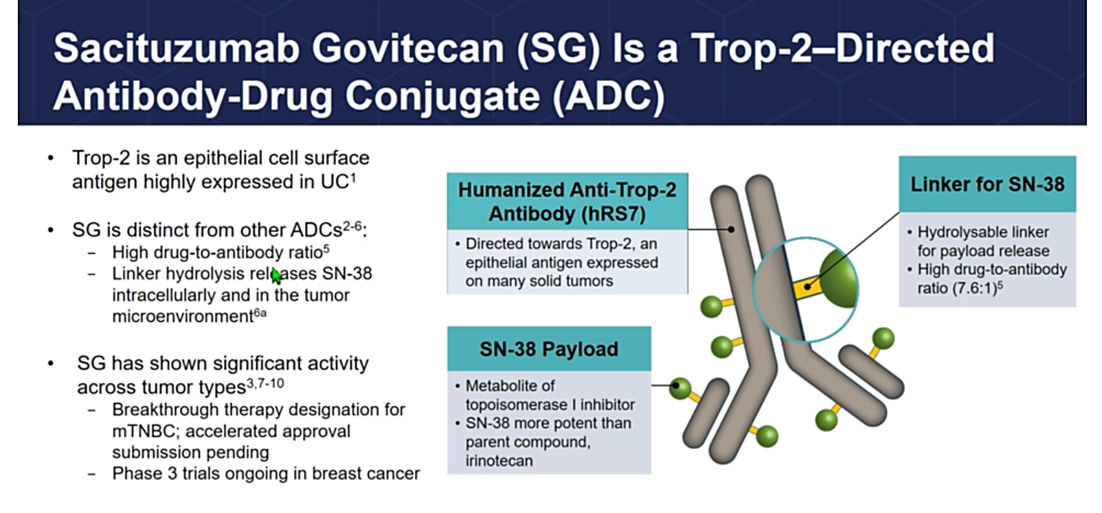
Sacituzumab Govitecan
Antibody target: Trop-2
Linker: Hydrolysable linker
Payload: SN-38-parent compound - irinotecan
Trop-2 is an epithelial cell surface antigen highly expressed in UC
Shown activity across multiple tumour types: NSCLC, SCLC, mTNBC
Humanised Anti-Trop-2 Antibody (hRS7)
Directed towards Trop-2, an epithelial antigen expressed on many solid tumours
Linker for SN-38
Hydrolysable linker for payload release High drug-to-antibody ratio (7.6:1)
SN-38 Payload
Metabolite of topoisomerase I inhibitor SN-38 more potent than parent compound, irinotecan
ADC, antibody drug conjugate; mTNBC, metastatic triple-negative breast cancer; NSCLC, non-small cell lung cancer; SCLC, small cell lung cancer; UC, urothelial cancer
Tagawa S, et al. Annals of Oncology 2019;30(suppl_5):v851-v934; Rugo S, et al. Future Medicine 2020; doi:10.2217/fon-2020-0163

Slide 15
Sacituzumab studies
IMMU-132 Phase 1 study¹
  Initial assessment of efficacy and safety in 45 mUC patient's pts who progressed after ≥1 prior systemic therapy
  ORR 31%
  Grade ≥3 AEs in ≥5% of pts were neutropenia/neutrophil count decreased (38%), anaemia (11%), hypophosphatemia (11%), diarrhoea (9%), fatigue (9%), and febrile neutropenia (7%).
TROPHY-U-01 : Phase 2 ongoing study²
  35 patients post platinum and post CPI included in interim analysis
  ORR 29%; CR 6%
TROPHY-U-01: TRAE ≥ 20% Any grade or ≥ 5% grade ≥3 (N=35)
Category | Event | All Grades (%) | Grade 3 (%) | Grade 4 (%)
Hematologic | Neutropenia | 66 | 29 | 26
 | Leukopenia | 40 | 20 | 9
 | Anaemia | 34 | 17 | 0
 | Febrile neutropenia | 11 | 9 | 3
 | Lymphocyte count decreased | 11 | 6 | 3
Gastrointestinal | Diarrhoea | 57 | 6 | 3
 | Nausea | 43 | 0 | 0
 | Abdominal pain | 20 | 3 | 0
General disorders & administrative site conditions | Fatigue | 54 | 6 | 0
Infections & infestations | Urinary tract infection | 14 | 11 | 0
Skin & subcutaneous tissue | Alopecia | 74 | 0 | 0
Metabolism & nutrition | Decreased appetite | 20 | 0 | 0
AE, adverse event; CPI, checkpoint inhibitors; CR, complete response; ORR, objective response rate; TRAE, treatment related adverse event
1. Tagawa S, et al. Journal of Clinical Oncology 2019;37(7_suppl):354; 2. Tagawa S, et al. Annals of Oncology 2019; 30 (suppl_5): v851-v934

Slide 16
ConclusionS
Immuno-drug conjugates are a new class of drugs in urothelial cancer
Enfortumab vedotin approved in advanced or metastatic urothelial cancer post platinum, post checkpoint inhibitor
Promising data of enfortumab in first line in combination with check
point inhibitors
Ongoing studies with sacituzumab govitecan which targets Trop-2
Await larger phase 3 confirmatory studies
Enfortumab vedotin Prescribing Information Dec 2019; Sau S, et al. Drug Discov Today 2017;22:1547-1556; Tagawa S, et al. Annals of Oncology 2019; 30 (suppl_5): v851-v934; Vlachostergios P, et al. Bladder Cancer 2018;4(3):247-259; Rosenberg JE, et al. Journal of Clinical Oncology 2020, 38,suppl 6: abstr 441

Slide 17
Antibody-Drug Conjugates for other genitourinary cancers

Slide 18
Antibody-Drug Conjugates in other GU tumour types
Prostate Cancer¹
  Prostate-specific membrane antigen (PSMA) is over expressed on the surface of cancer cells and is therefore a suitable target for selective drug delivery through conjugated antibodies
  There are a number of PSMA-ADC drugs in development for mCRPC that have shown promising activity in phase I/II trials
  Clinical trials are ongoing to investigate the effects of sacituzumab govitecan which targets TROP-2 in patients with mCRPC (NCT03725761)²
Renal Cell Carcinoma³
  ENPP3 is a novel target specific to renal cell carcinoma (RCC) with minimal expression in normal tissue
    ADCs targeting ENPP3 in initial human studies warrant further investigation
  Other antigen targets for ADCs under investigation in RCC include: CD70, CD27L, TIM-1^{4,5}
ADC, Antibody drug conjugate; CD, cluster of differentiation;ENPP3, ectonucleotide pyrophosphatase/phosphodiesterase 3; GU, genitourinary; IL, interleukin; mCRPC, metastatic castration resistant prostate cancer; PSMA, prostate-specific membrane antigen; TIM-1, T-cell immunoglobulin and mucin domain 1
1. Niaz M, et al. Cureus 2020;12(2):e7147. doi:10.7759/cureus.7147; 2. www.clinicaltrials.gov; 3. Thompson J, et al. Clinical Cancer Research 2018;24(18):4399-4406; 4. Sau S, et al. Drug Discov Today 2017;22:1547-1556; 5. Thomas L, et al. Mol Cancer Ther 2016;15(12):2946-2954

Slide 19

REACH GU CONNECT VIA
TWITTER, LINKEDIN, VIMEO & EMAIL
OR VISIT THE GROUP’S WEBSITE http://www.guconnect.info
Follow us on Twitter
@guconnectinfo
Follow the
GU CONNECT
group on LinkedIn
Watch us on the
Vimeo Channel
GU CONNECT
Email
elaine.wills@cor2ed.com

Slide 20
Dr. Antoine Lacombe
Pharm D, MBA
Phone: +41 79 529 42 79
antoine.lacombe@cor2ed.com
Dr. Froukje Sosef
MD
Phone: +31 6 2324 3636
froukje.sosef@cor2ed.com

