Slide 2
Highlights of 2021 from gu connect
Prof. David Pfister, MD
Professor and Deputy Director of The Department of Urology,
University Hospital of Cologne, Germany
DECEMBER 2021
Notes:
Prof. David Pfister (12 mins)

Slide 3
DISCLAIMER AND DISCLOSURES
Please note: The views expressed within this presentation are the personal opinions of the author.
They do not necessarily represent the views of the author’s academic institution or the rest of the
GU CONNECT group.
This content is supported by an Independent Educational Grant from Bayer.
Prof. David Pfister has received financial support/sponsorship for research support, consultation or speaker fees from the following companies:
Astellas, AstraZeneca, Bayer, Janssen, Merck, MSD, Pfizer

Slide 4
PROSTATE CANCER
2021 Highlights

Slide 5
¹⁷⁷Lu-PSMA-617 vs cabazitaxel in mCRPC progressing after docetaxel: Updated results including PFS and PROs
(TheraP ANZUP 1603)
Hofman M, et al.
ASCO GU 2021. Abstract #6. Oral presentation
mCRPC, metastatic castration-resistant prostate cancer; PFS, progression-free survival; PROs, patient reported outcomes

Slide 6
TheraP: OVERVIEW
¹⁷⁷Lu-PSMA-617 (Lu-PSMA) is a radiolabelled small molecule that delivers therapeutic β-radiation to PSMA-expressing tumours
Encouraging efficacy and safety of Lu-PSMA has been observed in prior trials of mCRPC
TheraP is the first randomised study comparing Lu-PSMA to cabazitaxel in men with mCRPC after docetaxel
Eligibility:
Metastatic castration-resistant prostate cancer post docetaxel
Rising PSA and PSA ≥ 20 ng/mL
ECOG 0-2
PSMA + FDG PET/CT:
SUV_{max} >20 at a site of disease
No FDG+ / PSMA- disease
Centrally reviewed
¹⁷⁷Lu-PSMA-617
8.5 GBq i.v. q6 weekly
↓ 0.5 GBq/cycle
Up to 6 cycles
SPECT/CT @ 24 h
Suspend Rx if exceptional response; recommence upon progression
Stratified by:
Disease burden (>20 sites vs ≤20 sites)
Prior enzalutamide or abiraterone
Study site
R
1:1
Cabazitaxel
20 mg/m² i.v. q3 weekly
Up to 10 cycles
Primary endpoint: PSA response (Reduction of
≥50% from baseline)
Key secondary endpoints: PSA PFS, Adverse events
FDG, Fluorodeoxyglucose; LuPSMA, 177Lu-PSMA-617; i.v., intravenous; mCRPC, metastatic castration resistant prostate cancer; PET/CT, positron-emission tomography-computed tomography; PFS, progression free survival; PSA, prostate specific antigen; PSMA, prostate specific membrane antigen; Rx, treatment; SUV, standardised uptake value.
Hofman MS, et al. J Clin Oncol. 2021;39 suppl 6:6 (ASCO GU 2021 oral presentation); Hofman M, et al. The Lancet. 2021;397:797-804

Slide 7


TheraP: Results
Baseline characteristics (itt)
Primary endpoint – PSA response
 | ¹⁷⁷Lu-PSMA-617 (N=99) | Cabazitaxel (N=101)
Age, years Mean (SD) Median (IQR) | 71.7 (7.9) 72.1 (66.9-76.7) | 71.5 (7.0) 71.8 (66.7-77.3)
>20 metastasesª | 77 (78%) | 79 (78%)
ECOG performance status 0 1 2 Missing data | 42 (42%) 53 (54%) 4 (4%) 0 | 44 (44%) 52 (52%) 4 (4%) 1 (1%)
PSA, ng/mL | 93.5 (44-219) | 110 (64-245)
Alkaline phosphatase, U/L | 111 (83-199) | 130 (79-187)
Gleason score at diagnosis ≤7 ≥8 Missing data | 25 (25%) 53 (53%) 21 (21%) | 35 (35%) 50 (50%) 16 (16%)
Disease stage Lymph node only Bone metastases Visceral metastases | 7 (7%) 90 (91%) 7 (7%) | 9 (9%) 90 (89%) 13 (13%)
Previous treatment Abiraterone only Enzalutamide only Both | 21 (21%) 49 (50%) 21 (21%) | 24 (24%) 58 (57%) 9 (9%)
100
PSA reduction ≥50%
from baseline
No
Yes
No post-baseline
PSA assessment
80
60
40
20
37% (95% CI 27-46)
66% (95% CI 56-75)
Charge from baseline (%)
0
-20
-40
-60
-80
-100
Cabazitaxel (N=101)
¹⁷⁷Lu-PSMA-617 (N=99)
Data are n (%), mean (SD) or median (IQR);
ªassessed using ⁶⁸Ga-PSMA-11 PET-CT by central review
¹⁷⁷Lu-PSMA-617, lutetium-177-prostate-specific membrane antigen-617; CI, confidence interval; CT, computed tomography; ECOG, Eastern Cooperative Oncology Group; IQR, interquartile range; ITT, intention-to-treat; PET, positron-emission tomography; PSA, prostate-specific antigen; SD, standard deviation
Hofman MS, et al. J Clin Oncol. 2021;39 suppl 6:6 (ASCO GU 2021 oral presentation); Hofman MS, et al. Lancet 2021;397:797-804

Slide 8
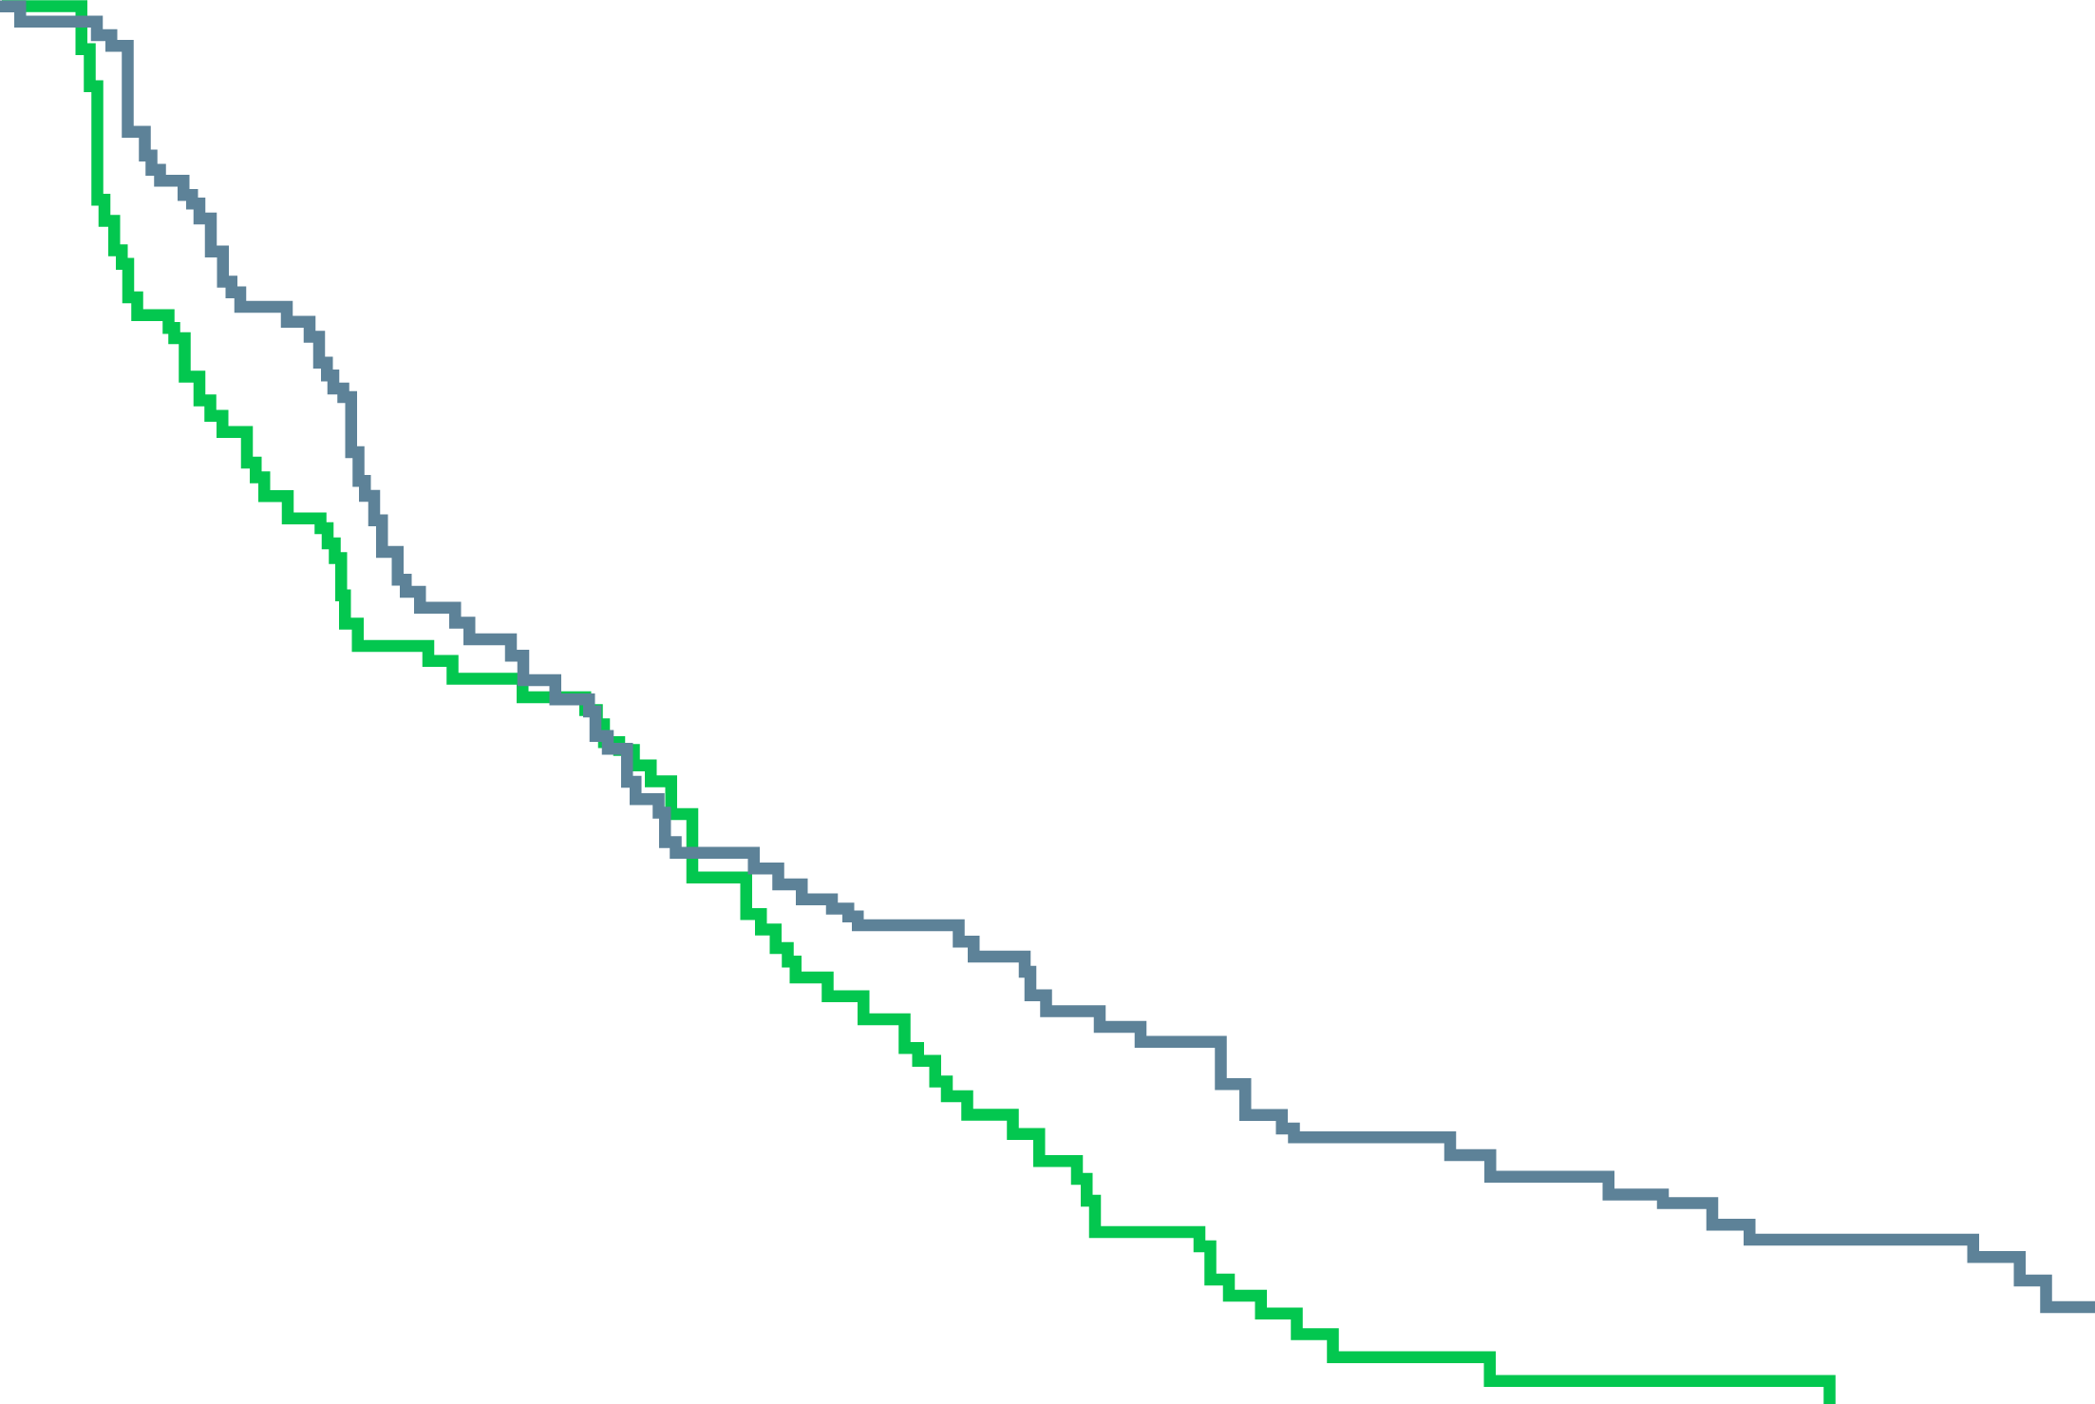
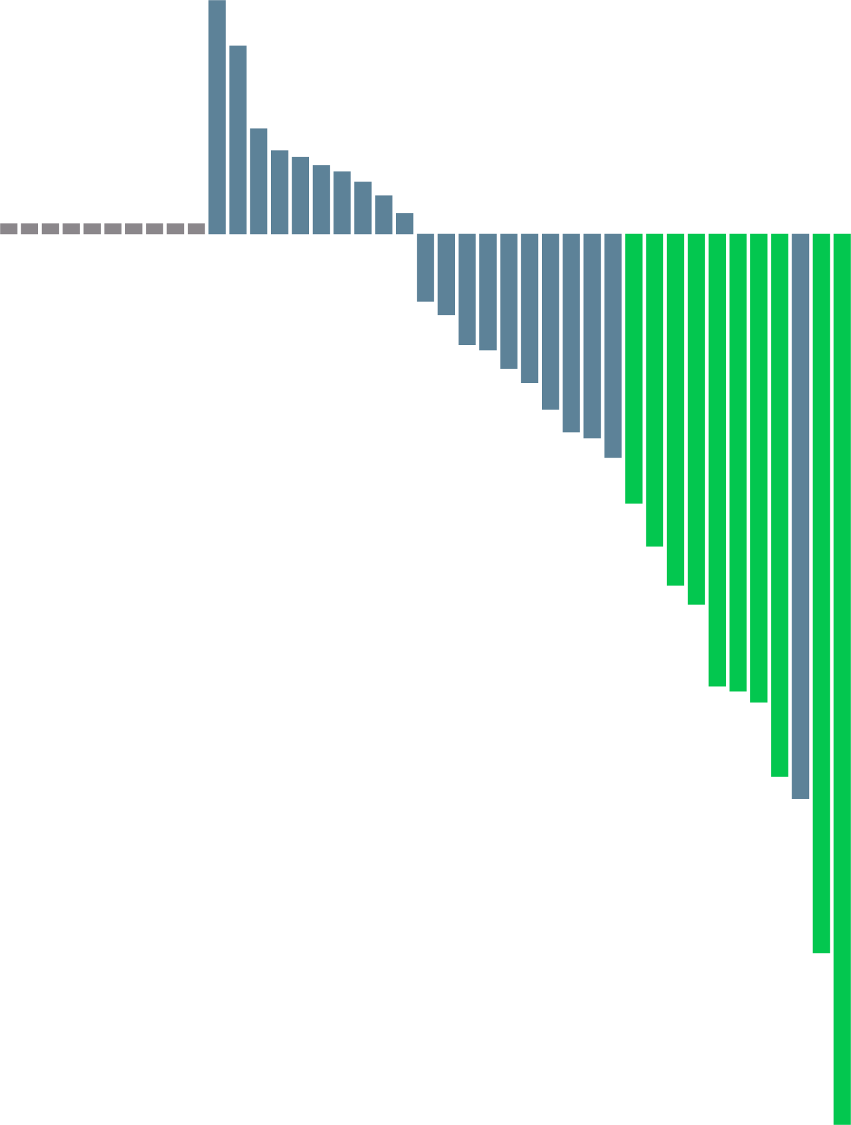
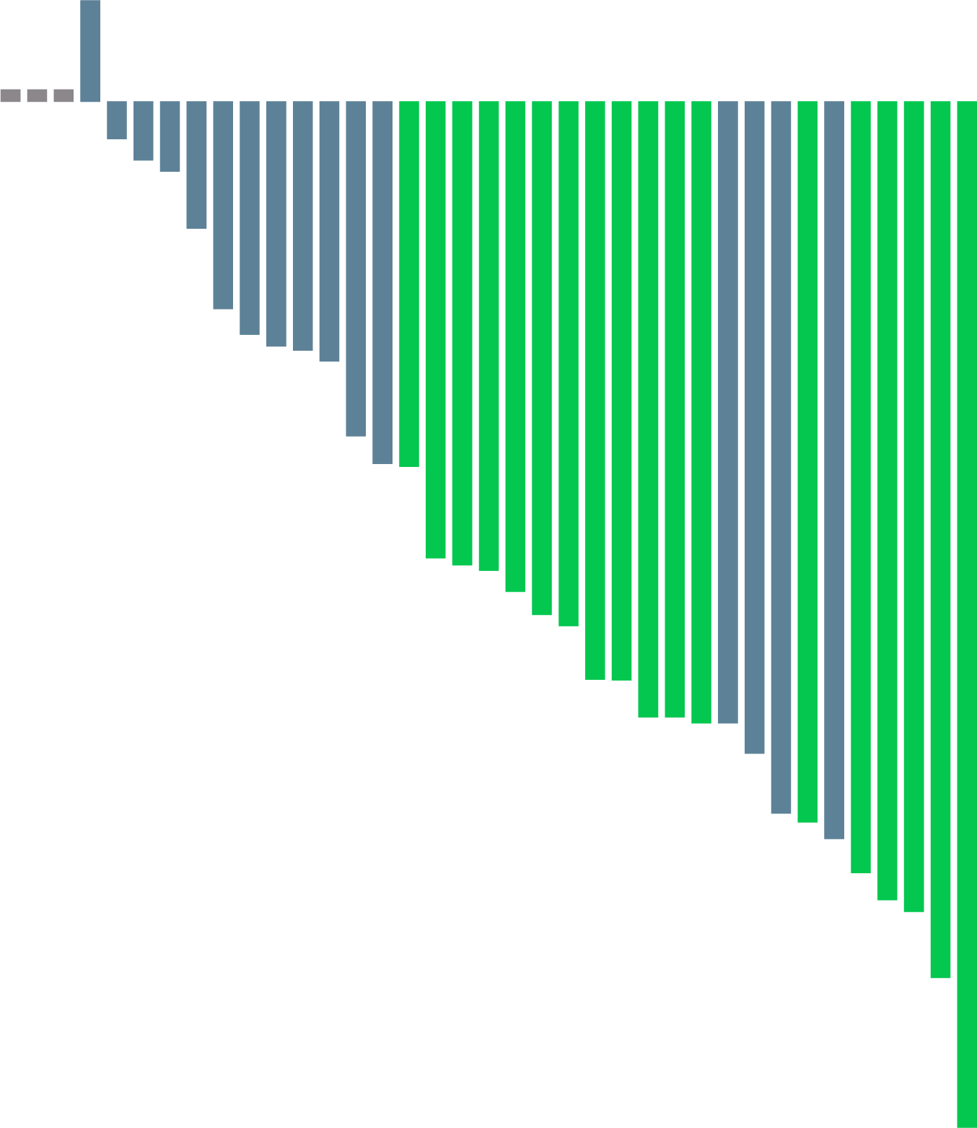
TheraP: Results
Progression-free survival
(psa AND Radiographic)
Objective response rate (recist 1.1)
1.00
40
40
No partial response
Partial response
No post-baseline assessment
0.75
20
20
HR 0.63 (95% CI: 0.46-0.86)
p=0.0028
0
0
Progression-free survival (%)
0.50
-20
-20
0.25
Charge from baseline (%)
Charge from baseline (%)
¹⁷⁷Lu-PSMA-617
-40
-40
Cabazitaxel
0
-60
-60
0
3
6
9
12
15
18
Months
-80
ORR
(95% CI)
24%
(11-38%)
-80
49%
(33-65%)
No. at risk
Cabazitaxel
¹⁷⁷Lu-PSMA-617
101
99
46
67
31
38
14
28
2
17
1
11
0
4
-100
-100
Cabazitaxel (N=41)
¹⁷⁷Lu-PSMA-617 (N=37)
¹⁷⁷Lu-PSMA-617, lutetium-177-prostate-specific membrane antigen-617; CI, confidence interval; HR, hazard ratio; ORR, objective response rate; RECIST, Response Evaluation Criteria in Solid Tumours
Hofman MS, et al. J Clin Oncol. 2021;39 suppl 6:6 (ASCO GU 2021 oral presentation); Hofman MS, et al. Lancet. 2021;397:797-804

Slide 9
TheraP: RESULTS
Term | Cabazitaxel (N=85) |  | Lu-PSMA (N=98)
 | G1-2 % | G3-4 % | G1-2 % | G3-4 %
Neutropenia (+/- fever) | 5 | 13 | 7 | 4
Thrombocytopaenia | 5 | 0 | 18 | 11
Dry mouth | 21 | 0 | 60 | 0
Diarrhoea | 52 | 5 | 18 | 1
Dry eye | 4 | 0 | 30 | 0
Dysgeusia | 27 | 0 | 12 | 0
Neuropathy (motor or sensory) | 26 | 1 | 10 | 0
Fatigue | 72 | 4 | 70 | 5
Nausea | 34 | 0 | 40 | 1
Anaemia | 13 | 8 | 19 | 8
Vomiting | 12 | 2 | 12 | 1
TOTAL (all AEs) | 40 | 54 | 54 | 33
Discontinuations for toxicity occurred in 1/98 (1%) Lu-PSMA vs 3/85 (4%) cabazitaxel-treated There were no Lu-PSMA related deaths
SELECTED AEs BY WORSE GRADE
AE, adverse event; G, grade; Lu-PSMA, ¹⁷⁷Lutetium-PSMA-617
Hofman MS, et al. J Clin Oncol. 2021;39 suppl 6:6 (ASCO GU 2021 oral presentation)

Slide 10
TheraP: SUMMARY
Lu-PSMA demonstrated a greater PSA50 response compared to cabazitaxel in men with mCRPC
after docetaxel
Lu-PSMA may represent a favourable treatment option compared to cabazitaxel in a selected population with high PSMA expression
PFS data is immature at the time of this analysis but initial data is favourable
Improvement in overall survival is yet to be confirmed from this trial
Relatively fewer G3-4 AEs were experienced by patients treated with Lu-PSMA compared to those receiving cabazitaxel
AE, adverse event; Lu-PSMA, ¹⁷⁷Lutetium-PSMA-617; mCRPC, metastatic castration resistant prostate cancer; PFS, progression free survival; PSA50, PSA ≥50% response
Hofman MS, et al. The Lancet. 2021;397:797-804

Slide 11
A PHASE 3 STUDY OF ¹⁷⁷LU-PSMA-617
IN PATIENTS WITH mCRPC (VISION TRIAL)
Morris MJ, et al.
ASCO 2021. Abstract #LBA4. Oral presentation
Fizazi K, et al.
ESMO 2021. Abstract # 576MO
177Lu-PSMA-617, lutetium-177-prostate-specific membrane antigen-617; mCRPC, metastatic castration-resistant prostate cancer

Slide 12
VISION: Overview
Prostate-specific membrane antigen (PSMA) is highly expressed on the surface of prostate cancer cells, including metastatic lesions, and is only expressed on a few normal tissues such as the salivary and lacrimal glands
Studies have confirmed that PSMA-bound imaging is highly specific for PET-based imaging of prostate cancer
The VISION trial randomised patients with mCRPC who had ≥1 PSMA-PET positive metastatic lesion and no PSMA-negative metastatic lesions to receive either ¹⁷⁷Lu-PSMA plus ongoing standard of care or standard of care
Eligibility:
Previous treatment with both
  ≥1 androgen receptor pathway inhibitor
  1 or 2 taxane regimens
Protocol-permitted SOC planned before randomisation
  Excluding chemotherapy, immunotherapy, radium-223, investigational drugs
ECOG performance status 0-2
Adequate major organ and bone marrow function
PSMA-positive mCRPC on PET/CT with ⁶⁸Ga-PSMA-11
Protocol-permitted SOC + ¹⁷⁷Lu-PSMA-617
7.4 GBq (200 mCi) every 6 weeks
4 cycles, increasable to 6 cycles
Treatment
Follow-up
R
2:1
Final analysis
Protocol-permitted
SOC alone
Alternate primary endpoints:
Radiographic progression-free survival
Overall survival
Other secondary endpoints:
Safety and tolerability
Biomarkers including PSA
Health-related quality of life and pain
  FACT-P
  Brief Pain Inventory – Short Form
  EQ-5D-5L
Key secondary endpoints:
Time to first symptomatic skeletal event
RECIST v1.1 overall response rate
RECIST v1.1 disease control rate
~87% of patients scanned met the VISION
imaging criteria for PSMA-positive mCRPC
¹⁷⁷Lu-PSMA-617, lutetium-177-prostate-specific membrane antigen-617; CT, computed tomography; ECOG, Eastern Cooperative Oncology Group; EQ-5D-5L, European Quality of Life (EuroQol)–5 domain 5 level scale; FACT-P, Functional Assessment of Cancer Therapy–Prostate; mCRPC, metastatic castration-resistant prostate cancer; PET, positron-emission tomography; PSA, prostate-specific antigen; PSMA prostate-specific membrane antigen; RECIST, Response Evaluation Criteria in Solid Tumours; SOC, standard of care
Morris MJ, et al. J Clin Oncol. 2021;39 suppl 15:LBA4 (ASCO 2021 oral presentation); Sartor O, et al. N Eng J Med. 2021;385:1091-103

Slide 13
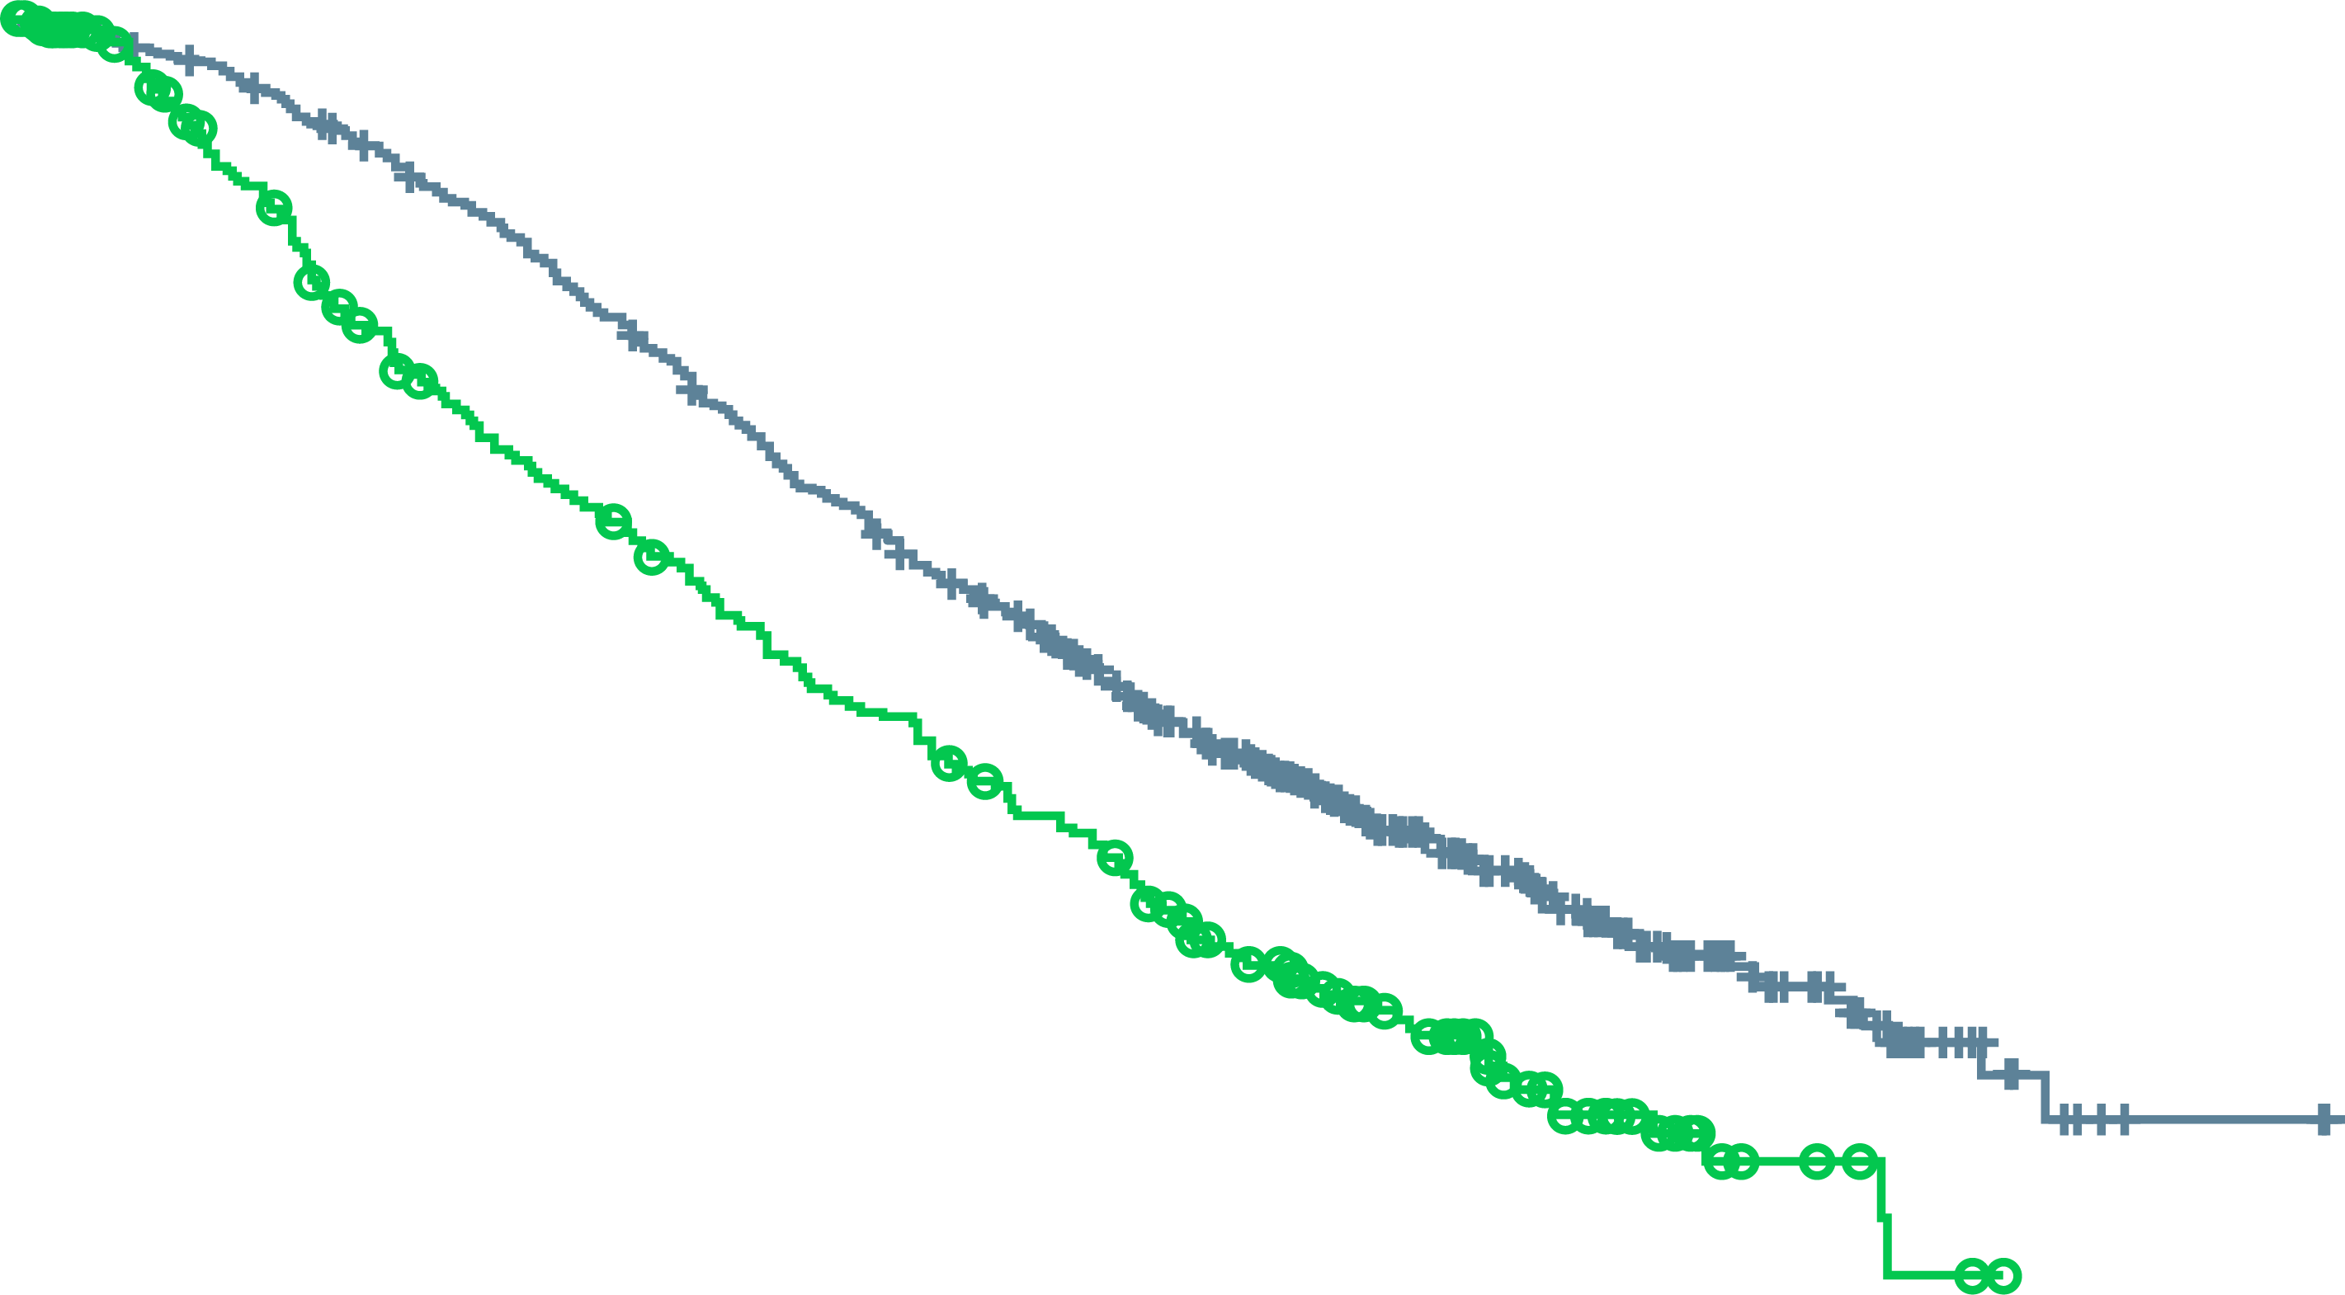
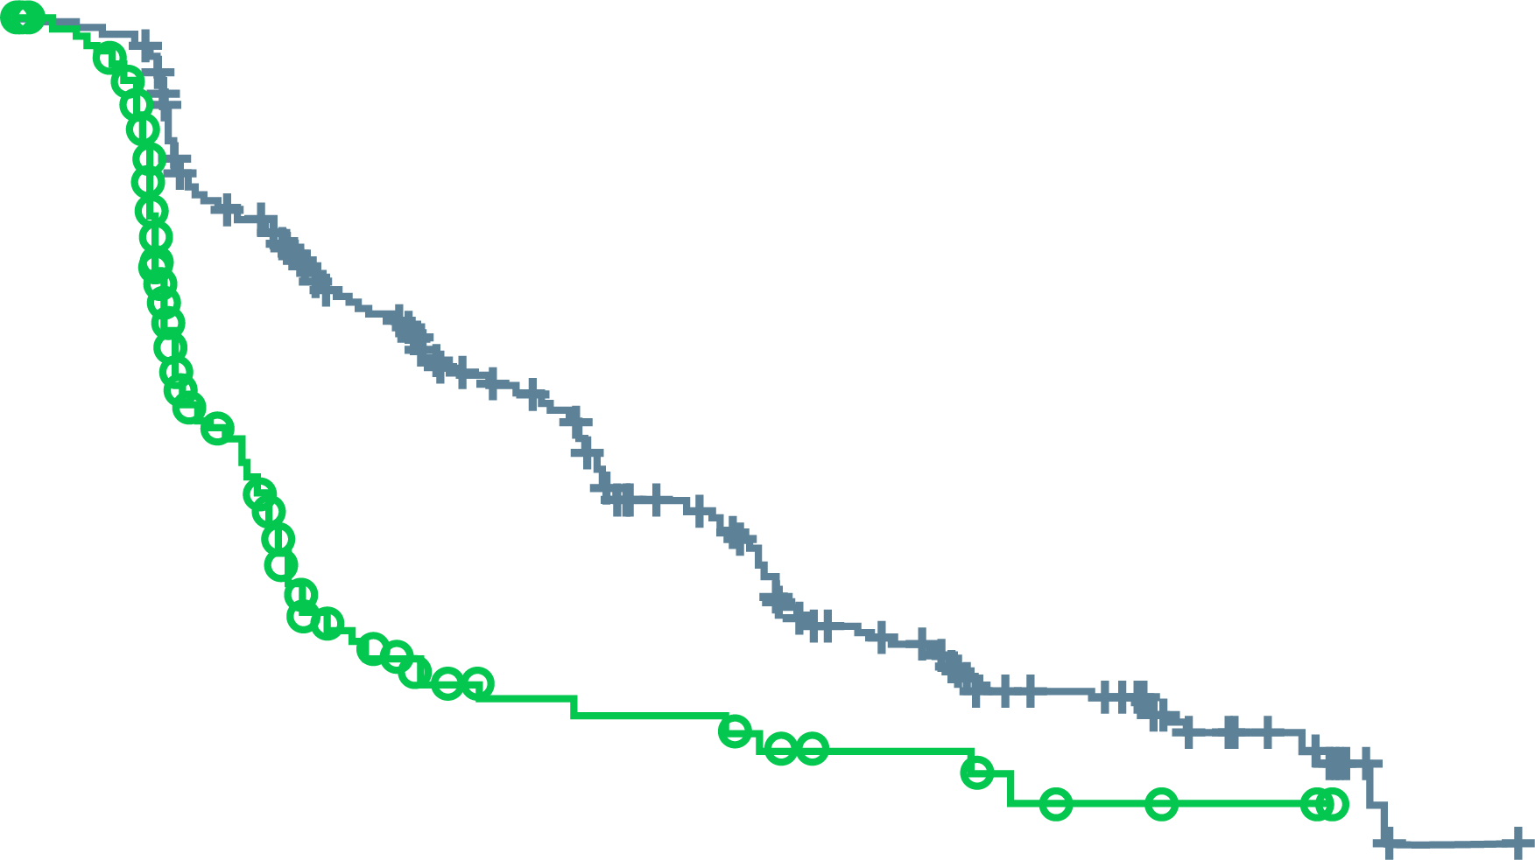
VISION: results
ALTERNATE PRIMARY ENDPOINTS
OS all randomised patients (N=831)
Imaging-based progression-free survival (n=581)
100
100
90
HR 0.62 (95% CI: 0.52-0.74)
p<0.001 (one-sided)
Median 15.3 vs 11.3 months
90
HR 0.40 (99.2% CI: 0.29-0.57)
p<0.001
Median 8.7 vs 3.4 months
80
80
70
70
60
60
Event-free probability (%)
Patients without
disease progression (%)
50
50
40
40
30
30
20
20
10
¹⁷⁷Lu-PSMA-617 + SOC (n=551)
SOC alone (n=280)
10
¹⁷⁷Lu-PSMA-617 + SOC (n=385)
SOC alone (n=196)
0
0
0
2
4
6
8
10
12
14
16
18
20
22
24
26
28
30
32
0
2
4
6
8
10
12
14
16
18
20
22
No. of patients
still at risk
¹⁷⁷Lu-PSMA-617 + SOC
SOC alone
Time from randomisation (months)
No. of patients
still at risk
¹⁷⁷Lu-PSMA-617 + SOC
SOC alone
Time from randomisation (months)
551
280
535
238
506
203
470
173
425
155
377
133
332
117
289
98
236
73
166
51
112
33
63
16
36
6
15
2
5
0
2
0
0
0
385
196
362
119
272
36
215
19
182
14
137
13
88
7
71
7
49
3
21
2
6
0
1
0
CI, confidence interval; ¹⁷⁷Lu-PSMA-617, lutetium-177-prostate-specific membrane antigen-617; HR, hazard ratio; OS, overall survival;
rPFS, radiographic progression-free survival; SOC, standard of care
Sartor O, et al. N Engl J Med. 2021;385:1091-103

Slide 14
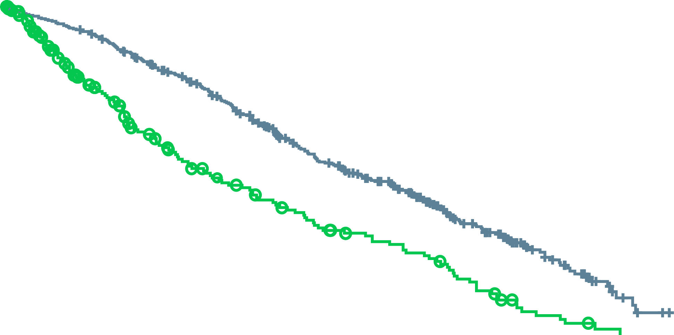
VISION: results
SECONDARY ENDPOINTS
Time to first symptomatic skeletal event
 | No. of events/ no. of patients | Median mo
¹⁷⁷Lu-PSMA-617 + SOC | 256/385 | 11.5
SOC alone | 137/196 | 6.8
HR (95% CI) | 0.50 (0.40-0.62)
P value | <0.001
Patients with evaluable disease at baseline | ¹⁷⁷Lu-PSMA-617 + SOC (N=319) | SOC (N=120)
ORR, n (%) | 95 (29.8) | 2 (1.7)
 | OR 24.99 (95% CI: 6.05-103.24) p<0.001
DCR, n (%) | 284 (89.0) | 80 (66.7)
 | OR 5.79 (95% CI: 3.18-10.55) p<0.001
100
90
¹⁷⁷Lu-PSMA-617 + SOC
80
70
60
Percent of patients
free from event
50
40
SOC alone
30
20
10
0
0
2
4
6
8
10
12
14
16
18
20
22
Time from randomisation (months)
No. at risk
¹⁷⁷Lu-PSMA-617 + SOC
SOC alone
385
196
363
141
329
104
290
75
240
61
189
48
153
36
117
29
73
15
34
6
12
2
2
0
¹⁷⁷Lu-PSMA-617, lutetium-177-prostate-specific membrane antigen-617; CI, confidence interval; DCR, disease control rate; HR, hazard ratio; mo, months; OR, odds ratio; ORR, overall response rate; SOC, standard of care
Sartor O, et al. N Engl J Med. 2021;385:1091-103

Slide 15
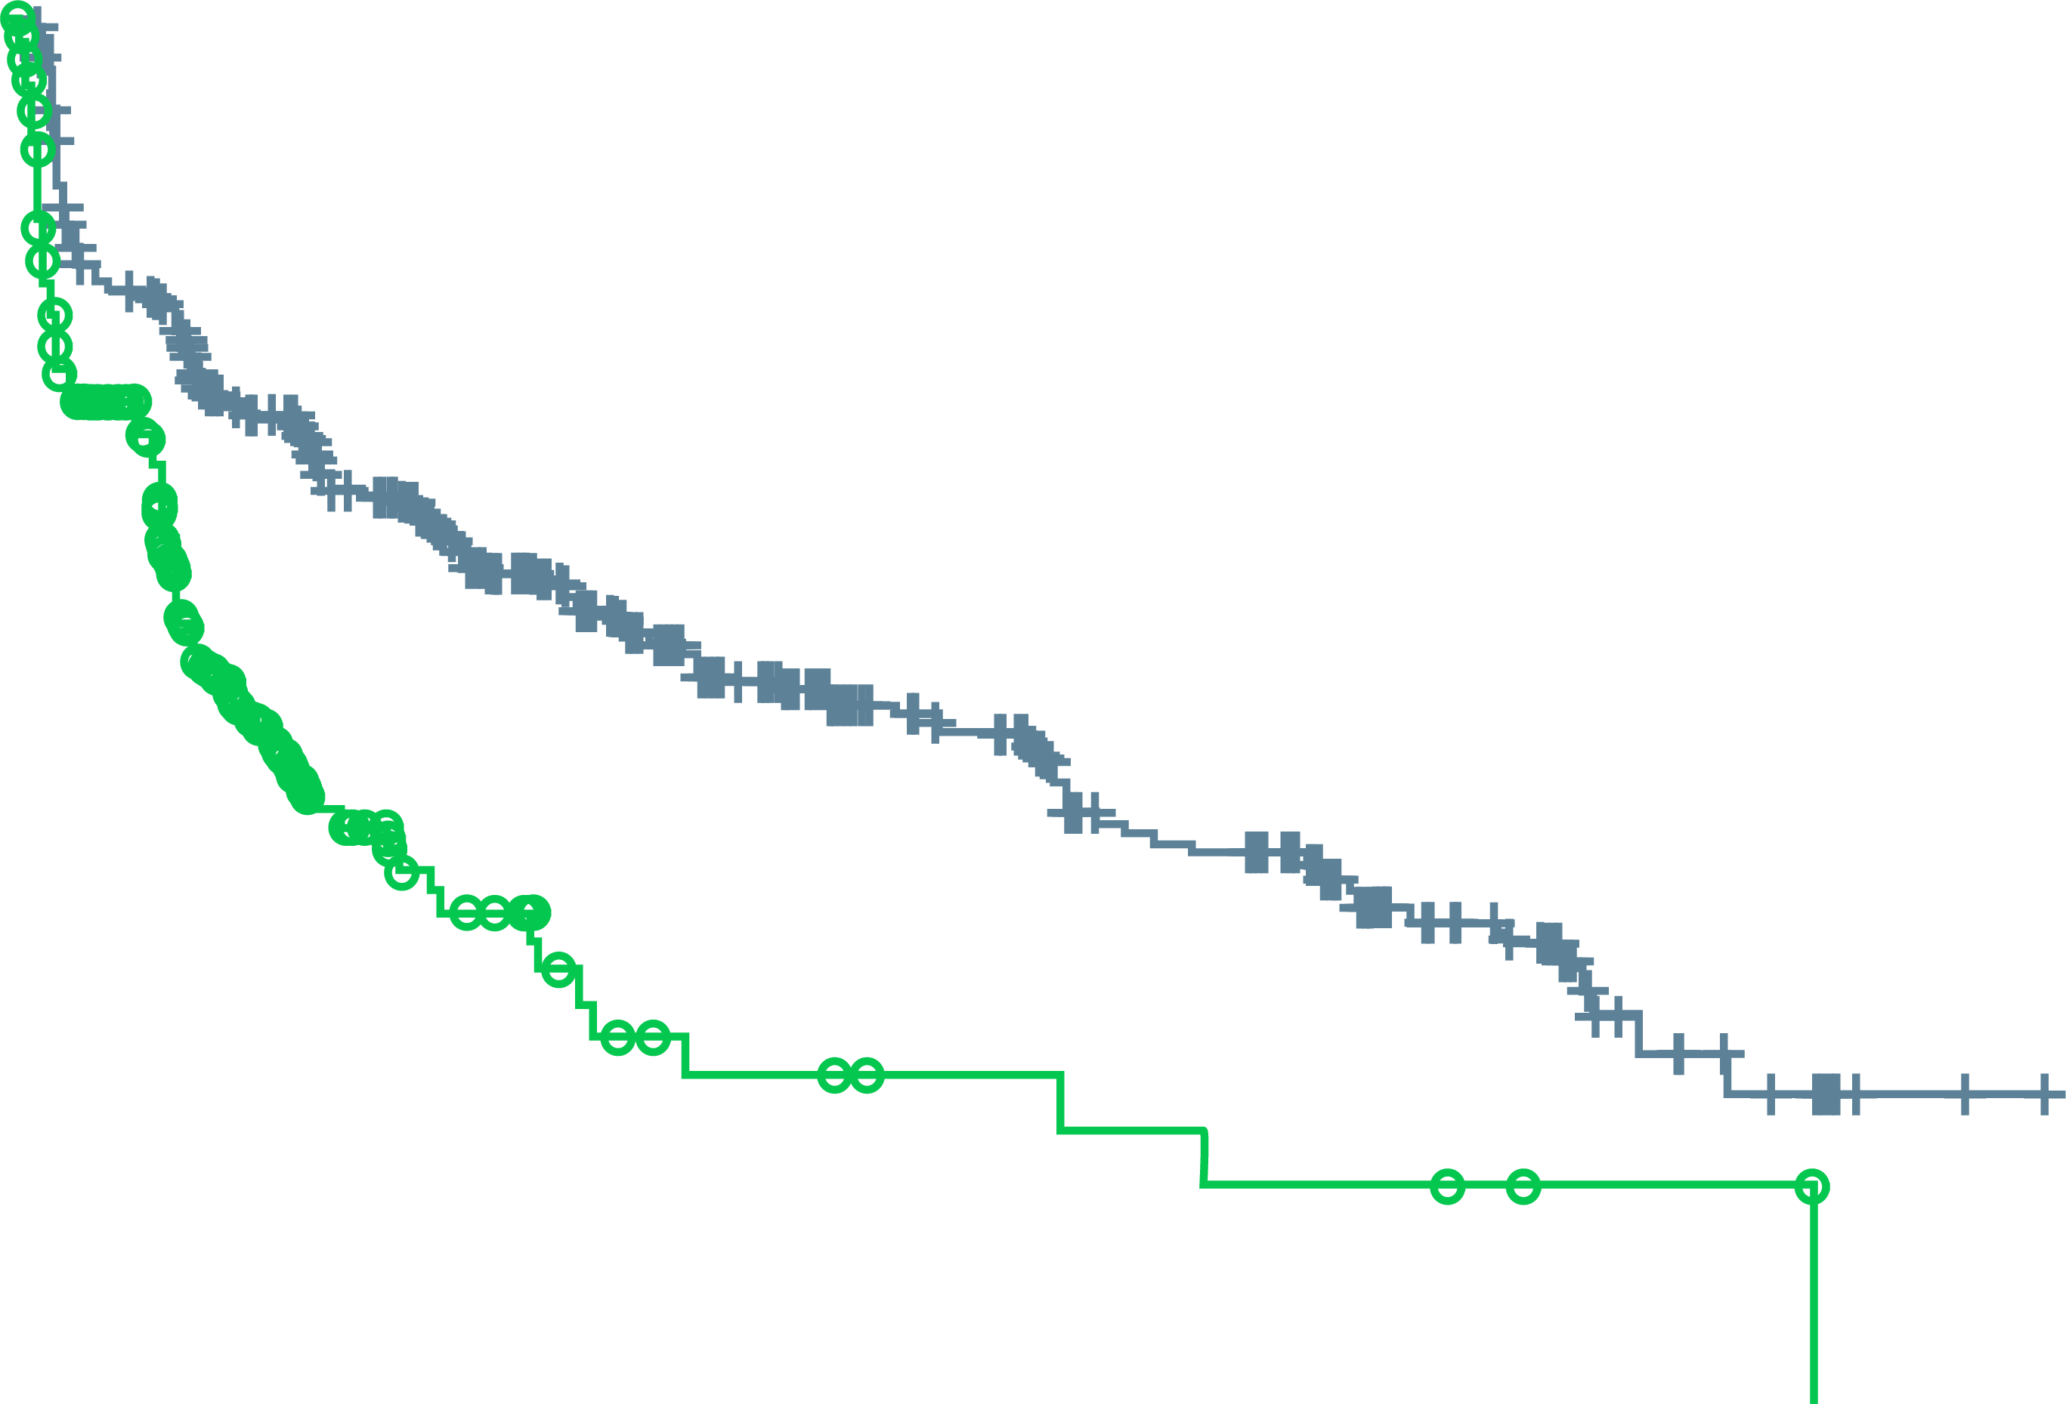
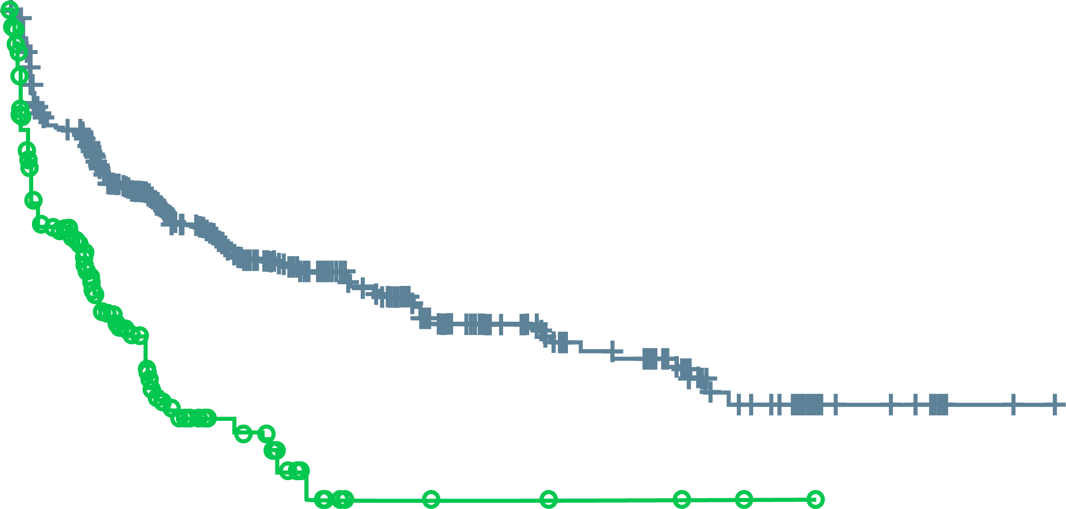
VISION: HEALTH-RELATED QUALITY OF LIFE
FACT-P TOTAL SCORE
Time to worsening favoured the ¹⁷⁷Lu-PSMA-617 arm
Bpi-sf pain intensity
Time to worsening favoured the ¹⁷⁷Lu-PSMA-617 arm
rPFS analysis set (N=581)
rPFS analysis set (N=581)
100
HR 0.46 (95% CI: 0.35-0.61)
p<0.001 (two-sided; nominal;
non-inferential analysis)
Median 9.7 vs 2.4 months
100
HR 0.45 (95% CI: 0.33-0.60)
p<0.001 (two-sided; nominal;
non-inferential analysis)
Median 14.3 vs 2.9 months
90
90
80
80
70
70
60
60
Event-free probability (%)
Event-free probability (%)
50
50
40
40
30
30
20
20
10
¹⁷⁷Lu-PSMA-617 + SOC (n=385)
SOC alone (n=196)
10
¹⁷⁷Lu-PSMA-617 + SOC (n=385)
SOC alone (n=196)
0
0
0
1
2
3
4
5
6
7
8
9
10
11
12
13
14
15
16
17
18
19
20
21
22
23
0
1
2
3
4
5
6
7
8
9
10
11
12
13
14
15
16
17
18
19
20
21
22
23
No. of patients
still at risk
¹⁷⁷Lu-PSMA-617 + SOC
SOC alone
Time from randomisation (months)
No. of patients
still at risk
¹⁷⁷Lu-PSMA-617 + SOC
SOC alone
Time from randomisation (months)
385
196
289
97
255
66
235
42
201
30
167
21
146
14
126
10
110
8
89
8
76
6
72
6
54
5
51
5
46
4
33
4
27
3
21
2
10
2
7
2
4
0
2
0
1
0
0
0
385
196
296
94
265
65
238
37
197
25
162
19
146
12
129
7
113
5
87
5
70
4
66
4
51
3
48
3
42
3
24
2
21
1
15
1
8
0
6
0
2
0
2
0
1
0
0
0
Time to the first occurrence of ≥10-point decrease in FACT-P total from baseline
Time to the first occurrence of ≥30-point or ≥2-point increase in BPI-SF pain intensity from baseline
¹⁷⁷Lu-PSMA-617, lutetium-177-prostate-specific membrane antigen-617; BPI-SF, Brief Pain Inventory–Short Form; CI, confidence interval; FACT-P, Functional Assessment of Cancer Therapy– Prostate; HR, hazard ratio; rPFS, radiographic progression-free survival; SOC, standard of care
Sartor O, et al. N Engl J Med. 2021;385:1091-103; Fizazi K, et al. Ann Oncol. 2021;32 suppl 5:S627-8 (ESMO 2021 oral presentation)

Slide 16
VISION: RESULTS
TREATMENT-EMERGENT ADVERSE EVENTS
Patients, n (%) | ¹⁷⁷Lu-PSMA-617 + SOC (N=529) |  | SOC alone (N=205)
 | All grades | Grade 3-5 | All grades | Grade 3-5
Any drug-related TEAE | 451 (85.3) | 150 (28.4) | 59 (28.8) | 8 (3.9)
Serious | 49 (9.3) | 43 (8.1) | 5 (2.4) | 5 (2.4)
Grade 5ª | 5 (0.9) | 5 (0.9) | 0 (0.0) | 0 (0.0)
TEAEs grouped by topics of interest
Fatigue | 260 (49.1) | 37 (7.0) | 60 (29.3) | 5 (2.4)
Bone marrow suppression | 251 (47.4) | 124 (23.4) | 36 (17.6) | 14 (6.8)
Leukopenia | 66 (12.5) | 13 (2.5) | 4 (2.0) | 1 (0.5)
Lymphopenia | 75 (14.2) | 41 (7.8) | 8 (3.9) | 1 (0.5)
Anaemia | 168 (31.8) | 68 (12.9) | 27 (13.2) | 10 (4.9)
Thrombocytopenia | 91 (17.2) | 42 (7.9) | 9 (4.4) | 2 (1.0)
Dry mouth | 208 (39.3) | 0 (0.0) | 2 (1.0) | 0 (0.0)
Nausea and vomiting | 208 (39.3) | 8 (1.5) | 35 (17.1) | 1 (0.5)
Renal effects | 46 (8.7) | 18 (3.4) | 12 (5.9) | 6 (2.9)
Second primary malignancies | 11 (2.1) | 4 (0.8) | 2 (1.0) | 1 (0.5)
Intracranial haemorrhage | 7 (1.3) | 5 (0.9) | 3 (1.5) | 2 (1.0)
ª There were five drug-related treatment-emergent adverse events leading to death in the ¹⁷⁷Lu-PSMA-617 arm: pancytopenia, n=2; bone-marrow failure, n=1; subdural haematoma, n=1; intracranial haemorrhage, n=1
¹⁷⁷Lu-PSMA-617, lutetium-177-prostate-specific membrane antigen-617; Lu-PSMA; SOC, standard of care; TEAE, treatment-emergent adverse event
Sartor O, et al. N Engl J Med. 2021; 385:1091-103; Fizazi K, et al. Ann Oncol. 2021;32 suppl 5:S627-8 (ESMO 2021 oral presentation)

Slide 17
VISION: SUMMARY
Radio-ligand therapy + standard of care was well tolerated in patients with advanced prostate cancer
Time interval to worsening of quality of life and pain is increased
  Take-home messages:
    Low negative side effects
    Prolonging PFS and OS
    Integration in therapy sequence of CRPC after results of randomised trials
    Improved quality of life
CRPC, castration-resistant prostate cancer; OS, overall survival; PFS, progression-free survival
Sartor O, et al. N Engl J Med. 2021;385:1091-103; Fizazi K, et al. Ann Oncol. 2021;32 suppl 5:S627-8 (ESMO 2021 oral presentation)

Slide 18
A phase 3 trial with a 2x2 factorial design in men with de novo mcspc: overall survival with Abiraterone plus prednisone in peace-1
Fizazi K, et al.
ESMO 2021. Abstract #LBA5_PR. Oral presentation
mCSPC, metastatic castration-sensitive prostate cancer

Slide 19
Peace-1: background and study design
ADT was SOC for men with metastatic castration-sensitive prostate cancer (mCSPC) for many years
Since 2015, combining ADT with either docetaxel, novel hormonal therapies, or RT to the primary tumor (for those with low-burden metastases) was shown to improve OS and is now the new SOC
PEACE-1 evaluates whether combining these new treatments on top of ADT leads to improved outcomes
Key eligibility criteria
De novo mCSPC
Distant metastatic disease by ≥1 lesion on bone scan and/or CT scan
ECOG PS 0-2
On-study requirement
Continuous ADT
Permitted
ADT ≤3 months
Stratification
ECOG PS (0 vs 1-2)
Metastatic sites (lymph node vs bone vs visceral)
Type of castration (orchidectomy vs LHRH agonist vs LHRH antagonist)
Docetaxel (yes vs no)
Nov 2013–Dec 2018
SOC
(N=296)
SOC + AAP
(N=292)
Co-primary
Radiographic progression-free survival (rPFS):
  PCWG 2 criteria
  Imaging at least every 6 months after PSA rise
OS
R
1:1:1:1
SOC + RT
(N=293)
N=1,173
SOC + AAP +
RT
(N=292)
2x2 factorial design
SOC = ADT and docetaxel 75 mg/m² every 3 weeks for 6 cycles
AAP, abiraterone and prednisone; ADT, androgen deprivation therapy; ECOG PS, Eastern Cooperative Oncology Group performance status; LHRH, luteinising hormone releasing hormone; mCSPC, metastatic castration-sensitive prostate cancer; OS, overall survival; PCWG 2, Prostate Cancer Working Group 2; PSA, prostate specific antigen; rPFS, radiographic progression-free survival; RT, radiotherapy; SOC, standard of care
Fizazi K, et al. Ann Oncol. 2021;32 suppl 5:S1299 (ESMO 2021 oral presentation)

Slide 20
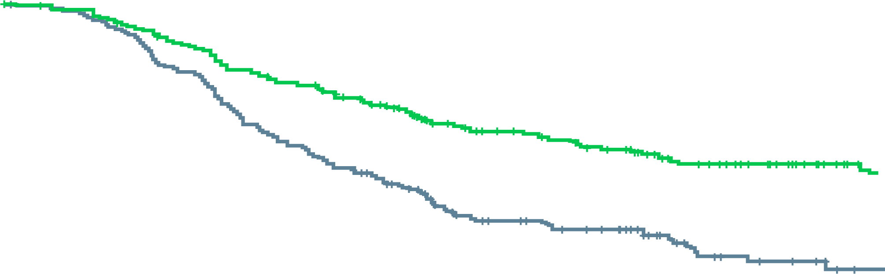
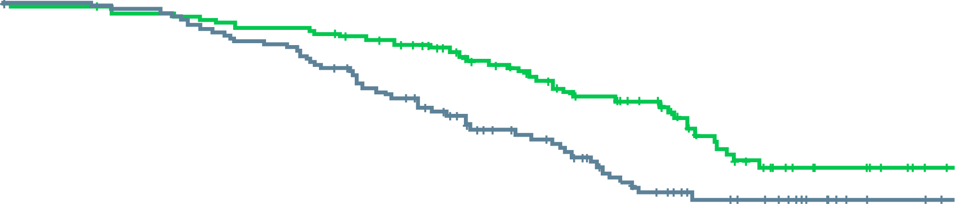
Peace-1: results
Previous results from PEACE-1, showed that AAP + ADT + docetaxel significantly improved rPFS in men with mCSPC (HR 0.50; (95% CI: 0.40-0.62), p<0.0001)¹
Low and high volume disease data were presented at ESMO²
 | SOC + AAP (N=225) | SOC (N=231)
Median, y (95% CI) | 4.1 (2.7-NE) | 1.6 (1.4-2.0)
Events | 97 | 156
HR (95% CI)ª | 0.47 (0.36-0.60)
P value | <0.0001
 | SOC + AAP (N=129) | SOC (N=122)
Median, y (95% CI) | NE (3.1-NE) | 1.6 (1.4-2.0)
Events | 41 | 55
HR (95% CI)ª | 0.58 (0.39-0.87)
P value | 0.006
High volume
Low volume
100%
100%
80%
80%
60%
60%
Radiographic
progression-free survival
Radiographic
progression-free survival
Yes
Yes
No
40%
40%
20%
No
20%
0%
0%
0
1
2
3
4
0
1
2
3
4
Time from randomization (years)
Time from randomization (years)
No
Yes
231
225
162
182
71
107
35
66
8
24
No
Yes
122
129
110
120
65
93
25
39
8
11
ªAdjusted on stratification parameters (RXT, PS, type of castration, metastatic burden)
AAP, abiraterone and prednisone; ADT, androgen deprivation therapy; CI, confidence interval; HR, hazard ratio; mCSPC, metastatic castration sensitive prostate cancer; NE, not estimable; rPFS, radiographic progression-free survival; RXT, radiotherapy to primary tumour; SOC, standard of care
1. Fizazi K, et al. Abstract #5000. ASCO 2021; 2. Fizazi K, et al. Ann Oncol. 2021;32 suppl 5:S1299 (ESMO 2021 oral presentation)

Slide 21
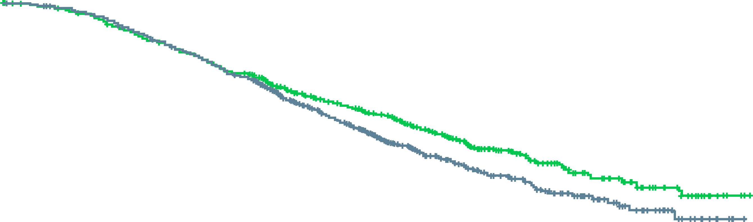
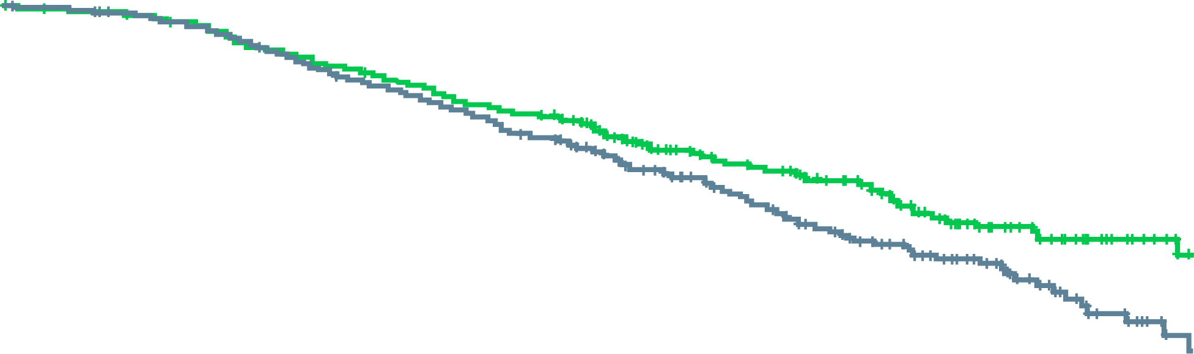
Peace-1: results
OS in the overall
population
 | SOC + AAP (N=583) | SOC (N=589)
Median, y (95% CI) | 5.7 (5.1-NE) | 4.7 (4.3-5.3)
Events | 228 | 268
HR (95% CI)ª | 0.82 (0.69-0.98)
P value | 0.030
OS with AAP in the
ADT + docetaxel
(+/- RXT) population
 | SOC + AAP (N=355) | SOC (N=355)
Median, y (95% CI) | NE (4.5-NE) | 4.4 (3.8-4.9)
Events | 121 | 151
HR (95% CI)ª | 0.75 (0.59-0.95)
P value | 0.017
100%
100%
80%
80%
60%
60%
Yes
Overall survival
Overall survival
40%
Yes
40%
No
No
20%
20%
0%
ªAdjusted on stratification
parameters (RXT, PS, type of
castration, metastatic burden,
doxetaxel)
0%
ªAdjusted on stratification
parameters (RXT, PS, type of
castration, metastatic burden)
0
1
2
3
4
5
6
7
0
1
2
3
4
5
Time from randomization (years)
Time from randomization (years)
No
Yes
589
583
556
541
480
470
334
340
207
230
101
111
37
47
4
6
No
Yes
355
355
329
328
281
287
172
183
78
98
18
25
OS effect seen across subgroups, including those with high volume disease (HR 0.72, 95% CI 0.55-0.95) and low volume disease (HR 0.83, 95% CI 0.50-1.38; data immature)
Combination of AAP + ADT + docetaxel was well tolerated
  No difference in rates of grade 3 to 5 neutropenia or febrile neutropenia
  Grade 3 to 5 liver toxicity (6% vs 1%) and hypertension (22% vs 13%) with SOC + AAP compared to SOC alone
AAP, abiraterone and prednisone; ADT, androgen deprivation therapy; CI, confidence interval; HR, hazard ratio; OS, overall survival; RXT, radiotherapy to primary tumour; SOC, standard of care
Fizazi K, et al. Ann Oncol. 2021;32 suppl 5:S1299 (ESMO 2021 oral presentation)

Slide 22
PEACE-1: RESULTS
TREATMENTS BEYOND PROGRESSION (ADT + DOCETAXEL POPULATION)
At least one treatment, n (%) | SOC (± RXT) + abiraterone n_{CRPC}=141 | SOC (± RXT) n_{CRPC}=263
Life-prolonging treatment | 104 (74) | 221 (84)
Next gen. hormonal therapy | 65 (46) | 213 (81)
Abiraterone | 22 (16) | 153 (58)
Enzalutamide | 57 (40) | 119 (45)
Docetaxel | 29 (21) | 25 (10)
Cabazitaxel | 84 (60) | 114 (43)
Radium-223 | 3 (2) | 11 (4)
Lu-PSMA | 2 (1) | 3 (1)
ADT, androgen deprivation therapy; Lu-PSMA, lutetium-PSMA; nCRPC, numbers developing castration-resistant prostate cancer; PSMA, prostate-specific membrane antigen; RXT, radiotherapy; SOC, standard of care
Fizazi K, et al. Ann Oncol. 2021;32 suppl 5:S1299 (ESMO 2021 oral presentation)

Slide 23
PEACE-1: RESULTS
G3-5 TOXICITY ON STUDY TREATMENTS (ADT + DOCETAXEL SAFETY POPULATION)
Toxicity, n (%) | SOC (± RXT) + abiraterone (N=346) | SOC (± RXT) (N=350)
Neutropenia | 34 (10) | 32 (9)
Febrile neutropenia | 18 (5) | 19 (5)
Liver | 20 (6) | 2 (1)
Hypertension | 76 (22) | 45 (13)
Hypokalemia | 11 (3) | 1 (0)
Cardiac | 6 (2) | 5 (1)
Fatigue | 10 (3) | 15 (4)
Gastro-intestinal | 14 (4) | 18 (5)
Grade 5 | 7 (2) | 3 (1)
ADT, androgen deprivation therapy; g, GRADE; RXT, radiotherapy; SOC, standard of care
Fizazi K, et al. Ann Oncol. 2021;32 suppl 5:S1299 (ESMO 2021 oral presentation)

Slide 24
Peace-1: summary
Adding AAP to ADT plus docetaxel improve both rPFS and OS in mCSPC men, even when 84% of mCRPC men from the control arm receive an androgen signalling inhibitor
Toxicity was as expected – no safety concerns from combination treatment
Triple therapy can be recommended
  Clinical perspective:
Benefit of a median lifetime gain of more than 1.5 years for mCSPC men with high volume disease (5.1 vs 3.5 years)
AAP, abiraterone and prednisone; ADT, androgen deprivation therapy; mCRPC, metastatic castration-resistant prostate cancer; mCSPC, metastatic castration-sensitive prostate cancer; mo, months; OS, overall survival; rPFS, radiographic progression free survival
Fizazi K, et al. Ann Oncol. 2021;32 suppl 5:S1299 (ESMO 2021 oral presentation)

Slide 25
Abiraterone acetate plus prednisolone without enzalutamide added to ADT compared to ADT alone for men with high-risk M0 PCa: Combined analysis from TWO comparisons in the stampede platform protocol
Attard G, et al.
ESMO 2021, Abstract #LBA4_PR. Oral presentation
ADT, androgen deprivation therapy; M0, non-metastatic; Pca, prostate cancer

Slide 26
STAMPEDE: Background and study design
Patients with high-risk non-metastatic prostate cancer (M0 PCa) are treated with androgen deprivation therapy (ADT) and local radiotherapy (RT), where indicated
Intensifying hormone treatment with abiraterone acetate plus prednisone (AAP), enzalutamide (ENZ) or apalutamide (APA) continuous to progression improves outcomes of metastatic PCa but its efficacy in M0 PCa starting ADT is unknown
This analysis of STAMPEDE evaluated whether there is a benefit for abiraterone acetate and prednisone (AAP) in high-risk M0 PCa patients
2011
2012
2013
2014
2015
2016
SOC: ADT x 3 years +RT*
Primary endpoint: metastasis-free survival (MFS)
Secondary endpoint: Overall survival (OS)
R
1:1
N=1,974
SOC + AAP (2y)
SOC + AAP + ENZ (2y)
Periods of accrual
* When indicated
AAP, abiraterone and prednisone; ADT, androgen deprivation therapy; APA, apalutamide; ENZ, enzalutamide; M0, non-metastatic; M1, metastatic; MFS, metastasis-free survival; OS, overall survival; PCa, prostate cancer; RT, radiotherapy; SOC, standard of care
Attard G, et al. Ann Oncol. 2021;32 suppl 5:S1298 (ESMO 2021 oral presentation)

Slide 27
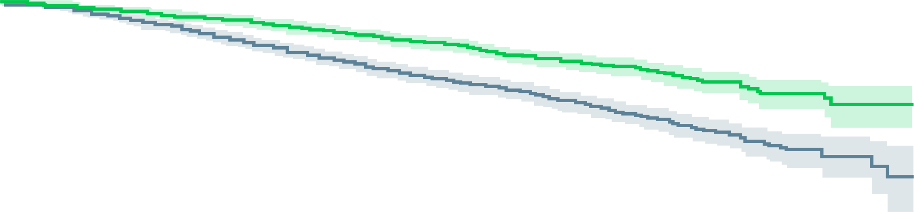
STAMPEDE: results
Metastasis-free survival
Events
180 ADT + AAP +/- ENZ
306 ADT
1.0
ADT + AAP +/- ENZ
0.8
HR: 0.53
95% CI: 0.44-0.64
P value: 2.9 × 10⁻¹¹
0.6
ADT
Metastasis-free survival
0.4
0.2
0
12
24
36
48
60
72
84
96
108
6-year MFS
improved from
69% to 82%
ADT
At-risk
Censored
Event
Months since randomisation
988
0
0
950
8
30
894
11
83
836
14
138
767
26
195
550
201
237
329
387
272
172
522
294
53
632
303
9
673
306
ADT + AAP +/- ENZ
At-risk
Censored
Event
986
0
0
948
21
17
917
28
41
884
31
71
839
45
102
622
225
139
369
460
157
198
615
173
71
737
178
14
792
180
Kaplan–Meier estimates with 95% CI in lighter shade
MFS: treatment effect was consistent in major subgroups and between AAP and AAP + ENZ randomisation periods
AAP, abiraterone and prednisone; ADT, androgen deprivation therapy; APA, apalutamide; CI, confidence interval; ENZ, enzalutamide; HR, hazard ratio;
MFS, metastasis-free survival
Attard G, et al. Ann Oncol. 2021;32 suppl 5:S1298 (ESMO 2021 oral presentation); Efstathiou, E. Discussant Abstract #LBA4_PR. ESMO 2021

Slide 28
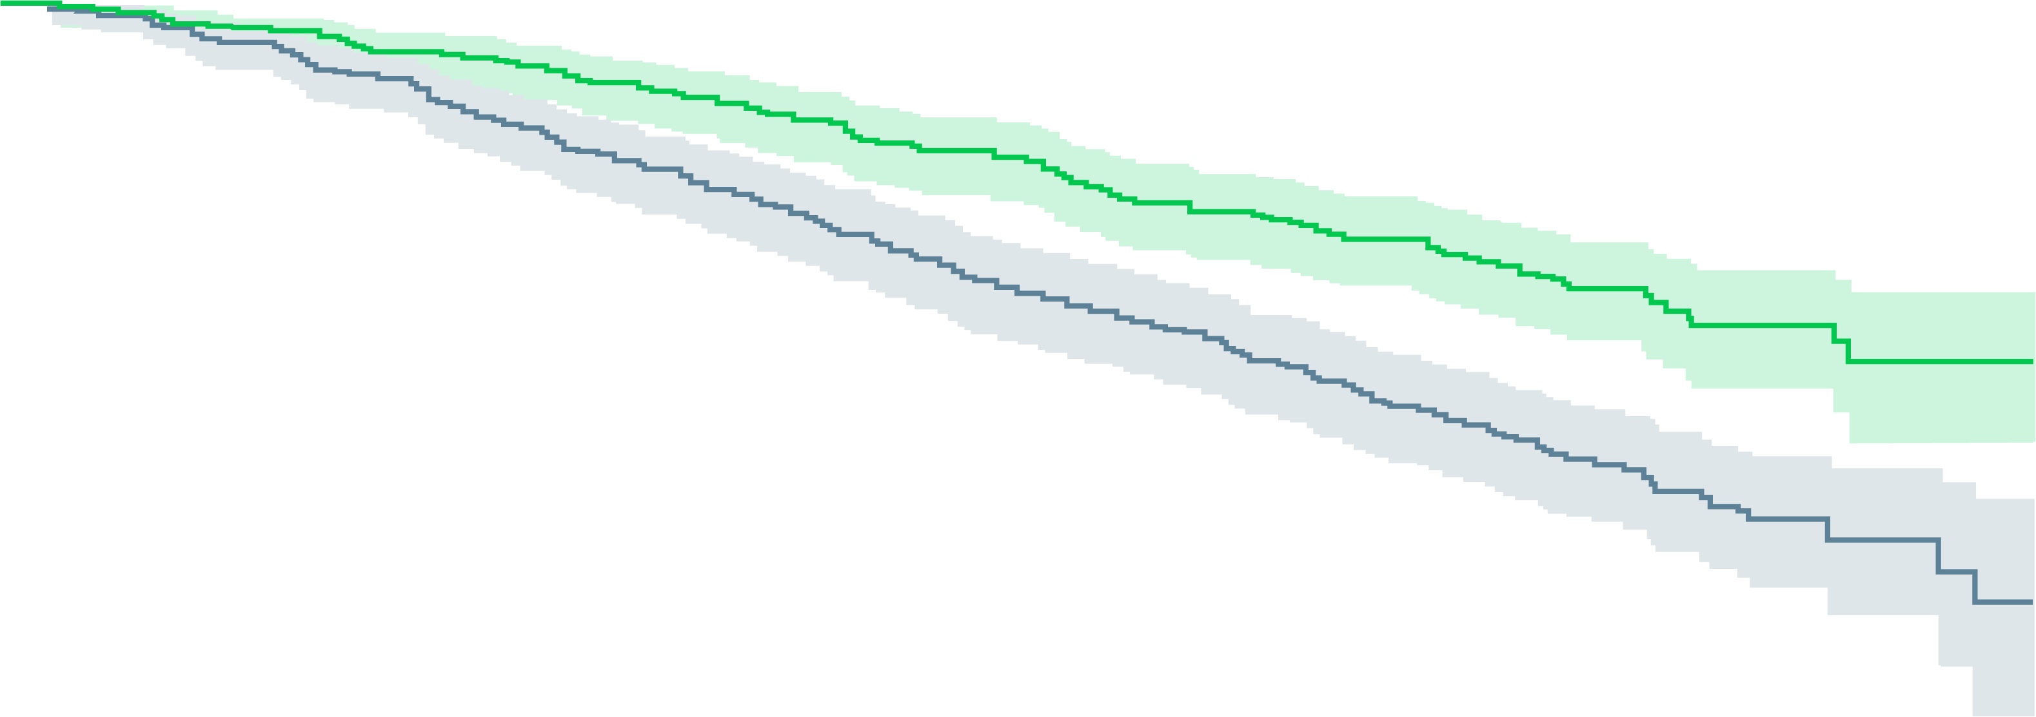
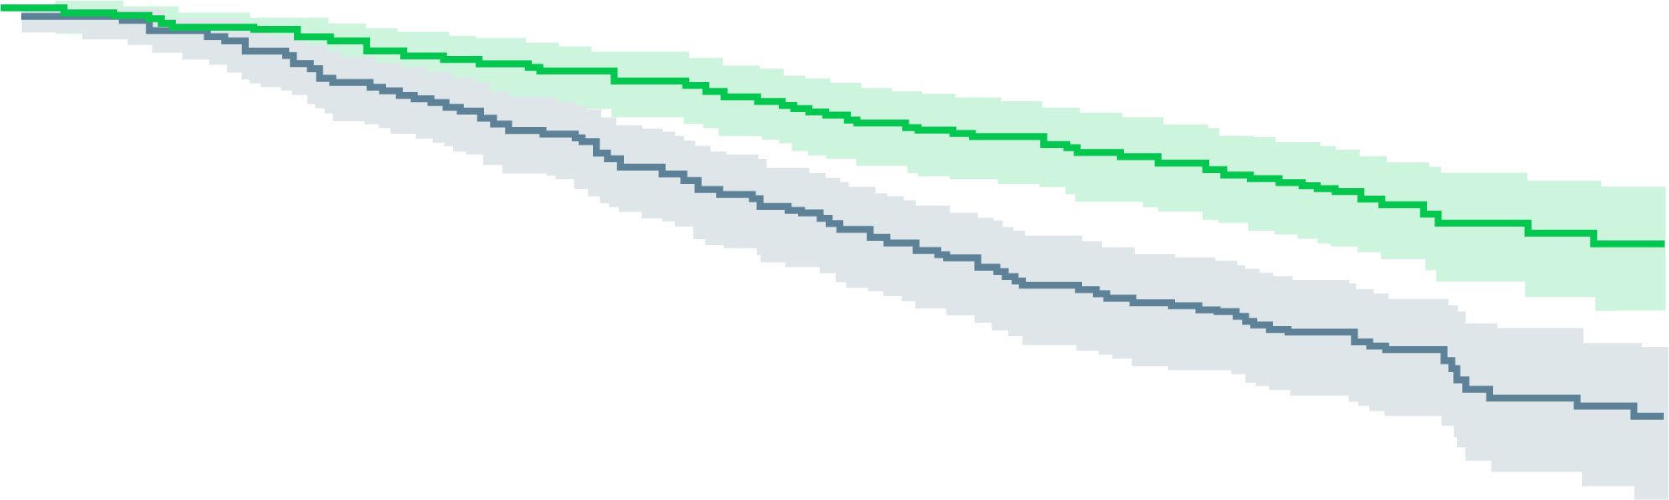
STAMPEDE: results
MFS BY RANDOMISATION PERIOD
1.0
1.0
ADT + AAP + ENZ
ADT + AAP
0.8
0.8
ADT
0.6
ADT
0.6
Metastasis-free survival
Metastasis-free survival
0.4
0.4
HR: 0.54
95% CI: 0.43-0.68
P value: 3.2 × 10⁻⁷
Events
111 ADT + AAP
183 ADT
HR: 0.53
95% CI: 0.39-0.71
P value: 2.1 × 10⁻⁵
Events
69 ADT + AAP + ENZ
123 ADT
0.2
0.2
0.0
0
12
24
36
48
60
72
84
96
108
0.0
0
12
24
36
48
60
72
84
96
108
ADT
At-risk
Censored
Event
Months since randomisation
ADT
At-risk
Censored
Event
Months since randomisation
455
0
0
438
3
14
411
4
40
385
5
65
351
8
96
318
15
122
266
40
149
172
112
171
53
222
180
9
263
183
533
0
0
512
5
16
483
7
43
451
9
73
416
18
99
232
186
115
63
347
123
ADT + AAP
At-risk
Censored
Event
ADT + AAP + ENZ
At-risk
Censored
Event
459
0
0
441
9
9
426
13
20
411
13
35
391
14
54
362
22
75
312
58
89
198
157
104
71
279
109
14
334
111
527
0
0
507
12
8
491
15
21
473
18
36
448
31
48
260
203
64
57
402
68
Kaplan–Meier estimates with 95% CI in lighter shade
Kaplan–Meier estimates with 95% CI in lighter shade
Interaction HR: 1.02 (95% CI: 0.70-1.50) p=0.908
AAP, abiraterone and prednisolone; ADT, androgen deprivation therapy; CI, confidence interval; ENZ, enzalutamide; HR, hazard ratio; MFS, metastasis-free survival
Attard G, et al. Ann Oncol. 2021;32 suppl 5:S1298 (ESMO 2021 oral presentation); Efstathiou, E. Discussant abstract #LBA4_PR. ESMO 2021

Slide 29
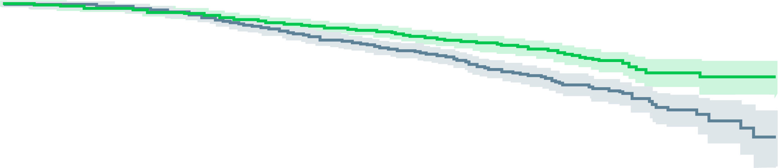
STAMPEDE: results
Overall survival
Events
147 ADT + AAP +/- ENZ
236 ADT
1.0
ADT + AAP +/- ENZ
0.8
0.6
ADT
HR: 0.60
95% CI: 0.48-0.73
P value: 9.3 × 10⁻⁷
Overall survival
0.4
0.2
0.0
0
12
24
36
48
60
72
84
96
108
6-year survival
improved from
77% to 86%
ADT
At-risk
Censored
Event
Months since randomisation
988
0
0
974
8
6
947
11
30
901
14
73
837
28
123
610
616
162
368
421
199
200
568
220
63
693
232
10
742
236
ADT + AAP +/- ENZ
At-risk
Censored
Event
986
0
0
956
21
9
928
29
29
899
32
55
861
46
79
645
234
107
386
477
123
205
641
140
74
766
146
16
823
147
Kaplan–Meier estimates with 95% CI in lighter shade
Non-proportional hazards p=0.1
OS: treatment effect was consistent between AAP and AAP + ENZ randomisation periods:
  ADT + AAP: HR 0.63 (95% CI: 0.48-0.82), p=0.0005
  ADT + AAP + ENZ: HR 0.54 (95% CI: 0.39-0.76), p=0.00043
    Interaction between comparisons p=0.5
AAP, abiraterone and prednisone; ADT, androgen deprivation therapy; APA, apalutamide; CI, confidence interval; ENZ, enzalutamide; HR, hazard ratio; OS, overall survival
Attard G, et al. Ann Oncol. 2021;32 suppl 5:S1298 (ESMO 2021 oral presentation); Efstathiou, E. Discussant Abstract #LBA4_PR. ESMO 2021

Slide 30
STAMPEDE: summary
2 years of AAP-based therapy significantly improved MFS and OS of high-risk M0 PCa patients starting ADT and should be considered a new standard of care
Adding ENZA to AAP increased toxicity but has no apparent effect on efficacy
  Clinical perspective:
Addressed an unmet need for high-risk M0 PCa patients
MFS and OS results are clinically meaningful
No quality of life data or long-term adverse event data at this stage
AAP, abiraterone and prednisone; ADT, androgen deprivation therapy; ENZA, enzalutamide; M0, non-metastatic; M1, metastatic; MFS, metastasis-free survival; OS, overall survival; PCa, prostate cancer
Attard G, et al. Ann Oncol. 2021;32 suppl 5:S1298 (ESMO 2021 oral presentation); Efstathiou, E. Discussant Abstract #LBA4_PR. ESMO 2021

Slide 31
Urothelial carcinoma
2021 Highlights

Slide 32
EV-301: BACKGROUND AND study DESIGN
Patients with advanced urothelial carcinoma have poor overall survival after platinum-containing chemotherapy and programmed cell death protein 1 (PD-1) or programmed death ligand 1 (PD-L1) inhibitor treatment
Enfortumab vedotin is an antibody-drug conjugate directed to nectin-4, a cell adhesion molecule highly expressed in urothelial carcinoma
EV-301 was a phase 3 trial of enfortumab vedotin versus chemotherapy in patients with previously treated locally advanced or metastatic urothelial carcinoma
Key eligibility criteria
Histologically/cytologically confirmed UC, including with squamous differentiation or mixed cell types
Radiographic progression or relapse during or after PD-1/PD-L1 treatment for advanced UC
Prior platinum-containing regimen for advanced UC
ECOG PS 0 or 1
Enfortumab vedotin
(N=301)
1.25 mg/kg on days 1, 8 and 15
of each 28-day cycle
Primary endpoint: Overall survival
Secondary endpoints:
Progression-free survival
Disease control rate
Overall response rate
Safety
1:1 randomisation
with stratification
Investigator-
assessed per
RECIST v1.1
Preselected chemotherapy
(N=307)
Docetaxel 75 mg/m² or
Paclitaxel 175 mg/m² or
Vinflunine 320 mg/m²
on Day 1 of each 21-day cycle
ECOG PS, Eastern Cooperative Oncology Group performance status; PD-1, programmed cell death protein 1; PD-L1, programmed death ligand 1; RECIST, Response Evaluation Criteria in Solid Tumours; UC, urothelial cell carcinoma
Powles T, et al. N Engl J Med. 2021;384:1125-35; Powles T, et al. J Clin Oncol. 2021;39 suppl 6:393

Slide 33
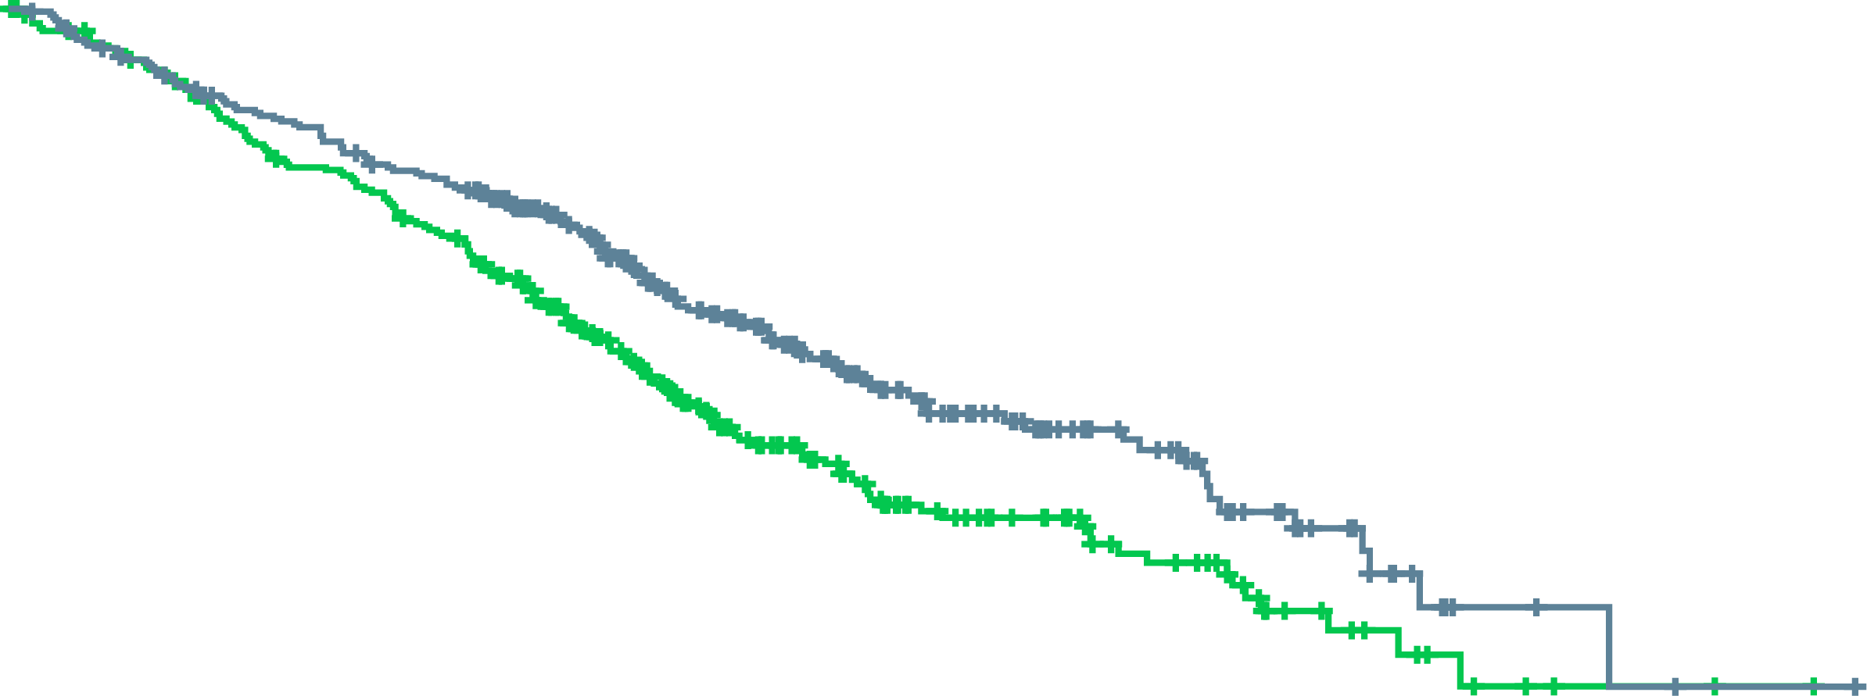
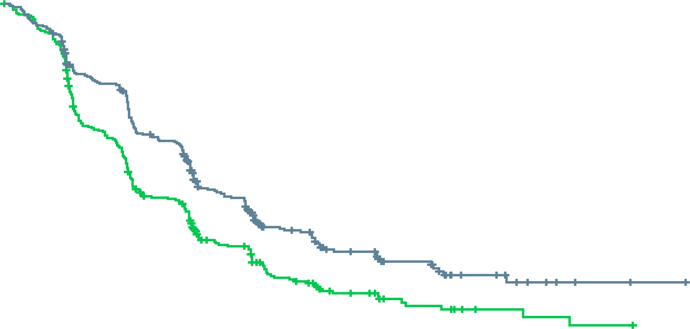
Ev-301: results
OVERALL SURVIVAL ACCORDING TO TREATMENT GROUP
Progression-free survival – itt population
 | No. of deaths/ No. of patients | Median overall survival (95% CI) mo
Enfortumab vedotin | 134/301 | 12.88 (10.58-15.21)
Chemotherapy | 167/307 | 8.97 (8.05-10.74)
HR for death (95% CI) | 0.70 (0.56-0.89)
P value | =0.001
 | No. of deaths/ No. of patients | Median progression-free survival (95% CI) mo
Enfortumab vedotin | 201/301 | 5.55 (5.32-5.82)
Chemotherapy | 231/307 | 3.71 (3.52-3.94)
HR for death (95% CI) | 0.62 (0.51-0.75)
P value | <0.001
100
100
90
90
80
80
70
70
60
60
Percentage of patients alive
Enfortumab vedotin
Percentage of patients free from
progression or death
50
50
40
Chemotherapy
40
Enfortumab vedotin
30
30
20
20
Chemotherapy
10
10
0
0
0
1
2
3
4
5
6
7
8
9
10
11
12
13
14
15
16
17
18
19
20
21
22
23
24
0
1
2
3
4
5
6
7
8
9
10
11
12
13
14
15
16
17
18
19
20
21
Months
Months
No. at risk
Enfortumab vedotin
Chemotherapy
301
307
286
288
272
274
257
250
246
238
234
219
222
198
190
163
158
131
130
101
105
84
85
66
63
51
52
44
42
32
33
29
23
16
15
11
7
6
4
4
3
2
2
2
1
1
1
0
0
0
No. at risk
Enfortumab vedotin
Chemotherapy
301
307
269
259
224
200
208
166
165
116
158
107
102
62
95
57
60
33
56
29
38
18
36
16
23
8
17
8
11
4
7
3
5
2
2
1
2
1
1
0
1
0
0
0
CI, confidence interval; HR, hazard ratio; ITT, intention-to-treat; mo, months
Powles T, et al. N Engl J Med. 2021;384:1125-35

Slide 34
Ev-301: results
DEATHS ACCORDING TO SUBGROUP
Subgroup | Enfortumab vedotin | Chemotherapy | Hazard ratio (95% CI)
 | No. of deaths/no. of patients
All patients | 134/301 | 167/307 |  | 0.70 (0.56-0.89)
Age group
<65 yr | 49/108 | 66/111 |  | 0.68 (0.47-0.99)
≥65 yr | 85/193 | 101/196 |  | 0.75 (0.56-1.00)
<75 yr | 109/249 | 128/239 |  | 0.69 (0.53-0.89)
≥75 yr | 25/52 | 39/68 |  | 0.91 (0.55-1.51)
Sex
Male | 101/238 | 132/232 |  | 0.61 (0.47-0.79)
Female | 33/63 | 35/75 |  | 1.17 (0.72-1.89)
Geographic region
Western Europe | 57/126 | 72/129 |  | 0.76 (0.53-1.07)
United States | 25/43 | 25/44 |  | 0.88 (0.51-1.54)
Rest of the world | 52/132 | 70/134 |  | 0.64 (0.45-0.92)
ECOG performance status
0 | 40/120 | 46/124 |  | 0.81 (0.53-1.24)
1 | 94/181 | 121/183 |  | 0.67 (0.51-0.87)
Liver metastasis
Yes | 53/93 | 63/95 |  | 0.66 (0.46-0.96)
No | 81/208 | 104/212 |  | 0.73 (0.55-0.98)
Preselected chemotherapy
Paclitaxel | 63/141 | 59/112 |  | 0.71 (0.49-1.10)
Docetaxel | 41/87 | 67/117 |  | 0.71 (0.48-1.04)
Vinflunine | 30/73 | 41/78 |  | 0.77 (0.48-1.24)
Primary site of tumour
Upper urinary tract | 44/98 | 52/107 |  | 0.85 (0.57-1.27)
Bladder or other site | 90/203 | 115/200 |  | 0.67 (0.51-0.88)
Previous systemic therapies
1-2 | 115/262 | 147/270 |  | 0.69 (0.54-0.88)
≥3 | 19/39 | 20/37 |  | 0.88 (0.47-1.64)
Best response among patients who previously received CPI treatment
Response | 18/61 | 23/50 |  | 0.63 (0.34-1.17)
No response | 100/207 | 120/215 |  | 0.76 (0.58-0.99)
0.25
1.00
2.00
Enfortumab vedotin better
Chemotherapy better
CI, confidence interval, CPI, checkpoint inhibitor; ECOG, Eastern Cooperative Oncology Group; yr, year
Powles T, et al. N Engl J Med. 2021;384:1125-35

Slide 35
Ev-301: results
TREATMENT-RELATED ADVERSE EVENTS (SAFETY POPULATION)
Adverse event | Enfortumab Vedotin Group (N=296) |  | Chemotherapy Group (N=291)
 | Any grade | Grade ≥3 | Any grade | Grade ≥3
Adverse event | 278 (93.9) | 152 (51.4) | 267 (91.8) | 145 (49.8)
Alopecia | 134 (45.3) | 0 | 106 (36.4) | 0
Peripheral sensory neuropathy† | 100 (33.8) | 9 (3.0) | 62 (21.3) | 6 (2.1)
Pruritus | 95 (32.1) | 4 (1.4) | 13 (4.5) | 0
Fatigue | 92 (31.1) | 19 (6.4) | 66 (22.7) | 13 (4.5)
Decreased appetite | 91 (30.7) | 9 (3.0) | 68 (23.4) | 5 (1.7)
Diarrhoea | 72 (24.3) | 10 (3.4) | 48 (16.5) | 5 (1.7)
Dysgeusia | 72 (24.3) | 0 | 21 (7.2) | 0
Nausea | 67 (22.6) | 3 (1.0) | 63 (21.6) | 4 (1.4)
Maculopapular rash | 48 (16.2) | 22 (7.4) | 5 (1.7) | 0
Anaemia | 34 (11.5) | 8 (2.7) | 59 (20.3) | 22 (7.6)
Decreased neutrophil count | 30 (10.1) | 18 (6.1) | 49 (16.8) | 39 (13.4)
Neutropenia | 20 (6.8) | 14 (4.7) | 24 (8.2) | 18 (6.2)
Decreased white-cell count | 16 (5.4) | 4 (1.4) | 31 (10.7) | 20 (6.9)
Febrile neutropenia | 2 (0.7) | 2 (0.7) | 16 (5.5) | 16 (5.5)
† A total of 113 patients (55 in the enfortumab vedotin group and 58 in the chemotherapy group) had preexisting peripheral neuropathy
Powles T, et al. N Engl J Med. 2021;384:1125-35

Slide 36
EV-301: Summary
Enfortumab vedotin:
Had superior overall survival compared with chemotherapy in patients with advanced urothelial carcinoma who had previously received platinum-based chemotherapy and a PD-1/PD-L1 inhibitor
Showed superior progression-free survival and response rates compared with chemotherapy
Demonstrated a tolerable and manageable safety profile, with no new safety signals identified
Is the first drug, beyond chemotherapy and immunotherapy, to show significant survival advantage in previously treated advanced urothelial carcinoma
PD-1, programmed cell death protein 1; PD-L1, programmed death ligand 1
Powles T, et al. N Engl J Med. 2021;384:1125-35

Slide 37
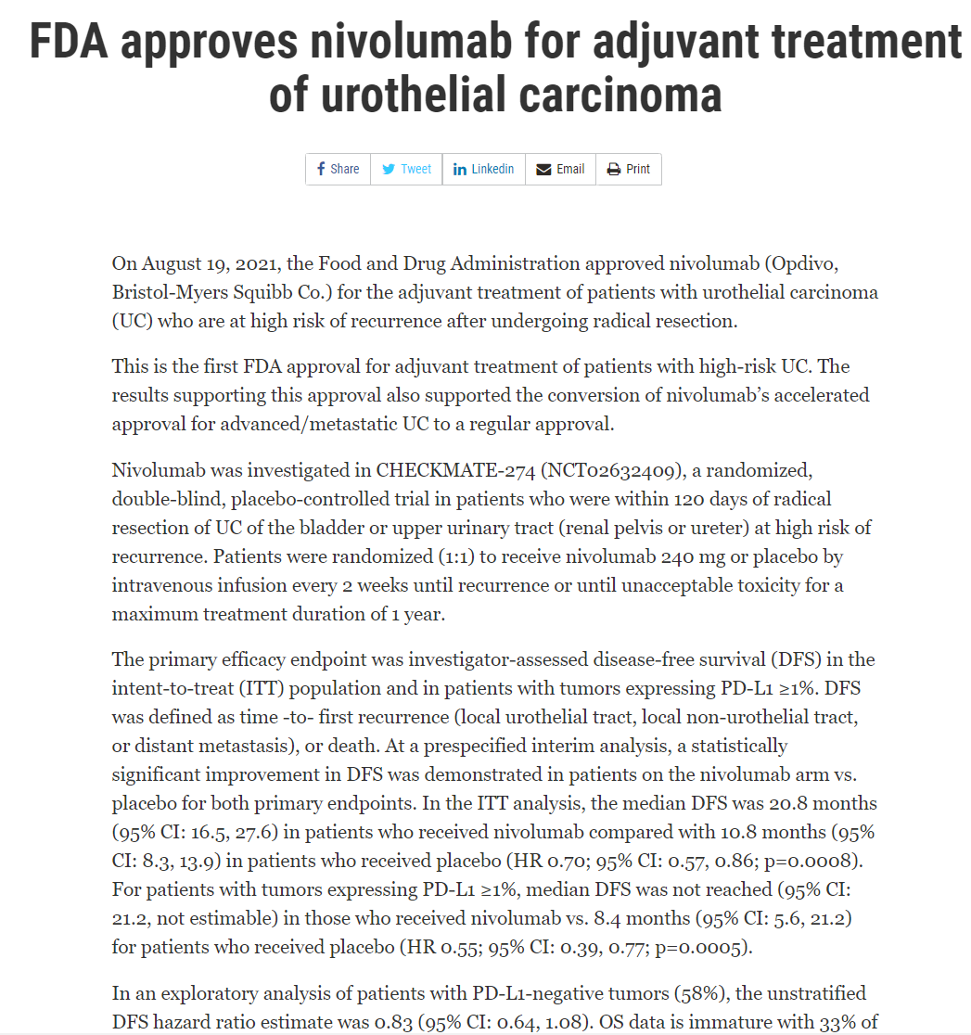
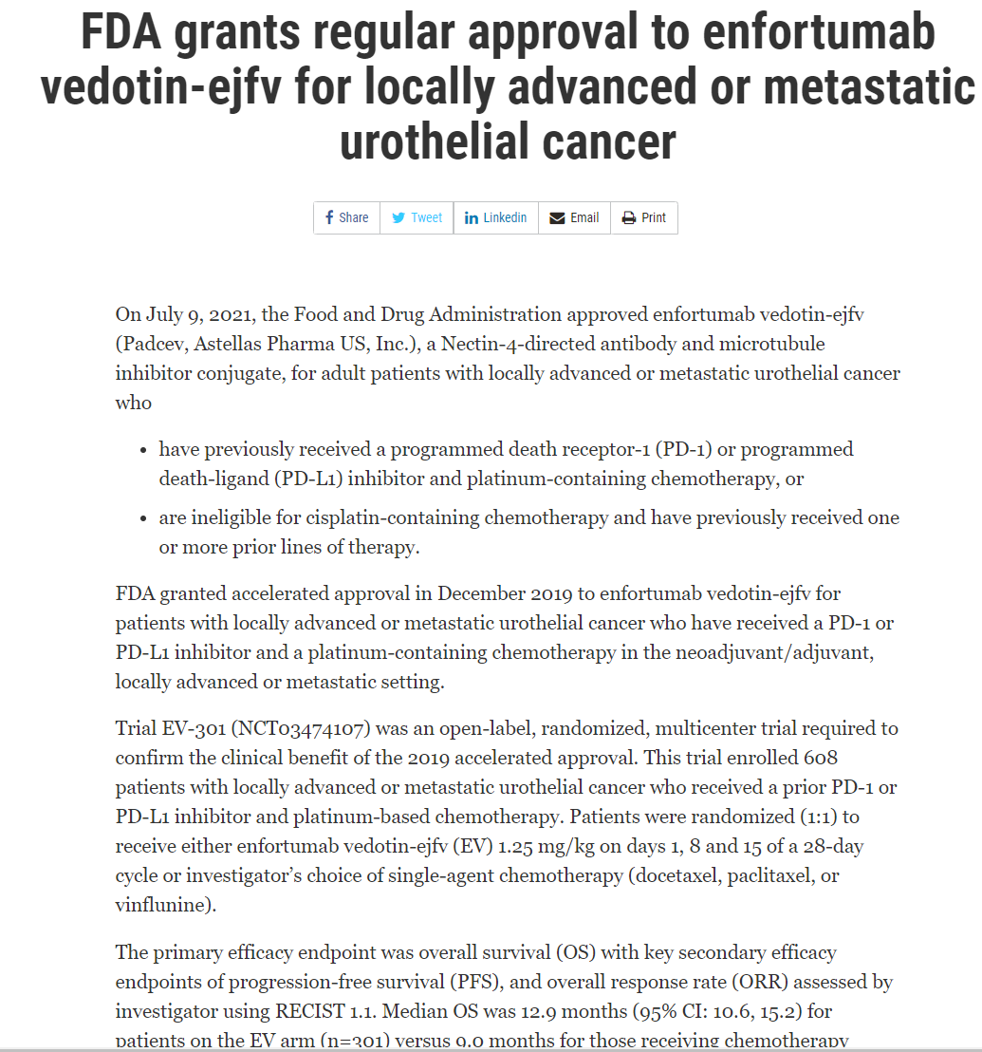
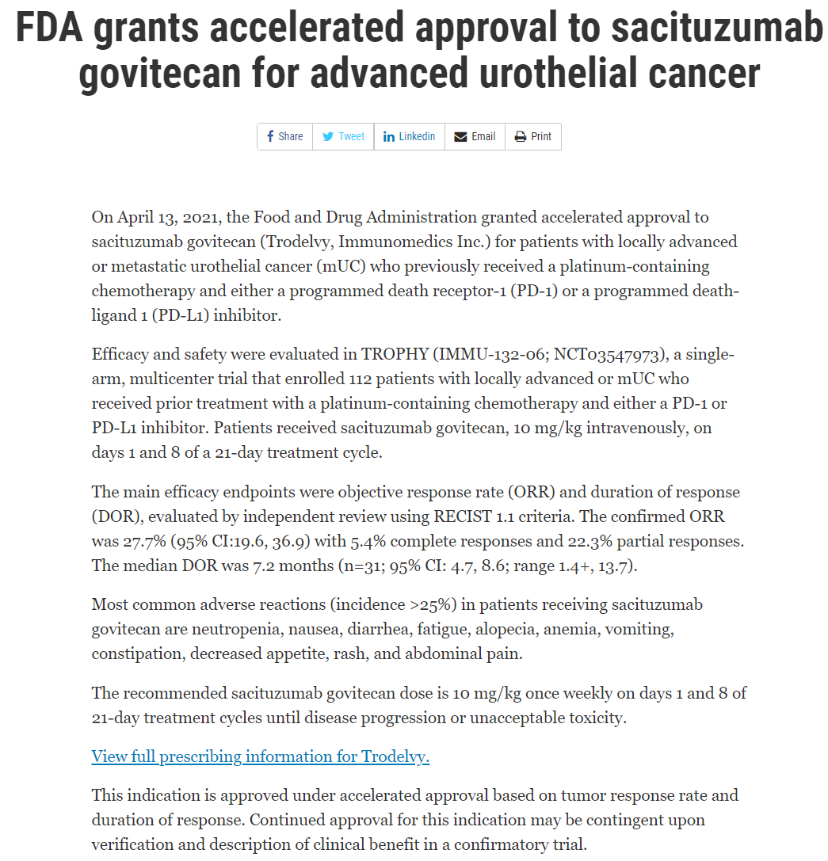
Key approvals: Urothelial cancer
FDA Approvals
www.fda.gov/drugs/. Accessed 16 November 2021

Slide 38
Renal cell carcinoma
2021 Highlights

Slide 39
KEYNOTE-564: BACKGROUND AND study DESIGN
Nephrectomy is the standard of care for locoregional renal cell carcinoma (RCC)
Up to 40% of patients with locoregional RCC experience disease recurrence after surgery and develop metastasis
KEYNOTE-564 investigated adjuvant pembrolizumab after nephrectomy in RCC patients
Pembrolizumab
200 mg Q3W for ~1 yearª
Key eligibility criteria:
Histology confirmed clear cell renal cell carcinoma
Nephrectomy ≤12 weeks prior to randomisation
No prior systemic therapy
ECOG PS 0 or 1
R
1:1
Placebo
Q3W for ~1 yearª
Stratification factors:
M0 vs M1 NED
M0 group further stratified:
  ECOG PS 0 vs 1
  US vs non-US
Primary end point: DFS per investigator
Key secondary endpoint: OS
Other secondary endpoints: Safety
ª ≤17 cycles of treatment were equivalent to ~1 year
DFS, disease-free survival; ECOG PS, Eastern Cooperative Oncology Group performance status; M0, non-metastatic; M1, metastatic; NED, no evidence of disease; OS, overall survival; Q3W, every 3 weeks; RCC, renal cell carcinoma
Choueiri TK, et al. J Clin Oncol. 2021;39 suppl 15:LBA5 (ASCO 2021 oral presentation); National Comprehensive Cancer Network. Kidney Cancer (Version 3.2022). https://www.nccn.org/professionals/physician_gls/pdf/kidney.pdf; Escudier B, et al. Ann Oncol. 2019;30:706-20; Smaldone MC, et al. Hematol Oncol North Am. 2011;25:765-91; Sun M, et al. Eur Urol. 2018;74:611-20; Correa AF, et al. J Clin Oncol. 2019;37:2062-71

Slide 40
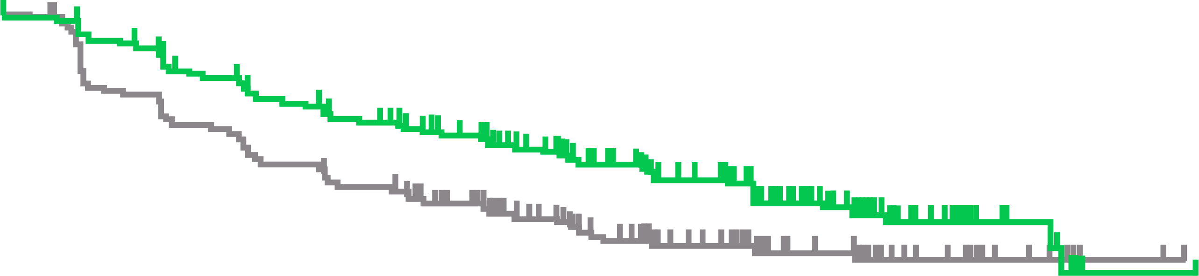
KEYNOTE-564: results
BASELINE CHARACTERISTICS (ITT POPULATION)
Dfs by investigator (ITT population)
Characteristic | Pembrolizumab (N=496) | Placebo (N=498)
Age Median (range), yr ≥65 yr, n (%) | 60.0 (27-81) 158 (31.9) | 60.0 (25-84) 172 (34.5)
Male sex, n (%) | 347 (70.0) | 359 (72.1)
ECOG performance status score of 1, n (%) | 75 (15.1) | 72 (14.5)
Geographic location North America European Union Rest of the world | 133 (26.8) 188 (37.9) 175 (35.3) | 125 (25.1) 187 (37.6) 186 (37.3)
Radical nephrectomy, n (%) | 459 (92.5) | 460 (92.4)
Sarcomatoid features, n (%) Present Absent Unknown | 52 (10.5) 417 (84.1) 27 (5.4) | 59 (11.8) 415 (83.3) 24 (4.8)
Disease risk category, n (%) M0, intermediate-to-high risk M0, high risk M1 NED | 427 (86.1) 40 (8.1) 29 (5.8) | 433 (86.9) 36 (7.2) 29 (5.8)
PD-L1 combined positive score, n (%) <1 ≥1 Missing data | 124 (25.0) 365 (73.6) 7 (1.4) | 113 (22.7) 383 (76.9) 2 (0.4)
100
90
80
Pembrolizumab
70
Placebo
60
Disease-free survival (%)
50
 | No. of events of disease recurrence or death
Pembrolizumab | 109
Placebo | 151
HR (95% CI) | 0.68 (0.53-0.87)
P value | 0.002
40
30
20
10
0
0
5
10
15
20
25
30
35
40
45
Months
No. at risk
Penbrolizumab
Placebo
496
498
457
436
414
389
371
341
233
209
151
145
61
56
21
19
1
1
0
0
CI, confidence interval; DFS, disease-free survival; ECOG, Eastern Cooperative Oncology Group; HR, hazard ratio; ITT, intention-to-treat; M0, non-metastatic; M1, metastatic; NED, no evidence of disease; PD-L1, programmed death ligand 1; yr, year
Choueiri TK, et al. J Clin Oncol. 2021;39 suppl 15:LBA5 (ASCO 2021 oral presentation); Choueiri TK, et al. N Engl J Med. 2021;385:683-94

Slide 41
KEYNOTE-564: results
DFS BY INVESTIGATOR IN SUBGROUPS (ITT POPULATION)
Any cause and trae (as-treated population)
Subgroup | No. of events/ no. of patients | Hazard ratio for recurrence or death (95% CI)
Overall | 260/994 |  | 0.68 (0.53-0.87)
Age
<65 yr | 166/664 |  | 0.62 (0.45-0.84)
≥65 yr | 94/330 |  | 0.84 (0.56-1.26)
Sex
Female | 79/288 |  | 0.75 (0.48-1.16)
Male | 181/706 |  | 0.66 (0.49-0.89)
ECOG performance status score
0 | 215/847 |  | 0.65 (0.49-0.85)
1 | 45/147 |  | 0.91 (0.50-1.63)
PD-L1 combined positive score
<1 | 42/237 |  | 0.83 (0.45-1.51)
≥1 | 215/748 |  | 0.67 (0.51-0.88)
Geographic region
North America | 65/258 |  | 0.87 (0.53-1.41)
European Union | 97/375 |  | 0.49 (0.32-0.74)
Rest of the world | 98/361 |  | 0.81 (0.55-1.21)
Metastatic staging
M0 | 234/936 |  | 0.74 (0.57-0.96)
M1 NED | 26/58 |  | 0.29 (0.12-0.69)
Type of nephrectomy
Partial | 10/75 |  | 0.22 (0.05-1.04)
Radical | 250/919 |  | 0.72 (0.56-0.93)
EVENT | Pembrolizumab (N=488) | Placebo (N=496)
Any-cause adverse events, n (%) Adverse event of any grade Adverse event of grade 3 to 5 Discontinuation of pembrolizumab or placebo due to adverse event Death due to adverse event Serious adverse event Discontinuation of pembrolizumab or placebo due to serious adverse event | 470 (96.3) 158 (32.4) 101 (20.7) 2 (0.4) 100 (20.5) 49 (10.0) | 452 (91.1) 88 (17.7) 10 (2.0) 1 (0.2) 56 (11.3) 5 (1.0)
Treatment-related adverse events, as assessed by investigator, n (%) Adverse event of any grade Adverse event of grade 3 to 5 Discontinuation of pembrolizumab or placebo due to adverse event Death due to adverse event Serious adverse event Discontinuation of pembrolizumab or placebo due to serious adverse event | 386 (79.1) 92 (18.9) 86 (17.6) 0 59 (12.1) 37 (7.6) | 265 (53.4) 6 (1.2) 3 (0.6) 0 1 (0.2) 0
0.1
0.5
1.0
1.5
Pembrolizumab better
Placebo better
CI, confidence interval; DFS, disease-free survival; ECOG, Eastern Cooperative Oncology Group; ITT, intention-to-treat; M0, non-metastatic; M1, metastatic;
NED, no evidence of disease; PD-L1, programmed death ligand 1; TRAE, treatment-related adverse event; yr, year
Choueiri TK, et al. J Clin Oncol. 2021;39 suppl 15:LBA5 (ASCO 2021 oral presentation); Choueiri T, et al. N Engl J Med. 2021;385:683-94

Slide 42
KEYNOTE-564: results
INTERIM OS DATA (ITT POPULATION)
100
Pembrolizumab
90
Placebo
80
70
60
Overall survival (%)
50
40
 | No. of deaths
Pembrolizumab | 18
Placebo | 33
HR (95% CI) | 0.54 (0.30-0.96)
30
20
10
0
0
5
10
15
20
25
30
35
40
45
No. at risk
Pembrolizumab
Placebo
Months
496
498
490
494
486
485
482
480
338
336
215
209
124
117
51
48
3
3
0
0
CI, confidence interval; HR, hazard ratio; ITT, intention-to-treat; OS, overall survival
Choueiri TK, et al. J Clin Oncol. 2021;39 suppl 15:LBA5 (ASCO 2021 oral presentation); Choueiri T, et al. N Engl J Med. 2021;385:683-94

Slide 43
Keynote-564: Summary
Adjuvant pembrolizumab post-nephrectomy demonstrated a statistically significant and clinically meaningful improvement in DFS compared with placebo
  This benefit was consistent across subgroups
Safety data were as expected with no new safety signals observed
Pembrolizumab is a potential new standard of care for RCC patients in the adjuvant setting
DFS, disease free survival; RCC, renal cell carcinoma
Choueiri TK, et al. J Clin Oncol. 2021;39 suppl 15:LBA5 (ASCO 2021 oral presentation); Choueiri T, et al. N Engl J Med. 2021;385:683-94

Slide 44
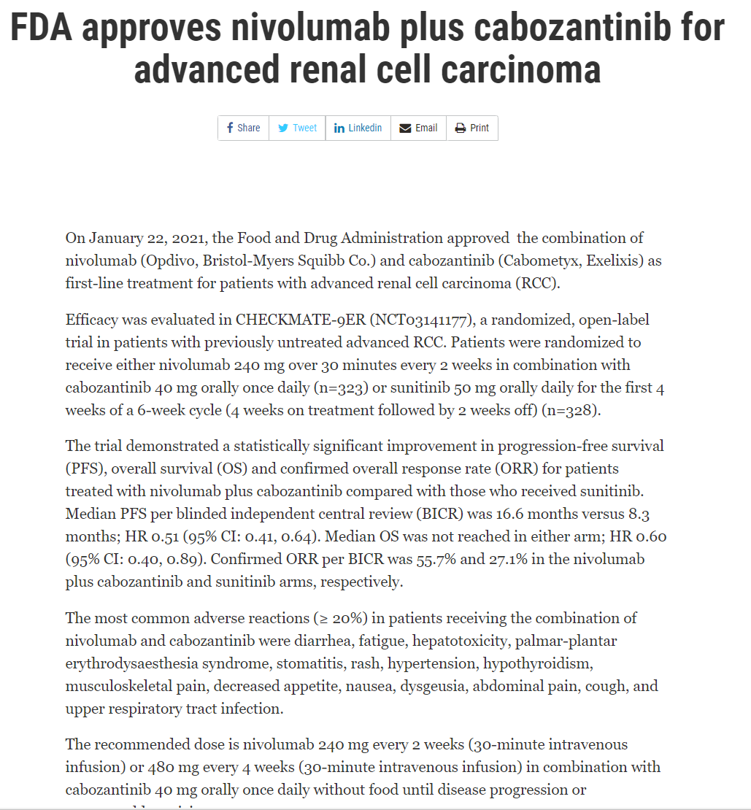
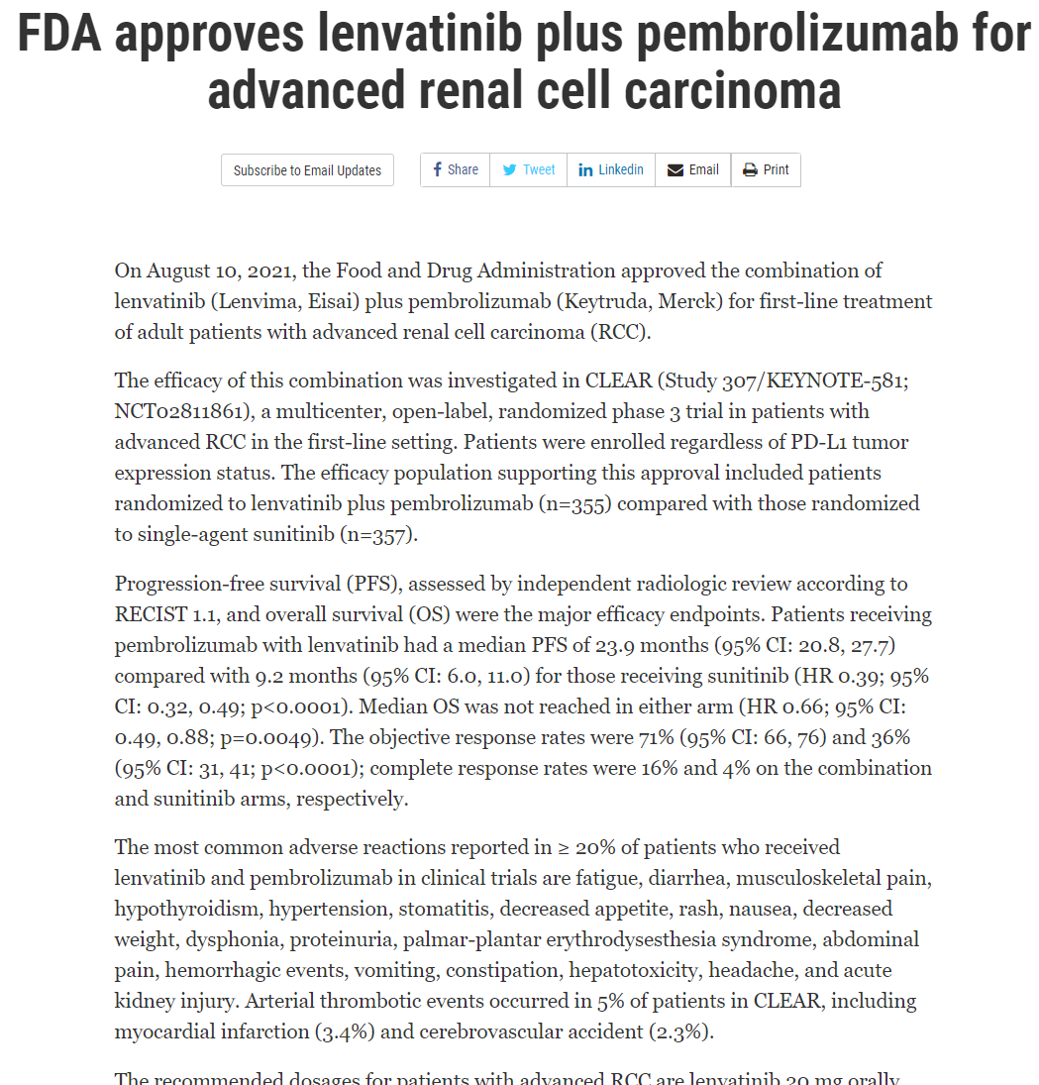
Key approvals: renal cell carcinoma
FDA Approvals
www.fda.gov/drugs/. Accessed 16 November 2021

Slide 45
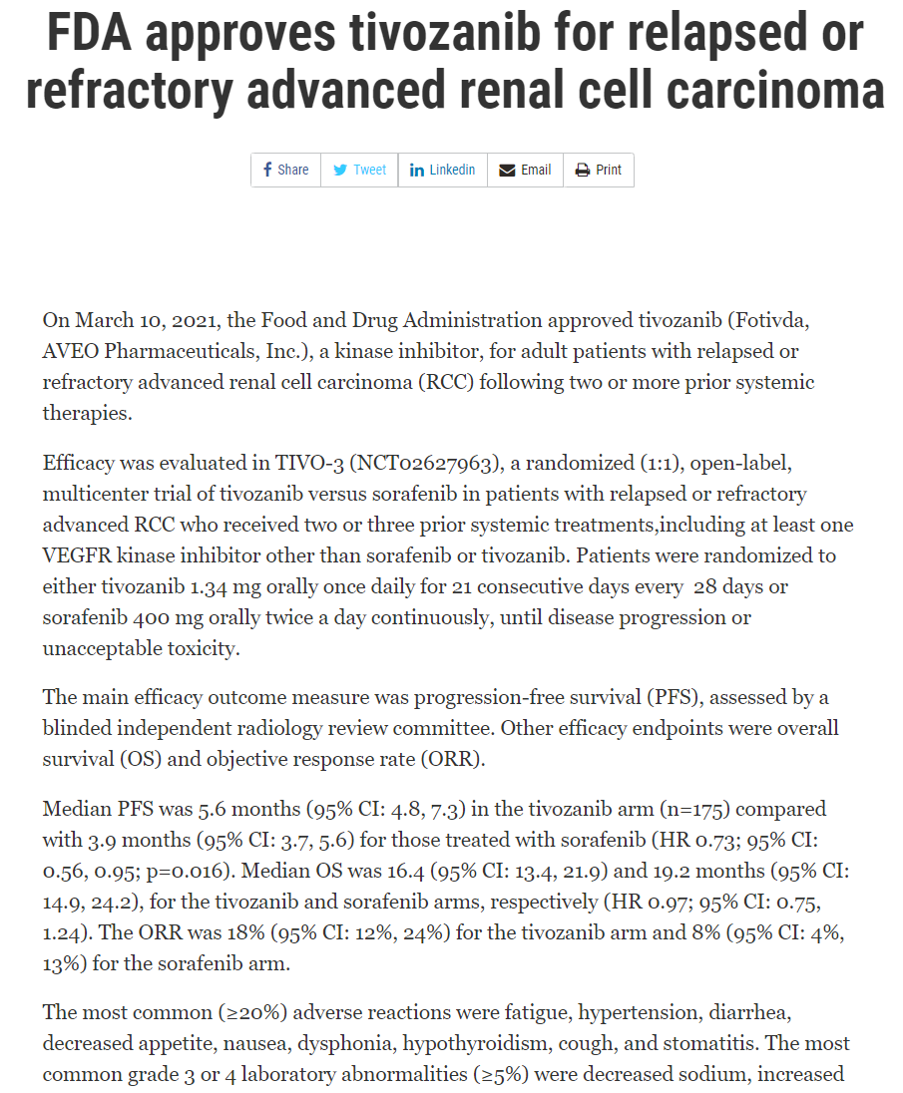
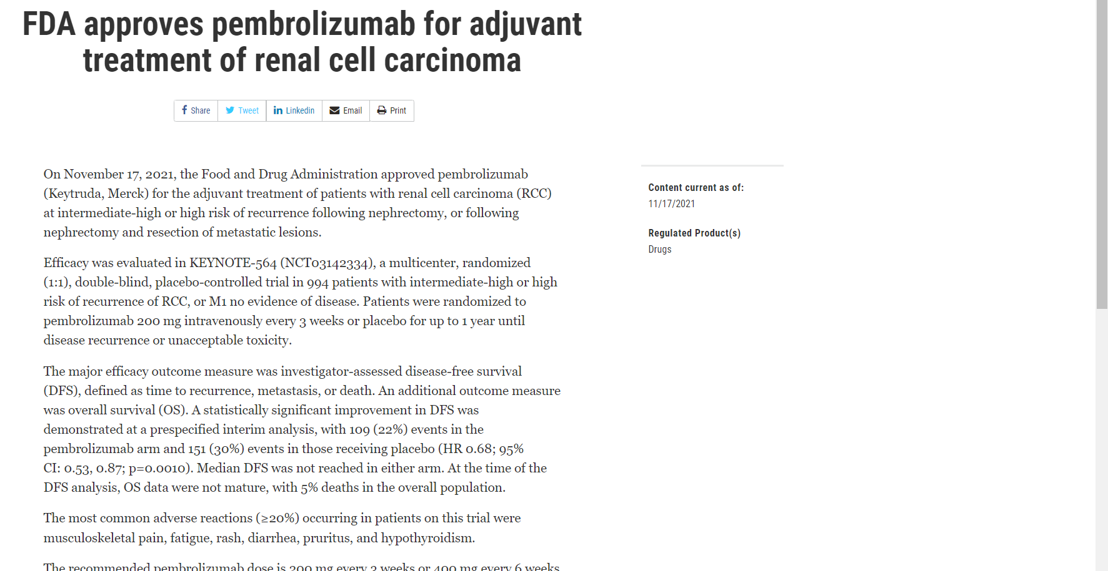
Key approvals: renal cell carcinoma
FDA Approvals
www.fda.gov/drugs/. Accessed 03 December 2021

Slide 46

REACH GU CONNECT VIA
TWITTER, LINKEDIN, VIMEO & EMAIL
OR VISIT THE GROUP’S WEBSITE https://guconnect.cor2ed.com/
Follow us on Twitter
@guconnectinfo
Follow the
GU CONNECT
group on LinkedIn
Watch us on the
Vimeo Channel
GU CONNECT
Email
sam.brightwell@cor2ed.com

