Slide 2
Overcoming common challenges encountered in the diagnosis of rare bone disease
An independent Symposium
23rd May 2022

Slide 3
Disclaimer
This Rare Bone Disease Pharmaceutical Consortium medical education symposium is provided by COR2ED, with an independent medical sponsorship from Ipsen, Alexion, and Kyowa Kirin
The programme is therefore independent; the content is not influenced by the Rare Bone Disease Pharmaceutical Consortium and is the sole responsibility of the experts
The pharmaceutical companies that compose the consortium are committed to joining forces to raise awareness of rare bone disease through medical education, with the intention of improving outcomes in rare bone diseases and quality of life for people living with them
Please note: The views expressed within this presentation are the personal opinions of the experts. They do not necessarily represent the views of the experts’ academic institutions or the rest of the faculty

Slide 4



expert Faculty
Richard Keen
Maria Luisa Brandi
Lothar Seefried
London, United Kingdom
Florence, Italy
Würzburg, Germany

Slide 5




agenda
Common challenges encountered in the diagnosis of rare bone disease:
Challenges in fibrodysplasia ossificans progressiva
Richard Keen (UK)
Challenges in FGF23-related hypophosphataemic rickets/osteomalacia
  Maria Luisa Brandi (Italy)
Challenges in hypophosphatasia
  Lothar Seefried (Germany)

Slide 6
CHALLENGES IN FIBRODYSPLASIA OSSIFICANS PROGRESSIVA (FOP)
Professor Richard Keen
Royal National Orthopaedic Hospital, London, UK
richard.keen1@nhs.net

Slide 7
DISCLOSURES
Research grants & educational grants:
  Ipsen, Kyowa Kirin, Mereo BioPharma, Regeneron Pharmaceuticals
Speakers Fees:
  Amgen, UCB
Consultancies:
  Alexion Pharmaceuticals, Ipsen, Kyowa Kirin
Other
  Brittle Bone Society Scientific Advisory Board, International Clinical Council on FOP, Royal Osteoporosis Society Bone Academy

Slide 8
What is Fibrodysplasia Ossificans Progressiva?
Fibrodysplasia ossificans progressiva (FOP) (OMIM #135100) is a rare, severely disabling disease characterised by malformed big toes and progressive heterotopic ossification (HO) in muscles, tendons, and ligaments; it is often associated with painful, recurrent episodes of soft tissue swelling (flare-ups)
The apparent prevalence of registered and confirmed FOP patients varies substantially from approximately 0.65 per million in North America, 0.47 per million in Western Europe, and 0.27 per million in Latin America, to 0.05 per million in Africa and nearly 0.04 per million in the Asia-Pacific region¹
Prevalence estimates are hampered by the ultra-rarity of FOP, heterogeneity of the disease, and access to medical services with appropriate diagnostic services
Liljesthrom M, et al. J Rare Dis Res Treat 2020; 5(2):31-6

Slide 9

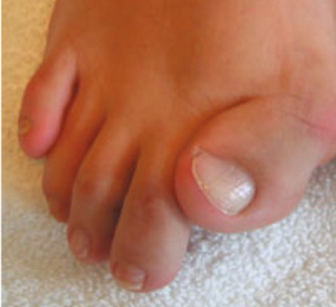
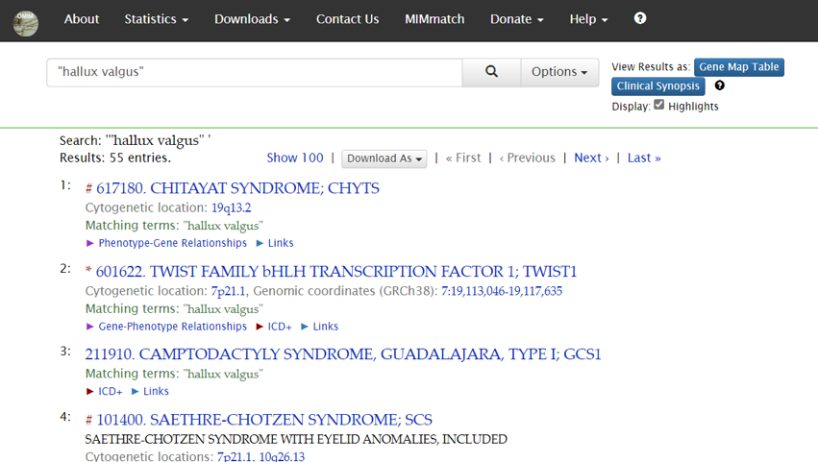
Malformation of Big Toes

Slide 10
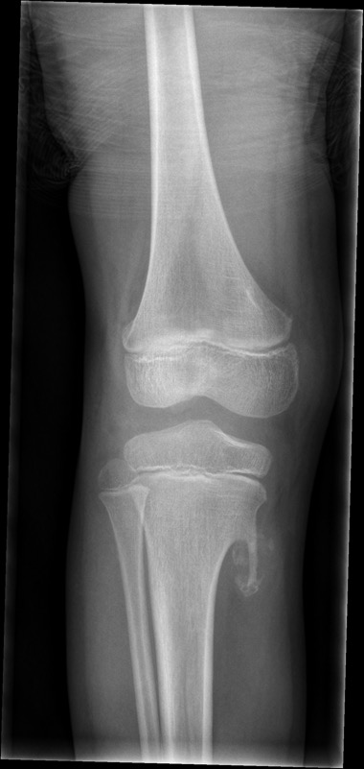
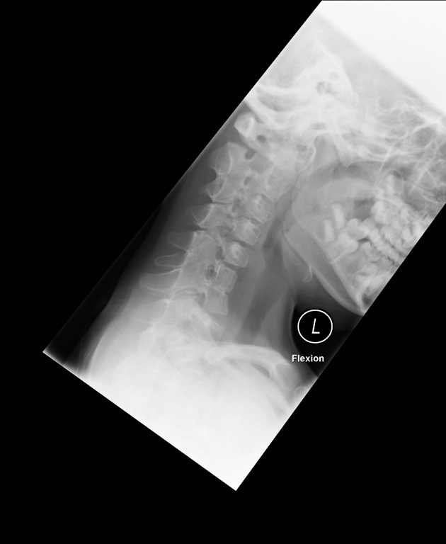
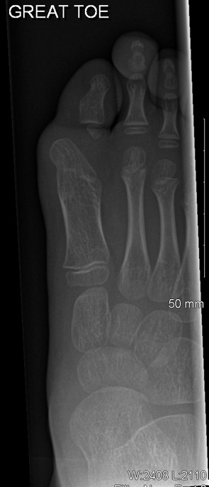
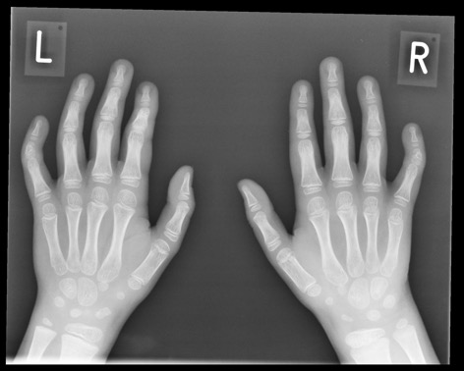
Radiological Features
Keen, R. Personal communication

Slide 11
Genetic Diagnosis
The diagnosis of FOP is clinical, but requires genetic confirmation
FOP is caused by heterozygous activating mutations in activin A receptor, type I/activin-like kinase 2 (ACVR1/ALK2), which is a bone morphogenetic protein (BMP) type I receptor
The most authoritative indicator is the detection of the ACVR1 gene mutation
  ~97% of cases have the classic c.617G>A mutation resulting in the substitution of arginine by histidine at codon 206 (p.R206H)
FOP, fibrodysplasia ossificans progressive
Kaplan FS, et al. Hum Mutat. 2009;30(3):379–390;
Whyte MP, et al. J Bone Miner Res. 2012; 27 (3): 729-37

Slide 12
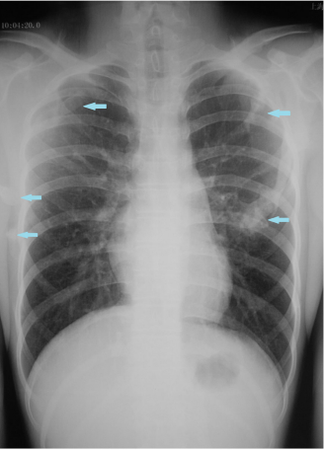
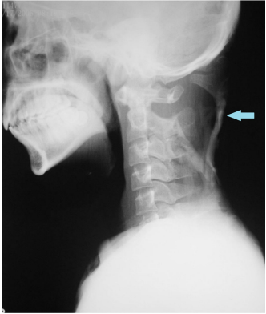
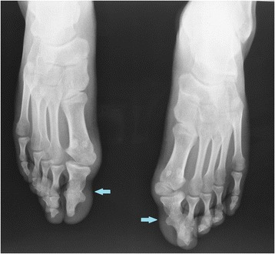
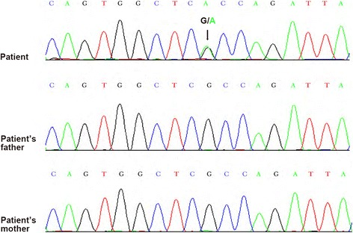
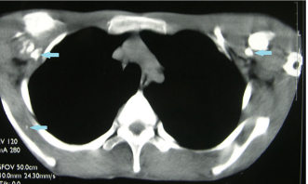
Patient Case – Genetic Confirmation
Boy 16 yrs who had suffered from pain and swelling in the biopsy site for two months
Initial tender stiffness of shoulders and back developed at age 9
Physical exam presented serious stiffness and multiple bony masses in the body, with his bilateral halluces characterized by hallux valgus deformity and macrodactyly
Imaging examinations showed widespread HO
Normal lab results except for alkaline phosphatase
de novo heterozygous mutation (c.617G > A; p.R206H) was found in the ACVR1/ALK2 using gene sequencing
FOP diagnosis confirmed
ER, emergency room
Tian S, et al. BMC Med Genet 2018; 19: 30

Slide 13
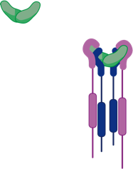


Pathological Pathway leading to Heterotopic Ossification
Activin A
antibodies
Anti-inflammatory
medication
Activin A
Inflammatory
factors
+
Hypoxic factors
ACVR1^{R206H}
SMAD1/5/8
mTOR inhibitor
Kinase inhibitors
P
SMAD1/5/8
RAR𝛾-agonist
SMAD4
P
Heterotopic
ossification
SMAD1/5/8
SMAD4
Adapted from: Smilde B, et al. Orthop Res Rev. 2022;14:113-120

Slide 14
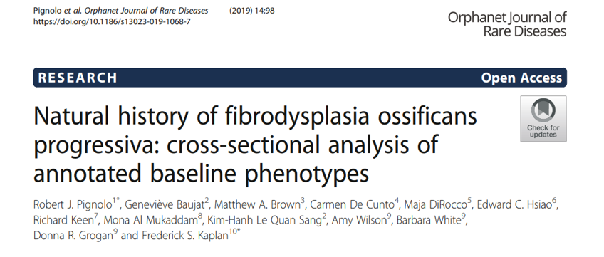
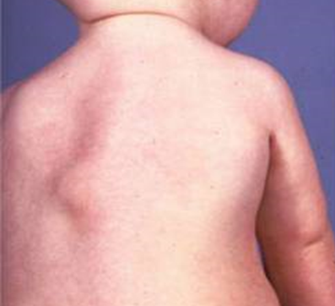
Symptom Onset
Demographic and baseline disease by age category
 | <8 years (N=17) | 8 to <15 years (N=36) | 15 to <25 years (N=27) | ≥25 to ≤65 years (N=27) | Total (N=114)
Males, n (%) | 9 (52.9) | 24 (66.7) | 16 (47.1) | 13 (48.1) | 62 (54.4)
Age (years) Mean ± SD Median (min, max) | 5.9 ± 1.1 6.0 (4, 7) | 11.4 ± 2.1 11.0 (8, 14) | 18.9 ± 3.1 18.5 (15, 24) | 31.7 ± 6.7 30.0 (25, 56) | 17.6 ± 9.7 15.0 (4, 56)
Age at 1st flare-up Mean ± SD Median (min, max) | 2.9 ± 2.1 2.0 (1, 6) | 4.4 ± 3.6 4.0 (0, 13) | 5.6 ± 4.8 3.5 (0, 17) | 7.1 ± 5.0 5.0 (0, 20) | 5.2 ± 4.4 4.0 (0, 20)
SD, standard deviation
Pignolo R, et al. Orphanet J Rare Dis. 2019;14:98

Slide 15
Recognition of Disease Flare-Ups
The majority of patients report swelling, pain, decreased movement, warmth, and redness as prominent symptoms of a flare-up.
Most patients reported confirmation of a flare-up within two days of onset of symptoms.
4-6
days
More than
6 days
13%
Immediately
17%
5%
Percentage
2-4 days
10%
1-6 hours
14%
1-2 days
25%
6-24 hours
16%
Pignolo RJ, et al. J Bone Miner Res. 2016;31:650-6

Slide 16
Misdiagnosis is Common in FOP
Approximately 53% of patients are misdiagnosed worldwide which can lead to unnecessary surgical intervention and disastrous results of early disability
Mistaken diagnoses: aggressive juvenile fibromatosis, lymphoedema, soft tissue sarcoma
Most common misdiagnoses in FOP⁴
Cancer
(e.g. osteosarcoma)
Juvenile
fibromatosis
Non-hereditary
myositis
ossificans
Klippel
Fiel syndrome
Benign
hallux
valgus
Ankylosing
spondylitis
Isolated
osteochondromas
Hematoma
Muscular
dystrophy
FOP, fibrodysplasia ossificans progressiva
Sherman A, et al. JBMR 2020; 35: S1 (P-841)
2020 FOP Registry Annual Report - IFOPA - International Fibrodysplasia Ossificans Progressiva Association, Accessed 12-May-2022

Slide 17
Risks of Surgery and Biopsy
25% of those who had received an intramuscular injection reported an immediate flare-up at the injection site, 84% of whom developed HO¹
Orthopaedic surgeries to remove HO or to correct deformities in the extremities or trunk have been reported, but most of them led to HO and worsening of motion/deformity; there is 100% risk of recurrence of HO after jaw surgery, which should be highly discouraged^{2,3}
HO, heterotopic ossification
1. Pignolo RJ, et al. J Bone Miner Res. 2016;31:650-6;
2. Kaplan FS, et al. Proc Intl Clin Council FOP. 2019;1:1-111;
3. Eekhoff EMW, et al. JBMR Plus. 2017;2:55-8

Slide 18
Patients Come into Contact with a Number of Specialists during their Journey
Approximately one quarter of Registry participants first sought care from a paediatrician for their FOP symptoms
Only 8% of participants reported that a paediatrician provided their correct diagnosis.
Speciality of Physician Who Provided Correct
FOP Diagnosis at Enrollment
50
45
40
35
30
Percent
25
20
15
10
5
0
Other
Geneticist
General
practitioner
Orthopedists
Paediatrician
Oncologist
Rheumatologist
Endocrinologist
Sherman A, et al. JBMR 2020; 35: S1 (P-841)
Scientific poster example (d3n8a8pro7vhmx.cloudfront.net), Accessed 12-May-2022

Slide 19
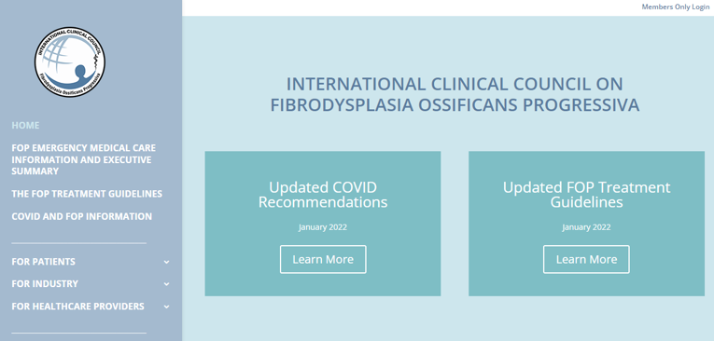

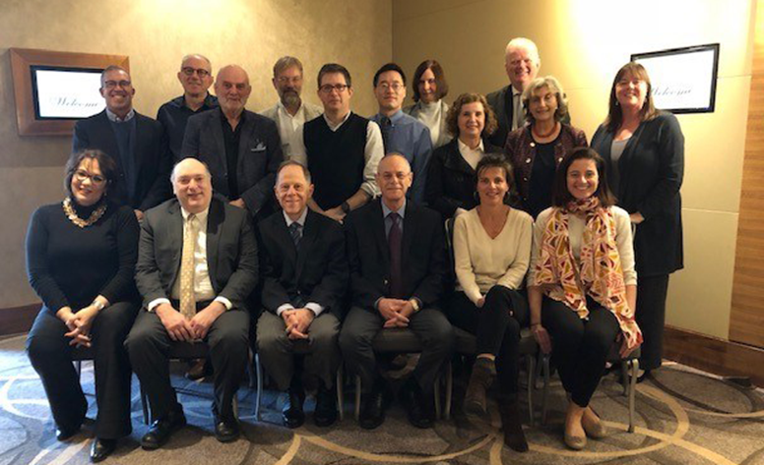
Finding an Expert

Slide 20







Patient Support
Patients and their families should be informed about the International Clinical Council on FOP, the International FOP Association (IFOPA), and country-specific support groups at the time of diagnosis
FOP, fibrodysplasia ossificans progressiva

Slide 21
Summary
Recognition of greater toe abnormalities at birth should raise suspicion of FOP
FOP can be confirmed with genetic testing of ACVR1
Avoid biopsies, surgery to remove heterotopic ossifications and IM injections/vaccines
Refer patient to expert clinician for further advice and management

Slide 22


FGF23-RELATED HYPOPHOSPHATAEMIC RICKETS/OSTEOMALACIA
Maria Luisa Brandi MD, PhD
FIRMO Foundation
Florence, Italy

Slide 23
DISCLOSURES
Dr Brandi has received honoraria from Amgen, Bruno Farmaceutici, Calcilytix, Kyowa Kirin, UCB
Grants and/or speaker: Abiogen, Alexion, Amgen, Amolyt, Amorphical, Bruno Farmaceutici, CoGeDi, Echolight, Eli Lilly, Enterabio, Gedeon Richter, Italfarmaco, Kyowa Kirin, Menarini, Monte Rosa, SPA, Takada, Theramex, UCB
Consultant: Aboca, Alexion, Amolyt, Bruno Farmaceutici, Calcilytix, Echolight, Kyowa Kirin, Personal Genomics, UCB

Slide 24
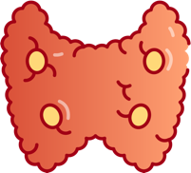
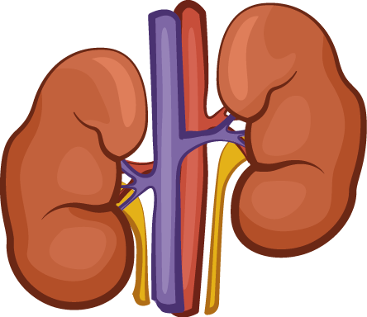
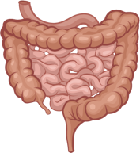

PHOSPHATE HOMEOSTASIS IN NORMAL PHYSIOLOGY
Parathyroid
Dietary phosphate
intake: 1500 mg/day
PTH
Kidney
Stimulates
PTH secretion
Npt2b
Filtration
Npt2a/2c
Extracellular
phosphate
Phosphate
absorption:
900 mg/day
Reabsorption
Intestine
Stimulates
FGF23
secretion
Formation
Urinary
phosphate
excretion:
900 mg/day
280 mg
Faecal
phosphate:
600 mg/day
FGF23
Bone
Resorption
FGF23, fibroblast growth factor 23; Npt2b/2c, sodium-dependent phosphate transport protein 2b/2c; PTH, parathyroid hormone
Adapted from: Komaba H, Fukagawa M. Kidney Int. 2016;90:753-63

Slide 25
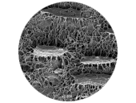
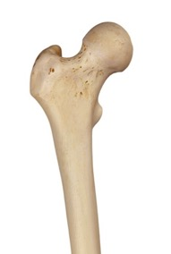


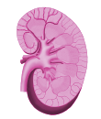
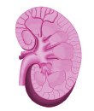
PHOSPHATE HOMEOSTASIS IN NORMAL PHYSIOLOGY
0
Bone: 14 800 mM
85% of total
Cell: 2 600 mM
15% of total
ECF: 17 mM
0.1% of total
Dietary P (1500 mg/d)
Gut
PHEX
DMP1
P absorption: (900 mg/d)
Inhibition
P exchange (280 mg/d)
Formation
Inhibition
NaPi-IIb
Bone
Gut
P
FGF23
Stimulation
Resorption
PiT-2
ECF
P: 1.2 mM
Cleavage
O-glycosylation
SPC
GALNT3
Faecal P (600 mg/d)
1,25(OH)₂D₃
1,25(OH)₂D₃
Filtration
FGFR/KL
Kidney
NaPi-II2a/c
Reabsorption
PTH
PTH
Parathyroids
NaPi-II2a/c
PTHR1
Urinary P (900 mg/d)
DMP1, dentin matrix acidic phosphoprotein 1; ECF, extracellular fluid; FGF23, fibroblast growth factor 23; FGFR/KL, fibroblast growth factor receptor klotho; GALNT3, polypeptide
N-acetylgalactosaminyltransferase 3; P, phosphate; PHEX, phosphate regulating endopeptidase homolog X-linked; PTH, parathyroid hormone; SPC, subtilisin-like protein convertases

Slide 26
Normal Ranges for TmP/GFR
(Adapted from Chong et al.)
Age | Female mg/dL (mmol/L) | Male mg/dL (mmol/L)
Newborn | 5.7-8.1 (1.27-2.59)
1 month-2 years | 3.6-5.4 (1.15-1.73)
2-12 years | 3.8-5.0 (1.22-1.60)
12-16 years | 3.4-4.6 (1.09-1.47)
16-25 years | 3.18-6.41 (1.01-2.05) | 3.33-5.9 (1.07-1.89)
25-45 years | 2.97-4.45 (0.95-1.42) | 3.09-4.18 (0.99-1.34)
45-65 years | 2.72-4.39 (0.87-1.40) | 2.78-4.18 (0.89-1.34)
65-75 years | 2.47-4.18 (0.79-1.34) | 2.47-4.18 (0.79-1.34)
TmP/GFR, maximum tubular phosphate reabsorption to glomerular filtration rate
Adapted from: Chong WH, et al. Endocr Relat Cancer. 2011;18:R53-77

Slide 27
FGF23: A New Hormone
Tissue source (bone), physiology (metabolism strictly controlled and action on kidney), biology (receptors are recognised)
Implications for human diseases of FGF23 excess and deficiency
Drug targets for FGF23-related disorders
FGF23, fibroblast growth factor 23

Slide 28
HypophosphatAemia: BASIC INSTRUCTIONS
FOR THE BONE DISEASE SPECIALIST
Normal circulating levels of P in the adult:
2.5-4.5 mg/dL
Mechanisms that result in hypophosphataemia:
Reduction of intestinal absorption
Increase of renal excretion
Redistribution of P inside the cells
Main causes of hypophosphataemia:
Mostly present in intensive care department
Malnutrition
Parenteral nutrition
Alterations in the acid–basic equilibrium (i.e. acute respiratory alkalosis)
Drugs
Often seen the bone disease specialist
Primary or secondary hyperparathyroidism
Hungry bone syndrome
Osteomalacia
Rickets
Malabsorption
Chronic use of thiazides
Excessive use of antacids
Steatorrhoea and chronic diarrhoea
Kidney tubulopathies
  FGF23
  Secreted frizzled protein 4
  FGF7
  Matrix extracellular phosphoglycoprotein
FGF, fibroblast growth factor; P, phosphate

Slide 29
Causes of Diseases/Conditions Characterised
by HypophosphatAemia
Human disease | Cause/mechanism of disease | Cause/mechanism of disease
FGF23-associated hypophosphataemic conditions/diseases (high plasma FGF23)
Genetic (hereditary) X-linked hypophosphataemia Autosomal dominant hypophosphataemic rickets Autosomal recessive hypophosphataemic rickets 1/osteomalacia Autosomal recessive hypophosphataemic rickets 2 Raine syndrome-associated hypophosphataemic rickets Osteoglophonic dysplasia |  | PHEX mutation FGF23 mutation DMP1 mutation ENPP1 mutation FAM20C mutation FGFR1 mutation
Genetic (mosaicism) Fibrous dysplasia/McCune-Albright syndrome Epidermal nevus syndrome |  | GNAS1 gain of function FGFR3 mutation
Sporadic/acquired Tumour-induced osteomalacia |  | FGF23-producing tumour
Drug-induced Chronic intravenous iron supplementation therapy-induced hypophosphataemia |  | Intravenous iron-induced increase in FGF23 levels (dependent on the type of intravenous iron, detailed mechanism not fully elucidated)
Non-FGF23-associated hypophosphatemic conditions/diseases (low-to-normal plasma FGF23)
Genetic (hereditary) Hypophosphataemic rickets with hypercalciuria Infantile idiopathic hypercalcemia Genetic Fanconi syndrome (including Wilson’s disease, Lowe syndrome, Dent’s disease) Inherited Vitamin D-dependent rickets |  | SLC34A3 (encoding the proximal tubule phosphate NaPi-llc) loss of function SLC34A1 (encoding the proximal tubule phosphate NaPi-llc) mutation CYP2R1, CYP27B1, or VDR mutation
Sporadic/acquired Primary hyperparathyroidism Secondary hyperparathyroidism due to nutritional phosphate, calcium, and/or vitamin D deficiencies Intracellular phosphate shift Acquired Fanconi syndrome |  | PTH effect on sodium-phosphate cotransporters Lack of adequate sun exposure, dietary insufficiency, or malabsorptive disorders Insulin administration or refeeding after starvation, respiratory or metabolic alkalosis, drug-induced redistribution of phosphate, alcohol intake and withdrawal Direct renal tubular damage by a drug or toxin, which results in a generalized proximal tubulopathy
FGF23, fibroblast growth factor 23; PTH, parathyroid hormone
Adapted from: Aljuraibah F, et al. J Bone Miner Res. 2022;37:12-20

Slide 30
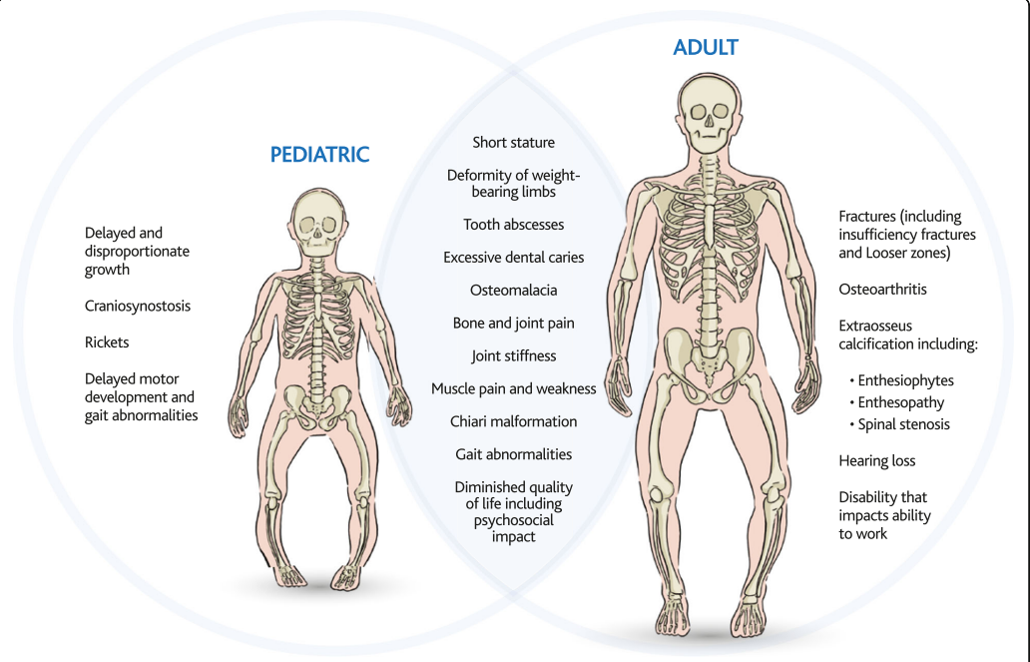
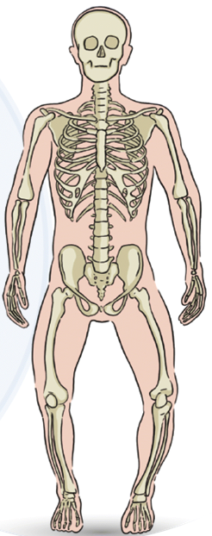
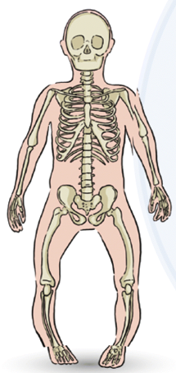
XLH RICKETS/OSTEOMALACIA
The condition is congenital
As the defect of mineralisation starts in the growing skeleton the resulting disease is usually rickets, but if bone abnormalities are not recognised in childhood the bone doctor will be the first to make the diagnosis
XLH, X-linked hypophosphataemia
Adapted from: Beck-Nielsen S, et al. Orphanet J Rare Dis. 2019;14:58

Slide 31
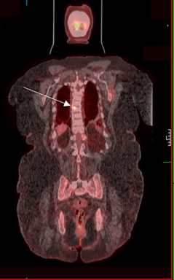
Differently to XLH, tumour-induced osteomalacia (TIO) is Usually Diagnosed in the Adult
XLH
TIO
XLH, X-linked hypophosphataemia
Adapted from: Beck-Nielsen S, et al. Orphanet J Rare Dis. 2019;14:58; Florenzano P, et al. Bone Rep. 2017;7:90-7;
Haffner D, et al. Nat Rev Nephrol. 2019;15:435-55; Minisola S, et al. Nat Rev Dis Primers. 2017;3:17044

Slide 32
Characteristics of inherited or acquired causes of phosphopenic rickets in comparison to calcipenic rickets
Disorder (abbreviation; OMIM#) | Gene (location) | Ca | P | ALP | U_{Ca} | U_{P} | TmP/ GFR | FGF23 | PTH | 25 (OH)Dª | 1,25 (OH)₂D | Pathogenesis
Rickets and/or osteomalacia with high PTH levels (calcipenic rickets)
Nutritional rickets (vitamin D and/or calcium deficiency) | NA | N, ↓ | N, ↓ | ↑↑↑ | ↓ | Varies | ↓ | N | ↑↑↑ | ↓↓, N | Varies | Vitamin D deficiency
Vitamin-D-dependent rickets type 1A; (VDDR1A; OMIM#264700) | CYP27B1 (12q14.1) | ↓ | N, ↓ | ↑↑↑ | ↓ | Varies | ↓ | N, ↓ | ↑↑↑ | N | ↓ | Impaired synthesis of 1,25(OH)₂D
Vitamin-D-dependent rickets type 1B; (VDDR1B; OMIM#600081) | CYP2R1 (11q15.2) | ↓ | N, ↓ | ↑↑↑ | ↓ | Varies | ↓ | N | ↑↑↑ | ↓↓ | Varies | Impaired synthesis of 25(OH)D
Vitamin-D-dependent rickets type 2A; (VDDR2A; OMIM#277440) | VDR (12q13.11) | ↓ | N, ↓ | ↑↑↑ | ↓ | Varies | ↓ | N, ↓ | ↑↑↑ | N | ↑↑ | Impaired signalling of the VDR
Vitamin-D-dependent rickets type 2B; (VDDR2B; OMIM#164020) | HNRNPC (14q11.2) | ↓ | N, ↓ | ↑↑↑ | ↓ | Varies | ↓ | N | ↑↑↑ | N | ↑↑ | Impaired signalling of the VDR
Vitamin-D-dependent rickets type 3; (VDDR3; OMIM# pending) | CYP3A4 (7q21.1) | ↓ | ↓ | ↑↑↑ | ↓ | Varies | ↓ | ? | ↑↑↑ | ↓ | ↓ | ↑ Inactivation of 1,25(OH)₂D
Phosphopenic rickets and/or osteomalacia due to dietary phosphate deficiency or impaired bioavailability
Breastfed very-low-birthweight infants Use of elemental or hypoallergenic formula diet or parental nutrition Excessive use of phosphate binders Gastrointestinal surgery or disorders | NA | N, ↑ | ↓ | ↑,↑↑ | ? | ↓ | N^{b} | N, ↓ | N | N | N, ↑ | Phosphate deficiency
ª Cave: prevalence of vitamin D deficiency was reported to be up to 50% in healthy children. ^{b} Normal after restoration of P, but falsely reduced before restoration.
↑, elevated; ↑↑ or ↑↑↑, very elevated; ↑(↑↑), might range widely; 1,25(OH)2D, 1,25-dihydroxyvitamin D; 25(OH)D, cholecalciferol; ALP, alkaline phosphatase;
Ca, serum levels of calcium; FGF23, fibroblast growth factor 23; N, normal; NA, not applicable; P, serum levels of phosphate; PTH, parathyroid hormone; TmP/GFR, maximum rate of renal tubular reabsorption of phosphate per glomerular filtration rate; U_{Ca}, urinary calcium excretion; U_{P}, urinary phosphate excretion; VDR, vitamin D receptor
Adapted from: Haffner D, et al. Nat Rev Nephrol. 2019;15:435-55

Slide 33
Characteristics of inherited or acquired causes of phosphopenic rickets in comparison to calcipenic rickets
Disorder (abbreviation; OMIM#) | Gene (location) | Ca | P | ALP | U_{Ca} | U_{P} | TmP/ GFR | FGF23 | PTH | 25 (OH)Dª | 1,25 (OH)₂D | Pathogenesis
Phosphopenic rickets and/or osteomalacia with renal tubular phosphate wasting due to elevated FGF23 levels and/or signalling
XLH (OMIM#307800) | PHEX (Xp22.1) | N | ↓ | ↑,↑↑ | ↓ | ↑ | ↓ | ↑, N | N, ↑^{b} | N | N^{c} | ↑ FGF23 expression in bone and impaired FGF23 cleavage
Autosomal dominant hypophosphataemic rickets (ADHR; OMIM#193100) | FGF23 (12p13.3) | N | ↓ | ↑,↑↑ | ↓ | ↑ | ↓ | ↑, N | N, ↑^{b} | N | N^{c} | FGF23 protein resistant to degradation
Autosomal recessive hypophosphataemic rickets 1 (ARHR1; OMIM#241520) | DMP1 (4q22.1) | N | ↓ | ↑,↑↑ | ↓ | ↑ | ↓ | ↑, N | N, ↑^{b} | N | N^{c} | ↑ FGF23 expression in bone
Autosomal recessive hypophosphataemic rickets 2 (ARHR2; OMIM#613312) | ENPP1 (6q23.2) | N | ↓ | ↑,↑↑ | ↓ | ↑ | ↓ | ↑, N | N, ↑^{b} | N | N^{c} | ↑ FGF23 expression in bone
Raine syndrome-associated (ARHR3; OMIM#259775) | FAM20C (7q22.3) | N | ↓ | ↑,↑↑ | ? | ↑ | ↓ | ↑, N | N, ↑^{b} | N | N^{c} | ↑ FGF23 expression in bone
Fibrous dysplasia (FD; OMIM#174800) | GNAS (20q13.3) | N, ↑ | ↓ | ↑,↑↑ | ↓ | ↑ | ↓ | N, ↑ | N, ↑^{b} | N | N^{c} | ↑ FGF23 expression in bone
TIO | NA | N, ↓ | ↓ | ↑,↑↑ | ↓ | ↑ | ↓ | N, ↑ | N, ↑^{b} | N | N^{c} | ↑ FGF23 expression in tumoral cells
Cutaneous skeletal hypophosphataemia syndrome (SFM; OMIM#163200) | RAS (1p13.2) | N, ↓ | ↓ | ↑,↑↑ | ↓ | ↑ | ↓ | N, ↑ | N, ↑^{b} | N | N^{c} | Unknown
Osteoglophonic dysplasia (OGD; OMIM#166250) | FGFR1 (8p11.23) | N | ↓ | ↑, N | N | ↑ | ↓ | N | N, ↑^{b} | N | N^{c} | ↑ FGF23 expression in bone
Hypophosphataemic rickets and hyperparathyroidism (OMIM#612089) | KLOTHO (13q13.1) | N | ↓ | ↑,↑↑ | ↓ | ↑ | ↓ | ↑ | ↑↑ | N | N^{c} | Unknown; translocation of the KLOTHO promoter
ª Cave: prevalence of vitamin D deficiency was reported to be up to 50% in healthy children. ^{b} PTH might be moderately elevated. ^{c} Decreased relative to the serum phosphate concentration
↑, elevated; ↑↑ or ↑↑↑, very elevated; ↑(↑↑), might range widely; 1,25(OH)2D, 1,25-dihydroxyvitamin D; 25(OH)D, cholecalciferol; ALP, alkaline phosphatase;
Ca, serum levels of calcium; FGF23, fibroblast growth factor 23; N, normal; NA, not applicable; P, serum levels of phosphate; PTH, parathyroid hormone; TIO, Tumour-induced osteomalacia;
TmP/GFR, maximum rate of renal tubular reabsorption of phosphate per glomerular filtration rate; U_{Ca}, urinary calcium excretion; U_{P}, urinary phosphate excretion; VDR, vitamin D receptor;
XLH, X-linked hypophosphataemia
Adapted from: Haffner D, et al. Nat Rev Nephrol. 2019;15:435-55

Slide 34
Characteristics of inherited or acquired causes of phosphopenic rickets in comparison to calcipenic rickets
Disorder (abbreviation; OMIM#) | Gene (location) | Ca | P | ALP | U_{Ca} | U_{P} | TmP/ GFR | FGF23 | PTH | 25 (OH)Dª | 1,25 (OH)₂D | Pathogenesis
Phosphopenic rickets and/or osteomalacia due to primary renal tubular phosphate wasting
Hereditary hypophosphataemic rickets with hypercalciuria (HHRH; OMIM#241530) | SLC34A3 (9q34.3) | N | ↓ | ↑(↑↑) | N, ↑ | ↑ | ↓ | ↓ | Low N, ↓ | N | ↑↑ | Loss of function of NaPi2c in the proximal tubule
X-linked recessive hypophosphataemic rickets (OMIM#300554) | CLCN5 (Xp11.23) | N | ↓ | ↑(↑↑) | N, ↑ | ↑ | ↓ | Varies | Varies | N | ↑ | Loss of function of CLCN5 in the proximal tubule
Hypophosphataemia and nephrocalcinosis (NPHLOP1; OMIM#612286) and Fanconi reno-tubular syndrome 2 (FRTS2; OMIM#613388) | SLC34A1 (5q35.3) | N | ↓ | ↑(↑↑) | ↑ | ↑ | ↓ | ↓ | Varies | N | ↑ | Loss of function of NaPi2a in the proximal tubule
Cystinosis (OMIM#219800) and other hereditary forms of Fanconi syndrome | CTNS (17p13.2) | N, ↓ | ↓ | ↑(↑↑) | N, ↑ | ↑ | N, ↓ | N, ↑^{b} | N, ↑^{b} | N | N^{c} | Cysteine accumulation in the proximal tubule
Iatrongenic proximal tubulopathy | NA | N | ↓ | ↑(↑↑) | Varies | ↑ | ↓ | ↓ | Varies | N | ↑ | Drug toxicity
ª Cave: prevalence of vitamin D deficiency was reported to be up to 50% in healthy children. ^{b} Depending on the stage of chronic kidney disease. ^{c} Decreased relative to the serum phosphate concentration.
↑, elevated; ↑↑ or ↑↑↑, very elevated; ↑(↑↑), might range widely; 1,25(OH)2D, 1,25-dihydroxyvitamin D; 25(OH)D, cholecalciferol; ALP, alkaline phosphatase;
Ca, serum levels of calcium; FGF23, fibroblast growth factor 23; N, normal; NA, not applicable; P, serum levels of phosphate; PTH, parathyroid hormone; TmP/GFR, maximum rate of renal tubular reabsorption of phosphate per glomerular filtration rate; U_{Ca}, urinary calcium excretion; U_{P}, urinary phosphate excretion; VDR, vitamin D receptor
Adapted from: Haffner D, et al. Nat Rev Nephrol. 2019;15:435-55

Slide 35
A MISSING LINK: UNDERSTANDING X-LINKED HYPOPHOSPHATAEMIA
AND FGF23-MEDIATED OSTEOMALACIA
Skeletal deformities in childhood and repeated unexplained fractures in later life are clues to rare bone disorders
It is important to be aware of the clues to find the ‘missing link’ and refer the patient as early as possible for specialist investigation
FGF23, fibroblast growth factor 23

Slide 36
HYPOPHOSPHATAEMIC CONDITIONS WITH RENAL TUBULAR PHOSPHATE WASTING DUE TO ELEVATED FGF23 LEVELS/SIGNALING
Disorder (abbreviation; OMIM#) | Gene/location | Pathogenesis
Congenital
XLH (OMIM#307800) | PHEX/Xp22.1 | ↑ FGF23 expression in bone and impaired FGF23 cleavage
Autosomal dominant hypophosphataemic rickets (ADHR; OMIM#193100) | FGF23/12p13.3 | FGF23 protein resistant to degradation
Autosomal recessive hypophosphataemic rickets 1 (ARHR1; OMIM#241520) | DMP1/4q22.1 | ↑ FGF23 expression in bone
Autosomal recessive hypophosphataemic rickets 2 (ARHR2; OMIM#613312) | ENPP1/6q23.2 | ↑ FGF23 expression in bone
Raine syndrome associated (ARHR3; OMIM#259775) | FAM20C/7q22.3 | ↑ FGF23 expression in bone
Fibrous dysplasia (FD; OMIM#174800) | GNAS/20q13.3 | ↑ FGF23 expression in bone
Cutaneous skeletal hypophosphataemia syndrome (SFM; OMIM#163200) | RAS/1p13.2 | ?
Osteoglophonic dysplasia (OGD; OMIM#166250) | FGFR1/8p11.23 | ↑ FGF23 expression in bone
Hypophosphataemic rickets and hyperparathyroidism (OMIM#612089) | KLOTHO/13q13.1 | Unknown; translocation of the KLOTHO promoter
Acquired
TIO | NA | ↑ FGF23 and other phosphatonins expression in the tumour
FGF23, fibroblast growth factor 23; TIO, tumour induced osteomalacia; XLH, X-linked hypophosphataemia
Adapted from: Haffner D, et al. Nat Rev Nephrol. 2019;15:435-55

Slide 37
Hypophosphataemia
Clinical history
Physical examination
Laboratory evaluation
Family history of inherited
phosphate disorder
No family history of inherited
phosphate disorder
Exclude:
Vitamin D and mineral deficiency
Malabsorption syndrome
Primary hyperparathyroidism
Other causes (such as nutritional phosphate deficiencies, medications
and heavy metals)
TUMOUR-INDUCED OSTEOMALACIA (TIO)
Consider genetic disorders of impaired tubular reabsorption
Rare paraneoplastic syndrome with overproduction
of phosphaturic hormones, as FGF23, by tumours
(the majority are mesenchymal in nature)
The disorder is usually described in adults, and an algorithm for its management has been published
Measure levels of FGF23
Normal values:
Exclude hereditary forms of FGF23-independent renal phosphate wasting
Exclude Fanconi syndrome
Increased values:
Exclude hereditary forms of FGF23-dependent renal phosphate wasting
Exclude McCune-Albright syndrome or fibrous dysplasia and cutaneous skeletal hypophosphataemia syndrome
Search for occult tumour
Removal of the tumour
Recovery
FGF23, fibroblast growth factor 23
Adapted from: Minisola S, et al. Nat Rev Disease Primers. 2017;3:17044

Slide 38
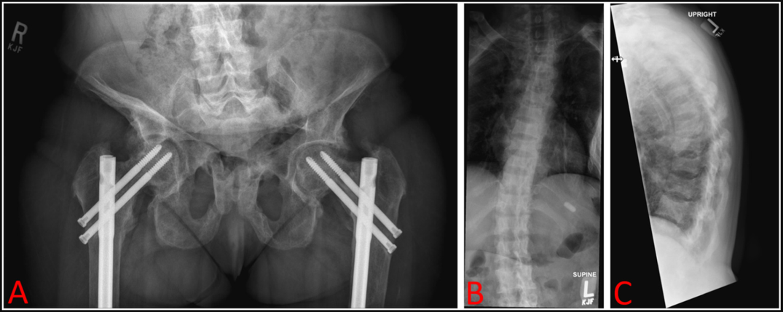
Misdiagnosis: TIO masquerading as XLH
41-year-old female. Prior diagnosis of hypophoshataemic rickets
    26-year history of low phosphorus, bone pain, proximal muscle weakness, gait abnormalities, multiple traumatic and insufficiency fractures
    Lost all secondary teeth. No family history of low phosphorus
    Maximum height 5’2’’ but presented at 4’8’’ due to progressive spine deformities
    Developed progressive gait abnormalities and decreased hip strength
    Sustained bilateral hip fractures and small fractures throughout her spine despite intermittent treatment with conventional therapy with phosphorus supplements and calcitriol during her teens and 20’s
Colazo J, et al. Bone Reports 2021; 14:100744

Slide 39
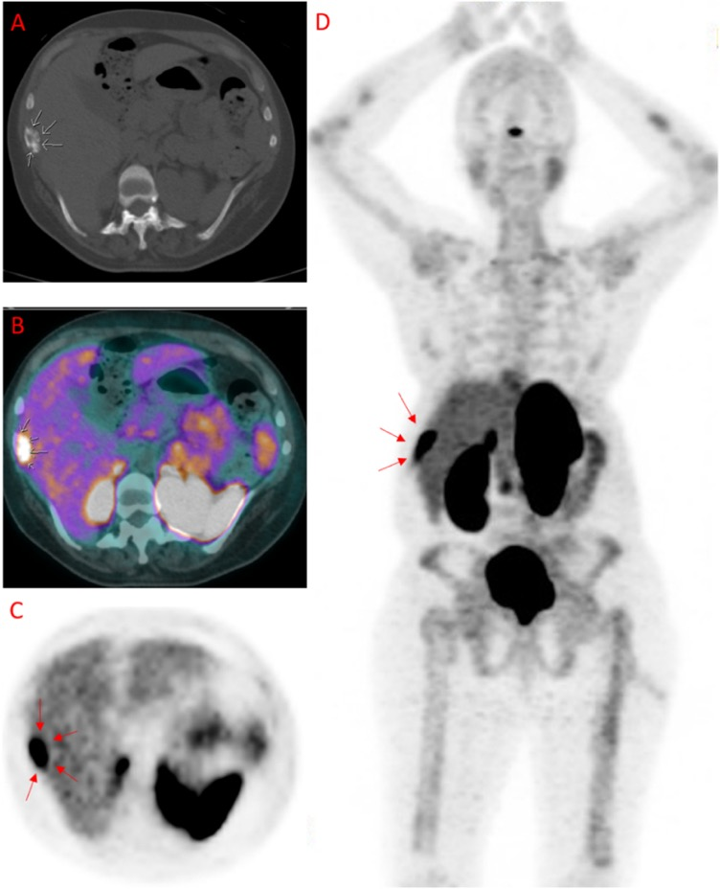
misdiagnosis– TIO masquerading as XLH
    Patient deteriorated further over 10 years requiring stability rods and screws in her femurs and hips and surgery following a traumatic left humerus fracture.
    Patient was eventually confined to a wheelchair
    Reevaluation of her history resulted in a diagnosis of XLH
    DXA revealed normal bone density in spine and significantly lower than expected density in the forearm
    Renal ultrasound showed a 4-mm non-obstructing calculus in the lower pole of the right kidney, indicating nephrolithiasis, a well-documented complication of long-term phosphorus and calcitriol therapy
    A 13-gene Invitae hypophosphatemia panel was performed to adjudicate her clinical diagnosis of XLH. No pathogenic variants were detected. Medical team suspected TIO not XLH
    Suspected TIO was further confirmed with a combined 68Ga-DOTATATE PET/CT scan
CT, computed tomography; DXA, Dual-energy X-ray absorptiometry; PET, positron emission tomograph; TIO, tumour induced osteomalacia; XLH, X-linked hypophosphataemia
Colazo J, et al. Bone Reports 2021; 14:100744

Slide 40
misdiagnosis– TIO masquerading as XLH
    Patient deteriorated further over 10 years requiring stability rods and screws in her femurs and hips and surgery following a traumatic left humerus fracture.
    Patient was eventually confined to a wheelchair
    Reevaluation of her history resulted in a diagnosis of XLH
    DXA revealed normal bone density in spine and significantly lower than expected density in the forearm
    Renal ultrasound showed a 4-mm non-obstructing calculus in the lower pole of the right kidney, indicating nephrolithiasis, a well-documented complication of long-term phosphorus and calcitriol therapy
    A 13-gene Invitae hypophosphatemia panel was performed to adjudicate her clinical diagnosis of XLH. No pathogenic variants were detected. Medical team suspected TIO not XLH
    Suspected TIO was further confirmed with a combined 68Ga-DOTATATE PET/CT scan
Demonstrates the utility of genetic testing in the diagnosis of phosphate wasting disorders
Importance of personal and family histories
The pitfalls of using exclusively clinical criteria in diagnosing phosphate wasting disorders
CT, computed tomography; DXA, Dual-energy X-ray absorptiometry; PET, positron emission tomograph; TIO, tumour induced osteomalacia; XLH, X-linked hypophosphataemia
Colazo J, et al. Bone Reports 2021; 14:100744

Slide 41
Limits in the Measurement of FGF23
Intact and C-terminal FGF23 concentrations are important in the diagnosis of hypo- and hyperphosphataemic diseases
FGF23 is stable when stored at 4°C and 22°C for 48 hours
FGF23 is stable under five freeze–thaw cycles
Long-term storage at −80°C induces some variability
Available assays do not give superimposable data
Sample type, handling, and choice of
assay are factors that affect FGF23 levels
FGF23, fibroblast growth factor 23
El-Maouche D, et al. Osteoporos Int. 2016;27:2345-53

Slide 42
KEY SUMMARY POINTS
FGF23 plays a central role in the mechanisms involved in disorders linked to phosphate wasting
Differential diagnosis of FGF23-related rickets/osteomalacia should be incorporated in the educational background of the endocrinologist
The bone doctor is a central figure in the management of these patients
FGF23, fibroblast growth factor 23

Slide 43
HYPOPHOSPHATASIA
Lothar Seefried

Slide 44
Disclosures:
Honoraria for lectures and advice: AstraZeneca/Alexion, Amgen, Chiesi, GlaxoSmithKline, Ipsen, Kyowa Kirin, medi, STADA, Theramx and UCB.
Support for scientific projects: AstraZeneca/Alexion, Kyowa Kirin and Novartis.

Slide 45
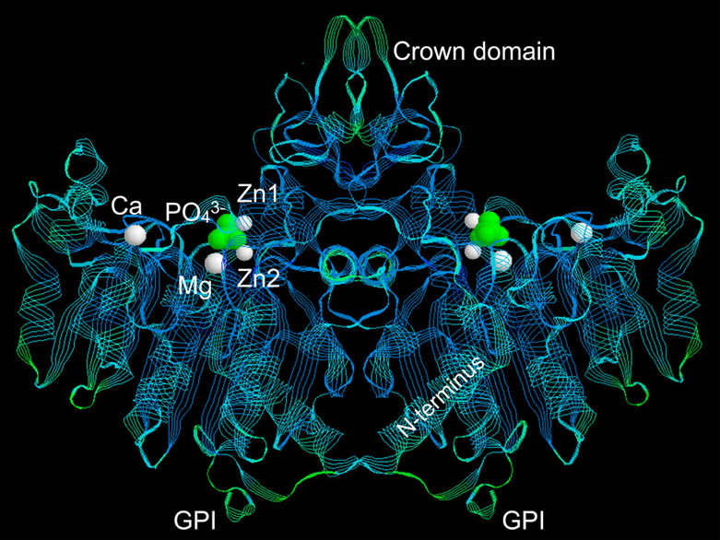
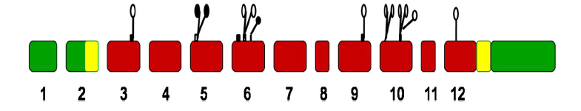

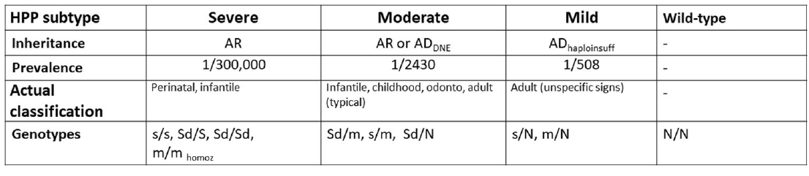
Genetic and Biochemical Background of HPP
ALPL-Gene, Chromosome 1p36.12 (OMIM 171760)
Length 50kb, 12 Exons Reference cDNA: NM_000478.4
Active site
Untranslated regions indicated by green colour. Signal peptide at amino terminus and hydrophobic stretch at the carboxyl terminus in exons 2 and 12, respectively, shown in yellow.
Homodimeric interface
Post-translational modifications incl. five putative N-glycosylation sites (Asn140, Asn230, Asn271, Asn303, Asn430) and an undetermined O-glycosylation site.
Millán JL and Whyte MP. Calcif Tissue Int. 2016;98:398-416
Currently (2022):
> 400 known genetic variants
Pathogenicity TBD
Mornet E, et al. Eur J Hum Genet. 202;29:289-99.

Slide 46
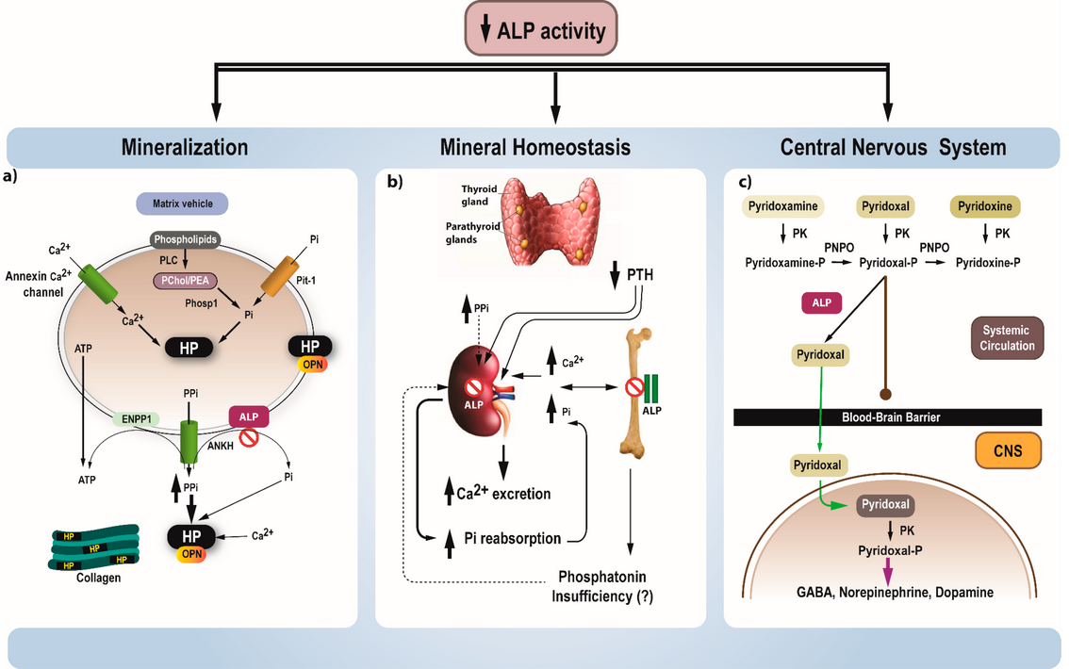
Pathophysiology of Hypophosphatasia
Tournis S, et al. J Clin Med. 2021;10:5676

Slide 47
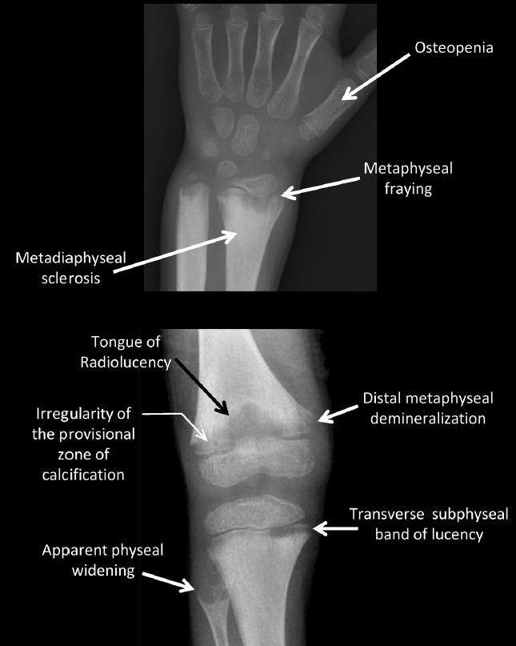
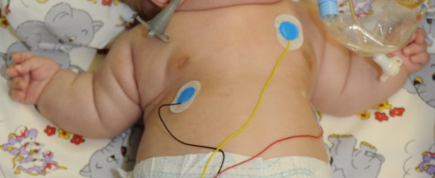
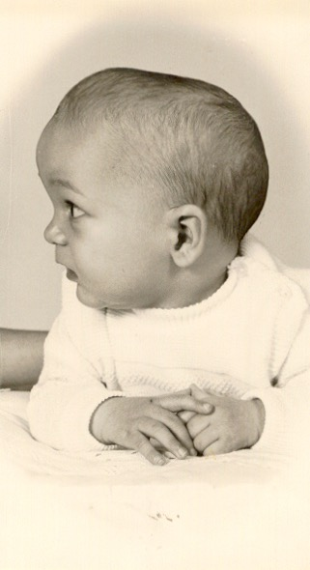
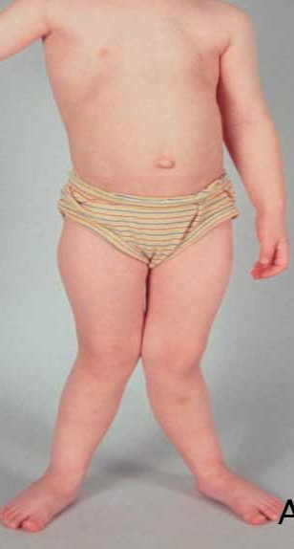
Pediatric HPP
Whyte MP, et al. JCI Insight. 2016;1:e85971

Slide 48


CNS/sensory organs:
Cephalgia/Migraine
Depression/Anxiety
Visual/auditory compromise
Clinical Picture in Adult HPP
Teeth:
Tooth loss
Periodontal disease
GI issues:
Diarrhea/constipation
Meteorism
Intolerances
Kidney:
Nephrocalcinosis
Renal insufficiency
Kidney stones
Bone:
Pseudofractures
Insufficiency fractures
Bone marrow edema
Osteomalacia
Muscle:
Weakness
Fatigue/induration
Modified according to: Seefried L, et al. Symptoms and Diagnosis in Adults. In: Hofmann, Girschick, Seefried eds, Diagnosis and Management of Hypophosphatasia, 2nd Edition, Uni-Med, 2022
Tendons:
Tendinosis calcarea
Enthesiopathy
Tendinitis/Enthesitis
Joint:
Osteoarthritis
Chondrocalcinosis
Pseudogout

Slide 49
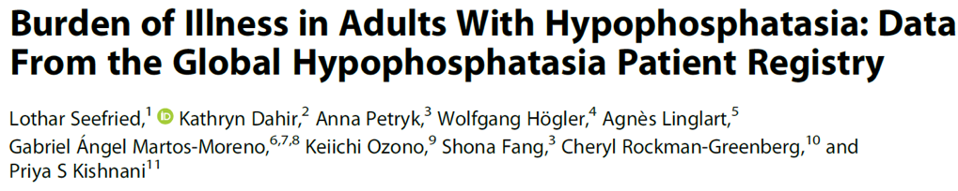
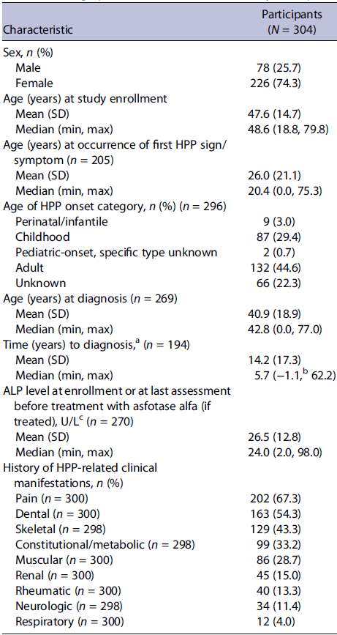
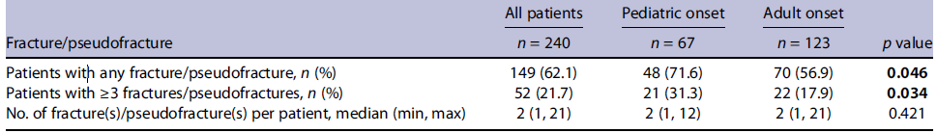
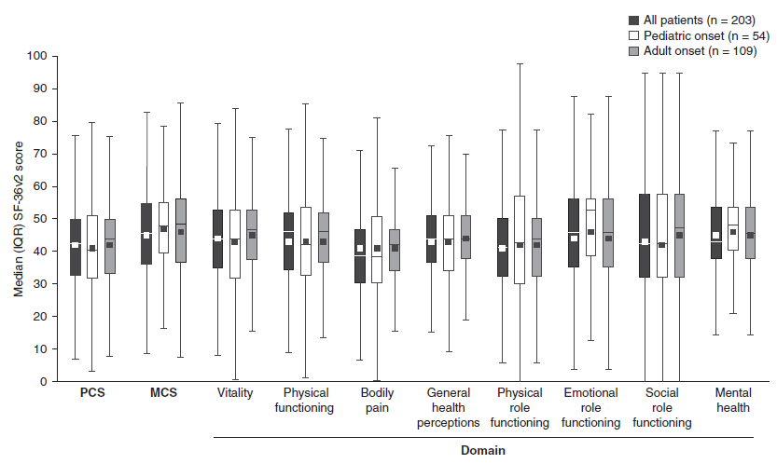
Fractures in HPP may be associated with the age of disease onset, but the individual patient‘s burden of disease is not
Seefried L, et al. J Bone Miner Res. 2020;35:2171-8

Slide 50
Clinical symptoms
Family history of HPP
Determine ALP activity
Normal range
Marginally reduced
Decreased
Norm
Consider differential diagnoses
Re-evaluate ALP activity (consider isoenzymes)
Determine PLP/PEA
Negative
Genetic Testing
Baseline workup for HPP:
Lab, functional testing, con meds, imaging,
BMD, dental, nephrol./ophthalmol. assessment
Seefried L, Genest F. Osteologie/Osteology. 2017;26:36-41

Slide 51
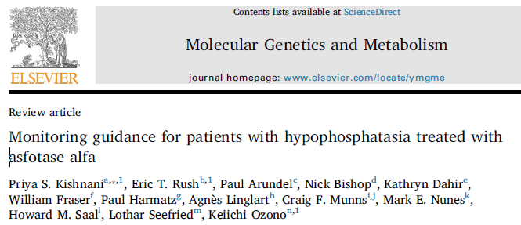
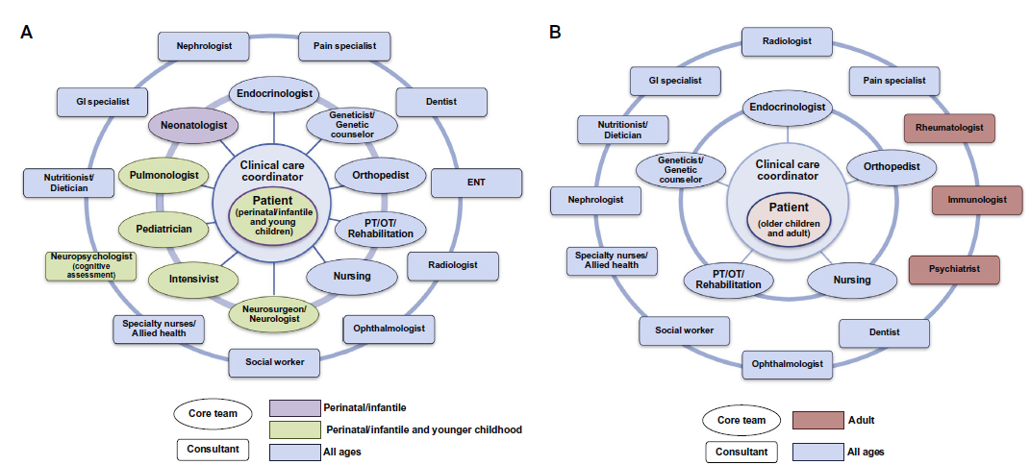
Multidisciplinary Management of HPP
Imaging:
X-ray: osteomalacia, fractures, pseudofractures
Ultrasound: calcifications (e.g. nephrocalcinosis)
MRI: bone marrow lesions
Consultations
- Dentist
Nephrologist
- Neurologist
Ophthalmologist
Physiotherapist…
Bone biopsy: conceivable/not diagnostic
Bone Mineral Density (DXA, qCT): helpful information, not diagnostic
Kishnani PS, et al. Mol Genet Metab. 2017;122:4-17

Slide 52
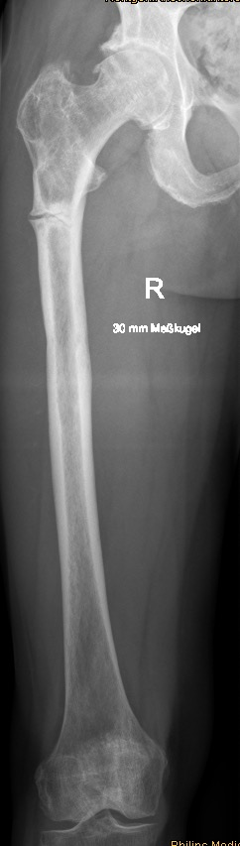
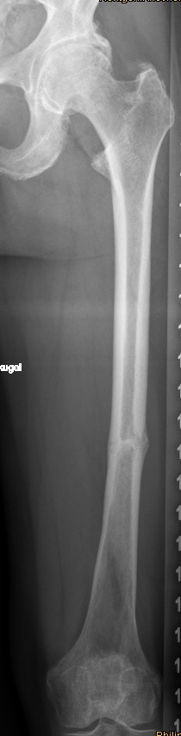
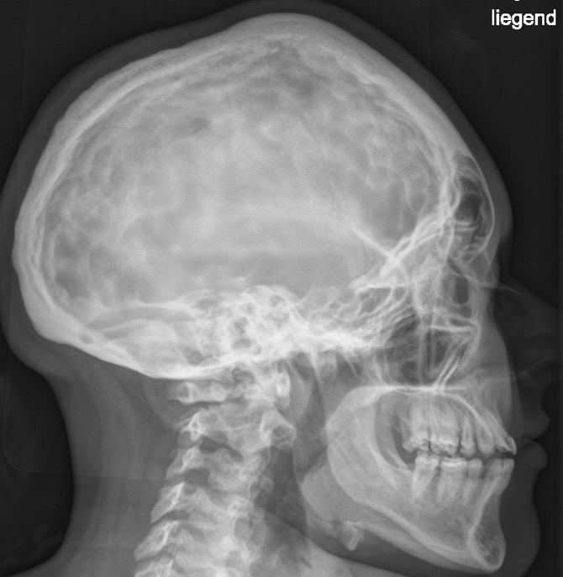
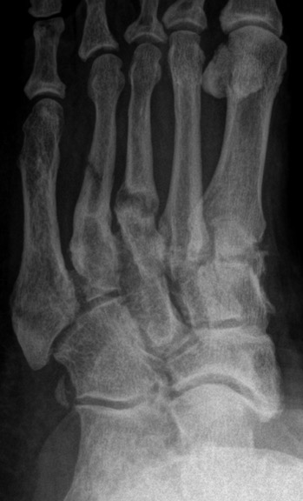
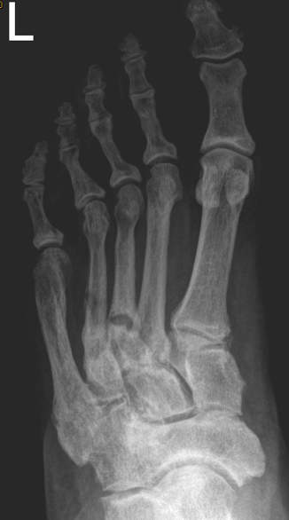
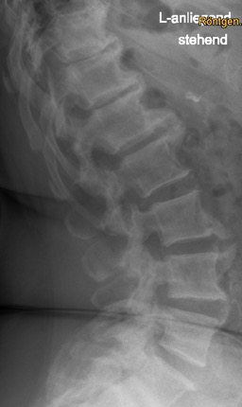
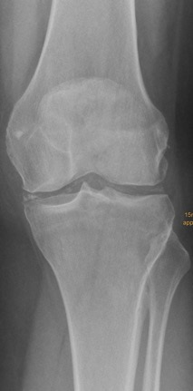

Hypophosphatasia

Slide 53


Bisphosphonates: 7/15
Hypovitaminosis D: 10/15
Adapted from: Genest F, Seefried L. Osteoporos Int. 2018;29:1815-25

Slide 54





Adapted from: Genest F, et al. Osteoporos Int. 2021;32:377-385

Slide 55







Modules of HPP Treatment
Analgesics/antiphlogistics
NSAIDs
Coping strategies
Opioids (second line)
  Supplements/nutrition
  Pyridoxin (seizures)
  Nutritional counseling
  Vitamin D
Physical therapy
  Ergo-/physiotherapy
  Sports/exercise
  Orthotics
Enzyme replacement therapy
Asfotase alfa
Bone-targeted treatment
  No bisphosphonates
  Teriparatide
  Anti-sclerostin
Dental care
  Regular prophylaxis
  Oral Hygiene
  Prosthetics/implants
  Surgery
  Neurosurgery
  Fracture stabilization
  Deformity Correction
  Total joint replacement
Seefried F, Jakob F. Internist (Berl). 2021;62:486-95

Slide 56

Hypophosphatasia
Multisystemic disorder due to deficient ALP activity:
  Rickets/pseudofractures (severe forms)
  Extraskeletal manifestations: generalized pain, muscle weakness, periodontal disease, neuropsychiatric issues, GI symptoms
Diagnostic approach:
  Low serum-ALP activity
  Elevated substrates: PLP/Vit B6, (urinary) PEA, PPi
  Genetic confirmation recommended
Multidisciplinary treatment:
  Enzyme replacement therapy
  Analgesics (NSAIDs)
  Physical therapy
  Surgery
  Dental care

Slide 57




Connect on
LinkedIn @COR2ED
Watch on
Vimeo @COR2ED
Visit us at
cor2ed.com
Follow us on
Twitter @COR2EDMedEd

