Slide 1
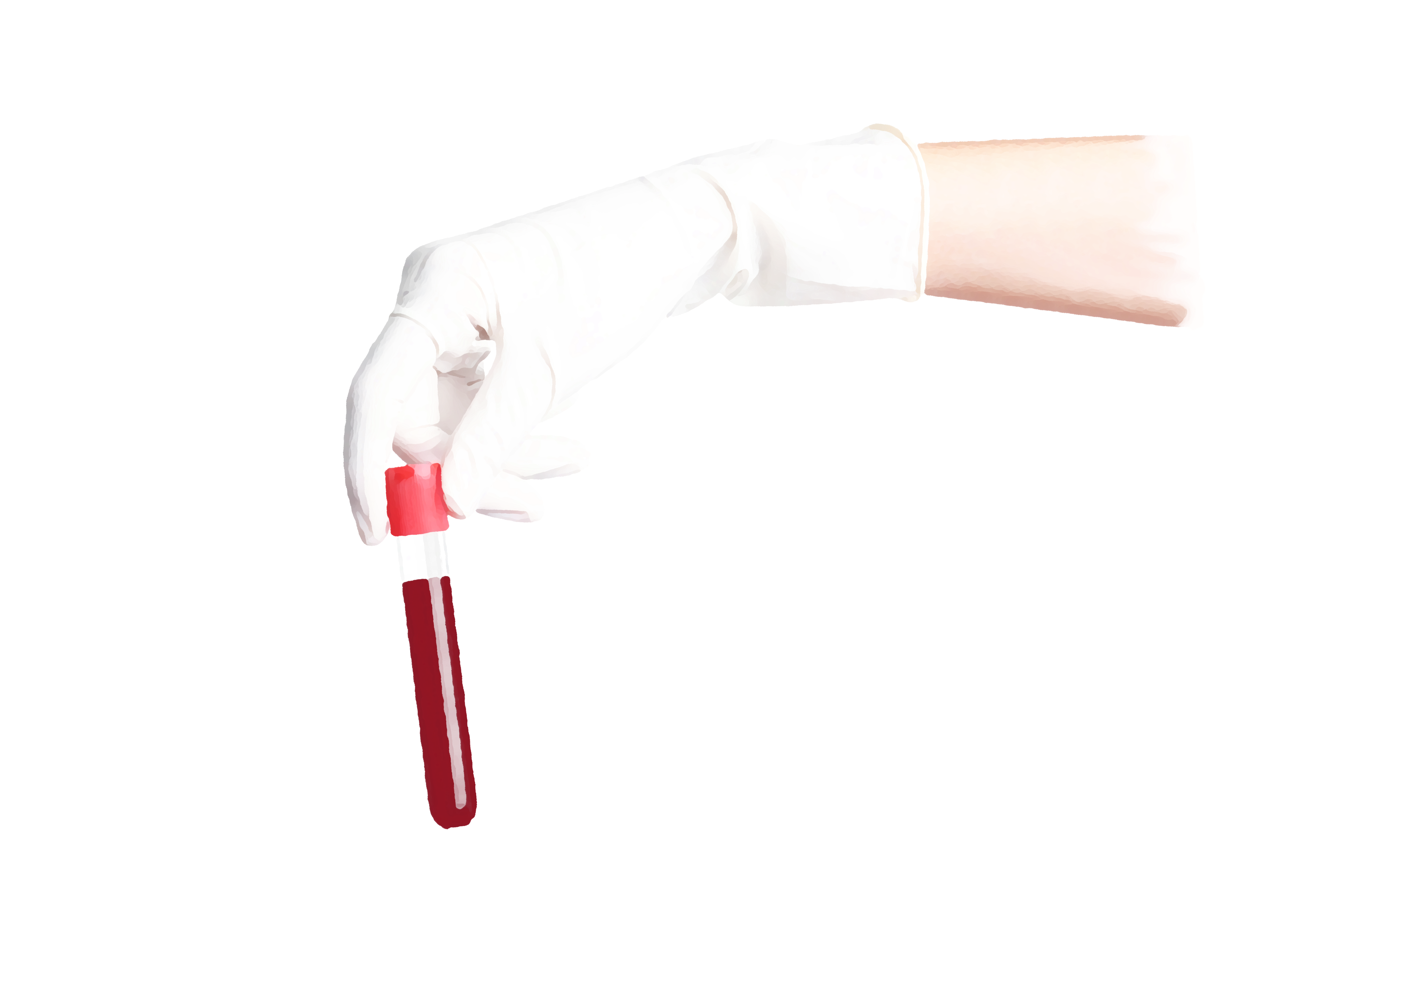


WOMEN WITH
BLEEDING DISORDERS
Module 2
Bleeding disorders in women: basic diagnosis and management
Endorsed by:
March 2021
CME credit available
Visit programme home page on:
The programme is supported by an independent educational grant from Takeda.
The programme is therefore independent; the content is not influenced by the
supporter and is under the sole responsibility of the experts.

Slide 2

What will you learn in this micro e-learning programme
on women with bleeding disorders?
This micro e-learning programme consists of two modules aiming to increase awareness, knowledge, and understanding of bleeding disorders and their management among healthcare professionals who are the first to see women and girls with signs and symptoms of bleeding disorders
AFTER MODULE 2 YOU WILL:
Current Module
Understand the strengths and limitations of tests used to diagnose bleeding
disorders in women
Be able to perform basic interpretation of test results to diagnose bleeding
disorders in women
Upon completion of the two modules, you will:
Be able to initiate management of bleeding symptoms in women until
specialist assessment can be performed
Be able to recognise the signs and
symptoms of bleeding disorders in women
and be aware of their impact on the
quality of life of women
REFER TO MODULE 1 TO:
Know how to identify women who are
likely to have undiagnosed bleeding
disorders, initiate basic diagnostic testing,
and arrange an appropriate referral for
diagnosis
Be able to recognise the signs and symptoms of bleeding disorders in women
Be aware of the impact on quality of life of bleeding disorders in women
Know how to effectively screen for symptoms of bleeding disorders in
women by using the tools available
Be able to initiate management of
bleeding symptoms in women until
specialist assessment is available
02

Slide 3
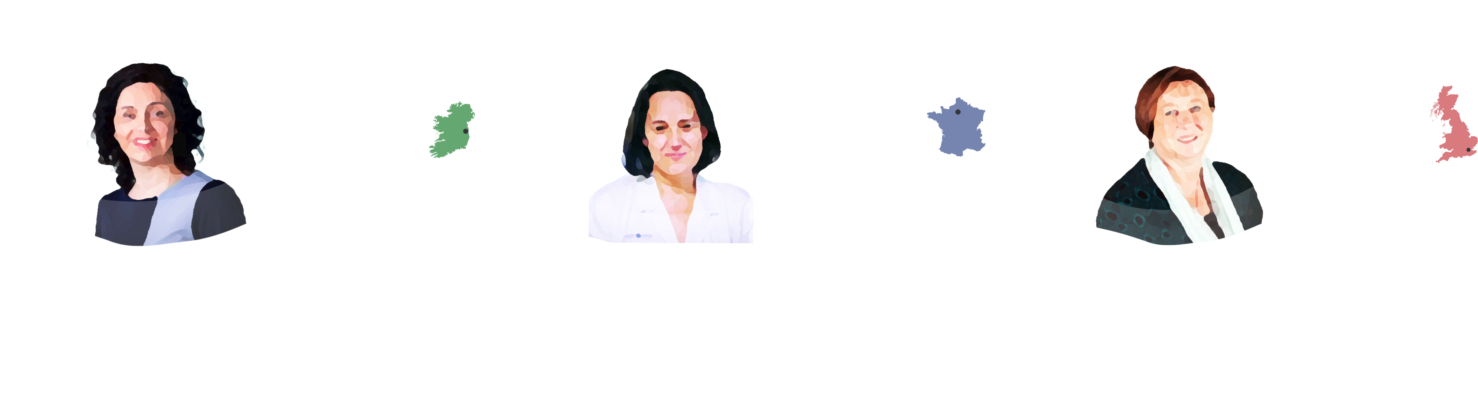
This micro e-learning module has been developed by a
multidisciplinary panel of experts
DR MICHELLE
LAVIN
DR ROSELINE
D’OIRON
DEBRA
POLLARD
HAEMATOLOGIST, NATIONAL
COAGULATION CENTRE, ST JAMES’
HOSPITAL, DUBLIN, IRELAND
HAEMATOLOGIST, REFERENCE CENTRE FOR
HAEMOPHILIA AND RBD, BICÊTRE HOSPITAL
AP-HP AND UNIVERSITY OF PARIS-SACLAY, LE
KREMLIN-BICÊTRE, FRANCE
LEAD NURSE, KATHARINE DORMANDY
HAEMOPHILIA AND THROMBOSIS
CENTRE, ROYAL FREE HOSPITAL,
LONDON, UK
Consultant Haematologist in the National
Coagulation Centre, St James’ Hospital,
Ireland
Medical Director at the Reference
Centre for Haemophilia and Rare
Congenital Bleeding Disorders at Bicêtre
Hospital AP-HP and University of
Paris-Saclay, France
Lead Nurse Specialist, Advanced Nurse
Practitioner at Katharine Dormandy
Haemophilia and Thrombosis Centre,
Royal Free Hospital, London, UK
Principal Investigator in the Irish Centre for
Vascular Biology of the Royal College of
Surgeons in Ireland
Director of Education at Haemnet
Current elected president of the Steering
Committee of the FranceCoag Network, a
national registry of bleeding disorders
Member of the European Haemophilia
Consortium’s Medial and Scientific
Advisory Group and of the UK’s
Haemophilia Society
Co-Chair on the von Willebrand Factor
scientific subcommittee of the International
Society on Thrombosis and Haemostasis
Member of the European Haemophilia
Consortium’s Medial and Scientific
Advisory Group
Member of the Women and Bleeding
Disorders Working Group of the European
Association for Haemophilia and Allied
Disorders (EAHAD)
Member of the Women and Bleeding
Disorders Working Group of the EAHAD
Member of the Women and Bleeding
Disorders Working Group of the EAHAD
The views expressed in this slide deck are the personal opinions of the experts. They do not necessarily represent the views of the experts’ institutions.
03

Slide 4
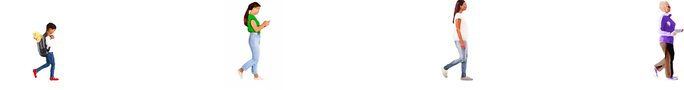


When to suspect a bleeding disorder in women and girls
MODULE 1 SUMMARY
Module 1 of this micro e-learning programme described how bleeding
disorders occur as often in women as in men, but women experience
the additional bleeding challenges of menstruation and childbirth.¹⁻⁴
Despite the negative impact of these disorders on the quality of
life and social participation of women and girls, there is a large
diagnostic delay.
LATE
ADULTHOOD
CHILDHOOD
ADOLESCENCE
ADULTHOOD
Nosebleeds
Heavy menstrual bleeding, especially since menarche
Primary and late
post-partum haemorrhage
Bleeding of gastrointestinal tract without an obvious anatomic lesion
Notable bruising without injury
Bleeding during ovulation leading to haemorrhagic ovarian cysts or haemoperitoneum*
Bleeding during ovulation leading to haemorrhagic ovarian cysts or haemoperitoneum*
Unexpected
post-surgical bleeding
Excessive bleeding from minor wounds
Prolonged or excessive bleeding after dental extraction
Post-surgical or spontaneous bleeding that requires blood transfusion
*Bleeding during ovulation leading to haemorrhagic
ovarian cysts or haemoperitoneum is often associated
with pain during ovulation (mittelschmerz)
Family history of a bleeding disorder
Prolonged or excessive bleeding after dental extraction
Be especially aware of an underlying
bleeding disorder when a patient has
multiple bleeding symptoms.
This figure shows common signs and symptoms in each phase of life.⁵⁻⁷ Please be aware
that most of these signs and symptoms can occur across a lifetime.
Heavy menstrual bleeding may increase near menopause
1. Kulkarni R. Eur J Haematol. 2015;95 Suppl 81:2-10; 2. Lavin M, et al. Blood Adv. 2018;2:1784-91; 3. Xu Y, et al. Haemophilia. 2017;23:115-21; 4. Noone D, et al. Haemophilia.
2019;25:468-74; 5. O’Brien SH. Blood. 2018;132:2134-42; 6. James AH, et al. Am J Obstet Gynecol. 2009;201:12.e1-8; 7. Philipp CS, et al. Obstet Gynecol. 2005;105:61-6
04

Slide 5


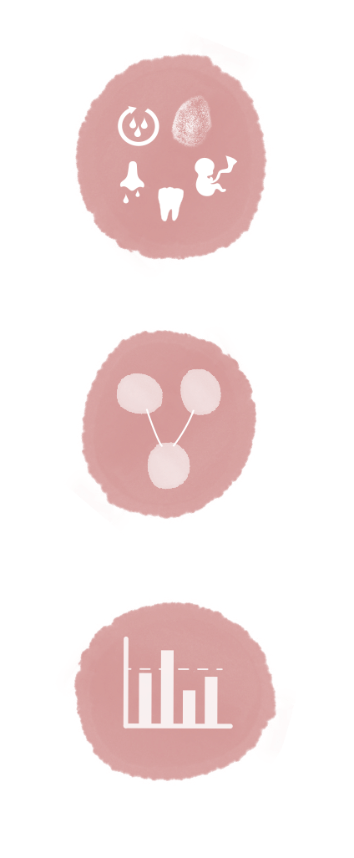


Next steps in women and girls with bleeding disorders
IN MODULE 1 WE LEARNED THAT IN WOMEN
AND GIRLS WITH BLEEDING SYMPTOM(S):
MODULE 2 DETAILS THE NEXT STEPS TO TAKE
WHEN SUSPECTING A BLEEDING DISORDER
The personal bleeding history should
be assessed.
FIRST LINE
Perform general laboratory assessment
and start symptomatic treatment
The family history should be assessed.
SECOND LINE
Contact a haematologist for diagnostic
laboratory assessment and specialised
management
Several tools can be used to screen for a
bleeding disorder
Note that if a patient has a known bleeding disorder, the patient’s family members (men and women) should be screened by
evaluating their personal bleeding histories and conducting laboratory assessment
05

Slide 6


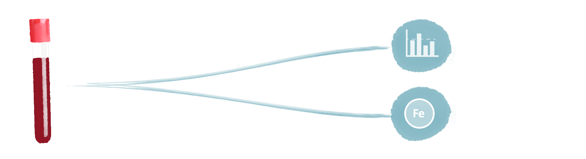
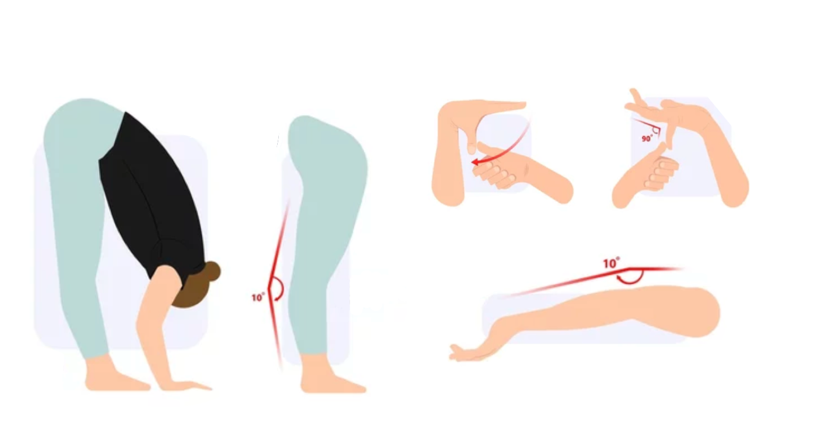

FIRST LINE: perform general laboratory assessment if
suspicion of a bleeding disorder is raised by personal bleeding
history, family history, and screening tools
General assessments can be performed in first line
The Beighton score can be used to detect
joint hypermobility¹
Full blood
count
Iron and ferritin
status
Note that coagulation screening is not necessary at this stage.
Abnormal coagulation tests may be indicative of a bleeding disorder, but
most women with a bleeding disorder have a normal prothrombin time
(PT) and activated partial thromboplastin time (aPTT).
Easy bruising as a unique bleeding symptom is
common in patients with joint hypermobility,
such as Ehlers-Danlos syndrome. In these
patients no specific treatment is required and
further bleeding workup is not needed.
In the event of a strong bleeding history, refer to a haematologist for
specialist assessment, even if the results of general laboratory
assessment are normal
1. Pacey V, et al. J Paediatr Child Health. 2015;51:373-80
06

Slide 7
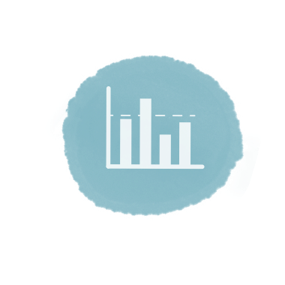
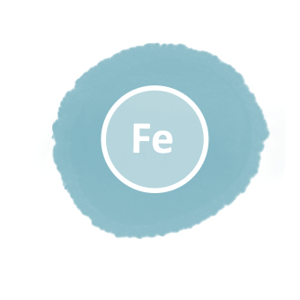


FIRST LINE: persistent or recurrent iron deficiency in younger
women should prompt consideration of a bleeding disorder
Assessment of iron status,
haemoglobin, and red blood cell
count is not specific to individual
bleeding disorders, but findings
provide important information for
clinical management¹
Iron deficiency is best assessed using
serum ferritin and transferrin
saturation^{1,3}
Low serum ferritin is a strong
indication for iron deficiency
World Health
Organization definition
of iron deficiency²
Iron deficiency with or without
anaemia is common in women
with bleeding disorders — even
without anaemia, iron deficiency
can be symptomatic and cause, for
example, fatigue, muscular
weakness, or hair and skin issues,
so it must be considered and
treated
Ferritin can be falsely raised in
inflammation and infection
Serum ferritin <15 μg/L or
If serum ferritin is normal (≥15 μ
g/L), transferrin saturation (<16%)
is helpful to discriminate between
truly and artificially normal ferritin
with or without iron deficiency
Transferrin saturation <16% or
Haemoglobin increase of 1
g/dL after 2 months of iron
supplementation (values differ
by ethnicity and in pregnancy)
Serum iron cannot be interpreted
in isolation because low
values may also be seen in infection
and inflammation
Anaemia (haemoglobin <120 g/L)²
is also common in women with
bleeding disorders
Iron supplementation
should be considered once
serum ferritin values fall
<30 μg/L⁴
1. O’Brien S. Blood. 2018;132:2134-42; 2. WHO. Iron deficiency anaemia: assessment, prevention and control. A guide for programme managers. 2001 WHO/NHD/01.3; 3. Kelly AU, et al. Br Med J.
2017;357:j2513; 4. Mirza FG, et al. Expert Rev Hematol. 2018;11:727-36
07

Slide 8
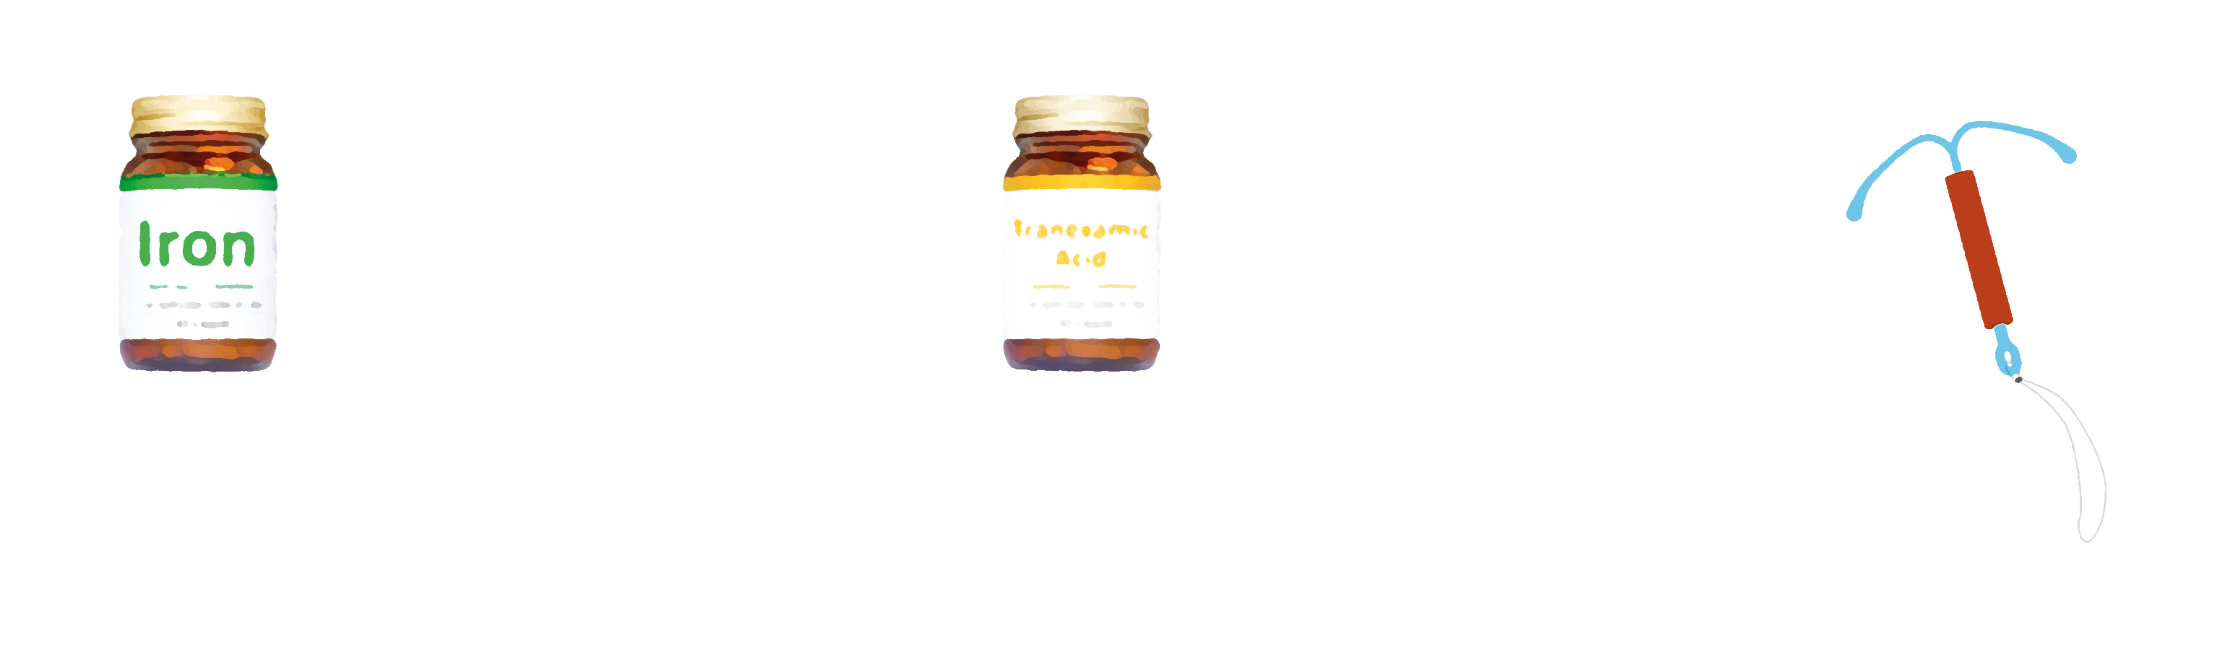


FIRST LINE: start symptomatic treatment, even in the absence of a definite diagnosis
First line treatment is the same for all women with bleeding disorders, so do not hesitate to start
therapy to avoid continued or recurrent bleeding symptoms¹
Iron replacement
therapy for iron
deficiency with or
without anaemia²
Anti-fibrinolytic agent
(tranexamic acid) for
bleeding symptoms^{4,5}
Hormonal therapy
for heavy menstrual
bleeding
Oral supplementation (e.g. ferrous sulfate or ferrous fumarate).
Tranexamic acid is used for a few days at a time and is not for continuous use.
Combined oral contraceptive or hormonal intrauterine device.
Oral iron administration is often poorly tolerated and increases hepcidin levels, thereby decreasing iron absorption from the gut. Therefore, once daily or alternate day rather than more frequent dosing is recommended.³
Clinical experience indicates that patients with regular periods can start tranexamic acid the night before their period to maximise the effect.
In case of dysmenorrhoea, analgesics can be advised.
Be aware that non-steroidal anti-inflammatory drug (NSAID) use may also interfere with coagulation and may increase bleeding risk, so their use is best reserved until after investigations have been completed.
Tranexamic acid is contraindicated in patients with
Rule out gastrointestinal causes of iron deficiency, as appropriate.
Severe renal failure (risk of accumulation)
Haematuria (risk of clot colic)
In some women with more severe bleeding symptoms, specialised haemostatic treatment, such as desmopressin, factor concentrates or platelets, may be considered by a haematologist.¹
Note that patients with severe bleeding should be referred to the Emergency Department for assessment.
1. O’Brien S. Blood. 2018;132:2134-42; 2. Peyrin-Biroulet L, et al. Am J Clin Nutr. 2015;102:1585-94; 3. Munro MG, et al. OBG Management. 2019;31:S1-8; 4. Summary of Product Characteristics.
Cyklo-f (tranexamic acid); 5. Chaplin S. J Haem Pract. 2016;3:1-9
08

Slide 9
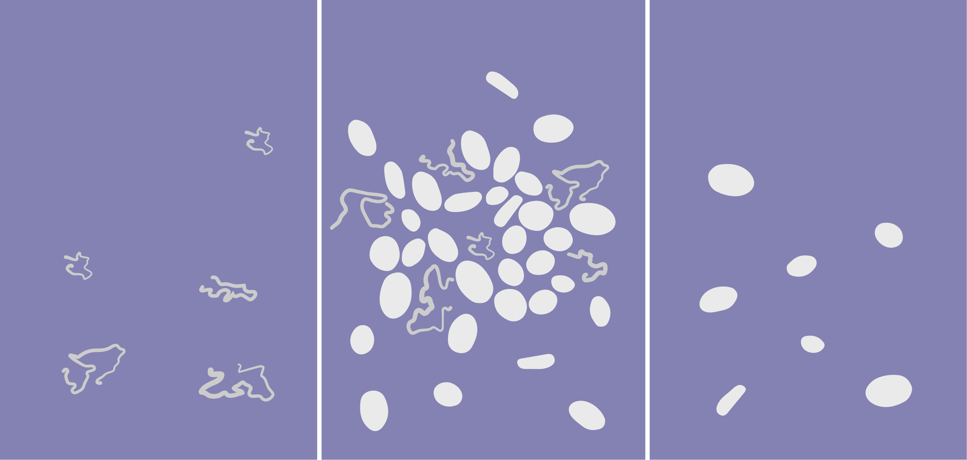

SECOND LINE: consult a haematologist for further testing if
suspicion of a bleeding disorder is raised by personal
bleeding history, family history, and screening tools
Refer to a haematologist for specialist assessment^{1,2}
Testing for von
Willebrand’s
disease
Coagulation
testing
Platelet function
testing
Other testing as
appropriate
Dietary assessment to assess
vitamin C intake³
Vitamin C deficiency, caused for
example by fad dieting, can cause
bleeding
Thyroid function testing⁴
Hypothyroidism can result in heavy
menstrual bleeding
Thyroid function testing is advised
only in patients with heavy
menstrual bleeding and symptoms
suggestive of hypothyroidism
1. Hayward CPM. Int J Lab Hematol. 2018;40 Suppl 1:6-14; 2. O’Brien S. Blood. 2018;132:2134-42; 3. Khalife R, et al. Blood Cells Mol Dis. 2019;76:40-4; 4. Demers C, et al. J Obstet Gynaecol Can. 2018;40:e91-103
09

Slide 10


SECOND LINE: routine coagulation testing can help elucidate the
cause of bleeding but is abnormal in only a minority of patients
THERE ARE MANY PITFALLS IN THE INTERPRETATION OF COAGULATION TESTS
EXPERT INTERPRETATION IS REQUIRED
Routine coagulation testing includes testing for aPTT and PT
aPTT provides an evaluation of the intrinsic coagulation pathway: all coagulation factors except factor VII
PT provides an evaluation of the extrinsic coagulation pathway: mainly factor VII, but also factors V and X,
prothrombin (factor II), and fibrinogen (factor I)
Note that the INR, used to reflect PT in the management of warfarin and hepatology, is not used
in bleeding disorders
PT and aPTT are normal in the majority of patients with the most common
bleeding disorders (von Willebrand’s disease and platelet function defects)
Next steps after an abnormal
coagulation test:
Common causes of prolonged aPTT or PT (or both):
Abnormal aPTT: factor-specific assays can be
performed, commonly to assess factors VIII, IX,
XI, and XII
Medication (the most common cause)
Reduced nutritional intake or malabsorption
Abnormal PT: factor-specific assays for factor VII
can be performed
Systemic disease (e.g. liver disease or connective tissue disease)
Consumptive coagulopathy (e.g. disseminated intravascular coagulation and fibrinolysis)
Clotting factor deficiencies (although these should be quite severe, <30% of normal, to cause
prolonged PT or aPTT)
aPTT, activated partial thromboplastin time; PT, prothrombin time
Green D. Blood Coagul Fibrinolysis. 2010;21 Suppl 1:S3-6; Hayward CPM. Int J Lab Hematol. 2018;40 Suppl 1:6-14; Kamal AH, et al. Mayo Clin Proc. 2007;82:864-73
10

Slide 11


SECOND LINE: testing for von Willebrand’s disease is complex
and is generally undertaken in specialist haematology centres
Von Willebrand’s disease is one of the most common bleeding
disorders worldwide, but many people are undiagnosed^{1,2}
VWF TESTING IS DONE IN SPECIALIST
HAEMATOLOGY CENTRES^{1,3}
Only ~1/10,000 people are diagnosed with low von
Willebrand factor (VWF) or von Willebrand’s disease
QUANTITATIVE
How much VWF is present
QUALITATIVE
How VWF functions
~1/1,000 people have reduced VWF levels
and bleeding symptoms
VWF-antigen (VWF:Ag) testing
VWF activity assays
VWF levels may be increased by
stress, infection, illness, exercise,
high-dose hormonal therapy,
pregnancy, or trauma
VWF activity assays examine the
important functions of VWF:
Platelet binding (VWF:RCo,VWF:GpIb
assays)
~1/100 people have
reduced VWF levels
Blood group also influences VWF
levels, which are lower in blood
group O than in non-O patients¹
Collagen binding (VWF:CB)
The ability to carry factor VIII (factor
VIII levels)
Routine coagulation testing (PT, aPTT) fails to detect low VWF
levels or von Willebrand’s disease, except in the most severe
cases³ — normal PT and aPTT does not exclude this condition
Expert interpretation of results of these tests and patient
history are essential for diagnosis of von Willebrand’s disease
or low VWF levels
aPTT, activated partial thromboplastin time; CB, collagen binding; GpIb, glycoprotein Ib; PT, prothrombin time; RCo, ristocetin cofactor
1. Leebeek FWG, Eikenboom JC. N Engl J Med. 2016;375:2067-80; 2. Bowman M, et al. J Thromb Haemost. 2010;8:213-6; 3. Ng C, et al. Blood. 2015;125:2029-37
11

Slide 12

SECOND LINE: platelet count and function should be assessed
in all women and girls with a suspected bleeding disorders
Abnormalities of platelet count and function are a common and
heterogeneous group of disorders that can result in bleeding
symptoms ranging from mild bruising to severe haemorrhage.
Platelet count and function should be assessed in any patient for
whom clinical suspicion of an underlying bleeding disorder is high.
PLATELET COUNT¹
PLATELET FUNCTION¹
A normal platelet count is not an indication of good
platelet function
Platelet function can be assessed by platelet function
tests that expose the patient’s platelets to specific triggers
to check responses
Note that the platelet count must fall below
20,000–30,000 mm⁻³ before significant
mucocutaneous bleeding occurs
Platelet function tests are performed only in specialist
centres
In most people with platelet function deficits, platelet
counts are normal but function is abnormal
Note that the results of platelet function testing can be
influenced by anaemia, blood volume, and intake of
specific foods, some dietary supplements, and NSAIDs
NSAID, non-steroidal anti-inflammatory drug
1. Simon D, et al. Haemophilia. 2008;14:1240-9; 2. O’Brien S. Blood. 2018;132:2134-42
12

Slide 13

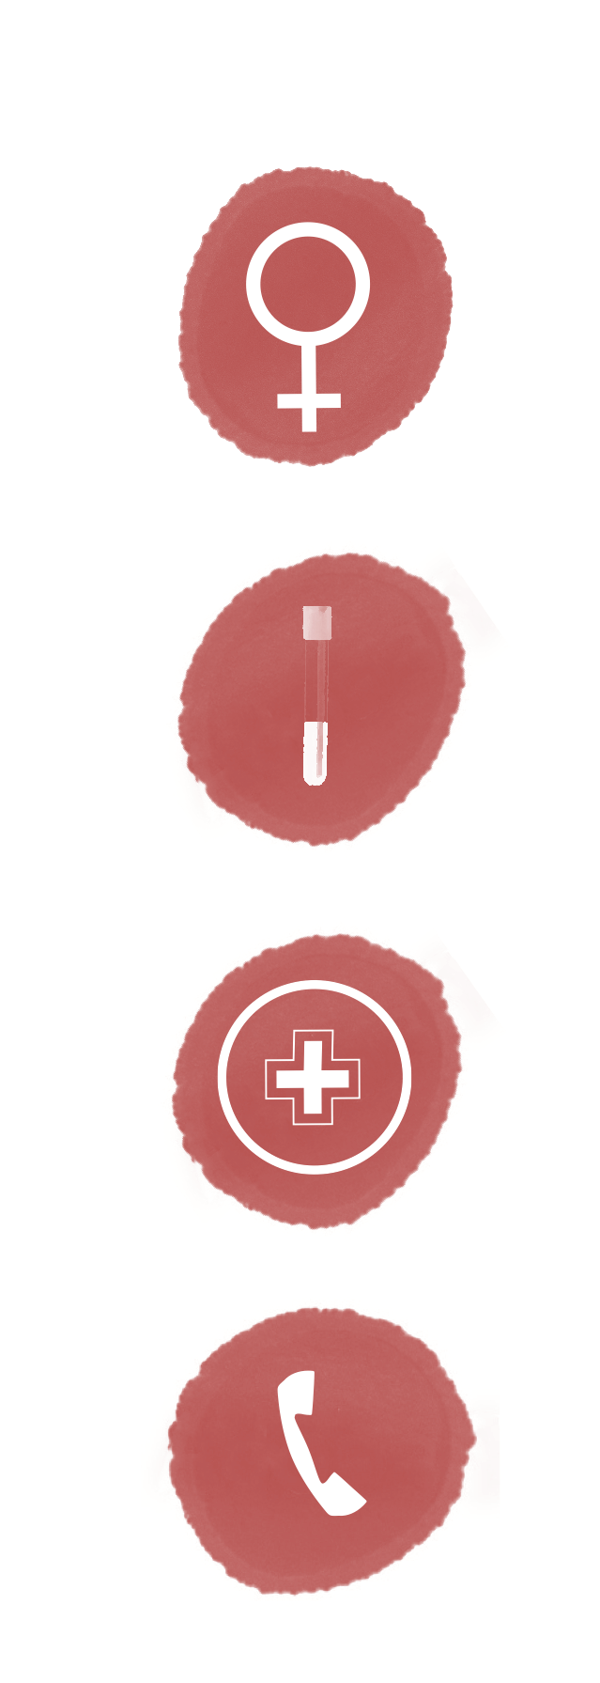
Summary & next steps
Bleeding disorders occur as often in women as in men and have a major
impact on quality of life, because women experience the additional and
frequent bleeding challenges of menstruation and childbirth
If suspicion of a bleeding disorder is raised by personal bleeding history,
family history, and screening tools, perform general laboratory assessment,
including full blood count and iron and ferritin status
First-line treatment is the same for all bleeding disorders, so do not hesitate to
start symptomatic treatment to avoid continued or recurrent bleeding
symptoms, even in the absence of a definite diagnosis. Symptomatic treatment
may include iron replacement, anti-fibrinolytic, and hormonal therapy
Contact a haematologist for diagnostic laboratory assessment including
coagulation, VWF, and platelet function testing and specialised management
VWF, von Willebrand factor
13

Slide 14



Next steps
Please proceed to the assessment quiz to test your knowledge.
Visit Module 1 of this micro e-learning programme to
learn more about:
Recognising signs and symptoms of bleeding disorders
in women
The impact of bleeding disorders on women’s quality of life
How to effectively screen for symptoms of bleeding
disorders in women by using the tools available
Note: you will be able to claim your CME credit after passing the
assessment quizzes in both Modules 1 and 2
Visit the assessment quiz at www.checkpoint.cor2ed.com
CME credit available
Visit programme home page on:
CME, continuing medical education
14

