Slide 1
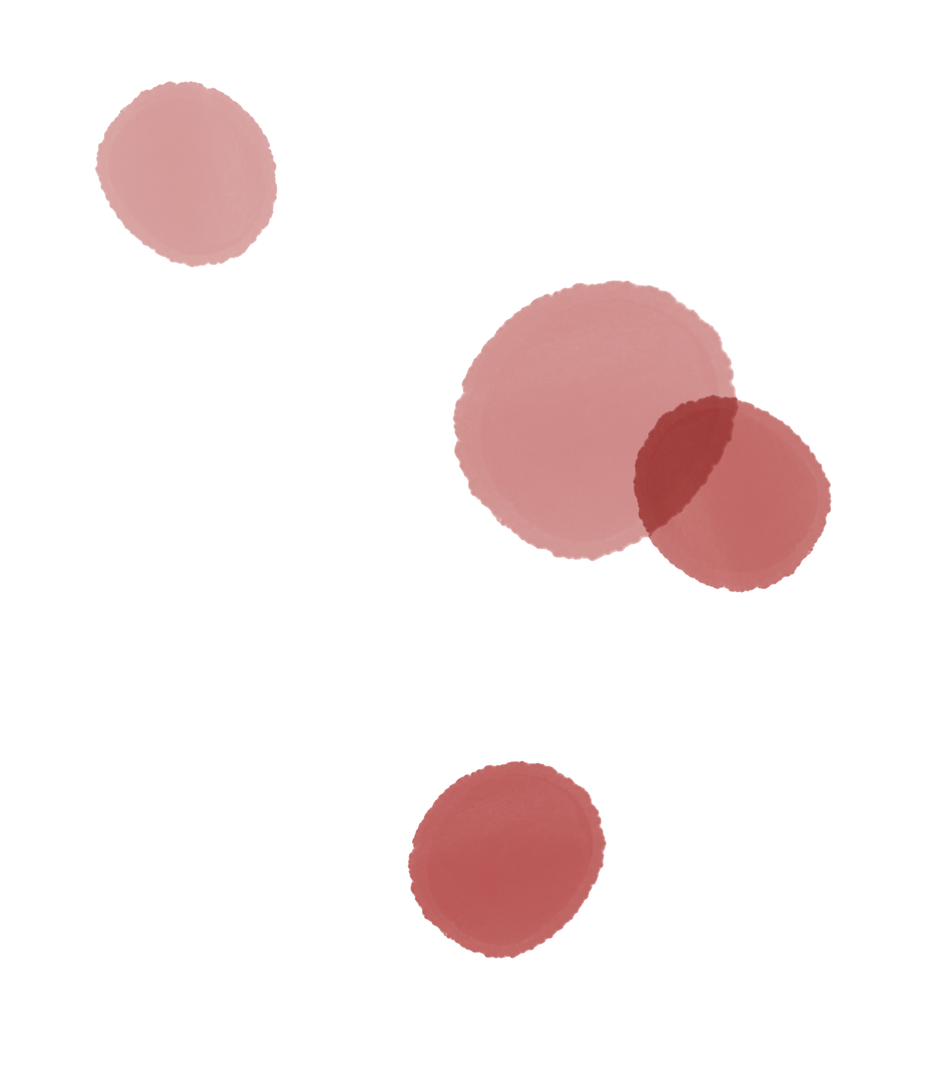


WOMEN WITH
BLEEDING DISORDERS
Module 1
How do I recognise and
screen for bleeding
disorders in women and girls
Endorsed by:
March 2021
CME credit available
Visit programme home page on:
The programme is supported by an independent educational grant from Takeda.
The programme is therefore independent; the content is not influenced by the
supporter and is under the sole responsibility of the experts.

Slide 2


What will you learn in this micro e-learning programme
on women with bleeding disorders?
This micro e-learning programme consists of
two modules aiming to increase awareness,
knowledge, and understanding of bleeding
disorders and their management by healthcare
professionals who are the first to see women
and girls with signs and symptoms of bleeding
disorders.
Current Module
AFTER MODULE 1 YOU WILL:
Be able to recognise the signs and symptoms of bleeding disorders in women
Be aware of the impact on quality of life of bleeding disorders in women
Know how to effectively screen for symptoms of bleeding disorders in
women by using the tools available
Upon completion of the two modules, you will:
Be able to recognise the signs and
symptoms of bleeding disorders in women
and be aware of their impact on the
quality of life of women
AFTER MODULE 2 YOU WILL:
Understand the strengths and limitations of tests used to diagnose bleeding disorders in women
Know how to identify women who are
likely to have undiagnosed bleeding
disorders, initiate basic diagnostic testing,
and arrange an appropriate referral for
diagnosis
Be able to perform basic interpretation of test results to diagnose bleeding
disorders in women
Be able to initiate management of bleeding symptoms in women until
specialist assessment is available
Be able to initiate management of
bleeding symptoms in women until
specialist assessment is available
02

Slide 3
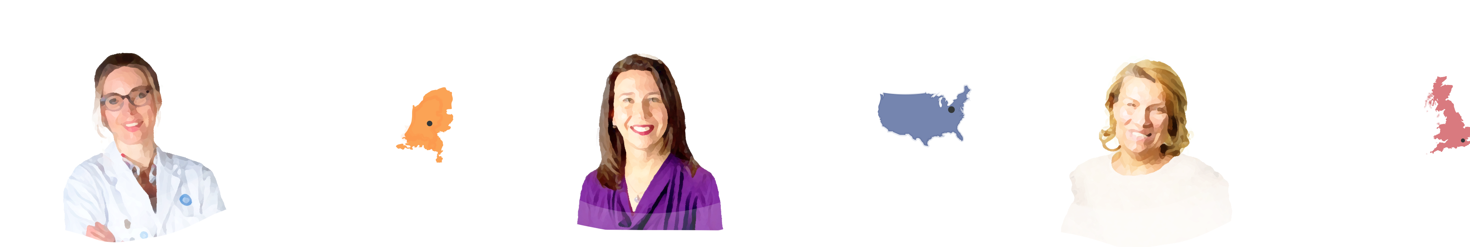
This micro e-learning module has been developed by a
multidisciplinary panel of experts
DR KARIN
VAN GALEN
DR SARAH
O’BRIEN
PROF REZAN
ABDUL-KADIR
HAEMATOLOGIST, VAN
CREVELDKLINIEK, UMC
UTRECHT, NETHERLANDS
PAEDIATRIC HAEMATOLOGIST,
NATIONWIDE CHILDREN’S
HOSPITAL, COLUMBUS, OH, USA
OBSTETRICIAN AND GYNAECOLOGIST,
THE ROYAL FREE FOUNDATION
HOSPITAL, LONDON, UK
Assistant Professor at the Department
Van Creveldkliniek of the UMC Utrecht,
Netherlands
Associate Professor of Paediatrics at
the Ohio State University College of
Medicine
Professor and Consultant Obstetrician
and Gynaecologist at the Royal Free
Hospital and University College London
Chair of the European Association for
Haemophilia and Allied Disorders
(EAHAD) Women and Bleeding Disorders
Committee
Leads a multidisciplinary young
women’s haematology clinic at
Nationwide Children’s Hospital
Leads multidisciplinary team service
for women with bleeding and
thrombotic disorders
Clinical and research interests include
the evaluation and diagnosis of mild
bleeding disorders and the
intersections between haematology
and women’s health
Leads research and postgraduate
training on women and haemostasis
Participates in (inter)national studies on
congenital bleeding disorders
Author of the book Inherited Bleeding
Disorders in Women and coauthor of
(inter)national guidelines and more
than 200 publications
Runs a post-doctoral research project on
pregnancy in women with inherited
bleeding disorders
The views expressed in this slide deck are the personal opinions of the experts. They do not necessarily represent the views of the experts’ institutions.
03

Slide 4
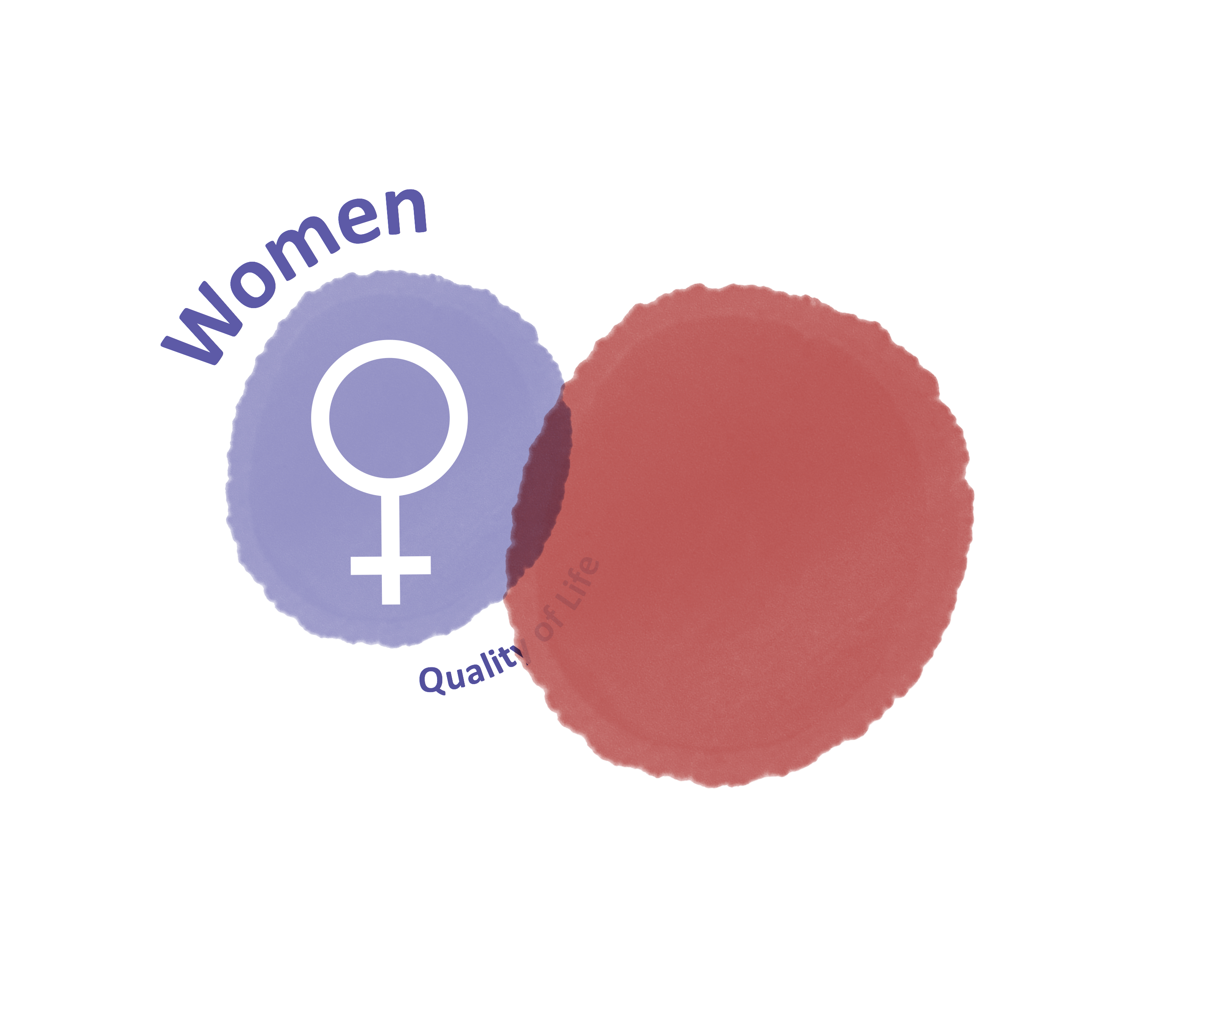
Bleeding disorders do occur in women and girls and have
a major impact on quality of life
Bleeding disorders occur as often in
women as in men, but women experience
the additional bleeding challenges of
menstruation and childbirth.
These disorders have a major impact on
the quality of life and social participation
of women and girls.¹⁻³
Studies show clinically and statistically
significant reductions in both physical
and mental aspects of health-related
quality of life
1. Kulkarni R. Eur J Haematol. 2015;95 Suppl 81:2-10; 2. Lavin M, et al. Blood Adv. 2018;2:1784-91; 3. Xu Y, et al. Haemophilia. 2017;23:115-21
04

Slide 5
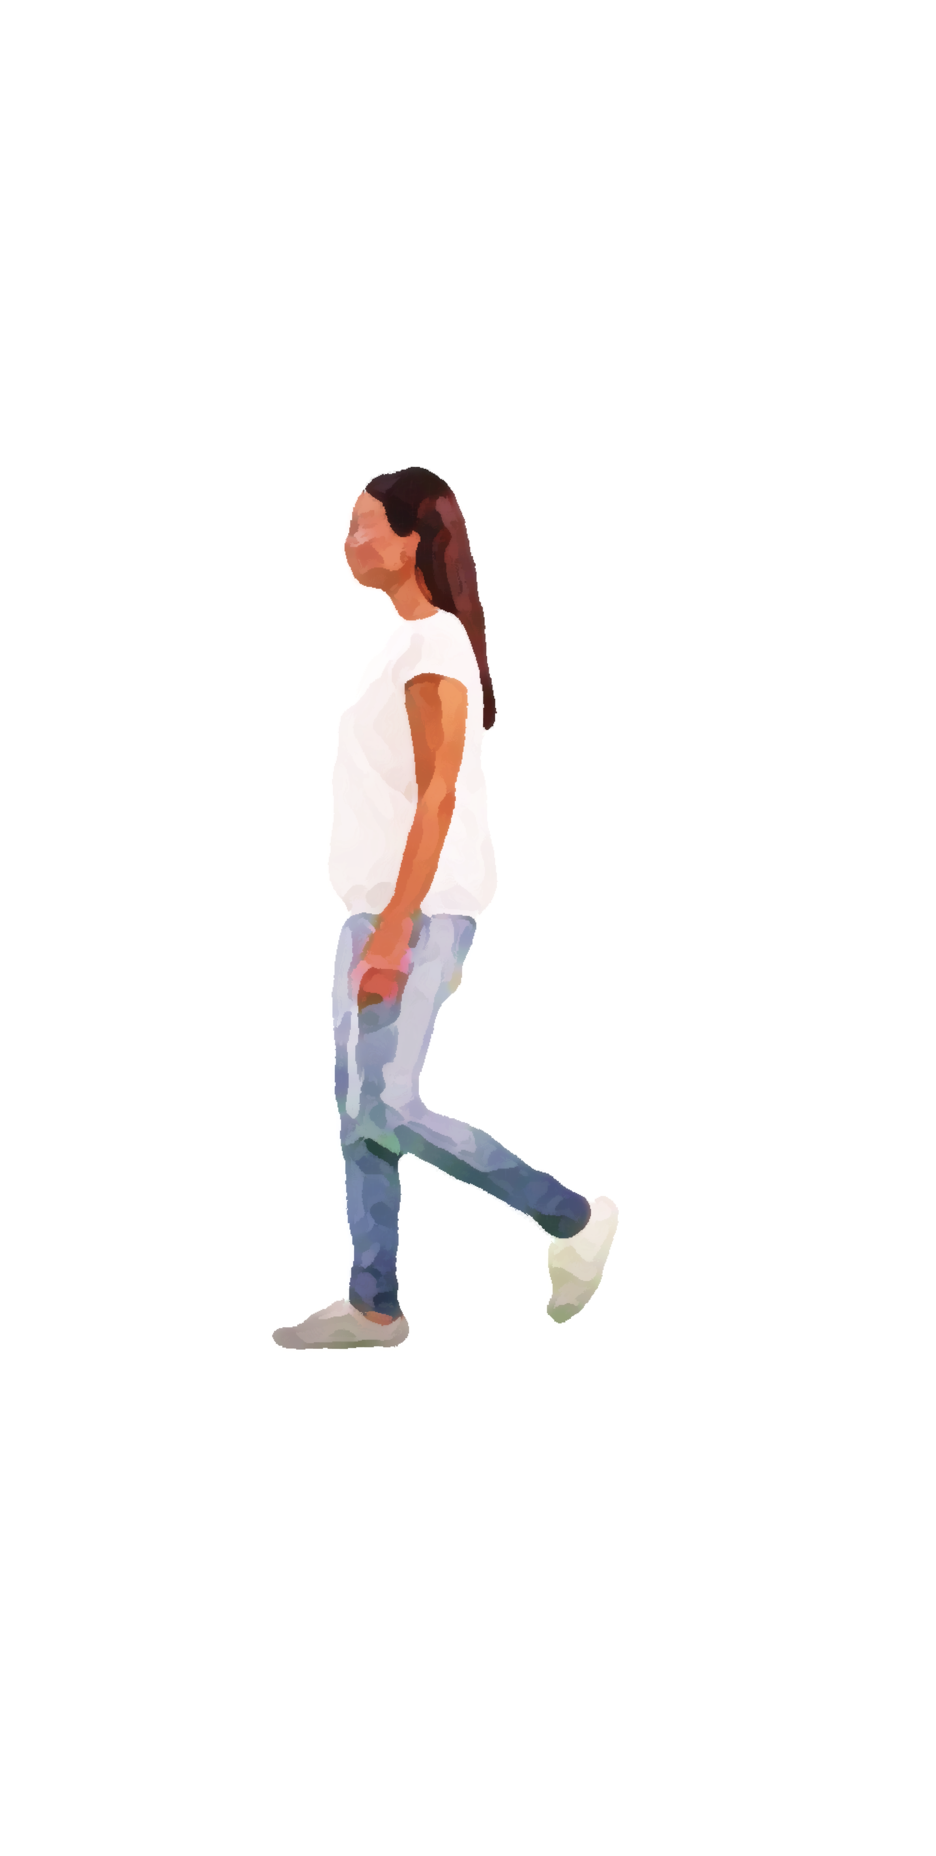
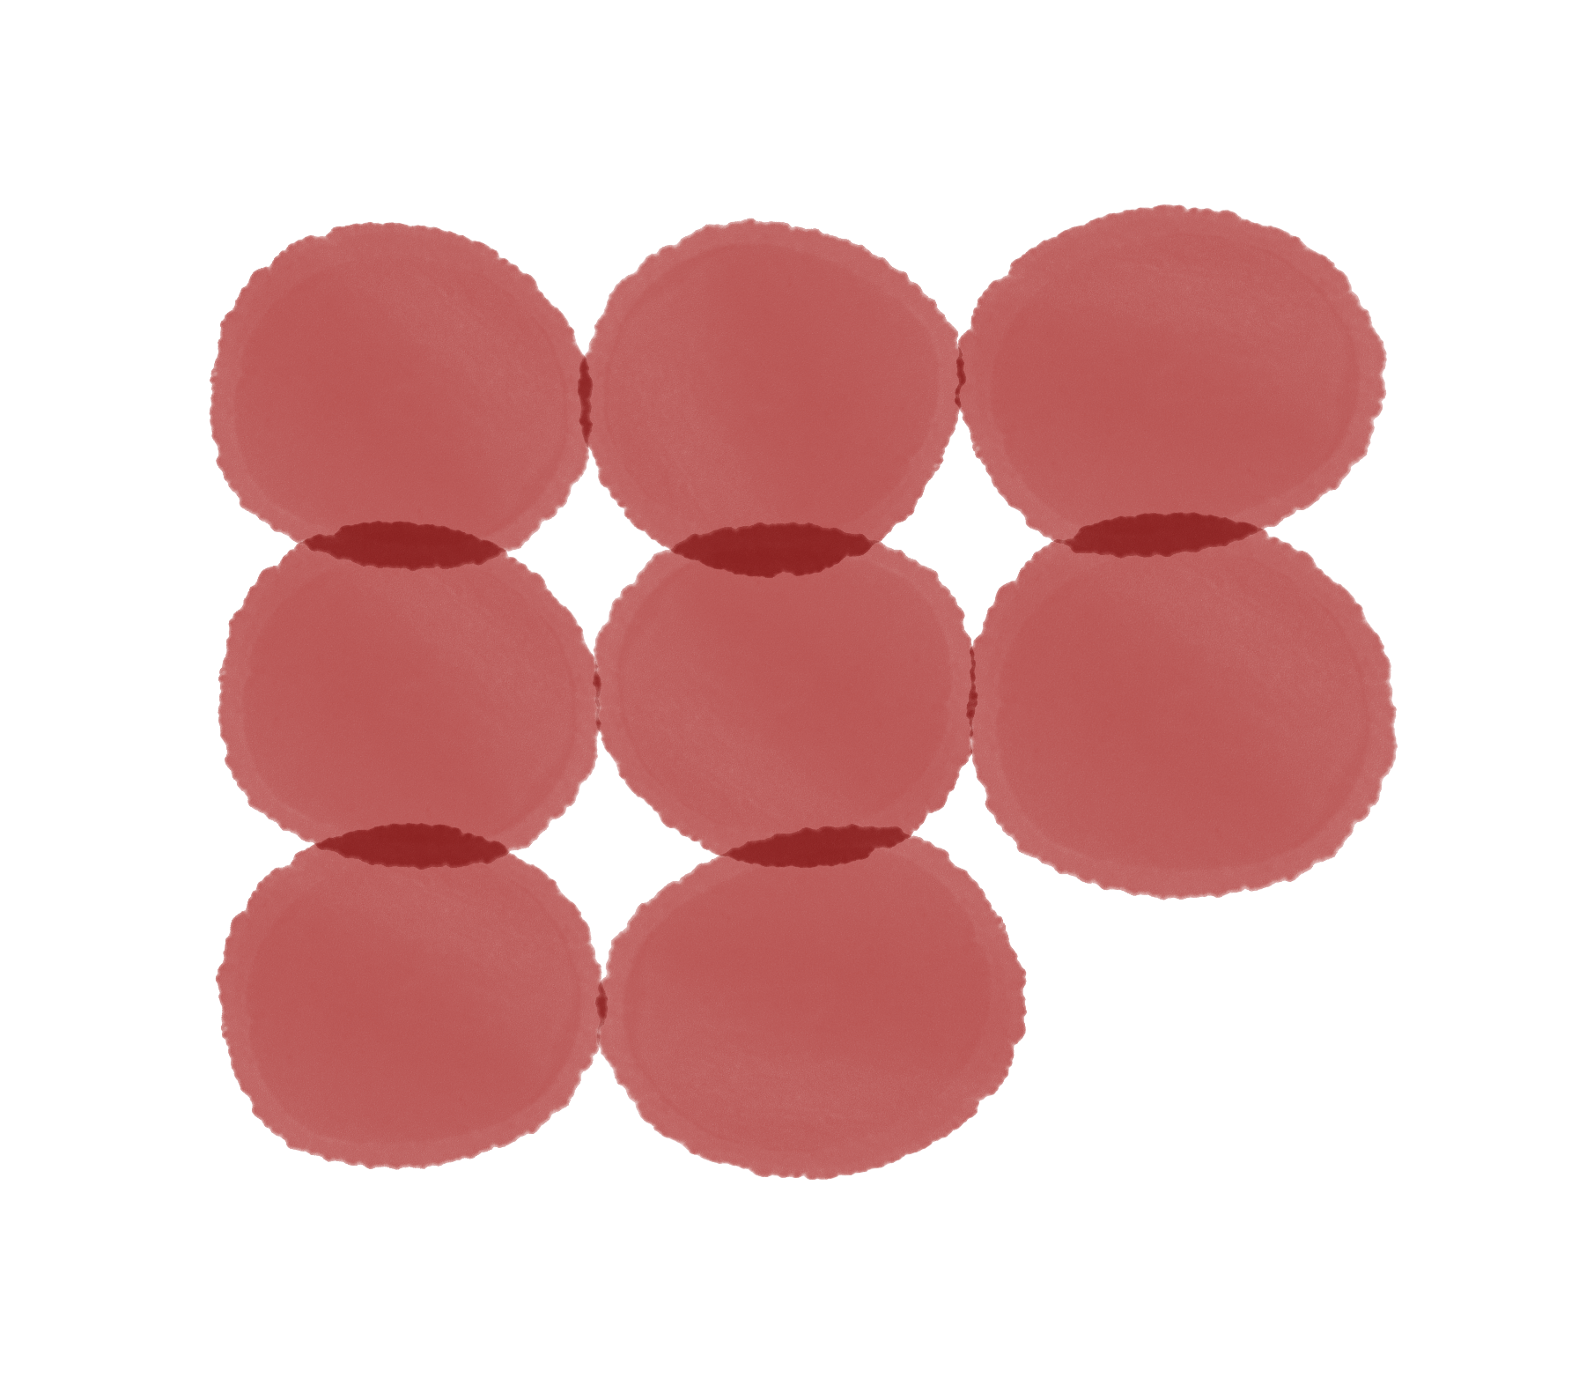
Bleeding disorders do occur in women and girls and have
a major impact on quality of life
Heavy menstrual bleeding is a common
symptom, and sometimes it is the only sign of a
bleeding disorder.^{2,3}
IMPACT OF BLEEDING DISORDERS ON
WOMEN AND GIRLS¹
In adolescents, heavy menstrual bleeding is
associated not only with iron deficiency (in up
to 60% of patients) and fatigue but also with
missed school days, social events, outdoor
activities, and physical education⁴⁻⁶
Pain during
periods
Adverse
psychosocial
effects
Time lost from
work or school
Despite the negative impact of bleeding
disorders on health-related quality of life,
there is a long delay between the onset of
symptoms and diagnosis of a bleeding
disorder.^{3,7}
Unnecessary
procedures
Anaemia:
iron deficiency
Hospitalisations
and maternal
mortality
Reduced
quality of life
Limitations in
daily activities
1. Kulkarni R. Eur J Haematol. 2015;95 Suppl 81:2-10; 2. Lavin M, et al. Blood Adv. 2018;2:1784-91; 3. Ragni MV, et al. Haemophilia. 1999;5:313-7; 4. Srivaths L, et al. Blood Adv. 2020;4:3209-16;
5. Wang W, et al. Haemophilia. 2013;19:225-30; 6. Torres R, et al. Rev Chil Pediatr. 2017;88:717-22; 7. Noone D, et al. Haemophilia 2019;25:468-74
05

Slide 6
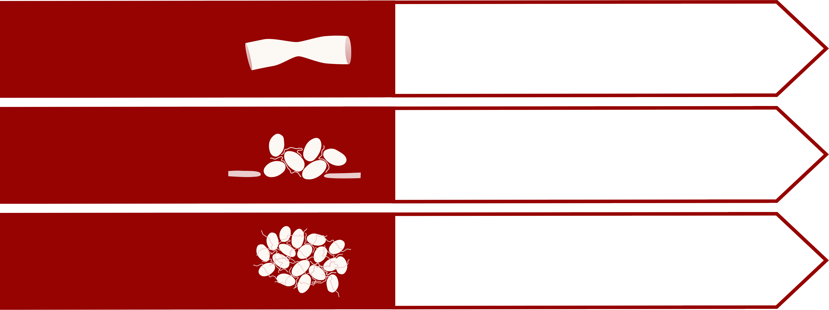
Bleeding symptoms can be caused by a variety of disorders in platelets and blood clotting factors
HAEMOSTASIS CONSISTS OF THREE PHASES
1. VASOCONSTRICTION
Vasoconstriction is generally not affected by
bleeding disorders
2. PLUG
FORMATION
BY PLATELETS
Bleeding disorders in women
Von Willebrand’s disease
Congenital abnormalities of platelet count and function
3. CLOT FORMATION
IN THE COAGULATION
CASCADE
Bleeding disorders in women
Haemophilia carriership
Rare bleeding disorders
Hermans C, Kulkarni R. Haemophilia. 2018;24 Suppl 6:29-36; Leebeek FWG, Eikenboom JCJ. N Engl J Med. 2016;375:2067-80; Simon D, et al. Haemophilia. 2008;14:1240-9
06

Slide 7
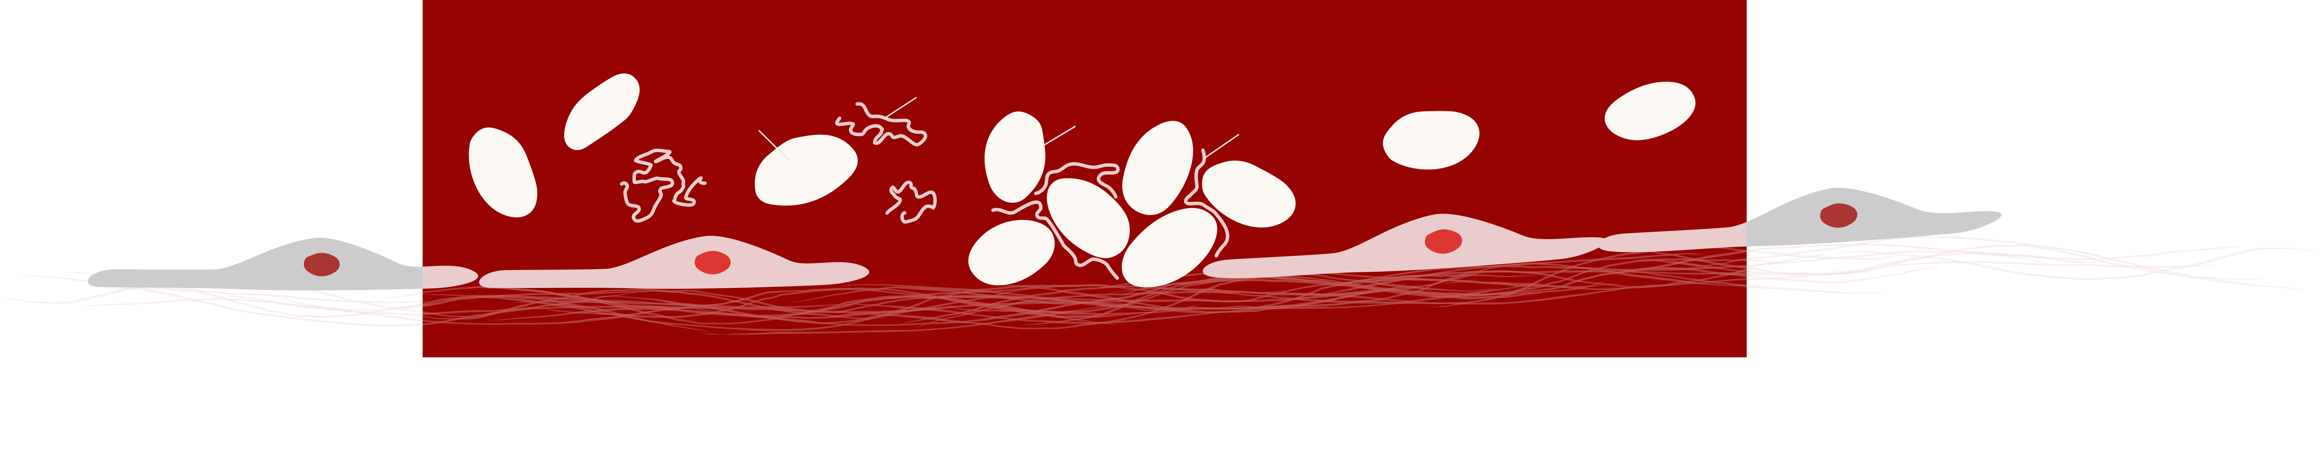
Plug formation can be affected by bleeding disorders in
women and girls
Von Willebrand factor (VWF) binds to collagen at sites of vascular
injury and mediates platelet adhesion and aggregation. Patients with
Von Willebrand’s disease have reduced levels of (functional) VWF
and, therefore, problems in plug formation. Von Willebrand’s disease
is the most common inherited bleeding disorder.
Congenital abnormalities of platelet count and function
are a heterogeneous group of disorders that can result in
bleeding symptoms ranging from mild bruising to severe
haemorrhage.
Blood Flow
Blood Flow
Coiled
Inactive VWF
Inactivated
Platelet
Activated
Platelet
Uncoiled
Active VWF
Endothelial Cells
Endothelial Cells
Subendothelial Collagen
Leebeek FWG, Eikenboom JCJ. N Engl J Med. 2016;375:2067-80; Simon D, et al. Haemophilia. 2008;14:1240-9
07

Slide 8
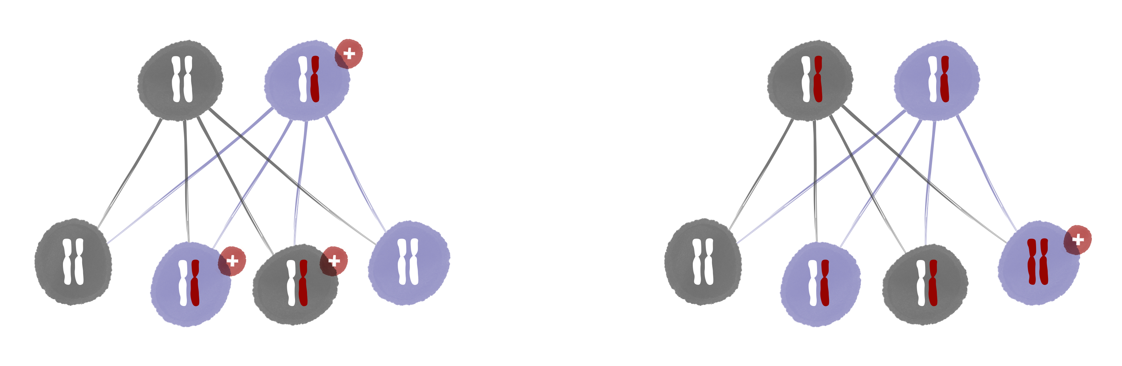
Plug formation can be affected by bleeding disorders in
women and girls
AUTOSOMAL DOMINANT
AUTOSOMAL RECESSIVE
Father
Mother
Father
Mother
Unaffected
Affected
Carrier
Carrier
Son
Daughter
Son
Daughter
Unaffected
Daughter
Son
Unaffected
Unaffected
Daughter
Son
Affected
Affected
Affected
Carrier
Carrier
Von Willebrand’s disease and congenital platelet defects
typically have an autosomal dominant pattern of inheritance.
Type 3 Von Willebrand’s disease and most severe types of
platelet function defects have an autosomal recessive pattern
of inheritance.
Leebeek FWG, Eikenboom JCJ. N Engl J Med. 2016;375:2067-80; Simon D, et al. Haemophilia. 2008;14:1240-9
08

Slide 9
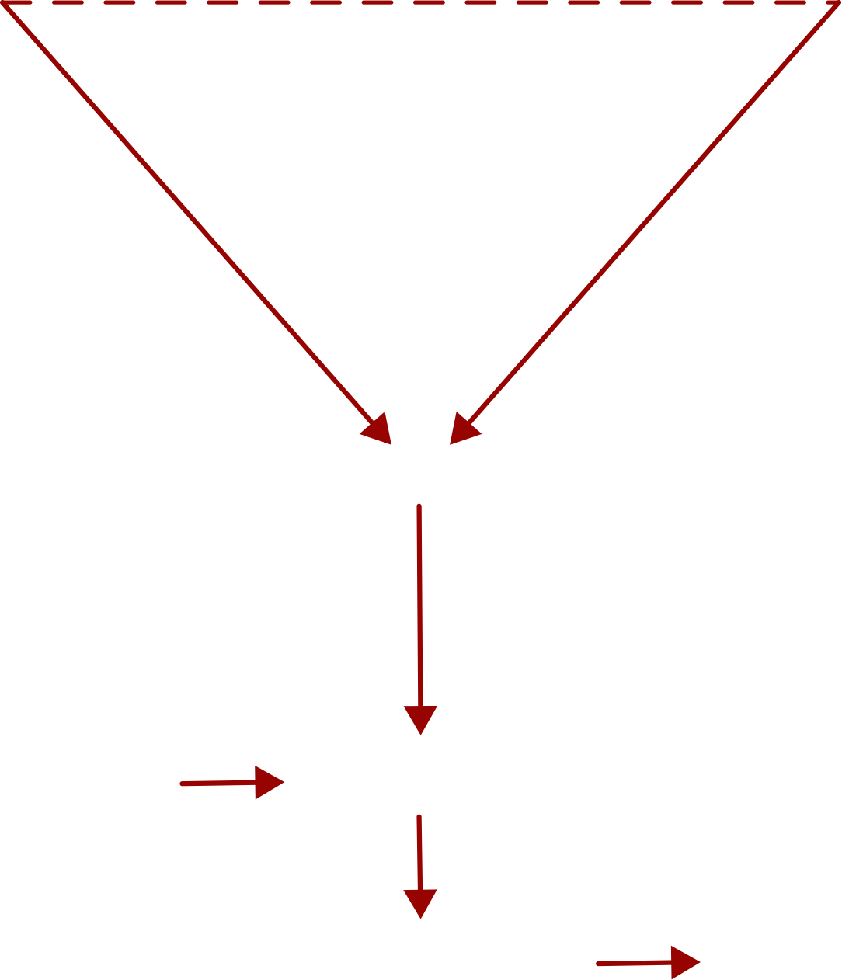

The coagulation cascade can be affected by bleeding
disorders in women and girls
Coagulation
Cascade
Intrinsic
Pathway
Extrinsic
Pathway
XII
Tissue Factor
XI
VII
IX
Haemophilia is a hereditary bleeding disorder
characterised by deficiency of coagulation factor VIII
(haemophilia A) or factor IX (haemophilia B).¹
Haemophilia A is more common than haemophilia B.
VIII
Common
Pathway
X
V
Ca++
Lipids
Prothrombin (II)
Thrombin
Fibrinogen (I)
Fibrin clot (XIII)
1. Hermans C, Kulkarni R. Haemophilia. 2018;24 Suppl 6:29-36; 2. Paroskie A, et al. Br J Haematol. 2015;170:223-8; 3. Plug I, et al. Blood. 2006:108:52-6
09

Slide 10
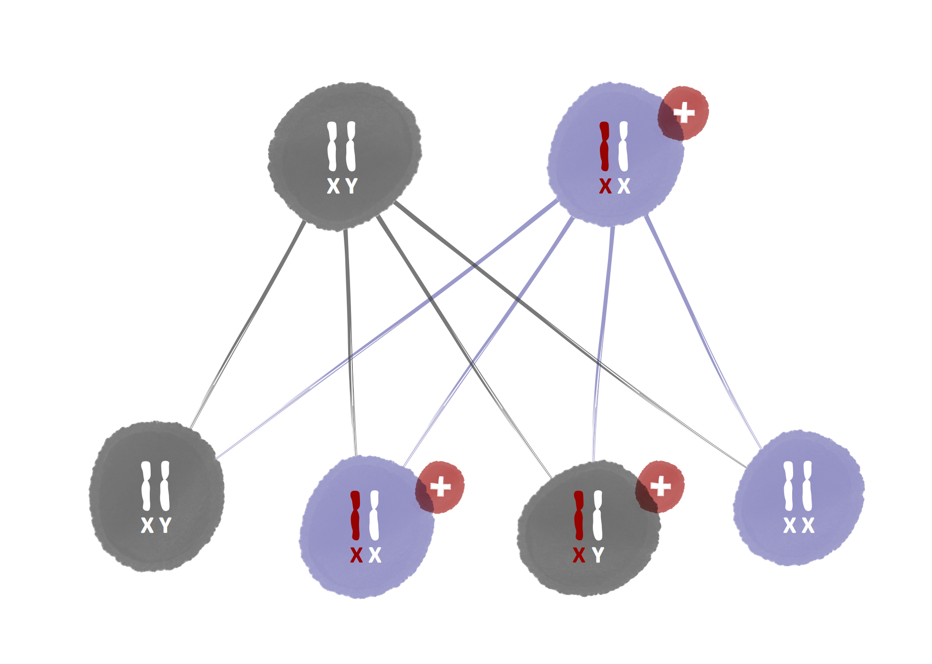


The coagulation cascade can be affected by bleeding
disorders in women and girls
Father
Mother
Unaffected
Carrier
Haemophilia has an X-linked recessive
pattern of inheritance.¹ Women and girls
with an altered copy of the gene on
chromosome X are called carriers.
Approximately 1/3 of haemophilia
carriers exhibit low factor levels.
!
Carriers often have a clinically relevant
increased bleeding tendency, even if
their factor levels are normal.^{2,3}
Son
Daughter
Unaffected
Daughter
Son
Unaffected
Carrier
Affected
1. Hermans C, Kulkarni R. Haemophilia. 2018;24 Suppl 6:29-36; 2. Paroskie A, et al. Br J Haematol. 2015;170:223-8; 3. Plug I, et al. Blood. 2006:108:52-6
10

Slide 11
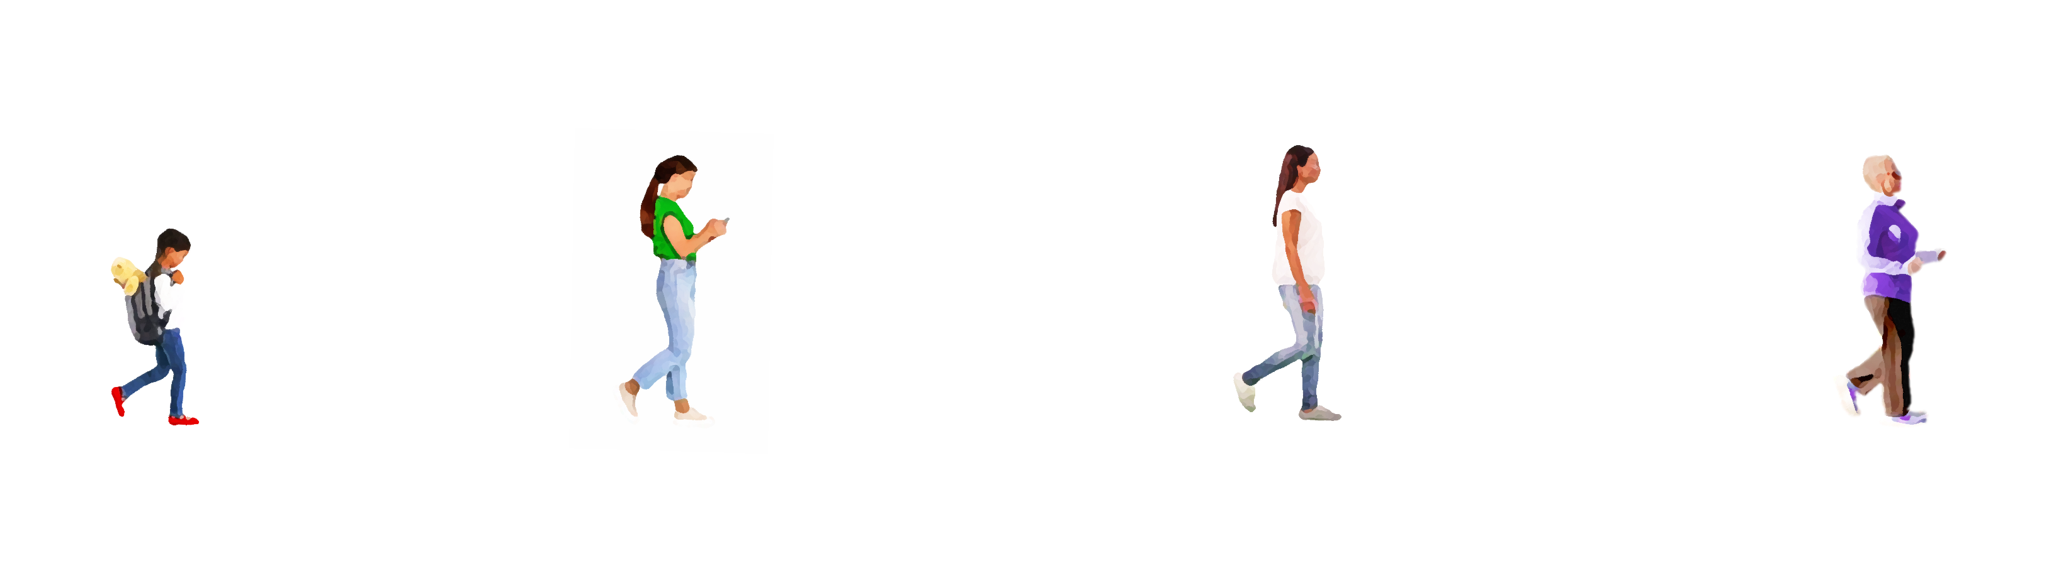
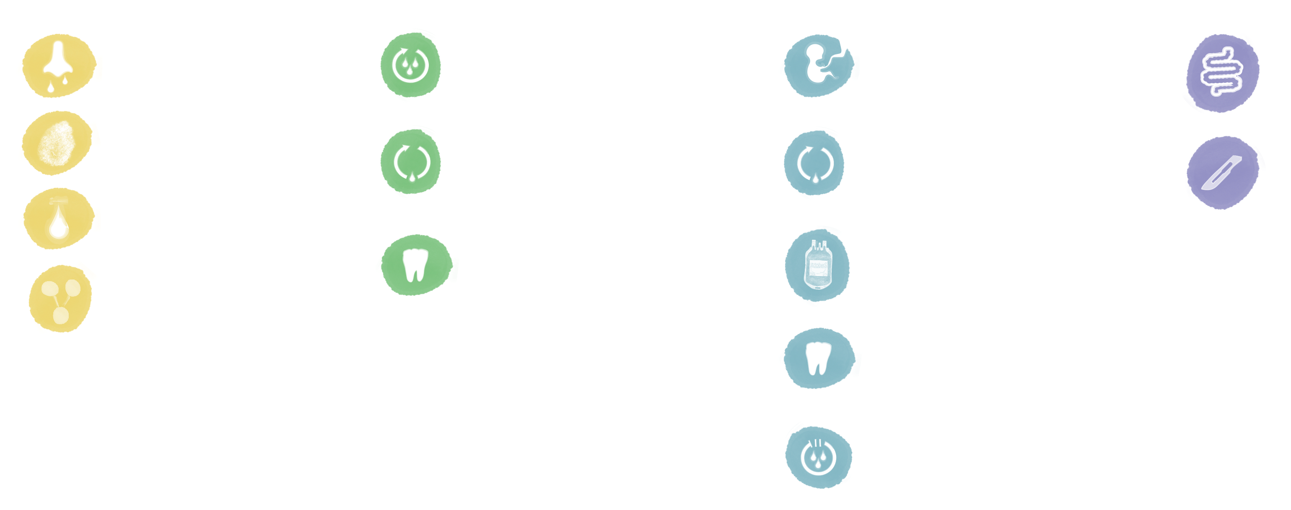

Signs and symptoms suggesting an underlying bleeding
disorder in women and girls
LATE
ADULTHOOD
CHILDHOOD
ADOLESCENCE
ADULTHOOD
Nosebleeds
Heavy menstrual bleeding,
especially since menarche
Primary and late
post-partum haemorrhage
Bleeding of gastrointestinal
tract without an obvious
anatomic lesion
Notable bruising
without injury
Bleeding during ovulation
leading to haemorrhagic
ovarian cysts or
haemoperitoneum*
Bleeding during ovulation
leading to haemorrhagic
ovarian cysts or
haemoperitoneum*
Unexpected
post-surgical bleeding
Excessive bleeding from
minor wounds
Prolonged or excessive
bleeding after dental
extraction
Post-surgical or spontaneous
bleeding that requires blood
transfusion
Family history of a
bleeding disorder
This figure shows common signs and symptoms in each phase of life. Please be aware that most of these signs and symptoms can occur across a lifetime.
Prolonged or excessive
bleeding after dental
extraction
*Bleeding during ovulation leading to haemorrhagic ovarian cysts or haemoperitoneum is often associated
with pain during ovulation (mittelschmerz).
Heavy menstrual bleeding
may increase near menopause
O’Brien SH. Blood. 2018;132:2134-42; James AH, et al. Am J Obstet Gynecol. 2009;201:12.e1-8; Philipp CS, et
al. Obstet Gynecol. 2005;105:61-6
11

Slide 12
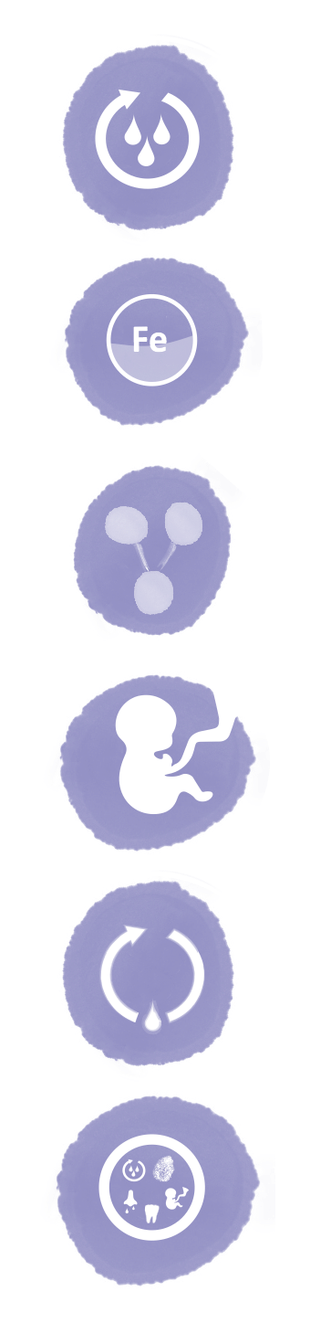
Identifying women and girls who are likely to have a bleeding disorder
Front-line healthcare professionals play a crucial role
in reducing the time to diagnosis of bleeding
disorders in women and girls.
PARTICULARLY CONSIDER SCREENING FOR
BLEEDING DISORDERS IN WOMEN AND GIRLS WITH
Assessing the personal bleeding history and family
history is key to identifying women and girls who
are likely to have undiagnosed bleeding disorders.
Heavy menstrual bleeding, especially
since menarche
One of the following screening tools can be used to
screen for a bleeding disorder by:
Iron deficiency or iron-deficiency anaemia
due to gynaecological bleeding
Pictorial blood assessment chart
Family history of bleeding symptoms
Philipp tool
ISTH-SSC bleeding assessment tool
Primary or late post-partum
haemorrhage
Recurrent ovulation bleeding
Multiple bleeding symptoms
ISTH, International Society on Thrombosis and Haemostasis; SSC, Scientific and Standardization Committee
12

Slide 13
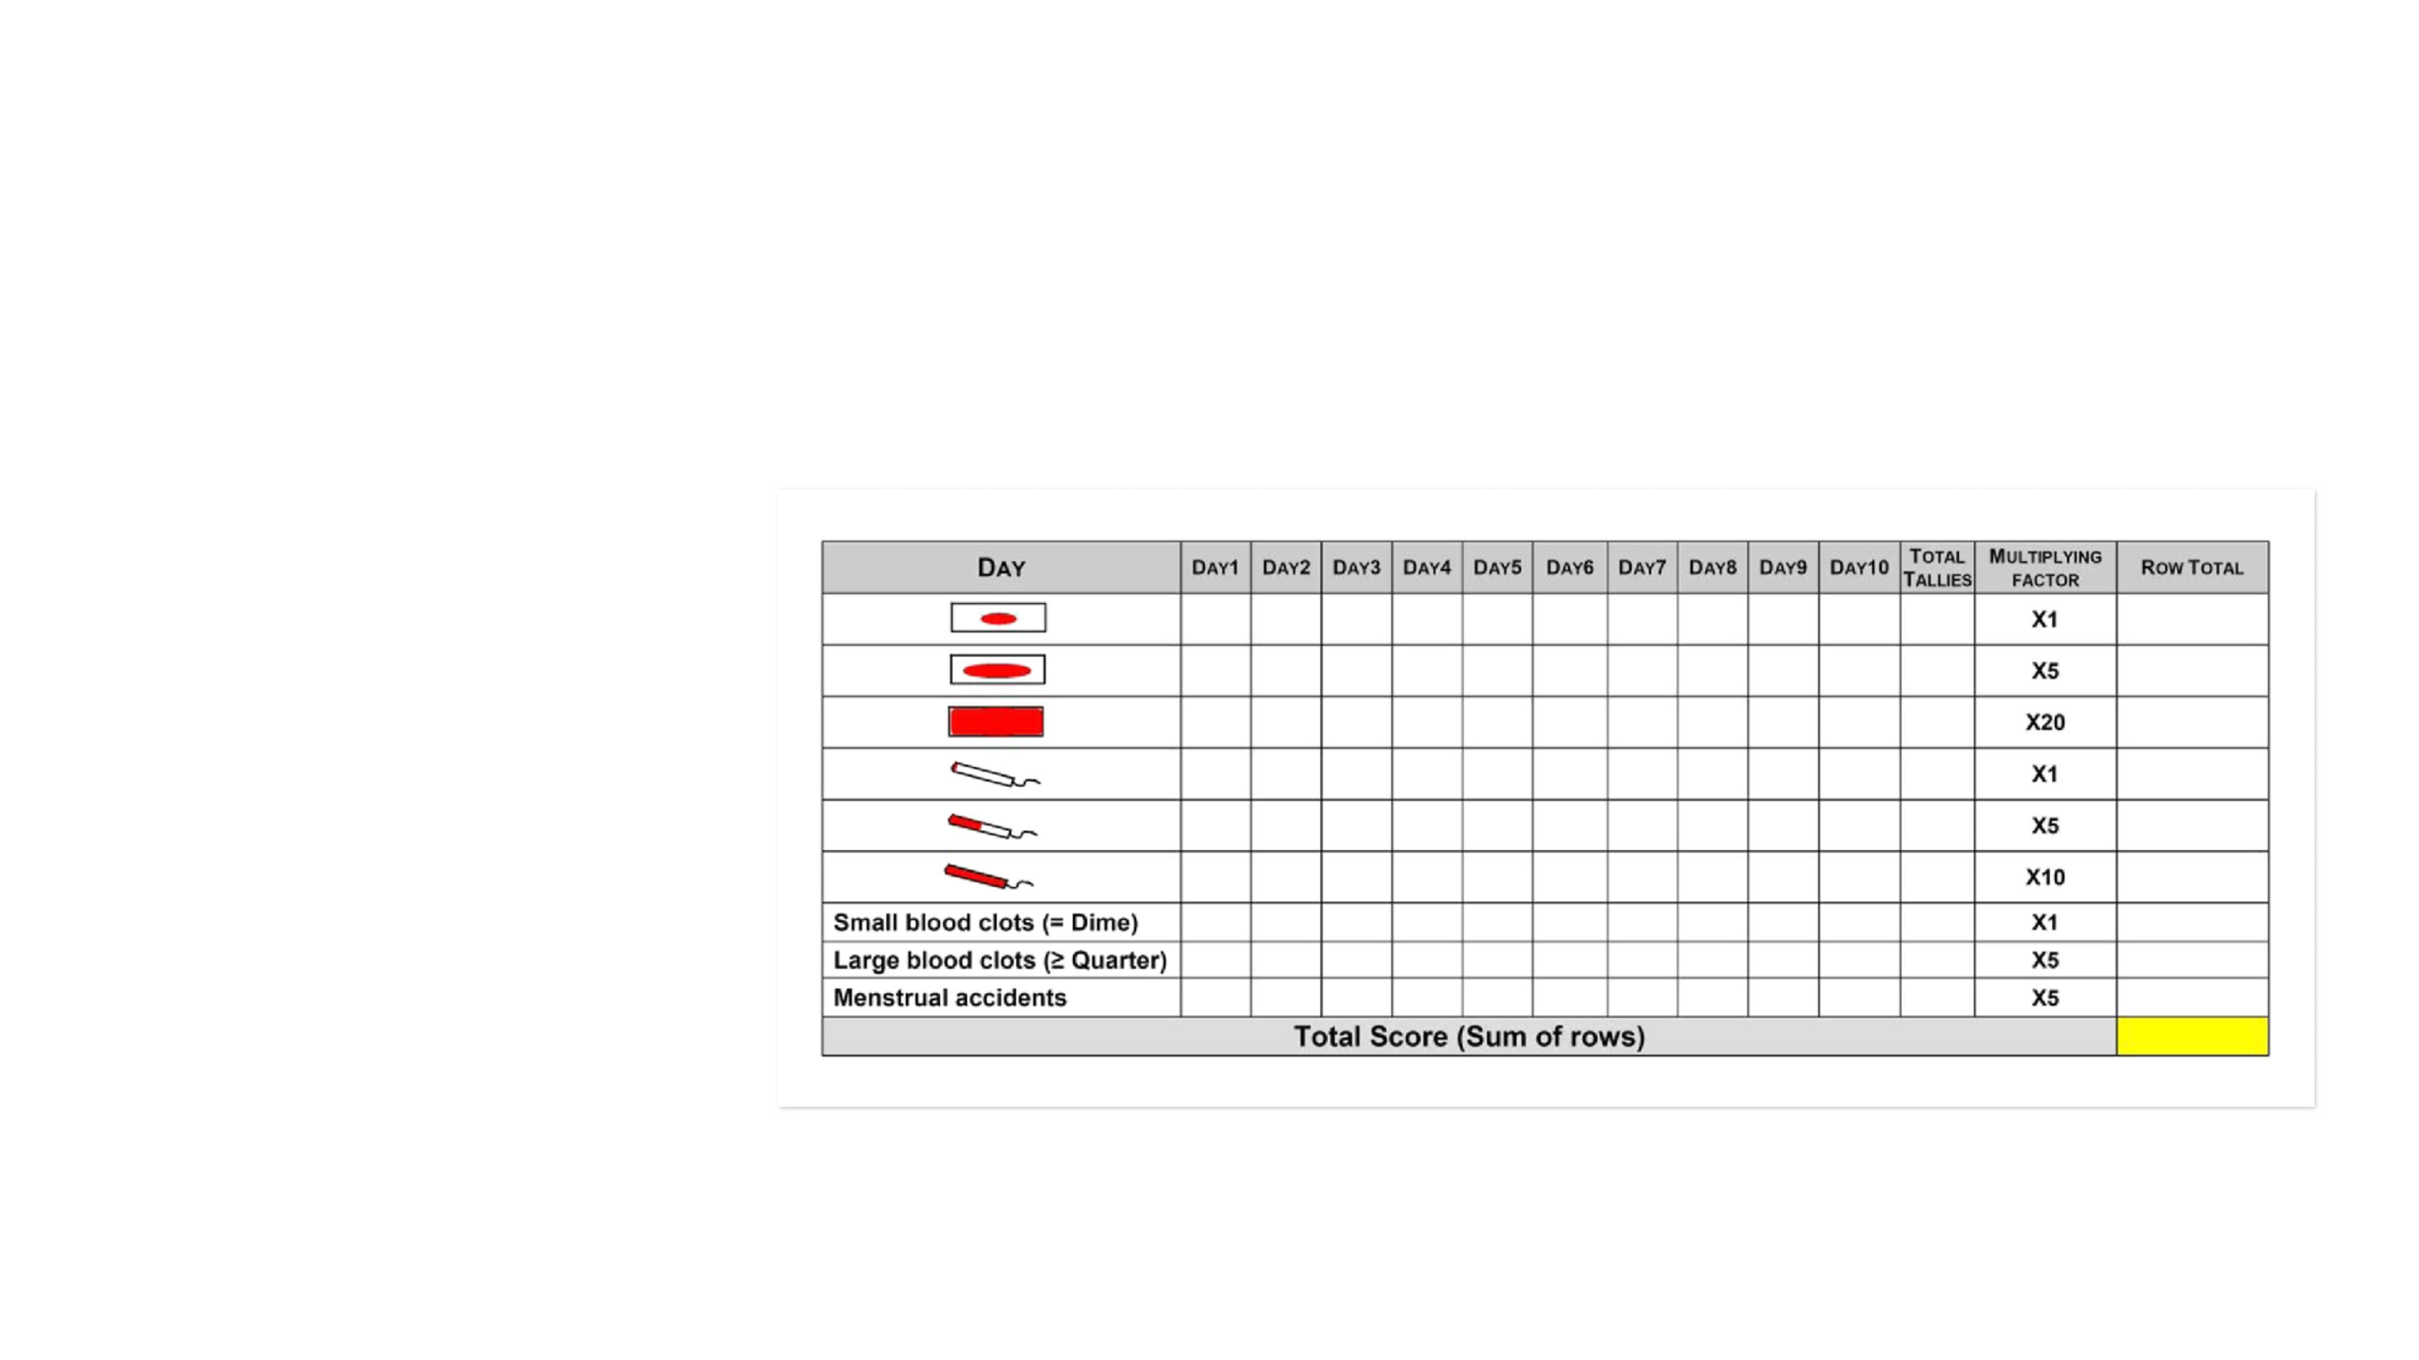
The pictorial blood assessment chart allows patients to
quantify blood loss during menstruation
DETECTING HEAVY MENSTRUAL BLEEDING
Patients fill out the chart themselves
during their period by placing a tally
mark, each time they change their
sanitary protection, next to the
amount of bleeding as well as
recording clots and any cases of
flooding.
At the end of their period, patients
calculate the total score by multiply-
ing the number of tallies in each row
by the multiplying factor and adding
up to get the row total.
A total score (sum of row scores) of ≥100 indicates heavy menstrual bleeding
Higham JM, et al. Br J Obstet Gynaecol. 1990;97:734-9; Janssen CAH, et al. Obstet Gynecol. 1995;85:977-82
13

Slide 14


The Philipp tool identifies women and girls who need
further evaluation
The Philipp tool was developed to help
identify women for testing and further
evaluation for bleeding disorders.
Philipp tool
SEVERITY OF MENORRHAGIA
Q1.
How many days did your period usually last, from the time bleeding began until it completely stopped?
Abnormal if ≥ 7 days
The Philipp tool is considered positive if
a response to 1 or more of the
questions in the severity category
reveals abnormality and/or an
affirmative response is obtained in any
other category.
Q2.
How often did you experience a sensation of “flooding” or “gushing” during your period?
Abnormal if every or most periods
Q3.
During your period did you ever have bleeding where you would bleed through sanitary protection in 2 hours?
Abnormal if every or most periods
HISTORY OF TREATMENT FOR ANAEMIA
Q4.
Have you ever been treated for anaemia?
FAMILY HISTORY
Q5.
Has anyone in your family ever been diagnosed with a bleeding disorder?
PERSONAL HISTORY
Q6.
Have you ever had a tooth extracted or had dental surgery?
If yes, did you have problem with bleeding after tooth extraction or dental surgery?
Q7.
Have you ever had surgery other than dental surgery?
If yes, did you have bleeding problem after surgery?
Q8.
Have you ever been pregnant?
If yes, have you ever had bleeding problem after delivery or after a miscarriage?
Philipp CS, et al. Am J Obstet Gynecol. 2008;198:163.e1-8; Philipp CS, et al. Am J Obstet Gynecol. 2011;204:209.e1-7
14

Slide 15



ISTH-SSC bleeding assessment tool further assesses patients
with a suspected inherited bleeding disorder
The ISTH-SSC subcommittees have developed
a tool to assess patients with a suspected
inherited bleeding disorder — it can be used
for men and for women.
The ISTH-SSC bleeding assessment tool scores the following symptoms
1.
Epistaxis
9.
Menorrhagia
2.
Cutaneous bruising
10.
Post-partum haemorrhage
The questionnaire is to be collected by an
adequately trained healthcare professional,
who will score symptoms and related
treatments before or at diagnosis (or both).
3.
Bleeding from minor wounds
11.
Muscle haematomas
4.
Oral cavity bleeding
12.
Haemarthrosis
5.
Gastrointestinal bleeding
13.
Central-nervous system bleeding
6.
Haematuria
14.
Other bleeding problems
In women, a score of ≥6 is considered
abnormal and indicates that further
testing is required.
7.
Dental extraction bleeds
8.
Surgical bleeding
An online version of the ISTH bleeding assessment tool is available at
https://bleedingscore.certe.nl
ISTH, International Society on Thrombosis and Haemostasis; SSC, Scientific and Standardization Committee
Elbatarny M, et al. Haemophilia. 2014;20:831-5; Rodeghiero F, et al. J Thromb Haemost. 2010;8:2063-5
15

Slide 16
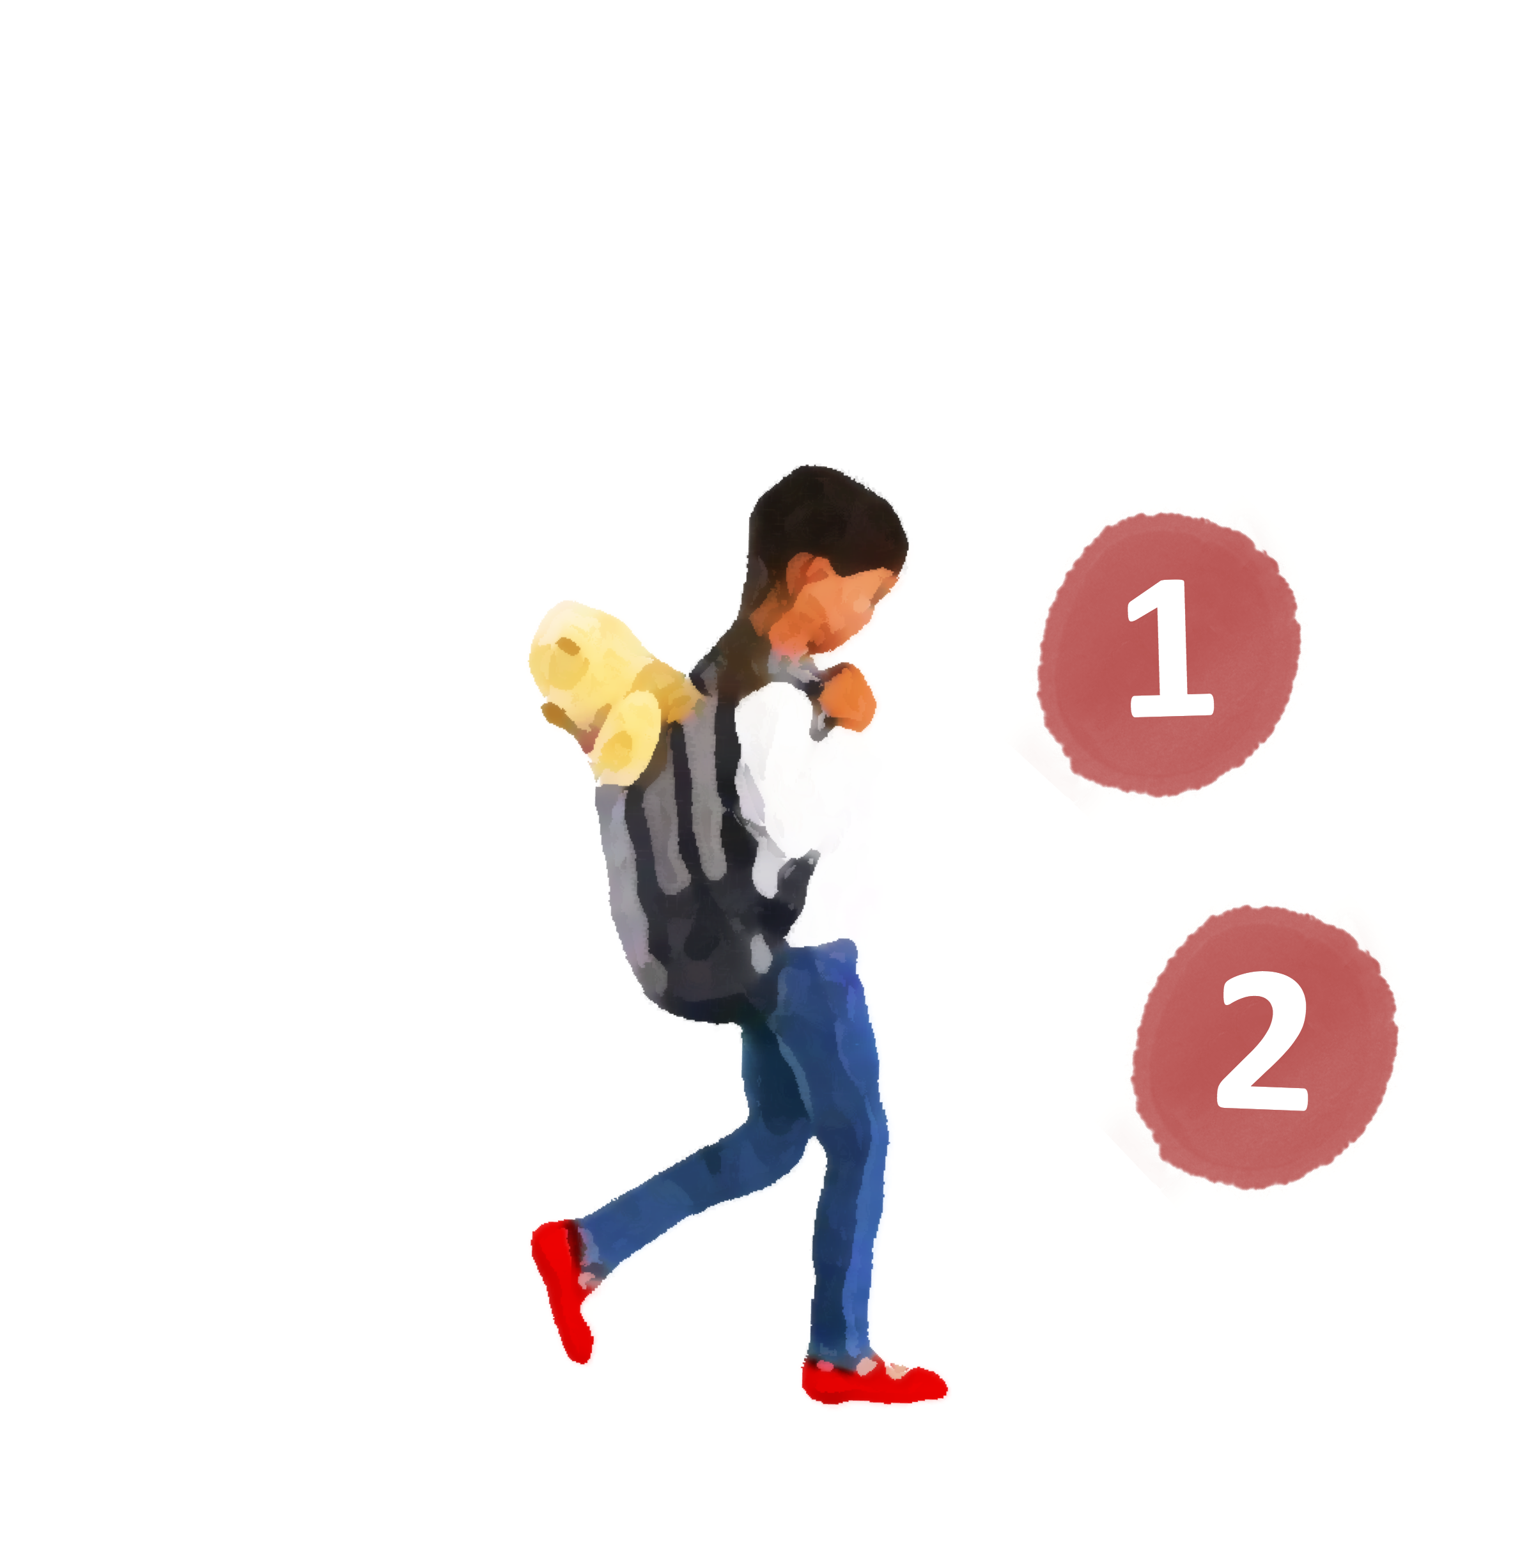

Next steps when suspecting a bleeding disorder
Start initial
treatment
Hormonal therapy or
tranexamic acid (or both) for
heavy menstrual bleeding
Iron replacement therapy
for iron deficiency
Consult a haematologist
For more information on the
diagnosis and management of
bleeding disorders, please refer
to Module 2 of this micro
e-learning programme at
www.checkpoint.cor2ed.com
for diagnostic laboratory
assessment
16

Slide 17
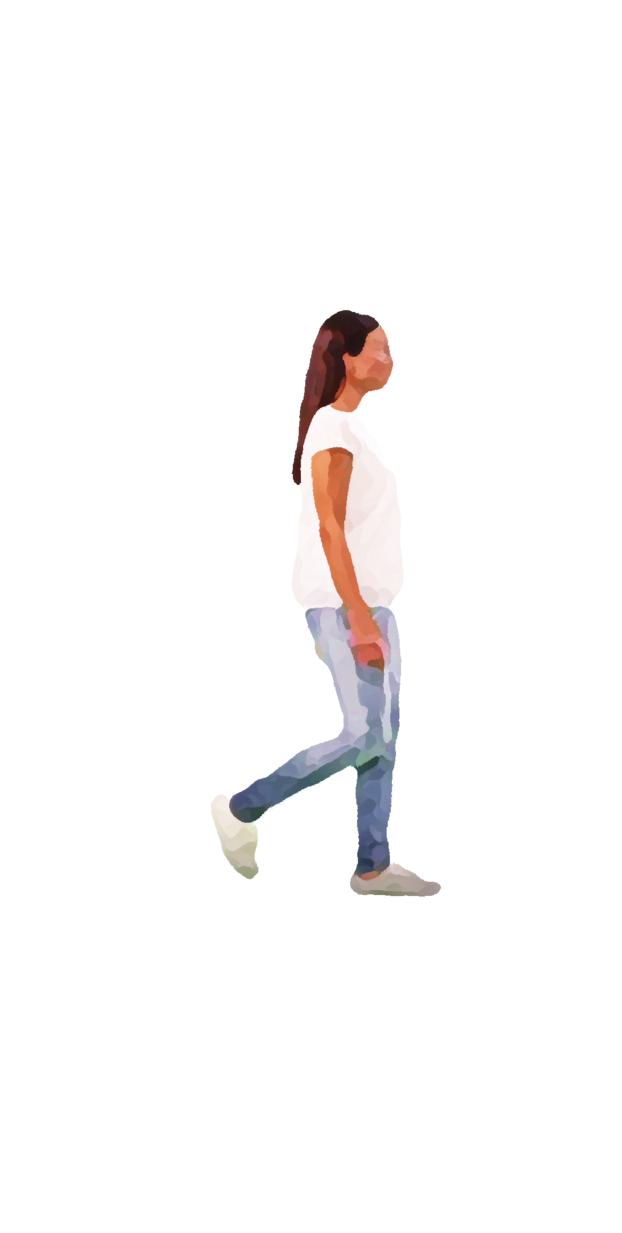
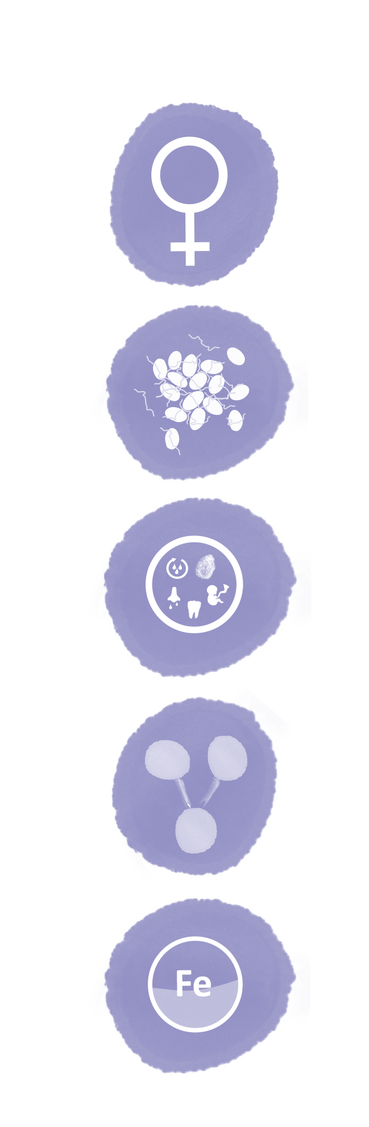
Summary
Bleeding disorders occur as often in women as they do in men
and have a major impact on quality of life
Bleeding symptoms can be caused by a variety of disorders in
platelets and blood clotting factors
Signs and symptoms suggesting a bleeding disorder in women and girls
include long-standing heavy menstrual bleeding, post-partum bleeding, and
iron-deficiency anaemia
Assessing the personal bleeding history and family history are key to
identifying women and girls who are likely to have undiagnosed bleeding
disorders and should undergo laboratory evaluation
When suspecting a bleeding disorder, start initial treatment and refer to a
haematologist for diagnostic laboratory assessment
17

Slide 18
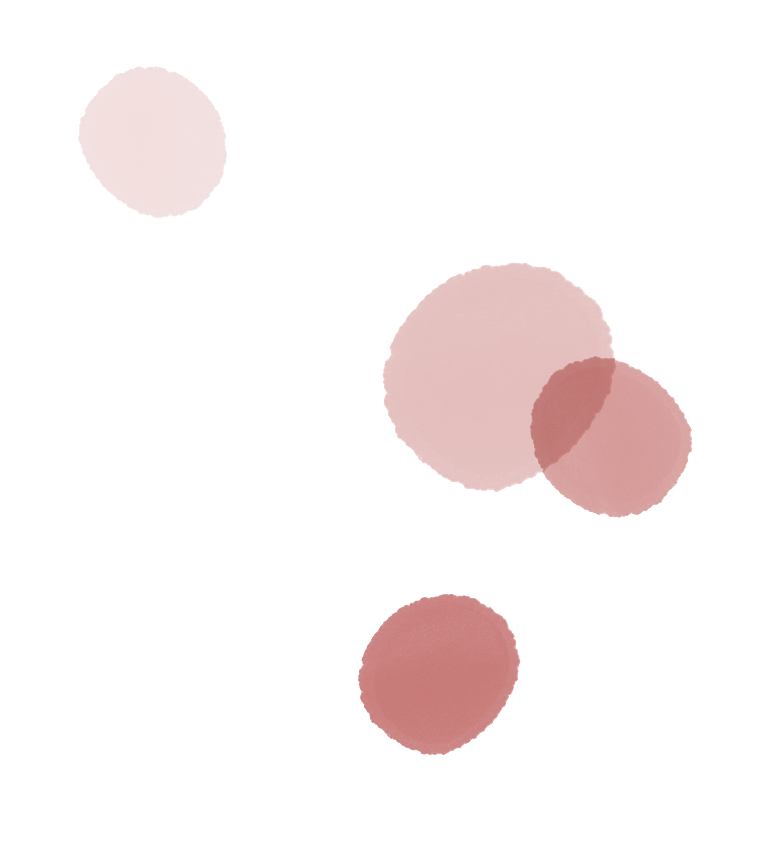


Next steps
Please now proceed to the assessment quiz to test your knowledge.
Visit Module 2 of this micro e-learning programme to learn more about:
The strengths and limitations of tests to diagnose bleeding
disorders in women
Basic interpretation of test results to diagnose bleeding disorders in
women
The management of bleeding symptoms in women until specialist
assessment is available
Note: you will be able to claim your CME credit after passing the
assessment quizzes in both Modules 1 and 2
Visit the assessment quiz at www.checkpoint.cor2ed.com
CME credit available
Visit programme home page on:
18

