Slide 2
Experts knowledge share diagnosing and treating trk fusion-positive cancer
Caterina Marchiò, David Hong and Philipp Ivanyi
11th September 2022

Slide 3
EXPERTS KNOWLEDGE SHARE
THE OBJECTIVE of this meeting is to have a practical and case-based discussion about TRK fusion-positive cancer
Your opportunity to discuss and share learnings on diagnosis and treatment of TRK Fusion-positive cancer
A chance to learn from the experience of Experts and ask questions that are important to you
discuss Patient Case Studies and questions that you MAY have from your practices/institutions

Slide 4
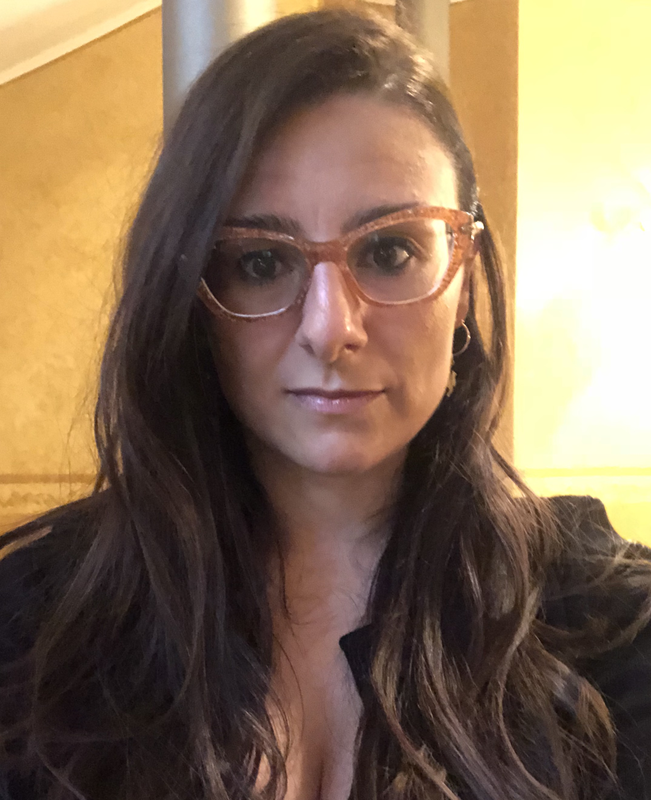
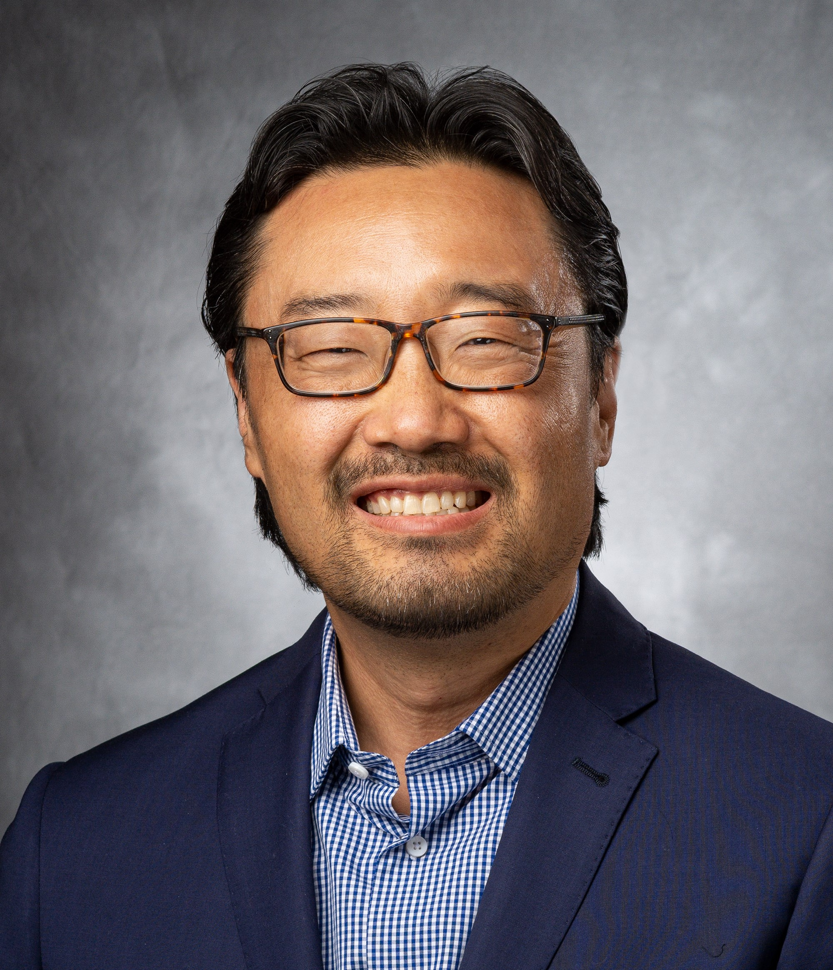
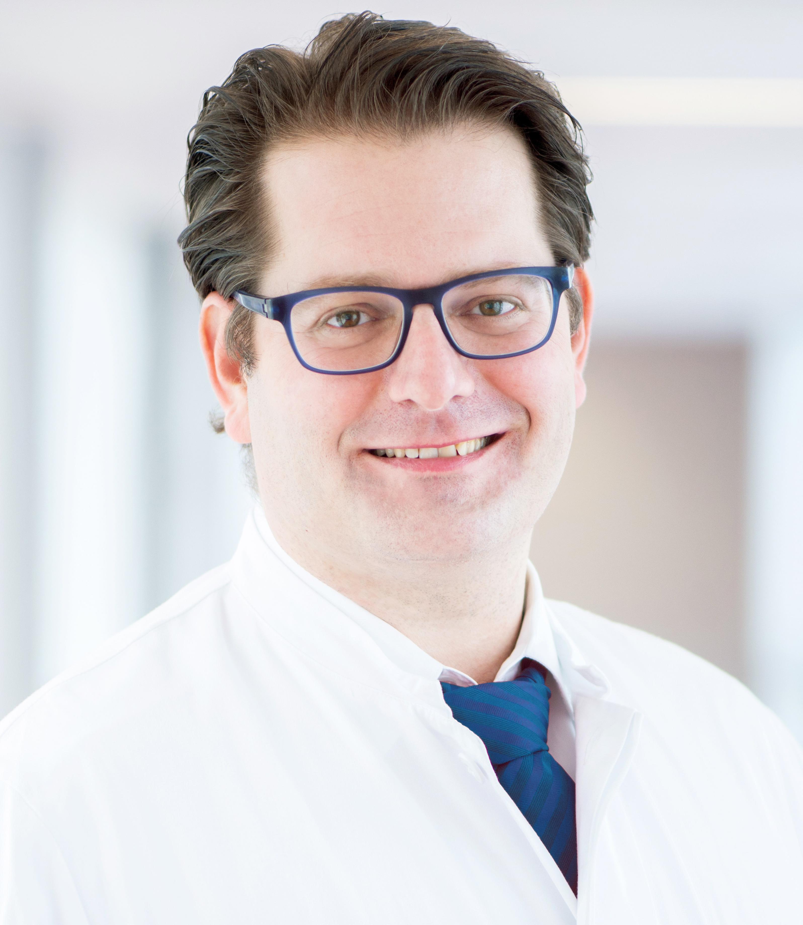
Introducing the scientific committee
Caterina Marchiò
David Hong
Philipp Ivanyi
University of Turin, Turin , Italy
University of Texas MD Andersen Cancer Center, Houston, TX, USA
Hannover Medical School, Hannover, Germany

Slide 5
Disclaimer
This programme is supported by an independent medical educational grant from Bayer. The programme is therefore independent; the content is not influenced by Bayer and is the sole responsibility of the experts.
Please note:
The views expressed within this presentation are the personal opinions of the experts. They do not necessarily represent the views of the experts’ academic institutions or the rest of the faculty.

Slide 6





Extending the reach for those not able to attend today
Experts Knowledge Share
Newsletter
e-learning
Newsletter #1:
Summarising video and
slides from EKS
Newsletter #2:
Link to e-learning:
Videos, Slides and Supporting reading material
Assessment test to obtain CME credit
CME, continuing medical education; EKS, Experts Knowledge Share

Slide 7
TODAY’s AGENDA
Session | Who | Duration
PLENARY Welcome and introductions Diagnostic approaches and a lung cancer case TRK inhibitor therapy and several case studies A thyroid cancer case KEY LEARNINGS & CLOSE | Caterina Marchiò David Hong Philipp Ivanyi All | 5 mins 25 mins 25 mins 25 mins 5 mins

Slide 8
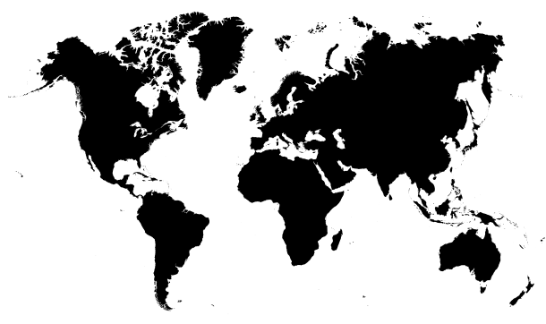

International participation
>40 registrations, spanning 20 countries
Primarily Oncologists
Main tumours of interest: sarcoma, breast, GI, melanoma, lung, and CNS
Source: Pre-meeting survey

Slide 9
Participant experience and first line trk inhibitor therapy choice
Qn: Have you diagnosed or treated TRK fusion-positive cancer?
Qn: First line TRK inhibitor therapy choice?
33.3% entrectinib
33.3% larotrectinib
16.7% no experience to date
11.1% other
5.6% no preference
Yes
No
Source: Pre-meeting survey (n=18)

Slide 10
A simple, yet paradigmatic, case
Caterina Marchiò
Dept. of Medical Sciences – University of Turin, Italy
Pathology Unit, FPO-IRCCS Candiolo

Slide 11
Disclosures
Consulting role: AstraZeneca, Bayer, Daiichi Sankyo, Roche.
Notes:
These are my disclosures

Slide 12
Case description
Male, 58 yo
For chest pain and cough -> chest X-ray May 2022: nodular lesion (54 mm diam)
in the left lung
Total body CT scan Jun 2022 -> voluminous lesion (> 5 cm) at the upper left lobe, with extension to the pleura + mediastinal LN + abdominal LN + brain lesion (3 cm) in the right fronto-parietal lobe (-> brain MRI confirmation)
First lung biopsy Jun 2022 -> non conclusive diagnosis. “Rare atypical elements with sarcomatoid aspects”
Jun 2022 underwent neurosurgery for brain lesion -> poorly differentiated carcinoma with sarcomatoid features
Ongoing brain RT on the surgery bed + SBRT on other little single lesion
Courtesy of colleagues from: Michele e Pietro Ferrero Hospital, Alba, dr. Tabbò, AOU San Luigi, Orbassano, Prof. Righi

Slide 13
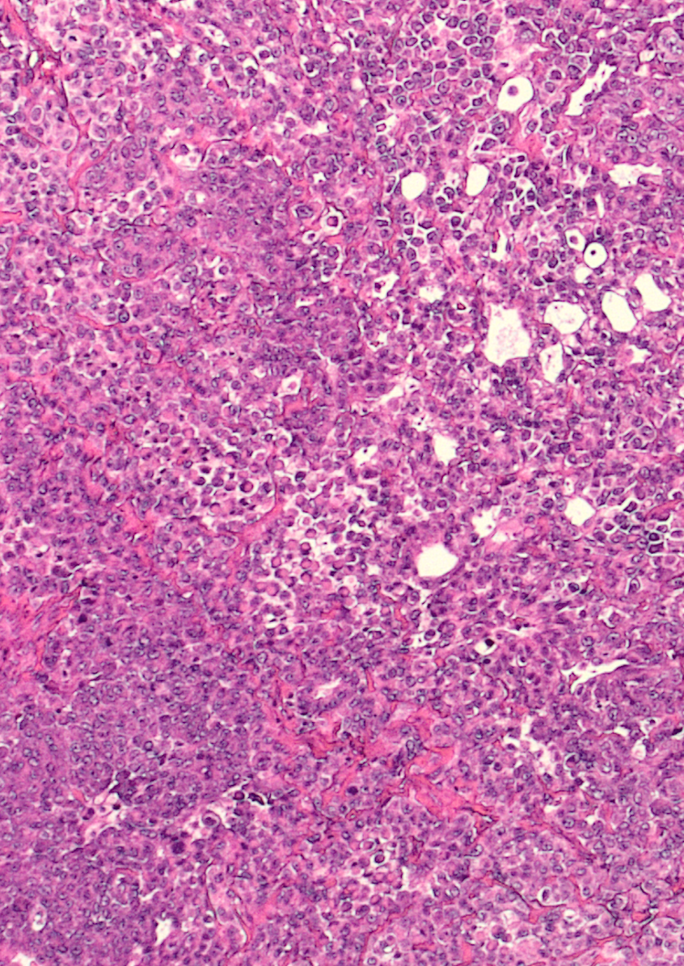
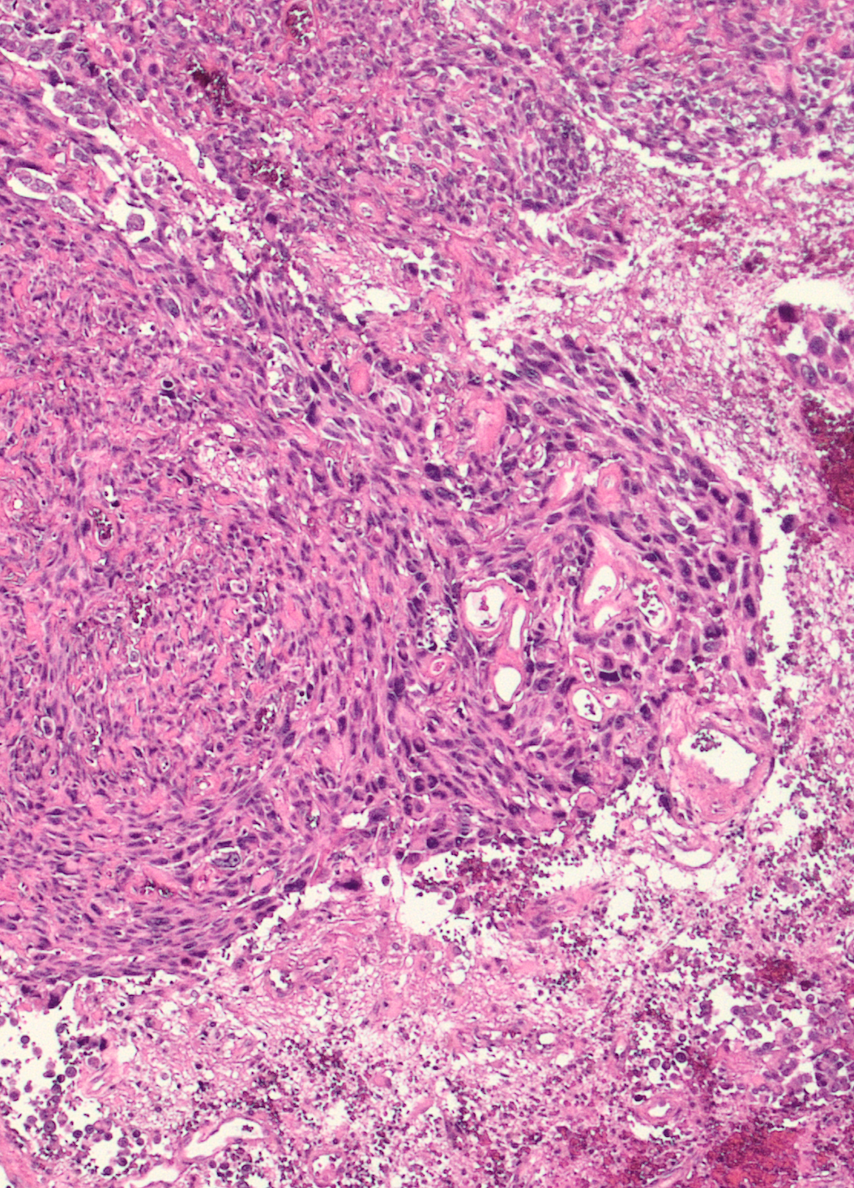
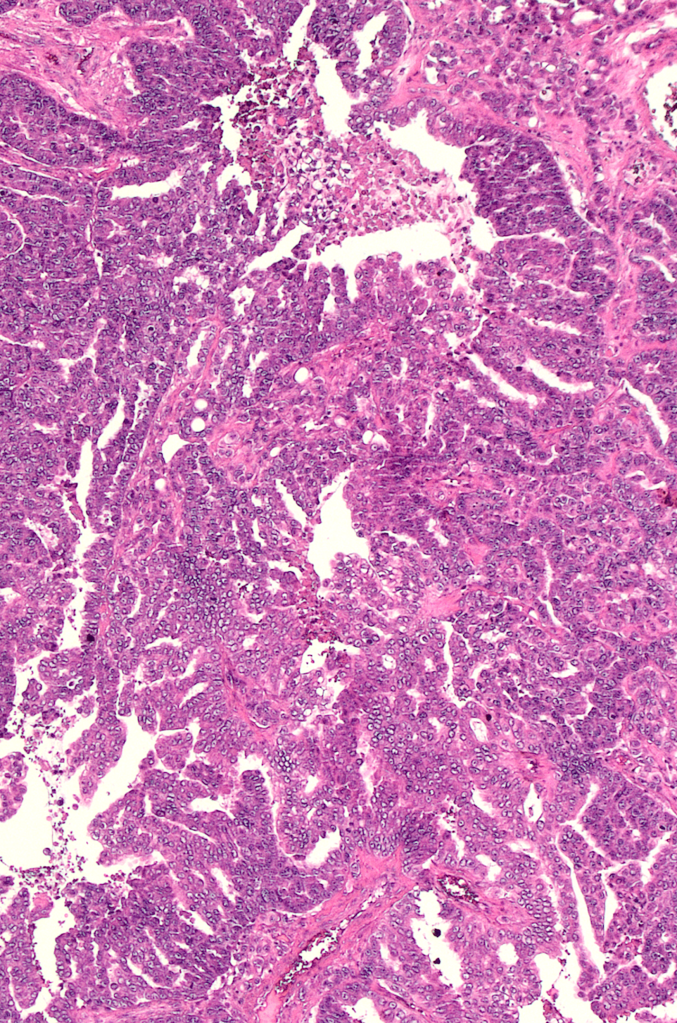

Slide 14
Is the histologic tumour type known to harbor highly recurrent NTRK fusions?
As a confirmatory technique use FISH, RT-PCR, or RNA-NGS assays with specific probes for the fusion involving the
known NTRK gene
Is there a sequencing platform available?
YES
NO
NO
YES
IHC to confirm expression
Use IHC as a screening tool
Use front line NGS reliably detecting NTRK fusions, preferably
including RNA testing when possible
NO TRK expression
Detection of TRK expression
Marchiò C et al, on behalf of the ESMO TR and PM Working Group, Annals of Oncology 2019

Slide 15
Case description
NGS analysis with a targeted panel of 50 genes (DNA and RNA workflows)
RNA workflow for gene fusions including NTRK1, NTRK2, NTRK3, ALK, ROS1, RET, FGFR1, FGFR2, FGFR3, NRG1
A TP53-NTRK1 fusion is identified
Courtesy of colleagues from: Michele e Pietro Ferrero Hospital, Alba, dr. Tabbò, AOU San Luigi, Orbassano, Prof. Righi

Slide 16
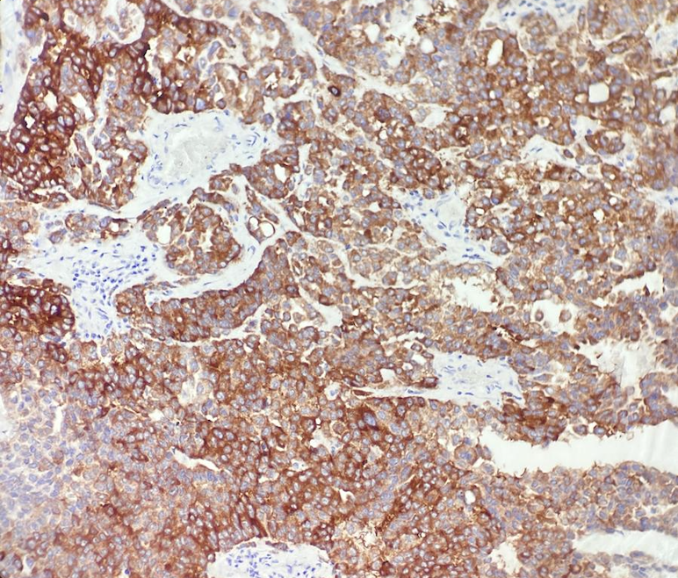
Case description
A TP53-NTRK1 fusion is identified
Strong and diffuse expression demonstrated by using a panTRK assay
Patient will start treatment with TKI (entrectinib)
Courtesy of colleagues from: Michele e Pietro Ferrero Hospital, Alba, dr. Tabbò, AOU San Luigi, Orbassano, Prof. Righi

Slide 17
discussion
Everything “by the book” – a story of success:
Team work
Optimal screening strategy
Optimal testing algorithm and method

Slide 18
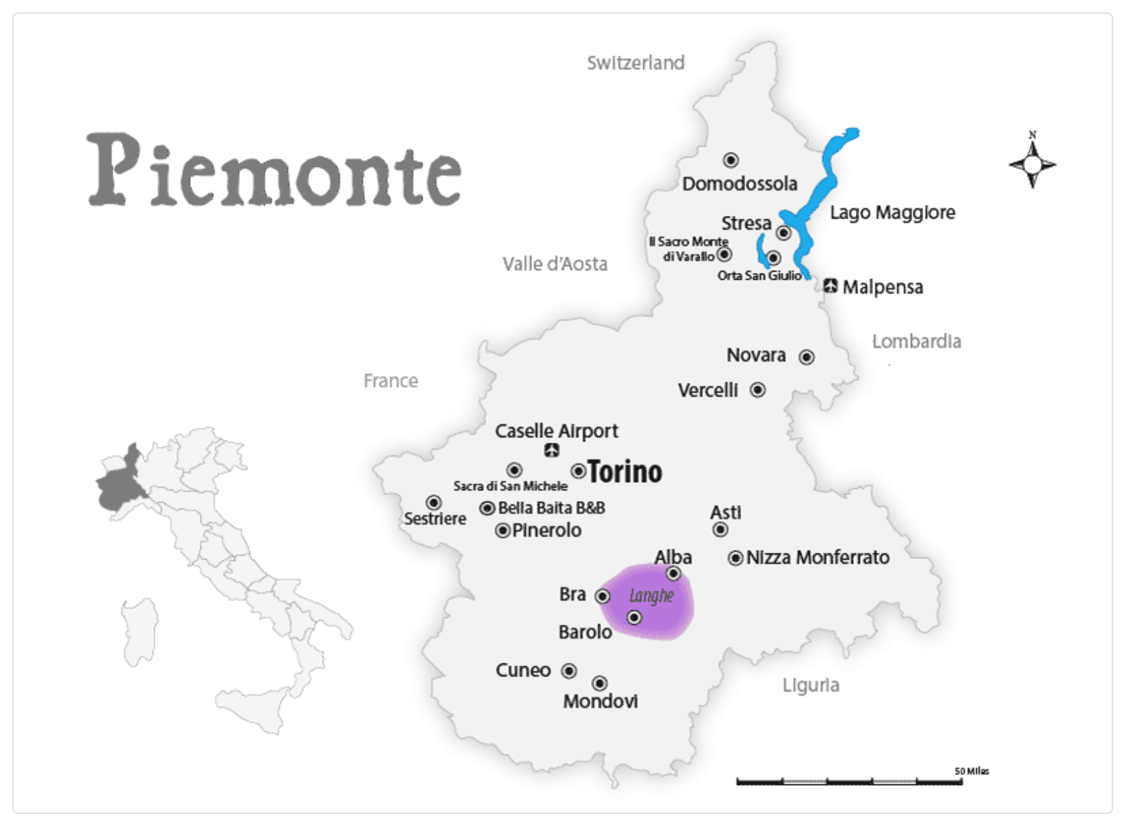
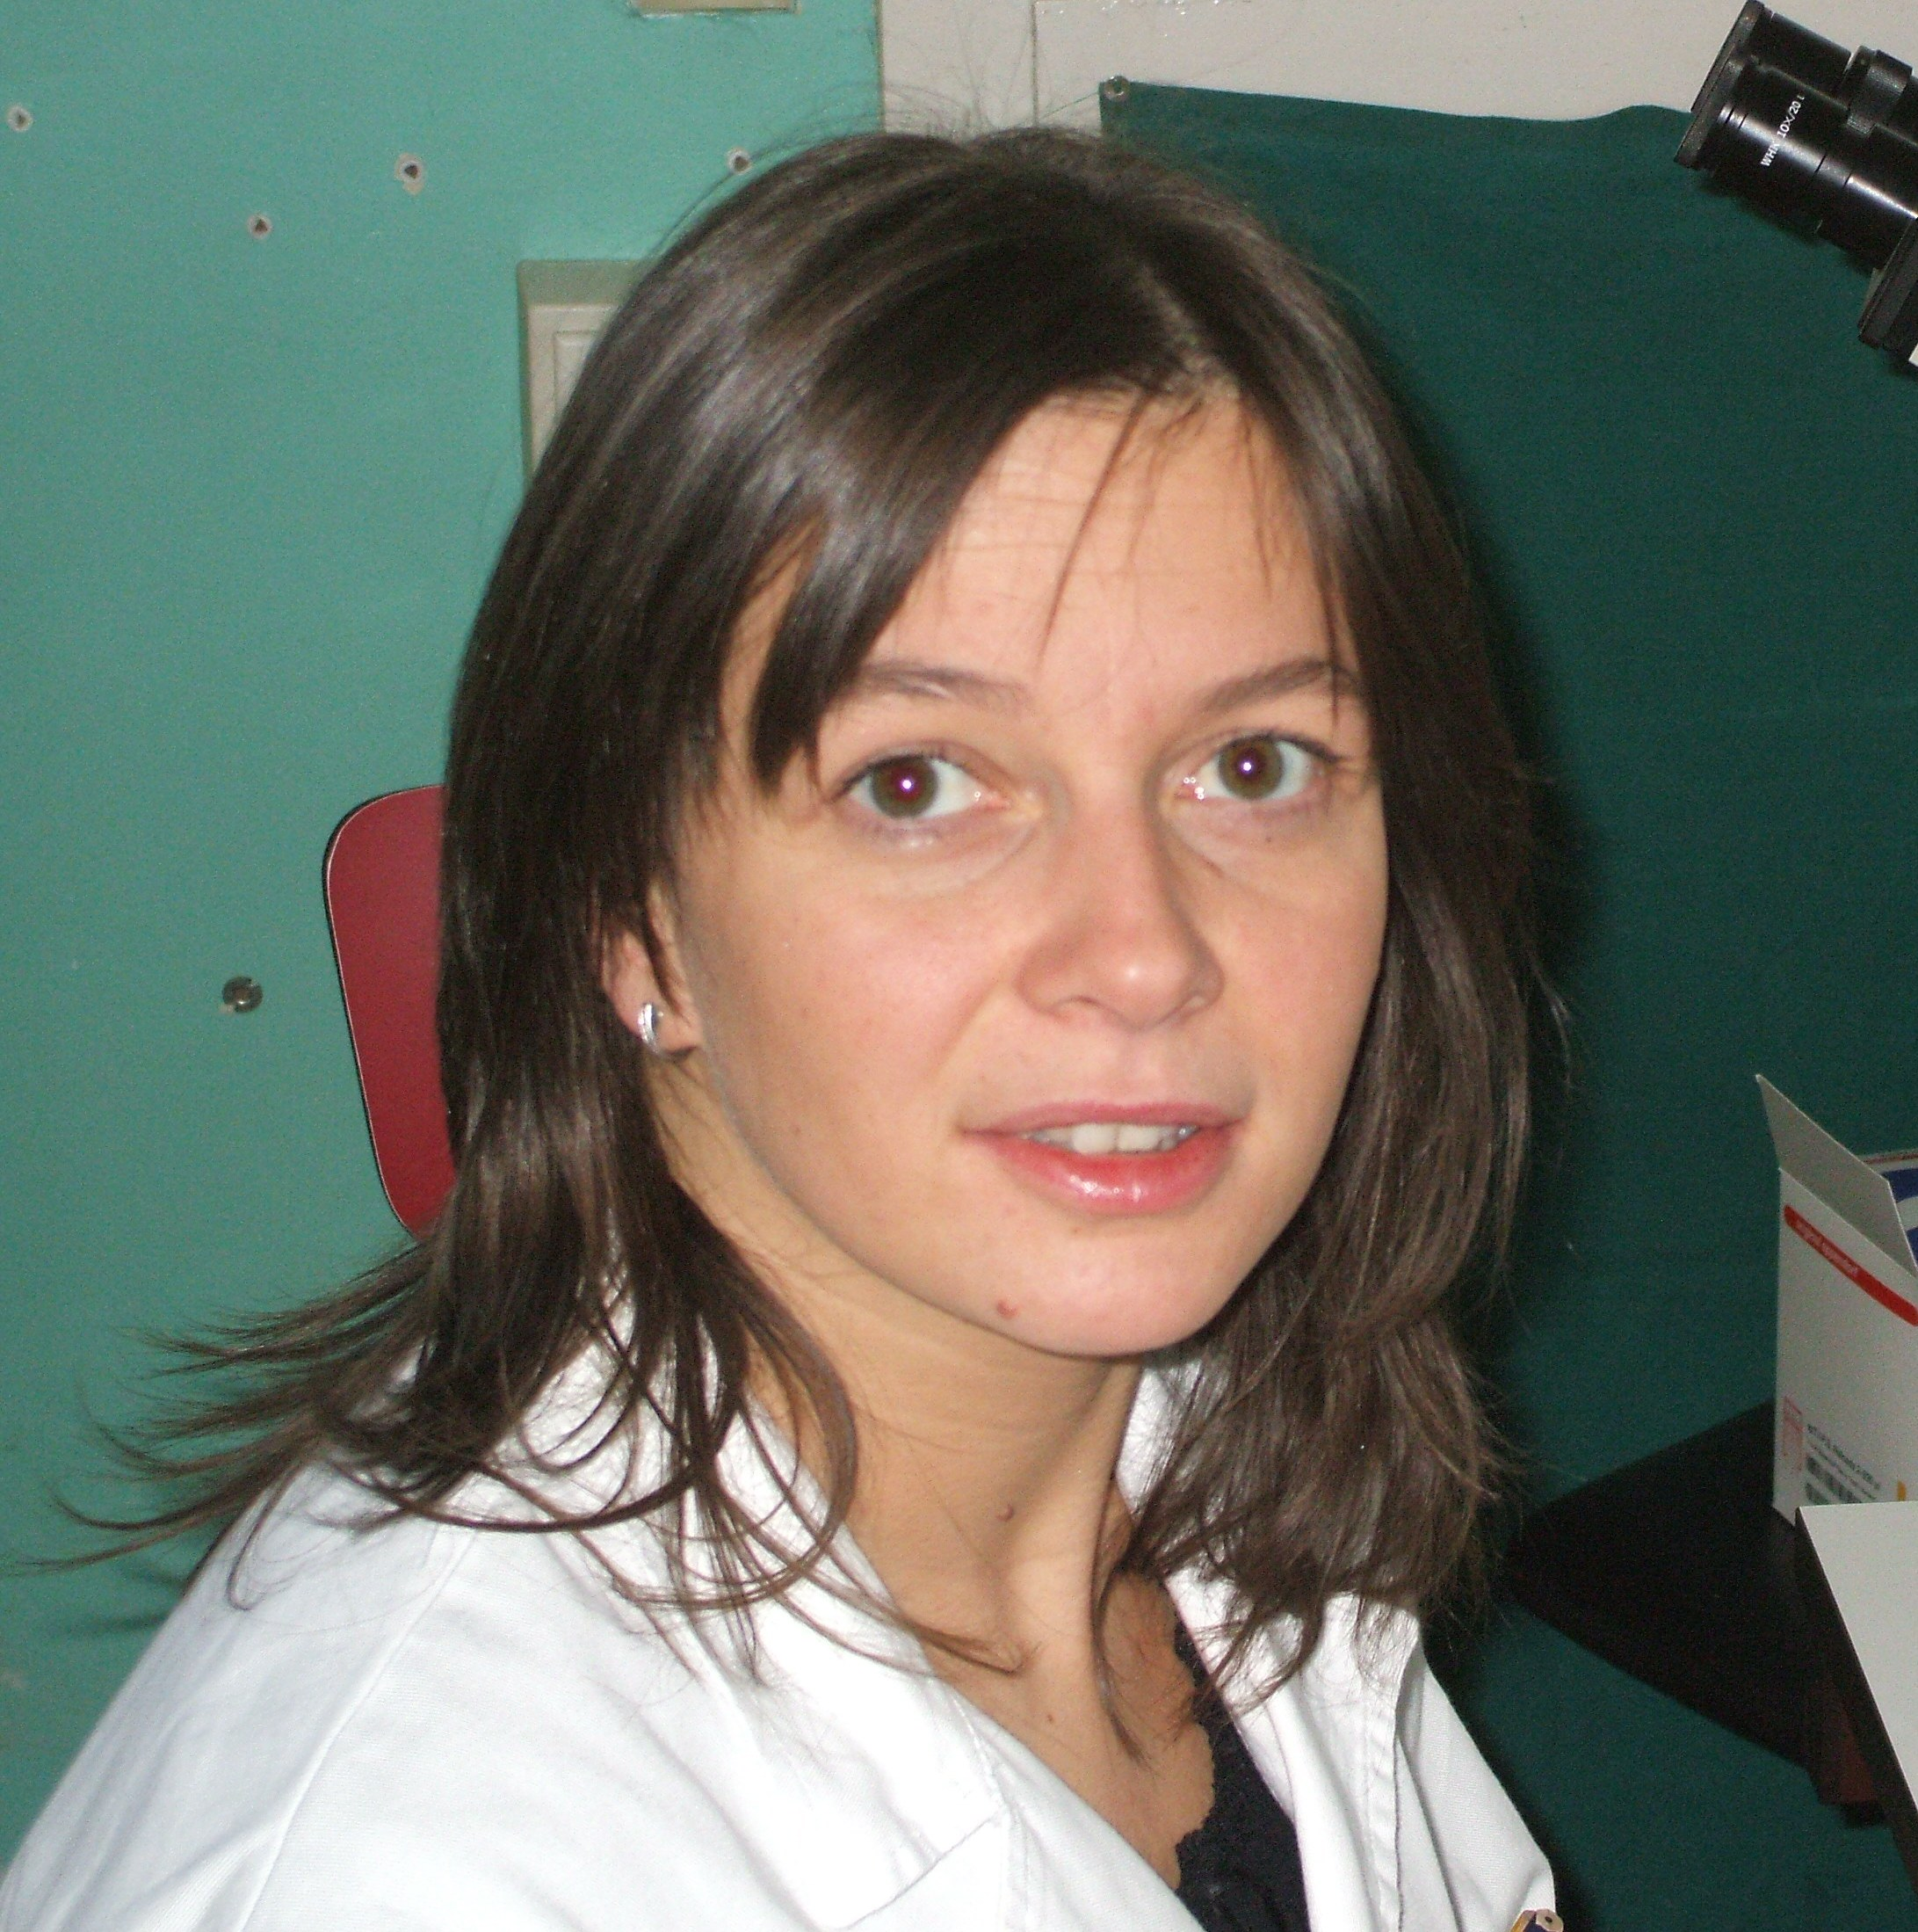
Team work – acknowledgements
Dr. Fabrizio Tabbò
Medical Oncologist, in charge of the patient’s care
MD, PhD
Solid background in translational research and Molecular Oncology, with a particular focus on Lung cancer
Prof. Luisella Righi
Pathologist, in charge of Lung Pathology at a Hub Centre for Lung Cancer
Medical Oncology
MD, PhD
Solid background in translational research and Molecular Pathology

Slide 19
Strategy: algorithm and methods
NSCLC is the golden example for molecular profiling
EGFR mutations
KRAS mutations
BRAF mutations
MET exon 14 skipping mutations
RET mutations
HER2 mutations
ALK fusions
ROS1 fusions
NTRK1/2/3 fusions
RET fusions
Neuregulin-1 fusions
PDL1 expression

Slide 20
Strategy: algorithm and methods
Is the histologic tumour type known to harbor highly recurrent NTRK fusions?
As a confirmatory technique use FISH, RT-PCR, or RNA-NGS assays with specific probes for the fusion involving the
known NTRK gene
Is there a sequencing platform available?
YES
NO
NO
YES
IHC to confirm expression
Use IHC as a screening tool
Use front line NGS reliably detecting NTRK fusions, preferably
including RNA testing when possible
NO TRK expression
Detection of TRK expression
Marchiò C et al, on behalf of the ESMO TR and PM Working Group, Annals of Oncology 2019

Slide 21
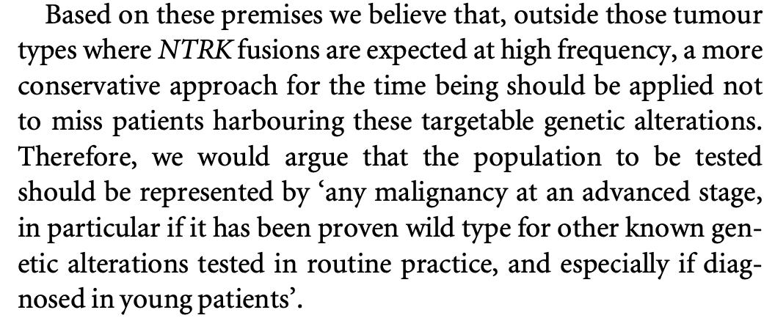
Strategy: algorithm and methods
Is the histologic tumor type known to harbor highly recurrent NTRK fusions?
In 2019 we were wondering:
who should be tested?
As a confirmatory technique use FISH, RT-PCR, or RNA-NGS assays with specific probes for the fusion involving the
known NTRK gene
Is there a sequencing platform available?
YES
NO
NO
YES
IHC to confirm expression
Use IHC as a screening tool
Use front line NGS reliably detecting NTRK fusions, preferably
including RNA testing when possible
NO TRK expression
Detection of TRK expression
Marchiò C et al, on behalf of the ESMO TR and PM Working Group, Annals of Oncology 2019

Slide 22
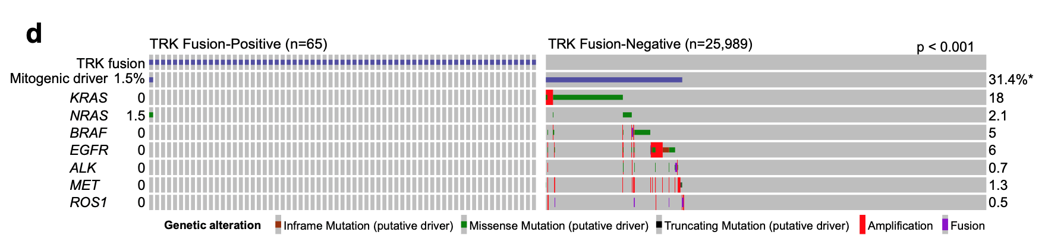
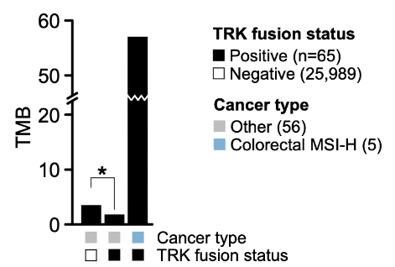
Association between NTRK fusion and TMB
Rosen E, et al. Clin Cancer Res. 2020;26(7):1624-1632

Slide 23

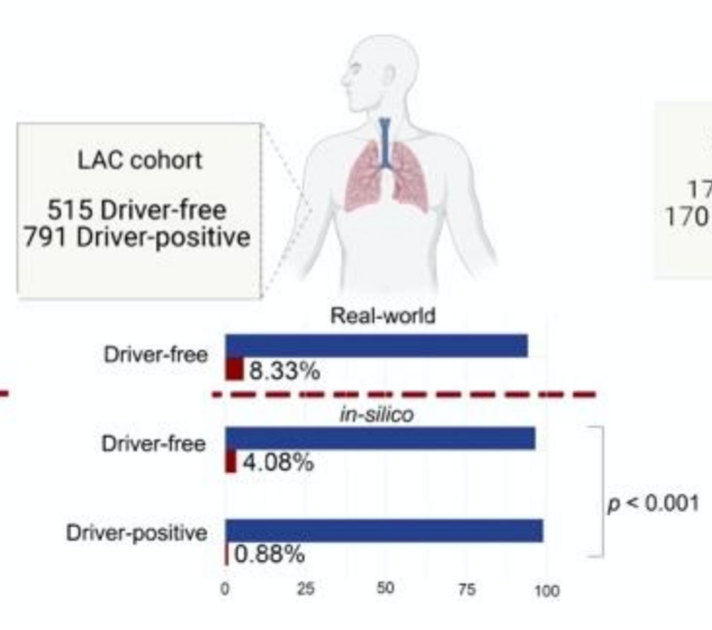
Berrino E et al, Cancers 2021, 13, 3376. https://doi.org/10.3390/cancers13133376
12.3% of fusion detection in colorectal carcinomas that
are MSI
5.71% of fusion detection in tumours that are WT for canonical drivers, as defined by routine diagnostic testing of a small panel of genes
NSCLC cohort

Slide 24
Case description
Male, 58 yo
For chest pain and cough -> chest X-ray May 2022: nodular lesion (54 mm diam)
in the left lung
Total body CT scan Jun 2022 -> voluminous lesion (>5 cm) at the upper left lobe, with extension to the pleura + mediastinal LN + abdominal LN + brain lesion (3 cm) in the right fronto-parietal lobe (-> brain MRI confirmation)
First lung biopsy Jun 2022 -> non conclusive diagnosis. “Rare atypical elements with sarcomatoid aspects”
Jun 2022 underwent neurosurgery for brain lesion -> poorly differentiated carcinoma with sarcomatoid features
Ongoing brain RT on the surgery bed + SBRT on other little single lesion
Courtesy of colleagues from: Verduno Hospital, Alba, Italy, dr. Tabbò, AOU San Luigi, Orbassano, Prof. Righi

Slide 25
Combined neoplasia => adenoK with neuroendocrine & sarcomatoid features => BLASTOMA

Slide 26
Thank You!
For further questions please contact: caterina.marchio@unito.it
Notes:
Finally thanks to our patients and their caregivers!

Slide 27
TRK inhibitor therapy and case studies
David S. Hong MD
The University of Texas MD Anderson Cancer Center
Professor
Deputy Chairman in the Dept of Investigational Cancer Therapeutics (Phase I Program)
Clinical Medial Director of Clinical and Translational Research Center
Associate Vice President of Clinical Research

Slide 28
Disclosures (last 36 months)
Research(Inst)/Grant Funding (Inst): AbbVie, Adaptimmune, Adlai-Nortye, Amgen, Astra-Zeneca, Bayer, Bristol-Myers Squibb, Daiichi-Sankyo, Deciphera, Eisai, Endeavor, Erasca, F. Hoffmann-La Roche, Fate Therapeutics, Genentech, Genmab, Ignyta, Infinity, Kite, Kyowa Kirin, Lilly, LOXO, Merck, Medimmune, Mirati, Mologen, Navier, NCI-CTEP, Novartis, Numab, Pfizer, Pyramid Bio, SeaGen, Takeda, TCR2, Teckro, Turning Point Therapeutics, VM Oncology
Travel, Accommodations, Expenses: Bayer, Genmab, AACR, ASCO, SITC, Telperian
Consulting, Speaker or Advisory Role: Adaptimmune, Alpha Insights, Acuta, Alkermes, Amgen, Aumbiosciences, Axiom, Baxter, Bayer, Boxer Capital, BridgeBio, COR2ed, COG, Cowen, Ecor1,
Gennao Bio, Genentech, Gilead, GLG, Group H, Guidepoint, HCW Precision, Immunogen, Infinity, Janssen, Liberium, MedaCorp, Medscape, Numab, Oncologia Brasil, Pfizer, Pharma Intelligence, POET Congress, Prime Oncology, RAIN, Seattle Genetics, ST Cube, Takeda, Tavistock, Trieza Therapeutics, Turning Point, WebMD, YingLing Pharma, Ziopharm
Other ownership interests: Molecular Match (Advisor), OncoResponse (Founder, Advisor),
Telperian (Founder,Advisor)
Notes:
These are my disclosures

Slide 29
TRK Receptors Mediate Neurotrophin Signaling
Neurotrophin Signaling¹
Neurotrophins are important growth factors that promote
sympathetic nervous system development^{1,2}
Neurotrophin signaling occurs through activation of the
tropomyosin-receptor kinase (TRK) receptor family^{1,2}
NGF
BDNF
NT-4
NT-3
Neurotrophin Family of Receptors^{1–5}
TRK Receptor | Gene (Chromosomal Location) | Functions | Natural Ligands
TRKA | NTRK1 (1q23.1) | Pain signaling, thermoregulation | Nerve growth factor (NGF), neurotrophin-3 (NT-3)
TRKB | NTRK2 (9q21.33) | Regulation of movement, memory, mood, appetite, body weight | Brain-derived neurotrophic factor (BDNF), neurotrophin-4 (NT-4), NT-3
TRKC | NTRK3 (15q25.3) | Proprioception | NT-3
Tyr
Tyr
Tyr
Tyr
Tyr
Tyr
Tyr
Tyr
Tyr
TrKA
TrKB
TrKC
AKT
ERK
AKT, protein kinase B; ERK, extracellular signal-regulated kinase; NTRK, neurotrophic tyrosine receptor kinase; Tyr, tyrosine
1. Nakagawara A. Cancer Letters. 2001;169:107-14; 2. Vaishnavi A, et al. Cancer Discov. 2015;5:25-34; 3. https://www.ncbi.nlm.nih.gov/gene/4914, accessed September 2, 2022; 4. https://www.ncbi.nlm.nih.gov/gene/4915, accessed September 2, 2022; 5. https://www.ncbi.nlm.nih.gov/gene/4916, accessed September 2, 2022

Slide 30
Approved TRK Inhibitors
First-generation trk inhibitors
 | Larotrectinib | Entrectinib
Drug targets | TRKA/B/C | TRKA/B/C, ROS1, ALK
ORR (all TRK fusion–positive cancers) | 81% | 58%
ORR (TRK fusion–positive lung cancers) | 71% | 70%
Median PFS (all TRK fusion–positive cancers) | Not reached | 11.2 months
Dose reduction rate | 9% | 27%
ALK, anaplastic lymphoma kinase; ORR, overall response rate; PFS, progression-free survival; ROS1, ROS Proto-Oncogene 1; TRK, tropomyosin-receptor kinase
Drilon A. Ann Oncol. 2019;30(Suppl_8):viii23-viii30

Slide 31
Baseline characteristics of IRC-assessed patients (n=244)
Each 1%:
pancreas,
congenital
mesoblastic
nephroma, bone
sarcoma
Each <1%: cancer of unknown primary, prostate, appendix,
gastric, hepatic, cervix, rectal, external auditory canal,
Uterus, osophageal, duodenal,† urothelial†
Characteristic | Integrated dataset (N=244)
Sex, n (%) Male Female | 123 (50) 121 (50)
Age, median (range), years Paediatric (<18 years), n (%) Adult (≥18 years), n (%) | 38 (0.1-84) 87 (36) 157 (64)
ECOG or equivalent Lansky PS, n (%) 0 1 2 3 | 126 (52) 87 (36) 25 (10) 6 (2)
No. of prior systemic therapies, median range | 1 (0-10)
No. of prior systemic regimens, n (%) 0 1 2 ≥3 | 67 (27) 69 (28) 49 (20) 59 (24)
NTRK gene fusion, n (%) NTRK1 NTRK2 NTRK3 | 113 (46) 7 (3) 124 (51)
Cholangiocarcinoma
1%
GIST
2%
Melanoma
3%
Soft tissue sarcoma
27%
Breast
3%
Colon
6%
Lung
9%
Salivary gland
10%
Infantile fibrosarcoma
19%
Thyroid
12%
† Tumour types not presented in previous data cut.
ECOG, Eastern Cooperative Oncology Group; GIST, gastrointestinal stromal tumour; IRC; independent review committee; NTRK, neurotrophic tyrosine receptor kinase; PS, performance status
Drilon A. et al. ASCO 2022, Journal of Clinical Oncology 40, no. 16_suppl:3100-3100.

Slide 32
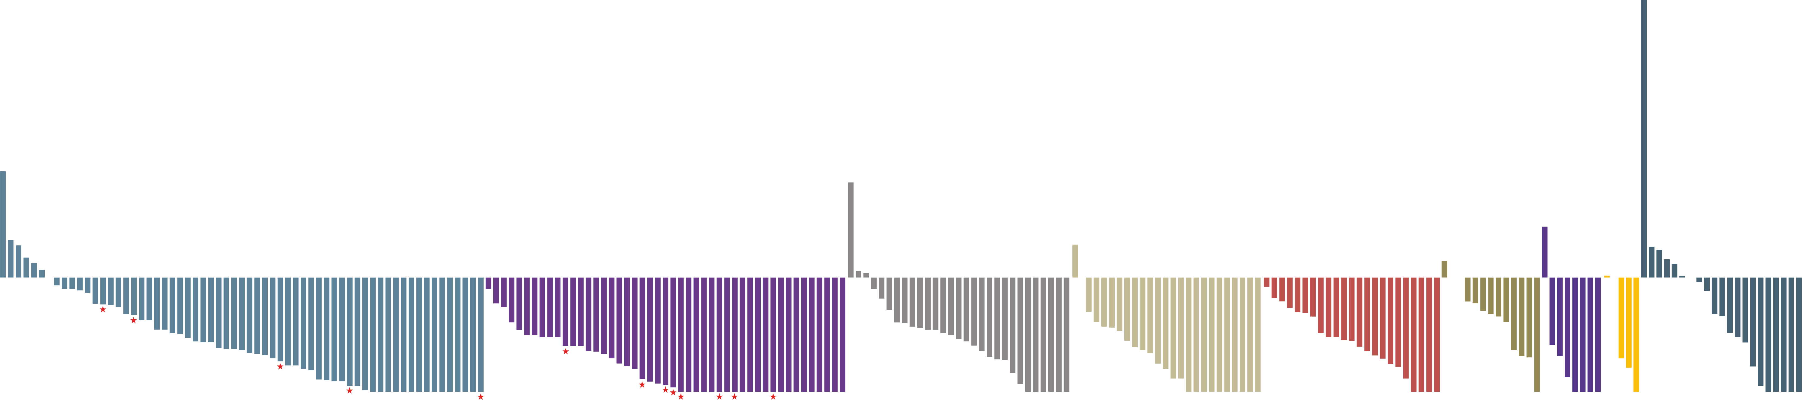
Maximum change in target lesions (N=234†) and best response (N=244)
260
Soft tissue sarcoma
IFS
Thyroid
Salivary gland
Lung
Colon
Breast
Melanoma
Other‡
Pathological complete response
240
220
200
180
160
140
120
100
Maximum change in tumour size (%)
80
60
40
20
0
-20
-40
-60
-80
-100
 | Integrated dataset
Evaluable patients, n | 244
ORR, % (95% CI) | 69 (63-75)
Best complete response, n (%) Complete response Pathological complete response Partial response Stable disease Progressive disease Not determined§ | 51 (21) 13 (5) 104 (43) 41 (17) 20 (8) 15 (6)
Among 18 patients with known baseline CNS metastases evaluable per IRC, ORR was 83% (95% CI 59-96)
The ORR for adult patients (n=157) ws 64% (95% CI 56-72). Median DoR was 41.7 months (95% CI 32.5-NE) at a median follow-up of 28.5 months
† Ten patients had no measurable lesions assessed by IRC; ‡ Other includes appendix (n=1), bone sarcoma (n=2), cancer of unknown primary (n=1), cervix (n=1), cholangiocarcinoma (n=2), congenital mesoblastic nephroma (n=2), duodenal (n=1), esophageal (n=1), external auditory canal (n=1), GIST (n=4), pancreas (n=2), prostate (n=1), rectal (n=1), urothelial (n=1). § Patients who discontinued study drug without evaluable postbaseline assessments.
CI, confidence interval; CNS, central nervous system; DoR, duration of response; GIST, gastrointestinal stromal tumour; IFS, infantile fibrosarcoma;
IRC, independent review committee; ORR, objective response rate; TRK, tropomyosin receptor kinase
Drilon A. et al. ASCO 2022, Journal of Clinical Oncology 40, no. 16_suppl:3100-3100.

Slide 33
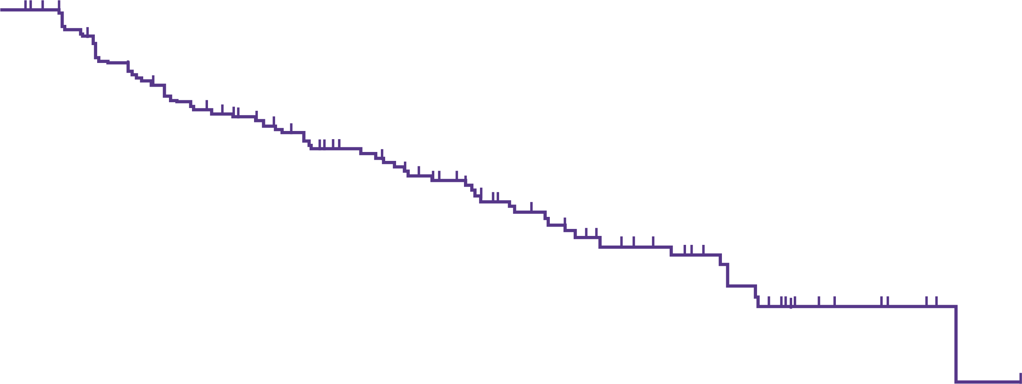
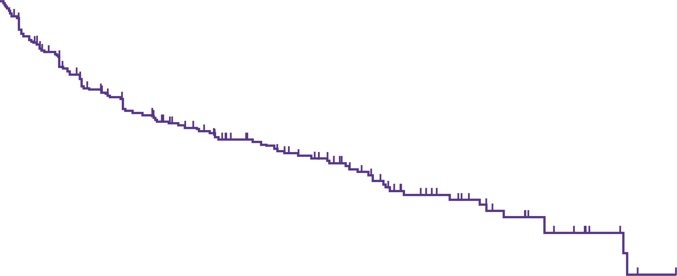
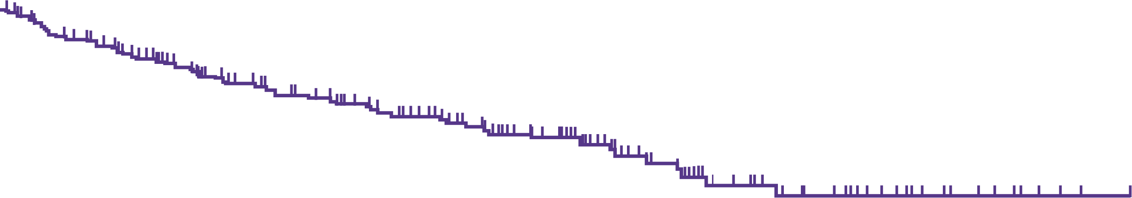
DoR, pfs and OS
DoR
100
Median DoR = 32.9 months (95% CI 27.3-41.7)
Median follow-up = 28.3 months
PFS
100
75
75
Median PFS = 29.4 months (95% CI 19.3-34.3)
Median follow-up = 29.3 months
DoR (%)
50
PFS (%)
50
25
25
0
0
0
6
12
18
24
30
36
42
48
54
60
66
0
6
12
18
24
30
36
42
48
54
60
Months from start of response
Months from start of response
No. at risk
139
113
96
76
60
40
26
16
6
2
0
No. at risk
244
169
117
93
74
58
31
22
14
5
1
0
OS
100
Median OS = NR (95% CI NE-NE)
Median follow-up = 32.2 months
82%
75
64%
OS (%)
50
25
0
0
6
12
18
24
30
36
42
48
54
60
66
72
Months from start of response
No. at risk
244
216
175
144
122
102
69
47
30
17
8
3
0
CI, confidence interval; DoR, duration of response; NE, not estimable; NR, not reached; OS, overall survival; PFS, progression-free survival
Drilon A. et al. ASCO 2022, Journal of Clinical Oncology 40, no. 16_suppl:3100-3100.

Slide 34
CASE 1: Treatment-naïve EPS15-NTRK1-Positive Lung Adenocarcinoma with Intracranial and Extracranial Response to Larotrectinib
76-year-old woman with lung adenocarcinoma
Metastatic to lung and brain
No prior systemic therapy, surgery or
radiotherapy
Refused platinum doublet therapy
Treated with larotrectinib
Confirmed PR (−34%)
Near intracranial CR (−95%, volumetric)
Remains on therapy at 6+ months
Patient was not evaluable at data cut-off.
CR, complete response; EPS15, Epidermal growth factor receptor substrate 15; NTRK, neurotrophic tyrosine receptor kinase; PR, partial response
Rosen, et al. JCO Precision Oncology (In press)
Drilon A, et al. J Clin Oncol. 37, 2019 (suppl; abstr 2006)

Slide 35
CASE 2: TPM3-NTRK1 fusion MSI high CRC
Patient
85-year-old female who presented with a presented with obstructive symptoms
Noted to have metastatic disease to the bowel and liver
Prior Treatment
Tumor sample disclosed dMMR (MLH1/PMS2), TPM3-NTRK1 fusion, CIMP high
Received pembrolizumab (7/2018-9/2018) with no response and progressive disease
Larotrectinib Treatment
Subsequently enrolled to the phase 2 larotrectinib trial (10/2018), NAVIGATE, at 100mg BID orally. Patient developed grade 3 LFTs dose reduced to 50 mg BID
Outcomes
Confirmed PR of (-42%) and remains on larotrectinib (8/2022)
BID, twice a day; CIMP, CpG island methylator phenotype; dMMR, Deficient mismatch repair ; LFTs, liver functions tests; MLH1, mutL homolog 1; NTRK, neurotrophic tyrosine receptor kinase; PMS2, PMS1 homolog 2; PR, partial response; TPM3, Tropomyosin alpha-3
Courtesy of Dr. David Hong

Slide 36
CASE 2: TPM3-NTRK1 fusion MSI high CRC
Study baseline
End of cycle 4
CRC; colorectal cancer; MSI, microsatellite instability; NTRK, neurotrophic tyrosine receptor kinase; TPM3, Tropomyosin alpha-3

Slide 37
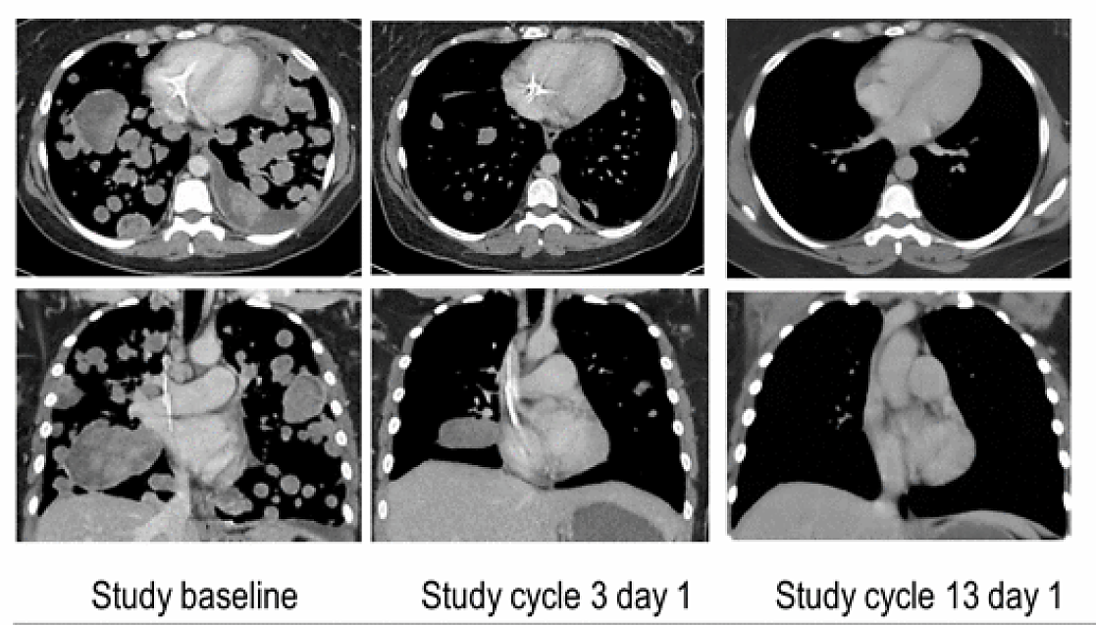
CASE 3: LMNA–NTRK1 fusion soft tissue sarcoma
42-year-old female with undifferentiated sarcoma progressed through epirubicin, ifosfamide, sorafenib, and doxorubicin
100 mg BID
Rapid resolution of dyspnea and hypoxemia
Confirmed partial response
Study baseline
Study cycle 3 day 1
Study cycle 13 day 1
PP-VIT-ALL-0137-2
PP-VIT-ES-0059-1 09/2019
BID, twice a day; LMNA, Pre-lamin A/C; NTRK, neurotrophic tyrosine receptor kinase
Doebele RC, et al. Cancer Discov. 2015;5:1049-57. Presented by D Hong at ESMO Asia 2016. Available at: https://www.sec.gov/Archives/edgar/data/1581720/000110465916162818/a16-23351_1ex99d2.htm (accessed September 2022).

Slide 38
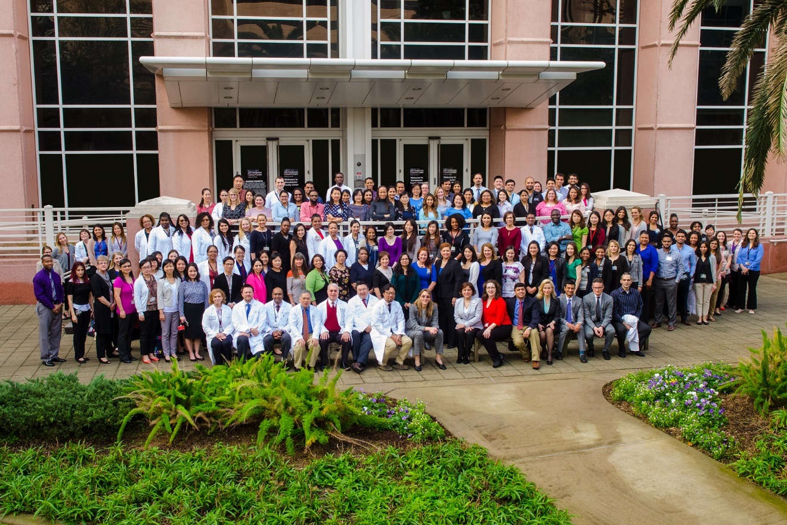
THANK YOU ALL!
Notes:
Again I want to thank AACR and ASCO educational committee for allowing me to comment on this new class of exciting therapies.

Slide 39
Acknowledgements
We thank the patients and their caregivers for taking part in our trials
For further questions please contact: dshong@mdanderson.org
Dr. David Hong
Notes:
Finally thanks to our patients and their caregivers!

Slide 40
SuCcessful NTRK fusion inhibition
Philipp Ivanyi
Adjunct Professor, MD, Assistant Medical Director
Head and Neck-, GU, Sarkoma-center
Comprehensive Cancer Center, Lower Saxoney
Department of Hematology, Hemostasis, Oncology and Stem-cell Transplantation
Hannover Medical School, Germany
Ivanyi.Philipp@mh-hannover.de

Slide 41
DISCLOSURES
Advisory Fees, Expert Testimony
BMS, Bayer, ClinSol, Deciphera, EISAI, EMD-Serono, EUSA, H5-Oncology, Ipsen, Merck Serono (Global), Metaplan, MSD, Onkowissen, Pfizer, Roche
Lecture Honoraria
AIM, Apogepha, AstraZeneca, Astella, BMS, Bayer (+Europe, Global), Deciphera, DKG-Onkoweb, EISAI, EUSA, FoFM, Id-Institut, Ipsen (Europe), Merck Serono (+Europe, Global), MSD, MedKom, MTE-Academy, MedWiss, New Concept Oncology, Onkowissen-tv.de, Pharma Mare, Pfizer, Roche, ThinkWired!, Schmitz-Communikation, StreamedUP!, Solution Academy, Vivantis
Clinical Trials/Research Grants
AIO, AstraZeneca, BMS, Bayer, GSK, Ipsen, Lilly, Merck Serono, Niedersächsische Krebsgesellschaft, Novartis, EUSA, EISAI, Pfizer, MSD, Roche, Stiftung Immunonkologie, Wilhelm Sander Stiftung
Travel grants, Others
BB-Biotech, BMS, Bayer, Deutsche Gesellschaft für Thoraxchirurgie, EUSA, Ipsen, Novartis,
Merck, Pharma Mare

Slide 42
04/2010
56 year
Dr. med. vet

Slide 43
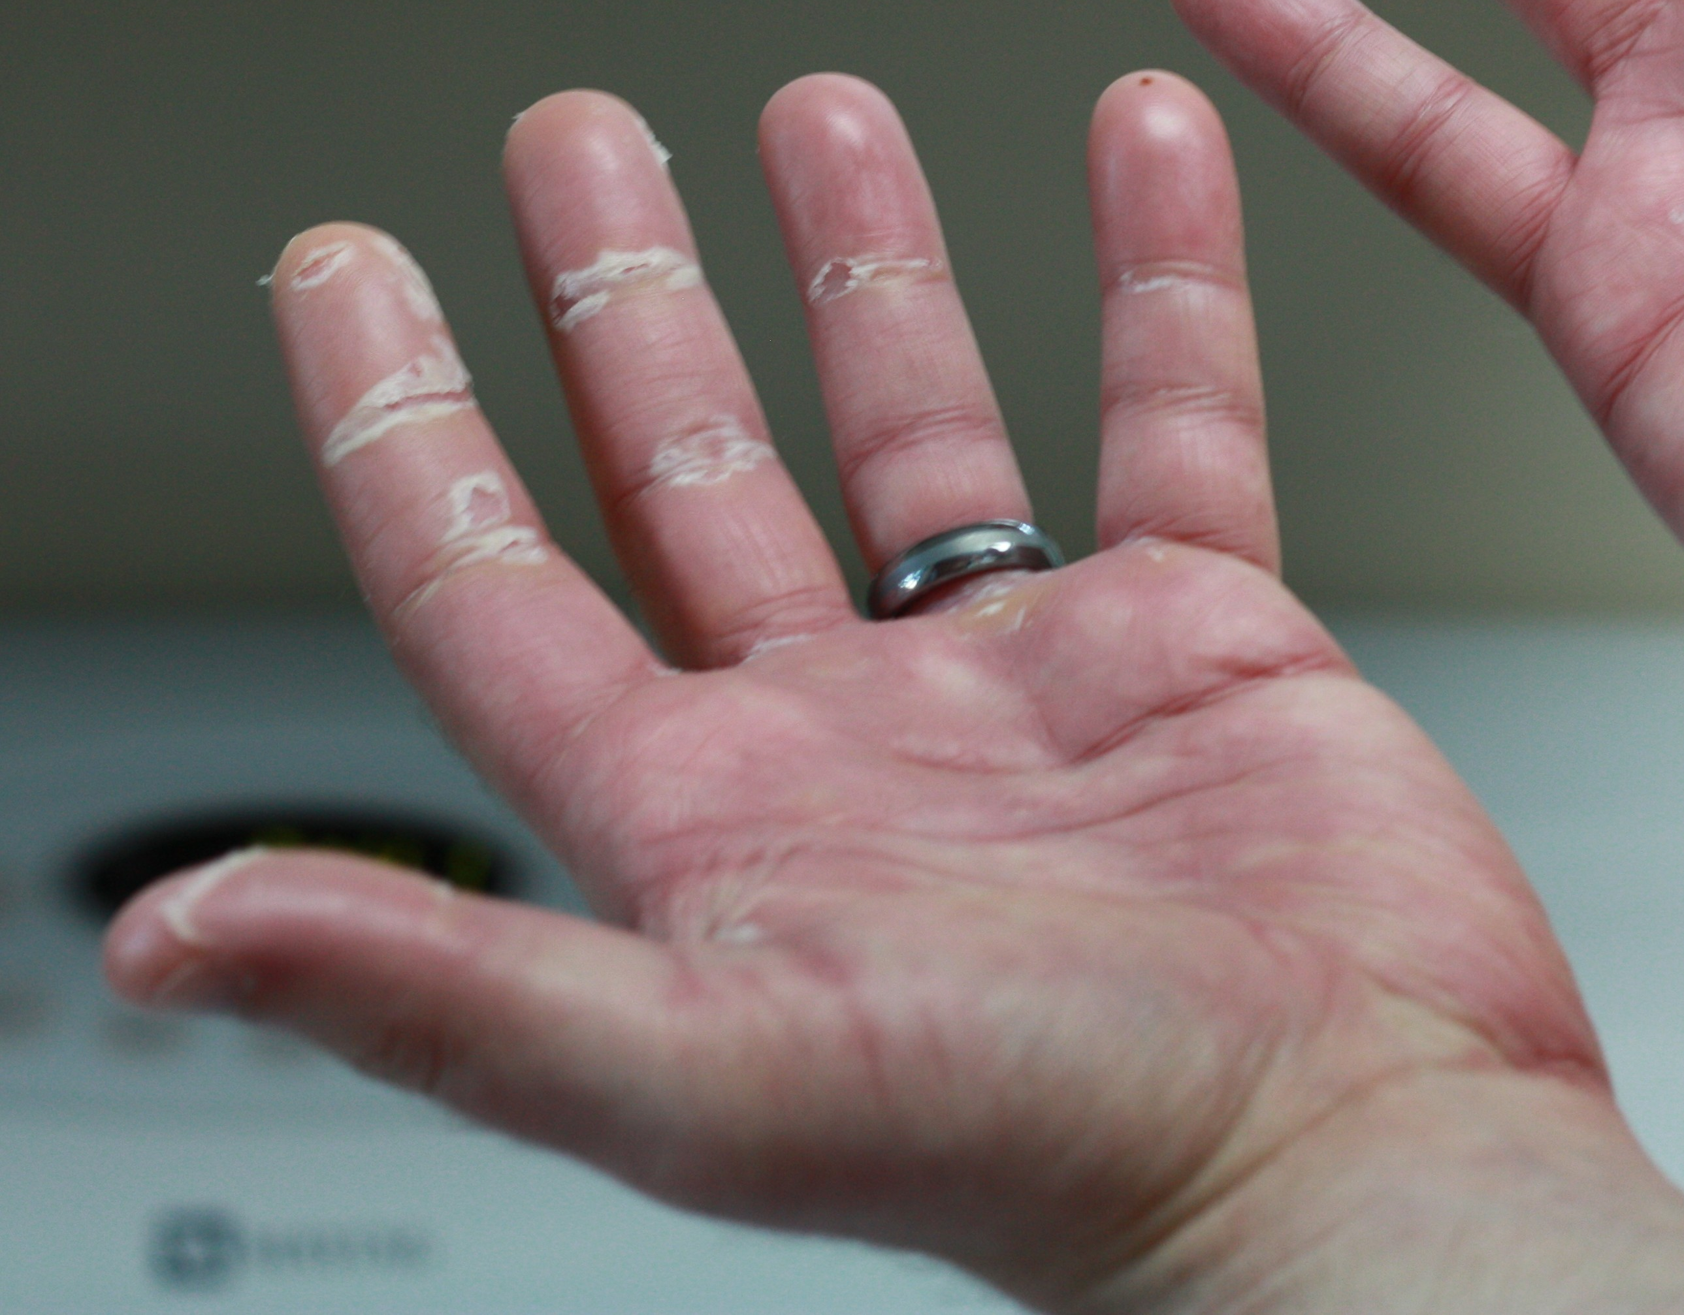

Modified according to Wikipedia; www.flaticon.com/free-icons/pig" title="pig icons">Pig icons created by Freepik - Flaticon

Slide 44
04/2010
56 year
Dr. med. vet
TGC

Slide 45
Fictional patient case
1stL
sorafenib
BOR: SD
AE: HFS (III), diarrhea (III),
DR: 200 mg/d
2ndL lenvatinib
BOR: SD
AE: HFS (II), diarrhea (I), HTN (III), dizziness
DR: 10mg/d
3rdL
sorafenib
Tox.: idem
DR: 200mg/d
T1 N1b M1
(oss) R0
TG
2 x RAI
2 x metastasectomy
+ RTx
+ denosumab
State after RAI,
State after metastasectomy
symptomatic PD
1/09
–
10/09
1/11
12/13
4/14
3/15
5/15
8/18
12/18
ECOG 0
ECOG 3
AE, adverse event; BOR, best overall response; DR, dose reduction; ECOG, Eastern Cooperative Oncology Group; HFS, hand-foot syndrome; HTN, hypertension; PD; disease progression; RAI, radioactive-iodine; RTx, radiotherapy; SD, stable disease

Slide 46
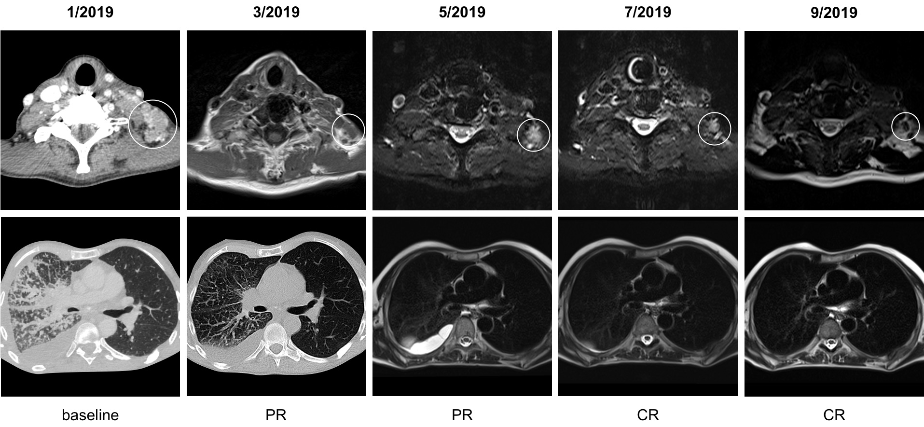
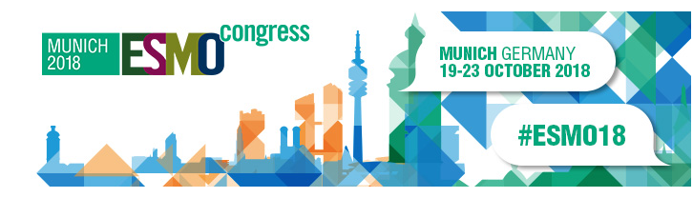
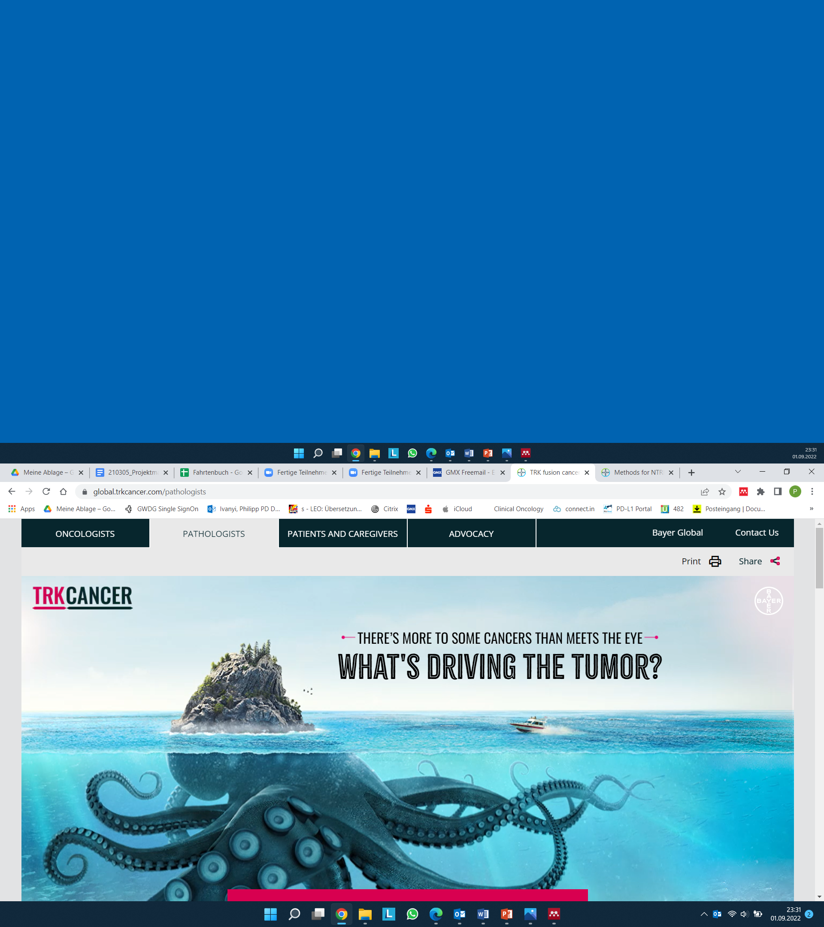
Sorafenib, TBP
Lenvatinib
Trial/off-label?
BSC
?
BSC, best supportive care; TBP, treatment beyond progression

Slide 47
56 year
Dr. med. vet
TGC
12/18
End of options – hope in NTRK inhibition?

Slide 48
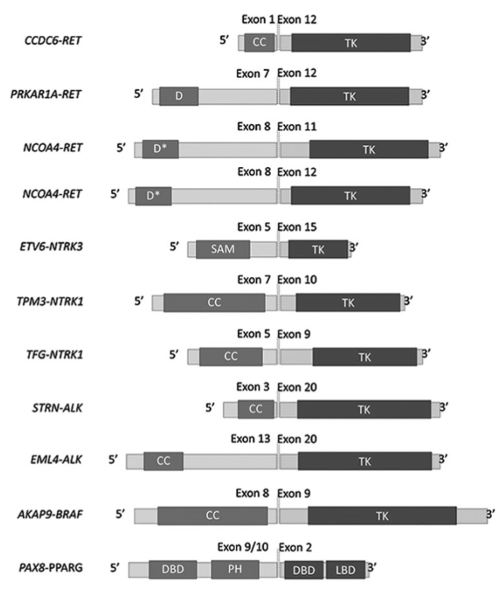
RET
5-25% of PTC are observed to harbour TRK fusions²
NTRK
ALK
BRAF
PPARG
ALK, Anaplastic lymphoma kinase; BRAF, B-Raf proto-oncogene; NTRK, neurotrophic tyrosine receptor kinase; PPARG, Peroxisome proliferator- activated receptor gamma; PTC, papillary thyroid cancer; RET, Ret Proto-Oncogene; TRK, Tropomyosin receptor kinase
1. Yakushina VD, et al. Thyroid. 2018;28:158-167; 2. Cocco E, et al. Nature Rev Clin Oncol. 2018;15:731-747

Slide 49
End of options –
NTRK, reasonable in TGC?
@ pathologist of my confidence

Slide 50
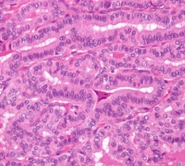
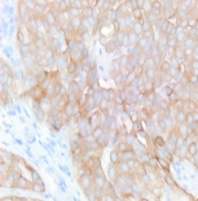
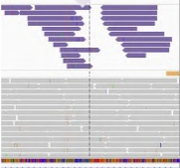
TRK A,B,C
NTRK1-TPM3
TPM3, tropomyosin 3; TRK, Tropomyosin receptor kinase

Slide 51
NTRK, MHH – strategy (2022)

Slide 52
High frequency NTRK
Y
N
Indication depends clinics/histology
Oncogenic driver (-)
Up-front molecular testing
NGS
(Oncomine Assay)
Y
N
IHC (TRK A, B, C) + FISH (NTRK3)
positive
negative
positive
negative
NTRK Expression/Fusion
FISH, Fluorescence in situ hybridisation; IHC, immunohistochemistry; NGS, next generation sequencing; NTRK, neurotrophic tyrosine receptor; TRK, Tropomyosin receptor kinase

Slide 53
He who seeks – finds!

Slide 54
TRK A,B,C
Starting
NTRKi
(Larotrectinib)
NTRK1-TPM3
NTRKi, neurotrophic tyrosine receptor inhibitor; TPM3, tropomyosin 3; TRK, Tropomyosin receptor kinase

Slide 55
Fictional case, MHH
ALT, alanine transaminase; BW, body weight; CEA, carcinoembryonic antigen; CR, complete response; ECOG, Eastern Cooperative Oncology Group; HB, haemoglobin; ORR, objective response rate; PR; partial response

Slide 56
Fictional case, Thanks to Adjucnt Professor von Falck
CR, complete response; PR, partial response

Slide 57
Fictonal case, MHH
ALT, alanine transaminase; BW, body weight; CEA, carcinoembryonic antigen; CR, complete response; ECOG, Eastern Cooperative Oncology Group; HB, haemoglobin; ORR, objective response rate; PR; partial response

Slide 58
ConclusionS

Slide 59
He who seeks finds!
However, rare alteration
NTRKi in NTRK-fusion tumours:
  highly potent
  highly efficient
  safe
Thanks for your attention – Ivanyi.philipp@mh-hannover.de
NTRKi, neurotrophic tyrosine receptor inhibitor; NTRK, neurotrophic tyrosine receptor

Slide 60
Questions from pre-meeting survey
TESTING
1. Which tumours to test? Which test, IHC or molecular biology?
2. Should we test our patients for NTRK after the failure of first line therapy?
3. Is NTRK status changing during different lines of therapies?
EFFICACY
4. What about the second line efficacy of TRK inhibitors in NTRK(+) tumours?
5. Is there any experience in combining TRK inhibitors with immune checkpoint inhibitors?
6. Are there data on melanoma and other skin cancers?

Slide 61
REACH NTRK CONNECT VIA
TWITTER, LINKEDIN, VIMEO & EMAIL
OR VISIT THE GROUP’S WEBSITE http://www.ntrkconnect.info
Follow us on Twitter
@ntrkconnectinfo
Follow the
NTRK CONNECT
group on LinkedIn
Watch us on the
Vimeo Channel
NTRK CONNECT
Email
froukje.sosef
@cor2ed.com

Slide 63
APPENDIX

Slide 64
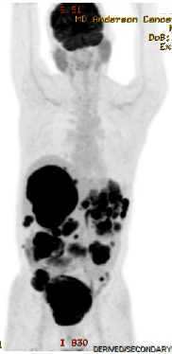
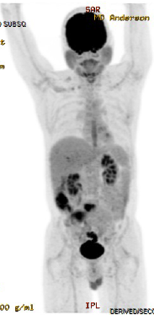
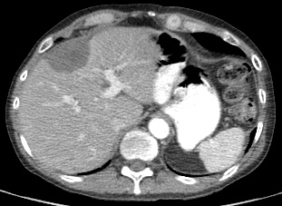
ETV6-NTRK3 fusion GIST
PET
55 yo male with GIST progressed
through imatinib, sunitinib, sorafenib,
nilotinib, and regorafenib
150 mg BID
Confirmed partial response
Study baseline
Baseline
Study cycle 3 day 1
Study cycle 9 day 1
Study baseline
Study cycle 5 day 1
Study cycle 9 day 1

Slide 65
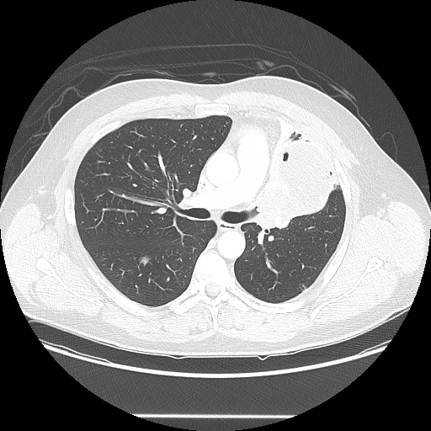
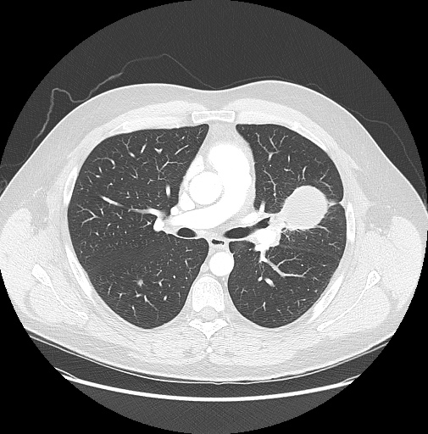
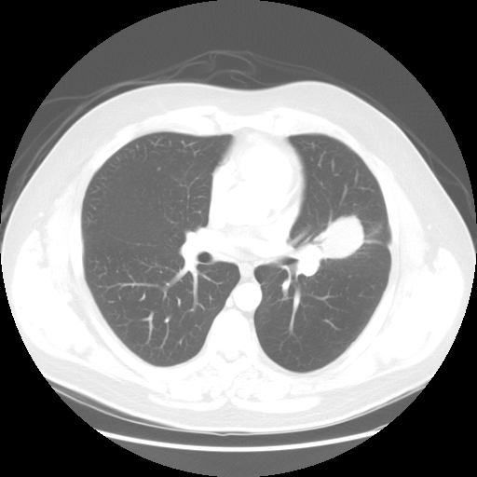
ETV6-NTRK3 fusion mammary analogue secretory carcinoma of the salivary gland (MASC)
33 yo male progressed
through docetaxel, carboplatin and 5FU
100 mg BID
Confirmed partial response
Study baseline
Study cycle 3 day 1
Study cycle 9 day 1

Slide 66
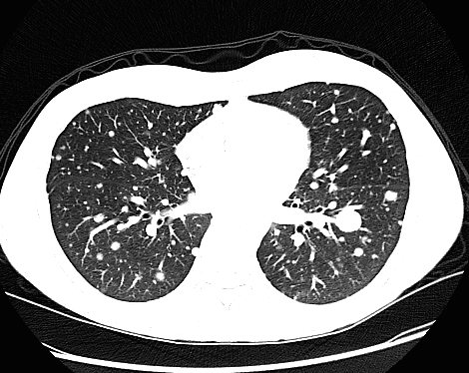
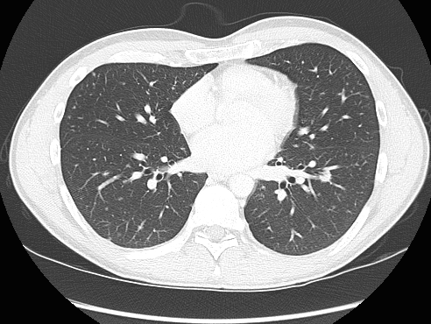
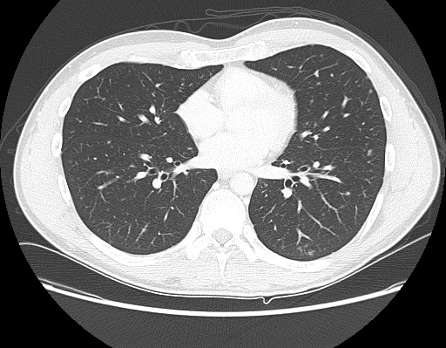
ETV6-NTRK3 fusion papillary thyroid cancer
33 yo male progressed
through RAI, pazopanib, trametanib
100 mg BID
Confirmed partial response
Rapid improvement cervical lymphadenopathy
Study baseline
Study cycle 3 day 1
Study cycle 7 day 1

