Slide 2
GU CONNECT
VIRTUAL EXPERTS KNOWLEDGE SHARE
Incorporating PARP inhibitors into prostate cancer clinical practice
NOVEMBER 2022
PARPi, poly-ADP ribose polymerase inhibitors

Slide 3
Today you will learn how to…
Recognise the efficacy and safety profiles of PARP inhibitors for patients with prostate cancer, including an overview of the data in other tumour types
Implement testing strategies to predict if a patient with prostate cancer is likely to respond to a PARP inhibitor or some other treatment
Understand the data from combination studies with PARP inhibitors, their appropriate implementation in treatment strategies, and their impact on clinical practice
PARP, poly-ADP ribose polymerase

Slide 4




Introducing the scientific committee
Fred Saad
Gerhardt Attard
Professor and Chairman of Urology,
Director of GU Oncology
Raymond Garneau Chair in Prostate Cancer
University of Montreal Hospital Center, QC, Canada
Clinician Scientist and Team Leader at
UCL Cancer Institute
Honorary Medical Oncology Consultant at
UCL Hospital, UK
Tanya Dorff
Neeraj Agarwal
Associate Professor of Medicine
Section Chief, Genitourinary Cancers,
City of Hope Comprehensive Cancer Center, Los Angeles, United States
Professor of Medicine, and Presidential Endowed Chair of Cancer Research at the Huntsman Cancer Institute (HCI), University of Utah, United States

Slide 5
Disclaimer and disclosures
Please note: The views expressed within this presentation are the personal opinions of the authors. They do not necessarily represent the views of the authors academic institutions, or the rest of the GU CONNECT group.
This content is supported by an Independent Educational Grant from AstraZeneca.
The experts have received financial support/sponsorship for research support, consultation, or speaker fees from the following companies:
Prof. Fred Saad: Amgen, Astellas, AstraZeneca, BMS, Bayer, Janssen, Myovant, Novartis/AAA, Pfizer, Sanofi
Prof. Gerhardt Attard: Abbott Laboratories, Astellas Pharma, AstraZeneca, Bayer Healthcare Pharmaceuticals, Essa Pharmaceuticals, Innocrin Pharma, Janssen-Cilag, Millennium Pharmaceuticals, Novartis, Pfizer, Roche/Ventana, Sanofi-Aventis, Takeda, Veridex
Assoc. Prof. Tanya Dorf: Astellas, AstraZeneca, Bayer, Exelixis, Janssen, Sanofi, Seattle Genetics
Prof. Neeraj Agarwal: Active Biotech, Astellas, AstraZeneca, Argos, Aveo, Bavarian Nordic, Bayer Oncology, BN Immunotherapeutics, Bristol Myers Squibb, Calithera, Celldex, Clovis, Eisai, Eli Lilly, EMD Serono, Exelixis, Foundation Medicine, Genentech, Glaxo SmithKline, Janssen, Medivation, Merck, MEI Pharma, Nektar, New link Genetics, Novartis, Pfizer, Pharmacyclics, Prometheus, Rexahn, Roche, Sanofi, Seattle Genetics, Takeda, Tracon

Slide 6
content
Incorporating PARP inhibitors into prostate cancer clinical practice
Topic | Facilitator
Scene setting | Fred Saad
Use of PARP inhibitors beyond the first-line setting in mCRPC | Fred Saad/Gert Attard
Use of PARP inhibitors in the first-line setting in mCRPC | Tanya Dorff/ Neeraj Agarwal
Future perspectives and summary | Fred Saad
mCRPC, metastatic castration-resistant prostate cancer

Slide 7
Incorporating PARPi into prostate cancer clinical practice introduction and scene setting
Prof. Fred Saad, MD, FRCS
Professor and Chairman of Urology, Director of GU Oncology
Raymond Garneau Chair in Prostate Cancer
University of Montreal Hospital Center, Montreal, QC, Canada
PARPi, poly-ADP ribose polymerase inhibitors

Slide 8
Spectrum of prostate cancer
Newly diagnosed mHSPC
Primary progressive mHSPC
Localised or locally advanced prostate cancer
Biochemical recurrence
mCRPC
Terminal progression
nmCRPC
mHSPC, metastatic hormone-sensitive prostate cancer; mCRPC, metastatic castration-resistant prostate cancer; mCRPC, non-metastatic castration-resistant prostate cancer
Adapted from Scher HI, et al. PLoS One. 2015;10:e0139440; Scher HI, et al. J Clin Oncol. 2016;34:1402-18

Slide 9
Systemic treatment options for prostate cancer
Abiraterone^{1,2}
Enzalutamide^{3,4}
Apalutamide^{5,6}
Docetaxel^{7,8}
Docetaxel + darolutamide⁷⁻¹⁰
Docetaxel +abiraterone^{1,2,7,8}
Newly diagnosed mHSPC
Primary progressive mHSPC
Localised or locally advanced prostate cancer
Biochemical recurrence
mCRPC
Terminal progression
Abiraterone for high-risk patients
nmCRPC
  Abiraterone^{1,2}
  Enzalutamide^{3,4}
  Docetaxel^{7,8}
  Cabazitaxel^{11,12}
  Radium-223^{13,14}
  Olaparib^{15,16}
  Sipuleucel-T¹⁷
  Rucaparib¹⁹
  Lutetium²⁰
Enzalutamide^{3,4}
Apalutamide^{5,6}
Darolutamide^{9,10}
mHSPC, metastatic hormone-sensitive prostate cancer; mCRPC, metastatic castration-resistant prostate cancer; nmCRPC, non-metastatic castration-resistant prostate cancer
1. Abiraterone acetate PI; 2. Abiraterone acetate SmPC; 3. Enzalutamide PI; 4. Enzalutamide SmPC; 5. Apalutamide PI; 6. Apalutamide SmPC; 7. Docetaxel PI; 8. Docetaxel SmPC; 9. Darolutamide PI; 10. Darolutamide SmPC; 11. Cabazitaxel PI; 12. Cabazitaxel SmPC; 13. Radium Ra 223 dichloride PI; 14. Radium Ra 223 dichloride SmPC; 15. Olaparib PI; 16. Olaparib SmPC; 17. Sipuleucel-T PI; 18. Pembrolizumab PI; 19. Rucaparib PI; 20. Lutetium Lu 177 vipivotide tetraxetan PI. All accessed August 2022

Slide 10
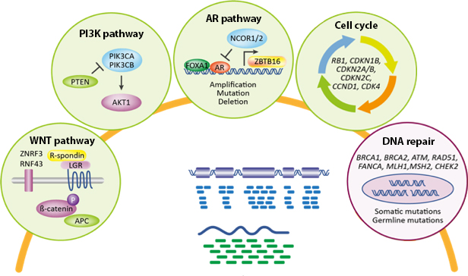
Metastatic prostate cancer is biologically heterogeneous
Multiple pathways have been identified with genomic alterations in association with advanced prostate cancer¹
Approximately 25% of patients with mCRPC have alterations associated with DNA repair pathways^{a,2}
PI3K
Cell cycle
Epigenetic
DNA repair
WNT
MAP kinase
AR
ETS
TP53
PTEN
RB1
PIK3CA
KMT2C
FOXA1
KMT2D
BRCA2
APC
CDK12
ATM
SPOP
CDKN1B
CTNNB1
ZBTB16
RNF43
CDKN2A
PIK3R1
KMT2A
KDM6A
PIK3CB
FANCA
BRAF
BRCA1
AKT1
KRAS
HRAS
0
10
20
30
40
50
60
Alteration frequency
Homologous recombination repair (HRR) is a
key mechanism
for DNA repair^{3,4}
Tumour/
germline
exomes
~23% of of mCRPC harbour
DNA repair aberrations¹
Mutation
Deep deletion
Amplification
Fusion
ª A multi-institutional study profiling 444 tumours from 429 mCRPC patients
AR, androgen receptor; ATM, ataxia telangiectasia mutated; BRCA1/2, breast cancer gene 1/2; mCRPC, metastatic castration-resistant prostate cancer; PI3K, phosphoinositide 3-kinase; WNT, wingless integration
1. Robinson D, et al. Cell. 2015;161:1215-28; 2. Abida W, et al. Proc Natl Acad Sci U S A. 2019;116:11428-36; 3. Lord CJ and Ashworth A. Nature. 2012;481:287-93; 4. O’Connor MJ. Mol Cell. 2015;60:547-60

Slide 11
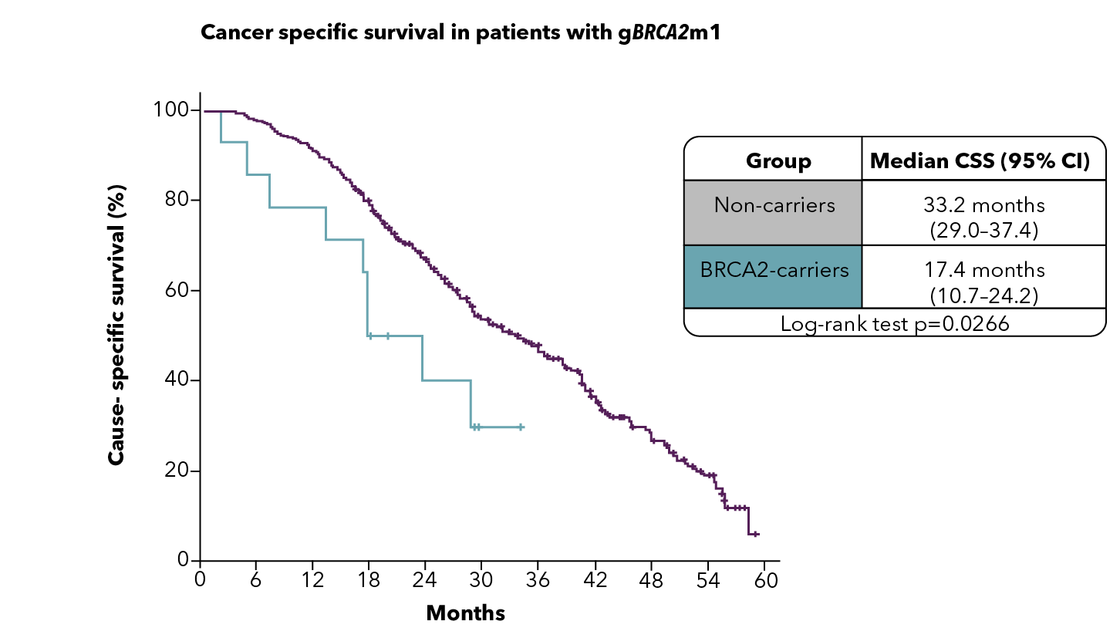
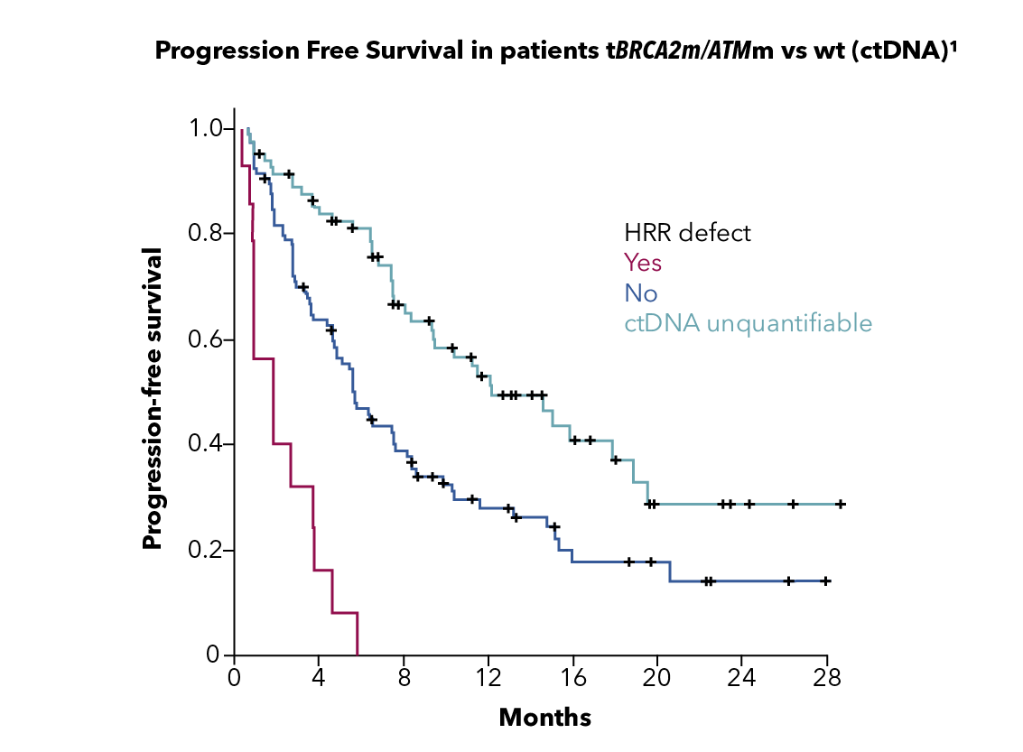
Patients WITH HRR MUTATIONS (INCLUDING BRCA2 MUTATIONS) ARE MORE LIKELY TO HAVE POOR OUTCOMES ON STANDARD-OF-CARE therapies¹⁻³
Patients with germline HRR mutations including BRCA2 mutations are more likely to have poor outcomes on standard-of care-therapies^{1,2}
Poor responses to standard therapy
also seen for tumour HRR mutations³
Cancer-specific survival in patients with
mCRPC with BRCA2 mutation¹
Time to progression in patients with
mCRPC with HRR mutations³
Group | Median CSS (95% CI)
Non-carriers | 33.2 months (29.0-37.4)
BRCA2 mutation carriers | 17.4 months (10.7-24.2)
Log-rank test p=0.0266
HRR defect
Yes
No
ctDNA unquantifiable
CSS (%)
PFS (%)
Months
We clearly need to do better
Months
CI, confidence interval; CSS, cause-specific survival; ctDNA, circulating tumour DNA; HRR, homologous recombination repair; mCRPC, metastatic castration-resistant prostate cancer;
PFS, progression-free survival
1. Adapted from: Castro E, et al. J Clin Oncol. 2019;6:490-503; 2. Annala M, et al. Eur Urol. 2017;72:34-42; 3. Annala M, et al. Cancer Discov. 2018;8:444-57

Slide 12
Goals of this meeting
Through short reviews of data and interactive clinical cases we hope to cover important aspects in the management of advanced prostate cancer
  Importance of testing for HRR mutations
  Appropriate timing and strategies for testing
  Review appropriate use of PARP inhibitors in the continuum of care
  Discuss and share insights in areas of controversy
  Review ongoing work in the earlier use of PARP inhibitors in patients with HRR mutation and non-HRR mutation prostate cancer
HRR, homologous recombination repair; PARP, poly-ADP ribose polymerase

Slide 13
Use of PARP inhibitors beyond the first-line setting in mCRPC
Prof. Fred Saad, MD, FRCS
Prof. Gerhardt Attard, MD, FRCP, PhD
PARP, poly-ADP ribose polymerase

Slide 14
Available PARP inhibitors and their current tumour indications
 | Olaparib | Rucaparib | Niraparib | Talazoparib
Single-agent dose (approved for olaparib, rucaparib, niraparib, and talazoparib) | 300 mg BID | 600 mg BID | 200/300^{d} mg QD | 1 mg QD
Tumour indications | Ovarian cancer, breast cancer, pancreatic cancer, prostate cancer^{1,2,3,a,b} | Ovarian cancer,^{4,5} prostate cancer^{5,c} | Ovarian cancer^{6,7} | Breast cancer^{8,9}
ª Olaparib is FDA-approved for the treatment of adult patients with deleterious or suspected deleterious germline or somatic HRR mutation-positive mCRPC who have progressed following prior treatment with enzalutamide or abiraterone¹
^{b} Olaparib is EMA-approved as monotherapy for the treatment of adult patients with mCRPC and BRCA1/2 mutations (germline and/or somatic) who have progressed following prior therapy that included an NHA² and has received a positive recommendation from the EMA CHMP to be used in combination with abiraterone and prednisone or prednisolone for the treatment of adult patients with mCRPC in whom chemotherapy is not clinically indicated³
^{c} Rucaparib is FDA-approved for the treatment of adult patients with a deleterious BRCA mutation-associated mCRPC who have been treated with AR-directed therapy and a taxane-based chemotherapy
(no current approval in prostate cancer in Europe)⁴
^{d} Niraparib FDA-approved dose is 300 mg QD and EMA approved dose is either 200 or 300 mg QD depending on weight and other factors
AR, androgen receptor; BID, twice daily; CHMP, Committee for Medicinal Products for Human Use; EMA, European Medicines Agency; QD, once daily; EMA, European Medicines Agency; FDA, Food and Drug Administration; HRR, homologous recombination repair; mCRPC, metastatic castration-resistant prostate cancer; NHA, new hormonal agent; PARP, poly-ADP ribose polymerase
1. Olaparib PI; 2. Olaparib SmPC; 3. Lynparza: Pending EC decision | European Medicines Agency (europa.eu); 4. Rucaparib SmPC; 5. Rucaparib PI; 6. Niraparib PI; 7. Niraparib SmPC; 8. Talazoparib SmPC; Talazoparib PI. All accessed November 2022.

Slide 15
Phase 2/3 PARP inhibitor monotherapy trials in mCRPC
Q1 2017¹
PROfound
study initiated
Q2 2020²
PROfound
study published
Q2 2020³
FDA approval
of olaparib
Q4 2020⁴
EMA approval of olaparib
2015 | 2016 | 2017 | 2018 | 2019 | 2020 | 2021 | 2022
Q4 2015⁵
TOPARP-A
data published
Q4 2019⁶
TOPARP-B
data published
Q1 2022⁷
P3 rucaparib study primary completion (TRITON3)
Q1 2017⁸
P2 rucaparib study initiated (TRITON2)
Q2 2017⁷
P3 rucaparib study initiated (TRITON3)
Q2 2020⁹
FDA accelerated approval of rucaparib
Q3 2020¹⁰
P2 rucaparib study
published (TRITON2)
Q3 2016¹¹
P2 niraparib study initiated (GALAHAD)
Q3 2017¹²
P2 talazoparib study initiated (TALAPRO-1)
Q1 2021¹¹
P2 niraparib study
primary completion (GALAHAD)
Q3 2021¹³
P2 talazoparib study publication
(TALAPRO-1)
EMA, European Medicines Agency; FDA, United States Food and Drug Administration; HRR, homologous recombination repair; mCRPC, metastatic castration-resistant prostate cancer; P, phase;
PARP, poly-ADP ribose polymerase; Q, quarter
1. NCT02987543; 2. de Bono J, et al. N Engl J Med. 2020;382:2091-102; 3. FDA approves olaparib for HRR gene-mutated metastatic castration-resistant prostate cancer. www.fda.gov/drugs/drug-approvals-and-databases/fda-approves-olaparib-hrr-gene-mutated-metastatic-castration-resistant-prostate-cancer; 4. Lynparza SmPC; 5. Mateo J, et al. N Engl J Med. 2015;373:1697-708;
6. Mateo J, et al. Lancet Oncol. 2020;21:162-74; 7. NCT02975934; 8. NCT02952534; 9. FDA grants accelerated approval to rucaparib for BRCA-mutated metastatic castration-resistant prostate cancer. www.fda.gov/drugs/fda-grants-accelerated-approval-rucaparib-brca-mutated-metastatic-castration-resistant-prostate; 10. Abida W, et al. J Clin Oncol. 2020;38:3763-72; 11. NCT02854436; 12. NCT03148795;
13. de Bono JS, et al. Lancet Oncol. 2022;9:1250-64. All accessed August 2022.

Slide 16
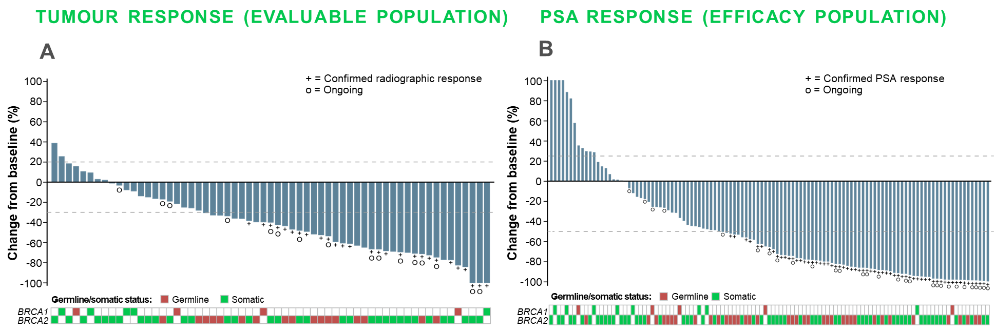
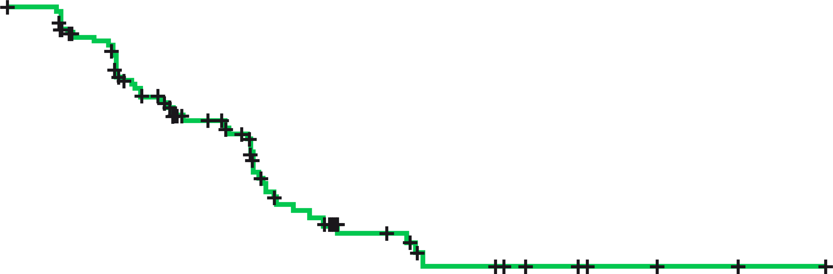
TRITON2: Post NHA and Chemo
Rucaparib Monotherapy in mCRPC with BRCA1 or BRCA2 alterations
A
100
Median, months | 95% CI | Range
9.0 | 8.3-13.5 | 0.0-27.6+
90
80
70
rPFS (%)
60
50
40
30
20
B
10
0
4
8
12
16
20
24
28
Time (months)
No. at risk:
(events)
115
(0)
80
(21)
53
(34)
17
(50)
9
(53)
4
(53)
3
(53)
0
(53)
Best change from baseline in (A) sum of target lesion(s) in the independent radiology review-evaluable population and in (B) PSA in the overall efficacy population
Chemo, chemotherapy; CI, confidence interval; mCRPC, metastatic castration resistant prostate cancer; NHA, new hormonal agent; PSA, prostate-specific antigen, rPFS, radiographic progression-free survival
Adapted from: Abida W, et al. J Clin Oncol. 2020;38:3763-72

Slide 17
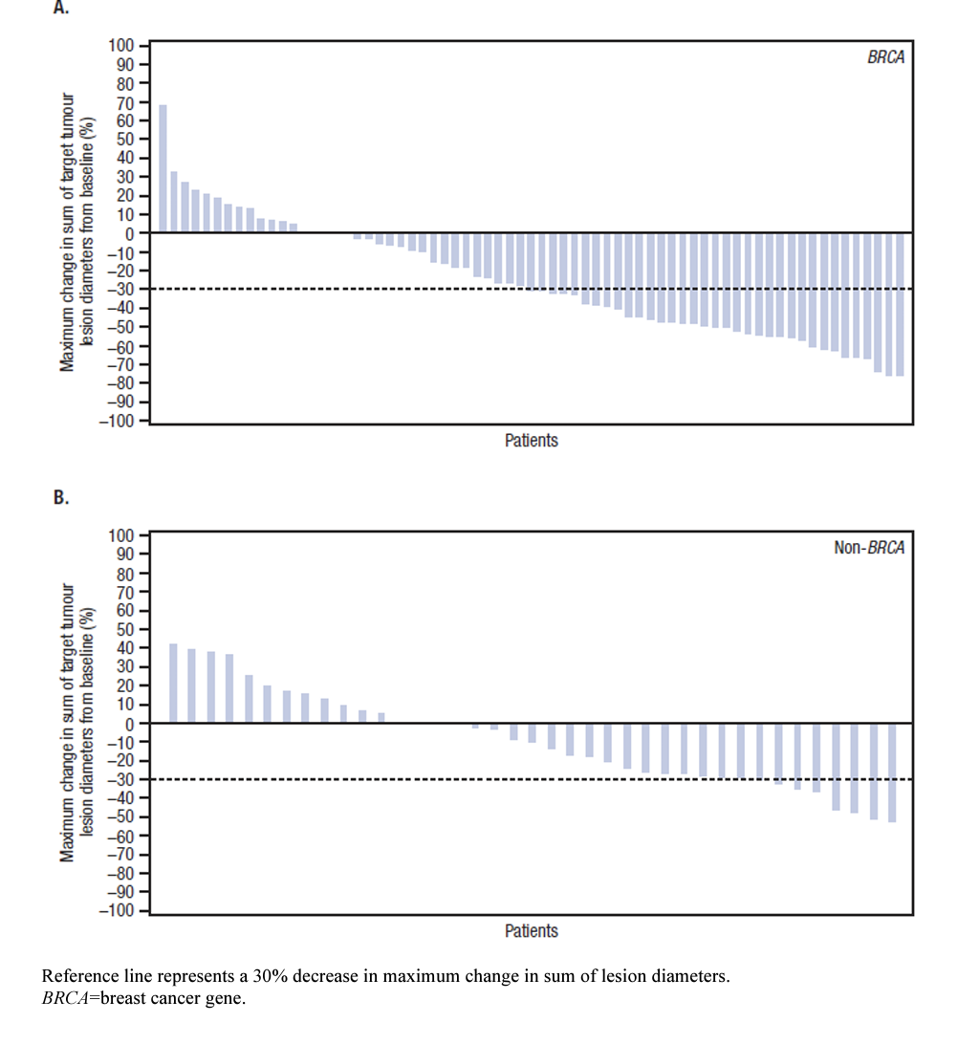
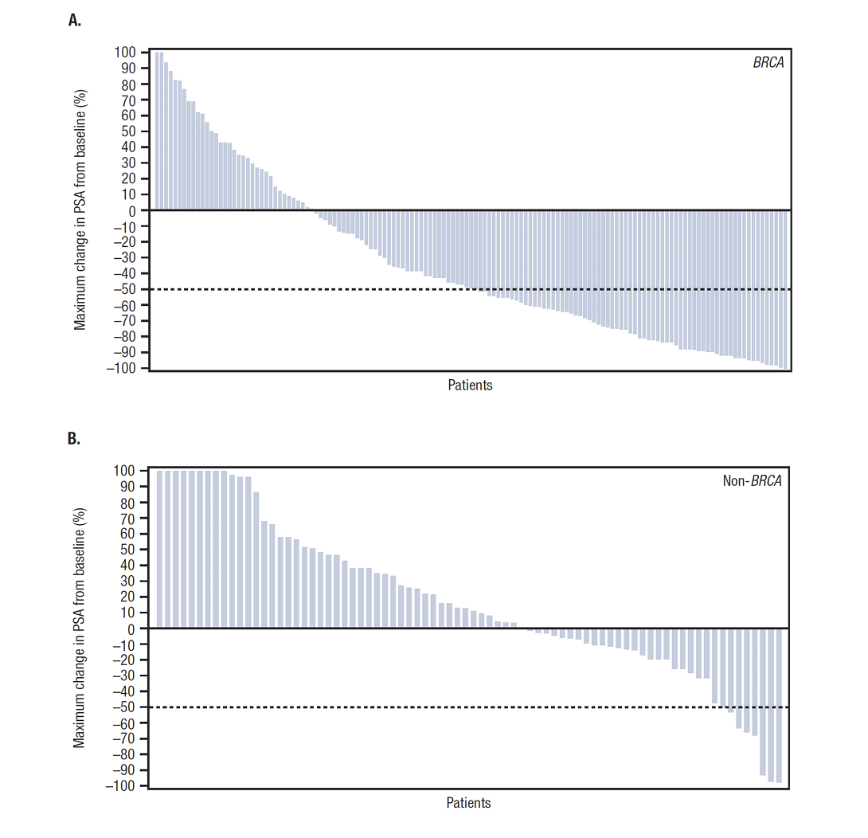
GALAHAD: Niraparib Monotherapy Post NHT and Chemo Results for BRCA-ALTERED vs Non BRCA-ALTERED mCRPC
Measurable response
PSA response
A.
A.
100
90
80
70
60
50
40
30
20
10
0
-10
-20
-30
-40
-50
-60
-70
-80
-90
-100
BRCA
100
90
80
70
60
50
40
30
20
10
0
-10
-20
-30
-40
-50
-60
-70
-80
-90
-100
BRCA
Maximum change in sum
of target tumour lesion
diameters from baseline (%)
Maximum change in PSA
from baseline (%)
B.
Patients
B.
Patients
100
90
80
70
60
50
40
30
20
10
0
-10
-20
-30
-40
-50
-60
-70
-80
-90
-100
Non BRCA
100
90
80
70
60
50
40
30
20
10
0
-10
-20
-30
-40
-50
-60
-70
-80
-90
-100
Non BRCA
Maximum change in sum
of target tumour lesion
diameters from baseline (%)
Maximum change in PSA
from baseline (%)
Patients
Patients
Patients were eligible to enter the study if a deleterious germline or somatic alteration was found in at least one of the following genes: ATM, BRCA1, BRCA2, BRIP1, CHEK2, FANCA, HDAC2, and PALB2
Chemo, chemotherapy; mCRPC, metastatic castration resistant prostate cancer; NHT, new hormonal therapy; PSA, prostate-specific antigen. Smith MR, et al. Lancet Oncol. 2022;23(3):362-73 (supplementary appendix)

Slide 18
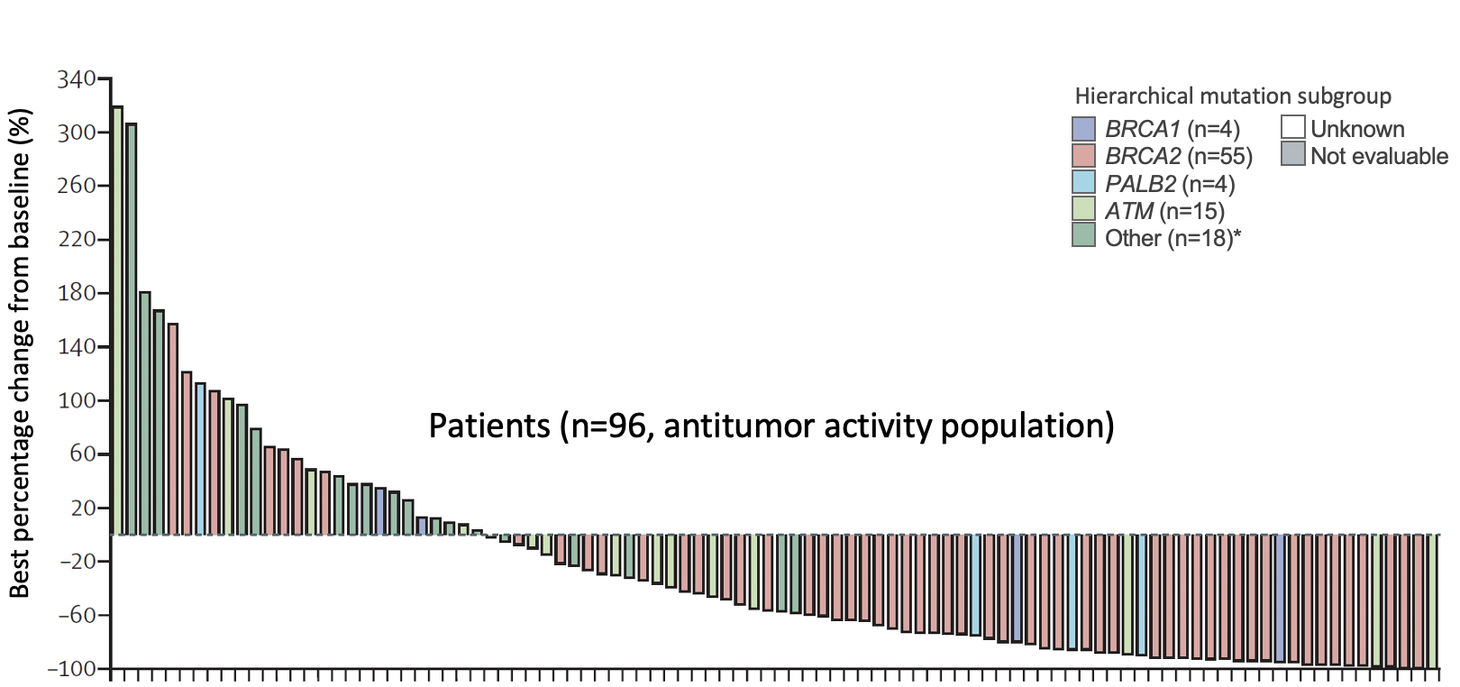
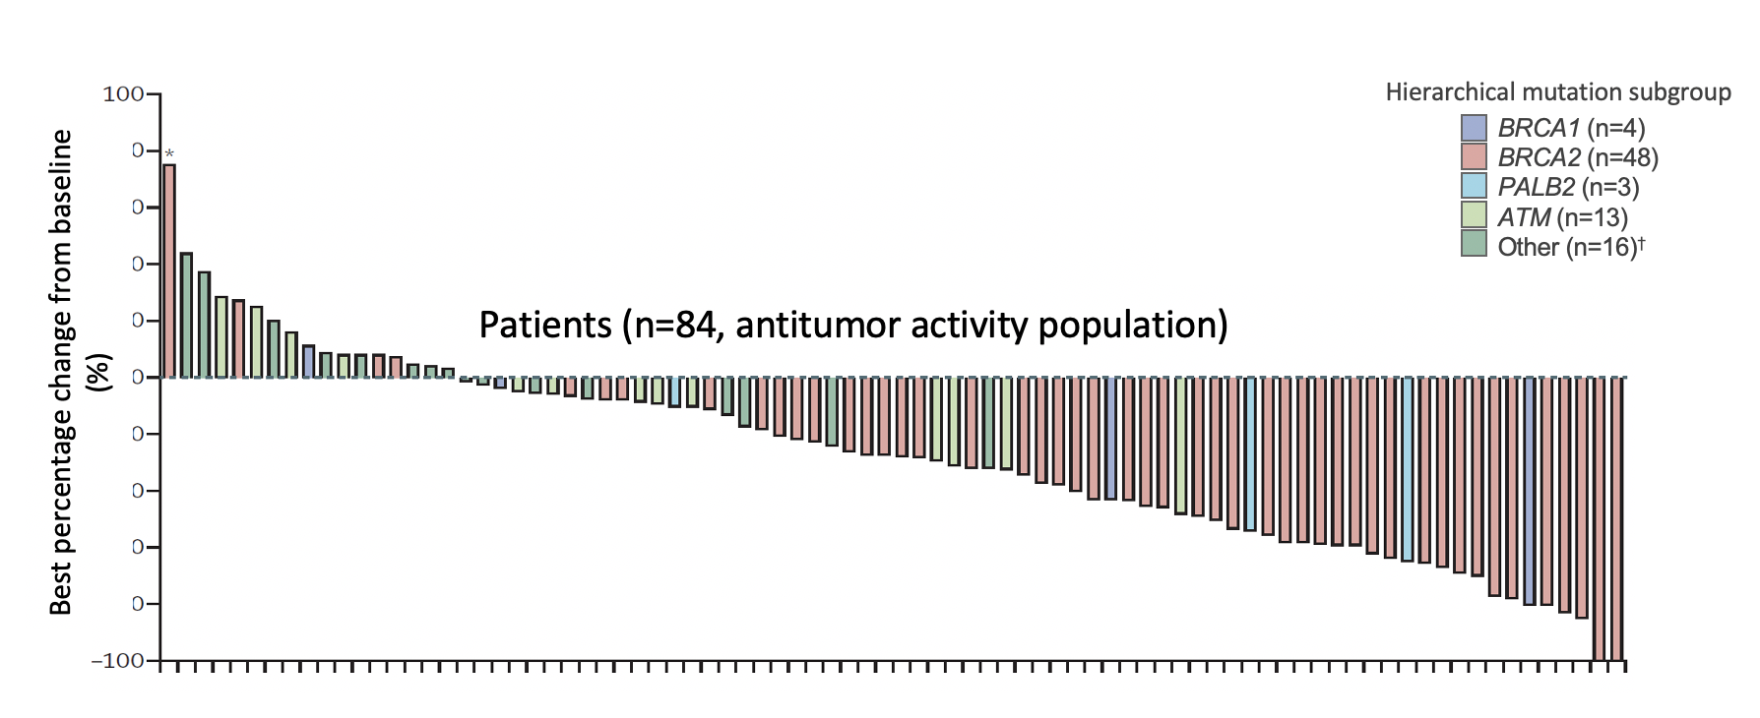
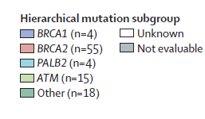
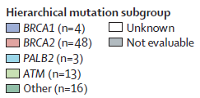
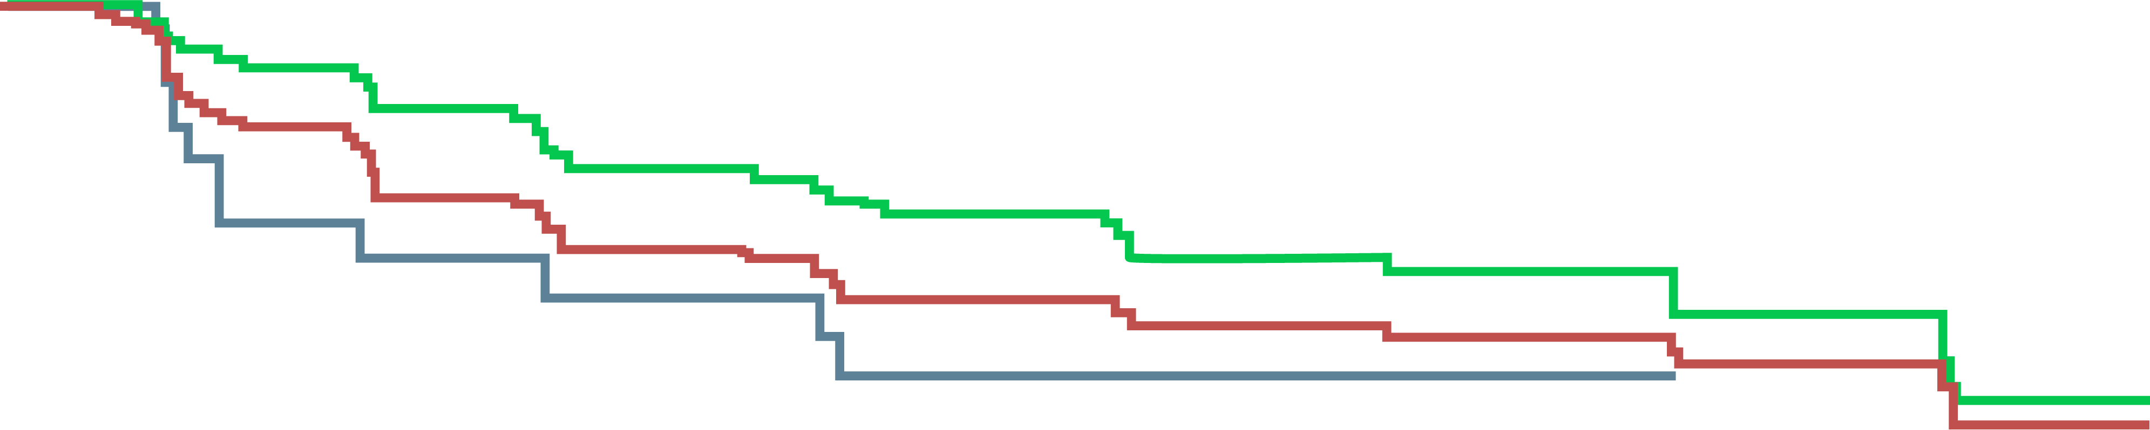
TALAPRO-1:
Talazoparib Monotherapy Post NHT and Chemo
rPFS by HRR gene alteredª
100
90
80
70
60
50
40
30
20
10
Overall (n=104; events: 63; median rPFS: 5.6 months [95% CI 3.7-8.8])
BRCA1/BRCA2 (n=61; events: 31; median rPFS: 11.2 months [95% CI 7.5-19.2])
ATM (n=17; events: 11; median rPFS: 3.5 months [95% CI 1.7-8.3])
rPFS (%)
0
3
6
9
12
15
18
21
No. of patients risk (no. censored)
Overall
BRCA1/BRCA2
ATM
Time since start of treatment (months)
104 (0)
61 (0)
17 (0)
72 (7)
52 (1)
8 (2)
38 (18)
31 (10)
5 (3)
26 (22)
23 (14)
3 (3)
16 (29)
15 (19)
1 (5)
10 (34)
9 (24)
1 (5)
4 (39)
4 (28)
0 (6)
ªBICR; antitumour activity population
BICR, blinded independent central review; chemo, chemotherapy; CI, confidence interval; NHT, new hormonal therapy; PSA, prostate specific antigen; rPFS, radiographic progression-free survival
Adapted from: de Bono J, et al. Lancet Oncol. 2021;22:1250-64

Slide 19
PROfound: First Phase 3 RCT of a PARP Inhibitor in mCRPC (Olaparib vs Enzalutamide or Abiraterone)
Randomised, open-label, phase 3 study
Olaparib (tablets)
(N=162)
COHORT A
(N=245)
BRCA1/2 or ATM
Key eligibility criteria
mCRPC with disease progression on prior NHA e.g. abiraterone or enzalutamide
Alterations in ≥1 of any qualifying gene with a direct or indirect role in HRR
2:1
Physician’s choice of enzalutamide or abiraterone (N=83)
Optional olaparib
upon progression at time of BICR
Open-label
Olaparib (tablets)
(N=94)
COHORT B
(N=142)
Other HRR mutationsª
2:1
Physician’s choice of enzalutamide or abiraterone (N=48)
Optional olaparib
upon progression at time of BICR
Primary endpoint: rPFS by BICR using RECIST v1.1 (soft tissue) and PCWG3 (bone) criteria (cohort A)
Key secondary endpoints:
Cohort A: Confirmed ORR, time to pain progression, OS
Cohort A + B: rPFS
ª Cohort B included patients with BARD1, BRIP1, CDK12, CHEK1, CHEK2, FANCL, PALB2, PPP2R2A, RAD51B, RAD51C, RAD51D, or RAD54L mutations
ARAT, androgen receptor-axis-targeted therapies; BICR, blinded independent central review; ECOG, Eastern Cooperative Oncology Group; HRR, homologous recombination repair; mCRPC, metastatic castration-resistant prostate cancer;
NHA, new hormonal agent; ORR, objective response rate; OS, overall survival; PARP, poly-ADP ribose polymerase; rPFS, radiographic progression-free survival; PVWG3, Prostate Cancer Working Group 3; RCT, randomised controlled trial;
RECIST, Response Evaluation Criteria in Solid Tumours
de Bono JS, et al. N Engl J Med. 2020;382:2091-102

Slide 20
PROfound Primary Endpoint:
Significant Improvement in rPFS in mCRPC with BRCA1/2 or ATM Mutations (Cohort A)
66% reduction in risk of progression or
death with olaparib vs physician’s choice
Confirmed ORR in Cohort A
1.0
0.9
HR (95% CI):
0.34 (0.25-0.47); p<0.001
0.8
0.7
0.6
7.4
Probability of rPFS
0.5
3.6
0.4
OR (95% CI):
20.86 (4.18- 379.18); p<0.001
0.3
0.2
0.1
0.0
0
1
2
3
4
5
6
7
8
9
10
11
12
13
14
15
16
17
18
19
20
21
No. at risk
Time from randomisation (months)
Olaparib
162
149
126
116
102
101
82
77
56
53
42
37
26
24
18
11
11
3
2
0
0
0
Physician's choice
83
79
47
44
22
20
13
12
7
6
3
3
3
2
2
1
1
1
1
0
0
0
CI, confidence interval; HR, hazard ratio; mCRPC, metastatic castration-resistant prostate cancer; OR, odds ratio; ORR, overall response rate; rPFS, radiographic progression-free survival
de Bono JS, et al. N Engl J Med. 2020;382:2091-102

Slide 21
PROfound Secondary Endpoint:
Significant Improvement in OS in mCRPC with BRCA1/2 or ATM Mutations (Cohort A)
31% reduction in risk of death with olaparib vs physician’s choice
Cohort A
Cohort A with adjustment for crossoverª
100
100
HR (95% CI) 0.69 (0.50-0.97)
Median OS: 19.1 vs 14.7 months; p=0.02
HR (95% CI): 0.42 (0.19-0.91)
Crossover rate: 67% (56/83)
80
80
60
60
OS (%)
OS (%)
40
40
20
20
0
0
0
2
4
6
8
10
12
14
16
18
20
22
24
26
28
30
32
34
0
2
4
6
8
10
12
14
16
18
20
22
24
26
28
30
32
34
No. at risk
Time from randomisation (months)
No. at risk
Time from randomisation (months)
Olaparib
Physician’s
choice
155
79
44
15
Olaparib
Physician’s
choice
155
79
44
0
162
83
150
74
142
69
136
64
124
58
107
50
101
43
91
37
71
27
56
18
30
11
18
9
6
6
2
3
1
1
0
0
162
83
150
73
142
67
136
56
124
47
107
29
101
15
91
9
71
3
56
0
30
0
18
0
6
0
2
0
1
0
0
0
Median follow-up duration for censored patients: olaparib, 21.9 months; control, 21.0 months
ª Re-censored; conducted using rank-preserving structural failure time model to demonstrate the impact on OS of crossover of patients from the control arm to receive olaparib as a first subsequent anticancer therapy
CI, confidence interval; HR, hazard ratio; OS, overall survival
Adapted from: Hussain M, et al. N Engl J Med. 2020;383:2345-57

Slide 22
Tolerability profile
Grade
All
Severe
Grade ≥3
Olaparib
Control
ª
Median duration of treatment was 7.6 months in the olaparib arm and 3.9 months in the control arm
ª Grouped term.
Hussain M, et al. N Engl J Med. 2020;383:2345-57

Slide 23
AE profiles of the PARP inhibitors in monotherapy prostate cancer trials
Frequency of AEs in prostate cancer trials, all grade % (grade ≥3 %) | Olaparib (PROfound)¹ | Rucaparib (TRITON-2)² | Niraparib (GALAHAD)³ | Talazoparib (TALAPRO-1)⁴
Hypertension | NR | NR | 11.8 (4.2) | 5.5 (3.1)
Increased ALT/AST | NR | 33.0 (5.2) | 12.8 (2.8) | 11.8 (2.4)
Insomnia | NR | NR | 8.3 (0.3) | NR
Alopecia | NR | NR | NR | NR
Frequency and grade of cytopenias in prostate cancer trials, % | Olaparib (PROfound)¹ | Rucaparib (TRITON-2)² | Niraparib (GALAHAD)³ | Talazoparib (TALAPRO-1)⁴
Anaemia grade ≥3 | 23 | 25.2 | 33 | 31
Neutropenia grade ≥3 | NRª | 7 | 10 | 8
Thrombocytopenia grade ≥3 | NRª | 9.6 | 16 | 9
Please note that head-to-head studies were not conducted between these products. This data is presented for information purposes only
ªFrequency of G3 AEs not reported but 1% of patients experienced TEAE leading to treatment discontinuation
AE, adverse event; PARP, Poly-ADP ribose polymerase
1. Hussain M, et al. New Engl J Med. 2020;383:2345-57; 2. Abida W, et al. J Clin Oncol. 2020;38:3763-72 (supplement); 3. Smith MR, et al. Lancet. 2022;22:362-73;
4. de Bono JS, et al. Lancet Oncol. 2021;22:1250-64

Slide 24
PROfound Secondary Endpoints: Improvements in Multiple Clinical and Patient-reported Endpoints in mCRPC With BRCA1/2 or ATM Mutations (Cohort A)
Time to pain progression in Cohort A^{1,2}
Improvement in patient-reported HRQoL³
Olaparib (N=162)
Physician’s choice (N=83)
OR, 2.67
95% CI,
1.12-7.42
1.0
OR, 4.40
95% CI,
1.47-18.98
20
18.4
18
0.8
16
OR, 8.32
95% CI,
1.64-151.84
15.1
OR, 3.51
95% CI,
0.94-22.80
OR, 2.50
95% CI,
0.79-11.10
OR, 3.51
95% CI,
0.94-22.80
14
0.6
12
Probability of no progression of pain
9.9
Patients (%)
8.6
9.2
10
8.6
7.8
0.4
8
Median NR vs 9.92 months
HR (95% CI): 0.44 (0.22-0.91);
p=0.02
6
3.9
3.9
0.2
2.6
2.6
4
2
1.3
0.0
0
2
4
6
8
10
12
14
16
18
20
0
FACT-P TS
TOI
FWB
PWB
PCS
FAPSI-6
Time from randomisation (months)
CI, confidence interval; FACT-P TS, Functional Assessment of Cancer Therapy–Prostate Total Score; FAPSI-6, FACT Advanced Prostate Symptom Index 6; FWB, functional wellbeing; HR, hazard ratio;
HRQoL, health-related QoL; NR, not reached; OR, odds ratio; pcNHA, physician’s choice of new hormonal agent; PCS, prostate cancer subscale; PWB, physical wellbeing; QoL, quality of life; TOI, Trial Outcome Index
1. de Bono JS, et al. N Engl J Med. 2020;382:2091-102; 2. Hussain M, et al. Presented at ESMO 2019; September 27–October 1; Barcelona, Spain. Abstract LBA12_PR; 3. Thiery-Vuillemin A, et al. Lancet Oncol. 2022;23:393-405

Slide 25
Triton3: rucaparib monotherapy in mcrpc with brca1/2 or atm alterationsª
Confirmatory phase 3 study
 | All patients (BRCA1/2 and ATM mutations) |  | BRCA mutations
 | Rucaparib N= 270 | Physician choice^{b} N=135 | Rucaparib N=201 | Physician choice^{b} N=101
Median rPFS | 10.2 mo | 6.4 mo | 11.2 mo | 6.4 mo
 | HR (95%CI): 0.61 (0.47-0.80) P=0.0003 |  | HR (95%CI): 0.50 (0.36-0.69) P<0.0001
ª patients enrolled in TRITON3 could have received prior taxane chemotherapy for CSPC and one prior novel hormonal agent in any disease setting
^{b}docetaxel, abiraterone acetate, or enzalutamide
Most common (≥5%) TEAEs ≥ G3 for rucaparib treated patients: anaemia (23.7%), neutropaenia (7.4%), asthenia/fatigue (7.0%), thrombocytopaenia (5.9%), increased ALT/AST (5.2%)
Discontinuation due to TEAEs: 14.8% rucaparib vs 21.5% for control arm
ALT, alanine transaminase; AST, aspartate transferase; CI, confidence interval; HR, hazard ratio; mCRPC, metastatic castration-resistant prostate cancer; mo, months; NHT, novel hormonal therapy; rPFS, radiographic, progression-free survival; TEAE, treatment emergent adverse event
Presented by Boye A, et al. Twenty-Ninth Annual Prostate Cancer Foundation Scientific Retreat 2022; Clovis Oncology, Inc. - TRITON3 Phase 3 Trial of Rubraca® (rucaparib) Achieves Primary Endpoint in Men with Metastatic Castration-Resistant Prostate Cancer with BRCA or ATM Mutations. Accessed 10-Nov-2022

Slide 26
Patient case discussion

Slide 27
Case discussion
27
Patient: Age 68 years
Presents with: Moderate urinary symptoms
Medical history:
Well-controlled hypertension and angina; relieved by stent 4 years prior
No known family history of cancer
PSA 132
Digital rectal exam: Nodule/induration suspected stage T3
TRUS biopsy: 9/12 cores; Adenocarcinoma Gleason 4+4
Imaging:
Metastases in hip, lumbar spine, and ribs
Multiple retroperitoneal lymph nodes between 1 and 3 cm and 2 pulmonary nodules suspicious of metastases
DRE, digital rectal exam; PSA, prostate-specific antigen; T, tumour stage; TRUS, transrectal ultrasound

Slide 28
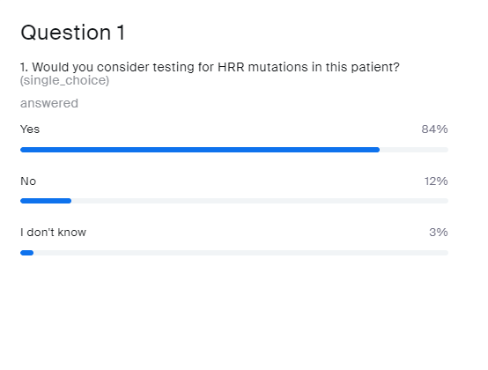
Would you consider testing for
HRR MUTATIONS IN this patient?
Yes
No
Don’t know
HRR, homologous recombination repair

Slide 29
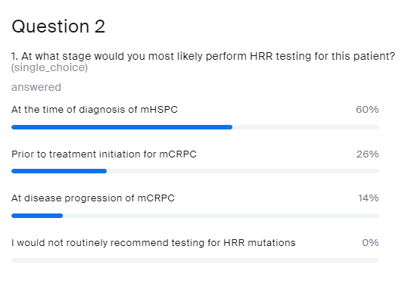
At what stage would you most likely perform HRR testing for this patient
At the time of diagnosis of mHSPC
Prior to treatment initiation for mCRPC
At disease progression of mCRPC
I would not routinely recommend testing for HRR mutations
HRR, homologous recombination repair; mCRPC, metastatic castration-resistant prostate cancer; mHSPC, metastatic hormone-sensitive prostate cancer

Slide 30

Case discussion
30
Patient: Age 68 years
Presents with: Moderate LUTS
Medical history:
Well-controlled hypertension and angina; relieved by stent 4 years prior
No known family history of cancer
PSA 132
PSA nadir 0.9
PSA 1.6
ADT +
abiraterone/prednisone
PSA 3.4
12 months
18 months
24 months
Biopsy: 9/12 cores; adenocarcinoma Gleason 4+4
Staging: T2b/T3 by DRE
Imaging:
Metastases in hip, lumbar spine and ribs
Multiple retroperitoneal lymph nodes between 1 and 3 cm and 2 pulmonary nodules suspicious of metastases
Slight discomfort in lumbar spine
Imaging:
Progression of bone and soft-tissue metastases
Haemoglobin: 10gm/dL
ADT, androgen-deprivation therapy; DRE, digital rectal exam; LUTS, lower urinary-tract symptoms; PSA, prostate-specific antigen’; T, tumour stage

Slide 31
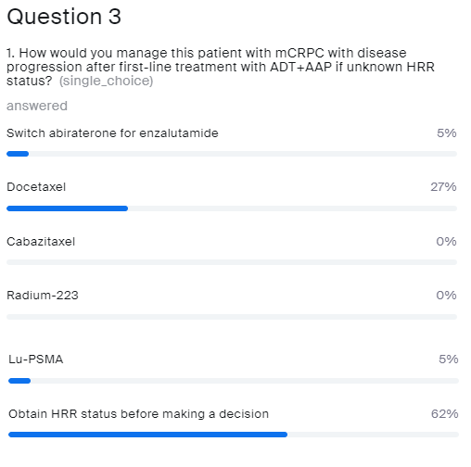
How would you manage this patient with mCRPC WITH DISEASE progression after
FIRST-line treatment with ADT + AAP?
If unknown HRR status
Switch abiraterone for enzalutamide
Docetaxel
Cabazitaxel
Radium-223
Lu-PSMA
Obtain HRR status before making a decision
ADT, androgen-deprivation therapy; AAP, abiraterone acetate and prednisone/prednisolone; HRR, homologous recombination repair; Lu-PSMA, lutetium prostate-specific membrane antigen; mCRPC, metastatic castration-resistant prostate cancer

Slide 32
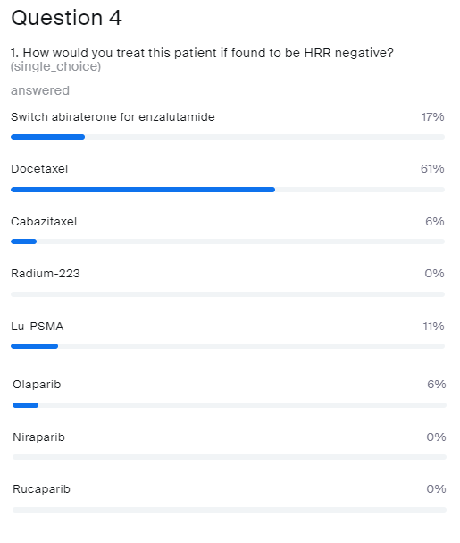
How would you treat this patient?
If found to be HRRd NEGATIVE
Switch abiraterone for enzalutamide
Docetaxel
Cabazitaxel
Radium-223
Lu-PSMA
Olaparib
Niraparib
Rucaparib
HRRd, homologous recombination repair deficient; Lu-PSMA, lutetium prostate-specific membrane antigen

Slide 33
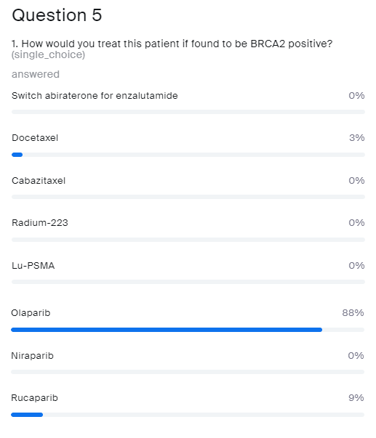
How would you treat this patient?
If found to be BRCA2 POSITIVE
Switch abiraterone for enzalutamide
Docetaxel
Cabazitaxel
Radium-223
Lu-PSMA
Olaparib
Niraparib
Rucaparib
Lu-PSMA, lutetium prostate-specific membrane antigen

Slide 34
Is earlier better with Olaparib?

Slide 35
PROfound Secondary Endpoint:
Significant Improvement in OS in mCRPC with BRCA1/2 or ATM Mutations (Cohort A)
31% reduction in risk of death with olaparib vs physician’s choice
Cohort A
Cohort A with adjustment for crossoverª
100
100
HR (95% CI): 0.69 (0.50-0.97)
Median OS: 19.1 vs 14.7 months; p=0.02
HR (95% CI): 0.42 (0.19-0.91)
Crossover rate: 67% (56/83)
80
80
60
60
OS (%)
OS (%)
40
40
20
20
0
0
0
2
4
6
8
10
12
14
16
18
20
22
24
26
28
30
32
34
0
2
4
6
8
10
12
14
16
18
20
22
24
26
28
30
32
34
No. at risk
Time from randomisation (months)
No. at risk
Time from randomisation (months)
Olaparib
Physician’s
choice
155
79
44
15
Olaparib
Physician’s
choice
155
79
44
0
162
83
150
74
142
69
136
64
124
58
107
50
101
43
91
37
71
27
56
18
30
11
18
9
6
6
2
3
1
1
0
0
162
83
150
73
142
67
136
56
124
47
107
29
101
15
91
9
71
3
56
0
30
0
18
0
6
0
2
0
1
0
0
0
Median follow-up duration for censored patients: Olaparib 21.9 months vs control 21.0 months
ª Re-censored; conducted using rank-preserving structural failure time model to demonstrate the impact on OS of crossover of patients from the control arm to receive olaparib as a first subsequent anticancer therapy
CI, confidence interval; HR, hazard ratio; OS, overall survival
1. Hussain M, et al. N Engl J Med. 2020;383:2345-57

Slide 36

median rPFS and final OS for the BRCA1 and BRCA2 subgroup was longer with olaparib vs physician’s choice^{1,2}
rPFS¹
OS²
Probability of rPFS
1.0
1.0
HR (95% CI): 0.22 (0.15-0.32)
Median rPFS:
9.8 vs 3.0 months
HR (95% CI): 0.63 (0.42-0.95)
Median OS: 20.1 vs 14.4 months
0.8
0.8
Probability of OS
0.6
0.6
0.4
0.4
0.2
0.2
0
0
0
1
2
3
4
5
6
7
8
9
10
11
12
13
14
15
16
17
18
19
20
21
0
2
4
6
8
10
12
14
16
18
20
22
24
26
28
30
32
34
Time from randomisation (months)
No. at risk Olaparib
Time from randomisation (months)
No. at risk
Olaparib 102 93 87 83 78 77 67 66 48 45 36 33 23 22 16 8 8
102 96 93 89 87 78 68 66 60 46 35 27 22 12 4
58 55 50 48 44 38 33 30 26 20 12 11 9 8 5
2
3
1
1
0
0
2 2 0 0 0
0 0 0 0 0
Physician’s choice
Physician’s 58 56 30 27 10 10 6 5 4 3 1 1 1 0 0 0 0
choice
BICR, blinded independent central review; CI, confidence interval; HR, hazard ratio; OS, overall survival; mCRPC, metastatic castration-resistant prostate cancer; rPFS, radiographic progression-free survival
1. de Bono J, et al. N Engl J Med. 2020;382:2091-102 (supplement); 2. de Bono J, et al. J Clin Oncol 2021; 39: suppl 6; abstr 126

Slide 37
In what sequence?

Slide 38
For final OS, an improved treatment effect was seen with olaparib IN PATIENTS WITH BRCA MUTATION-POSITIVE mCRPC AND who had not received a taxaneª
No prior taxane
Prior taxane
100
100
HR (95% CI): 0.64 (0.39-1.08)
Median OS: 17.4 vs 12.6 months
80
80
OS (%)
OS (%)
60
60
40
40
20
HR (95% CI): 0.30 (0.10-0.78)
Median OS: NR vs 18.8 months
20
0
0
0
2
4
6
8
10
12
14
16
18
20
22
24
26
28
30
32
34
0
2
4
6
8
10
12
14
16
18
20
22
24
26
28
30
32
34
Time from randomisation (months)
Time from randomisation (months)
No. at risk
Olaparib | 23 | 23 | 23 | 23 | 23 | 23 | 21 | 21 | 20 | 18 | 16 | 10 | 10 | 5 | 2 | 0 | 0 | 0
Physician’s choice | 20 | 20 | 19 | 19 | 18 | 15 | 14 | 13 | 12 | 7 | 5 | 4 | 3 | 3 | 1 | 0 | 0 | 0
No. at risk
Olaparib | 66 | 60 | 57 | 55 | 53 | 46 | 38 | 36 | 32 | 23 | 16 | 15 | 11 | 6 | 2 | 2 | 1 | 0
Physician’s choice | 32 | 29 | 25 | 23 | 21 | 19 | 16 | 14 | 11 | 10 | 5 | 5 | 4 | 3 | 3 | 2 | 0 | 0
ª Data are reported only for patients with alteration in a single gene
CI, confidence interval; HR, hazard ratio; mCRPC, metastatic castration-resistant prostate cancer; NR, not reached; OS, overall survival
1. Hussain M, et al. N Engl J Med. 2020;383:2345-57 (Supplementary Appendix)

Slide 39
What about NHT to NHT in patients with mCRPC?
mCRPC, metastatic castration-resistant prostate cancer; NHT, new hormonal therapy

Slide 40
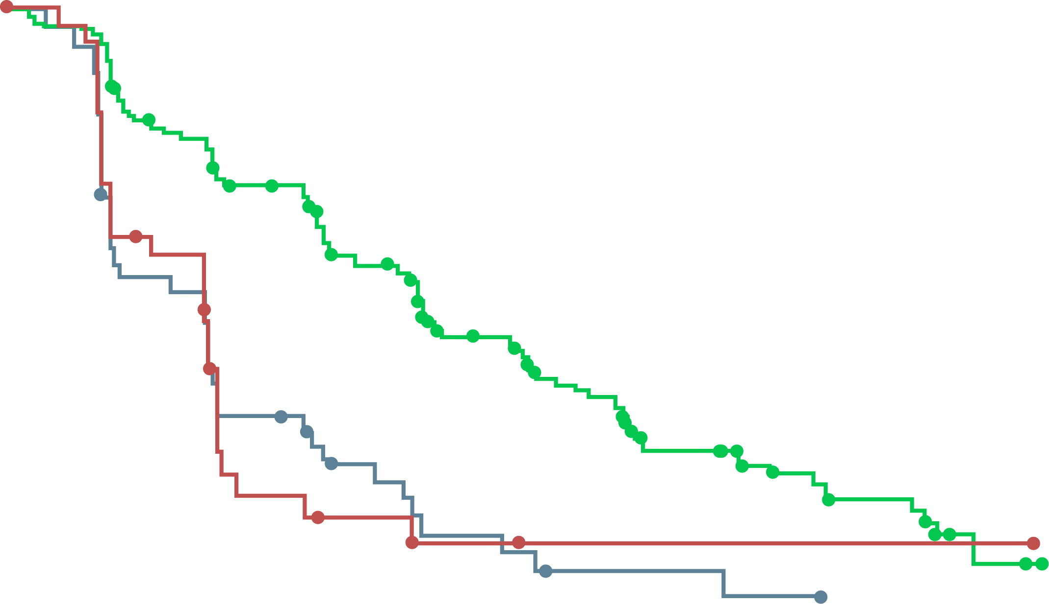
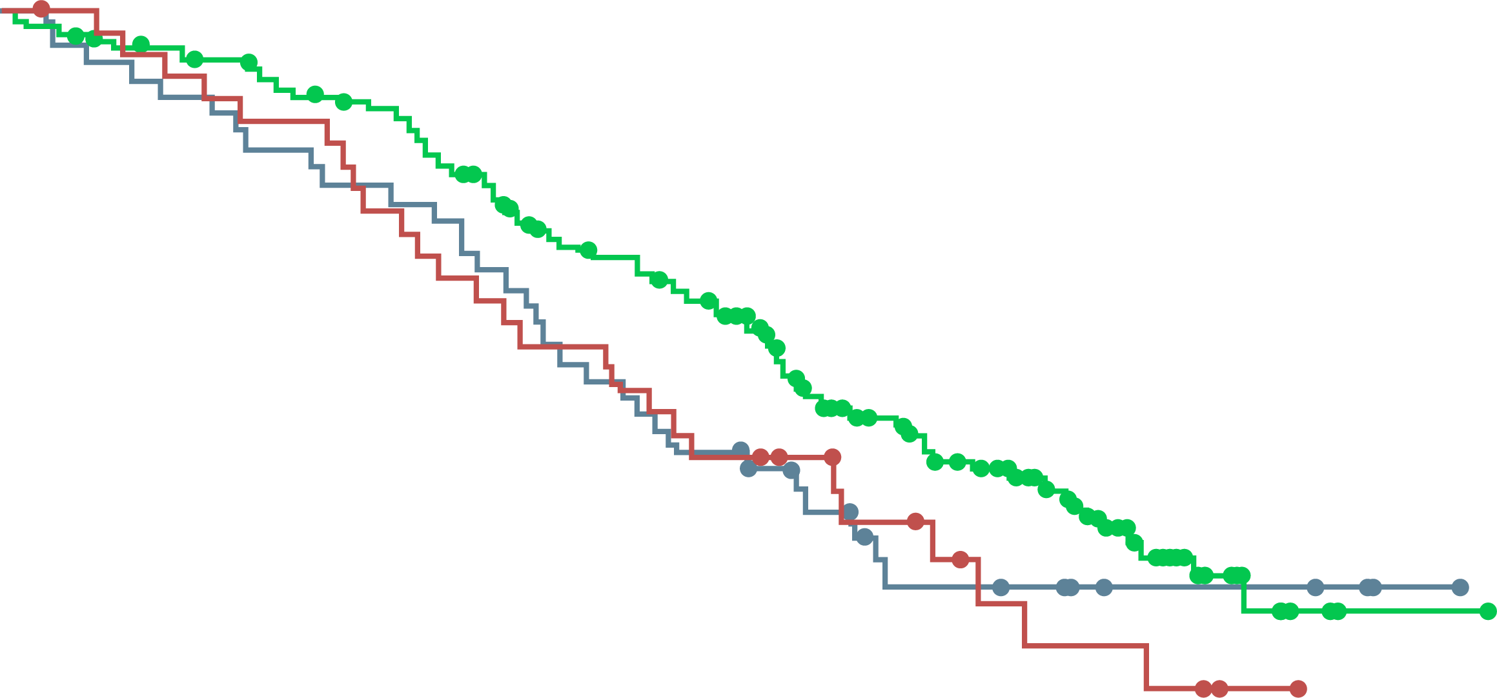
rPFS and OS benefit for olaparib was shown against both enzalutamide and abiraterone (Cohort A)
rPFS
OS
 | Ola | Abi | Enza
Median rPFS (months) | 7.4 | 3.5 | 3.6
HR (95% CI) |  | 0.35 (0.24-0.51) | 0.33 (0.21-0.52)
 | Ola | Abi | Enza
Median OS (months) | 19.1 | 14.5 | 14.9
HR (95% CI) |  | 0.72 (0.48-1.11) | 0.65 (0.43-1.03)
1.0
0.9
0.8
0.7
0.6
0.5
0.4
0.3
0.2
0.1
0.0
1.0
0.9
0.8
0.7
0.6
0.5
0.4
0.3
0.2
0.1
0.0
Probability of rPFS
Probability of OS
0
1
2
3
4
5
6
7
8
9
10
11
12
13
14
15
16
17
18
19
20
21
22
23
0
2
4
6
8
10
12
14
16
18
20
22
24
26
28
30
32
34
36
38
Time from randomisation (months)
Time from randomisation (months)
No. at risk:
Olaparib
Abiraterone
Enzalutamide
162
46
37
149
45
34
126
25
22
116
24
20
102
15
7
101
14
6
82
9
4
77
8
4
56
5
2
53
4
2
42
2
1
37
2
1
26
2
1
24
1
1
18
1
1
11
0
1
11
0
1
3
0
1
2
0
1
0
0
0
0
0
0
No. at risk:
Olaparib
Abiraterone
Enzalutamide
162
46
37
155
43
36
150
41
33
142
38
31
136
36
28
124
34
24
107
29
21
101
24
19
91
21
16
71
15
12
56
9
9
44
9
6
30
7
4
16
6
3
6
5
1
2
3
0
1
1
0
0
0
0
Findings suggests that sequential use of an NHA may be of limited benefit
Abi, abiraterone; CI, confidence interval; Enza, enzalutamide; HR, hazard ratio; NHA, new hormonal agent; Ola, olaparib; OS, overall survival; rPFS, radiographic progression-free survival
Saad F, et al. AUA 2021: PD34-09 (oral presentation)

Slide 41
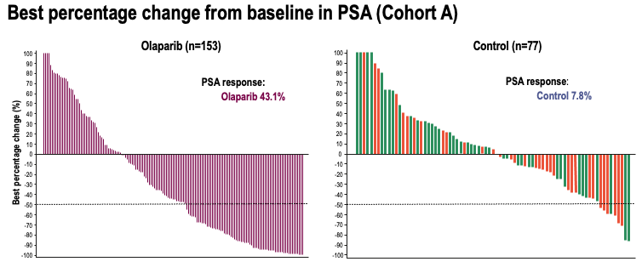
Best percentage change from baseline in PSA (cohort A)
Olaparib (n=153)
Control (n=77)
100
90
80
70
60
50
40
30
20
10
0
-10
-20
-30
-40
-50
-60
-70
-80
-90
-100
100
90
80
70
60
50
40
30
20
10
0
-10
-20
-30
-40
-50
-60
-70
-80
-90
-100
PSA response: Olaparib 43.1%
PSA response: Control 7.8%
Best percentage change (%)
Best percentage change (%)
Best percentage change in PSA was not influenced by sequence of NHA
NHA, new hormonal agent; PSA, prostate-specific antigen
Saad F, et al. AUA 2021: PD34-09 (oral presentation)

Slide 42
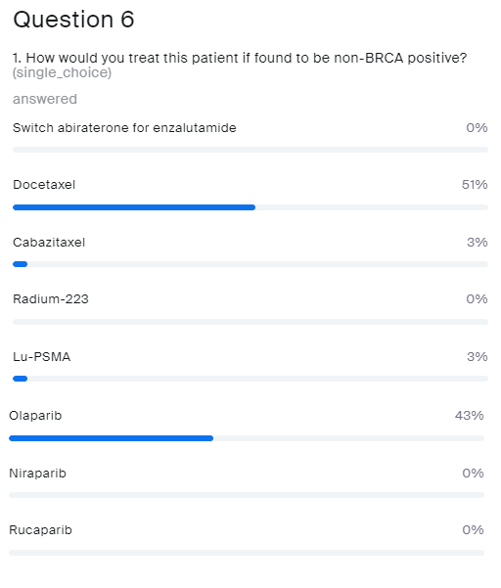
How would you treat this patient?
If found to be non-BRCA positive
Switch abiraterone for enzalutamide
Docetaxel
Cabazitaxel
Radium-223
Lu-PSMA
Olaparib
Niraparib
Rucaparib
Lu-PSMA, lutetium prostate-specific membrane antigen

Slide 43
43
Patient: Age 68 years
Presents with: Moderate LUTS
Medical history:
Well-controlled hypertension and angina; relieved by stent 4 years prior
No known family history of cancer
PSA 132
PSA nadir 0.9
PSA 1.6
ADT + docetaxel (6 cycles)
+ abiraterone/prednisone
PSA 3.4
12 months
18 months
24 months
HRR mutation negative on plasma testing prior to commencing docetaxel
Biopsy: 9/12 cores; adenocarcinoma Gleason 4+4
Staging: T2b/T3 by DRE
Imaging:
Metastases in hip, lumbar spine and ribs
Multiple retroperitoneal lymph nodes between 1 and 3 cm and 2 pulmonary nodules suspicious of metastases
Slight discomfort in lumbar spine
Imaging:
Progression of bone and soft-tissue metastases
Haemoglobin: 10gm/dL
ADT, androgen-deprivation therapy; DRE, digital rectal exam; HRR, homologous recombination repair; LUTS, lower urinary-tract symptoms; PSA, prostate-specific antigen

Slide 44
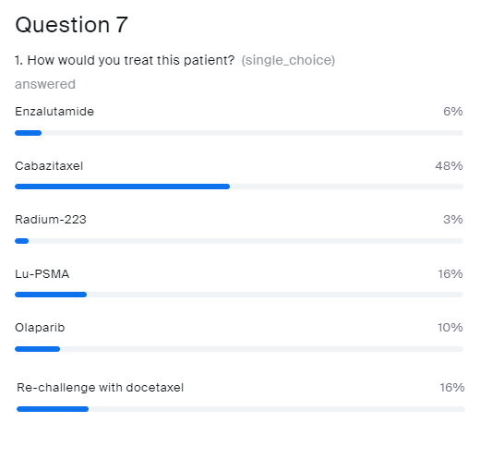
How would you treat this patient?
Enzalutamide
Cabazitaxel
Radium-223
Lu-PSMA
Olaparib
Re-challenge with docetaxel
Lu-PSMA, lutetium prostate-specific membrane antigen

Slide 45
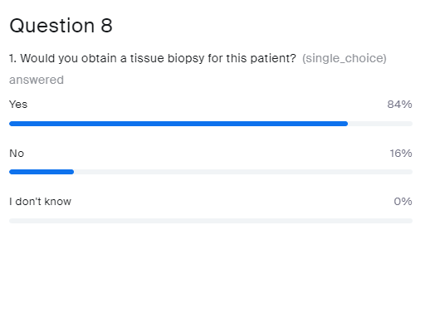
Would you obtain a tissue biopsy for this patient?
  Yes
  No
  I don’t know

Slide 46
Use of PARP inhibitors in the first-line setting in mCRPC
Assoc. Prof. Tanya Dorff, MD
Prof. Neeraj Agarwal, MD
mCRPC, metastatic castration-resistant prostate cancer; PARP, poly-ADP ribose polymerase

Slide 47
Case discussion
47
Patient: Age 68 years
Presents with: Moderate urinary symptoms
Medical history:
Well-controlled hypertension and angina; relieved by stent 4 years prior
No known family history of cancer
PSA: Nadir 0.1 rising to 5.0
Imaging: 2 new bone lesions (on bone scan)
PSA, prostate-specific antigen

Slide 48
“Life Extending Therapies” for mCRPC
Abiraterone
  COU301: Median OS 14.8 months vs 10.9 months for placebo (post taxane)¹
  COU 302: PFS 8.3 months → 16.5 months (pre taxane)²
Enzalutamide
  AFFIRM: Median OS 18.4 months vs 13.6 for placebo³ (post taxane)
  PREVAIL: Median OS 32.4 months vs 30.2⁴ pre taxane (17-month delay in chemotherapy)
Sipuleucel-T
  IMPACT: Median OS 23.2 months⁵ (vs 18.9 months for placebo)
Cabazitaxel
  Median OS 15.1 months vs 12.7 months mitoxantrone (post taxane)⁶
Radium-223
  ALSYMPCA: Median OS 14.9 months (vs 11.3 months for placebo)⁷
mCRPC, metastatic castration-resistant prostate cancer; OS, overall survival; PFS, progression-free survival
1. de Bono J, et al. N Engl J Med. 2011;364:1995-2005; 2. Rahtkopf D, et al. J Clin Oncol. 2012;31 Suppl: Abstract 5; 3. Scher HI, et al, N Engl J Med. 2012;367:1187-97;
4. Beer TM, et al. J Clin Oncol. 2014;32 Suppl: LBA1; 5. Higano CS, et al. Cancer. 2009;115:3670-9; 6. de Bono JS, et al. Lancet. 2010;376:1147-54;
7. Parker C, et al. N Engl J Med. 2013;369:213-2

Slide 49
Current Paradigms for Metastatic prostate cancer
HSPC
ADT + Abi/Apa/
Daro/Enza
Doce/
radium-223/ PARPª
Cabazitaxel
PARPiª/ICI^{b}
Abi/Enza/Daro?
Lu-PSMA
ADT +
Doce
Abi/
Enza
Cabazitaxel (Doce)
Radium-223
PARPiª/ICI^{b}
Abi/Enza/Daro?
Lu-PSMA
ADT
Abi/
Enza/
Doce
Cabazitaxel/Doce/
radium-223
PARPiª/ICI^{b}
Lu-PSMA
Sip-T?
Sip-T?
Sip-T?
Genomic profiling
C
R
P
C
ª If DNA repair mutation identified; ^{b} i.e. Pembrolizumab if microsatellite-instable high; Abi, abiraterone; ADT, androgen-deprivation therapy; Apa, apalutamide; CRPC, castration-resistant prostate cancer; Daro, darolutamide; Enza, enzalutamide; HSPC, hormone-sensitive prostate cancer; ICI, immune checkpoint inhibitor; Lu-PSMA, lutetium prostate-specific membrane antigen; Sip-T, sipuleucel-T; PARP, poly-ADP ribose polymerase
Dorff T, personal communication

Slide 50
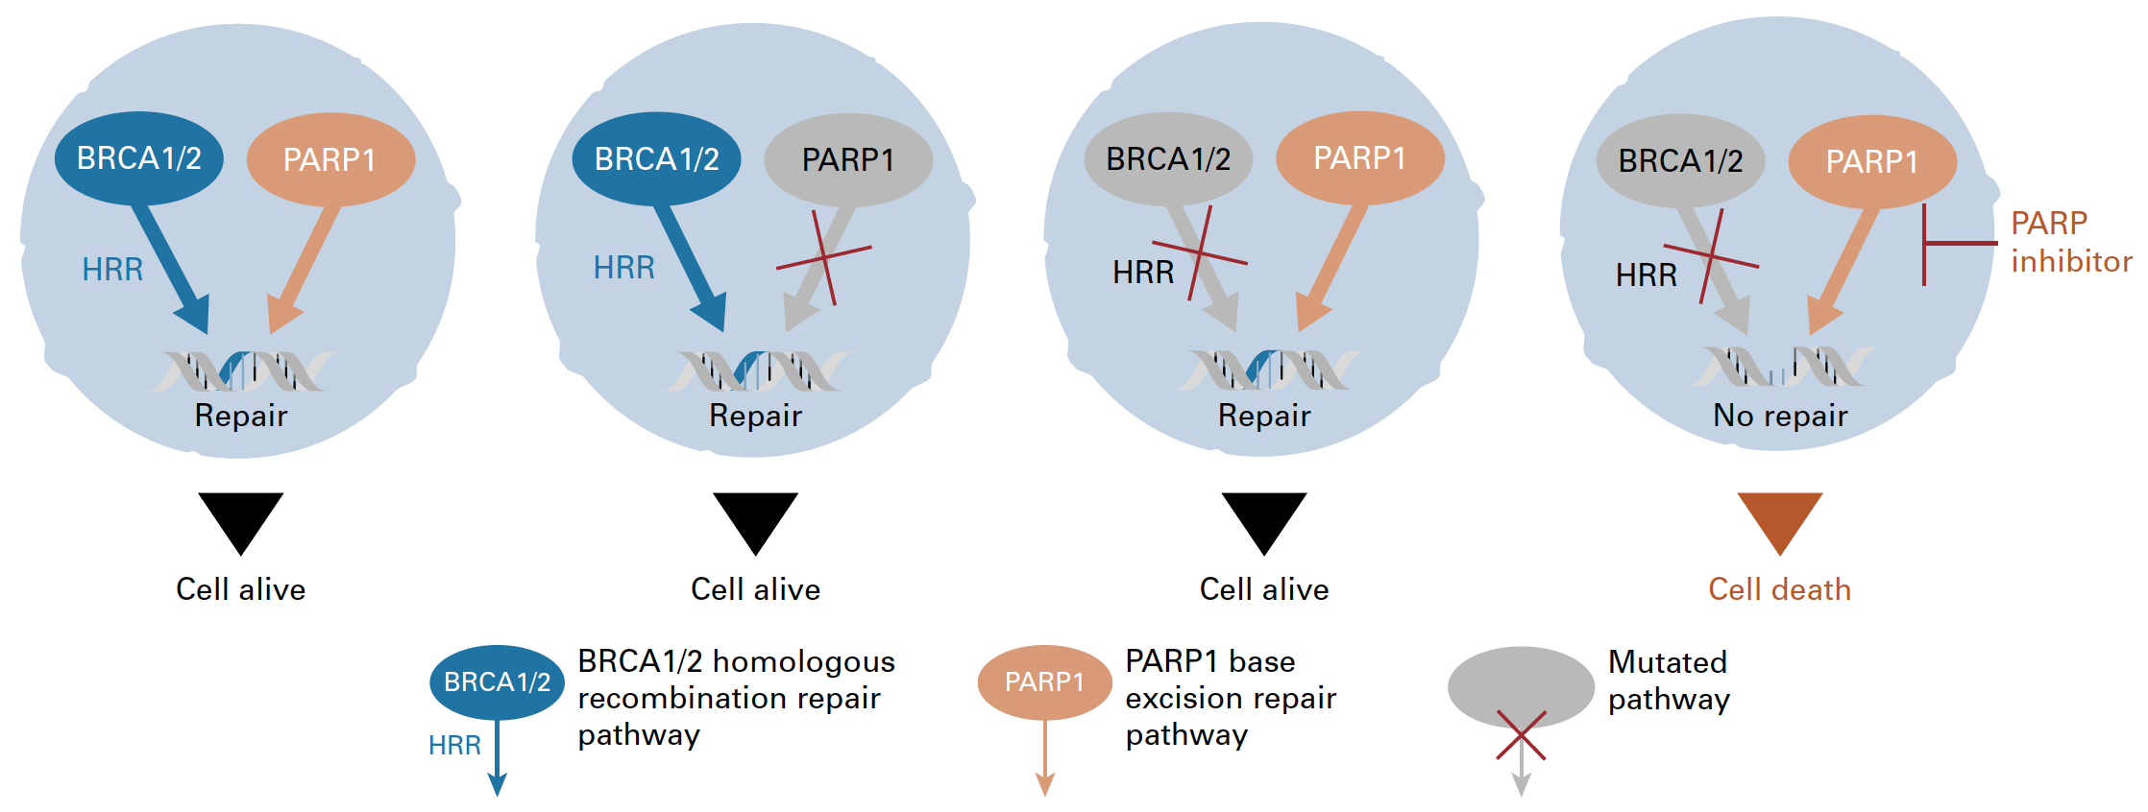

PARP inhibitors:
“Synthetic Lethality” in cancer
BRCA: “copy editor”; HRR
PARP: “spell check”; BER
BER
BER
BER
BER
BER
PARP is required for single-strand break repair (e.g. via BER)
MOA – inhibiting SSB/BER is synthetic lethal with HRD
BER, base excision repair; BRCA1/2, breast cancer type 1/2 susceptibility protein; HRD, homologous recombination deficiency; HRR, homologous recombination repair; MOA, mode of action;
PARP, poly-ADP ribose polymerase; SSB, single-strand break
Adapted from Gourley C, et al. J Clin Oncol. 2019;37:2257-69; Banerjee S, et al. Nat Rev Clin Oncol. 2010;7:508-19

Slide 51
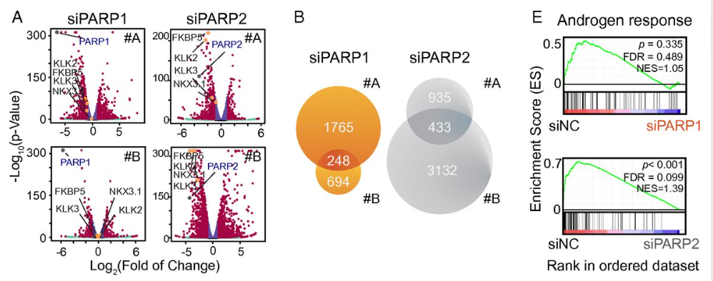
PARP also impacts transcription of
AR-regulated genes
AR, androgen receptor; (si) PARP, (small interfere RNA)-poly-ADP ribose polymerase
Reproduced from: Gui B, et al. Proc Natl Acad Sci U S A. 2019;116:14573-82

Slide 52
Rationale for combining PARP inhibitors and NHAs
Interaction between PARP signalling and AR signalling pathways may explain the combined effect of agents observed in preclinical models
PARP inhibitor + NHA¹⁻³
PARP involved in AR-dependent transcription; PARP inhibition may increase activity of NHAs¹
NHA-induced HRR deficiency increasing susceptibility to
PARP inhibition^{2,3}
Combined effect
Antitumour activity in HRR mutation and non HRR mutation prostate cancer¹⁻³
AR, androgen receptor; HRR, homologous recombination repair; NHA, novel hormonal agent; PARP, poly-ADP ribose polymerase
1. Schiewer MJ, et al. Cancer Discov. 2012;2:1134-49; 2. Polkinghorn WR, et al. Cancer Discov. 2013;3:1245-53; 3. Asim M, et al. Nat Commun. 2017;8:374;
Adapted from Saad F, et al. J Clin Oncol. 2022;40 Suppl: Abstract 11 (ASCO GU 2022 oral presentation)

Slide 53
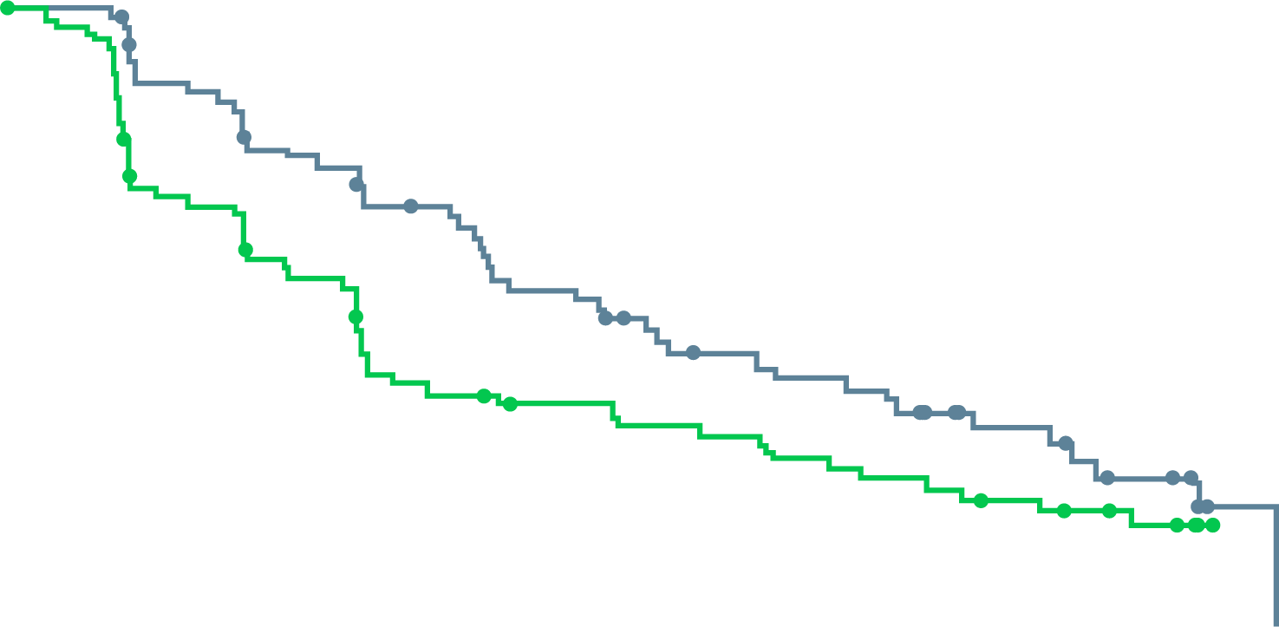
Olaparib and abiraterone:
A randomised phase 2 study
Patients with mCRPC, unselected by HRR mutation status, with prior docetaxel treatment
Randomised 1:1 to full dose of olaparib + abiraterone vs placebo + abirateroneª
Statistically significant improvement in rPFS with olaparib + abiraterone, irrespective of HRR mutation status
Investigator-assessed rPFS
rPFS BY HRR MUTATION SUBGROUP^{b}
1.0
 | Ola + abi (N=71) | Abi (N=71)
Events, n (%) | 46 (65) | 54 (76)
 | HR (95% CI): 0.65 (0.44-0.97); p=0.034
HRR mutation(s)
N=23 (16%)
0.62
0.8
0.6
8.2
13.8
HRR mutation(s) partially
characterised
N=46 (32%)
0.95
Proportion of patients event-free
0.4
0.2
No HRR mutation(s)
N=73 (51%)
0.54
∆=5.6
0.0
0
3
6
9
12
15
18
21
24
27
30
0.25
0.50
1.00
2.00
ª Olaparib 300 mg BID, abiraterone 1,000 mg QD and all patients also received prednisone/prednisolone 5 mg BID
^{b} Dashed line and shaded area show HR and 95% CI, respectively, for the intent to treat population
Time from randomisation (months)
HRR (95% CI)
Abi, abiraterone; BID, twice daily; CI, confidence interval; HR, hazard ratio; HRR, homologous recombination repair; mCRPC, metastatic castration-resistant prostate cancer; Ola, Olaparib; rPFS, radiographic progression-free survival; QD, once daily
Carr TH, et al. Cancers (Basel). 2021;13:5830; Clarke N, et al. Lancet Oncol. 2018;19:975-86
Adapted from Saad F, et al. J Clin Oncol. 2022;40 Suppl: Abstract 11 (ASCO GU 2022 oral presentation)

Slide 54
PROpel Study Design
a global, randomised, double-blind phase 3 trial
Key eligibility criteria
First-line mCRPC
  Docetaxel allowed at mCSPC stage
  No prior abiraterone
  Other NHAs allowed if stopped
  ≥12 months prior to enrolment
  Ongoing ADT
  ECOG PS 0 or 1
Stratification Factors
Site of distant metastases: bone only vs visceral vs other
Prior taxane at mCSPC: yes vs no
Olaparib
300 mg BIDª +
abiraterone 1,000 mg Qd^{b}
(n=399)
Full dose of abiraterone
and olaparib used
Primary endpoint:
rPFS by investigator assessment
Key secondary endpoint:
OS (alpha control)
Additional endpoints:
TFST, ORR, PFS2
HRR gene mutation^{c} status (by tissue and ctDNA testing)
Health-related quality of life
Safety and tolerability
Randomise
1:1
Placebo +
abiraterone 1,000 mg QD^{b}
(n=397)
Full dose of abiraterone
used
NCT03732820
First patient randomized: Nov 2018​; last patient randomized: Mar 2020; DCO1: July 30, 2021, for interim analysis of rPFS and OS
Multiple testing procedure is used in this study: 1-sided alpha of 0.025 fully allocated to rPFS; if the rPFS result is statistically significant, OS to be tested in a hierarchical fashion with alpha passed on to OS
ª Full dose of olaparib used; ^{b} abiraterone used in combination with prednisone or prednisolone 5 mg BID; ^{c} HRR mutation, including 14-gene panel, using the FoundationOne®CDx test and FoundationOne®Liquid CDx test
ADT, androgen-deprivation therapy; BICR, blinded independent central review; BID, twice daily; ECOG PS, Eastern Cooperative Oncology Group performance status; HRR, homologous recombination repair;
mCRPC, metastatic castration-resistant prostate cancer; mCSPC, metastatic castration-sensitive prostate cancer; NHA, novel hormonal agents; ORR, objective response rate; OS, overall survival;
PFS2, time to second progression; QD, per day; rPFS, radiographic progression-free survival; TFST, time to first subsequent therapy or death; TTPP, time to pain progression
Clarke NW, et al. J Clin Oncol. 2019;37 Suppl: TPS340; NCT03732820; Saad F, et al. J Clin Oncol. 2022;40 Suppl: Abstract 11 (ASCO GU 2022 oral presentation)

Slide 55
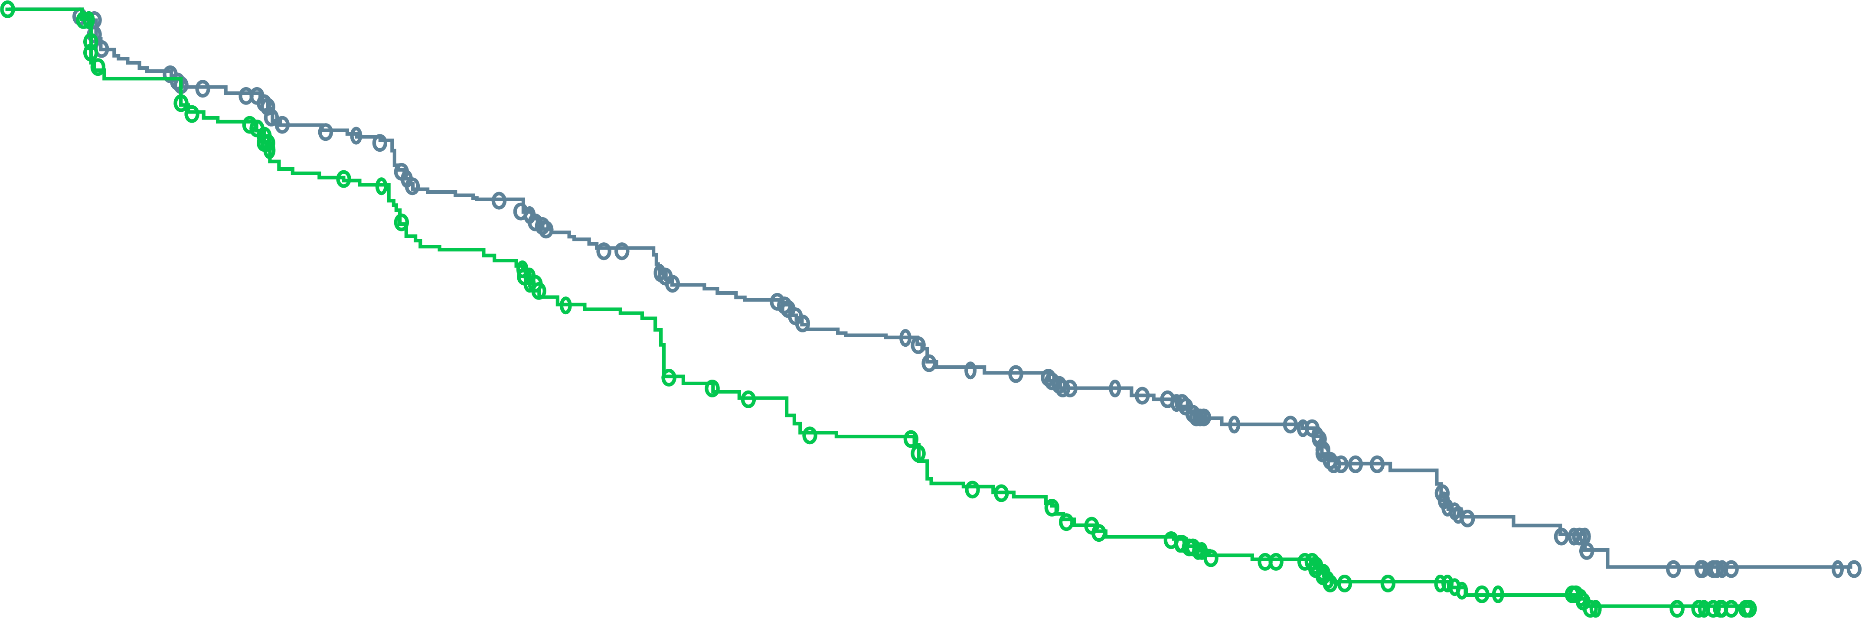
PROpel: updated rPFS by investigator assessment in the ITT population
AT DCO2, rPFS WAS 8.6 MONTHS GREATER FOR ABIRATERONE + OLAPARIB
VERSUS ABIRATERONE + PLACEBO
 | Abiraterone + olaparib (n=399) | Abiraterone + placebo (n=397)
Events, n (%) | 199 (49.9) | 258 (65.0)
Median rPFS (months) | 25.0 | 16.4
HR (95% CI) | 0.67 (0.56-0.81); p<0.0001ª
1.0
0.9
0.8
0.7
0.6
Probability of rPFS
0.5
0.4
0.3
0.2
0.1
0.0
0
2
4
6
8
10
12
14
16
18
20
22
24
26
28
30
32
34
36
38
40
Number of patients at risk:
Time from randomisation (months)
Abiraterone + olaparib
Abiraterone + placebo
399
397
367
359
340
338
313
306
301
297
274
264
251
232
228
199
220
187
200
169
184
145
174
135
158
117
110
84
62
51
58
48
33
30
15
8
5
3
3
0
0
0
Median duration of follow-up for censored patients was 24.9 months (range 0.03-38.80) in the abiraterone + olaparib arm and 27.4 months (range 0.03-36.76) in the abiraterone + placebo arm
ª Nominal
CI, confidence interval; DCO2, second data cut-off; HR, hazard ratio; ITT, intention-to-treat; rPFS, radiographic progression-free survival
Saad F, et al. Annals of Oncology 2022; 33 (suppl_7): S616-S652 (ESMO 2022 oral presentation)

Slide 56
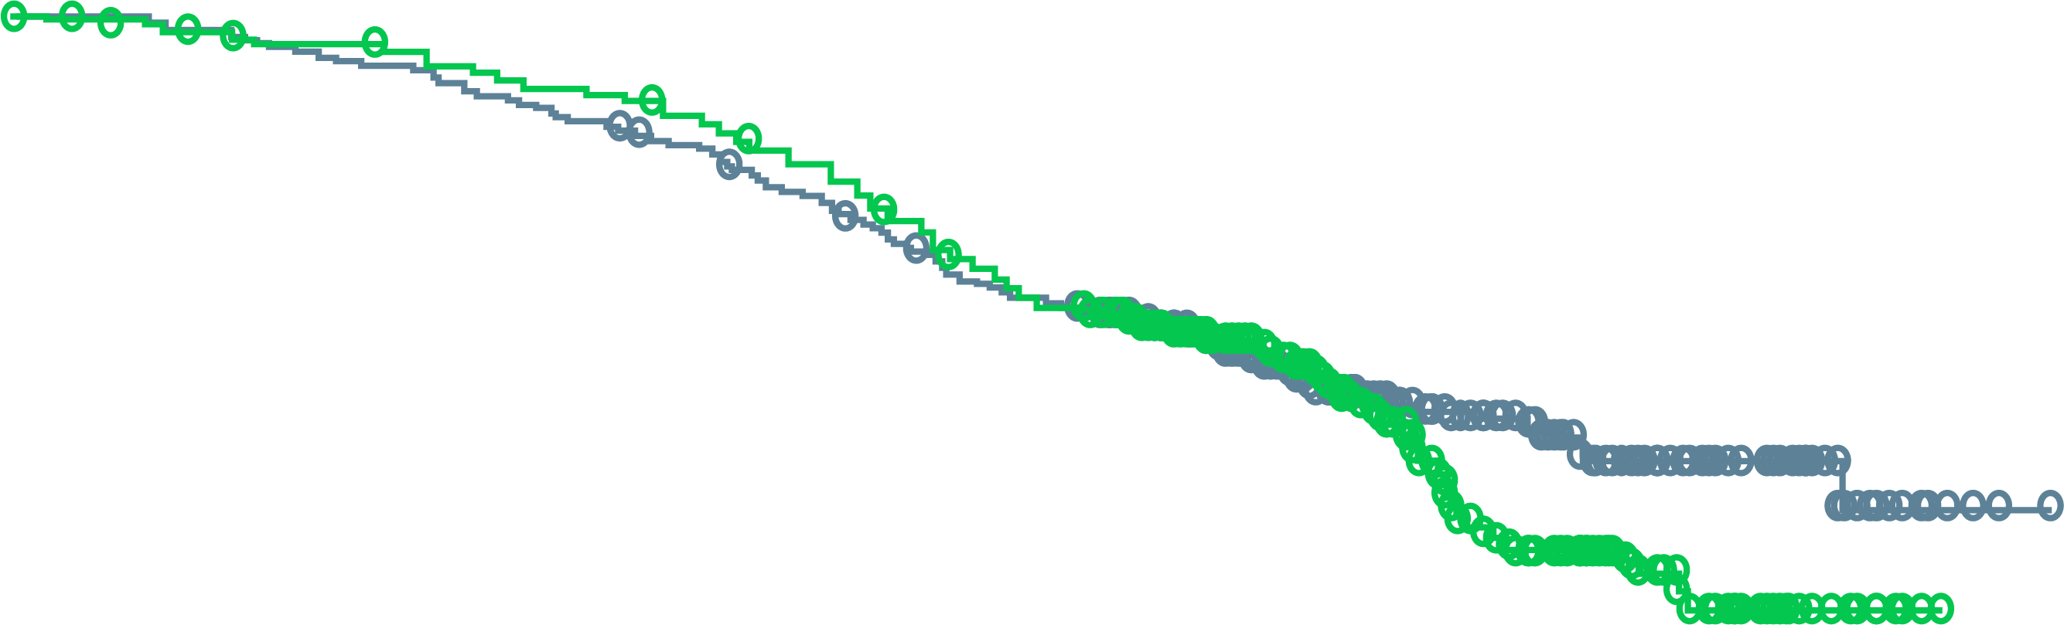
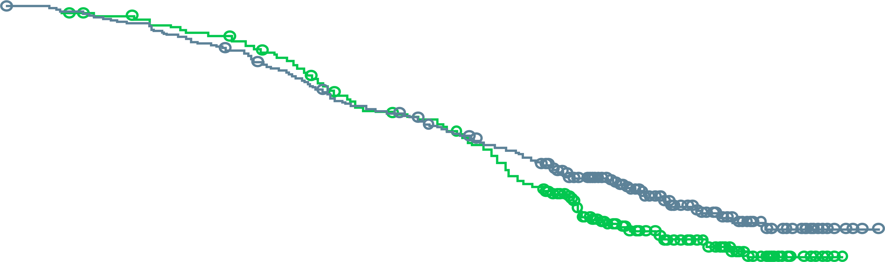
PROpel key secondary endpoint: OS in the ITT population
AT DCO2, THERE WAS A CONTINUED TREND TOWARDS IMPROVED OS WITH ABIRATERONE + OLAPARIB, WITH KM CURVES SHOWING CLEAR SEPARATION BETWEEN THE ARMS AFTER ~22 MONTHS BEFORE EXTENSIVE CENSORING WAS OBSERVED
Primary analysis (DCO1, 28.6% maturity)
Updated results (DCO2, 40.1% maturity)
1.0
1.0
0.9
0.9
0.8
0.8
0.7
0.7
0.6
0.6
Probability of overall survival
0.5
0.5
0.4
0.4
0.3
 | Abiraterone + olaparib (n=399) | Abiraterone + placebo (n=397)
Events, n (%) | 107 (26.8) | 121 (30.5)
Median OS (months) | NR | NR
HR (95% CI) | 0.86 (0.66-1.12); p=0.29
0.3
 | Abiraterone + olaparib (n=399) | Abiraterone + placebo (n=397)
Events, n (%) | 148 (37.1) | 171 (43.1)
Median OS (months) | NR | NR
HR (95% CI) | 0.83 (0.66-1.03); p=0.11
0.2
0.2
0.1
0.1
0.0
0.0
0
2
4
6
8
10
12
14
16
18
20
22
24
26
28
30
32
0
2
4
6
8
10
12
14
16
18
20
22
24
26
28
30
32
34
36
38
40
42
Time from randomisation (months)
Time from randomisation (months)
Number of patients at risk:
Abiraterone + olaparib
Abiraterone + placebo
399
397
398
392
391
385
385
381
374
374
364
368
349
353
333
335
316
314
290
286
231
223
159
151
116
104
73
63
37
22
11
6
1
0
399
397
398
395
391
388
385
383
374
376
365
370
350
355
335
337
318
316
313
304
298
300
284
280
274
253
232
211
188
154
135
106
93
81
53
46
23
13
5
1
1
0
0
0
Median duration of follow-up for censored patients at DCO1 was 22.2 months (range 0.03-32.56) in the abiraterone + olaparib arm and 21.8 months (range 0.10-30.88) in the abiraterone + placebo arm
Median duration of follow-up for censored patients at DCO2 was 30.0 months (range 0.03-40.02) in the abiraterone + olaparib arm and 29.4 months (range 2.89-38.34) in the abiraterone + placebo arm
CI, confidence interval; DCO1, first data cut-off; DCO2, second data cut-off; HR, hazard ratio; ITT, intention-to-treat; KM, Kaplan-Meier; NR, not reached; OS, overall survival
Saad F, et al. Annals of Oncology 2022; 33 (suppl_7): S616-S652 (ESMO 2022 oral presentation)

Slide 57
PROpel: most common AEs (in ≥10% patients)
The AE profile at DCO2 remained generally consistent with the
profile at DCO1 and the known profiles of the individual drugs
Abiraterone + olaparib (n=398)
Abiraterone + placebo (n=396)
97.7
Grade ≥3
1.0
Grade ≥3
All grade
All grade
0.5
Grade ≥3
Grade ≥3
All grade
All grade
Proportion of patients (%)
Safety was assessed through the reporting of AEs according to the National Cancer Institute Common Terminology Criteria for Adverse Events (NCI CTCAE v4.03) and laboratory assessments
* Anaemia category includes anaemia, decreased haemoglobin level, decreased red-cell count, decreased haematocrit level, erythropenia, macrocytic anaemia, normochromic anaemia, normochromic normocytic anaemia, and normocytic anaemia
AE, adverse event; DCO1, first data cut-off; DCO2, second data cut-off
Saad F, et al. Annals of Oncology 2022; 33 (suppl_7): S616-S652 (ESMO 2022 oral presentation)

Slide 58
PROpel: FACT-P quality of life over time
Quality of life comparable between treatment arms
Least-squares mean change from baseline
in FACT-P TSª
20
15
Combination of olaparib and abiraterone resulted in no detriment to quality of life, allowing most patients stay on therapy
10
Olaparib + abiraterone (N=399)
Placebo + abiraterone (N=397)
5
Least-squares mean change from
baseline in FACT-P TSª
0
-5
-10
-15
-20
5
9
13
17
21
25
29
33
37
41
45
49
53
61
69
77
85
93
101
109
117
Analysis visit (weeks)
ª Plot includes 95% confidence limits. FACT-P total score change from baseline values can be a minimum of -156 and a maximum of 156
A clinically meaningful change in FACT-P total score is 10
FACT-P TS, Functional Assessment of Cancer Therapy-Prostate Total Score
Saad F, et al. J Clin Oncol. 2022;40 Suppl: Abstract 11 (ASCO GU 2022 oral presentation)

Slide 59
MAGNITUDE: Randomised, Double-Blind, Placebo-Controlled Study
biomarker cohorts selected prior to randomisation designed to test HRR BM⁺ and HRR BM–
Study start:
February 2019
Prescreening for
BM statusª
Allocation
to cohort
1:1
randomisation
Patient eligibility
First-line mCRPC
  ≤4 months prior AAP allowed for mCRPC
ECOG PS 0 or 1
BPI-SF worst pain score ≤3
Stratifications
Prior taxane-based chemotherapy for mCSPC
Prior AR inhibitor for nmCRPC or mCSPC
Prior AAP for first-line mCRPC
BRCA1/2 vs other HRR alterations (HRR BM⁺ cohort)
Niraparib 200 mg^{b} + abiraterone 1000 mg^{c}
Primary endpoint
rPFS by central review
HRR BM⁺
Planned N=400
HRR BM⁺ panel:
ATM
BRCA1
BRCA2 BRIP1 CDK12 CHEK2 FANCA HDAC2 PALB2
Secondary endpoints
Time to cytotoxic chemotherapy
Time to symptomatic progression
OS
Placebo + abiraterone 1000 mg^{c}
Other prespecified endpoints
Time to PSA progression
ORR
PFS2
Time to pain progression
Patient-reported outcomes
Niraparib 200 mg^{b} + abiraterone 1000 mg^{c}
HRR BM–
Planned N=600
Placebo + abiraterone 1000 mg^{c}
Note: Patients could request to be unblinded by the study steering
committee and go on to subsequent
therapy of the investigator's choice
Clinical data cut-off was October 8, 2021 for the final rPFS analysis.
ª Tissue and plasma assays: FoundationOne tissue test (FoundationOne®CDx), Resolution Bioscience liquid test (ctDNA), AmoyDx blood and tissue assays, Invitae germline testing (blood/saliva), local lab biomarker test results demonstrating a pathogenic germline or somatic alteration listed in the study biomarker gene panel
^{b} Dose of niraparib used was lower than the usual monotherapy dose
^{c} Abiraterone given in combination with prednisone or prednisolone 5 mg BID
AAP, abiraterone acetate and prednisone/prednisolone; AR, androgen receptor; BM, biomarker; BPI-SF, Brief Pain Inventory–Short Form; ctDNA, circulating tumour DNA; ECOG PS, Eastern Cooperative Oncology Group performance status; HRR, homologous recombination repair; L1, first line; mCRPC, metastatic castration-resistant prostate cancer; mCSPC, metastatic castration-sensitive prostate cancer;
nmCRPC, nonmetastatic castration-resistant prostate cancer; ORR, overall response rate; OS, overall survival; PFS, progression-free survival; PFS2, progression-free survival on first subsequent therapy;
PSA, prostate-specific antigen; rPFS, radiographic progression-free survival
Chi K, et al. J Clin Oncol. 2022;40 Suppl: Abstract 12 (ASCO GU 2022 oral presentation)

Slide 60
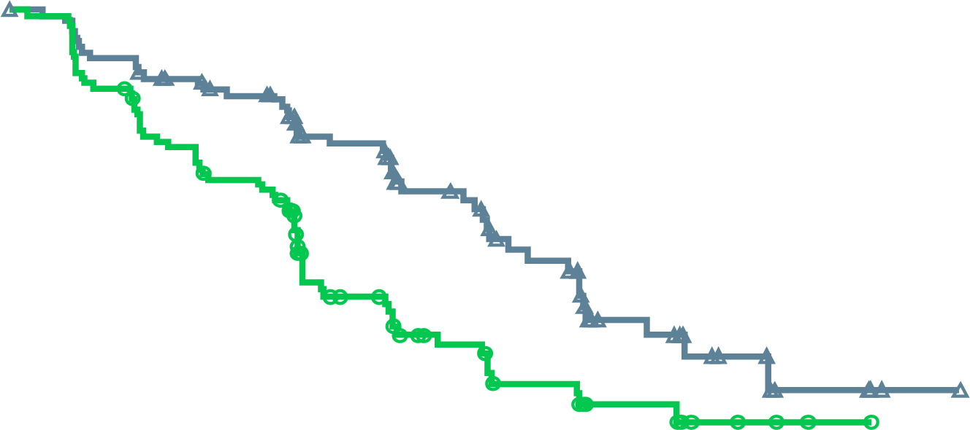
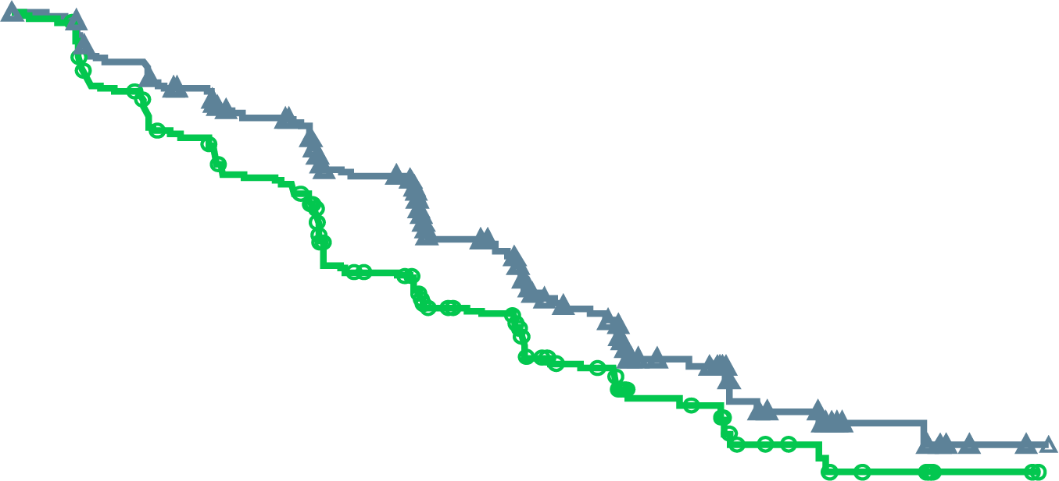
MAGNITUDE: Primary Endpoint
BRCA1/2 mutation-positive
rPFS assessed by central review
All HRR BM⁺ patients
rPFS assessed by central review
Niraparib + AAP:
16.6 months
Niraparib + AAP:
16.5 months
Placebo + AAP:
10.9 months
HR (95% CI): 0.73 (0.56-0.96);
p=0.0217
Placebo + AAP:
13.7 months
HR (95% CI): 0.53 (0.36-0.79);
p=0.0014
No. at risk
Niraparib + AAP | 113 | 103 | 90 | 65 | 45 | 31 | 18 | 9 | 4 | 1 | 0
Placebo + AAP | 112 | 97 | 77 | 43 | 28 | 20 | 11 | 5 | 2 | 0 | 0
No. at risk
Niraparib + AAP | 212 | 192 | 167 | 129 | 96 | 64 | 45 | 21 | 10 | 2 | 0
Placebo + AAP | 211 | 182 | 149 | 102 | 78 | 53 | 35 | 15 | 9 | 2 | 0
Median follow-up 16.7 months
Median follow-up: 16.7 months
Median follow-up: 18.6 months
AAP, abiraterone acetate and prednisone/prednisolone; CI, confidence interval; HR, hazard ratio; HRR, homologous recombination repair; rPFS, radiographic progression-free survival
Chi K, et al. J Clin Oncol. 2022;40 Suppl: Abstract 12 (ASCO GU 2022 oral presentation)

Slide 61
MAGNITUDE All HRR BM⁺:
Prespecified Subgroup Analysis of rPFS
Median (months)
Events/N
Median (months)
Events/N
Variable
Subgroup
Niraparib
Control
HR (95% CI)
Niraparib
Control
Variable
Subgroup
Niraparib
Control
HR (95% CI)
Niraparib
Control
All HRR mutation-positive patients
Yes
13.4
10.9
0.89 (0.48-1.66)
20/40
21/41
All
16.5
13.7
0.74 (0.57-0.97)
100/212
117/211
Past taxane–based chemotherapy
Age group
<65
13.9
13.9
1.01 (0.61-1.66)
32/61
30/62
No
16.6
13.8
0.71 (0.53-0.96)
80/172
96/170
≥65-74
19.4
13.6
0.58 (0.38-0.89)
34/88
57/100
Past androgen receptor-targeted
therapyª
Yes
NE
4.3
0.19 (0.03-1.23)
2/8
3/4
≥75
16.4
10.9
0.76 (0.46-1.24)
34/63
30/49
No
16.5
13.8
0.76 (0.58-1.00)
98/204
114/207
Race group
Asian
22.0
10.9
0.48 (0.22-1.05)
9/29
22/41
Prior AAP use^{b}
Yes
13.9
14.6
0.95 (0.54-1.67)
23/47
26/45
White
14.4
13.8
0.83 (0.61-1.13)
82/160
83/153
No
16.7
12.7
0.71 (0.52-0.96)
77/165
91/166
Other
18.4
9.0
0.47 (0.20-1.14)
9/23
12/17
Presence of visceral metastases
Yes
11.0
8.1
1.03 (0.60-1.77)
34/51
22/39
Baseline ECOG performance
status
0
19.5
13.9
0.65 (0.46-0.92)
53/130
76/146
No
19.4
13.8
0.64 (0.47-0.87)
66/161
95/172
1
13.1
10.5
0.84 (0.55-1.28)
47/82
41/65
Bone-only metastases at entry
Yes
19.4
15.4
0.72 (0.45-1.14)
32/78
41/85
Baseline BPI-SF#3 Score
0
16.7
16.8
0.75 (0.51-1.12)
47/108
53/103
No
14.8
10.9
0.73 (0.53-1.02)
68/134
76/126
1 to 3
13.9
10.5
0.78 (0.52-1.17)
46/88
50/86
Number of bone lesions at baseline
≤10
19.4
15.4
0.76 (0.53-1.10)
54/127
65/128
>3
13.7
13.7
0.68 (0.26-1.79)
6/14
14/22
>10
13.8
8.4
0.69 (0.47-1.04)
46/85
52/83
Region
Asia Pacific
19.5
13.8
0.64 (0.35-1.17)
17/43
27/52
Baseline PSA above median
Yes
15.7
8.3
0.58 (0.40-0.82)
56/110
66/101
Europe
14.4
13.7
0.82 (0.58-1.14)
68/128
71/120
No
16.7
18.2
0.93 (0.62-1.40)
44/102
51/110
North and South America
16.6
16.4
0.60 (0.30-1.18)
15/41
19/39
Gene mutation type
BRCA
16.6
10.9
0.55 (0.38-0.81)
45/113
64/112
Other HRR
14.8
16.4
0.99 (0.68–1.45)
55/99
53/99
0.1
1
0.1
1
Favouring niraparib
Favouring control
Favouring niraparib
Favouring control
a Past AR-targeted therapy was considered prior novel anti-androgen therapy, such as enzalutamide, apalutamide, or darolutamide
b Prior AAP use was up to 4 months prior to study start
AAP, abiraterone acetate and prednisone/prednisolone; AR, androgen receptor; BM, biomarker; BPI-SF, Brief Pain Inventory–Short Form; CI, confidence interval;
ECOG PS, Eastern Cooperative Oncology Group performance status; HR, hazard ratio; HRR, homologous recombination repair; NE, not estimable; PSA, prostate-specific antigen;
rPFS, radiographic progression-free survival.
Chi K, et al. J Clin Oncol. 2022;40 Suppl: Abstract 12 (ASCO GU 2022 oral presentation)

Slide 62
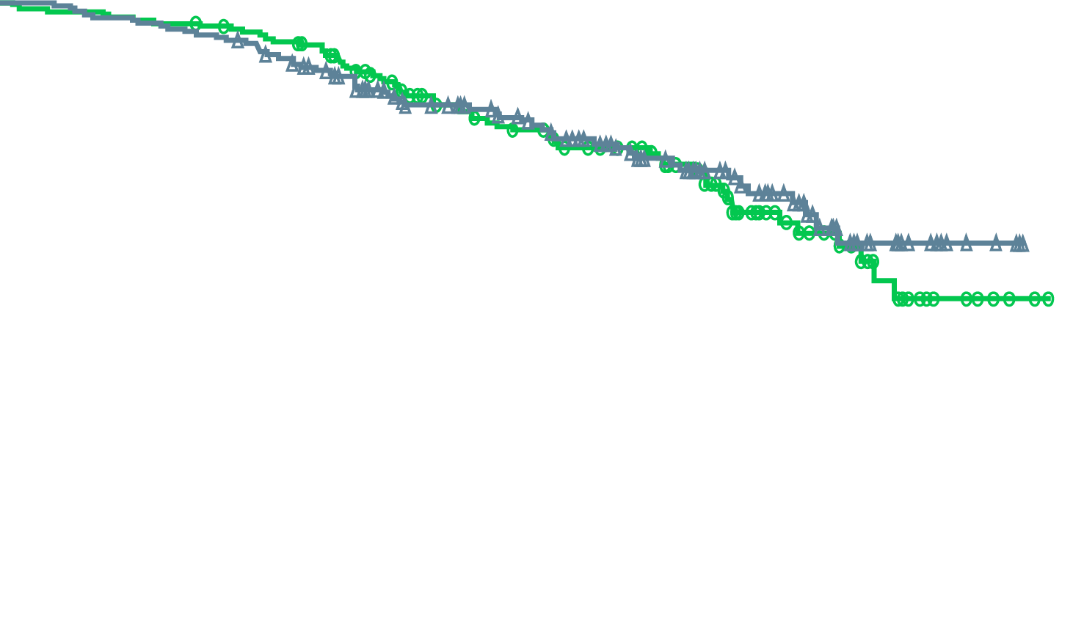
MAGNITUDE All HRR BM⁺:
Overall Survival First Interim Analysis With Median Follow-up of 18.6 Months
Niraparib + AAP: NE
(55 death events)
Placebo + AAP: NE
(59 death events)
HR (95% CI): 0.94 (0.65-1.36);
p=0.733 (boundary for significance, 0.0005)
No. at risk
Niraparib + AAP | 212 | 207 | 200 | 180 | 146 | 110 | 84 | 52 | 20 | 4 | 0
Placebo + AAP | 211 | 206 | 202 | 187 | 141 | 113 | 82 | 47 | 22 | 5 | 0
46.3% of the required death events for the final analysis observed and thus OS data are immature
AAP, abiraterone acetate and prednisone/prednisolone; BM, biomarker; CI, confidence interval; HR, hazard ratio; HRR, homologous recombination repair; NE, not estimable; OS, overall survival
Chi K, et al. J Clin Oncol. 2022;40 Suppl: Abstract 12 (ASCO GU 2022 oral presentation)

Slide 63
MAGNITUDE HRR BM⁺: TEAEs Consistent With the Known Safety Profile for Each Therapy
TEAEs occurring at >20% in the niraparib arm or otherwise of clinical interest, n (%) |  | Niraparib + AAP (n=212) |  | Placebo + AAP (n=211)
 |  | All grades | Grade ≥3 | All grades | Grade ≥3
Haematologic | Anaemia | 98 (46.2) | 63 (29.7) | 43 (20.4) | 16 (7.6)
 | Thrombocytopaenia | 45 (21.2) | 14 (6.6) | 18 (8.5) | 5 (2.4)
 | Neutropenia | 29 (13.7) | 14 (6.6) | 12 (5.7) | 3 (1.4)
 | Acute myeloid leukaemia/ Myelodysplastic syndrome | 0 | 0 | 1 (0.5) | 1 (0.5)
Cardiovascular | Hypertension | 67 (31.6) | 33 (15.6) | 47 (22.3) | 30 (14.2)
 | Arrhythmia | 27 (12.7) | 6 (2.8)ª | 12 (5.7) | 3 (1.4)
 | Cardiac failure | 4 (1.9) | 3 (1.4)ª | 4 (1.9) | 1 (0.5)
 | Ischaemic heart disease | 4 (1.9) | 4 (1.9) | 8 (3.8) | 6 (2.8)^{b}
General disorders | Fatigue | 56 (26.4) | 7 (3.3) | 35 (16.6) | 9 (4.3)
Gastrointestinal | Constipation | 65 (30.7) | – | 29 (13.7) | –
 | Nausea | 50 (23.6) | 1 (0.5) | 29 (13.7) | 0
Hepatotoxicity |  | 25 (11.8) | 4 (1.9) | 26 (12.3) | 10 (4.7)
Cerebrovascular disorders |  | 6 (2.8) | 2 (0.9) | 2 (0.9) | 1 (0.5)ª
ª Includes 1 grade 5 event.
^{b} Includes 3 grade 5 events.
AAP, abiraterone acetate and prednisone/prednisolone; BM, biomarker; HRR, homologous recombination repair; TEAE, treatment-emergent adverse event
Chi K, et al. J Clin Oncol. 2022;40 Suppl: Abstract 12 (ASCO GU 2022 oral presentation)

Slide 64
MAGNITUDE All HRR BM⁺:
HRQol Was Maintained with the combination of Niraparib + AAP
15
Clinically meaningful change
10
Better HRQoL
5
FACT-P TS
(change from baseline)
Niraparib + AAP
0
-5
Worse HRQoL
Placebo + AAP
-10
Clinically meaningful change
-15
2
3
4
5
6
7
9
11
13
15
17
19
21
23
No. at risk
Niraparib + AAP
Placebo + AAP
Cycle
190
184
175
179
176
180
170
167
162
159
164
152
151
146
136
129
115
104
94
83
85
64
66
50
54
37
39
24
Note: The threshold for definition of FACT-P total score deterioration is ≤10
AAP, abiraterone acetate and prednisone/prednisolone; BM, biomarker; FACT-P TS, Functional Assessment of Cancer Therapy-Prostate Total Score; HRQoL, health-related quality of life;
HRR, homologous recombination repair
Chi K, et al. J Clin Oncol. 2022;40 Suppl: Abstract 12 (ASCO GU 2022 oral presentation)

Slide 65
Design and Baseline Comparison of PROpel and MAGNITUDE trials
 | PROpel¹ (N=796) | MAGNITUDE² (N=423)
Primary endpoint | rPFS (investigator view) | rPFS (central view)
Prior NHA in mCSPC, n (%) | Allowed as long as stopped at least 12 months before enrollment (abiraterone not allowed) 1 (0.3) | 13 (3.0)ª
Prior docetaxel in mCSPC, n (%) | 179 (22.5) | 85 (20)ª
HRR status required at randomisation | No | Yes
HRR analysis | Tissue or ctDNA | Tissue or ctDNA
HRR mutation status, n (%)
HRR mutation positive | 226 (28.4) | 423 (100)
Non-HRR mutation | 552 (69.3) | -
HRR mutation-status unknown | 18 (2.3) | -
BRCA mutation prevalence, n (%)
BRCA1 | 12 (1.5) | 16 (3.8)
BRCA2 | 73 (9.2) | 174 (41)
a Includes prior therapy for nmCRPC/mCSPC
Please note that these studies cannot be directly compared. This data is presented for information purposes only
ctDNA, circulating tumour DNA; HRR, homologous recombination repair; mCSPC, metastatic castration sensitive prostate cancer; NHA, new hormonal agent; rPFS, radiographic progression free survival
1. Saad F, et al. Journal of Clinical Oncology2022; 40 Suppl: Abstract 11 (ASCO GU 2022 oral presentation); 2. Chi K, et al. J Clin Oncol. 2022;40 Suppl: Abstract 12 (ASCO GU 2022 oral presentation)

Slide 66
Results Comparison of PROpel and Magnitude trials
 | PROpel (N=796) | MAGNITUDE (N=423)
rPFS
All comers | + (HR 0.66) | Not reported
HRR mutation negative | + (HR 0.76) | No benefit
HRR mutation positive | + (HR 0.50) | + (HR 0.73)
BRCA1/2 | + (HR 0.23) | + (HR 0.53)
OS | Immature | Immature
Please note that these studies cannot be directly compared. This data is presented for information purposes only
HRR, homologous recombination repair; rPFS, radiographic progression free survival
1. Clarke N, et al. NEJM Evidence 2022: DOI: 10.1056/EVIDoa2200043; 2. Clarke N, et al. Lancet Oncol. 2018;19:975-86;
3. Chi K, et al. J Clin Oncol. 2022;40 Suppl: Abstract 12 (ASCO GU 2022 oral presentation); 4. Saad F, et al. Annals of Oncology 2022; 33 (suppl_7): S616-S652

Slide 67
TALAPRO-2: First-line Talazoparib + Enzalutamide in mCRPC
Global, 2-part, phase 3 trial
Part 1: non-randomised, open-label study confirming talazoparib starting dose in combination with enzalutamide (planned n=19)
Part 2: randomised, double-blind, placebo-controlled study (planned n=1,018)
Patient eligibility
Adult men with mCRPC
adenocarcinoma of the prostate
no small cell/signet cell features
mild or no symptoms
PD at study entry
life expectancy ≥12 mos
ECOG PS 0/1
Stratifications
prior novel hormonal tx or taxane based CT for CSPC (yes vs no)
DDR alteration status (deficient vs non-deficient/unknown)
Primary endpoint:
rPFS per RECIST v1.1 (soft
tissue disease) and PCWG3 (bone disease) in DDR-unselected and
DDR-mutant populations
Key secondary endpoint:
OS, objective response, PSA response, PFS2, TTNT, PK, HRQoL
Safety and tolerability
Talazoparib 0.5 mg/day +
enzalutamide 160 mg/day
To safety
follow-up
(28 days after last dose of tx) and long-term
follow-up every 8-12 weeks
R
Placebo +
enzalutamide 160 mg/day
1:1
N=1018
ClinicalTrials.gov identifier: NCT03395197
CSPC, castration-sensitive prostate cancer; CT, chemotherapy; DDR, DNA damage repair; ECOG PS, Eastern Cooperative Oncology Group performance status; HRQoL, health-related quality of life; mCRPC, metastatic castration-resistant prostate cancer; OS, overall survival; PCWG3, Prostate Cancer Working Group 3; PD, progressive disease; PFS2, progression-free survival on next line of therapy; PK, pharmacokinetics; PSA, prostate-specific antigen; RECIST, Response Evaluation Criteria in Solid Tumors; rPFS, radiographic progression-free survival; TTNT, time to next therapy; tx, treatment
1. Agarwal N, et al. J Clin Oncol. 2020;38 15_suppl:TPS5598 (poster); 2. TALAPRO-2. ClinicalTrials.gov identifier: NCT03395197. Accessed October 11, 2022. https://clinicaltrials.gov/ct2/show/NCT03395197

Slide 68
TALAPRO-2:combination of talazoparib plus enzalutamide prolongs rPFS in mCRPC
INITIAL DATA BASED ON PRESS RELEASE – AWAITING DATA PRESENTATION
The combination of talazoparib plus enzalutamide resulted in a statistically significant and clinically meaningful improvement in rPFS compared with placebo plus enzalutamide in 1L mCRPC pts
  Robust, highly consistent efficacy observed in patients with and without HRR gene mutations
A trend toward improved overall survival was observed but data immature
Benefits also observed in other secondary endpoints:
  investigator assessed rPFS,
  PSA response,
  time to PSA progression
  ORR
Safety of the combination treatment was generally consistent with the known safety profile of the individual treatments
1L, first-line; HRR, homologous recombination repair; mCRPC, metastatic castration-resistant prostate cancer; ORR, overall response rate; PSA, prostate specific antigen; rPFS, radiographic progression-free survival
https://www.pfizer.com/news/press-release/press-release-detail/pfizer-announces-positive-topline-results-phase-3-talapro-2 Accessed 13th October 2022

Slide 69
Patient case discussion

Slide 70
Case discussion
70
Patient: Age 65 years
Presents with: mCRPC with rising PSA
Medical history:
de novo (synchronous), high volume mCSPC (Gleason 5+4) treated with ADT +
upfront docetaxel (six cycles) for 30 months
PSA 132
PSA 0.1
PSA 5.0
ADT + docetaxel (6 cycles)
12 months
30 months
Imaging:
3 new bone lesions
ADT, androgen-deprivation therapy; mCRPC, metastatic castration-resistant prostate cancer; mCSPC, metastatic castration-sensitive prostate cancer; PSA, prostate-specific antigen

Slide 71
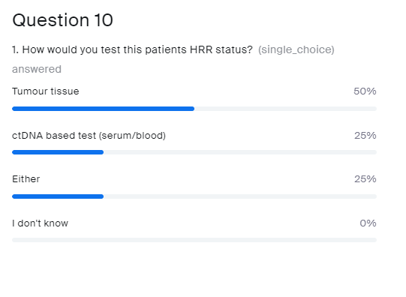
How would you test this patients HRR status?
Tumour tissue
ctDNA based test (serum/blood)
Either
I don’t know

Slide 72
Data on HRRm testing in PROpel DEMONSTRATES good concordance between ctDNA and tumour tissue testing
 | Tumour tissue test
ctDNA-based test | HRRm |  | Non-HRRm | HRRm unknown | Total
HRRm | 90 |  | 51 | 57 | 198
Non-HRRm | 22 |  | 328 | 186 | 536
HRRm unknown | 6 |  | 38 | 18 | 62
Total | 118 |  | 417 | 261 | 796
Positive-percent agreement |  | 80.4% (90/112; 95% CI, 72–87%)
Negative-percent agreement |  | 86.5% (328/379; 95% CI, 83–90%)
Overall-percent agreement |  | 85.1% (418/491; 95% CI, 82–88%)
Positive predictive value |  | 63.8% (90/141; 95% CI, 55–72%)
Negative predictive value |  | 93.7% (328/350; 95% CI, 90–96%)
CI, confidence interval; ctDNA, circulating tumour DNA; HRRm, homologous recombination repair gene mutation
Armstrong AJ, et al. Presented at ESMO 9th–13th September 2022, Paris, France. Poster 1370P

Slide 73
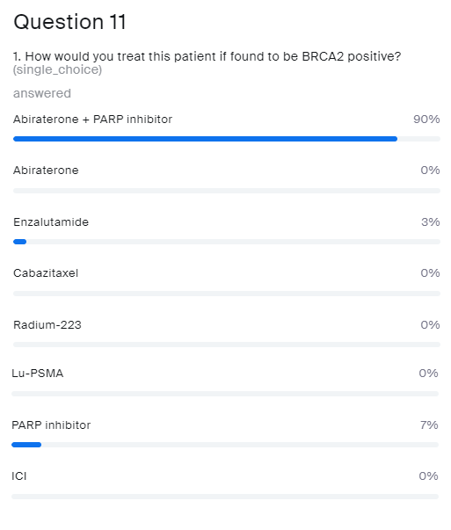
Patient was found to be BRCA2 positive
How would you treat him?
Abiraterone + PARP inhibitor
Abiraterone
Enzalutamide
Cabazitaxel
Radium-223
Lu-PSMA
PARP inhibitor
ICI
ICI, immune checkpoint inhibitor; Lu-PSMA, lutetium prostate-specific membrane antigen; PARP, poly-ADP ribose polymerase

Slide 74
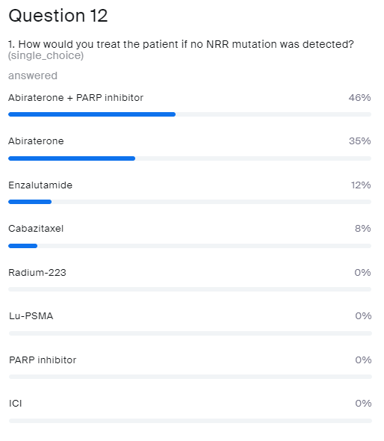
How would you treat the patient if no HRR mutation was detected?
Abiraterone + PARP inhibitor
Abiraterone
Enzalutamide
Cabazitaxel
Radium-223
Lu-PSMA
PARP inhibitor
ICI
HRR
HRR, homologous recombination repair; ICI, immune checkpoint inhibitor; Lu-PSMA, lutetium prostate-specific membrane antigen; PARP, poly-ADP ribose polymerase

Slide 75
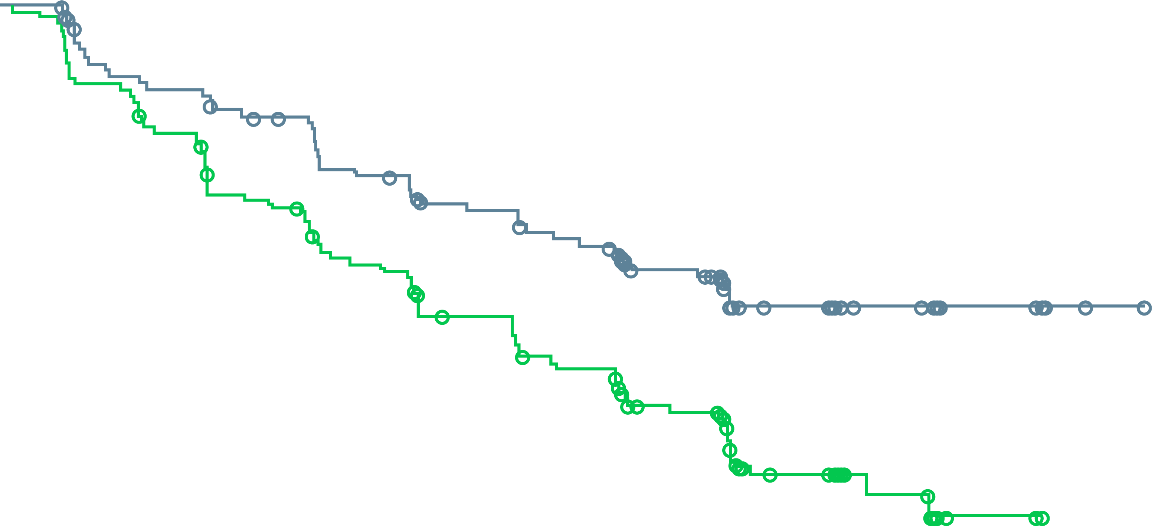
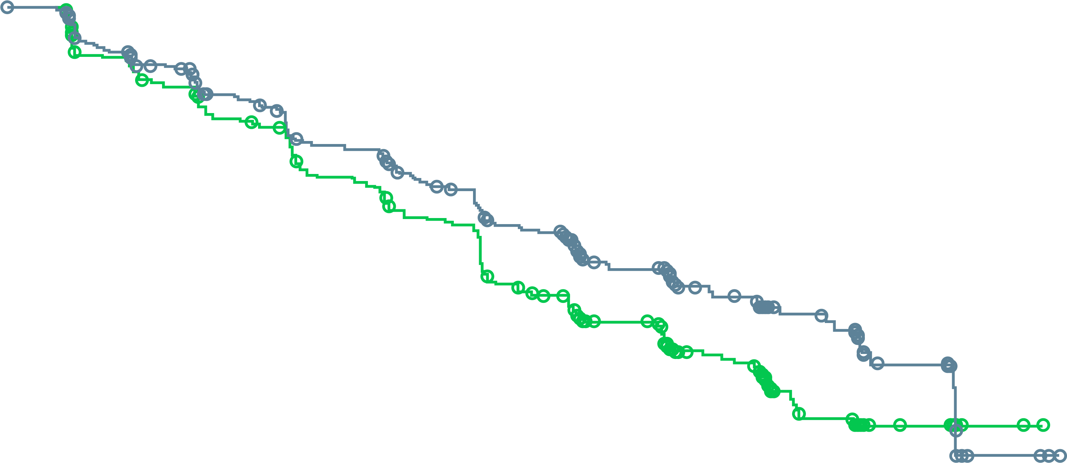
PROpel: rPFS for HRRm and non-HRRm subgroups
A benefit was observed with abiraterone + olaparib
across HRRm and non-HRRm subgroups (DCO1)
HRRm subgroup (investigator assessment)
Non-HRRm subgroup (investigator assessment)
1.0
1.0
0.9
0.9
0.8
0.8
0.7
0.7
0.6
0.6
Probability of rPFS
0.5
0.5
0.4
 | Abiraterone + olaparib (n=111) | Abiraterone + placebo (n=115)
Events, n (%) | 43 (38.7) | 73 (63.5)
Median rPFS (months) | NR | 13.9
HR (95% CI) | 0.50 (0.34-0.73)
0.4
 | Abiraterone + olaparib (n=279) | Abiraterone + placebo (n=273)
Events, n (%) | 119 (42.7) | 149 (54.6)
Median rPFS (months) | 24.1 | 19.0
HR (95% CI) | 0.76 (0.60-0.97)
0.3
0.3
0.2
0.2
0.1
0.1
0.0
0.0
0
2
4
6
8
10
12
14
16
18
20
22
24
26
28
30
0
2
4
6
8
10
12
14
16
18
20
22
24
26
28
30
Time from randomisation (months)
Time from randomisation (months)
Number of patients at risk:
Abiraterone + olaparib
Abiraterone + placebo
111
115
103
103
94
94
90
81
87
78
78
68
72
58
66
51
64
49
52
39
34
22
28
20
14
11
8
2
2
0
1
0
279
273
255
248
238
236
216
218
207
212
190
190
175
169
157
143
151
133
112
100
69
64
59
52
43
31
18
15
3
2
3
1
Sensitivity analysis by blinded independent central review:
Median 28.8 vs 13.8 months;
HR 0.45, 95% CI 0.31-0.65
Sensitivity analysis by blinded independent central review:
Median 27.6 vs 19.1 months;
HR 0.72, 95% CI 0.56-0.93
Patient enrolment was not based on HRRm status; however, HRRm testing was prespecified. HRR status was determined after randomisation and before primary analysis using results from tumour tissue and plasma ctDNA HRRm tests. A total of 18 patients did not have a valid HRR testing result from either a tumour tissue or ctDNA test and were excluded from the subgroup analysis. This subgroup analysis is post-hoc exploratory analysis. A circle indicates a censored observation CI, confidence interval; ctDNA, circulating tumour DNA; DCO1, first data cut-off; HR, hazard ratio; HRRm, homologous recombination repair mutation; NR, not reached; rPFS, radiographic progression-free survival
Saad F, et al. Annals of Oncology 2022; 33 (suppl_7): S616-S652 (ESMO 2022 oral presentation)

Slide 76
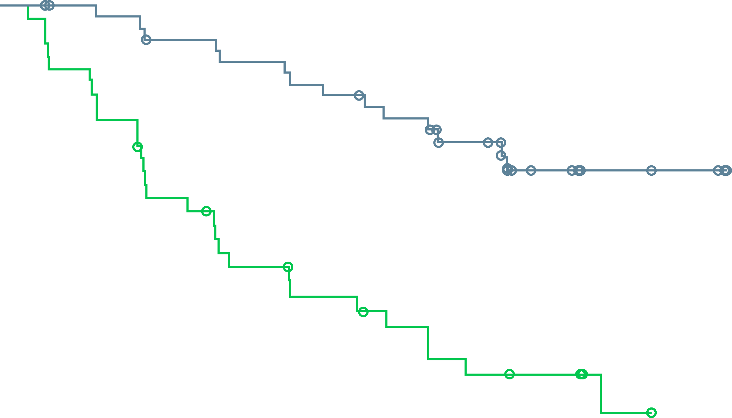
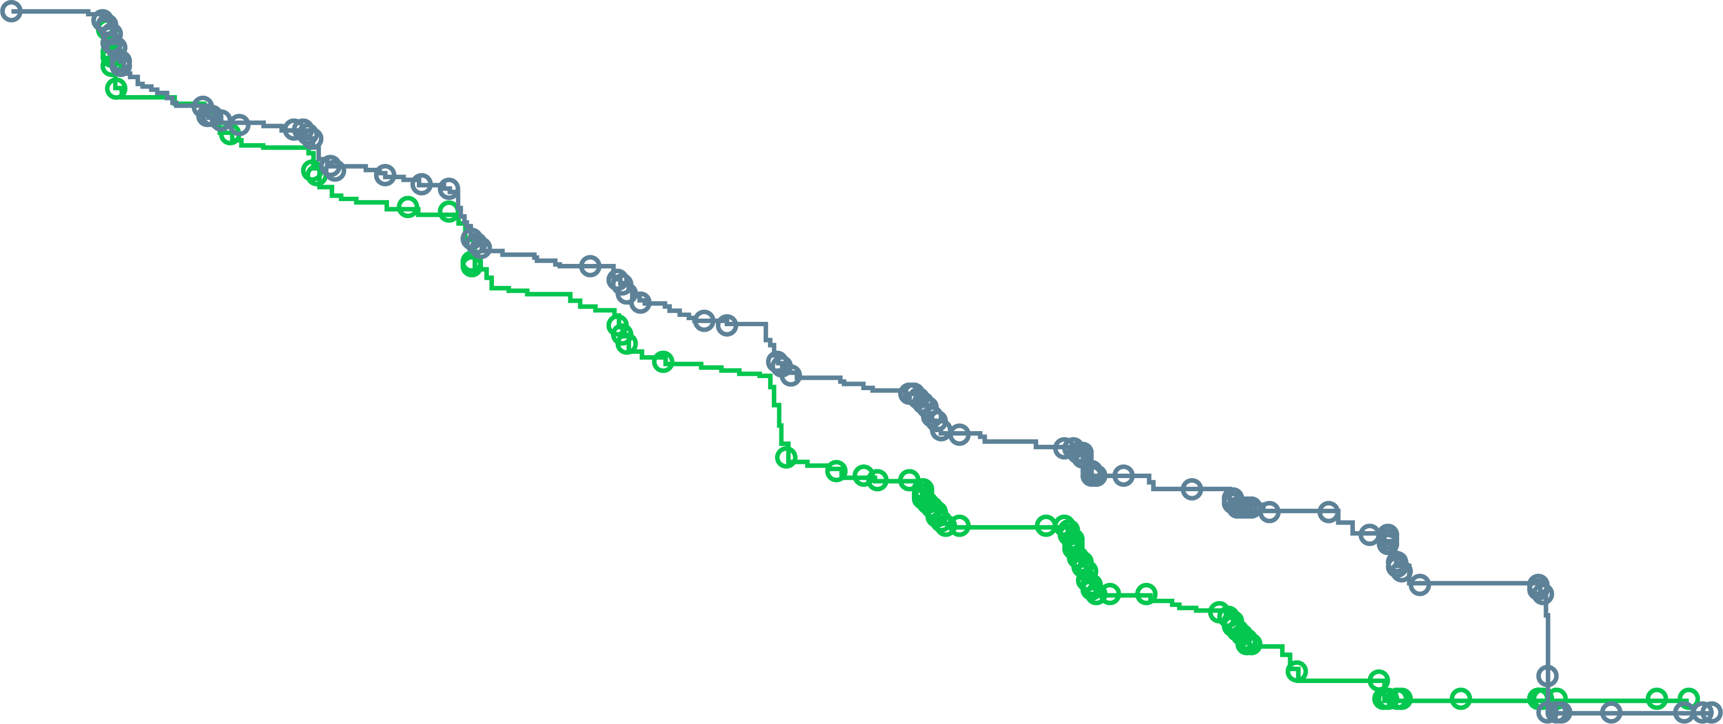
PROpel: rPFS for BRCAm and non-BRCAm subgroups
A benefit was observed with abiraterone + olaparib
across BRCAm, non-BRCAm, BRCA2 and non-BRCA2 subgroups (DCO1)ª
BRCAm subgroup (investigator assessment)
Non-BRCAm subgroup (investigator assessment)
1.0
1.0
0.9
0.9
0.8
0.8
0.7
0.7
0.6
 | Abiraterone + olaparib (n=47) | Abiraterone + placebo (n=38)
Events, n (%) | 14 (29.8) | 28 (73.7)
Median rPFS (months) | NR | 8.4
HR (95% CI) | 0.23 (0.12-0.43)
0.6
Probability of rPFS
0.5
0.5
0.4
0.4
 | Abiraterone + olaparib (n=343) | Abiraterone + placebo (n=350)
Events, n (%) | 148 (43.1) | 194 (55.4)
Median rPFS (months) | 24.1 | 19.0
HR (95% CI) | 0.76 (0.61-0.94)
0.3
0.3
0.2
0.2
0.1
0.1
0.0
0.0
0
2
4
6
8
10
12
14
16
18
20
22
24
26
28
0
2
4
6
8
10
12
14
16
18
20
22
24
26
28
30
Time from randomisation (months)
Time from randomisation (months)
Number of patients at risk:
Abiraterone + olaparib
Abiraterone + placebo
343
350
314
318
289
301
266
277
254
270
230
242
211
214
190
183
183
172
137
132
87
80
73
66
50
40
21
17
5
2
4
1
47
38
44
33
43
29
40
22
40
20
38
16
36
13
33
11
32
10
27
7
16
6
14
6
7
2
5
0
0
0
Sensitivity analysis by blinded independent central review:
Median NR vs 8.4 months;
HR 0.18, 95% CI 0.09-0.34
Sensitivity analysis by blinded independent central review:
Median 27.6 vs 16.6 months;
HR 0.72, 95% CI 0.58-0.90
ª BRCA2m: HR 0.25, 95% CI 0.12-0.48. Non-BRCA2m: HR 0.74, 95% CI 0.60-0.92. Patient enrolment was not based on HRRm status; however, the HRRm and BRCAm status of patients in PROpel was determined after randomisation and before primary analysis using aggregated results from tumour tissue and plasma ctDNA HRRm tests. This subgroup analysis is post-hoc exploratory analysis. A circle indicates a censored observation
BRCA2, breast cancer gene 2; BRCAm, breast cancer gene mutation; CI, confidence interval; ctDNA, circulating tumour DNA; DCO1, first data cut-off; HR, hazard ratio; HRRm, homologous recombination repair mutation; NR, not reached; rPFS, radiographic progression-free survival
Saad F, et al. Annals of Oncology 2022; 33 (suppl_7): S616-S652 (ESMO 2022 oral presentation)

Slide 77
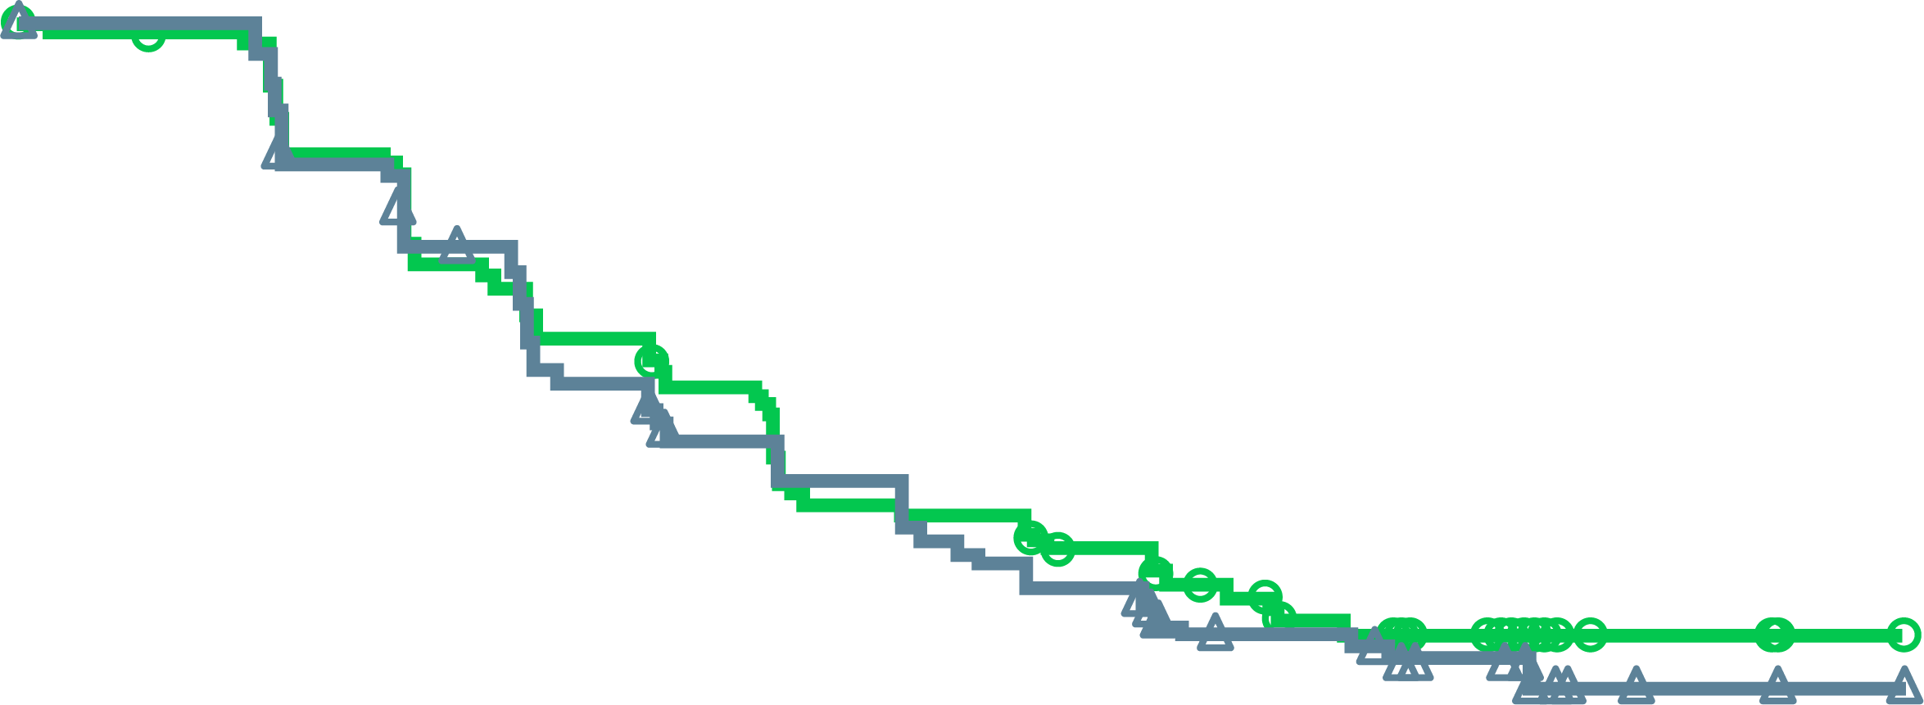
MAGNITUDE HRR BM–: Prespecified Early Futility Analysis – No Benefit of Nira + AAP in HRR BM– Patients
Composite progression endpoint
(radiographic or PSA progression)
Composite endpointª (N=233)
HR (95% CI):1.09^{b} (0.75-1.59)
[futility was defined as ≥1]
Additional grade 3 or 4 toxicity was observed using niraparib + APP vs placebo + AAP
With added toxicity and no added efficacy in patients with HRR BM⁻ mCRPC, the IDMC recommend stopping enrolment in this cohort
100
80
60
Placebo + AAP
Patients without events (%)
40
Niraparib + AAP
20
0
0
3
6
9
12
15
Time from randomisation (months)
No. at risk
Niraparib + AAP | 117 | 92 | 68 | 51 | 4 | 0
Placebo + AAP | 116 | 91 | 68 | 56 | 8 | 0
a rPFS or PSA progression, whichever occurred first
b Breakdown of composite endpoint events: 83 PSA events (HR [95% CI):1.03 [0.67-1.59]); 65 rPFS events (HR [95% CI]: 1.03 [0.63-1.67])
AAP, abiraterone acetate and prednisone/prednisolone; AE, adverse event; BM, biomarker; CI, confidence interval; HR, hazard ratio; HRR, homologous recombination repair;
IDMC, independent data monitoring committee; mCRPC, metastatic castration-resistant prostate cancer; PSA, prostate-specific antigen, rPFS, radiographic progression-free survival
Chi K, et al. J Clin Oncol 2022; 40, (suppl 6; abstr 12)

Slide 78
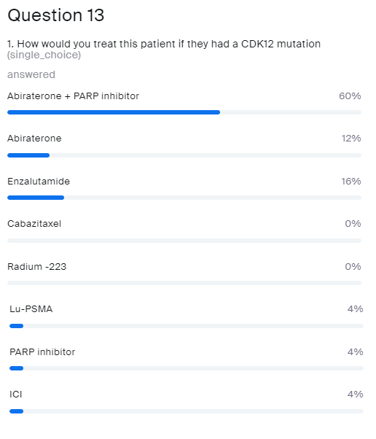
How would you treat this patient if they had a CDK12 mutation?
Abiraterone + PARP inhibitor
Abiraterone
Enzalutamide
Cabazitaxel
Radium-223
Lu-PSMA
PARP inhibitor
ICI
ICI, immune checkpoint inhibitor; Lu-PSMA, lutetium prostate-specific membrane antigen; PARP, poly-ADP ribose polymerase

Slide 79
PROpel: subgroup analysis of rPFS
An rPFS benefit was observed across all patient subgroups, including the HRRm and BRCAm biomarker subgroups (DCO1)
 | Number of patients, n | Median rPFS, months |  |  |  | HR (95% CI)
All patients | 796 | 24.8 | 16.6 |  |  | 0.66 (0.54–0.81)
Age at randomisation, years
<65 | 227 | NR | 16.4 |  |  | 0.51 (0.35–0.75)
≥65 | 569 | 22.0 | 16.7 |  |  | 0.78 (0.62–0.98)
Site of distant metastases
Bone only | 434 | 27.6 | 22.2 |  |  | 0.73 (0.54–0.98)
Visceral | 105 | 13.7 | 10.9 |  |  | 0.62 (0.39–0.99)
Other | 257 | 20.5 | 13.7 |  |  | 0.62 (0.44–0.85)
Docetaxel treatment at mHSPC stage
Yes | 189 | 27.6 | 13.8 |  |  | 0.61 (0.40–0.92)
No | 607 | 24.8 | 16.8 |  |  | 0.71 (0.56–0.89)
HRRm statusª
HRRm | 226 | NR | 13.9 |  |  | 0.50 (0.34–0.73)
Non-HRRm | 552 | 24.1 | 19.0 |  |  | 0.76 (0.60–0.97)
BRCAm statusª
BRCAm | 85 | NR | 8.4 |  |  | 0.23 (0.12–0.43)
Non-BRCAm | 693 | 24.1 | 19.0 |  |  | 0.76 (0.61–0.94)
0.1
1
10
Abiraterone + olaparib better
Abiraterone + placebo better
ª The HRRm and BRCAm status of patients in PROpel was determined after randomisation and before primary analysis using aggregated results from tumour tissue and plasma ctDNA HRRm tests. Aggregate HRRm and BRCAm subgroup analyses are post-hoc exploratory analyses. Results shown are by investigator assessment
BRCAm, breast cancer gene mutation; CI, confidence interval; ctDNA, circulating tumour DNA; DCO1, first data cut-off; HR, hazard ratio; HRRm, homologous recombination repair mutation; mHSPC, metastatic hormone-sensitive prostate cancer; NR, not reached; rPFS, radiographic progression-free survival
Saad F, et al. Annals of Oncology 2022; 33 (suppl_7): S616-S652 (ESMO 2022 oral presentation)

Slide 80
MAGNITUDE: Niraparib + AAP Improves Overall Response Rate Consistently Across Gene Alterations
All HRR BM⁺ patients
BRCA1/2 mutation positive
Relative risk, 2.13
nominal p<0.001
Relative risk, 1.66
nominal p=0.035
60%
(55/92)
52%
(29/56)
28%
(23/82)
31%
(15/48)
Niraparib + AAP nearly doubles ORR rate and provides deeper response in patients with measurable disease
Note: Relative risk >1 favours niraparib and AAP treatment. Percent of responder is based on the number of subjects with measurable disease at baseline
AAP, abiraterone acetate plus prednisone; CR, complete response; HRR, homologous recombination repair; ORR, overall response rate; PR, partial response
Chi K, et al. J Clin Oncol 2022; 40, (suppl 6; abstr 12)

Slide 81
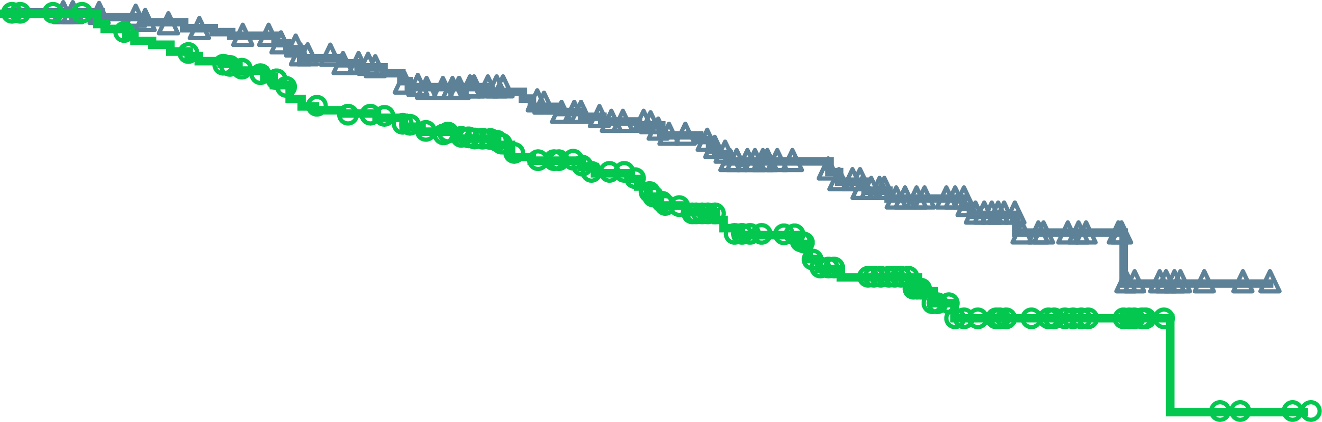
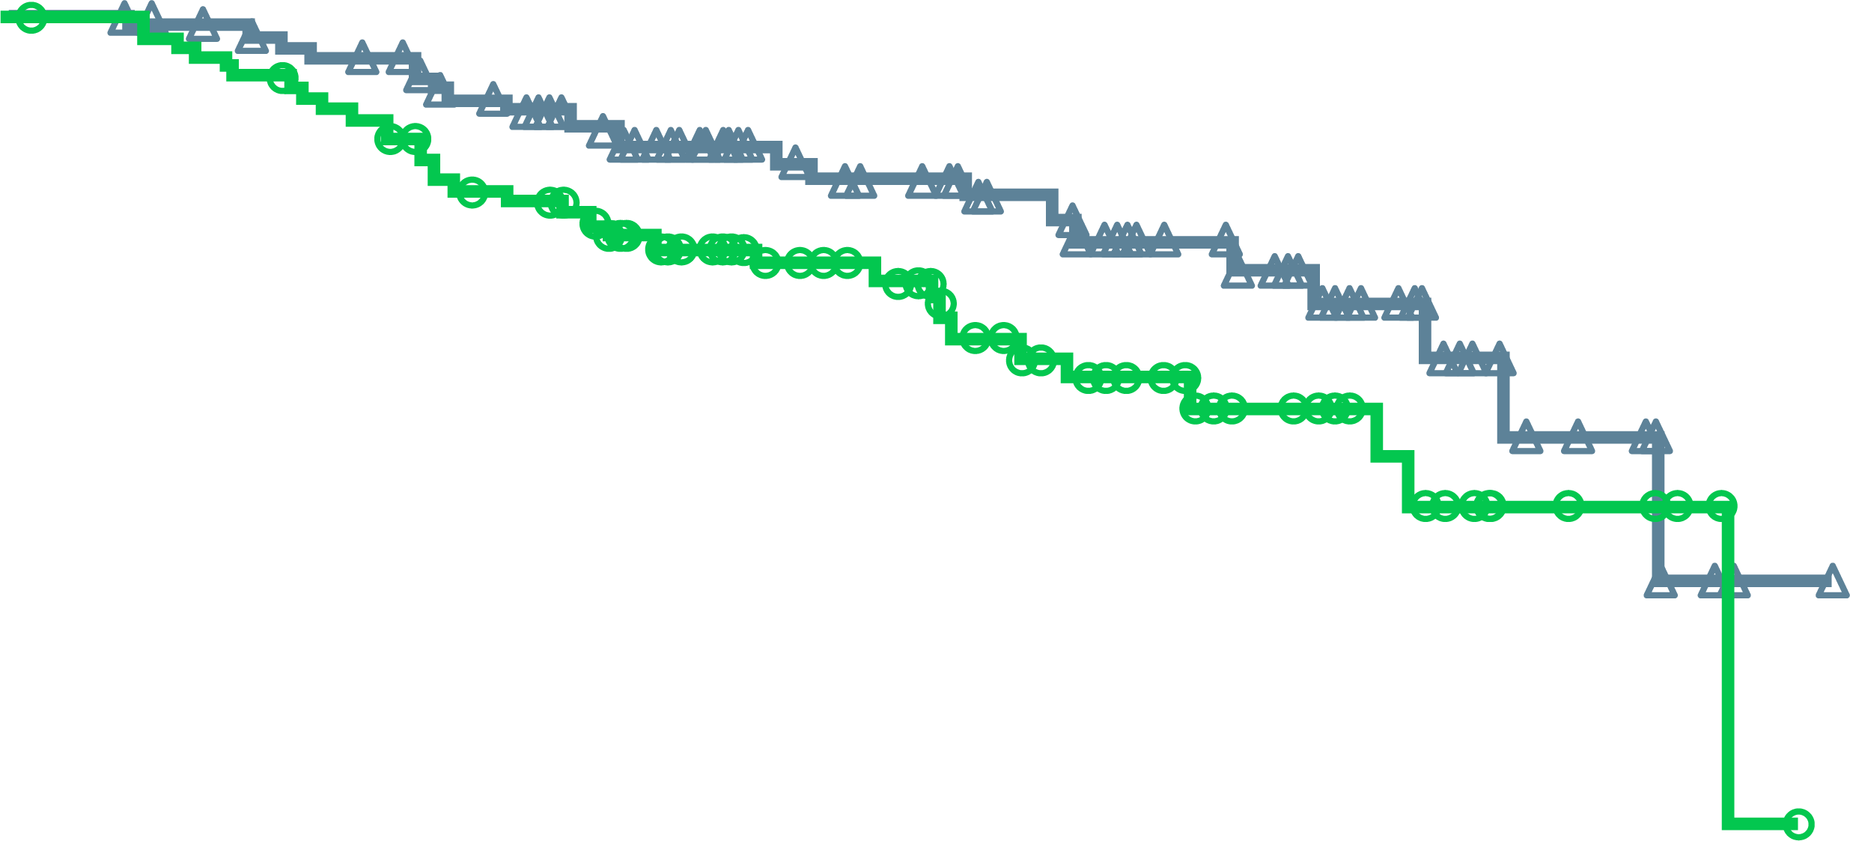
MAGNITUDE: Niraparib + AAP Prolongs Time to Cytotoxic Chemotherapy Across Gene Alterations
All HRR BM⁺ patients
^{BRCA1/2 mutation positive}
100
100
Niraparib + AAP: NE
Niraparib + AAP: NE
80
80
60
60
Patients without events (%)
Patients without events (%)
40
Placebo + AAP:
26.0 months
40
20
HR (95% CI): 0.59 (0.39-0.89);
p=0.0108
20
HR (95% CI): 0.58 (0.33-1.01);
nominal p=0.0495
Placebo + AAP:
26.0 months
0
0
0
3
6
9
12
15
18
21
24
27
30
0
3
6
9
12
15
18
21
24
27
30
Time from randomisation (months)
Time from randomisation (months)
No. at risk
Niraparib + AAP | 212 | 205 | 196 | 169 | 127 | 98 | 74 | 44 | 18 | 3 | 0
Placebo + AAP | 211 | 200 | 184 | 161 | 118 | 90 | 61 | 32 | 16 | 4 | 0
No. at risk
Niraparib + AAP | 113 | 109 | 104 | 86 | 61 | 44 | 33 | 18 | 7 | 1 | 0
Placebo + AAP | 112 | 107 | 97 | 81 | 53 | 41 | 26 | 14 | 6 | 1 | 0
Niraparib + AAP provided a consistent magnitude of improvement (>40%) across evaluated groups
AAP, abiraterone acetate and prednisone/prednisolone; BM, biomarker; CI, confidence interval; HR, hazard ratio; HRR, homologous recombination repair; NE, not estimable
Chi K, et al. J Clin Oncol 2022; 40, (suppl 6; abstr 12)

Slide 82
Case discussion
82
Patient: Age 65 years
Presents with: mCRPC with rising PSA
Medical history:
de novo (synchronous), high volume mCSPC (Gleason 5+4) treated with ADT +
upfront docetaxel (six cycles) for 30 months
PSA 132
PSA 0.1
PSA 5.0
ADT + apalutamide
12 months
30 months
Imaging:
3 new bone lesions
ADT, androgen-deprivation therapy; mCRPC, metastatic castration-resistant prostate cancer; mCSPC, metastatic castration-sensitive prostate cancer; PSA, prostate-specific antigen

Slide 83
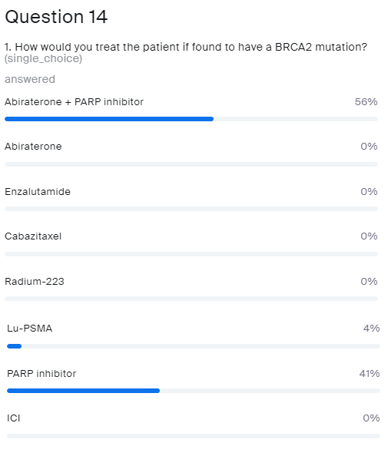
The patient is found to have a
BRCA2 mutation
How would you treat?
Abiraterone + PARP inhibitor
Abiraterone
Enzalutamide
Cabazitaxel
Radium-223
Lu-PSMA
PARP inhibitor
ICI
ICI, immune checkpoint inhibitor; Lu-PSMA, lutetium prostate-specific membrane antigen; PARP, poly-ADP ribose polymerase

Slide 84
questions
Panel discussion

Slide 85
FUTURE PERSPECTIVES and summary
Prof. Fred Saad, MD, FRCS

Slide 86
PARP inhibitor monotherapy or PARP inhibitor + ARAT in the future landscape?
mHSPC or nmCRPC
First-line mCRPC
Second-line mCRPC
BM⁺
Olaparib monotherapy¹
ARAT-exposed
HRR testing
BM⁻
Taxane or other
Olaparib + AAP²
HRR mutation positive
Olaparib monotherapy¹
ARAT-naive
No HRR selection
Taxane or non-ARAT
ARAT
HRR testing
Olaparib AAP¹
(HRR mutation positive or wild type)
or
Niraparib + AAP³
(only BRCA-mutation positive)
HRR testing
HRR mutation negative
Other
ARAT, androgen receptor axis-targeted therapies; AAP, abiraterone acetate and prednisone/prednisolone; BM, biomarker; HRR, homologous recombination repair;
mHSPC, metastatic hormone-sensitive prostate cancer; (n)mCRPC, (non-)metastatic castration-resistant prostate cancer
1. de Bono JS, et al. N Engl J Med. 2020;382:2091-102; 2. Saad F, et al. J Clin Oncol. 2022;40 Suppl: Abstract 11 (ASCO GU 2022 oral presentation);
3. Chi K, et al. J Clin Oncol. 2022;40 Suppl: Abstract 12 (ASCO GU 2022 oral presentation)

Slide 87
There are multiple trials investigating the use of PARP inhibitors in prostate cancer¹⁻¹¹
Primary
Adjuvant
Biochemical Recurrence (BCR)
mHSPC
(incl de novo)
1L mCRPC
2L mCRPC
3L mCRPC
nmCRPC
PROpel¹
P3 Olaparib + abi vs abi
Primary endpoint: rPFS unselected pts
PROfound²*
P3 Olaparib vs abi/enza, HRRm, post-NHA Primary endpoint: rPFS BRCA/ATMm
TALAPRO-3³
P3 Talazoparib + enza
Primary endpoint: rPFS HRRm
TALAPRO-2⁴
P3 Talazoparib + enza vs. enza
Primary endpoint: rPFS unselected pts/HRRm
TALAPRO-1⁵
P2 Talazoparib
HRRm
Post-NHA, post-taxane
Primary endpoint: ORR HRRm
AMPLITUDE⁶
P3 Niraparib + abi
Primary endpoint: rPFS HRRm
MAGNITUDE⁷
P3 Niraparib + abi vs abi
Primary endpoint: rPFS BRCAm/HRRm
GALAHAD⁸
P2 Niraparib, HRRm
Post-NHA, post-taxane
Primary endpoint: ORR BRCAm
Prostate Specific Antigen
TRITON-3⁹
P3 Rucaparib vs abi/enza/docetaxel
BRCAm / ATM, post-NHA
TRITON-2¹⁰
P2 Rucaparib HRRm/BRCAm†
Post-NHA, post-taxane
Primary endpoint: ORR and PSA HRRm
Met
CASPAR¹¹
P3 Rucaparib + enza vs. enza
Primary endpoint rPFS & OS
Unselected patients
Time
Non-metastatic
Metastatic
Hormone-sensitive
Castration-resistant
Asymptomatic
Symptomatic
Please see slide notes for references. ª As a result of the data from PROfound, olaparib monotherapy was approved for treatment of mCRPC in patients with HRR mutations (FDA approval) or for patients with mutations in only BRCA1/2 (EMA approval) after progression on a NHA^{12,13; b} As a result of the data from TRITON2, rucaparib monotherapy was approved by the FDA only for the treatment of mCRPC in patients with a BRCA1/2m who have disease progression after treatment with prior AR-directed therapy and prior taxane¹⁴
Abi, abiraterone; BCR, biochemical recurrence; Enza, enzalutamide; FDA, US Food and Drug Administration; HRR, homologous recombination repair; mCRPC, metastatic castration-resistant prostate cancer;
mHSPC, metastatic hormone-sensitive prostate cancer; NHA, new hormonal agent; nmCRPC, non-metastatic castration-resistant prostate cancer; Ola, olaparib; P, phase; PSA, prostate-specific antigen

Slide 88
Conclusion
Patients in the mCRPC state live less than 3 years even with the best available treatments
A significant proportion of men destined to die of prostate cancer harbour HRR mutations
  Treatment improves PFS and OS
  Strategies to identify patients is challenging but critically important
Future will likely include earlier introduction of PARP inhibitor and possibly treatment beyond patients with HRR/DDR mutations
DDR, DNA damage repair; HRR, homologous recombination repair; mCRPC, metastatic castration-resistant prostate cancer; OS, overall survival; PARP, poly-ADP ribose polymerase;
PFS, progression-free survival

Slide 89

REACH GU CONNECT VIA
TWITTER, LINKEDIN, VIMEO & EMAIL
OR VISIT THE GROUP’S WEBSITE https://guconnect.cor2ed.com/
Follow us on Twitter
@guconnectinfo
Follow the
GU CONNECT
group on LinkedIn
Watch us on the
Vimeo Channel
GU CONNECT
Email
sam.brightwell
@cor2ed.com

