Slide 2
The role of SSA at progression – to continue or not?
Prof. Martyn Caplin, DM, FRCP
Dr Aman Chauhan, MD
December 2022

Slide 3
Conflict of Interest and Funding
This NET CONNECT programme is supported through an independent educational grant from Ipsen. The programme is therefore independent, the content is not influenced by the supporters and is under the sole responsibility of the experts.
Please note: The views expressed within this programme are the personal opinions of the experts. They do not necessarily represent the views of the experts’ institutions, or the rest of the NET CONNECT group.
Prof. Martyn Caplin has received financial support/sponsorship for research support, consultation, or speaker fees from the following companies: AAA - Novartis, Chiasma,
Ipsen, Pfizer
Dr Aman Chauhan has received financial support/sponsorship for research support, consultation, or speaker fees from the following companies: BMS, Clovis, EMD Serono, Nanotherapeutics, Ipsen, Lexicon, TerSera, Novartis/AAA

Slide 4
therapies approved for the treatment of Neuroendocrine Tumours
GEP, gastroenteropancreatic; NET, neuroendocrine tumour; p, pancreatic
Chauhan A, et al. Cancers 2022;14:5248

Slide 5
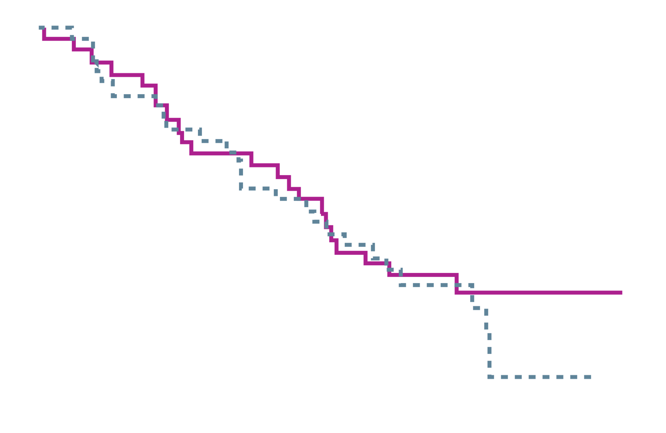
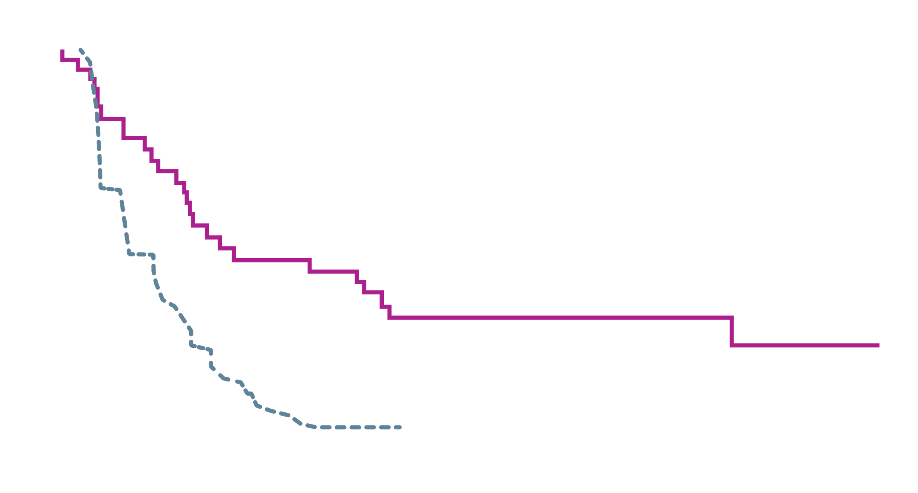
Promid: efficacy
Octreotide vs placebo in mid-gut NET
PRIMARY ENDPOINT: TTP¹
SECOND PRIMARY ENDPOINT: OS²
Octreotide LAR, 42 patients/22 events; median, 84.7 months
Placebo, 43 patients/26 events; median, 83.71 months
1.00
1.0
Placebo, 40 events; median, 6.0 months
Octreotide LAR, 26 events; median, 14.3 months
0.75
0.8
0.5
0.6
Proportion of patients
Patients (proportion)
0.4
0.25
0.2
p=0.511, HR=0.83 (95% CI: 0.47-1.46)
0
6
12
18
24
30
36
42
48
54
60
66
72
78
0
12
24
36
48
60
72
84
96
108
120
132
144
Time Since Random Allocation (months)
Months
No. of patients at risk
Placebo
Octreotide LAR
Lon-rank test stratified by functional activity: p=0.000072, HR=0.34 (95% CI, 0.20 to 0.59)
Patients at risk
43
42
21
30
9
19
3
16
1
15
1
10
0
10
0
9
0
9
0
6
0
5
0
3
0
1
0
0
42
43
40
42
38
36
32
33
31
31
27
27
22
24
20
18
16
14
11
8
6
3
3
1
CI, confidence interval; HR, hazard ratio; LAR, long-acting release; NET, neuroendocrine tumour; OS; overall survival; TTP, time to tumour progression
1. Rinke A, et al. J Clin Oncol. 2009;27:4656-63; 2. Rinke A, et al. Neuroendocrinology. 2017;104:26-32

Slide 6
Promid: SAFETY
SERIOUS ADVERSE EVENTS
 | Octreotide LAR (N=42) | Placebo (N=43)
Serious adverse events | 11 | 10
Affecting GI tract | 6 | 8
Affecting haematopoietic system | 5 | 1
Affecting general health status (fatigue and fever) | 8 | 2
Treatment discontinuation due to AEs | 5 | 0
AEs, adverse events; GI, gastrointestinal; LAR, long acting release
Rinke, et al. J Clin Oncol 2009;27:4656-63

Slide 7
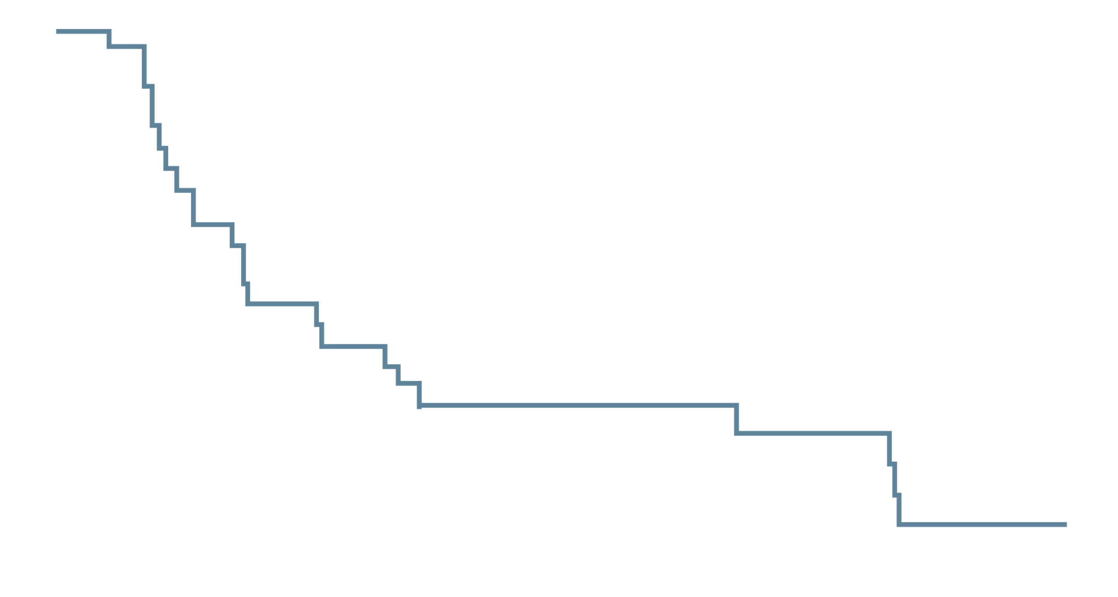
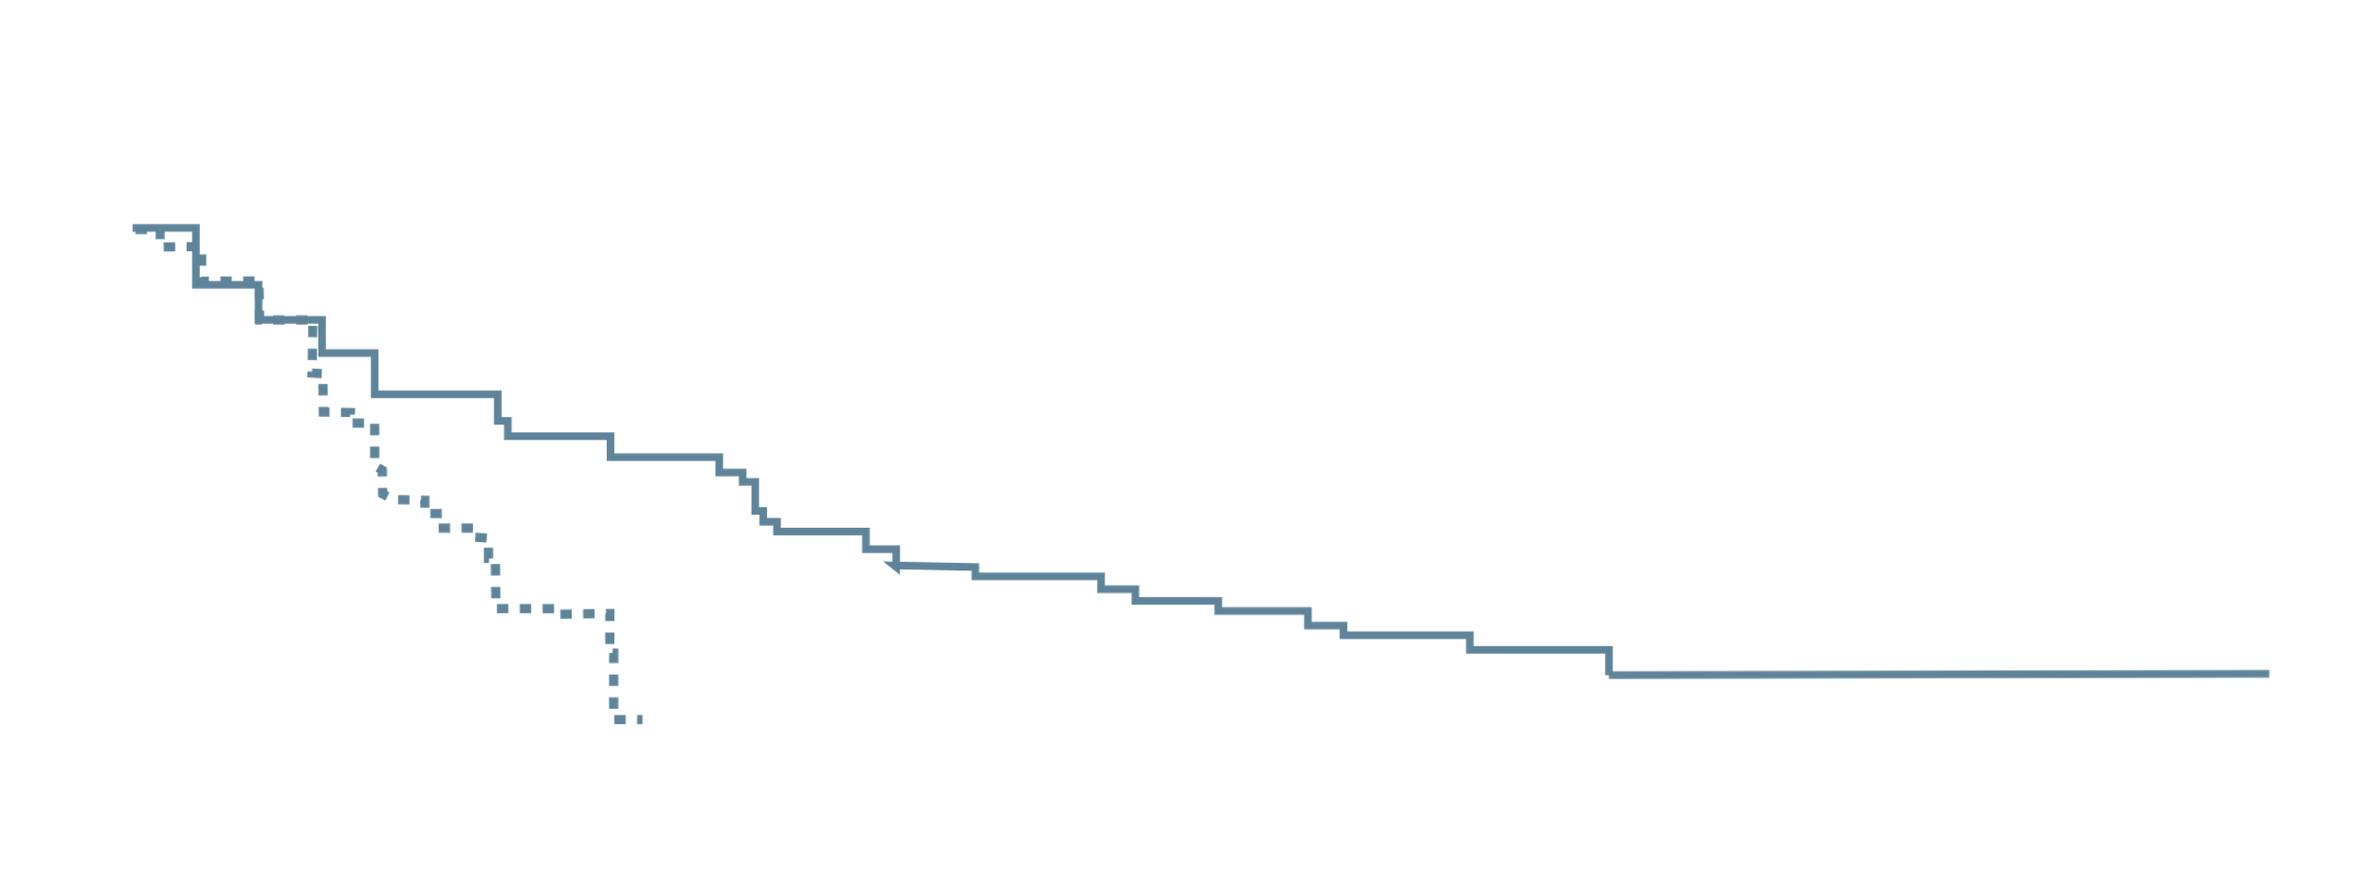
CLARINET: EFFICACY
Lanreotide vs placebo in GEP-NET
PRIMARY ENDPOINT: PFS
SECONDARY ENDPOINT: TIME TO DEATH OR SUBSEQUENT PD
Overall population
OLE study
Local radiologic assessment
Core study
Central radiologic assessment
OLE study
Local radiologic assessment
Lanreotide: 51 events/101 patients
(core: 32 events/101 patients; OLE 19 events/41 patients)
Median [95% CI] for core plus OLE studies
38.5 [30.9; 59.4] months
100
80
100
80
60
Lanreotide: 23 events/32 patients
Median [95%CI] time to subsequent PD: 19.0 [10.1; 26.7] months
Patients alive and with no progression (%)
Patients alive and with no subsequent progression (%)
60
41 patients with stable disease while
receiving lanreotide autogel in the core
study continued into the OLE study
40
40
20
Placebo: 61 events/103 patients (core study)
20
32 patients had progressive disease whilst receiving placebo in the core study
0
Median [95% CI]: 18.0 [12.1; 21.1] months
0
12
24
36
48
60
72
84
96
108
0
Time from randomisation in core study (months)
0
6
12
18
24
30
36
42
48
54
60
66
72
78
84
Number of patients at risk of death or PD
Time from centrally assessed disease progression in core study (months)
Lanreotide
101
71
51
33
26
20
10
6
3
0
Placebo
103
59
26
Number of patients at risk of death or PD
Lanreotide
32
27
18
14
12
8
8
6
6
5
5
2
2
0
0
PFS centrally assessed according to RECIST. OS accordingly to investigator follow up of patients
CI, confidence interval; PD, progressive disease; PFS, progression-free survival; RECIST, response evaluation criteria in solid tumours
Caplin, et al. Endocrine 2021;71:502-13

Slide 8
CLARINET: SIDE effects
ADVERSE EVENTS (SAFETY POPULATION)
Event | Lanreotide (N=101) | Placebo (N=103)
 | Number of patients (%)
Any adverse event | 89 (88) | 93 (90)
Any adverse event related to study treatment | 50 (50) | 29 (28)
Any adverse event according to intensity
Severe | 26 (26) | 32 (31)
Moderate | 44 (44) | 44 (43)
Mild | 17 (17) | 17 (17)
Any serious adverse event | 25 (25) | 32 (31)
Serious adverse event related to study treatment | 3 (3) | 1 (1)
Withdrawal from study because of any adverse event | 3 (3) | 3 (3)
Withdrawal because of adverse event related to study treatment | 1 (1) | 0
Caplin, et al. N Engl J Med 2014;371:224-33

Slide 9
Clinical evidence for continuing SSA on progression

Slide 10
NETTER-1: study design
Patient population: advanced, progressive, somatostatin-receptor positive mid-gut NETs
PATIENTS
Stratified according to:
Somatostatin receptor scintigraphy grade
2-4
Length of octreotide treatment (≤6 or >6m)
4 administrations of
7.4 GBq of ¹⁷⁷Lu-Dotatate every 8 weeks +
Octreotide LAR 30 mg every 4 weeks
N=116
STUDY END POINTS
Primary:
PFS
Key Secondary:
OS
Side effect profile
R
1:1
Octreotide LAR 60 mg
every 4 weeks
N=113
¹⁷⁷Lu, lutetium-177; GBq, gigabecquerels; LAR, long-acting release; m, months; NET, neuroendocrine tumour; OS, overall survival; PFS, progression-free survival; R, randomisation
Strosberg, et al. N Engl J Med 2017;376:125-35

Slide 11
NETTER-1: EFFICACY
All study patients continued high dose octreotide regardless of functional status
PRIMARY ENDPOINT: PFS SECONDARY ENDPOINT: OS (interim)
100
N=229 (ITT)
Number of events: 91
¹⁷⁷Lu-Dotatate: 23
Oct 60 mg LAR: 68
100
90
90
80
¹⁷⁷ Lu-DOTATATE
80
70
¹⁷⁷ Lu-DOTATATE
70
60
60
Progression-free survival (% of patients)
50
Overall survival (% of patients)
50
40
mPFS = NR vs 8.4 months
HR 0.21 [95% CI 0.13-0.33]
p<0.001
40
Control
HR 0.40
p=0.004
30
30
20
20
10
10
0
0
0
5
10
15
20
25
30
0
5
10
15
20
25
30
Months since randomisation
Months since randomisation
No. at risk
¹⁷⁷ Lu-DOTATATE
group
Control group
Control
No. at risk
¹⁷⁷ Lu-DOTATATE
group
Control group
116
113
97
80
76
47
59
28
42
17
28
10
19
4
12
3
3
1
2
0
0
0
116
113
108
103
96
83
79
64
64
41
47
32
31
17
21
5
8
1
3
0
0
0
Primary analysis of NETTER-1 with interim analysis of overall survival
¹⁷⁷Lu, lutetium-177; CI, confidence interval; HR, hazard ratio; ITT, intent-to-treat; (m)PFS, (median) progression-free survival; NR, not reached; LAR, long-acting release; Oct, octreotide, OS, overall survival
Strosberg J, et al. N Engl J Med. 2017;376:125-35

Slide 12
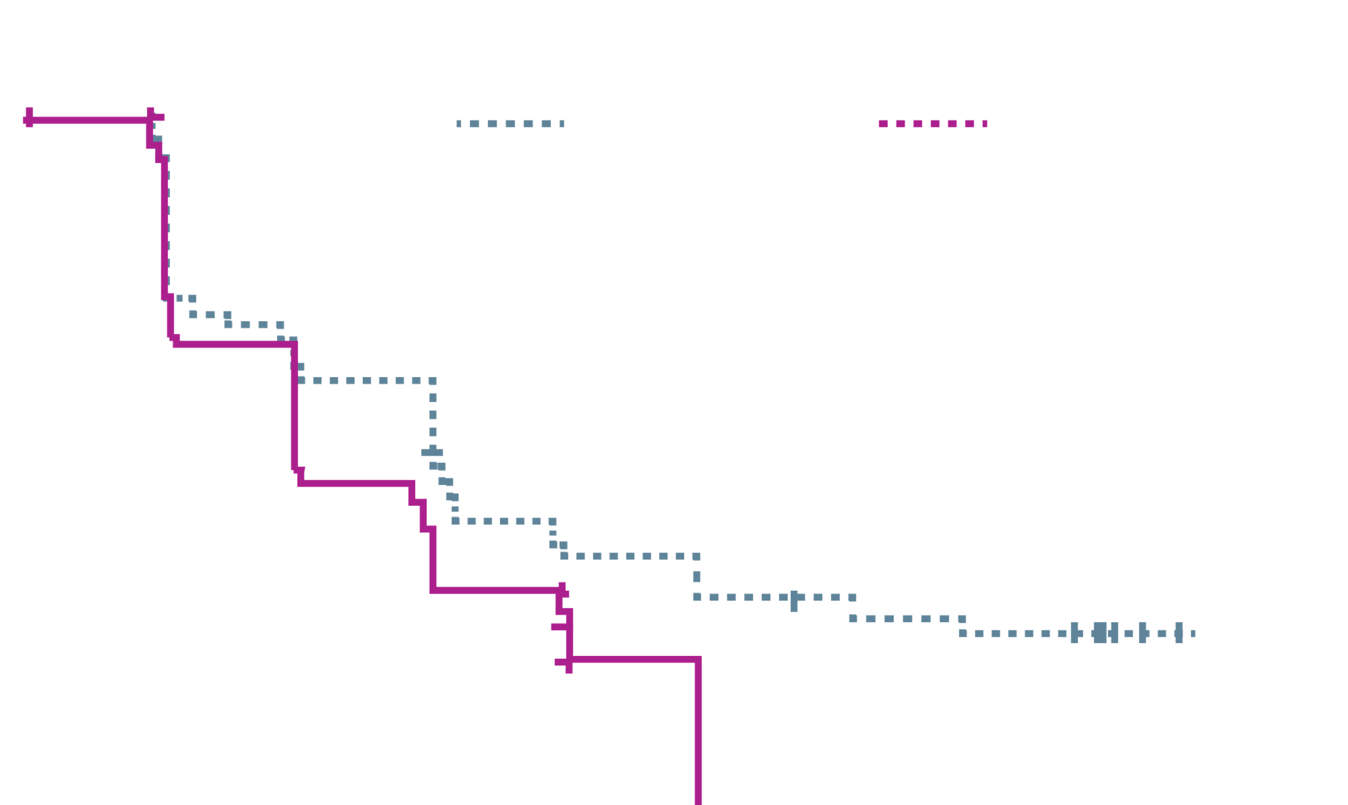
CLARINET FORTE
Increase dosing frequency before escalation to less
well-tolerated therapies
High-dose lanreotide autogel (120 mg every 14 days) in patients with progressive pancreatic or mid-gut NETs following first-line standard-dose treatment (120 mg every 28 days)
Reducing the dosing interval provided clinically meaningful PFS
There were no safety concerns
PRIMARY ENDPOINT: PFS
1.00
Mid-gut NET PanNET
0.90
0.80
0.70
*Mid-gut NET, median (5% CI)
PFS = 8.3 (5.6-11.1) months
0.60
0.50
Progression-free survival
0.40
0.30
0.20
0.10
PanNET, median (95% CI)
PFS = 5.6 (5.5-8.3) months
0.00
0
3
6
9
12
15
18
21
22
Number pf patients
Mid-gut NET at risk
Censor
Event
PanNET at risk
Censor
Event
Time (months)
51
0
0
48
0
0
36
2
13
31
3
14
30
2
19
21
3
24
19
3
29
14
3
31
17
3
31
2
12
34
14
3
34
0
12
36
12
4
35
0
12
36
11
4
36
0
12
36
0
15
36
0
12
36
CI, confidence interval; NET, neuroendocrine tumour; pan, pancreatic; PFS, progression-free survival
Pavel M, et al. Eur J Cancer. 2021;157:403-14

Slide 13
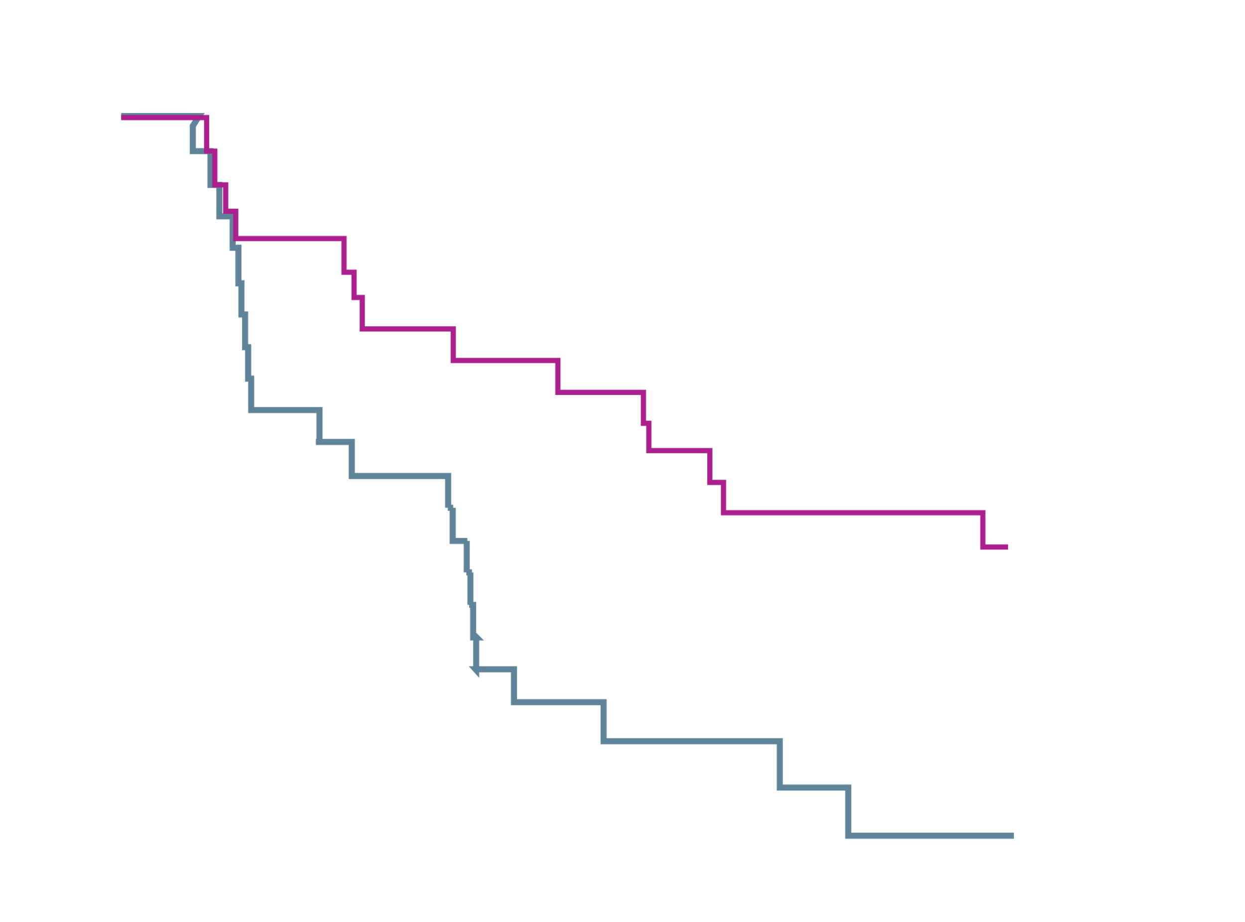
REMINET
Maintenance treatment with SSA is feasible
Lanreotide autogel (120 mg every 28 days) as maintenance treatment after ≥2 months of first-line treatment in aggressive G1/2 DP-NET
Encouraging results as a
maintenance treatment
Treatment toxicity is reduced
PRIMARY ENDPOINT: PFS
100
Planned treatment group
LANREOTIDE
PLACEBO
Median (95% CI)
19.4 (11.8-NE)
7.6 (3.0-10.9)
+Censor
90
80
70
60
50
Proportion alive without progression
40
30
20
10
0
0
3
4
6
8
10
12
14
16
18
20
No. at risk
LANROTIDE
PLACEBO
Months
27
25
27
24
23
16
20
14
19
11
18
7
16
4
13
4
13
3
13
2
11
2
CI, confidence interval; DP-NET, duodeno-pancreatic neuroendocrine tumour; G, grade; NE, not estimable; PFS, progression-free survival; SSA, somatostatin analogue
Lepage C, et al. Eur J Cancer. 2022;175:31-40
0
0

Slide 14
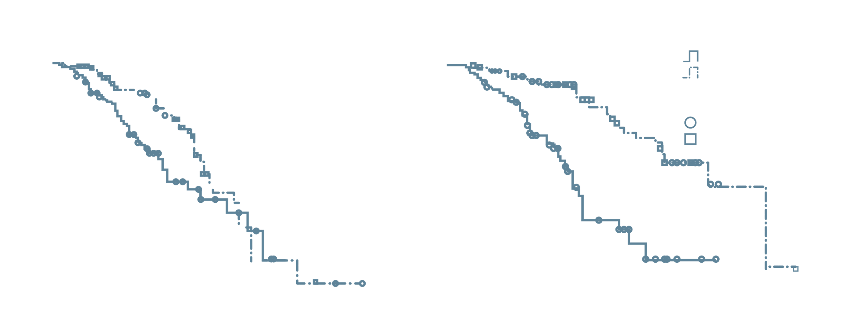
adding SSA to PRRT as combination and/ or maintenance therapy
benefit of combination/maintenance SSA with PRRT
Retrospective analysis at the University Hospital Bonn, Bonn, Germany
of survival benefit of
adding SSA to PRRT
as combination and/or maintenance therapy
Patients with advanced
GEP-NET
Significantly better outcomes with SSA + PRRT vs PRRT alone
0.0
0.0
PRRT monotherapy
PRRT + SSA combination
Censored values
PRRT monotherapy
PRRT + SSA combination
-0.5
-0.5
-1.0
Cumulative survival
-1.0
-1.5
-2.0
-1.5
Log-rank p=0.012
Log-rank p<0.001
-2.5
-2.0
0
20
40
60
80
100
120
0
50
100
150
Progression-free survival in months
Overall survival in months
GEP-NET, gastroenteropancreatic neuroendocrine tumour; PFS, progression-free survival; PRRT, peptide receptor radionuclide therapy; SSA, somatostatin analogue
Yordanova A, et al. Clin Cancer Res. 2018;24:4672-79

Slide 15
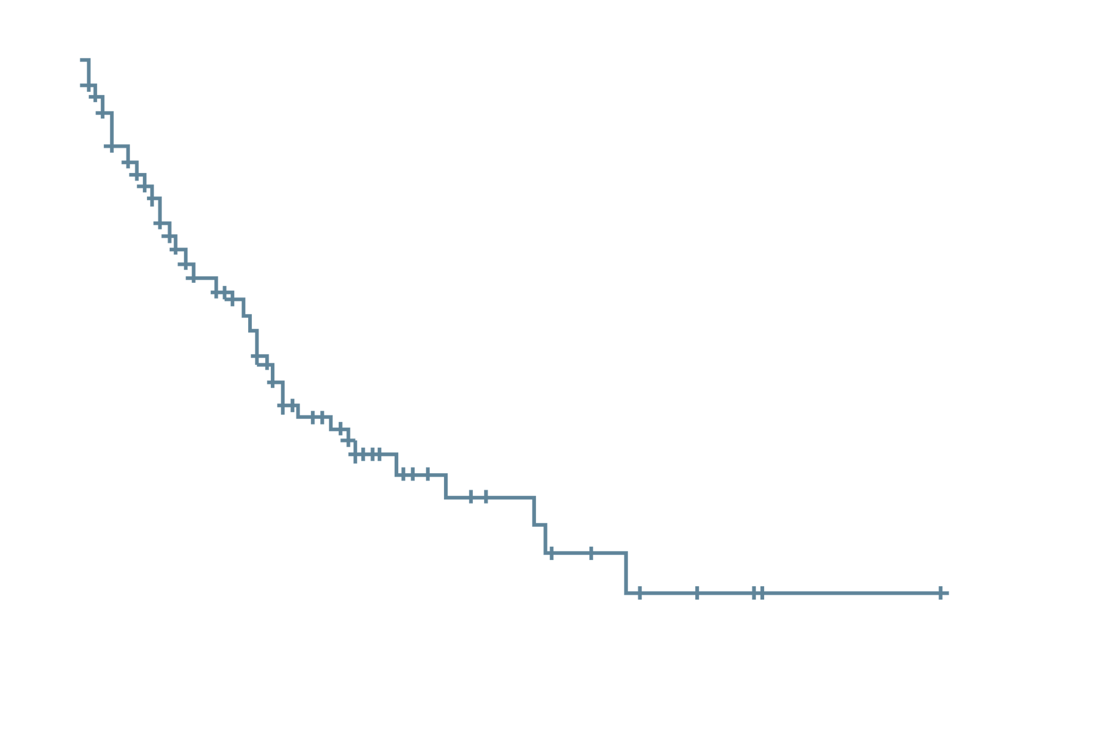
High-dose SSA for progressive well-differentiated nets
High-dose SSA can be a feasible option in selected NETs
Retrospective analysis of data from 13 Italian NET centres
Patients with well-differentiated
GEP-NET and disease progression
SSA with increased administered
dose or shortened interval between administrations was an active and safe treatment option
Main efficacy ENDPOINT: PFS
100
Median PFS 31.0 months (95% CL 19.3-42.6)
80
60
Progression-free survival probability (%)
40
20
0
0
20
40
60
80
100
120
Months
CI, confidence interval; GEP gastroenteropancreatic; NET, neuroendocrine tumour; PFS, progression-free survival; SSA, somatostatin analogue
Lamberti G, et al. J Clin Endocrinol Metab. 2020;105(1):dgz035

Slide 16
Clinical Takeaways

Slide 17
Clinical Takeaways
Potential patient groups and treatment strategies
In patients with well-differentiated Grade 1 or 2 NETs and slowly progressive asymptomatic disease, the following strategies could be potential considerations in selected patients
  Increase the SSA dose (increase frequency from 4 weeks to 2 weeks)
  Increase the monthly dose of SSA
SSA as maintenance (after stopping chemotherapy [for toxicity concerns] in stable patients)
Patients receiving PRRT (during and/or post-PRRT)
NET, neuroendocrine tumour; PRRT, peptide receptor radionuclide therapy; SSA, somatostatin analogue

Slide 18
REACH NET CONNECT VIA
TWITTER, LINKEDIN, VIMEO & EMAIL
OR VISIT THE GROUP’S WEBSITE https://netconnect.cor2ed.com/
Follow us on Twitter
@net-connectinfo
Follow the
NET CONNECT
group on LinkedIn
Watch us on the
Vimeo Channel
NET CONNECT
Email
veronica.thomlinson
@cor2ed.com

