Slide 2
Treatment sequencing in mCRC: third line and beyond
Prof. Dr. med Sebastian Stintzing, MD
Charité Universitaetsmedizin Berlin, Germany
Dr Juan Manuel O’Connor, MD, MSc
Instituto Alexander Fleming, Buenos Aires, Argentina
mCRC, metastatic colorectal cancer

Slide 3
Disclaimer and disclosures
Please note: The views expressed within this presentation are the personal opinions of the author.
They do not necessarily represent the views of the author’s academic institution, or the rest of the
GI CONNECT group.
This content is supported by an Independent Educational Grant from Bayer.
Prof. Dr. med Sebastian Stintzing has received financial support/sponsorship for research support, consultation, or speaker fees from the following companies:
  AMGEN, Bayer, Boehringer Ingelheim, BMS, EISAI, Isofol, Lilly, Merck KGaA, MSD, Novartis, Pierre Fabre, Roche, Sanofi, Servier, Taiho, Takeda
Dr Juan Manuel O’Connor has received financial support/sponsorship for research support, consultation, or speaker fees from the following companies:
  Bayer, BMS, Ipsen, Merck Serono, MSD, Pfizer, Roche, Sanofi, Servier

Slide 4
Educational objectives
Know how to optimise treatment sequencing for mCRC patients third line and beyond
  Understand the potential treatment options for these patients
  Understand the available data to support the optimal sequencing of these treatments
  Know which patient considerations are important when making treatment sequencing decisions
  Know the best ways to manage toxicities and quality of life through treatment sequencing
mCRC, metastatic colorectal cancer

Slide 5
Clinical takeaways
Optimal sequencing of cytotoxic/targeted agents in metastatic colorectal cancer (mCRC) is unclear
First-line choice of therapy is critical as it affects treatment decisions in later lines
Molecular profiling has an important role in determining treatment options and sequence
Physicians should consider patient characteristics, such as comorbidities, prior adverse reactions to treatments, and overall performance status
Management of adverse events, to minimise the effect on quality of life, while maximising treatment benefit is crucial
Clinical trials of emerging agents, new treatment combinations, and novel therapies are important for continued improvement in outcomes in these patients
mCRC, metastatic colorectal cancer

Slide 6
Treatment sequencing considerations

Slide 7
Key factors for consideration in the CRC treatment strategy
Overall condition and emotional status of patients
Fit versus unfit for a combination therapy (triplet vs doublet vs monotherapy) Eastern Cooperative Oncology Group performance status Patient age Established comorbidities Patient attitude Patient disease history (e.g. previous oxaliplatin-based adjuvant treatment)
Tumour characteristics and clinical course
Indolent versus aggressive tumour Disease presentation (synchronous vs metachronous) Tumour load Mutational status (RAS and BRAF)
Treatment goal
Tumour shrinkage to achieve a radical surgery of metastases or palliation of disease-related symptoms Disease control to delay progression and worsening of patient’s general condition
BRAF, proto-oncogene B-Raf; CRC, colorectal cancer; RAS, RAS proto-oncogene GTPase
Argiles G, et al. ESMO Open 2019;4:e000495. doi:10.1136/esmoopen-2019-000495

Slide 8
treatment goaLs aCCordIng to LIne of therapy
Line of systemic treatment
Realistic treatment goal
Adjuvant
Cure
Reduce risk of recurrence
First-line
Deepest tumour response
Long duration of low/no tumour burden
Second-line
Durable disease control
Tumour response if needed
Third-line
Durable disease control
Maintenance of QoL and PS
Subsequent lines
Disease control
and maintenance of QoL; palliation
PS, performance status; QoL, quality of life
Argiles G, et al. ESMO Open 2019;4:e000495. doi:10.1136/esmoopen-2019-000495

Slide 9
TREATMENT LINE: DIMINISHING OUTCOMES
Optimising treatment across multiple lines of therapy in mCRC is challenging, with 1st-line therapy a key to success:
When no potential curative path is reached by 1st-line therapy, the question of sequencing gains in importance
This review explores current treatment approaches in the 3rd-line mCRC setting, including biological aspects affecting sequencing and rechallenge
Outcome* | First-line¹⁻⁸ | Second-line⁹⁻¹⁶ | Third-line and beyond¹⁷⁻²¹
Response rate | 38–65% | 5–36% | 1–31%
Progression-free survival | 9–12 months | 4–7 months | 2–5 months
* Efficacy ranges taken from the targeted/experimental treatment arms of studies reporting the specified outcome (for EGFR trials, results are shown for RAS wild-type subsets where applicable)
EGFR, epidermal growth factor receptor; mCRC, metastatic colorectal cancer; RAS, RAS proto-oncogene GTPase
1. Saltz LB, et al. J Clin Oncol. 2008;26:2013-9; 2. Heinemann V, et al. Lancet Oncol. 2014;15:1065-75; 3. Douillard JY, et al. J Clin Oncol. 2010;28:4697-705; 4. Loupakis F, et al. N Engl J Med. 2014;371:1609-18;
5. Douillard JY, et al. Ann Oncol. 2014;25:1346-55; 6. Falcone A, et al. J Clin Oncol. 2007;25:1670-6; 7. Van Cutsem E, et al. J Clin Oncol. 2011;29:2011-9; 8. Venook AP, et al. JAMA. 2017;317:2392-2401; 9. Giantonio BJ, et al.
J Clin Oncol. 2007;25:1539-44; 10. Peeters M, et al. J Clin Oncol. 2010; 28:4706-13; 11. Bennouna J, et al. Lancet Oncol. 2013;14:29-37; 12. Van Cutsem E, et al. J Clin Oncol. 2012;30:3499-506; 13. Tabernero J, et al. Lancet
Oncol. 2015;16:499-508; 14. Sobrero AF, et al. J Clin Oncol. 2008;26:2311-9; 15. Seymour MT, et al. Lancet Oncol. 2013;14:749-59; 16. Peeters M, et al. Ann Oncol. 2014;25:107-16; 17. Amado RG, et al. J Clin Oncol. 2008;26:1626-34; 18. Grothey A, et al. Lancet. 2013;381:303-12; 19. Karapetis CS, et al. N Engl J Med. 2008;359:1757-65; 20. Mayer RJ, et al. N Engl J Med. 2015;372:1909-19; 21. Kim TW, et al. Br J Cancer. 2016;115:1206-14
Notes:
References
1. Saltz LB, et al. J Clin Oncol 2008;26:2013-9; 2. Heinemann V, et al. Lancet Oncol 2014;15:1065-75; 3. Douillard JY, et al. J Clin Oncol 2010;28:4697-705; 4. Loupakis F, et al. N Engl J Med 2014;371:1609-18; 5. Douillard JY, et al. Ann Oncol 2014;25:1346-55; 6. Falcone A, et al. J Clin Oncol 2007;25:1670-6; 7. Van Cutsem E, et al. J Clin Oncol 2011;29:2011-9; 8. Venook AP, et al. JAMA 2017;317:2392-2401; 9. Giantonio BJ, et al. J Clin Oncol 2007;25:1539-44; 10. Peeters M, et al. J Clin Oncol 2010;28:4706-13; 11. Bennouna J, et al. Lancet Oncol 2013;14:29-37; 12. Van Cutsem E, et al. J Clin Oncol 2012;30:3499-506; 13. Tabernero J, et al. Lancet Oncol 2015;16:499-508; 14. Sobrero AF, et al. J Clin Oncol 2008;26:2311-9; 15. Seymour MT, et al. Lancet Oncol 2013;14:749-59; 16. Peeters M, et al. Ann Oncol 2014;25:107-16; 17. Amado RG, et al. J Clin Oncol 2008;26:1626-34; 18. Grothey A, et al. Lancet 2013;381:303-12; 19. Karapetis CS, et al. N Engl J Med 2008;359:1757-65; 20. Mayer RJ, et al. N Engl J Med 2015;372:1909-19; 21. Kim TW, et al. Br J Cancer 2016;115:1206.

Slide 10
Phase 3 data influencing treatment decisions

Slide 11
CORRECT Study: Regorafenib vs placebo PROLONGED PFS AND OS in refractory mCRC patients
PROGRESSION-FREE SURVIVAL
OVERALL SURVIVAL
100
Regorafenib 160 mg
Placebo
100
Regorafenib 160 mg
Placebo
75
75
HR 0.77, 95% CI 0.64-0.94, P=0.0052
50
HR 0.49, 95% CI 0.42-0.58, P<0.0001
50
Progression-free survival (%)
Overall survival (%)
25
25
0
0
2
4
6
8
10
12
0
0
2
4
6
8
10
12
14
Number at risk
Regorafenib
Placebo
Months after randomisation
Number at risk
Regorafenib
Placebo
Months after randomisation
238
51
98
9
42
2
12
2
3
0
452
221
352
150
187
75
93
32
33
9
7
3
PFS: 1.9 mo vs. 1.7 mo (HR 0.49; p<0.0001)
OS: 6.4 mo vs. 5.0 mo (HR 0.77; p= 0.0052)
Tumour response:
ORR: 1.0% vs. 0.4% (p=0.19)
DCR: 41% vs. 15% (p<0.0001)
CI, confidence interval; DCR, disease control rate; HR, hazard ratio; mCRC, metastatic colorectal cancer; mo, months; ORR, objective response rate; OS, overall survival; PFS, progression free survival
Grothey A, et al. Lancet. 2013;381:303-12

Slide 12
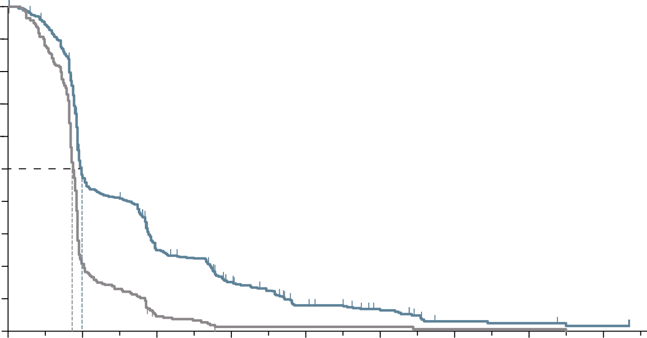
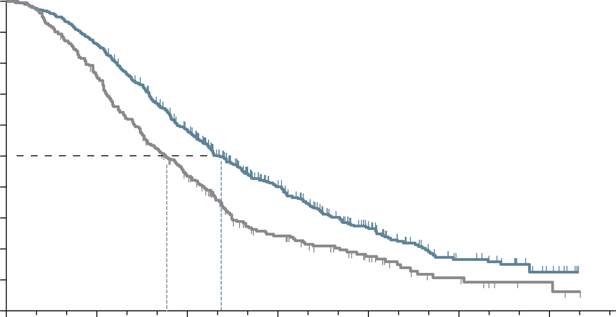
RECOURSE Study: TAS-102 PROLONGED PFS AND OS in refractory mcrc patients
PROGRESSION-FREE SURVIVAL
OVERALL SURVIVAL
100
100
90
90
80
Hazard ratio for progression or death, 0.48 (95% CI, 0.41-0.57)
P<0.001 by log-rank test
80
Hazard ratio for death, 0.68 (95% CI, 0.58-0.81)
P<0.001
70
70
60
60
50
50
Progression-free survival (%)
Overall survival (%)
40
40
30
TAS-102
30
TAS-102
20
20
10
Placebo
10
Placebo
0
0
2
4
6
8
10
14
16
0
0
3
6
9
12
15
18
Months after randomisation
Months after randomisation
Number at risk
TAS-102
Placebo
Number at risk
TAS-102
Placebo
534
266
238
51
121
10
66
2
30
2
18
2
5
1
4
1
2
0
534
266
459
198
294
107
137
47
64
24
23
9
7
3
PFS: 2.0 mo vs. 1.7 mo (HR 0.48; p<0.001)
OS: 7.1 mo vs. 5.3 mo (HR 0.68; p<0.001)
Tumour response:
ORR: 1.6% vs. 0.4% (p=0.29)
DCR: 44% vs. 16% (p<0.001)
CI, confidence interval; DCR, disease control rate; HR, hazard ratio; mCRC, metastatic colorectal cancer; mo, months; ORR, objective response rate; OS, overall survival; PFS, progression free survival; TAS-102, trifluridine/tipiracil
Mayer RJ, et al N Engl J Med. 2015;372:1909-19

Slide 13
InfLuenCe of safety profILe In patIents beyond the seCond LIne
Most commonly reported (≥25%) side effects for TAS-102 and regorafenib in phase 3 clinical studies^{1,2}
TAS-102 (N=533)¹ |  |  | Regorafenib (N=500)^{2,a}
 | Overall (%) | Grade ≥3 (%) |  | Overall (%) | Grade ≥3 (%)
Leucopenia | 77 | 21 | Hand-foot skin reaction | 47 | 17
Anaemia | 77 | 18 | Fatigue | 47 | 10
Neutropaenia | 67 | 38 | Diarrhoea | 34 | 7
Nausea | 48 | 2 | Anorexia | 30 | 3
Thrombocytopaenia | 42 | 5 | Voice changes | 29 | <1
Decreased appetite | 39 | 4 | Hypertension | 28 | 7
Fatigue | 35 | 4 | Oral mucositis | 27 | 3
Diarrhoea | 32 | 3 | Rash/desquamation | 26 | 6
ªTreatment-related adverse events from start of treatment to 30 days after end of treatment Please note that these drugs have not been compared in head-to-head studies. The information is presented for information purposes only
TAS-102, trifluridine/ tipiracil
Adapted from Argiles G, et al. ESMO Open 2019;4:e000495. doi:10.1136/esmoopen-2019-000495
1. Mayer RJ, et al. N Engl J Med. 2015;372:1909-19; 2. Grothey A, et al. Lancet. 2013;381:303-12

Slide 14
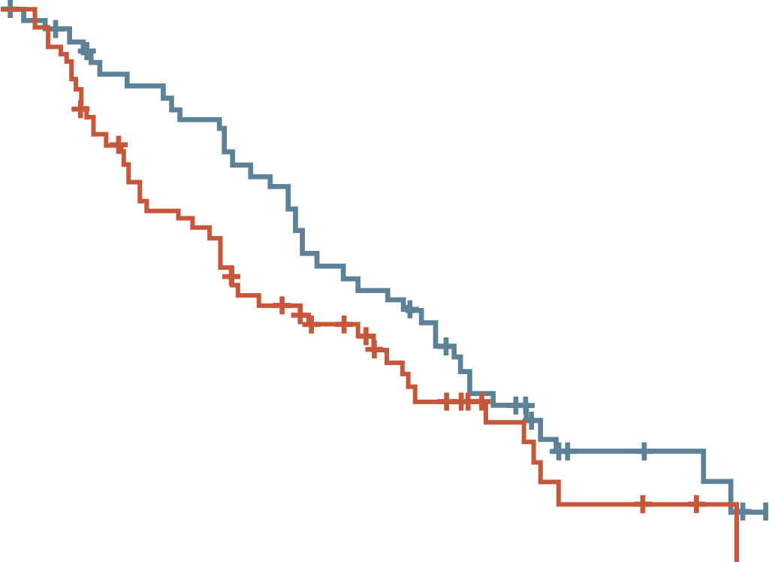
Dose-escalated strategy for management of adverse events with regorafenib
PHASE 2 ReDOS STUDY
100
90
80
Week 1
80 mg PO daily
for 1 week
70
60
No
SDRT
50
Overall survival (%)
Week 2
120 mg PO daily
for 1 week
80 mg PO daily
for 1 week
40
SDRT
30
No
SDRT
20
Dose-escalation group
160 mg PO daily
for 1 week
120 mg PO daily
for 1 week
10
Week 3
SDRT
0
Standard-dose group
0
3
6
9
12
15
18
21
24
No
SDRT
Time from randomisation (months)
Off for 1 week
Number at risk (number censored)
Week 4
Dose escalation
Standard dose
54 (0)
62 (0)
44 (4)
45 (2)
36 (4)
28 (3)
26 (4)
21 (7)
14 (4)
10 (12)
5 (11)
3 (14)
3 (12)
1 (16)
0 (14)
0 (16)
–
–
Dose-escalated arm: regorafenib initiated at 80 mg/day, increased weekly up to 160 mg/day if no significant drug-related toxicities
Standard-dose arm: regorafenib 160 mg/day
PO, by mouth; SDRT, significant drug-related toxicities
Bekaii-Saab TS, et al. Lancet Oncol. 2019;20(8):1070-82; Grothey A. Clin Adv Hematol Oncol. 2015;13(8):514-7

Slide 15
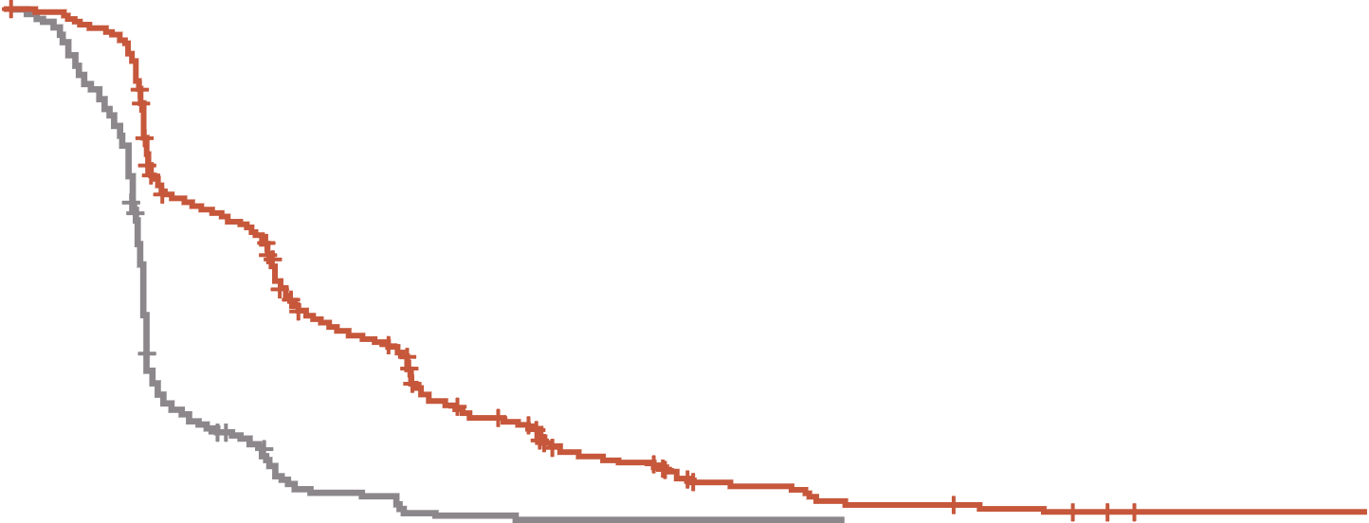
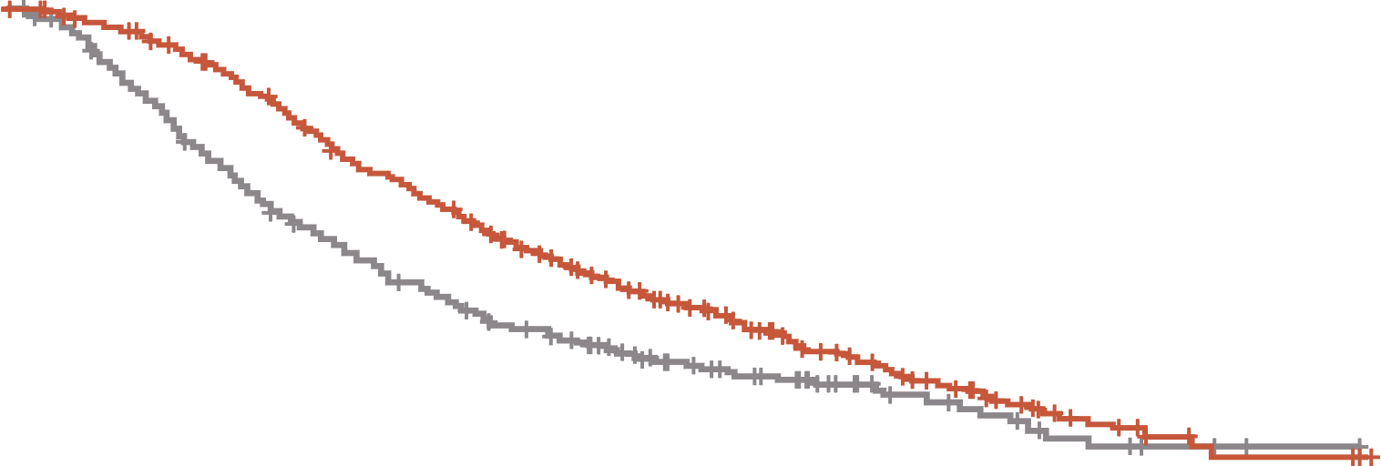
FRESCO-2: Fruquintinib prolonged OS and PFS in patients with refractory mCRC
PROGRESSION-FREE SURVIVAL
OVERALL SURVIVAL
 | Fruquintinib | Placebo
Events/patients (%) | 392/461 (85.0%) | 213/230 (92.6%)
Stratified p-value (log-rank) | <0.001
Stratified HR (95% CI) | 0.321 (0.267, 0.386)
Median (mo) (95% CI) | 3.7 (3.5, 3.8) | 1.8 (1.8, 1.9)
Median PFS difference (mo) | 1.9
 | Fruquintinib | Placebo
Events/patients (%) | 317/461 (68.8%) | 173/230 (75.2%)
Stratified p-value (log-rank) | <0.001
Stratified HR (95% CI) | 0.662 (0.549, 0.800)
Median (mo) (95% CI) | 7.4 (6.7, 8.2) | 4.8 (4.0, 5.8)
Median OS difference (mo) | 2.6
1.0
1.0
0.8
0.8
0.6
0.6
Probability of progression‑free survival (%)
Probability of overall survival (%)
Median follow-up:
Fruquintinib: 11.3 mo
Placebo: 11.2 mo
0.4
0.4
0.2
0.2
Fruquintinib + BSC
Placebo + BSC
Fruquintinib + BSC
Placebo + BSC
0
0
0
1
2
3
4
5
6
7
8
9
10
11
12
13
14
15
16
17
18
19
0
1
2
3
4
5
6
7
8
9
10
11
12
13
14
15
16
17
18
19
Time from randomisation (months)
Time from randomisation (months)
Patients at risk
Fruquintinib
Placebo
461
230
430
194
291
60
256
36
170
12
146
10
89
2
71
2
43
1
36
1
21
1
17
1
10
0
9
6
4
2
2
2
Patients at risk
Fruquintinib
Placebo
461
230
449
216
429
184
395
153
349
125
297
105
266
89
224
73
184
63
143
45
113
37
79
31
58
20
41
15
23
10
14
6
7
3
4
2
4
1
0
0
PFS: 3.7 mo vs. 1.8 mo (HR 0.32; p<0.001)
OS: 7.4 mo vs. 4.8 mo (HR 0.66; p<0.001)
Tumour response:
ORR: 1.5% vs. 0.0% (p=0.059)
DCR: 55.5% vs. 16.1% (p<0.001)
BSC, best supportive care; CI, confidence interval; DCR, disease control rate; HR, hazard ratio; mCRC, metastatic colorectal cancer; mo, months; ORR, objective response rate; OS, overall survival; PFS, progression free survival
Dasari NA, et al. Ann Oncol. 2022;33(suppl_7):S808-S869 (ESMO 2022 oral presentation)

Slide 16
FRESCO-2: safety results
Category, n (%) | Fruquintinib (N=456) | Placebo (N=230)
Any TEAE Grade ≥3 Treatment-related Grade ≥3 Leading to death | 451 (98.9) 286 (62.7) 164 (36.0) 48 (10.5) | 213 (92.6) 116 (50.4) 26 (11.3) 45 (19.6)
Any serious TEAE Grade ≥3 | 171 (37.5) 162 (35.5) | 88 (38.3) 85 (37.0)
TEAEs leading to dose modifications Dose interruption Dose reduction Dose discontinuation | 247 (54.2) 110 (24.1)ª 93 (20.4)^{b} | 70 (30.4) 9 (3.9) 49 (21.3)
ª Most common TEAEs leading to dose reduction in fruquintinib arm: hand-foot syndrome (5.3%), hypertension (3.7%), and asthenia (3.5%) ^{b} Most common TEAE leading to dose discontinuation in the fruquintinib arm: asthenia (1.5%)
TEAE, treatment-emergent adverse event
Dasari NA, et al. Ann Oncol. 2022;33 (suppl_7):S808-S869 (ESMO 2022 oral presentation)

Slide 17
Management of stage IV unresectable mCRC in third-line therapy and beyond
ESMO CLINICAL PRACTICE GUIDELINES
Stage IV unresectable mCRC: third-line and beyond
RAS-wt and BRAF-wt
RAS-mut
BRAFV600E-mut
PD
HER2-positive
PD
PD
PD
Anti-HER2 drugs
(III, C; ESCAT II-B)
Single agent anti-EGFR mAb
(I, A; panitumumab MCBS 3)
or
Irinotecan–cetuximab (II,B)
Regorafenib
(I, A; MCBS 1)
or
Trifluridine–tipiracil
(I, A; MCBS 3)
Encorafenib–cetuximab
(I, A; MCBS 4; ESCAT I-A)
BRAF, proto-oncogene B-Raf; ESCAT, ESMO Scale for Clinical Actionability of Molecular Targets; EGFR, epidermal growth factor receptor; ESMO, European Society for Medical Oncology; HER2, human epidermal growth factor receptor 2; mAb, monoclonal antibody; MCBS, ESMO Magnitude of Clinical Benefit Scale; mCRC, metastatic colorectal cancer; mut, mutant; PD, progressive disease; RAS, RAS proto-oncogene GTPase; wt, wild-type
Cervantes A, et al. Ann Oncol. 2022 Oct 25;S0923-7534(22)04192-8. doi: https://doi.org/10.1016/j.annonc.2022.10.003

Slide 18
Systemic therapy for advanced or metastatic crc
NCCN CLINICAL PRACTICE GUIDELINES
SUBSEQUENT THERAPY
Regorafenib
or
Trifluridine + tipiracil
± bevacizumab
or
Best supportive care
NCCN Guidelines for
Palliative Care
Regorafenib
or
Trifluridine + tipiracil ± bevacizumab
or
([Nivolumab ± ipilimumab]
or pembrolizumab [preferred]) or
dostarlimab-gxly (dMMR/MSI-H only)
or
(Trastuzumab + [pertuzumab or
lapatinib]) or fam-trastuzumab
deruxtecan-nxki (HER2-amplified
and RAS and BRAF WT)
Irinotecan + (cetuximab or panitumumab)
(KRAS/NRAS/BRAF WT only)
or
Encorafenib + (cetuximab or panitumumab)
(BRAF V600E mutation positive)
or
Regorafenib
or
Trifluridine + tipiracil
± bevacizumab
or
Best supportive care
NCCN Guidelines for
Palliative Care
Previous
treatment
with
oxaliplatin
and
irinotecan
See Subsequent Therapy
Regorafenib
or
Trifluridine + tipiracil ± bevacizumab
or
([Nivolumab ± ipilimumab] or pembrolizumab
[preferred]) or dostarlimab-gxly
(dMMR/MSI-H only)
or
(Trastuzumab + [pertuzumab or lapatinib])
or fam-trastuzumab deruxtecan-nxki (HER2-
amplified and RAS and BRAF WT)
See Subsequent Therapy
BRAF, proto-oncogene B-Raf; dMMR, deficient mismatch repair; HER2, human epidermal growth factor receptor 2; KRAS, Kirsten rat sarcoma virus; mCRC, metastatic colorectal cancer; MSI-H, microsatellite instability-high; NCCN, National Comprehensive Cancer Network; NRAS, NRAS Proto-Oncogene GTPase; RAS, RAS proto-oncogene GTPase; WT, wild-type
NCCN guidelines, Version 2.2022. https://www.nccn.org/professionals/physician_gls/pdf/colon.pdf. Accessed December 2022

Slide 19
What’s next?
Combining TS inhibitors with anti-VEGF strategies
TS, thymidylate synthase; VEGF, vascular endothelial growth factor

Slide 20
Sunlight phase 3 study
TAS-102 + bevacizumab
Patients with mCRC
Histologically confirmed mCRC
After two prior regimens
Disease progression or intolerance
Known RAS status
ECOG PS 0-1
Trifluridine/tipiracil p.o. 35 mg/m² BID
day 1-5 and 8-12; every 28 days
Bevacizumab 5 mg/kg IV
day 1 and 15; every 28 days
Follow-up every 8 weeks for radiologic progression and/or survival status
R
1:1
Trifluridine/tipiracil p.o. 35 mg/m² BID
day 1-5 and 8-12; every 28 days
BID, twice a day; ECOG, Eastern Cooperative Oncology Group; IV, intravenous; mCRC, metastatic colorectal cancer; p.o., by mouth; R, randomisation; RAS, RAS proto-oncogene GTPase; TAS-102, trifluridine/tipiracil
Tabernero J, et al. Future Oncol. 2021;17:16:1977-85

Slide 21
RAMTAS-Study (AIO-KRK-0316/ass): phase 3, Ongoing
Ramucirumab + tas-102
Inclusion
advanced metastatic CRCª
ECOG 0-1
adequate hepatic and renal function
N=144^{b}
Stratification
Arm A#
Ramucirumab + TAS-102
(n=72) ^{b}
Until:
Progression
Intolerance
Completion of 6 cycles
prior anti-angiogenic therapy
<12 months
≥12 months
R
1:1
Phase 3; n=213^{c}
TAS-102
(n=72)^{b}
Arm B
Phase 3; n=426^{c}
Phase 3; n=213^{c}
ª failure or intolerance to fluoropyrimidines, oxaliplatin, irinotecan, anti-angiogenic drugs (bevacizumab, aflibercept, ramucirumab or regorafenib and (if indicated) cetuximab or panitumumab
^{b} enrolment for the phase 2 trial (study changed status from a phase 2 to a phase 3 trial with accompanying changes in enrolment numbers)
^{c} estimated enrolment for the phase 3 trial
CRC, colorectal cancer; ECOG, Eastern Cooperative Oncology Group; PD, progressive disease; R, randomisation; TAS-102, trifluridine/tipiracil https://www.clinicaltrials.gov/ct2/show/NCT03520946. Accessed December 2022

Slide 22
Rechallenge with anti-egfr
EGFR, epidermal growth factor receptor

Slide 23
CRICKET Study
a phase 2 single-arm trial
Phase 2, non-comparative, study
N = 28 pts
PD
PD
mCRC pts
RAS and BRAF wt
FOLFIRI/
FOLFOXIRI
+ cetuximab
FOLFOX/XELOX/
FOLFOXIRI
+ bevacizumab
Irinotecan
180 mg/m² iv
+ cetuximab
500 mg/ m² iv
≥6 Months
≥4 Months
At least a RECIST 1.1 partial response
1st-line PFS ≥6 months
PD to 1st-line therapy within 4 weeks after the last cetuximab administration
Time between the end of
1st-line therapy and the start of 3rd-line ≥4 months
Progression to a 2L bevacizumab-containing therapy
Study treatment
BRAF, proto-oncogene B-Raf; FOLFIRI, folinic acid, fluorouracil and irinotecan; FOLFOXIRI, folinic acid, fluorouracil, oxaliplatin and irinotecan; iv, intravenous; mCRC, metastatic colorectal cancer; PD, progressive disease; PFS, progression-free survival; RAS, RAS proto-oncogene GTPase; RECIST, response evaluation criteria in solid tumours; wt, wild-type; XELOX, capecitabine plus oxaliplatin
Cremolini S, et al. JAMA Oncol. 2019;5(3):343-350

Slide 24
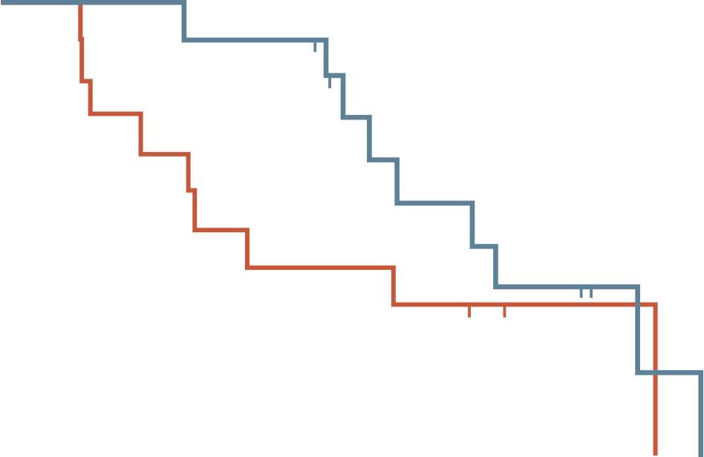
CRICKET trial: anti-egfr Re-Challenge
PROGRESSION-FREE SURVIVAL
OVERALL SURVIVAL
100
100
RAS wild-type ctDNA: 4.0 mo
RAS mutated ctDNA: 1.9 mo
RAS wild-type ctDNA: 12.5 mo
RAS mutated ctDNA: 5.2 mo
80
80
60
60
Probability (%)
Probability (%)
40
40
20
20
0
0
2
4
6
8
10
12
14
0
0
5
10
15
20
Follow-up (months)
Follow-up (months)
Number at risk
Wild-type ctDNA
Mutated ctDNA
Number at risk
Wild-type ctDNA
Mutated ctDNA
13
12
10
5
6
2
4
1
3
0
2
0
1
0
0
0
13
12
12
7
7
5
4
1
0
0
PFS: 4.0 mo vs. 1.9 mo (median overall: 3.4 mo)
OS: 12.5 mo vs. 5.2 mo (median OS 9.8 mo)
Tumour response:
ORR: 21%
DCR: 54%
ctDNA, circulating tumour DNA; DCR, disease control rate; EGFR, epidermal growth factor receptor; mo, months; ORR, objective response rate; OS, overall survival; PFS, progression free survival; RAS, RAS proto-oncogene GTPase
Cremolini C, et al JAMA Oncol. 2019;5(3):343-350

Slide 25
CHRONOS trial: anti-egfr Re-Challenge
1.0
Best response RECIST 1.1 by centralised revision | N | %
Responses (PR+CR) | 8 | 30%
Partial response | 8* | 30%
Stable disease ≥4 mo | 9 | 33%
Stable disease <4 mo | 2 | 7%
Control of disease (PR+SD ≥4 mo) | 17 | 63%
Progressive disease | 8 | 30%
Total | 27 | 100%
* Two PR were unconfirmed
0.8
0.6
Survival probability
0.4
0.2
0.0
0
4
8
12
16
20
24
28
32
36
Time (weeks)
Number at risk
27
26
24
18
15
10
8
5
2
0
Median PFS: 16.4 weeks (9-25)
CR, complete response; EGFR, epidermal growth factor receptor; mo, months; PFS, progression-free survival; PR, partial response; RECIST, response evaluation criteria in solid tumours; SD, stable disease
Sartore-Bianchi A, et al. J Clin Oncol. 2021;39,no. 15_suppl:3506-3506 (ASCO 2021. Abstract #3506, oral presentation)

Slide 26
FIRE-4 study (AIO KRK-0114) phase 3
1st progression
2nd progression
FOLFIRI or FOLFOX or
FOLFOXIRI
+
cetuximab or
panitumumab
FOLFIRI or FOLFOX or FOLFOXIRI
or 5-FU or capecitabine
+/-
bevacizumab or aflibercept or
ranucirumab
(anti-EGFR-free treatment)
(FOLF)-IRI
cetuximab
mCRC
RAS-wild-type
R2
Physician’s
choice
(no anti EGFR
substances)
N=230
1st-line
≥6 Months
2nd-line
≥4 Months
Study treatment
Best response: PR or CR
or
SD with a PFS ≥6 months
5-FU, fluorouracil; CR, complete response; EGFR, epidermal growth factor receptor; FOLFIRI, folinic acid, fluorouracil and irinotecan; FOLFOX, folinic acid, fluorouracil, oxaliplatin and irinotecan; FOLFOXIRI, folinic acid, fluorouracil, oxaliplatin and irinotecan; mCRC, metastatic colorectal cancer; PFS, progression-free survival; PR, partial response; R, randomisation; RAS, RAS proto-oncogene GTPase; SD, stable disease
https://clinicaltrials.gov/ct2/show/NCT02934529. Accessed December 2022; Heinemann V, et al. World congress on GI Cancer 2022 (SO-16, oral presentation)

Slide 27
Other treatment strategies in development

Slide 28
Molecularly selected trials
Study | ClinicalTrials.gov identifier | Treatments | Patient population | Recruitment stage | Primary completion date
CodeBreak 300¹ | NCT05198934 | Sotorasib plus panitumumab Investigator's choice (TAS-102 or regorafenib) | Previously treated (at least 1 line of therapy) mCRC subjects with KRAS G12C mutation (N=153) | Recruiting | April 2023
MOUNTAINEER² | NCT03043313 | Tucatinib combined with trastuzumab Tucatinib monotherapy | HER2 positive mCRC patients (N=117) | Active, not recruiting | March 2022
DESTINY-CRC02³ | NCT04744831 | Trastuzumab deruxtecan | Patients with HER2‑expressing metastatic colorectal cancer (N=122) | Active, not recruiting | February 2023
HER2, human epidermal growth factor receptor 2; mCRC, metastatic colorectal cancer; KRAS, Kirsten rat sarcoma virus
1. https://clinicaltrials.gov/ct2/show/NCT05198934. Accessed December 2022. 2. https://www.clinicaltrials.gov/ct2/show/NCT03043313. Accessed December 2022. 3. https://clinicaltrials.gov/ct2/show/NCT04744831. Accessed December 2022

Slide 29
Non-molecularly selected trials
Study | ClinicalTrials.gov identifier | Treatments | Patient population | Recruitment stage | Primary completion date
MK-7902-017/E7080-G000-325/LEAP-017¹ | NCT04776148 | Lenvatinib + pembrolizumab Standard of care (TAS-102 or regorafenib) | mCRC (N=434) | Active, not recruiting | January 2024
RELATIVITY-123² | NCT05328908 | Relatlimab-nivolumab fixed-dose combination Investigator's choice (TAS-102 or regorafenib) | Non-MSI-H/dMMR CRC participants who failed at least 1 but no more than 4 prior lines of therapy for metastatic disease (N=700) | Recruiting | January 2025
dMMR, deficient mismatch repair; CRC, colorectal cancer; mCRC, metastatic CRC; MSI-H, microsatellite instability high
https://clinicaltrials.gov/ct2/show/NCT04776148. Accessed December 2022. 2. https://clinicaltrials.gov/ct2/show/NCT05328908. Accessed December 2022

Slide 30
summary

Slide 31
Summary
The increased number of potential treatment options for mCRC along with the use of some agents in more than one line or as adjuvant therapy can make the treatment landscape
appear complex
Treatment choice will depend on multiple factors including:
  molecular characterisation of the tumour
  treatment goal
  overall condition
  tumour load
  clinical course
Recommended treatments in the 3L setting include: regorafenib, TAS-102, anti-EGFR, in RAS- and BRAF wild-type patients not previously treated with EGFR antibodies
The refractory setting in CRC is a moving field. We look forward other treatment strategies, in molecularly and non-molecularly selected patients
3L, third line; BRAF, proto-oncogene B-Raf; CRC, colorectal cancer; EGFR, epidermal growth factor receptor; mCRC, metastatic CRC; RAS, RAS proto-oncogene GTPase; TAS-102, trifluridine/tipiracil

Slide 32




REACH GI CONNECT VIA
TWITTER, LINKEDIN, VIMEO & EMAIL
OR VISIT THE GROUP’S WEBSITE https://giconnect.cor2ed.com/
Follow us on Twitter
@giconnectinfo
Follow the
GI CONNECT
group on LinkedIn
Watch us on the
Vimeo Channel
GI CONNECT
Email
louise.handbury
@cor2ed.com

