Slide 2
GI CONNECT
MEETING SUMMARY
Lower gi cancer HIGHLIGHTS
FROM asco gi 2023
Prof. Andrea Sartore-Bianchi, MD
Niguarda Cancer Center, Milano, Italy
Prof. Shubham Pant, MD
University of Texas, MD Anderson Cancer Center, Houston, USA
JANUARY 2023

Slide 3

Developed by GI COnnect
This programme is developed by GI CONNECT,
an international group of experts in the field of
gastrointestinal oncology.
Acknowledgement and disclosures
This GI CONNECT programme is supported through an independent educational grant from Bayer. The programme is therefore independent, the content is not influenced by the supporter and is under the sole responsibility of the experts.
Please note: The views expressed within this programme are the personal opinions of the experts. They do not necessarily represent the views of the experts’ institutions, or the rest of the GI CONNECT group.
Expert Disclaimers:
Prof. Andrea Sartore-Bianchi has received financial support/sponsorship for research support, consultation, or speaker fees from the following companies: Amgen, Bayer, Sanofi and Servier Pharmaceuticals
Prof. Shubham Pant has received financial support/sponsorship for research support, consultation, or speaker fees from the following companies: Xencor, 4D, Tyme

Slide 4


This programme has been developed by the following experts
Prof. Andrea Sartore-Bianchi
Niguarda Cancer Center, Italy
Prof. Shubham Pant
MD Anderson Cancer Center, USA

Slide 5
Clinical takeaways
SUNLIGHT trial¹
  FTD/TPI plus bevacizumab improved OS and PFS in refractory CRC patients and should be considered a standard of care in the refractory treatment setting
Kinetics of postoperative cfDNA/ctDNA²
  Post operative ctDNA-positivity is significantly associated with shorter recurrence-free survival
  Clinical data are insufficient at this stage to consider MRD testing as standard of care for patients with resectable CRC
Study of balstilimab plus botensilimab in MSS mCRC patients³
  Durable objective responses were observed in heavily pre-treated MSS CRC patients treated with balstilimab plus botensilimab. Further investigation is warranted
  NRG-GI002⁴
  Neither veliparib or pembrolizumab significantly improved short-term outcomes in unselected patients when added to TNT
  NRG-GI002 provides TNT outcome data for benchmarking in future LARC trials
CRC, colorectal cancer; cfDNA, cell-free DNA; ctDNA, circulating tumour DNA; FTD/TPI, trifluridine/tipiracil; LARC, locally advanced rectal cancer; MRD, molecular residual disease; MSS, microsatellite stable; OS, overall survival; PFS, progression free survival; TNT, total neoadjuvant therapy
1. Tabernero J, et al. J Clin Oncol 41, 2023 (suppl 4; abstr 4); 2. Cohen SA, et al. J Clin Oncol 41, 2023 (suppl 4; abstr 5); 3. El-Khoueiry AB, et al. J Clin Oncol 41, 2023 (suppl 4; abstr LBA8); 4. George TJ, et al. J Clin Oncol 41, 2023 (suppl 4; abstr 7)

Slide 6
Trifluridine/tipiracil plus bevacizumab for third-line treatment of refractory metastatic colorectal cancer: The phase 3 randomised SUNLIGHT study
Tabernero J, et al. J Clin Oncol 41, 2023 (suppl 4; abstr 4)

Slide 7
Sunlight: background and study design
Standard treatment options for refractory mCRC (3rd/4th line) include trifluridine/tipiracil and regorafenib based on data from the RECOURSE and CORRECT trials^{1,2}
Recent data from the FRESCO-2 study suggests that fruquintinib may also be a future treatment option for these patients³
FTD/TPI plus bevacizumab improved OS and PFS in a previous randomised phase 2 trial in heavily pre-treated mCRC patients⁴
SUNLIGHT was designed to further confirm the efficacy and safety of the combination treatment⁵
Patients with mCRC
Histologically confirmed mCRC
After two prior regimens
Disease progression or intolerance
Known RAS status
ECOG PS 0-1
Trifluridine/tipiracil p.o. 35 mg/m² BID
day 1-5 and 8-12; every 28 days
Bevacizumab 5 mg/kg IV
day 1 and 15; every 28 days
Follow-up every 8 weeks for radiologic progression and/or survival status
Primary endpoint:
OS in full analysis set
Secondary endpoints:
PFS
DCR
ORR
Safety profile
QoL
R
1:1
Trifluridine/tipiracil p.o. 35 mg/m² BID
day 1-5 and 8-12; every 28 days
BID, twice a day; DCR, disease control rate; ECOG PS, Eastern Cooperative Oncology Group performance status; FTD/TPI, trifluridine/tipiracil; IV, intravenous; mCRC, metastatic colorectal cancer; ORR, objective response rate; OS, overall survival; PFS, progression-free survival; p.o., by mouth; QoL, quality of life; R, randomisation; RAS, RAS proto-oncogene GTPase
1. Mayer RJ, et al. N Engl J Med. 2015;372:1909-19; 2. Grothey A, et al. Lancet. 2013;381:303-12; 3. Dasari NA, et al. Ann Oncol. 2022; 33 (suppl_7): S808-S869 (ESMO 2022 presentation); 4. Van Custem E, et al. Ann Oncol 2020; 31 (9): 1160-1168; 5. Tabernero J, et al. J Clin Oncol 41, 2023 (suppl 4; abstr 4) (ASCO GI 2023, oral presentation)

Slide 8
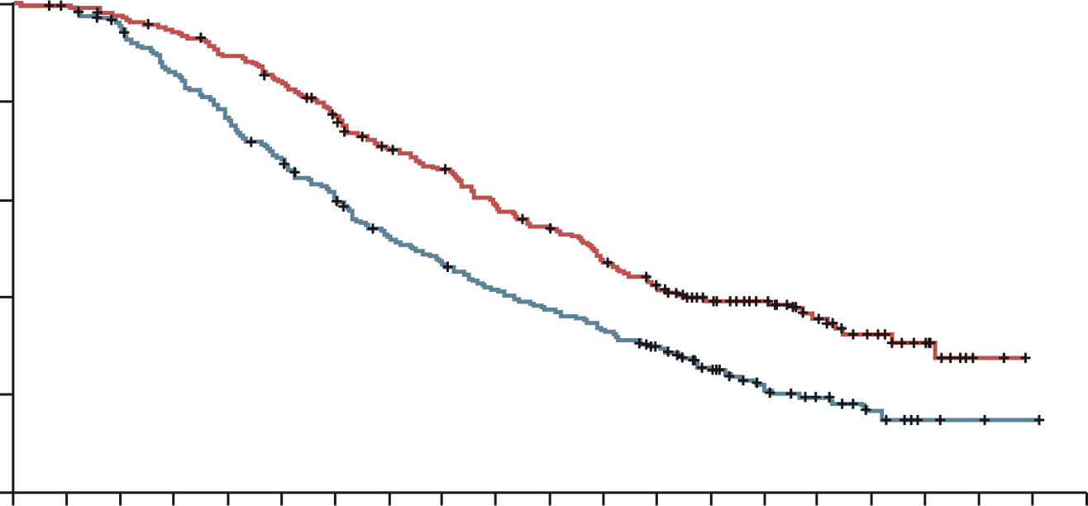
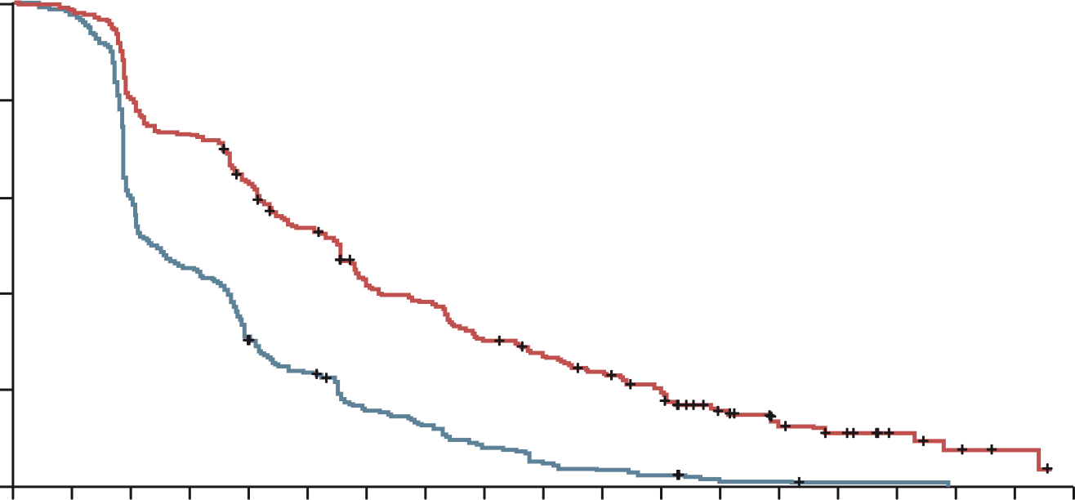
Sunlight: EFFICACY results
(Full Analysis Set)
FTD/TPI plus bevacizumab improved OS and PFS in refractory CRC patients
Overall survival (primary endpoint)
Progression-free survival
 | FTD/TPI plus bevacizumab (N=246) | FTD/TPI (N=246)
Median OS, months | 10.8 | 7.5
6-month OS rate, % | 77 | 61
12-month OS rate, % | 43 | 30
 | FTD/TPI plus bevacizumab (N=246) | FTD/TPI (N=246)
Median PFS, months | 5.6 | 2.4
6-month PFS rate, % | 43 | 16
12-month PFS rate, % | 16 | 1
100
100
80
80
FTD/TPI plus bevacizumab group
FTD/TPI group
60
60
Survival probability (%)
Survival probability (%)
HR, 0.44 (95% CI, 0.36-0.54)
p<0.001
40
40
FTD/TPI plus bevacizumab group
FTD/TPI group
20
HR, 0.61 (95% CI, 0.49-0.77)
p<0.001
20
0
0
1
2
3
4
5
6
7
8
9
10
11
12
13
14
15
16
17
18
19
20
0
0
1
2
3
4
5
6
7
8
9
10
11
12
13
14
15
16
17
18
No. at risk
FTD/TPI plus bevacizumab group
FTD/TPI group
Months
No. at risk
FTD/TPI plus bevacizumab group
FTD/TPI group
Months
246
246
244
242
239
230
230
205
217
184
203
163
183
143
160
120
149
108
131
95
119
85
104
76
88
63
69
44
52
24
37
16
24
10
13
5
2
2
0
1
0
0
246
246
242
236
198
147
179
109
153
74
128
56
99
36
89
29
70
19
61
12
52
8
43
6
25
2
18
2
13
1
7
1
4
0
2
0
0
0
CI, confidence interval; CRC, colorectal cancer; FTD/TPI, trifluridine/tipiracil; HR, hazard ratio; OS, overall survival; PFS, progression free survival
Tabernero J, et al. J Clin Oncol 41, 2023 (suppl 4; abstr 4) (ASCO GI 2023, oral presentation)

Slide 9
Sunlight: SAFETY results
Overall safety
TEAEs in ≥20% of All Patients
Event (any cause), n (%) | FTD/TPI plus bevacizumab (N=246) | FTD/TPI (N=246)
Overall AEs | 241 (98) | 241 (98)
FTD/TPI-related AEs | 221 (90) | 200 (81)
Bevacizumab-related AEs | 119 (48) | NA
Severe (grade ≥3) AEs | 178 (72) | 171 (70)
Serious AEs | 61 (25) | 77 (31)
Treatment-related deaths | 0 | 0
AEs leading to withdrawal from the study | 31 (13) | 31 (13)
TEAE, n (%) | FTD/TPI plus bevacizumab (N=246) |  | FTD/TPI (N=246)
 | Any grade | Grade 3 or 4 | Any grade | Grade 3 or 4
Neutropenia | 153 (62) | 106 (43) | 126 (51) | 79 (32)
Nausea | 91 (37) | 4 (2) | 67 (27) | 4 (2)
Anemia | 71 (29) | 15 (6) | 78 (32) | 27 (11)
Asthenia | 60 (24) | 10 (4) | 55 (22) | 10 (4)
Fatigue | 53 (22) | 3 (1) | 40 (16) | 9 (4)
Diarrhea | 51 (21) | 2 (1) | 46 (19) | 6 (2)
Decreased appetite | 50 (20) | 2 (1) | 38 (15) | 3 (1)
Dose modification, n (%) | FTD/TPI plus bevacizumab (N=246) | FTD/TPI (N=246)
Dose reductions | 40 (16) | 30 (12)
Dose delays | 171 (70) | 131 (53)
Hypertension (10% vs 2%), nausea and neutropenia occurred more frequently in the combination group
  One case of febrile neutropenia with FTD/TPI plus bevacizumab versus six with FTD/TPI
AE, adverse event; FTD/TPI, trifluridine/tipiracil; TEAE, treatment emergent AE
Tabernero J, et al. J Clin Oncol 41, 2023 (suppl 4; abstr 4) (ASCO GI 2023, oral presentation)

Slide 10
Sunlight: summary
FTD/TPI plus bevacizumab improved OS and PFS in refractory CRC patients
Improvements in survival occurred in all clinically relevant subgroups
The safety profile was manageable and consistent with the individual safety profiles of FTD/TPI and bevacizumab
Clinical Takeaway
SUNLIGHT results indicate that FTD/TPI plus bevacizumab should be considered a standard of care in the refractory treatment setting
There was a modest increase in toxicities and financial cost, but this comes with significant improvements in mPFS and mOS
CRC, colorectal cancer; FTD/TPI, trifluridine/tipiracil; (m)OS, median overall survival; (m)PFS, median progression-free survival
Tabernero J, et al. J Clin Oncol 41, 2023 (suppl 4; abstr 4) (ASCO GI 2023, oral presentation); Deming D, Discussant of abstract 4 (ASCO GI 2023)

Slide 11
Kinetics of postoperative circulating cell-free DNA and impact on MRD detection rates in patients with resected stage I-III CRC
Cohen SA, et al. J Clin Oncol 41, 2023 (suppl 4; abstr 5)
CRC, colorectal cancer; MRD, minimal residual detection

Slide 12
background and study design
background
Circulating tumour DNA (ctDNA) has emerged as a useful biomarker for detecting molecular residual disease (MRD) in colorectal cancer (CRC)^{1,2}
High levels of cell-free DNA (cfDNA) from normal tissue may limit the detection of tumour-derived ctDNA in certain clinical scenarios (immediately after surgery or during adjuvant therapy)³
The optimal timing of blood collection for reliable MRD detection after surgery or adjuvant therapy needs to be determined
Study design
A retrospective, US-based, multi-institutional study where data from commercial ctDNA testing in 16,347 patients with stage I-III CRC were analysed
  Complete clinical data were available for 417 patients with 2,538 plasma samples collected between 6/2019 and 4/2022
  Median follow-up for relapsed and non-relapsed patients was 730 and 615 days, respectively
  A NGS assay (Signatera) was used to quantify ctDNA prior to surgery and postoperatively
  The kinetics of total cfDNA was analysed and compared with the ctDNA MRD positivity rates at various time points after surgery
NGS, next generation sequencing; US, United States
1. Kotani D, et al. Nature Med. 2023;29:127-34; 2. Malla M, et al. J Clin Oncol. 2022;40:2846-57; 3. Henriksen TV, et al. Mol Oncol. 2020;14:1670-9; 4. Cohen SA, et al. J Clin Oncol 41, 2023 (suppl 4; abstr 5) (ASCO GI 2023, oral presentation)

Slide 13
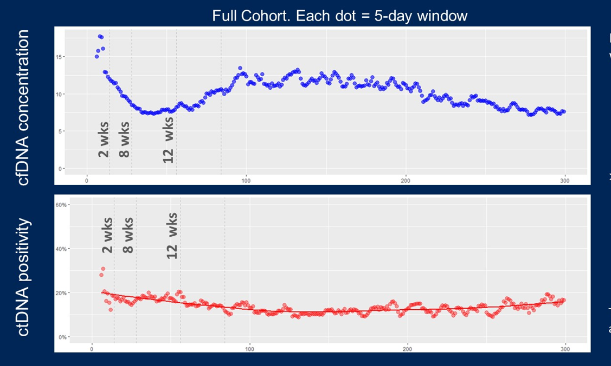
results
cfDNa (A) Concentration AND ctDNA positivity (B) over time post-surgery
Recurrence-free survival by ctdna status
A
MRD window (2-8 weeks), N=154
Full Cohort. Each dot = 5-day window
1.00
15
0.75
10
cfDNA concentration
HR = 14.1 (95% CI: 5.8-34.0)
p<0.0001
5
Recurrence-free survival
0.50
0
B
0
100
200
300
60%
0.25
40%
Recurrence during follow-up:
ctDNA-ve: 5.8% (7/120)
ctDNA+ve: 52.9% (18/34)
ctDNA positivity
0.00
20%
0
250
500
750
1000
0%
No. at risk
ctDNA-
ctDNA+
Days from surgery
0
100
200
300
120
34
108
18
62
5
20
2
0
0
cfDNA, cell-free DNA, CI, confidence interval; ctDNA, circulating tumour DNA; HR, hazard ratio; MRD, molecular residual disease
Cohen SA, et al. J Clin Oncol 41, 2023 (suppl 4; abstr 5) (ASCO GI 2023, oral presentation)

Slide 14
summary
cfDNA concentration is significantly increased in first 2 weeks post surgery
Higher cfDNA levels did not impact ctDNA detection
High ctDNA positivity in the first week after surgery
Standard MRD testing windows could start as early as 2 weeks after surgery (Day 15+)
Testing for MRD between weeks 2-4 showed similar sensitivity as weeks 4-8
Post operative ctDNA-positivity is significantly associated with shorter recurrence-free survival
cfDNA, cell-free DNA; CRC, colorectal cancer; ctDNA, circulating tumour DNA; MRD, minimal residual disease
Cohen SA, et al. J Clin Oncol 41, 2023 (suppl 4; abstr 5) (ASCO GI 2023, oral presentation)

Slide 15
summary
CLINICAL TAKEAWAY
  Levels of cfDNA in plasma do not significantly affect ctDNA detection
  Standard testing window for MRD could start as early as 15 days postoperatively
  MRD testing via ctDNA is not standard of care for CRC
  The study provides the first stage III data and builds on the DYNAMIC trial results which demonstrated that a ctDNA-guided approach to the treatment of stage II colon cancer reduced adjuvant chemotherapy use without compromising recurrence-free survival
  At this stage, ctDNA is an interesting biomarker but further studies required before it can be used to guide treatment decisions
cfDNA, cell-free DNA; CRC, colorectal cancer; ctDNA, circulating tumour DNA; MRD, minimal residual disease
Cohen SA, et al. J Clin Oncol 41, 2023 (suppl 4; abstr 5) (ASCO GI 2023, oral presentation); Deming D. Discussant of abstract 5 (ASCO GI 2023); Tie J, et al. N Engl J Med 2022; 386: 2261-2272

Slide 16
Results from a phase 1a/1b study of BOT, a novel innate/adaptive immune activator, plus BAL (anti-PD-1 antibody) in metastatic heavily pre-treated MSS CRC
El-Khoueiry AB, et al. J Clin Oncol 41, 2023 (suppl 4; abstr LBA8)
BAL, balstilimab; BOT, botensilimab; CRC, colorectal cancer; MSS, microsatellite stable; PD-1; programmed cell death protein 1

Slide 17
background and study design
Botensilimab is an Fc-enhanced CTLA-4 inhibitor which is active in ‘cold’ and IO refractory tumours^{1,2}
Balstilimab is a PD-1 inhibitor with safety and efficacy analogous to approved anti-PD-1 mAbs^{3,4}
Results are presented for an expanded phase 1a/1b study of BOT plus BAL in MSS CRC patients⁵
Key eligibility for CRC:
Refractory metastatic CRC
MSS by local assessment
Prior IO allowed
Tbili ≤1.5 × IULN
AST/ALT ≤2.5 × IULN
BOT
+
BAL
Fc-enhanced CTLA-4
1 or 2 mg/kg Q6W
PD-1
3 mg/kg Q2W
Combination therapy
Evaluable population:
Treated with 1 or 2 mg/kg bot + bal as of 29 August 2022 with ≥1 Q6W imaging assessment
0
2
4
6
8
10
12
Week
NCT03860272
ALT, alanine aminotransferase; AST, aspartate aminotransferase; BAL, balstilimab; BOT, botensilimab; CRC, colorectal cancer; CTLA-4, cytotoxic T-lymphocyte-associated protein 4; IO, immuno-oncology; IULN, institutional upper limit of normal; mAbs, monoclonal antibodies; MSS, microsatellite stable; PD-1; programmed cell death protein 1; Q’X’W, every ‘X’ weeks; Tbili, bilirubin test
1. El-Khoueiry AB. SITC 2021 Annual meeting. Poster #479; 2. Wilky B, SITC 2022 Annual Meeting. Oral #778; 3. O’Malley et al. Gynecol. Oncol. 2021;163:274-80;
4. O’Malley et al. J Clin Oncol 2022;40(7):762-71; 5. El-Khoueiry AB, et al. J Clin Oncol 41, 2023 (suppl 4; abstr LBA8) (ASCO GI 2023, oral presentation)

Slide 18
results
BASELINE DATA
Median age: 57 years (25–83), 57% female
Median prior lines of therapy: 4
31% had received prior immunotherapy
EFFICACY
Any grade TRAEs in ≥15% of All Patients
Efficacy | N=70
ORR, % (95% CI) | 23 (14-34)
BOR, n (%)
CR | 1 (1)
PR | 15 (21)
SD | 37 (53)
DCR (CR + PR + SD), % (95% CI) | 76 (64-85)
Median OS, months (95% CI) | NR (10.3-NR)
Median PFS, months (95% CI) | 4.1 (2.8-5.5)
Median F/U, months (min, max) | 7 (2, 31)
N (%) | All Grade | Grade 3 | Grade 4
Any TRAE | 64 (91) | 28 (40) | 2 (3)
Gastrointestinal
IM diarrhea/colitisª | 30 (43) | 14 (20) | 1 (1)
Nausea | 16 (23) | 1 (1) | 0
Constitutional
Fatigue | 24 (34) | 3 (4) | 0
Decreased appetite | 19 (27) | 0 | 0
Chills | 15 (21) | 0 | 0
Pyrexia | 16 (23) | 3 (4) | 0
N (%) | All Grade | Grade 3 | Grade 4
Skin
Rash | 19 (27) | 0 | 0
Pruritus | 12 (17) | 0 | 0
Endocrine
Hypo/hyperthyroidism | 11 (16) | 0 | 0
ªimmune-mediated diarrhoea/colitis defined as patients who received steroids or infliximab
BOR, best overall response; CI, confidence interval; CR, complete response; DCR, disease control rate; F/U, follow-up; NR, not reached; ORR, objective response rate; PFS, progression free survival; PR, partial response; SD, stable disease; TRAE, treatment-related adverse event
El-Khoueiry AB, et al. J Clin Oncol 41, 2023 (suppl 4; abstr LBA8) (ASCO GI 2023, oral presentation)

Slide 19
results
Overall survival
Efficacy evaluable population, N=70
 | Overall | No active liver mets | Active liver mets
Median, OS (95% CI) | NR (10.3-NR) | NR (NR-NR) | 9.4 (6.1-NR)
12-month, OS (95% CI) | 63 (46-76) | 81 (66-90) | 40 (17-62)
1.0
0.9
0.6
0.6
0.6
Survival probability (%)
0.5
0.4
0.3
No active liver mets
All patients
Active liver mets
0.2
0.3
0.0
0
3
6
9
12
15
18
21
24
27
30
33
Months
CI, confidence interval; NR, not reached; OS, overall survival
El-Khoueiry AB, et al. J Clin Oncol 41, 2023 (suppl 4; abstr LBA8) (ASCO GI 2023, oral presentation)

Slide 20
summary
Durable objective responses were observed in heavily pre-treated MSS CRC patients treated with BOT plus BAL
The combination treatment was well tolerated with no new immune-mediated safety signals
All objective responses and a better overall survival were observed to patients w/o active liver metastases
A global phase 2 trial is ongoing investigating BOT as monotherapy and in combination with BAL or standard of care in patients with MSS CRC (NCT05608044)
Clinical Takeaway
Interesting early data for the first human trial of botensilimab plus balstilimab in patients with advanced MSS CRC. Further investigation is warranted.
BAL, balstilimab; BOT, botensilimab; CRC, colorectal cancer; MSS, microsatellite stable; w/o, without
El-Khoueiry AB, et al. J Clin Oncol 41, 2023 (suppl 4; abstr LBA8) (ASCO GI 2023, oral presentation)

Slide 21
Long-term results from NRG-GI002: A phase 2 clinical trial platform using TNT in LARC
George TJ, et al. J Clin Oncol 41, 2023 (suppl 4; abstr 7)
LARC, locally advanced rectal cancer; TNT, total neoadjuvant therapy

Slide 22
NRG-GI002: background and study design
Total neoadjuvant therapy (TNT) is a therapeutic strategy that incorporates chemotherapy with chemoradiotherapy antecedent to surgery
The NRG-GI002 nested, randomised, phase 2 study was designed to rapidly seek activity signals for new agents in TNT
Long-term outcomes of all patients enrolled in the NRG-GI002 study are presented
EA1 hypothesis: PARPi can enhance RT‑induced synthetic lethality
EA2 hypothesis: RT can enhance anti-tumour immunogenicity via release of neoantigens and immunogenic cell surface marker upregulation
FOLFOX × 8
XRT +
capecitabine
Surgery
Very High-risk Stage II & III
EA1
FOLFOX × 8
XRT +
capecitabine +
veliparib
Surgery
Low lying
Bulky
N2
APR req’d
Locally
advanced
rectal
cancer
EA2
R
Primary endpoint:
Neoadjuvant rectal score (NAR)
Key secondary endpoints:
pCR
cCR rates
OS
DFS
Toxicity
FOLFOX × 8
XRT +
capecitabine +
pembrolizumab
Surgery
Stratified by cT
and cN stage
Arms added through protocol amendments
FOLFOX × 8
+
XRT +
capecitabine +
Surgery
?
?
NCT02921256
APR, Abdominoperineal resection; cCR, clinical complete response; cT, clinical T stage; DFS, disease-free survival; EA, experimental arms; FOLFOX, folinic acid, fluorouracil and oxaliplatin; N, evaluation of regional lymph nodes; OS, overall survival; PARPi, poly (ADP-ribose) polymerase inhibitor; pCR, pathological complete response; RT, radiation; XRT, radiotherapy
George TJ, et al. J Clin Oncol 41, 2023 (suppl 4; abstr 7) (ASCO GI 2023, oral presentation)

Slide 23
NRG-GI002: results
Patient tumour characteristics
EFFICACY RESULTS
First comparison (EA1) – Median follow-up: EA1 = 3.5 yrs
Outcome | Control (N=88) | Veliparib (N=90) | Stat | p value (*Log rank)
NAR score | Mean 12.5 95% CI (9.7, 15.2) | Mean 13.3 95% CI (10.1, 16.5) | Mean diff -0.8 (95% CI (-5.0, 3.3) | 0.81
3 yr DFS | 67% 29 events | 60% 38 events | HR=1.36 95% CI (0.83, 2.25) | 0.23*
3 yr OS | 92% 7 deaths | 85% 14 deaths | HR=2.13 95% CI (0.86, 5.29) | 0.10*
Patient tumour characteristics, % | EA1 | EA2
Distal | 65 | 72
Bulky | 58 | 62
N2 | 43 | 39
Not SSS candidate | 50 | 46
T4 | 29 | 22
Addition secondary endpoints
(control vs veliparib)
pCR: 21.6 vs 33.8%
cCR: 28.2 vs 33.3%
SSS: 52.5 vs 59.3%
Second comparison (EA2) – Median follow-up: EA2 = 3.15 yrs
Outcome | Control (N=95) | Pembrolizumab (N=90) | Stat | p value (*Log rank)
NAR score | Mean 14.4 95% CI (11.1, 17.7) | Mean 11.5 95% CI (8.5, 14.5) | Mean diff 2.9 95% CI (-1.6, 7.3) | 0.21
3 yr DFS | 64% 33 events | 64% 31 events | HR=0.95 95% CI (0.58, 1.55) | 0.82*
3 yr OS | 87% 13 deaths | 95% 6 deaths | HR=0.35 95% CI (0.12, 1.00) | 0.04*
Addition secondary endpoints
(control vs veliparib)
pCR: 29.4 vs 31.9%
cCR: 13.6 vs 13.9%
SSS: 71.0 vs 59.4%
cCR, clinical complete response; CI, confidence interval; DFS, disease free survival; EA1/2, experimental arm 1/2; HR, hazard ratio; N, evaluation of regional lymph nodes; NAR, neoadjuvant rectal; OS, overall survival; pCR, pathological complete response; SSS, sphincter-sparing surgery; T, T stage; TNT, total neoadjuvant therapy; yr/s, year/s
George TJ, et al. J Clin Oncol 41, 2023 (suppl 4; abstr 7) (ASCO GI 2023, oral presentation)

Slide 24
NRG-GI002: summary
Neither veliparib or pembrolizumab significantly improved short-term outcomes in unselected patients when added to TNT
Pembrolizumab improved 3-year OS despite no significant improvement in NAR score or DFS
Clinical Takeaway
The NRG-GI002 provides TNT outcome data for benchmarking in future LARC trials
Further work is ongoing to identify subgroups that might benefit from these targeted treatments
DFS, disease-free survival; LARC, locally advanced rectal cancer; NAR, neoadjuvant rectal; OS, overall survival; TNT, total neoadjuvant therapy
George TJ, et al. J Clin Oncol 41, 2023 (suppl 4; abstr 7) (ASCO GI 2023, oral presentation)

