Slide 1


Pain management with IUD placement
February 2023

Slide 2
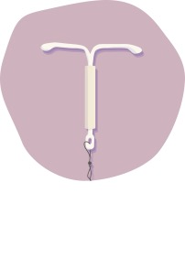



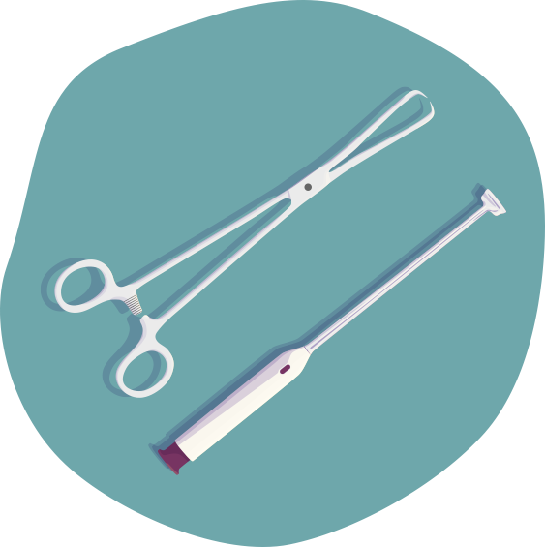

Clinical takeaways
Fear of pain is a widespread concern among people considering an IUD
With the right tools you can address anxiety and pain before, during, and after placement
A pre-placement conversation puts the patient in control, and allows you to assess and address concerns and prepare for placement
The way you choose and use the instruments needed to place the IUD impacts the pain experienced by the patient
IUD, intrauterine device
2

Slide 3

DEVELOPED BY OBSTETRICS & GYNECOLOGY CONNECT
This programme is developed by OBSTETRICS & GYNECOLOGY CONNECT, an international group of experts in the field of obstetrics and gynaecology
Acknowledgement and disclosures
This OBSTETRICS & GYNECOLOGY CONNECT programme is supported through an independent educational grant from Aspivix. The programme is therefore independent, the content is not influenced by the supporter and is under the sole responsibility of the experts.
Please note: The views expressed within this programme are the personal opinions of the experts. They do not necessarily represent the views of the experts’ organisations, or the rest of the OBSTETRICS & GYNECOLOGY CONNECT group.
Expert disclaimers:
Dr Carolyn Westhoff has received financial support/sponsorship for research from Sebela Women's Health (Sebela Pharmaceuticals).
Dr Michal Yaron’s institution has received financial support/sponsorship for research from Aspivix.
Patty Cason has received financial support/sponsorship for research or consultation from Sebela Women's Health (Sebela Pharmaceuticals), Organon, and Merck.
3

Slide 4




This programme has been developed by a multidisciplinary panel of experts
Patty Cason, RN, MS,
FNP-BC
Dr Carolyn Westhoff
Dr Michal Yaron
Sarah Billinghurst Solomon Professor of Reproductive Health
at the Department of Obstetrics and Gynecology, Columbia University, New York, NY, USA
Editor-in-Chief of Contraception
Published more than 250 articles on contraception and abortion
Head of the Gynaecology Outpatient Clinic at the Department of Woman, Child and Adolescent Medicine at Geneva University Hospitals, Geneva, Switzerland
Global experience as a practicing obstetrician–gynaecologist working in Israel, Canada, and Switzerland
Assistant Clinical Professor, School of Nursing, University of California, Los Angeles, CA, USA
Family nurse practitioner, trainer, and educator with a specialty in sexual and reproductive health
More than 40 years of experience in a wide variety of settings
4

Slide 5
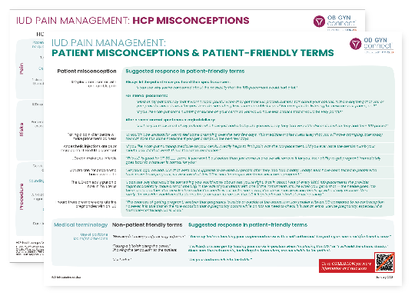
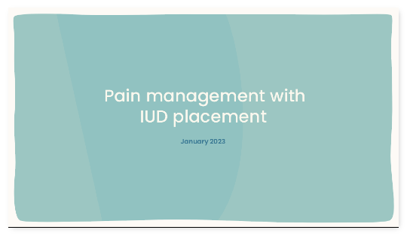
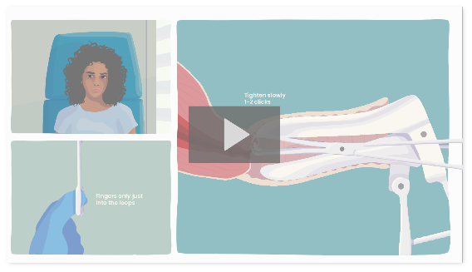
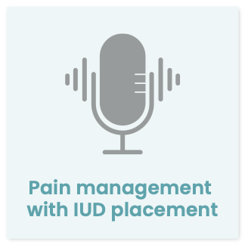

What will you learn in this programme?
This slide deck is part of a programme consisting of four short educational resources aiming to support HCPs who place IUDs in the reduction of anxiety and pain before, during, and after IUD placement
SLIDE DECK FULL OVERVIEW
VIDEO
THE PAIN MANAGEMENT TOOLBOX
FLASHCARD
COMMON MISCONCEPTIONS
PODCAST
EXPERTS SHARE THEIR PERSONAL TIPS AND TRICKS
These four educational resources will provide you with tools and information to address anxiety and pain around IUD placement
UPON COMPLETION OF THIS PROGRAMME, YOU WILL:
Understand the causes of pain during and after IUD placement, including the need for cervix stabilisation
Know alternative and innovative solutions to reduce pain during and after IUD placement
Actively address pain and anxiety associated with IUD placement
Understand the potential for innovation in procedures similar to IUD placement
Be able to implement guidelines on pain management before, during, and after IUD placement
HCP, healthcare professional; IUD, intrauterine device
5

Slide 6
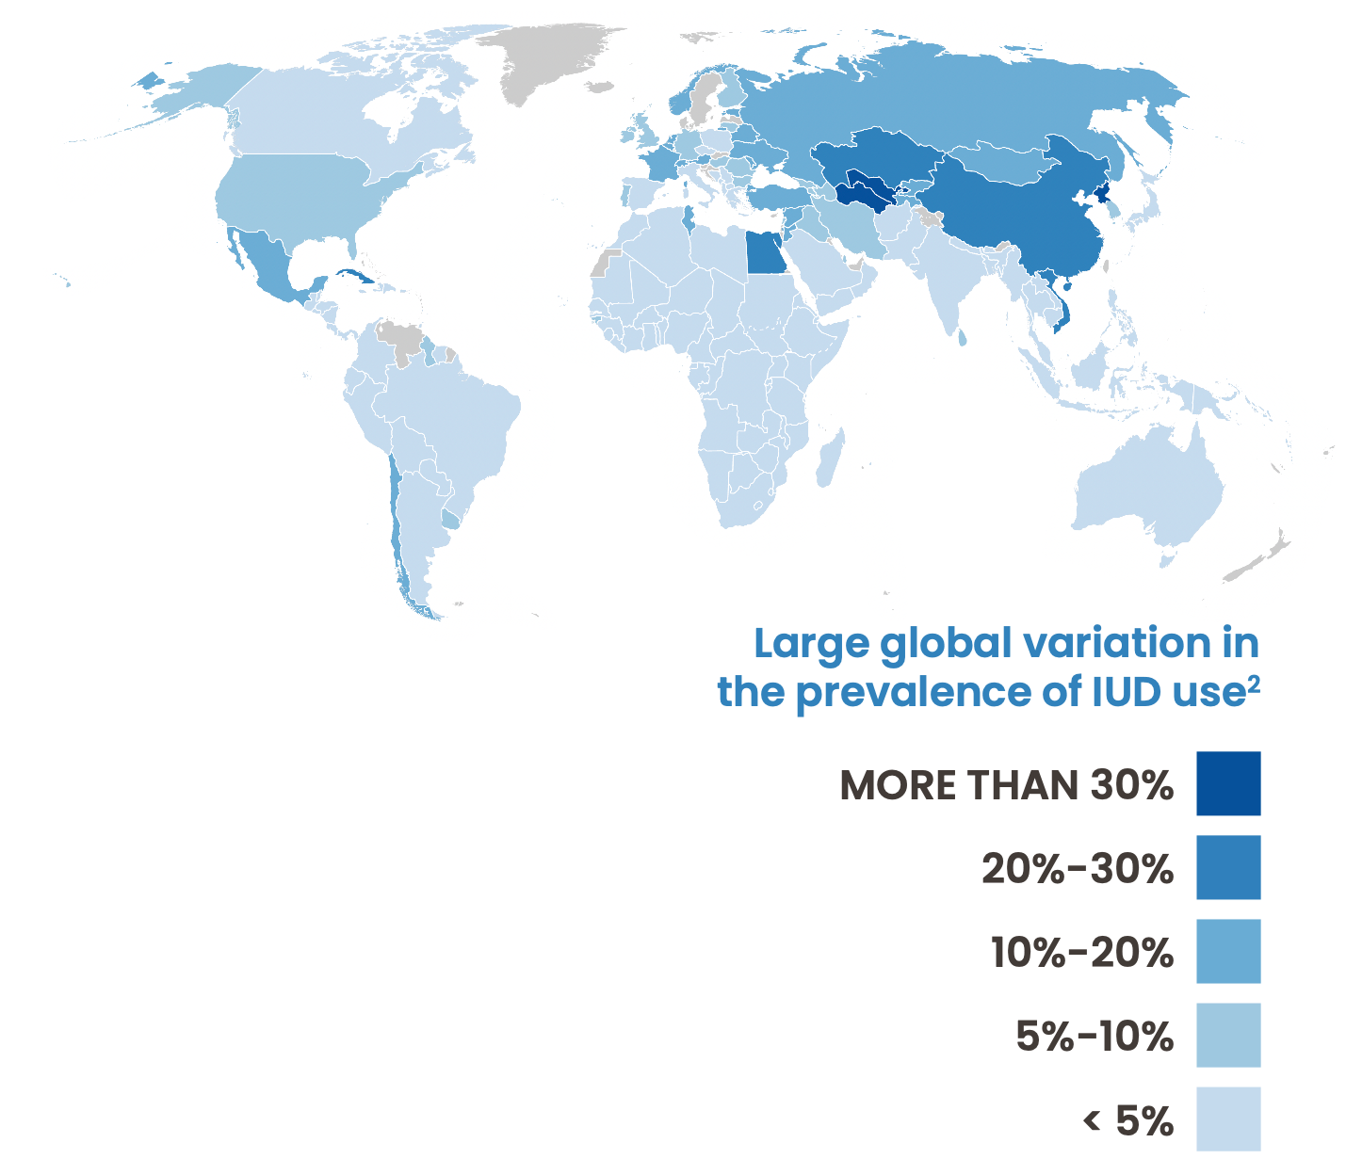
IUDs are associated with high patient satisfaction, but fear of pain is a widespread concern among people considering an IUD
IUDs are one of the most effective methods of contraception.¹
~17% of women of reproductive age use an IUD, with 159 million users worldwide in 2019²
The two main types of IUDs include levonorgestrel-containing and copper devices, both indicated for contraception; various sizes are available.
52 mg levonorgestrel-containing IUDs are also indicated for the treatment of abnormal uterine bleeding and during menopause, for endometrium protection during hormone therapy³
IUDs are also used (mostly off-label) as emergency contraception^{4,5}
IUD placement is also possible immediately after aspiration abortion (after confirmation of successful procedure) or at the check-up following medication abortion
Key contraindications for IUDs are current pelvic infection, pregnancy, certain malignancies (genital tract carcinomas; breast and liver cancer for hormone-containing IUDs), and uterine anomalies.⁶
IUD placement may be painful in some people, and fear of pain is still one of concerns people have about using an IUD.⁷
BACKGROUND READING
More information on eligibility criteria for IUDs: WHO Medical Eligibility Criteria for Contraceptive Use or US Medical Eligibility Criteria for Contraceptive Use. More information on advantages and disadvantages of IUDs, as well as adverse events: Guidelines from The Faculty of Sexual and Reproductive Healthcare.
IUD, intrauterine device
1. Cleland K, et al. Hum Reprod. 2012;27:1994-2000; 2. United Nations, Department of Economic and Social Affairs, Population Division. Contraceptive Use by Method 2019: Data Booklet (ST/ESA/SER.A/435); 3. Grandi G, et al. Expert Opin Pharmacother. 2018;19:677-86; 4. Goldstuck ND, et al. Int J Womens Health. 2019;11:471-9; 5. Contraception d'urgence, methode Fiche Memo, April 2013, MAJ July 2019. 6. Faculty of Sexual & Reproductive Healthcare Clinical Effectiveness Unit of the Royal College of Obstetricians and Gynaecologists. Clinical Guidance: Intrauterine Contraception. September 2019; 7. Gemzell-Danielsson K, et al. Acta Obstet Gynecol Scand. 2019;98:1500-13
6

Slide 7







When placing an IUD, start with a pre-placement conversation
Anticipation or concern around potential pain is a predictor for actual pain.¹⁻³
Before placement, it is essential to have a conversation with the patient to address any concerns around the IUD and the placement, putting the patient in control and allowing the HCPs to assess and address concerns, explain the procedure, and prepare for placement.
This conversation should take place in the same visit as the placement; if this is not possible, schedule a separate (virtual or in-person) pre-placement visit
Assess the patient’s knowledge and address any misconceptions
Explain the procedure and potential complications in patient-centred language
Answer any questions the patient may have
Ask for consent to proceed
See the flashcard associated with this programme for suggestions
On the next slide you will find tips for addressing vasovagal syncope
POTENTIAL TOPICS TO EXPLORE
1
Parity, time since last pregnancy, and type of delivery (vaginal or caesarean)
History of dysmenorrhea
3
Pain during speculum insertion or pelvic exam
Apprehension/anticipation of pain
(Negative) perceptions of IUDs
6
Anxiety, stress
Sexual trauma
Breastfeeding
4
7
2
5
8
HCP, healthcare professional; IUD, intrauterine device
1. Gemzell-Danielsson K, et al. Acta Obstet Gynecol Scand. 2019;98:1500-13; 2. Allen RH, et al. J Obstet Gynecol. 2014;34:263-7; 3. Dina B, et al. Am J Obstet Gynecol. 2018;218:236.e1-9
7

Slide 8

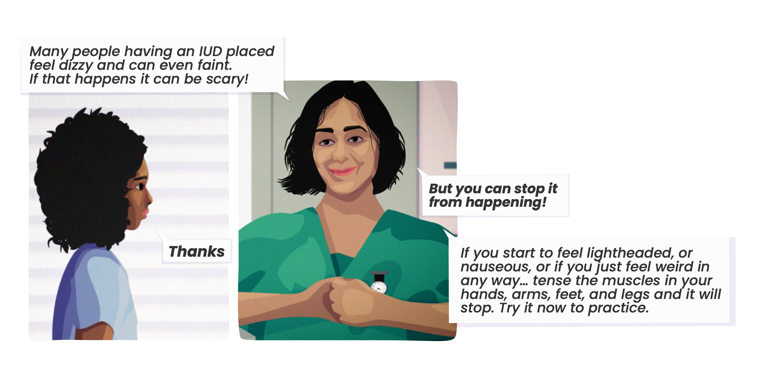
Prevention of vasovagal collapse starts before placement
Up to half of patients have pre-syncopal symptoms when they have an IUD placed.¹
Isometric contractions of the extremities and intense gripping of the arm, hand, leg, and foot muscles can stop the vasovagal reaction.^{2,3}
As part of the pre-placement conversation, educate the patient on the potential for vasovagal reactions, and on what to do if they experience pre-syncopal symptoms immediately after IUD placement.
PRE-SYNCOPAL SIGNS AND SYMPTOMS
Facial pallor
Yawning
Pupillary dilatation
Nervousness
Weakness
Lightheadedness
Diaphoresis
Visual blurring
Headache
Nausea
Feeling warm or cold
Sudden need to go to the bathroom
IUD, intrauterine device
1. Hall AM, Kutler BA. J Fam Plann Reprod Health Care. 2016;42:36-42; 2. van Dijk N, et al. J Am Coll Cardiol. 2006;48:1652-7; 3. Benditt DG, Nguyen JT. J Am Coll Cardiol. 2009;53:1741-51
8

Slide 9

Predictors of pain experience
Factor
Aspect thought to be associated with more pain¹
History
Low or nulliparity²⁻⁴
Caesarean delivery;5 significantly less pain with a history of vaginal delivery⁶
Longer interval between birth and placement (≥13 months)²
History of dysmenorrhea^{3,7}
Circumstances at the time of placement
Not breastfeeding²
Anticipating pain⁴⁻⁶
During placement
Placement difficulty⁶
Placement of an IUD with a thicker (4.8 mm) inserter⁴
Greater cervical resistance⁸
No difference in pain with placement during or outside of menstruation in parous and nulliparous women⁹
IUD, intrauterine device
1. Gemzell-Danielsson K, et al. Acta Obstet Gynecol Scand. 2019;98:1500-13; 2. Chi IC, et al. Contraception. 1996;34:483-95; 3. Allen RH, et al. Contraception. 2013;88:730-36; 4. Dina B, et al. Am J Obstet Gynecol. 2018;218:236.e1-9; 5. Santos ARG, et al. Contraception. 2013;88:164-8; 6. Allen RH, et al. J Obstet Gynecol. 2014;34:263-7; 7. Kaislasuo J, et al . Obstet Gynecol. 2014;124:345-53; 8. Goldstuck ND, Matthews ML. Clin Reprod Fertil. 1985;3:65-71;9. van der Heijden P, et al. BJOG. 2017;124:299-305
9

Slide 10
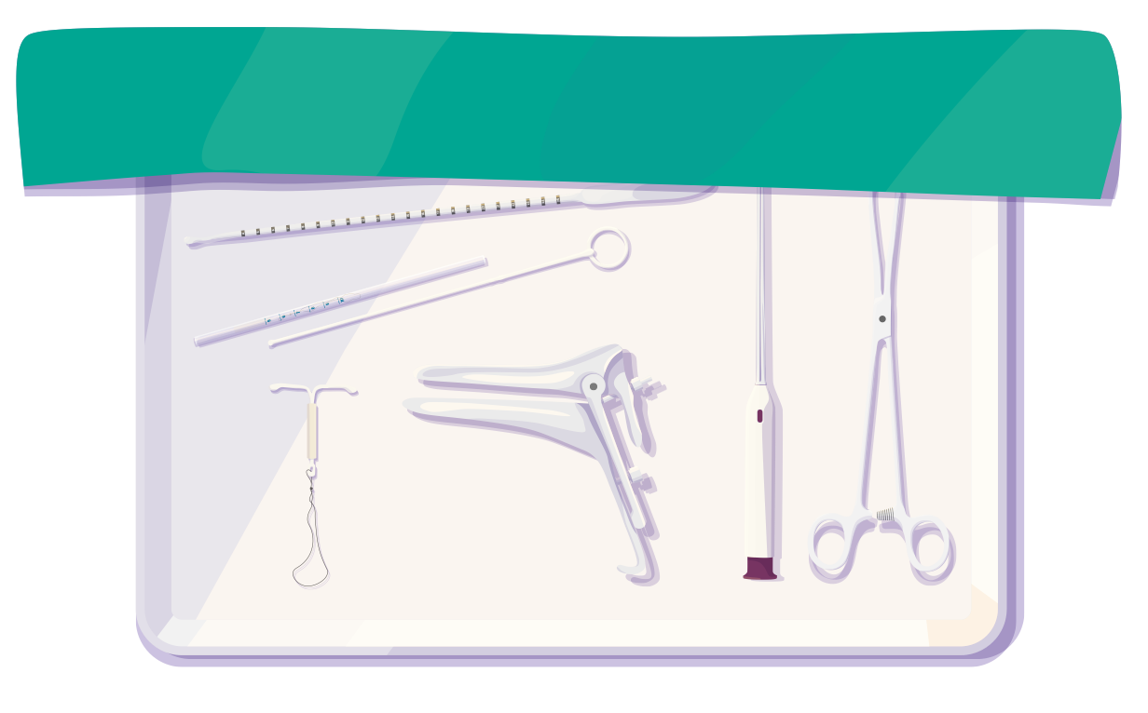



Practical organisation: setup for success
Organisation
Make sure all instruments and materials are readily available, but covered
Make sure there is sufficient light, and that you can work in a comfortable position
Make sure the space is comfortable and warm
Keep the patient as clothed as possible
Warm instruments before use
Preparation
Perform a bimanual exam to ascertain size and position of uterus
If available, consider performing an ultrasound to exclude malformations and to assess uterine depth
Assess the depth of the uterus and cervical resistance using a sound/hysterometer; in some cases, this may inform the choice of device (based on the size of the device or the diameter of the insertion tube)
Faculty of Sexual & Reproductive Healthcare Clinical Effectiveness Unit of the Royal College of Obstetricians and Gynaecologists. Clinical Guidance: Intrauterine Contraception. September 2019; Serfaty D, et al. Eur J Contracep Rep Health Care. 2019;24:305-13
10

Slide 11


Apply trauma-informed care and consider anaesthetic options
Apply trauma-informed care throughout the procedure
MORE INFORMATION
www.traumainformedcare.chcs.org
Respect a ‘no’ or other signals to stop from the patient
Pause for a moment and allow the patient to make the choice whether to proceed or not
VARIOUS ANAESTHETIC OPTIONS ARE AVAILABLE
Practical tips
Paracervical (or intracervical) blocks^{1,2}
Although 2016 ACOG guidelines state that effectiveness is controversial, a RCT from 2018 in nulliparous women showed paracervical blocks decrease pain during and straight after IUD placement
While administration of the block can be painful, perception of pain for the overall procedure was lower vs no block
There are various methods for administering the block
(Ipasa has practical guidance available:
www.ipas.org/resource/paracervical-block-technique)
Allow sufficient time for the analgesic to work before
starting the procedure
Cervical anaesthesia should be part of informed consent
Move gently and slowly throughout the placement procedure
Engage the patient in comfortable conversation, asking questions to provide distraction
Systemic analgesics (e.g. NSAIDs)^{2,3}
Effective in reducing post-placement cramps
No evidence of reducing pain during placement
ª Ipas is an international reproductive justice organization focused on expanding access to abortion and contraception. ACOG, American College of Obstetricians and Gynecologists; IUD, intrauterine device; NSAID, non-steroidal anti-inflammatory drug; RCT, randomised controlled trial
1. Mody SK, et al. Obstet Gynecol. 2018;132:575-82; 2. American College of Obstetricians and Gynecologists’ Committee on Gynecologic Practice; Long-Acting Reversible Contraceptive Expert Work Group. Obstet Gynecol. 2016;128:e69-77; 3. Lopez LM, et al. Cochrane Database Syst Rev. 2015:CD007373
11

Slide 12
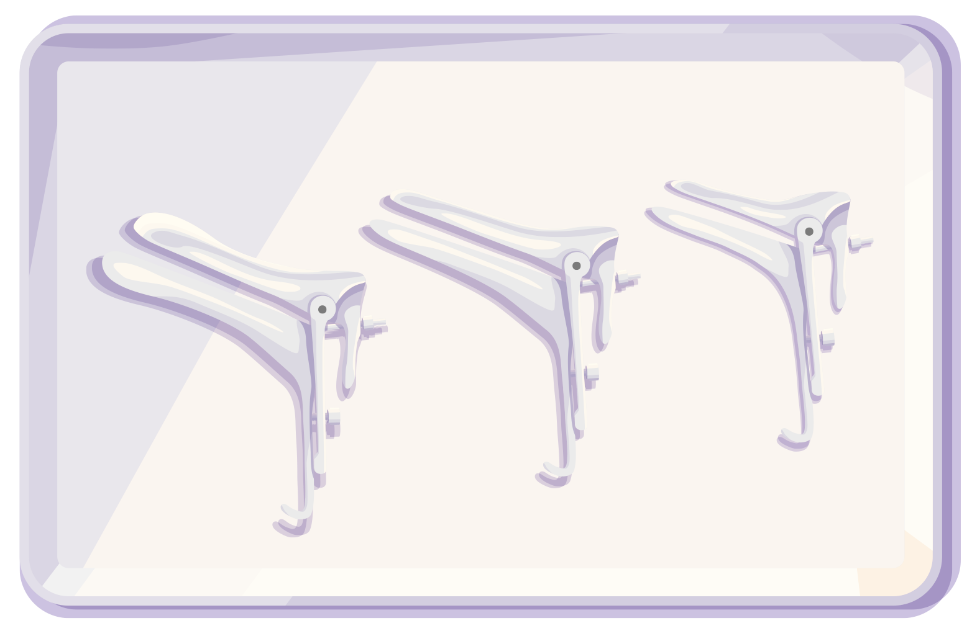
The right use of the speculum can limit pain during
IUD placement
Select the right size: smaller if possible; avoid a long speculum
Select the right shape based on patient anatomy
Warm the speculum before use
Time: don’t keep it in the vagina for longer than needed
IUD, intrauterine device
12

Slide 13
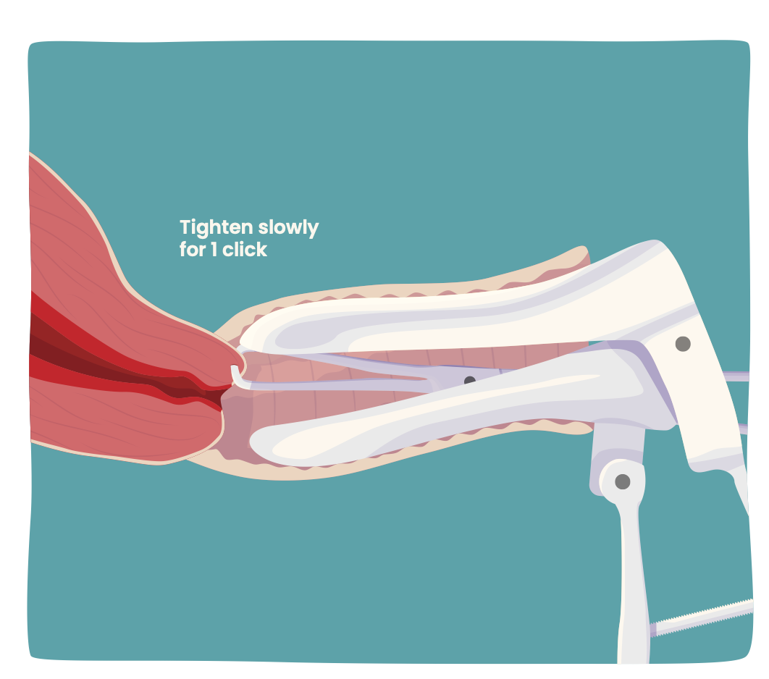
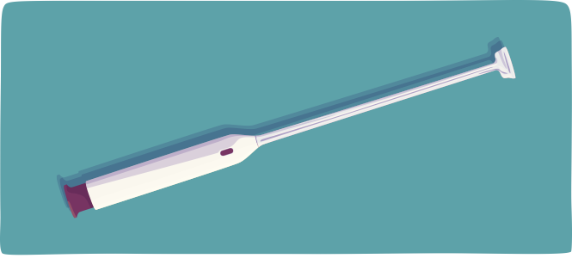
Stabilising the cervix correctly can limit pain during
IUD placement
When using a tenaculum
Take a bite of 1-1.5 cm
Too small a bite will risk a tear, too big a bite may make it more difficult to close the tenaculum, can obstruct the cervical canal, and may inflict more pain
Tighten slowly for one click
Some clinicians ask the patient to cough, quickly placing the tenaculum timed to the cough; if you do this, hold the speculum during the cough and let the patient practice once before taking the actual bite
Take care not to unnecessarily move the tenaculum after tightening it; each movement can be felt by the patient
Avoid hooking fingers through the rings to avoid inadvertent movement
Use of a vulsellum or a single-tooth tenaculum does not seem to be associated with different levels of pain.¹
Alternative devices are becoming available, including a suction cervical stabiliser,
which is associated with lower rates of pain than a tenaculum throughout the procedure.²
IUD, intrauterine device
1. Doty N, MacIsaac L. Contraception. 2015;92:567-71; 2. Yaron M, et al. ESC 2022. Abstract #P105
13

Slide 14
The right use of the sound can limit pain during IUD placement
When sounding and placing the IUD, place traction on the tenaculum but take care not to move it when not necessary.
For metal sounds, bend the distal 6-9cm to be consistent with the shape of the uterus¹
Plastic sounds may be less likely to perforate²
Initiate the movement of the sound with wrist or finger action
Avoid applying elbow or shoulder strength
Prevent perforation
Only proceed if the depth and direction of the sound are compatible with bimanual exam findings
Apply steady pressure to advance gently through the internal os without force
If you encounter resistance at the internal os, evaluate the position and consider using a graduated plastic ‘os-finder’ to open the os before advancing the sound
Once the sound is passed through the internal os, pause, and then advance slowly and intentionally to the fundus
Prevent discomfort by avoiding repeat tapping of the fundus
Some clinicians prefer to not use a sound, but measure the length of the uterine cavity with ultrasound instead
IUD, intrauterine device
1. Cason P and Goodman S. Protocol for Provision of Intrauterine Contraception. San Francisco: UCSF Bixby Center Beyond the Pill, 2016; 2. Duncan J, et al. BMC Womens Health. 2021;21:141
14

Slide 15



After IUD placement
Some clinicians verify IUD placement by ultrasound
Prevent vasovagal syncope
Use anticipatory guidance so the patient can make isometric contractions of the extremities in case of pre-syncopal signs/symptoms
Advise the patient to slowly change position, from the chair to standing up
Inform the patient that
It’s normal to have cramps for up to a week after IUD placement, and that these can be treated with NSAIDs if they are painful or uncomfortable
It’s normal to have changes in the menstrual bleeding pattern, and educate the patients on what these changes may be
They may wish to regularly self-check if they can feel the threads
IUD, intrauterine device; NSAID, non-steroidal anti-inflammatory drug
15

Slide 16


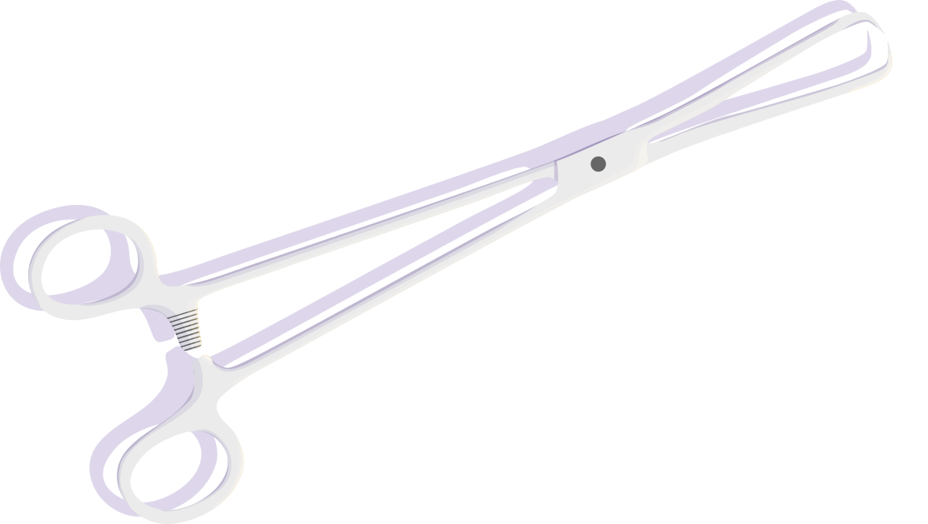
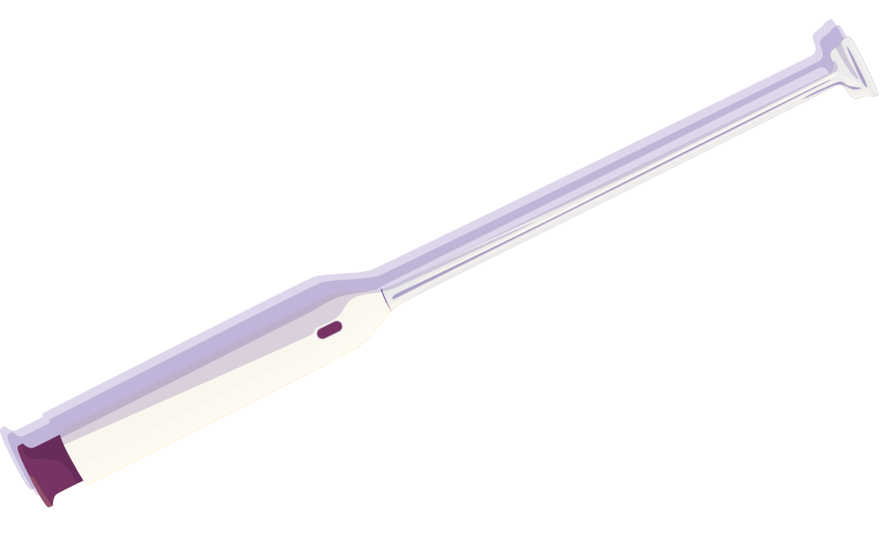
Future developments and innovation
Analgesics
Devices
Anaesthetic gels
Novel IUDs are in development or becoming available
Although a 2015 Cochrane review found no evidence that lidocaine 2% gel reduced pain associated with insertion, in 2016 a small RCT (N=59) showed self-administered lidocaine 2% did not lead to less pain on placement of the IUD in nulliparous people, but it did reduce pain with tenaculum placement^{1,2}
Studies are ongoing to assess whether intravaginal lidocaine in higher concentrations (5% or 10%) is effective in reducing pain
In clinical practice, intravaginal lidocaine can be helpful (e.g. in patients with vaginismus or genitourinary syndrome of menopause)
Smaller, thinner IUDs
Different materials (e.g. nitinol)
Different shapes (e.g. round IUDs)
Reusable IUD inserters are in development.
Alternatives for the tenaculum are becoming available, such as a suction cervical stabiliser, which is associated with lower rates of pain and bleeding than a tenaculum throughout the procedure.³
In select cases, inhaled anxiolytics or a combination of oral medications and nitrous oxide are used.
Studies are ongoing to assess the effect of hypnosis and virtual reality
IUD, intrauterine device; RCT, randomised controlled trial
1. Lopez LM, et al. Cochrane Database Syst Rev. 2015:CD007373; 2. Rapkin RB, et al. Obstet Gynecol. 2016;128:621-8; 3. Yaron M, et al. ESC 2022. Abstract #P105
16

Slide 17



Key learnings
IUDs have high level of patient satisfaction, but fear of pain is a widespread concern among people considering this type of contraception
Take a patient history to identify predictors of pain
Develop your own ‘toolbox’ to address anxiety and pain before, during, and after IUD placement
Have a conversation with the patient before placement to assess knowledge; address any misconceptions; explain the procedure, prevention of vasovagal collapse, and potential complications; answer questions
Consider and discuss cervical anaesthetic options
End with asking for consent to proceed and apply trauma-informed care throughout the procedure
Proper preparation sets you up for success
The right use of instruments and devices can limit pain during IUD placement, including the choice and use of the speculum, cervix stabilisation, and the use of the sound
Prevent vasovagal syncope during and after placement by isometric contractions of the extremities in case of pre-syncopal symptoms
Inform the patient on what to expect after placement
Many new approaches and devices are becoming available to reduce pain around IUD placement, including anaesthetic options and novel IUDs, inserters, and cervical stabilisers
17

Slide 18
Further reading
Allen RH, et al. Contraception. 2013;88:730-36
Allen RH, et al. J Obstet Gynecol. 2014;34:263-7
American College of Obstetricians and Gynecologists’ Committee on Gynecologic Practice; Long-Acting Reversible Contraceptive Expert Work Group. Obstet Gynecol. 2016;128:e69-77
Benditt DG, Nguyen JT. J Am Coll Cardiol. 2009;53:1741-51
Cason P and Goodman S. Protocol for Provision of Intrauterine Contraception. San Francisco: UCSF Bixby Center Beyond the Pill, 2016
Chi IC, et al. Contraception. 1996;34:483-95
Cleland K, et al. Hum Reprod. 2012;27:1994-2000
Dina B, et al. Am J Obstet Gynecol. 2018;218:236.e1-9
Duncan J, et al. BMC Womens Health. 2021;21:141
Faculty of Sexual & Reproductive Healthcare Clinical Effectiveness Unit of the Royal College of Obstetricians and Gynaecologists. Clinical Guidance: Intrauterine Contraception. September 2019
FSRH Clinical Guidance. Intrauterine Contraception. September 2019
Gemzell-Danielsson K, et al. Acta Obstet Gynecol Scand. 2019;98:1500-13
Goldstuck ND, et al. Int J Womens Health. 2019;11:471-9
Goldstuck ND, Matthews ML. Clin Reprod Fertil. 1985;3:65-71
Grandi G, et al. Expert Opin Pharmacother. 2018;19:677-86
Hall AM, Kutler BA. J Fam Plann Reprod Health Care. 2016;42:36-42
Kaislasuo J, et al . Obstet Gynecol. 2014;124:345-53
Lopez LM, et al. Cochrane Database Syst Rev. 2015:CD007373
Mody SK, et al. Obstet Gynecol. 2018;132:575-82
Rapkin RB, et al. Obstet Gynecol. 2016;128:621-8
Santos ARG, et al. Contraception. 2013;88:164-8
Serfaty D, et al. Eur J Contracep Rep Health Care. 2019;24:305-13
United Nations, Department of Economic and Social Affairs, Population Division. Contraceptive Use by Method 2019: Data Booklet (ST/ESA/SER.A/435)
van der Heijden P, et al. BJOG. 2017;124:299-305
van Dijk N, et al. J Am Coll Cardiol. 2006;48:1652-7
18

