Slide 2
The use of IMMUNOTHERAPY IN hcc
Micro learning module one:
Efficacy and safety
Dr Aiwu Ruth He, MD, PhD
Medstar Georgetown University Hospital, Washington DC, USA
Prof. Dr Peter R. Galle, MD, PhD
University Medical Centre Mainz, Mainz, Germany
MAy 2023

Slide 3
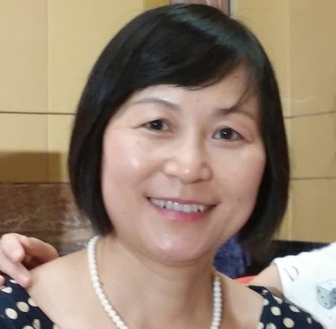


This programme has been developed by two international experts
Dr Aiwu Ruth He
GI Medical Oncologist
Medstar Georgetown University Hospital, USA
Prof. Peter R. Galle
Hepatology Specialist
University Medical Centre Mainz, Germany

Slide 4

Developed by HCC COnnect
This programme is developed by HCC CONNECT,
an international group of experts in the field of
hepatocellular carcinoma.
Acknowledgement and disclosures
This HCC CONNECT programme is supported through an independent educational grant from AstraZeneca. The programme is therefore independent, the content is not influenced by the supporter and is under the sole responsibility of the experts.
Please note: The views expressed within this programme are the personal opinions of the experts. They do not necessarily represent the views of the experts’ institutions, or the rest of the HCC CONNECT group.
Expert disclaimers:
Dr Aiwu Ruth He has received financial support/sponsorship for research support, consultation, or speaker fees from the following companies: AstraZeneca, BMS, Boston Scientific, Eisai, Genentech, and Merck
Prof. Peter R. Galle has received financial support/sponsorship for research support, consultation, or speaker fees from the following companies: Adaptimmune, AstraZeneca, Bayer, BMS, Boston Scientific, Eisai, Guerbet, Ipsen, Lilly, MSD, Roche, and Sirtex

Slide 5
Educational objectives
Upon completion of this micro learning you will:
Recognise the efficacy of IO and IO combinations
  Understand the survival curve when assessing IO treatment
  Know the place of IO and IO combinations in the treatment landscape for patients with HCC
Recognise the immune-related adverse events (irAEs), and potentially additive or synergistic toxicities associated with IO combinations
  Know how to early identify and manage these AEs
Be able to implement IO treatments for patients with HCC in clinical practice
HCC, hepatocellular carcinoma; IO, immunotherapy

Slide 6
Clinical takeaways
IO, and in particular IO combinations, are effective treatments for patients with
advanced HCC
Survival analysis for IO treatment shifts from median overall survival (OS) to landmark analysis
IO and IO combinations may result in inflammatory side effects, known as irAEs. Most of these AEs can be treated with steroids
HCC, hepatocellular carcinoma; IO, immunotherapy; irAE, immune-related adverse event

Slide 7
1st & 2nd line systemic treatment options for patients with HCC
HCC, hepatocellular carcinoma

Slide 8

TWO Types of systemic treatment options for patients with HCC
IO
TYROSINE KINASE INHIBITORS (TKIs)
PD-L1 binds to PD-1 and inhibits
T cell killing of tumour cell
Blocking PD-L1 or PD-1 allows
T cell killing of tumour cell
GF
GF
EGFR, VEGFR, PDGFR, ABL, SCR…
GF
GF
Tyrosine kinase
receptor
Cell
membrane
Tumour cell
Tumour cell death
TKI
TKI
ATP
ATP
TKI
PD-L1
Antigen
PD-L1
PD-1
T cell
receptor
Anti-PD-L1
MAPK
JAK/STAT
PI3K/AKT
Signalling
pathways
Anti-
PD-1
PD-1
T cell
T cell
Metastasis, angiogenesis,
cell proliferation
Figure adapted from Terese Winslow LLC¹
Figure adapted from Gabora K, et al.²
ABL, Abelson tyrosine kinase family; AKT, protein kinase B; ATP, adenosine triphosphate; EGFR, endothelial growth factor receptor; GF, growth factor; JAK, Janus kinase protein; MAPK, mitogen-activated protein kinase; PD-1, programmed death 1; PDGFR, platelet-derived growth factor receptor; PD-L1, programmed death-ligand 1; PI3K, phosphoinositide-3-kinase; SCR, SCR tyrosine kinase family; STAT, signal transducer and activation of transcription protein; VEGFR, vascular endothelial growth factor receptor
1. Terese Winslow LLC. 2015. Available from: https://www.teresewinslow.com/. Accessed March 2023; 2. Gabora K, et al. Drug Metab Rev. 2019;51:562-9

Slide 9
1st and 2nd line systemic treatment options
1st line
Lenvatinib
2018
REFLECT²
Durvalumab + tremelimumab
2022
HIMALAYA⁴
Sorafenib
2007
SHARP¹
Atezolizumab + bevacizumab
2020
IMbrave150³
Durvalumab
2022
HIMALAYA⁴
2007
2017
2022
Regorafenib
2017
Ramucirumab
2019
2nd line and beyond
Cabozantinib
2019
TKI
IO or IO combination
Pembrolizumab
2018
Nivolumab + ipilimumab
2020
IO, immunotherapy; TKI, tyrosine kinase inhibitor
1. Llovet JM, et al. N Engl J Med. 2008;359:378-90; 2. Kudo M, et al. Lancet. 2018;391:1163-73;
3. Cheng A-L, et al. J Hepatol. 2022;76:862-73; 4. Abou-Alfa GK, et al. NEJM Evid. 2022;1:10.1056/EVIDoa2100070

Slide 10
Single-agent IO
IO, immunotherapy

Slide 11
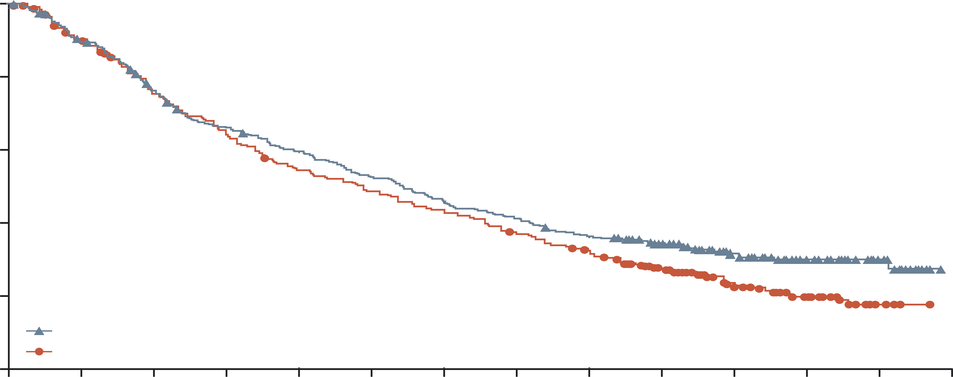
Nivolumab
Single-agent IO THAT did not meet its primary endpoint in Phase 3 study
Resulted in a durable response in a subset of patients with HCC in a Phase 1/2 study (CheckMate-040)¹
Did not show significant OS improvement over sorafenib in a Phase 3 study (CheckMate-459)²
 | Nivolumab (N=371) | Sorafenib (N=372)
Events, n | 244 | 275
Median OS (95% CI), months | 16.4 (13.9-18.4) | 14.7 (11.9-17.2)
HR (95% CI) | 0.85 (0.72-1.02)
p value | 0.075
100
80
12-month OS (95% CI), %:
60 (54-65)
55 (50-60)
18-month OS (95% CI), %
47 (41-52)
44 (38-49)
Negative trial
Clinically positive:
Favourable safety profile
Durable response in a subgroup of patients may result in improvement of landmark survival, but not in median OS
60
OS (%)
24-month OS (95% CI), %
37 (32-42)
33 (28-38)
40
20
Nivolumab group
Sorafenib group
0
0
3
6
9
12
15
18
21
24
27
30
33
36
39
Number at risk
(number censored)
Nivolumab
Sorafenib
Time since randomisation (months)
371 (0)
372 (0)
326 (7)
328 (8)
271 (12)
274 (12)
235 (14)
232 (12)
211 (15)
196 (14)
187 (15)
174 (14)
165 (15)
155 (14)
146 (15)
133 (15)
129 (16)
115 (17)
104 (34)
80 (36)
63 (68)
47 (58)
39 (89)
30 (69)
17 (111)
7 (90)
0 (127)
0 (97)
Figure adapted from Yau T, et al.²
CI, confidence interval; HCC, hepatocellular carcinoma; HR, hazard ratio; IO, immunotherapy; OS, overall survival
1. El-Khoueiry AB, et al. Lancet. 2017;389:2492-502; 2. Yau T, et al. Lancet Oncol. 2022;23:77-90

Slide 12
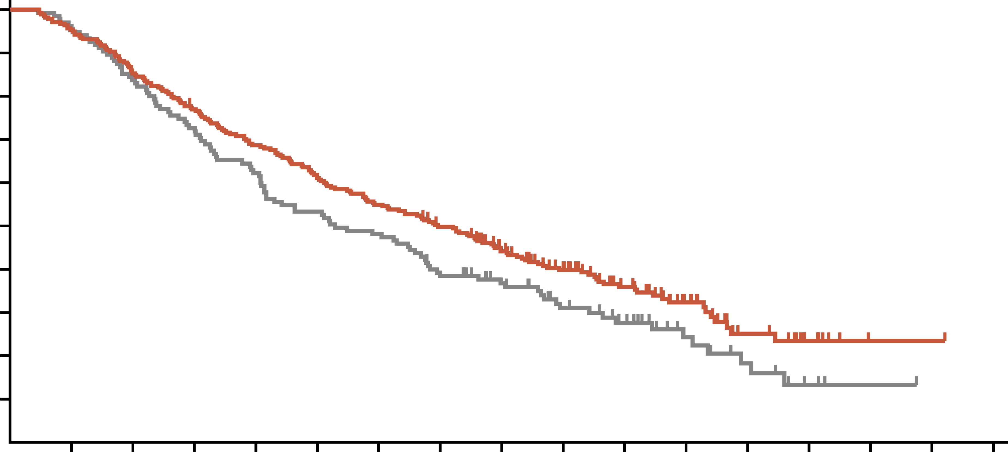
pembrolizumab
Single-agent IO THAT did not meet its primary endpoint in Phase 3 study
Resulted in a durable response in a subset of patients with HCC in a Phase 1/2 study (KEYNOTE-224)¹
Did not show significant OS improvement over placebo treatment in a Phase 3 study (KEYNOTE-240)²
100
Best response, %¹ | Patients (N=104)
Objective response Complete Partial | 17.3 1.0 16.3
Stable disease | 44.2
Disease progression | 32.7
90
80
HR (95% CI): 0.781 (0.611-0.998);
p=0.0238
70
60
OS (%)
50
40
30
20
Pembrolizumab
10
Placebo
0
2
4
6
8
10
12
14
16
18
20
22
24
26
28
30
32
Time (months)
Number at risk
Pembrolizumab
Placebo
278
135
265
130
237
113
213
98
190
84
169
72
152
65
135
51
110
42
86
30
57
23
33
13
16
8
7
3
1
1
1
0
Figure adapted from Finn RS, et al.²
CI, confidence interval; HCC, hepatocellular carcinoma; HR, hazard ratio; IO, immunotherapy; OS, overall survival
1. Zhu AX, et al. Lancet Oncol. 2018;19:940-52; 2. Finn RS, et al. J Clin Oncol. 2019;38:193-202

Slide 13
challenges with single-agent IO
Nivolumab and pembrolizumab (single IO agents):
  Did not show significant improvement in OS (CheckMate-459 + KEYNOTE-240)
  Showed favourable safety profiles
Response rates from single-agent IO are relatively low (14-20%)
Preclinical studies showed synergistic effects with IO combination therapy that demonstrated significant advancement in treating many types of cancers¹
IO, immunotherapy; OS, overall survival
1. Finn RS, Zhu AX. Hepatology. 2021;73 suppl 1:150-7

Slide 14
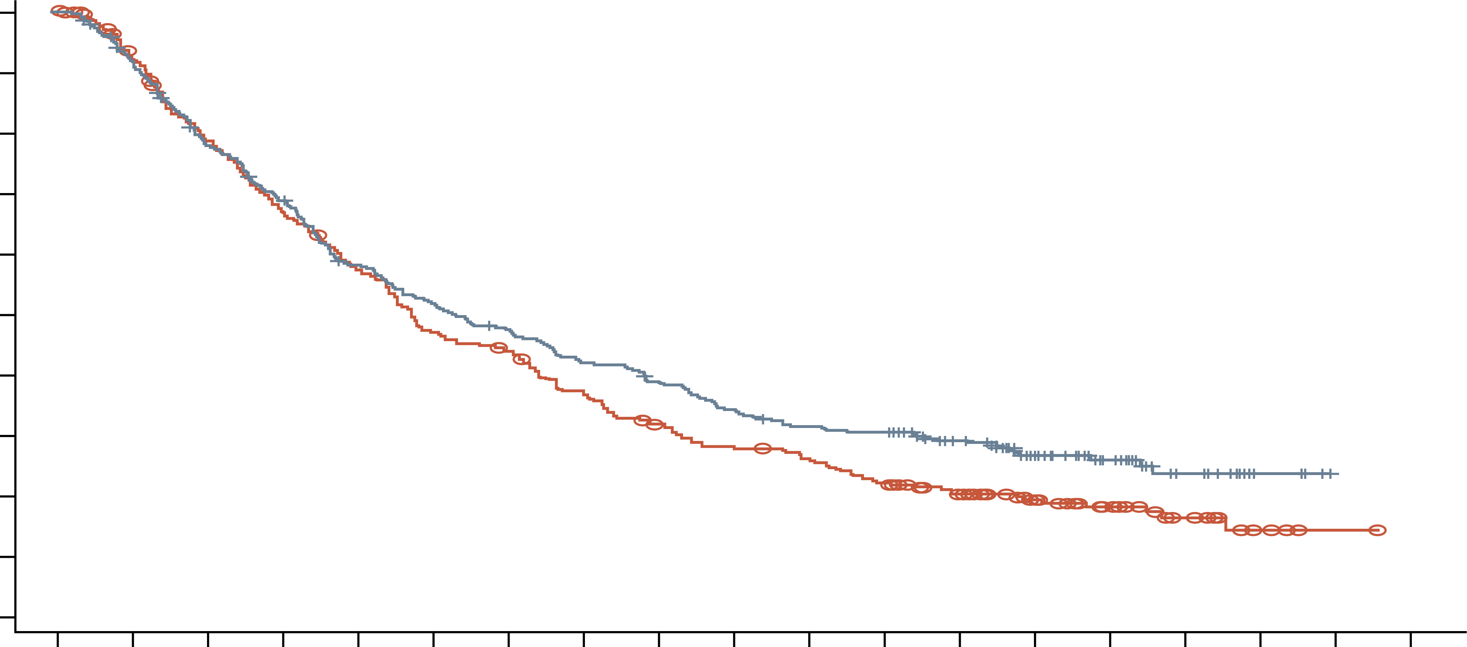
Tislelizumab
Single-agent IO THAT met its primary endpoint in Phase 3 study
RATIONALE-301 met its primary endpoint of OS noninferiority with tislelizumab versus sorafenib in first-line HCC
100
 | Tislelizumab (n=342) | Sorafenib (n=332)
Events, n (%) | 242 (70.8) | 255 (76.8)
Median OS (95% CI), months | 15.9 (13.2-19.7) | 14.1 (12.6-17.4)
Stratified HR (95.003% CI) | 0.85 (0.712-1.019)
p value | 0.0398
90
80
70
60
50
OS probability (%)
40
58.3%
30
57.2%
20
39.0%
Tislelizumab
10
31.8%
29.2%
Sorafenib
0
20.3%
0
3
6
9
12
15
18
21
24
27
30
33
36
39
42
45
48
51
54
Number at risk
Tislelizumab
Sorafenib
Time (months)
342
332
307
291
259
247
228
208
191
179
170
147
155
136
137
113
126
96
111
84
101
77
98
66
77
52
53
39
33
29
18
13
4
4
0
1
0
0
Data cut-off date: 11 July 2022; OS was assessed in the intent-to treat population; Figure adapted from Qin S, et al. 2022
CI, confidence interval; HCC, hepatocellular carcinoma; HR, hazard ratio; IO, immunotherapy; OS, overall survival
Qin S, et al. Ann Oncol. 2022;33:S1402-3

Slide 15
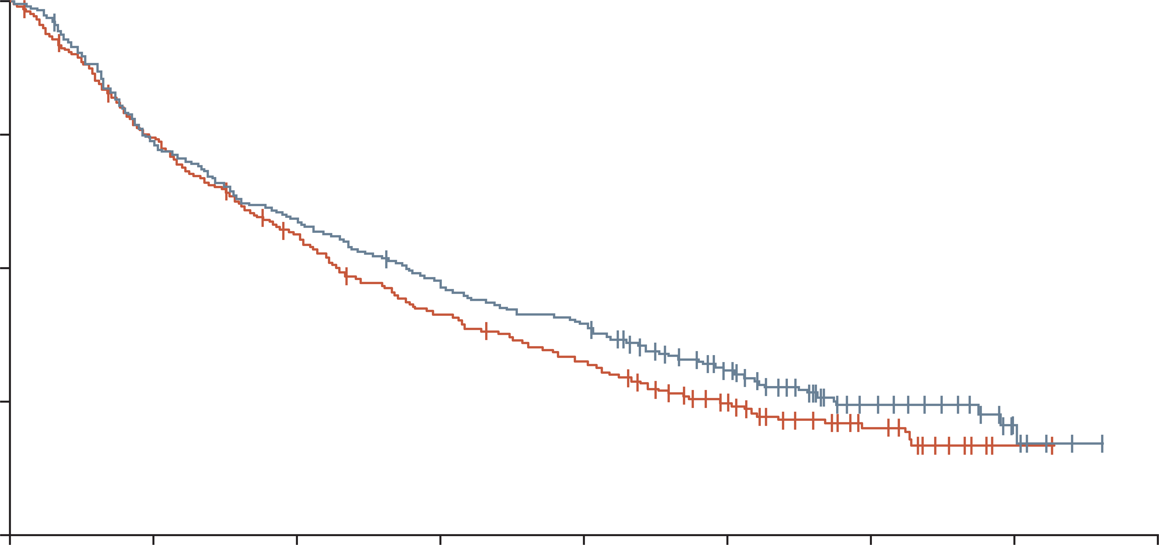
durvalumab
Single-agent IO THAT met its primary endpoint in Phase 3 study
HIMALAYA met its primary endpoint of OS noninferiority with durvalumab versus sorafenib in HCC
1.00
 | Durvalumab (n=389) | Sorafenib (n=389)
Events, n (%) | 280 (72.0) | 293 (75.3)
Median OS survival (95% CI), months | 16.56 (14.06-19.12) | 13.77 (12.25-16.13)
HR (95.67% CI) | 0.86 (0.73-1.03)
0.75
OS probability
0.50
Sorafenib
0.25
Durvalumab
0
0
6
12
18
24
30
36
42
48
Time from randomisation (months)
Number at risk
Durvalumab
Sorafenib
389
389
286
283
230
211
183
155
153
121
87
62
27
21
6
1
0
0
Figure adapted from Abou-Alfa GK, et al. 2022
CI, confidence interval; HCC, hepatocellular carcinoma; HR, hazard ratio; IO, immunotherapy; OS, overall survival
Abou-Alfa GK, et al. J Clin Oncol. 2022;4 suppl:379

Slide 16
1st line io-based combination treatments:
Efficacy and safety
IO, immunotherapy

Slide 17
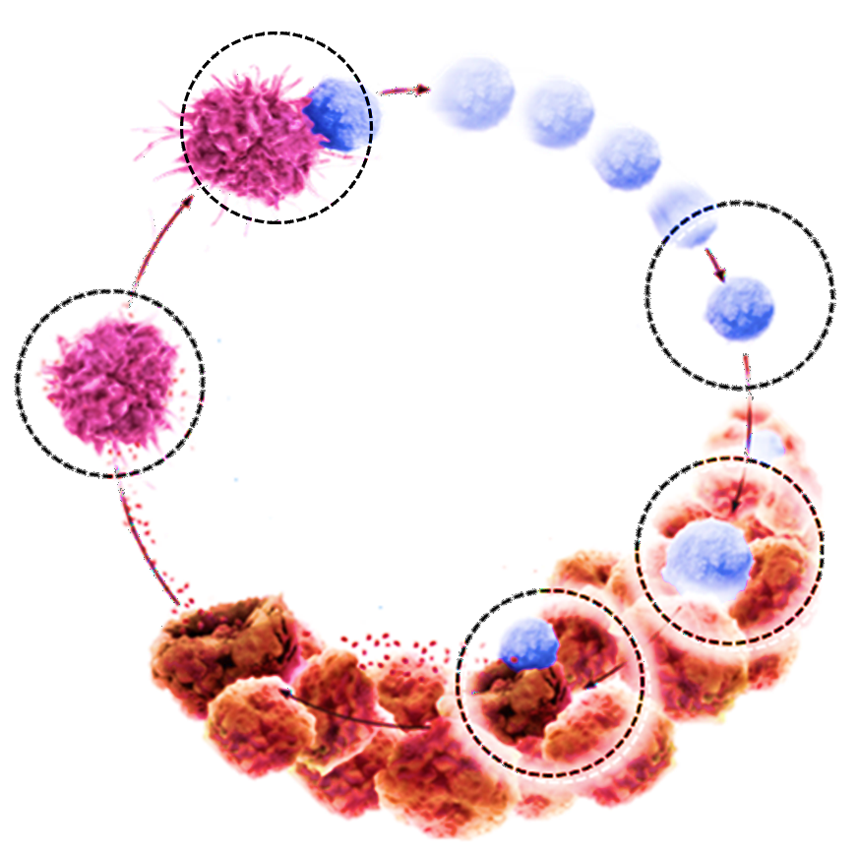
Atezolizumab + bevacizumab immune checkpoint inhibitor (anti-Pd-l1) + anti-VEGf
Atezolizumab
Promotes T-cell activation by allowing B7.1 co-stimulation¹
Bevacizumab (anti-VEGF) is an antiangiogenic agent with additional immunomodulatory effects
In combination, bevacizumab may enhance the efficacy of atezolizumab by reversing VEGF-mediated immunosuppression to promote anticancer T-cell activity
Activated
TCs
Bevacizumab
Normalises tumour vasculature, increasing T-cell infiltration²⁻⁶
DCs
Tumour
antigens
TCs
Bevacizumab
Decreases the activity of immunosuppressive cells (myeloid-derived suppressor cells and T_{regs})^{2,3,7-10}
Bevacizumab
Promotes DC maturation^{2,11,12}
Atezolizumab
Restores anticancer immunity¹
DC, dendritic cell; PD-L1, programmed death-ligand 1; TC, T cell; T_{reg}, regulatory T cell; VEGF, vascular endothelial growth factor
1. Chen DS, Mellman I. Immunity. 2013;39:1-10; 2. Hegde PS, et al. Semin Cancer Biol. 2018;52:117-24; 3. Wallin JJ, et al. Nat Commun. 2016;7:12624; 4. Goel S, et al. Physiol Rev. 2011;91:1071-121; 5. Motz GT, et al. Nat Med. 2014;20:607-15; 6. Hodi FS, et al. Cancer Immunol Res. 2014;2:632-42; 7. Gabrilovich DI, Nagaraj S. Nat Rev Immunol. 2009;9:162-74; 8. Roland CL, et al. PLoS One. 2009;4:e7669; 9. Facciabene A, et al. Nature. 2011;13;475:226-30; 10. Voron T, et al. J Exp Med. 2015;212:139-48; 11. Gabrilovich DI, et al. Nat Med. 1996;2:1096-103; 12. Oyama T, et al. J Immunol. 1998;160:1224-32

Slide 18
Atezolizumab + bevacizumab (Imbrave150)
Updated analysis: OS benefit versus sorafenib
Approved as first line in 2020 by the FDA and EMA
1.0
 | Atezo + Bev (n=336) | Sorafenib (n=165)
Median OS (95% CI), months | 19.2 (17.0-23.7) | 13.4 (11.4-16.9)
Stratifiedª HR (95% CI) | 0.66 (0.52-0.85)
p value | <0.001*
0.8
0.6
OS estimate
0.4
Relatively quick separation of the two curves, possibly due to the
anti-VEGF component
0.2
13.4
19.2
0
0
1
2
3
4
5
6
7
8
9
10
11
12
13
14
15
16
17
18
19
20
21
22
23
24
25
26
27
28
29
Time (months)
ª Stratification factors included are geographic region (Asia excluding Japan vs RoW), AFP level (<400 ng/mL vs ≥400 ng/mL) at baseline, and MVI and/or EHS (yes vs no) per IxRS;
* p value for descriptive purposes only
AFP, alpha fetoprotein; Atezo, atezolizumab; Bev, bevacizumab; CI, confidence interval; EHS, extrahepatic spread; EMA, European Medicines Agency; FDA, U.S. Food and Drug Administration; HR, hazard ratio; IxRS, interactive voice/web response system; MVI, macrovascular invasion; OS, overall survival; RoW, rest of world; VEGF, vascular endothelial growth factor
Cheng A-L, et al. J Hepatol. 2022;76:862-73

Slide 19
Atezolizumab + bevacizumab (Imbrave150)
Updated analysis: pfS benefit vERSUs sorafenib
1.0
 | Atezo + Bev (n=336) | Sorafenib (n=165)
Median PFS (95% CI), months | 6.9 (5.7-8.6) | 4.3 (4.0-5.6)
Stratified^{b} HR (95% CI) | 0.65 (0.53-0.81)
p value | <0.001*
0.8
0.6
PFS estimateª
0.4
0.2
4.3
6.9
0
0
1
2
3
4
5
6
7
8
9
10
11
12
13
14
15
16
17
18
19
20
21
22
23
24
25
26
27
Time (months)
ª IRF, RECIST v1.1; ^{b} Stratification factors included in the Cox model are geographic region (Asia excluding Japan vs RoW), AFP level (<400 ng/mL vs ≥400 ng/mL) at baseline, and MVI and/or EHS (yes vs no) per IxRS; * p value for descriptive purposes only
Atezo, atezolizumab; Bev, bevacizumab; CI, confidence interval; EHS, extrahepatic spread; HR, hazard ratio; IRF, independent review facility; IxRS, interactive voice/web response system;
MVI, macrovascular invasion; PFS, progression-free survival; RoW, rest of world; RECIST, Response Evaluation Criteria in Solid Tumours
Cheng A-L, et al. J Hepatol. 2022;76:862-73

Slide 20
Atezolizumab + bevacizumab (Imbrave150)
Updated analysis: safety summary
Event | Atezo + Bev (n=329) | Sorafenib (n=156)
Median treatment duration, months | Atezo: 8.4; Bev: 7.0 | 2.8
AEs, n (%)
All grade, any cause | 322 (98) | 154 (99)
Treatment-related | 284 (86) | 148 (95)
Grade 3 or 4^{b}, n (%) | 207 (63) | 89 (57)
Treatment-related^{b} | 143 (43) | 72 (46)
SAE | 160 (49) | 51 (33)
Treatment-related | 76 (23) | 25 (16)
Grade 5, n (%) | 23 (7) | 9 (6)
Treatment-related | 6 (2) | 1 (<1)
AE leading to withdrawal from any component | 72 (22) | 18 (12)
AE leading to withdrawal from both components | 34 (10) | 0
AE leading to dose interruption of any study treatment | 195 (59) | 68 (44)
AE leading to dose modification of sorafenib^{c} | 0 | 58 (37)
AE, adverse event
1. Cheng, Ann-Lii, et al. Journal of hepatology. 2022:76(4);862-73
ª Safety-evaluable population; ^{b} Highest grade experienced; ^{c} No dose modification allowed for the atezolizumab + bevacizumab arm
AE, adverse event; Atezo, atezolizumab; Bev, bevacizumab; SAE, serious adverse event
1. Cheng A-L, et al. J Hepatol. 2022;76:862-73

Slide 21
Atezolizumab + bevacizumab (Imbrave150)
Primary analysis: bleeding events were typically low in grade and unrelated to varices
Bleeding event, % | IMbrave150¹
 | Atezo + Bev (n=336) |  | Sorafenib (n=165)
 | Any grade | Grade 3 or 4ª | Any grade | Grade 3 or 4ª
Varices at baseline | 26 |  | 26
Treated at baseline | 11 |  | 14
All-grade bleeding/ haemorrhage events | 25 |  | 17
Epistaxis | 10.3 | 0 | 4.5 | 0.6
Oesophageal varices haemorrhage | 2.4 | 1.8 | 0.6 | 0.6
GI haemorrhage | 2.4 | 1.2 | 1.9 | 1.9
Upper GI haemorrhage | 1.2 | 0.6 | 1.3 | 1.3
ª Highest grade assigned
Atezo, atezolizumab; Bev, bevacizumab; GI gastrointestinal
1. Finn RS, et al. N Engl J Med. 2020;382:1894-905

Slide 22
Atezolizumab + bevacizumab (Imbrave150)
SUMMARY OF AEs: ≥10% frequency of AEs in either arm and >5% difference between arms
Atezolizumab + bevacizumab
Sorafenib
Diarrhoea
PPE
Decreased appetite
Hypertension
Abdominal pain
Alopecia
Asthenia
Pyrexia
ALT increased
Proteinuria
All-grade AEs
All-grade AEs
Infusion-related reaction
Grade 3 or 4 AEs
Grade 3 or 4 AEs
60
50
40
30
20
10
0
10
20
30
40
50
60
Patients (%)
AE, adverse event; ALT, alanine aminotransferase; PPE, palmar-plantar erythrodysaesthesia
1. Finn RS, et al. N Engl J Med. 2020;382:1894-905

Slide 23
Tremelimumab + Durvalumab¹ immune checkpoint inhibitors anti-ctla-4 + anti-pd-l1
Approved as first line in 2022 by the FDA and EMA
Lymph node
Tremelimumab
Mechanism of action^{1,2}
STRIDE regimen:
Novel combination
Single high-priming dose of tremelimumab (anti-CTLA-4)
Regular interval durvalumab (anti-PD-L1)
CD28
CD8
CD80/86
T cell
CTLA-4
APC
Tumour
Durvalumab
PD-1
T cell
PD-L1
Tumour cell
APC, antigen presenting cells; CD, cluster of differentiation; CTLA-4, cytotoxic T lymphocyte antigen 4; EMA, European medicines Agency; FDA, U.S. Food and Drug Administration; PD-1, programmed death 1; PD-L1, programmed death-ligand 1; STRIDE, Single Tremelimumab Regular Interval Durvalumab
1. Abou-Alfa GK, et al. NEJM Evid. 2022;1:10.1056/EVIDoa2100070; 2. Kudo M. Liver Cancer. 2019;8:413-26

Slide 24
Tremelimumab + Durvalumab (HIMALAYA)
Primary endpoint: significant benefit in OS versus sorafenib
Later separation of the two curves due to IO+IO, but durable response
 | T300+D (n=393) | Sorafenib (n=389)
OS events, n (%) | 262 (66.7) | 293 (75.3)
Median OS (95% CI), months | 16.4 (14.2-19.6) | 13.8 (12.3-16.1)
HR (96.02% CI) | 0.78 (0.65-0.93)
p value (2-sided) | 0.0035
1.0
0.9
0.8
0.7
0.6
Probability of OS
0.5
0.4
HR for time up to
9 months (95% CI)
0.87 (0.68-1.11)
HR for time after
9 months (95% CI)
0.70 (0.56-0.89)
0.3
0.2
0.1
T300+D
Sorafenib
0
0
6
12
18
24
30
36
42
48
Time from randomisation (months)
Number at risk
T300+Dª
Sorafenib
393 | 308 | 235 | 190 | 158 | 98 | 32 | 1 | 0
389 | 283 | 211 | 155 | 121 | 62 | 21 | 1 | 0
Data cut-off date: 27 August 2021; Median follow-up: 33.18 (95% CI, 31.74-34.53) months for T300+D and 32.23 (95% CI, 30.42-33.71) months for sorafenib;
ª Or: STRIDE
CI, confidence interval; HR, hazard ratio; IO, immunotherapy; OS, overall survival; STRIDE, Single Tremelimumab Regular Interval Durvalumab; T300+D, tremelimumab 300 mg × 1 dose + durvalumab 1,500 mg every 4 weeks Q4W
Abou-Alfa GK, et al. NEJM Evid. 2022;1:10.1056/EVIDoa2100070

Slide 25
Tremelimumab + Durvalumab (HIMALAYA) significant benefit in OS versus sorafenib
1.0
0.9
Landmark analysis
0.8
0.7
18-month OS:
48.7%
41.5%
0.6
24-month OS:
40.5%
32.6%
Probability of OS
36-month OS:
30.7%
20.2%
0.5
0.4
0.3
0.2
0.1
T300+D
Sorafenib
0
0
6
12
18
24
30
36
42
48
Time from randomisation (months)
Number at risk
T300+Dª
Sorafenib
393 | 308 | 235 | 190 | 158 | 98 | 32 | 1 | 0
389 | 283 | 211 | 155 | 121 | 62 | 21 | 1 | 0
Data cut-off date: 27 August 2021; Median follow-up: 33.18 (95% CI, 31.74-34.53) months for T300+D and 32.23 (95% CI, 30.42-33.71) months for sorafenib; ª Or: STRIDE
CI, confidence interval; OS, overall survival; STRIDE, Single Tremelimumab Regular Interval Durvalumab; T300+D, tremelimumab 300 mg × 1 dose + durvalumab 1,500 mg every 4 weeks
Abou-Alfa GK, et al. NEJM Evid. 2022;1:10.1056/EVIDoa2100070

Slide 26
Tremelimumab + Durvalumab (HIMALAYA)
Secondary endpoint: no significant difference in median PFS versus sorafenib
 | T300+D (n=393) | Sorafenib (n=389)
PFS events, n (%) | 335 (85.2) | 327 (84.1)
Median PFS (95% CI), months | 3.78 (3.68-5.32) | 4.07 (3.75-5.49)
PFS HRª (95% CI) | 0.90 (0.77-1.05) | –
Progression-free at data cut-off, n (%) | 49 (12.5) | 19 (4.9)
Median TTP (95% CI), months | 5.42 (3.81-5.62) | 5.55 (5.13-5.75)
Treated ≥1 cycle beyond progression, n (%)^{b} | 182 (46.9) | 134 (35.8)
1.0
0.8
0.6
Probability of PFS
0.4
0.2
T300+D
Sorafenib
0
0
6
12
18
24
30
36
42
48
Time from randomisation (months)
Number at risk
T300+D^{c}
Sorafenib
393 | 135 | 81 | 55 | 43 | 26 | 7 | 0 | 0
389 | 118 | 53 | 31 | 18 | 6 | 0 | 0 | 0
ª Versus sorafenib; ^{b} Percent calculated from total patients in the safety analysis set: T300+D (N=388), durvalumab (N=388), sorafenib (N=374); ^{c} Or: STRIDE
CI, confidence interval; HR, hazard ratio; PFS, progression-free survival; T300+D, tremelimumab 300 mg × 1 dose + durvalumab 1,500 mg every 4 weeks; TTP, time to progression
Abou-Alfa GK, et al. NEJM Evid. 2022;1:10.1056/EVIDoa2100070

Slide 27
Tremelimumab + Durvalumab (HIMALAYA) safety summary: AEs
Event, n (%) | T300+D (n=388) | Sorafenib (n=374)
Any AE | 378 (97.4) | 357 (95.5)
Any TRAEª | 294 (75.8) | 317 (84.8)
Any grade 3 or 4 AE | 196 (50.5) | 196 (52.4)
Any grade 3 or 4 TRAE | 100 (25.8) | 138 (36.9)
Any serious TRAE | 68 (17.5) | 35 (9.4)
Any TRAE leading to death | 9 (2.3)^{b} | 3 (0.8)^{c}
Any TRAE leading to discontinuation | 32 (8.2) | 41 (11.0)
Includes AEs with onset or increase in severity on or after the date of the first dose through 90 days following the date of the last dose or the date of initiation of the first subsequent therapy; ª Treatment-related was as assessed by investigator; ^{b} Nervous system disorder (n=1), acute respiratory distress syndrome (n=1), hepatitis (n=1), myocarditis (n=1), immune-mediated hepatitis (n=2), pneumonitis (n=1), hepatic failure (n=1), myasthenia gravis (n=1); ^{c} Haematuria (n=1), cerebral haematoma (n=1), hepatic failure (n=1)
AE, adverse event; T300+D, tremelimumab 300 mg × 1 dose + durvalumab 1,500 mg every 4 weeks; TRAE, treatment related adverse event
Abou-Alfa GK, et al. NEJM Evid. 2022;1:10.1056/EVIDoa2100070

Slide 28
Tremelimumab + Durvalumab (HIMALAYA)
Safety: treatment-related hepatic or haemorrhage SMQ events
 | T300+D (n=388) |  | Sorafenib (n=374)
Event, n (%) | All grades | Grade ≥3 | All grades | Grade ≥3
Hepatic SMQ TRAE | 66 (17.0) | 23 (5.9) | 46 (12.3) | 17 (4.5)
Haemorrhage SMQ TRAE | 7 (1.8) | 2 (0.5) | 18 (4.8) | 4 (1.1)
ALT increased | 18 (4.6) | 4 (1.0) | 8 (2.1) | 3 (0.8)
Aspartate aminotransferase increased | 22 (5.7) | 9 (2.3) | 10 (2.7) | 6 (1.6)
Blood bilirubin increased | 6 (1.5) | 1 (0.3) | 10 (2.7) | 2 (0.5)
Ascites | 1 (0.3) | 0 | 2 (0.5) | 0
Hepatic encephalopathy | 0 | 0 | 2 (0.5) | 1 (0.3)
International normalised ratio increased | 4 (1.0) | 1 (0.3) | 0 | 0
Oesophageal varices haemorrhage | 0 | 0 | 0 | 0
Includes AEs with onset or increase in severity on or after the date of the first dose through 90 days following the date of the last dose or the date of initiation of the first subsequent therapy; Treatment-related was as assessed by investigator
AE, adverse event; ALT, alanine aminotransferase; MedRA, Medical Dictionary for Regulatory Activities; SMQ, standardised MedRA query; T300+D, tremelimumab 300 mg × 1 dose + durvalumab 1,500 mg every 4 weeks; TRAE, treatment-related adverse event
Abou-Alfa GK, et al. NEJM Evid. 2022;1:10.1056/EVIDoa2100070

Slide 29
Tremelimumab + Durvalumab (HIMALAYA) safety: irAes
Event, n (%) | T300+D (N=388)
 | All grades | Grade 3 or 4 | Received high-dose steroids | Leading to discontinuation
irAEs | 139 (35.8) | 49 (12.6) | 78 (20.1) | 22 (5.7)
Hepatic event | 29 (7.5) | 16 (4.1) | 29 (7.5) | 9 (2.3)
Diarrhoea/colitis | 23 (5.9) | 14 (3.6) | 20 (5.2) | 5 (1.3)
Dermatitis/rash | 19 (4.9) | 7 (1.8) | 12 (3.1) | 2 (0.5)
Pancreatic event | 9 (2.3) | 7 (1.8) | 7 (1.8) | 0
Adrenal insufficiency | 6 (1.5) | 1 (0.3) | 1 (0.3) | 0
Hyperthyroid event | 18 (4.6) | 1 (0.3) | 2 (0.5) | 0
Hypothyroid event | 42 (10.8) | 0 | 1 (0.3) | 0
Pneumonitis | 5 (1.3) | 0 | 4 (1.0) | 1 (0.3)
Renal event | 4 (1.0) | 2 (0.5) | 3 (0.8) | 2 (0.5)
Includes AEs with onset or increase in severity on or after the date of the first dose through 90 days following the date of the last dose or the date of initiation of the first subsequent therapy. Patients may have had >1 event. Events include those that occurred in ≥1% of patients in either treatment arm
AE, adverse event; irAE, immune-related adverse event; T300+D, tremelimumab 300 mg × 1 dose + durvalumab 1,500 mg every 4 weeks
Abou-Alfa GK, et al. NEJM Evid. 2022;1:10.1056/EVIDoa2100070

Slide 30
irAEs management iraes can be treated with steroids
CTCAE v5.0 grade definition | Grade 1 Mild | Grade 2 Moderate | Grade 3 Severe | Grade 4 Life-threatening
ICI modification | Continue ICI Consider withholding ICI for suspected pneumonitis or myocarditis during diagnostic work-up | Withhold ICI until ≤ grade 1 (except for hypothyroidism, adrenalitis, limited rash, or sensory neuropathy) ICI can be resumed after completion of steroid taper Consider permanent discontinuation for pneumonitis, myocarditis, or peripheral neuromotor syndromes based on clinical judgement | Permanently discontinue CTLA-4 inhibitors in any event Permanently discontinue PD-1 and PD-L1 inhibitors except for hypothyroidism, adrenal insufficiency, nephritis, or rash that resolve within 30 days | Permanently discontinue any ICI
Monitoring | Monitor within 2 weeks, or more frequently, depending on irAE and clinical judgement | Refer to the specialist Monitor within 1 week, or more frequently, depending on irAE and clinical judgement | Monitor every 2-3 days, or more frequently, depending on irAE and clinical judgement Refer to the specialist | Continuous monitoring during hospitalisation
Medical therapy | Not needed | Initiate steroids (prednisone at 0.5-1.0 mg/kg/day or equivalent p.o. or i.v.) Decision to start steroids can be differed a few days for nephritis If it worsens, treat as grade 3 | Initiate steroids immediately (prednisone at 1-2 mg/kg/day or equivalent i.v.); i.v. route for pneumonitis, diarrhoea, and others based on clinical judgement If no improvement, consider infliximab, particularly for pneumonitis and colitis | Manage as grade 3
CTCAE, Common Terminology Criteria for Adverse Events; CTLA-4, cytotoxic T lymphocyte antigen 4; ICI, immune checkpoint inhibitor, irAE; immune-related adverse event; i.v., intravenous(ly); PD-1, programmed death 1; PD-L1, programmed death-ligand 1
Sangro B, et al. J Hepatol. 2020;72:320-41

Slide 31
understanding the survival curve

Slide 32
Understanding the survival curve
IO+IO combination therapies: raising the tail of the curve
An IO+IO combination therapy, such as durvalumab + tremelimumab
  Needs weeks to months to build an antitumour response, following initiation of therapy
  Raises the tail of the survival curve compared to conventional therapy and thus shows a durable response
Different analysis for efficacy, such as landmark analysis, in clinical trials should therefore be considered^{1,2}
Typical Kaplan–Meier survival curves observed with IO therapies
versus conventional therapies
Non-separation
Separation
Plateau
OS
IO
Conventional therapy
0
1
2
3
4
5
Time (years)
Figure adapted from Quinn C, et al. 2020³
IO, immunotherapy
1. Harris SJ, et al. Cancer Biol Med. 2016;13:171-93; 2. Anagnostou V, et al. Clin Cancer Res. 2017:23:4959-69; 3. Quinn C, et al. J Immunother Cancer. 2020;8:e000648

Slide 33
Understanding the survival curve landmark analysis designates certain timepoints in the follow-up period
Landmark OS¹
Multiple landmark rates can be used¹
Can be extracted at any time point
of interest¹
Represents what matters to patients and their doctors, by showing what to expect in 1-, 3-, and 5-years’ time
The use of landmark survival rates
Probability of survival is the same for Drugs A and B at 12 months
Drug A
Drug B
1.0
Probability of survival is
24% for Drug B vs 3% for Drug A at 24 months
Proportion surviving overall
0.5
Probability of survival is
11% for Drug B vs 0% for Drug A at 36 months
0
0
12
24
36
48
60
72
84
96
108
Time (months)
Figure adapted from Chan E, et al. 2018¹
OS, overall survival
1. Chan E, et al. OncoImmunology. 2018;8:e1343774

Slide 34
Understanding the survival curve
IO+IO combination therapies: raising the tail of the curve
The different characteristics of the survival curves for IO and conventional therapies suggest:
  To consider using atezolizumab + bevacizumab (IO+anti-VEGF) for more aggressive, bulky tumours
  To consider using durvalumab + tremelimumab (IO+IO) for less aggressive tumours
Effects of IO and targeted therapy on melanoma survival curves
IO
Targeted therapy
Delayed
response
Rapid antitumour response (early improvement)
Durable tumour response (plateau in the tail of the curve)
Tumour responses are not durable (unclear beneficial effects on the tail of the curve)
Patients alive (%)
Patients alive (%)
0
1
2
3
0
1
2
3
Time (years)
Time (years)
Figure adapted from Ribas A et al. 2012¹
IO, immunotherapy; VEGF, vascular endothelial growth factor
Ribas A, et al. Clin Cancer Res. 2012;18:336-341

Slide 35
Io in the full systemic treatment landscape for hcc
HCC, hepatocellular carcinoma; IO, immunotherapy

Slide 36
The place of IO IN THE TREATMENT LANDSCAPE
Multidisciplinary Care for patients with hepatobiliary Cancer
(2022 update BCLC)
HCC
Based on tumour burden,
liver function, and
physical status
Refined by AFP, ALBI score,
Child-Pugh score, MELD
Very early stage (0)
Single ≤2 cm
Preserved liver function,ª PS 0
Early stage (A)
Single; or ≤3 nodules, each ≤3 cm
Preserved liver function,ª PS 0
Intermediate stage (B)
Multinodular
Preserved liver function,ª PS 0
Advanced stage (C)
Portal invasion and/or extrahepatic spread
Preserved liver function, PS 1 or 2
Terminal stage (D)
Any tumour burden
End-stage liver function, PS 3 or 4
Prognosis
To decide individualised
treatment approach
Potential candidate
for liver
transplantation
Single
≤3 nodules,
each ≤3 cm
Extended
liver transplant
criteria
(size, AFP)
Well-defined
nodules, preserved
portal flow,
selective access
Diffuse, infiltrative,
extensive
bilobar liver
involvement
Portal pressure, bilirubin
Patient characterisation
No
Yes
Normal
Increased^{b}
Contraindications
to LT
Yes^{b}
No
First treatment option
Ablation
Resection
Ablation
Transplant
TACE
Systemic treatment
BSC
Expected survival
>5 years
>2.5 years
>2 years
3 months
Treatment stage migration
Primes lower priority
options due to non-liver-related clinical profile
(Age, comorbidities, patient
values, and availability)
First line
Not feasible or failure
Successful
downstaging
Atezolizumab + bevacizumab/durvalumab + tremelimumab
If not feasible sorafenib or lenvatinib or durvalumab
Second line
Regorafenib
(sorafenib-tolerant)
Cabozantinib
Ramucirumab
(AFP ≥400 ng/mL)
Clinical
trials
Not
feasible
or failure
Not
feasible
Clinical decision-making
TACE
Radioembolisation (only for single lesion ≤8 cm)
Post sorafenib
Post atezolizumab + bevacizumab
Post durvalumab + tremelimumab
Post lenvatinib or durvalumab
Not feasible
Alternative
sequences may
be considered
but they have not
been proved
Third line
Cabozantinib
Not
feasible
ª Except for those with tumour burden acceptable for transplant; ^{b} Resection may be considered for single peripheral HCC with adequate remnant liver volume
AFP, alpha-fetoprotein; ALBI, Albumin-Bilirubin; BCLC, Barcelona Clinic Liver Cancer; BSC, best supportive care; HCC, hepatocellular carcinoma; LT, liver transplantation; MELD, model of end-stage liver disease; PS, performance status; TACE, transarterial chemoembolisation
Reig M, et al. J Hepatol. 2022;76:681-93

Slide 37
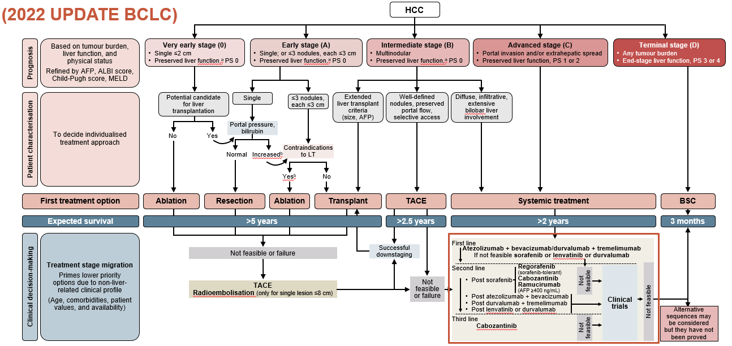
The place of IO IN THE TREATMENT LANDSCAPE
Multidisciplinary Care for patients with hepatobiliary Cancer
(2022 update BCLC)
HCC
Based on tumour burden,
liver function, and
physical status
Refined by AFP, ALBI score,
Child-Pugh score, MELD
Very early stage (0)
Single ≤2 cm
Preserved liver function,ª PS 0
Early stage (A)
Single; or ≤3 nodules, each ≤3 cm
Preserved liver function,ª PS 0
Intermediate stage (B)
Multinodular
Preserved liver function,ª PS 0
Advanced stage (C)
Portal invasion and/or extrahepatic spread
Preserved liver function, PS 1 or 2
Terminal stage (D)
Any tumour burden
End-stage liver function, PS 3 or 4
First line
Prognosis
Atezolizumab + bevacizumab/durvalumab + tremelimumab
If not feasible sorafenib or lenvatinib or durvalumab
To decide individualised
treatment approach
Potential candidate
for liver
transplantation
Single
≤3 nodules,
each ≤3 cm
Extended
liver transplant
criteria
(size, AFP)
Well-defined
nodules, preserved
portal flow,
selective access
Diffuse, infiltrative,
extensive
bilobar liver
involvement
Second line
Regorafenib
(sorafenib-tolerant)
Cabozantinib
Ramucirumab
(AFP ≥400 ng/mL)
Clinical
trials
Portal pressure, bilirubin
Not
feasible
Patient characterisation
No
Post sorafenib
Not
feasible
Yes
Normal
Increased^{b}
Contraindications
to LT
Post atezolizumab + bevacizumab
Post durvalumab + tremelimumab
Post lenvatinib or durvalumab
Yes^{b}
No
Not feasible
First treatment option
Ablation
Resection
Ablation
Transplant
TACE
Systemic treatment
BSC
Expected survival
>5 years
>2.5 years
>2 years
3 months
Treatment stage migration
Primes lower priority
options due to non-liver-related clinical profile
(Age, comorbidities, patient
values, and availability)
Third line
Not
feasible
Cabozantinib
Successful
downstaging
First line
Not feasible or failure
Atezolizumab + bevacizumab/durvalumab + tremelimumab
If not feasible sorafenib or lenvatinib or durvalumab
Second line
Regorafenib
(sorafenib-tolerant)
Cabozantinib
Ramucirumab
(AFP ≥400 ng/mL)
Clinical
trials
Not
feasible
or failure
Not
feasible
Clinical decision-making
TACE
Radioembolisation (only for single lesion ≤8 cm)
Post sorafenib
Post atezolizumab + bevacizumab
Post durvalumab + tremelimumab
Post lenvatinib or durvalumab
Not feasible
Alternative
sequences may
be considered
but they have not
been proved
Third line
Cabozantinib
Not
feasible
ª Except for those with tumour burden acceptable for transplant
^{b} Resection may be considered for single peripheral HCC with adequate remnant liver volume
AFP, alpha-fetoprotein;
Reig M, et al. J Hepatol. 2022;76:681-93

Slide 38
in conclusion

Slide 39
In conclusion
The treatment landscape for patients with HCC has evolved rapidly over recent years
IO, and in particular IO combinations, are effective treatments for patients with
advanced HCC
Approved IO and IO combinations as first-line treatment:
  Atezolizumab + bevacizumab (FDA – May 2020,¹ EMA – Sept 2020²)
  Tremelimumab + durvalumab (FDA – Oct 2022,³ EMA – Dec 2022⁴)
IO and IO combinations may result in inflammatory side effects referred to as irAEs
  Most of these adverse AEs can be treated with steroids
Survival analysis for IO treatment shifts from median OS to landmark analysis
AE, adverse event; EMA, European Medicines Agency; FDA, U.S. Food and Drug Administration; HCC, hepatocellular carcinoma; IO, immunotherapy; OS, overall survival
1. U.S. Food and Drug Administration. Available from: https://www.fda.gov/drugs/resources-information-approved-drugs/fda-approves-atezolizumab-plus-bevacizumab-unresectable-hepatocellular-carcinoma. Last updated June 2020. Accessed March 2023; 2. European Medicines Agency. Available from: https://www.ema.europa.eu/en/documents/smop/chmp-post-authorisation-summary-positive-opinion-tecentriq-ii-39_en.pdf. Last updated September 2020. Accessed March 2023; 3. U.S. Food and Drug Administration. Available from: https://www.fda.gov/drugs/resources-information-approved-drugs/fda-approves-tremelimumab-combination-durvalumab-unresectable-hepatocellular-carcinoma. Last updated October 2022. Accessed March 2023; 4. European Medicines Agency. Available from: https://www.ema.europa.eu/en/documents/smop-initial/chmp-summary-positive-opinion-imjudo_en.pdf. Last updated December 2022. Accessed March 2023

Slide 40
Outlook to Module 2 the use of immunotherapy in hCC:
In-depth subgroup analyses and challenges

