Slide 2
The use of IMMUNOTHERAPY IN hcc
Micro learning module two: in-depth subgroup analyses and challenges
Dr Aiwu Ruth He, MD, PhD
Medstar Georgetown University Hospital, Washington DC, USA
Prof. Dr Peter R. Galle, MD, PhD
University Medical Centre Mainz, Mainz, Germany
JUNE 2023

Slide 3



This programme has been developed by two international experts
Dr Aiwu Ruth He
GI Medical Oncologist
Medstar Georgetown University Hospital, USA
Prof. Peter R. Galle
Hepatology Specialist
University Medical Centre Mainz, Germany

Slide 4

Developed by HCC COnnect
This programme is developed by HCC CONNECT,
an international group of experts in the field of
hepatocellular carcinoma.
Acknowledgement and disclosures
This HCC CONNECT programme is supported through an independent educational grant from AstraZeneca. The programme is therefore independent, the content is not influenced by the supporter and is under the sole responsibility of the experts.
Please note: The views expressed within this programme are the personal opinions of the experts. They do not necessarily represent the views of the experts’ institutions, or the rest of the HCC CONNECT group.
Expert disclaimers:
Dr Aiwu Ruth He has received financial support/sponsorship for research support, consultation, or speaker fees from the following companies: AstraZeneca, BMS, Boston Scientific, Eisai, Genentech, and Merck
Prof. Peter R. Galle has received financial support/sponsorship for research support, consultation, or speaker fees from the following companies: Adaptimmune, AstraZeneca, Bayer, BMS, Boston Scientific, Eisai, Guerbet, Ipsen, Lilly, MSD, Roche, and Sirtex

Slide 5
Educational objectives
Upon completion of this micro learning you will:
Know how to assess liver function in patients with HCC using the Albumin-Bilirubin (ALBI) scoring system
  To evaluate the eligibility for IO treatment
Understand the data in the different subgroups of HCC patients
eligible for IO treatment
  To study the efficacy and safety of IO combinations for these subgroups
HCC, hepatocellular carcinoma; IO, immunotherapy

Slide 6
Clinical takeaways*
The Child-Pugh and ALBI scoring systems are methods to assess liver function
  The ALBI scoring system is more objective and easier to retrieve than the Child–Pugh score
  The ALBI scoring system helps to further divide patients with compensated cirrhosis into subgroups to predict clinical outcome of IO in patients with HCC
Given the expanding systemic treatment options for HCC, including IO and IO combinations, there is a need to understand whether specific groups of patients benefit more from one therapy than another
Subgroup analyses in patients with HCC receiving IO and IO combinations show variable hazard ratios (HRs) across etiologies and across liver function
  Data are not mature enough to guide treatment decisions
*These clinical takeaways are based on scientific literature that is discussed in greater detail and referred to in this slide deck
ALBI, Albumin-Bilirubin; HCC, hepatocellular carcinoma; IO, immunotherapy

Slide 7
liver function:
Child-pugh and aLBI scoring systems in clinical trials in hcc
ALBI, Albumin-Bilirubin; HCC, hepatocellular carcinoma

Slide 8



Measuring Liver function in PATIENTS WITH HCC¹
The child-pugh scoring system is widely used to grade liver function
For patients with HCC, among several other factors, survival depends on tumour stage, liver function, and potentially on performance status
The Child–Pugh system may be insufficient in defining the liver dysfunction and prognosis for patients with HCC categorised as Child–Pugh class A¹
The Child–Pugh system was designed to predict mortality in cirrhosis patients²
The Child–Pugh system does not offer a wide degree of discrimination for patients with HCC¹
Child-Pugh is based on 5 measures to grade liver function from class A to C (mild to severe):
  Serum bilirubin, serum albumin, ascites status, prothrombin time, and degree of encephalopathy.
ALBI, Albumin-Bilirubin; HCC, hepatocellular carcinoma
1. Johnson PJ, et al. J Clin Oncol. 2015;33:550-8, 2. Tsoris A, Marlar CA, StatPearls Publishing LLC, 2023: PMID: 31194448

Slide 9
Measuring Liver function in patients with HCC the Albi scoring system was developed more recently to grade liver function¹
5
10
ALBI
Objective measures of liver function were identified¹
  Using international databases
  These objective measures influence survival independently in patients with HCC
These measures were combined into the ALBI scoring system¹
  Combining serum bilirubin and serum albumin concentrations
  ALBI score = −0.085 × (albumin g/L) + 0.66 × log(bilirubin μmol/L)
The ALBI scoring system was implemented in the Barcelona Clinic Liver Cancer system in 2016²
0.5
15
(A3)
0
20
100
90
80
70
60
50
−0.5
55
−1
25
40
45
30
35
20
25
−1.5
15
(A2)
30
Bilirubin (µmol/L)
Albumin (g/L)
10
9
8
7
6
5
−2
4
−2.5
3
35
2
−3
1
−3.5
(A1)
40
−4
−4.5
45
50
55
Figure adapted from Johnson PJ, et al.¹; Nomogram to quickly assess the ALBI score
ALBI, Albumin-Bilirubin; HCC, hepatocellular carcinoma
1. Johnson PJ, et al. J Clin Oncol. 2015;33:550-8; 2. Chan AWH, et al. J Gastroenterol Hepatol. 2016;31:1300-6

Slide 10
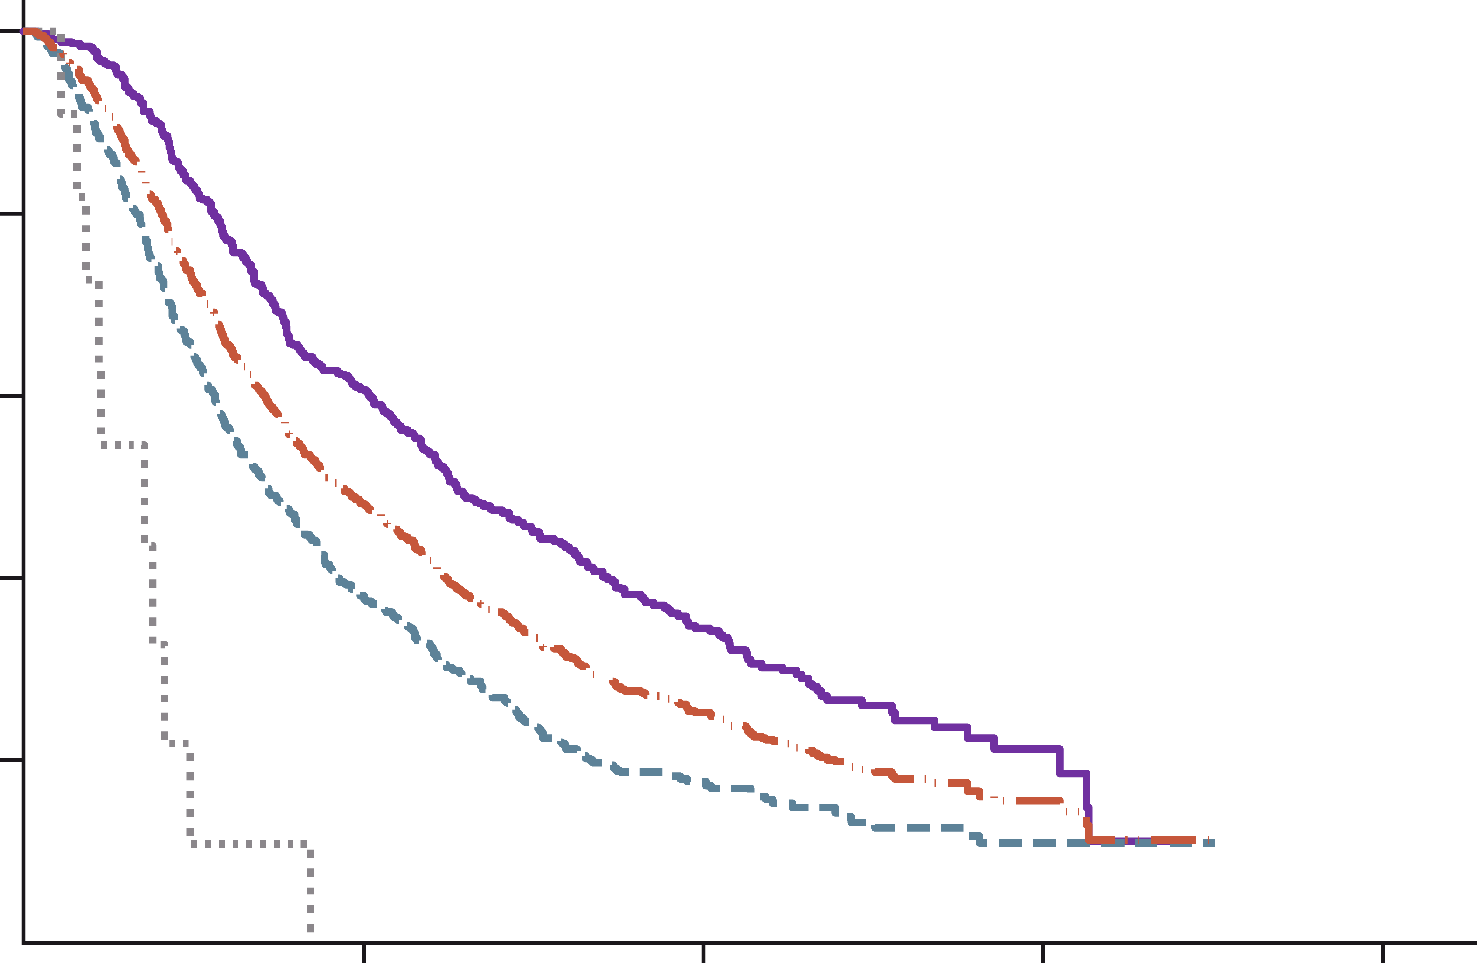
Performance of the ALBI scoring system in patients receiving sorafenib treatment
Many HCC clinical trials are limited to
Child–Pugh class A patients¹
Not all Child–Pugh class A patients are the same
  Heterogeneity might impact survival findings¹
The ALBI scoring system may highlight distinct prognostic subgroups within Child–Pugh class A patients¹
  It allows for more precise patient selection
  for clinical trials of systemic treatments²
1.0
ALBI grade | N | Median survival (95% CI), months
1 | 475 | 12.7 (11.7-14.9)
2 | 542 | 7.2 (6.4-8.2)
3 | 11 | 3.6 (1.6-4.9)
All sorafenib treated | 1,028 | 9.3 (8.5-10.5)
0.8
0.6
Survival (probability)
0.4
0.2
0
10
20
30
40
Time (months)
Figure adapted from Johnson PJ, et al.¹; Median survival difference of nearly 6 months between patients with ALBI grade 1 and ALBI grade 2 treated with sorafenib
ALBI, Albumin-Bilirubin; CI, confidence interval; HCC, hepatocellular carcinoma
1. Johnson PJ, et al. J Clin Oncol. 2015;33:550-8; 2. Chan AWH, et al. J Gastroenterol Hepatol. 2016;31:1300-6
Notes:
.

Slide 11
The modified ALBI scoring system
May provide better prognostic and predictive value for patients with HCC^{1,2}
The modified Albumin-Bilirubin (mALBI) scoring system is superior to the ALBI as:¹
  it produces a uniform distribution of patients among grades 2a and 2b
  it improves stratification performance
It is expected that the mALBI scoring system is now becoming widely used¹
ALBI score | ALBI grade definition³ | mALBI grade definition² | Liver dysfunction/decompensation
≤ −2.60 | 1 | 1 | Mild
> −2.60 to < −2.270 ≥ −2.270 to ≤ −1.39 | 2 2 | 2a 2b | Moderate
> −1.39 | 3 | 3 | Severe
ALBI, Albumin-Bilirubin; HCC, hepatocellular carcinoma
1. Kudo M. Liver Cancer. 2022;11:1-8; 2. Hiraoka A, et al. Liver Cancer. 2019;8:121-9; 3. Johnson PJ, et al. J Clin Oncol. 2015;33:550-8

Slide 12
subgroup analyses in IO HCC trials
HCC, hepatocellular carcinoma; IO, immunotherapy

Slide 13
Subgroup analyses are important if…
There are potential differences in prognosis between subgroups, with or without treatment
There is potential heterogeneity of treatment effect in relation to pathophysiology of underlying liver disease
There are practical questions about when to treat
There are doubts about benefit in specific groups, which are leading to potentially inappropriate treatment
Rothwell PM. Lancet. 2005;365:176-86

Slide 14
Heterogeneity of patients with hcc
There are various patient groups with HCC with specific comorbidities or disease features that require extra clinical attention¹, such as:
  Solid organ transplantation, prior or active auto immune disease, or decompensated cirrhosis
There are no specific genetic biomarkers to determine the prognosis or response to systemic treatment
In general, these patient subgroups are underrepresented in clinical trials of systemic treatment¹
  Comorbidities, such as vascular invasion or decompensated cirrhosis, impact prognosis negatively and potentially confound outcomes
This results in a lack of robust safety and efficacy data for these specific patient groups¹
HCC, hepatocellular carcinoma
1. Rimassa L, et al. J Hepatol. 2021;74:931-43

Slide 15
Subgroups for io treatment in HCC an overview
PATIENT SUBGROUPS
Liver function
Frail patients
Etiology of HCC: viral and non-viral
HCC, hepatocellular carcinoma; IO, immunotherapy

Slide 16
Subgroup liver function
PATIENT SUBGROUPS
Liver function
Frail patients
Etiology of HCC: viral and non-viral
Subgroup analyses by ALBI grade have been performed:
  in IMbrave150 (atezolizumab + bevacizumab vs sorafenib)¹
  in HIMALAYA (tremelimumab + durvalumab vs sorafenib)²
ALBI, Albumin-Bilirubin
1. Kudo M, et al. ILCA (Virtual) 2021. Abstract #O-18. Oral presentation; 2. Vogel A, et al. Ann Oncol. 2022;33 suppl 9:S1454-84 (ESMO Asia 2022 poster presentation 79-P)

Slide 17
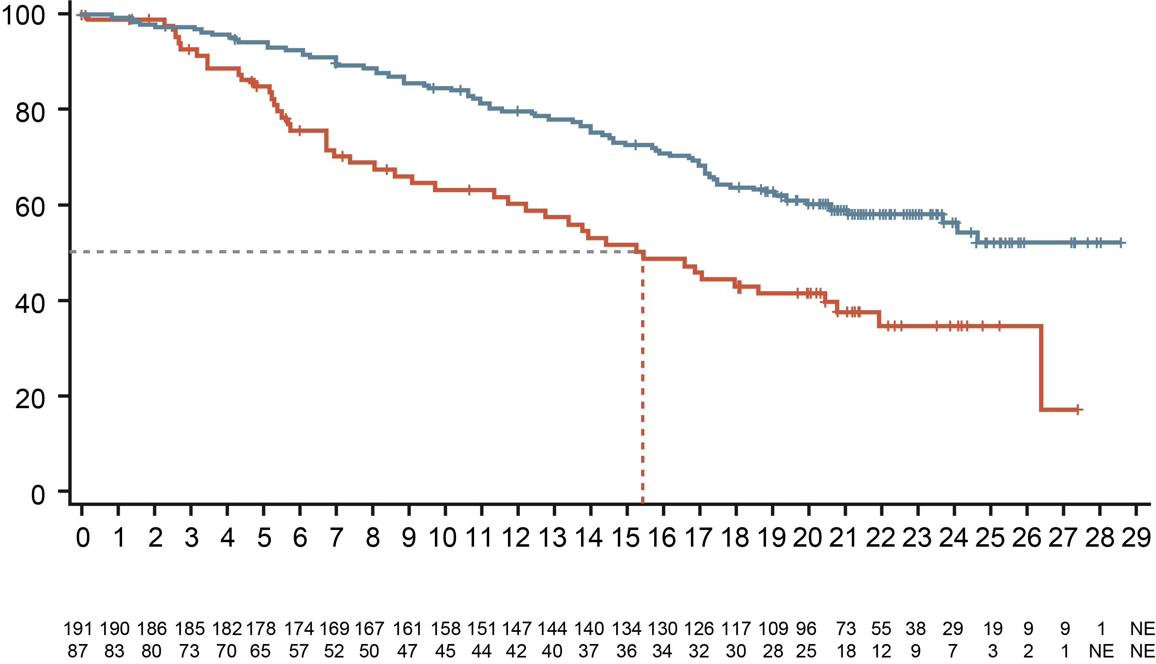
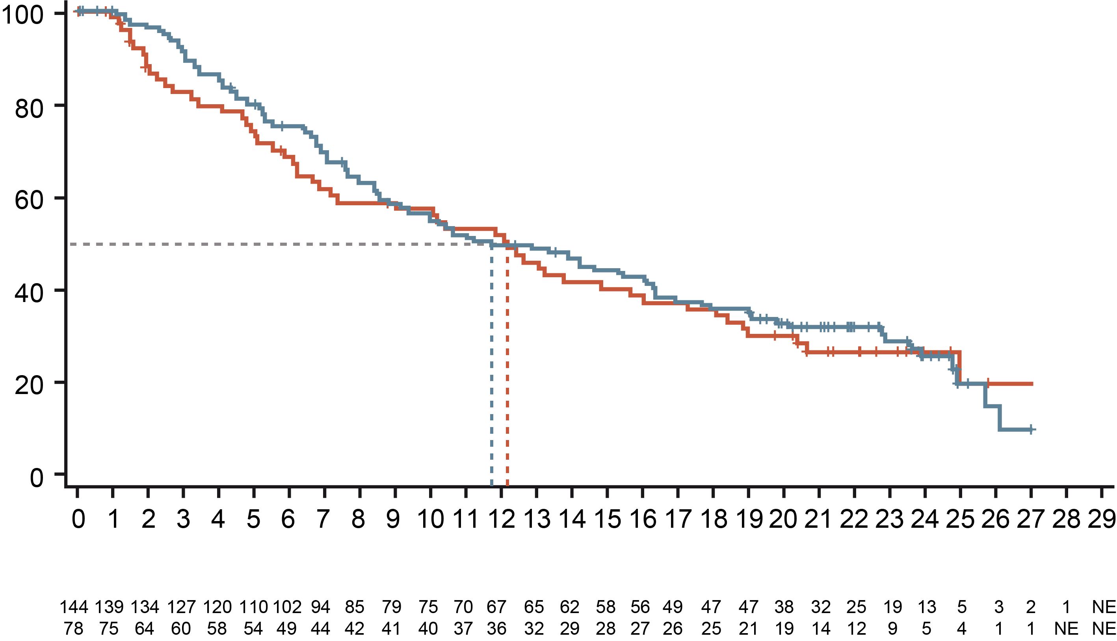
Subgroup: Liver function | Atezolizumab + bevacizumab
Albi Grade 1 had a greater overall survival (OS) benefit with Atezolizumab + Bevacizumab than with sorafenib¹
ALBI grade 1
ALBI grade 2
 | Atezo + Bev (n=191) | Sorafenib (n=87)
OS events, n (%) | 79 (41) | 47 (54)
HR (95% CI)ª | 0.50 (0.35-0.72)
 | Atezo + Bev (n=144) | Sorafenib (n=78)
OS events, n (%) | 100 (69) | 53 (68)
HR (95% CI)ª | 0.92 (0.66-1.29)
NE
(23.7-NE)
OS (%)
OS (%)
Median OS
(95% CI), months
Median OS
(95% CI), months
15.4
(11.7-20.8)
11.7
(9.1-16.1)
12.2
(7.2-16.1)
Time (months)
Time (months)
Number at risk
Atezo + Bev
Sorafenib
Number at risk
Atezo + Bev
Sorafenib
Clinical cut-off date: 31 August 2020; Median follow-up: 15.6 months; ªHR is unstratified.
Full analysis set - Updated IMbrave150 results (Cheng et al. J. Hepatol. 2022): Median OS was 5.8 months longer with atezolizumab +bevacizumab than sorafenib
ALBI, Albumin-Bilirubin; Atezo, atezolizumab; Bev, bevacizumab; CI, confidence interval; HR, hazard ratio; NE, not estimable
1. Kudo M, et al. ILCA (Virtual) 2021. Abstract #O-18. Oral presentation

Slide 18
Subgroup: Liver function | Atezolizumab + bevacizumab safety profiles across subgroups based on liver function were generally consistent
 | mALBI grade 1 |  | mALBI grade 2a |  | mALBI grade 2b
 | Atezo + Bev (n=189) | Sorafenib (n=81) | Atezo + Bev (n=71) | Sorafenib (n=37) | Atezo + Bev (n=69) | Sorafenib (n=38)
Median treatment duration, months | Atezo: 10.4 (0-28); Bev: 9.6 (0-28) | 2.9 (0-25) | Atezo: 6.9 (0-26); Bev: 5.1 (0-25) | 1.9 (0-21) | Atezo: 4.3 (0-24); Bev: 4.7 (0-24) | 2.8 (0-21)
All-grade AE, any cause, n (%) | 185 (98) | 79 (98) | 70 (99) | 37 (100) | 67 (97) | 38 (100)
Treatment-related | 169 (89) | 75 (93) | 61 (86) | 36 (97) | 54 (78) | 37 (97)
Grade 3 or 4 AE, n (%)ª | 122 (65) | 47 (58) | 46 (65) | 21 (57) | 39 (57) | 21 (55)
Treatment-relatedª | 90 (48) | 37 (46) | 27 (38) | 21 (57) | 26 (38) | 14 (37)
Serious AE, n (%) | 79 (42) | 22 (27) | 38 (54) | 12 (32) | 43 (62) | 17 (45)
Treatment-related | 41 (22) | 10 (12) | 12 (17) | 5 (14) | 23 (33) | 10 (26)
Grade 5 AE, n (%) | 7 (4) | 3 (4) | 5 (7) | 2 (5) | 11 (16) | 4 (11)
Treatment-related | 2 (1) | 0 | 1 (1) | 0 | 3 (4) | 1 (3)
AE leading to withdrawal from any component, n (%) | 33 (17) | 7 (9) | 18 (25) | 5 (14) | 21 (30) | 6 (16)
AE leading to dose interruption of any study treatment, n (%) | 122 (65) | 28 (35) | 37 (52) | 19 (51) | 36 (52) | 21 (55)
AE leading to dose modification of sorafenib, n (%)^{b} | 0 | 30 (37) | 0 | 14 (38) | 0 | 14 (37)
The safety and tolerability profile of atezolizumab + bevacizumab was consistent with the known safety profiles of each individual drug and with the underlying disease, regardless of mALBI grade
Clinical cut-off date: 31 August 2020; Median follow-up: 15.6 months; ª Highest grade experienced; ^{b} No dose modification allowed for the atezolizumab + bevacizumab arm; AE, adverse event; Atezo, atezolizumab; Bev, bevacizumab; mALBI, modified Albumin-Bilirubin; SAE, serious adverse event
1. Kudo M, et al. ILCA (Virtual) 2021. Abstract #O-18. Oral presentation

Slide 19
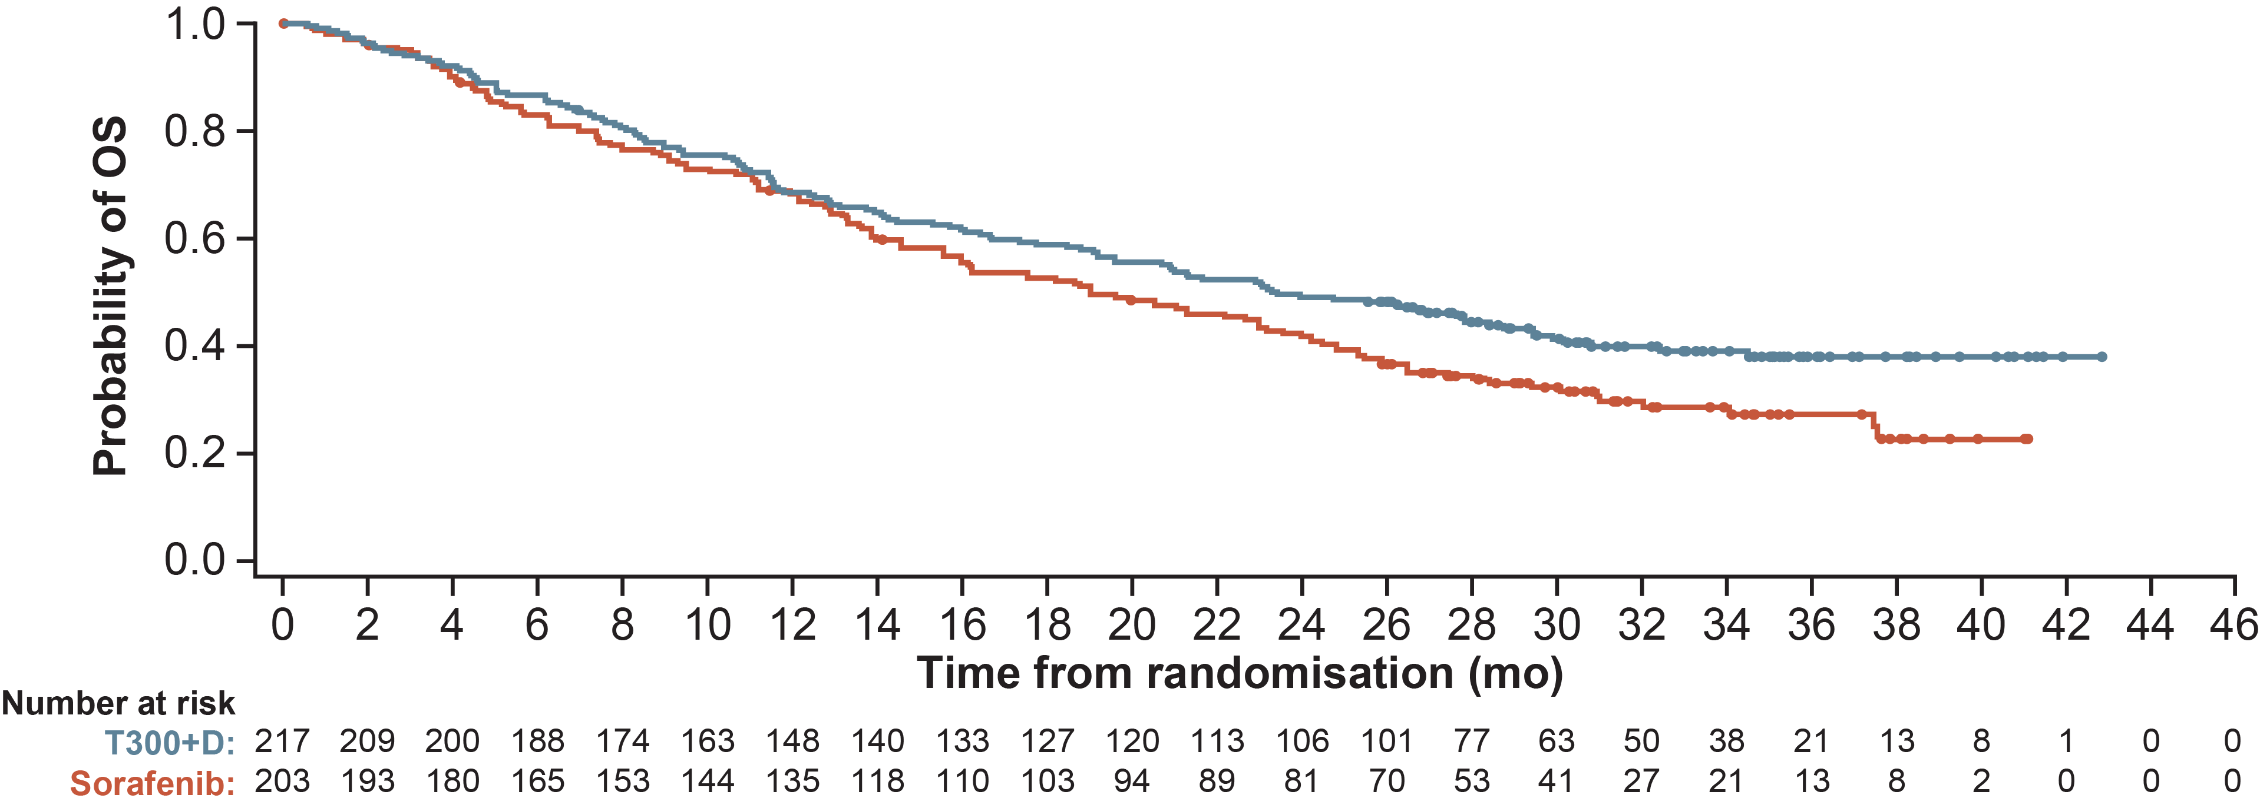
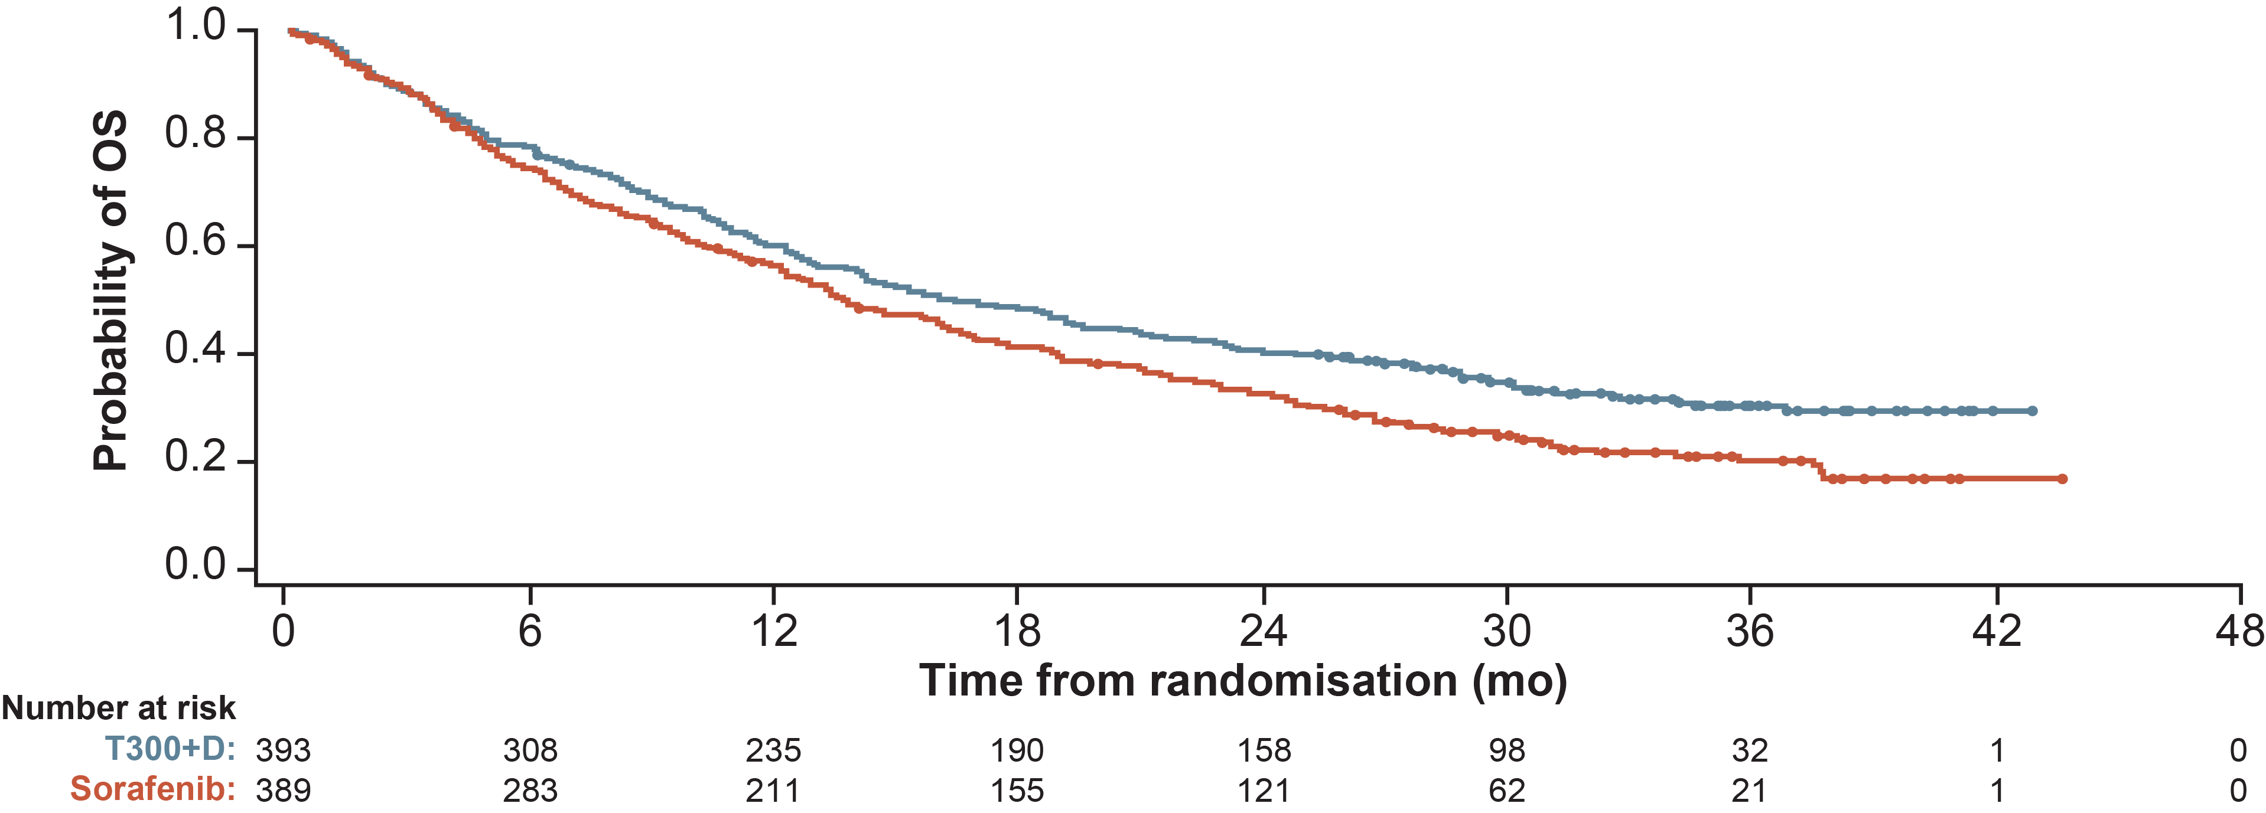
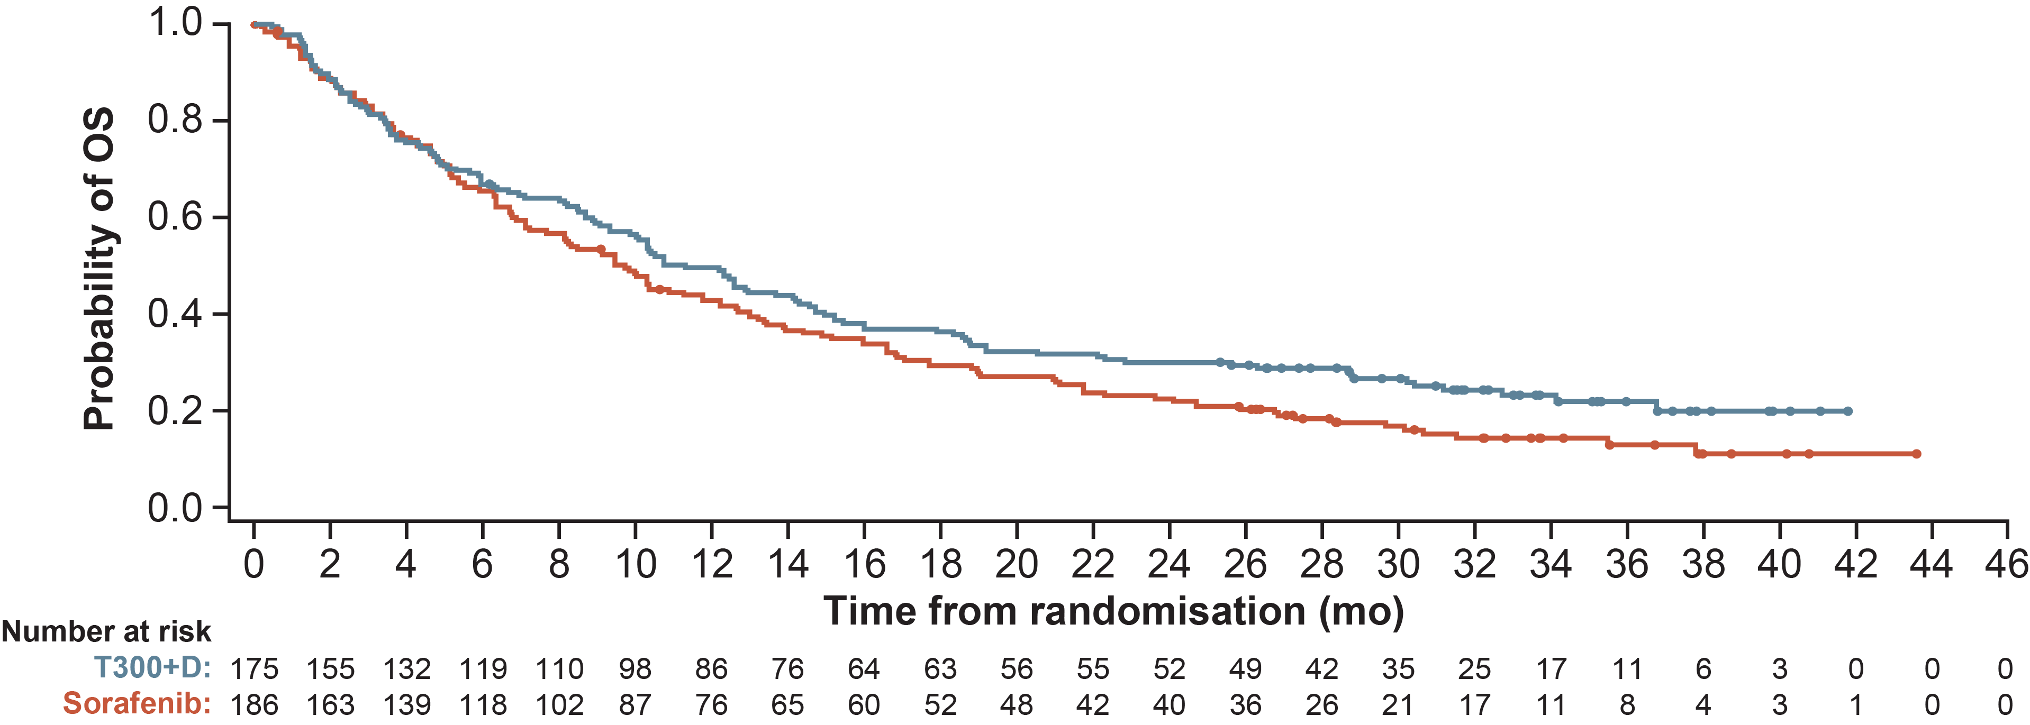
Subgroup: Liver function | tremelimumab + Durvalumab
OS in both subgroups was consistent with the full analysis set
ALBI grade 1
Full analysis set
 | T300+D | Sorafenib
Median OS (95% CI), months | 23.43 (19.19-28.75) | 19.02 (15.67-23.16)
OS HR† (95% CI) | 0.79 (0.62-1.01)
 | T300+D | Sorafenib
OS events, n (%) | 262 (66.7) | 293 (75.3)
Median OS (95% CI), months | 16.4 (14.2-19.6) | 13.8 (12.3-16.1)
OS HRª (96.02% CI) | 0.78 (0.65-0.93)
p-value (2-sided) | 0.0035
T300+D (N=217)
Sorafenib (N=203)
T300+D (N=393)
Sorafenib (N=389)
ALBI grade 2 or 3
 | T300+D | Sorafenib
Median OS (95% CI), months | 11.30 (9.33-14.19) | 9.72 (7.23-11.76)
OS HR† (95% CI) | 0.83 (0.65-1.05)
Figures adapted from Vogel A, et al.¹; data cut-off date: 27 August 2021; median follow-up (95% CI): 33.18 (31.74-34.53) months for T300+D, 32.56 (31.57-33.71) months for durvalumab, and 32.23 (30.42–33.71) months for sorafenib
ª OS HRs and CIs were calculated using a Cox proportional hazards model adjusting for treatment, etiology, Eastern Cooperative Oncology Group performance status, and macrovascular invasion
T300+D (N=175)
Sorafenib (N=186)
ALBI, Albumin-Bilirubin; CI, confidence interval; HR, hazard ratio; mo, months; OS, overall survival; T300+D, tremelimumab 300 mg x 1 dose + durvalumab 1,500 mg every 4 weeks (Q4W)
1. Vogel A, et al. Ann Oncol. 2022;33 suppl 9:S1454-84 (ESMO Asia 2022 poster presentation 79-P)

Slide 20
Subgroup: Liver function | tremelimumab + Durvalumab safety profiles according to liver function were generally consistent
Tremelimumab + durvalumab had a similar safety profile in both ALBI subgroups, consistent with the safety analysis set
Durvalumab had a similar safety profile in both ALBI subgroups, consistent with the safety analysis set
 | ALBI grade 1 |  |  | ALBI grade 2 or 3 |  |  | Safety analysis set
Patients with an event, n (%) | T300+D (n=216) | Durvalumab (n=198) | Sorafenib (n=197) | T300+D (n=171) | Durvalumab (n=190) | Sorafenib (n=177) | T300+D (n=388) | Durvalumab (n=388) | Sorafenib (n=374)
Any TEAE | 210 (97.2) | 171 (86.4) | 187 (94.9) | 167 (97.7) | 174 (91.6) | 170 (96.0) | 378 (97.4) | 345 (88.9) | 357 (95.5)
Any TRAE | 166 (76.9) | 99 (50.0) | 168 (85.3) | 127 (74.3) | 103 (54.2) | 149 (84.2) | 294 (75.8) | 202 (52.1) | 317 (84.8)
Any grade 3 or 4 TEAE | 111 (51.4) | 63 (31.8) | 102 (51.8) | 85 (49.7) | 81 (42.6) | 94 (53.1) | 196 (50.5) | 144 (37.1) | 196 (52.4)
Any grade 3 or 4 TRAE | 59 (27.3) | 17 (8.6) | 76 (38.6) | 41 (24.0) | 33 (17.4) | 62 (35.0) | 100 (25.8) | 50 (12.9) | 138 (36.9)
Any TEAE leading to death | 8 (3.7) | 6 (3.0) | 11 (5.6) | 22 (12.9) | 20 (10.5) | 16 (9.0) | 30 (7.7) | 26 (6.7) | 27 (7.2)
Any TRAE leading to death | 5 (2.3) | 0 | 1 (0.5) | 4 (2.3) | 0 | 2 (1.1) | 9 (2.3) | 0 | 3 (0.8)
Any serious TEAE | 89 (41.2) | 48 (24.2) | 49 (24.9) | 68 (39.8) | 67 (35.3) | 62 (35.0) | 157 (40.5) | 115 (29.6) | 111 (29.7)
Any serious TRAE | 44 (20.4) | 14 (7.1) | 15 (7.6) | 24 (14.0) | 18 (9.5) | 20 (11.3) | 68 (17.5) | 32 (8.2) | 35 (9.4)
Any TEAE leading to discontinuation | 27 (12.5) | 10 (5.1) | 20 (10.2) | 26 (15.2) | 22 (11.6) | 43 (24.3) | 53 (13.7) | 32 (8.2) | 63 (16.8)
Any TRAE leading to discontinuation | 20 (9.3) | 4 (2.0) | 15 (7.6) | 12 (7.0) | 12 (6.3) | 26 (14.7) | 32 (8.2) | 16 (4.1) | 41 (11.0)
Any immune-mediated TEAE | 94 (43.5) | 25 (12.6) | 20 (10.2) | 45 (26.3) | 39 (20.5) | 10 (5.6) | 139 (35.8) | 64 (16.5) | 30 (8.0)
TEAEs include AEs with onset or increase in severity on or after the date of the first dose through 90 days following the date of the last dose or the date of initiation of the first subsequent therapy; Treatment-related was as assessed by the investigator
AE, adverse event; ALBI, albumin-bilirubin; T300+D, tremelimumab 300 mg x 1 dose + durvalumab 1,500 mg Q4W; TEAE, treatment-emergent adverse event; TRAE, treatment-related adverse event
Vogel A, et al. Ann Oncol. 2022;33 suppl 9:S1454-84 (ESMO Asia 2022 poster presentation 79-P)

Slide 21
Subgroup
According to etiology of HCC: viral and non-viral HCC
PATIENT SUBGROUPS
Liver function
Frail patients
Etiology of HCC: viral and non-viral
HCC can have viral and non-viral causes
Non-viral causes of HCC include non-alcoholic steatohepatitis (NASH), non-alcoholic fatty liver disease (NAFLD) and alcohol use
Viral causes of HCC are hepatitis B (HBV) and hepatitis C (HCV)
HCC, hepatocellular carcinoma
Pfister D, et al. Nature. 2021;592:450-6

Slide 22
Subgroup: the cause of HCC – viral and non-viral HCC¹
OS may be related to underlying liver disease
Study | HR (95% CI) | HR±95% CI | IO, n | Control, n | Weight, %
CheckMate-459 IMbrave150 KEYNOTE-240 Subtotal | 0.95 (0.74-1.22) 0.91 (0.52-1.59) 0.88 (0.64-1.21) 0.92 (0.77-1.11) |  | 168 100 163 431 | 168 53 85 306 | 22.7 9.3 18.6 50.6
CheckMate-459 IMbrave150 KEYNOTE-240 Subtotal | 0.74 (0.58-0.94) 0.48 (0.33-0.70) 0.70 (0.42-1.17) 0.64 (0.48-0.84) |  | 203 236 115 554 | 203 112 50 365 | 23.1 15.7 10.7 49.4
Test for subgroup differences: 𝜒² = 4.58, d.f. = 1 (p=0.03), I² = 78.2%
Total | 0.77 (0.63-0.94) |  | 985 | 671 | 100.0
Meta-analysis of 1,656 patients
  OS improved with immunotherapy
Separate meta-analyses were subsequently performed for each of the three etiologies: non-viral (NASH and alcohol intake), hepatitis C virus (HCV), and hepatitis B virus (HCV)
  Survival was superior to the control arm in patients with HBV-related HCC (n=574; p=0.0008) and HCV-related HCC (n=345; p=0.04)
  Survival was not superior to the control arm in patients with non-viral HCC (n=737; p=0.39)
Non-viral
HCC
Viral
HCC
0.2
0.5
1.0
2.0
Favours IO
Favours control
Study | HR (95% CI) | HR±95% CI | IO, n | Control, n | Weight, %
CheckMate-459 IMbrave150 KEYNOTE-240 Subtotal | 0.95 (0.74-1.22) 0.91 (0.52-1.59) 0.88 (0.64-1.21) 0.92 (0.77-1.11) |  | 168 100 163 431 | 168 53 85 306 | 55.1 11.0 33.9 100.0
CheckMate-459 IMbrave150 KEYNOTE-240 Subtotal | 0.71 (0.50-1.01) 0.43 (0.21-0.87) 0.96 (0.48-1.92) 0.68 (0.48-0.97) |  | 87 72 43 202 | 86 36 21 143 | 56.6 21.4 22.0 100.0
CheckMate-459 IMbrave150 KEYNOTE-240 Subtotal | 0.77 (0.56-1.06) 0.51 (0.32-0.81) 0.57 (0.35-0.93) 0.64 (0.49-0.83) |  | 116 164 72 352 | 117 76 29 222 | 48.9 26.5 24.5 100.0
Non-viral
HCC
HCV-
HCC
HBV-
HCC
0.1
1.0
10.0
CI, confidence interval; d.f., degrees of freedom; HCC, hepatocellular carcinoma;
HR, hazard ratio; IO, immunotherapy; NASH, non-alcoholic steatohepatitis; OS, overall survival
1. Pfister D, et al. Nature. 2021;592:450-6
Favours IO
Favours control

Slide 23
Subgroup: viral/non-viral | Atezolizumab + bevacizumab
OS (Updated Imbrave150)
The atezolizumab + bevacizumab combination seems to be less effective in non-viral HCC
Characteristic (n) | Median OS, months |  |  | HRª (95% CI)
Characteristic (n) | Atezo + Bev | Sorafenib |  | HR (95% CI)
All patients (501) | 19.2 | 13.4 |  | 0.66 (0.52-0.85)
HBV-HCC (240) | 19.0 | 12.4 |  | 0.58 (0.40-0.83)
HCV-HCC (108) | 24.6 | 12.6 |  | 0.43 (0.25-0.73)
Non-viral HCC (153) | 17.0 | 18.1 |  | 1.05 (0.68-1.63)
0.2
1.0
2.0
Favours atezo + bev
Favours sorafenib
Clinical cut-off date: 31 August 2020; Median follow-up: 15.6 months; ª HRs are from unstratified analyses
atezo, atezolizumab; bev, bevacizumab; CI, confidence interval; HBV, hepatitis B virus; HCC, hepatocellular carcinoma; HCV, hepatitis C virus; HR, hazard ratio; OS, overall survival
1. Cheng A-L, et al. J Hepatol. 2022;76:862-73

Slide 24
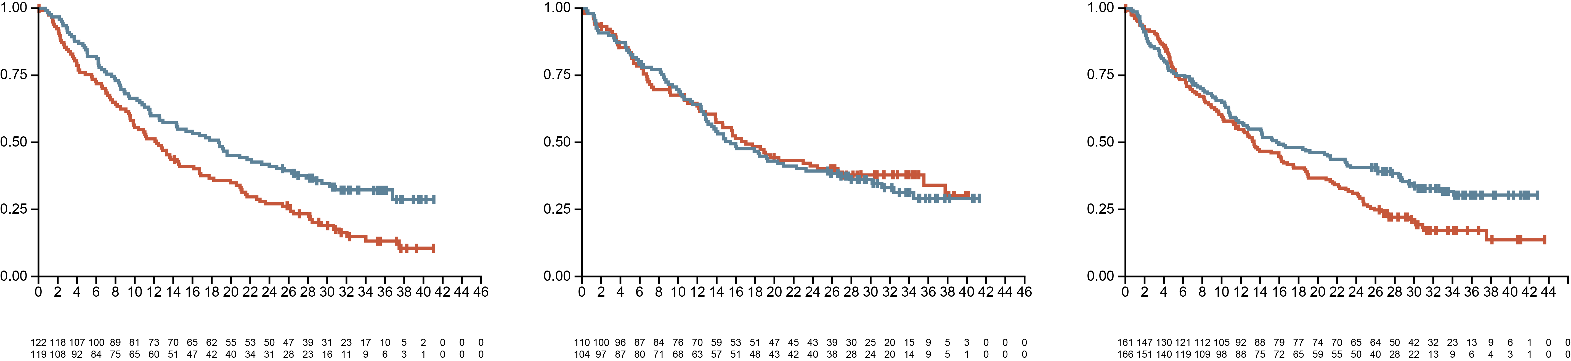
Subgroup: viral/non-viral | tremelimumab + Durvalumab survival benefit of IO in patients with non-viral HCC and HBV-infected HCC
HBV
HCV
Non-viral
 | STRIDE (n=122) | Sorafenib (n=119)
Events, n (%) | 82 (67.2) | 98 (82.4)
Median OS, months | 18.7 | 12.3
HR (95% CI)ª | 0.64 (0.48-0.86)
 | STRIDE (n=110) | Sorafenib (n=104)
Events, n (%) | 73 (66.4) | 64 (61.5)
Median OS, months | 15.4 | 17.1
HR (95% CI)ª | 1.06 (0.76-1.49)
 | STRIDE (n=161) | Sorafenib (n=166)
Events, n (%) | 107 (66.5) | 131 (78.9)
Median OS, months | 16.0 | 13.4
HR (95% CI)ª | 0.74 (0.57-0.95)
Probability of OS
Probability of OS
Probability of OS
STRIDE
Sorafenib
STRIDE
Sorafenib
STRIDE
Sorafenib
Number at risk
STRIDE
Sorafenib
Time from randomisation (months)
Number at risk
STRIDE
Sorafenib
Time from randomisation (months)
Number at risk
STRIDE
Sorafenib
Time from randomisation (months)
ª HR and 95% CI are estimated from an unstratified Cox proportional hazards model with treatment as the only covariate and using the Efron method to control for ties
CI, confidence interval; HBV, hepatitis B virus; HCV, hepatitis C virus; HR, hazard ratio; IO, immunotherapy; OS, overall survival; STRIDE, Single Tremelimumab Regular Interval Durvalumab
Chan LS, et al. Ann Oncol. 2022;33 suppl 9:S869-70 (ESMO 2022 poster presentation 714-P)

Slide 25
Subgroup: viral/non-viral | tremelimumab + Durvalumab survival benefit of IO in patients with non-viral HCC and HBV-infected HCC
Characteristic | Median OS, months |  |  | HRª (95% CI)
Characteristic (n) | Durva + Treme | Sorafenib |  | HR (95% CI)
All patients | 16.4 | 13.8 |  | 0.77 (0.65-0.91)
HBV-HCC | 18.7 | 12.3 |  | 0.64 (0.48-0.86)
HCV-HCC | 15.4 | 17.1 |  | 1.06 (0.76-1.49)
Non-viral HCC | 16.0 | 13.4 |  | 0.73 (0.57-0.95)
0.25
0.5
1.0
2.0
4.0
Favours treme + durva
Favours sorafenib
ª HR and 95% CI are estimated from an unstratified Cox proportional hazards model with treatment as the only covariate and using the Efron method to control for ties. Please refer to the original publication for the stratified results
Durva, durvalumab; treme, tremelimumab; CI, confidence interval; HBV, hepatitis B virus; HCV, hepatitis C virus; HR, hazard ratio; IO, immunotherapy;
Chan LS, et al. Ann Oncol. 2022;33 suppl 9:S869-70 (ESMO 2022 poster presentation 714-P)

Slide 26
Subgroup: viral vERSUs non-viral etiology | tremelimumab + Durvalumab
INCIDENCES OF trAEs were lower across etiology subgroups
The incidences of trAEs or grade 3 or 4 trAEs were generally lower for durvalumab + tremelimumab and durvalumab than for sorafenib across etiology subgroups
Participants with event, n (%) | HBV (N=354) |  |  | HCV (N=315) |  |  | Non-viral (N=481)
Participants with event, n (%) | STRIDE (n=122) | Durvalumab (n=117) | Sorafenib (n=115) | STRIDE (n=108) | Durvalumab (n=107) | Sorafenib (n=100) | STRIDE (n=158) | Durvalumab (n=164) | Sorafenib (n=159)
Any AE | 116 (95.1) | 96 (82.1) | 108 (93.9) | 105 (97.2) | 99 (92.5) | 97 (97.0) | 157 (99.4) | 150 (91.5) | 152 (95.6)
Any trAE | 88 (72.1) | 57 (48.7) | 98 (85.2) | 82 (75.9) | 64 (59.8) | 85 (85.0) | 124 (78.5) | 81 (49.4) | 134 (84.3)
Any grade 3 or 4 AE | 53 (43.4) | 35 (29.9) | 52 (45.2) | 54 (50.0) | 47 (43.9) | 57 (57.0) | 89 (56.3) | 62 (37.8) | 87 (54.7)
Any grade 3 or 4 trAE | 26 (21.3) | 14 (12.0) | 32 (27.8) | 26 (24.1) | 19 (17.8) | 39 (39.0) | 48 (30.4) | 17 (10.4) | 67 (42.1)
Any serious trAE | 16 (13.1) | 9 (7.7) | 7 (6.1) | 12 (11.1) | 11 (10.3) | 9 (9.0) | 40 (25.3) | 12 (7.3) | 19 (11.9)
Any trAE leading to death | 0 | 0 | 1 (0.9) | 2 (1.9) | 0 | 0 | 7 (4.4) | 0 | 2 (1.3)
Any trAE leading to discontinuation | 4 (3.3) | 2 (1.7) | 5 (4.3) | 8 (7.4) | 8 (7.5) | 18 (18.0) | 20 (12.7) | 6 (3.7) | 18 (11.3)
Any immune-mediated AE | 38 (31.1) | 13 (11.1) | 6 (5.2) | 39 (36.1) | 30 (28.0) | 14 (14.0) | 62 (39.2) | 21 (12.8) | 10 (6.3)
AE, adverse event; HBV, hepatitis B virus; HBC, hepatitis C virus; STRIDE, Single Tremelimumab Regular Interval Durvalumab; trAE, treatment-related adverse event
Chan LS, et al. Ann Oncol. 2022;33 suppl 9:S869-70 (ESMO 2022 poster presentation 714-P)

Slide 27
Subgroup frail patients
PATIENT SUBGROUPS
Liver function
Frail patients
Etiology of HCC: viral and non-viral
Frail patients may not tolerate the high risk of immune-related adverse events and have routinely been excluded from clinical trials*
More studies are needed (e.g. real-world evidence studies) on the efficacy and safety of new treatments such as tremelimumab + durvalumab
HCC, hepatocellular carcinoma
* For general efficacy and safety of IO in HCC, please refer to Micro learning module 1 (COR2ED 2023) of this series

Slide 28
Frail patients with Child–Pugh class b or c these patients are usually excluded from clinical trials
Management of advanced HCC in Child–Pugh class B patients
There is a lack of evidence on the safety and efficacy of immunotherapy in the Child–Pugh class B patient population
  Available data come from retrospective cohorts or single-arm Phase 2 trials
  Atezolizumab + bevacizumab and nivolumab are the most evaluated immunotherapies in Child–Pugh class B patients
Advanced HCC
Liver function assessment (Child–Pugh, ALBI)
Portal hypertension assessment
(systemic upper GI endoscopy
Standard guidelines:
Atezo + Bevª
Durva + Treme^{b}
Durva^{b}
Child–Pugh A
Child–Pugh B
Treatment of underlying
liver disease
(antiviral therapies, etc.)
Management of PHT (carvedilol, etc.)
Decompensated cirrhosis
If contraindications to IO:
Sorafenib^{c,f}
Lenvatinib^{d}
Child–Pugh B
Compensated cirrhosis
Child–Pugh B
Options:
Durva + Treme
Durva
Nivolumab^{g}
Sorafenib^{f}
Lenvatinib
Pembrolizumab
BSC
No CSPH
CSPH
BSC
Options:
Durva + Treme
Durva
Nivolumab^{g}
Sorafenib^{f}
BSC
Controlled PHT
Persistent severe CSPH
or high bleeding risk
or contraindication to Bev
Atezo + Bev^{e}
Figure adapted from Roth GS, et al.¹; Standards of care validated in Child–Pugh class B patients by published prospective studies or multicentre retrospective cohort studies are written in bold; Standards of care lacking evidence in Child–Pugh class B patients but are considered as reasonable treatment options (expert opinion) are in italics;
ª IMbrave150 Phase 3 study; ^{b} HIMALAYA Phase 3 study; ^{c} SHARP Phase 3 study; ^{d} REFLECT Phase 3 study and its post hoc analysis in Child–Pugh class B patients; ^{e} Multicentre, retrospective cohort study by D'Alessio et al. (2022); ^{f} GIDEON prospective, observational registry study; ^{g} CheckMate-040 Phase 2 study
ALBI, Albumin-Bilirubin; Atezo, atezolizumab; Bev, bevacizumab; BSC, best supportive care; CSPH, clinically significant portal hypertension; Durva, durvalumab; GI, gastrointestinal; HCC, hepatocellular carcinoma; IO, immunotherapy; PTH, portal hypertension; Treme, tremelimumab
1. Roth GS, et al. Liver Int. 2023;43:546-57

Slide 29
Frail patients with cardiovascular morbidity
Patients with a recent cardiovascular event were excluded from Imbrave150
Bevacizumab may expose patients to bleeding complications
All-causality AEs of special interest by medical concept^{a*} | Atezolizumab + bevacizumab (n=329) |  | Sorafenib (n=156)
 | All grade | Grade 3 or 4 | All grade | Grade 3 or 4
Patients with at least one event, n (%) | 190 (57.8) | 76 (23.1) | 76 (48.7) | 29 (18.6)
Hypertension | 102 (31.0) | 50 (15.2) | 40 (25.6) | 19 (12.2)
Bleeding/haemorrhage | 83 (25.2) | 21 (6.4) | 27 (17.3) | 9 (5.8)
Proteinuria | 70 (21.3) | 10 (3.0) | 13 (8.3) | 1 (0.6)
Thromboembolic event–venous | 10 (3.0) | 5 (1.5) | 5 (3.2) | 2 (1.3)
Thromboembolic event–arterial | 9 (2.7) | 4 (1.2) | 2 (1.3) | 1 (0.6)
Congestive heart failure | 1 (0.3) | 0 | 2 (1.3) | 0
ª Grouped Medical Dictionary for Regulatory Activities preferred terms;
* Bevicizumab-related AEs only;
AE, adverse event
Finn R, et al. N Engl J Med. 2020;382:1894-905

Slide 30
In conclusion

Slide 31
Multidisciplinary Team
Important to Determine the Course of Therapy for Patients with HCC
Patient
with
HCC
Hepatology
Hepatobiliary and transplant surgery
Diagnostic radiology
Medical oncology
Radiation oncology
Palliative care
Primary care provider
Pathology
Interventional
radiology
HCC, hepatocellular carcinoma

Slide 32
In conclusion
Liver function in patients with HCC is a critical prognostic factor
The ALBI scoring system is a method to assess liver function based on albumin and bilirubin levels
  It helps to further divide patients with compensated cirrhosis into subgroups to predict clinical outcome of IO
There is a need to understand whether specific patient groups benefit more from one therapy rather than another one
Subgroup analysis according to liver function has been performed
  For IMbrave150, ALBI grade 1 had a greater OS benefit with atezolizumab + bevacizumab than with sorafenib
  For HIMALAYA, all ALBI grades had a consistent OS with tremelimumab + durvalumab compared to the full analysis set
Subgroup analysis according to underlying liver disease has been performed
  IMbrave150 showed that atezolizumab + bevacizumab may be less effective in non-viral HCC
  HIMALAYA showed a survival benefit of tremelimumab + durvalumab in non-viral HCC and HBV-infected HCC
There are not enough mature data available to guide treatment decisions for these patient groups
  Predictive biomarkers for therapeutic decision making are urgently needed
ALBI, Albumin-Bilirubin; HBV, hepatitis B virus; HCC, hepatocellular carcinoma; IO, immunotherapy; OS, overall survival; NASH, non-alcoholic steatohepatitis

