Slide 2
BREAST CANCER CONNECT
VIRTUAL EXPERTS KNOWLEDGE SHARE
NEW ORAL ENDOCRINE THERAPY OPTIONS
IN BREAST CANCER
Tuesday 20th June 2023

Slide 3

DEVELOPED BY BREAST CANCER CONNECT
This programme is developed by BREAST CANCER CONNECT, an international group of experts in the field of breast cancer.
Acknowledgement and disclosures
This BREAST CANCER CONNECT programme is supported through an independent educational grant from Menarini Stemline Oncology. The programme is therefore independent, the content is not influenced by the supporter and is under the sole responsibility of the experts.
Expert Disclaimers:
Assoc. Prof. Aditya Bardia has received financial support from Daiichi/AstraZeneca, Eli Lilly, Foundation Medicine, Genentech/Roche, Immunomedics/Gilead, Merck, Novartis, Pfizer, Phillips, Radius Health/Menarini, Spectrum Pharma, Taiho Pharm, Sanofi for consultant/advisory board and research grants, including institutional, from Daiichi/AstraZeneca, Genentech/Roche, Immunomedics/Gilead, Merck, Natera, Novartis, Pfizer, Radius Health, Sanofi.
Dr Sara Tolaney has received institutional research funds from Genentech/Roche, Merck, Exelixis, Pfizer, Lilly, Novartis, Bristol Myers Squibb, Eisai, AstraZeneca, Gilead, NanoString Technologies, Gilead, Seattle Genetics, OncoPep and has received honoraria for consultant and advisory role from Novartis, Pfizer, Merck, Eli Lilly, AstraZeneca, Genentech/Roche, Eisai, Sanofi, Bristol Myers Squibb, Seattle Genetics, CytomX Therapeutics, Daiichi Sankyo, Gilead, Ellipses Pharma, 4D Pharma, OncoSec Medical Inc., BeyondSpring Pharmaceuticals, OncXerna, Zymeworks, Zentalis, Blueprint Medicines, Reveal Genomics, ARC Therapeutics, Infinity Therapeutics, Myovant, Zetagen, Umoja Biopharma, Menarini/Stemline, Aadi Bioscience, Bayer
Prof. Frédérique Penault-llorca has received financial support from AbbVie, AstraZeneca, Bayer, BMS, Daiichi Sankyo, Genomic Health, Gilead, GSK, Lilly, Menarini /Stemline, MERCK, MSD, Myriad, NanoString Technologies, Novartis, Pfizer, Pierre-Fabre, Roche, Seagen, Servier, Tesaro; Institutional research grants from AbbVie, Agendia, AstraZeneca, Bayer, BMS, Genomic Health, MSD, Myriad, NanoString Technologies, Roche; Congress invitations from AbbVie, AstraZeneca, BMS, MSD, Novartis, Pfizer, Roche

Slide 4



TODAY YOU WILL
EXPLORE oral SERDs efficacy and safety profiles in patients with ER+/HER2- advanced or metastatic breast cancer and their place in treatment landscape
UNDERSTAND how to optimise treatment selection and sequencing in ER+/HER2- advanced or metastatic breast cancer
KNOW why, when and how to test for ESR1 mutation in patients with ER+/HER2- advanced or metastatic breast cancer
ER, estrogen receptor; ESR1, estrogen receptor 1; HER2, human epidermal growth factor receptor 2; SERD, selective estrogen receptor degrader

Slide 5
AGENDA
NEW ORAL ENDOCRINE THERAPY OPTIONS IN BREAST CANCER
Topic | Facilitator | Duration
Welcome & Introductions | COR2ED & Dr Sara Tolaney | 5 mins
Overview of Clinical Data of SERDs & Their Place in Treatment Landscape | Dr Aditya Bardia | 15 mins
Q&A | All | 5 mins
Optimisation of Treatment Selection & Sequencing Decisions in ER+/HER2- Advanced or Metastatic Breast Cancer | Dr Sara Tolaney | 15 mins
Q&A | All | 5 mins
ESR1 Mutation: The Need for & Role of Testing in ER+/HER2-Advanced or Metastatic Breast Cancer | Prof. Frederique Penault-Llorca | 15 mins
Q&A | All | 5 mins
Discussion and Questions | All | 20 mins
Future Perspectives and Summary | Dr Aditya Bardia | 5 mins
ER, estrogen receptor; ESR1, estrogen receptor 1; HER2, human epidermal growth factor receptor 2; Q&A, questions & answers; SERD, selective estrogen receptor degrader

Slide 6



INTRODUCING THE SCIENTIFIC COMMITTEE
Dr Aditya Bardia
Director of Breast Cancer Research, Associate Professor
at Harvard Medical School, Attending Physician at Mass General Cancer Center, USA
Dr Sara Tolaney
Chief, Division of Breast
Oncology Dana Farber Cancer Institute, Associate Professor at Harvard Medical School, USA
Prof. Frédérique
Penault-Llorca
Professor of Pathology at University of Clermont-Ferrand, CEO of the Comprehensive Regional Cancer Institute Centre Jean PERRIN, Head of the Molecular Biology Platform, Centre Jean Perrin, France

Slide 7
KEY CLINICAL TAKEAWAYS
Elacestrant is the 1st oral SERD to be FDA approved (January 2023) for postmenopausal women or adult men with ER+/HER2-, ESR1-mutated advanced or metastatic breast cancer
  FDA approved Guardant360 CDx assay as a companion diagnostic device to identify patients with ER+/HER2- advanced or metastatic breast cancer for treatment with elacestrant
With the aim of redefining treatment landscapes, for ER+/HER2- advanced and metastatic breast cancer, several oral SERDs are in clinical development both as monotherapy and in combination therapy with other targeted therapies, including CDK4/6i
ESR1, PI3K, CDK4/6, BRCA, and AKT pathways alterations can be used as targets to guide treatment selection and sequencing decisions in ER+/HER2- advanced or metastatic breast cancer
ESR1 mutational status can be determined without repeated tissue biopsy of a metastatic site, instead it can be done reliably by liquid biopsy at recurrence or progression on ET
AKT, alpha serine/threonine kinase; BRCA, BReast CAncer gene; CDK4/6i, cyclin-dependent kinase 4/6 inhibitor; CDx, companion diagnostics; ER, estrogen receptor; ESR1, estrogen receptor 1; ET, endocrine therapy; FDA, Food and Drug Administration; HER2, human epidermal growth factor receptor 2; PI3K, phosphoinositide 3-kinase; SERD, selective estrogen receptor degrader

Slide 8
OVERVIEW OF CLINICAL DATA OF SERDs & THEIR PLACE IN TREATMENT LANDSCAPE
Dr Aditya Bardia
SERD, selective estrogen receptor degrader

Slide 9
POLLING QUESTION
PATIENT CASE OVERVIEW
55-year-old female with
  2005: HR+/HER2- breast cancer (localised)
  2010: Completed adjuvant tamoxifen
  2015: Disease recurrence (bone): started letrozole with CDK4/6i
  2017: Disease progression (bone)
Which therapy would you have
considered next?
Fulvestrant
Fulvestrant + CDK4/6i
Exemestane + everolimus
Clinical trial
CDK4/6i, cyclin-dependent kinase 4/6 inhibitor; HER2, human epidermal growth factor receptor 2; HR, hormone receptor

Slide 10
POLLING QUESTION
PATIENT CASE OVERVIEW
55-year-old female with
  2005: HR+/HER2- breast cancer (localised)
  2010: Completed adjuvant tamoxifen
  2021: Disease recurrence (bone): started letrozole with CDK4/6i
  2023: Disease progression (bone)
  ctDNA revealed ESR1 mutation
Which therapy would you consider next?
Fulvestrant
Fulvestrant + CDK4/6i
Exemestane + everolimus
Elacestrant ✅
CDK4/6i, cyclin-dependent kinase 4/6 inhibitor; ctDNA, circulating tumour DNA; ESR1, estrogen receptor 1; HER2, human epidermal growth factor receptor 2; HR, hormone receptor

Slide 11
ENDOCRINE THERAPY RESISTANCE: FACTORS TO CONSIDER
IGF1R
EGFR/HER2/HER3
P
P
P
P
P
Estrogen-independent,
ER-mediated signalling
P
SOS
RAS
PI3K
RAF
AKT
MEK
p90^{RSK}
MAPK
ER
CDK4/6
mTOR
Cytoplasm
ER Target Gene
Transcription
Tumour
growth
ERE
P
P
P
P
CBP
Nucleus
ER
p160
ER
AKT, alpha serine/threonine kinase; CBP, CREB binding protein; CDK4/6, cyclin-dependent kinase 4/6; EGFR, epidermal growth factor receptor; ER, estrogen receptor; ERE, estrogen response element; HER2/3, human epidermal growth factor receptor 2/3; IGF1R, insulin-like growth factor 1 receptor; MAPK, mitogen-activated protein kinase; MEK, mitogen-activated protein kinase; mTOR, mammalian target of rapamycin; P, phosphorylation; P90 RSK, ribosomal S6 kinase; PI3K, phosphatidylinositol-3 kinase; SOS, mammalian son-of-sevenless
Johnston SR, J Natl Cancer Inst. 2015;107:djv212
Notes:
Johnston SR. Enhancing Endocrine Therapy for Hormone Receptor-Positive Advanced Breast Cancer: Cotargeting Signaling Pathways. J Natl Cancer Inst. 2015;107(10):djv212. doi:10.1093/jnci/djv212. https://academic.oup.com/jnci/article/107/10/djv212/987019?login=false
Johnston SR. J Natl Cancer Inst. 2015;107:djv212.

Slide 12
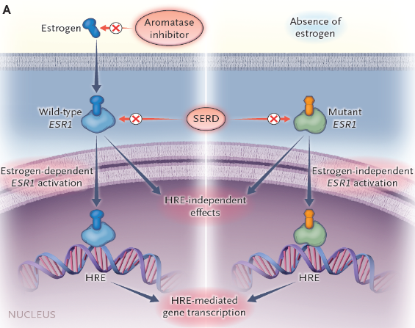
ESR1 (ACQUIRED) MUTATIONS: RESISTANCE TO AI
AI, aromatase inhibitor; ESR1, estrogen receptor 1; HRE, hormone response element; SERD, selective estrogen receptor degrader
Bardia A, et al. N Engl J Med. 2018;379:1946-53
Notes:
Bardia A, Hovnanian MD, Brachtel EF, Nardi V. Case 35-2018: A 68-Year-Old Woman with Back Pain and a Remote History of Breast Cancer. N Engl J Med. 2018;379(20):1946-1953. doi:10.1056/NEJMcpc1616400. https://pubmed.ncbi.nlm.nih.gov/30428289/
Bardia A, et al. N Engl J Med. 2018;379:1946-1953.

Slide 13
ELACESTRANT &
THE EMERALD TRIAL

Slide 14
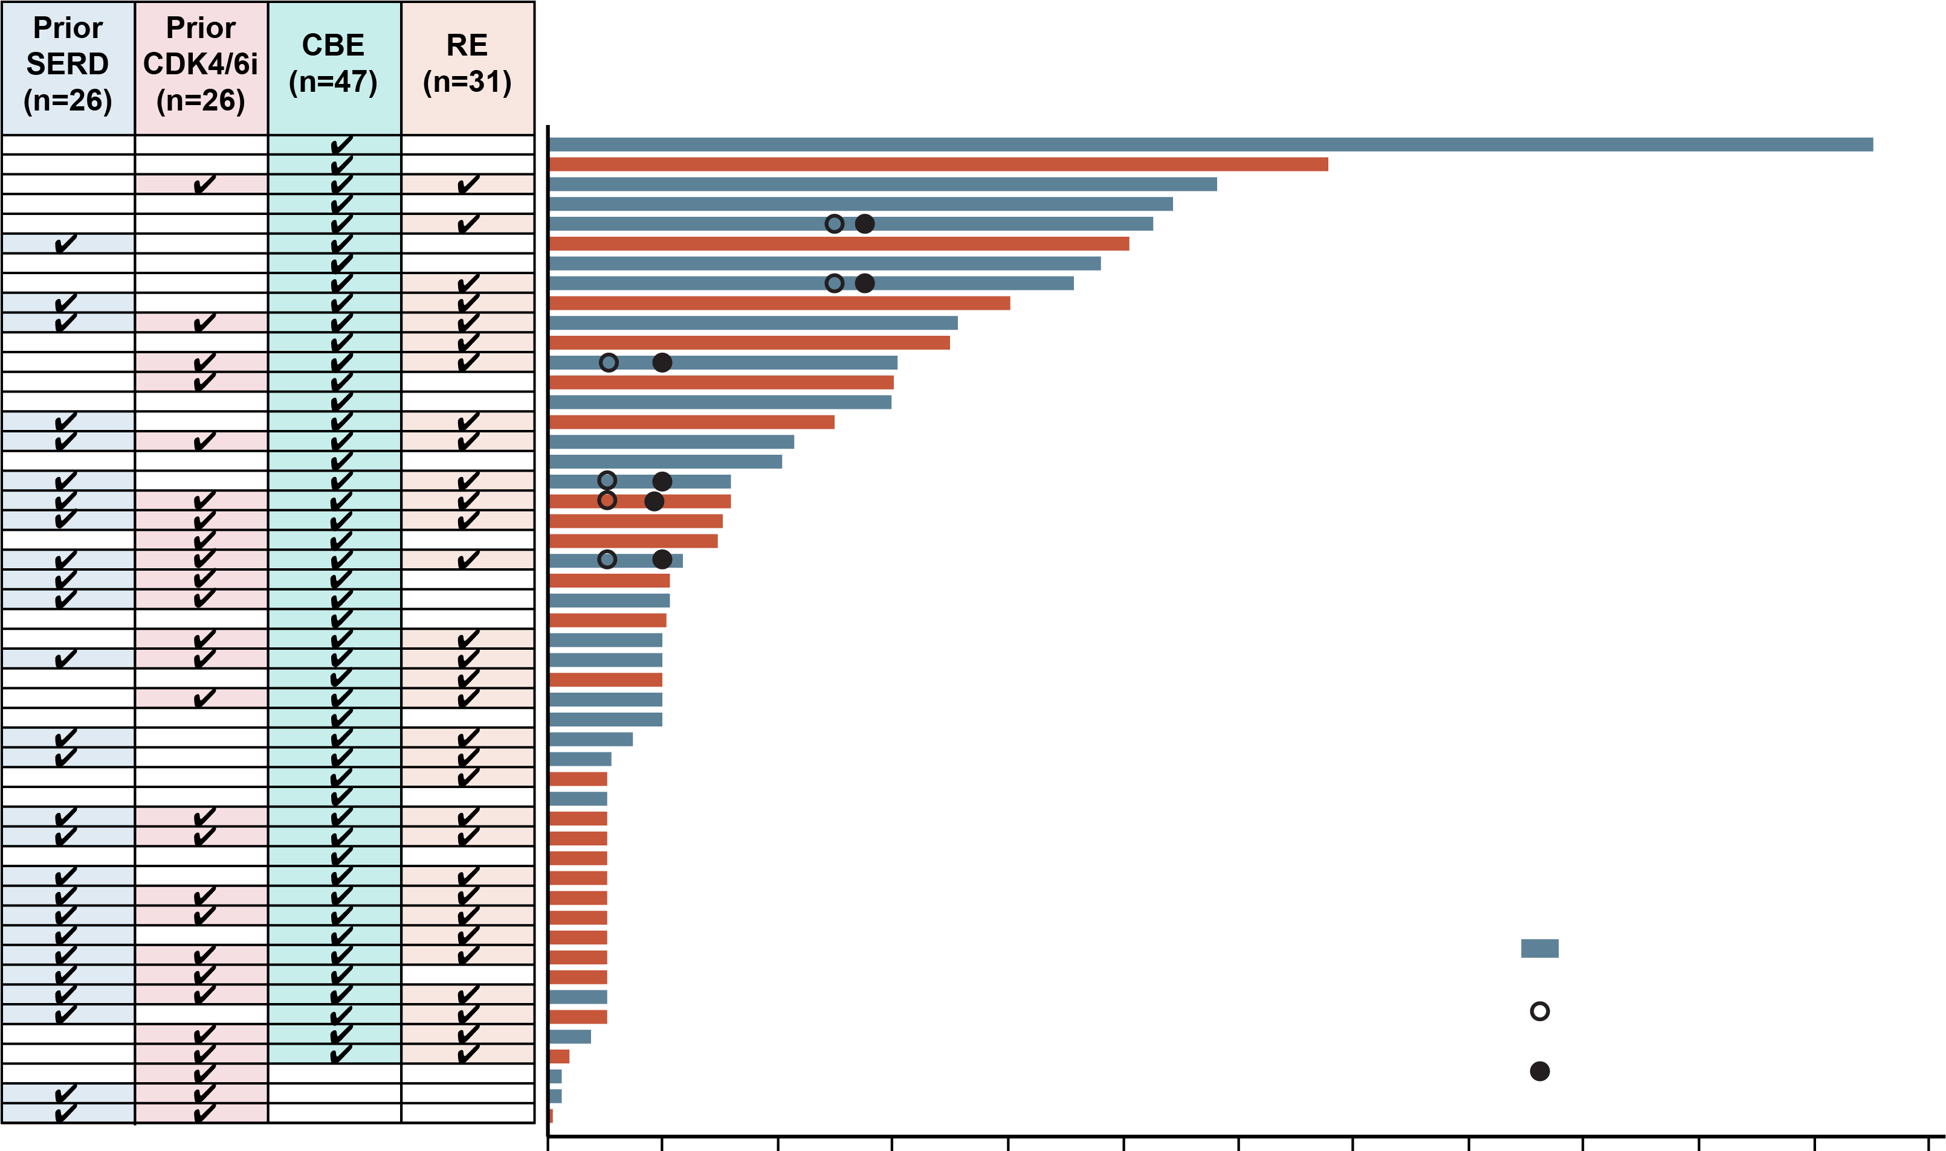
ELACESTRANT CLINICAL ACTIVITY: PHASE 1 TRIAL
CBR AT 24 WEEKS 42.6%
Median of 3 prior systemic therapies
  52% had previously received prior SERD
  52% had previously received CDK4/6i therapy
  50% had ESR1 mutation
ESR1 mutant (n=25)
PR first reached
PR confirmed
0
16
32
48
64
80
96
112
128
144
160
176
192
Treatment duration (weeks)
CBE, clinical benefit–evaluable; CBR, clinical benefit rate; CDK4/6i, cyclin-dependent kinase 4/6 inhibitor; ESR1, estrogen receptor 1; PR, partial response; RE, response-evaluable; SERD, selective estrogen receptor degrader
Bardia A, et al. J Clin Oncol. 2021;39:1360-70
Notes:
Bardia A, Kaklamani V, Wilks S, et al. Phase I Study of Elacestrant (RAD1901), a Novel Selective Estrogen Receptor Degrader, in ER-Positive, HER2-Negative Advanced Breast Cancer. J Clin Oncol. 2021;39(12):1360-1370. doi:10.1200/JCO.20.02272. https://ascopubs.org/doi/10.1200/JCO.20.02272
Bardia A, et al. J Clin Oncol. 2021;39:1360-1370.

Slide 15
PHASE 3 EMERALD: STUDY DESIGN
A multicentre, international, randomised, open-label, active-controlled phase 3 trial for postmenopausal patients with ER+/HER2- MBC
Primary end point: assess PFS in all patients and those with mESR1
Secondary end point: assess OS in all patients and those with mESR1
Study design considerations:
  planned sample size: 466 patients (randomised 1:1)
  planned number of countries/study sites: ~17/215
  planned study duration: ~30–33 months
  stratification factors: mESR1 status (detected by ctDNA), prior fulvestrant and presence of visceral disease
Key inclusion criteria
Advanced/metastatic ER+/HER2- breast cancer; progressed or relapsed on or after one or two lines of ET, one of which was given in combination with a CDK4/6 inhibitor, for advanced or MBC;
ECOG PS 0 or 1
Elacestrant (400 mg oral QD)
Investigator’s choice of fulvestrant, anastrozole, letrozole, exemestane
CBR, clinical benefit rate; CDK4/6, cyclin-dependent kinase 4/6; ctDNA, circulating tumour DNA; DoR, duration of response; ECOG PS; Eastern Cooperative
Oncology Group performance status; ER, estrogen receptor; ET, endocrine therapy; HER2, hormone epidermal growth factor receptor 2; MBC, metastatic breast cancer;
mESR1, estrogen receptor 1 mutation; ORR, objective response rate; OS, overall survival; PFS, progression-free survival; PK, pharmacokinetics; PRO patient reported outcome; QD, Use "every day"
Bardia A, et al. SABCS 2021. Abstract GS2-02. Oral presentation
Notes:
Elacestrant, an oral SERD, has demonstrated antitumor activity in preclinical models of ER+ BC, including those resistant to CDK4/6 inhibitors and with mESR1, as well as in a Phase 1 trial (NCT02338349) of elacestrant in heavily pretreated patients with mBC.
Post-menopausal women or men with mBC.
Bardia A, Neven P, Streich G, et al. Elacestrant, an oral selective estrogen receptor degrader vs investigator’s choice of endocrine monotherapy for ER+/HER2– advanced/metastatic breast cancer following progression on prior endocrine and CDK4/6 inhibitor therapy: Results of EMERALD phase 3 trial. Presented at: 2021 San Antonio Breast Cancer Symposium. December 7-10, 2021; San Antonio, TX. Abstract GS2-02.
Bardia A, et al. SABCS 2021. Abstract GS2-02.

Slide 16
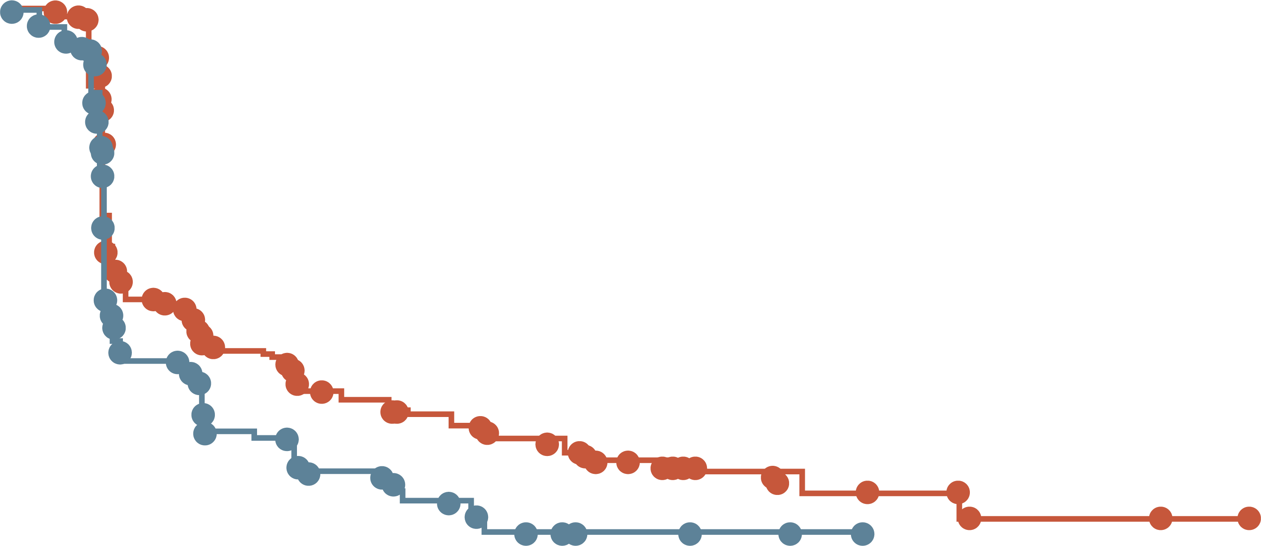
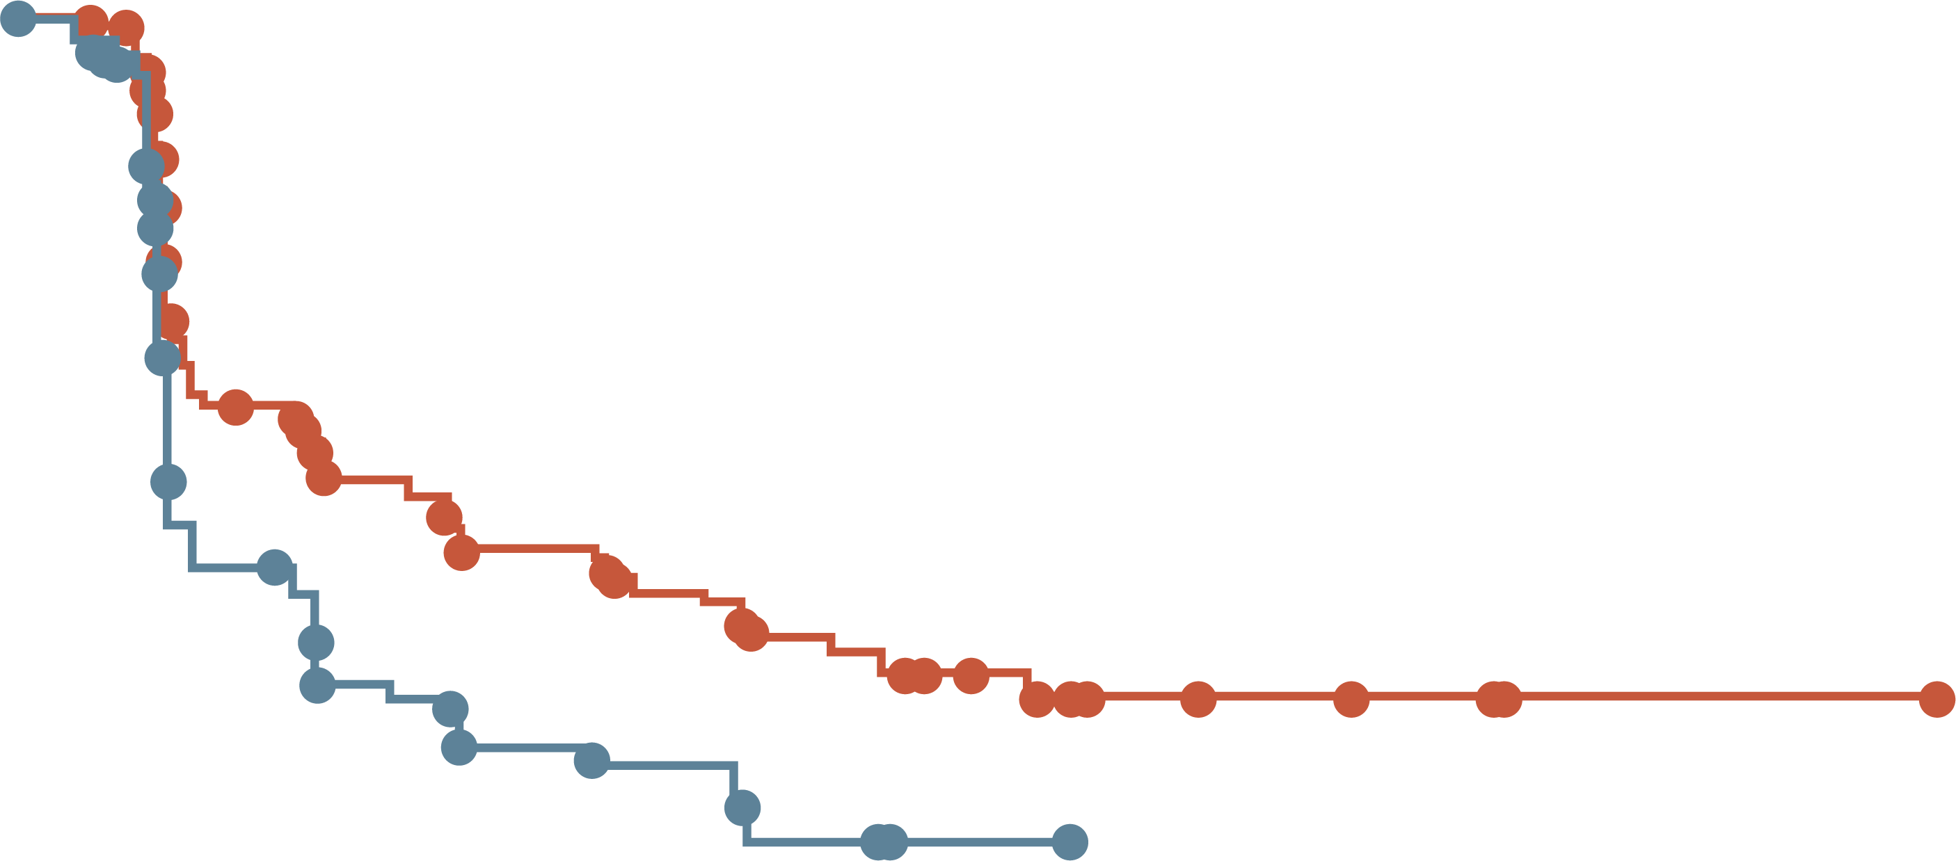
EMERALD: PFS RATE AT 6 & 12 MONTHS ALL PATIENTS AND mESR1 GROUP
All patients
Patients with tumours harbouring mESR1
 | Elacestrant | SoC
N | 239 | 238
PFS rate at 6 months, % (95% CI) | 34.3 (27.2-41.5) | 20.4 (14.1-26.7)
PFS rate at 12 months, % (95% CI) | 22.3 (15.2-29.4) | 9.4 (4.0-14.8)
 | Elacestrant | SoC
N | 115 | 113
PFS rate at 6 months, % (95% CI) | 40.8 (30.1-51.4) | 19.1 (14.1-26.7)
PFS rate at 12 months, % (95% CI) | 26.8 (16.2-37.4) | 8.2 (1.3-15.1)
100
100
90
90
80
80
70
70
60
60
Probability of PFS (%)
Probability of PFS (%)
50
50
40
40
30
30
20
20
10
Elacestrant
Standard of Care
10
Elacestrant
Standard of Care
0
0
0
1
2
3
4
5
6
7
8
9
10
11
12
13
14
15
16
17
18
19
20
21
22
23
24
25
0
1
2
3
4
5
6
7
8
9
10
11
12
13
14
15
16
17
18
19
20
21
22
23
24
25
Time (months)
Time (months)
Elacestrant
SOC
239
238
223
206
106
84
89
68
60
39
57
38
42
25
40
25
34
16
33
15
27
7
24
4
19
3
13
3
11
2
8
2
7
1
6
0
6
2
2
2
2
1
0
Elacestrant
SOC
115
113
105
99
54
39
46
34
35
19
33
18
26
12
26
12
21
9
20
9
16
4
14
1
11
1
9
1
7
0
5
5
4
4
1
1
1
1
1
0
Elacestrant demonstrated a higher PFS rate versus SoC ET at 6 and 12 months in patients with ER+/HER2- advanced/metastatic breast cancer following prior CDK4/6i therapy
CDK4/6i, cyclin-dependent kinase 4/6 inhibitor; CI, confidence interval; ER, estrogen receptor; ET, endocrine therapy; HER2, human epidermal growth factor receptor 2; mESR1, estrogen receptor 1 mutation; N, sample size; PFS, progression-free survival; SoC, standard of care
Bardia A, et al. SABCS 2021. Abstract GS2-02. Oral presentation
Notes:
Exploratory Add to speaker notes. As this was additional analysis
Bardia A, Neven P, Streich G, et al. Elacestrant, an oral selective estrogen receptor degrader vs investigator’s choice of endocrine monotherapy for ER+/HER2– advanced/metastatic breast cancer following progression on prior endocrine and CDK4/6 inhibitor therapy: Results of EMERALD phase 3 trial. Presented at: 2021 San Antonio Breast Cancer Symposium. December 7-10, 2021; San Antonio, TX. Abstract GS2-02.
Bardia A, et al. SABCS 2021. Abstract GS2-02.

Slide 17
POLLING QUESTION
ACCORDING TO DATA PRESENTED IN THE EMERALD TRIAL, WHO OF THE FOLLOWING PATIENTS, WITH ER+/HER2- MBC, WOULD MOST BENEFIT FROM ELACESTRANT TREATMENT?
Patients with ESR1 WT, regardless of prior duration of CDK4/6i
Patients with ESR1 MT and prior duration of CDK4/6i of < 12 months
Patients with ESR1 MT and prior duration of CDK4/6i of >12 months
All of the above
✅​
CDK4/6i, cyclin-dependent kinase 4/6 inhibitor; ER, estrogen receptor; HER2, human epidermal growth factor receptor 2; MBC, metastatic breast cancer; MT, mutation; WT, wild type

Slide 18
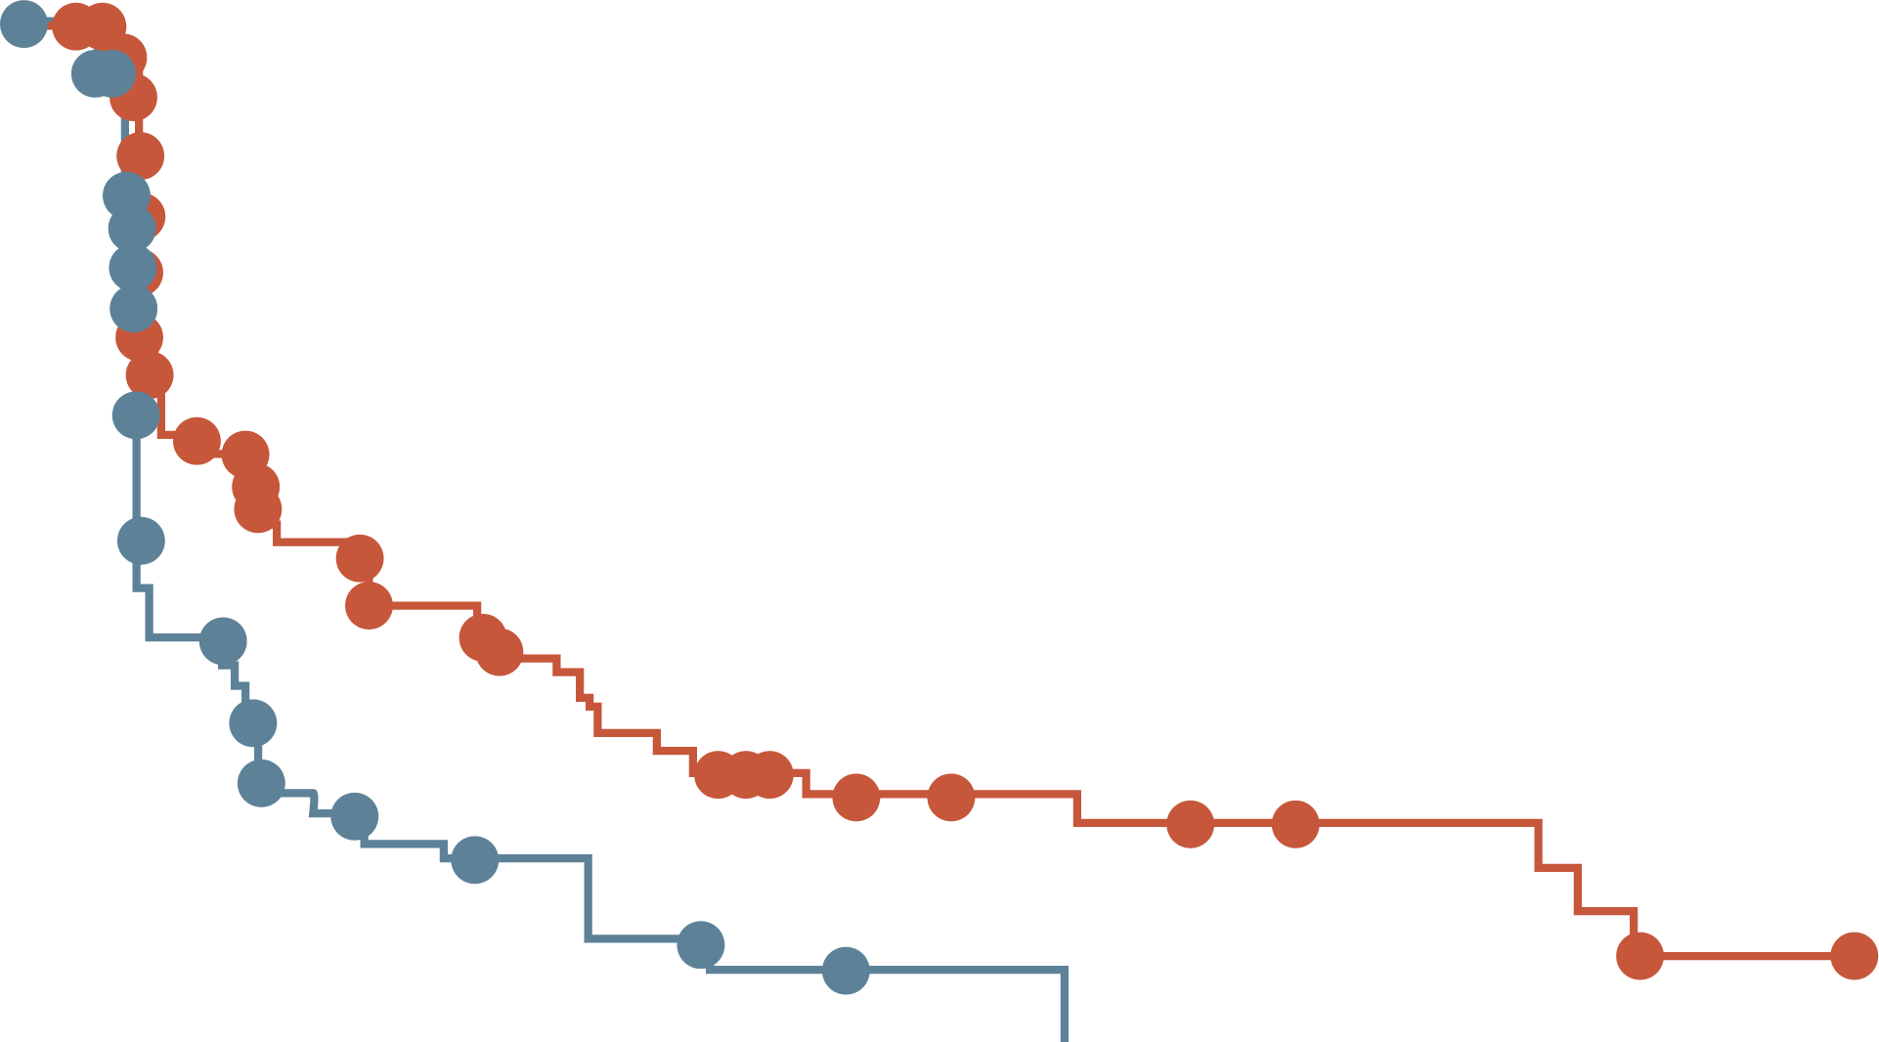
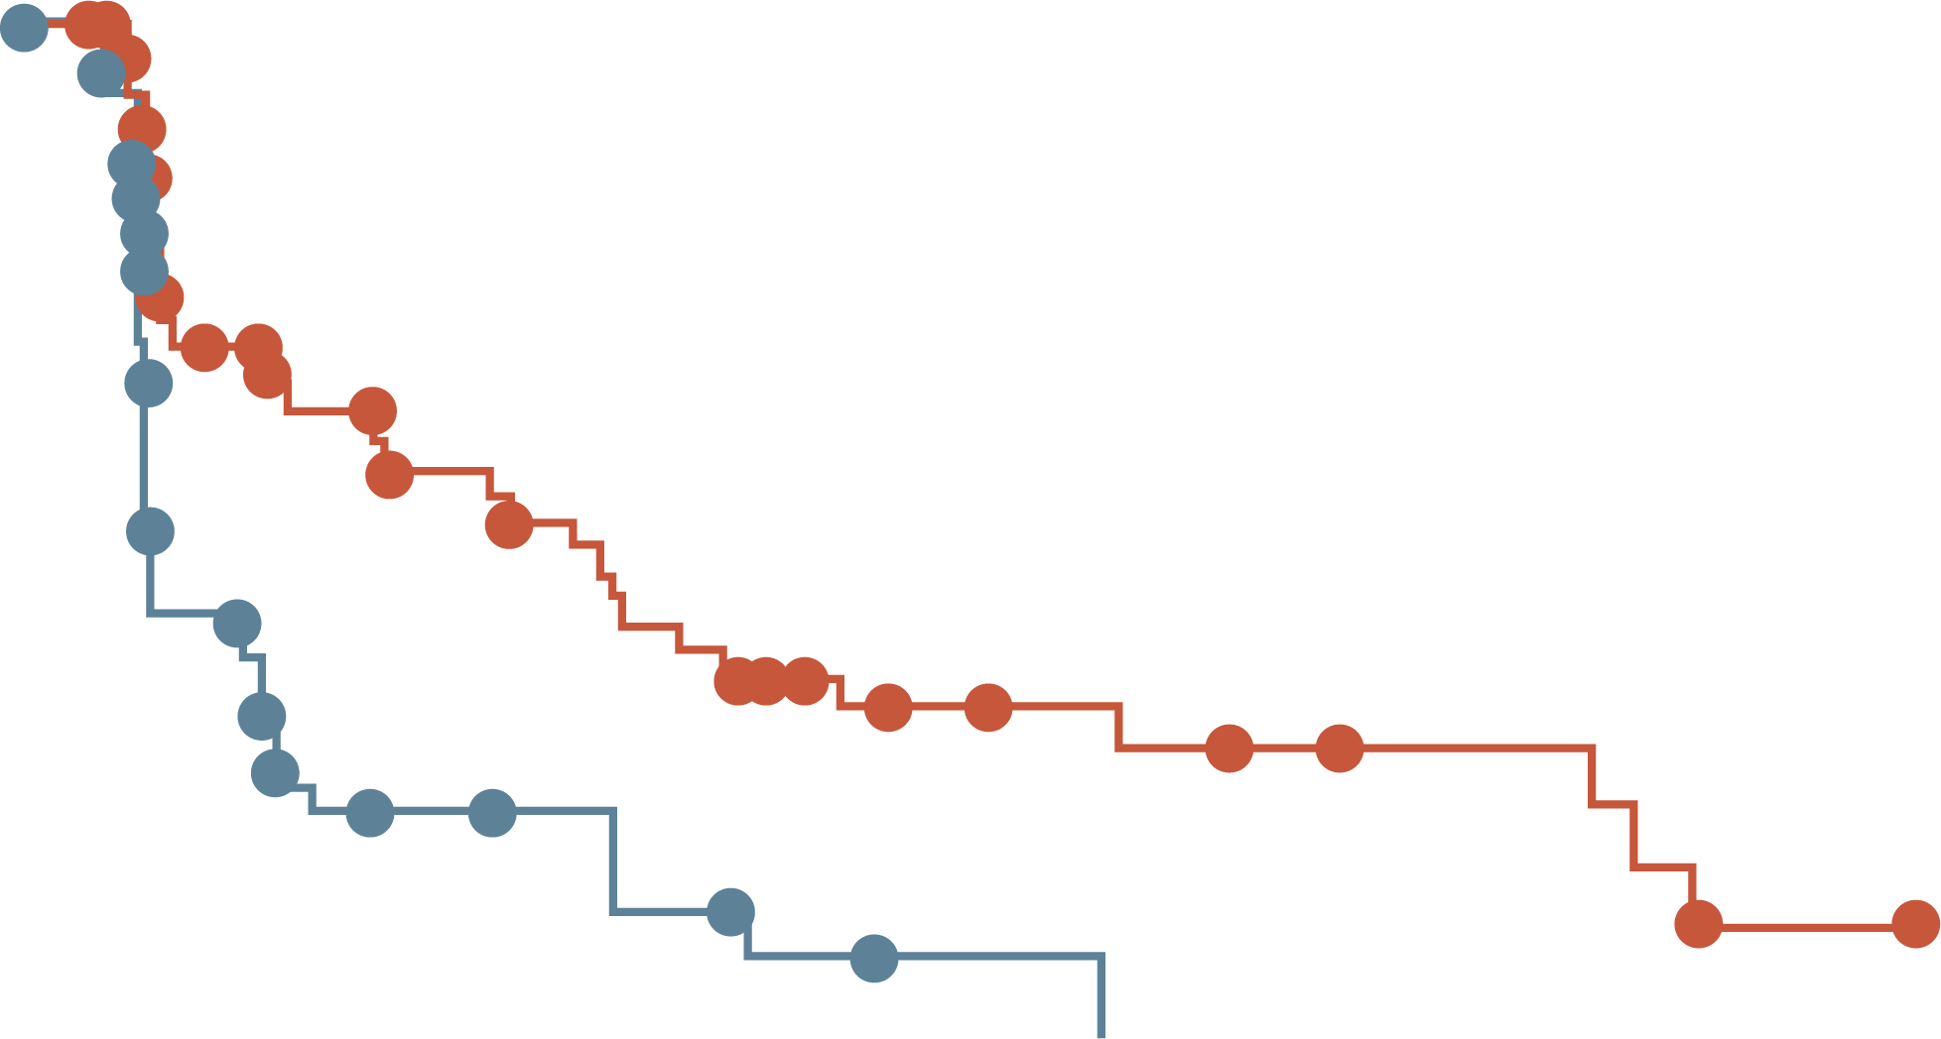
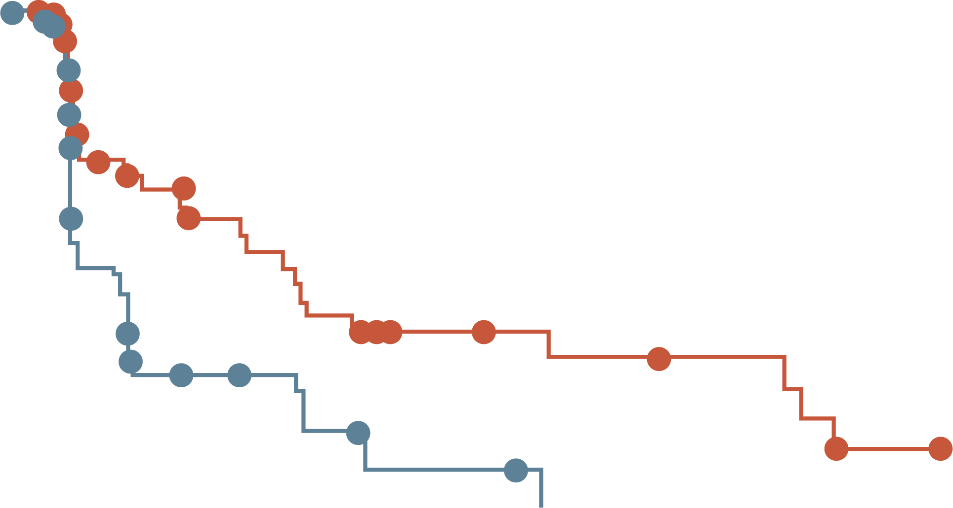
EMERALD: PFS BY DURATION OF CDK4/6i (mESR1)
At least 6 mo
CDK4/6i
At least 12 mo
CDK4/6i
At least 18 mo
CDK4/6i
100
100
100
80
Elacestrant
Standard of care
80
Elacestrant
Standard of care
80
Elacestrant
Standard of care
60
60
60
Probability of PFS (%)
Probability of PFS (%)
Probability of PFS (%)
40
40
40
20
20
20
0
0
0
0
5
10
15
20
25
30
0
5
10
15
20
25
30
0
5
10
15
20
25
30
Elacestrant
SOC
Time (months)
Elacestrant
SOC
Time (months)
Elacestrant
SOC
Time (months)
103
102
50
34
33
16
25
11
20
9
16
5
11
2
9
1
8
1
7
0
6
5
5
1
1
0
78
81
42
26
31
12
24
10
20
9
16
5
11
2
9
1
8
1
7
0
6
5
5
1
1
0
55
56
30
21
23
9
18
8
15
7
12
4
8
1
8
1
7
1
6
0
6
5
5
1
1
0
 | Elacestrant | SoC Hormonal Therapy
Median PFS, months (95% CI) | 4.14 (2.20-7.79) | 1.87 (1.87-3.29)
PFS rate at 12 months, % (95% CI) | 26.02 (15.12-36.92) | 6.45 (0.00-13.65)
Hazard ratio (95% CI) | 0.517 (0.361-0.738)
 | Elacestrant | SoC Hormonal Therapy
Median PFS, months (95% CI) | 8.61 (4.14-10.84) | 1.91 (1.87-3.68)
PFS rate at 12 months, % (95% CI) | 35.81 (21.84-49.78) | 8.39 (0.00-17.66)
Hazard ratio (95% CI) | 0.410 (0.262-0.634)
 | Elacestrant | SoC Hormonal Therapy
Median PFS, months (95% CI) | 8.61 (5.45-16.89) | 2.10 (1.87-3.75)
PFS rate at 12 months, % (95% CI) | 35.79 (19.54-52.05) | 7.73 (0.00-20.20)
Hazard ratio (95% CI) | 0.466 (0.270-0.791)
CDK4/6i, cyclin-dependent kinase 4/6 inhibitor; CI, confidence interval; mESR1, estrogen receptor 1 mutation; mo, months; PFS, progression-free survival; SoC; standard of care
Bardia A, et al. SABCS 2022. Oral presentation

Slide 19
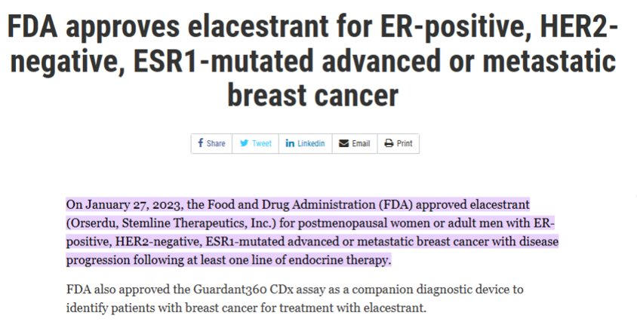
JANUARY 2023: ELACESTRANT (ORSERDU) APPROVAL
ER, estrogen receptor; ESR1, estrogen receptor 1; HER2, human epidermal growth factor receptor 2
https://www.fda.gov/drugs/resources-information-approved-drugs/fda-approves-elacestrant-er-positive-her2-negative-esr1-mutated-advanced-or-metastatic-breast-cancer (accessed May 23, 2023)

Slide 20
SAFETY

Slide 21
POLLING QUESTION
WHAT ARE THE TWO MOST COMMON GRADE 3 or 4 ADVERSE EVENTs IDENTIFIED WHEN TREATING PATIENTS WITH ELACESTRANT?
Diarrhoea and dyspepsia
Nausea and arthralgia
Nausea and back pain
Back pain and fatigue
✅

Slide 22
ELACESTRANT VS SOC: ADVERSE EVENTS
Event |  | SoC | AI
AEsc occurring in ≥10% of patients in any arm | Elacestrant (N=237) | Total (N=229) | Fulvestrant (N=161) | AI (N=68)
Any AE | 218 (92.0) | 197 (86.0) | 144 (89.4) | 53 (77.9)
Grade 3 and 4ª | 64 (27.0) | 47 (20.5) | 33 (20.5) | 14 (20.6)
Grade 5^{b} | 4 (1.7) | 6 (2.6) | 5 (3.1) | 1 (1.5)
Leading to dose reduction | 7 (3.0) | 0 | 0 | Not applicable
Leading to study drug discontinuation | 15 (6.3) | 10 (4.4) | 6 (3.7) | 4 (5.9)
AEs^{c} occurring in ≥10% of patients in any arm | Elacestrant |  | Total |  | Fulvestrant |  | AI
AEsc occurring in ≥10% of patients in any arm | All grades | Grade 3 or 4 | All grades | Grade 3 or 4 | All grades | Grade 3 or 4 | All grades | Grade 3 or 4
Nausea | 83 (35.0)^{d} | 6 (2.5) | 43 (18.8) | 2 (0.9) | 26 (16.1) | 0 | 17 (25.0) | 2 (2.9)
Fatigue | 45 (19.0) | 2 (0.8) | 43 (18.8) | 2 (0.9) | 35 (21.7) | 1 (0.6) | 8 (11.8) | 1 (1.5)
Vomiting | 45 (19.0)^{e} | 2 (0.8) | 19 (8.3) | 0 | 12 (7.5) | 0 | 7 (10.3) | 0
Decreased appetite | 35 (14.8) | 2 (0.8) | 21 (9.2) | 1 (0.4) | 12 (7.5) | 0 | 9 (13.2) | 1 (1.5)
Arthralgia | 34 (14.3) | 2 (0.8) | 37 (16.2) | 0 | 28 (17.4) | 0 | 9 (13.2) | 0
Diarrhoea | 33 (13.9) | 0 | 23 (10.0) | 2 (0.9) | 14 (8.7) | 1 (0.6) | 9 (13.2) | 1 (1.5)
Back pain | 33 (13.9) | 6 (2.5) | 22 (9.6) | 1 (0.4) | 16 (9.9) | 1 (0.6) | 6 (8.8) | 0
AST increased | 31 (13.1) | 4 (1.7) | 28 (12.2) | 2 (0.9) | 20 (12.4) | 2 (1.2) | 8 (11.8) | 0
Headache | 29 (12.2) | 4 (1.7) | 26 (11.4) | 0 | 18 (11.2) | 0 | 8 (11.8) | 0
Constipation | 29 (12.2) | 0 | 15 (6.6) | 0 | 10 (6.2) | 0 | 5 (7.4) | 0
Hot flush | 27 (11.4) | 0 | 19 (8.3) | 0 | 15 (9.3) | 0 | 4 (5.9) | 0
Dyspepsia | 24 (10.1) | 0 | 6 (2.6) | 0 | 4 (2.5) | 0 | 2 (2.9) | 0
ALT increased | 22 (9.3) | 5 (2.1) | 23 (10.0) | 1 (0.4) | 17 (10.6) | 0 | 6 (8.8) | 1 (1.5)
ªAE severity was graded according to the National Cancer Institute’s Common Terminology Criteria for Adverse Events version 5.0. ^{b}No fatal events were attributed to study drug by the investigator.
^{c}Preferred terms were coded using the Medical Dictionary for Regulatory Activities version 23.0. ^{d}Grade 1 nausea, n=59 (24.9%); grade 2 nausea, n=18 (7.6%); grade 3 nausea, n= 6 (2.5%); and no patients experienced grade 4 nausea. Percentages reflect maximum grade experienced. ^{e}Grade 1 vomiting, n=36 (15.2%); grade 2 vomiting, n=7 (3.0%); grade 3 vomiting, n=2 (0.8%); and no patients experienced grade 4 vomiting. Percentages reflect maximum grade experienced
AE, adverse event; AI, aromatase inhibitor; ALT, alanine transaminase; AST, aspartate transferase; n, sample size; SoC, standard of care
https://ascopubs.org/na101/home/literatum/publisher/asco/journals/content/jco/2022/jco.2022.40.issue-28/jco.22.00338/20220921/images/large/jco.22.00338t2.jpeg (accessed May 23, 2023)

Slide 23
OTHER SERDs & TREATMENT
LANDSCAPE
SERD, selective estrogen receptor degrader

Slide 24
ORAL SERD IN ER+ MBC: CURRENT DEVELOPMENT STATUS
Drug name | Trial nameª | Current Development Status
Elacestrant (RAD-1901) | EMERALD¹ | FDA Approved¹¹
Giredestrant (GDC-9545) | persevERA² | Phase 3
Amcenestrant (SAR439859) | AMEERA-6³ | Discontinued
Imlunestrant (LY3484356) | EMBER⁴ | Phase 3
Camizestrant (AZD9833) | SERENA⁵ | Phase 3
Borestrant (ZB716) | ENZENO⁶ | Phase 1/2
ZN-c5 | NCT03560531⁷ | Phase 1/2
Rintodestrant (G1T48) | NCT03455270⁸ | Phase 1
D-0502 | NCT03471663⁹ | Phase 1
LSZ-102 | NCT02734615¹⁰ | Phase 1
Need to be careful with cross-study comparisons:
Differences in prior lines of treatment, endocrine sensitivity, tumour biology
ER, estrogen receptor; FDA, Food and Drug Administration; MBC, metastatic breast cancer; SERD, selective estrogen receptor degrader
¹ https://clinicaltrials.gov/ct2/show/NCT03778931?term=ELACESTRANT&phase=2&draw=2&rank=1; ² https://www.clinicaltrials.gov/ct2/show/NCT04546009;
³https://clinicaltrials.gov/ct2/show/NCT05128773?term=Amcenestrant&draw=2&rank=3; ⁴ https://clinicaltrials.gov/ct2/show/NCT04975308?term=EMBER+phase+3&draw=2&rank=1
⁵https://clinicaltrials.gov/ct2/show/NCT04964934?term=SERENA+phase+3&draw=2&rank=1; ⁶ https://clinicaltrials.gov/ct2/show/NCT04669587?term=ENZENO&draw=2&rank=1;
⁷ https://clinicaltrials.gov/ct2/show/NCT03560531?term=NCT03560531&draw=2&rank=1;⁸ https://clinicaltrials.gov/ct2/show/NCT03455270?term=NCT03455270&draw=2&rank=1;
⁹ https://clinicaltrials.gov/ct2/show/NCT03471663?term=NCT03471663&draw=1&rank=1; ¹⁰ https://clinicaltrials.gov/ct2/show/NCT02734615?term=NCT02734615&draw=2&rank=1
¹¹https://www.fda.gov/drugs/resources-information-approved-drugs/fda-approves-elacestrant-er-positive-her2-negative-esr1-mutated-advanced-or-metastatic-breast-cance^{r; a}All references accessed may 22, 2023

Slide 25
CLOSER LOOK AT ORAL SERDs PHASE 3 TRIALS
 | EMERALD¹ | persevERA² | SERENA-6³ | EMBER-3⁴
N | 466 | 992 | 300 | 860
PATIENT POPULATION | ER+/HER2- ABC/MBC | ER+/HER2- ABC/MBC | ER+/HER2- MBC with detectable ESR1 mutation | ER+/HER2- ABC/MBC
PRIOR CHEMO | 20% had 1 line⁵ | Allowed | Allowed | Not allowedª
PRIOR FULV | 30%⁵ | Not allowed | Not allowed | Not allowed
PRIOR CDK4/6i (advanced/metastatic settings) | Required | Allowed | Required | Allowed
TREATMENT ARMS | Elacestrant vs ET (AI or fulvestrant) | Giredestrant + letrozole-matched placebo + palbociclib vs giredestrant-matched placebo + letrozole + palbociclib | Camizestrant + palbociclib or abemaciclib vs anastrozole or letrozole + palbociclib or abemaciclib | Imlunestrant vs ET (AI or fulv) vs imlunestrant + abemaciclib
PRIMARY ENDPOINT | PFS in ITT⁵ | PFS | PFS | PFS
RESULTS | FDA-Approved⁶ | Not yet reported Estimated primary completion date: April 2024 | Not yet reported Estimated primary completion date: January 2025 | Not yet reported Estimated primary completion date: April, 2024
ABC, advanced breast cancer; AI, aromatase inhibitor; CDK4/6i, cyclin-dependent kinase 4/6 inhibitor; chemo, chemotherapy; ER, estrogen receptor; ESR1, estrogen receptor 1; ET, endocrine therapy; FDA, Food and Drug Administration; fulv, fulvestrant; HER2, human epidermal growth factor 2; ITT, intent-to-treat; MBC, metastatic breast cancer; N, sample size; PFS, progression-free survival
¹ https://clinicaltrials.gov/ct2/show/NCT03778931?term=ELACESTRANT&phase=2&draw=2&rank=1 (accessed May 22, 2023)
² https://www.clinicaltrials.gov/ct2/show/NCT04546009 (accessed May 22, 2023)
³ https://clinicaltrials.gov/ct2/show/NCT04964934?term=SERENA+phase+3&draw=2&rank=1 (accessed May 22, 2023)
⁴ https://clinicaltrials.gov/ct2/show/NCT04975308?term=EMBER+phase+3&draw=2&rank=1 (accessed May 22, 2023) ⁵Bidard F-C, et al. J Clin Oncol. 2022;40:3246-56
⁶¹https://www.fda.gov/drugs/resources-information-approved-drugs/fda-approves-elacestrant-er-positive-her2-negative-esr1-mutated-advanced-or-metastatic-breast-cancer (accessed May 22, 2023)
^{A}Except for neoadjuvant/ adjuvant chemotherapy

Slide 26
HR+ MBC: TREATMENT ALGORITHM
Metastatic HR+ breast cancer
First line
therapy
ET + CDK4/6 inhibitor
Second line
therapy (plus)
Tumour genotyping (plasma-based preferred)
ESR1
mutation
PIK3CA
mutation
Not actionable
alteration
Elacestrant
ET + alpelisib
ET +/- CDK4/6i
Third line
therapy (plus)
ET-based options, chemotherapy, ADCs
Consider clinical trials when available
*ADC, antibody drug conjugate; CDK4/6(i), cyclin-dependent kinase 4/6 (inhibitor); ESR1, estrogen receptor 1; ET, endocrine therapy; HR, hormone receptor; MBC, metastatic breast cancer; PIK3CA, phosphatidylinositol-4,5-bisphosphate 3-kinase catalytic subunit alpha
Provided by Aditya Bardia

Slide 27
CONCLUSION
OVERVIEW OF CLINICAL DATA OF SERDs & THEIR PLACE IN TREATMENT LANDSCAPE
Endocrine therapy is the mainstay of management of patient with HR+ MBC
Elacestrant, an oral SERD, has demonstrated superiority over standard endocrine therapy in second-/third-line setting, and FDA approved for ESR1 mutant MBC
Elacestrant exhibited manageable toxicity with most adverse events being of
grade 1 or 2 severity
There are several oral SERDs in clinical development for HR+ metastatic breast cancer, alone and in combination therapy with other targeted therapies, including CDK4/6, PI3K, and AKT inhibitors, which could redefine the therapeutic landscape of breast cancer
AKT, alpha serine/threonine kinase; CDK4/6, cyclin-dependent kinase 4/6; ESR1, estrogen receptor 1; FDA, Food and Drug Administration; HR, hormone receptor; MBC, metastatic breast cancer; PI3K, phosphoinositide 3-kinase; SERD, selective estrogen receptor degrader

Slide 28
DISCUSSION

Slide 29
OPTIMISATION OF TREATMENT SELECTION & SEQUENCING DECISIONS IN ER+ ADVANCED OR METASTATIC BREAST CANCER
Dr Sara Tolaney
ER, estrogen receptor

Slide 30
POLLING QUESTION
WHAT IS A POTENTIAL SECOND LINE TREATMENT OPTION FOR ER+/HER2- MBC
PATIENTS in CDK4/6i PRETREATED PATIENTS
Elacestrant (if mESR1)
Fulvestrant + everolimus
Fulvestrant + alpelisib (if mPI3K)
All of the above
✅​
CDK4/6i, cyclin-dependent kinase 4/6 inhibitor; ER, estrogen receptor; HER2, human epidermal growth factor 2; MBC, metastatic breast cancer; mESR1, estrogen receptor 1 mutation; mPI3K, phosphoinositide 3-kinase mutation

Slide 31
POST CDK4/6i ALGORITHM
gBRCA1/2 mutation
PARP inhibitor
No OS benefit
Factors:
Prior ET
Somatic mutations - ESR1, PIK3CA, AKT, PTEN
BRCA1/2 status
Response to prior CDK4/6i- ≤12 mo vs >12 mo
PIK3CA mutation
Alpelisib + FUL
Numerical OS benefit
Discontinuation rate 25%
AKT mutated pathway
(PIK3CA/AKT/PTEN)
Capivasertib + FUL
Numerical OS benefit (immature)
Discontinuation rate 13%
PIK3CA/AKT/PTEN wt (Benefit to 1st line
CDK4/6i <12 mo)
ESR1 mutated tumours Prolonged benefit to
1st line CDK4/6i (>12 mo)
Elacestrant
AI + CDK4/6i
Low discontinuation rate
Fulvestrant mono
less effective
Mild progression
No Rb mutation
(if known)
Switching ET + ribociclib
No mutations detected
Everolimus + ET
Low discontinuation rate
No data from randomised trials
with CDK4/6i pre-treatment
Imminent organ failure
Chemotherapy
AI, aromatase inhibitor; AKT, alpha serine/threonine kinase; CDK4/6i, cyclin-dependent kinase 4/6 inhibitor; ESR1, estrogen receptor 1; ET, endocrine therapy; FUL, fulvestrant; (g)BRCA, (germline) BReast CAncer gene, mo, months; OS, overall survival; PARP, poly ADP ribose polymerase; PIK3CA, phosphatidylinositol-4,5-bisphosphate 3-kinase catalytic subunit alpha; PTEN, phosphatase and tensin homolog; Rb, retinoblastoma ; wt, wild type
Provided by Sara Tolaney
Notes:
Bardia A, Hovnanian MD, Brachtel EF, Nardi V. Case 35-2018: A 68-Year-Old Woman with Back Pain and a Remote History of Breast Cancer. N Engl J Med. 2018;379(20):1946-1953. doi:10.1056/NEJMcpc1616400. https://pubmed.ncbi.nlm.nih.gov/30428289/
Bardia A, et al. N Engl J Med. 2018;379:1946-1953.

Slide 32
PI3K INHIBITION
PI3K, phosphoinositide 3-kinase

Slide 33
POLLING QUESTION
WHAT PERCENTAGE OF HR+ METASTATIC BREAST CANCER HARBOR A
PIK3CA MUTATION?
~15%
~25%
~40%
~50%
✅​
HR, hormone receptor; PIK3CA, phosphatidylinositol-4,5-bisphosphate 3-kinase catalytic subunit alpha

Slide 34
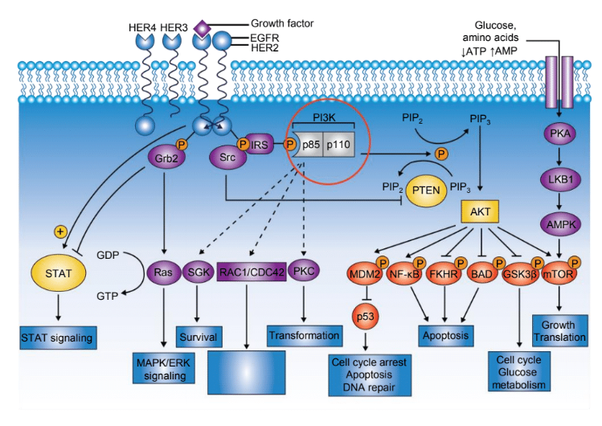
ROLE OF PI3K PATHWAY IN hr+ bc
PI3K/AKT Pathway⁹
PI3K/mTOR pathway is frequently altered in HR+ BC and has been implicated in resistance to endocrine therapies^{1,2}
≈40% of HR+ BC harbour a PIK3CA mutation, leading to hyperactivation
of the PI3K pathway³⁻⁵
PI3K signalling promotes estrogen-independent growth of ER+ BC cells, and this growth is inhibited by the addition of PI3K inhibitors to antiestrogens⁶⁻⁸
Cytoskeletal rearrangement transformation
AKT, alpha serine/threonine kinase; AMP, adenosine monophosphate; AMPK, AMP activated protein kinase; ATP, adenosine triphosphate; BAD; Bcl-2-associated death promoter; BC, breast cancer; EGFR, epidermal growth factor receptor; ER, estrogen receptor; ERK, extracellular signal-regulated kinase; FKHR, forkhead transcription factor; GDP, guanosine diphosphate; Grb2, growth factor receptor-bound protein 2; GSK3β, glycogen synthase kinase-3 beta; GTP, nucleotide guanosine triphosphate; HER, human epidermal growth factor, HR, hormone receptor; IRS, insulin receptor substrate; LKB1, liver kinase B1; MAPK, mitogen-activated protein kinase; MDM2, mouse double minute 2 homolog; mTOR, mammalian target of rapamycin; NF-kB, nuclear factor kappa-light-chain-enhancer of activated B cells; P, phosphorylation; PI3K,phosphoinositide 3-kinase; PIK3CA, phosphatidylinositol-4,5-bisphosphate 3-kinase catalytic subunit alpha; PKA/C, protein kinase A/C; PIP, prolactin-induced protein; PTEN, phosphatase and tensin homolog; STAT, signal transducer and activator of transcription
1. Miller TW, et al. J Clin Oncol. 2011;29:4452-61; 2. Bosch A, et al. Sci Transl Med. 2015;7283ra51; 3. Mayer IA, et al. Clin Cancer Res. 2017;23:26-34; 4. Loi S, et al. Proc Natl Acad Sci. 2010;107:10208-13;
5. Stemke-Hale K, et al. Cancer Res. 2008;68:6084-91; 6. Miller TW, et al. J Clin Invest. 2010;120:2406-13; 7. Crowder RJ, et al. Cancer Res. 2009;69:3955-62; 8. Miller TW, et al. Cancer Discov. 2011;1:338-51;
9. Hennessy BT, et al. Nat Rev Drug Discov. 2005;4:988-1004

Slide 35
BYLieve: ALPELISIB + FULVESTRANT IN PIK3CA-MUTANT HR+/HER2- ABC
INTERNATIONAL, OPEN-LABEL, MULTICOHORT, NONCOMPARATIVE PHASE 2 STUDY
Cohort A: Prior CDK4/6i + AI
Alpelisib 300 mg PO QD + fulvestrant 500 mg IM^{b,c}
(n=119)
Men and pre-/post-menopausal women with PIK3CA mutated HR+/HER2- advanced BC
Immediate prior treatment CDK4/6i and ET, systemic CT, or ET
No prior PI3Ki
Measurable disease or ≥1 predominantly lytic bone lesion
ECOG PS ≤2
Planned
N=340
Cohort B: Prior CDK4/6i + Fulvestrant
R
Alpelisib 300 mg PO QD + letrozole 2.5 mg PO QD^{c}
(minimum n=114)
Cohort C: Prior AI then CT or ET
Alpelisib 300 mg PO QD + fulvestrant 500 mg IM^{b,c}
(minimum n=115)
Primary endpoint: proportion of each cohort alive without PD at 6 months (RECIST v1.1)
  Endpoint met if lower 95% CI >30%
Secondary endpoints (in each cohort): PFS, PFS2, ORR, CBR, DoR, OS, and safety
ªCentrally confirmed. ^{b}Fulvestrant given on days 1 and 15 of cycle 1, day 1 for subsequent cycles. ^{c}Men in letrozole cohort and premenopausal women received goserelin 3.6 mg SC Q28D or leuprolide 7.5 mg IM Q28D for adequate gonadal suppression
ABC, advanced metastatic breast cancer; AI, aromatase inhibitor; BC, breast cancer; CBR, clinical benefit rate; CDK4/6i, cyclin-dependent kinase 4/6 inhibitor; CI, confidence interval; CT, chemotherapy; DoR, duration of response; ECOG PS, Eastern Cooperative Oncology Group performance status; ET, endocrine therapy; HER2, hormone epidermal growth factor 2; HR, hormone receptor; IM; intramuscular; ORR, objective response rate; OS, overall survival; PD, disease progression; PFS(2), progression-free survival (2); PIK3CA, phosphatidylinositol-4,5-bisphosphate 3-kinase catalytic subunit alpha; PI3Ki, phosphoinositide 3-kinases inhibitor; PO QD, orally once per day; Q28D, every 28 days; R, randomisation; RECIST, Response Evaluation Criteria in Solid Tumours; SC, subcutaneous
Chia S. ASCO 2023. Abstract 1078. Oral presentation

Slide 36
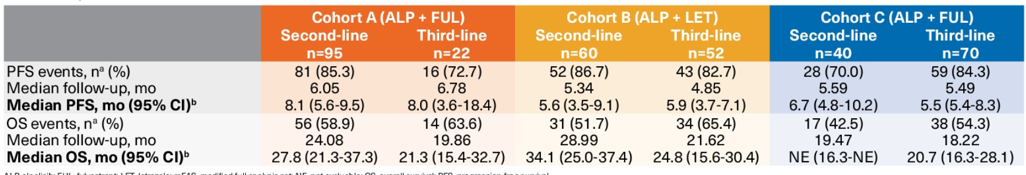
ACTIVITY WITH PI3K INHIBITORS & VARIOUS ENDOCRINE PARTNERS
Median pfs & os per local investigator assessment in 2L & 3L
2L, second line of treatment; BC, breast cancer; CDK4/6i, cyclin-dependent kinase 4/6 inhibitor; ET, endocrine therapy; HER2, human epidermal growth factor receptor 2; HR, hormone receptor; mo, months; NA, not applicable; PFS progression free survival; PI3K(i), phosphoinositide 3-kinase (inhibitor); PIK3CA, phosphatidylinositol-4,5-bisphosphate 3-kinase catalytic subunit alpha; tx, treatment
Hope R. et al, SABCS 2021. Oral presentation; Hope R. et al. Cancer Res 2021; 81 (4): PD2-07

Slide 37
AKT INHIBITION
AKT, alpha serine/threonine kinase

Slide 38
CAPIVASERTIb + FULVESTRANT IN AI- RESISTANT HR+/HER2- BC
CAPItello-291 Phase 3 STUDY DESIGN
Patients with HR+/HER2– ABC
Men and pre-/post-menopausal women
Recurrence while on or <12 months from end of adjuvant AI, or progression while on prior AI for ABC
≤2 lines of prior endocrine therapy for ABC
≤1 line of chemotherapy for ABC
Prior CDK4/6 inhibitors allowed (at least 51% required)
No prior SERD, mTOR inhibitor, PI3K inhibitor or AKT inhibitor
HbA1c <8.0% (63.9 mmol/mol) and diabetes not requiring insulin allowed
FFPE tumour sample from the primary/recurrent cancer available for retrospective central molecular testing
Capivasertib: 400 mg twice daily,
4 days on, 3 days off
Dual primary endpoints
PFS by investigator assessment
Overall
AKT pathway-altered tumours (≥1 qualifying PIK3CA, AKT1, or PTEN alteration)
Fulvestrant: 500 mg: cycle 1,
days 1 and 15; then every 4 weeks
R
1:1
(N=708)
Stratification factors:
Liver metastases (yes/no)
Prior CDK4/6 inhibitor (yes/no)
Region
Key secondary endpoints
Overall survival
Overall
AKT pathway-altered tumours
Objective response rate
Overall
AKT pathway-altered tumours
Placebo: twice daily,
4 days on, 3 days off
Fulvestrant: 500 mg: cycle 1,
days 1 and 15; then every 4 weeks
ABC, advanced breast cancer; AI, aromatase inhibitor; AKT, alpha serine/threonine kinase; BC, breast cancer; CDK4/6, cyclin-dependent kinase 4/6; FFPE, formalin‑fixed paraffin-embedded; HbA1c, haemoglobin A1c; HER2, human epidermal growth factor receptor; HR, hormone receptor; mTOR, mammalian target of rapamycin; PFS, progression-free survival; PI3K, phosphoinositide 3-kinase; PIK3CA, phosphatidylinositol-4,5-bisphosphate 3-kinase catalytic subunit alpha; PTEN, phosphatase and tensin homolog; R, randomisation; SERD, selective estrogen receptor degrader
Presented by Nick Turner, SABCS 2022. Oral presentation

Slide 39
INVESTIGATOR ASSESSED PFS BY SUBGROUP
 |  | Number of patients |  | HR (95% CI)
All patients |  | 708 |  | 0.60 (0.51, 0.71)
Age | <65 years | 491 |  | 0.65 (0.53, 0.79)
 | ≥65 years | 217 |  | 0.65 (0.47, 0.90)
Race | Asian | 189 |  | 0.62 (0.44, 0.86)
 | White | 407 |  | 0.65 (0.52, 0.80)
 | Other | 112 |  | 0.63 (0.42, 0.96)
Region | 1 | 395 |  | 0.60 (0.48, 0.75)
 | 2 | 136 |  | 0.77 (0.51, 1.16)
 | 3 | 177 |  | 0.60 (0.42, 0.85)
Menopausal status (females only) | Pre/peri | 154 |  | 0.86 (0.60, 1.20)
 | Post | 547 |  | 0.59 (0.48, 0.71)
Liver metastases | Yes | 306 |  | 0.61 (0.48, 0.78)
 | No | 402 |  | 0.62 (0.49, 0.79)
Visceral metastases | Yes | 478 |  | 0.69 (0.56, 0.84)
 | No | 230 |  | 0.54 (0.39, 0.74)
Endocrine resistance | Primary | 262 |  | 0.66 (0.50, 0.86)
 | Secondary | 446 |  | 0.64 (0.51, 0.79)
Prior use of CDK4/6 inhibitors | Yes | 496 |  | 0.62 (0.51, 0.75)
 | No | 212 |  | 0.65 (0.47, 0.91)
Prior chemotherapy for ABC | Yes | 129 |  | 0.61 (0.41, 0.91)
 | No | 579 |  | 0.65 (0.54, 0.78)
0.3
0.5
1.0
2.0
Favours capivasertib + fulvestrant
Hazard ratio (95% CI)
Favours placebo + fulvestrant
ABC, advanced breast cancer; CDK4/6, cyclin-dependent kinase 4/6; CI, confidence interval; HR, hazard ratio; PFS, progression-free survival
Presented by Nick Turner, SABCS 2022. Oral presentation

Slide 40
CDK4/6 INHIBITION
CDK4/6, cyclin-dependent kinase 4/6

Slide 41
POLLING QUESTION
IS THERE A ROLE FOR CONTINUATION OF CDK4/6 INHIBITION BEYOND PROGRESSION?
YES
NO
MAYBE
I DON’T KNOW
CDK4/6, cyclin-dependent kinase 4/6

Slide 42


CASE SERIES: ABEMA POST PALBOCICLIB
1.00
PFS, 5.3 mo (95% CI, 3.5-7.8)
0.75
Six-institution retrospective analysis
  87 pts treated with abemaciclib post palbociclib/ribociclib
  9.2% stopped abema due to toxicity without progression
  71.3% received non-sequential therapy with >1 intervening non-CDK4/6i regimen
  Endocrine partners: FULV: 47.1%; AI: 27.6%; monotherapy, 19.5%
Efficacy
  Subset of patients derived clinical benefit (with 36.8% received abema for ≥ 6 mo)
  No relationship between the duration of clinical benefit on palbo and subsequent duration of treatment on abema
Rapid progression on abema associated with RB1, ERBB2, and CCNE1 alterations were noted among patients with rapid progression on abema
0.50
Progression-free survival
0.25
PFS, 5.3 mo
0.00
0
3
6
9
12
Follow-up (month)
No. at risk
87
53
34
15
5
1.00
0.75
Overall survival
0.50
0.25
OS, 17.2 mo
0.00
OS, 17.2 mo (95% CI, 13.2-NR)
0
3
6
9
12
15
18
Follow-up (month)
No. at risk
87
74
62
43
25
14
1
abema, abemaciclib; AI, aromatase inhibitor; CCNE1, cyclin E1; CDK4/6(i), cyclin-dependent kinase 4/6 (inhibitor); CI, confidence interval; pts, patients; ERBB2, v-erb-b2 avian erythroblastic leukaemia viral oncogene homolog 2; FULV, fulvestrant; mo, months; NR, not reached; OS, overall survival; PFS, progression-free survival; RB1, retinoblastoma protein
Wander SA, et al. J Natl Compr Canc Network. 2021; doi: 10.6004/jnccn.2020.7662. Online ahead of print

Slide 43
PACE TRIAL : Palbociclib after CDK & ET in hR+ mbc
Eligibility Criteria
HR+/HER2- MBC
Progression on CDK4/6i
and ET, with ≥6 mo SD on
prior regimen
≤2 prior lines ET for MBC
No prior fulvestrant
0-1 prior chemo for MBC
R
A
N
D
O
M
I
S
E
Fulvestrant: 500 mg IM C1D1,15, then q28d
1:2:1 randomisation;
stratified by exposure
to chemo between
CDK4/6i and entry
onto trial
Fulvestrant: 500 mg IM C1D1,15, then q28d
Palbociclib: 125 mg PO qd 1-21d in a 28d cycle (or lower
starting dose to match prior treatment)
Fulvestrant: 500 mg IM C1D1,15, then q28d
Palbociclib: 125 mg PO qd 1-21d in a 28d cycle (or lower
starting dose to match prior treatment)
Avelumab: 10 mg/kg IV q14d
N=220
Baseline archival tissue
Baseline ctDNA, CTC
ctDNA
ctDNA
CTC
ctDNA
ctDNA
CTC
Primary objective: To compare PFS (RECIST-confirmed) for fulvestrant+palbociclib vs fulvestrant alone
Secondary objectives: To compare PFS for fulvestrant+palbociclib+avelumab vs fulvestrant alone, response endpoints,
safety, outcomes in predefined molecular subgroups including ESR1, PIK3CA, and Rb
C1D1, cycle 1 day 1; CDK4/6i, cyclin-dependent 4/6 inhibitor; chemo, chemotherapy; CTC, circulating tumour cell; ctDNA, circulating tumour DNA; d, day; ESR1, estrogen receptor 1; ET, endocrine therapy; HER2, human epidermal growth factor receptor 2; HR, hormone receptor; IM, intramuscular; IV, intravenous; MBC, metastatic breast cancer; PFS, progression-free survival; PIK3CA, phosphatidylinositol-4,5-bisphosphate 3-kinase catalytic subunit alpha; PO, orally; qd, every day; Rb, retinoblastoma; RECIST, response evaluation criteria in solid tumours; SD, stable disease
Presented by Erica Mayer, ASCO 2022. Oral presentation

Slide 44
PACE TRIAL: PRIOR TREATMENT CHARACTERISTICS
 | Fulvestrant (n=55) |  | Fulvestrant + palbociclib (N=111) |  | Fulvestrant + palbociclib + avelumab (N=54) |  | Overall (N=220)
 | N | % | N | % | N | % | N | %
Prior adjuvant endocrine exposure Endocrine resistant Endocrine sensitive | 10 45 | 18.2 81.8 | 32 78 | 28.8 70.3 | 16 37 | 29.6 68.5 | 58 160 | 26.4 72.7
Prior CDK4/6i Palbociclib Ribociclib Abemaciclib | 52 1 2 | 94.5 1.8 3.6 | 102 5 3 | 19.9 4.5 2.7 | 46 4 4 | 85.2 7.4 7.4 | 200 10 9 | 90.9 4.5 4.1
Duration of prior CDK4/6i + ET 6-12 months >12 months | 10 45 | 18.2 81.8 | 26 84 | 23.4 75.7 | 16 38 | 29.6 70.4 | 52 167 | 23.6 75.9
Prior chemotherapy for MBC | 11 | 20.0 | 16 | 14.4 | 9 | 16.7 | 36 | 16.4
Line of MBC therapy initiated in PACE First line Second line > Second line | 3 42 10 | 5.5 76.4 18.2 | 5 83 21 | 4.5 74.8 18.9 | 2 44 7 | 3.7 81.5 13.0 | 10 169 38 | 4.5 76.8 17.3
Any systemic therapy between prior CDK4/6i and randomisation | 5 | 9.1 | 16 | 14.4 | 5 | 9.3 | 26 | 11.8
CDK4/6i, cyclin-dependent kinase 4/6 inhibitor; ET, endocrine therapy; MBC, metastatic breast cancer; N, sample size
Presented by Erica Mayer, ASCO 2022. Oral presentation

Slide 45
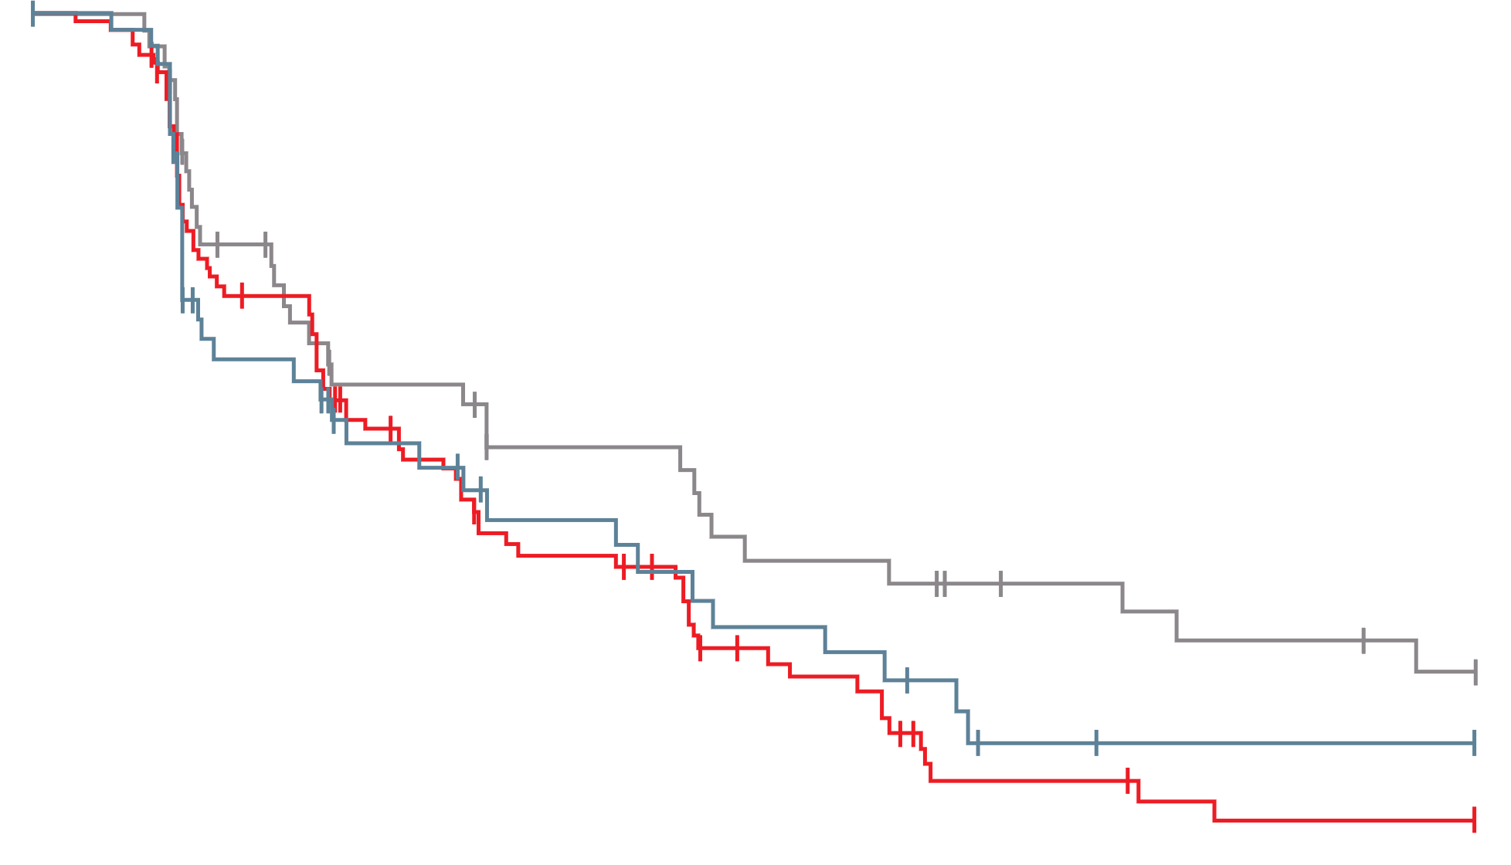
PACE TRIAL: PROGRESSION FREE SURVIVAL ITT
100
 | Pts | PFS events | Median PFS, mo (90% CI) | HR vs F (90% CI) | p value
F | 55 | 34 | 4.8 (2.1, 8.2) | – | –
F+P | 111 | 79 | 4.6 (3.6, 5.9) | 1.11 (0.74-1.66) | 0.62
F+P+A | 54 | 35 | 8.1 (3.2, 10.7) | 0.75 (0.47-1.20) | 0.23
6-month PFS:
F: 42.9%
F+P: 40.0%
F+P+A: 50.8%
80
12-month PFS:
F: 17.5%
F+P: 13.1%
F+P+A: 35.6%
60
Percent alive and progression-free
40
20
0
0
2
4
6
8
10
12
14
16
18
Numbers at risk
F
F+P
F+P+A
Months since randomisation
55
111
54
31
73
38
20
48
25
14
32
20
12
28
20
9
16
15
4
7
12
3
5
10
3
4
9
3
4
7
A, avelumab; CI, confidence interval; F, fulvestrant; HR, hazard ratio; ITT, intention to treat; mo, months; P, palbociclib; PFS, progression free survival; pt, patient
Presented by Erica Mayer, ASCO 2022. Oral presentation

Slide 46
PALMIRA Study Design (NCT03809988)
Fulvestrant‡
500 mg IM, on day 1, 15, 29 and monthly thereafter
Letrozole‡
2.5 mg PO, once daily, continuously
Treatment until progressive disease,
unacceptable toxicity,
or
study withdrawal
Key Eligibility Criteria
Patients with HR[+]/HER2[‑] ABC*
PD on a 1L of palbociclib plus ET (AI or fulvestrant) after clinical benefit, or
PD on palbociclib–based adjuvant regimen after at least 12 months of treatment but no more than 12 months following completion
No other prior treatment for ABC
OR
N = 136
Palbociclib†
75/100/125 mg PO, once daily, 3 weeks on, 1 week off
R
2:1
N = 198
Fulvestrant‡
500 mg IM, on day 1, 15, 29 and monthly thereafter
Letrozole‡
2.5 mg PO, once daily, continuously
Stratification Factors
Prior ET (fulvestrant vs. AIs)
Site of disease (visceral vs. non-visceral)
N = 62
OR
1L: First–line; ABC: Advanced breast cancer; AI: Aromatase inhibitors; ET: Endocrine therapy; HER2[-]: Human Epidermal Growth Factor Receptor 2-negative; HR[+]: Hormone receptor-positive; IM: Intramuscular injection; PO: oral administration; PD: Progressive disease; R: Randomization.
*If pre-menopausal, ovarian function suppression method required.
†Palbociclib dose could be reduced until 75 mg. If a dose reduction below 75 mg is required, treatment must be discontinued.
‡Administration of endocrine therapy was chosen depending on the prior administered agent.
Llombard Cussac A et al, ASCO 2023

Slide 47
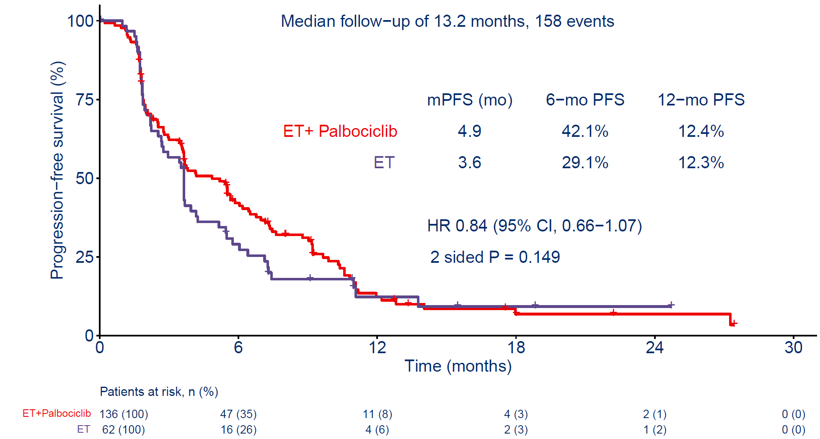
Primary Objective: Investigator-assessed PFS (ITT Population)
  CI: Confidence interval; HR: Hazard ratio; ITT: Intention to treat; mo: Months; mPFS: Median progression-free survival; PFS: Progression-free survival.
Llombard Cussac A et al, ASCO 2023

Slide 48
ONGOING CDK4/6 SEQUENCING TRIALS in HR+ BC
KEY TRIALS IN PROGRESS
Trial | Patient Population | Treatment Arms | N (est), (R) | Endpoints | Est. PCD
postMONARCH¹ (Phase 3) | HR+/HER2- mBC Disease progression on 1L CDK4/6i + AI OR disease recurrence on or after CDK4/6i + ET in the adjuvant setting | Arm 1: ABM + FUL Arm 2: PBO + FUL | 350 (1:1) | Primary: PFS (by investigator assessment, RECIST v1.1) Secondary: OS, ORR, CBR, DoR, PROs, safety, pharmacokinetics | August 2023
ElAINE-3² (Phase 3) | ER+/HER2- locally advanced or mBC with mESR1 Progressed on an AI in combination with either PALBO or RIBO in 1L | Arm 1: LASO + ABEMA Arm 2: FUL + ABEMA | 400 (2:1) | Primary: PFS, according to RECIST v1.1 Secondary: OS, ORR, CBR, DoR, QoL, TCC, TRR, safety | June 2025
EMBER-3³ (Phase 3) | ER+/HER2- locally advanced or mBC Disease progression on or after treatment with AI ± CDK4/6i | Arm 1: Imlunestrant Arm 2: Imlunestrant + ABM Arm 3: investigator's choice of ET | 860 | Primary: PFS in ITT population and in the mESR1 population Secondary: OS (in the ITT population and in the mESR1 population), ORR, DoR, CBR, PFS, PROs | April 2024
1L, first line; aBC, advanced breast cancer; ABM, abemaciclib; AI, aromatase inhibitor; CBR, clinical benefit rate; CDK4/6, cyclin dependent kinase 4/6 inhibitor; DoR, duration of response; ER, estrogen receptor; est, estimated; ET, endocrine therapy; FUL, fulvestrant; HER2, human epidermal growth factor receptor 2; HR, hormone receptor; ITT, intention to treat; LASO, lasofoxifene; mBC, metastatic breast cancer; mESR1, estrogen receptor 1 mutation; N, sample size; PAL, palbociclib; PFS, progression-free survival; PRO patient reported outcome; ORR, objective response rate; OS, overall survival; PCD, primary completion date; QoL, quality of life; R, randomisation; RECIST, Response Evaluation Criteria in Solid Tumours; TCC, time to cytotoxic chemotherapy; TTC, time to chemotherapy; TTR, time to response
1. Kalinsky K, et al. ASCO 2022. Poster TPS1117; 2. ClinicalTrials.gov. https://clinicaltrials.gov/ct2/show/NCT05696626?term=ELAINEIII&cond=BReast+cancer&draw=2&rank=1 (accessed May 22, 2023);
3. ClinicalTrials.gov. https://clinicaltrials.gov/ct2/show/NCT04975308 (accessed May 22, 2023)

Slide 49
CONCLUSION
SHOULD WE BE SWITCHING ET AND CDK4/6i ROUTINELY IN THE
second LINE SETTING?
Maybe a reasonable strategy for select patients with use of ribociclib or abemaciclib
(i.e. lack of Rb mutation)
No role for palbociclib beyond progression at this time
Unclear if need to switch both ET and CDK4/6i
Will need to better understand genomic predictors of benefit/resistance
Will need to await data from other continuation trials for a better understanding
CDK4/6i, cyclin dependent kinase 4/6 inhibitor; ET, endocrine therapy; Rb, retinoblastoma

Slide 50
DISCUSSION

Slide 51
ESR1 MUTATION:
THE NEED for & ROLE OF TESTING IN
ER+/HER2- METASTATIC BREAST CANCER
Prof. Frédérique Penault-Llorca
ER, estrogen receptor; ESR1, estrogen receptor 1; HER2, human epidermal growth factor receptor 2

Slide 52
USEFUL BIOMARKERS: METASTATIC OR LOCALLY ADVANCED UNRESECTABLE BREAST CANCER HR+/HER2-
gBRCA if not performed before
HER2 Low status (45-60%)
mPIK3CA
mESR1
HER2 mutations (lobular) (sensitivity to TKIs, T-DXd...)
NTRK gene fusion, rare in luminal BC
IO biomarkers MSI-h <0.5%, TMB high 10% (lobular)
No validated biomarkers for CDK4/6i (evidence that basal subtype are resistant)
CDK4/6i, cyclin‑dependent kinase 4/6 inhibitor; gBRCA, germline BReast CAncer gene; HER2, human epidermal growth factor receptor 2; HR, hormone receptor; IO, immuno-oncology; mESR1, estrogen receptor 1 mutation; mPIK3CA, phosphatidylinositol-4,5-bisphosphate 3-kinase catalytic subunit alpha mutation; NTRK, neurotrophic tyrosine receptor kinase; MSI-h; microsatellite instability High; T-DXd, trastuzumab deruxtecan; TMB, tissue tumour mutational burden; TKI, tyrosine kinase inhibitor

Slide 53
ESR1 MUTATION
ESR1, estrogen receptor 1

Slide 54

ESR1 MUTATION: CLINICAL BIOMARKERS IN HR+ MBC
40%
Primary
Metastasis
WT
MUT
35%
E2, SERM, SERD
30%
LBD + AF-2
E380Q
Y537S/N/C/H
S463P
25%
P<0.05
D538G
L536R
Ligand-binding
pocket
Genetic Alteration percentage
20%
AF-1
15%
10%
5%
DBD
0%
TP53
PIK3CA
CCND1
MCL1
MYC
FGFR1
ESR1
ERBB2
AKT1
NF1
PTEN
Constitutively active conformation
↑ basal transactivator function
↓ affinity for E2, SERM, SERD
↑ proteolytic stability
↑ proliferation
↑ survival
↑ migration
↑ Al resistance
ESR1 mutation
4-5% in recurrent BC after adjuvant AI
1.5-7% after neoadjuvant AI
<1% in MBC not treated by ET
20-40% in MBC treated by AI
AF, activation function; AI, aromatase inhibitor; AKT1, alpha serine/threonine-protein kinase 1; CCND1, cyclin D1; DBD, DNA binding domain; E2, estradiol; ERBB2, v-erb-b2 avian erythroblastic leukaemia viral oncogene homolog 2; ESR1, estrogen receptor 1; ET, endocrine therapy; FGFR1, fibroblast growth factor receptor 1; HR, hormone receptor; LBD, ligand binding domain; MBC, metastatic breast cancer; MCL1,myeloid cell leukemia-1; MUT, mutant; NF1, neurofibromatosis type 1; PIK3CA, phosphatidylinositol-4,5-bisphosphate 3-kinase catalytic subunit alpha; PTEN, phosphatase and tensin homolog; SERD, selective estrogen receptor degrader; SERM, selective estrogen receptor modulator; TP53, tumour protein 53; WT, wild type
Brett JO, et al. Breast Cancer Res. 2021;23:85; Jeselsohn R, et al. Clin Can Res. 2014;20:1757-67

Slide 55
POLLING QUESTION
WHAT IS THE MOST COMMON TYPE OF ESR1 MUTATION IN METASTATIC LUMINAL TUMORS PREVIOUSLY TREATED WITH AI?
A. ESR1 epigenetic modification
B. ESR1 amplification
C. ESR1 point mutation
D. ESR1 fusion
✅​
AI, aromatase inhibitor; ESR1, estrogen receptor 1

Slide 56
DIFFERENT TYPES OF ESR1 ALTERATIONS IN METASTATIC LUMINAL BC
A
Wild-type ESR1
ESR1
Epigenetic modifications
Cross Talks
Chr 6
20% loss of ESR1 expression
(Aurilio et al. Eur J. Cancer 2015)
ESR1
e1
e2
e3
e4
e5
e6
e7
e8
e9
e10
ERα (wild type)
AF1
DBD
Hinge
LBD/AF2
0
100
200
300
400
500
595a
B
ESR1 amplification
2-20% of luminal tumours
(depending on method)
Metastasis
ESR1
Chr 6
Breast cancer
cells at
metastatic
site
C
ESR1 point mutations
20-30% of metastatic luminal tumours
(<3% of primary tumours)
E380Q
S463P
Y537C/S/N
L536Q
D538G
ERα
AF1
DBD
Hinge
LBD/AF2
0
100
200
300
400
500
595a
D
ESR1 fusions
2-6% of luminal tumours
(different fusion partners)
ESR1-e6 fusion
transcript
e1
e2
e3
e4
e5
e6
Partner gene
ESR1 fusion
protein
AF1
DBD
Hinge
Fusion partner
0
100
200
300
365aa
AF, activation function; BC, breast cancer; Chr, chromosome; DBD, DNA binding domain; e, exons; ERα, estrogen receptor alpha; ESR1, estrogen receptor; LBD, ligand‑binding domain
Lei JT, et al. J Cancer Metastasis Treat. 2019;5:38; Nat Com. 2022: 13(1), 2011

Slide 57
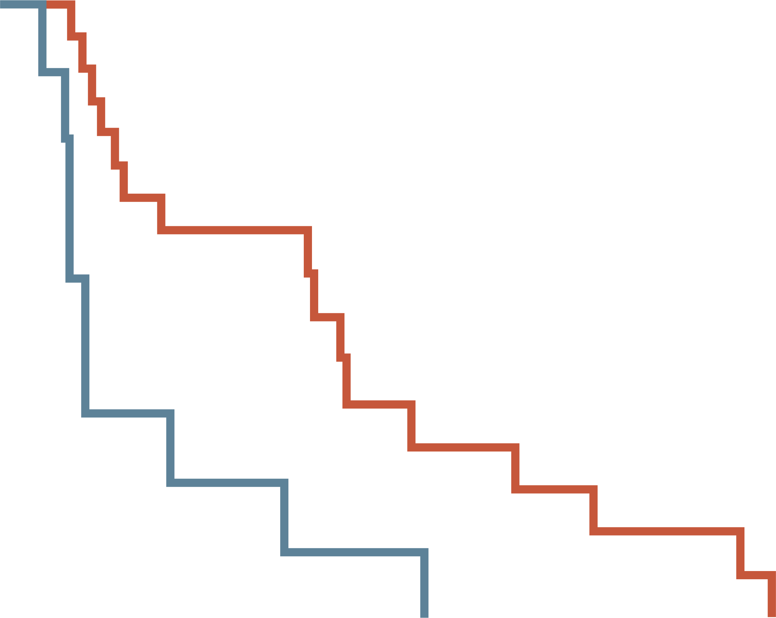
ESR1 MUTATIONS: METASTATIC LUMINAL BREAST CANCER
ESR1 mutations are associated
with poor outcome
ESR1 mutations are associated
with poor outcome
TCGA luminal A and luminal B (n=321)
TCGA breast cancer (n=507)
MSKCC (n=22)
100
ESR1 Negative
ESR1 Positive
ESR1 mutations as a new mutation in
20-30% of metastatic tumours
80
60
Disease-free survival
P=0.006
40
20
0
0
50
100
150
200
250
300
Percentage of matched cases with mutations
Time (months)
ERBB3,v-erb-b2 avian erythroblastic leukaemia viral oncogene homolog; ESR1, estrogen receptor 1; GATA3, GATA binding protein 3; HR, hazard ratio;
MSKCC, Memorial Sloan-Kettering Cancer Center; PIK3CA, phosphatidylinositol-4,5-bisphosphate 3-kinase catalytic subunit alpha; OS, overall survival; RPTOR, regulatory associated protein of mTOR complex 1; TCGA, The Cancer Genome Atlas; TP53, tumour protein 53; WT, wild type
Toy W, et al. Nat Genet.2013;45:1439-45; Crucitta et al, Cancers 2023:15,1306.; Li Z, et al. Nat Com. 2022: 13(1), 2011

Slide 58

EMERALD TRIAL: BASELINE PATIENT CHARACTERISTICS
Median age was 63 years (range: 24-89)
47.8% had a detectable ESR1 mutation
43.4% had previously received two lines of endocrine therapy for advanced or metastatic disease
22.2% received a prior line of chemotherapy for advanced/metastatic disease
68.2% had visceral metastases in the elacestrant group
71% had visceral metastases in the SoC group
Guardant360 CDx assay, FDA approved as companion test for ESR1m screening
CDx, companion diagnostics; ER, estrogen receptor; ESR1, estrogen receptor 1; FDA, Food and Drug Administration; HER2, human epidermal factor receptor 2; SoC, standard of care
Bidard FC, et al. J Clin Oncol. 2022.40:3246-56

Slide 59
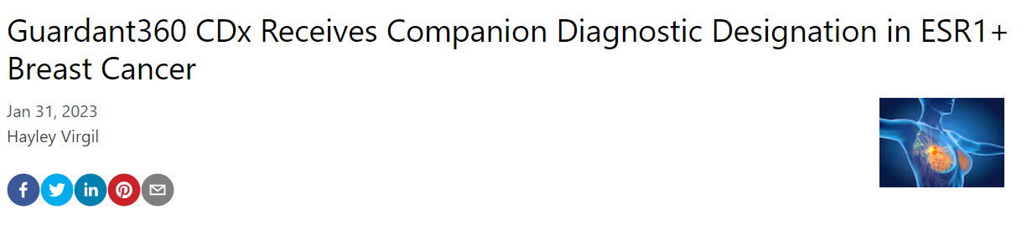
ESR1 MUTATION: COMPANION DIAGNOSTIC
The analytical sensitivity of the Guardant360® test at the panel level is
100% with an allelic fraction >0.5%
88.3% with an allelic fraction between 0.01-0.5% for SNVs, based on a cell-free DNA contribution of ≥30 ng in patient samples
CDx, companion diagnostics; ESR1, estrogen receptor 1; SNV, single nucleotide variant
https://guardanthealth.eu/wp-content/uploads/2021/01/G360-Specification-Sheet-1.pdf (accessed May 22, 2023)

Slide 60
RECOMMENDATIONS & GUIDELINES

Slide 61
POLLING QUESTION
WHEN would you TEST FOR ESR1 MUTATION?
Upon diagnosis
After 1st line of endocrine therapy only
At recurrence or progression on endocrine therapy
All of the above
✅​
ESR1, estrogen receptor 1

Slide 62
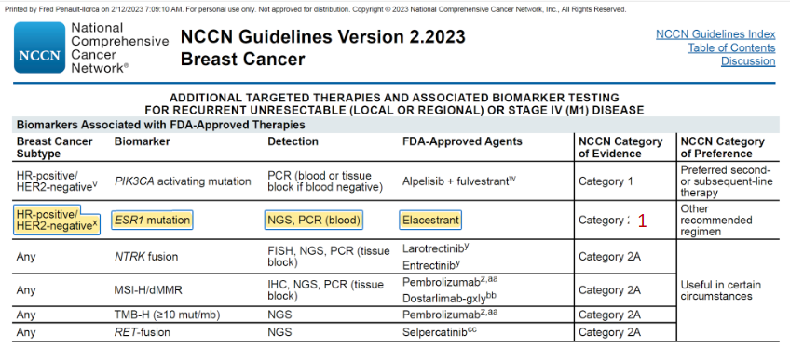
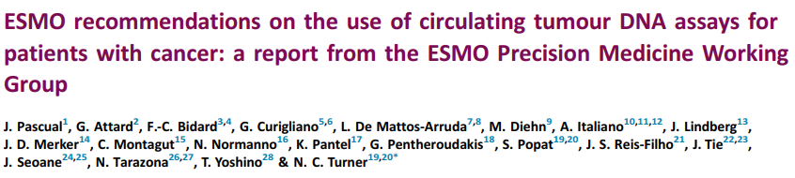
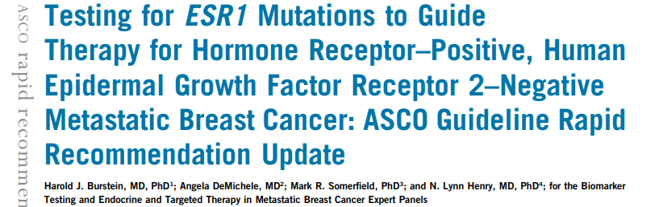
ESR1 MUTATION: TESTING Recommendations
When?
  ASCO 2023 guidelines recommend testing at recurrence or progression on ET (given with or without CDK4/6i)¹
How?
  Liquid biopsy
    ESMO recommends test in ctDNA
    ASCO recommends blood-based ctDNA¹
    PADA-1 trial used ddPCR
    NCCN recommends NGS or PCR(blood)²
1L, first line treatment; ctDNA, circulating tumour DNA; ESMO; European Society for Medical Oncology; ESR1, estrogen receptor 1; ET, endocrine therapy; (dd) PCR, droplet digital polymerase chain reaction; NCCN, National Comprehensive Cancer Network; NGS, next generation sequencing
¹https://ascopubs.org/doi/full/10.1200/JCO.23.00638?role=tab&utm_source=twitter&utm_medium=social&utm_content=7656ec54-2b3b-47a0-9520-5eb98fb2df9f&utm_campaign=Twitter+Website+Traffic (accessed May 22, 2023) ; ²https://www.nccn.org/professionals/physician_gls/pdf/breast_blocks.pdf (accessed May 22, 2023)

Slide 63




TISSUE OR PLASMA?
If negative, how long will it take to retest? Or wait for evolution under 2L?
Little invasive and dynamic
Captures tissue heterogeneity
Requires a sensitive technique
In case of negativity repeat the technique a few months later
(limit of sensitivity)
Tissue biopsy
Liquid biopsy
2L, second line of treatment

Slide 64
DETECTION OF CIRCULATING DNA AND Available technologies
Clinical relevance
ctDNA abundance
Molecular techniques
100%
Sanger sequencing
Advanced and
metastatic-stage
disease
10%
Limit of detection
Real-time PCR
NGS
Tumour burden:
~ 10 cm²
1%
Limit of detection
ARMS PCR
PNA/LNA PCR
PAP/bi-PAP
BEAMing
dPCR
E-NGS
Diagnosis, early-
stage and residual
disease
0.1%
0.01%
Limit of detection
ARMS, amplification refractory mutation system; BEAMing, beads, emulsion, amplification, magnetics; bi‑PAP, bi‑directional pyrophosphorolysis-activated polymerisation; ctDNA, circulating tumour DNA; (d)PCR, (digital) polymerase chain reaction; E-NGS, enhanced next generation sequencing; LNA, locked nucleic acid; PNA; peptide nucleic acid
Saliou A, et al. Expert Rev Mol Diagn. 2016;16:39-50

Slide 65




CIRCUITS TO SEARCH FOR ESR1 LIQUID BIOPSY MUTATION
Request for ESR1 mutation
research by oncologist
on liquid biopsy edition of an
order form
Laboratory of
biology
<6h
EDTA tubes
Streck tubes
Centrifugation +/–
Freezing if not
processed on site
Mailing
within a
week
Return of results
2-15 days
Special
shipment on
dry ice bed
by carrier
Molecular Biology Platform:
DNA extraction
PCR, ddPCR or NGS technique
EDTA, ethylenediaminetetraacetic acid; ESR1, estrogen receptor 1; (dd)PCR, (droplet digital) polymerase chain reaction; NGS, next generation sequencing; PCR, polymerase chain reaction

Slide 66
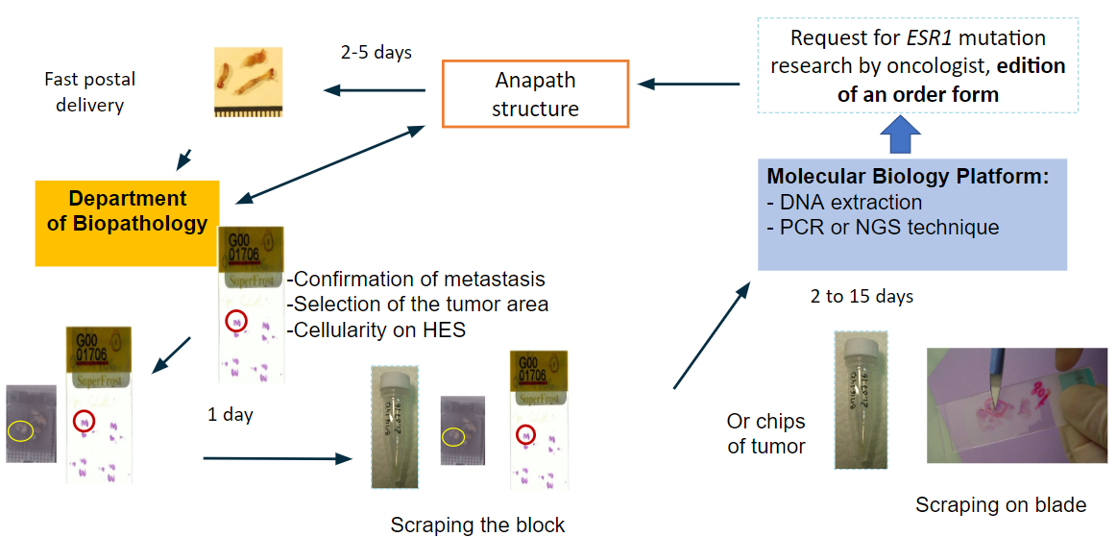
CIRCUITS TO SEARCH FOR ESR1 Mutation
UNLIKELY BECAUSE RESEARCH TO BE DONE AFTER CDK4/6 FAILURE IS DEBATABLE IF tBRCA
Request for ESR1 mutation
research by oncologist,
edition of an order form
2-5 days
Pathology
structure
Fast postal
delivery
Department of
Biopathology
Molecular Biology Platform:
DNA extraction
PCR, or NGS technique
Confirmation of metastasis
Selection of the tumour area
Cellularity on H&E
2 to 15 days
1 day
Or chips
of tumour
Scraping on blade
Scraping the block
CDK4/6, cyclin‑dependent kinase 4/6; ESR1, estrogen receptor 1; H&E, hematein & eosin stained slides; NGS, next generation sequencing; PCR, polymerase chain reaction; tBRCA, tumour BReast CAncer gene

Slide 67
CONCLUSION
ESR1 MUTATION: THE NEED for & ROLE OF TESTING IN ER+/HER2- METASTATIC BREAST CANCER
Alterations in ESR1 are mainly in the ligand binding domain and their frequency increases during the course of disease in ER+/HER2- advanced and metastatic breast cancer
treated by AI
Point mutation (25%-40%) > rearrangement (5%) > amplification (1%)
The presence of ESR1 mutation seems to be both prognostic (worse) and predictive (resistance to aromatase inhibitors and sensitivity to some SERDs)
Mutation search is possible without repeated biopsy of a metastatic site
This research can be performed reliably by liquid biopsy at recurrence or progression on or after endocrine therapy
AI, aromatase inhibitor; ER, estrogen receptor; ESR1, estrogen receptor 1; HER2, human epidermal growth factor receptor 2; SERD, selective estrogen receptor degrader

Slide 68
DISCUSSION

Slide 69

DISCUSSION & QUESTIONS

Slide 70
KEY CLINICAL TAKEAWAYS
Elacestrant is the 1st oral SERD to be FDA approved (January 2023) for postmenopausal women or adult men with ER+/HER2-, ESR1-mutated advanced or metastatic breast cancer
  FDA approved Guardant360 CDx assay as a companion diagnostic device to identify patients with ER+/HER2- advanced or metastatic breast cancer for treatment with elacestrant
With the aim of redefining treatment landscapes, for ER+/HER2- advanced and metastatic breast cancer, several oral SERDs are in clinical development both as monotherapy and in combination therapy with other targeted therapies, including CDK4/6i
ESR1, PI3K, CDK4/6, BRCA, and AKT pathways alterations can be used as targets to guide treatment selection and sequencing decisions in ER+/HER2- advanced or metastatic breast cancer
ESR1 mutational status can be determined without repeated tissue biopsy of a metastatic site, instead it can be done reliably by liquid biopsy at recurrence or progression on ET
AKT, alpha serine/threonine kinase; BRCA, BReast CAncer gene; CDK4/6i, cyclin-dependent kinase 4/6 inhibitor; CDx, companion diagnostics; ER, estrogen receptor; ESR1, estrogen receptor 1; ET, endocrine therapy; FDA, Food and Drug Administration; HER2, human epidermal growth factor receptor 2; PI3K, phosphoinositide 3-kinase; SERD, selective estrogen receptor degrader

Slide 71
FUTURE PERSPECTIVES
Awaiting the outcomes of phase 3 trials on Oral SERDs: persevERA, SERENA-6, and the EMBER-3 trial investigating giredestrant, camizestrant, and imlunestrant respectively.
Ongoing clinical trials investigating combination of oral SERDs with targeted therapies including CDK 4/6i and PI3K/AKT/mTOR inhibitors
Ongoing clinical trials exploring the role of CDK4/6i beyond progression on prior treatment with CDK4/6i
Further exploration of novel switch strategies based on circulating tumor DNA (ctDNA) has the potential to refine the therapeutic paradigm in the setting of metastatic breast cancer

