Slide 2
Pituitary highlights:
Acromegaly & Beyond from ece & ENDO 2023
Prof. Maria Fleseriu, MD
Oregon Health & Science University, USA
JULY 2023
ECE, European Congress of Endocrinology; ENDO, Endocrine Society meeting

Slide 3

Developed by PITUITARY Connect
This programme is developed by PITUITARY CONNECT,
an international group of experts in the field of
pituitary diseases.
Acknowledgement and disclosures
This PITUITARY CONNECT programme is supported through an independent educational grant from Ipsen.
The programme is therefore independent, the content is not influenced by the supporter and is under the sole responsibility of the experts.
Please note: The views expressed within this programme are the personal opinions of the experts. They do not necessarily represent the views of the experts’ institutions, or the rest of the PITUITARY CONNECT group.
Expert Disclaimers:
Prof. Maria Fleseriu has received financial research support to Oregon Health & Science University from Amryt, Crinetics, Ionis, and Recordati and scientific consulting fees from Amryt, Camurus, Debiopharm, Ipsen, and Recordati.

Slide 4
Educational objectives
To educate learners on the key clinical data in functioning pituitary adenomas, including acromegaly, from endocrinology congresses in the first half of 2023:
Improve overall awareness and understanding of the latest acromegaly data
Recognise key data for current and potential future treatment options and strategies for acromegaly care

Slide 5
Precision medicine in acromegaly: results of the ACROFAST study
Puig-Domingo M, et al. ECE 2023. Abstract EP730

Slide 6
ACROFAST: background and study design
Some biomarkers have been reported to predict first generation somatostatin receptor ligand (fgSRL) response including T2 MRI intensity, GH at 2 hours (GH_{2h} ) and GH acute decrease (ΔGH_{2h} % ) after short acute octreotide test (sAOT) and molecules such as SST2 and E-cadherin)
The prospective ACROFAST trial evaluated the assignation of treatment according to fgSRLs response biomarkers compared to a control group in which fgSRLs or PEGV, or their combination were considered
Participants: Newly diagnosed & non cured after surgery with acromegaly from 21 university hospitals in Spain
Sequential treatment (A) (n=30)
Personalized treatment (B)
(n=27)
Full response
Intermediate response
Non-response
Protocol: fgSRLs were initiated at medium dose (octreotide LAR 20 mg or lanreotide SR 90mg) and up-titrated if required
sAOT: GH_{2h} <2.7 ng/ml
sAOT: GH_{2h} >2.7 ng/ml &
ΔGH_{2h} % >50%
sAOT: GH_{2h} >2.7 ng/ml &
ΔGH_{2h} % <50%
Or
E-cadherin +ve
& T2 MRI
Hypointense
& T2 MRI
Hyperintense
& T2 MRI
Invasion
& T2 MRI
non-Invasion
Or
E‑cadherin -ve
Outcome: Differences in time to control & in the percentage of subjects controlled with medical treatment at 6 months in each group
fgSRLs
fgSRLs
fgSRLs + PEGV 1.0 mg/Kg/w
PEGV 1.0 mg/Kg/w
GH, growth hormone; LAR, long-acting release; MRI, magnetic resonance imaging; PEGV, pegvisomant; SR, sustained release; SRLs, somatostatin receptor ligands; SST2, somatostatin receptor type
Puig-Domingo M, et al. ECE 2023. Abstract EP730 (poster presentation)

Slide 7
ACROFAST: results
DIFFERENCES IN BIOCHEMICAL CONTROL
AT 6 MONTHS OF MEDICAL TREATMENT
(p=0.03; FISHER'S EXACT TEST)
DIFFERENCES IN TIME TO CONTROL
AMONG NON-RESPONDERS
(p=0.04; MANN-WHITNEY U TEST)
Sequential treatment
(n=30)
Personalised treatment
(n=27)
Sequential
treatment
Personalised
treatment
Non-
controlled
8 (30%)
400
360.0
350
Controlled
13 (43%)
300
263.1
250
Non-controlled
17 (57%)
Controlled
19 (70%)
Time to control
(mean ± SD; days)
200
150
100
50
0
SD, standard deviation
Puig-Domingo M, et al. ECE 2023. Abstract EP730 (poster presentation)

Slide 8
ACROFAST: Summary
Significantly higher proportion of patients in the personalized treatment group not only achieved hormonal control, but also achieved it in a significantly shorter period of time compared to the sequential group
Clinical Perspective
Personalised treatment guided by biomarkers, imaging and patient characteristics, should be the "standard of practice" and used in all patients with acromegaly to improve outcomes
Puig-Domingo M, et al. ECE 2023. Abstract EP730 (poster presentation)

Slide 9
[18f]FET PET-MRI: a novel and improved technique for detection of small functional pituitary adenomas
Pruis I, et al. ECE 2023. Abstract OC3.3
[18F] FET PET, 18F-fluoro-ethyl-tyrosine positron emission tomography; MRI, magnetic resonance imaging

Slide 10
[18f]FET PET-MRI: background and study design
Background
Surgical planning for small functional pituitary adenomas is often complicated due to inconclusive diagnostic MRI in up to 40% of patients, therefore hampering cure rates
This study investigated [18F]FET-PET MRI as a novel method for the detection of small functional pituitary adenoma
Protocol & Outcomes:
Patients with CD (n=22) or acromegaly (n=6) with a suspected primary or recurrent small functional pituitary adenoma underwent [18F]FET PET-MRI
Focal uptake of [18F]FET was evaluated by a single nuclear radiologist and MRI was separately evaluated by a single neuroradiologist
Outcomes were compared with clinical follow-up and sensitivity and positive predictive values were calculated
[18F]FET PET, 18F-fluoro-ethyl-tyrosine positron emission tomography; CD, Cushing's disease; MRI, magnetic resonance imaging
Pruis I, et al. ECE 2023. Abstract OC3.3

Slide 11
Cushing’s disease (N=22)
[18f]FET PET-MRI: RESULTS
Acromegaly (N=6)
17 patients with primary diagnosis had also undergone IPSS
22 patients had positive [18F]FET PET findings, identifying pituitary adenomas as small as 3mm in size on accompanying MRI
14 patients underwent transsphenoidal surgery after [18F]FET PET (others waiting or refused)
11 of these 14 patients are in biochemical remission: estimated sensitivity of 100% and PPV between 78-100% to detect CD
3 patients had primary diagnosis
4 patients had positive [18F]FET PET findings
This patient is biochemically in remission
1 patient underwent transsphenoidal surgery after [18F]FET PET (others waiting or refused)
[18F] FET PET, 18F-fluoro-ethyl-tyrosine positron emission tomography; CD, Cushing's disease; IPSS, inferior petrosal sinus sampling; MRI, magnetic resonance imaging; PPV, positive predictive values
Pruis I, et al. ECE 2023. Abstract OC3.3

Slide 12
[18f]FET PET-MRI: summary
[18F]FET PET-MRI shows high accuracy for localising small functional pituitary adenoma in patients with CD and acromegaly
The diagnostic yield of this hybrid imaging technique exceeds that of MRI alone and IPSS
Clinical Perspective
With increased availability, [18F]FET PET-MRI could be used in clinical practice for localisation of small pituitary adenomas and thus increased yield of surgery or repeat surgery for IDMC intermediate/poor risk patients
[18F]FET PET, 18F-fluoro-ethyl-tyrosine positron emission tomography; CD, Cushing's disease; IPSS, inferior petrosal sinus sampling; MRI, magnetic resonance imaging
Pruis I, et al. ECE 2023. Abstract OC3.3

Slide 13
Treatment Patterns in Acromegaly: Analysis of Real-World US Insurance Claims from the MarketScan® Database
Fleseriu M, et al. ENDO 2023. Abstract THU-061

Slide 14
TREATMENT PATTERNS IN ACROMEGALY: background and study design
Background
Medical treatments for acromegaly include fgSRLs (LAN, OCT, and oral octreotide) sgmSRLs (pasireotide), dopamine agonists (cabergoline), and GHRAs (pegvisomant)
This study aims to describe real-world treatment patterns of individuals receiving medications for acromegaly in the United States
Methods
Key eligibility Criteria:
Received monotherapy or combination therapy
(≥2 treatments overlapping for >3 m) for ≥90 days without treatment gaps
≥2 condition claims associated w/ acromegaly diagnosis
Had data ≥3 m before and ≥6 m after diagnosis/first treatment claim (whichever earlier)
≥18 years old at diagnosis
Outcomes:
Treatment frequency by LOT & changes between LOTs
Treatment adherence and persistence for LOT 1
Treatment up-/down-titration and extended dosing interval use, evaluated for OCT and LAN
fg/sgmSRLs, first-generation/second-generation multiligand somatostatin receptor ligand; GHRA, growth hormone receptor antagonist; LAN, lanreotide depot; LOT, line of treatment; m, months; OCT, octreotide long-acting release
Fleseriu M, et al. ENDO 2023. Abstract THU-061 (poster presentation)

Slide 15
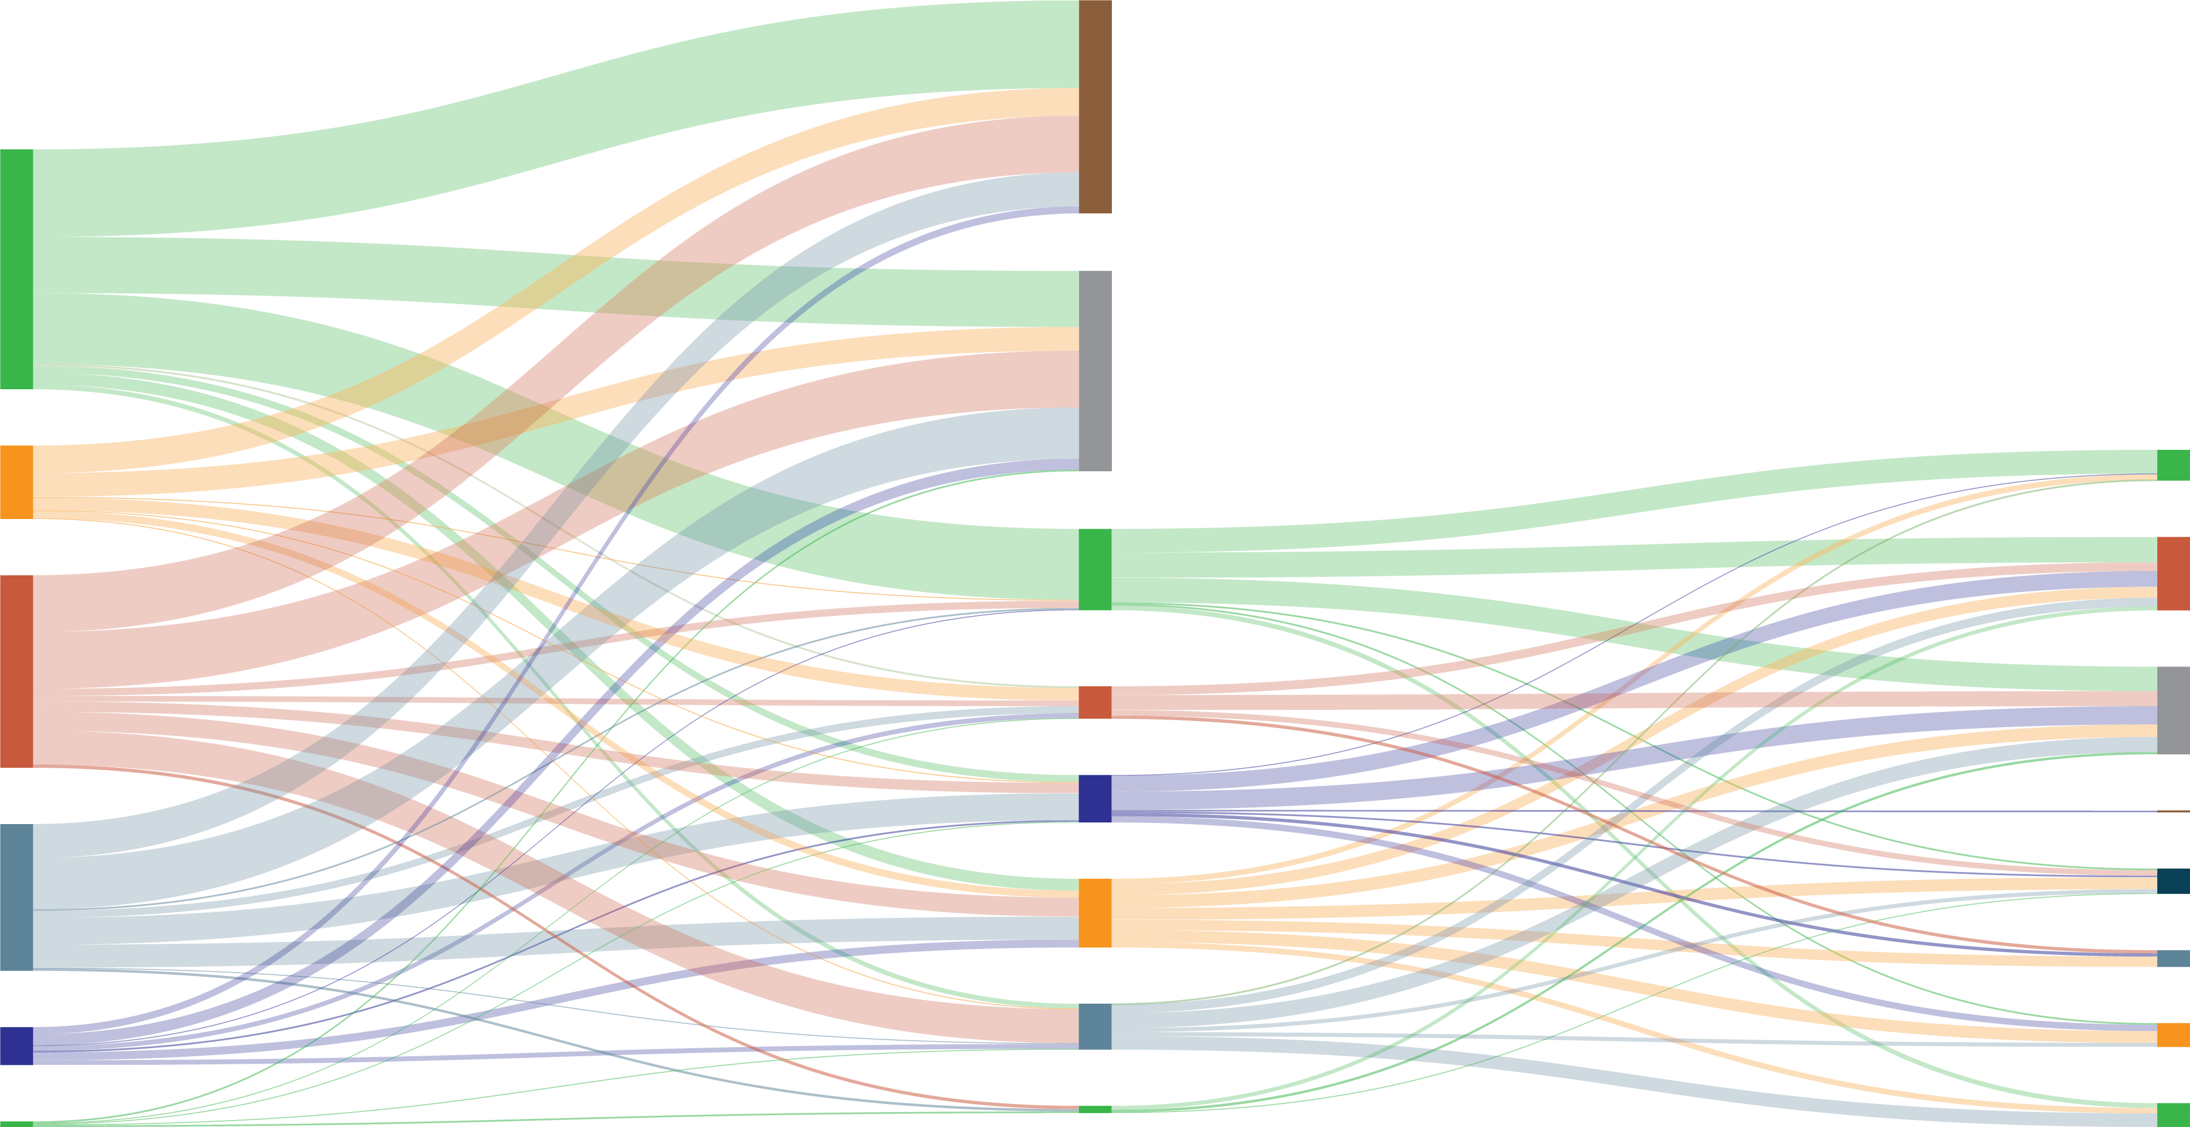
TREATMENT PATTERNS IN ACROMEGALY: Changes in LOT for monotherapies & combination therapies
Treatment journey
First line
Second line
Third line
n=882
Treatment stopped
304
(34.5%)
Cabergoline
Censored^{b}
93
(10.5%)
Pegvisomant
Cabergoline
Cabergoline
Octreotide LAR
244
(27.7%)
Octreotide LAR
Octreotide LAR
Censored
Combination
Treatment stopped
186
(21.1%)
Lanreotide depot
Combination
Pegvisomant
Lanreotide depot
48
(5.4%)
Combination
Lanreotide depot
Pegvisomant
7
(0.8%)
Other therapiesª
Other therapies
Other therapies
ª Includes other monotherapies, such as pasireotide and oral octreotide
^{b} Loss to follow-up or data cut-off on July 31, 2022, whichever occurred first
LAR, long-acting release; LOT, line of therapy
Fleseriu M, et al. ENDO 2023. Abstract THU-061 (poster presentation)

Slide 16
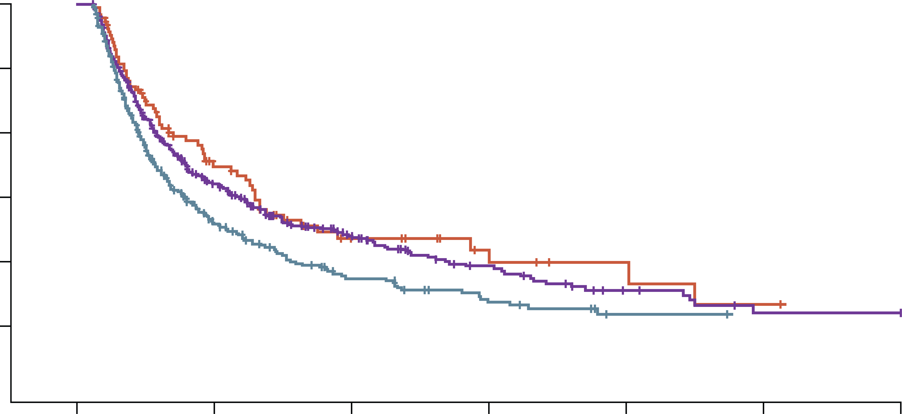
TREATMENT PATTERNS IN ACROMEGALY: treatment persistence for monotherapies in lot 1
1.0
Medication classª
Dopamine agonists
GHRAs
First-generation SRLs
0.8
0.6
+ Censored
Persistence probability
0.4
0.2
Number
at risk
0.0
304
93
430
63
35
141
21
12
57
8
6
24
1
3
8
0
1
2
0
0
2
0
25
50
75
100
125
150
Time to event (months)
ª Oral octreotide (n=5) and pasireotide (n=18) were not included due to small sample size
GHRA, growth hormone receptor antagonist; LOT, line of treatment; SRL, somatostatin receptor ligand
Fleseriu M, et al. ENDO 2023. Abstract THU-061 (poster presentation)

Slide 17
TREATMENT PATTERNS IN ACROMEGALY: treatment titration for first-generation SRL monotherapies
Change type | Treatment line | Variable | LAN | OCT
Up-titration | LOT 1 | Individuals with ≥1 dose up-titration, n (%) | 107 (57.5) | 105 (43.0)
 | LOT 2 |  | 35 (58.3) | 19 (30.7)
 | LOT 3 |  | 17 (56.7) | 7 (22.6)
Down-titration | LOT 1 | Individuals with ≥1 dose down-titration, n (%) | 72 (38.7) | 62 (25.4)
 | LOT 2 |  | 26 (43.3) | 15 (24.2)
 | LOT 3 |  | 13 (43.3) | 3 (9.7)
ª Recommended starting dose for LAN is 90 mg every 4 weeks for 3 months; recommended starting dose for OCT is 20 mg every 4 weeks for 3 months ^{b} Percentages sum to over 100% as individuals may have received more than one dose within the same LOT
LAN, lanreotide depot; LOT, line of treatment; OCT, octreotide long-acting release; SRL, somatostatin receptor ligand
Fleseriu M, et al. ENDO 2023. Abstract THU-061 (poster presentation)

Slide 18
TREATMENT PATTERNS IN ACROMEGAly: summary
Cabergoline was the most frequent of all LOT 1 medications (34.5%) despite having the shortest adherence and persistence
OCT (27.7%) and LAN (21.1%), which had longer adherence and persistence, were also commonly used in LOT 1
EDIs, which can achieve biochemical control and safety comparable with standard monthly administration while decreasing the clinical and economic burden on individuals were
seldom used
Clinical Perspective
Real world data from administrative claims highlights that not all patients are treated per guideline recommendations; however, lack of biochemical data could limit some of the conclusions
EDI, extended dosing interval; LAN, lanreotide depot; LOT, line of treatment; OCT, octreotide long-acting release
Fleseriu M, et al. ENDO 2023. Abstract THU-061 (poster presentation)

Slide 19
Long-term Depot Specific Changes in Adipose Tissue after Treatment of Acromegaly
Falch CM, et al. ENDO 2023. Abstract THU-067

Slide 20
LONG-TERM Depot-specific Changes in AT after treatment of acroMEGALY: background and study design
Background
Patients with active acromegaly present a decreased adipose tissue mass. Short-term studies show that AT increases following treatment; however, long term effects are unclear
This study aims to characterize the depot specific changes of AT after treatment of acromegaly and identify contributing factors
Methods
Patients with acromegaly (n=62), VAT, SAT, TAT and A/G ratio were measured by DXA at diagnosis, and at a short- and long-term visit
GH, IGF-1, glucose and HbA1c levels, gonadal status, and diabetes status were recorded
Remission status was assessed at the long-term visit (IGF-1 ≤1.3 x ULN)
A/G ratio, android gynoid ratio; AT, adipose tissue; DXA, dual energy X-ray absorptiometry; GH, growth hormone; HbA1c, haemoglobin A1c; IGF-1, insulin-like growth factor 1; SAT, subcutaneous adipose tissue; TAT, total adipose tissue; ULN, upper limit of normal; VAT, visceral adipose tissue
Falch CM, et al. ENDO 2023. Abstract THU-067 (poster presentation)

Slide 21
LONG-TERM DEPOT-SPECIFIC CHANGES IN AT AFTER TREATMENT
OF ACROMEGALY: SEx differences in fat depot changes
***/**
2500
***/***
2000
***/*
*/***
*/*
2000
1500
VAT mass (g)
SAT mass (g)
1500
Women
Men
1000
1000
500
500
Interaction p=0.567
Group p=0.035
Interaction p=0.581
Group p=0.009
0
0
Baseline
1 y
5 y
Baseline
1 y
5 y
Time
Time
VAT and A/G ratio increased at both time points, whereas SAT and TAT mainly increased at short-term, plateauing afterwards
VAT and A/G ratio were higher in men, and the A/G ratio increased more compared to women
The increase in VAT, but not SAT, TAT or A/G ratio, was more pronounced in patients with diabetes mellitus
A/G ratio, android gynoid ratio; AT, adipose tissue; SAT, subcutaneous adipose tissue; TAT, total adipose tissue; VAT, visceral adipose tissue; y, years
* p<0.05, ** p<0.02, *** p<0.001
Falch CM, et al. ENDO 2023. Abstract THU-067 (poster presentation)

Slide 22
LONG-TERM DEPOT-SPECIFIC CHANGES IN AT AFTER TREATMENT
OF ACROMEGALY: Key findings
Glucose and HbA1c decreased at short-term and remained stable at long-term, with no obvious sex differences
BMI remained stable
The gonadal status had no effect on the increase in AT in women
The increase in AT strongly correlated with the decrease in GH at long-term
The decrease in glucose correlated with the decrease in HbA1c and IGF-1 at long-term
Long-term remission had no effect on changes in AT mass during follow-up
AT, adipose tissue; BMI, body mass index; GH, growth hormone; HbA1c, haemoglobin A1c; IGF-1, insulin-like growth factor 1
Falch CM, et al. ENDO 2023. Abstract THU-067 (poster presentation)

Slide 23
LONG-TERM DEPOT-SPECIFIC CHANGES IN AT AFTER TREATMENT
OF ACROMEGALY: summary
Treatment of acromegaly leads to an increase in AT mass in a depot- and sex-specific manner both at short- and long-term follow-up
Glucose metabolism improves rapidly after disease control and persists, whereas patients with diabetes mellitus have a higher VAT increase that may worsen their long-term metabolic outcome
Clinical Perspective
Increased awareness of long-term changes in adipose tissues following treatment of acromegaly is needed; increased adiposity, especially in patients with diabetes mellitus, needs to be recognized
AT, adipose tissue; VAT, visceral adipose tissue
Falch CM, et al. ENDO 2023. Abstract THU-067 (poster presentation)

