Slide 2
Nursing Support for metastatic castrate resistant prostate cancer (mCRPC) patients during radiopharmaceutical treatments
Janet Forgenie
Uro-oncology Clinical Nurse Specialist
University College London Hospital
JUly 2023

Slide 3

Developed by GU NURSES COnnect
This programme is developed by GU NURSES CONNECT,
an international group of experts in the field of
genitourinary oncology nursing.
Acknowledgement and disclosures
This GU NURSES CONNECT programme is supported through an independent educational grant from Bayer. The programme is therefore independent, the content is not influenced by the supporter and is under the sole responsibility of the experts.
Please note: The views expressed within this programme are the personal opinions of the experts. They do not necessarily represent the views of the experts’ institutions, or the rest of the GU NURSES CONNECT group.
Expert Disclaimers:
Janet Forgenie has received financial support/sponsorship for research support, consultation, or speaker fees from the following companies: Astellas and Bayer

Slide 4
Clinical takeaways
Radiopharmaceuticals such as radium-223 and ¹⁷⁷Lu-PSMA-617 offer a survival benefit to mCRPC patients as well as managing bone pain and QoL
They are able to deliver targeted radiation to prostate cancer cells thereby minimising toxicity to normal healthy tissue
Real-world data support using ¹⁷⁷Lu-PSMA-617 in patients who previously received Ra-223
Nurses and patients should be aware of post-treatment precautions, but radiopharmaceuticals are an effective and manageable treatment option for mCRPC patients
mCRPC, metastatic castrate-resistant prostate cancer; PSMA, prostate-specific membrane antigen; QoL, quality of life

Slide 5
Educational objectives
Recognise the considerations for treatment selection for mCRPC in clinical practice, minimising the impact of treatment on patient lives
Understand the clinical application of recent data to treatment sequencing in bone dominant mCRPC
Be able to educate and support patients during treatment to ensure patients understand what to expect
mCRPC, metastatic castrate-resistant prostate cancer

Slide 6
THE PROSTATE CANCER LANDSCAPE is complicated!
Docetaxel
Taxane chemotherapy
Treatment sequencing decisions are complex
Patients with mCRPC should receive as many life-prolonging therapies as possible
Abiraterone
NHA / NHA + CT combinations
Enzalutamide
Radiopharmaceuticals
Apalutamide
Immunotherapy
Darolutamide + docetaxel
PARPis / PARPi + NHA combinations
NEWLY
DIAGNOSED
mHSPC
PRIMARY
PROGRESSIVE
mHSPC
LOCALISED OR LOCALLY
ADVANCED
PROSTATE CANCER
BIOCHEMICAL
RECURRENCE
mCRPC
TERMINAL DISEASE
(DEATH)
nmCRPC
Docetaxel
All options added to ADT
Cabazitaxel
Enzalutamide
Abiraterone
Apalutamide
Enzalutamide
Darolutamide
Radium-223
FDA approved radiopharmaceuticals
ª Labels vary in terms of HRR alteration requirements, refer to local prescribing information
ADT, androgen deprivation therapy; FDA, Food and Drug Administration; mHSPC, metastatic hormone sensitive prostate cancer; NHA, novel hormonal agents; (n)mCRPC, (non-)metastatic castrate resistant prostate cancer
Lutetium-617
Sipuleucel-T
Pembrolizumab
Olaparib ± abirateroneª
Abiraterone acetate PI; Abiraterone acetate SmPC; Enzalutamide PI; Enzalutamide SmPC; Apalutamide PI; Apalutamide SmPC; Docetaxel PI; Docetaxel SmPC; Darolutamide PI; Darolutamide SmPC; Cabazitaxel PI; Cabazitaxel SmPC; Radium dichloride PI; Radium dichloride SmPC; Olaparib PI; Olaparib SmPC; Sipuleucel-T PI; Pembrolizumab PI; Rucaparib PI; Lutetium Lu 177 vipivotide tetraxetan PI; https://www.esmo.org/oncology-news/ema-recommends-granting-a-marketing-authorisation-for-akeega-fixed-dose-combinations-of-niraparib-abiraterone-acetate. All accessed April 2023
Niraparib + abirateroneª
Rucaparib ª

Slide 7
FDA-approved therapeutic radiopharmaceuticals for mcrpc patients
Radiopharmaceuticals | Radioactive particles | Description | Survival Benefit
Strontium-89 | β-emitter | Palliative agent for chemotherapy-refractory mCRPC patients with bone metastasis | No survival benefit
Samarium-153 | β-emitter | Provides significant pain relief to patients with bone metastasis | No survival benefit
Radium-223 | α-emitter | Improves overall survival in symptomatic bone-predominant mCRPC without visceral metastasis | 2.8-month improvement in OS compared to placebo (HR 0.70, 95% CI: 0.58-0.83, p<0.001)
¹⁷⁷Lu-PSMA-617 | β-emitter | Improves overall survival in PSMA-positive mCRPC patients previously treated with ARPI and taxane-based chemotherapy | 4-month improvement in OS compared to SoC (HR 0.62, 95% CI: 0.52-0.74, p<0.001)
¹⁷⁷Lu-PSMA-617, lutetium-177-prostate-specific membrane antigen-617; ARPI, androgen receptor pathway inhibitor; CI, confidence interval; FDA, Food and Drug Administration; HR, hazard ratio; mCRPC, metastatic castrate-resistant prostate cancer; OS, overall survival; SoC, standard of care
Ramnaraign B, et al. Oncologist. 2023;28:392-401; Parker C, et al. N Engl J Med 2013; 369: 213-223; Sartor O, et al. N Eng J Med. 2021;385:1091-103

Slide 8
Radium-223

Slide 9
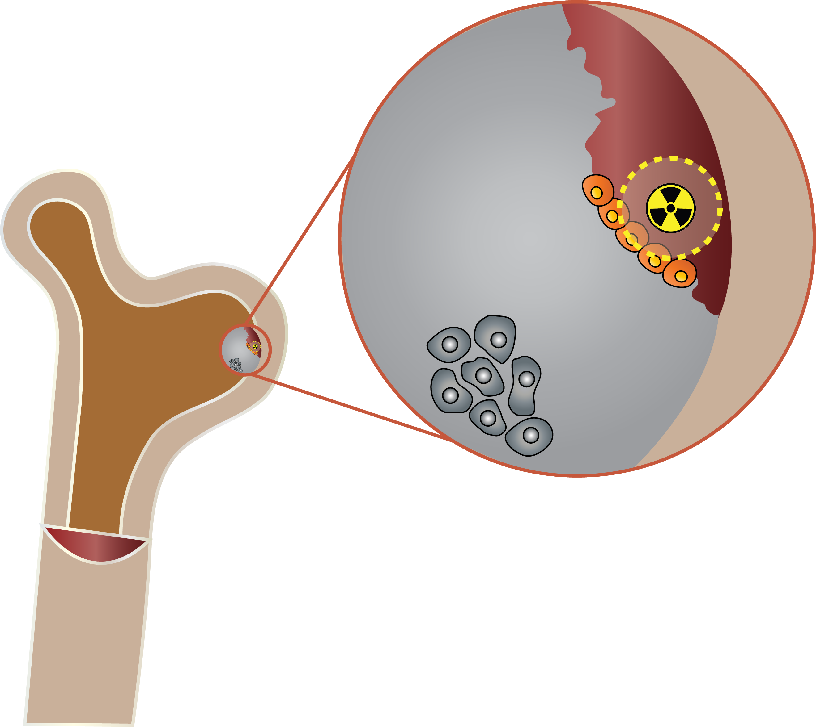

Radium-223: Mechanism of Action
Radiopharmaceutical targets bone metastasis
Radium-223 mimics calcium
Taken up by the bone mets, emit alpha radiation causing double stranded DNA breaks
New abnormal bone
formation (woven bone)
Ra-223
Range of ɑ-particle
Osteoblastic
factors
Growth
factors
Osteoblasts
Bone
Ra-223 binds with hydroxypatite and is
incorporated into the bone matrix
Bone marrow
Prostate cancer cells
mets, metastases
Radium-223 Prescribing Information Dec 2019
Figure adapted from: Faria T, et al. Br J Cancer Res 2018; 1(2): 156-161
Notes:
9

Slide 10
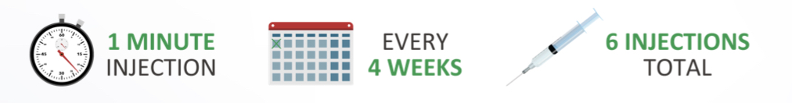
Radium-223 Administration and Dose
Ra-223 should be administered only by persons authorised to handle radiopharmaceuticals in designated clinical settings and after evaluation of the patient by a qualified physician
The dose is 55 kBq (1.49 microcurie) per kg body weight
The volume to be administered to a given patient is calculated as follows:
Patient treated as an outpatient
=
Body weight in kg
× 55 kBq/kg body weight
OR
Body weight in kg
× 1.49 mCi/kg body weight
Volume to be
administered (mL)
Decay factor × 1100 kBq/mL
Decay factor × 30 mCi/mL
kBq, kilobecquerel; mCi, microcurie; Ra-233, radium-233
Radium-223 US Prescribing Information (Dec 2019); Radium-223 SmPC

Slide 11
Alsympca study
Phase 3 study in mCRPC patients with symptomatic bone metastases and no known
visceral mets
TREATMENT
6 injections at
4-week intervals
PATIENTS
Confirmed symptomatic CRPC
≥2 bone metastases
No known visceral metastases
Post-docetaxel or unfit for docetaxel
STRATIFICATION
Total ALP:
<220 U/L vs ≥220 U/L
Bisphosphonate use:
Yes vs No
Prior docetaxel:
Yes vs No
Radium-223 (50 kBq/kg)
+ best standard of care
R
2:1
Placebo (saline)
+ best standard of care
N=921
ALP, alkaline phosphatase; kBq, kilobecquerel; (m)CRPC, (metastatic) castrate resistant prostate cancer; mets, metastases; R, randomisation
Parker C, et al. N Engl J Med. 2013;369:213-23 (inc. protocol)

Slide 12
ALsyMPCA: Ra-223 prolongs Overall survival
Radium-223 significantly improved overall survival compared to placebo in mCRPC patients with symptomatic bone metastases
100
HR: 0.70 (95% CI: 0.58-0.83)
p<0.001
90
80
70
60
Survival (%)
Radium-223
Median OS: 14.9 months
50
40
30
20
Placebo
Median OS: 11.3 months
10
0
0
3
6
9
12
15
18
21
24
27
30
33
36
39
Time since randomisation (months)
No. at risk
Radium-223
Placebo
614
307
578
288
504
228
369
157
274
103
178
67
105
39
60
24
41
14
18
7
7
4
1
2
0
1
0
0
CI, confidence interval; HR, hazard ratio; mCRPC, metastatic castrate resistant prostate cancer; OS, overall survival; Ra-223, radium-223
Parker C, et al. N Engl J Med. 2013;369:213-23

Slide 13
ALSYMPCA: Ra-223 delays Time to first SSE
Time to first symptomatic sKeletal event
100
90
HR: 0.66 (95% CI: 0.52-0.83)
p<0.001
80
70
Radium-223
(median time to first symptomatic skeletal event: 15.6 months)
60
Patients without symptomatic
skeletal event (%)
50
40
30
Placebo
(median time to first symptomatic skeletal event: 9.8 months)
20
10
0
0
3
6
9
12
15
18
21
24
27
30
Time since randomisation (months)
No. at risk
Radium-223
Placebo
614
307
496
211
342
117
199
56
129
36
63
20
31
9
8
7
8
4
1
1
0
0
CI, confidence interval; HR, hazard ratio; Ra-223, radium-223; SSE, symptomatic skeletal event
Parker C, et al. N Engl J Med. 2013;369:213-23

Slide 14
ALSYMPCA: ra-223 results in a meaningful improvement in QoL
p=0.004
p=0.020
Responders (%)
n/N
106/431
30/186
138/472
37/200
BSoC, best standard of care; EQ-5D, EuroQoL 5D; FACT-P, Functional Assessment of Cancer Therapy Prostate; QoL, quality of life; Ra-223, radium-223
Adapted from Nilsson S, et al. Ann Oncol. 2016;27:868-74

Slide 15
ALSYMPCA: safety data
Event, n (%)¹ | Radium-223 dichloride (n=600) |  |  |  | Placebo (n=301) |  | Crossover (N=83)
 | All grades | Grade 3 | Grade 4 | Grade 5ª | All grades | Grade 3 | Grade 4 | Grade 5ª
Haematological AEs
Anaemia | 187 (31) | 65 (11) | 11 (2) | 0 | 92 (31) | 37 (12) | 2 (1) | 1 (<1)
Thrombocytopenia | 69 (12) | 20 (3) | 18 (3) | 1 (<1) | 17 (6) | 5 (2) | 1 (<1) | 0
Neutropenia | 30 (5) | 9 (2) | 4 (1) | 0 | 3 (1) | 2 (1) | 0 | 0
Non-haematological AEs
Constipation | 108 (18) | 6 (1) | 0 | 0 | 64 (21) | 4 (1) | 0 | 0
Diarrhoea | 151 (25) | 9 (2) | 0 | 0 | 45 (15) | 5 (2) | 0 | 0
Nausea | 213 (36) | 10 (2) | 0 | 0 | 104 (35) | 5 (2) | 0 | 0
Vomiting | 111 (18) | 10 (2) | 0 | 0 | 41 (14) | 7 (2) | 0 | 0
Asthenia | 35 (6) | 5 (1) | 0 | 0 | 18 (6) | 4 (1) | 0 | 0
Fatigue | 154 (26) | 21 (4) | 3 (1) | 0 | 77 (26) | 16 (5) | 2 (1) | 0
General physical health deterioration | 27 (4) | 9 (2) | 2 (<1) | 5 (1) | 21 (7) | 8 (3) | 2 (1) | 2 (1)
Peripheral oedema | 76 (13) | 10 (2) | 0 | 0 | 30 (10) | 3 (1) | 1 (<1) | 0
Pyrexia | 38 (6) | 3 (1) | 0 | 0 | 19 (6) | 3 (1) | 0 | 0
Pneumonia | 18 (3) | 9 (2) | 0 | 4 (1) | 16 (5) | 5 (2) | 2 (1) | 0
ª Only one grade 5 haematological AE was considered possibly related to study drug: thrombocytopenia in one patient in the radium-223 group | 119 (46) | NA | 25 (19) | NA |  |  | 44 (53) | NA
Final 3-year safety analysis of ALSYMPCA showed that radium-223 remained well tolerated, with low myelosuppression incidence and no new safety concern²
AE, adverse event
1. Parker C, et al. N Engl J Med. 2013;369:213-23; 2. Parker C, et al. Eur Urol. 2018;73:427-35

Slide 16
Radium-223: Side effect management
Diarrhoea and sickness
  Monitor oral intake and fluid status to prevent dehydration
Low blood cell count – risk of infection/anaemia/bruising
  Haematological evaluation at baseline and prior to every dose of radium-223
Increased bone pain in the area of bone disease for a few days after treatment
  Increase pain medication during this period
  Levels of pain decrease with progressive cycles of radium-223
Peripheral oedema
  Gentle exercise, raise swollen areas on chair
  Treat with diuretics if required
Radium-223 SmPC and US Prescribing Information; Local guidelines University College London Hospital, Janet Forgenie personal communication

Slide 17


When to use Ra-223
Radium-223 FDA-approved indication¹
Radium-223 EMA-approved indication²
Indicated for the treatment of patients with castrate-resistant prostate cancer, symptomatic bone metastases and no known visceral metastatic disease
Indicated as monotherapy or in combination with an LHRH analogue for the treatment of adult patients with mCRPC, symptomatic bone metastases and no known visceral metastases, who are in progression after at least two prior lines of systemic therapy for mCRPC (other than LHRH analogues), or ineligible for any available systemic mCRPC treatment
FDA, Food and Drug Administration; LHRH, luteinising hormone-releasing hormone; mCRPC, metastatic castrate-resistant prostate cancer; Ra-223, radium-223
1. Radium-223 US prescribing information (Dec 2019); 2. Radium-223 SmPC (Jun 2018)

Slide 18
¹⁷⁷Lu-PSMA-617
¹⁷⁷Lu-PSMA-617, lutetium-177-prostate-specific membrane antigen-617

Slide 19

¹⁷⁷LU-psma-617: Mechanism of action
MECHANISM OF ACTION
¹⁷⁷Lu-PSMA is a radionuclide therapy that is directed to PSMA expressing prostate cancer
¹⁷⁷Lu-PSMA-617 pairs PSMA targeting ligand
(PSMA-617) to radioactive atom (¹⁷⁷lutetium)
“Ligand” is a small molecule designed to bind to PSMA, a protein highly expressed on the cell surface of most prostate cancer cells
Once bound, the ¹⁷⁷lutetium atom releases an energetic beta particle that kills cancer cell
ADMINISTRATION
Administered as 6 fractions of treatment
(once every 6 weeks ± 1 week)
  7.4 GBq (± 10%) of ¹⁷⁷Lu-PSMA-617 will be administered
  Treatment will be administered on an outpatient basis in the Department of Nuclear Medicine
Imaging/
dosimetry
Lu
Radionuclide
𝛄
PSMA-ligand
Lu
PSMA
Lu
Cell death
β
β
¹⁷⁷Lu-PSMA-617, lutetium-177-prostate-specific membrane antigen-617; β, β particle; GBq, gigabecquerel; PSMA, prostate specific membrane antigen; RLT, radioligand therapy
Ferdinandusa J, et al. Curr Opin Urol. 2018;28:197-204; Lutetium Lu 177 vipivotide tetraxetan US Prescribing Information (Oct 2022)

Slide 20
Vision study: background and design
Prostate-specific membrane antigen (PSMA) is highly expressed on the surface of prostate cancer cells, including metastatic lesions, and is only expressed on a few normal tissues such as the salivary and lacrimal glands
Studies have confirmed that PSMA-bound imaging is highly specific for PET-based imaging of prostate cancer
The VISION trial randomised patients with mCRPC who had ≥1 PSMA-PET positive metastatic lesion and no PSMA-negative metastatic lesions to receive either ¹⁷⁷Lu-PSMA-617 plus ongoing standard of care or standard of care
Eligibility:
Previous treatment with both
  ≥1 androgen receptor pathway inhibitor
  1 or 2 taxane regimens
Protocol-permitted SoC planned before randomisation
  Excluding chemotherapy, immunotherapy, radium-223, investigational drugs
ECOG performance status 0-2
Adequate major organ and bone marrow function
PSMA-positive mCRPC on PET/CT with ⁶⁸Ga-PSMA-11
Protocol-permitted SoC + ¹⁷⁷Lu‑PSMA-617
7.4 GBq (200 mCi) every 6 weeks
4 cycles, increasable to 6 cycles
Treatment
Follow-up
R
2:1
Final analysis
Protocol-permitted
SoC alone
N=831
Alternate primary endpoints:
Radiographic progression-free survival
Overall survival
Other secondary endpoints:
Safety and tolerability
Biomarkers including PSA
Health-related quality of life and pain
  FACT-P
  Brief Pain Inventory – Short Form
  EQ-5D-5L
Key secondary endpoints:
Time to first symptomatic skeletal event
RECIST v1.1 objective response rate
RECIST v1.1 disease control rate
~87% of patients scanned met the VISION
imaging criteria for PSMA-positive mCRPC
⁶⁸Ga-PSMA-11; gallium-68-prostate-specific membrane antigen-11; ¹⁷⁷Lu-PSMA-617, lutetium-177-prostate-specific membrane antigen-617; CT, computed tomography; ECOG, Eastern Cooperative Oncology Group; EQ-5D-5L, European Quality of Life (EuroQol)–5 domain 5 level scale; FACT-P, Functional Assessment of Cancer Therapy–Prostate; mCi, microcurie; mCRPC, metastatic castrate-resistant prostate cancer; PET, positron-emission tomography; PSA, prostate-specific antigen; PSMA prostate-specific membrane antigen; R, randomisation; RECIST, Response Evaluation Criteria in Solid Tumours; SoC, standard of care
Morris MJ, et al. J Clin Oncol. 2021;39 suppl 15:LBA4 (ASCO 2021 oral presentation); Ferdinandusa J, et al. Curr Opin Urol. 2018;28:197-204 ; Sartor O, et al. N Eng J Med. 2021;385:1091-103 (Supplementary Appendix)

Slide 21
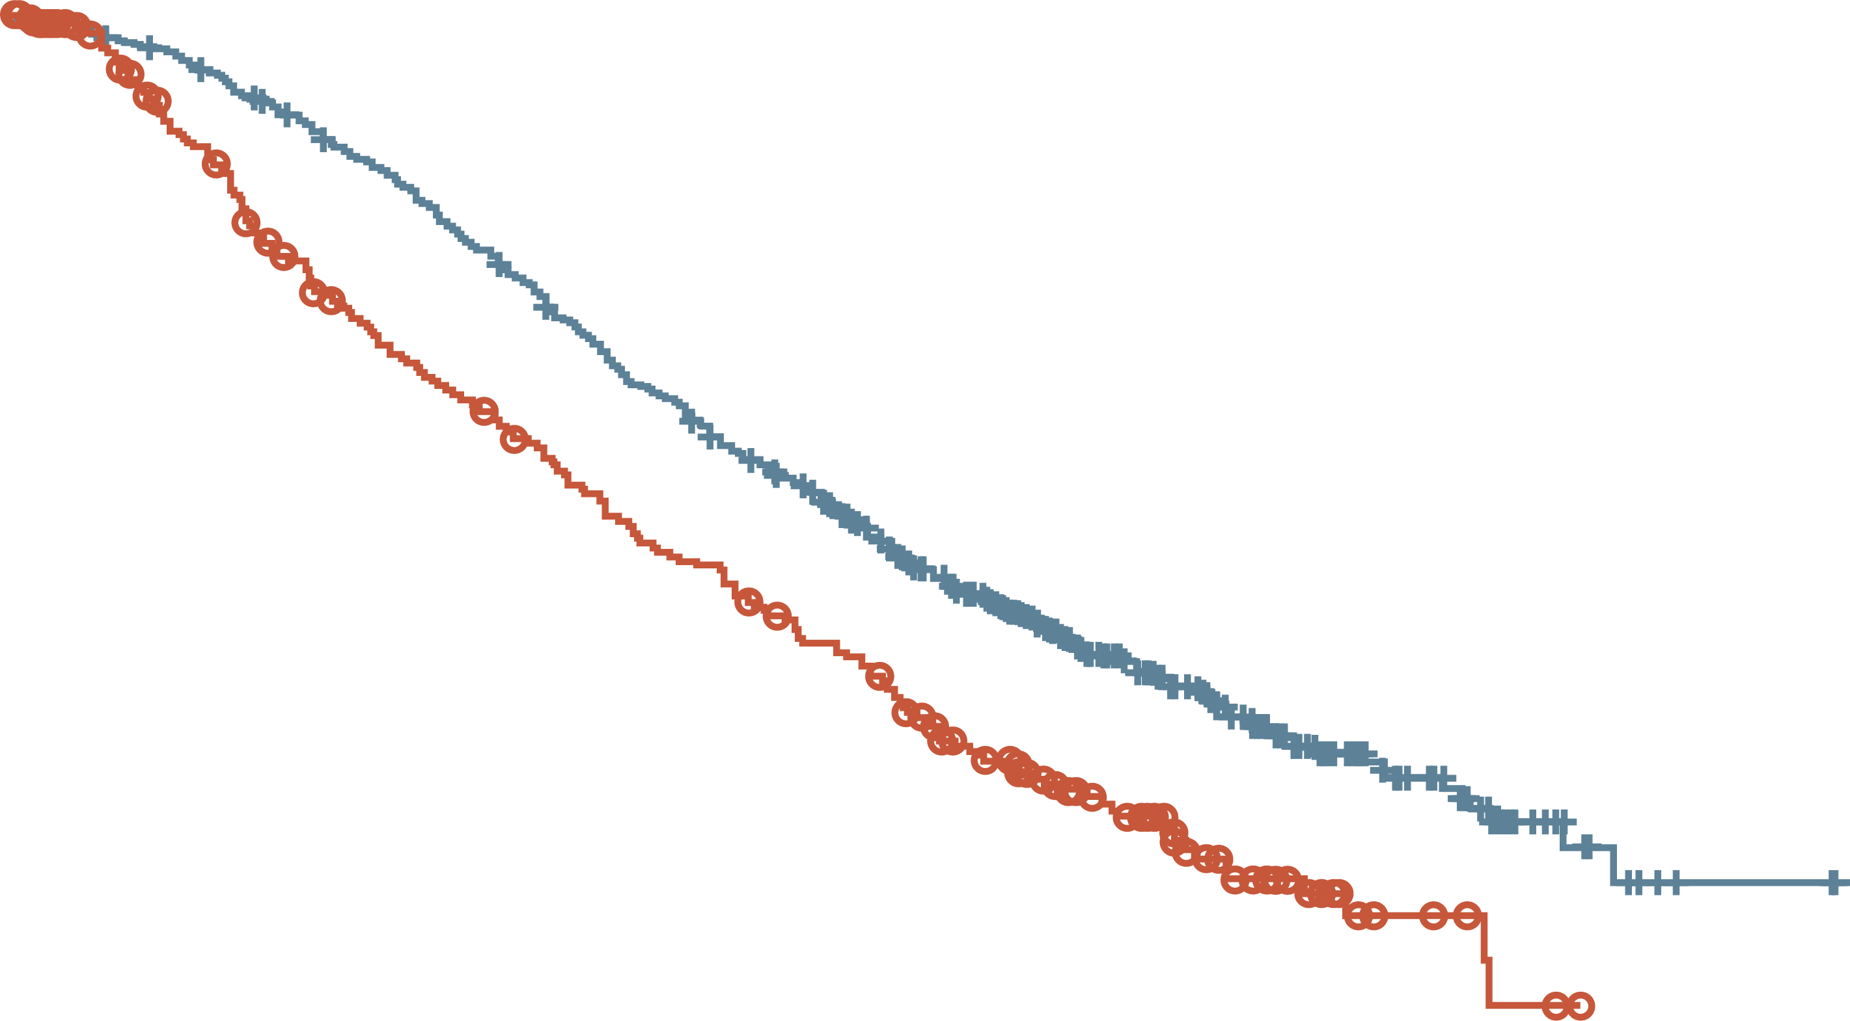
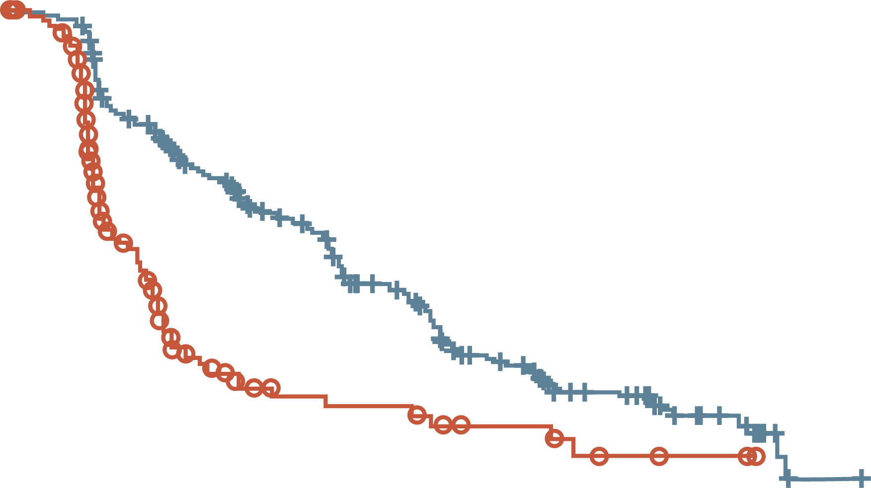
VISION study: ¹⁷⁷Lu-PSMA-617 prolongs OS in pts who have received ≥1 ARI, and 1 or 2 prior taxane-based ct regimens
ALTERNATE PRIMARY ENDPOINTS
OS all randomised patients (N=831)
Imaging-based progression-free survival (n=581)
100
100
90
HR 0.62 (95% CI: 0.52-0.74)
p<0.001 (one-sided)
Median 15.3 vs 11.3 months
90
HR 0.40 (99.2% CI: 0.29-0.57)
p<0.001
Median 8.7 vs 3.4 months
80
80
70
70
60
60
Event-free probability (%)
Patients without
disease progression (%)
50
50
40
40
30
30
20
20
10
¹⁷⁷Lu-PSMA-617 + SoC (n=551)
SoC alone (n=280)
10
¹⁷⁷Lu-PSMA-617 + SoC (n=385)
SoC alone (n=196)
0
0
0
2
4
6
8
10
12
14
16
18
20
22
24
26
28
30
32
0
2
4
6
8
10
12
14
16
18
20
22
No. of patients
still at risk
¹⁷⁷Lu-PSMA-617 + SoC
SoC alone
Time from randomisation (months)
No. of patients
still at risk
¹⁷⁷Lu-PSMA-617 + SoC
SoC alone
Time from randomisation (months)
551
280
535
238
506
203
470
173
425
155
377
133
332
117
289
98
236
73
166
51
112
33
63
16
36
6
15
2
5
0
2
0
0
0
385
196
362
119
272
36
215
19
182
14
137
13
88
7
71
7
49
3
21
2
6
0
1
0
¹⁷⁷Lu-PSMA-617, lutetium-177-prostate-specific membrane antigen-617; ARI, androgen receptor inhibitor; CI, confidence interval; CT, chemotherapy; ¹⁷⁷Lu-PSMA-617, lutetium-177-prostate specific membrane antigen-617; HR, hazard ratio; OS, overall survival; pt, patient; SoC, standard of care
Sartor O, et al. N Eng J Med. 2021;385:1091-103

Slide 22
VISION study: ¹⁷⁷Lu-PSMA-617 significantly improves all secondary endpoints
including time to first symptomatic skeletal event, ORR and DCR
Time to first symptomatic skeletal event
Patients with evaluable disease at baseline | ¹⁷⁷Lu-PSMA-617 + SoC (N=319) | SoC (N=120)
ORR, n (%) | 95 (29.8) | 2 (1.7)
 | OR 24.99 (95% CI: 6.05-103.24) p<0.001
DCR, n (%) | 284 (89.0) | 80 (66.7)
 | OR 5.79 (95% CI: 3.18-10.55) p<0.001
100
¹⁷⁷Lu-PSMA-617 + SoC
90
HR 0.50 (95% CI: 0.40-0.62)
p<0.001
Median 11.5 vs 6.8 months
80
70
60
Percent of patients
free from event
50
40
30
SoC alone
20
10
0
0
2
4
6
8
10
12
14
16
18
20
22
Time from randomisation (months)
No. at risk
¹⁷⁷Lu-PSMA-617 + SoC
SoC alone
385
196
363
141
329
104
290
75
240
61
189
48
153
36
117
29
73
15
34
6
12
2
2
0
¹⁷⁷Lu-PSMA-617, lutetium-177-prostate-specific membrane antigen-617; CI, confidence interval; DCR, disease control rate; HR, hazard ratio; mo, months; OR, odds ratio; ORR, overall response rate; SoC, standard of care
Sartor O, et al. N Engl J Med. 2021;385:1091-103 (Supplementary Appendix)

Slide 23
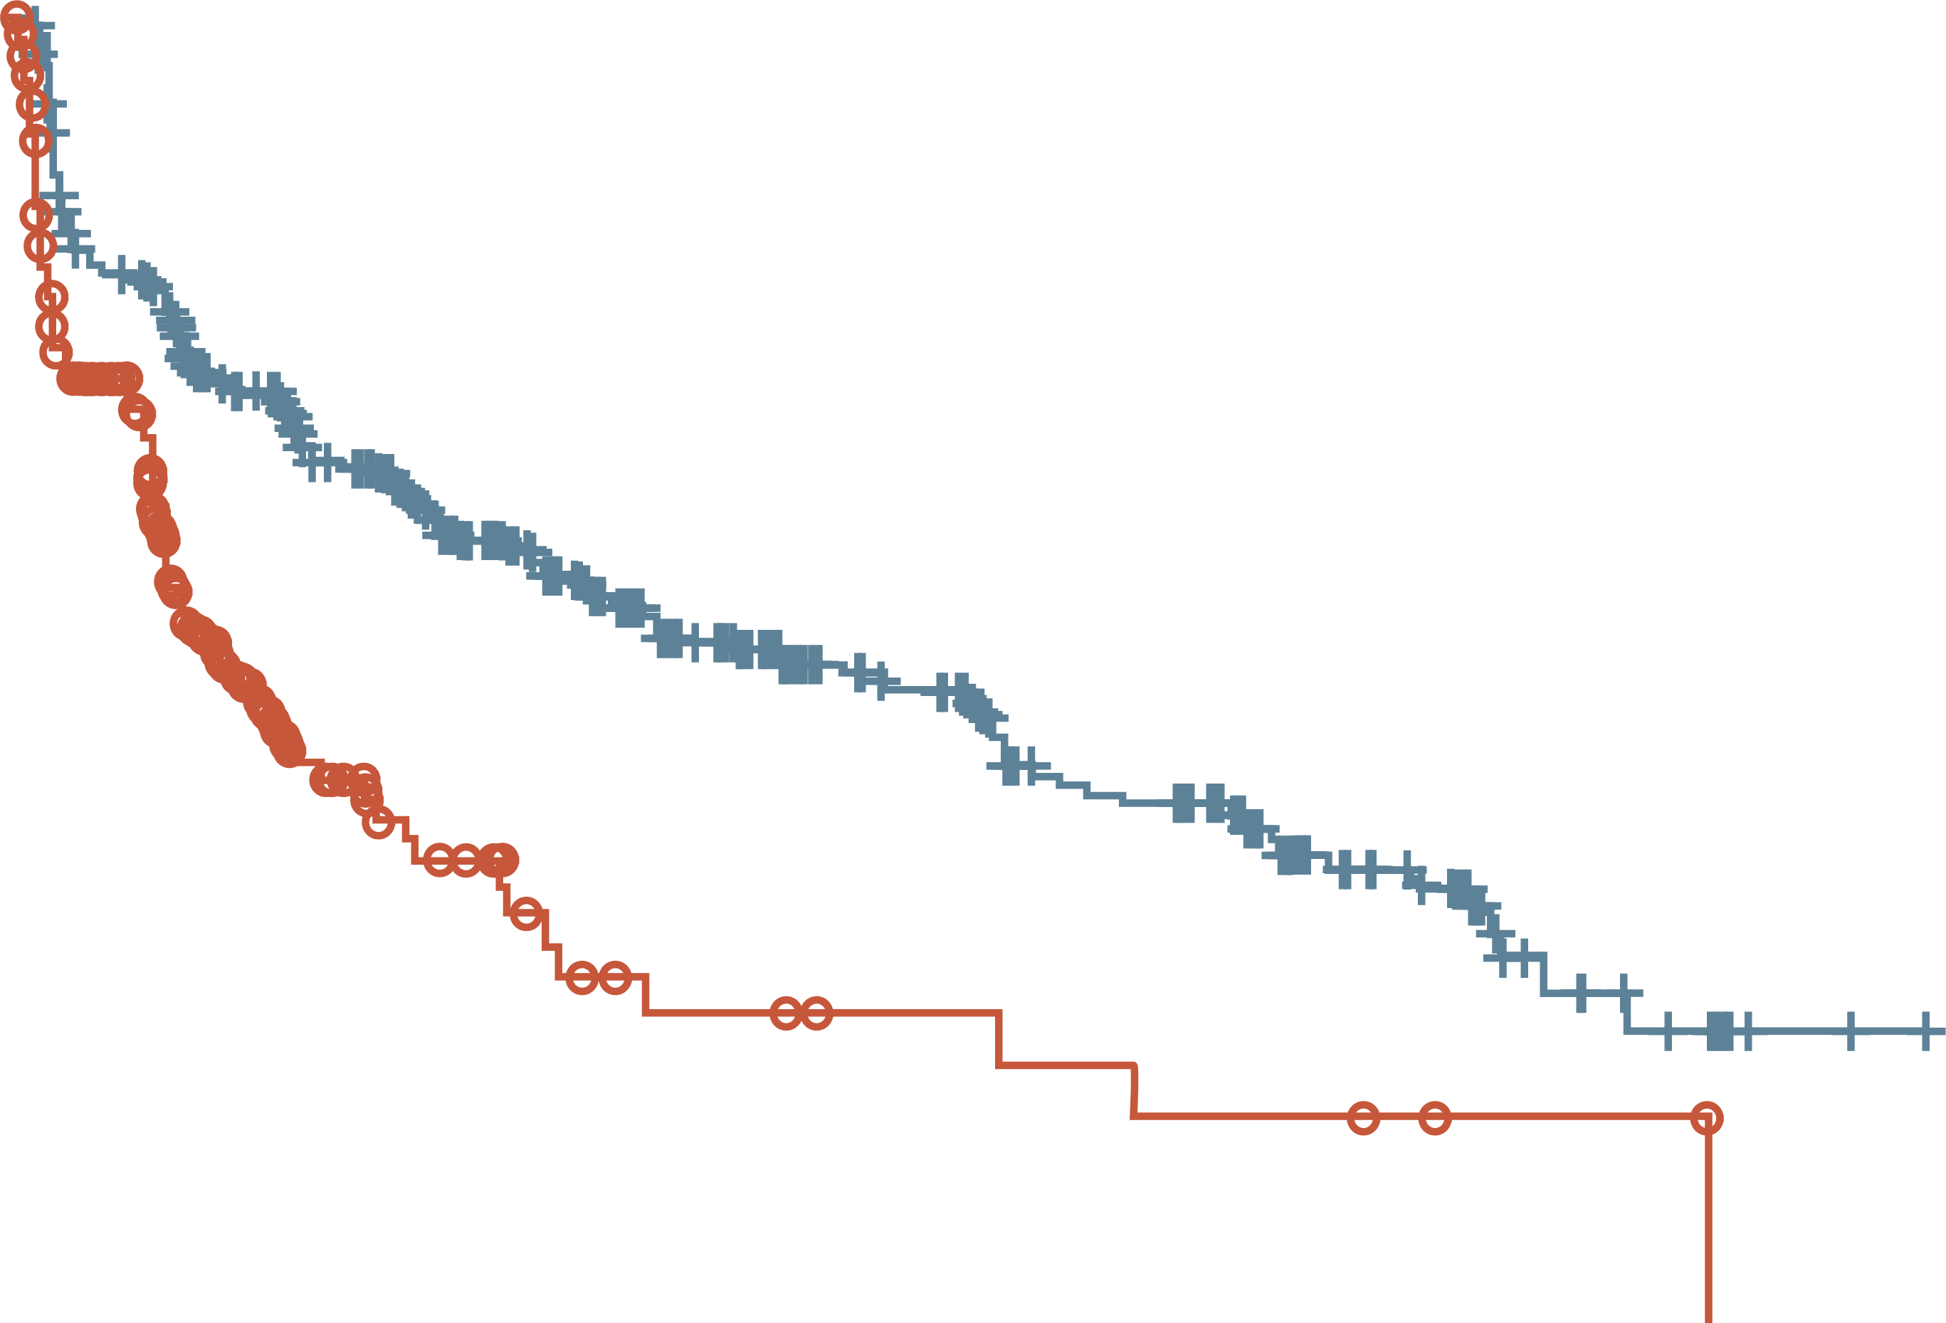
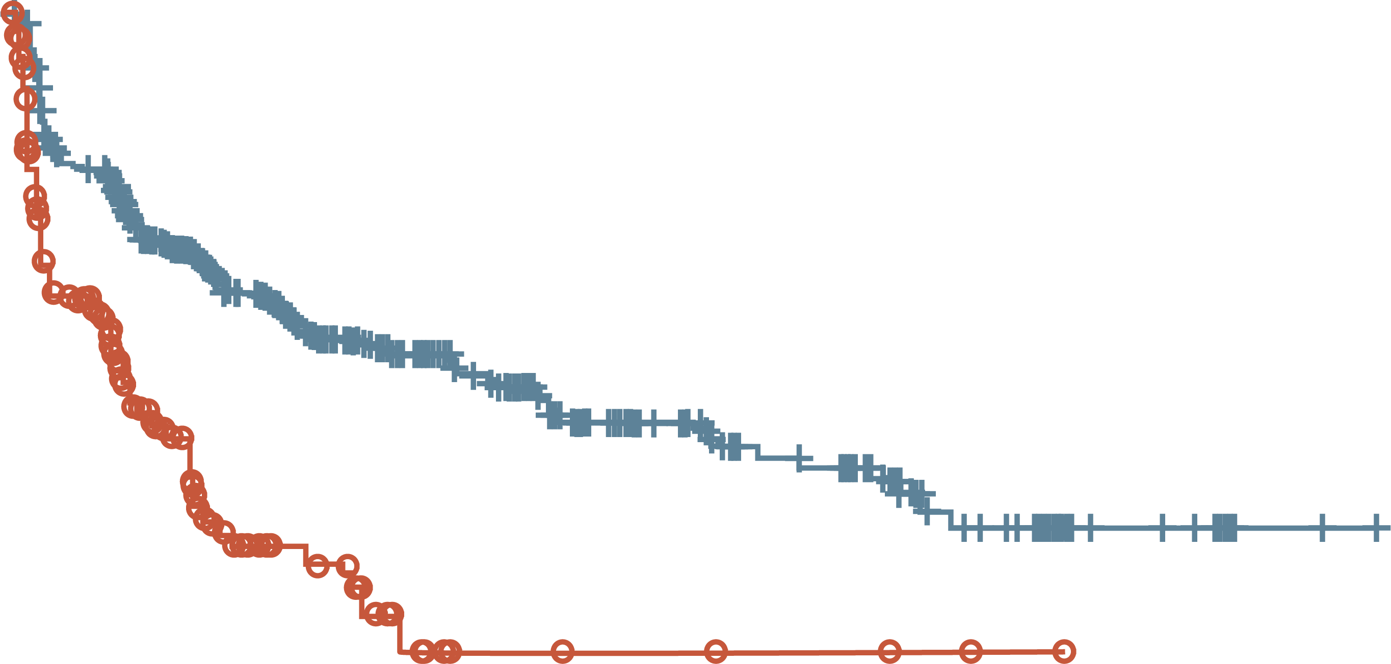
VISION study: ¹⁷⁷Lu-PSMA-617 beneficial effect on pain and QoL
Bpi-sf pain intensity
Time to worsening favoured the ¹⁷⁷Lu-PSMA-617 arm
FACT-P TOTAL SCORE
Time to worsening favoured the ¹⁷⁷Lu-PSMA-617 arm
rPFS analysis set (N=581)
rPFS analysis set (N=581)
100
HR 0.46 (95% CI: 0.35-0.61)
p<0.001 (two-sided; nominal;
non-inferential analysis)
Median 9.7 vs 2.4 months
100
HR 0.45 (95% CI: 0.33-0.60)
p<0.001 (two-sided; nominal;
non-inferential analysis)
Median 14.3 vs 2.9 months
90
90
80
80
70
70
60
60
Event-free probability (%)
Event-free probability (%)
50
50
40
40
30
30
20
20
10
¹⁷⁷Lu-PSMA-617 + SoC (n=385)
SoC alone (n=196)
10
¹⁷⁷Lu-PSMA-617 + SoC (n=385)
SoC alone (n=196)
0
0
0
1
2
3
4
5
6
7
8
9
10
11
12
13
14
15
16
17
18
19
20
21
22
23
0
1
2
3
4
5
6
7
8
9
10
11
12
13
14
15
16
17
18
19
20
21
22
23
No. of patients
still at risk
¹⁷⁷Lu-PSMA-617 + SoC
SoC alone
Time from randomisation (months)
No. of patients
still at risk
¹⁷⁷Lu-PSMA-617 + SoC
SoC alone
Time from randomisation (months)
385
196
289
97
255
66
235
42
201
30
167
21
146
14
126
10
110
8
89
8
76
6
72
6
54
5
51
5
46
4
33
4
27
3
21
2
10
2
7
2
4
0
2
0
1
0
0
0
385
196
296
94
265
65
238
37
197
25
162
19
146
12
129
7
113
5
87
5
70
4
66
4
51
3
48
3
42
3
24
2
21
1
15
1
8
0
6
0
2
0
2
0
1
0
0
0
Time to the first occurrence of ≥10-point decrease in FACT-P total from baseline
Time to the first occurrence of ≥30-point or ≥2-point increase in BPI-SF pain intensity from baseline
¹⁷⁷Lu-PSMA-617, lutetium-177-prostate-specific membrane antigen-617; BPI-SF, Brief Pain Inventory–Short Form; CI, confidence interval; FACT-P, Functional Assessment of Cancer Therapy– Prostate; HR, hazard ratio; QoL, quality of life; rPFS, radiographic progression-free survival; SoC, standard of care
Fizazi K, et al. Ann Oncol. 2021;32 suppl 5:S627-8 (ESMO 2021 oral presentation)

Slide 24
VISION study: side effects
TREATMENT-EMERGENT ADVERSE EVENTS
Patients, n (%) | ¹⁷⁷Lu-PSMA-617 + SoC (N=529) |  | SoC alone (N=205)
 | All grades | Grade 3 to 5 | All grades | Grade 3 to 5
Any drug-related TEAE | 451 (85.3) | 150 (28.4) | 59 (28.8) | 8 (3.9)
Serious | 49 (9.3) | 43 (8.1) | 5 (2.4) | 5 (2.4)
Grade 5ª | 5 (0.9) | 5 (0.9) | 0 (0.0) | 0 (0.0)
TEAEs grouped by topics of interest
Fatigue | 260 (49.1) | 37 (7.0) | 60 (29.3) | 5 (2.4)
Bone marrow suppression | 251 (47.4) | 124 (23.4) | 36 (17.6) | 14 (6.8)
Leukopenia | 66 (12.5) | 13 (2.5) | 4 (2.0) | 1 (0.5)
Lymphopenia | 75 (14.2) | 41 (7.8) | 8 (3.9) | 1 (0.5)
Anaemia | 168 (31.8) | 68 (12.9) | 27 (13.2) | 10 (4.9)
Thrombocytopenia | 91 (17.2) | 42 (7.9) | 9 (4.4) | 2 (1.0)
Dry mouth | 208 (39.3) | 0 (0.0) | 2 (1.0) | 0 (0.0)
Nausea and vomiting | 208 (39.3) | 8 (1.5) | 35 (17.1) | 1 (0.5)
Renal effects | 46 (8.7) | 18 (3.4) | 12 (5.9) | 6 (2.9)
Second primary malignancies | 11 (2.1) | 4 (0.8) | 2 (1.0) | 1 (0.5)
Intracranial haemorrhage | 7 (1.3) | 5 (0.9) | 3 (1.5) | 2 (1.0)
ª There were five drug-related treatment-emergent adverse events leading to death in the ¹⁷⁷Lu-PSMA-617 arm: pancytopenia, n=2; bone-marrow failure, n=1; subdural haematoma, n=1; intracranial haemorrhage, n=1
¹⁷⁷Lu-PSMA-617, lutetium-177-prostate-specific membrane antigen-617; SoC, standard of care; TEAE, treatment-emergent adverse event
Fizazi K, et al. Ann Oncol. 2021;32 suppl 5:S627-8 (ESMO 2021 oral presentation)

Slide 25
When to use ¹⁷⁷LU-PSMA-617
¹⁷⁷Lu-PSMA-617 FDA and EMA approved indications^{1,2}
¹⁷⁷Lu-PSMA-617 is approved by the FDA and EMA for the treatment of adult patients with progressive PSMA-positive mCRPC who have been previously treated with ARPI and taxane-based chemotherapy ^{1,2}
The pivotal VISION trial supports the use of ¹⁷⁷Lu-PSMA-617 in patients previously treated with an ARPI and docetaxel in a setting currently occupied with cabazitaxel³
The phase 2, TheraP trial performed a direct comparison between ¹⁷⁷Lu-PSMA-617 and cabazitaxel⁴:
  ¹⁷⁷Lu-PSMA-617 led to a higher PSA response (66 vs 37%, p<0.0001) and fewer grade 3 to 4 AEs
  (33 vs 53%)
  Based on these results, cabazitaxel - ¹⁷⁷Lu-PSMA-617 sequence could be reversed
However, the 3-year follow up of the TheraP study showed no difference in OS between the treatments (19.1 vs 19.6 months, difference -0.5, 95% CI -3.7 to + 2.7)⁵
¹⁷⁷Lu-PSMA-617, lutetium-177-prostate-specific membrane antigen-617; ADT, androgen deprivation therapy; AE, adverse event; ARPI, androgen receptor pathway inhibitor; CI, confidence interval; EMA, European Medicines Agency; FDA, Food and Drug Administration; mCRPC, metastatic castrate-resistant prostate cancer; OS overall survival; PSA, prostate-specific antigen; PSMA, prostate specific membrane antigen
1. Lu-PSMA US Prescribing Information; 2. Lu-PSMA SmPC; 3. Sartor O, et al. N Engl J Med. 2021;385:1091-103; 4. Hofman M, et al. Lancet. 2021;397:797-804; 5. Hofman M, et al. J Clin Oncol. 2022;40, no. 16_suppl:5000-5000

Slide 26
Sequencing radiopharmaceuticals

Slide 27
VISION study: rpfs by prior treatments (BICR)
~78% of patients had received ≥3 lines of prior therapy in the VISION trial
n/N (%) |  | ¹⁷⁷Lu-PSMA-617 + SoC (n=385) | SoC alone (n=196) | Favours ¹⁷⁷Lu-PSMA-617 | Favours SoC | HR (95% CI)
ARPIs | 1 ≥2 | 138/209 (66.0) 116/176 (65.9) | 42/97 (43.3) 51/99 (51.5) |  |  | 0.51 (0.35, 0.73) 0.32 (0.23, 0.45)
Taxane regimens | 1 ≥2 | 142/224 (63.4) 94/134 (70.1) | 49/110 (44.5) 40/77 (51.9) |  |  | 0.39 (0.27, 0.54) 0.44 (0.30, 0.66)
Non-taxane regimens | 0 ≥1 | 230/347 (66.3) 24/38 (63.2) | 88/183 (48.1) 5/13 (38.5) |  |  | 0.41 (0.32, 0.54) 0.20 (0.07, 0.56)
Immunotherapies | 0 ≥1 | 199/306 (65.0) 55/79 (69.6) | 65/146 (44.5) 28/50 (56.0) |  |  | 0.44 (0.33, 0.59) 0.33 (0.20, 0.53)
Bone health agents | Yes No | 45/66 (68.2) 209/319 (65.5) | 21/35 (60.0) 72/161 (44.7) |  |  | 0.35 (0.20, 0.62) 0.42 (0.31, 0.56)
²²³Ra | Yes No | 43/63 (68.3) 211/322 (65.5) | 19/36 (52.8) 74/160 (46.3) |  |  | 0.49 (0.28, 0.87) 0.38 (0.28, 0.50)
PARP inhibitors | Yes No | 18/24 (75.0) 236/361 (65.4) | 5/11 (45.5) 88/185 (47.6) |  |  | 0.31 (0.11, 0.89) 0.41 (0.31, 0.53)
All patients |  | 254/385 (66.0) | 93/196 (47.4) |  |  | 0.40 (0.31, 0.52)
0.05
0.2
0.8
3.2
rPFS benefits with ¹⁷⁷Lu-PSMA-617 were consistent across all prior treatment groups, including prior treatment with the radiopharmaceutical Ra-223
ARPI, androgen receptor pathway inhibitor; CI, confidence interval; HR, hazard ratio; PARP, poly (ADP-ribose) polymerase; PSMA, prostate-specific membrane antigen; Ra, radium; rPFS, radiographic progression-free survival; SoC, standard of care
Sartor O, et al. N Eng J Med. 2021;385:1091-103 (supplementary data appendix); Vaishampayan N, et al. ASCO 2022; abstract #5001 (oral presentation)

Slide 28
VISION study: Os by prior treatments (BICR)
OS benefits with ¹⁷⁷Lu-PSMA-617 were consistent across all prior treatment groups
n/N (%) |  | ¹⁷⁷Lu-PSMA-617 + SoC (n=551) | SoC alone (n=280) | Favours ¹⁷⁷Lu-PSMA-617 | Favours SoC | HR (95% CI)
ARPIs | 1 ≥2 | 182/296 (61.5) 161/255 (63.1) | 83/130 (63.8) 104/150 (69.3) |  |  | 0.74 (0.57, 0.97) 0.52 (0.41, 0.67)
Taxane regimens | 1 ≥2 | 206/342 (60.2) 113/170 (66.5) | 108/165 (65.5) 70/99 (70.7) |  |  | 0.59 (0.46, 0.75) 0.73 (0.53, 0.99)
Non-taxane regimens | 0 ≥1 | 299/485 (61.6) 44/66 (66.7) | 167/252 (66.3) 20/28 (71.4) |  |  | 0.61 (0.50, 0.74) 0.71 (0.42, 1.23)
Immunotherapies | 0 ≥1 | 255/414 (61.6) 88/137 (64.2) | 134/200 (67.0) 53/80 (66.3) |  |  | 0.58 (0.47, 0.73) 0.72 (0.51, 1.01)
Bone health agents | Yes No | 66/99 (66.7) 277/452 (61.3) | 43/57 (75.4) 144/223 (64.6) |  |  | 0.54 (0.36, 0.80) 0.64 (0.52, 0.79)
²²³Ra | Yes No | 59/97 (60.8) 284/454 (62.6) | 31/48 (64.6) 156/232 (67.2) |  |  | 0.73 (0.47, 1.13) 0.60 (0.49, 0.73)
PARP inhibitors | Yes No | 22/30 (73.3) 321/521 (61.6) | 11/16 (68.8) 176/264 (66.7) |  |  | 0.60 (0.28, 1.28) 0.62 (0.51, 0.75)
All patients |  | 343/551 (62.3) | 187/280 (66.8) |  |  | 0.62 (0.52, 0.74)
0.05
0.2
0.8
3.2
ARPI, androgen receptor pathway inhibitor; CI, confidence interval; HR, hazard ratio; OS, overall survival; PARP, poly (ADP-ribose) polymerase; PSMA, prostate-specific membrane antigen; Ra, radium; SoC, standard of care
Sartor O, et al. N Eng J Med. 2021;385:1091-103 (supplementary data appendix); Vaishampayan N, et al. ASCO 2022; abstract #5001 (oral presentation)

Slide 29
Ralu study: ¹⁷⁷Lu-PSMA-617 in patients previously treated with Ra-223
The RALU study was a retrospective, multicentre medical chart review evaluating the safety and clinical outcomes of sequential radium-223/¹⁷⁷Lu-PSMA therapy in mCRPC patients
RESULTS
Low rates of overall and hematologic AEs indicated an acceptable safety profile when using ¹⁷⁷Lu-PSMA-617 after Ra-223
Median OS was 12.6 and 31.4 mo from the first dose of ¹⁷⁷Lu-PSMA-617 and Ra-223, respectively, and 39% of patients had at least a 30% decline in PSA
Primary endpoint
Safety of ¹⁷⁷Lu-PSMA
mCRPC diagnosis
First ¹⁷⁷Lu-PSMA dose
Grade 3 to 4
laboratory abnormalities
≤90 d
Ra-223
≥1 dose
¹⁷⁷Lu-PSMA
≥1 dose
AEs/SAEs
≤30 d
60 d
Pre-baseline
period
Baseline
period
¹⁷⁷Lu-PSMA-617
treatment
Follow-up period
Key secondary endpoints
OS and change from baseline in
PSA and ALP levels
The use of novel mechanisms of action with life-prolonging benefits, such as Ra-223 and
¹⁷⁷Lu-PSMA-617, can be achieved in heavily pretreated mCRPC patients
The data support using ¹⁷⁷Lu-PSMA-617 in patients who previously received Ra-223
¹⁷⁷Lu-PSMA, lutetium-177-prostate-specific membrane antigen; AE, adverse event; ALP, alkaline phosphatase; d, days; mCRPC, metastatic castrate resistant prostate cancer; mo, months; OS, overall survival; PSA, prostate specific antigen; Ra-223, radium-223; SAE, serious adverse event
Rahbar K, et al. J Nucl Med. 2023; 64:574-8

Slide 30
Nurse management of patients

Slide 31
Risk Assessment: determine patients medical & personal Circumstances
Do they have any urinary or faecal incontinence?
Do they have a urinary catheter/urostomy or stoma bag?
Does the patient have a separate toilet at home they can use for one week post treatment?
Does the patient need any personal care?
Does the patient care for anyone?
Is the patient sexually active (should not father a child for 6 months post-treatment and use of a condom recommended)?
Does the patient share their accommodation with any pregnant/breastfeeding women or children
Is the patient solely or chiefly responsible for care of any children
  They need to avoid prolonged close contact e.g. sitting on the sofa watching television, contact with babies and small children under 16 for the first 3 days
  No isolation from family or friends is required
Consider patient’s occupation/activities/family commitments and social life
  Does the patient work, or do they carry out any tasks outside of the house?
  Any important upcoming family/social events (e.g. wedding)?
Local Questionnaire and guidelines University College London Hospital, Janet Forgenie personal communication

Slide 32
Best practice: Managing bodily fluids during treatment
Bodily fluids are slightly radioactive for the first 7 days therefore precautions are required
  Sit to void & double flush with the lid down after each use
  Does the patient have a separate toilet at home they can use for one week post treatment?
  If a shared toilet, wipe the toilet seat after use
  Wipe carefully after bowel movement/some patients use gloves
  When handling bodily fluids, simply wearing gloves and hand washing will protect caregivers
  Soiled clothing should be washed promptly and separately from other clothing
Local Guidelines University College London Hospital, Janet Forgenie personal communication

Slide 33
Radium-223: safety/radiation considerations
Patients should stay well hydrated, and their oral intake, fluid status, and urine output should be monitored while on treatment
  Patients should promptly report signs of dehydration, hypovolemia, urinary retention, or renal failure / insufficiency
There are no restrictions regarding personal contact (visual or physical proximity) with other people after receiving Ra-223
Male patients should use condoms and their female partners of reproductive potential should use effective contraception during and for 6 months following completion of treatment
Perform complete blood counts prior to treatment initiation and before every dose of Ra-223:
  Discontinue treatment if haematologic values do not recover within 6 to 8 weeks after treatment. Monitor patients with compromised bone marrow reserve closely. Discontinue treatment in patients who experience life-threatening complications despite supportive care measures
ANC, absolute neutrophil counts; Ra-223, radium-223
Radium-223 SmPC and US Prescribing Information

Slide 34
¹⁷⁷Lutetium-PSMA-617: safety/radiation considerations
Ensure patients increase oral fluid intake and advise patients to void as often as possible to reduce bladder radiation
Advise patients to limit close contact (less than 3 feet) with household contacts for 2 days or with children and pregnant women for 7 days
Following administration of ¹⁷⁷Lutetium-PSMA-617:
  advise patients to refrain from sexual activity for 7 days
  advise patients to sleep in a separate bedroom from household contacts for 3 days, from children for 7 days, or from pregnant women for 15 days
  Advise male patients with female partners of reproductive potential to use effective contraception during treatment and for 14 weeks after the last dose
Perform complete blood counts before and during treatment with ¹⁷⁷Lutetium-PSMA-617
  withhold, reduce dose, or permanently discontinue treatment and clinically treat patients based on the severity of myelosuppression
Perform kidney function laboratory tests
  withhold, reduce dose, or permanently discontinue treatment based on severity
¹⁷⁷Lu-PSMA-617, lutetium-177-prostate-specific membrane antigen-617
¹⁷⁷Lu-PSMA-617 SmPC and US Prescribing Information

Slide 35
Managing bone health

Slide 36
Musculoskeletal events
Bone is the most common site of prostate cancer metastases and is associated with significant morbidity¹
Bone decay with ADT is associated with an increase in fracture risk²
When treated with ADT, over 58% of men with risk factors for skeletal complications develop at least one fracture within 12 years³
  Men who sustained a fracture within 48 months experienced an almost 40% higher risk of mortality than those who did not
ADT, androgen-deprivation therapy
1. Coleman RE. Clin Cancer Res. 2006;12:6243-9s; 2. Cheung AS, et al. Endocr Relat Cancer. 2014;21:R371-94; 3. Shao YH, et al. BJU Int. 2013;111:745-52

Slide 37
The effects of prostate cancer treatment on bone
Bone mass loss is associated with ADT
We see skeletal related events in patient with bone mets
Pathological fractures resulting in pain/risk of MSCC and reduce QoL
Giving active therapy to treat bone mets can prolong survival
Bone loss is most pronounced during initial ADT exposure but persists throughout treatment, increasing the longer patients are exposed
Ultimately prevention is better than cure – hormone therapy is associated with a 34% increase in fracture risk among men with non-metastatic PC and a 51% increase in fracture risk among men with metastatic PC
Concomitant use of bone health agent is recommended to minimise fracture risk
ADT, androgen deprivation therapy; mets, metastases; MSCC, metastatic spinal cord compression; PC, prostate cancer; QoL, quality of life ​
1. Suzman D, et al. Cancer Metastasis Rev. 2014;33:619-28; 2. El Badri S, et al. Curr Osteoporos Rep. 2019;17:527-37; ​
3. Hussain A, et al. Crit Rev Oncol Hematol 2019; 139: 108-16​; 4. Beebe-Dimmer JL, et al. Pharmacoepidemiol Drug Saf. 2012;21(1):70-8.

Slide 38
PROPORTION experiencing fractures 1-5 years after prostate cancer diagnosis
ADT RESULTED IN 21% - 54% INCREASE IN RELATIVE RISK OF FRACTURE
+6.7; p<0.001
Frequency (%)
+2.8; p<0.001
ADT, androgen deprivation therapy
Shahinian VB, et al. N Engl J Med. 2005;352:154-64

Slide 39
BONE METASTASES AND SREs
Approx. 90% of patients with mCRPC develop bone metastases^{1,2}
Approx. 50% of PC patients with bone metastases will have SREs³
NUMBER OF FIRST CASES OF SRE⁴
Cases (% of total cohort)
Mean (SD) follow-up was 10.6 (11.6) months
mCRPC, metastatic castrate resistant prostate cancer; PC, prostate cancer; SREs, skeletal related events
1. Bubendorf L, et al. Hum Pathol. 2000;31:578-83; 2. Tannock IF, et al. N Engl J Med. 2004;352:1502-12; 3. Yong C, et al. Curr Opin Oncol. 2014;26:274-83;
4. Kawai A, et al. Prostate Cancer. 2019;2019:5971615

Slide 40
Thinking ahead
DEXA studies show that bone mineral density falls by 2% to 6% per year at the lumbar spine and by 2% to 4% at the total hip during the first 1-2 years of ADT​¹⁻⁴
  This is a significantly faster rate of bone loss than in healthy controls or prostate cancer patients who are not receiving ADT¹⁻⁴
Bone loss is most pronounced during initial ADT exposure, it persists throughout treatment. In one study of 390 men receiving long-term ADT for prostate cancer, the prevalence of osteoporosis was 35% at baseline, 43% after 2 years, 49% after 4 years, 66% after 8 years, and 81% after 10 or more years of ADT⁵
Studies also have estimated the extent to which ADT increases fracture risk. In an analysis of SEER-Medicare linked records from more than 80,000 prostate cancer patients, gonadotropin-releasing hormone (GnRH) agonist therapy was associated with a 34% increase in risk of fracture among men with non‑metastatic prostate cancer, and a 51% increase in risk of fracture among men with metastatic prostate cancer⁶ ​
ADT, androgen deprivation therapy; DEXA, dual-energy X-ray absorptiometry; SEER, Surveillance, Epidemiology, and End Results
1. Choo et al. International Journal of Radiation Oncology. 2013; 85(5):1239-4; 2. Alibhai SM, et al. Osteoporos Int. 2013;24(10):2571-2579.; 3. Brown SA, et al. Crit Rev Eukaryot Gene Expr. 2009;19:47–60; 4. Greenspan SL, et al. J Clin Endocrinol Metab. 2005;90:6410–6417; 5. Morote J, et al. Urology. 2007;69(3):500-504; 6. Beebe-Dimmer JL, et al. Pharmacoepidemiol Drug Saf. 2012;21(1):70-8.

Slide 41
summary
The landscape for mCRPC patients has evolved rapidly over the past few years providing clinicians with a greater choice of treatments, including radiopharmaceuticals
  Radiopharmaceuticals such as Ra-223 and 177Lu-PSMA-617 offer a survival benefit to mCRPC patients as well as managing bone pain and QOL¹⁻⁴
~90% of men with advanced PC will develop bone metastasis which often lead to skeletal-related events⁵⁻⁷
  Bone health agents are therefore recommended for patients with advanced prostate cancer
Combining bisphosphonates or denosumab with newer therapies may improve outcomes. Post hoc data suggest that additive effects for such combinations are possible but further evaluation required⁸
Real-world data supports using ¹⁷⁷Lu-PSMA in patients who previously received Ra-223⁹
Nurses and patients should be aware of post-treatment precautions, but radiopharmaceuticals are an effective and manageable treatment option for mCRPC patients
¹⁷⁷Lu-PSMA-617, lutetium-177-prostate-specific membrane antigen-617; mCRPC, metastatic castrate-resistant prostate cancer; mets, metastases; (m)PC, (metastatic) prostate cancer; QoL, quality of life
1. Parker C, et al. N Engl J Med. 2013;369:213-23; 2. Nilsson S, et al. Ann Oncol. 2016;27:868-74; 3. Sartor O, et al. N Engl J Med. 2021;385:1091-103; 4. Fizazi K, et al. Ann Oncol. 2021;32 suppl 5:S627-8; 5. Bubendorf L, et al. Hum Pathol. 2000;31:578-83; 6. Tannock IF, et al. N Engl J Med. 2004;352:1502-12; 7. Suzman D, et al. Cancer Metastasis Rev. 2014;33:619-283. 8. Saad F, et al. Cancer Treat Rev 2018; 68:25-37; 9. Rahbar K, et al. J Nucl Med 2023; 64:574–578

