Slide 2
Recognising, diagnosing and managing neuroendocrine tumours micro learning
Dr Jaume Capdevila
Vall d’Hebron University Hospital and Vall d’Hebron Institute of Oncology, Spain
Asst Prof. Mauro Cives
University of Bari “Aldo Moro”, Italy
AUGUST 2023

Slide 3

Developed by NET COnnect
This programme is developed by NET CONNECT,
an international group of experts in the field of
neuroendocrine tumours.
Acknowledgement and disclosures
This NET CONNECT programme is supported through an independent educational grant from Ipsen. The programme is therefore independent, the content is not influenced by the supporter and is under the sole responsibility of the experts.
Please note: The views expressed within this programme are the personal opinions of the experts. They do not necessarily represent the views of the experts’ institutions, or the rest of the NET CONNECT group.
Expert Disclaimers:
Dr Jaume Capdevila has received financial support/sponsorship for research support, consultation, or speaker fees from the following companies: AAA, Bayer, Eisai, Ipsen, Merck, Novartis, Pfizer and Sanofi
Asst. Prof. Mauro Cives has received financial support/sponsorship for research support, consultation, or speaker fees from the following companies: AAA, Ipsen and Novartis

Slide 4

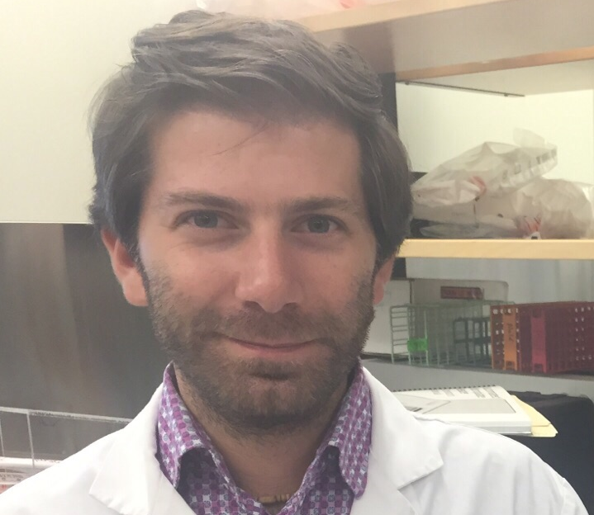
This programme has been developed by two international experts
Dr Jaume Capdevila
Medical Oncologist
Vall d’Hebron University Hospital and Vall d’Hebron Institute of Oncology, Spain
Asst Prof. Mauro Cives
Medical Oncologist
University of Bari “Aldo Moro”, Italy

Slide 5
Educational objectives
Be able to recognise the presenting symptoms of potential NET patients
Be aware of the steps to diagnosis and the importance of referral to a NET centre of excellence/expertise
NET, neuroendocrine tumour

Slide 6
Clinical takeaways
Recognising the symptoms of a potential NET can be challenging as presentation may be heterogenous, dependent on hormone secretion and many patients have symptoms similar to those found in other conditions
Steps to diagnosis include symptom assessment, size, grade and stage of the tumour, whether the tumour is hormone-secreting and evaluation of predisposition to an underlying hereditary syndrome
Referral to a NET centre of excellence is advised, to ensure comprehensive care by a multidisciplinary team, which provides access to advanced imaging techniques and innovative treatments for the earliest possible treatment of localised and advanced tumours
NET, neuroendocrine tumour

Slide 7
Introduction
Gastrointestinal neuroendocrine tumours covered in this module include pancreatic, gastric, rectal and appendiceal NETs. GI NETs have diverse presentations and can be mistaken for other common conditions, leading to delays in diagnosis
Comprehensive evaluation of patients with possible NETs includes assessing symptoms, tumour characteristics, hormone secretion, and hereditary predisposition. This requires specialist investigations such as nuclear medicine scans
Patient management and prognosis should be discussed by a fully constituted NET multidisciplinary team in a NET centre of excellence
Localised tumours are typically considered for endoscopic or surgical resection. Early referral to a NET specialist centre can improve patient outcomes and quality of life
Pancreatic
Gastric
Appendiceal
Rectal
GI, gastrointestinal; NET, neuroendocrine tumour
Cives M, et al. CA Cancer J Clin. 2018;68:471-87

Slide 8
Pancreatic NEUROENDOCRINE TUMOuRs (PanNETs)

Slide 9
PANCREATIC NEUROENDOCRINE TUMOURS – OVERVIEW
PanNETs are mostly sporadic but a variable portion are a result of inherited syndromes
MEN1 is the most inherited condition followed by more uncommon conditions such as von Hippel-Lindau (VHL), von Recklinghausen's syndrome (neurofibromatosis 1), and tuberous sclerosis
Categorised as:
Functional panNETs (hormone secreting)
Non-functional panNETs (non-hormone secreting) include up to 90%
Non-functional panNETs are asymptomatic and frequently diagnosed incidentally, leading to a delayed and challenging diagnosis
panNET, pancreatic neuroendocrine tumour
Cives M, et al. CA Cancer J Clin. 2018;68:471-87; Jansen et al. J Cancer. 2008; 113 suppl 57: 1807-1843

Slide 10
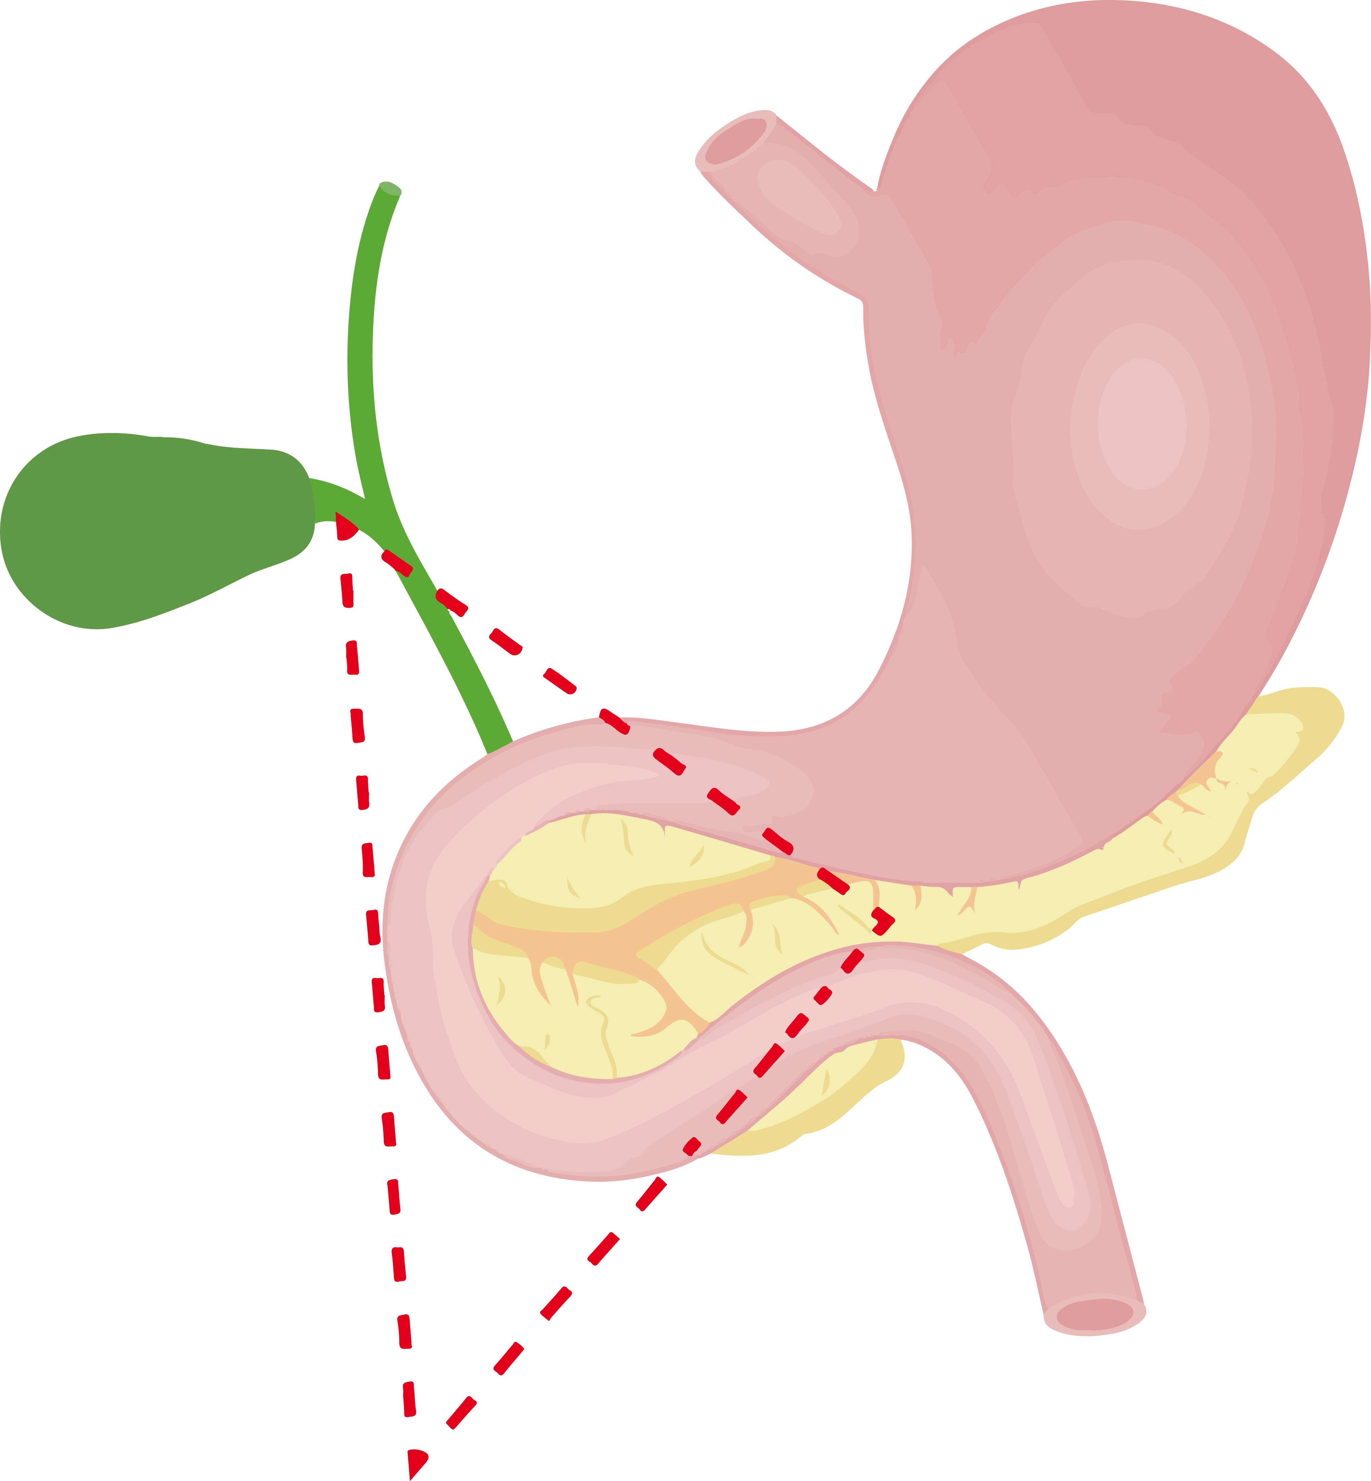
FUNCTIONAL PanNETs – Presenting symptoms
Functional panNET type | Presenting symptoms
Gastrinomas (ZES) | Symptoms due to gastric acid hypersecretion If an underlying ZES, frequent multiple gastric ulcers Abdominal pain due to ulcers, diarrhoea and heart burn Typically located in the gastrinoma triangle
Insulinomas | Weight gain in 20-40% of patients Characterised by symptoms of the Whipple triad including: Episodic hypoglycaemia Neuroglycopenic symptoms (confusion, visual disturbances, headaches and coma) Restoration of the symptoms after glucose intake
Rare functional panNETs | Glucagonoma, VIPoma, somatostatinoma
Gastrinoma triangle
panNET, pancreatic neuroendocrine tumour; VIP, vasoactive intestinal peptide; ZES, Zollinger-Ellison syndrome
Jensen R, et al. Neuroendocrinology. 2012;95:98-119; Cives M, et al. CA Cancer J Clin. 2018;68:471-87; Dizon AM, et al. AM J Med. 1999;106 (3):307-310

Slide 11

NON-FUNCTIONAL PanNETs – Presenting symptoms
Location | Presenting symptoms
Head of pancreas | Jaundice, pain
Body/Tail | Diabetes, exocrine pancreatic insufficiency, pain
Neck
Tail
Head
Body
The pancreas is divided into four general regions, the head, neck, body and tail
panNET, pancreatic neuroendocrine tumour
Jensen R, et al. Neuroendocrinology. 2012;95:98-119; Falconi M, et al. Neuroendocrinology. 2012;95:120-34

Slide 12
PanNETs – STEPS TO DIAGNOSIS
Pathological diagnosis
  Preferably via EUS-FNAB done by skilled endoscopist
Laboratory test in non-functional NET
  Plasma chromogranin A (CgA) testing can be useful in diagnosing panNETs, but it is not definitive and should be used in combination with other diagnostic methods
  Peptide hormones (insulin, gastrin, glucagon, etc) can be used as tumour markers in functioning panNETs
Cross-sectional and functional imaging
Cross-sectional imaging is mandatory before functional imaging
  70% of tumours express high levels of somatostatin receptors mainly SSTR2 and SSTR5 and can be imaged with a radio-labelled somatostatin analogue
  Ga⁶⁸-PET/CT provides imaging of whole body and functional information about somatostatin expression
Genetic testing and counselling
  Should be performed in case of suspected familial predisposition and suggestive clinical scenarios (i.e., co-occurrence of parathyroid adenoma, pituitary adenoma and panNET is highly suspicious for MEN1 syndrome)
  Upon confirmation of histopathological diagnosis: advisable to refer patient to NET centre of excellence
  Patient survival is usually long and treatment centres closer to home are deemed more favourable
CT, computed tomography; EUS-FNAB, endoscopic ultrasound fine needle aspiration biopsy; Ga⁶⁸, gallium-68; GI, gastrointestinal; NET, neuroendocrine tumour; panNET, pancreatic NET; PET, positron emission tomography; SSTR2, somatostatin receptor 2; SSTR2. somatostatin receptor 5
Jensen R, et al. Neuroendocrinology. 2012;95:98-119; Falconi M, et al. Neuroendocrinology. 2012;95:120-34

Slide 13
PanNETs – Management based on tumour functionality And size
Functionality | Tumour management
Functional | Surgery is the main treatment for localised disease SSAs might be administered to palliate hormonal symptoms before surgery PPIs are the treatment of choice for the palliation of Zollinger-Ellison syndrome
Non-functional | Treatment should be tailored according to tumour size for G1 Surgery is the mainstay for G2 and G3
Size | Tumour management
<1 cm | Watch and Wait (W&W) is recommended for G1 panNETs
1–2 cm | W&W or surgical resection should be discussed with the patient Results of the ASPEN study will highlight if any difference exists between the two management modalities
>2 cm | Surgical resection + regional lymph node dissection should be performed
G, grade; panNET, pancreatic neuroendocrine tumour; SSA, somatostatin analogue
Jensen R, et al. Neuroendocrinology. 2012;95:98-119; Cives M, et al. CA Cancer J Clin. 2018;68:471-87

Slide 14
GASTRIC NEUROENDOCRINE TUMOuRS (GNETs)

Slide 15
GASTRIC NEUROENDOCRINE TUMOURS – OVERVIEW
GNETs represent about 8.7% of all NETs
Categorised as types 1, 2 and 3
Tumour markers include CgA but elevation of this marker alone does not necessarily indicate presence of GNET, particularly in the context of atrophic gastritis
CgA, chromogranin A; GNET, gastric NET; NET, neuroendocrine tumour
Li TT. World J Gastroenterol. 2014;20(1):118-125; Cives M, et al. CA Cancer J Clin. 2018;68:471-87

Slide 16
GNETs – Presenting symptoms
GNET type | Presenting symptoms & frequency
1 | Occurs in patients with chronic gastritis and accounts for 80% of GNETs Benign behaviour
2 | Occurs in patients with underlying gastrinoma primarily in patients with MEN1 Symptoms of Zollinger-Ellison syndrome including diarrhoea, heartburn and peptic ulceration
3 | Sporadic (less than 15% of all GNETs) Higher malignancy potential
GNET, gastric neuroendocrine tumour; MEN1, multiple endocrine neoplasia type 1
Li TT. World J Gastroenterol. 2014;20:118-25; Cives M, et al. CA Cancer J Clin. 2018;68:471-87

Slide 17
GNETs – STEPS to Diagnosis
GNET type 1
Elevated serum gastrin level Gastric pH >4 CgA elevation Evidence of chronic atrophic gastritis on biopsy
GNET type 2
Elevated serum gastrin level Low gastric pH In case of underlying gastrinoma, painful abdominal point in the choledocho-pancreatic area of ​​Chauffard-Rivet
GNET type 3
Not associated with gastrin overproduction Ki-67 index of >20%
CgA, chromogranin A; GNET, gastric neuroendocrine tumour
Basuroy R, et al. Aliment Pharmacol Ther. 2014; 39:1071-84; Cives M, et al. CA Cancer J Clin. 2018;68:471-87

Slide 18
GNETs – MANAGEMENT
GNET type | Management
1 | Endoscopic surveillance every 6-12 months is appropriate in the vast majority of cases In selected cases, netazepide, an oral antagonist of gastrin/cholecystokinin receptors can be useful There is no indication for gastrectomy Patient should be referred to the nearest NET centre of excellence for consultation and surveillance
2 | Treatment for underlying gastrinoma in NET centre of excellence
3 | Surgical resection Patient should be referred to NET centre of excellence
GNET, gastric NET; NET, neuroendocrine tumour
Basuroy R, et al. Aliment Pharmacol Ther. 2014; 39:1071-84; Cives M, et al. CA Cancer J Clin. 2018;68:471-87

Slide 19
RECTAL NEUROENDOCRINE TUMOuRS (RNETs)

Slide 20
RECTAL NEUROENDOCRINE TUMOURS – OVERVIEW and presenting symptoms
Prevalence/incidence
  RNETs: 12% to 27% of all NETs
  Higher incidence and prevalence in both African American and Asian populations vs Caucasians
Symptoms
  Often asymptomatic
  50% present with:
    Rectal tenesmus
    Changes in bowel habits
Classification
  Low grade (G1)
  Intermediate grade (G2)
  High grade (G3)
NET, neuroendocrine tumour; RNET, rectal NET
Volante M, et al. Pathologica. 2021.DOI: 10.32074/1591-951X-230; Caplin M, et al. Neuroendocrinology. 2012;95:88-97; Cives M, et al. CA Cancer J Clin. 2018;68:471-87

Slide 21
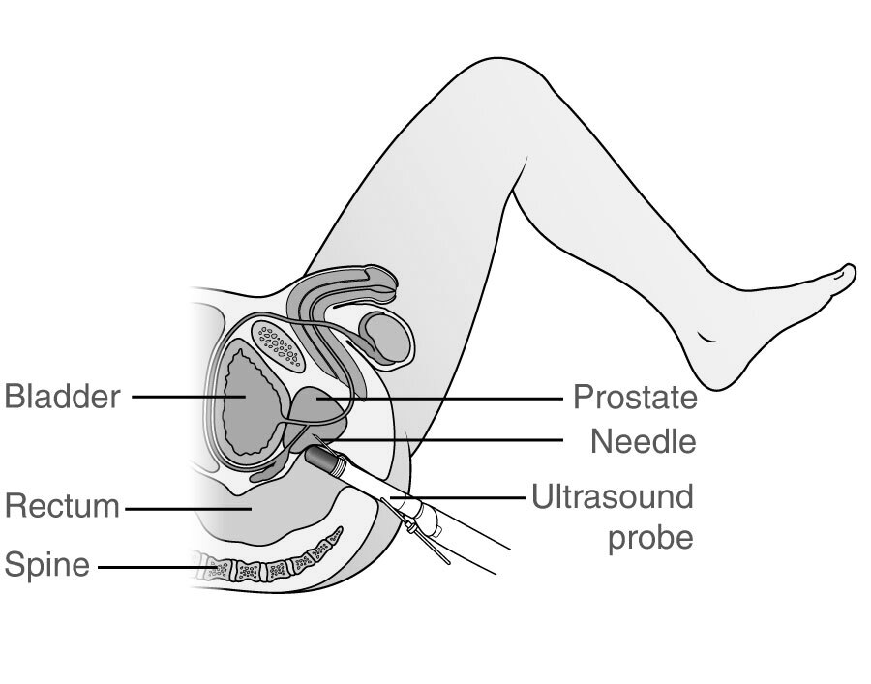
Rnets – STEPS to DIAGNOSIS
Endoscopy
Most rectal tumours are discovered endoscopically and receive a confirmed diagnosis after histological assessment
Full colonoscopy is used to rule out other colonic diseases
Gold standard of diagnosing RNETs
Imaging
Endoanal/rectal ultrasound (EUS) highly useful for pre-operative assessment. EUS can assess tumour size, depth of invasion and presence of pararectal lymph node metastases
Bladder
Prostate
Needle
Rectum
Ultrasound
probe
Spine
RNET, rectal neuroendocrine tumour
Caplin M, et al. Neuroendocrinology. 2012;95:88-97

Slide 22
RNETs – management
Tumour size | Tumour management
<1 cm | Endoscopic removal
1–2 cm | Mostly removed endoscopically if there is a low mitotic index and no invasion of muscularis propria
>2 cm | Surgical resection
It is important to note that localised rectal NETs should not be treated as typical rectal cancers by treating patients with chemoradiotherapy
Endoscopic removal methods
Endoscopic submucosal dissection (ESD) – high complete and en-bloc resection rates, but also an increased risk of complications including perforation
Endoscopic mucosal resection (EMR) – first line for resection of small rectal NETs due to safety and effectiveness. EMR-L is a variation that includes a ligation band and is commonly used
Due to highly specialised nature of procedure, referral of patients to NET centres of excellence is advisable
EMR-L, EMR with a ligation device; NET, neuroendocrine tumour; RNET, rectal NET
Chablaney S, et al. Clin Endosc. 2017;50:530-36; Maione F, et al. Diagnostics. 2021;11:771; Caplin M, et al. Neuroendocrinology. 2012;95:88-97

Slide 23
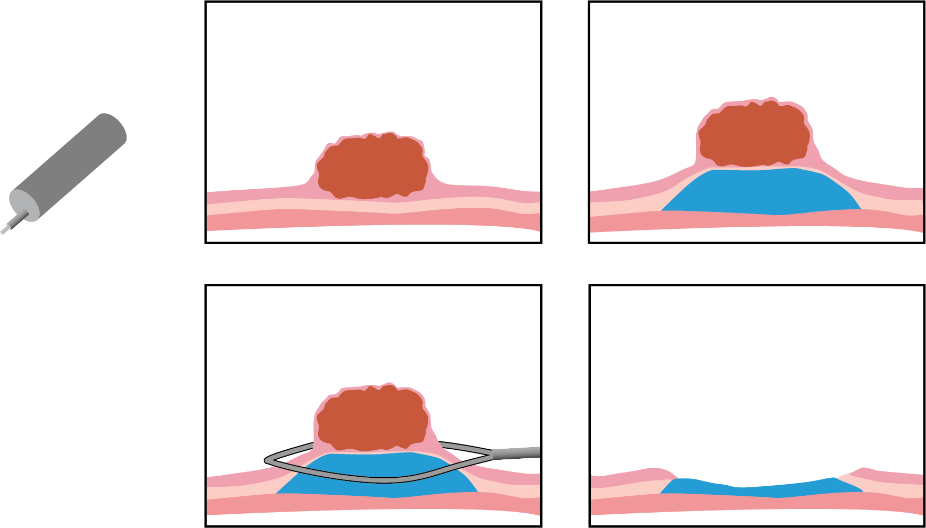
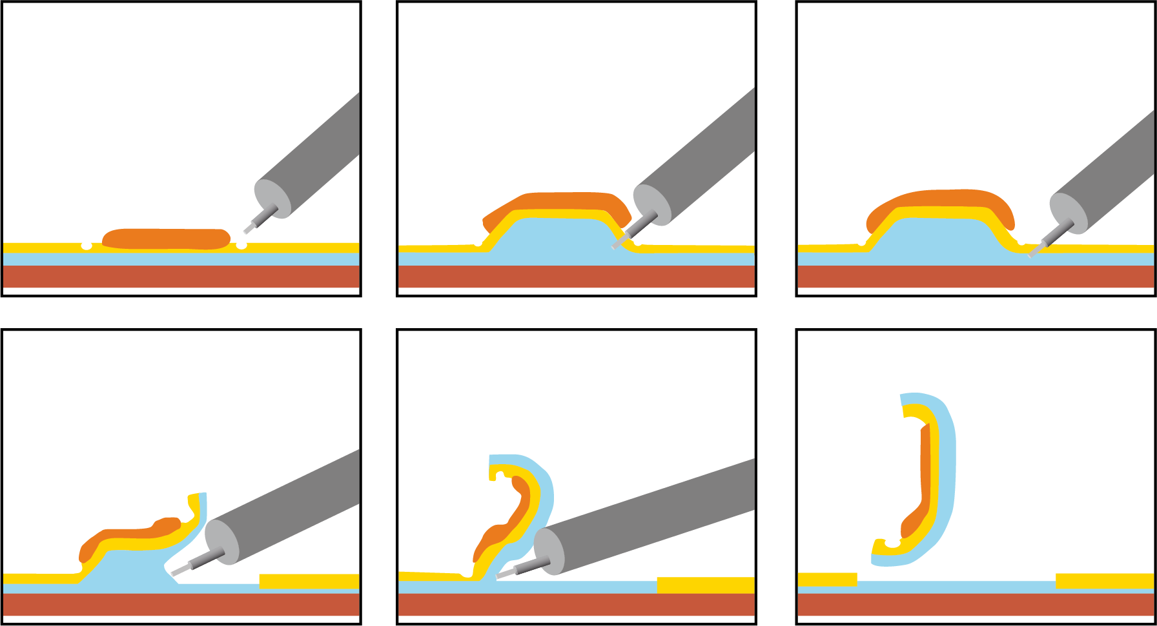

ESD and EMR endoscopic techniques
1.
Marking
2.
Injection
3.
Cutting mucosa
1.
2.
4.
Dissection
5.
Proceeding dissection
6.
Complete resection
3.
4.
ESD
EMR
EMR, endoscopic mucosal resection; ESD, endoscopic submucosal dissection
https://www.adventhealth.com/sites/default/files/assets/cie-understanding-endoscopic-mucosal-resection_0.pdf (accessed March 2023)

Slide 24
APPENDICEAL NEUROENDOCRINE TUMOuRS (ANETs)

Slide 25
Appendiceal neuroendocrine tumours – overview and diagnosis
The prognosis of lower stage appendiceal NETs is excellent with more than 90% survival probability at 10 years and an overall risk of metastases of <10%
No characteristic tumour specific symptoms
In most cases incidentally found during surgery for appendicitis
Histopathologically confirmed patients can be referred to NET centres of excellence for a multidisciplinary approach and treatment
NET, neuroendocrine tumour
Volante M, et al. Pathologica. 2021;113:19-27; Pape U-F, et al. Neuroendocrinology. 2016;103:144-152

Slide 26
ANETs – Management and RECENT DEVELOPMENTS
Tumour size | Intervention
<2 cm | Simple appendectomy
>2 cm | Simple appendectomy with right-sided hemicolectomy
The SurvivApp trial found evidence that right-sided hemicolectomy is not indicated in
patients with 1-2 cm tumours who had complete resection, via appendectomy
Retrospective cohort study
Pooled data from 40 hospitals in 15 European countries
Patients of any age and ECOG PS
Histopathologically confirmed ANETs sized 1-2 cm
ANET, appendiceal NET; ECOG PS, Eastern Cooperative Oncology Group performance status; NET, neuroendocrine tumour
Nesti C, et al. Lancet Oncol. 2023. 24:187-94

Slide 27
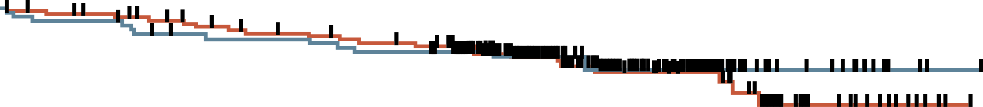
SurvivApp – results and discussion
OS from the time of primary surgery
Two main findings:
Right-sided hemicolectomy has no benefit on long-term survival after complete resection of the primary 1-2 cm tumours by appendectomy
Regional lymph node metastases of appendiceal NETs of 1-2 cm in size are clinically not relevant and not associated with reduced tumour-specific survival
However, the follow-up duration from this study has been too short to confirm that remnant lymph nodes have no impact on OS and more data is required
100
75
Overall survival (%)
50
25
Appendectomy
Right-sided hemicolectomy
Hazard ratio 0.88 (95% CI 0.44-1.75); P=0.71
0
0
5
10
15
20
Number at risk
(number censored)
Appendectomy
Right-sided
hemicolectomy
Time since primary surgery (years)
163 (0)
115 (0)
147 (9)
105 (3)
134 (16)
96 (9)
50 (95)
38 (65)
4 (141)
3 (101)
CI, confidence interval; NET, neuroendocrine tumour; OS, overall survival
Nesti C, et al. Lancet Oncol. 2023. 24:187-94

Slide 28
summary
Recognising pancreatic, gastric, rectal and appendiceal NETs can be challenging and patients may experience no symptoms or symptoms found in other diseases. At the localised stage, symptoms also depend on size and the hormones produced by the tumour
Steps to diagnosis of a potential NET include assessing all symptoms, size, grade, and stage of the tumour. In panNET diagnosis, hereditary syndromes may play a key role and genetic counselling is advised
Referral to a NET centre of excellence with a multidisciplinary team is recommended for comprehensive care, specialised expertise, access to advanced diagnostic techniques and personalised support for patients with neuroendocrine tumours
NET, neuroendocrine tumour; panNET, pancreatic NET

