Slide 2
Long-term response in advanced colorectal cancer
Assoc. Prof. Gerald Prager, MD
Medical Oncologist, Medical University of Vienna, Austria
AUG 2023

Slide 3

Developed by GI COnnect
This programme is developed by GI CONNECT,
an international group of experts in the field
of gastrointestinal oncology.
Acknowledgement and disclosures
This GI CONNECT programme is supported through an independent educational grant from Bayer. The programme is therefore independent, the content is not influenced by the supporter and is under the sole responsibility of the experts.
Please note: The views expressed within this programme are the personal opinions of the experts. They do not necessarily represent the views of the experts’ institutions, or the rest of the GI CONNECT group.
Expert Disclaimers:
Assoc. Prof. Gerald Prager has received financial support/sponsorship for research support, consultation, or speaker fees from the following companies:
  Amgen, AstraZeneca, Bayer, BMS, Incyte, Merck Serono, MSD, Servier, Takeda

Slide 4
Educational objectives
Understand the considerations for achieving a long-term response in advanced colorectal cancer:
  How to view CRC treatment as a continuum of care
  What to consider when making treatment decisions
  Which treatment options are available for CRC patients’ 3rd line and beyond
CRC, colorectal cancer

Slide 5
Clinical takeaways
Treatment of advanced colorectal cancer (CRC) should be considered as a continuum of care and patients should be offered as many life prolonging therapies as possible
Decision-making at each stage of therapy should consider patients' suitability and tolerability, tumour biomarkers and prior exposure to chemotherapies and/or targeted agents
There are a number of treatment options for CRC patients third-line and beyond that should be considered such as regorafenib, trifluridine/tipiracil as well as consideration of clinical trials and rechallenge with chemotherapy or anti-EGFR
EGFR, epidermal growth factor receptor

Slide 6
introduction
With the introduction of targeted therapy over the past two decades, the life expectancy of patients with metastatic CRC (mCRC) has improved significantly from 12 to 30-40 months in various studies¹
More than 50% of patients are now receiving treatment in the third-line setting²
We cannot predict which patients will achieve a long-term response but there are some clinical factors that can help decision-making:
  Left sided tumours even in the metastatic setting have a better prognosis than right sided³⁻⁵
  Molecular markers, among them BRAF mutations as a worse prognostic marker but with specific treatment options for these patients⁶
  Clinically useful predictive biomarkers aid clinical decision making, such as the presence of KRAS gene mutations predicting a lack of benefit from anti-EGFR therapy⁷
BRAF, proto-oncogene B-Raf; EGFR, epidermal growth factor receptor; KRAS, Kirsten rat sarcoma viral oncogene homologue
1. Novakova-Jiresova A, et al. Cancer Manag Res. 2020;12:5365-5372; 2. Tampellini M, et al. Clin Colorectal Cancer. 2017;16(4):372-376;
3. Loupakis F, et al. J Natl Cancer Inst. 2015;107(3):dju427; 4. Brule SY, et al. J Clin Oncol 2013; 31 (Suppl):3528; 5. Petrelli F, et al. JAMA Oncol. 2017;3(2):211-219;
6. Sahin IH, et al. JCO Oncol Pract2021;17(12):723-730; 7. Koncina E, et al. Cancers. 2020;12(2):319

Slide 7
Patient characteristics and considerations

Slide 8
Key factors for consideration in the CRC treatment strategy
Overall condition and emotional status of patients
Fit versus unfit for a combination therapy (triplet vs doublet vs monotherapy) Eastern Cooperative Oncology Group performance status (ECOG PS) Patient age Established comorbidities Patient attitude Patient disease history (e.g. previous oxaliplatin-based adjuvant treatment)
Tumour characteristics and clinical course
Indolent versus aggressive tumour Disease presentation (synchronous vs metachronous) Tumour load Mutational status (e.g. RAS and BRAF)
Treatment goal
Tumour shrinkage to achieve a radical surgery of metastases or palliation of disease-related symptoms Disease control to delay progression and worsening of patient’s general condition
BRAF, proto-oncogene B-Raf; CRC, colorectal cancer; RAS, rat sarcoma viral oncogene homologue
Argiles G, et al. ESMO Open 2019;4:e000495. doi:10.1136/esmoopen-2019-000495

Slide 9
Molecular analysis in mcrc is the mainstay of treatment decision-making
Several biomarkers are used to inform treatment selection and understand the prognosis for patients with mCRC¹
Around 70% of RAS wild-type CRCs simultaneously harbour heterogeneous genomic alterations involved in EGFR and other signalling pathways that confer resistance to anti-EGFR monoclonal antibodies therapy²
BRAF V600E is a well-established oncogenic driver mutation associated with highly aggressive behaviour in CRC³
  BRAF V600E–mutant CRC is associated with resistance to chemotherapy and EGFR–directed therapies, leading to shorter survival outcomes compared with wild-type BRAF
  BRAF inhibitors combined with EGFR blockade create a synergistic effect, resulting in significant therapeutic efficacy in colon cancer with BRAF V600E mutation
  The BRAF V600E mutation is also associated with MMR–deficient CRC, which is highly responsive to immune checkpoint inhibitor therapy
MMR enzyme deficiency caused by mutations in MMR genes is a predictive and prognostic factor, especially in the early stage of CRC⁴
  Patients with CRCs that are microsatellite instability (MSI) and high somatic tumour mutation burden (TMB) have shown encouraging outcomes after receiving immunotherapy^{5,6}
HER2 is an emerging biomarker for CRC⁷
BRAF, proto-oncogene B-Raf; EGFR, epidermal growth factor receptor; HER2, human epidermal growth factor receptor 2; (m)CRC, (metastatic) colorectal cancer; MMR, mismatch repair; RAS, rat sarcoma viral oncogene homologue
1. Yekeduz E, et al. Cureus. 2022;14(4):e24175; 2. Dienstmann R, et al. Am Soc Clin Oncol Educ Book. 2015;35:e149-156;
3. Sahin IH, et al. JCO Oncol Pract 2021;17(12):723-730; 4. Molinari C, et al. Int J Mol Sci. 2018;19:3733; 5. Le DT, et al. N Engl J Med. 2015;372:2509-2520;
6. Overman MJ, et al. Lancet Oncol. 2017;18:1182-1191; 7. Djaballah S, et al. Am Soc Clin Oncol Educ Book. 2022;42:219-232

Slide 10
Tumour sidedness and treatment considerations
A retrospective analysis of data from the CALGB/SWOG 80405 trial found that patients whose cancer originated in the left side of the colon lived more than a year longer after initial treatment than patients whose disease originated in the right side of the colon¹
The study also linked tumour location to the likelihood of benefit from specific targeted therapies used to treat patients with colorectal cancer¹
Tumour sidedness may also be predictive of response to treatment; greater benefit from treatment with an anti-EGFR therapy was observed in patients with RAS wild-type disease who
had left-sided tumours than in patients with right-sided tumours^{1,2}
Bevacizumab plus chemotherapy may provide greater clinical benefit than anti-EGFR therapies in patients with right-sided tumours²
Anti-EGFR therapy when added to an irinotecan-based regimen has been shown to have significant activity in patients with irinotecan-refractory colorectal cancer³
Tailoring first-line treatment for patients with mCRC
Patients clinical condition
Unfit for
any treatment
Unfit for combination
therapies
Fit for combination
therapies
Best supportive care
FP plus anti-EGFR or bev; or personalised low-intensity ChT
Tumour location
and mutational status
Unfit for combination
therapies
Fit for combination
therapies
First choice:
doublet ChT plus
anti-EGFR
First choice:
ChT (triplet if feasible)
plus bev
bev, bevacizumab; ChT, chemotherapy; EGFR, epidermal growth factor receptor; FP fluoropyrimidine; mCRC, metastatic colorectal cancer; RAS, rat sarcoma viral oncogene homologue
Figure adapted from: Cremolini C, et al. Gastrointestinal tumours, Essentials for Clinicians (2nd Edition, Chapter 7), ESMO Press 2021
1. Venook, AP, et al. J Clin Oncol. 2016;34 no. 15_suppl:3504-3504; 2. Arnold D, et al. Ann Oncol. 2017;28(8):1713-1729; 3. Cunningham D, et al. New Engl J Med. 2004;351:337-345;

Slide 11
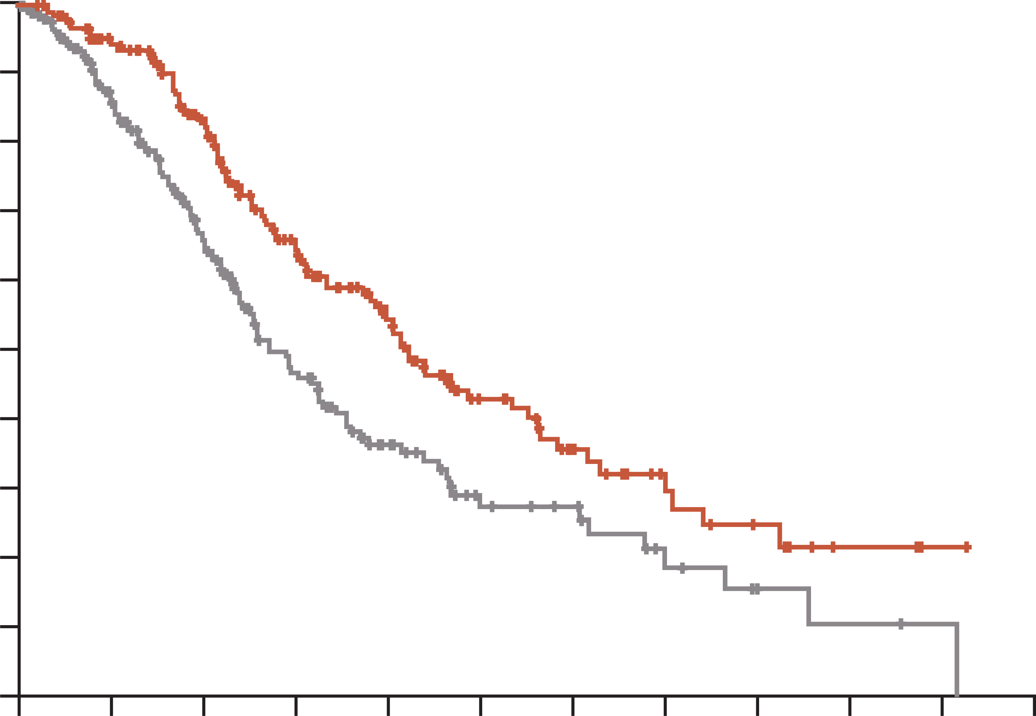
Encorafenib plus cetuximab improves survival in previously treated patients with BRAF V600E–mutant mCRC
Overall survival, doublet regimen vs control
1.0
In the BEACON CRC study, treatment with doublet therapy (encorafenib plus cetuximab) improved OS, ORR, and PFS in previously treated patients in the metastatic setting compared with standard chemotherapyª
0.9
 | Median overall survival mo (95% CI)
Doublet | 8.4 (7.5-11.0)
Control | 5.4 (4.8-6.6)
0.8
0.7
0.6
Hazard ratio for death,
0.60 (95% CI, 0.45-0.79)
p<0.001
Probability of survival
0.5
0.4
0.3
Doublet
0.2
0.1
0.0
Control
0
2
4
6
8
10
12
14
16
18
20
22
Months
Number at risk
Doublet
Control
220
221
184
158
133
102
87
60
57
34
33
18
21
15
12
7
8
4
3
2
1
1
0
0
ª Standard chemotherapy: cetuximab and irinotecan or cetuximab and FOLFIRI
BRAF, proto-oncogene B-Raf; CI, confidence interval; FOLFIRI, folinic acid, fluorouracil and irinotecan; (m)CRC, (metastatic) colorectal cancer; mo, months; ORR, objective response rate; OS, overall survival; PFS, progression-free survival
Kopetz S, et al. N Engl J Med. 2019;381:1632-1643; Tabernero J, et al. J Clin Oncol. 2021;39(4):273-284

Slide 12
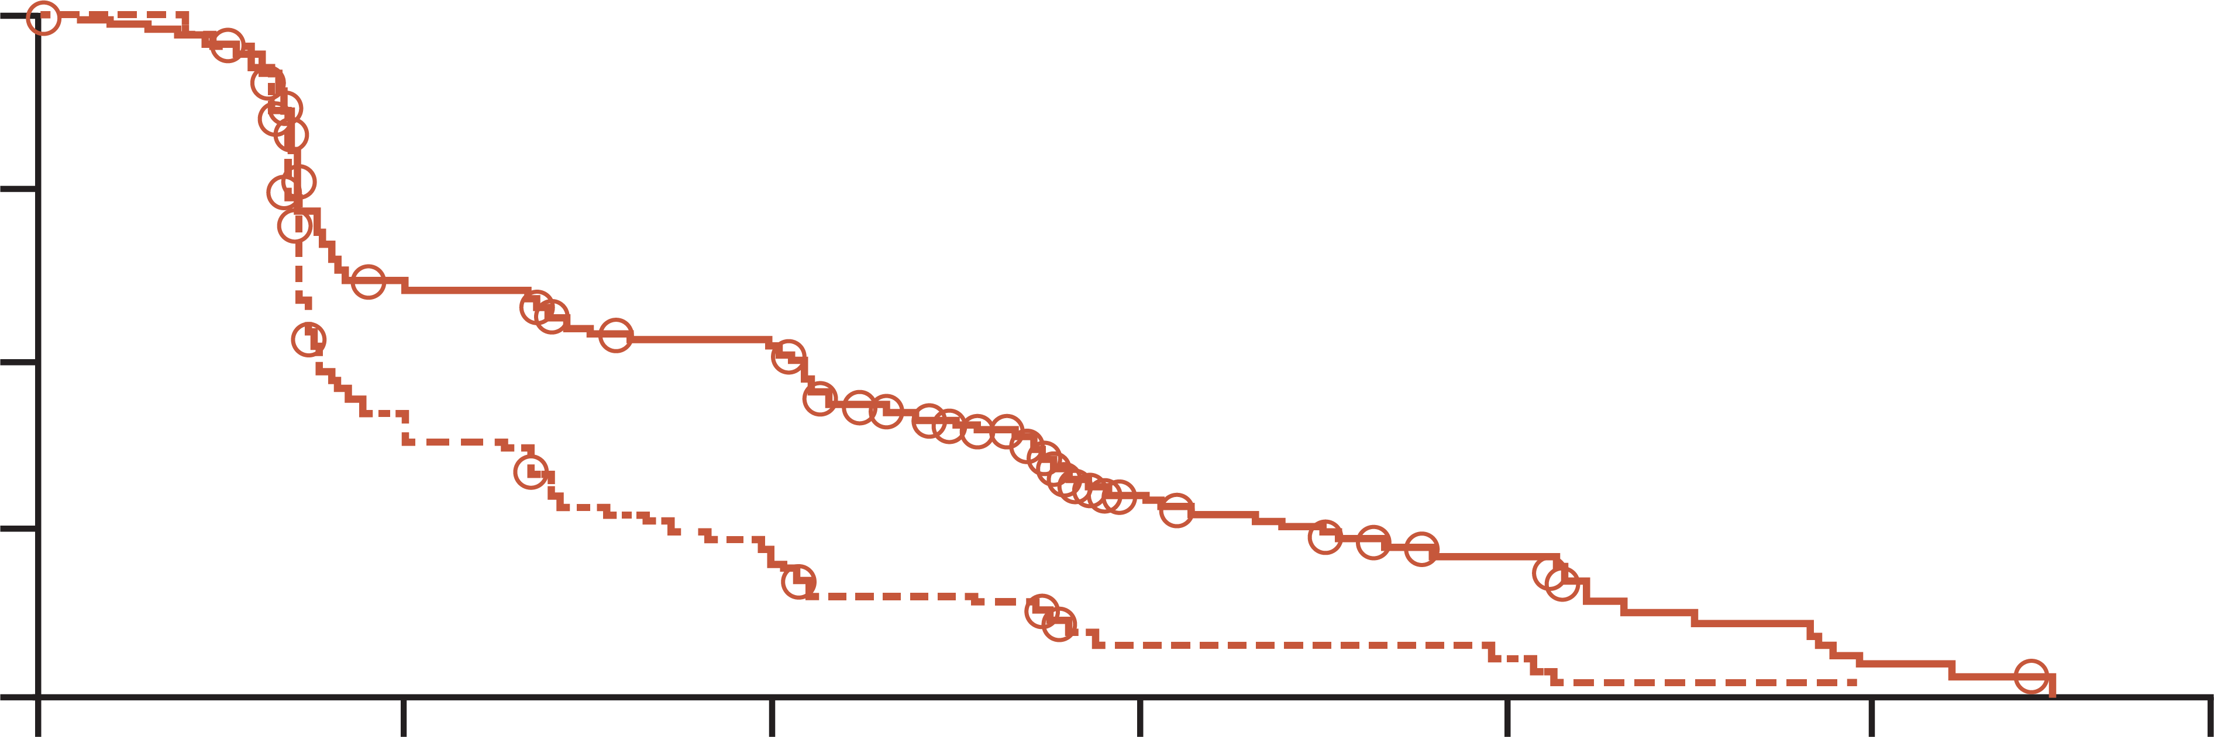
Anti-EGFR plus irinotecan based chemotherapy has benefit in irinotecan-refractory CRC
Cetuximab has clinically significant activity when given alone or in combination with irinotecan in patients with irinotecan-refractory colorectal cancer
RATES OF RADIOLOGIC RESPONSE*
TIME TO DISEASE PROGRESSION IN
THE TWO STUDY GROUPS
Subgroup and variable | Cetuximab plus irinotecan n=218 | Cetuximab n=111
Response – n (%)
Complete response | 0 | 0
Partial response | 50 (22.9) | 12 (10.8)
Stable disease | 71 (32.6) | 24 (21.6)
Progressive disease | 68 (31.2) | 59 (53.2)
Could not be evaluated | 29 (13.3) | 16 (14.4)
100
75
Patients free of
progression (%)
50
25
Cetuximab plus irinotecan
Cetuximab
0
0
2
4
6
8
10
12
Time to progression (months)
Patients treated with cetuximab plus irinotecan vs cetuximab, achieved:
Overall response: 22.9% vs 10.8%, p=0.007
Disease control rate: 55.5% vs 32.4%, p<0.001
The hazard ratio for disease progression in the combination-therapy group as compared
with the monotherapy group was 0.54 (95 percent confidence interval, 0.42 to 0.71)
(p<0.001 by the log-rank test). The points on the curves represent the dates on which
a patient’s data were censored
CI, confidence interval; CRC, colorectal cancer; EGFR, epidermal growth factor receptor
Cunningham D, et al. N Engl J Med. 2004;351:337-345

Slide 13
third line treatment options

Slide 14
Management of stage IV unresectable mCRC in third-line therapy and beyond
ESMO CLINICAL PRACTICE GUIDELINES
Stage IV unresectable mCRC: third-line and beyond
RAS-wt and BRAF-wt
RAS-mut
BRAFV600E-mut
PD
HER2-positive
PD
PD
PD
Anti-HER2 drugs
(III, C; ESCAT II-B)
Single agent anti-EGFR mAb
(I, A; panitumumab MCBS 3)
or
Irinotecan–cetuximab (II,B)
Regorafenib
(I, A; MCBS 1)
or
Trifluridine–tipiracil
(I, A; MCBS 3)
Encorafenib–cetuximab
(I, A; MCBS 4; ESCAT I-A)
BRAF, proto-oncogene B-Raf; ESCAT, ESMO Scale for Clinical Actionability of Molecular Targets; EGFR, epidermal growth factor receptor; ESMO, European Society for Medical Oncology; HER2, human epidermal growth factor receptor 2; mAb, monoclonal antibody; MCBS, ESMO Magnitude of Clinical Benefit Scale;
mCRC, metastatic colorectal cancer; mut, mutant; PD, progressive disease; RAS, rat sarcoma viral oncogene homologue; ; wt, wild-type
Cervantes A, et al. Ann Oncol. 2022;4(1):10-32

Slide 15
Systemic therapy for advanced or metastatic crc
NCCN CLINICAL PRACTICE GUIDELINES
SUBSEQUENT THERAPY
Regorafenib
or
Trifluridine + tipiracil
± bevacizumab
or
Best supportive care
Regorafenib
or
Trifluridine + tipiracil ± bevacizumab
or
(Trastuzumab + [pertuzumab or
lapatinib]) or fam-trastuzumab
deruxtecan-nxki (HER2-amplified
and RAS and BRAF WT)
Cetuximab or panitumumab
(KRAS/NRAS/BRAF WT and left-sided tumours only)
or
Encorafenib + (cetuximab or panitumumab)
(BRAF V600E mutation positive)
or
Previous
treatment
with
oxaliplatin
and
irinotecan
See Subsequent Therapy
Regorafenib
or
Trifluridine + tipiracil
± bevacizumab
or
Best supportive care
Regorafenib
or
Trifluridine + tipiracil ± bevacizumab
or
(Trastuzumab + [pertuzumab or lapatinib])
or fam-trastuzumab deruxtecan-nxki (HER2-
amplified and RAS and BRAF WT)
See Subsequent Therapy
BRAF, proto-oncogene B-Raf; CRC, colorectal cancer; dMMR, deficient mismatch repair; HER2, human epidermal growth factor receptor 2; KRAS, Kirsten rat sarcoma virus; MSI-H, microsatellite instability-high; NCCN, National Comprehensive Cancer Network; NRAS, neuroblastoma ras viral oncogene homolog; RAS, rat sarcoma viral oncogene homologue; WT, wild-type
NCCN guidelines, Version 2.2023. https://www.nccn.org/professionals/physician_gls/pdf/colon.pdf. Accessed July 2023

Slide 16
CORRECT Study: Regorafenib vs placebo PROLONGED PFS AND OS in refractory mCRC patients
PROGRESSION-FREE SURVIVAL
OVERALL SURVIVAL
100
Regorafenib 160 mg
Placebo
100
Regorafenib 160 mg
Placebo
75
75
OS: 6.4 mo vs. 5.0 mo
PFS: 1.9 mo vs. 1.7 mo
HR 0.77, 95% CI 0.64-0.94, p=0.0052
50
HR 0.49, 95% CI 0.42-0.58, p<0.0001
50
Progression-free survival (%)
Overall survival (%)
25
25
0
0
2
4
6
8
10
12
0
0
2
4
6
8
10
12
14
Number at risk
Regorafenib
Placebo
Months after randomisation
Number at risk
Regorafenib
Placebo
Months after randomisation
238
51
98
9
42
2
12
2
3
0
452
221
352
150
187
75
93
32
33
9
7
3
Tumour response:
ORR: 1.0% vs. 0.4% (p=0.19)
DCR: 41% vs. 15% (p<0.0001)
CI, confidence interval; DCR, disease control rate; HR, hazard ratio; mCRC, metastatic colorectal cancer; mo, months; ORR, objective response rate; OS, overall survival; PFS, progression-free survival
Grothey A, et al. Lancet. 2013;381:303-312

Slide 17
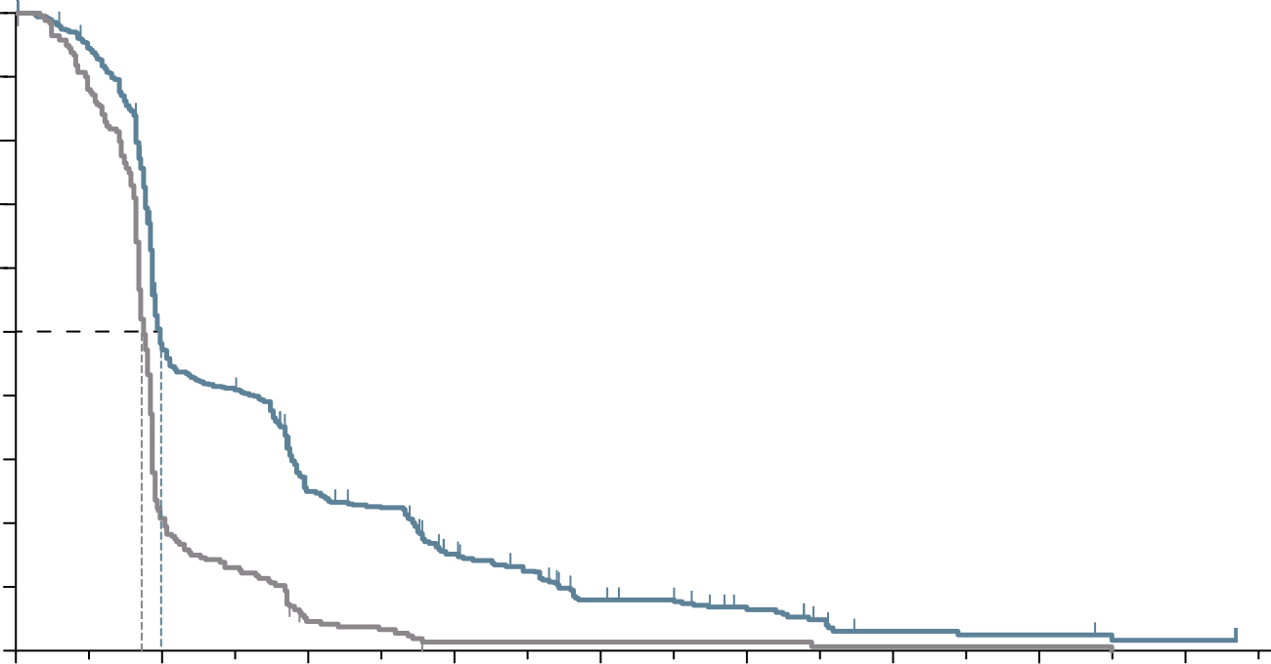
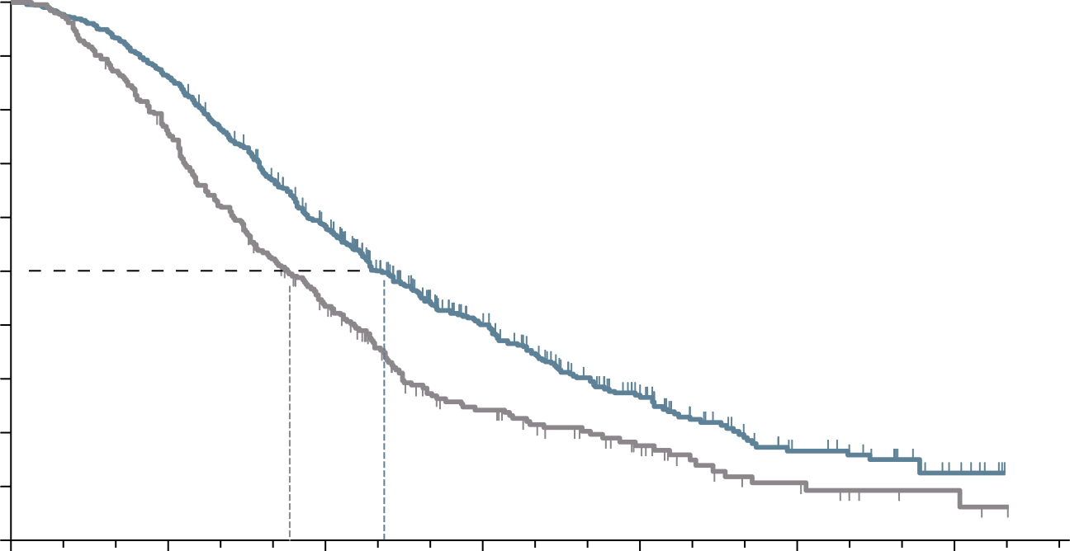
RECOURSE Study: TAS-102 PROLONGED PFS AND OS in refractory mcrc patients
PROGRESSION-FREE SURVIVAL
OVERALL SURVIVAL
100
100
90
PFS: 2.0 mo vs. 1.7 mo
90
OS: 7.1 mo vs. 5.3 mo
80
Hazard ratio: 0.48 (95% CI, 0.41-0.57)
p<0.001 by log-rank test
80
Hazard ratio: 0.68 (95% CI, 0.58-0.81)
p<0.001
70
70
60
60
50
50
Progression-free survival (%)
Overall survival (%)
40
40
30
TAS-102
30
TAS-102
20
20
10
Placebo
10
Placebo
0
0
2
4
6
8
10
14
16
0
0
3
6
9
12
15
18
12
Months after randomisation
Months after randomisation
Number at risk
TAS-102
Placebo
Number at risk
TAS-102
Placebo
534
266
238
51
121
10
66
2
30
2
18
2
5
1
4
1
2
0
534
266
459
198
294
107
137
47
64
24
23
9
7
3
Tumour response:
ORR: 1.6% vs. 0.4% (p=0.29)
DCR: 44% vs. 16% (p<0.001)
CI, confidence interval; DCR, disease control rate; HR, hazard ratio; mCRC, metastatic colorectal cancer; mo, months; ORR, objective response rate;
OS, overall survival; PFS, progression-free survival; TAS-102, trifluridine/tipiracil
Mayer RJ, et al N Engl J Med. 2015;372:1909-1919

Slide 18
safety profILe In patIents beyond the seCond LIne
Most commonly reported (≥25%) adverse events for TAS-102 and regorafenib in phase 3 clinical studies^{1,2}
TAS-102 (N=533)¹ |  |  | Regorafenib (N=500)^{2,a}
 | Overall (%) | Grade ≥3 (%) |  | Overall (%) | Grade ≥3 (%)
Leucopenia | 77 | 21 | Hand-foot skin reaction | 47 | 17
Anaemia | 77 | 18 | Fatigue | 47 | 10
Neutropenia | 67 | 38 | Diarrhoea | 34 | 7
Nausea | 48 | 2 | Anorexia | 30 | 3
Thrombocytopaenia | 42 | 5 | Voice changes | 29 | <1
Decreased appetite | 39 | 4 | Hypertension | 28 | 7
Fatigue | 35 | 4 | Oral mucositis | 27 | 3
Diarrhoea | 32 | 3 | Rash/desquamation | 26 | 6
Vomiting | 28 | 2
ª Treatment-related adverse events from start of treatment to 30 days after end of treatment
Please note that these drugs have not been compared in head-to-head studies. The information is presented for information purposes only
Adapted from Argiles G, et al. ESMO Open 2019;4:e000495. doi:10.1136/esmoopen-2019-000495
TAS-102, trifluridine/ tipiracil
1. Mayer RJ, et al. N Engl J Med. 2015;372:1909-1919; 2. Grothey A, et al. Lancet. 2013;381:303-312

Slide 19
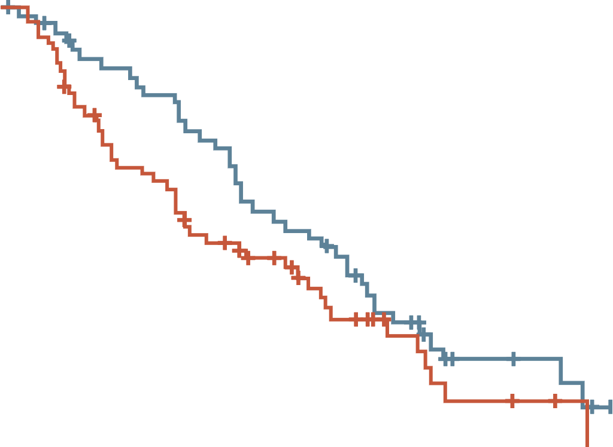
Dose-escalated strategy for management of adverse events with regorafenib
ReDOS study: no significant difference in overall survival between dose escalation and standard dosing
A dose-escalation schedule for regorafenib to minimise toxicities¹
PHASE 2 ReDOS STUDY²
100
90
80 mg PO daily
for 1 week
80
Week 1
70
No
SDRT
60
50
120 mg PO daily
for 1 week
80 mg PO daily
for 1 week
Overall survival (%)
Week 2
SDRT
40
No
SDRT
30
Dose-escalation group
20
Week 3
160 mg PO daily
for 1 week
120 mg PO daily
for 1 week
10
SDRT
Standard-dose group
0
0
3
6
9
12
15
18
21
24
No
SDRT
Time from randomisation (months)
Week 4
Off for 1 week
Number at risk (number censored)
Dose escalation
Standard dose
54 (0)
62 (0)
44 (4)
45 (2)
36 (4)
28 (3)
26 (4)
21 (7)
14 (4)
10 (12)
5 (11)
3 (14)
3 (12)
1 (16)
0 (14)
0 (16)
–
–
Dose-escalated arm: regorafenib initiated at 80 mg/day, increased weekly up to 160 mg/day if no significant drug-related toxicities; Standard-dose arm: regorafenib 160 mg/day
PO, by mouth; SDRT, significant drug-related toxicities
1. Grothey A. Clin Adv Hematol Oncol. 2015;13(8):514-517; 2. Bekaii-Saab TS, et al. Lancet Oncol. 2019;20(8):1070-1082

Slide 20
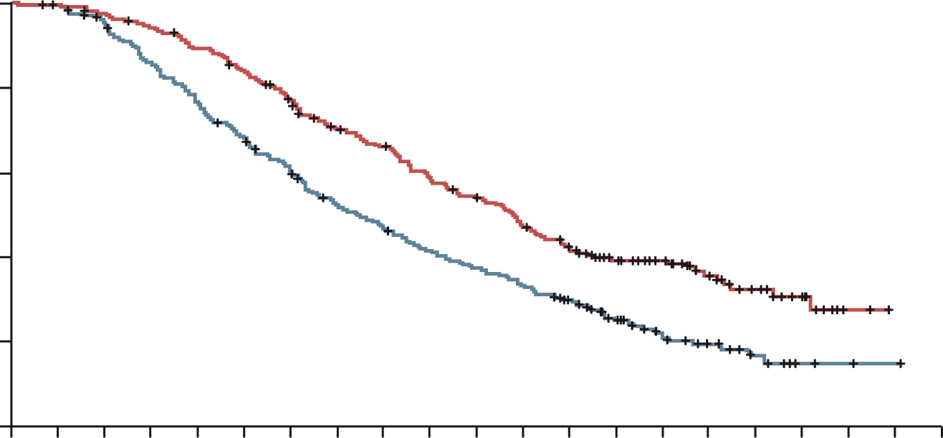
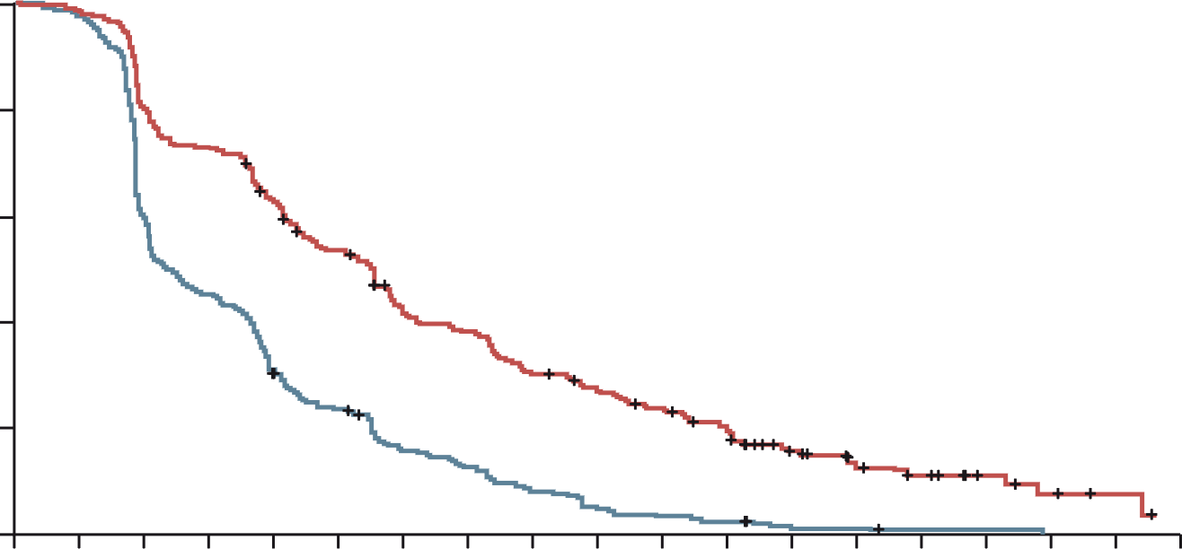
Sunlight: TAS-102 plus bevacizumab improves outcomes in refractory mcrc
TAS-102 plus bevacizumab improved OS and PFS in refractory CRC patients
Overall survival (primary endpoint)
Progression-free survival
 | TAS-102 plus bevacizumab (N=246) | TAS-102 (N=246)
Median OS, months | 10.8 | 7.5
6-month OS rate, % | 77 | 61
12-month OS rate, % | 43 | 30
 | TAS-102 plus bevacizumab (N=246) | TAS-102 (N=246)
Median PFS, months | 5.6 | 2.4
6-month PFS rate, % | 43 | 16
12-month PFS rate, % | 16 | 1
100
100
80
80
TAS-102 plus bevacizumab group
TAS-102 group
60
60
Overall Survival (%)
Progression-free survival (%)
HR, 0.44 (95% CI, 0.36-0.54)
p<0.001
40
40
TAS-102 plus bevacizumab group
TAS-102 group
20
HR, 0.61 (95% CI, 0.49-0.77)
p<0.001
20
0
0
1
2
3
4
5
6
7
8
9
10
11
12
13
14
15
16
17
18
19
20
0
0
1
2
3
4
5
6
7
8
9
10
11
12
13
14
15
16
17
18
No. at risk
TAS-102 plus bevacizumab group
TAS-102 group
Months
No. at risk
TAS-102 plus bevacizumab group
TAS-102 group
Months
246
246
244
242
239
230
230
205
217
184
203
163
183
143
160
120
149
108
131
95
119
85
104
76
88
63
69
44
52
24
37
16
24
10
13
5
2
2
0
1
0
0
246
246
242
236
198
147
179
109
153
74
128
56
99
36
89
29
70
19
61
12
52
8
43
6
25
2
18
2
13
1
7
1
4
0
2
0
0
0
CI, confidence interval; HR, hazard ratio; (m)CRC, (metastatic) colorectal cancer; OS, overall survival; PFS, progression-free survival; TAS-102, trifluridine/tipiracil
Tabernero J, et al. J Clin Oncol. 2023;41(suppl 4; abstr 4) (ASCO GI 2023, oral presentation); Prager G, et al. N Engl J Med. 2023; 388:1657-1667

Slide 21
Sunlight: SAFETY results
Overall safety
TEAEs in ≥20% of All Patients
Event (any cause), n (%) | TAS-102 plus bevacizumab (N=246) | TAS-102 (N=246)
Overall AEs | 241 (98) | 241 (98)
TAS-102-related AEs | 221 (90) | 200 (81)
Bevacizumab-related AEs | 119 (48) | NA
Severe (grade ≥3) AEs | 178 (72) | 171 (70)
Serious AEs | 61 (25) | 77 (31)
Treatment-related deaths | 0 | 0
AEs leading to withdrawal from the study | 31 (13) | 31 (13)
TEAE, n (%) | TAS-102 plus bevacizumab (N=246) |  | TAS-102 (N=246)
 | Any grade | Grade 3 or 4 | Any grade | Grade 3 or 4
Neutropenia | 153 (62) | 106 (43) | 126 (51) | 79 (32)
Nausea | 91 (37) | 4 (2) | 67 (27) | 4 (2)
Anemia | 71 (29) | 15 (6) | 78 (32) | 27 (11)
Asthenia | 60 (24) | 10 (4) | 55 (22) | 10 (4)
Fatigue | 53 (22) | 3 (1) | 40 (16) | 9 (4)
Diarrhea | 51 (21) | 2 (1) | 46 (19) | 6 (2)
Decreased appetite | 50 (20) | 2 (1) | 38 (15) | 3 (1)
Dose modification, n (%) | TAS-102 plus bevacizumab (N=246) | TAS-102 (N=246)
Dose reductions | 40 (16) | 30 (12)
Dose delays | 171 (70) | 131 (53)
Hypertension (10% vs 2%), nausea and neutropenia occurred more frequently in the combination group
  One case of febrile neutropenia with TAS-102 plus bevacizumab versus six with TAS-102
AE, adverse event; TAS-102, trifluridine/tipiracil; TEAE, treatment emergent adverse event
Tabernero J, et al. J Clin Oncol. 2023;41(suppl 4; abstr 4) (ASCO GI 2023, oral presentation); Prager G, et al. N Engl J Med. 2023; 388:1657-1667

Slide 22
After regorafenib and tas-102 ± bev what next?
bev, bevacizumab; TAS-102, trifluridine/tipiracil

Slide 23
FRESCO-2: background and study design
AFTER REGORAFENIB AND/OR TAS-102
Effective treatment options are limited for patients with refractory metastatic colorectal cancer
Fruquintinib is a highly selective and potent oral tyrosine kinase inhibitor of VEGFR-1, -2 and -3 and was approved in China in the 3L+ mCRC setting based on results from the FRESCO trial
FRESCO-2 evaluated fruquintinib in more heavily pre-treated patients reflecting current global practices
Patient eligibility
Prior treatment with fluoropyrimidine-, oxaliplatin- and irinotecan-based chemotherapy, an anti-VEGF biological therapy and, if RAS wild‑type, an anti-EFGR therapy
Progression on, or intolerance to, TAS-102 and/or regorafenib
Prior treatment with an immune checkpoint inhibitor or BRAF inhibitor if indicated
Fruquintinib 5 mg PO, QD
(3 weeks on, 1 week off)
+
BSC
(N=458)
Primary Objective
Overall survival
Secondary objectives
Progression-free survival
Objective response rate
Disease control rate
Safety
R
2:1
Treatment until
progression or
unacceptable toxicity
Placebo 5 mg PO, QD
(3 weeks on, 1 week off)
+
BSC
(N=229)
N=687
Stratification factors
Prior therapy (TAS-102 vs regorafenib vs TAS-102 and regorafenib)
RAS mutational status (wild-type vs mutant)
Duration of metastatic disease (≤18 months vs >18 months
Note: to ensure the patient population is reflective of clinical practice, the number of patients with prior regorafenib was limited to 344 patients (50%); TAS-102, trifluridine and tipiracil hydrochloride
3L, third line; BRAF, proto-oncogene B-Raf; BSC, best supportive care; EFGR, endothelial growth factor; mCRC, metastatic prostate cancer; PO, orally; QD, once a day; R, randomisation; RAS, rat sarcoma viral oncogene homologue; VEGF(R), vascular endothelial growth factor (receptor); TAS-102, trifluridine/tipiracil
Dasari NA, et al. Ann Oncol. 2022;33(suppl_7):S808-S869 (ESMO 2022 presentation)

Slide 24
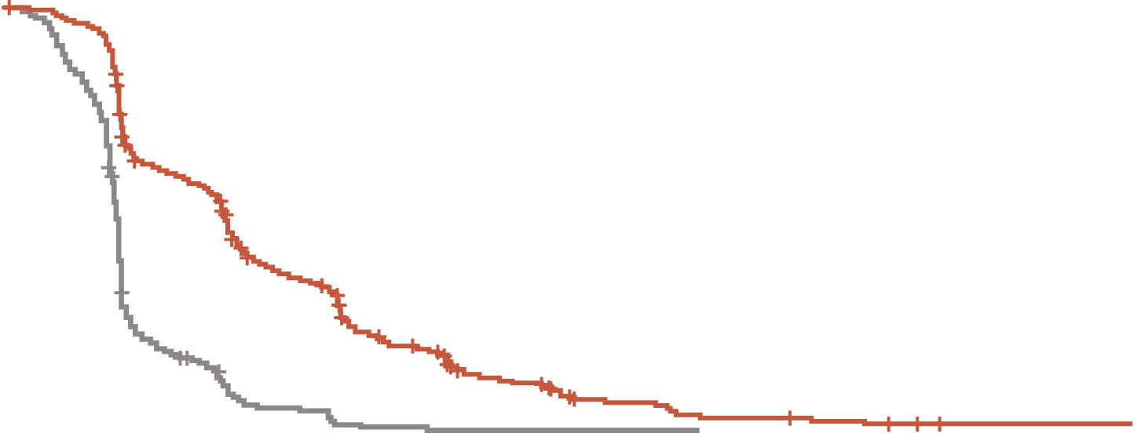
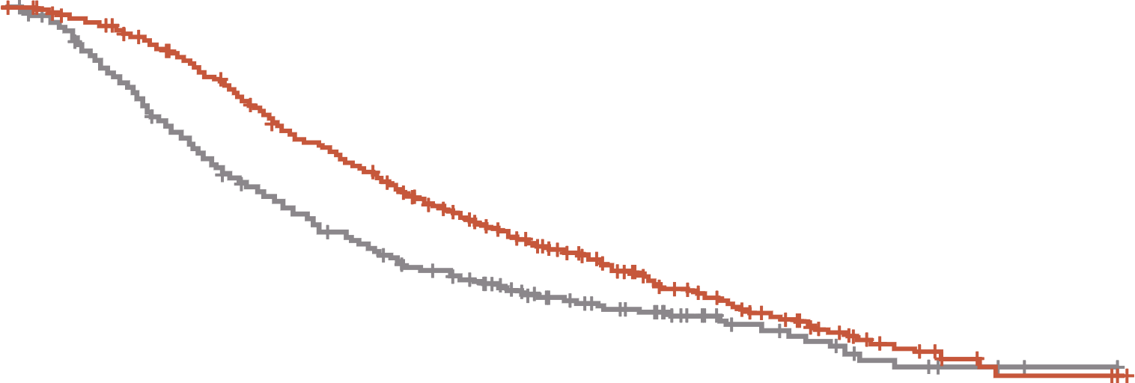
FRESCO-2: Fruquintinib prolonged OS and PFS in patients with refractory mCRC
PROGRESSION-FREE SURVIVAL
OVERALL SURVIVAL
 | Fruquintinib | Placebo
Events/patients (%) | 392/461 (85.0%) | 213/230 (92.6%)
Stratified p-value (log-rank) | <0.001
Stratified HR (95% CI) | 0.321 (0.267, 0.386)
Median (95% CI), months | 3.7 (3.5, 3.8) | 1.8 (1.8, 1.9)
Median PFS difference, months | 1.9
 | Fruquintinib | Placebo
Events/patients (%) | 317/461 (68.8%) | 173/230 (75.2%)
Stratified p-value (log-rank) | <0.001
Stratified HR (95% CI) | 0.662 (0.549, 0.800)
Median (95% CI), months | 7.4 (6.7, 8.2) | 4.8 (4.0, 5.8)
Median OS difference, months | 2.6
1.0
1.0
0.8
0.8
0.6
0.6
Probability of progression‑free survival (%)
Probability of overall survival (%)
Median follow-up:
Fruquintinib: 11.3 mo
Placebo: 11.2 mo
0.4
0.4
0.2
0.2
Fruquintinib + BSC
Placebo + BSC
Fruquintinib + BSC
Placebo + BSC
0
0
0
1
2
3
4
5
6
7
8
9
10
11
12
13
14
15
16
17
18
19
0
1
2
3
4
5
6
7
8
9
10
11
12
13
14
15
16
17
18
19
Time from randomisation (months)
Time from randomisation (months)
Patients at risk
Fruquintinib
Placebo
461
230
430
194
291
60
256
36
170
12
146
10
89
2
71
2
43
1
36
1
21
1
17
1
10
0
9
6
4
2
2
2
Patients at risk
Fruquintinib
Placebo
461
230
449
216
429
184
395
153
349
125
297
105
266
89
224
73
184
63
143
45
113
37
79
31
58
20
41
15
23
10
14
6
7
3
4
2
4
1
0
0
PFS: 3.7 mo vs. 1.8 mo (HR 0.32; p<0.001)
OS: 7.4 mo vs. 4.8 mo (HR 0.66; p<0.001)
Tumour response:
ORR: 1.5% vs. 0.0% (p=0.059)
DCR: 55.5% vs. 16.1% (p<0.001)
BSC, best supportive care; CI, confidence interval; DCR, disease control rate; HR, hazard ratio; mCRC, metastatic colorectal cancer; mo, months; ORR, objective response rate; OS, overall survival; PFS, progression-free survival
Dasari NA, et al. Ann Oncol. 2022;33(suppl_7):S808-S869 (ESMO 2022 oral presentation)

Slide 25
FRESCO-2: safety results
Category, n (%) | Fruquintinib (N=456) | Placebo (N=230)
Any TEAE Grade ≥3 Treatment-related Grade ≥3 Leading to death | 451 (98.9) 286 (62.7) 164 (36.0) 48 (10.5) | 213 (92.6) 116 (50.4) 26 (11.3) 45 (19.6)
Any serious TEAE Grade ≥3 | 171 (37.5) 162 (35.5) | 88 (38.3) 85 (37.0)
TEAEs leading to dose modifications Dose interruption Dose reduction Dose discontinuation | 247 (54.2) 110 (24.1)ª 93 (20.4)^{b} | 70 (30.4) 9 (3.9) 49 (21.3)
ª Most common TEAEs leading to dose reduction in fruquintinib arm: hand-foot syndrome (5.3%), hypertension (3.7%), and asthenia (3.5%) ^{b} Most common TEAE leading to dose discontinuation in the fruquintinib arm: asthenia (1.5%)
TEAE, treatment-emergent adverse event
Dasari NA, et al. Ann Oncol. 2022;33 (suppl_7):S808-S869 (ESMO 2022 oral presentation)

Slide 26
summary

Slide 27
summary
SEQUENTIAL treatment considerations for advanced colon cancer
Treatment of advanced CRC should be considered as a continuum of care.
Decision-making at each stage of therapy should account for patient suitability and tolerability,
tumour biomarkers, and prior exposure to chemotherapies and/or targeted agents.
Please refer to relevant treatment guidelines for the full details of the decision-making pathway and treatment options at each stage
Initial systemic therapy:
Is the patient considered appropriate for intensive therapy?
Consider the patient’s prior treatments.
Have they received a previous:
Oxaliplatin-based chemotherapy?
Irinotecan-based chemotherapy?
Oxaliplatin- and irinotecan-based regimen?
FP without oxaliplatin/irinotecan?
Consider the results of molecular testing. Is the patient’s tumour:
KRAS/NRAS/BRAF wild-type?
BRAF V600E-positive?
dMMR/MSI-H?
HER2-amplified, RAS wild-type?
Consider the location of the
patient’s tumour:
Left- or right sided?
Please refer to relevant treatment guidelines for the full details of the decision-making pathway and treatment options at each stage
BRAF, proto-oncogene B-Raf; CRC, colorectal cancer; FP, fluoropyrimidine; HER2, human epidermal growth factor receptor 2; KRAS, Kirsten rat sarcoma viral oncogene homologue; dMMR, deficient mismatch repair; MSI-H, microsatellite instability-high; NRAS, neuroblastoma RAS viral oncogene homolog; RAS, rat sarcoma viral oncogene homologue

Slide 28




REACH GI CONNECT VIA
TWITTER, LINKEDIN, VIMEO & EMAIL
OR VISIT THE GROUP’S WEBSITE https://giconnect.cor2ed.com/
Follow us on Twitter
@giconnectinfo
Follow the
GI CONNECT
group on LinkedIn
Watch us on the
Vimeo Channel
GI CONNECT
Email
louise.handbury
@cor2ed.com

