Slide 2
Gu connect meeting summary
RENAL cancer highlights from asco 2023
Prof. Thomas Powles, MD
Medical Oncologist, Bart’s Cancer Centre, UK
JUNE 2023

Slide 3

Developed by GU COnnect
This programme is developed by GU CONNECT,
an international group of experts in the field of
genitourinary oncology.
Acknowledgement and disclosures
This GU CONNECT programme is supported through an independent educational grant from Eisai Europe Limited. The programme is therefore independent, the content is not influenced by the supporter and is under the sole responsibility of the experts.
Please note: The views expressed within this programme are the personal opinions of the experts. They do not necessarily represent the views of the experts’ institutions, or the rest of the GU CONNECT group.
Expert Disclaimers:
Prof. Thomas Powles has received financial support/sponsorship for research support, consultation, or speaker fees from the following companies: Astellas, AstraZeneca, BMS, Eisai, Exelixis, Incyte, Ipsen, Johnson & Johnson, Mashup Ltd, Merck Serono, MSD, Novartis, Pfizer, Roche, Seattle Genetics

Slide 4
Clinical takeaways
CONTACT-03: For patients with mRCC, adding the atezolizumab to cabozantinib did not improve clinical outcomes compared with treatment with cabozantinib alone and higher toxicities were also observed in the combination arm
KEYNOTE-426: Pembrolizumab + axitinib continued to demonstrate improved OS, PFS, and ORR versus sunitinib for patients with previously untreated clear cell RCC and no new safety signals were observed
CLEAR: The combination of lenvatinib plus pembrolizumab remains superior to sunitinib on clinical outcomes as first-line treatment for advanced renal cell carcinoma after 4-years follow-up with no new safety signals detected
Long-term follow up data from KEYNOTE-426 and the CLEAR trial re-confirms current clinical practice of frontline combination immunotherapy/TKI for IDMC intermediate/poor risk patients
IDMC, International Metastatic RCC Database Consortium; (m)RCC, (metastatic) renal cell carcinoma; ORR, objective response rate; OS, overall survival; PFS, progression-free survival; TKI, tyrosine kinase inhibitor

Slide 5
Educational objectives
Help physicians translate the latest Renal cell carcinoma data from ASCO 2023 into clinical practice

Slide 6
Efficacy and safety of atezolizumab plus cabozantinib vs cabozantinib alone after progression with prior ICI treatment in mRCC: Primary PFS analysis from the phase 3, randomiSed, open-label CONTACT-03 study
Choueiri T, et al. ASCO 2023. Abstract #LBA4500
ICI, immune checkpoint inhibitor; PFS, progression-free survival; mRCC, metastatic renal cell carcinoma

Slide 7
CONTACT-03: background and study design
ICI-based regimens are the standard of care for first-line treatment of metastatic clear cell RCC
Treatment options following disease progression during or after ICI therapy are limited but can include single-agent TKIs, such as cabozantinib (cabo)
CONTACT-03 evaluated anti–PD-L1 atezolizumab + cabo vs cabo alone in patients with mRCC that progressed during or after prior ICI treatment
Key eligibility criteria:
Advanced/metastatic clear cell or non–clear cellª RCC with or without a sarcomatoid component
Radiographic progression on or after prior ICI treatment
  ICI as adjuvant, 1L or 2L (single agent or in combination with another permitted agent)
  ICI in the immediately preceding line of therapy
Atezolizumab 1200 mg IV Q3W
+ cabozantinib 60 mg daily PO
R
1:1
Cabozantinib 60 mg daily PO
(N=522)
Stratification factors:
IMDC risk group
0 vs 1-2 vs ≥3
Histology
Dominant clear cell without sarcomatoid vs dominant non-clear cell without sarcomatoid vs any sarcomatoid^{b}
Most recent line of ICI
Adjuvant vs 1L vs 2L
Primary endpoints:
Independent centrally-assessed PFS^{c}
OS
Key secondary endpoint:
Investigator-assessed PFS^{c}
ORR (per central review and per investigator)^{c}
Duration of response (per central review and per investigator)^{c}
Safety
ClinicalTrials.gov ID, NCT04338269. IMDC, International Metastatic RCC Database Consortium. Patients were enrolled between July 28, 2020 and December 27, 2021
ª Papillary, chromophobe or unclassified (chromophobe requires sarcomatoid differentiation); ^{b} Clear cell or non-clear cell; ^{c} Assessed according to RECIST 1.1
1L, first line; 2L, second line; ICI, immune checkpoint inhibitors; IDMC, International Metastatic RCC Database Consortium; IV, intravenously; (m)RCC, (metastatic) renal cell carcinoma; ORR, objective response rate; OS, overall survival; PD-L1, programmed death‑ligand 1; PFS, progression-free survival; PO, oral administration; Q3W, every 3 weeks; R, randomisation; RECIST, response evaluation criteria in solid tumours; TKI, tyrosine kinase inhibitor
Choueiri T, et al. J Clin Oncol. 2023;41 (suppl 17): abstr LBA4500 (ASCO 2023 oral presentation)

Slide 8
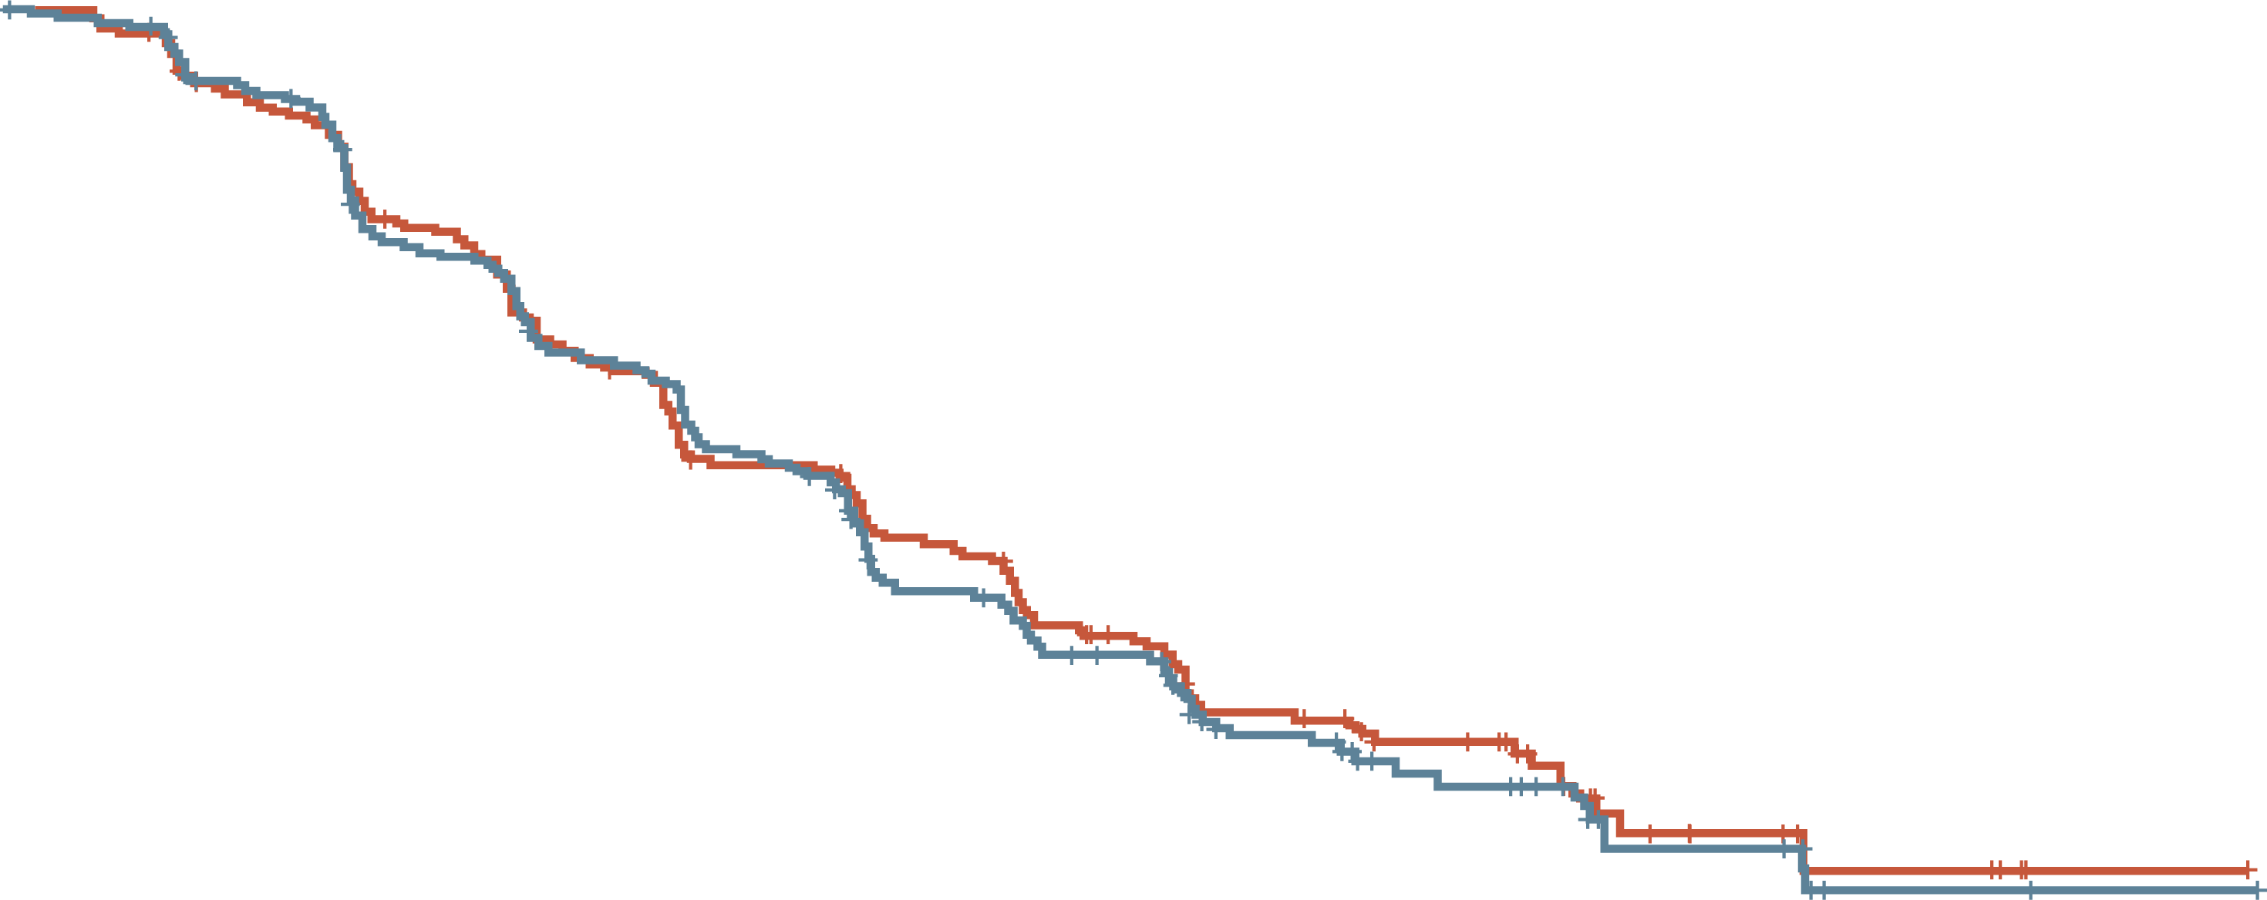
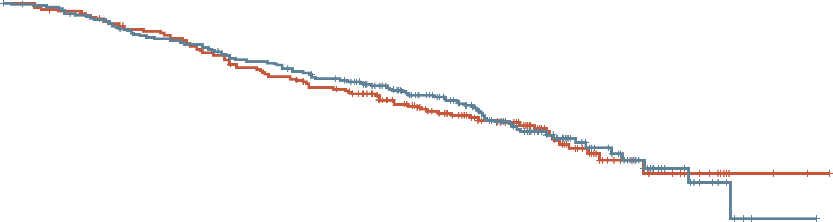
CONTACT-03: efficacy results
rPFS (Centrally Reviewed)
OS (INTERIM ANALYSIS)
 | Atezo + cabo (N=263) | Cabo (N=259)
PFS events, n (%) | 171 (65) | 166 (64)
Median PFS (95% CI), mo | 10.6 (9.8-12.3) | 10.8 (10.0-12.5)
12-month PFS (95% CI), % | 44 (38-50) | 48 (42-54)
Stratified HR (95% CI)ª | 1.03 (0.83-1.28); p=0.784^{b}
100
100
80
80
60
60
PFS per central review (%)
Overall Survival (%)
 | Atezo + cabo (N=263) | cabo (N=259)
PFS events, n (%) | 89 (34) | 87 (34)
Median OS (95% CI), mo | 25.7 (25.1-NE) | NE (21.1-NE)
12-month OS (95% CI), % | 79 (73-84) | 76 (71-81)
Stratified HR (95% CI)ª | 0.94 (0.70-1.27); p=0.690
40
40
20
20
0
0
0
2
4
6
8
10
12
14
16
18
20
22
24
26
0
2
4
6
8
10
12
14
16
18
20
22
24
26
28
Number at risk
Atezo + cabo
Cabo
Time (months)
Number at risk
Atezo + cabo
Cabo
Time (months)
263 | 253 | 226 | 188 | 158 | 133 | 100 | 68 | 43 | 22 | 7 | 6 | 2 | 1
259 | 242 | 216 | 183 | 153 | 130 | 109 | 71 | 52 | 34 | 12 | 8 | 5 | 1
263 | 259 | 240 | 229 | 215 | 207 | 196 | 157 | 127 | 91 | 50 | 31 | 15 | 3 | 1
259 | 247 | 235 | 221 | 207 | 195 | 182 | 145 | 113 | 88 | 50 | 22 | 11 | 3 | 2
ª Stratified for IMCD risk group; ^{b} Non-significant at α=0.02
ª Stratified for IMDC risk group
atezo, atezolizumab; cabo, cabozantinib; CI, confidence interval; HR, hazard ratio; IDMC, International Metastatic RCC Database Consortium; NE, not evaluable; OS, overall survival; (r)PFS, (radiographic) progression-free survival
Choueiri T, et al. J Clin Oncol. 2023;41 (suppl 17): abstr LBA4500 (ASCO 2023 oral presentation)

Slide 9
CONTACT-03: safety results
Adverse event, n (%) | Atezo + cabo (N=262) | Cabo (N=256)
Any-cause AE | 262 (100) | 254 (99.2)
Any-cause treatment-related AE | 252 (96.2) | 249 (97.3)
Grade 3 or 4 AE | 177 (67.6) | 158 (61.7)
Grade 3 or 4 treatment-related AE | 145 (55.3) | 121 (47.3)
Death due to AE | 17 (6.5) | 9 (3.5)
Death due to treatment-related AE | 3 (1.1)ª | 0
Serious AE | 126 (48.1) | 84 (32.8)
Serious treatment-related AE | 63 (24.0) | 30 (11.7)
AE leading to withdrawal from a trial drug | 41 (15.6) | 10 (3.9)
AE leading to withdrawal from atezo | 29 (11.1) | –
AE leading to withdrawal from cabo | 25 (9.5) | 10 (3.9)
AE leading to interruption or reduction of a trial drug | 240 (91.6) | 223 (87.1)
AE leading to interruption of atezo^{b} | 159 (60.7) | –
AE leading to interruption or reduction of cabo | 234 (89.3) | 223 (87.1)
ª Treatment-related AEs leading to death were immune-mediated enterocolitis and renal failure (both related to atezo) and intestinal perforation (related to cabo) ^{b} Dose reduction of atezo was not permitted
AE, adverse events; atezo, atezolizumab; cabo, cabozantinib
Choueiri T, et al. J Clin Oncol. 2023;41 (suppl 17): abstr LBA4500 (ASCO 2023 oral presentation)

Slide 10
CONTACT-03: summary
For patients with mRCC, adding the PD-L1 inhibitor atezolizumab to cabozantinib did not improve clinical outcomes compared with treatment with cabozantinib alone
Higher toxicities were also observed in the combination arm
Clinical Perspective
CONTACT-03 is the first randomised, phase 3 oncology trial to test the benefit of PD-(L)1 inhibitor continuation by direct addition to a standard control arm; the results prompt caution with this approach in other cancers
mRCC, metastatic renal cell carcinoma; PD1, programmed cell death protein 1; PD-L1, programmed death-ligand 1
Choueiri T, et al. J Clin Oncol. 2023;41 (suppl 17): abstr LBA4500 (ASCO 2023 oral presentation)

Slide 11
Pembrolizumab plus axitinib versus sunitinib as first-line therapy for advanced ccrcc: 5-year analysis of KEYNOTE-426
Rini B, et al. ASCO 2023. Abstract #LBA4501
ccRCC, clear cell renal cell carcinoma

Slide 12
Keynote-426: background and study design
At the first interim analysis of the randomised, open-label, phase 3 KEYNOTE-426 study, first-line pembrolizumab + axitinib showed statistically significant OS, PFS, and ORR over sunitinib for advanced ccRCC
Long-term results after a median follow-up of 67 months (minimum 60 months) are reported
Pembrolizumab 200 mg IV Q3W for up to
35 cycles (approximately 2 years)
+
axitinib 5 mg orally twice dailyª
N=432
Key eligibility criteria:
Newly diagnosed or recurrent stage IV clear cell RCC
No previous systemic treatment for advanced disease
Measurable disease per RECIST v1.1
R
1:1
Sunitinib 50 mg orally once daily for first
4 weeks of each 6-week cycle^{b}
N=861
N=429
Stratification factors:
IMDC risk group
(favourable vs intermediate vs poor)
Geographic region
(North America vs Western Europe vs RoW)
Endpoints:
Dual primary: PFS (RECIST v1.1, BICR) and OS in ITT
Key secondary: ORR (RECIST v1.1, BICR) in ITT
Other secondary: DoR (RECIST v1.1, BICR), safety
ª Axitinib dose could be increased to 7 mg, then 10 mg, twice daily if safety criteria were met; dose could be reduced to 3 mg, then 2 mg, twice daily to manage toxicity
^{b} Sunitinib dose could be decreased to 37.5 mg, then 25 mg, once daily for the first 4 weeks of each 6-week cycle to manage toxicity. Data cut-off: January 23, 2023
BICR, blinded central independent review; (cc)RCC, (clear cell) renal cell carcinoma; DoR, duration of response; IMDC, International Metastatic RCC Database Consortium; ITT, intention-to-treat; IV, intravenously; ORR, objective response rate; OS, overall survival; PFS, progression-free survival; Q3W, every 3 weeks; R, randomised; RECIST v1.1, Response Evaluation Criteria in Solid Tumours version 1.1; RoW, rest of world
Rini B, et al. J Clin Oncol. 2023;41 (suppl 17): abstr LBA4501 (ASCO 2023 oral presentation)

Slide 13
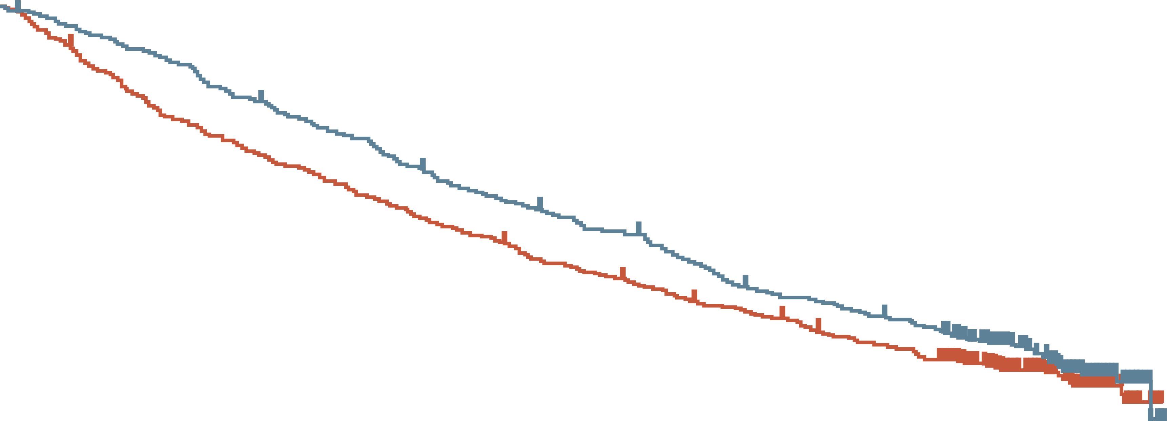
Keynote-426: EFFICACY results (ITT population)
FINAL OS ANALYSIS
EFFICACY SUMMARY
 | Pembro + axitinib (n=432) | Sunitinib (n=429)
Events, n (%) | 270 (62.5) | 280 (65.3)
Median (95% CI), mo | 47.2 (43.6-54.8) | 40.8 (34.3-47.5)
HR (95% CI) | 0.84 (0.71-0.99)
100
End of pembrolizumab
treatment
90
 | Pembro + axitinib (n=432) | Sunitinib (n=429) | Sunitinib (n=429)
Progression-free survival Events, n Median (95% CI), mo HR (95% CI) | 306 15.7 (13.6-20.2) | 11.1 (8.9-12.5) | 311 11.1 (8.9-12.5)
 | 0.69 (0.59-0.81)
Best Overall Response ORR, % CR, % | 60.6 11.6 | 39.6 4.0%
Duration of Response Pts with response, n Median, mo (95% CI) | 262 23.6 (1.4+ to 68.6+) | 170 15.3 (2.3-68.3)
80
62.6%
53.8%
70
60
49.2%
45.0%
41.9%
37.1%
Overall survival (%)
50
40
30
20
10
0
0
6
12
18
24
30
36
42
48
54
60
66
72
78
Number at risk
Pembro + axitinib
Sunitinib
Time (months)
432 | 409 | 386 | 347 | 320 | 287 | 268 | 242 | 209 | 194 | 173 | 88 | 14 | 0
429 | 379 | 336 | 306 | 279 | 252 | 228 | 210 | 189 | 170 | 152 | 76 | 9 | 0
Data cut-off: January 23, 2023
CI, confidence interval; CR, complete response; DoR, duration of response; HR, hazard ratio; ITT, intention-to-treat; mo, months; ORR, objective response rate; OS, overall survival; pembro, pembrolizumab; PFS, progression-free survival
Rini B, et al. J Clin Oncol. 2023;41 (suppl 17): abstr LBA4501 (ASCO 2023 oral presentation)

Slide 14
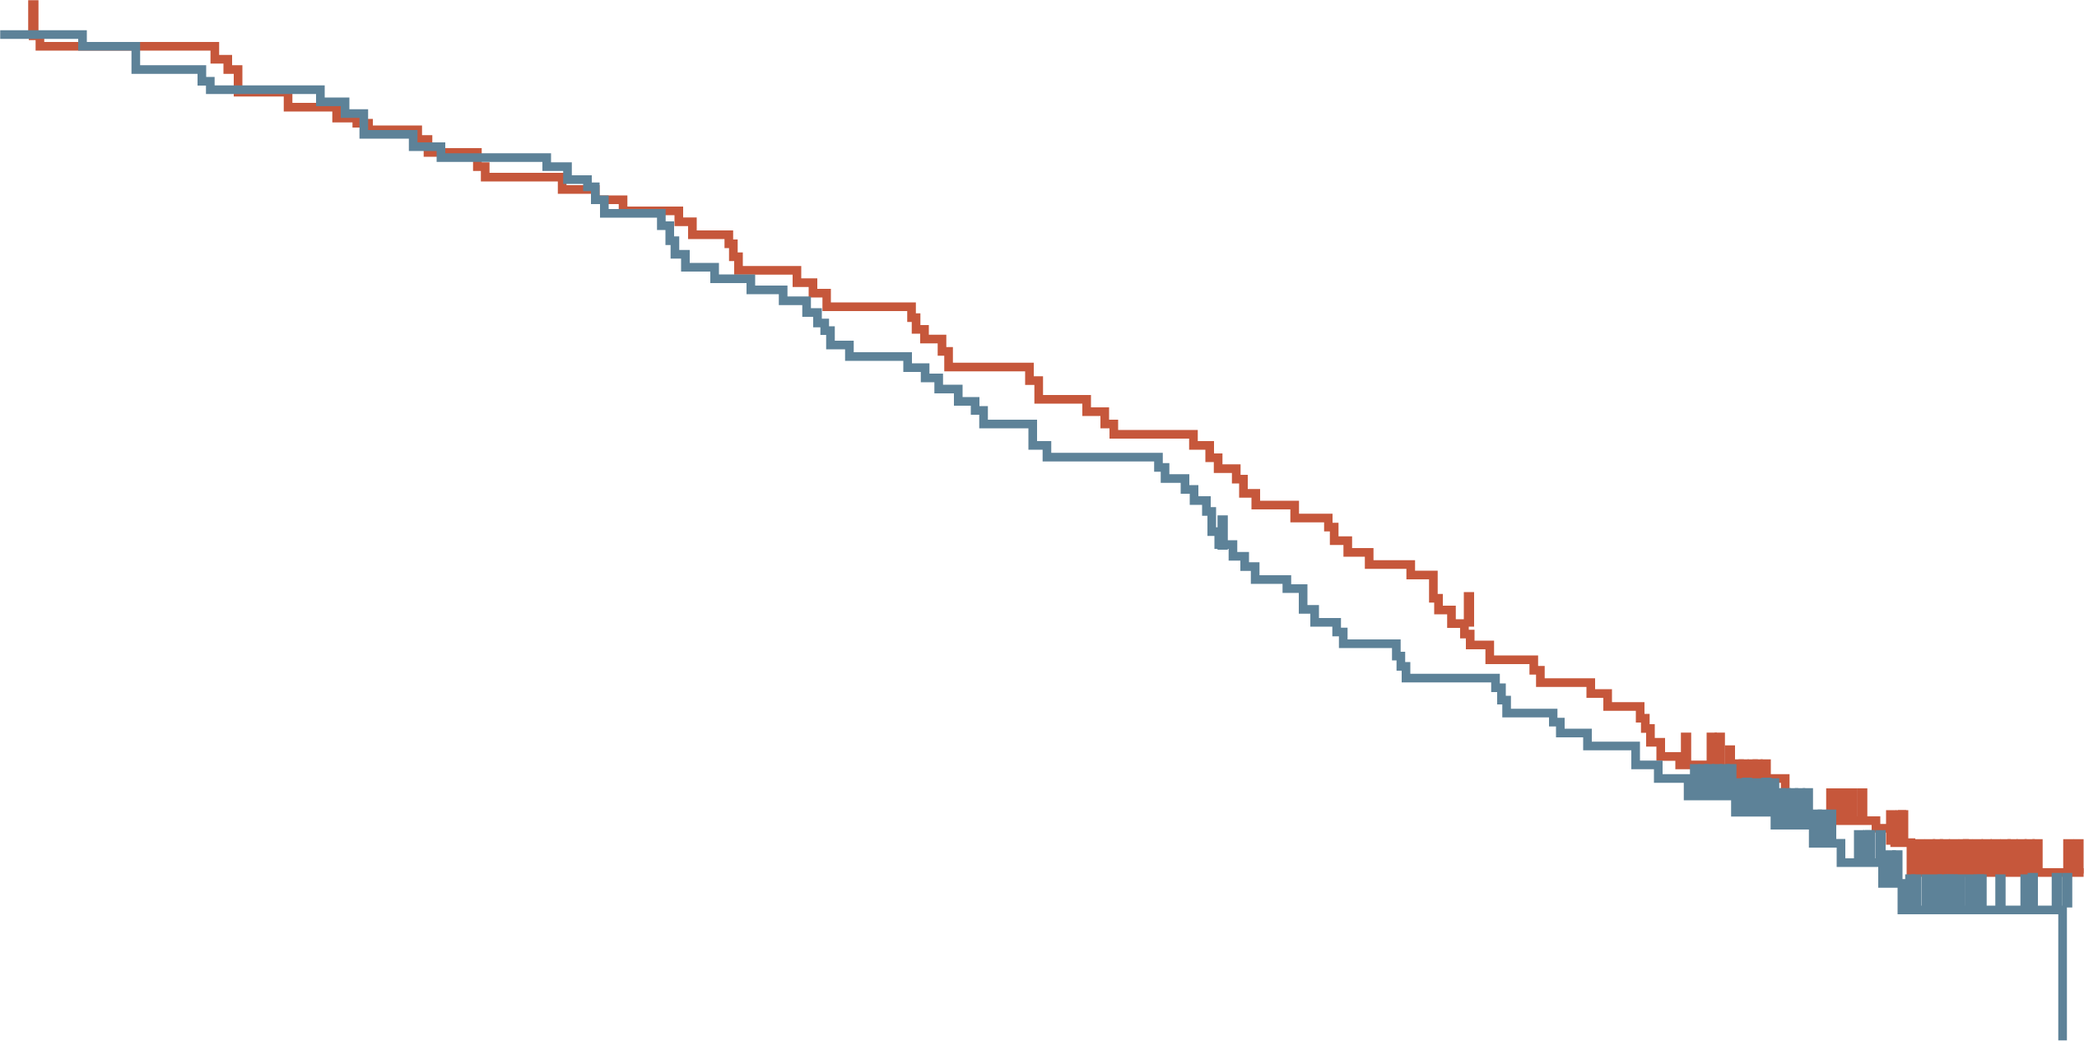
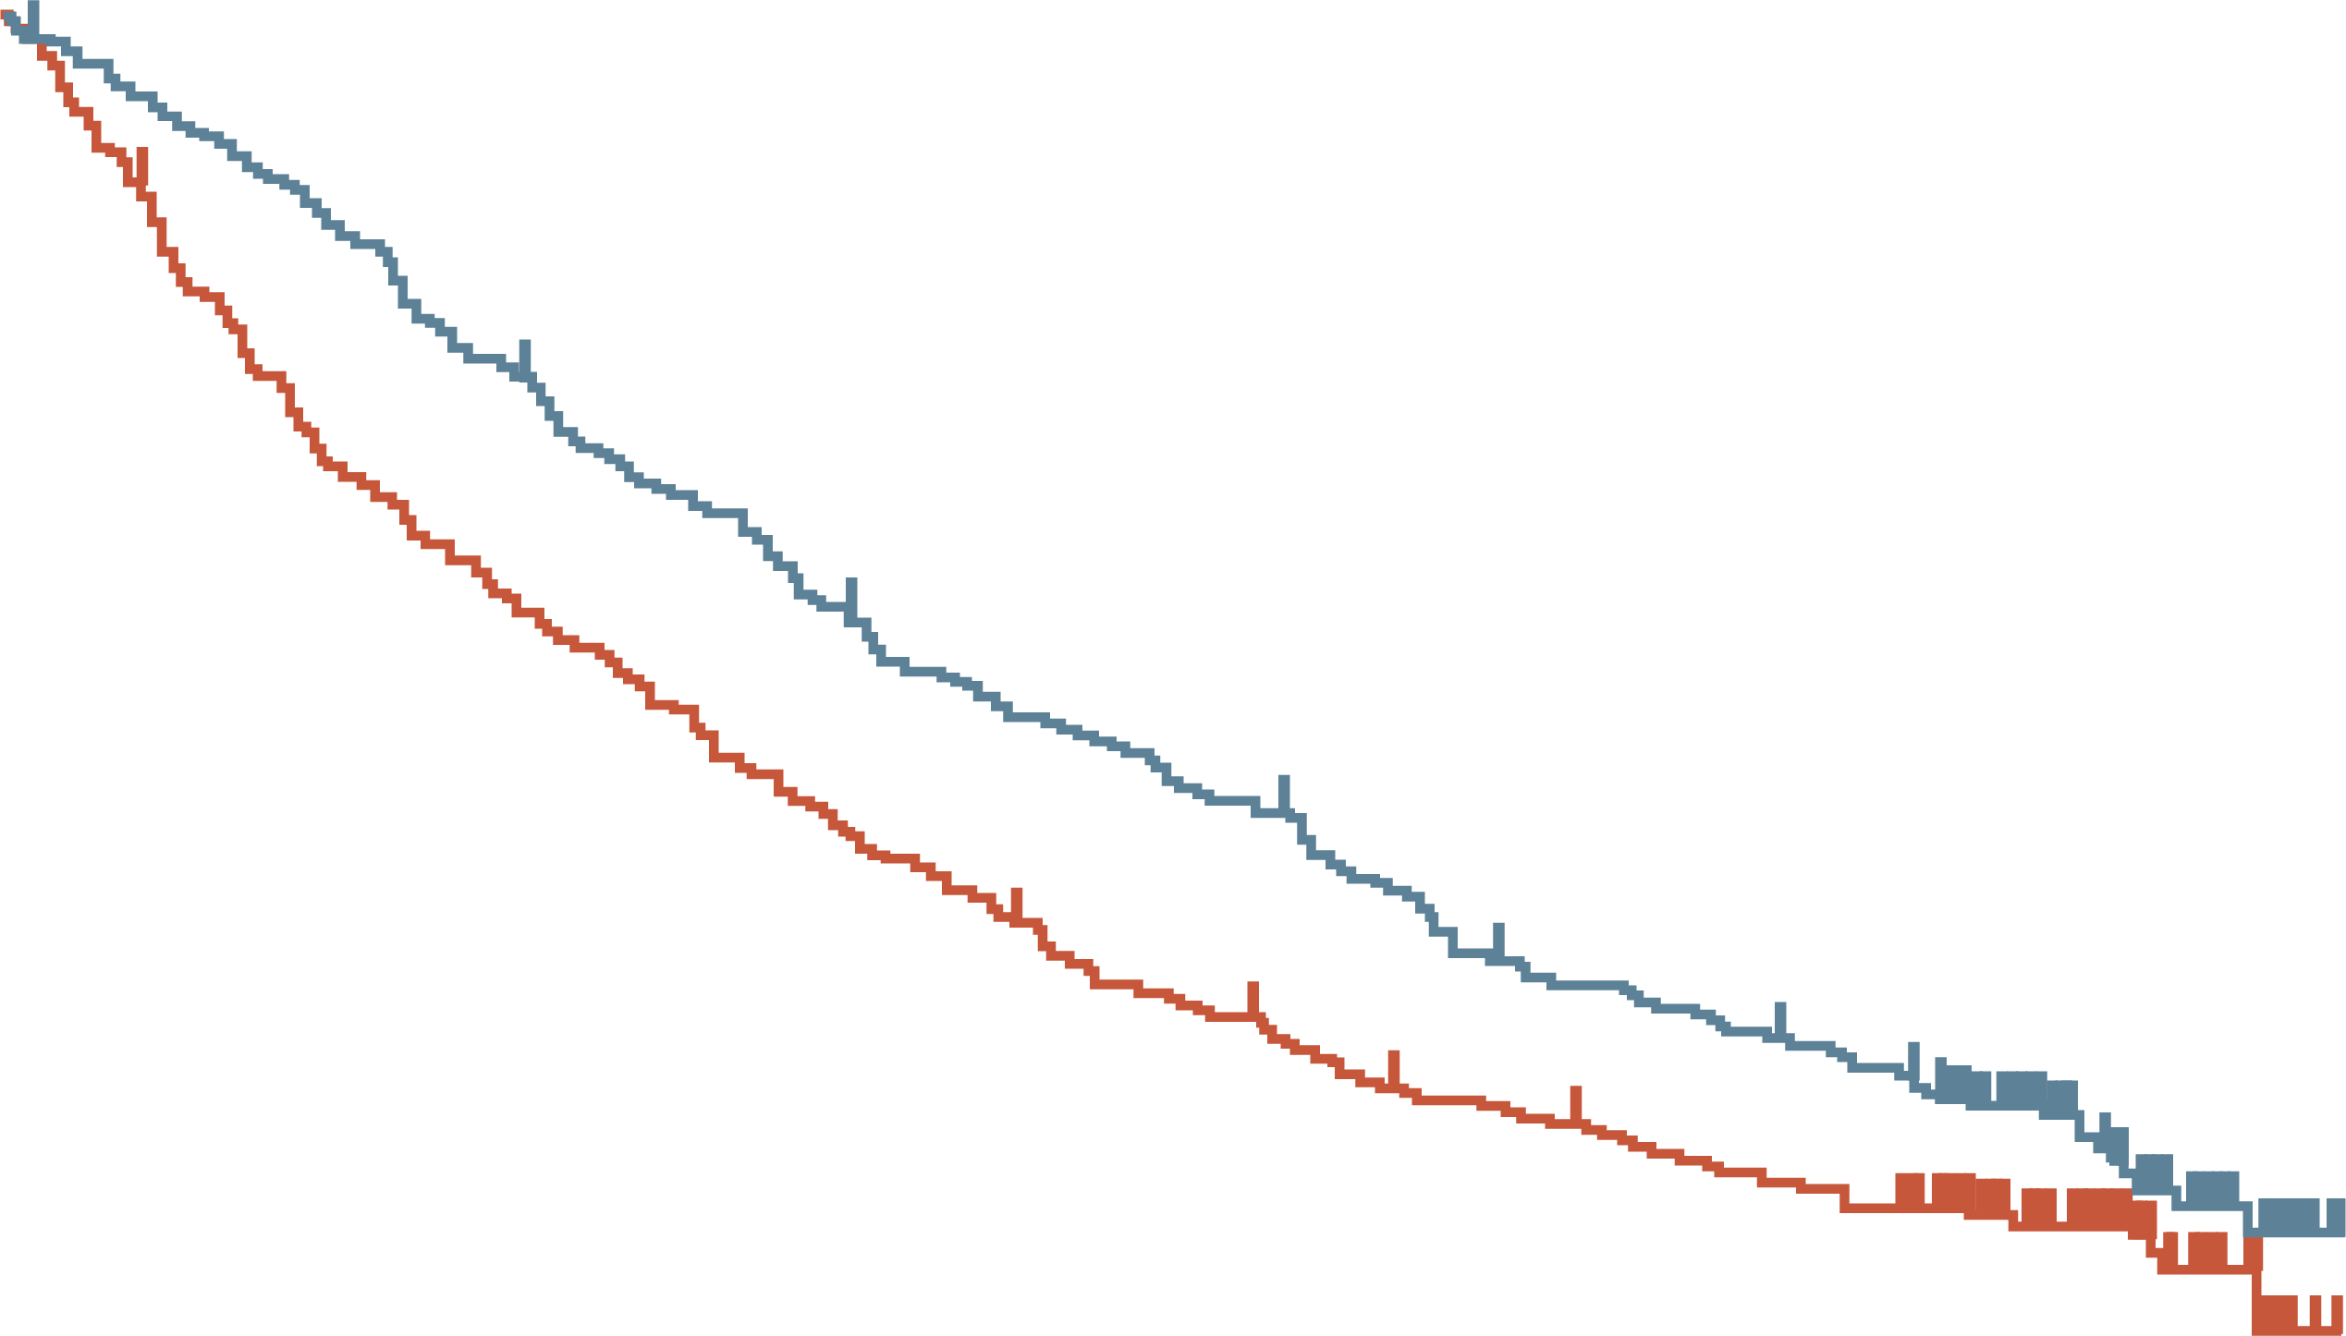
Keynote-426: final OS in IDMC risk subgroups
FAVOURABLE RISK
INTERMEDIATE/POOR RISK
 | Pembro + axitinib | Sunitinib
Events, n (%) | 194 (66.0) | 212 (71.1)
Median (95% CI), mo | 42.2 (36.5-47.9) | 29.3 (23.7-34.3)
HR (95% CI) | 0.76 (0.62-0.93)
100
74.6%
78.5%
100
90
90
80
80
70
50.0%
52.2%
70
56.9%
42.9%
60
60
38.0%
30.4%
Overall survival (%)
Overall survival (%)
50
50
40
40
30
 | Pembro + axitinib | Sunitinib
Events, n (%) | 76 (55.1) | 68 (51.9)
Median (95% CI), mo | 60.3 (49.6-NE) | 62.4 (54.1-NE)
HR (95% CI) | 1.10 (0.79-1.54)
30
20
20
10
10
0
0
0
6
12
18
24
30
36
42
48
54
60
66
72
78
0
6
12
18
24
30
36
42
48
54
60
66
72
78
Number at risk
Pembro + axitinib
Sunitinib
Time from randomisation (months)
Number at risk
Pembro + axitinib
Sunitinib
Time from randomisation (months)
138 | 135 | 132 | 127 | 118 | 109 | 103 | 97 | 83 | 77 | 67 | 36 | 5 | 0
131 | 129 | 123 | 118 | 114 | 107 | 102 | 96 | 86 | 76 | 66 | 33 | 3 | 0
294 | 274 | 254 | 220 | 202 | 178 | 165 | 145 | 128 | 117 | 106 | 52 | 9 | 0
298 | 250 | 213 | 188 | 165 | 145 | 126 | 114 | 103 | 94 | 86 | 43 | 6 | 0
CI, confidence interval; HR, hazard ratio; IDMC, International Metastatic RCC Database Consortium; mo, months; NE, not evaluable; OS, overall survival; pembro, pembrolizumab
Rini B, et al. J Clin Oncol. 2023;41 (suppl 17): abstr LBA4501 (ASCO 2023 oral presentation)

Slide 15
Keynote-426: safety summary
No new safety signals were observed
 | Pembrolizumab + axitinib N=429 | Sunitinib N=425
Any adverse event | 422 (98.4) | 425 (100)
Treatment-related adverse event | 413 (96.3) | 415 (97.6)
Grade 3 to 5 treatment-related adverse event | 291 (67.8) | 270 (63.5)
Serious treatment-related adverse event | 126 (29.4) | 69 (16.2)
Discontinuation of any drug because of a treatment‑related adverse event | 143 (33.3) | 58 (13.6)
Death from treatment-related adverse event | 5 (1.2) | 6 (1.4)
Values are n (%). Data cut-off: January 23, 2023
Rini B, et al. J Clin Oncol. 2023;41 (suppl 17): abstr LBA4501 (ASCO 2023 oral presentation)

Slide 16
Keynote-426: summary
KEYNOTE-426 represents the longest follow-up to date of the combination of a checkpoint inhibitor plus a VEGFR-TKI for the first-line clear cell RCC
Pembrolizumab + axitinib continued to demonstrate improved overall survival, progression free survival, and objective response rate versus sunitinib for patients with previously untreated clear cell RCC
  Benefit was observed despite a greater proportion of patients in the sunitinib arm receiving therapy, including predominantly PD-(L)1 inhibitors, and more lines of therapy
No new safety signals were observed in this updated analysis
Clinical Perspective
Long-term follow up data re-confirms current clinical practice for IDMC intermediate/poor risk patients
IDMC, International Metastatic RCC Database Consortium; PD1, programmed cell death protein 1; PD-L1, programmed death-ligand 1; RCC, renal cell carcinoma; VEGFR-TKI, vascular endothelial growth factor receptor tyrosine kinase inhibitor
Rini B, et al. J Clin Oncol. 2023;41 (suppl 17): abstr LBA4501 (ASCO 2023 oral presentation)

Slide 17
Final prespecified OS analysis of CLEAR: 4-year follow-up of lenvatinib plus pembrolizumab vs sunitinib in patients with aRCC
Motzer RJ, et al. ASCO 2023. Abstract #4502
aRCC, advanced renal cell carcinoma; OS, overall survival

Slide 18
clear: background and study design
In the phase 3 CLEAR trial, lenvatinib + pembrolizumab showed clinically meaningful and statistically significant benefits in PFS and OS, and improved ORR compared with sunitinib in 1L aRCC
4-yr follow-up results from the final prespecified OS analysis of CLEAR are reported
(data cutoff: 31 Jul 2022)
Lenvatinib
20 mg oral QD
+
pembrolizumabª
200 mg IV Q3W
Key eligibility criteria:
Advanced clear-cell RCC
Treatment-naïve
Karnofsky performance status ≥70
Measurable disease
Adequate organ function
Primary endpoint:
PFS by IRC per RECIST v1.1
Secondary endpoints:
OS
ORR by IRC per RECIST v1.1
Safety
PFS by investigator assessment
Key exploratory endpoints:
DoR
ORR by investigator assessment
Lenvatinib
18 mg oral QD
+
everolimus
5 mg oral QD
R
1:1:1
Stratification factors:
Geographic region: Western Europe and North America vs rest of the world
MSKCC risk category: favourable, intermediate or poor
Sunitinib
50 mg oral QD
4 weeks on/
2 weeks off
Tumour assessments were performed by an IRC and assessed via RECIST v1.1
ª Patients could receive a maximum of 35 pembrolizumab treatments
1L, first line; (a)RCC, (advanced) renal cell carcinoma; DoR, duration of response; HRQoL, health-related quality of life; IRC, independent review committee; IV, intravenously; MSKCC, Memorial Sloan Kettering Cancer Center; ORR, objective response rate; QD, once daily; OS, overall survival; PFS, progression-free survival; Q3W, once every 3 weeks; R, randomisation; RECIST v1.1, Response Evaluation Criteria In Solid Tumours version 1.1
Motzer R, et al. N Eng J Med 2021; 384 (14):1289-1300; Motzer R, et al. J Clin Oncol 2023;41 (suppl 16): abstr 4502 (ASCO 2023, oral presentation)

Slide 19
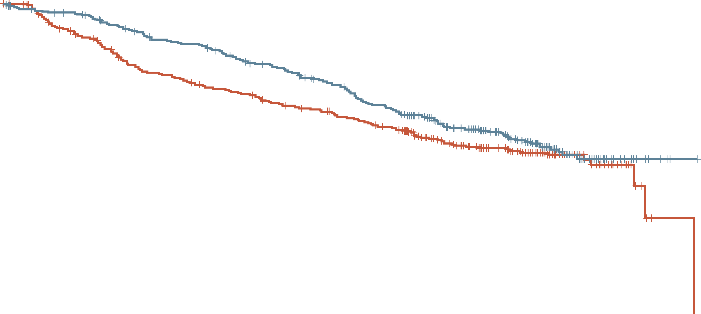
clear: EFFICACY RESULTS
FINAL OS ANALYSIS
EFFICACY SUMMARY
 | Len + pembro (N=355) | Sun (N=357)
No. of events | 149 | 159
Median OS (95% CI), mo | 53.7 (48.7-NE) | 54.3 (40.9-NE)
HR (95% CI) | 0.79 (0.63-0.99)
Nominal p value | 0.0424
1.0
0.9
80.4%
 | Len + pembro (N=N55) | Sun (N=357)
Median follow-up (95% CI), mo | 49.8 (48.8-50.4) | 49.4 (48.1-50.1)
PFS HR vs sunitinib (95% CI) | 0.47 (0.38-0.57); p<0.0001ª
PFS rate at 24/36 mo, % | 49.0/37.3 | 23.4/17.6
ORR (95% CI), % CR, % | 71.3 (66.6-76.0); 18.3 | 36.7 (31.7-41.7); 4.8
Median DoR (95% CI), mo | 26.7 (22.8-34.6) | 14.7 (9.4-18.2)
0.8
0.7
66.4%
0.6
69.6%
60.2%
Len + pembro
0.5
Survival probability
0.4
Sun
0.3
0.2
0.1
ªNominal p-values
0
0
6
12
18
24
30
36
42
48
54
60
66
Number at risk
Len + pembro
Sun
Time (months)
355 | 338 | 313 | 296 | 269 | 245 | 216 | 158 | 117 | 34 | 5 | 0
357 | 308 | 264 | 242 | 226 | 208 | 188 | 145 | 108 | 33 | 3 | 0
At median OS follow-up time of 49.8 months (IQR: 41.4-53.1) in the lenvatinib plus pembrolizumab group and 49.4 months (IQR: 41.6-52.8) in the sunitinib group
CI, confidence interval; CR, complete response; DoR, duration of response; HR, hazard ratio; IQR, inter-quartile range; len, lenvatinib; mo, months; NE, not evaluable; ORR, objective response rate; OS, overall survival; pembro, pembrolizumab; PFS, progression-free survival; sun, sunitinib
Motzer R, et al. J Clin Oncol 2023;41 (suppl 16): abstr 4502 (ASCO 2023, oral presentation)

Slide 20
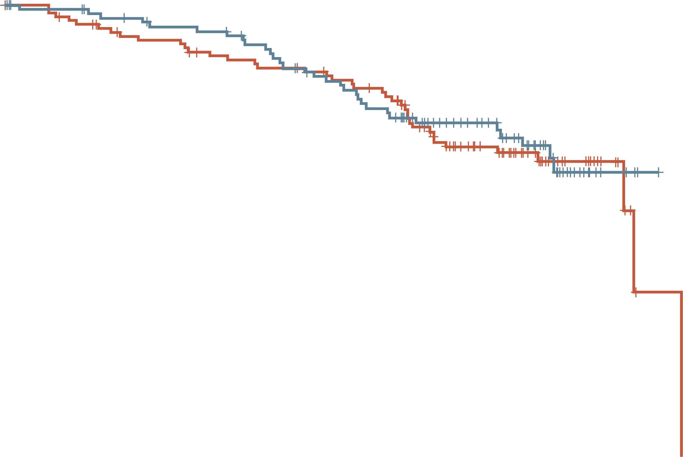
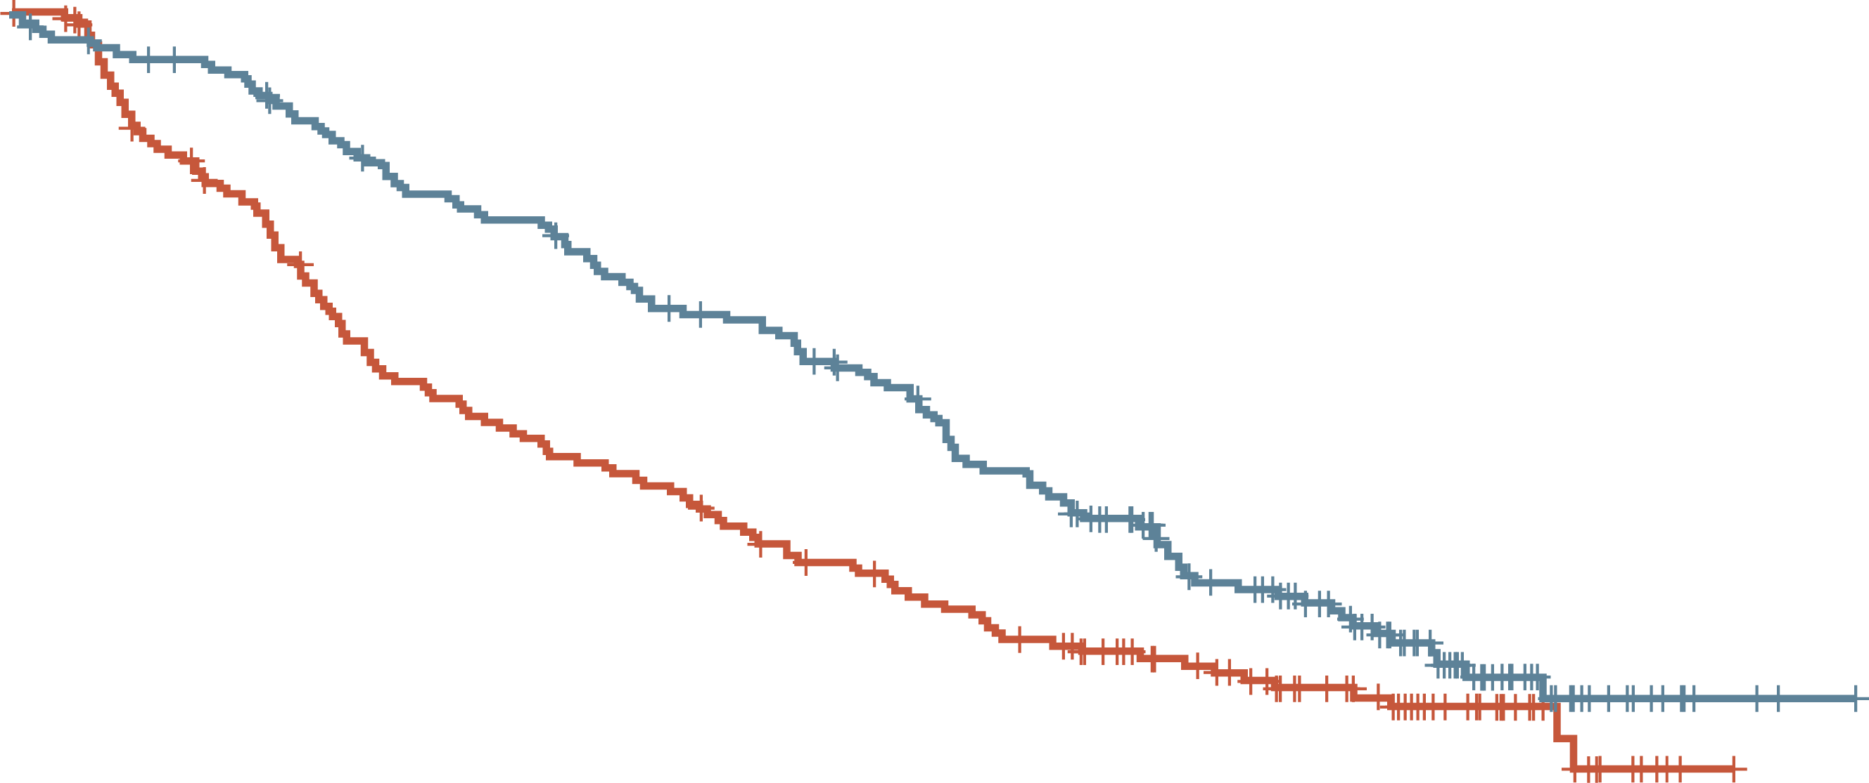
clear: final OS in IDMC risk subgroups
FAVOURABLE
INTERMEDIATE + POOR
1.0
1.0
0.9
0.9
0.8
Len + pembro
0.8
0.7
0.7
0.6
0.6
0.5
0.5
Len + pembro
Survival probability
Survival probability
0.4
Sun
0.4
0.3
0.3
Sun
0.2
 | Len + pembro | Sun
Median OS (95% CI), mo | NR (NE-NE) | 59.9 (58.8-NE)
HR (95% CI) | 0.94 (0.58-1.52)
0.2
 | Len + pembro | Sun
Median OS (95% CI), mo | 47.9 (40.5-NE) | 34.3 (26.3-54.3)
HR (95% CI) | 0.74 (0.57-0.96)
0.1
0.1
0
0
0
6
12
18
24
30
36
42
48
54
60
66
0
6
12
18
24
30
36
42
48
54
60
66
Number at risk
Len + pembro
Sun
Time (months)
Number at risk
Len + pembro
Sun
Time (months)
110 | 106 | 101 | 98 | 92 | 83 | 76 | 57 | 42 | 11 | 2 | 0
124 | 115 | 107 | 102 | 98 | 95 | 88 | 65 | 46 | 15 | 2 | 0
243 | 230 | 210 | 196 | 176 | 161 | 139 | 101 | 75 | 23 | 3 | 0
229 | 190 | 155 | 138 | 127 | 112 | 99 | 79 | 61 | 18 | 1 | 0
IMDC risk group was not a stratification factor and relevant data were derived programmatically. Hazard ratio is for lenvatinib + pembrolizumab vs sunitinib based on a Cox regression model with treatment as a factor. The Efron method was used for correction of tied events. Medians were estimated by the Kaplan-Meier method, and the 95% CIs were estimated with a generalised Brookmeyer and Crowley method
CI, confidence interval; HR, hazard ratio; IDMC, International Metastatic RCC Database Consortium; len, lenvatinib; NE, not evaluable; NR, not reached; OS, overall survival; pembro, pembrolizumab; sun, sunitinib
Motzer R, et al. J Clin Oncol 2023;41 (suppl 16): abstr 4502 (ASCO 2023, oral presentation)

Slide 21
clear: safety results (TRAEs ≥25%ª)
No new safety signals were detected
Len + pembro (N=352) (%)
Sun (N=340) (%)
Diarrhoea
Hypertension
Hypothyroidism
Decreased appetite
Fatigue
Stomatitis
Proteinuria
PPES
Nausea
Dysphonia
Dysgeusia
56.0
9.1
4.4
45.3
54.3
26.7
19.1
40.3
44.9
1.1
0
24.1
TRAEs – % | Len + pembro (N=352) | Sun (N=340)
Any grade | 96.9 | 92.1
Grade ≥3 | 74.1 | 60.3
Deaths | 1.1 | 0.3
35.5
3.4
1.5
25.3
34.1
3.7
4.1
32.9
32.7
1.7
2.1
37.4
30.4
9.7
3.2
13.5
28.7
4.0
3.2
36.2
28.1
1.7
0.6
28.2
25.0
0
0
2.6
Any grade
Grade ≥3
Grade ≥3
Any grade
11.1
0.3
0.3
25.9
70
60
50
40
30
20
10
0
10
20
30
40
50
60
70
The median duration of treatment was 22.6 months (IQR: 9.4-37.1) in the Len + pembro group and 7.8 months (3.7-19.4) in the Sun group
ªTRAEs ≥ 25% in either group
QR, interquartile range; len, lenvatinib; pembro, pembrolizumab; PPES, palmar–plantar erythrodysesthesia syndrome; sun, sunitinib; TRAE, treatment related adverse event
Motzer R, et al. J Clin Oncol 2023;41 (suppl 16): abstr 4502 (ASCO 2023, oral presentation)

Slide 22
clear: summary
With extended 4-year follow-up data, the combination of lenvatinib plus pembrolizumab remains superior to sunitinib on clinical outcomes as first-line treatment for advanced renal cell carcinoma
There were no new safety signals and adverse events were managed with dose modifications as necessary
These results support the robustness of the primary analysis data from CLEAR
Clinical Perspective
Long-term follow up data re-confirms current clinical practice of frontline combination immunotherapy/TKI for IDMC intermediate/poor risk patients
IDMC, International Metastatic RCC Database Consortium; TKI, tyrosine kinase inhibitor
Motzer R, et al. J Clin Oncol 2023;41 (suppl 16): abstr 4502 (ASCO 2023, oral presentation)

