Slide 2

DEVELOPED BY BREAST CANCER CONNECT
This programme is developed by BREAST CANCER
CONNECT, an international group of experts in the field
of breast cancer.
Acknowledgement and disclosures
This BREAST CANCER CONNECT programme is supported through an independent educational grant from Menarini Stemline Oncology. The programme is therefore independent, the content is not influenced by the supporter and is under the sole responsibility of the experts.
Please note: The views expressed within this programme are the personal opinions of the experts. They do not necessarily represent the views of the experts’ institutions, or the rest of the BREAST CANCER CONNECT group.
Expert Disclaimers:
Prof. Francois-Clement Bidard discloses financial support/sponsorship from AstraZeneca, Daiichi-Sankyo, Caris, Exact Sciences, General Electrics Healthcare, GSK, Inatherys, Lilly, Merck KGaA, Menarini Silicon Biosystems, Menarini/Stemline, Novartis, Pfizer, Prolynx, Rain Oncology, Roche, SAGA Diagnostics, Seagen, Sanofi

Slide 3
BREAST CANCER CONNECT
ANIMATED VIDEO
OPTIMIZING TREATMENT SELECTION AND MAKE APPROPRIATE SEQUENCING DECISIONS FOR PATIENTS WITH ER+/HER2- MBC PREVIOUSLY TREATED WITH CDK4/6 INHIBITORS
Prof. Francois-Clement Bidard
University of Versailles/Paris-Saclay, Paris, France
September 2023
3
CDK4/6, Cyclin-Dependent Kinase 4/6; ER+, Estrogen Receptor Positive; HER2-, Human Epidermal Growth Factor Receptor 2 Negative;
MBC, Metastatic Breast Cancer

Slide 4
CLINICAL TAKEAWAYS
To optimize treatment selection, molecular characterization should be conducted for each patient, taking into account 'stable' characteristics and 'labile' traits which are often associated with resistance to endocrine therapy
ESR1 mutation testing should be done with a liquid biopsy platform at the time of progression on an aromatase inhibitor as well as after subsequent lines of progression
Elacestrant was the 1st oral SERD to be FDA approved (January 2023), with optimal efficacy and manageable safety for patients with ESR1 mutated ER+/HER2- advanced or metastatic breast cancer
Oral SERDs are being studied as a monotherapy and in combination with targeted therapies (i.e. CDK4/6, PI3K and AKT inhibitors), offering promising prospects for their integration into clinical practice
AKT, Protein Kinase B; CDK4/6, Cyclin-Dependent Kinase 4/6; ESR1, Estrogen Receptor 1; FDA, U.S. Food and Drug Administration; HER2,
Human Epidermal Growth Factor Receptor 2; PI3K, Phosphoinositide 3-Kinase; SERD, Selective Estrogen Receptor Degrader.

Slide 5
CLINICAL SCENARIO

Slide 6
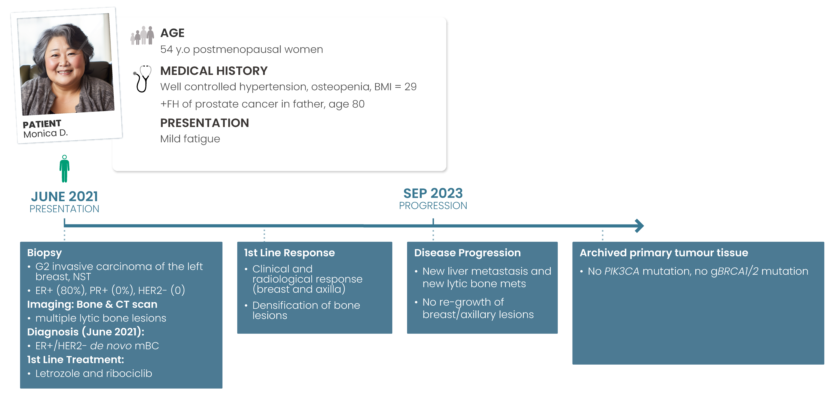
PATIENT CASE: DE NOVO METASTATIC BREAST CANCER
BMI, Body Mass Index; ER+, Estrogen Receptor; FH, Family History; HER2, Human Epidermal Growth Factor Receptor 2; NST, No Special Type; y.o, years old
Notes:
Talking Points:
Elaborate through patients’ personal information, diagnosis & first line of treatment
Based on this case: what are your​
(1) molecular investigation(s) ?​
(2) treatment decision(s) ?

Slide 7
MOLECULAR CHARACTERISATION

Slide 8
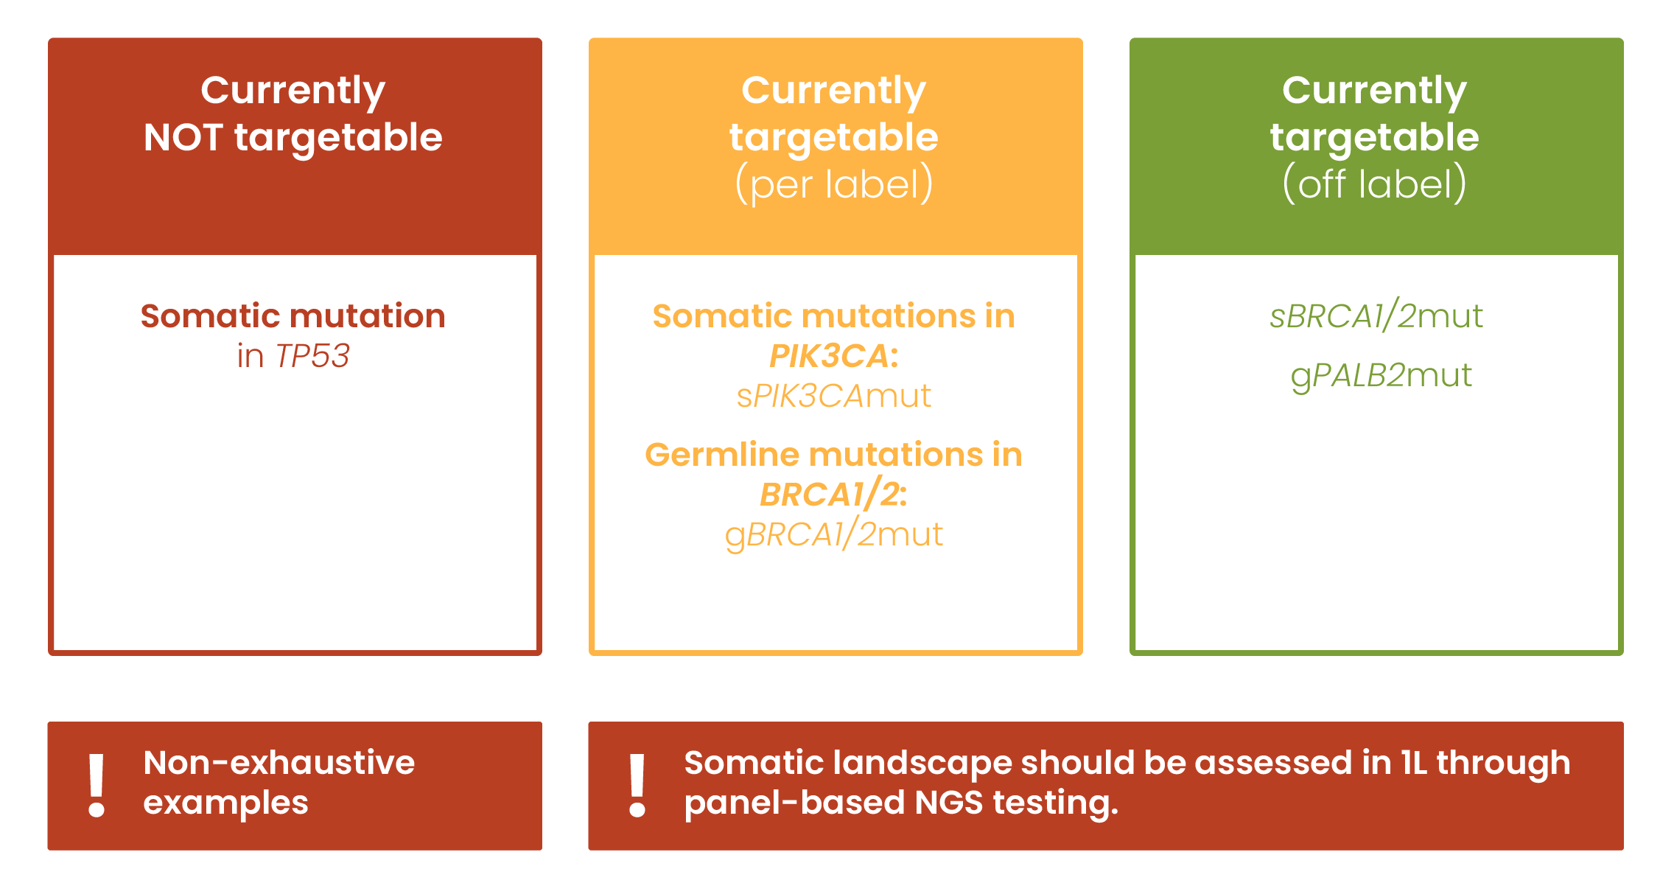
MOLECULAR CHARACTERISATION: ‘STABLE’ BC CHARACTERISTICS
‘STABLE’ BC CHARACTERISTICS
‘LABILE’ BC CHARACTERISTICS
BRCA1/2, Germline mutations in Breast Cancer Susceptibility Genes 1 and 2; gBRCA1/2mut, Germline mutations in Breast Cancer Susceptibility Genes 1 and 2;
gPALB2mut, Germline mutations in Partner and Localizer of BRCA2; PIK3CA, Phosphatidylinositol-4,5-bisphosphate 3-kinase catalytic subunit alpha (gene);
sBRCA1/2mut, Somatic mutations in Breast Cancer Susceptibility Genes 1 and 2; sPIK3CAmut, Somatic mutations in Phosphatidylinositol-4,5-bisphosphate 3-kinase catalytic subunit alpha (gene); TP53, Tumor Protein 53
Notes:
Talking points:
Stable characteristics are unlikely to change over time throughout a patient’s primary diagnosis, possible relapse or progression under AI+CDK4/6i
Such characteristics are clonal genetic abnormalities which drove the early oncogenesis
We can divide them into three categories: Currently Not Targetable, Currently Targetable (per Lable) & Currently Targetable (off label)
Take time to go over each category
Ideally the somatic (+/- germline) mutational landscape has been assessed while the patient was in first line.​
Most common approach: Subjecting archived tumor tissue to panel NGS testing​
Turn around time: varies between institution and depends on the availability of archived tumor block.

Slide 9
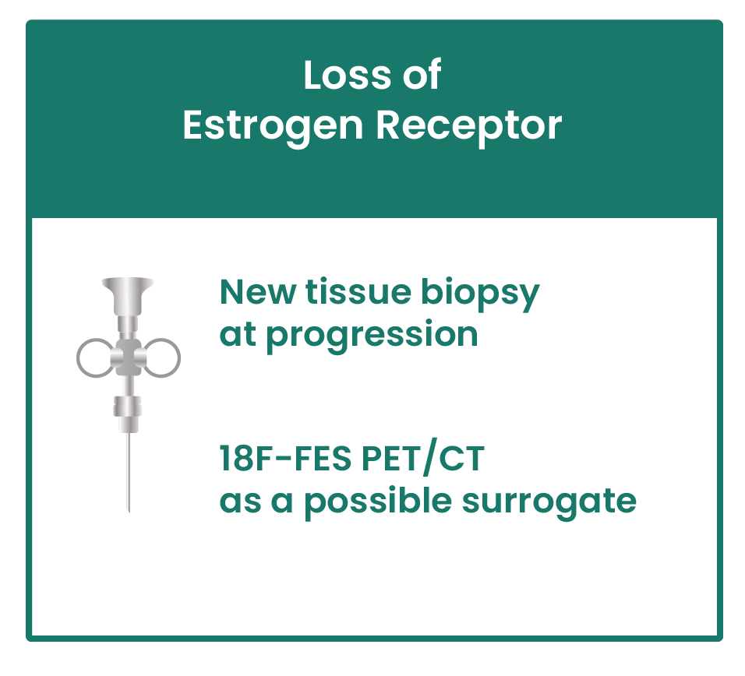
MOLECULAR CHARACTERISATION: ‘LABILE’ BC CHARACTERISTICS
‘STABLE’ BC CHARACTERISTICS
‘LABILE’ BC CHARACTERISTICS
Loss of Estrogen Receptor
ESR1 mutation
18F-FES PET/CT, 18F-Fluoroestradiol Positron Emission Tomography/Computed Tomography
Notes:
Talking points:
Define liable characteristics:
Phenotypic characteristics + genotypic changes associated with resistance to AI and CDK4/6i​
Tissue biopsy should be conducted at progression to check for loss of Estrogen Receptor expression by tumor cell
18F-FES PET/CT as a possible surrogate ​

Slide 10
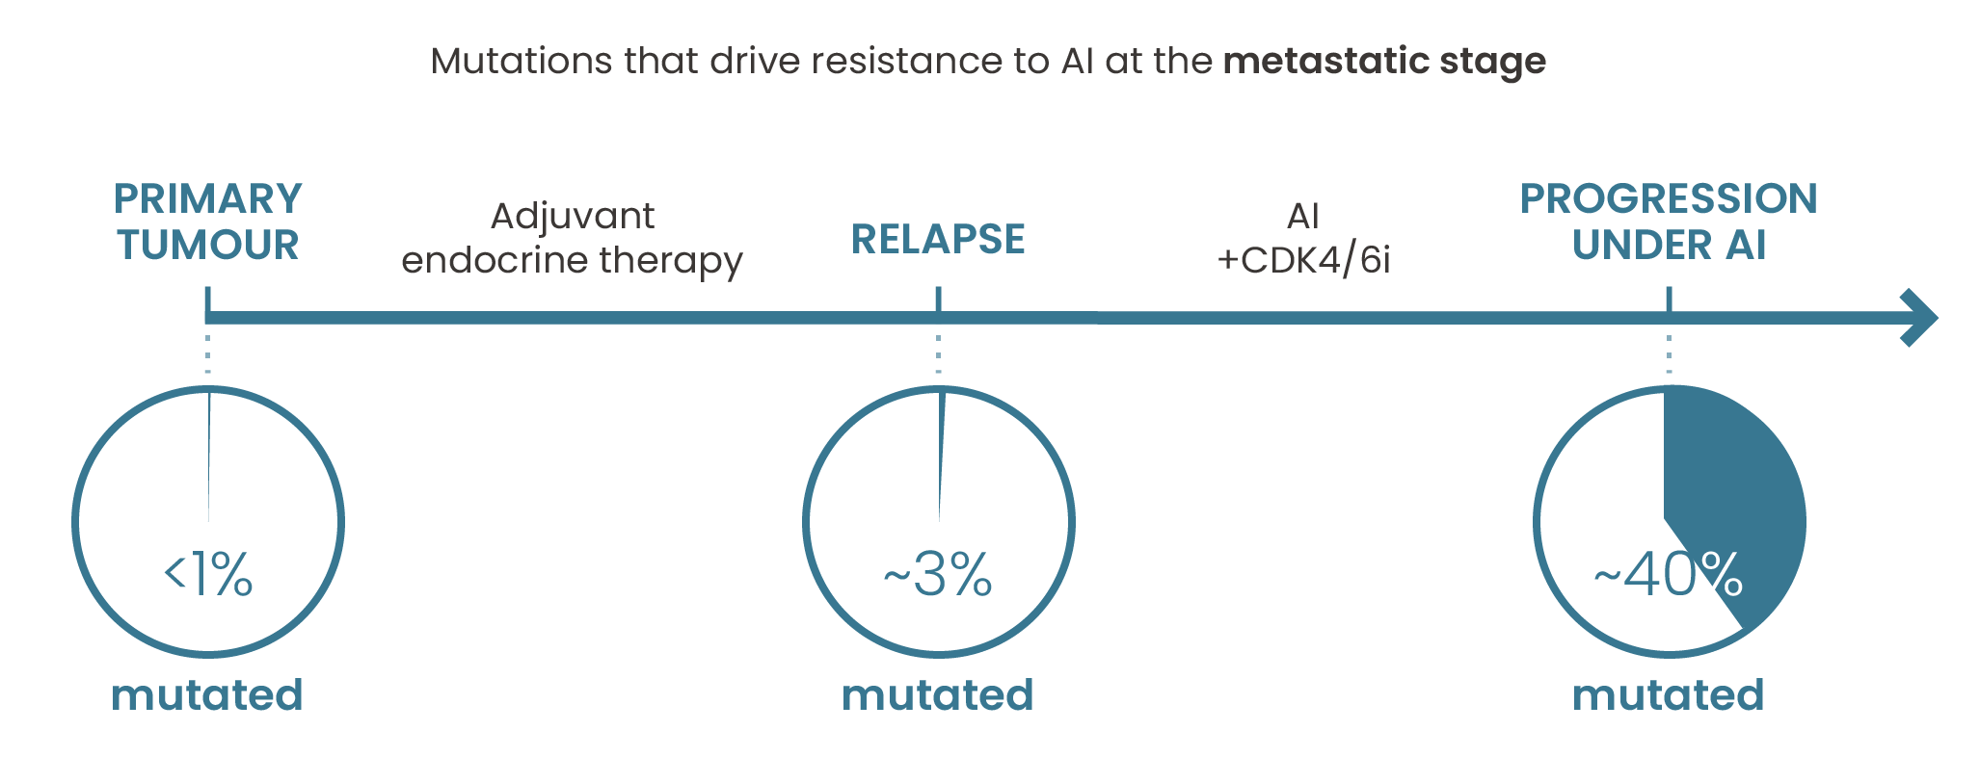


MOLECULAR CHARACTERISATION: ‘LABILE’ BC CHARACTERISTICS
‘STABLE’ BC CHARACTERISTICS
‘LABILE’ BC CHARACTERISTICS
Phenotypic characteristics + genotypic changes associated with resistance to AI and CDK4/6i​
Loss of Estrogen Receptor expression by tumor cell
ESR1 mutation
AI, Artificial Intelligence; CDK4/6i: Cyclin-Dependent Kinase 4/6 Inhibitor; ESR1, Estrogen Receptor 1; SERDs, Selective Estrogen Receptor Degraders
Notes:
Talking points:
Mutations in the Estrogen Receptor gene ‘ESR1’ (ESR1mut)
Mutation driving resistance resistant to AI at metastatic stage are present in :
1% of primary tumors
3% at relapse
40% at progression under an AI
ESR1mut are the MOST frequent resistance-associated mutations in breast cancer
Making them also sensitive to SERDs treatment

Slide 11
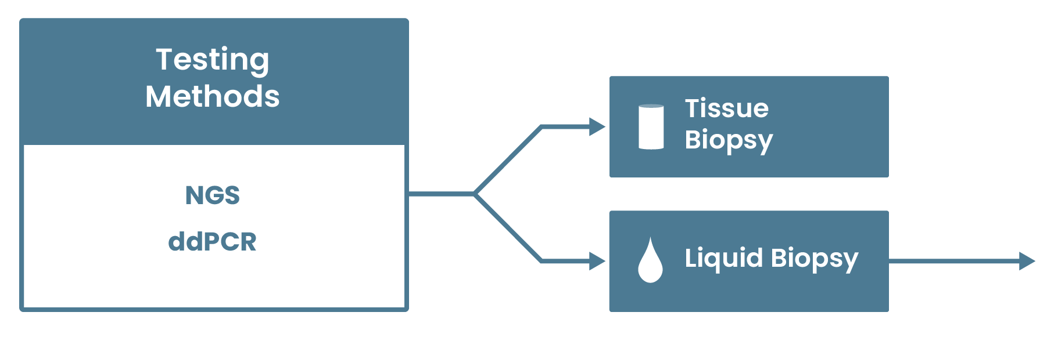
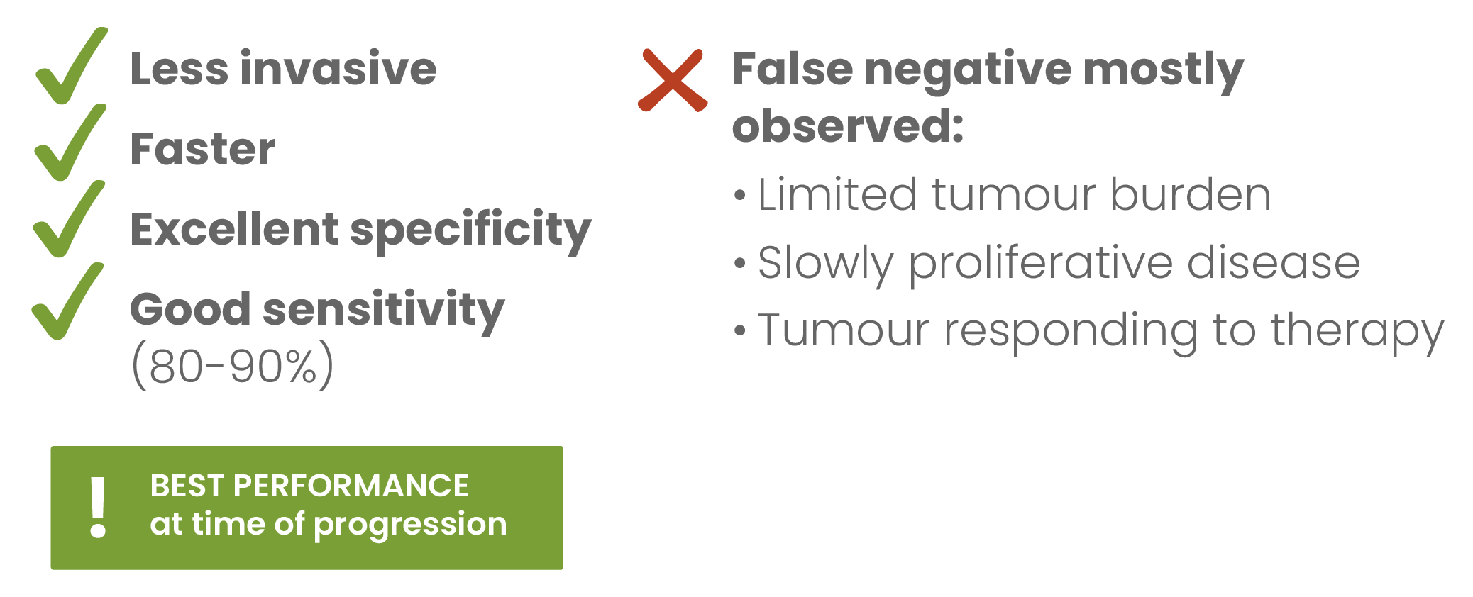
MOLECULAR CHARACTERISATION
‘STABLE’ BC CHARACTERISTICS
‘LABILE’ BC CHARACTERISTICS
Phenotypic characteristics + genotypic changes associated with resistance to AI and CDK4/6i​
Loss of Estrogen Receptor expression by tumor cell
ESR1 mutation
ctDNA, Circulating Tumor DNA; ddPCR, Digital Droplet Polymerase Chain Reaction; ESR1, Estrogen Receptor 1; NGS, Next-Generation Sequencing
Notes:
Talking points
Commonly tested via NGS or ddPCR
Can conduct either tissue Biopsy or Liquid biopsy (shortly explaining pros & cons of each)
For liquid biopsy ctDNA is the golden standard

Slide 12
UPDATED CLINICAL SCENARIO

Slide 13
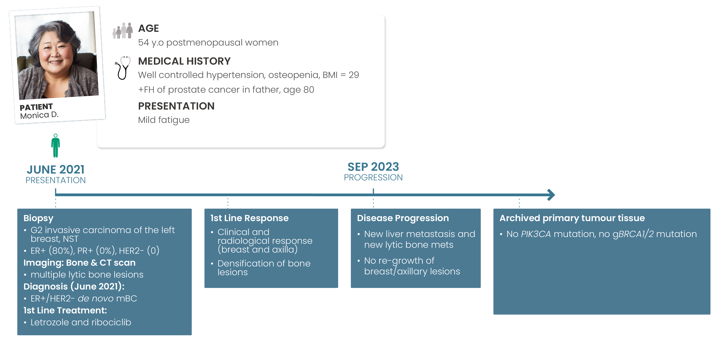
PATIENT CASE: ER+/HER2- METASTATIC BREAST CANCER
ER+, Estrogen Receptor Positive; ESR1, Estrogen Receptor 1; gBRCA1/2, Germline mutations in Breast Cancer Susceptibility Genes 1 and 2;
HER2-, Human Epidermal Growth Factor Receptor 2 Negative; PIK3CA, Phosphatidylinositol-4,5-bisphosphate 3-kinase catalytic subunit alpha (gene)

Slide 14
TREATMENT OPTIONS:
PATIENT CASE SPECIFIC

Slide 15
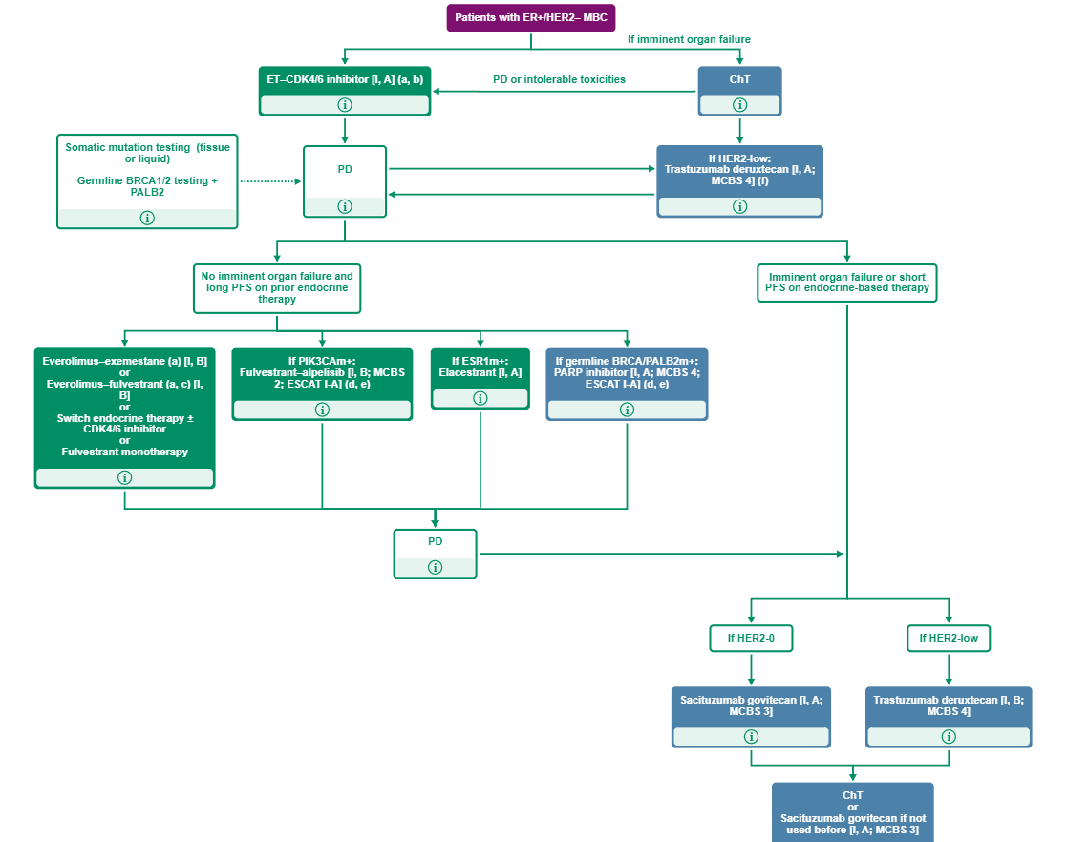
ESMO TREATMENT GUIDELINES FOR ER+/HER2- MBC
ADC, antibody-drug conjugate; BRCA, breast cancer (gene); CDK4/6i, cyclin-dependent kinase 4/6 inhibitor; ChT, chemotherapy; ESR1, estrogen receptor 1 (gene); ER, estrogen receptor; ET, endocrine therapy; HER2, human epidermal growth factor 2 HR, hormone receptor; PALB2, pattern and localizer BRCA2; PARP, poly ADP ribose polymerase; PFS, progression free survival;PIK3CA, phosphatidylinositol-4,5-bisphosphate 3-kinase catalytic subunit alpha (gene),
https://www.esmo.org/living-guidelines/esmo-metastatic-breast-cancer-living-guideline/er-positive-her2-negative-breast-cance r (Septembe 2023)

Slide 16
AVAILABLE CURRENT TREATMENT OPTIONS: CASE SPECIFIC
Chemotherapy
Patient is not in visceral crisis¹ & had long PFS with letrozole + ribociclib. ET should still be considered
Excluded
Fulvestrant + Alpelisib
No PIK3CA mutation in tumour¹
Olaparib/Talazoparib
Patient does not have a gBRCA1/2 mutation¹
Fulvestrant
Short PFS as monotherapy in 2nd line post-CDK4/6i
Potentially Suboptimal
AI + Everolimus
ESR1mut call for SERD as ET (no benefit shown using AI post AI therapy)
Fulvestrant +
Everolimus
+ Could be used in all comers
- No phase 3 data & toxicity of everolimus¹ & IM injection
Potentially Optimal
Fulvestrant + CDK4/6i Switch
+ Less toxic than FUL + Everolimus
- Only small phase 2 data with mixed results​ & IM injection
Elacestrant
+ oral drug, less toxic than the above combination therapies & long PFS expected according to EMERALD trial results²
AI, Aromatase Inhibitor; CDK4/6i, Cyclin-Dependent Kinase 4/6 Inhibitor; ESR1, Estrogen Receptor 1; ET, Endocrine Therapy; FUL, Fulvestrant; gBRCA1/2, Germline mutations in Breast
Cancer Susceptibility Genes 1 and 2; IM, intramuscular; PFS, Progression-Free Survival; PIK3CA, Phosphatidylinositol-4,5-bisphosphate 3-kinase catalytic subunit alpha (gene);
SERD, Selective Estrogen Receptor Degrader
1. https://www.annalsofoncology.org/article/S0923-7534(21)04498-7/fulltext (Accessed August 08, 2023); 2. Bidard, J Clin Oncol. 2022; PMID: 35584336
Notes:
​Talking points:
Excluded​
Chemotherapy no visceral crisis, long PFS with letrozole + ribociclib, patient still working​
Fulvestrant + Alpelisib no PIK3CA mutation​
Olaparib/Talazoparib no gBRCA1/2 mutation
In guidelines, but could be seen as suboptimal​
Fulvestrant (monotherapy) Very short PFS as monotherapy in 2nd line post-CDK4/6i​
AI + Everolimus ESR1mut call for a SERD as endocrine therapy; ( ‘AI after AI’ strategy never shown
beneficial​)
In ASCO and ESMO guidelines​
Fulvestrant + everolimus +: could be used in all comers​
-: no phase 3 data; phase 2 conducted before the CDK4/6i era​
-: toxicity of everolimus (mucositis, pneumopathy, etc) & IM injection​
Elacestrant
​

Slide 17
ELACESTRANT & THE EMERALD TRIAL

Slide 18
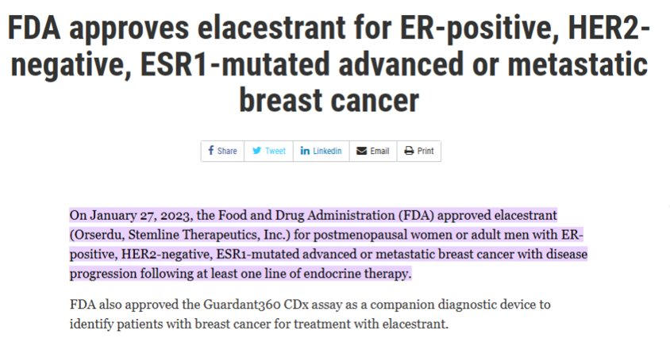
JANUARY 2023: ELACESTRANT (ORSERDU) APPROVAL
ER, estrogen receptor; ESR1, estrogen receptor 1; HER2, human epidermal growth factor receptor 2
https://www.fda.gov/drugs/resources-information-approved-drugs/fda-approves-elacestrant-er-positive-her2-negative-esr1-mutated-advanced-or-metastatic-breast-cancer (accessed May 23, 2023)

Slide 19
PHASE 3 EMERALD: STUDY DESIGN
A multicentre, international, randomised, open-label, active-controlled phase 3 trial for postmenopausal patients with ER+/HER2- MBC
Primary end point: assess PFS in all patients and those with mESR1
Secondary end point: assess OS in all patients and those with mESR1
Study design considerations:
  planned sample size: 466 patients (randomised 1:1)
  planned number of countries/study sites: ~17/215
  planned study duration: ~30–33 months
  stratification factors: mESR1 status (detected by ctDNA), prior fulvestrant and presence of visceral disease
Key inclusion criteria
Advanced/metastatic ER+/HER2- breast cancer; progressed or relapsed on or after one or two lines of ET, one of which was given in combination with a CDK4/6 inhibitor, for advanced or MBC;
ECOG PS 0 or 1
Elacestrant (400 mg oral QD)
Investigator’s choice of fulvestrant, anastrozole, letrozole, exemestane
CBR, clinical benefit rate; CDK4/6, cyclin-dependent kinase 4/6; ctDNA, circulating tumour DNA; DoR, duration of response; ECOG PS; Eastern Cooperative Oncology Group performance status; ER, estrogen receptor; ET, endocrine therapy; HER2, hormone epidermal growth factor receptor 2; MBC, metastatic breast cancer; mESR1, estrogen receptor 1 mutation; ORR, objective response rate; OS, overall survival; PFS, progression-free survival; PK, pharmacokinetics; PRO patient reported outcome; QD, Use "every day"
Bardia A, et al. SABCS 2021. Abstract GS2-02. Oral presentation
Notes:
Elacestrant, an oral SERD, has demonstrated antitumor activity in preclinical models of ER+ BC, including those resistant to CDK4/6 inhibitors and with mESR1, as well as in a Phase 1 trial (NCT02338349) of elacestrant in heavily pretreated patients with mBC.
Post-menopausal women or men with mBC.
Bardia A, Neven P, Streich G, et al. Elacestrant, an oral selective estrogen receptor degrader vs investigator’s choice of endocrine monotherapy for ER+/HER2– advanced/metastatic breast cancer following progression on prior endocrine and CDK4/6 inhibitor therapy: Results of EMERALD phase 3 trial. Presented at: 2021 San Antonio Breast Cancer Symposium. December 7-10, 2021; San Antonio, TX. Abstract GS2-02.
Bardia A, et al. SABCS 2021. Abstract GS2-02.

Slide 20
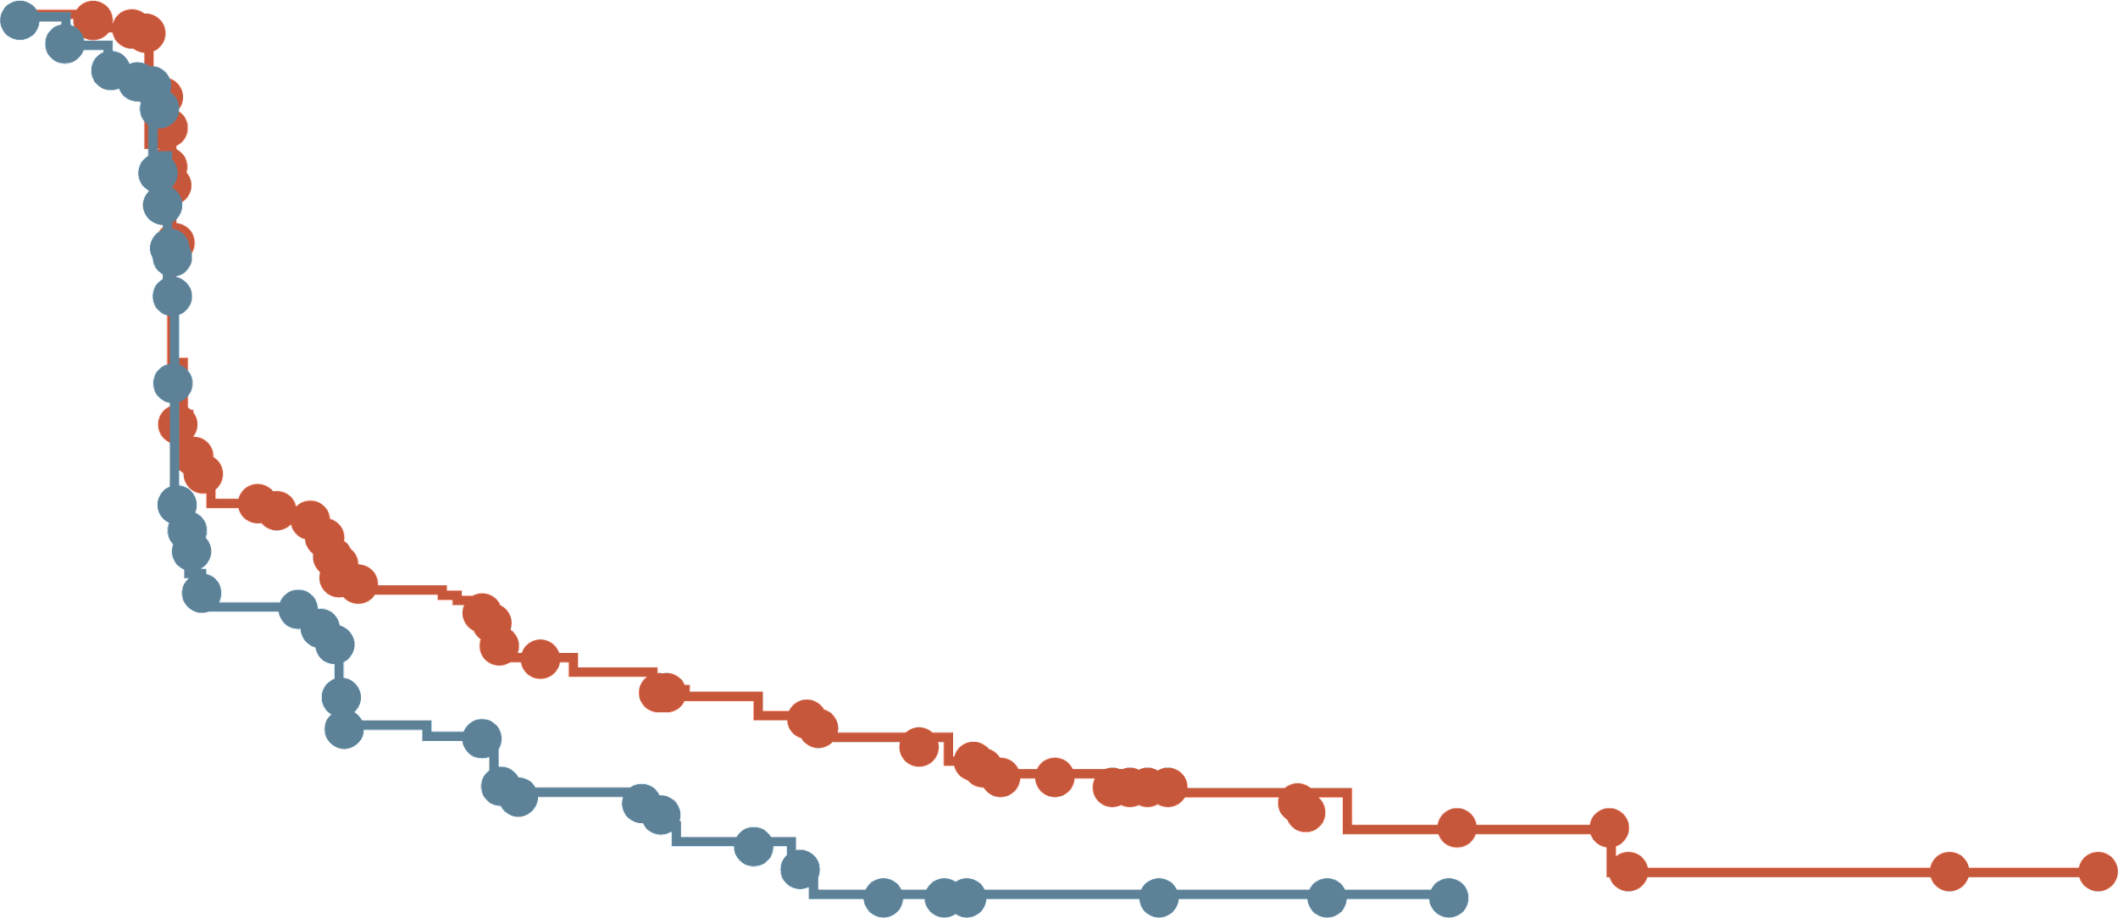
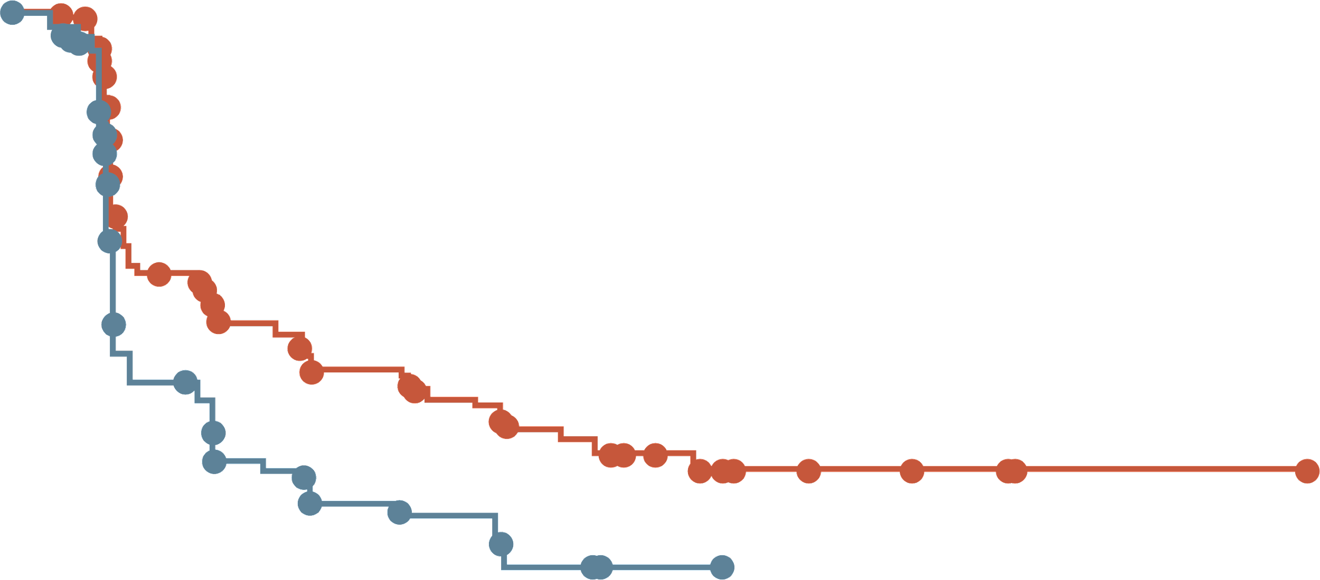
EMERALD: PFS RATE AT 6 & 12 MONTHS ALL PATIENTS AND mESR1 GROUP
All patients
Patients with tumours harbouring mESR1
 | Elacestrant | SoC
N | 239 | 238
PFS rate at 6 months, % (95% CI) | 34.3 (27.2-41.5) | 20.4 (14.1-26.7)
PFS rate at 12 months, % (95% CI) | 22.3 (15.2-29.4) | 9.4 (4.0-14.8)
 | Elacestrant | SoC
N | 115 | 113
PFS rate at 6 months, % (95% CI) | 40.8 (30.1-51.4) | 19.1 (14.1-26.7)
PFS rate at 12 months, % (95% CI) | 26.8 (16.2-37.4) | 8.2 (1.3-15.1)
100
100
90
90
80
80
70
70
60
60
Probability of PFS (%)
Probability of PFS (%)
50
50
40
40
30
30
20
20
10
Elacestrant
Standard of Care
10
Elacestrant
Standard of Care
0
0
0
1
2
3
4
5
6
7
8
9
10
11
12
13
14
15
16
17
18
19
20
21
22
23
24
25
0
1
2
3
4
5
6
7
8
9
10
11
12
13
14
15
16
17
18
19
20
21
22
23
24
25
Time (months)
Time (months)
Elacestrant
SOC
239
238
223
206
106
84
89
68
60
39
57
38
42
25
40
25
34
16
33
15
27
7
24
4
19
3
13
3
11
2
8
2
7
1
6
0
6
2
2
2
2
1
0
Elacestrant
SOC
115
113
105
99
54
39
46
34
35
19
33
18
26
12
26
12
21
9
20
9
16
4
14
1
11
1
9
1
7
0
5
5
4
4
1
1
1
1
1
0
Elacestrant demonstrated a higher PFS rate versus SoC ET at 6 and 12 months in patients with ER+/HER2- advanced/metastatic breast cancer following prior CDK4/6i therapy
CDK4/6i, cyclin-dependent kinase 4/6 inhibitor; CI, confidence interval; ER, estrogen receptor; ET, endocrine therapy; HER2, human epidermal growth factor receptor 2; mESR1, estrogen receptor 1 mutation; N, sample size; PFS, progression-free survival; SoC, standard of care
Bidard, J Clin Oncol. 2022; PMID: 35584336
Notes:
Exploratory Add to speaker notes. As this was additional analysis
Bardia A, Neven P, Streich G, et al. Elacestrant, an oral selective estrogen receptor degrader vs investigator’s choice of endocrine monotherapy for ER+/HER2– advanced/metastatic breast cancer following progression on prior endocrine and CDK4/6 inhibitor therapy: Results of EMERALD phase 3 trial. Presented at: 2021 San Antonio Breast Cancer Symposium. December 7-10, 2021; San Antonio, TX. Abstract GS2-02.
Bardia A, et al. SABCS 2021. Abstract GS2-02.

Slide 21
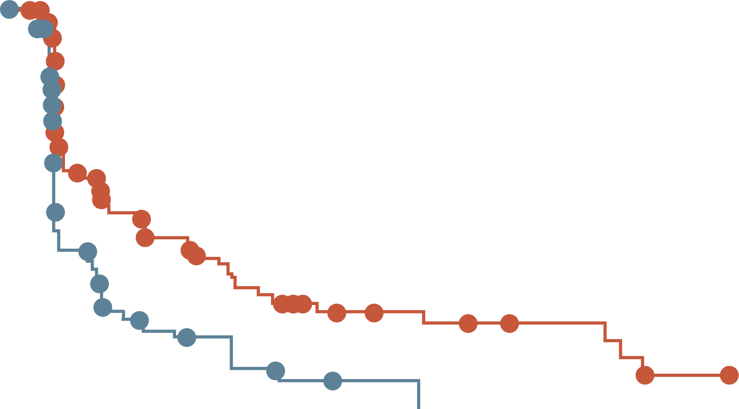
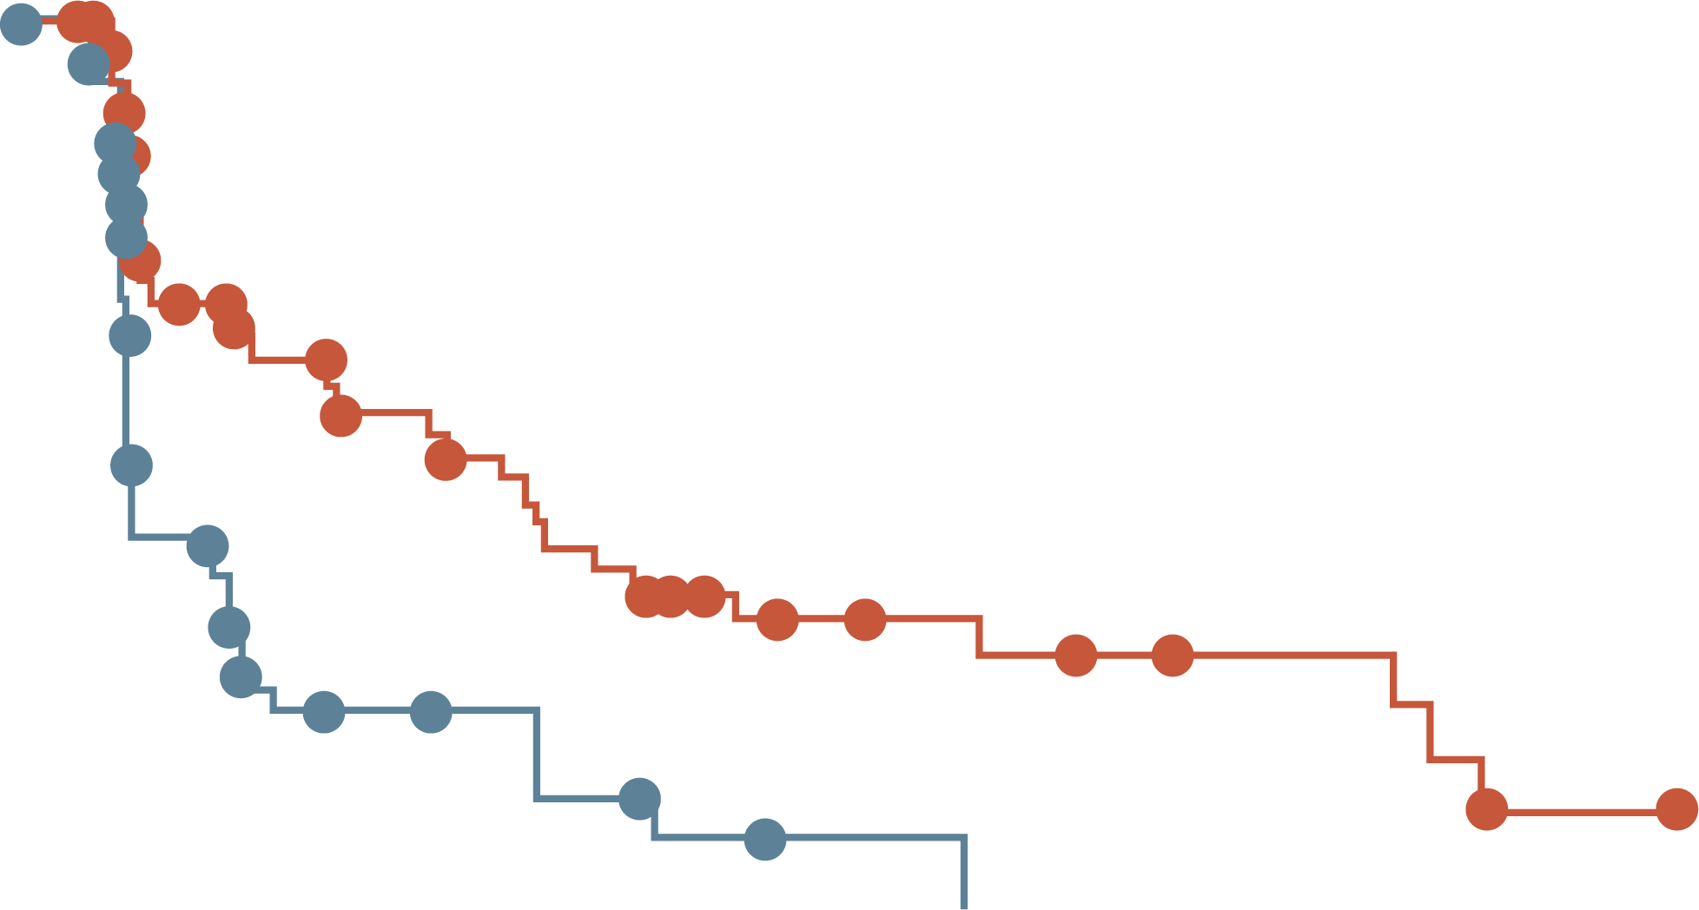
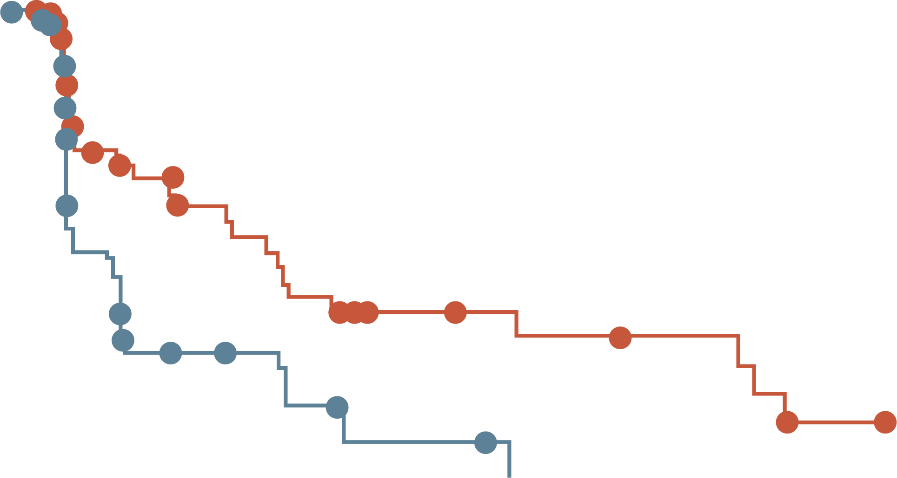
EMERALD: PFS BY DURATION OF CDK4/6i (mESR1)
At least 6 mo
CDK4/6i
At least 12 mo
CDK4/6i
At least 18 mo
CDK4/6i
100
100
100
80
Elacestrant
Standard of care
80
Elacestrant
Standard of care
80
Elacestrant
Standard of care
60
60
60
Probability of PFS (%)
Probability of PFS (%)
Probability of PFS (%)
40
40
40
20
20
20
0
0
0
0
5
10
15
20
25
30
0
5
10
15
20
25
30
0
5
10
15
20
25
30
Elacestrant
SOC
Time (months)
Elacestrant
SOC
Time (months)
Elacestrant
SOC
Time (months)
103
102
50
34
33
16
25
11
20
9
16
5
11
2
9
1
8
1
7
0
6
5
5
1
1
0
78
81
42
26
31
12
24
10
20
9
16
5
11
2
9
1
8
1
7
0
6
5
5
1
1
0
55
56
30
21
23
9
18
8
15
7
12
4
8
1
8
1
7
1
6
0
6
5
5
1
1
0
 | Elacestrant | SoC Endocrine Therapy
Median PFS, months (95% CI) | 4.14 (2.20-7.79) | 1.87 (1.87-3.29)
PFS rate at 12 months, % (95% CI) | 26.02 (15.12-36.92) | 6.45 (0.00-13.65)
Hazard ratio (95% CI) | 0.517 (0.361-0.738)
 | Elacestrant | SoC Endocrine Therapy
Median PFS, months (95% CI) | 8.61 (4.14-10.84) | 1.91 (1.87-3.68)
PFS rate at 12 months, % (95% CI) | 35.81 (21.84-49.78) | 8.39 (0.00-17.66)
Hazard ratio (95% CI) | 0.410 (0.262-0.634)
 | Elacestrant | SoC Endocrine Therapy
Median PFS, months (95% CI) | 8.61 (5.45-16.89) | 2.10 (1.87-3.75)
PFS rate at 12 months, % (95% CI) | 35.79 (19.54-52.05) | 7.73 (0.00-20.20)
Hazard ratio (95% CI) | 0.466 (0.270-0.791)
CDK4/6i, cyclin-dependent kinase 4/6 inhibitor; CI, confidence interval; mESR1, estrogen receptor 1 mutation; mo, months; PFS, progression-free survival;
SoC; standard of care
Bidard, J Clin Oncol. 2022; PMID: 35584336

Slide 22
ELACESTRANT VS SOC: ADVERSE EVENTS
Event |  | SoC
 | Elacestrant (N=237) | Total (N=229) | Fulvestrant (N=161) | AI (N=68)
Any AE | 218 (92.0) | 197 (86.0) | 144 (89.4) | 53 (77.9)
Grade 3 and 4ª | 64 (27.0) | 47 (20.5) | 33 (20.5) | 14 (20.6)
Grade 5^{b} | 4 (1.7) | 6 (2.6) | 5 (3.1) | 1 (1.5)
Leading to dose reduction | 7 (3.0) | 0 | 0 | Not applicable
Leading to study drug discontinuation | 15 (6.3) | 10 (4.4) | 6 (3.7) | 4 (5.9)
AEs^{c} occurring in ≥10% of patients in any arm | Elacestrant |  | Total |  | Fulvestrant |  | AI
 | All grades | Grade 3 or 4 | All grades | Grade 3 or 4 | All grades | Grade 3 or 4 | All grades | Grade 3 or 4
Nausea | 83 (35.0)^{d} | 6 (2.5) | 43 (18.8) | 2 (0.9) | 26 (16.1) | 0 | 17 (25.0) | 2 (2.9)
Fatigue | 45 (19.0) | 2 (0.8) | 43 (18.8) | 2 (0.9) | 35 (21.7) | 1 (0.6) | 8 (11.8) | 1 (1.5)
Vomiting | 45 (19.0)^{e} | 2 (0.8) | 19 (8.3) | 0 | 12 (7.5) | 0 | 7 (10.3) | 0
Decreased appetite | 35 (14.8) | 2 (0.8) | 21 (9.2) | 1 (0.4) | 12 (7.5) | 0 | 9 (13.2) | 1 (1.5)
Arthralgia | 34 (14.3) | 2 (0.8) | 37 (16.2) | 0 | 28 (17.4) | 0 | 9 (13.2) | 0
Diarrhoea | 33 (13.9) | 0 | 23 (10.0) | 2 (0.9) | 14 (8.7) | 1 (0.6) | 9 (13.2) | 1 (1.5)
Back pain | 33 (13.9) | 6 (2.5) | 22 (9.6) | 1 (0.4) | 16 (9.9) | 1 (0.6) | 6 (8.8) | 0
AST increased | 31 (13.1) | 4 (1.7) | 28 (12.2) | 2 (0.9) | 20 (12.4) | 2 (1.2) | 8 (11.8) | 0
Headache | 29 (12.2) | 4 (1.7) | 26 (11.4) | 0 | 18 (11.2) | 0 | 8 (11.8) | 0
Constipation | 29 (12.2) | 0 | 15 (6.6) | 0 | 10 (6.2) | 0 | 5 (7.4) | 0
Hot flush | 27 (11.4) | 0 | 19 (8.3) | 0 | 15 (9.3) | 0 | 4 (5.9) | 0
Dyspepsia | 24 (10.1) | 0 | 6 (2.6) | 0 | 4 (2.5) | 0 | 2 (2.9) | 0
ALT increased | 22 (9.3) | 5 (2.1) | 23 (10.0) | 1 (0.4) | 17 (10.6) | 0 | 6 (8.8) | 1 (1.5)
ª AE severity was graded according to the National Cancer Institute’s Common Terminology Criteria for Adverse Events version 5.0. ^{b} No fatal events were attributed to study drug by the investigator.
^{c} Preferred terms were coded using the Medical Dictionary for Regulatory Activities version 23.0. dGrade 1 nausea, n=59 (24.9%); grade 2 nausea, n=18 (7.6%); grade 3 nausea, n= 6 (2.5%); and no patients experienced grade 4 nausea. Percentages reflect maximum grade experienced. eGrade 1 vomiting, n=36 (15.2%); grade 2 vomiting, n=7 (3.0%); grade 3 vomiting, n=2 (0.8%); and no patients experienced grade 4 vomiting. Percentages reflect maximum grade experienced
AE, adverse event; AI, aromatase inhibitor; ALT, alanine transaminase; AST, aspartate transferase; n, sample size; SoC, standard of care
Bidard, J Clin Oncol. 2022; PMID: 35584336

Slide 23
FUTURE PERSPECTIVE & CONCLUSION

Slide 24
FUTURE DIRECTION IN 2ND LINE POST CDK4/6I
CAPITELLO-291¹
SERENA-6²
evERA³
&
EMBER-3⁴
ASCENT-07⁵
&
DESTINY BREAST-06⁶
Objective: Investigated Capivesertib as a novel AKT inhibitor
Results: CAPI+ FUL Significantly improved PFS compared to FUL alone. Target Population is TBD
Objective Assess AZD9833+ CDK4/​6i in HR+/​HER2-MBC with detectable ESR1m Before Progression
Primary Outcome: PFS
Objective: Exploring combining oral SERD therapies with everolimus or abemaciclib
Primary Outcome: PFS in ESR1m subpopulation & ITT population
Objective: Investigating ADCs as a front-line chemotherapy choice
Primary Outcomes: PFS
ADCs: Antibody-Drug Conjugates; AKT: Protein Kinase B; CAPI: Capivasertib; CDK4/6i: Cyclin-Dependent Kinase 4/6 Inhibitors; ESR1m: Estrogen Receptor 1 Mutations;
FUL: Fulvestrant; HR+: Hormone Receptor Positive; ITT: Intent-to-Treat; MBC: Metastatic Breast Cancer; PFS: Progression-Free Survival.
1. Turner N.C, N Engl J Med 2023; 388:2058-2070; 2. https://clinicaltrials.gov/study/NCT04964934?tab=table (Accessed 08 August, 2023);
3. https://classic.clinicaltrials.gov/ct2/show/NCT05306340 (Accessed 08 August, 2023); 4. https://classic.clinicaltrials.gov/ct2/show/NCT04975308 (Accessed 08 August 2023);
5. https://classic.clinicaltrials.gov/ct2/show/NCT05840211 (Accessed 08 August 2023); 6. https://classic.clinicaltrials.gov/ct2/show/NCT04494425 (Accessed 08 August 2023)

Slide 25
CLINICAL TAKEAWAYS
To optimize treatment selection, molecular characterization should be conducted for each patient, taking into account 'stable' characteristics and ‘labile’ traits which are often associated with resistance to endocrine therapy
ESR1 mutation testing should be done with a liquid biopsy platform at the time of progression on an aromatase inhibitor as well as after subsequent lines of progression
Elacestrant is the 1st oral SERD to be FDA approved (January 2023), with optimal efficacy and manageable safety for patients with ESR1 mutated ER+/HER2- advanced or metastatic breast cancer
Oral SERDs are being studied as a monotherapy and in combination with targeted therapies (i.e. CDK4/6, mTOR and AKT inhibitors), offering promising prospects for their integration into clinical practice
AKT, Protein Kinase B; CDK4/6, Cyclin-Dependent Kinase 4/6; ESR1, Estrogen Receptor 1; FDA, U.S. Food and Drug Administration;
HER2, Human Epidermal Growth Factor Receptor 2; PI3K, Phosphoinositide 3-Kinase; SERD, Selective Estrogen Receptor Degrader.

