Slide 2

DEVELOPED BY BREAST CANCER CONNECT
This programme is developed by BREAST CANCER
CONNECT, an international group of experts in the field
of breast cancer.
Acknowledgement and disclosures
This BREAST CANCER CONNECT programme is supported through an independent educational grant from Menarini Stemline Oncology. The programme is therefore independent, the content is not influenced by the supporter and is under the sole responsibility of the experts.
Please note: The views expressed within this programme are the personal opinions of the experts. They do not necessarily represent the views of the experts’ institutions, or the rest of the BREAST CANCER CONNECT group.
Expert Disclaimers:
Prof. Maria Vittoria Dieci has received financial support/sponsorship for research support, consultation, or speaker fees from the following companies: Eli Lilly, Pfizer, Novartis, Roche, Exact Science, Daiichi Sankyo, Gilead, Seagen.

Slide 3
BREAST CANCER CONNECT
ANIMATED VIDEO
ER+ METASTATIC BREAST CANCER: THE PATIENT JOURNEY ON ELACESTRANT TREATMENT
Prof. Maria Vittoria Dieci
November 2023
ER+, estrogen receptor positive

Slide 4
CLINICAL TAKEAWAYS
PROs results demonstrating no difference between treatment arms in the EMERALD trial, support elacestrant as a clinically meaningful option in this setting
Elacestrant has a manageable safety profile
If a patient progresses on elacestrant, the choice of subsequent therapy line should be based on multiple factors including sensitivity to prior treatments, disease burden, tumour biology. In this context, ADCs represent a new option
ADC, antibody-drug conjugate; PRO, patient-reported outcome

Slide 5
CLINICAL SCENARIO

Slide 6

THE ROAD AFTER SELECTING ELACESTRANT
PATIENT CASE OVERVIEW
AGE
54 y.o. postmenopausal woman
MEDICAL HISTORY
Well controlled hypertension, osteopenic, BMI=29
+FH of prostate cancer in father, 80 y.o
MONICA D.
DIAGNOSIS
(2021)
V1L TREATMENT
(2021)
PROGRESSION (2023)
MUTATION TEST RESULTS
V2L TREATMENT
(2023)
ER+/HER2- de novo
mBC
(bone mets)
Letrozole + ribociclib
New Bone & Liver mets
ESR1 mutation
Elacestrant
1L, first-line; 2L, second-line; BMI, body mass index; ER, estrogen receptor; ESR1, estrogen receptor 1 (gene); FH, family history; HER2, human epidermal growth factor receptor 2; mBC, metastatic breast cancer; mets, metastases; y.o, years old

Slide 7
EMERALD TRIAL PFS RESULTS:
LANDMARK ANALYSIS &
PFS BY DURATION OF PRIOR CDK4/6i
CDK4/6i, cyclin-dependent kinase 4/6 inhibitor; PFS, progression-free survival

Slide 8
PHASE 3 EMERALD: STUDY DESIGN
A multicentre, international, randomised, open-label, active-controlled phase 3 trial for postmenopausal patients with ER+/HER2- mBC
Primary end point: assess PFS in all patients and those with mESR1
Secondary end point: assess OS in all patients and those with mESR1
Study design considerations:
  planned sample size: 466 patients (randomised 1:1)
  planned number of countries/study sites: ~17/215
  planned study duration: ~30–33 months
  stratification factors: mESR1 status (detected by ctDNA), prior fulvestrant and presence of visceral disease
Key inclusion criteria
Advanced/metastatic ER+/HER2- breast cancer; progressed or relapsed on or after one or two lines of ET, one of which was given in combination with a CDK4/6 inhibitor, for advanced or mBC;
ECOG PS 0 or 1
Elacestrant (400 mg oral QD)
Investigator’s choice of fulvestrant, anastrozole, letrozole, exemestane
CDK4/6, cyclin-dependent kinase 4/6; ctDNA, circulating tumour DNA; ECOG PS; Eastern Cooperative Oncology Group performance status; ER, estrogen receptor; ET, endocrine therapy; HER2, hormone epidermal growth factor receptor 2; mBC, metastatic breast cancer; mESR1, estrogen receptor 1 (gene) mutation; OS, overall survival; PFS, progression-free survival; QD, use "every day"
Bardia A, et al. Cancer Res 2022;82(4 Suppl):Abstract nr GS2-02 (SABCS 2021. Oral presentation); Bidard F-C, et al. J Clin Oncol. 2022;40:3246-3256
Notes:
Elacestrant, an oral SERD, has demonstrated antitumor activity in preclinical models of ER+ BC, including those resistant to CDK4/6 inhibitors and with mESR1, as well as in a Phase 1 trial (NCT02338349) of elacestrant in heavily pretreated patients with mBC.
Post-menopausal women or men with mBC.
Bardia A, Neven P, Streich G, et al. Elacestrant, an oral selective estrogen receptor degrader vs investigator’s choice of endocrine monotherapy for ER+/HER2– advanced/metastatic breast cancer following progression on prior endocrine and CDK4/6 inhibitor therapy: Results of EMERALD phase 3 trial. Presented at: 2021 San Antonio Breast Cancer Symposium. December 7-10, 2021; San Antonio, TX. Abstract GS2-02.
Bardia A, et al. SABCS 2021. Abstract GS2-02.

Slide 9
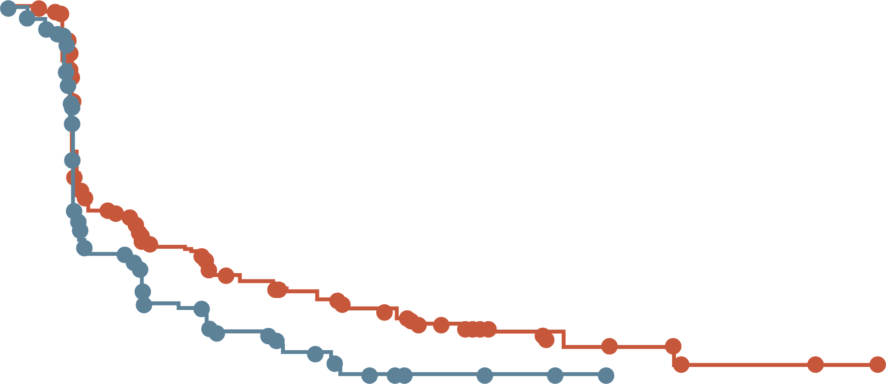
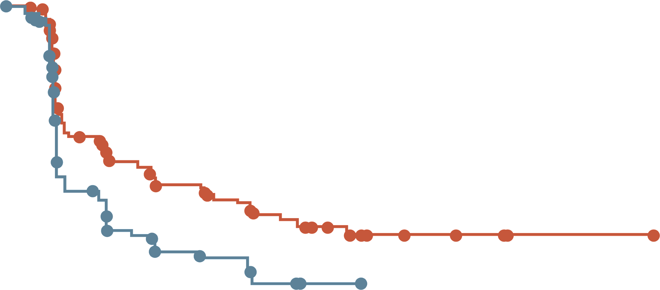
EMERALD: PFS RATE AT 6 & 12 MONTHS ALL PATIENTS AND mESR1 GROUP
All patients
Patients with tumours harbouring mESR1
 | Elacestrant | SoC
N | 239 | 238
PFS rate at 6 months (95% CI), % | 34.3 (27.2-41.5) | 20.4 (14.1-26.7)
PFS rate at 12 months (95% CI), % | 22.3 (15.2-29.4) | 9.4 (4.0-14.8)
 | Elacestrant | SoC
N | 115 | 113
PFS rate at 6 months (95% CI), % | 40.8 (30.1-51.4) | 19.1 (10.5-27.8)
PFS rate at 12 months (95% CI), % | 26.8 (16.2-37.4) | 8.2 (1.3-15.1)
100
100
90
90
80
80
70
70
60
60
Probability of PFS (%)
Probability of PFS (%)
50
50
40
40
30
30
20
20
10
Elacestrant
Standard of Care
10
Elacestrant
Standard of Care
0
0
0
1
2
3
4
5
6
7
8
9
10
11
12
13
14
15
16
17
18
19
20
21
22
23
24
25
0
1
2
3
4
5
6
7
8
9
10
11
12
13
14
15
16
17
18
19
20
21
22
23
24
25
Time (months)
Time (months)
Elacestrant
SOC
239
238
223
206
106
84
89
68
60
39
57
38
42
25
40
25
34
16
33
15
27
7
24
4
19
3
13
3
11
2
8
2
7
1
6
0
6
2
2
2
2
1
0
Elacestrant
SOC
115
113
105
99
54
39
46
34
35
19
33
18
26
12
26
12
21
9
20
9
16
4
14
1
11
1
9
1
7
0
5
5
4
4
1
1
1
1
1
0
Elacestrant demonstrated a higher PFS rate versus SoC ET at 6 and 12 months in patients with ER+/HER2- advanced/metastatic breast cancer following prior CDK4/6i therapy
CDK4/6i, cyclin-dependent kinase 4/6 inhibitor; CI, confidence interval; ER, estrogen receptor; ET, endocrine therapy; HER2, human epidermal growth factor receptor 2; mESR1, estrogen receptor 1 (gene) mutation; N, sample size; PFS, progression-free survival; SoC, standard of care
Bidard F-C, et al. J Clin Oncol. 2022;40:3246-3256
Notes:
Exploratory Add to speaker notes. As this was additional analysis
Bardia A, Neven P, Streich G, et al. Elacestrant, an oral selective estrogen receptor degrader vs investigator’s choice of endocrine monotherapy for ER+/HER2– advanced/metastatic breast cancer following progression on prior endocrine and CDK4/6 inhibitor therapy: Results of EMERALD phase 3 trial. Presented at: 2021 San Antonio Breast Cancer Symposium. December 7-10, 2021; San Antonio, TX. Abstract GS2-02.
Bardia A, et al. SABCS 2021. Abstract GS2-02.

Slide 10
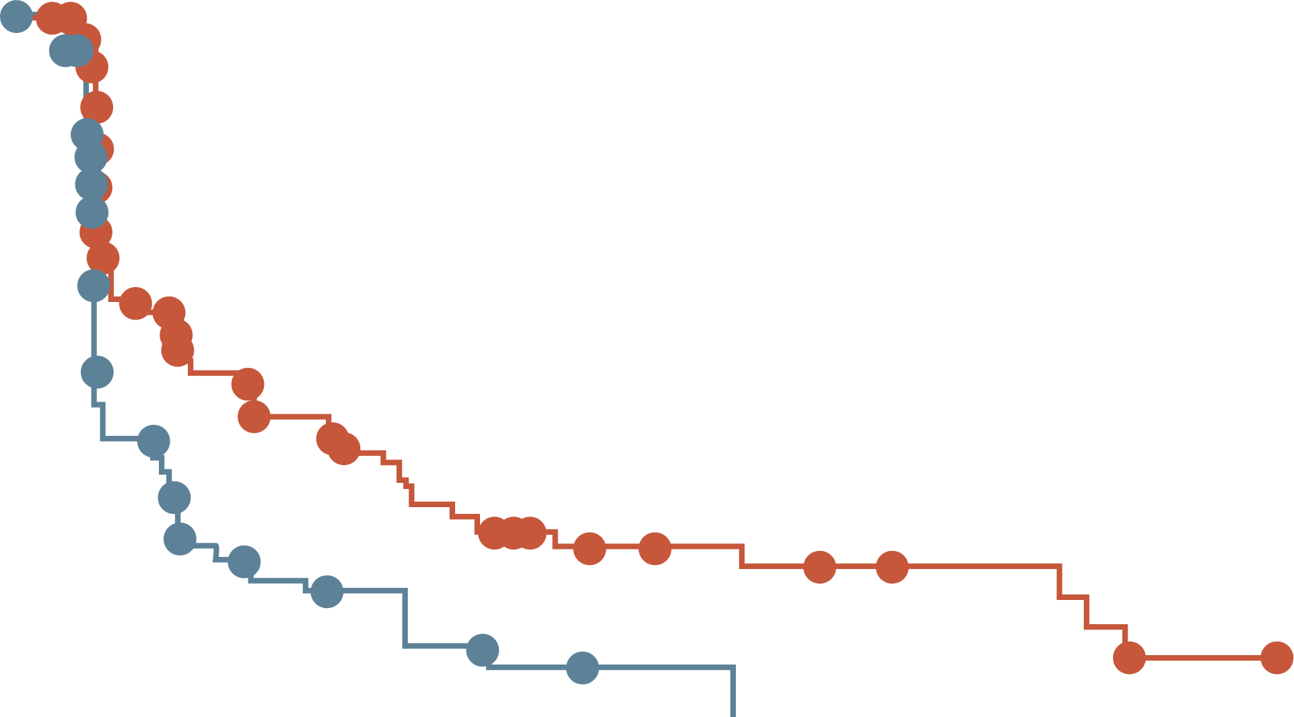
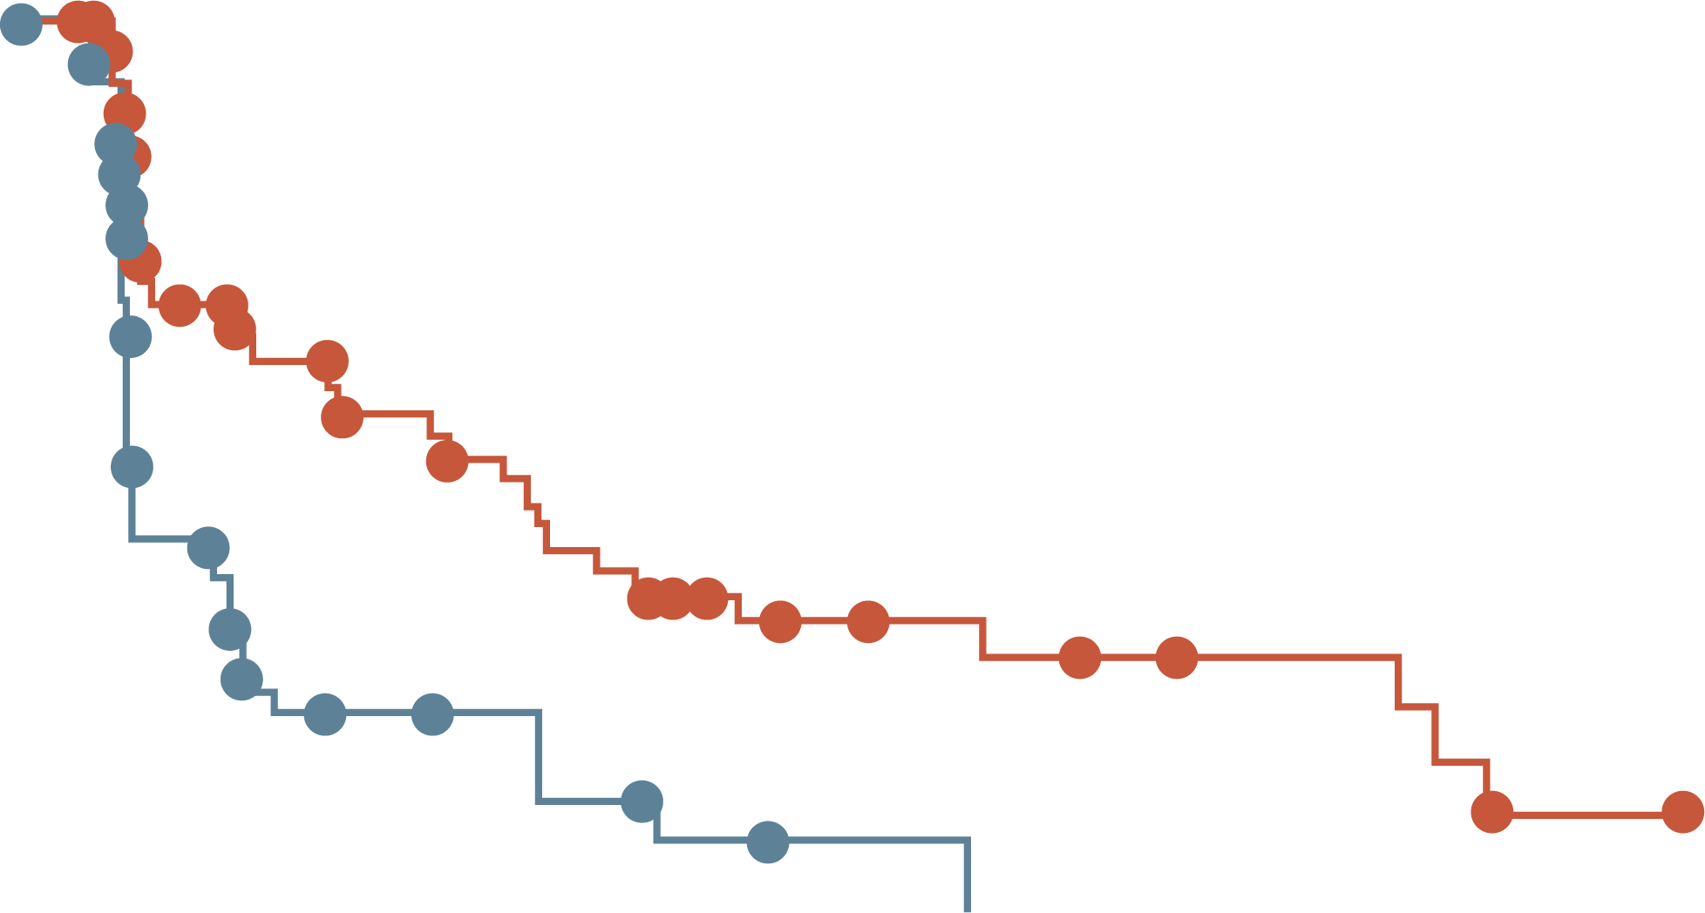
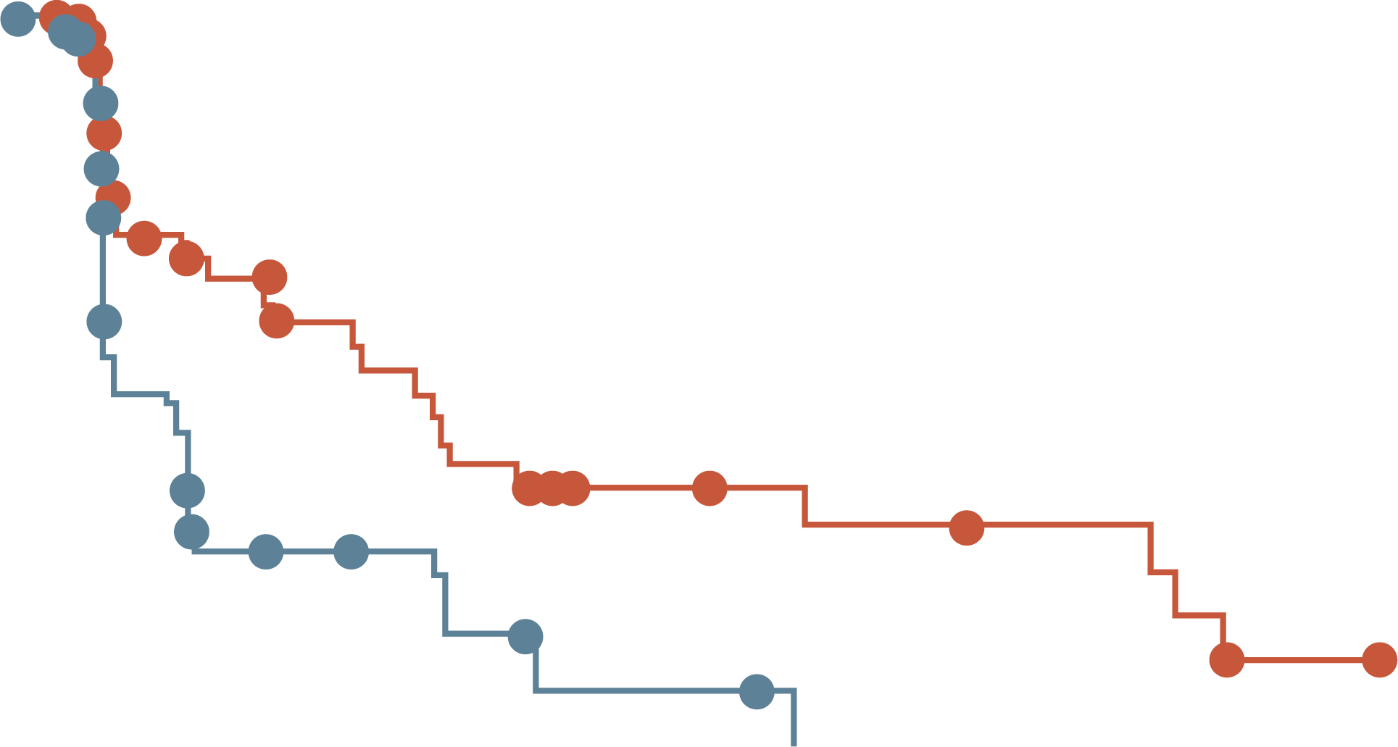
EMERALD: PFS BY DURATION OF CDK4/6i (mESR1)
At least 6 mo
CDK4/6i
At least 12 mo
CDK4/6i
At least 18 mo
CDK4/6i
100
100
100
80
Elacestrant
Standard of care
80
Elacestrant
Standard of care
80
Elacestrant
Standard of care
60
60
60
Probability of PFS (%)
Probability of PFS (%)
Probability of PFS (%)
40
40
40
20
20
20
0
0
0
0
5
10
15
20
25
30
0
5
10
15
20
25
30
0
5
10
15
20
25
30
Elacestrant
SOC
Time (months)
Elacestrant
SOC
Time (months)
Elacestrant
SOC
Time (months)
103
102
50
34
33
16
25
11
20
9
16
5
11
2
9
1
8
1
7
0
6
5
5
1
1
0
78
81
42
26
31
12
24
10
20
9
16
5
11
2
9
1
8
1
7
0
6
5
5
1
1
0
55
56
30
21
23
9
18
8
15
7
12
4
8
1
8
1
7
1
6
0
6
5
5
1
1
0
 | Elacestrant | SoC Endocrine Therapy
Median PFS (95% CI), months | 4.14 (2.20-7.79) | 1.87 (1.87-3.29)
PFS rate at 12 months (95% CI), % | 26.02 (15.12-36.92) | 6.45 (0.00-13.65)
Hazard ratio (95% CI) | 0.517 (0.361-0.738)
 | Elacestrant | SoC Endocrine Therapy
Median PFS (95% CI), months | 8.61 (4.14-10.84) | 1.91 (1.87-3.68)
PFS rate at 12 months (95% CI), % | 35.81 (21.84-49.78) | 8.39 (0.00-17.66)
Hazard ratio (95% CI) | 0.410 (0.262-0.634)
 | Elacestrant | SoC Endocrine Therapy
Median PFS (95% CI), months | 8.61 (5.45-16.89) | 2.10 (1.87-3.75)
PFS rate at 12 months (95% CI), % | 35.79 (19.54-52.05) | 7.73 (0.00-20.20)
Hazard ratio (95% CI) | 0.466 (0.270-0.791)
CDK4/6i, cyclin-dependent kinase 4/6 inhibitor; CI, confidence interval; mESR1, estrogen receptor 1 (gene) mutation; mo, months; PFS, progression-free survival;
SoC, standard of care
Bardia A, et al. Presented at SABCS 2022. December 6-10, 2022. Abstract GS3-01

Slide 11
ELACESTRANT VS SOC: ADVERSE EVENTS
Event |  | SoC
 | Elacestrant (N=237) | Total (N=229) | Fulvestrant (N=161) | AI (N=68)
Any AE | 218 (92.0) | 197 (86.0) | 144 (89.4) | 53 (77.9)
Grade 3 and 4ª | 64 (27.0) | 47 (20.5) | 33 (20.5) | 14 (20.6)
Grade 5^{b} | 4 (1.7) | 6 (2.6) | 5 (3.1) | 1 (1.5)
Leading to dose reduction | 7 (3.0) | 0 | 0 | Not applicable
Leading to study drug discontinuation | 15 (6.3) | 10 (4.4) | 6 (3.7) | 4 (5.9)
AEs^{c} occurring in ≥10% of patients in any arm (n(%)) | Elacestrant |  | Total |  | Fulvestrant |  | AI
 | All grades | Grade 3 or 4 | All grades | Grade 3 or 4 | All grades | Grade 3 or 4 | All grades | Grade 3 or 4
Nausea | 83 (35.0)^{d} | 6 (2.5) | 43 (18.8) | 2 (0.9) | 26 (16.1) | 0 | 17 (25.0) | 2 (2.9)
Fatigue | 45 (19.0) | 2 (0.8) | 43 (18.8) | 2 (0.9) | 35 (21.7) | 1 (0.6) | 8 (11.8) | 1 (1.5)
Vomiting | 45 (19.0)^{e} | 2 (0.8) | 19 (8.3) | 0 | 12 (7.5) | 0 | 7 (10.3) | 0
Decreased appetite | 35 (14.8) | 2 (0.8) | 21 (9.2) | 1 (0.4) | 12 (7.5) | 0 | 9 (13.2) | 1 (1.5)
Arthralgia | 34 (14.3) | 2 (0.8) | 37 (16.2) | 0 | 28 (17.4) | 0 | 9 (13.2) | 0
Diarrhoea | 33 (13.9) | 0 | 23 (10.0) | 2 (0.9) | 14 (8.7) | 1 (0.6) | 9 (13.2) | 1 (1.5)
Back pain | 33 (13.9) | 6 (2.5) | 22 (9.6) | 1 (0.4) | 16 (9.9) | 1 (0.6) | 6 (8.8) | 0
AST increased | 31 (13.1) | 4 (1.7) | 28 (12.2) | 2 (0.9) | 20 (12.4) | 2 (1.2) | 8 (11.8) | 0
Headache | 29 (12.2) | 4 (1.7) | 26 (11.4) | 0 | 18 (11.2) | 0 | 8 (11.8) | 0
Constipation | 29 (12.2) | 0 | 15 (6.6) | 0 | 10 (6.2) | 0 | 5 (7.4) | 0
Hot flush | 27 (11.4) | 0 | 19 (8.3) | 0 | 15 (9.3) | 0 | 4 (5.9) | 0
Dyspepsia | 24 (10.1) | 0 | 6 (2.6) | 0 | 4 (2.5) | 0 | 2 (2.9) | 0
ALT increased | 22 (9.3) | 5 (2.1) | 23 (10.0) | 1 (0.4) | 17 (10.6) | 0 | 6 (8.8) | 1 (1.5)
ª AE severity was graded according to the National Cancer Institute’s Common Terminology Criteria for Adverse Events version 5.0
^{b} No fatal events were attributed to study drug by the investigator
^{c} Preferred terms were coded using the Medical Dictionary for Regulatory Activities version 23.0.
^{d} Grade 1 nausea, n=59 (24.9%); grade 2 nausea, n=18 (7.6%); grade 3 nausea, n= 6 (2.5%); and no patients experienced grade 4 nausea. Percentages reflect maximum grade experienced.
^{e} Grade 1 vomiting, n=36 (15.2%); grade 2 vomiting, n=7 (3.0%); grade 3 vomiting, n=2 (0.8%); and no patients experienced grade 4 vomiting. Percentages reflect maximum grade experienced
AE, adverse event; AI, aromatase inhibitor; ALT, alanine transaminase; AST, aspartate transferase; n, number with event; N, number in population; SoC, standard of care
Bidard F-C, et al. J Clin Oncol. 2022;40:3246-3256

Slide 12
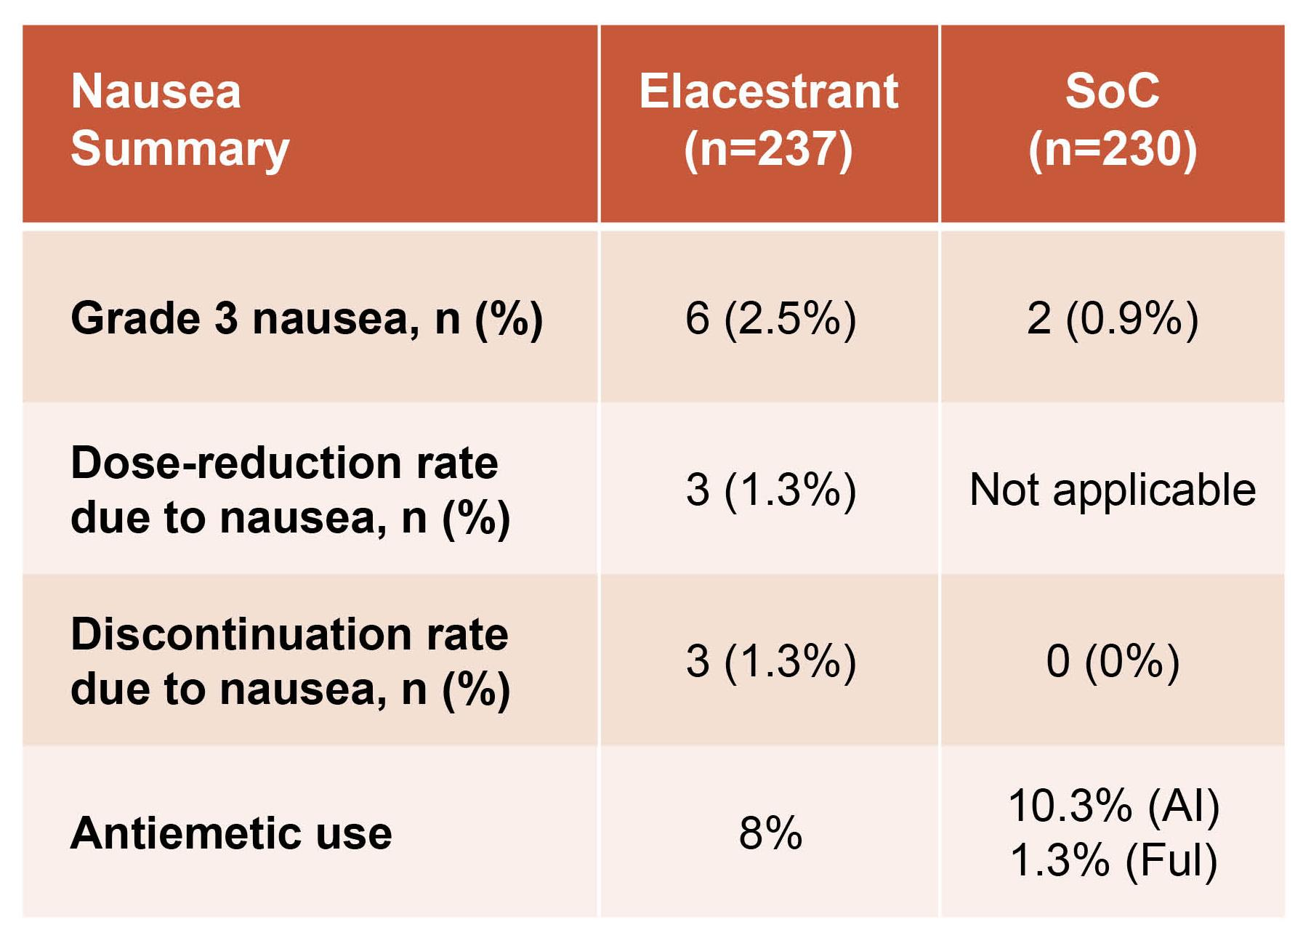
EMERALD TRIAL: A CLOSER LOOK AT THE ADVERSE EVENTS
Most adverse events, including nausea, were grade 1 and 2, and no grade 4 TRAEs were reported¹
Only 3.4% of patients receiving elacestrant and 0.9% receiving SoC discontinued therapy due to any TRAE¹
Dyslipidaemia was infrequent, mostly grade 1, there were no discontinuations, and it was similar to SoC²
No deaths assessed as treatment-related were reported in either arm¹
No hematologic safety signal was observed³
Nausea summary²
AI, aromatase inhibitor; Ful, fulvestrant; SoC, standard of care; TRAE, treatment-related adverse event
1. Bidard F-C, et al. J Clin Oncol. 2022;40:3246-3256
2. Cortes J. et al. ESMO Op. 2023;8(suppl 4):101377. Available at: https://doi.org/10.1016/j.esmoop.2023.101377 (accessed November 2023). Presented at ESMO Breast Cancer Annual Congress (2023). Abstract 188O
3. Bardia A, et al. Presented at SABCS 2022. December 6-10, 2022. Abstract GS3-01

Slide 13
EMERALD TRIAL: PATIENT CENTERED OUTCOME ANALYSIS

Slide 14
PATIENT CENTERED OUTCOME ANALYSIS: EMERALD TRIAL
METHODOLOGY
Endpoints: Mean score change and change from baseline between treatment groups for EORTC QLQ-C30, PRO‑CTCAE and EQ-5D-5L
PRO tools were assessed for all patient & patient with ESR1m
PRO completions rate
80% and 90% until cycle 4
~70% by cycle 6
Incomplete PRO assessments where primarily due to:
Patient language
Patient refusal
Technical problems
COVID-19-related issues (study overlap with pandemic)
PRO-CTCAE
Measurement
tools
EQ-5D-5L
EORTC QLQ-C30
EMERALD TRIAL
PRO ANALYSIS
Time of Screening
Assessment conducted at
Cycle 1
All Subsequent cycles
*All PRO data are for the full ITT population up to cycle 6
COVID-19, coronavirus disease 2019; EQ-5D-5L, EuroQol 5-Dimensions 5-Levels; EORTC QLQ-C30, European Organisation for Research and Treatment of Cancer Quality of Life Questionnaire-Core 30; ESR1m, estrogen receptor 1 (gene) mutation; ITT, intent-to-treat; PRO, patient-reported outcome; PRO-CTCAE, Patient-Reported Outcomes version of the Common Terminology Criteria for Adverse Events
Cortes J. et al. ESMO Op. 2023;8(suppl 4):101377. Available at: https://doi.org/10.1016/j.esmoop.2023.101377 (accessed November 2023). Presented at ESMO Breast Cancer Annual Congress (2023). Abstract 188O

Slide 15
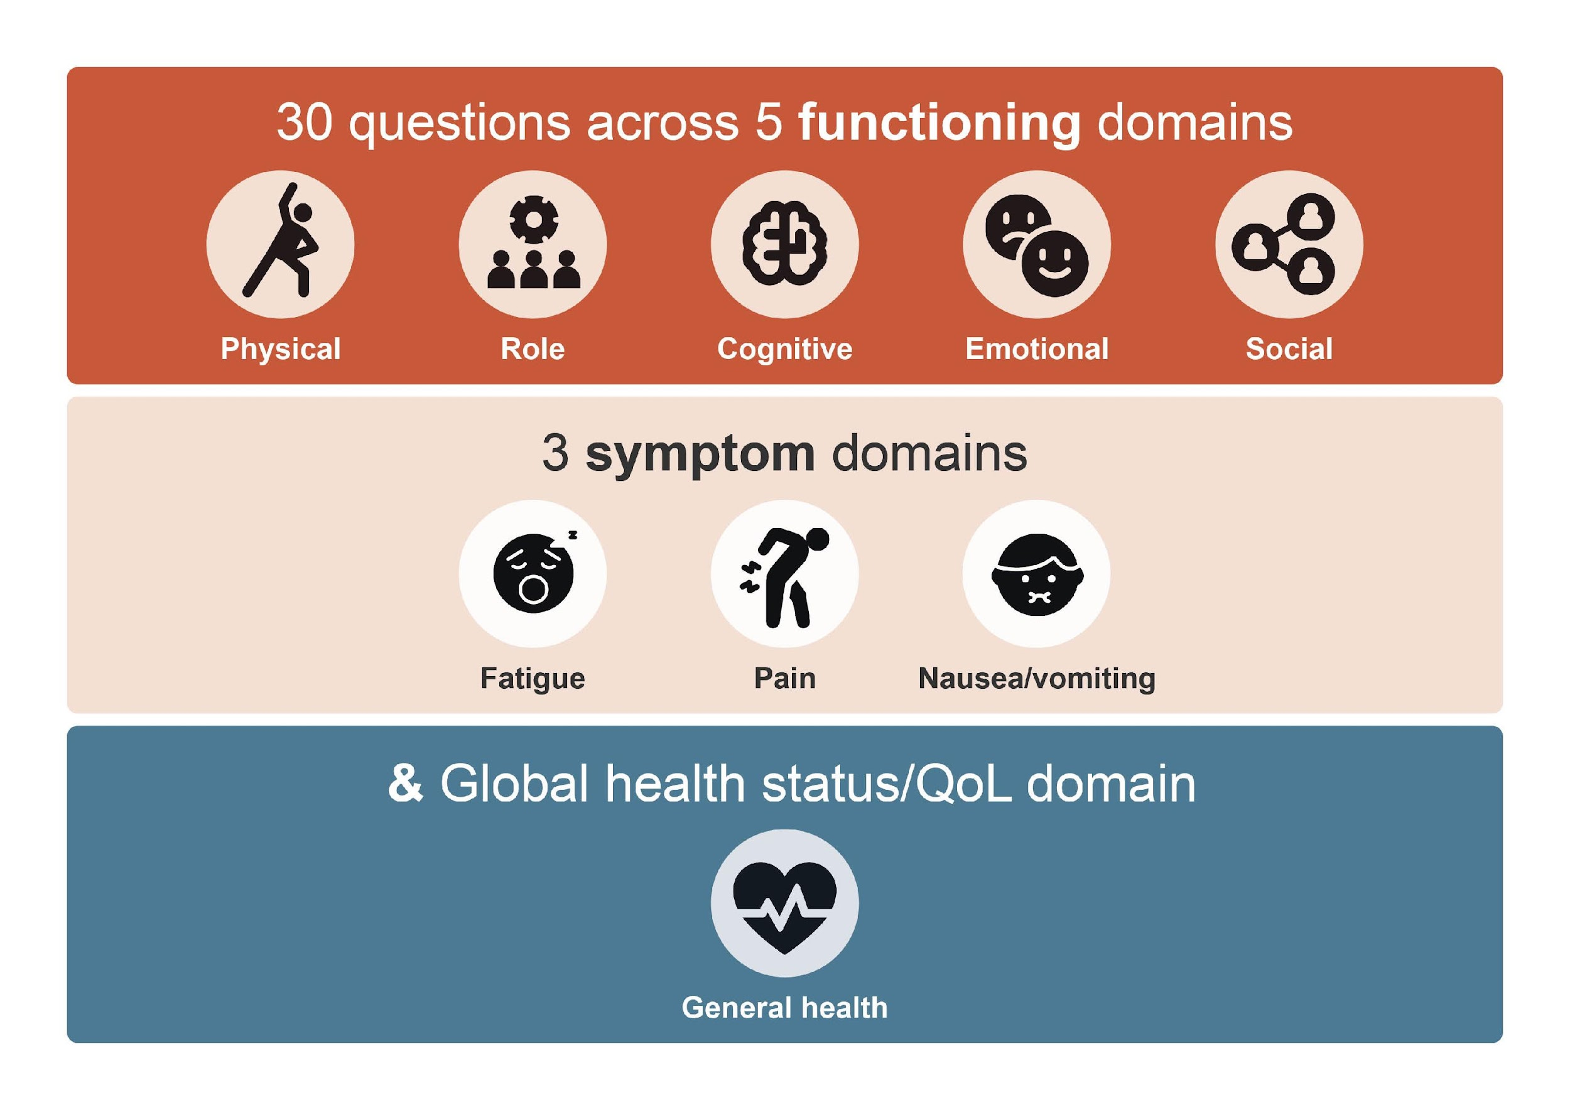
EORTC QLQ-C30: Methods
EORTC QLQ-C30, European Organisation for Research and Treatment of Cancer Quality of Life Questionnaire-Core 30; QoL, quality of life
Cortes J. et al. ESMO Op. 2023;8(suppl 4):101377. Available at: https://doi.org/10.1016/j.esmoop.2023.101377 (accessed November 2023). Presented at ESMO Breast Cancer Annual Congress (2023). Abstract 188O

Slide 16
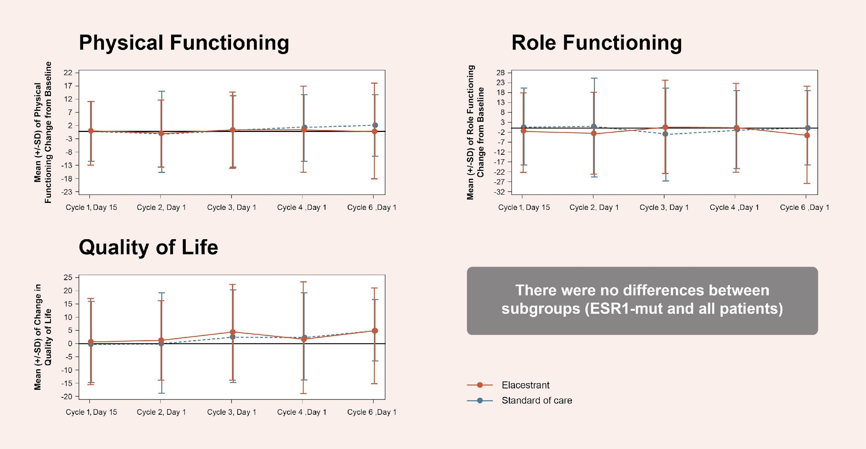
EORTC QLQ-C30: RESULTS
EORTC QLQ-C30 scores were similar for elacestrant and SoC, with no differences across all time points for functional, symptom, and global health status/QoL domains
EORTC QLQ-C30, European Organisation for Research and Treatment of Cancer Quality of Life Questionnaire-Core 30; ESR1, estrogen receptor 1 (gene); mut, mutant; QoL, quality of life; SD, standard deviation; SoC, standard of care
Cortes J. et al. ESMO Op. 2023;8(suppl 4):101377. Available at: https://doi.org/10.1016/j.esmoop.2023.101377 (accessed November 2023). Presented at ESMO Breast Cancer Annual Congress (2023). Abstract 188O

Slide 17
PRO-CTCAE: METHODS
Questionnaire measuring subject-reported frequency, severity & interference of AEs of interest including nausea, vomiting, joint & muscle pain, & hot flashes occurring during cancer clinical trials
Measurements
Frequency
Interference
Severity
AE, adverse event; PRO-CTCAE, Patient-Reported Outcomes version of the Common Terminology Criteria for Adverse Events
Cortes J. et al. ESMO Op. 2023;8(suppl 4):101377. Available at: https://doi.org/10.1016/j.esmoop.2023.101377 (accessed November 2023). Presented at ESMO Breast Cancer Annual Congress (2023). Abstract 188O
Interference

Slide 18
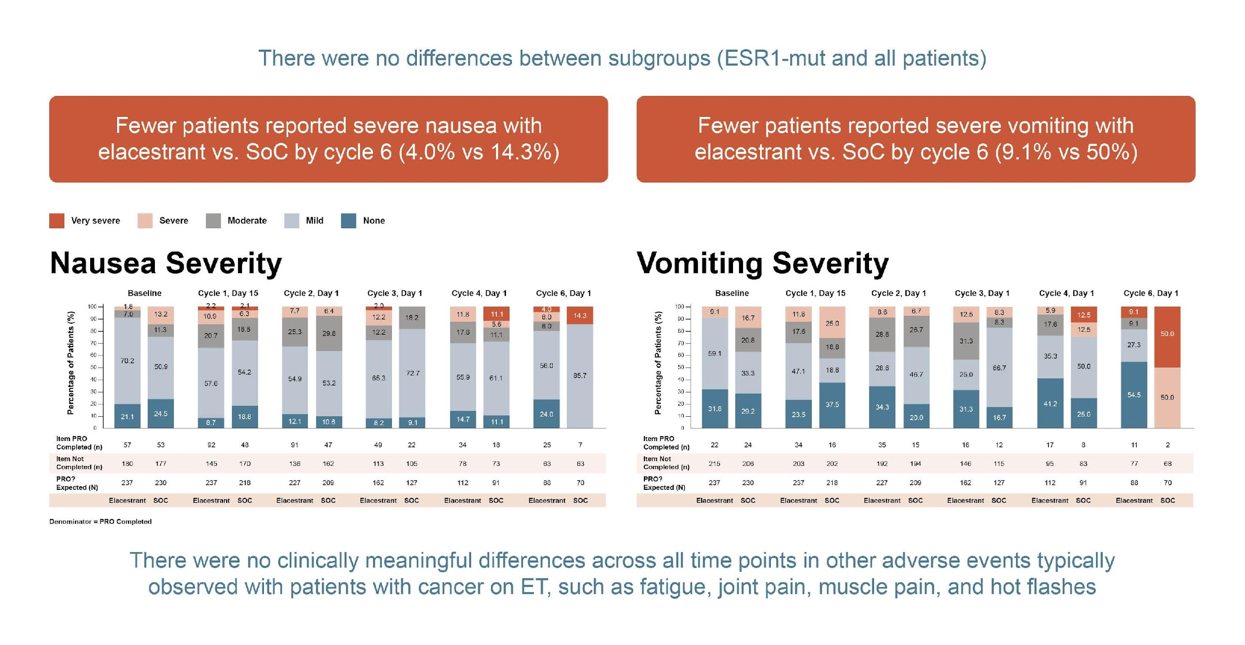
PRO-CTCAE: ADVERSE EVENTS RESULTS
ESR1, estrogen receptor 1 (gene); ET, Endocrine Therapy; mut, mutation; n, number with event; N, number in population; PRO, patient-reported outcome; PRO-CTCAE, Patient-Reported Outcomes version of the Common Terminology Criteria for Adverse Events; SoC, standard of care
Cortes J. et al. ESMO Op. 2023;8(suppl 4):101377. Available at: https://doi.org/10.1016/j.esmoop.2023.101377 (accessed November 2023). Presented at ESMO Breast Cancer Annual Congress (2023). Abstract 188O

Slide 19
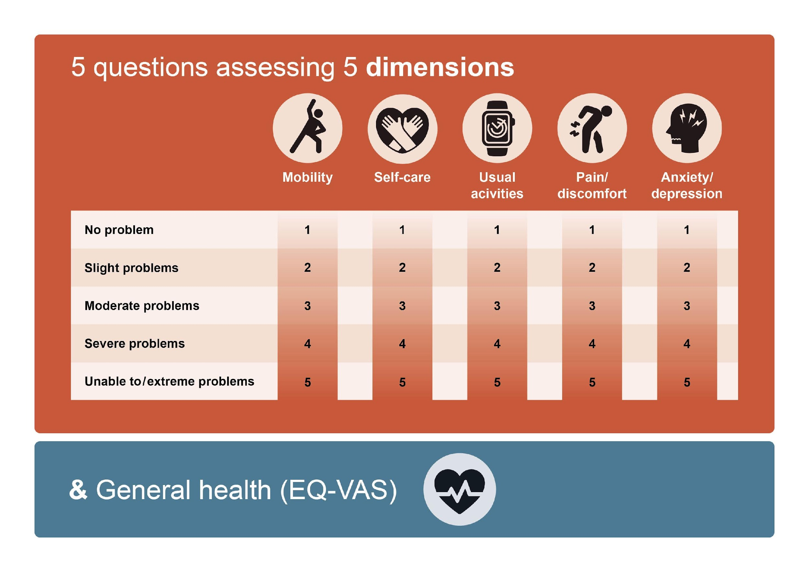
EQ-5D-5L: METHODS
EQ-5D-5L, EuroQol 5-Dimensions 5-Levels; EQ-VAS, EuroQol visual analogue scale
Cortes J. et al. ESMO Op. 2023;8(suppl 4):101377. Available at: https://doi.org/10.1016/j.esmoop.2023.101377 (accessed November 2023). Presented at ESMO Breast Cancer Annual Congress (2023). Abstract 188O

Slide 20
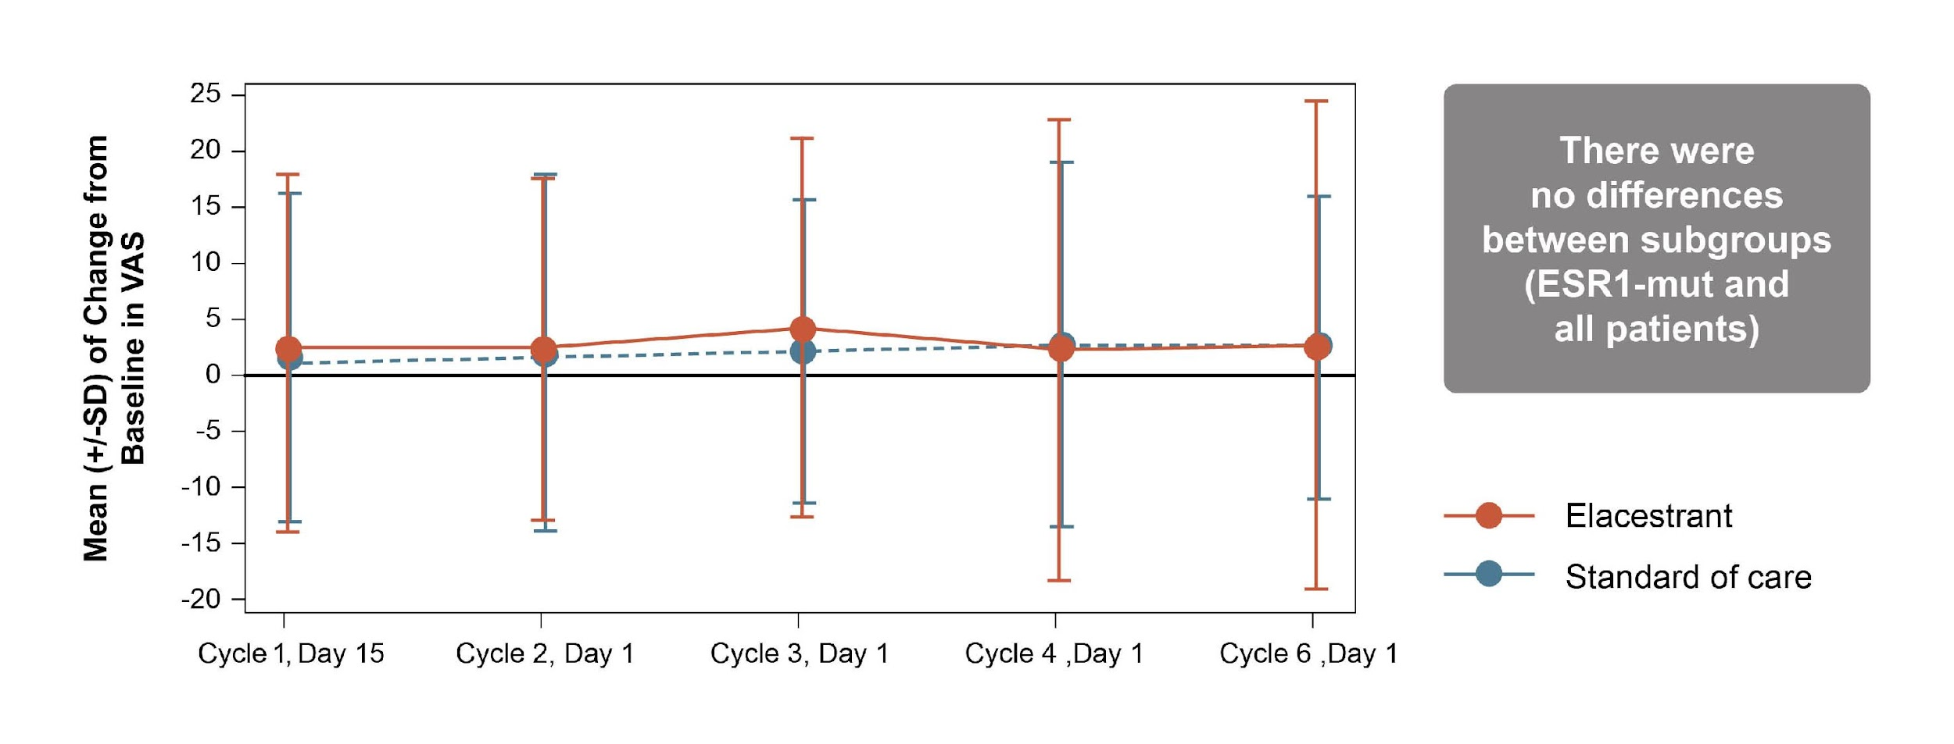
EQ-5D-5L: RESULTS
EQ-5D-5L scores were generally comparable in all patients (elacestrant vs SoC) for mobility, self-care, and usual activities
EQ-5D-5L, EuroQol 5-Dimensions 5-Levels; ESR1, estrogen receptor 1 (gene); SD, standard deviation; SoC, standard of care; VAS, visual analogue scale
Cortes J. et al. ESMO Op. 2023;8(suppl 4):101377. Available at: https://doi.org/10.1016/j.esmoop.2023.101377 (accessed November 2023). Presented at ESMO Breast Cancer Annual Congress (2023). Abstract 188O

Slide 21
ELACESTRANT AND MANAGING TREATMENT RELATED ADVERSE EVENTS

Slide 22
ELACESTRANT AND TREATMENT RELATED ADVERSE EVENTS
PATIENT CASE DEVELOPMENT
AGE
54 y.o. postmenopausal woman
MEDICAL HISTORY
Well controlled hypertension, osteopenic, BMI=29
+FH of prostate cancer in father, 80 y.o
DIAGNOSIS
(2021)
2L TREATMENT (2023)
TREATMENT RELATED AEs
ER+/HER2- de novo
mBC
(bone mets)
Elacestrant
Nausea (G2)
MONICA D.
2L, second-line; AE, adverse event; BMI, body mass index; ER, estrogen receptor; FH, family history; G2, grade 2; HER2, human epidermal growth factor receptor 2; mBC, metastatic breast cancer; mets, metastases; y.o, years old

Slide 23
ELACESTRANT AND TREATMENT RELATED ADVERSE EVENTS
DOSING RECOMMENDATIONS
Initial dose recommendations
345 mg/day (PO)
Dose reduction recommendations for adverse reactions
First dose reduction: 258 mg/day
Second dose reduction: 172 mg/day
Permanently discontinue if dose reduction <172 mg/day required
Modifications for adverse reactions
Grade 1: Continue at current dose level
Grade 2: Consider dose interruption until recovery to Grade ≤1 or baseline, then resume at same dose
Grade 3:
  Interrupt dose until recovery to Grade ≤1 or baseline, then resume at next lower dose
  If Grade 3 toxicity recurs, interrupt until recovery to Grade ≤1 or baseline, then resume elacestrant reduced by another dose level
Grade 4:
  Interrupt dose until recovery to Grade ≤1 or baseline, then resume at next lower dose
  Permanently discontinue if Grade 4 or intolerable adverse reaction recurs
PO, orally
Medscape. Elacestrant Dosage & Usage. 2023. Available at: https://reference.medscape.com/drug/orserdu-elacestrant-4000317 (accessed November 2023)

Slide 24
ELACESTRANT AND TREATMENT RELATED ADVERSE EVENTS
PATIENT CASE DEVELOPMENT
AGE
54 y.o. postmenopausal woman
MEDICAL HISTORY
Well controlled hypertension, osteopenic, BMI=29
+FH of prostate cancer in father, 80 y.o
DIAGNOSIS
(2021)
2L TREATMENT (2023)
TREATMENT RELATED AEs
ER+/HER2- de novo
mBC
(bone mets)
Elacestrant
Nausea (G2)
MONICA D.
Adverse event management recommendations for Monica:
Drug was suspended for 1 week, then restarted at the same dose🡪 no Grade >2 AEs occurred thereafter
Drug to be taken with food to reduce nausea
2L, second-line; AE, adverse event; BMI, body mass index; ER, estrogen receptor; FH, family history; G2, grade 2; HER2, human epidermal growth factor receptor 2; mBC, metastatic breast cancer; mets, metastases; y.o, years old

Slide 25
DISEASE PROGRESSION: BEYOND ELACESTRANT

Slide 26
DISEASE PROGRESSION: BEYOND ELACESTRANT
PATIENT CASE DEVELOPMENT
AGE
57 y.o. postmenopausal woman
MEDICAL HISTORY
Well controlled hypertension, osteopenic, BMI=29
+FH of prostate cancer in father, 80 y.o
MONICA D.
DIAGNOSIS
(2021)
2L TREATMENT (2023)
TREATMENT RELATED AEs
PROGRESSION
(20??)
ER+/HER2- de novo
mBC
(bone mets)
Elacestrant
Nausea (G3)
?
2L, second-line; AE, adverse event; BMI, body mass index; ER, estrogen receptor; FH, family history; G3, grade 3; HER2, human epidermal growth factor receptor 2; mBC, metastatic breast cancer; mets, metastases; y.o, years old

Slide 27
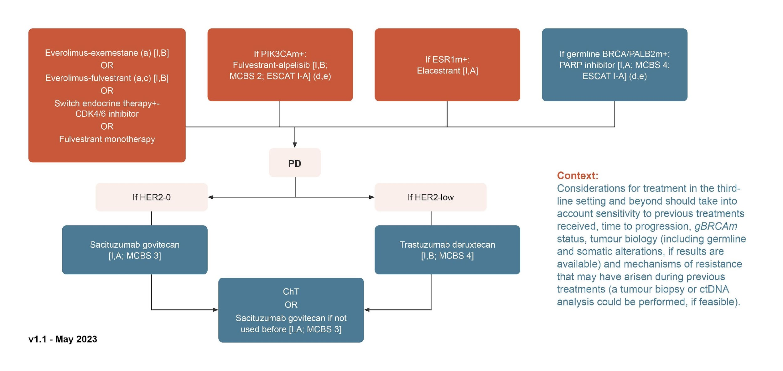
DISEASE PROGRESSION: BEYOND ELACESTRANT
ESMO 2023 RECOMMENDATIONS
BRCA, breast cancer susceptibility gene; CDK4/6, cyclin-dependent kinase 4/6; ChT, chemotherapy; ctDNA, circulating tumour DNA; ESR1m, estrogen receptor 1 (gene) mutation; ESCAT I-A, ESMO Scale for Clinical Actionability of Molecular Targets; gBRCAm, germline BRCA mutations; HER2, human epidermal growth factor receptor 2; MCBS, magnitude of clinical benefit scale (ESMO); PALB2m, partner and localizer of BRCA2 (gene) mutation; PARP, poly(ADP-ribose) polymerase; PD, progression disease; PIK3CAm, phosphatidylinositol-4,5-bisphosphate 3-kinase catalytic subunit alpha (gene) mutation
Gennari A, et al. Ann Oncol. 2021 Dec;32(12):1475-1495; Curigliano G, et al. ESMO Metastatic Breast Cancer Living Guidelines, v1.1 May 2023 (ER-positive HER2-negative Breast Cancer). Available at: https://www.esmo.org/living-guidelines/esmo-metastatic-breast-cancer-living-guideline/er-positive-her2-negative-breast-cancer (accessed November 2023)

Slide 28
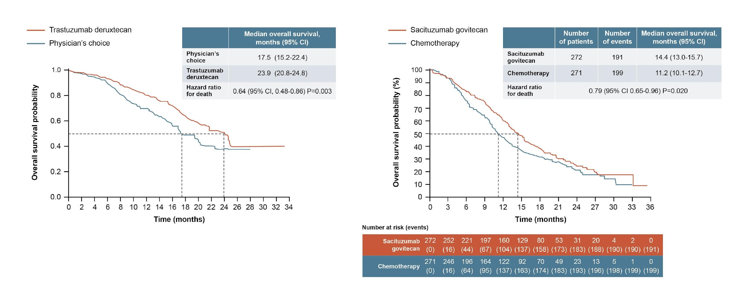
OPTIMAL TREATMENT SEQUENCE IN ER+/HER2- mBC IN 2023
ADCs IN 2L & 3L SETTING
DESTINY-Breast04: Trastuzumab deruxtecan vs
SoC 2L +, HER2-low only¹
TROPiCS-02: Sacituzumab govitecan vs SoC 3L +, all comers²
2L, second-line; 3L, third-line; ADC, antibody-drug conjugate; CI, confidence interval; ER, estrogen receptor; HER2, human epidermal growth factor receptor 2; mBC, metastatic breast cancer; SoC, standard of care
1. Modi S, et al. N Eng J Med. 2022;387:9-20; 2. Rugo HS, et al. Lancet. 2023;402:1423-1433

Slide 29
ORAL SERDS FUTURE PERSPECTIVES
& CONCLUSION
SERD, selective estrogen receptor degrader

Slide 30
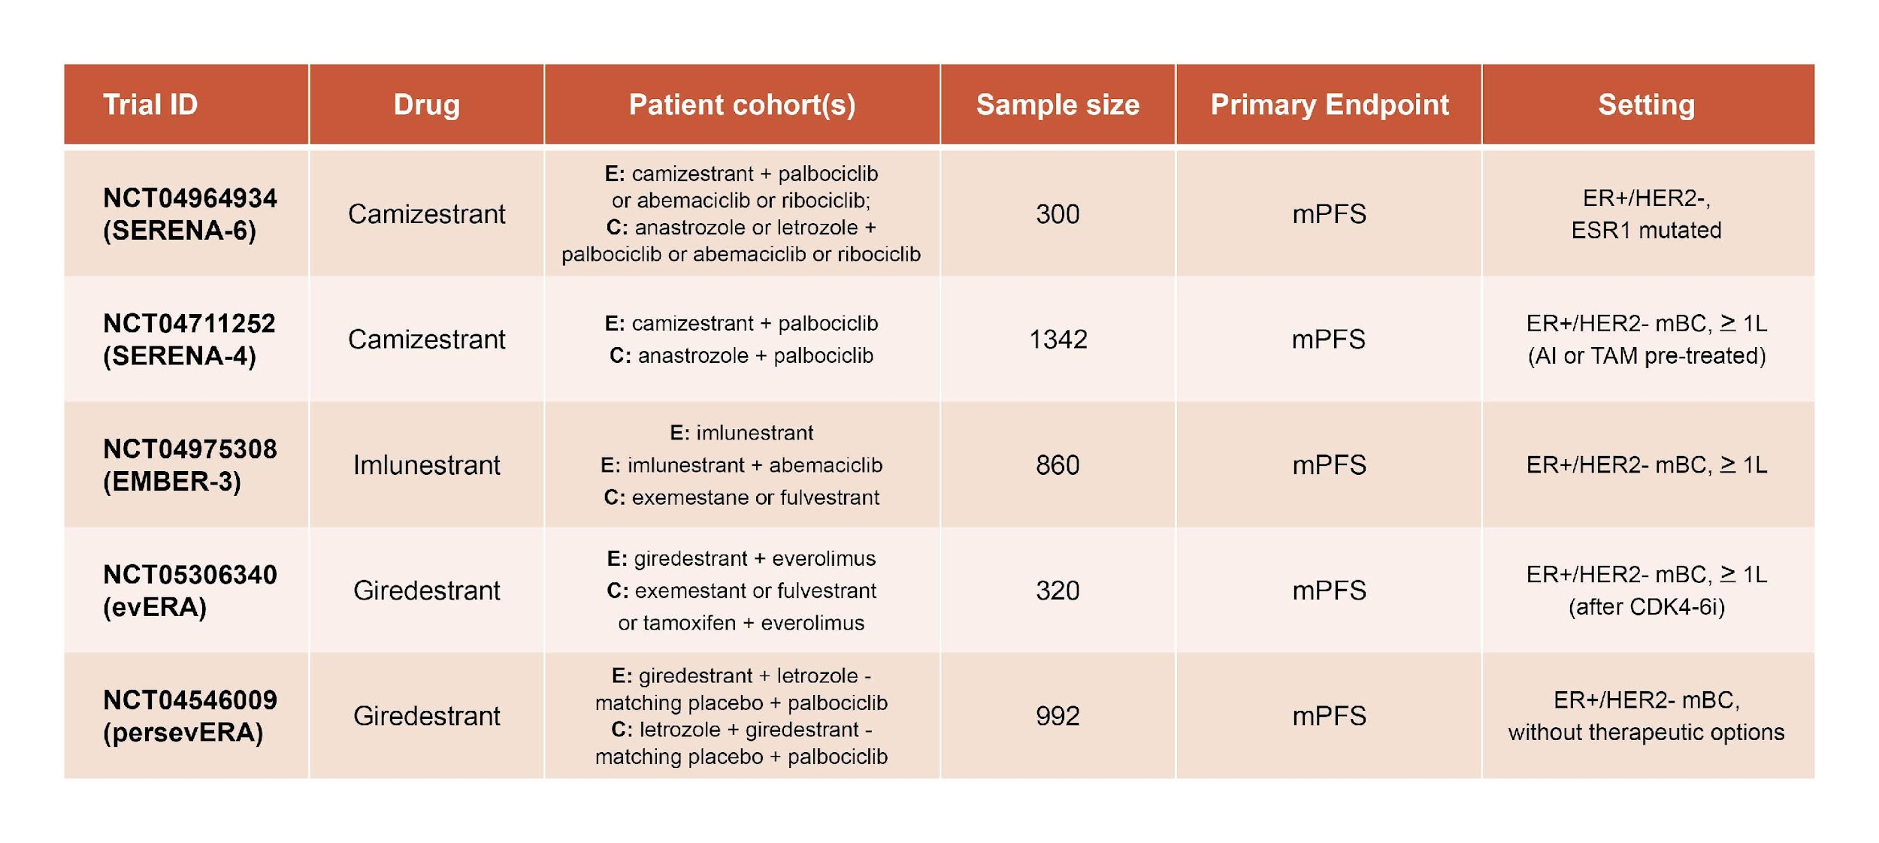
ONGOING ORAL SERDS PHASE 3 TRIALS IN ER+/HER2- mBC
1L, first-line; AI, aromatase inhibitor; C, comparator; CDK4/6i, cyclin-dependent kinase 4/6 inhibitor; E, experimental; ER, estrogen receptor; ESR1, estrogen receptor 1 (gene); HER2, human epidermal growth factor receptor 2; mBC, metastatic breast cancer; mPFS, median progression-free survival; TAM, tamoxifen
https://www.clinicaltrials.gov/study/NCT04964934 (accessed November 2023)
https://www.clinicaltrials.gov/study/NCT04711252 (accessed November 2023)
https://clinicaltrials.gov/study/NCT04975308 (accessed November 2023)
https://clinicaltrials.gov/study/NCT05306340 (accessed November 2023)
https://clinicaltrials.gov/study/NCT04546009 (accessed November 2023)

Slide 31
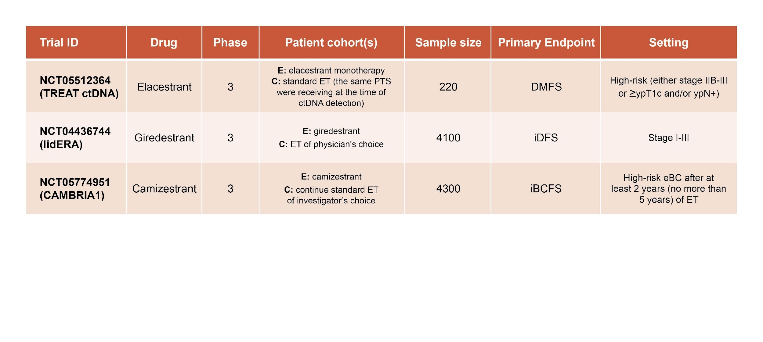
ONGOING PHASE 3 TRIALS IN ER+/HER2- eBC
C, comparator; ctDNA, circulating tumour DNA; DMFS, distant metastasis-free survival; E, experimental; eBC, early breast cancer; ER, estrogen receptor; ET, endocrine therapy; HER2, human epidermal growth factor receptor 2; iBCFS, invasive breast cancer-free survival; iDFS, invasive disease-free survival; pts, patients; ypT1c, residual tumour at surgery of ≥1 cm; ypN+, pathological lymph node involvement
https://www.clinicaltrials.gov/study/NCT05512364 (accessed November 2023)
https://www.clinicaltrials.gov/study/NCT04961996?cond=BREAST%20CANCER&intr=GIREDESTRANT&term=EARLY%20BREAST%20CANCER%20&rank=3 (accessed November 2023)
https://clinicaltrials.gov/study/NCT05774951 (accessed November 2023)

Slide 32
CLINICAL TAKEAWAYS
PRO results demonstrate no difference between treatment arms in the EMERALD trial, support elacestrant as a clinically meaningful option in this setting
Elacestrant has a manageable safety profile
If a patient progresses on elacestrant, the choice of subsequent therapy line should be based on multiple factors including sensitivity to prior treatments, disease burden, tumour biology. In this context, ADCs represent a new option
ADC, antibody-drug conjugate; PRO, patient-reported outcome

