Slide 2
Optimising outcomes with late-line treatment of mcrc
Assoc. Prof. Gerald Prager, MD
Medical Oncologist, Medical University of Vienna, Austria
Dr Victor Hugo Fonseca de Jesus, MD
Medical Oncologist, Grupo Oncoclínicas, Florianópolis, Brazil
MARCH 2024

Slide 3

Developed by GI COnnect
This programme is developed by GI CONNECT,
an international group of experts in the field
of gastrointestinal oncology.
Acknowledgement and disclosures
This GI CONNECT programme is supported through an independent educational grant from Bayer. The programme is therefore independent, the content is not influenced by the supporter and is under the sole responsibility of the experts.
Please note: The views expressed within this programme are the personal opinions of the experts. They do not necessarily represent the views of the experts’ institutions, or the rest of the GI CONNECT group.
Expert disclosures:
Assoc. Prof. Gerald Prager has received financial support/sponsorship for research support, consultation, or speaker fees from the following companies:
  Amgen, Arcus, Astellas, AstraZeneca, Bayer, BMS, CECOG, Incyte, Lilly, MSD, Merck Serono, Pierre Fabre, Roche, Servier, Takeda
Dr Victor Hugo Fonseca de Jesus has received financial support/sponsorship for research support, consultation, or speaker fees from the following companies:
  Amgen, Astellas, BMS, Daiichi-Sankyo, Knight, Pfizer, Roche, Servier

Slide 4
Educational objectives
Know how to optimise outcomes with late-line treatment of mCRC
  Understand the potential treatment options for these patients and available data to support treatment decisions
  Know which patient considerations are important when making treatment sequencing decisions
  Know the best ways to manage toxicities and quality of life to ensure patients can stay on treatment to achieve optimal outcomes
CRC, colorectal cancer

Slide 5
Clinical takeaways
There are numerous novel treatment options for later line use for mCRC patients
Molecular profiling is key and should be available prior to starting the first systemic therapy
By later line, mCRC patients will most likely already have received targeted therapy if they are suitable candidates
There are a number of effective treatment options for molecularly unselected mCRC patients third line and beyond: regorafenib, fruquintinib, trifluridine/tipiracil +/- bevacizumab
Rechallenging with an earlier line of treatment may be considered for patients who have exhausted other lines of therapy

Slide 6
What do the guidelines recommend?

Slide 7
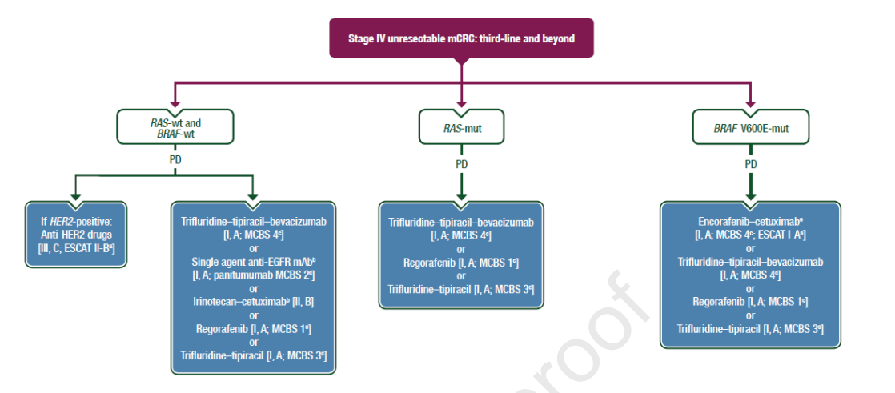
Management of stage IV unresectable mCRC in third‑line therapy and beyond
ESMO CLINICAL PRACTICE GUIDELINES
Stage IV unresectable mCRC: third-line and beyond
RAS-wt and
BRAF-wt
RAS-mut
BRAF V600E-mut
PD
PD
PD
If HER2-positive:
Anti-HER2 drugs
[III, C; ESCAT II-B]
Trifluridine–tipiracil–bevacizumab
[I, A; MCBS 4]
or
Single agent anti-EGFR mAb
[I, A; panitumumab MCBS 2]
or
Irinotecan–cetuximab [II, B]
or
Regorafenib [I, A; MCBS 1]
or
Trifluridine–tipiracil [I, A; MCBS 3]
Trifluridine–tipiracil–bevacizumab
[I, A; MCBS 4]
or
Regorafenib [I, A; MCBS 1]
or
Trifluridine–tipiracil [I, A; MCBS 3]
Encorafenib–cetuximab
[I, A; MCBS 4; ESCAT I-A]
or
Trifluridine–tipiracil–bevacizumab
[I, A; MCBS 4]
or
Regorafenib [I, A; MCBS 1]
or
Trifluridine–tipiracil [I, A; MCBS 3]
BRAF, proto-oncogene B-Raf; EGFR, epidermal growth factor receptor; ESCAT, ESMO Scale for Clinical Actionability of Molecular Targets; ESMO, European Society for Medical Oncology; HER2, human epidermal growth factor receptor 2; mAb, monoclonal antibody; MCBS, ESMO Magnitude of Clinical Benefit Scale; mCRC, metastatic colorectal cancer; mut, mutant; PD, progressive disease; RAS, RAS proto-oncogene GTPase; wt, wild-type
Cervantes A, et al. Ann Oncol. 2023; 34 (1):10-32; ESMO Metastatic Colorectal Cancer Living Guidelines, v1.1 July 2023. Accessed February 2024

Slide 8
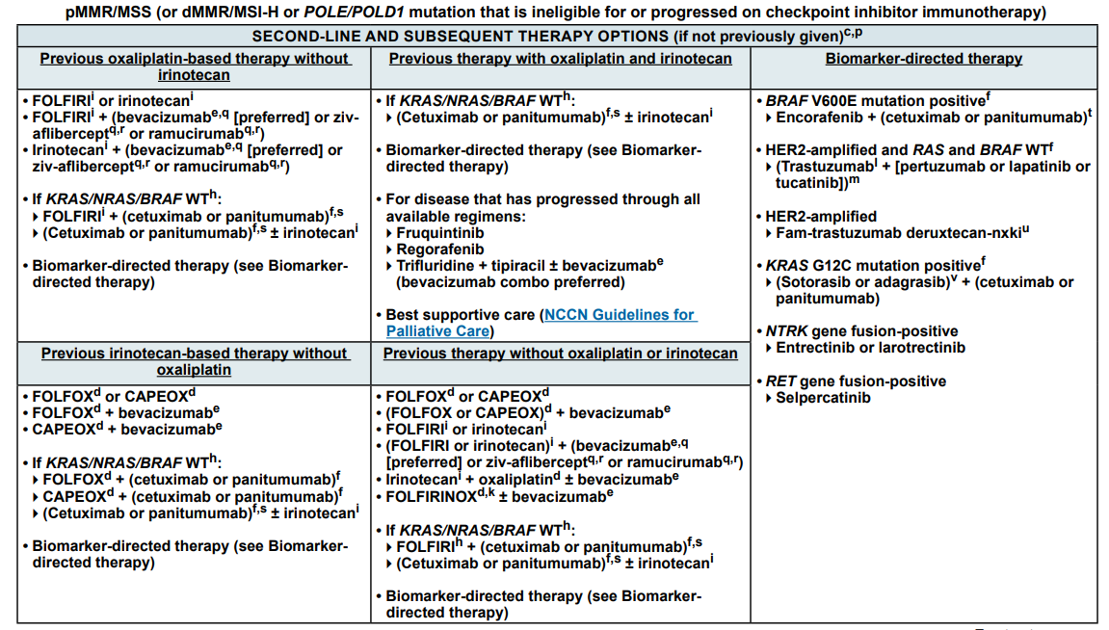
Systemic therapy for advanced or metastatic crc
NCCN CLINICAL PRACTICE GUIDELINES
BRAF, proto-oncogene B-Raf; dMMR, deficient mismatch repair; HER2, human epidermal growth factor receptor 2; KRAS, Kirsten rat sarcoma virus;
mCRC, metastatic colorectal cancer; MSI-H, microsatellite instability-high; MSS, microsatellite stable; NCCN, National Comprehensive Cancer Network; NRAS, NRAS Proto-Oncogene GTPase; pMMR, proficient mismatch repair; RAS, RAS proto-oncogene GTPase; WT, wild-type
NCCN guidelines, Version 1.2024. colon.pdf (nccn.org). Accessed February 2024

Slide 9
Treatment options for Molecularly unselected mcrc population

Slide 10
CORRECT Study: Regorafenib vs placebo PROLONGED PFS AND OS in refractory mCRC patients
PROGRESSION-FREE SURVIVAL
OVERALL SURVIVAL
100
Regorafenib
Placebo
100
Regorafenib
Placebo
75
75
HR 0.77, 95% CI 0.64-0.94, P=0.0052
50
HR 0.49, 95% CI 0.42-0.58, P<0.0001
50
Progression-free survival (%)
Overall survival (%)
25
25
0
0
2
4
6
8
10
12
0
0
2
4
6
8
10
12
14
Number at risk
Regorafenib
Placebo
Months after randomisation
Number at risk
Regorafenib
Placebo
Months after randomisation
238
51
98
9
42
2
12
2
3
0
452
221
352
150
187
75
93
32
33
9
7
3
PFS: 1.9 mo vs. 1.7 mo (HR 0.49; p<0.0001)
OS: 6.4 mo vs. 5.0 mo (HR 0.77; p= 0.0052)
Tumour response:
ORR: 1.0% vs. 0.4% (p=0.19)
DCR: 41% vs. 15% (p<0.0001)
CI, confidence interval; DCR, disease control rate; HR, hazard ratio; mCRC, metastatic colorectal cancer; mo, months; ORR, objective response rate; OS, overall survival; PFS, progression free survival
Grothey A, et al. Lancet. 2013;381:303-12

Slide 11
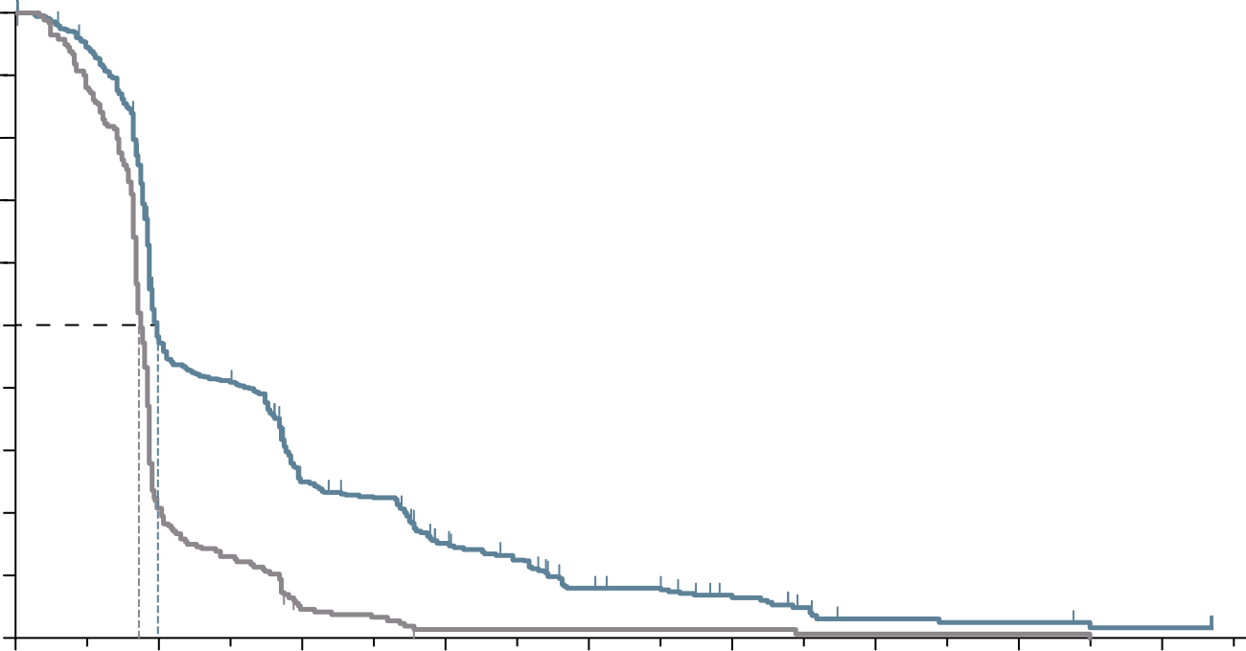
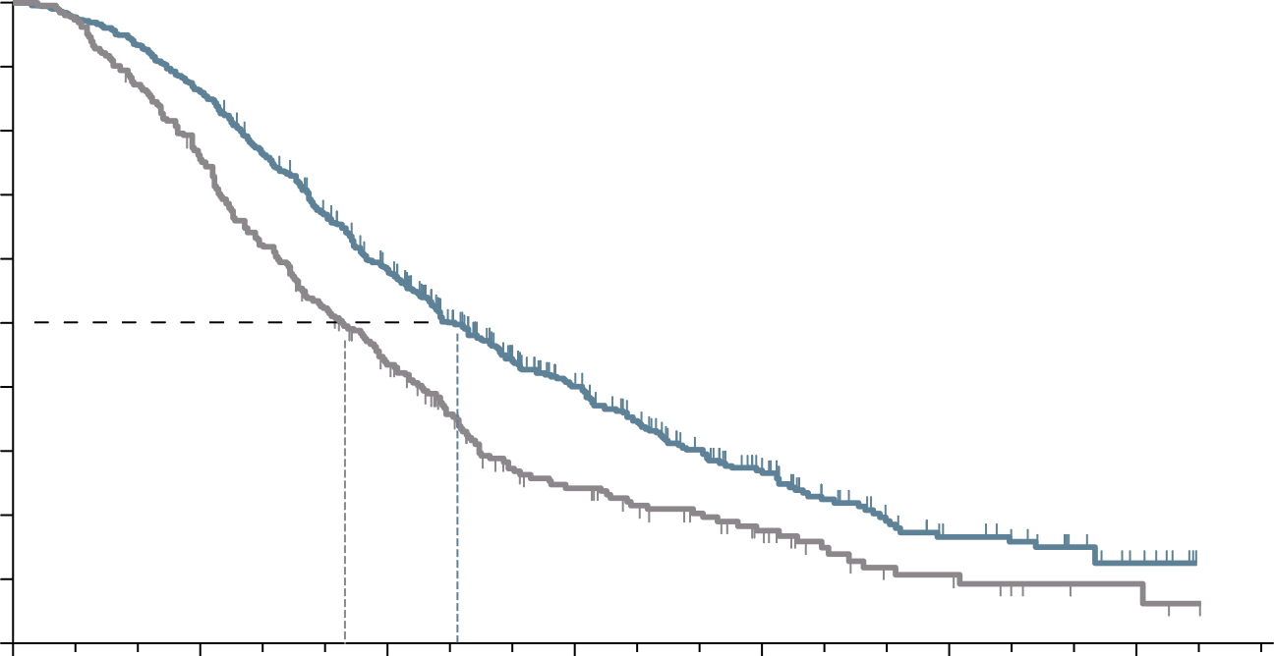
RECOURSE Study: trifluridine/tipiracil PROLONGED PFS AND OS in refractory mcrc patients
PROGRESSION-FREE SURVIVAL
OVERALL SURVIVAL
100
100
90
90
80
Hazard ratio for progression or death, 0.48 (95% CI, 0.41-0.57)
P<0.001 by log-rank test
80
Hazard ratio for death, 0.68 (95% CI, 0.58-0.81)
P<0.001
70
70
60
60
50
50
Progression-free survival (%)
Overall survival (%)
40
40
30
Trifluridine/Tipiracil
30
Trifluridine/Tipiracil
20
20
10
Placebo
10
Placebo
0
0
2
4
6
8
10
14
16
0
0
3
6
9
12
15
18
Months after randomisation
Months after randomisation
Number at risk
Trifluridine/Tipiracil
Placebo
Number at risk
Trifluridine/Tipiracil
Placebo
534
266
238
51
121
10
66
2
30
2
18
2
5
1
4
1
2
0
534
266
459
198
294
107
137
47
64
24
23
9
7
3
PFS: 2.0 mo vs. 1.7 mo (HR 0.48; p<0.001)
OS: 7.1 mo vs. 5.3 mo (HR 0.68; p<0.001)
Tumour response:
ORR: 1.6% vs. 0.4% (p=0.29)
DCR: 44% vs. 16% (p<0.001)
CI, confidence interval; DCR, disease control rate; HR, hazard ratio; mCRC, metastatic colorectal cancer; mo, months; ORR, objective response rate; OS, overall survival; PFS, progression free survival
Mayer RJ, et al N Engl J Med. 2015;372:1909-19

Slide 12
safety profILe In patIents beyond the seCond LIne
Most commonly reported (≥25% of pts) adverse events for Trifluridine/Tipiracil and regorafenib in phase 3 clinical studies^{1,2}
Trifluridine/Tipiracil (N=533)¹ |  |  | Regorafenib (N=500)^{2,a}
 | Overall (%) | Grade ≥3 (%) |  | Overall (%) | Grade ≥3 (%)
Leucopenia^{b} | 77 | 21 | Hand-foot skin reaction | 47 | 17
Anaemia^{b} | 77 | 18 | Fatigue | 47 | 10
Neutropenia^{b} | 67 | 38 | Diarrhoea | 34 | 7
Nausea | 48 | 2 | Anorexia | 30 | 3
Thrombocytopaenia^{b} | 42 | 5 | Voice changes | 29 | <1
Decreased appetite | 39 | 4 | Hypertension | 28 | 7
Increase in ALP | 39 | 8 | Oral mucositis | 27 | 3
Increase in total bilirubin^{d} | 36 | 9 | Rash/desquamation | 26 | 6
Fatigue | 35 | 4
Diarrhoea | 32 | 3
Increase in AST^{c} | 30 | 4
Vomiting | 28 | 2
ª Treatment-related adverse events from start of treatment to 30 days after end of treatment;^{b}N=528; ^{c}N=524; ^{d}N=526 (the denominator for the percentage of patients with laboratory abnormalities is the number of patients with at least one post-baseline measurement during treatment). Please note that these drugs have not been compared in head-to-head studies. The information is presented for information purposes only. Adapted from Argiles G, et al. ESMO Open 2019;4:e000495. doi:10.1136/esmoopen-2019-000495;
ALP, alkaline phosphatase; AST, aspartate aminotransferase level; PTS, patients
1. Mayer RJ, et al. N Engl J Med. 2015;372:1909-1919; 2. Grothey A, et al. Lancet. 2013;381:303-312

Slide 13
Sunlight phase 3 study
Trifluridine/Tipiracil + bevacizumab
Patients with mCRC
Histologically confirmed mCRC
After two prior regimens
Disease progression or intolerance
Known RAS status
ECOG PS 0-1
Trifluridine/tipiracil p.o. 35 mg/m² BID
day 1-5 and 8-12; every 28 days
Bevacizumab 5 mg/kg IV
day 1 and 15; every 28 days
Follow-up every 8 weeks for radiologic progression and/or survival status
R
1:1
Trifluridine/tipiracil p.o. 35 mg/m² BID
day 1-5 and 8-12; every 28 days
BID, twice a day; ECOG, Eastern Cooperative Oncology Group; IV, intravenous; mCRC, metastatic colorectal cancer; p.o., by mouth; R, randomisation;
RAS, RAS proto-oncogene GTPase
Tabernero J, et al. Future Oncol. 2021;17:16:1977-85

Slide 14
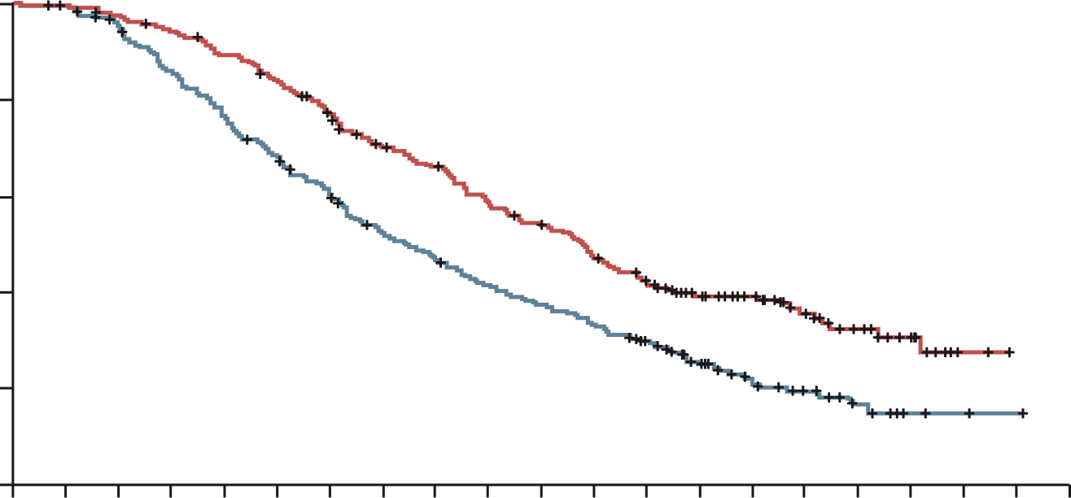
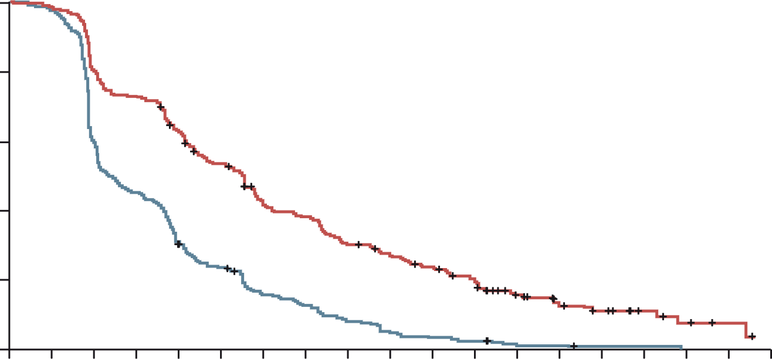
Sunlight: Trifluridine/Tipiracil plus bevacizumab improves outcomes in refractory mcrc
Trifluridine/Tipiracil plus bevacizumab improved OS and PFS in refractory CRC patients
Overall survival (primary endpoint)
Progression-free survival
 | FTD–TPI + Bev (N=246) | FTD–TPI (N=246)
Median OS, months | 10.8 | 7.5
6-month OS rate, % | 77 | 61
12-month OS rate, % | 43 | 30
 | FTD–TPI + Bev (N=246) | FTD–TPI (N=246)
Median PFS, months | 5.6 | 2.4
6-month PFS rate, % | 43 | 16
12-month PFS rate, % | 16 | 1
100
100
80
80
FTD–TPI + Bev group
FTD–TPI group
60
60
Overall Survival (%)
Progression-free survival (%)
HR, 0.44 (95% CI, 0.36-0.54)
p<0.001
40
40
FTD–TPI + Bev group
FTD–TPI group
20
HR, 0.61 (95% CI, 0.49-0.77)
p<0.001
20
0
0
1
2
3
4
5
6
7
8
9
10
11
12
13
14
15
16
17
18
19
20
0
0
1
2
3
4
5
6
7
8
9
10
11
12
13
14
15
16
17
18
No. at risk
FTD–TPI + Bev group
FTD–TPI group
Months
No. at risk
FTD–TPI + Bev group
FTD–TPI group
Months
246
246
244
242
239
230
230
205
217
184
203
163
183
143
160
120
149
108
131
95
119
85
104
76
88
63
69
44
52
24
37
16
24
10
13
5
2
2
0
1
0
0
246
246
242
236
198
147
179
109
153
74
128
56
99
36
89
29
70
19
61
12
52
8
43
6
25
2
18
2
13
1
7
1
4
0
2
0
0
0
Bev, bevacizumab; CI, confidence interval; FTD-TPI, Trifluridine/Tipiracil; HR, hazard ratio; (m)CRC, (metastatic) colorectal cancer; OS, overall survival; PFS, progression-free survival
Tabernero J, et al. J Clin Oncol. 2023;41(suppl 4; abstr 4) (ASCO GI 2023, oral presentation); Prager G, et al. N Engl J Med. 2023; 388:1657-1667

Slide 15
Sunlight: SAFETY results
Overall safety
TEAEs in ≥20% of All Patients
Event (any cause), n (%) | FTD–TPI + Bev (N=246) | FTD–TPI (N=246)
Overall AEs | 241 (98) | 241 (98)
Trifluridine/tipiracil-related AEs | 221 (90) | 200 (81)
Bevacizumab-related AEs | 119 (48) | NA
Severe (grade ≥3) AEs | 178 (72) | 171 (70)
Serious AEs | 61 (25) | 77 (31)
Treatment-related deaths | 0 | 0
AEs leading to withdrawal from the study | 31 (13) | 31 (13)
TEAE, n (%) | FTD–TPI + Bev (N=246) |  | FTD–TPI (N=246)
 | Any grade | Grade 3 or 4 | Any grade | Grade 3 or 4
Neutropenia | 153 (62) | 106 (43) | 126 (51) | 79 (32)
Nausea | 91 (37) | 4 (2) | 67 (27) | 4 (2)
Anemia | 71 (29) | 15 (6) | 78 (32) | 27 (11)
Asthenia | 60 (24) | 10 (4) | 55 (22) | 10 (4)
Fatigue | 53 (22) | 3 (1) | 40 (16) | 9 (4)
Diarrhea | 51 (21) | 2 (1) | 46 (19) | 6 (2)
Decreased appetite | 50 (20) | 2 (1) | 38 (15) | 3 (1)
Dose modification, n (%) | FTD–TPI + Bev (N=246) | FTD–TPI (N=246)
Dose reductions | 40 (16) | 30 (12)
Dose delays | 171 (70) | 131 (53)
Hypertension (10% vs 2%), nausea and neutropenia occurred more frequently in the combination group
  One case of febrile neutropenia with trifluridine/tipiracil plus bevacizumab versus six with trifluridine/tipiracil
AE, adverse event; Bev, bevacizumab; FTD-TPI, trifluridine/tipiracil; TEAE, treatment emergent adverse event
Tabernero J, et al. J Clin Oncol. 2023;41(suppl 4; abstr 4) (ASCO GI 2023, oral presentation); Prager G, et al. N Engl J Med. 2023; 388:1657-1667

Slide 16
FRESCO-2: background and study design
AFTER REGORAFENIB AND/OR trifluridine/tipiracil
Effective treatment options are limited for patients with refractory metastatic colorectal cancer
Fruquintinib is a highly selective and potent oral tyrosine kinase inhibitor of VEGFR-1, -2 and -3 and was approved in China in the 3L+ mCRC setting based on results from the FRESCO trial
FRESCO-2 evaluated fruquintinib in more heavily pre-treated patients reflecting current global practices
Patient eligibility
Prior treatment with fluoropyrimidine-, oxaliplatin- and irinotecan-based chemotherapy, an anti-VEGF biological therapy and, if RAS wild‑type, an anti-EFGR therapy
Progression on, or intolerance to, trifluridine/tipiracil and/or regorafenib
Prior treatment with an immune checkpoint inhibitor or BRAF inhibitor if indicated
Fruquintinib 5 mg PO, QD
(3 weeks on, 1 week off)
+
BSC
(N=458)
Primary Objective
Overall survival
Secondary objectives
Progression-free survival
Objective response rate
Disease control rate
Safety
R
2:1
Treatment until
progression or
unacceptable toxicity
Placebo 5 mg PO, QD
(3 weeks on, 1 week off)
+
BSC
(N=229)
N=687
Stratification factors
Prior therapy (trifluridine/tipiracil vs regorafenib vs trifluridine/tipiracil and regorafenib)
RAS mutational status (wild-type vs mutant)
Duration of metastatic disease (≤18 months vs >18 months
Note: to ensure the patient population is reflective of clinical practice, the number of patients with prior regorafenib was limited to 344 patients (50%)
3L, third line; BRAF, proto-oncogene B-Raf; BSC, best supportive care; EFGR, endothelial growth factor; mCRC, metastatic prostate cancer; PO, orally; QD, once a day; R, randomisation; RAS, rat sarcoma viral oncogene homologue; VEGF(R), vascular endothelial growth factor (receptor)
Dasari NA, et al. Ann Oncol. 2022;33(suppl_7):S808-S869 (ESMO 2022 presentation)

Slide 17
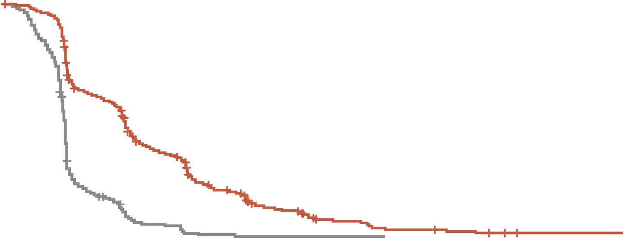
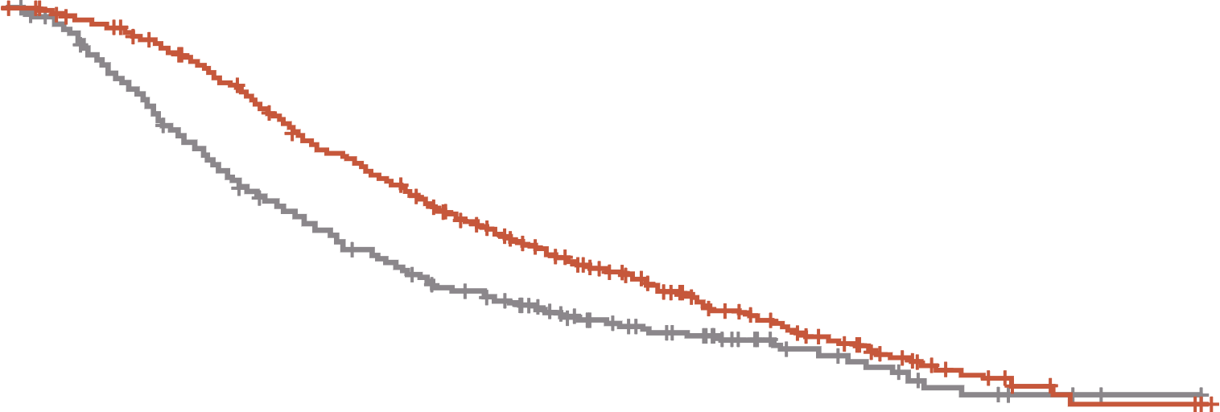
FRESCO-2: Fruquintinib prolonged OS and PFS in patients with refractory mCRC
PROGRESSION-FREE SURVIVAL
OVERALL SURVIVAL
 | Fruquintinib | Placebo
Events/patients (%) | 392/461 (85.0%) | 213/230 (92.6%)
Stratified p-value (log-rank) | <0.001
Stratified HR (95% CI) | 0.321 (0.267, 0.386)
Median (95% CI), months | 3.7 (3.5, 3.8) | 1.8 (1.8, 1.9)
Median PFS difference, months | 1.9
 | Fruquintinib | Placebo
Events/patients (%) | 317/461 (68.8%) | 173/230 (75.2%)
Stratified p-value (log-rank) | <0.001
Stratified HR (95% CI) | 0.662 (0.549, 0.800)
Median (95% CI), months | 7.4 (6.7, 8.2) | 4.8 (4.0, 5.8)
Median OS difference, months | 2.6
1.0
1.0
0.8
0.8
0.6
0.6
Probability of progression‑free survival (%)
Probability of overall survival (%)
Median follow-up:
Fruquintinib: 11.3 mo
Placebo: 11.2 mo
0.4
0.4
0.2
0.2
Fruquintinib + BSC
Placebo + BSC
Fruquintinib + BSC
Placebo + BSC
0
0
0
1
2
3
4
5
6
7
8
9
10
11
12
13
14
15
16
17
18
19
0
1
2
3
4
5
6
7
8
9
10
11
12
13
14
15
16
17
18
19
Time from randomisation (months)
Time from randomisation (months)
Patients at risk
Fruquintinib
Placebo
461
230
430
194
291
60
256
36
170
12
146
10
89
2
71
2
43
1
36
1
21
1
17
1
10
0
9
6
4
2
2
2
Patients at risk
Fruquintinib
Placebo
461
230
449
216
429
184
395
153
349
125
297
105
266
89
224
73
184
63
143
45
113
37
79
31
58
20
41
15
23
10
14
6
7
3
4
2
4
1
0
0
PFS: 3.7 mo vs. 1.8 mo (HR 0.32; p<0.001)
OS: 7.4 mo vs. 4.8 mo (HR 0.66; p<0.001)
Tumour response:
ORR: 1.5% vs. 0.0% (p=0.059)
DCR: 55.5% vs. 16.1% (p<0.001)
BSC, best supportive care; CI, confidence interval; DCR, disease control rate; HR, hazard ratio; mCRC, metastatic colorectal cancer; mo, months; ORR, objective response rate; OS, overall survival; PFS, progression-free survival
Dasari NA, et al. Ann Oncol. 2022;33(suppl_7):S808-S869 (ESMO 2022 oral presentation)

Slide 18
FRESCO-2: safety results
Category, n (%) | Fruquintinib (N=456) | Placebo (N=230)
Any TEAE Grade ≥3 Treatment-related Grade ≥3 Leading to death | 451 (98.9) 286 (62.7) 164 (36.0) 48 (10.5) | 213 (92.6) 116 (50.4) 26 (11.3) 45 (19.6)
Any serious TEAE Grade ≥3 | 171 (37.5) 162 (35.5) | 88 (38.3) 85 (37.0)
TEAEs leading to dose modifications Dose interruption Dose reduction Dose discontinuation | 247 (54.2) 110 (24.1)ª 93 (20.4)^{b} | 70 (30.4) 9 (3.9) 49 (21.3)
ª Most common TEAEs leading to dose reduction in fruquintinib arm: hand-foot syndrome (5.3%), hypertension (3.7%), and asthenia (3.5%) ^{b} Most common TEAE leading to dose discontinuation in the fruquintinib arm: asthenia (1.5%)
TEAE, treatment-emergent adverse event
Dasari NA, et al. Ann Oncol. 2022;33 (suppl_7):S808-S869 (ESMO 2022 oral presentation)

Slide 19
Treatment optimisation

Slide 20
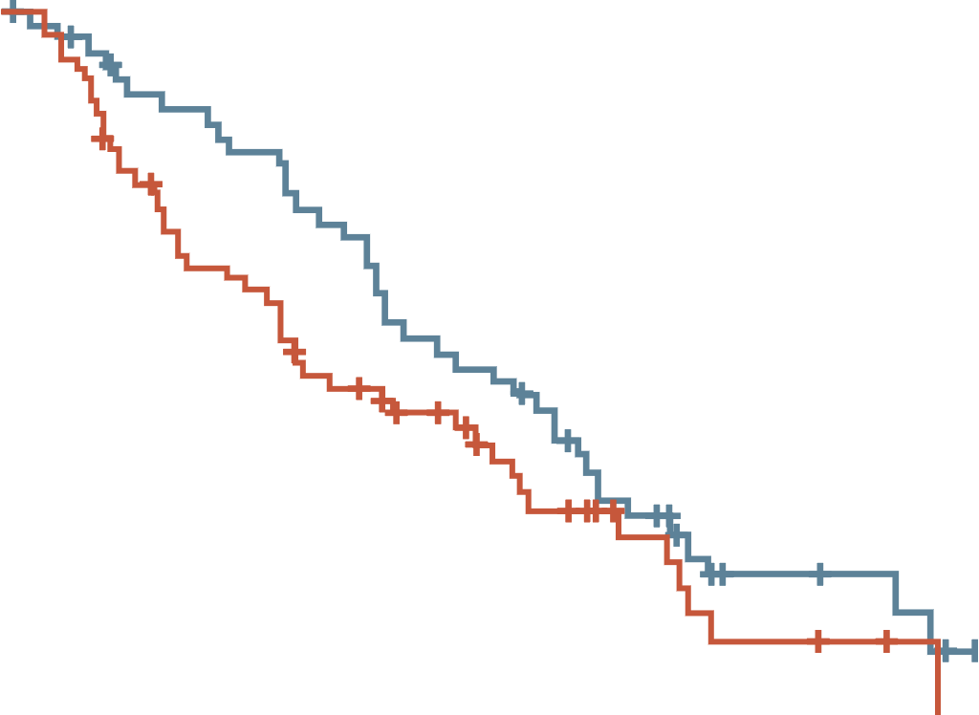
Dose-escalated strategy for management of adverse events with regorafenib
ReDOS study: no significant difference in overall survival between dose escalation and standard dosing²
A dose-escalation schedule for regorafenib to minimise toxicities¹
PHASE 2 ReDOS STUDY²
100
Median OS: 9.8 mo vs. 6.0 mo (HR 0.72; p=0.12)
90
80 mg PO daily
for 1 week
80
Week 1
70
No
SDRT
60
50
120 mg PO daily
for 1 week
80 mg PO daily
for 1 week
Overall survival (%)
Week 2
SDRT
40
No
SDRT
30
Dose-escalation group
20
Week 3
160 mg PO daily
for 1 week
120 mg PO daily
for 1 week
10
SDRT
Standard-dose group
0
0
3
6
9
12
15
18
21
24
No
SDRT
Time from randomisation (months)
Week 4
Off for 1 week
Number at risk (number censored)
Dose escalation
Standard dose
54 (0)
62 (0)
44 (4)
45 (2)
36 (4)
28 (3)
26 (4)
21 (7)
14 (4)
10 (12)
5 (11)
3 (14)
3 (12)
1 (16)
0 (14)
0 (16)
–
–
Dose escalation arm: weekly incremental dose escalation up to 160 mg/day if no SDRTs observed. If SDRTs were observed during first 2 cycles, regorafenib dose was reduced to the preceding dose level. In cycle 2 and all subsequent cycles, patients received the highest tolerated dose from cycle 1; Standard dose arm: regorafenib 160 mg/day starting on day 1 until dose modification or discontinuation. Regorafenib was administered for 21 consecutive days of a 28-day treatment cycle in both treatment arms.
HR, hazard ratio; mo, months; OS, overall survival; PO, by mouth; SDRT, significant drug-related toxicities
1. Grothey A. Clin Adv Hematol Oncol. 2015;13(8):514-517; 2. Bekaii-Saab TS, et al. Lancet Oncol. 2019;20(8):1070-1082

Slide 21
ReDOS trial: results
% OF PTS STARTING CYCLE 3
MOST COMMON GRADE 3-4 AEsª
P=0.043
 | Escalating dose N=54 | Standard dose N=62
Hand-foot skin reaction, n (%) | 8 (15) | 10 (16)
Abdominal pain, n (%) | 9 (17) | 4 (6)
Hypertension, n (%) | 4 (7) | 9 (15)
Fatigue, n (%) | 7 (13) | 11 (18)
ªGrade 3-4 AEs occurring in > 10% of patients in either treatment arm
AE, adverse event; pts, patients
Bekaii-Saab TS, et al. Lancet Oncol. 2019;20(8):1070-1082

Slide 22
Treatment options for a Molecularly selected mcrc population
mCRC, metastatic colorectal cancer

Slide 23
Beacon crc study design
SAFETY LEAD-IN
RANDOMISED PORTION
Triplet therapy
Binimetinib + encorafenib + cetuximab
n=205
DISEASE
PROGRESSION
Complete
Safety and tolerability will be assessed in patients receiving binimetinib, encorafenib and cetuximab for the treatment of BRAF V600E-mutant metastatic colorectal cancer
N=30
Patient population
BRAF V600E mutant
1-2 prior regimens in metastatic setting
N=615
R
Doublet therapy
Encorafenib + cetuximab
n=205
DISEASE
PROGRESSION
Continued follow-up for
evaluation of OS
Control Arm
FOLFIRI + cetuximab or irinotecan + cetuximab
n=205
DISEASE
PROGRESSION
Primary Endpoint: Overall survival (OS) of the triplet therapy compared to the control arm.
Secondary Endpoints: Address efficacy of the doublet therapy compared to the control arm, and the triplet therapy compared
to the doublet therapy.
Other Secondary Endpoints: Progression-free survival (PFS), objective response rate (ORR), duration of response, safety and
tolerability. Health related quality of life data will also be assessed.
Kopetz S, et al. N Engl J Med. 2019;381(17):1632-43

Slide 24
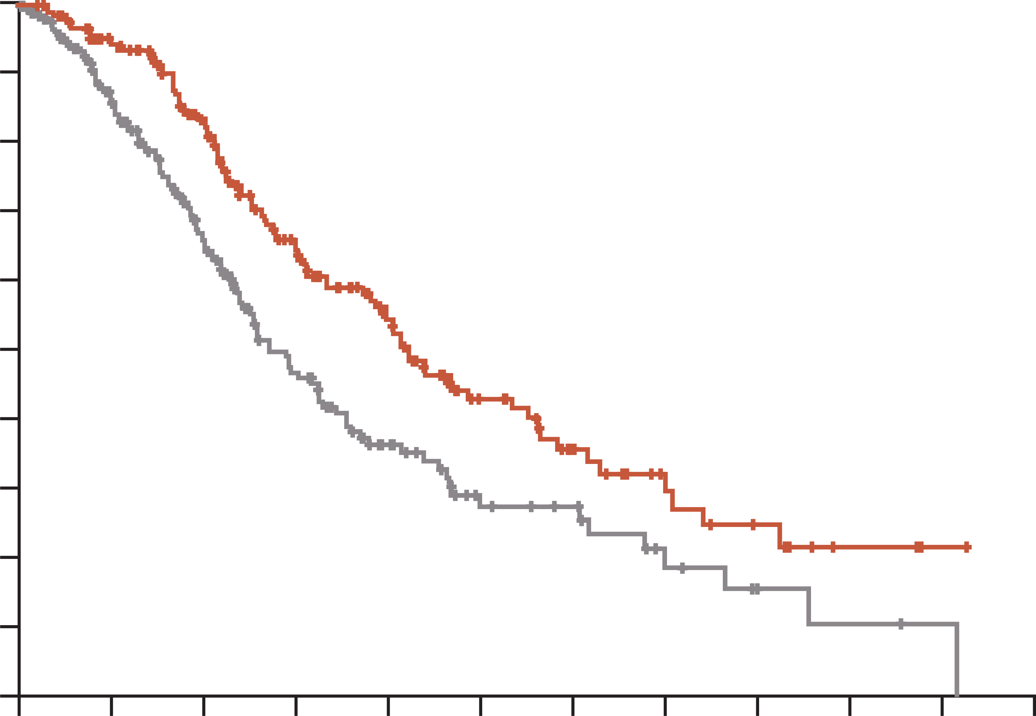
Encorafenib plus cetuximab improves survival in previously treated patients with BRAF V600E–mutant mCRC
Overall survival, doublet regimen vs control
1.0
In the BEACON CRC study, treatment with doublet therapy (encorafenib plus cetuximab) improved OS, ORR, and PFS in previously treated patients in the metastatic setting compared with standard chemotherapyª
0.9
 | Median overall survival mo (95% CI)
Doublet | 8.4 (7.5-11.0)
Control | 5.4 (4.8-6.6)
0.8
0.7
0.6
Hazard ratio for death,
0.60 (95% CI, 0.45-0.79)
p<0.001
Probability of survival
0.5
0.4
0.3
Doublet
0.2
0.1
0.0
Control
0
2
4
6
8
10
12
14
16
18
20
22
Months
Number at risk
Doublet
Control
220
221
184
158
133
102
87
60
57
34
33
18
21
15
12
7
8
4
3
2
1
1
0
0
ª Standard chemotherapy: cetuximab and irinotecan or cetuximab and FOLFIRI
BRAF, proto-oncogene B-Raf; CI, confidence interval; FOLFIRI, folinic acid, fluorouracil and irinotecan; (m)CRC, (metastatic) colorectal cancer; mo, months; ORR, objective response rate; OS, overall survival; PFS, progression-free survival
Kopetz S, et al. N Engl J Med. 2019;381:1632-1643; Tabernero J, et al. J Clin Oncol. 2021;39(4):273-284

Slide 25
Heracles: study design
Dual-targeted therapy with trastuzumab and lapatinib in treatment-refractory HER2 amplified mCRC
Define HER2 positivity in CRC
(archival study + expert consensus panel)
HERACLES DIAGNOSTIC CRITERIA
Endpoints
Primary: ORR by RECIST 1.1 (centralised imaging)
Secondary: PFS, safety
Translational: HER2 ctDNA in plasma, HER2 ectodomain in serum, tissue and plasma NGS in de novo resistant patients and upon PD
Screen for HER2+ mCRC
Statistics
Primary: two sequential cohorts, phase 2 trials, A’Hern single stage for each cohort (A and B)
Assumptions: ORR H0 10%; H1 >30%; α=0.05; β=0.85
Sample size: in each cohort, six responses out of 27 to declare the study positive
HER2+ mCRC cases
IHC 2+/3+ >50% cellularity and
FISH positive
Phase 2 with sequential
cohorts design
HERACLES cohort A
trastuzumab + lapatinib
HERACLES cohort B
trastuzumab + pertuzumab
ctDNA, circulating tumour DNA; FISH, fluorescence in-situ hybridisation; H0, null hypothesis; H1, alternative hypothesis; HER2, human epidermal growth factor 2; IHC, immunohistochemistry; (m)CRC, (metastatic) colorectal cancer; NGS, next-generation sequencing; ORR, objective response rate; PD, progressive disease; PFS, progression-free survival; RECIST, response evaluation criteria in solid tumours;
Valtorta E, et al. Mod Pathol. 2015;25(11):1481-91; Siena S, et al. J Clin Oncol. 2015;33, no. 15_suppl:3508-3508; Sartore-Bianchi A, et al. Lancet Oncology 2016;17(6):738-46; Sartore-Bianchi A, et al. ESMO Open 2020;5:e000911; https://clinicaltrials.gov/study/NCT03225937

Slide 26
HERACLES: Dual-targeted therapy with trastuzumab and lapatinib in treatment-refractory HER2 amplified mCRC
 | Patients given trastuzumab and lapatinib (N=27)
Complete response, n (%, 95% CI) | 1 (4%, -3 to 11)
Partial response, n (%, 95% CI) | 7 (26%, 9 to 43)
Stable disease ≥16 weeks,ª n (%, 95% CI) | 8 (30%, 13 to 47)
Stable disease <16 weeks, n (%, 95% CI) | 4 (15%, 1 to 27)
Objective response, n (%, 95% CI) | 8 (30%, 14 to 50)
Disease control,^{b} n (%, 95% CI) | 16 (59%, 39 to 78)
Duration of response (weeks), median (range) | 38 (24 to 94+)
Time to response (weeks), median (range) | 8 (3 to 16)
ª Including one unconfirmed partial response according to RECIST 1.1
^{b} Defined as complete plus partial responses plus stable disease >16 weeks
Response data are best response according to RECIST 1.1
CI, confidence interval; HER2, human epidermal growth factor 2; mCRC, metastatic colorectal cancer; RECIST, response evaluation criteria in solid tumours
Sartore-Bianchi A, et al. Lancet Oncology 2016;17(6):738-46

Slide 27
Mountaineer: study design
Key eligibility criteria
≥2L mCRC
HER2+ per local IHC/ISH/NGS testing
RAS wild-type
Measurable disease per RECIST 1.1
Prior fluoropyrimidines, oxaliplatin, irinotecan and anti-VEGF mAb
Cohort A (n=45)
Tucatinib 300 mg PO BID
+
Trastuzumab 6 mg/kg Q3W
(loading dose 8 mg/kg
C1D1)^{a, b}
Cohort B (n=41)
Tucatinib 300 mg PO BID
+
Trastuzumab 6 mg/kg Q3W
(loading dose 8 mg/kg
C1D1)^{a, b}
Endpoints
Efficacy
Assessed in patients who received any amount of study treatment and had HER2+ tumours^{e}
Primary: Confirmed ORR in Cohorts A+B (RECIST 1.1 per BICR)
Secondary:
Cohorts A+B DoR per BICR, PFS per BICR, and OS
Cohort C: ORR by 12 weeks of treatment
(RECIST 1.1 per BICR)
Safety presented in Cohorts A+B who received any amount of study treatment
R^{c}
Expansion
Cohort C (n=31)
Tucatinib 300 mg
PO BID^{a, d}
MOUNTAINEER began as a US Investigator-Sponsored Trial and initially consisted of a single cohort (Cohort A) and was expanded globally to include
patients randomised to receive tucatinib + trastuzumab (Cohort B) or tucatinib monotherapy (Cohort C)
ª Each treatment cycle is 21 days; ^{b} Patients remained on therapy until evidence of radiographic or clinical progression, unacceptable toxicity, withdrawal of consent, or study closure; ^{c} Stratification: Left sided tumour primary vs other; ^{d} Patients were allowed to cross over and receive tucatinib and trastuzumab if they experienced radiographic progression at any time point or if they had not achieved a PR or CR by week 12; ^{e} Patients had HER2+ tumours as defined by one or more protocol required local tests: IHC 3+ (n=46), amplification by ISH (n=36), or amplification by NGS (n=69)
Data cut-off for current analysis, March 28, 2022
2L, second line and later; BICR, blinded independent central review; BID, twice a day; C1D1, cycle 1 day 1; CR, complete response; DoR, duration of response; HER2, human epidermal growth receptor 2; IHC, immunohistochemistry; ISH, in situ hybridisation; mAb, monoclonal antibody; mCRC, metastatic colorectal cancer; NGS, next-generation sequencing; ORR, objective response rate; OS, overall survival; PFS, progression-free survival; PO, orally; PR, partial response; Q3W, every 3 weeks; R, randomisation; RAS, rat sarcoma virus; RECIST, Response Evaluation Criteria in Solid Tumours; US, United States; VEGF, vascular endothelial growth factor
Strickler JH, et al. Ann Oncol 2022; 33 (suppl 4): S375-376. Presented at ESMO World Congress on Gastrointestinal Cancers 2022. Abstract LBA-2 (oral presentation)

Slide 28
MOUNTAINEER: Trastuzumab plus tucatinib is effective in PTs with RAS wt and HER2-amplified mCRC
Responses | Tucatinib + trastuzumab Cohorts A + B n=84
Best overall response per BICR,ª n (%)
CR | 3 (3.6)
PR | 29 (34.5)
SD^{b} | 28 (33.3)
PD | 22 (26.2)
Not available^{c} | 2 (2.4)
cORR per BICR, % (95% CI)^{d} | 38.1 (27.7, 49.3)
cORR per investigator, % (95% CI)^{d} | 42.9 (32.1, 54.1)
Median time to objective response per BICR,^{e} months (range) | 2.1 (1.2, 9.8)
DCR per BICR, ^{f} n (%) | 60 (71.4)
Median DoR per BICR, months (95% CI) | 12.4 (8.5, 20.5)
Median PFS per BICR, mo (95% CI) | 8.2 (4.2, 10.3)
Median OS, mo (95% CI) | 24.1 (20.3, 36.7)
ª Confirmed best overall response assessed per RECIST 1.1; ^{b} Includes SD and non-CR/non-PD; ^{c} Includes patients with no post-baseline response assessment and patients whose disease assessments are not evaluable; ^{d} Two-sided 95% exact CI, computed using the Clopper-Pearson method (1934); ^{e} Time from the start of study treatment (Cohort A) or date of randomisation (Cohort B) to the first documentation of objective response (CR or PR that is subsequently confirmed); ^{f} Defined as sum of CR, PR, and SD
BICR, blinded independent central review; CI, confidence interval; cORR, confirmed objective response; CR, complete response; DCR, disease control rate; DoR, duration of response; HER2, human epidermal growth factor receptor 2; mCRC, metastatic colorectal cancer; mo, months; OS, overall survival; PD, progressive disease; PFS, progression-free survival; PR, partial response; pts, patients; RAS, RAS proto-oncogene GTPase; RECIST, Response Evaluation Criteria in Solid Tumours; SD, stable disease; wt, wild-type
Strickler JH, et al. Ann Oncol 2022; 33 (suppl 4): S375-376. Presented at ESMO World Congress on Gastrointestinal Cancers 2022. Abstract LBA-2 (oral presentation)

Slide 29
DEsTINY-CRC02: study design
A randomised, blinded, 2-stage, 2-arm, multicentre, global, phase 2 study (nct04744831)
Stage 1 (randomised) was followed by Stage 2 (non-randomised), which enrolled an additional 42 patients
Stage 1
Stage 2
Arm 1:
T-DXd
5.4 mg/kg
Q3W IV
n=40
T-DXd
5.4 mg/kg
Q3W IV
n=42
Primary endpoint:
cORR by BICR
Secondary endpoints:^{b}
cORR by investigator
DoR
DCR
CBR
PFS
OS
Safety and tolerability
Patients with HER2+,
RAS wild-type or mutant,
BRAF wild-type, unresectable,
recurrent, or mCRC
Primary analysis^{c}
(Data cutoff:
November 1, 2022)
R
1:1
Arm 2:
T-DXd
6.4 mg/kg
Q3W IV
n=40
Stratified by:
ECOG PS of 0 or 1
Centrally confirmed HER2 status:
IHC 3+ or IHC 2+/ISH+ª
RAS status (wild-type or mutant)
This study was not powered to statistically compare the two arms
ª HER2 status was assessed with the Roche VENTANA HER2 Dual ISH DNA probe cocktail assay (IUO); ^{b} Exploratory endpoints included best percent change in the sum of diameters of measurable tumours based on BICR and investigator; ^{c} Primary analysis occurred ≥6 months after the last patient had been enrolled or when all patients discontinued from the study, whichever was earlier.
Both investigators and patients were blind to treatments
BICR, blinded independent central review; BRAF, proto-oncogene B-Raf; CBR, clinical benefit rate; cORR, confirmed objective response; DCR, disease control rate; DoR, duration of response; ECOG PS, Eastern Cooperative Oncology Group performance status; HER2, human epidermal growth factor receptor 2; IHC, immunohistochemistry; ISH, in situ hybridisation; IV, intravenous; mCRC, metastatic colorectal cancer; OS, overall survival; PFS, progression-free survival; Q3W, every 3 weeks; R, randomisation; RAS, RAS proto-oncogene GTPase; T-DXd, trastuzumab deruxtecan
Raghav K, et al. J Clin Oncol. 2023;41(16_suppl):3501-3501. ASCO 2023 (oral presentation)

Slide 30
Destiny-crc02: T-Dxd is effective in HER2-expressing mCRC (after 2 median prior regimens)
 | T-DXd 5.4 mg/kg Q3W |  |  | T-DXd 6.4 mg/kg Q3W
 | Stage 1 n=40 | Stage 2 n=42 | Total N=82 | Stage 1 N=40
cORR, n (%) [95% CI] | 18 (45.0) [29.3-61.5] | 13 (31.0) [17.6-47.1) | 31 (37.8) [27.3-49.2] | 11 (27.5) [14.6-43.9]
CR | 0 | 0 | 0 | 0
PR | 18 (45.0) | 13 (31.0) | 31 (37.8) | 11 (27.5)
SD | 20 (50.0) | 20 (47.6) | 40 (48.8) | 23 (57.5)
PD | 2 (5.0) | 6 (14.3) | 8 (9.8) | 4 (10.0)
NE | 0 | 3 (7.1) | 3 (3.7) | 2 (5.0)
Confirmed DCR, n (%) [95% CI] | 38 (95.0) [83.1-99.4] | 33 (78.6) [63.2-89.7] | 71 (86.6) [77.3-93.1] | 34 (85.0) [70.2-94.3]
Median DoR, mo (95% CI) | 8.1 (4.2-NE) | 4.6 (4.1-7.0) | 5.5 (4.2-8.1) | 5.5 (3.7-NE)
Median follow-up, mo (range) | 10.6 (2.9-17.1) | 7.7 (0.5-10.3) | 8.9 (0.5-17.1) | 10.3 (0.7-16.4)
Median treatment duration, mo (range) | 5.5 (1.4-13.2) | 4.8 (0.7-10.8) | 5.5 (0.7-13.2) | 4.9 (0.7-13.8)
Median total dose, mg/kg (range) | 39.6 (10.5-96.8) | 37.4 (5.4-81.3) | 37.8 (5.4-96.8) | 40.8 (6.4-128.4)
Median number of cycles initiated (range) | 8.0 (2-19) | 7.0 (1-15) | 7.0 (1-19) | 7.0 (1-20)
Median PFS, mo (95% CI) |  |  | 5.8 (4.6-7.0) | 5.5 (4.2-7.0)
Median OS, mo (95% CI) |  |  | 13.4 (12.5-16.8) | NE (9.9-NE)
CI, confidence interval; cORR, confirmed objective response; CR, complete response; DCR, disease control rate; DoR, duration of response; HER2, human epidermal growth factor receptor 2; mCRC, metastatic colorectal cancer; mo, months; NE, not evaluable; OS, overall survival; PD, progressive disease; PFS, progression-free survival; PR, partial response; Q3W, every 3 weeks; SD, stable disease; T-DXd, trastuzumab deruxtecan
Raghav K, et al. J Clin Oncol. 2023;41(16_suppl):3501-3501. ASCO 2023 (oral presentation)

Slide 31
CodeBreak 300: Study design
An open label, multicentre phase 3 study of sotorasib plus panitumumab in
KRAS G12C-mutated mCRC
Key eligibility criteria
≥18 years of age
KRAS G12C-mutated mCRC, identified through central molecular testing
≥1 prior line of therapy for mCRC; progressed on or after fluoropyrimidine, irinotecan, and oxaliplatinª
ECOG PS ≤2
Measurable disease per RECIST 1.1
No prior KRAS^{G12C} inhibitor^{b}
Sotorasib 960 mg daily +
panitumumab 6 mg/kg Q2W
(n=53)
R
1:1:1
Sotorasib 240 mg daily +
panitumumab 6 mg/kg Q2W
(n=53)
N=160
Investigator’s choice:
trifluridine/tipiracil or regorafenib
(n=54)
Stratified by:
Prior anti-angiogenic therapy (yes/no), time from diagnosis
of mCRC (≥18 mo/<18 mo), ECOG status (0 or 1/2)
Treat until disease progression, start of another anti-cancer treatment, withdrawal of consent, or intolerance of treatment
Primary endpoint: PFS by BICR (measured by CT/MRI and assessed by RECIST v1.1)
Secondary endpoints: OS, ORR
ª Patients deemed by the investigator not to be candidates for fluoropyrimidine, irinotecan, or oxaliplatin may still be eligible if ≥1 prior line of therapy was received for metastatic disease and trifluridine and tipiracil and/or regorafenib were deemed appropriate next line of therapy
^{b} Patients with prior treatment with trifluridine and tipiracil and with regorafenib were excluded, where the investigator’s choice would be these agents
BICR, blinded independent central review; CT, computed tomography; ECOG PS, Eastern Cooperative Oncology Group Performance Status; KRAS, Kirsten rat sarcoma; mCRC, metastatic colorectal cancer; mo, months; MRI, magnetic resonance imaging; ORR, objective response rate; OS, overall survival; PFS, progression-free survival; Q2W, every 2 weeks; R, randomisation; RECIST, Response Evaluation Criteria in Solid Tumours
Pietrantonio F, et al. Ann Oncol (2023) 34 (suppl_2): S1281-S1282. ESMO 2023, abstract LBA10 (oral presentation)

Slide 32
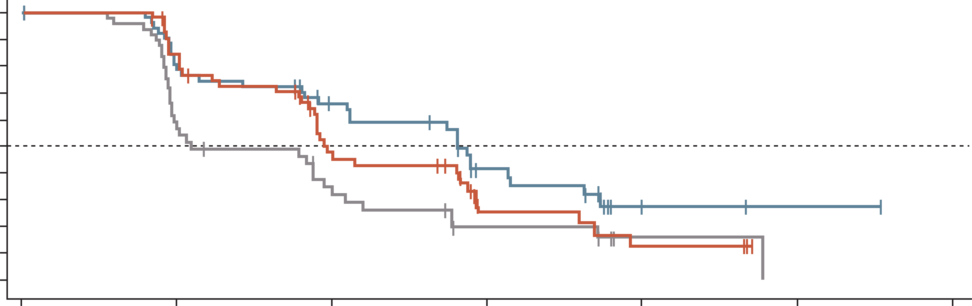
CODEbreak-300: anti-EGFR therapy combined with a KRAS^{G12C} inhibitor is effective in KRAS
G12C-mutated mCRC
After a median follow-up of 7.8 months, sotorasib (960 mg and 240 mg) in combination with panitumumab significantly improved PFS by BICR versus investigator’s choice
 | Sotorasib 960 mg + panitumumab (n=53) | Sotorasib 240 mg + panitumumab (n=53) | Investigator’s choice (n=54)
Median PFS, months | 5.6 | 3.9 | 2.2
HR (95% CI) | 0.49 (0.30, 0.80) | 0.58 (0.36, 0.93) | –
p value (2-sided) | 0.006 | 0.030 | –
100
90
80
70
60
50
Progression-free survival (%)
40
30
20
Sotorasib 960 mg + panitumumab
Sotorasib 240 mg + panitumumab
Investigator’s choice
10
0
0
2
4
6
8
10
12
Months from randomisation
Number of patients at risk
Sotorasib 960 mg + panitumumab
Sotorasib 240 mg + panitumumab
Investigator’s choice
53
53
54
40
43
24
28
20
12
13
6
5
2
3
1
1
0
0
0
BICR, blinded independent central review; CI, confidence interval; EGFR, epidermal growth factor receptor; HR, hazard ratio; ; KRAS, Kirsten rat sarcoma; mCRC, metastatic colorectal cancer; PFS, progression-free survival
Pietrantonio F, et al. ESMO 2023 (oral presentation)

Slide 33
NAVIGATE: Study design
investigation of trk fusion-positive tumours treated with larotrectinib
Primary endpoints
Objective response rate
  Investigator-assessed per
  RECIST v1.1
Secondary endpoints
Duration of response
Progression-free survival
Overall survival
Phase II basket trial (NAVIGATE, NCT02576431)
Age ≥12 years
Advanced solid tumours
TRK fusion-positive cancer
TRK fusion status determined by local CLIA-accredited (or similar) laboratories
34 patients with
TRK fusion metastatic GI cancer
Data cut-off: 20 July 2021
Larotrectinib dose
  100 mg BID
BID, twice daily; CLIA, Clinical Laboratory Improvement Amendments; GI, gastrointestinal; RECIST, Response Evaluation Criteria in Solid Tumours; TRK, tropomyosin receptor kinase
Garralda E, et al. World Congress on GastroIntestinal Cancer 2022 (Poster #SO-31)

Slide 34
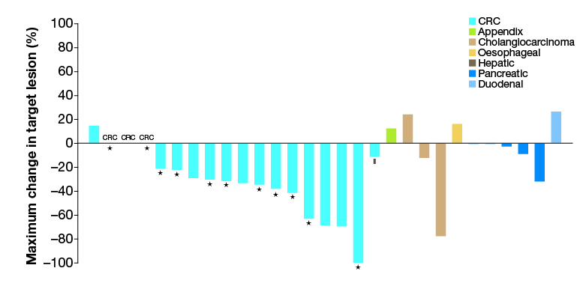
Efficacy of Larotrectinib in trk-positive metastatic GI tumours
Maximum change in target lesion size following treatment
in patients with TRK fusion GI cancer (N=29ª)
 | All patients (N=34) | CRC patients (N=19)
Evaluable patients | 33 | 19
ORR, % (95% CI) | 33 (18-52) | 47 (24-71)
Best overall response, n (%) Complete response Partial response Stable disease Progressive disease Not determined^{b} | 1 (3) 10 (30)ª 15 (45) 4 (12) 3 (9) | 1 (5) 8 (42)ª 8 (42) 1 (5) 1 (5)
ªThree responses pending confirmation; ^{b}Patients who discontinued study drug without evaluable post baseline assessments
†
ªFive patients had no measurable lesions assessed by INV.
* Indicates MSI-H patients.
§ Indicates rectal cancer with an unknown MSI status.
Sixty-six percent of patients (9/29) with measurable disease at baseline had tumour shrinkage
CI, confidence interval; CRC, colorectal cancer; GI, gastrointestinal; MSI; microsatellite instability; ORR, objective response rate; TRK, tropomyosin receptor kinase
Garralda E, et al. World Congress on GastroIntestinal Cancer 2022 (Poster #SO-31)

Slide 35
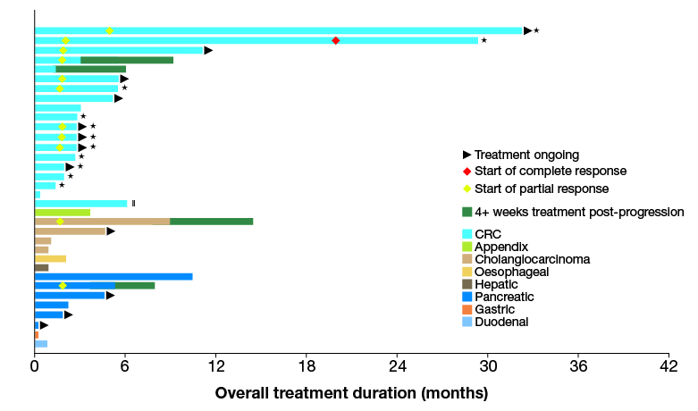
Treatment duration in patients with TRK fusion GI cancer (N=34)
Treatment duration ranged from 0.2+ to 32.2+ months
Four patients with PD continued on larotrectinib for ≥ 4 weeks post-progression
Median time to response: 1.9 months (range 1.7-5.0)
Median DOR: 7.3 months (95% CI 3.5-27.3)
Indicates MSI-H patients. ‖Indicates rectal cancer with an unknown MSI status.
CRC, colorectal cancer; GI, gastrointestinal; MSI-H, microsatellite instability-high; TRK, tropomyosin receptor kinase.
CRC, colorectal cancer; GI, gastrointestinal; MSI-H; microsatellite instability-high; TRK, tropomyosin receptor kinase
Garralda E, et al. World Congress on GastroIntestinal Cancer 2022 (Poster #SO-31)

Slide 36
Rechallenge with anti-egfr
EGFR, epidermal growth factor receptor

Slide 37
CRICKET Study
a phase 2 single-arm trial
Phase 2, non-comparative, study
N=28 pts
PD
PD
mCRC pts
RAS and BRAF wt
FOLFIRI/
FOLFOXIRI
+ cetuximab
FOLFOX/XELOX/
FOLFOXIRI
+ bevacizumab
Irinotecan
180 mg/m² iv
+ cetuximab
500 mg/ m² iv
≥6 Months
≥4 Months
At least a RECIST 1.1 partial response
1st-line PFS ≥6 months
PD to 1st-line therapy within 4 weeks after the last cetuximab administration
Time between the end of
1st-line therapy and the start of 3rd-line ≥4 months
Progression to a 2L bevacizumab-containing therapy
Study treatment
BRAF, proto-oncogene B-Raf; FOLFIRI, folinic acid, fluorouracil and irinotecan; FOLFOXIRI, folinic acid, fluorouracil, oxaliplatin and irinotecan; iv, intravenous; mCRC, metastatic colorectal cancer; PD, progressive disease; PFS, progression-free survival; RAS, RAS proto-oncogene GTPase; RECIST, response evaluation criteria in solid tumours; wt, wild-type; XELOX, capecitabine plus oxaliplatin
Cremolini S, et al. JAMA Oncol. 2019;5(3):343-50

Slide 38
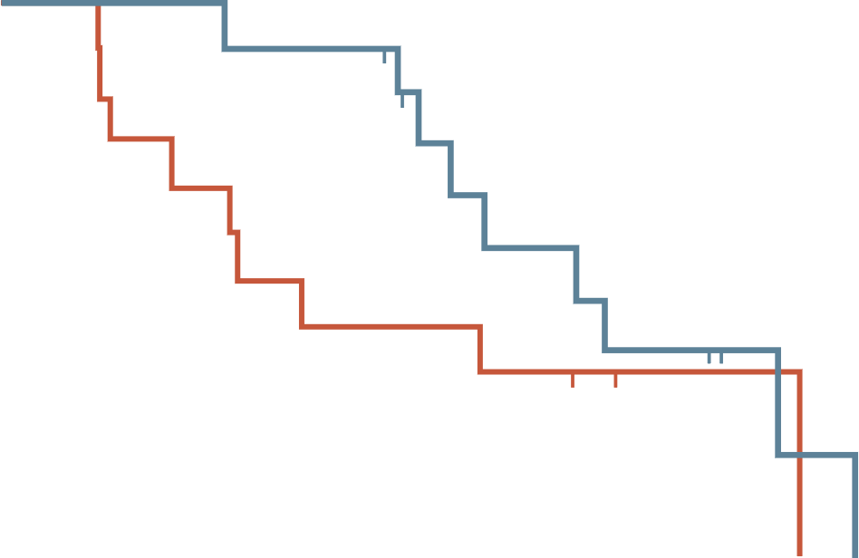
CRICKET trial: anti-egfr Re-Challenge
PROGRESSION-FREE SURVIVAL
OVERALL SURVIVAL
100
100
RAS wild-type ctDNA: 4.0 mo
RAS mutated ctDNA: 1.9 mo
RAS wild-type ctDNA: 12.5 mo
RAS mutated ctDNA: 5.2 mo
80
80
60
60
Probability (%)
Probability (%)
40
40
20
20
0
0
2
4
6
8
10
12
14
0
0
5
10
15
20
Follow-up (months)
Follow-up (months)
Number at risk
Wild-type ctDNA
Mutated ctDNA
Number at risk
Wild-type ctDNA
Mutated ctDNA
13
12
10
5
6
2
4
1
3
0
2
0
1
0
0
0
13
12
12
7
7
5
4
1
0
0
PFS: 4.0 mo vs. 1.9 mo (median overall: 3.4 mo)
OS: 12.5 mo vs. 5.2 mo (median OS 9.8 mo)
Tumour response:
ORR: 21%
DCR: 54%
ctDNA, circulating tumour DNA; DCR, disease control rate; EGFR, epidermal growth factor receptor; mo, months; ORR, objective response rate; OS, overall survival; PFS, progression free survival; RAS, RAS proto-oncogene GTPase
Cremolini C, et al JAMA Oncol. 2019;5(3):343-50

Slide 39
summary
There are several effective later-line options for mCRC patients offering disease control and a survival benefit but impact on quality of life should be considered
The aim is to give the patient as many life-prolonging therapies as possible, so sequencing considerations are important
It is important to consider patient characteristics (prior treatments, biomarker status, PS, tumour sidedness) and patient preferences when deciding on the most appropriate treatment
There are high-level of evidence options derived from phase 3 trials, and more experimental options derived from non-randomised phase 2 trials, which are based on the molecular profile
It is important to understanding the most appropriate patients for rechallenge of prior treatment versus a starting a new treatment
Managing side effects is a key strategy for helping patients remain on treatment to achieve optimal outcomes
mCRC, metastatic CRC; PS, performance status

Slide 40




REACH GI CONNECT VIA
TWITTER, LINKEDIN, VIMEO & EMAIL
OR VISIT THE GROUP’S WEBSITE https://giconnect.cor2ed.com/
Follow us on Twitter
@giconnectinfo
Follow the
GI CONNECT
group on LinkedIn
Watch us on the
Vimeo Channel
GI CONNECT
Email
louise.handbury
@cor2ed.com

