Slide 2
Virtual experts knowledge share
Precision oncology in practice – The journey from testing to treatment in lung and prostate cancer
Tuesday 30th April 2024

Slide 3

Developed by PRECISION ONCOLOGY COnnect
This programme is developed by PRECISION ONCOLOGY CONNECT,
an international group of experts in the field of oncology.
Acknowledgement and disclosures
This PRECISION ONCOLOGY CONNECT programme is supported through an independent educational grant from AstraZeneca and Amoy Diagnostics. The programme is therefore independent, the content is not influenced by the supporter and is under the sole responsibility of the experts.
Please note: The views expressed within this programme are the personal opinions of the experts. They do not necessarily represent the views of the experts’ institutions, or the rest of the PRECISION ONCOLOGY
CONNECT group.
Expert disclosures – the experts have received financial support/sponsorship for research support, consultation, Travel or speaker fees from the following companies:
Prof. Fernando Lopez-Rios: AbbVie, Astellas, AstraZeneca, Bayer. BMS, Daiichi Sankyo, Janssen, Lilly, Merck, MSD, Pfizer, Roche, Takeda and Thermo Fisher
Assoc. Prof. Alicia Morgans: Astellas, AstraZeneca, AAA, Bayer, Exelixis, Janssen, Lantheus, Myovant, Novartis, Pfizer, Telix, Sanofi
Assoc. Prof. Herbert Loong: AbbVie, Bayer, Boehringer-Ingelheim, Celgene, Daiichi-Sankyo, Eisai, Eli-Lilly, George Clinical, Guardant Health, Illumina, Merck Sereno, MSD, Mundipharma, Novartis, Pfizer, Takeda

Slide 4



In this meeting you WILL
Know how to address pre-analytical phase challenges, and how to collect, store,
process and prepare the samples
Recognise the relevant biomarkers and appropriate molecular tests/assays to request for your patients
Understand the diagnostic modalities, and the role of biomarkers in oncology
Be able to implement or improve the leading role of the pathologist on the MDT
MDT, multidisciplinary team

Slide 5
Agenda: Tuesday 30th April 2024
Precision oncology in practice – The journey from testing to treatment in lung and prostate cancer
Timings | Topic | Facilitator
5 mins | Welcome and introductions | COR2ED
10 mins | Scene setting: Overview of the challenges related to biomarker testing across all tumours | Fernando López-Ríos
5 mins | Q&A
20 mins | Addressing the challenges of biomarker testing in lung cancer* | Herbert Loong
5 mins | Q & A | Fernando López-Ríos
20 mins | Addressing the challenges of biomarker testing in prostate cancer* | Alicia Morgans
5 mins | Q & A | Fernando López-Ríos
15 mins | Panel discussion and audience questions | All
5 mins | Future perspectives and summary | Fernando López-Ríos
* Includes MDT discussion and best practice recommendations

Slide 6



Introducing the scientific committee
Prof. Fernando López-Ríos
Pathologist
12 de Octubre University Hospital,
Madrid, Spain
Assoc. Prof. Herbert Loong
Medical Oncologist
The Chinese University
of Hong Kong, HK
Assoc. Prof. Alicia Morgans
GU Medical Oncologist
Dana-Farber Cancer Institute, Boston, USA

Slide 7
Overview of challenges related to biomarker testing across all tumours
Fernando López-Ríos MD, PhD
Department of Pathology
Hospital Universitario 12 de Octubre
Madrid, Spain

Slide 8



What are the clinical practice gaps?
The four “Ts”
RESULTS: For every 1,000 patients in the study cohort, 497 (49.7%) are lost to precision oncology because of factors associated with getting biomarker test results.
Step 1: Biopsy referral: Initial solid or blood biopsy was never performed
Step 2: Biospecimen collection: Biospecimen collection challenges including insufficient tissue or tumour cell content of initial biopsy or rebiopsy inhibited biomarker testing and its accuracy
Step 3: Biospecimen evaluation/pathology: Biospecimen tumour cell content was overestimated, inhibiting biomarker testing and its accuracy
Step 4: Biomarker test ordering: Appropriate testing was not ordered, or treatment began before testing was ordered
Step 5: Biomarker testing performance: Biomarker testing provided inconclusive or false-negative (FN) results
Step 6: Test result reporting: As a result of turnaround time (TAT) delays, treatment was initiated without consideration of test results
Step 7: Treatment decision: Targeted treatment was not selected despite positive test results
Tissue
Testing
Time (TAT)
Tab (cost)
Sadik H, et al. JCO Precis Oncol. 2022:Oct;6:e2200246

Slide 9
Content
Six opportunities for improvement!
Tissue:
  Less is more
  A molecular pathology code of conduct
Testing
  Focus on results not methods
  The whole is greater than the sum of its parts
Time
  Remove, do not add
  Good teams are noisy

Slide 10
Content
6 opportunities for improvement!
Tissue:
  Less is more
  A molecular pathology code of conduct
Testing
  Focus on results not methods
  The whole is greater than the sum of its parts
Time
  Remove, do not add
  Good teams are noisy

Slide 11
Sensible use of diagnostic IHC
Tissue – Less is more
Key questions and recommendations for diagnostic immunohistochemistry in lung cancer
Key questions | Short answers
What is the best combination of markers to use in daily practice? | When IHC is needed for the subtyping of NSCC, TTF1 and p40 are the criterion standard, and these two markers are usually sufficient in clinical practice if there are no morphologic features of NE differentiation. p40 is preferable to p63 to identify squamous cell carcinoma
What extent of TTF1- and p40-positive reactions should we consider to be positive? | Focal positivity for TTF1 is considered a positive reaction indicating pulmonary adenocarcinoma in the proper clinical context, whereas for p40 the cutoff rate should be positivity in more than 50% of tumour nuclei. Focal or weak positivity for p40 is not diagnostic of squamous cell carcinoma
Are there any staining differences in lung among TTF1 clones (SPT24, SP141, and 8G7G3/1)? | The staining performance of TTF1 varies among the clones. Among the most commonly used antibodies, 8G7G3/1 is the most specific antibody to identify lung adenocarcinoma
Should an NSCC that is diffusely positive for CK7 but negative for TTF1 and p40 be regarded as probably adenocarcinoma? | CK7 is not specific for adenocarcinoma; the marker can be seen in squamous cell carcinoma. The use of CK7 is discouraged for subtyping of NSCC
When should NE markers be applied to an NSCC? | NE markers should be applied only in support of NE morphology
What is the best antibody panel to differentiate NE tumours from other types of NSCC, and which one is the most reliable? | A panel of chromogranin A, synaptophysin, and CD56 is the best combination to identify NE tumours. The staining significance of each antibody varies among the sample types, histologic subtypes, and extent and/or intensity of positive reactions
When should a proliferation marker be used in diagnosis? | The main established role of Ki-67 in lung carcinomas is to help distinguish carcinoids from high-grade NE carcinomas (large cell NE carcinoma and small cell carcinomas), especially in small or crushed biopsy or cytologic samples. The role of Ki-67 in separating typical from atypical carcinoids is not established and needs more investigation
IHC, immunohistochemistry; NE, neuroendocrine; NSCC, non-small cell carcinoma; TTF1, thyroid transcription factor-1
Yatabe Y, et al. J Thorac Oncol. 2019;14(3):377-407

Slide 12

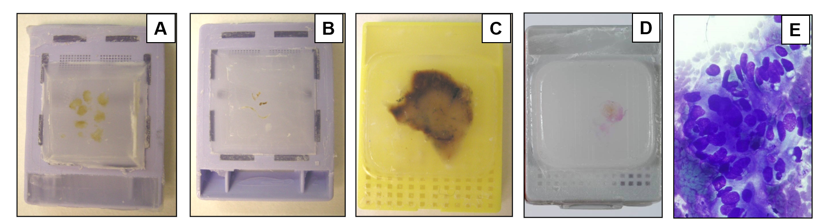
DNA & RNA: quantity and quality
A molecular pathology code of conduct
  Biopsy
  Core needle biopsy
  Surgical specimen
  Cell block
  Cytological slide
Formalin
fixed paraffin embedded (FFPE)
Tissue
Paraffin blocks preferred
Cytology
Depends on the lab
Personal communication, López-Ríos, F

Slide 13
Content
6 opportunities for improvement!
Tissue:
  Less is more
  A molecular pathology code of conduct
Testing
  Focus on results not methods
  The whole is greater than the sum of its parts
Time
  Remove, do not add
  Good teams are noisy

Slide 14
Coexistence of multiple assays
Focus on results not methods
Methods for detecting mutations
Technique | Analytical sensitivity | Diagnostic sensitivity | Precise annotation of variants | Allele frequency reported | Input DNA | Cost | Turn-around time
PCR and direct sequencing | Lowest | Excellent | Yes | No | High | Lowest | 3-4 days
PCR and pyrosequencing | Variable | Intermediate | Sometimes | No | High | Low | 3-4 days
Real-time PCR | High | Intermediate | Sometimes | No | Low | Low | Hours to 1-2 days
Digital PCR | Highest | Low | Yes | No | Lowest | Low | Hours to 1-2 days
NGS-targeted amplicon based | Variable (high) | Variable (high) | Yes | Yes | Low | Intermediate | 1-2 to 10 days
NGS-targeted hybridisation capture | Variable (high) | Variable (high) | Yes | Yes | High | Intermediate | 15-20 days
NGS-whole exome | Variable | Excellent | Yes | Yes | High | High | Weeks
NGS-whole genome | Variable | Excellent | Yes | Yes | High | Highest | Weeks
EGFR, epidermal growth factor receptor; NGS, next-generation sequencing; PCR, polymerase chain reaction
IASLC (International Association for the Study of Lung Cancer) Atlas of Molecular Testing for Targeted Therapy in Lung Cancer 2023. Available at: https://www.iaslc.org/iaslc-atlas-molecular-testing-targeted-therapy-lung-cancer/. Accessed 27 February 2024

Slide 15
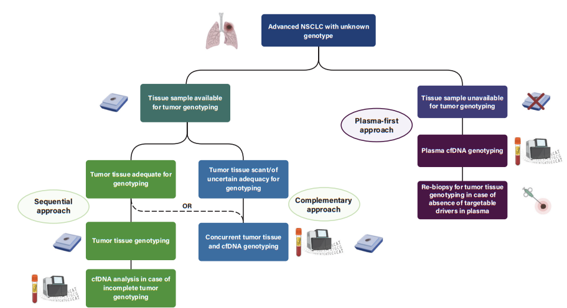
Correlation between tissue & plasma
The whole is greater than the sum of its parts
cfDNA, cell-free DNA; NSCLC, non-small cell lung cancer
IASLC (International Association for the Study of Lung Cancer) Atlas of Molecular Testing for Targeted Therapy in Lung Cancer 2023. Available at: https://www.iaslc.org/iaslc-atlas-molecular-testing-targeted-therapy-lung-cancer/. Accessed 27 February 2024

Slide 16
Content
6 opportunities for improvement!
Tissue:
  Less is more
  A molecular pathology code of conduct
Testing
  Focus on results not methods
  The whole is greater than the sum of its parts
Time
  Remove, do not add
  Good teams are noisy

Slide 17
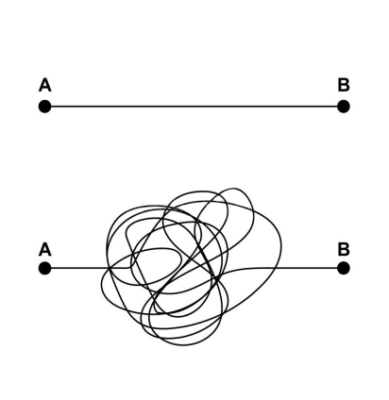
Reflex workflow
Remove, do not add
Turn-around time
Remember Gall′s Law
If you want to build
a complex system that works,
build a simpler system first,
and then improve it over time

Slide 18

Effective communication
Good teams are noisy
Intra-laboratory molecular tumour board
Members:
  Molecular biologist
  Pathologist
  Technicians
Aims:
  Check NGS quality
  Discuss NGS data
  Request additional molecular studies
  Integrate histology + clinical history + molecular data
Final result:
  NGS report
Pre-analytical
&
Analytical issues
Pathogenicity
&
Actionability
Molecular redundancy
&
Pan-negative
NGS, next-generation sequencing
Personal communication, López-Ríos, F

Slide 19
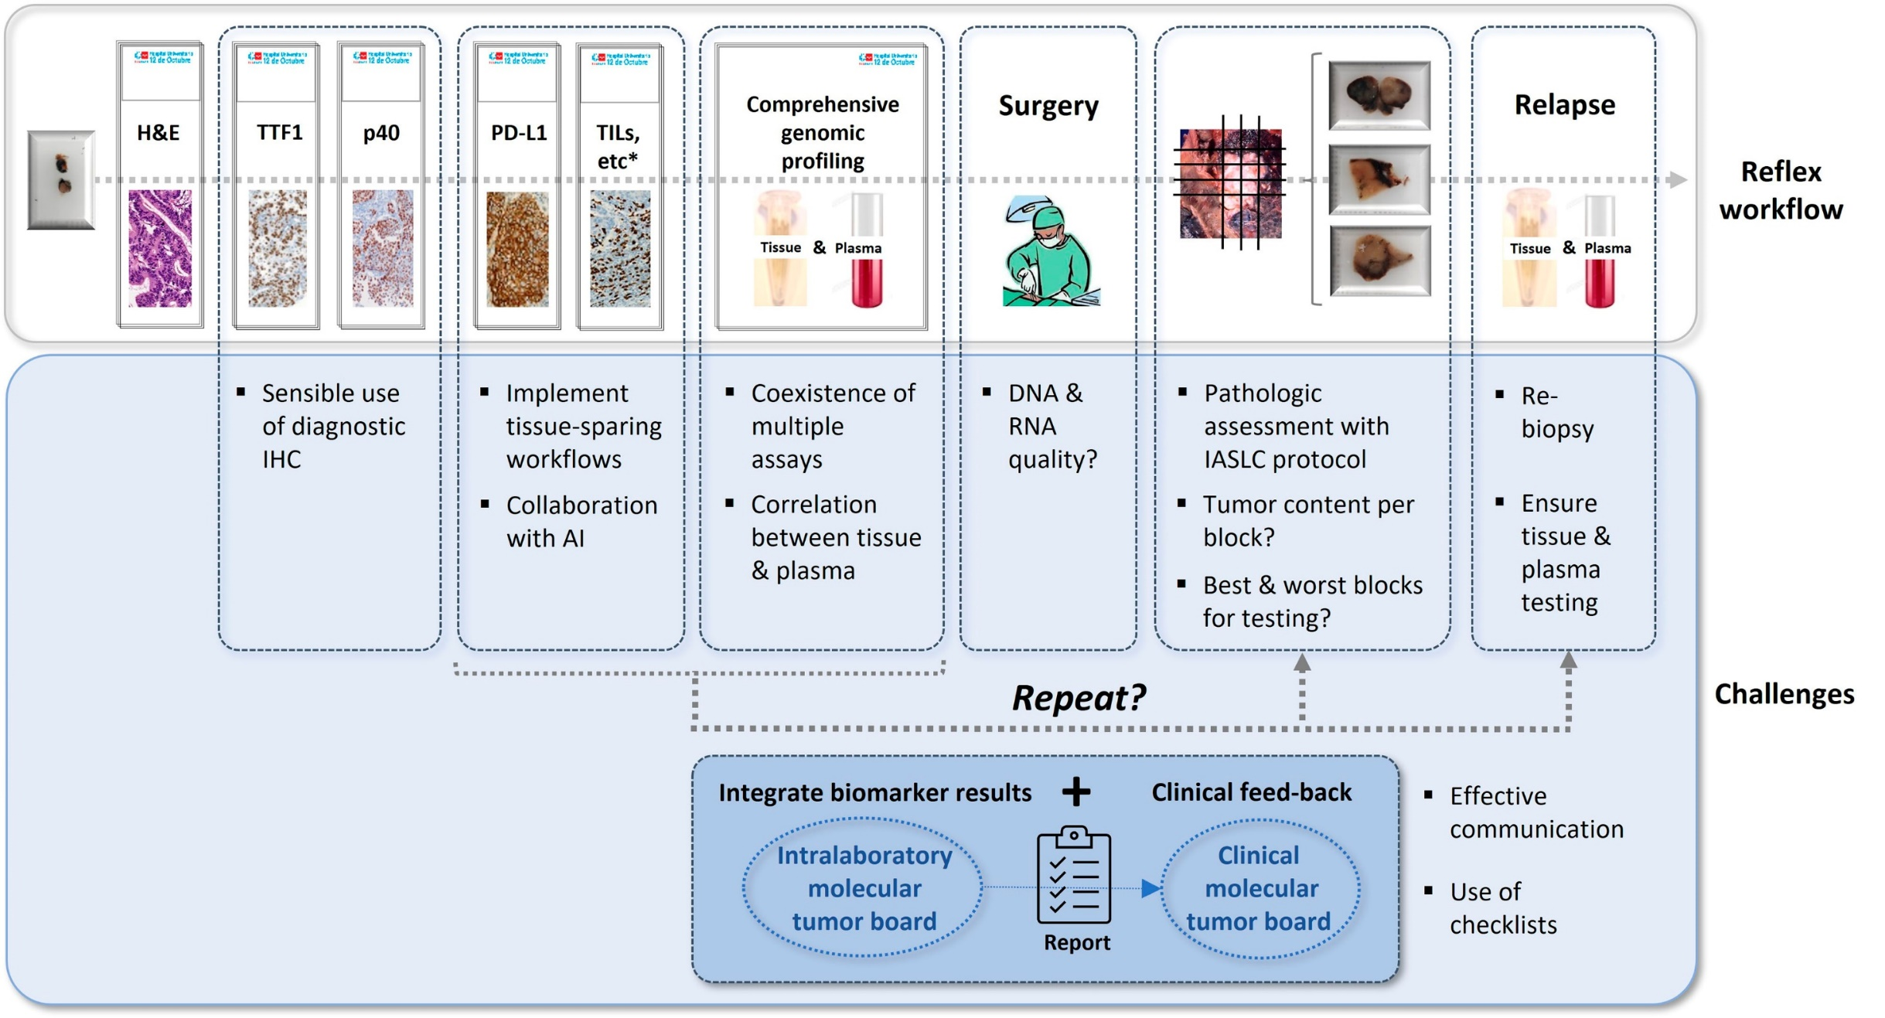

A comprehensive perspective of cancer biomarker testing
Tumour content per block?
Intralaboratory
molecular
tumour board
Clinical
molecular
tumour board
AI, artificial intelligence; H&E, hematoxylin and eosin; IASLC, International Association for the Study of Lung Cancer; IHC, immunohistochemistry; PD-L1, programmed death ligand-1; TIL, tumour infiltrating lymphocytes; TTF1, thyroid transcription factor-1
Conde E, et al. Mod Pathol. 2022;35:1754-1756

Slide 20
Overview of challenges related to biomarker testing across all tumours
Q&A Session

Slide 21
Addressing the challenges of biomarker testing in lung cancer
Assoc. Prof. Herbert Loong
Medical Oncologist
The Chinese University of Hong Kong, HK

Slide 22
Actionable biomarkers in lung carcinoma
NTRK rearrangement (0.23%)
RET rearrangement (1.7%)
BRAF V600E mutation (2.1%)
HER2 exon 20 insertion mutation (2.3%)
ROS1 rearrangement (2.6%)
◼︎ No actionable
alteration
MET exon 14 mutation (3.0%)
ALK rearrangement (3.8%)
◼︎ Other KRAS mutation
◼︎ KRAS G12C mutation
◼︎ Other EGFR mutation
◼︎ EGFR exon
20 insertion
mutation
Outer circle: Asian populations
Inner circle: Western populations
◼︎ EGFR exon 19 deletion and L858R mutation
ALK, anaplastic lymphoma kinase; BRAF, B-Raf proto-oncogene; EGFR, epidermal growth factor receptor; HER2, human epidermal growth factor receptor 2; KRAS, Kirsten ras oncogene; MET, MET proto-oncogene; NTRK, neurotrophic tyrosine receptor kinase; RET, RET proto-oncogene; ROS1, ROS proto-oncogene 1 receptor tyrosine kinase
Tan AC and Tan DSW. J Clin Oncol. 2022;40:611-625

Slide 23
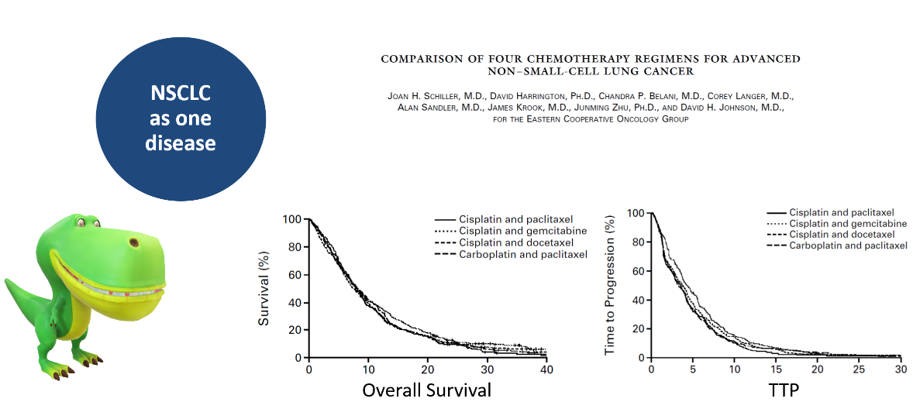
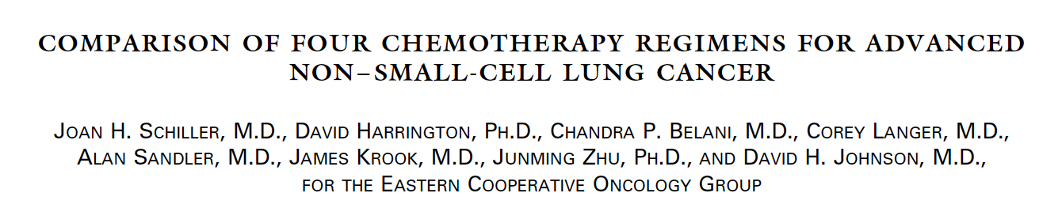

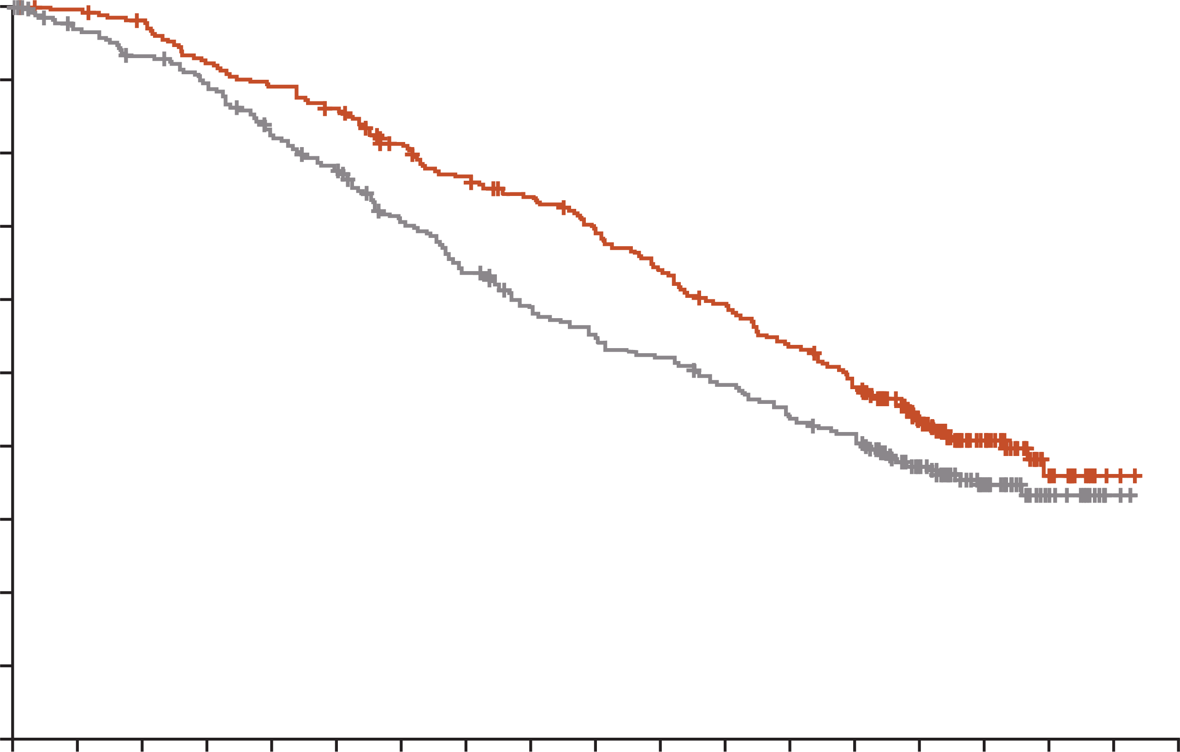
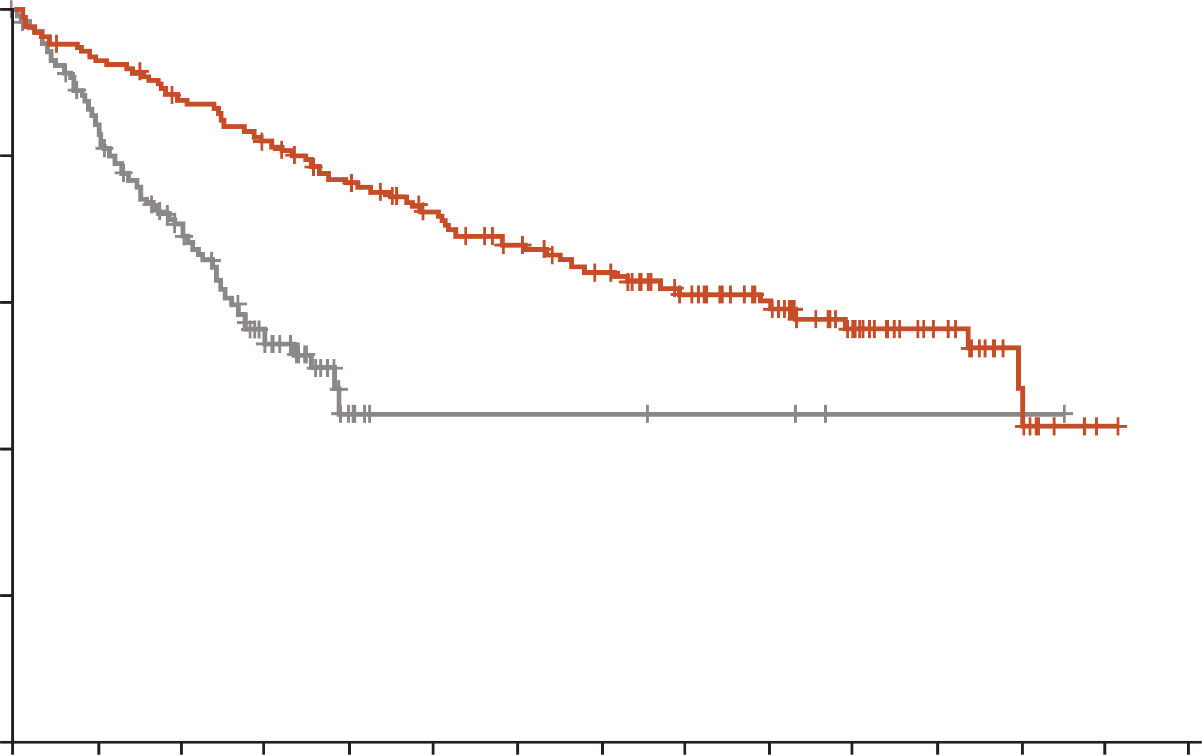
Median OS ~7-8 months
Median TTP 3.5 months
In treatment naïve patients!
100
Cisplatin and paclitaxel
Cisplatin and gemcitabine
Cisplatin and docetaxel
Carboplatin and paclitaxel
100
Cisplatin and paclitaxel
Cisplatin and gemcitabine
Cisplatin and docetaxel
Carboplatin and paclitaxel
80
80
60
60
Survival (%)
Survival (%)
Time to progression (%)
40
40
20
20
0
0
10
20
30
40
0
0
5
10
15
20
25
30
Month
Month
1.0
HR, 0.80 (95.05% CI, 0.64-1.00)
P=0.046
100
0.9
HR, 0.346 (95% bootstrap CI, 0.081-0.718)
0.8
80
0.7
NSCLC circa 2020
0.6
60
Crizotinib
Probability of overall survival
Overall survival (%)ª
Chemotherapy
0.5
Osimertinib
0.4
40
0.3
Median OS (95% CI)
mo
38.6 (34.5-41.8)
31.8 (26.6-36.0)
Comparator
EGFR-TKI
Median OS (95% CI)
mo
59.8 (46.6-NR)
19.2 (13.6-NR)
0.2
Osimertinib
Comparator
EGFR-TKI
20
0.1
Crizotinib (n=172)
Chemotherapy (n=171)
0
0
3
6
9
12
15
18
21
24
27
30
33
36
39
42
45
48
51
54
0
0
5
10
15
20
25
30
35
40
45
50
55
60
65
70
Months since randomisation
Time (months)
EGFR+ (FLAURA – 1st line osimertinib OS = 38.6 mo, comparator [1st gen EGFR TKIs] 31.8 mo)
ALK+ (PROFILE 1014) – 1st line crizotinib group
median OS = 59.8 mo (upper bound not reached)
ªOS adjusted for crossover
ALK, anaplastic lymphoma kinase; CI, confidence interval; EGFR, epidermal growth factor receptor; gen, generation; HR, hazard ratio; mo, months; NR, not reached; NSCLC, non-small cell lung cancer; OS, overall survival; TKI, tyrosine kinase inhibitor; TTP, time to progression
Schiller JH, et al. N Engl J Med. 2002;346:92-98; Ramalingam SS, et al. N Engl J Med. 2020;382:41-50; Solomon BJ, et al. J. Clin Oncol. 2018;36:2251-2258

Slide 24
Current Treatment Paradigm for Molecular Biomarker-positive Advanced NSCLC – NCCN Guidelines
EGFR+ª
KRAS+
KRAS+
BRAF V600E+
ALK+
ALK+
METex14
RET+
RET+
ROS1+
EGFRex20ins+
ROS1+
NTRK+
Capmatinib, tepotinib, crizotinib
Selpercatinib, pralsetinib
Osimertinib (preferred),
osimertinib + pemetrexed + (cisplatin or carboplatin); erlotinib, afatinib, gefitinib, dacomitinib,
erlotinib/ramucirumab,
erlotinib/bevacizumab
Amivantamab-vmjw + carboplatin + pemetrexed
Progression on
systemic therapy
Dabrafenib + trametinib (preferred),
encorafenib + binimetinib, vemurafenib, dabrafenib
Alectinib, brigatinib, lorlatinib (preferred), ceritinib, crizotinib
Selpercatinib, pralsetinib (preferred), cabozantinib,
vandetanib
Crizotinib, entrectinib (preferred), repotrectinib, ceritinib
Larotrectinib, entrectinib (preferred)
1L
Osimertinib (T790M+),^{b} erlotinib ± ramucirumab or bevacizumab, afatinib, gefitinib, dacomitinib; Amivantamab-vmjw + carboplatin + pemetrexed
Amivantamab-vmjw
Sotorasib
Sotorasib^{c,}
Adagrasib
Dabrafenib + trametinib, encorafenib + binimetinib
Alectinib, brigatinib, lorlatinib, ceritinib
Lorlatinib, entrectinib, repotrectinib
Capmatinib, tepotinib, crizotinib
Selpercatinib, pralsetinib
Lorlatinib, entrectinib
Larotrectinib, entrectinib
2L
Progression on
osimertinib
Other treatment options for advanced NSCLC without actionable biomarker
ª exon 19 deletion or exon 21 L858R. ^{b} Osimertinib is recommended as 2L and beyond for patients with EGFR T790M-positive metastatic NSCLC who have progressed
on erlotinib, afatinib, gefitinib, or dacomitinib.
1L, first line; 2L, second line; ALK, anaplastic lymphoma kinase; BRAF, B-Raf proto-oncogene; EGFR, epidermal growth factor receptor; ex20ins, exon 20 insertion; KRAS, Kirsten ras oncogene; METex14, MET proto-oncogene exon 14 mutation; NCCN, National Comprehensive Cancer Network; NSCLC, non-small cell lung cancer; NTRK, neurotrophic tyrosine receptor kinase; RET, RET proto-oncogene; ROS1, ROS proto-oncogene 1 receptor tyrosine kinase
NCCN guidelines V4.2024. Available from: https://www.nccn.org/professionals/physician_gls/pdf/nscl.pdf. Accessed April 2024

Slide 25

What are the factors that contribute to
‘best practice’?
What can the clinician do to help achieve these targets?
Accurate & Precise pathological diagnosis
Timely initiation of Effective treatment
Accessibility to effective therapies
Molecular testing is now standard of care
Increasing varieties and lines of treatment deemed efficacious
Increasing costs of healthcare and associated disparities

Slide 26
Identifying the Right Patients to be treated with the Right Drugs …

Slide 27
Is it cost-effective to proceed with multiplex testing upfront?
Upfront NGS: At mNSCLC diagnosis, pts received a panel that tested simultaneously for all alterations with or without FDA-approved therapies
Sequential testing: Received a sequence of single-gene tests for alterations of FDA approved Tx (EGFR, ALK, ROS1, BRAF). If all four negative, move onto single-gene or NGS testing for alterations with non-FDA approved therapies (MET, HER2, RET, NTRK1)
Exclusionary testing: Tested KRAS first, if negative, move onto sequential testing pathway
Hotspot panel: Testing of four FDA-approved Tx alterations simultaneously, if negative, move onto NGS
Total cost vs cost difference vs NGS
Upfront NGS testing in patients with mNSCLC was associated with:
(i) cost savings and
(ii) shorter time
to test results for both Medicare and commercial payers
Testing strategy | Medicare-insured patients (n=2,066) |  | Commercially insured patients (n=156)
 | Total cost | Cost difference vs NGS | Total cost | Cost difference vs NGS
NGS | 2,190,499 | – | 620,369 | –
Sequential | 3,721,368 | 1,530,869 | 747,771 | 127,402
Exclusionary | 3,584,177 | 1,393,678 | 624,178 | 3,809
Hotspot panel | 4,331,295 | 2,140,795 | 871,211 | 250,842
NOTE: Costs are given in 2017 US dollars
ALK, anaplastic lymphoma kinase; BRAF, B-Raf proto-oncogene; EGFR, epidermal growth factor receptor; FDA, Food and Drug Administration; HER2, human epidermal growth factor receptor 2; KRAS, Kirsten ras oncogene; MET, MET proto-oncogene; mNSCLC, metastatic non-small cell lung cancer; NGS, next-generation sequencing; NTRK1, neurotrophic tyrosine receptor kinase1; RET, RET proto-oncogene; ROS1, ROS proto-oncogene 1 receptor tyrosine kinase; Tx, treatments; US, United States
Pennell NA, et al. JCO Precision Oncol. 2019;3:1-9

Slide 28
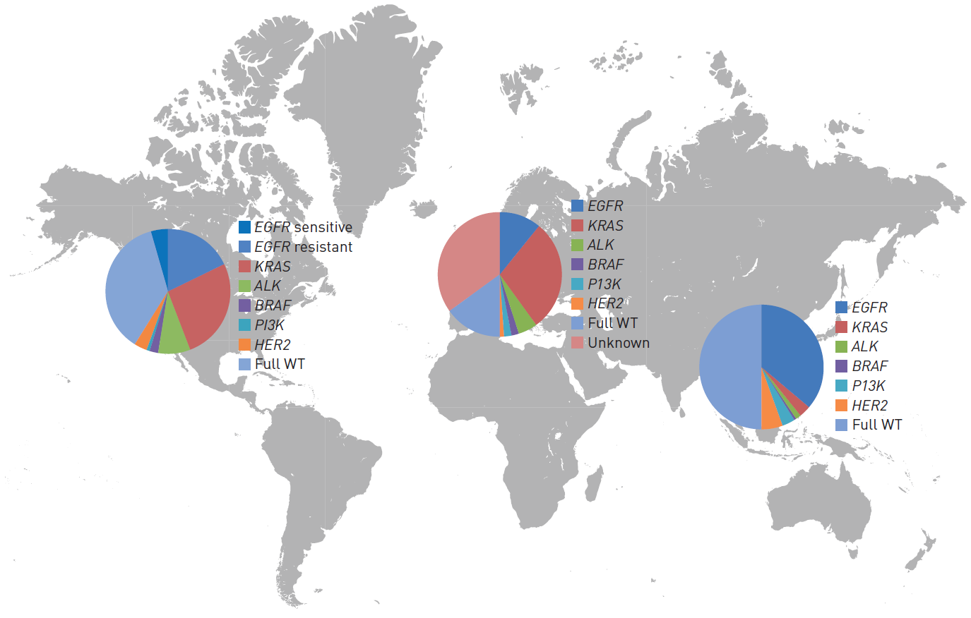
But does this necessarily apply worldwide?
In East Asia, predominant EGFR+ population is actionable!
Thus, if we replace KRAS with EGFR and use the exclusionary approach → we may see these findings less significant
ALK, anaplastic lymphoma kinase; BRAF, B-Raf proto-oncogene; EGFR, epidermal growth factor receptor; HER2, human epidermal growth factor receptor 2; KRAS, Kirsten rat sarcoma virus; PI3K, phosphoinositide-3-kinase; WT, wild-type
Calvayrac O, et al. Eur Respir J. 2017;49:1601734

Slide 29
Clinical and economic impact of upfront ngs for mnsclc in east asia
Confirmed
actionable mutation
/rearrangement
Appropriate
therapy
Confirmed
actionable mutation
/rearrangement
Appropriate
therapy
Enough
tissue
Go back to test
until end of
actionable
mutations
Sequential/
Exclusionary/Panel
No mutation
/rearrangement
and next test
No actionable
mutations
detected
Test non-actionable
mutation/rearrangement
Appropriate
therapy
No mutation
/rearrangement
Patients diagnosed
with mNSCLC
(biopsy performed
Go back
to test
Successful
rebiopsy
Rebiopsy due to
not enough tissue
No rebiopsy/
Failed rebiopsy
Appropriate
therapy
NGS
Appropriate
therapy
mNSCLC, metastatic non-small cell lung cancer; NGS, next generation sequencing
Loong HH, et al. JTO Clin Res Rep. 2022;3:100290

Slide 30
Results – Comparison of NGS vs each TESTING MODALITY
Best
Worst
Exclusionary
$6.5M
Sequential
$10.4M
Hotspot panel
$13.2M
NGS
$14.1M
Costs
Exclusionary
1.6 weeks
Hotspot panel
2.0 weeks
NGS
2.0 weeks
Sequential
5.2 weeks
Time to appropriate
therapy
NGS
100%
Hotspot panel
100%
Sequential
92.6%
Exclusionary
90.7%
Actionable
alterations identified
Nonactionable alterations identified
NGS
100%
Hotspot panel
63.1%
Sequential
49.8%
Exclusionary
46.5%
Values reported in 2020 US dollars.
M, million; NGS, next generation sequencing; US, United States
Loong HH, et al. JTO Clin Res Rep. 2022;3:100290
Notes:
For 4,094 adults diagnosed with mNSCLC, exclusionary testing at a total cost of $6.5M was found to be the cheapest among the four testing modalities, and NGS at a total cost of $14.1M was the most expensive option
Exclusionary testing yielded the shortest time to appropriate therapy for actionable mutations at 1.6 weeks. NGS and hotspot panel testing identified 100% of patients with actionable genomic alterations
Total cost differences between NGS and other testing modalities were robust to variations in model inputs. Among the varied inputs, total cost differences were most sensitive to variations in NGS costs, and single-gene test costs

Slide 31
Cost effectiveness of different testing strategies based on regional molecular epidemiology
Outcome influenced by the higher prevalence of mNSCLC patients with EGFR
mutations in East Asian populations versus Western populations, which can be
readily detected by single-gene tests
Exclusionary testing, however, does not capture all possible genomic alterations.
As more non-actionable genomic alterations become actionable, and NGS testing
costs reduce, upfront NGS may potentially be a cost saving option
EGFR, epidermal growth factor receptor; mNSCLC, metastatic non-small cell lung cancer; NGS, next generation sequencing
Loong HH, et al. JTO Clin Res Rep. 2022;3:100290

Slide 32


Patient’s background
Age: 82 years
Sex: M
Race: Asian
ECOG PS: 1
Medical history:
Hyperlipidaemia
Ischemic heart disease
Parkinsonism
Benign prostatic hypertrophy
History of pulmonary TB
8/2020
Stage IA (pT1bN0) moderately differentiated adenocarcinoma of the lung
8/2020
Right VATS with upper lobe and middle lobe wedge resection
8/2020
EGFR x PCR performed confirmed exon 19del
del, deletion; EGFR, epidermal growth factor receptor; M, male; N, lymph nodes; p, pathology (staging); PCR, polymerase chain reaction; T, (primary) tumour; TB, tuberculosis; VATS, video‑assisted thoracoscopic surgery

Slide 33

Patient’s progress
Close observation with serial CT imaging and monitoring of
CEA (no adjuvant treatment was given due to early stage and advanced age)
10/2020: Surveillance CT scan – Non-specific ground glass opacification in the right upper lobe
03/2021: CEA elevated at 24.8 µg/L
Male
82 years of age
EGFR exon 19del recurrent adenocarcinoma
CEA, serum carcinoembryonic antigen; CT, computed tomography; del, deletion; EGFR, epidermal growth factor receptor

Slide 34
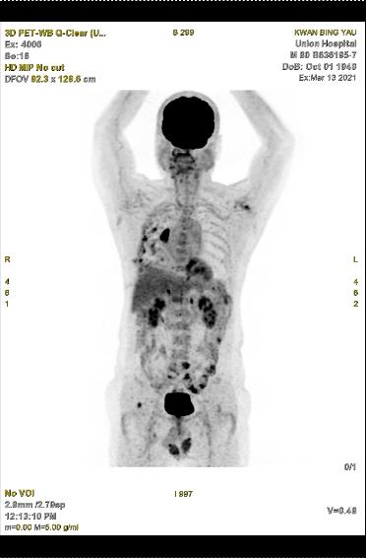
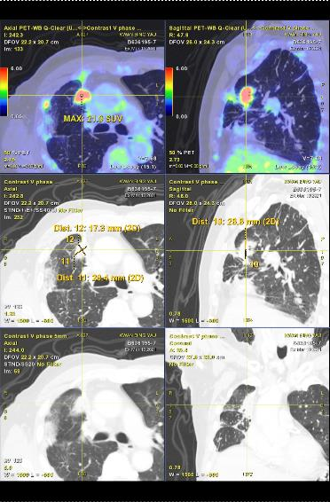
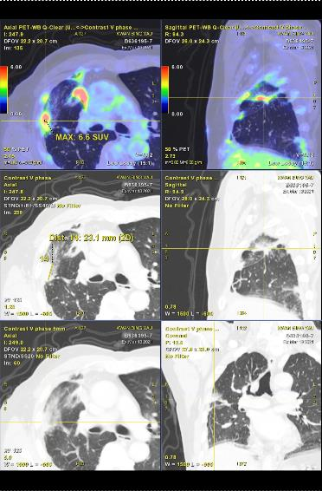
PET-CT 3/2021: Local tumour recurrence in association with hypermetabolic soft tissue at lateral inferior aspect of right upper lobe → suspicious of malignancy. Irregular hypermetabolic nodular thickening along right fissure and right pleura suspicious of tumour deposits
CT, computed tomography; PET, positron emission tomography

Slide 35
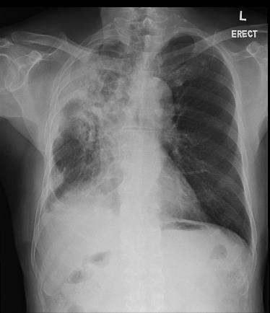
Patient’s progress
03/2021:
  Began receiving 1L osimertinib
  Developed increasing symptoms whilst on osimertinib
06/2021:
  Admitted for haemoptysis
  (3 months after starting osimertinib)
  Reassessment PET-CT: PD
  with extensive hypermetabolic lesions along the resection margin and pleural right hemithorax, associated with worsening ground glass appearance in the RUL
Male
82 years of age
Recurrent adenocarcinoma in lung (EGFR exon 19del)
CXR taken 6/2021
1L, first line; CT, computed tomography; CXR, chest X-ray; del, deletion; EGFR, epidermal growth factor receptor; PD, progressive disease; PET, positron emission tomography; RUL, right upper lobe

Slide 36
Patient’s progress
06/2021: Bronchoscopy:
  Blood over the whole right lung-dependent area of the right
  lower lobe with fresh blood in RB3 and RB4
  Adrenaline instillation was performed, and a biopsy taken
Male
82 years of age
Recurrent adenocarcinoma in lung (EGFR exon 19del)
del, deletion; EGFR, epidermal growth factor receptor; RB3, right upper lobe anterior segmental bronchus; RB4, medial segmental bronchus

Slide 37
Polling question
What biomarker testing will you consider in this situation?
Repeat EGFR x PCR testing on bronchoscopy specimen
Perform PD-L1 testing on bronchoscopy specimen
Perform tissue-based NGS testing on bronchoscopy specimen ✅
Perform liquid-based NGS testing
No need for biomarker testing. To proceed directly with chemotherapy
+/- immunotherapy (e.g. KEYNOTE-189 regimen with pemetrexed+carboplatin
+/- pembrolizumab)
EGFR, epidermal growth factor receptor; NGS, next-generation sequencing; PCR, polymerase chain reaction; PD-L1, programmed death-ligand 1

Slide 38
Polling question
What biomarker testing will you consider in this situation?
Repeat EGFR x PCR testing on bronchoscopy specimen
Perform PD-L1 testing on bronchoscopy specimen
Perform tissue-based NGS testing on bronchoscopy specimen
Perform liquid-based NGS testing
No need for biomarker testing. To proceed directly with chemotherapy
+/- immunotherapy (e.g. KEYNOTE-189 regimen with pemetrexed+carboplatin
+/- pembrolizumab)
EGFR, epidermal growth factor receptor; NGS, next-generation sequencing; PCR, polymerase chain reaction; PD-L1, programmed death-ligand 1

Slide 39
What did we do?
“Option C” – NGS testing on bronchoscopy specimen
NGS performed on bronchial biopsy specimen:
  MET amplification +++
  EGFR exon 19del
Identification of MET amplification allowed for concurrent use of osimertinib + tepotinib
Osimertinib + tepotinib
Date | CEA (μg/L)
5/28/2021 | 23
7/23/2021 | 18
9/30/2021 | 23
11/22/2021 | 8.4
1/20/2022 | 5.5
3/25/2022 | 5
5/30/2022 | 4.9
8/8/2022 | 3.9
CEA, serum carcinoembryonic antigen; del, deletion; EGFR, epidermal growth factor receptor; MET proto-oncogene; NGS, next-generation sequencing

Slide 40
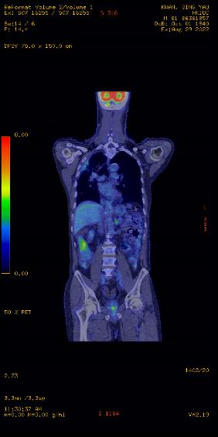
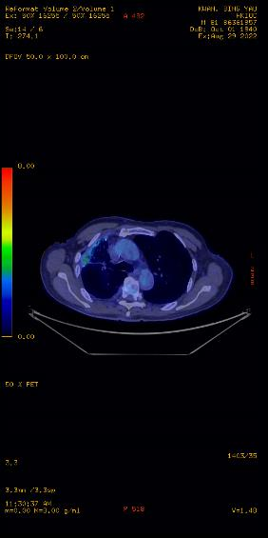

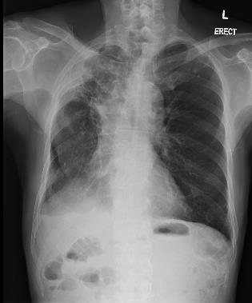
9/2021
11/2022
Osimertinib + tepotinib for 15 months and on-going
PET-CT 8/2022: metabolic quiescence
PET, positron emission tomography

Slide 41
What are some of the remaining challenges?

Slide 42
Gaps throughout the patient journey impact molecular testing and clinical outcomes
Step 1
Biopsy referral
Initial solid or blood biopsy was
never performed
6.6%
Step 2
Specimen collection
Initial biopsy/re-biopsy had insufficient tissue or tumour cell content
14.6%
Step 3
Specimen evaluation/pathology
Biospecimen
tumour cell content was overestimated
1.7%
% of eligible patients ‘lost’ to receive targeted therapy because of each gap
Step 4
Biomarker test ordering
Appropriate testing not ordered/ treatment began before testing was ordered
18.1%
Step 5
Biomarker testing performances
Biomarker testing provided inconclusive or false-negative results
18.4%
Step 6
Test result reporting
Treatment was initiated before release of biomarker test results
4%
Step 7
Treatment decision
Targeted treatment was not done despite positive biomarker test results
29.2%
Sadik H, et al. JCO Precis Oncol. 2022;6:e2200246
Notes:
New slide
Sadik et al_JCO Precis Oncol_2022
p2B
Sadik et al_JCO Precis Oncol_2022
p2A

Slide 43
Challenges in the real world contribute to delays in patients’ diagnostic journeys
Broad-range biomarker testing modalities take longer
to release results²
PCR-based tests:
1-4 days
NGS: 7-20 days/weeks
Further delays due to inadequate staging, insufficient tissue,
re-biopsy,
re-testing, etc
Visit to primary care provider¹
Referral to a thoracic surgeon, interventional radiologist, or pulmonologist, then biopsy¹
Referral to an oncologist; molecular testing ordered¹
Results of
molecular testing¹
Day 0
Week 1
Week 2
Week 3
Week 4
Week 5
Week 6
Week 7
Week 8
NGS, next-generation sequencing; PCR, polymerase chain reaction
1. Gregg JP, et al. Transl Lung Cancer Res. 2019;8:286-301; 2. Pennell NA, et al. Am Soc Clin Oncol Educ Book. 2019;39:531-542; 3. Loong H, personal experience
Notes:
This long and inefficient timeline potentially subjects a patient harboring genetic mutations to unnecessary treatment-related adverse events (AEs) and/or less-effective treatment
New slide
Gregg et al_Transl Lung Cancer Res_2019
p4A
Gregg et al_Transl Lung Cancer Res_2019
p5B
Pennell et al_ASCO Pubs_2019
P5/Table2

Slide 44

Challenges in the real world contribute to delays in patients’ diagnostic journeys
Visit to primary care provider
Referral to a thoracic surgeon, interventional radiologist, or pulmonologist, then biopsy
Referral to an oncologist; molecular testing ordered
Day 0
Week 1
Week 2
Week 3
Week 4
Week 5
Week 6
Week 7
Week 8
Treatment initiation based on liquid biopsy results
Moving this process earlier
Week 6
Week 7
Week 8
Treatment initiation based on tissue biopsy results
Week 6
Week 7
Week 8
Notes:
This long and inefficient timeline potentially subjects a patient harboring genetic mutations to unnecessary treatment-related adverse events (AEs) and/or less-effective treatment
New slide
Gregg et al_Transl Lung Cancer Res_2019
p4A
Gregg et al_Transl Lung Cancer Res_2019
p5B
Pennell et al_ASCO Pubs_2019
P5/Table2

Slide 45
Proposed strategies to address challenges in NSCLC diagnosis
Clinical suspicion of advanced NSCLC prompts specialist to order molecular testing
Broad-range biomarker testing modalities take longer
to release results²
PCR-based tests:
1-4 days
NGS: 7-20 days/weeks
Pathologists conduct “reflex-testing” immediately after histologic diagnosis of adenocarcinoma in NSCLC patients
Further delays due to inadequate staging, insufficient tissue,
re-biopsy,
re-testing, etc¹
Liquid biopsies to detect ctDNA are conducted immediately after pathologic-confirmation of NSCLC
Visit to primary care provider¹
Referral to a thoracic surgeon, interventional radiologist, or pulmonologist, then biopsy¹
Referral to an oncologist; molecular testing ordered¹
Results of
molecular testing¹
Day 0
Week 1
Week 2
Week 3
Week 4
Week 5
Week 6
Week 7
Week 8
ctDNA, circulating tumour DNA; NGS, next-generation sequencing; NSCLC, non-small cell lung cancer; PCR, polymerase chain reaction
1. Gregg JP, et al. Transl Lung Cancer Res. 2019;8:286-301; 2. Pennell NA, et al. Am Soc Clin Oncol Educ Book. 2019;39:531-542; 3. 3. Loong H, personal experience
Notes:
New slide
Gregg et al_Transl Lung Cancer Res_2019
p5D
Gregg et al_Transl Lung Cancer Res_2019
p6B-C
Gregg et al_Transl Lung Cancer Res_2019
p7A

Slide 46
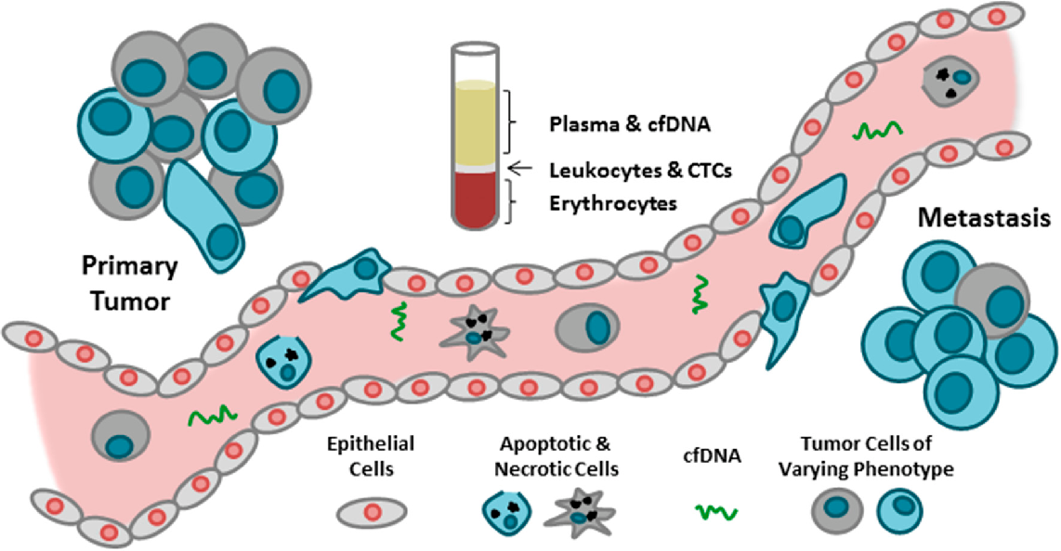
Role of Liquid Biopsy in diagnosis and management of nsclc
What is liquid biopsy?
  Blood sample containing cell-free DNA from multiple sources, including DNA shed from tumour
When do we use liquid biopsy?
  Molecular testing is needed but amount
  of available biopsy tissue is inadequate or unknown, or tissue biopsy not possible
  Resistance to TKIs
Advantages
  Minimally invasive
  May overcome tumour heterogenicity
Limitations
  Sensitivity: 70%-80%; specificity:
  near 100%
  Negative result is non-informative
cfDNA, cell-free DNA; CTC, circulating tumour cell; NSCLC, non-small cell lung cancer; TKI, tyrosine kinase inhibitors
Bauml J, et al. Clin Cancer Res. 2018;24:4352-4354; Lowes LE, et al. Int J Mol Sci. 2016:17:E1505; Bonanno L, et al. Br J Cancer 2022; 127: 383-393
Notes:
cfDNA, cell-free DNA; CTC, circulating tumor cell.

Slide 47
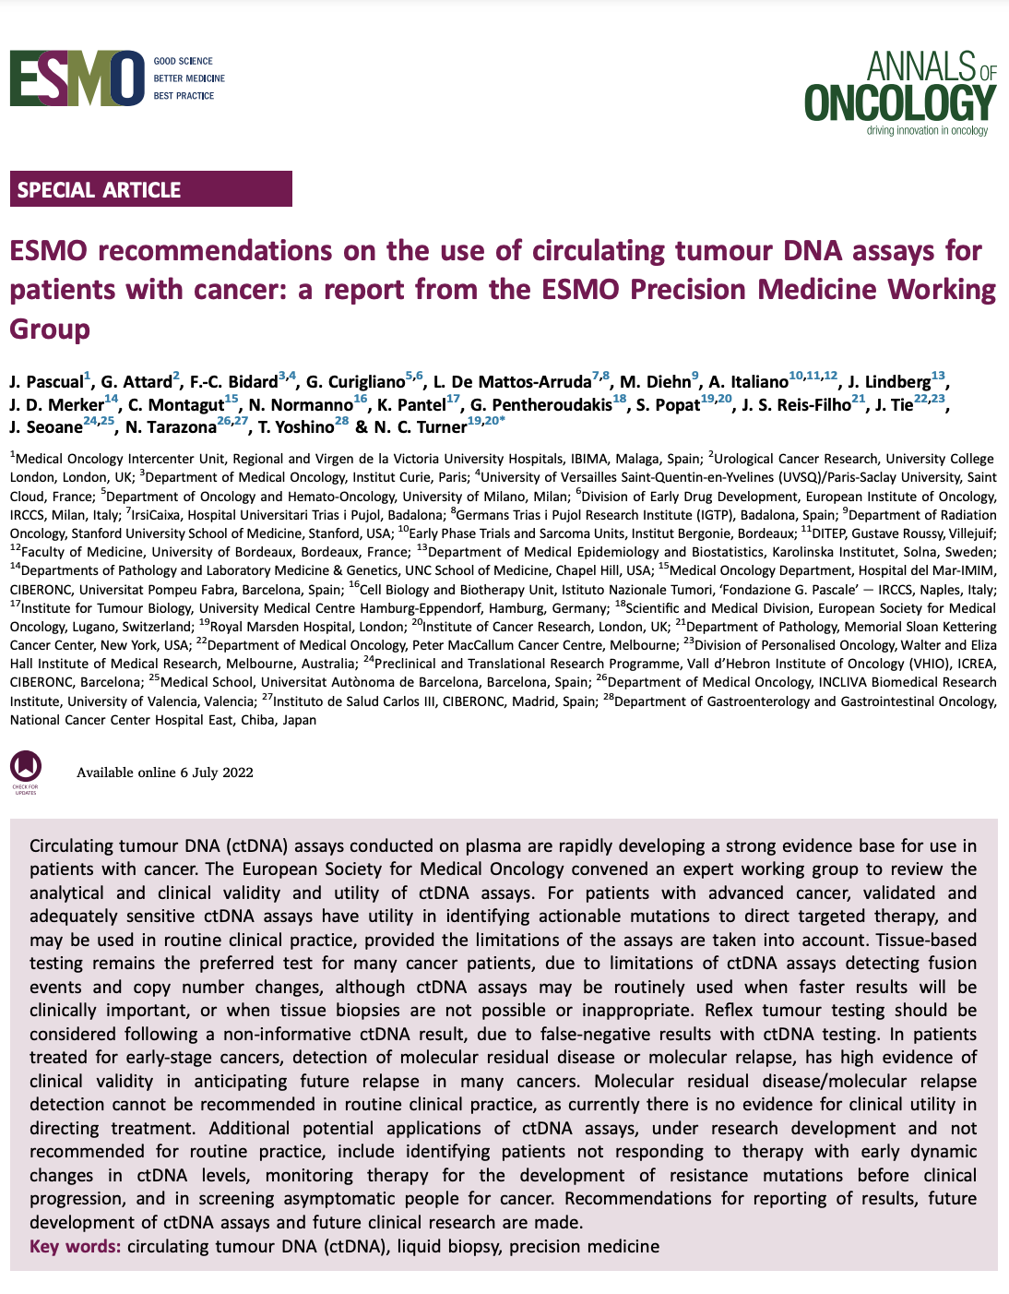
Highlights from ESMO liquid biopsy guidelines
“Liquid biopsy assays with very high analytical
and clinical specificity may be used in practice with limitations considered”
“A liquid first strategy is recommended as an alternative option to tissue genotyping where time to result is clinically important or tissue biopsy is unavailable or inappropriate”
“Blood samples should be collected when
cancer is progressing, either treatment naive
or after prior lines of therapy”
ESMO, European Society for Medical Oncology
Pascual J, et al. Ann Oncol. 2022;33:750-768

Slide 48
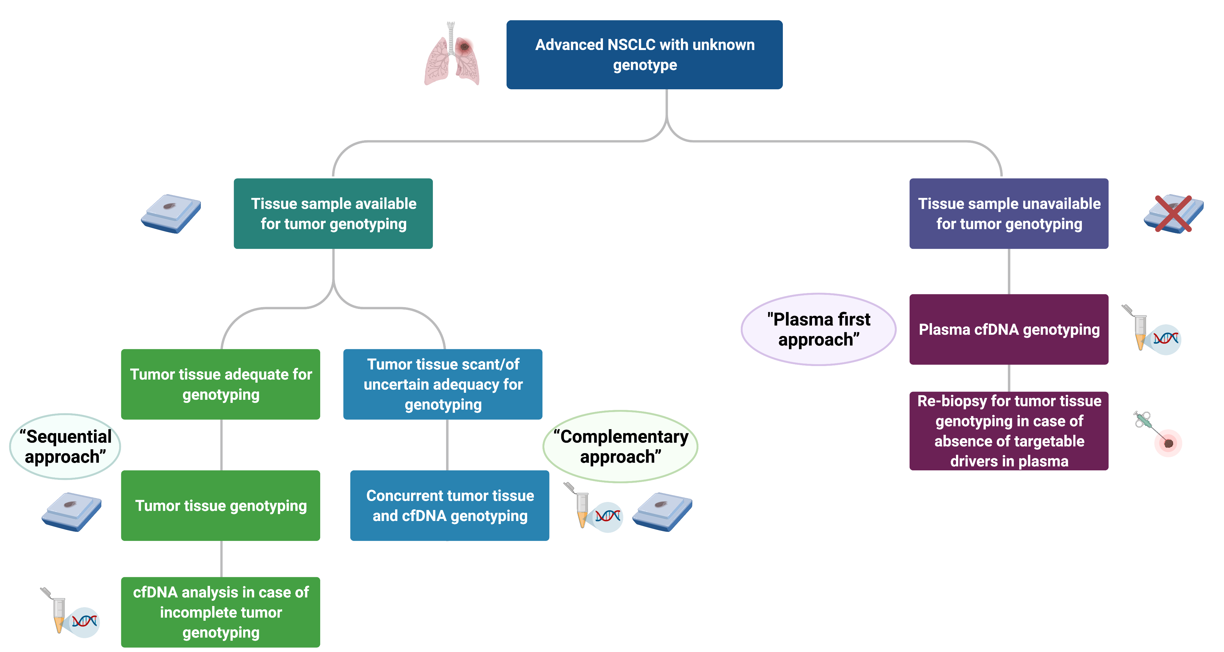
Positioning cfDNA genotyping in NSCLC
Update in 2021 recommendation
cfDNA, cell-free DNA; NSCLC, non-small cell lung cancer
International Association for the Study of Lung Cancer (IASLC) Atlas of Molecular Testing for Targeted Therapy in Lung Cancer 2023
Rolfo C, et al. J Thorac Oncol. 2021;16:1647-1662

Slide 49

We need …
Good QUALITY biopsies taken at 1st attempt
Incorporation of molecular testing as REFLEX testing in pathology department
Costs of NGS to come further down …
For NGS: REFLEX Workflow to incorporate RNA-based testing either concurrently with DNA or in event of DNA non-conclusive
Establish the role of liquid biopsies as a complementary testing method
With this in place – upfront NGS becomes more effective!
NGS, next-generation sequencing

Slide 50
Addressing the challenges of biomarker testing in lung cancer
Q&A Session

Slide 51
Addressing the challenges of biomarker testing in prostate cancer
Assoc. Prof. Alicia Morgans
GU Medical Oncologist
Dana-Farber Cancer Institute, Boston, USA

Slide 52

Despite Treatment Options, Outcomes Remain Poor for Patients With Metastatic Prostate Cancer^{1,2}
Clinical states of prostate cancer¹
Newly diagnosed:
Clinically localised disease
No visible metastases:
Castrate-resistant
Clinical metastases: castrate-resistant
Biochemical recurrence, no visible metastases:
Hormone sensitive
1st line
2nd line
Later lines
Newly diagnosed: Locally advanced disease
Clinical metastases:
Hormone sensitive
Relative 5-year survival by Stage^{1,2}
Stage I | Stage II | Stage III | Stage IV (metastases)
~100% | ~100% | ~95% | ~30%
1.Scher H, et al. PLoS One. 2015;10:e0139440; 2. Prostate cancer survival statistics. Available at https://www.cancerresearchuk.org/health-professional/cancer-statistics/statistics-by-cancer-type/prostate-cancer/survival#ref-3. Accessed 21-Mar-2024
Notes:
Talking Point
Multiple clinical states have been defined in prostate cancer based on the status of the primary tumor, presence or absence of detectable metastases, prior and current treatment (including cytotoxic therapy), and serum testosterone levels (non-castrate/castrate).¹ At the point of developing metastatic disease, clinical outcomes are poor^{1,2}
References
Scher H, et al. PLoS One. 2015;10:e0139440.
Cancer Research UK. Available at https://www.cancerresearchuk.org/health-professional/cancer-statistics/statistics-by-cancer-type/prostate-cancer/survival#ref-3

Slide 53
Mutations in the HRR Pathway May Be Associated With Development and Progression of Prostate Cancer
Increased risk of developing prostate cancer
by age 65 years with germline mutations
in BRCA1 and/or BRCA2
BRCA1
BRCA2
1.8X
8.6X
Mutations in the HRR pathway may play a role in progression of prostate cancer to the
lethal castration-resistant form, and BRCA2 mutations appear to have a negative impact
on response to first-line taxane treatment in castration-resistant prostate cancer
Up to
1 in 3
men diagnosed with advanced prostate cancer
harbour HRR mutations.
BRCA1/2, breast cancer gene 1/2; HRR, homologous recombination repair
Palmbos PL and Hussain MH. Oncology (Williston Park). 2016;30(5):377-85; Castro E, et al. J Clin Oncol. 2019;37(6):490-503;
Page E, et al. European Urology. 2019;76:831-42
Notes:
Talking Points
Germline mutations in BRCA1 and/or BRCA2 increase the risk of developing prostate cancer by age 65 years 1.8-fold and 8.6-fold, respectively, and occur in 2%-5% of patients with prostate cancer
Additionally, somatic mutations in genes involved in HRR are common in prostate cancer
Mutations in the HRR-associated genes may play a role in progression of prostate cancer to the castration-resistant form
Up to 19% of castration-resistant prostate cancers harbor BRCA1, BRCA2, or ATM mutations
Reference
Palmbos PL, Hussain MH. Targeting PARP in prostate cancer: novelty, pitfalls, and promise. Oncology (Williston Park). 2016;30(5):377-385.

Slide 54




Mutations in HRR Genes Can Be Germline or Somatic
Germline mutations
are inherited from
a parent¹
Somatic mutations
can arise from DNA
damage caused
by internal or
external insults¹
Hereditary¹
Present in germ cells from parents; in every cell of offspring (constitutional)¹
Can be detected by saliva, buccal swab, blood, or tumour testing²
Acquired¹
Present only in certain somatic cells; do not impact reproductive cells¹
Can be detected by tumour testing or
liquid biopsy^{2,3,a}
Cells with HRR mutations
Cells without HRR mutations
Tumour with HRR-mutated cells
ª Blood testing could theoretically capture circulating tumour cells; however, tumour testing is the only reliable method of detecting somatic mutations.^{2,4}
HRR, homologous recombination repair
1. National Institutes of Health. https://medlineplus.gov/genetics/understanding/mutationsanddisorders/genemutation/. Accessed 17-Mar-24;
2. Wu H, et al. Gene Ther. 2017;24(10):601-9; 3. Fiala C, Diamandis EP. BMC Med. 2018;16(1):166;
4. BRACAnalysis CDx® | Myriad International (myriadgenetics.eu). Accessed 17-Mar-24
Notes:
Talking Points
Cancers develop as a result of mutations in certain genes, such as those involved in the regulation of cell growth or DNA repair¹
These gene mutations can be hereditary (germline) or sporadic/nonhereditary (somatic)²:
Hereditary (germline) mutations are inherited from parents and are present throughout virtually every cell in the body. Germline mutations can be detected by testing saliva, buccal swab, blood, and tumor samples²
Sporadic (or acquired or somatic) mutations are mutations that occur at some time during a person’s life and are present in only certain cells in the body. Somatic mutations cannot be passed on to children. Somatic mutations can be identified by tumor testing; however, tumor testing does not distinguish between somatic and germline mutations^{2,3}

Slide 55

Mutations in DNA Repair Pathways Can Lead to Genetic Instability and Drive Tumour Growth1,2
DNA single
strand breaks
Bulky
adducts
Base mismatches,
insertions & deletions
DNA double
strand breaks
Non-homologous
end joining (NHEJ)
Repair
pathway
Base
excision
repair
(BER)
Nucleotide
excision
repair
(NER)
Mismatch
repair
(including MSH2 MLH1)
Homologous
recombination
repair (HRR)
including ATM, BRCA1/2, PALB2, CHEK1/2, RAD51
Homologous recombination repair (HRR)
is a key mechanism for the repair of DNA double strand breaks^{1,2}
ATM, ataxia telangiectasia mutated; BRCA1/2, breast cancer gene 1/2; CHEK1/2, checkpoint kinase 1/2; MLH1, MutL Homolog 1;
MSH2, MutS protein homolog 2; PALB2, partner and localizer of BRCA2
1. Lord CJ and Ashworth A. Nature. 2012;481:287-93; 2. O’Connor MJ. Mol Cell. 2015;60:547-60

Slide 56
Genetic Testing Informs Decision Making
Clinical
question
Test
selection
Test implementation & results
Clinical
decision
Clinical questions and decisions:
Understanding familial risk (germline mutations)
Estimating disease prognosis
Informing treatment decisions, including eligibility for clinical trials
Evaluating genomic alterations for other research purposes
Testing considerations:
Technical limitation and sample availability
Detection of germline only, or both germline and somatic mutations
Test availability/access
Turnaround time
Access to and availability of testing
and genetic counselling
Bilkey GA, et al. Front Public Health. 2019;7:40; Katsanis SH and Katsanis N. Nat Rev Genet. 2013;14(6):415-26

Slide 57
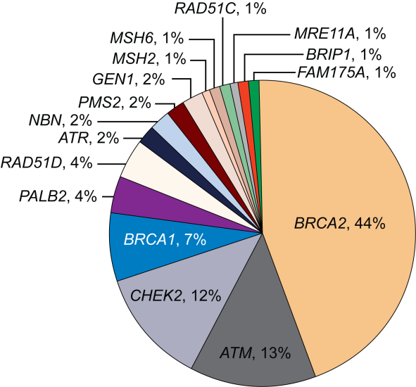
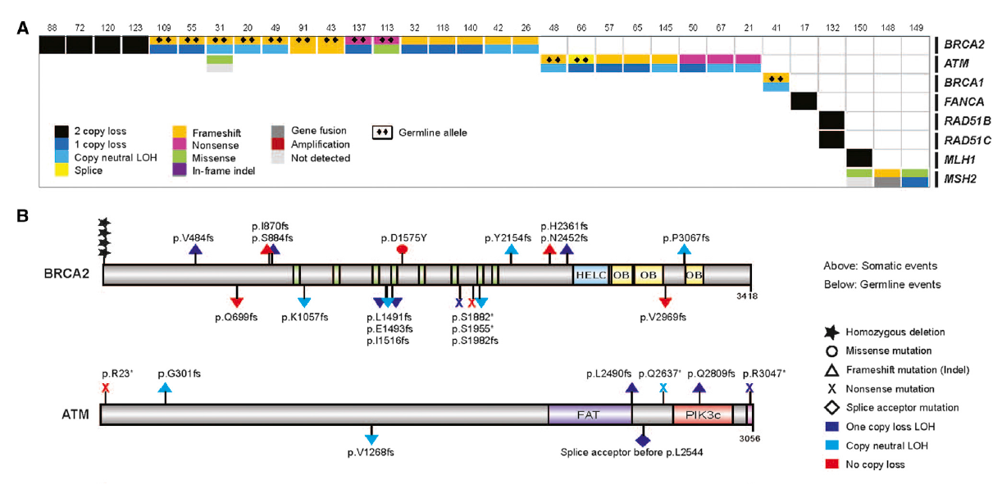
DNA Repair Alterations are Common in Advanced Prostate Cancer
Somatic
Germline
~23% of men with mCRPC have DNA repair pathway aberrations
The incidence of DNA repair alterations is higher in men with metastatic prostate cancer than those with localised disease
~12% of men with metastatic prostate
cancer have germline mutations in one or more of the 16 DNA repair genes
LOH, loss of heterozygosity; mCRPC, metastatic castration resistant prostate cancer; PC, prostate cancer
1. Robinson D, et al. Cell. 2015;161:1215-1228; 2. Pritchard CC, et al. N Engl J Med. 2016;375:443-453; 3. Antonarakis ES, et al. Eur Urol. 2018;74:218-225

Slide 58
Estimated Germline and Somatic Mutations in Metastatic Prostate Cancer
 | Somatic Mutation | Germline Mutation | Combined Rate
BRCA1 | 1% | 1% | 2%
BRCA2 | 5% | 5.4% | 10-11%
PALB2 | 4%ª | 0.4% | 4.4%
ATM | 2-3% | 1.6% | 3.5-4.5%
MSH2/6 | 4-5% | 1.5% | 5.5-6.5%
ªmCRPC rate
ATM, ataxia telangiectasia mutated; BRCA1/2, breast cancer gene 1/2; mCRPC, metastatic castration resistant prostate cancer; MSH2/6, MutS protein homolog 2/6; PALB2, partner and localizer of BRCA2
Adapted from Pritchard C, APCCC Basel 2019, Cheng H, et al. J. Natl Compr Canc Netw. 2019: 17: 515-521; Lang S, et al. Int J Onc 2019; 55: 597-616 (Supplementary material)

Slide 59
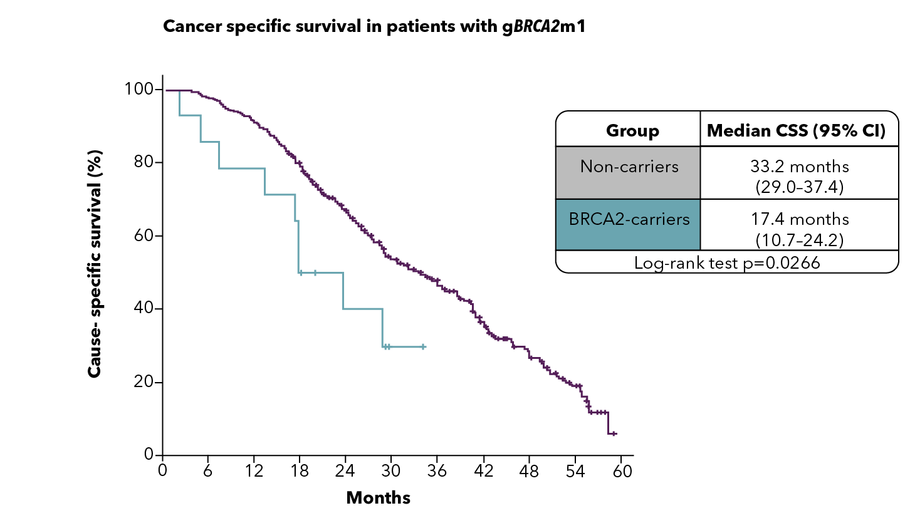
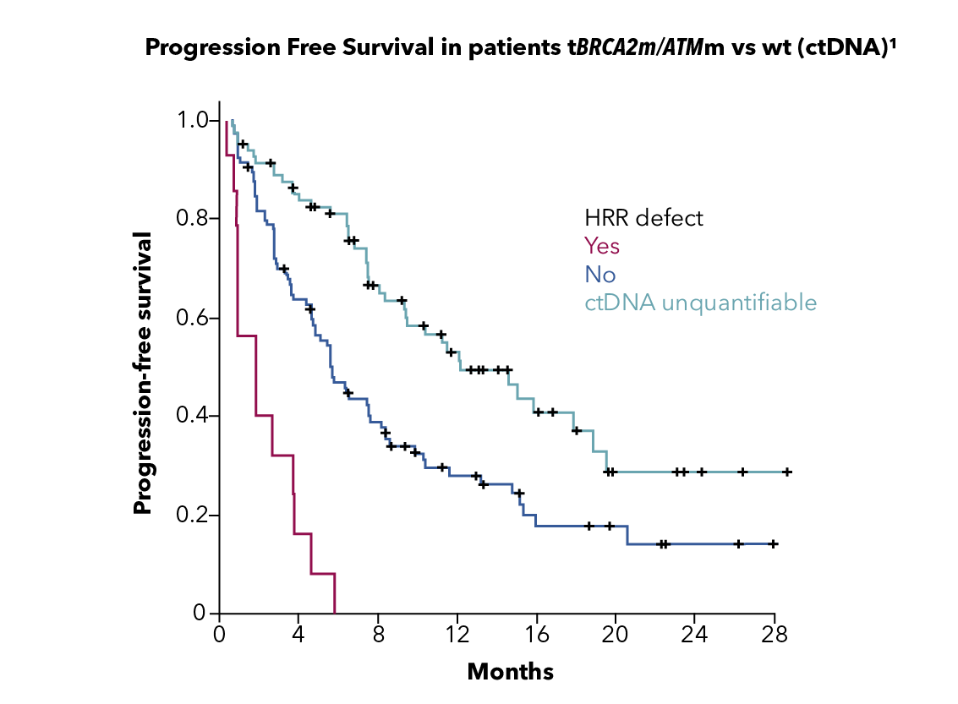
Patients WITH HRR MUTATIONS (INCLUDING BRCA2 MUTATIONS) ARE MORE LIKELY TO HAVE POOR OUTCOMES ON STANDARD-OF-CARE therapies¹⁻³
Patients with germline HRR mutations including BRCA2 mutations are more likely to have poor outcomes on standard-of care-therapies^{1,2}
Poor responses to standard therapy
also seen for tumour HRR mutations²
Cancer-specific survival in patients with
mCRPC with BRCA2 mutation¹
Time to progression in patients with
mCRPC with HRR mutations³
Group | Median CSS (months) (95% CI)
Non-carriers | 33.2 (29.0-37.4)
BRCA2 mutation carriers | 17.4 (10.7-24.2)
Log-rank test p=0.0266
HRR defect
Yes
No
ctDNA unquantifiable
CSS (%)
PFS (%)
Months
Months
BRCA2, breast cancer gene 2; CI, confidence interval; CSS, cause-specific survival; ctDNA, circulating tumour DNA; HRR, homologous recombination repair; mCRPC, metastatic castration-resistant prostate cancer; PFS, progression-free survival
1. Adapted from: Castro E, et al. J Clin Oncol. 2019;6:490-503; 2. Annala M, et al. Eur Urol. 2017;72:34-42; 3. Annala M, et al. Cancer Discov. 2018;8:444-57

Slide 60
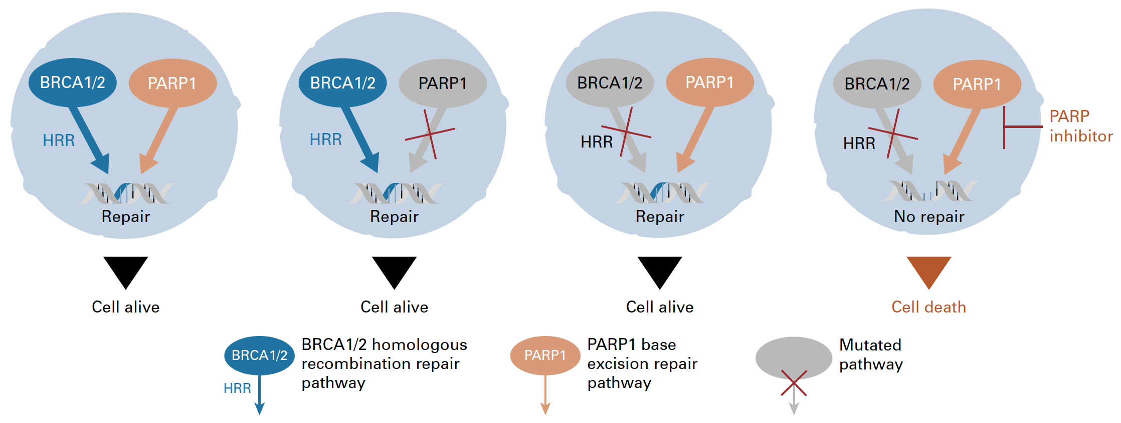

PARP inhibitors:
‘Synthetic Lethality’ in cancer
BRCA: “copy editor”; homologous recombination repair (HRR)
PARP: “spell check”; base excision repair (BER)
BER
BER
BER
BER
BER
PARP is required for single-strand break repair (e.g. via BER)
MOA – inhibiting SSB/BER is synthetic lethal with HRD
BER, base excision repair; BRCA1/2, breast cancer type 1/2 susceptibility protein; HRD, homologous recombination deficiency;
HRR, homologous recombination repair; MOA, mode of action; PARP, poly-ADP ribose polymerase; SSB, single-strand break
Adapted from Gourley C, et al. J Clin Oncol. 2019;37(25):2257-69; Banerjee S, et al. Nat Rev Clin Oncol. 2010;7:508-19

Slide 61
Trials investigating PARPi in advanced Prostate cancer
Primary
Adjuvant
Biochemical Recurrence (BCR)
mHSPC
(incl de novo)
1L mCRPC
2L mCRPC
3L mCRPC
nmCRPC
PROpel^{1,a}
P3 Olaparib + abi vs abi
Primary endpoint: rPFS unselected pts
PROfound^{2,b}
P3 Olaparib vs abi/enza, HRRm, post-NHA Primary endpoint: rPFS BRCA/ATMm
TALAPRO-3³
P3 Talazoparib + enza
Primary endpoint: rPFS HRRm
TALAPRO-2^{4,C}
P3 Talazoparib + enza vs. enza
Primary endpoint: rPFS unselected pts/HRRm
TALAPRO-1⁵
P2 Talazoparib
HRRm
Post-NHA, post-taxane
Primary endpoint: ORR HRRm
AMPLITUDE⁶
P3 Niraparib + abi
Primary endpoint: rPFS HRRm
MAGNITUDE^{7,d}
P3 Niraparib + abi vs abi
Primary endpoint: rPFS BRCAm/HRRm
GALAHAD⁸
P2 Niraparib, HRRm
Post-NHA, post-taxane
Primary endpoint: ORR BRCAm
Prostate Specific Antigen
TRITON-3⁹
P3 Rucaparib vs abi/enza/docetaxel
BRCAm / ATM, post-NHA
TRITON-2^{10,e}
P2 Rucaparib HRRm/BRCAm†
Post-NHA, post-taxane
Primary endpoint: ORR and PSA HRRm
Met
CASPAR¹¹
P3 Rucaparib + enza vs. enza
Primary endpoint rPFS & OS
Unselected patients
Time
Non-metastatic
Metastatic
Hormone-sensitive
Castration-resistant
Asymptomatic
Symptomatic
Please see slide notes for references. ª PROpel led to the approval of olaparib in combination with abiraterone in patients with BRCAm mCRPC (FDA approval) or in patients for whom chemotherapy is not clinically indicated (EMA approval); ^{b} PROfound, olaparib monotherapy was approved for treatment of mCRPC in patients with HRR mutations (FDA approval) or for patients with mutations in only BRCA1/2 (EMA approval) after progression on a NHA; ^{c} Talapro-2 led to the approval of talazoparib in combination with enzalutamide for HRR gene-mutated mCRPC (FDA approval); ^{d} MAGNITUDE led to the approval of niraparib in combination with abiraterone in patients with BRCAm mCRPC (FDA approval) or patients with mCRPC and BRCA1/2 mutations (germline and/or somatic) in whom chemotherapy is not clinically indicated; ^{e} As a result of the data from TRITON2, rucaparib monotherapy was approved by the FDA only for the treatment of mCRPC in patients with a BRCA1/2m who have disease progression after treatment with prior AR-directed therapy and prior taxane
1/23L, first/second/third line; abi, abiraterone; AR, androgen receptor; ATM, ataxia telangiectasia mutated; BRCA, breast cancer gene; EMA, European Medicines Agency; enza, enzalutamide; FDA, US Food and Drug Administration; HRR, homologous recombination repair; m, mutation; mCRPC, metastatic castration-resistant prostate cancer; mHSPC, metastatic hormone-sensitive prostate cancer; NHA, new hormonal agent; nmCRPC, non-metastatic castration-resistant prostate cancer; ORR, objective response rate; OS, overall survival; P, phase; PARP, poly (ADP-ribose) polymerase; PSA, prostate-specific antigen; pts, patients; rPFS, radiographic progression-free survival
Notes:
References:
1. Study NCT03732820. Available at ClinicalTrials.gov; 2. Study NCT02987543. Available at ClinicalTrials.gov; 3. Study NCT04821622. Available at ClinicalTrials.gov; 4. Study NCT03395197. Available at ClinicalTrials.gov; 5. Study NCT03148795. Available at ClinicalTrials.gov; 6. Study NCT04497844. Available at ClinicalTrials.gov; 7. Study NCT03748641. Available at ClinicalTrials.gov; 8. Study NCT02854436. Available at ClinicalTrials.gov; 9. Study NCT02975934. Available at ClinicalTrials.gov; 10. Study NCT02952534. Available at ClinicalTrials.gov; 11. Study NCT04455750. Available at ClinicalTrials.gov

Slide 62
Patient Case
Mr. GC is a 68 yo man who presented to his primary care physician for his annual visit
PMH: Hyperlipidaemia
Meds: simvastatin
Family History: Grandmother had breast cancer
He is married and has good family support. He recently retired from being a high school history teacher
Routine labs were unremarkable other than a PSA of 12.6 ng/mL
He was referred to a urologist for further evaluation. His urologist proceeded with
MRI of the prostate that demonstrated a 12 mm PI-RADS 5 lesion on the right
MRI, magnetic resonance imaging; PI-RADS, Prostate Imaging Reporting & Data System; PMH, prior medical history; PSA, prostate specific antigen; yo, year-old

Slide 63
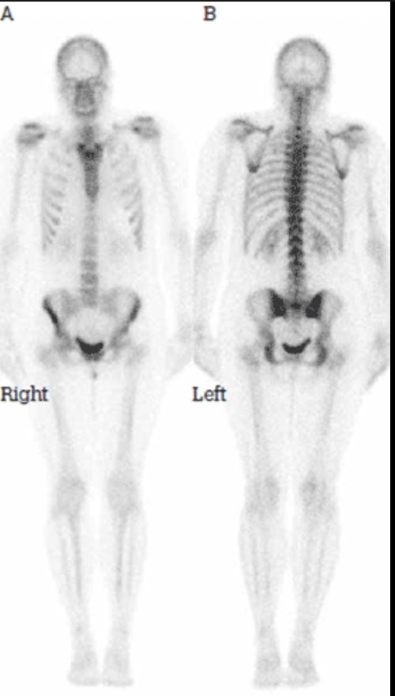
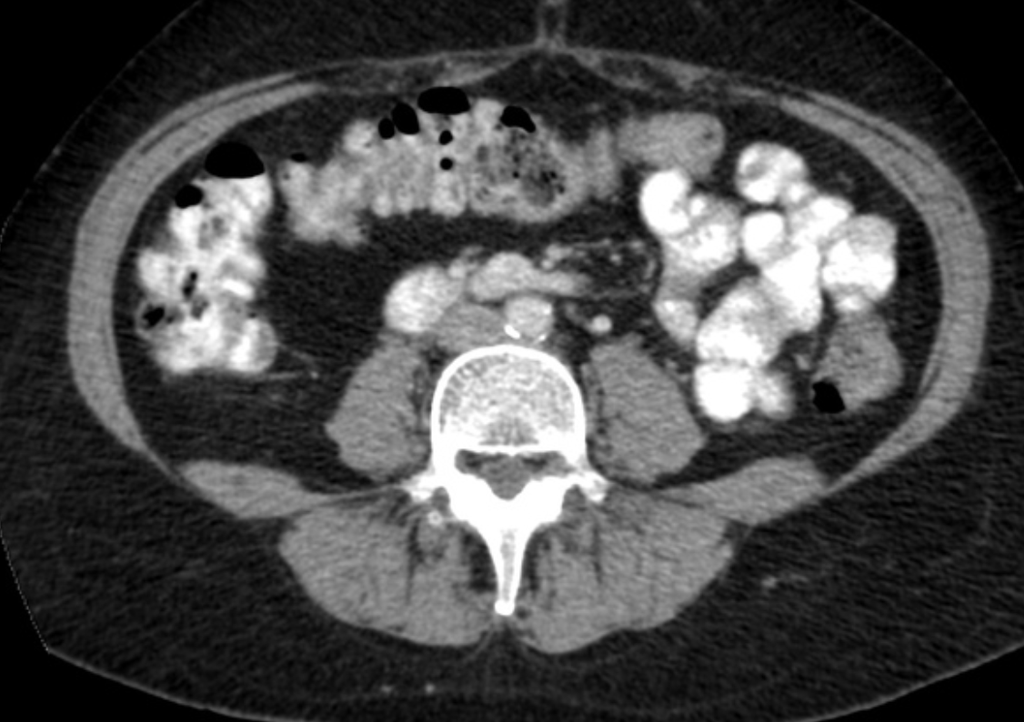
PATIENT CASE
MRI guided biopsy was performed. This demonstrated Gleason 4+5, GG 5, prostate adenocarcinoma in
5 of 12 cores
He completed staging work up, which was negative for evidence of metastatic disease
MRI, magnetic resonance imaging; GG, grade group

Slide 64
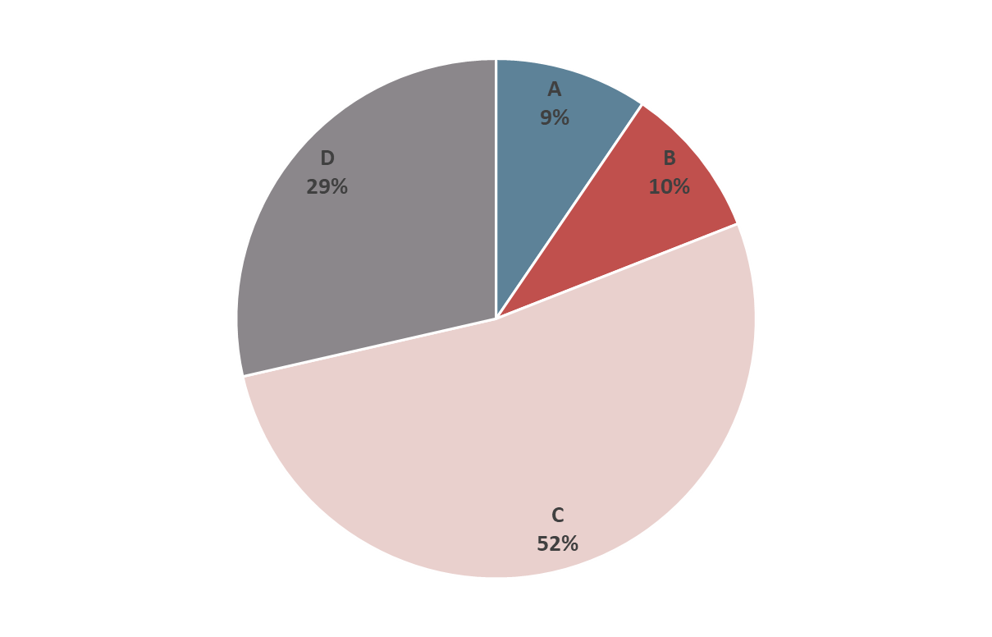
Should he undergo genetic testing at this time?
POLLING QUESTION
No, he does not have a family history of prostate cancer
No, he does not have enough first-degree relatives with cancer and was not diagnosed
at a young age
Yes, he has high risk localised prostate cancer and should get germline testing ✅
Yes, all patients with prostate cancer should undergo germline genetic testing

Slide 65
Should he undergo genetic testing at this time?
POLLING QUESTION: response
No, he does not have a family history of prostate cancer
No, he does not have enough first-degree relatives with cancer and was not diagnosed
at a young age
Yes, he has high risk localised prostate cancer and should get germline testing
Yes, all patients with prostate cancer should undergo germline genetic testing
Notes:
All patients with high risk localized prostate cancer should undergo germline genetic testing by NCCN guidelines. This may vary by country/region of practice.

Slide 66

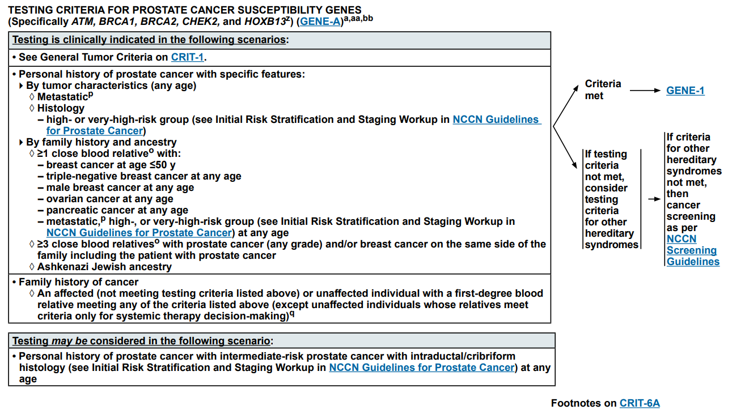
https://www.nccn.org/professionals/physician_gls/pdf/genetics_bop.pdf. Accessed 14-Mar-2024

Slide 67

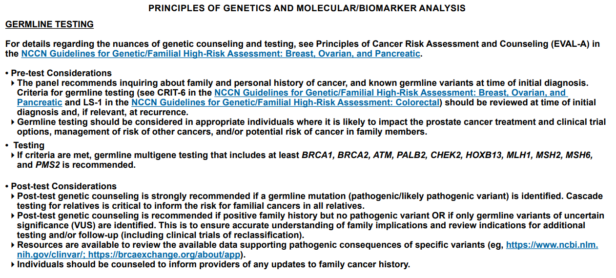
https://www.nccn.org/professionals/physician_gls/pdf/prostate.pdf. Accessed 14-Mar-2024

Slide 68
Patient Case continued
He completes germline testing by blood-based assay, and it was negative
for HRR alterations
HRR, homologous recombination repair

Slide 69

Diagnostic Options for Molecular Testing in Prostate Cancer^{1,2}
Germline
Somatic
Blood or buccal swab testing
Tissue
testing
ctDNA testing
CTC
testing
Tumour molecular testing can identify both germline and somatic HRR mutations,
while germline testing detects only germline HRR mutations³
CTC, circulating tumour cell; ctDNA, circulating tumour DNA; HRR, homologous recombination repair
1. Cheng H, et al. ASCO Educational Book. 2018;38:372-381; 2. Haber DA and Velculescu VE. Cancer Discov. 2014;4:650-661;
3. Raymond VM, et al. J Natl Cancer Inst. 2015;108(4):djv351; 4. Wu H, et al. Gene Ther. 2017;24(10):601-609
Notes:
Haber 2014/ p654/col2/para3/line9-13
Haber 2014/ p654/col2/para3/line1-5
Cheng 2018/ p375/col1/para2/line1-4
Cheng 2018/ p375/col2/para2/line1-4

Slide 70
Patient Case continued
He discussed his high-risk localised disease at length, and proceeded with
prostatectomy, and tolerated well
  PSA undetectable post-operatively
PSA rose to 0.2 ng/mL approximately 6 months after surgery. Underwent salvage radiation with ADT PSA nadir was 0.05 ng/mL
10 months later, testosterone was 35 ng/dL and PSA started to rise
  PSA 0.9 ng/mL
  PSA 1.48 ng/mL
  PSA 2.59 ng/mL
ADT, androgen deprivation therapy; PSA, prostate specific antigen

Slide 71
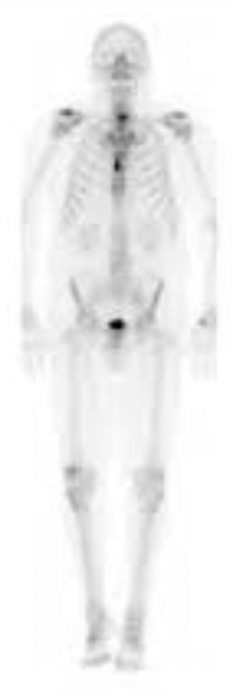
Patient Case continued
He undergoes repeat imaging for restaging
Bone scan demonstrated sternal lesion concerning for metastatic disease
His CT scan is negative for lymph node and visceral involvement but demonstrates several bone lesions in the pelvis
PSA 4.23 ng/mL, testosterone in castrate range
He declines biopsy that was requested due to relatively low PSA in the setting of metastatic disease
CT, computed tomography; PSA, prostate specific antigen

Slide 72
Should he undergo additional genetic testing at this time?
POLLING QUESTION
No, he already completed genetic testing
No, he has declined a biopsy
No, he only has bone lesions and it is not possible to do genetic testing with
bone biopsy tissue
Yes, he should undergo somatic testing ✅

Slide 73
Should he undergo additional genetic testing at this time?
POLLING QUESTION: response
No, he already completed genetic testing
No, he has declined a biopsy
No, he only has bone lesions and it is not possible to do genetic testing with
bone biopsy tissue
Yes, he should undergo somatic testing

Slide 74
Which option is not suitable for somatic genetic testing for this patient?
POLLING QUESTION
Buccal swab testing ✅
Metastatic bone biopsy
Circulating tumour DNA (liquid biopsy)
Prostatectomy specimen tissue testing

Slide 75
Which option is not suitable for somatic genetic testing for this patient?
POLLING QUESTION: response
Buccal swab testing
Metastatic bone biopsy
Circulating tumour DNA (liquid biopsy)
Prostatectomy specimen tissue testing

Slide 76
Genetic Testing Approaches:
Strengths and Weaknesses
Tumour testing
Germline testing
ctDNA testing
Most validated technique that allows somatic and germline mutations detection
Easy to obtain whole blood or buccal swab samples to test for germline mutations
Can only detect germline mutations
Plasma ctDNA is tested with easy-to-obtain blood samples
Can detect germline mutations
Plasma testing can also detect somatic mutations if there is an appreciable level of ctDNA
✓
Advantages
Requires invasive biopsies which may provide only limited tissue quantity and quality
Prostate cancer primary spreads to bone; tissue samples from bone metastases are difficult to obtain and process
A biopsy may miss within-tumour genetic heterogeneity
Unable to identify somatic mutations
Tests not currently widely available
Highly sensitive tests are required
May miss patients who do not shed sufficient ctDNA
✘
Disadvantages
ctDNA, circulating tumour DNA
Capoluongo E, et al. Oncotarget. 2018;9:19463-19468; Cheng H, et al. Am Soc Clin Oncol Educ Book. 2018;38:372-381;
Ossandon MR, et al. J Natl Cancer Inst. 2018;110:929-934; Kammesheidt A, et al. Int J Mol Epidemiol Genet. 2018;9(1):1-12

Slide 77
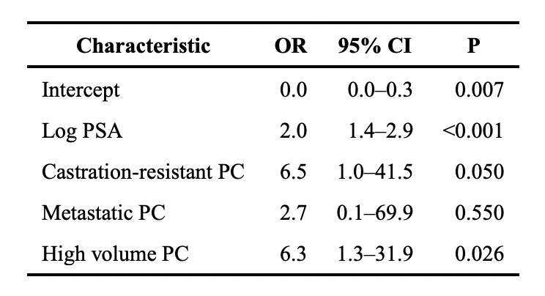
Factors affecting success for cfDNA
High volume PC
100%
PSA
Characteristic | OR | 95% CI | P
Intercept | 0.0 | 0.0-0.3 | 0.007
Log PSA | 2.0 | 1.4-2.9 | <0.001
Castration-resistant PC | 6.5 | 1.0-41.5 | 0.050
Metastatic PC | 2.7 | 0.1-69.9 | 0.550
High volume PC | 6.3 | 1.3-31.9 | 0.026
1000
75%
100
Percent
50%
Value
10
1
25%
Somatic mutations were identified in cfDNA in 91% of patients with PSA >10 ng/mL
0.1
0%
Successful
Not successful
Successful
Not successful
Detection of somatic alterations in plasma by PSA level
NOTE: Blue bars indicate percentage of patients with high-volume PC
cfDNA, cell-free DNA; CI, confidence interval; OR, odds ratio; PC, prostate cancer; PSA, prostate specific antigen
Schweizer MT, et al. Prostate. 2019;79(7):701-708

Slide 78
Men with PC are at high risk of being misdiagnosed as being eligible for PARPi therapy using current cfDNA tests
Prevalence of CHIP
80
Prostate cancer mutations are identified in
plasma only
CHIP can be detected in plasma and
whole blood
Use of a whole blood control can distinguish CHIP from PC variants
r2 = 0.821
60
40
CHIP (%)
20
0
40-50
51-60
61-70
71-80
81-90
Age (year)
CHIP clones detected in DNA repair genes used for PARPi eligibility
Age, y | Gene | CHIP variants(s) | VAF cfDNA | VAF blood control | Notes
81 | ATM | p.R3008C, p.E3007D | 16%; 5% | 16%; 5% | CHIP hotspot by outside lab in bone marrow
54 | ATM | p.S305* | 2% | 3%
82 | ATM | p.G2891D | 12% | 13% | Kinase domain
81 | ATM | c.2921 + 1G>A | 78% | 65% | Not germline based on tumour testing
87 | ATM | p.L2492R | 7% | 9% | CHIP hotspot
76 | BRCA2 | p.T3310Nfs*17 | 3% | 3% | Reported by outside lab, recommending PARPi
74 | CHEK2 | p.P426H | 19% | 18% | Kinase domain
ATM, ataxia telangiectasia mutated; BRCA2, breast cancer gene 2; cfDNA, cell free DNA; CHEK2, checkpoint kinase 2; CHIP, clonal haematopoiesis of indeterminate potential; PARPi, poly(ADP) ribose polymerase inhibitor; PC, prostate cancer; VAF, variant allele fraction
Jensen K, et al. JAMA Oncol. 2021;7(1):107-110

Slide 79
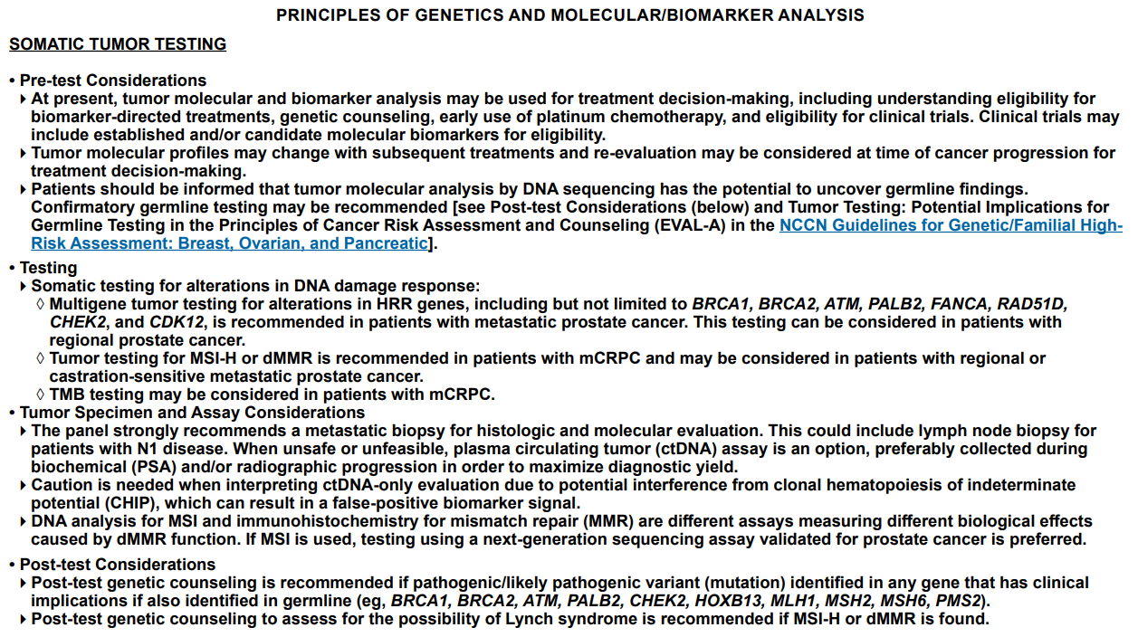
ctDNA, circulating tumour DNA; MMR, mismatch repair; MSI, microsatellite instability; PSA, prostate specific antigen
https://www.nccn.org/professionals/physician_gls/pdf/prostate.pdf. Accessed 14-Mar-2024

Slide 80
ATM, ataxia telangiectasia mutated; BRCA1/2, breast cancer gene 1/2; CDK12, cyclin-dependent kinase 12; CHEK1/2, checkpoint kinase 1/2; PALB2, partner and localizer of BRCA2; TMB, tumour mutational burden
https://www.nccn.org/professionals/physician_gls/pdf/prostate.pdf. Accessed 14-Mar-2024

Slide 81
Biomarker driven treatment for mcrpc
mCRPC, metastatic castration resistant prostate cancer

Slide 82
Key PARPi Investigations in Prostate Cancer
PARP Inhibitor Monotherapy
Olaparib | PROfound¹ | FDA approved for HRR-mutated mCRPCª
Rucaparib | TRITON2² | FDA approved for BRCA-mutated mCRPCª
Talazoparib | TALAPRO-1³ | Clinical activity in BRCA-mutated mCRPC
Niraparib | GALAHAD⁴ | Clinical activity in BRCA-mutated mCRPC
PARP Inhibitor Combination Therapy
Olaparib + Abiraterone | PROpel⁵ | FDA approved for BRCA-mutated mCRPCª (May 2023)
Talazoparib + Enzalutamide | TALAPRO-2⁶ | FDA approved for HRR-mutated mCRPCª (June 2023)
Niraparib + Abiraterone^{b} | MAGNITUDE⁷ | FDA approved for BRCA-mutated mCRPCª (August 2023)
ª
ª
ª
ª Information taken from product prescribing information; ^{b} Approved as a fixed dose combination
BRCA, breast cancer gene; FDA, US Food and Drug Administration; HRR, homologous recombination repair; mCRPC, metastatic castration resistant prostate cancer; PARP(i), poly (ADP-ribose) polymerase (inhibitor)
1. de Bono J, et al. N Engl J Med. 2020;382:2091-2102; 2. Abida W, et al. J Clin Oncol. 2020;38:3763-3772; 3. de Bono JS, et al. Lancet Oncol. 2021;22:1250-1264; 4. Smith M, et al. Lancet Oncol. 2022;23:362-373; 5. Clarke N, et al. NEJM Evidence 2022;1(9): doi: https://doi.org/10.1056/EVIDoa2200043;
6. Agarwal A, et al. Lancet. 2023;402:291-303; 7. Chi KN, et al. J Clin Oncol. 2023;41:3339-3351
ª

Slide 83
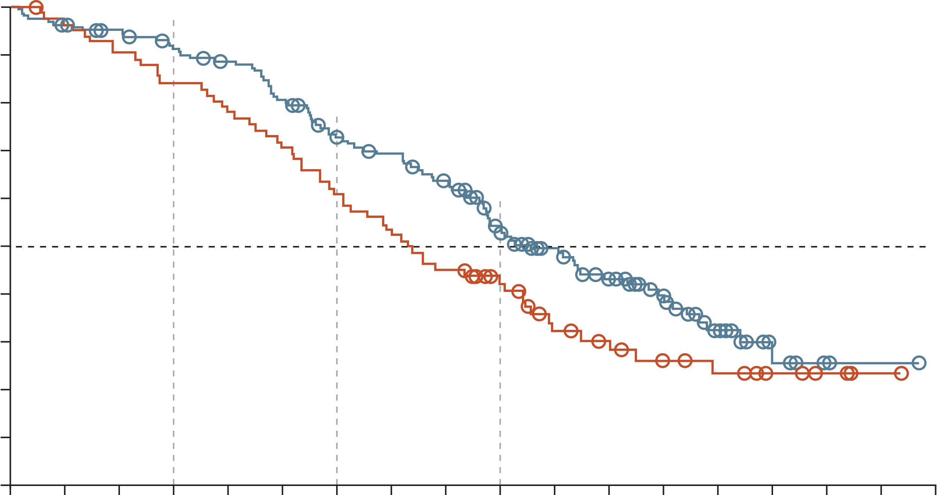
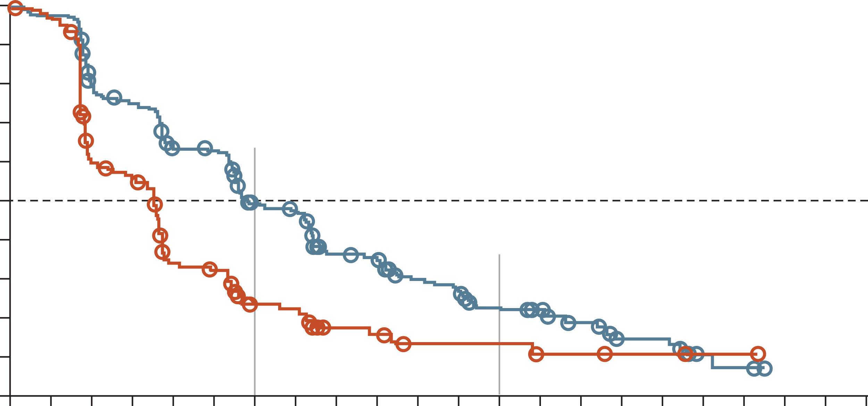
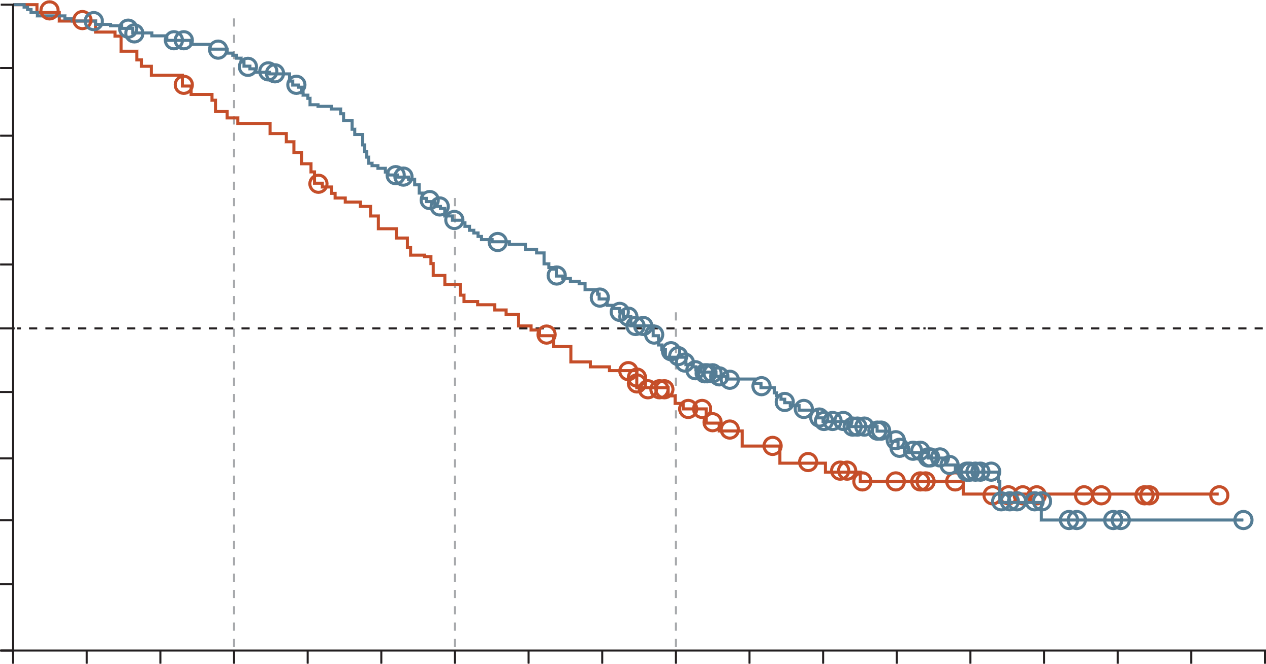
PROFOUND: efficacy in Cohort A and Overall Population
Cohort A (BRCA1/2 or ATM)²
 | Olaparib | Control
No. of deaths/ No. of patients | 91/162 | 57/83
Median OS (95% CI) mo | 19.1 (17.4-23.4) | 14.7 (11.9-18.8)
HR for death (95% CI) | 0.69 (0.50-0.97) 2-sided p=0.02
Overall^{1,a}
91%
84%
 | Olaparib | Placebo
Median (months) | 5.8 | 3.5
HR for progression or death (95% CI) | 0.49 (0.38-0.63); p<0.001
100
1.00
90
73%
61%
0.90
80
54%
42%
70
0.80
60
50
Value at
6 mo
Percent of patients alive
0.70
40
Olaparib
30
0.60
20
Control
Probability of imaging-based
progression-free survival
0.50
10
0.50
0
Value at
12 mo
0
2
4
6
8
10
12
14
16
18
20
22
24
26
28
30
32
34
0.40
No. at risk
Olaparib
Control
Months since randomisation
0.30
162 | 155 | 150 | 142 | 136 | 124 | 107 | 101 | 91 | 71 | 56 | 44 | 30 | 18 | 6 | 2 | 1 | 0
83 | 79 | 74 | 69 | 64 | 58 | 50 | 43 | 37 | 27 | 18 | 15 | 11 | 9 | 6 | 3 | 1 | 0
0.22
Overall^{2,a}
0.20
Olaparib
92%
83%
 | Olaparib | Control
No. of deaths/ No. of patients | 160/256 | 88/131
Median OS (95% CI) mo | 17.3 (15.5-18.6) | 14.0 (11.5-17.1)
HR for death (95% CI) | 0.79 (0.61-1.03)
0.24
100
0.10
0.13
Placebo
90
67%
56%
0.00
80
70
47%
39%
0
1
2
3
4
5
6
7
8
9
10
11
12
13
14
15
16
17
18
19
20
21
60
Months since randomisation
50
Percent of patients alive
No. at risk
Olaparib
Control
40
Control
256 | 239 | 188 | 176 | 145 | 143 | 106 | 100 | 67 | 63 | 48 | 43 | 31 | 28 | 21 | 11 | 11 | 3 | 2 | 0 | 0 | 0
131 | 123 | 73 | 67 | 38 | 35 | 20 | 19 | 9 | 8 | 5 | 5 | 5 | 3 | 3 | 2 | 2 | 1 | 1 | 0 | 0 | 0
30
20
Olaparib
10
0
0
2
4
6
8
10
12
14
16
18
20
22
24
26
28
30
32
34
ª mCRPC patients with alterations of BRCA1, BRCA2, ATM, BARD1, BRIP1, CDK12, CHEK1,
CHEK2, FANCL, PALB2, PPP2R2A, RAD51B, RAD51C, RAD51D, or RAD54L in their tumour tissue
No. at risk
Olaparib
Control
Months since randomisation
256 | 249 | 240 | 228 | 209 | 182 | 157 | 146 | 126 | 96 | 73 | 56 | 39 | 22 | 7 | 2 | 1 | 0
131 | 125 | 115 | 106 | 96 | 83 | 71 | 63 | 55 | 37 | 27 | 22 | 15 | 11 | 6 | 3 | 1 | 0
ATM, ataxia telangiectasia mutated; BRCA1/2, breast cancer gene 1/2; CDK12, cyclin-dependent kinase 12; CHEK1/2, checkpoint kinase 1/2; CI, confidence interval; HR, hazard ratio; mCRPC, metastatic castration resistant prostate cancer; mo, months; OS, overall survival; PALB2, partner and localiser of BRCA2;
1. de Bono J, et al. N Engl J Med. 2020;382:2091-2102; 2. Hussain M, et al. N Engl J Med. 2020;383:2345-2357

Slide 84
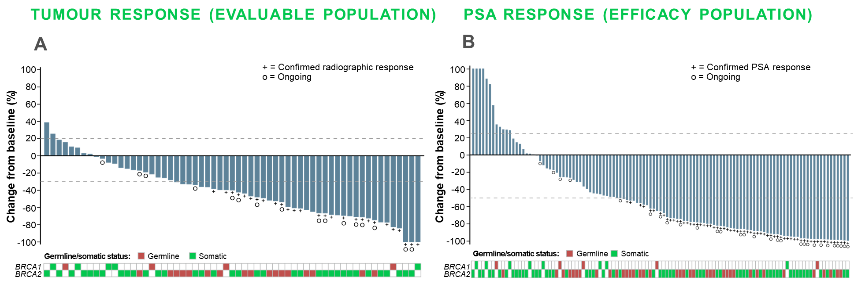
TRITON2: Post NHA and Chemo Rucaparib Monotherapy in mCRPC with brca1 or brca2 alterations
Best change from baseline in sum of target lesion(s) in the IRR-evaluable population
Best change from baseline in PSA in the overall efficacy population
A
B
BRCA1/2, breast cancer gene 1/2; chemo, chemotherapy; CI, confidence interval; IRR, independent radiology review; mCRPC, metastatic castration resistant prostate cancer; NHA, new hormonal agent; PSA, prostate-specific antigen, rPFS, radiographic progression-free survival
Adapted from: Abida W, et al. J Clin Oncol. 2020;38:3763-72

Slide 85
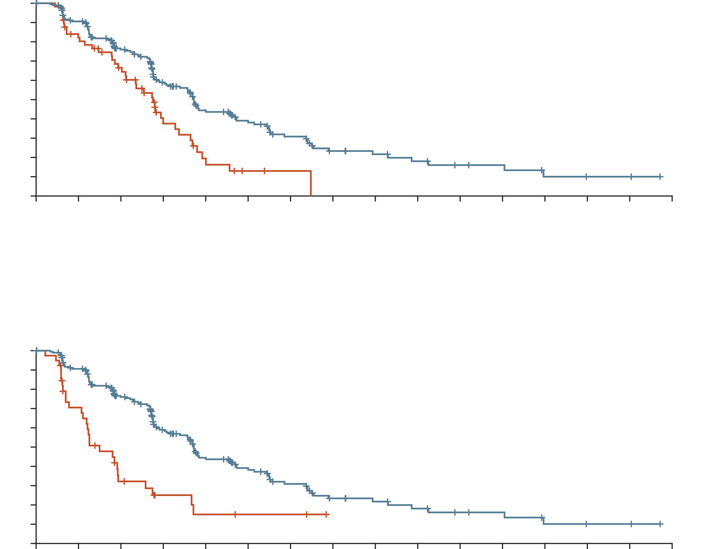
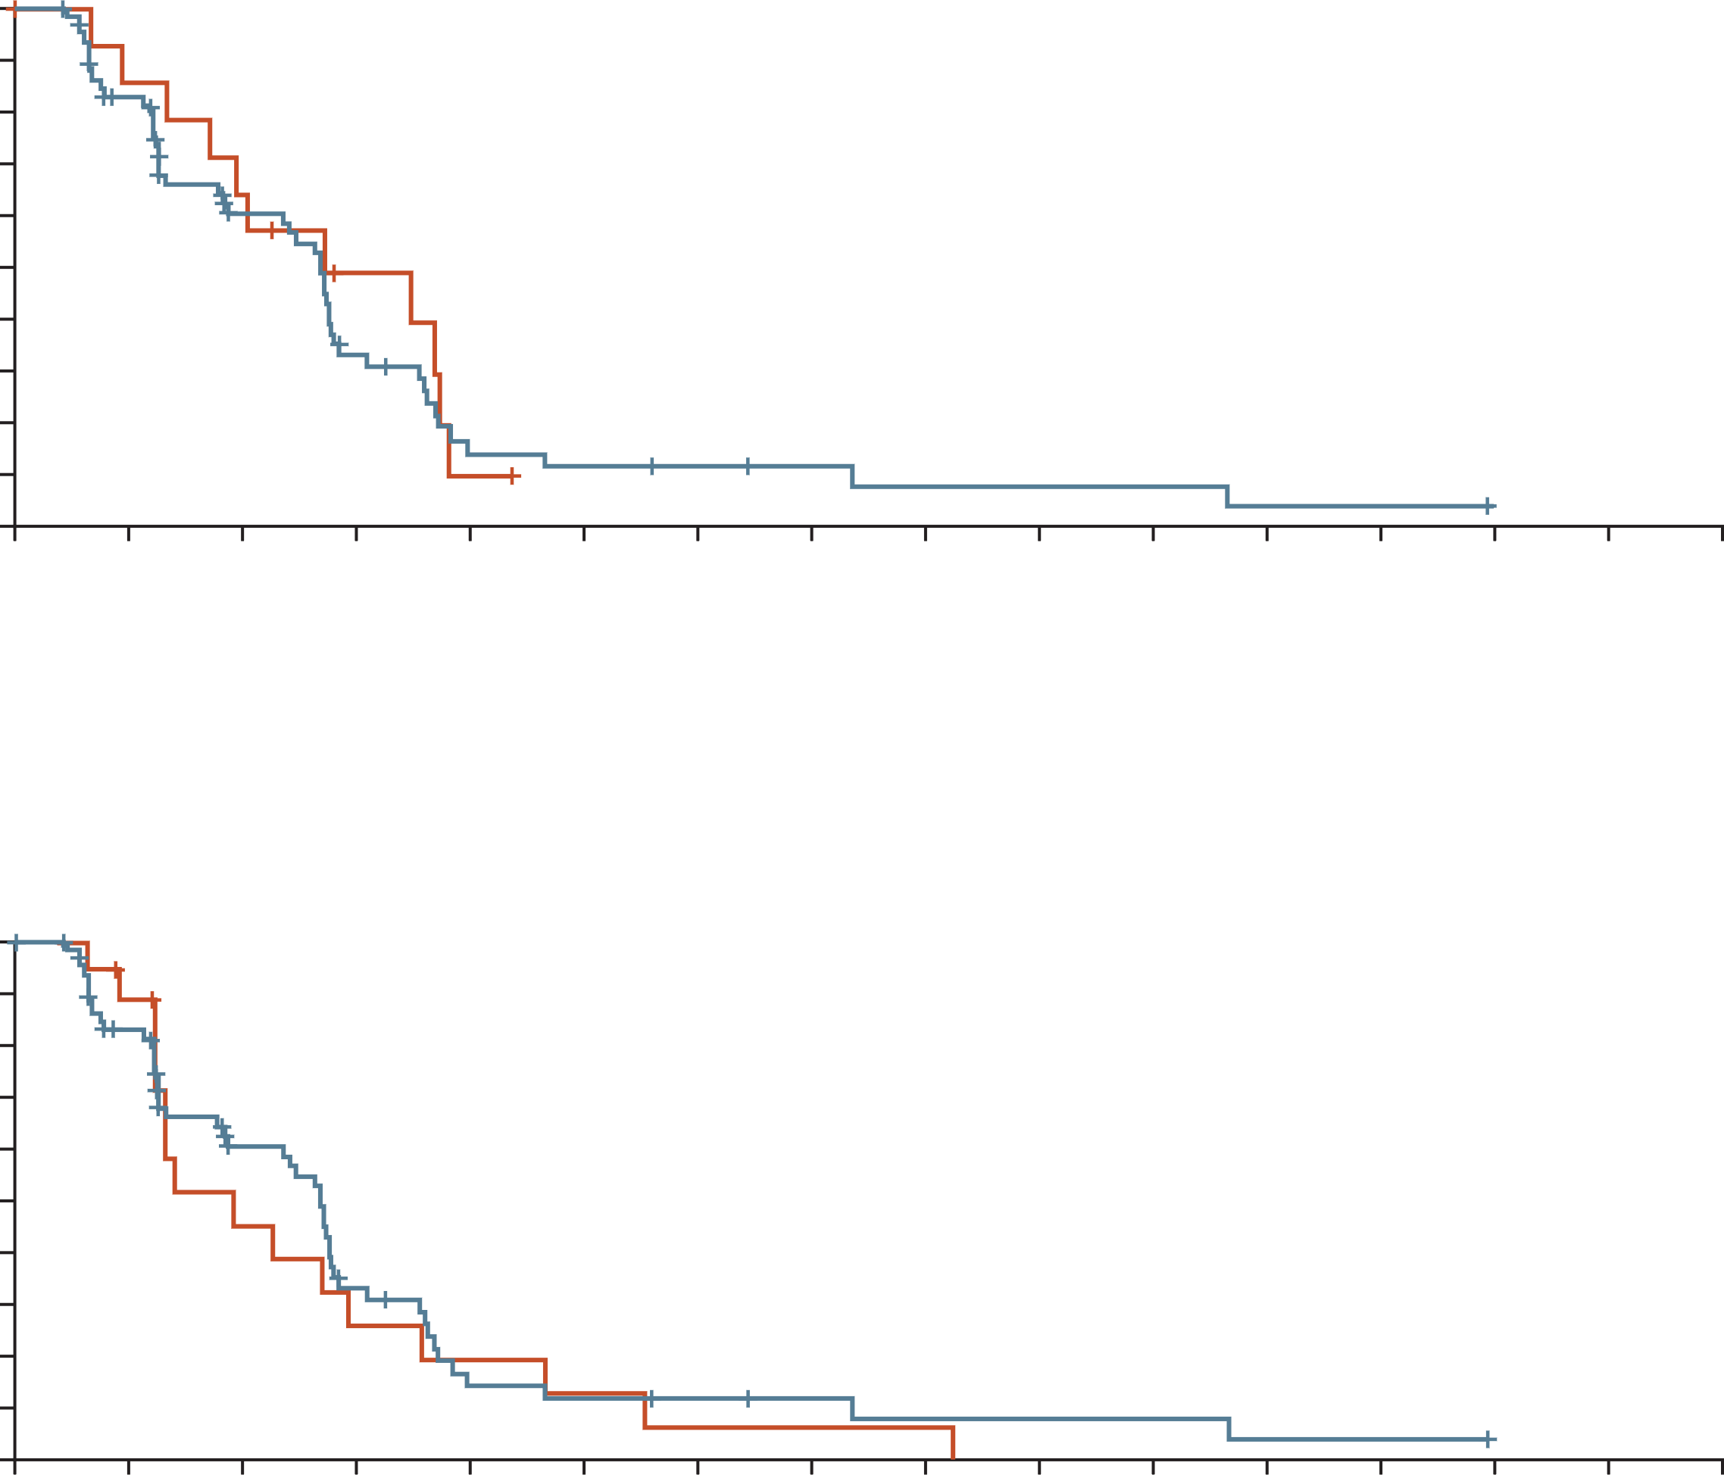
TRITON3 Study: Rucaparib vs Physician’s Choice in Patients with BRCA1/2 or ATM Alterations
Rucaparib vs. docetaxel in the BRCA subgroup
Rucaparib vs. docetaxel in the ATM subgroup
100
 | Rucaparib | Docetaxel
Median PFS (95% CI) mos | 11.2 (9.2-13.8) | 8.3 (6.1-9.9)
HR (95% CI) | 0.53 (0.37-0.77)
100
 | Rucaparib | Docetaxel
Median PFS (95% CI) mos | 8.1 (5.5-8.3) | 8.1 (4.0-11.1)
HR (95% CI) | 1.10 (0.57-2.11)
90
90
80
80
70
70
60
60
Percentage of patients with
progression-free survival
Progression-free survival
by independent
radiographic review (%)
50
50
40
40
30
Rucaparib
30
20
20
Docetaxel
Rucaparib
10
Docetaxel
10
0
0
3
6
9
12
15
18
21
24
27
30
33
36
39
42
45
0
0
3
6
9
12
15
18
21
24
27
30
33
36
39
42
45
No. at risk (no. of events)
Rucaparib
Docetaxel
Months
No. at risk (no. of events)
Rucaparib
Docetaxel
Months
201 (0) | 169 (18) | 124 (44) | 83 (70) | 55 (89) | 41 (95) | 27 (103) | 16 (109) | 13 (110) | 10 (112) | 7 (113) | 6 (113) | 3 (115) | 2 (115) | 2 (115) | 0 (115)
60 (0) | 44 (10) | 32 (18) | 14 (29) | 6 (36) | 2 (38) | 1 (38) | 0 (39)
69 (0) | 51 (11) | 31 (24) | 16 (38) | 6 (46) | 5 (47) | 4 (47) | 3 (47) | 2 (48) | 2 (48) | 2 (48) | 1 (49) | 1 (49) | 0 (49)
15 (0) | 12 (2) | 9 (5) | 5 (7) | 1 (11) | 0 (11)
Rucaparib vs. second-generation ARPI therapies in the BRCA subgroup
Rucaparib vs. second-generation ARPI therapies in the ATM subgroup
100
 | Rucaparib | 2nd-gen ARPI
Median PFS (95% CI) mos | 11.2 (9.2-13.8) | 4.5 (3.3-5.8)
HR (95% CI) | 0.38 (0.25-0.58)
100
 | Rucaparib | 2nd-gen ARPI
Median PFS (95% CI) mos | 8.1 (5.5.-8.3) | 5.7 (3.7-8.7)
HR (95% CI) | 0.82 (0.47-1.45)
90
90
80
80
70
70
60
60
Percentage of patients with
progression-free survival
Progression-free survival
by independent
radiographic review (%)
50
50
40
40
30
Rucaparib
30
20
20
Rucaparib
10
Second-generation ARPI
10
Second-generation ARPI
0
0
3
6
9
12
15
18
21
24
27
30
33
36
39
42
45
0
0
3
6
9
12
15
18
21
24
27
30
33
36
39
42
45
No. at risk (no. of events)
Rucaparib
2nd-gen ARPI
Months
No. at risk (no. of events)
Rucaparib
2nd-gen ARPI
Months
201 (0) | 169 (18) | 124 (44) | 83 (70) | 55 (89) | 41 (95) | 27 (103) | 16 (109) | 13 (110) | 10 (112) | 7 (113) | 6 (113) | 3 (115) | 2 (115) | 2 (115) | 0 (115)
41 (0) | 25 (11) | 10 (24) | 5 (26) | 3 (28) | 2 (28) | 2 (28) | 2 (28)
69 (0) | 51 (11) | 31 (24) | 16 (38) | 6 (46) | 5 (47) | 4 (47) | 3 (47) | 2 (48) | 2 (48) | 2 (48) | 1 (49) | 1 (49) | 0 (49)
19 (0) | 16 (2) | 7 (9) | 4 (12) | 3 (13) | 2 (14) | 1 (15) | 1 (15) | 1 (15) | 0 (16)
ARPI, androgen receptor pathway inhibitor; ATM, ataxia telangiectasia mutated; BRCA(1/2), breast cancer gene (1/2); CI, confidence interval; HR, hazard ratio; PFS, progression-free survival
Fizazi K, et al. N Engl J Med. 2023;388(8):719-732 (including supplementary appendix)

Slide 86
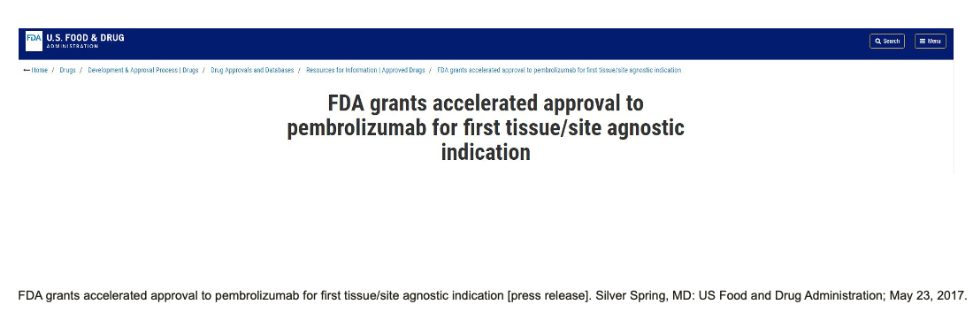
Pembrolizumab: Approved for MSI-H, TMB ≥10, and MSH/dMMR mutations
dMMR, deficient DNA mismatch repair; FDA, Food and Drug Administration; MSH, MutS protein homolog; MSH, mismatch repair genes; MSI-H, microsatellite instability high; TMB, tumour mutational burden
FDA grants accelerated approval to pembrolizumab for first tissue/site agnostic indication [press release]
Silver Spring, MD: US Food and Drug Administration; May 23, 2017; Pembrolizumab Prescribing Information, March 2024

Slide 87
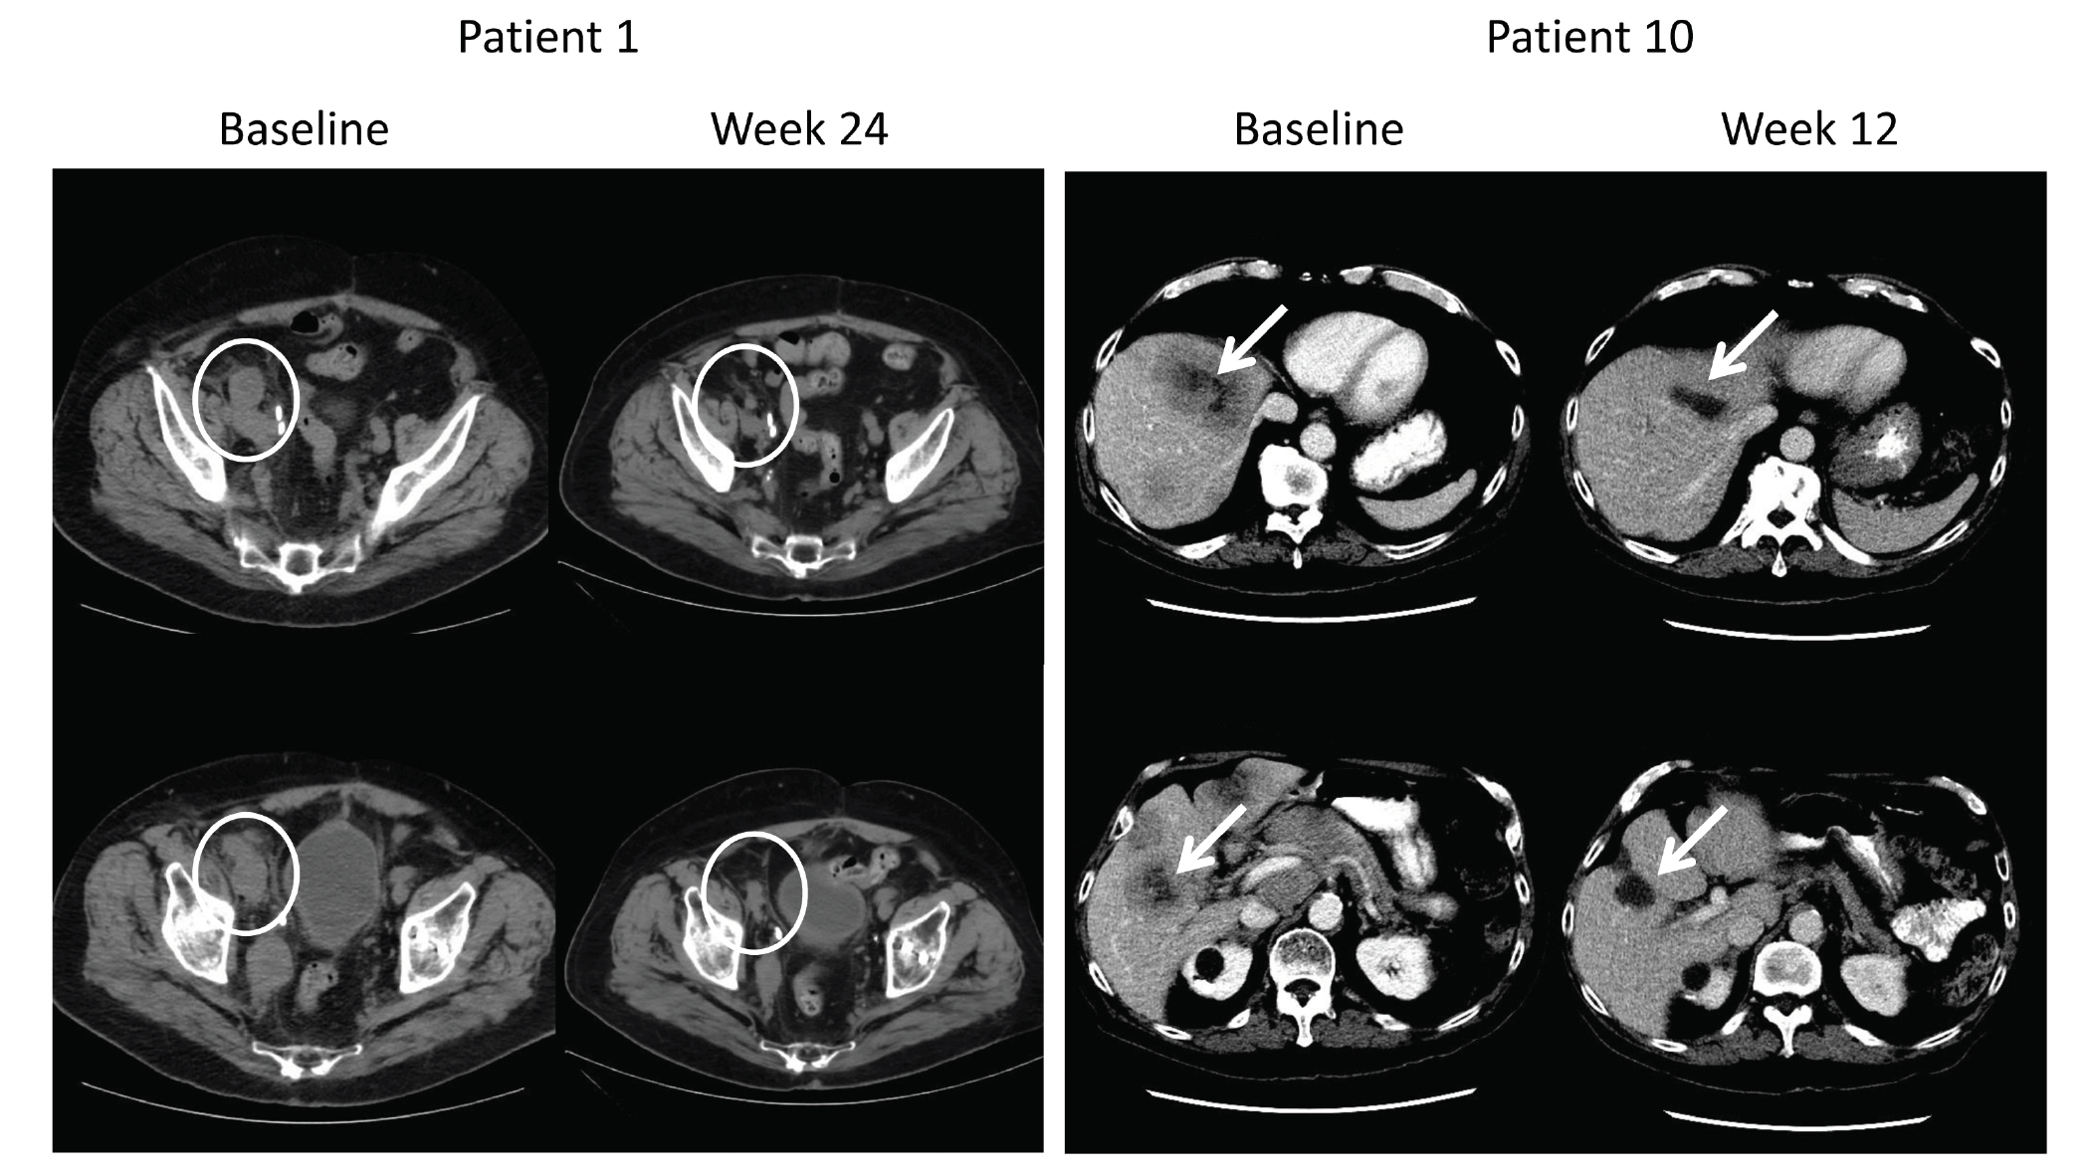
Pembrolizumab: Consider for MSI-H, TMB >10, and MSH/MLH mutations
Approximately 2-3% of men with prostate cancer have MSI-H tumours (left)^{1,2} and can have radiographic responses to pembrolizumab (right)³
MLH, MutL homolog; MSH, MutS protein homolog; MSI-H, microsatellite instability high; mut/Mb, mutations per megabase; TMB, tumour mutational burden
1. Abida W, et al. JAMA Oncol. 2019;5(4):471-478; 2. Abida W, et al. J Clin Oncol 2018; 36 (15)_Suppl: 5020; 3. Graff J, et al. Oncotarget. 2016;7(33):52810-52817

Slide 88
Combination PARPi Data in mCRPC
mCRPC, metastatic castration resistant prostate cancer; PARPi, poly-ADP ribose polymerase inhibitor

Slide 89
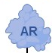
Interactions between PARP signaling and AR signaling
PARP and AR are important for DNA repair in prostate cancer
PARP
PARP activity facilitates repair
of DNA single-strand breaks
DNA damage
(single- and double-strand breaks)
AR
AR binds DNA and facilitates
repair through multiple pathways
three non-redundant DNA repair mechanisms that involve AR and PARP
PARP
DNA repair
AR
PARP enables AR binding to damaged DNA
Inhibition of PARP and AR in combination results in more DNA damage in AR-driven cancer cells
PARPi
AR
NHA
e.g. abiraterone
PARPi
PARP
PARPi
PARP trapping
PARP
accumulation of DNA double-strand breaks
Increased DNA damage and anti-prostate cancer efficacy
DNA single-strand breaks
Inhibition of AR DNA binding and repair
AR, androgen receptor; DNA, deoxyribonucleic acid; NHA, novel hormonal agent; PARP, poly(ADP-ribose) polymerase
Chaudhuri AR, et al. Nat Rev Mol Cell Biol. 2017;18:610-21; 2. Polkinghorn WR, et al. Cancer Discov. 2013;3:1245-53; 3. Lord CJ, et al. Science 2017;355:1152-8;
4. Pommier Y, et al. Sci Transl Med 2016;8:p362ps17; 5. Schiewer MJ, et al. Cancer Discov. 2012;2:1134-49; 6. Asim M, et al. Nat Commun. 2017;8:374;
7. Li L, et al. Sci Transl Med. 2017;10:10.1126/scisignal.aam7479; 8. Clarke N, et al. GU ASCO 2023; 9. Clarke N, et al. NEJM Evidence 2022.EVIDoa2200043

Slide 90
rPFS across AR-PARP Inhibitor Combination trials (Primary Endpoint)
*
 | Primary endpoint analysis | TALAPRO-2 (BICR)¹ |  |  | PROpel (invest. review)^{2,3} |  | Magnitude (BICR)⁴
 |  | TALA+ ENZA | Placebo+ ENZA |  | OLA+ ABI | Placebo+ ABI | NIRA+ ABI | Placebo+ ABI
All comers/unselected | n | 402 | 403 |  | 399 | 397 | Not applicable
 | Median rPFS, mo | Not reached | 21.9 |  | 24.8 | 16.6
 | HR | 0.63 |  |  | 0.66
HRR deficient | n | 85 | 84 |  | 111 | 115 | 212 | 211
 | Median rPFS, mo | 27.9 | 16.4 |  | Not reached | 13.9 | 16.5 | 13.7
 | HR | 0.46 |  |  | 0.50 |  | 0.73
HRR non-deficientª | n | 198 | 214 |  | 279 | 273 | 117 | 116
 | Median rPFS, mo | Not reached | 22.1 |  | 24.1 | 19.0 | NA | NA
 | HR | 0.66 |  |  | 0.76 |  | (1.09)
BRCAm | n | 27 | 32 | 32 | 47 | 38 | 113 |  | 112
 | Median rPFS, mo | Not reported | Not reported | Not reported | Not reached | 8.4 | 16.6 |  | 10.9
 | HR | 0.23 |  |  | 0.23 |  | 0.53
Non-BRCAm | n | 58 |  | 52 | 343 | 350 | 99 |  | 99
 | Median rPFS, mo | Not reported |  | Not reported | 24.1 | 19.0 | 14.8 |  | 16.4
 | HR | 0.66 |  |  | 0.76 |  | 0.99
ªin TALAPRO-2 determined by prospective tumour tissue testing. Please note that these studies cannot be directly compared. The data are presented for information purposes only
ABI, abiraterone acetate; AR, androgen receptor; BICR, blinded independent central review; BRCAm, breast cancer gene mutation; CI, confidence interval; ENZA, enzalutamide; HR, hazard ratio; HRR, homologous recombination repair; mo, months; NIRA, niraparib; OLA, olaparib; PARP, poly-ADP ribose polymerase; rPFS, radiographic progression-free survival; TALA, talazoparib
1. Agarwal A, et al. The Lancet 2023: https://doi.org/10.1016/S0140-6736(23)01055-3; 2. Clarke N, et al. NEJM Evidence 2022; 1(9): DOI: 10.1056/EVIDoa2200043; 3. Clarke N, et al. J Clin Oncol 41, 2023 (suppl 6; abstr LBA16) (ASCO GU 2023 oral presentation); 4. Chi K, et al. J Clin Oncol 2023: DOI: 10.1200/JCO.22.01649

Slide 91
mOS across AR-PARP Inhibitor Combination trials
*
 |  | TALAPRO-2 (BICR)¹ |  | PROpel (invest. review)² |  | Magnitude (BICR)^{3,4}
 |  | TALA+ ENZA | Placebo+ ENZA | OLA+ ABI | Placebo+ ABI | NIRA+ ABI | Placebo+ ABI
All comers/unselected | n | 402 | 403 | 399 | 397 | Not applicable
 | Median OS, mo | 36.4 | Not reached | 42.1 | 34.7
 | HR | 0.89 (31% mature) |  | 0.81 (47.9% mature)
HRR deficient | N | Not reported |  | 111 | 115 | 212 | 211
 | Median OS, mo |  |  | Not reached | 28.5 | Not reached | Not reached
 | HR |  |  | 0.66 |  | 0.94 (46.3% mature)
HRR non-deficient | n | Not reported |  | 279 | 273 | Not reported
 | Median OS, mo |  |  | 42.1 | 38.9
 | HR |  |  | 0.89
BRCAm | n | Not reported |  | 47 | 38 | 113 |  | 112
 | Median OS, mo |  |  | Not reached | 23.0 | 29.3 |  | 28.6
 | HR |  |  | 0.29 |  | 0.88
Non-BRCAm | n | Not reported |  | 343 | 350 | Not reported
 | Median OS, mo |  |  | 39.6 | 38.0
 | HR |  |  | 0.91
Please note that these studies cannot be directly compared. The data are presented for information purposes only
ABI, abiraterone acetate; AR, androgen receptor; BICR, blinded independent central review; BRCAm, breast cancer gene mutation; CI, confidence interval; ENZA, enzalutamide; HR, hazard ratio; HRR, homologous recombination repair; mo, months; NA, not applicable (not reported); NIRA, niraparib; OLA, olaparib; PARP, poly-ADP ribose polymerase; rPFS, radiographic progression-free survival; TALA, talazoparib
1. Agarwal A, et al. The Lancet 2023: https://doi.org/10.1016/S0140-6736(23)01055-3 (Data supplement); 2. Clarke N, et al. J Clin Oncol 41, 2023 (suppl 6; abstr LBA16) (ASCO GU 2023 oral presentation); 3. Chi K, et al. J Clin Oncol 2023: DOI: 10.1200/JCO.22.01649; 4. Efstathiou E, et al. J Clin Oncol 41, 2023 (suppl 6; abstr 170) (ASCO GU 2023 oral presentation);

Slide 92


PARP inhibitors are approved in prostate cancer
Olaparib FDA-approved indication¹
Indicated as monotherapy for the treatment of adult patients with mCRPC and HRRm, who have progressed on enzalutamide or abiraterone acetate
In combination with abiraterone and prednisone or prednisolone for the treatment of adult patients with BRCAm mCRPC
Olaparib EMA-approved indication²
Indicated as monotherapy for the treatment of adult patients with mCRPC and a BRCAm, who have progressed on prior therapy, including an NHA
In combination with abiraterone and prednisone or prednisolone for the treatment of adult patients with mCRPC in whom chemotherapy is not clinically indicated
Niraparib FDA-approved indication³
Indicated as a fixed-dose combination of niraparib/abiraterone acetate with prednisone for the treatment of adult patients with BRCAm mCRPC
Niraparib EMA-approved indication⁴
Indicated as a fixed-dose combination of niraparib/abiraterone acetate with prednisone or prednisolone for the treatment of adult patients with mCRPC and BRCA1/2 gene mutations (germline and/or somatic) in whom chemotherapy is not clinically indicated
Rucaparib FDA-approved indication⁵
Indicated as monotherapy for the treatment of adult patients with BRCAm mCRPC who have progressed on AR-directed therapy and a taxaneª
ªRucaparib has no current approval in prostate cancer in Europe
Talazoparib FDA-approved indication
In combination with enzalutamide for the treatment of adult patients with HRRm mCRPC
Talazoparib EMA-approved indication
In combination with enzalutamide for the treatment of adult patients with mCRPC in whom chemotherapy Is not clinically indicated
AR, androgen receptor; BRCAm, breast cancer gene mutation; EMA, European Medicines Agency; FDA, US Food and Drug Administration; HRRm, homologous recombination repair mutation; LHRH, luteinising hormone-releasing hormone; mCRPC, metastatic castration-resistant prostate cancer; NHA, new hormonal agent; PARP, poly-ADP ribose polymerase
1. Lynparza (olaparib) US prescribing information (Sep-2023); 2. Lynparza (olaparib) summary of product characteristics (Mar 2023); 3. FDA approves niraparib and abiraterone acetate plus prednisone for BRCA-mutated metastatic castration-resistant prostate cancer | FDA; 4. https://www.esmo.org/oncology-news/ema-recommends-granting-a-marketing-authorisation-for-akeega-fixed-dose-combinations-of-niraparib-abiraterone-acetate; 5. Rubraca (rucaparib) US prescribing information (Jun 2022); 6. Talzenna (talazoparib) summary of product characteristics (Apr 2024)

Slide 93
Expanding Reach of Combination Approaches
Earlier in Disease
mHSPC: Phase 3 AMPLITUDE
mHSPC: Phase 3 TALAPRO-3
Talazoparib + enzalutamide in mHSPC
Remain on blinded
treatment
Key eligibility criteria:
Adult patients with metastatic prostate adenocarcinoma and confirmed DDR gene alteration
Ongoing ADT for participants who have not undergone bilateral orchiectomy
ECOG PS 0-1
N=~599
Talazoparib 0.5 mg/d (0.35 mg/d if moderate renal impairment) PO + enzalutamide
160 mg/d PO
Follow-up:
Safety: through
28 d after last
dose of study
treatment
Long-term:
every 8 wk
through wk 57,
then every
12 wk until
radiographic
progression
Key eligibility criteria:
Adult patients with prostate adenocarcinoma and deleterious germline or somatic HRR gene alteration
ADT started ≥14 d prior to randomisation and planned continue though treatment phase
N=788
Niraparib 200 mg and abiraterone acetate 1,000 mg (in dual-action formulation) + prednisone 5 mg daily
n=394
Stratification:
Setting (de novo vs relapsed)
Disease volume (high vs low)
Mutational status (BRCA vs non-BRCA
R
1:1
R
1:1
Placebo +
enzalutamide
160 mg/d PO
Abiraterone acetate 1,000 mg
+ prednisone 5 mg daily
n=394
Primary endpoint: Investigator-assessed radiographic PFS
Secondary endpoints: OS, symptomatic PFS, time to
subsequent therapy
Primary endpoint: Radiologic PFS
Secondary endpoints: OS, objective response and DoR in soft-tissue
disease, PSA response, time to PSA progression, time to PFS
ADT, androgen deprivation therapy; BRCA, breast cancer gene; d, day; DDR, DNA damage response; DoR, duration of response; ECOG PS, Eastern Cooperative Oncology Group performance status; HRR, homologous recombination repair; mHSPC, metastatic hormone sensitive prostate cancer; OS, overall survival; PFS, progression free survival; PO, orally; PSA, prostate-specific antigen; R, randomisation; wk, weeks
Clinicaltrials.gov (NCT04497844; NCT04821622); TALAPRO-3 clinical trial protocol: phase III study of talazoparib plus enzalutamide in metastatic castration-sensitive prostate cancer | Future Oncology (futuremedicine.com), Accessed 17-Mar-24

Slide 94
Patient Case continued
Results of genomic testing
Somatic tissue testing of the prostatectomy specimen demonstrated a BRCA2 mutation
Patient results
Tumour type: Prostate acinar adenocarcinoma
4 genomic findings
5 therapies associated with potential clinical benefit
0 therapies associated with lack of response
15 clinical trials
Genomic alterations identified BRCA2 loss PTEN loss exons 2-9
Additional findings† Microsatellite status: MS-Stable Tumour Mutational Burden: TMB-Low; 4 Muts/Mb
Therapeutic implications
Genomic findings detected | FDA-approved therapies (in patient’s tumour type) | FDA-approved therapies (in another tumour type) | Potential clinical trials
BRCA2 loss | None | Niraparib Olaparib Rucaparib | Yes, see clinical trials section
PTEN loss exons 2-9 | None | Everolimus Temsirolimus | Yes, see clinical trials section
Microsatellite status MS-Stable | None | None | None
Tumour Mutational Burden TMB-Low; 4 Muts/Mb | None | None | None
Example genetic testing report
BRCA2, breast cancer gene 2; FDA, US Food and Drug Administration; MS, microsatellite; Muts/Mb, mutations per megabase; PTEN, phosphatase and tensin homolog; TMB, tumour mutational burden
Julika P, et al. Case Rep Oncol 2020; 13: 55-61

Slide 95
Patient Case continued
He now meets criteria for treatment of mCRPC with abiraterone acetate plus prednisone, enzalutamide, docetaxel, olaparib, or PARPi and novel hormonal treatment combination
He and his team consider the options in a shared decision
  He feels strongly that he does not want to lose his hair
  He prefers oral treatment
  He would like to be as aggressive as possible in terms of getting cancer control given the rapid progression to mCRPC
  He likes the idea of targeted therapy for his BRCA2 mutation
BRCA2, breast cancer gene 2; mCRPC, metastatic castration resistant prostate cancer; PARPi, poly(ADP-ribose) polymerase inhibitor

Slide 96
Patient Case continued
After considering his options, he proceeds with treatment with abiraterone acetate plus olaparib
He favoured the combination of an oral option, aggressiveness against the BRCA2 target, and no hair loss
He feels improvement in fatigue, and tolerates treatment well
PSA decreased in 8 weeks (PSA 4.23 → 1.67 ng/mL)
BRCA2, breast cancer gene 2; PSA, prostate specific antigen

Slide 97
Conclusions
Germline testing in patients with advanced prostate cancer can be used to identify patients whose families need cascade testing
Multiple options for testing are available
  Somatic testing using primary prostatectomy tissue, prostate biopsy, metastatic biopsy,
  or ctDNA testing
  Germline testing with buccal swab or plasma testing
Genetic testing in patients with advanced prostate cancer may identify patients for highly effective targeted agents
  Germline and somatic genetic testing are may identify patients who are eligible for
  treatment with PARPi and pembrolizumab
  Both forms of genetic testing are recommended
ctDNA, circulating tumour DNA; PARPi, poly(ADP-ribose) polymerase inhibitor

Slide 98
Addressing the challenges of biomarker testing in prostate cancer
Q&A Session

Slide 99
Panel discussion and audience questions

Slide 100
Future perspectives and summary
Fernando López-Ríos MD, PhD
Department of Pathology
Hospital Universitario 12 de Octubre
Madrid, Spain

Slide 101
FINAL COMMENTS
Molecular testing is now standard of care
  Preserve and prioritise tissue
  A more comprehensive perspective of predictive biomarker testing
Lung
  Organise your testing strategy: upfront NGS versus sequential testing
  Patient-centered workflows: reflex testing and integrate liquid biopsies
Prostate
  Importance of HRR mutations and MSI-H
  Germline and somatic testing are recommended

