Slide 2
Interpreting real-world evidence in later line mCRC
Prof. Shubham Pant, Medical Oncologist
MD Anderson Cancer Centre, Houston, TX, USA
Prof. Tanios Bekaii- Saab, Medical Oncologist
Mayo Clinic, Phoenix, AZ, USA
APRIL 2024
mCRC, metastatic colorectal cancer

Slide 3

Developed by GI COnnect
This programme is developed by GI CONNECT,
an international group of experts in the field
of gastrointestinal oncology.
Acknowledgement and disclosures
This GI CONNECT programme is supported through an independent educational grant from Bayer. The programme is therefore independent, the content is not influenced by the supporter and is under the sole responsibility of the experts.
Please note: The views expressed within this programme are the personal opinions of the experts. They do not necessarily represent the views of the experts’ institutions, or the rest of the GI CONNECT group.
Expert disclosures:
Prof. Tanios Bekaii-Saab has received financial support/sponsorship for research support, consultation, or speaker fees from the following companies:
  Research Funding (to institution): Agios, Arys, Arcus, Atreca, Boston Biomedical, Bayer, Eisai, Celgene, Lilly, Ipsen, Clovis, Seattle Genetics, Genentech, Novartis, Mirati, Merus, Abgenomics, Incyte, Pfizer, BMS. Consulting (to institution): Servier, Ipsen, Arcus, Pfizer, Seattle Genetics, Bayer, Genentech, Incyte, Eisai, Merus, Merck KGaA and Merck. Consulting (to self): Stemline, AbbVie, Blueprint Medicines , Boehringer Ingelheim, Janssen, Daiichi Sankyo, Natera, TreosBio, Celularity, Caladrius Biosciences, Exact Science, Sobi, Beigene, Kanaph, AstraZeneca, Deciphera, Zai Labs, Exelixis, MJH Life Sciences, Aptitude Health, Illumina, Foundation Medicine and Sanofi. Glaxo SmithKline , Xilio. IDMC/DSMB: The Valley Hospital, Fibrogen, Suzhou Kintor, AstraZeneca, Exelixis, Merck/Eisai, PanCan and 1Globe. Scientific Advisory Board: Imugene, Immuneering, Xilis, Replimune, Artiva and Sun Biopharma. Royalties: Uptodate. Inventions/Patents: WO/2018/183488: HUMAN PD1 PEPTIDE VACCINES AND USES THEREOF – Licensed to Imugene, WO/2019/055687: METHODS AND COMPOSITIONS FOR THE TREATMENT OF CANCER CACHEXIA – Licensed to Recursion
Prof. Shubham Pant has received financial support/sponsorship for research support, consultation, or speaker fees from the following companies:
  Consulting or advisory Role: Zymeworks, Ipsen, Novartis, Janssen, AskGene Pharma, BPGBio, Jazz, AstraZeneca, Boehringer Ingelheim, USWorldmeds, Nihon Medi-Physics Co, Ltd, Alligator Bioscience, Theriva Biosciences. Research funding (funding to institution): Mirati Therapeutics, Lilly, Xencor, Novartis, Bristol-Myers Squibb, Astellas, Framewave, 4D Pharma, Boehringer Ingelheim, NGM Pharmaceuticals, Janssen, Arcus, Elicio, Biontech, Ipsen, Zymeworks, Pfizer, ImmunoMET, Immuneering, Amal Therapeutics.

Slide 4


This programme has been developed by the following experts
Prof. Tanios Bekaii-Saab
Mayo Clinic, USA
Prof. Shubham Pant
MD Anderson Cancer Centre, USA

Slide 5
Educational Objectives
Understand how real-world evidence can complement data obtained from randomised controlled trials
Know the benefits and limitations of real-world evidence
Review recent RWE data for mCRC and understand its implications for clinical practice
mCRC, metastatic colorectal cancer; RWE, real-world evidence

Slide 6
Clinical takeaways
Randomised clinical trials are the gold standard to determine causal effect and help guide clinical practice, but do not represent patients in routine clinical practice
Real-world evidence can augment traditional clinical data by providing useful efficacy and safety information of treatments in patients representative of those in clinical practice
However, we need to be mindful of the limitations and potential biases that might arise from real-world data collection and analysis methods

Slide 7
Utility of Real-World Evidence

Slide 8
What is RWD and RWE?
Real-world data (RWD)
Data relating to patient health status and/or the delivery of health care routine collected from electronic health records (EHRs), claims databases, registries, PROs and devices, etc.
Data that are collected outside of a clinical trial.
Real-world evidence (RWE)
Clinical evidence about the usage and potential benefits or risks of a medical product derive from analysis of RWD
Data
science
Analysis of real-world data, leads to real-world evidence
PRO, patient reported outcomes; RWD, real-world data; RWE, real-world evidence
NICE real-world evidence framework summary. Accessed 01-Apr-24; Saesen R, et al. Eur J Cancer 2023;186:52-61; Khosla S, et al. F1000Res. 2018;7:111; Castelo-Branco L, et al. Ann Oncol. 2023;34:1097-1112

Slide 9








There are multiple Sources of Real-world data
EHRs^{3,4}
Patient
Registries^{1,3,4}
Hospital data^{1,3,4}
Real-world data sources¹
Pharmacy
data¹
Laboratory/
biomarker data^{1,6}
Patient-reported outcomes^{5,6}
Health
insurance
claims data^{3,4}
Adapted from: CHCUK¹
Consumer
data¹
EHR, electronic health record
1. China – Key Considerations in Using Real-World Evidence to Support Drug Development. https://www.chcuk.co.uk/china-key-considerations-in-using-real-world-evidence-to-support-drug-development/. Accessed 15-Apr-2024; 2. NICE real-world evidence framework summary. Accessed 15-Apr-24; 3. Saesen R, et al. Eur J Cancer. 2023;186:52-61; 4. Khosla S, et al. F1000Res. 2018;7:111; 5. Castelo-Branco L, et al. Ann Oncol. 2023;34:1097-1112; 6. Moss B, et al. Future Oncol. 2023;19:1811-1823

Slide 10





How can RWD and RWE be used?
More effective reimbursement based on the value of medicines
Optimisation of patient management (e.g., tailoring treatments in subpopulations)
HCPs
Payors
Access to most appropriate treatment based on evidence generated from both clinical trials and the real world
Patients
Generating new targets that direct R&D towards areas of unmet need
R&D
Regulators
Supplemental/confirmatory understanding of the potential impact and outcomes of treatment (efficacy and safety)
HCP, healthcare professional; R&D, research and development; RWD, real-world data; RWE, real-world evidence
Khosla S, et al. F1000Res. 2018;7:111

Slide 11
Clinical trials versus Real-World Evidence
Clinical Trials
Real-World Practice
RCT | RWE
“Gold standard” for determining cause-effect relationship of treatment and outcome¹ | Can provide insights into patient populations underrepresented in RCTs³
Prospective¹ | Prospective or retrospective²
Interventional (fixed treatment protocol)² | Observational (flexible regimen)²
Randomised to minimise bias² | Not usually randomised⁴
Control and experimental arms² | May or may not have a control arm²
Homogenous/highly selected study group – not representative of patients in routine practice¹ | Heterogenous/real-world study group⁴
RCT, randomised clinical trial; RWE, real-world evidence
1. Tang M, et al. Curr Oncol. 2023;30:1844-1859; 2. Moss B, et al. Future Oncol. 2023;19:1811-1823; 3. European Medicines Agency and Heads of Medicines Agencies. https://www.ema.europa.eu/en/documents/report/european-union-medicines-agencies-network-strategy-2025-protecting-public-health-time-rapid-change_en.pdf. Accessed 15-Apr-2024; 4. Di Maio M, et al. Oncologist. 2020;25:e746-e752

Slide 12





How RWE might Influence HCP decision-making
Optimise patient management in clinical practice: Real-life use of drugs, impact of any associated comorbidities, help identify patient subgroups that may be more likely to benefit
Pharmacovigilance: Characterise rare or long-term toxicities
Access to most appropriate treatment: Based on evidence generated from
RCTs and RWE
Adherence: RWE could show that an oral formulation is associated with a
higher proportion of days covered than an injectable
Long-term efficacy: RWE can show that effects of one treatment do not last
as long as another
HCP, healthcare professional; RCT, randomised controlled trial; RWE, real-world evidence
Khosla S, et al. F1000Res. 2018;7:111; Essentials of Real World Evidence, Medical Affairs Professional Society 2020, available from: https://medicalaffairs.org/essentials-real-world-evidence/

Slide 13
LIMITATIONS
Considerations and challenges of rwe
MITIGATING SOLUTIONS
There are several limitations associated with the use of real-world data that need to be considered^{1,2,4}
  Variability in data from multiple sources can increase the heterogeneity of the results^{1,4}
  Susceptibility to confounding bias due to lack of randomisation^{2,4,5}
  Bias due to variability in the quality of the data and in the handling of missing data³⁻⁵
Transparency in reporting methodology
and data source(s)²⁻⁴
Use best methodologic standards, including strategies for handling missing values and adjusting for confounding factors (e.g., propensity score matching)^{3,4}
Follow best practice guidelines in
planning and reporting²
RWE, real-world evidence
1. Saesen R, et al. Eur J Cancer. 2023;186:52-61; 2. Khosla S, et al. F1000Res. 2018;7:111; 3. Castelo-Branco L, et al. Ann Oncol. 2023;34:1097-1112;
4. Cave A, et al. Clin Pharmacol Ther. 2019;106:36-39; 5. Tang M, et al. Curr Oncol. 2023;30:1844-1859

Slide 14
Later-line clinical trial data for mCRC
mCRC, metastatic colorectal cancer

Slide 15
CORRECT Study: Regorafenib vs placebo PROLONGED PFS AND OS in refractory mCRC patients
PROGRESSION-FREE SURVIVAL
OVERALL SURVIVAL
100
Regorafenib
Placebo
100
Regorafenib
Placebo
75
75
HR 0.77, 95% CI 0.64-0.94, P=0.0052
50
HR 0.49, 95% CI 0.42-0.58, P<0.0001
50
Progression-free survival (%)
Overall survival (%)
25
25
0
0
2
4
6
8
10
12
0
0
2
4
6
8
10
12
14
Number at risk
Regorafenib
Placebo
Months after randomisation
Number at risk
Regorafenib
Placebo
Months after randomisation
238
51
98
9
42
2
12
2
3
0
452
221
352
150
187
75
93
32
33
9
7
3
PFS: 1.9 mo vs. 1.7 mo (HR 0.49; p<0.0001)
OS: 6.4 mo vs. 5.0 mo (HR 0.77; p= 0.0052)
Tumour response:
ORR: 1.0% vs. 0.4% (p=0.19)
DCR: 41% vs. 15% (p<0.0001)
CI, confidence interval; DCR, disease control rate; HR, hazard ratio; mCRC, metastatic colorectal cancer; mo, months; ORR, objective response rate; OS, overall survival; PFS, progression free survival
Grothey A, et al. Lancet. 2013;381:303-12

Slide 16
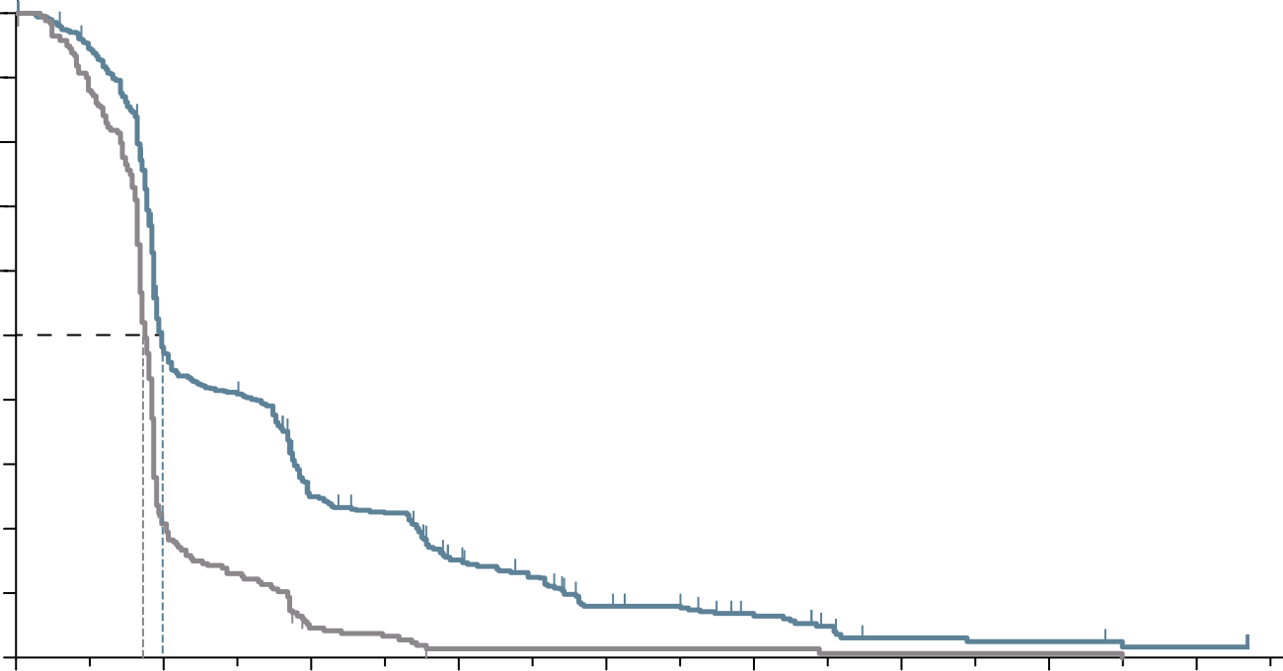
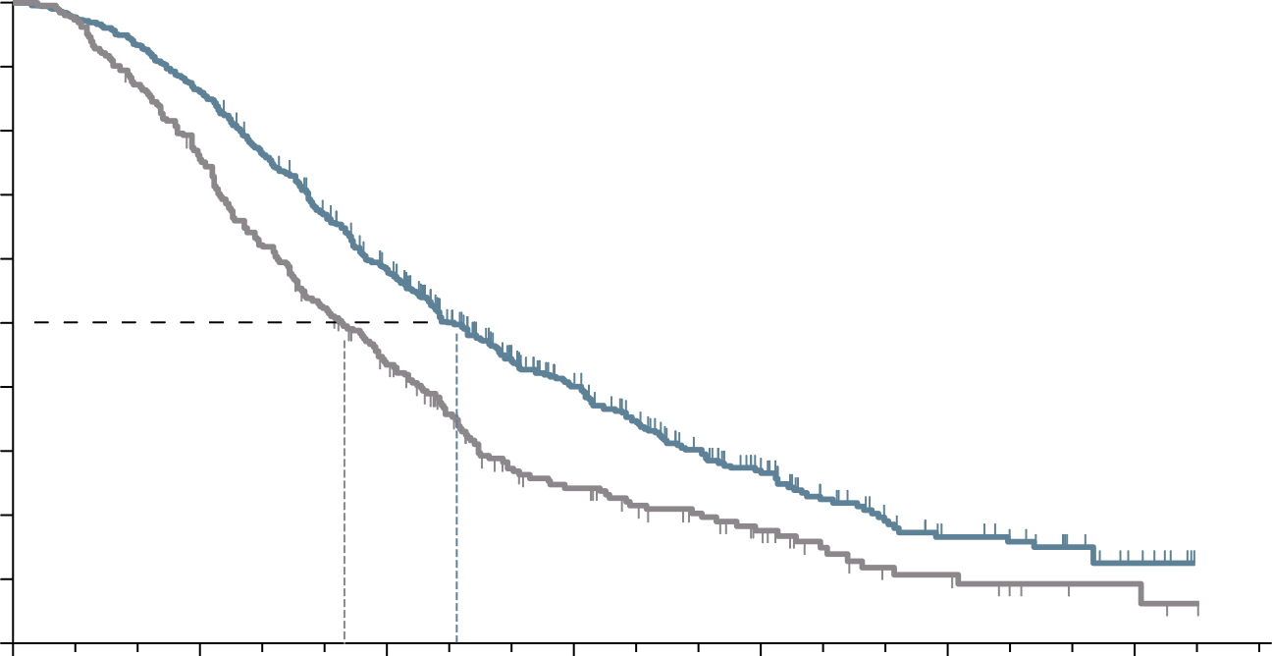
RECOURSE Study: trifluridine/tipiracil PROLONGED PFS AND OS in refractory mcrc patients
PROGRESSION-FREE SURVIVAL
OVERALL SURVIVAL
100
100
90
90
80
Hazard ratio for progression or death, 0.48 (95% CI, 0.41-0.57)
P<0.001 by log-rank test
80
Hazard ratio for death, 0.68 (95% CI, 0.58-0.81)
P<0.001
70
70
60
60
50
50
Progression-free survival (%)
Overall survival (%)
40
40
30
Trifluridine/Tipiracil
30
Trifluridine/Tipiracil
20
20
10
Placebo
10
Placebo
0
0
2
4
6
8
10
14
16
0
0
3
6
9
12
15
18
Months after randomisation
Months after randomisation
Number at risk
Trifluridine/Tipiracil
Placebo
Number at risk
Trifluridine/Tipiracil
Placebo
534
266
238
51
121
10
66
2
30
2
18
2
5
1
4
1
2
0
534
266
459
198
294
107
137
47
64
24
23
9
7
3
PFS: 2.0 mo vs. 1.7 mo (HR 0.48; p<0.001)
OS: 7.1 mo vs. 5.3 mo (HR 0.68; p<0.001)
Tumour response:
ORR: 1.6% vs. 0.4% (p=0.29)
DCR: 44% vs. 16% (p<0.001)
CI, confidence interval; DCR, disease control rate; HR, hazard ratio; mCRC, metastatic colorectal cancer; mo, months; ORR, objective response rate; OS, overall survival; PFS, progression free survival
Mayer RJ, et al N Engl J Med. 2015;372:1909-19

Slide 17
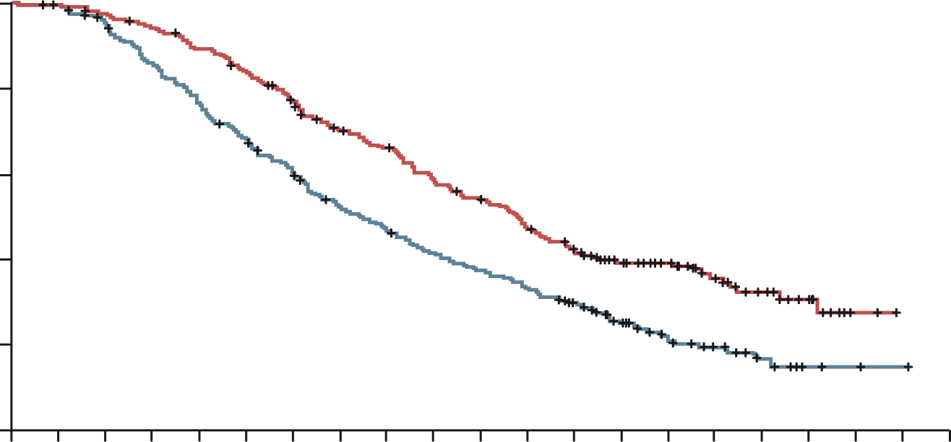
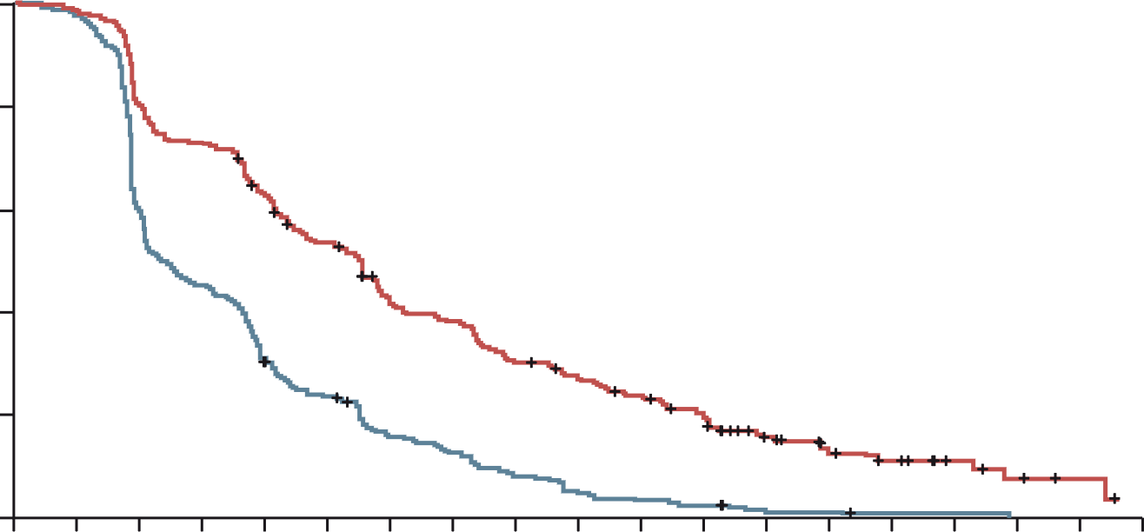
Sunlight: Trifluridine/Tipiracil plus bevacizumab improves outcomes in refractory mcrc
Trifluridine/Tipiracil plus bevacizumab improved OS and PFS in refractory CRC patients
Overall survival (primary endpoint)
Progression-free survival
 | FTD–TPI + Bev (N=246) | FTD–TPI (N=246)
Median OS, months | 10.8 | 7.5
6-month OS rate, % | 77 | 61
12-month OS rate, % | 43 | 30
 | FTD–TPI + Bev (N=246) | FTD–TPI (N=246)
Median PFS, months | 5.6 | 2.4
6-month PFS rate, % | 43 | 16
12-month PFS rate, % | 16 | 1
100
100
80
80
FTD–TPI + Bev group
FTD–TPI group
60
60
Overall Survival (%)
Progression-free survival (%)
HR, 0.44 (95% CI, 0.36-0.54)
p<0.001
40
40
FTD–TPI + Bev group
FTD–TPI group
20
HR, 0.61 (95% CI, 0.49-0.77)
p<0.001
20
0
0
1
2
3
4
5
6
7
8
9
10
11
12
13
14
15
16
17
18
19
20
0
0
1
2
3
4
5
6
7
8
9
10
11
12
13
14
15
16
17
18
No. at risk
FTD–TPI + Bev group
FTD–TPI group
Months
No. at risk
FTD–TPI + Bev group
FTD–TPI group
Months
246
246
244
242
239
230
230
205
217
184
203
163
183
143
160
120
149
108
131
95
119
85
104
76
88
63
69
44
52
24
37
16
24
10
13
5
2
2
0
1
0
0
246
246
242
236
198
147
179
109
153
74
128
56
99
36
89
29
70
19
61
12
52
8
43
6
25
2
18
2
13
1
7
1
4
0
2
0
0
0
Bev, bevacizumab; CI, confidence interval; FTD-TPI, Trifluridine/Tipiracil; HR, hazard ratio; (m)CRC, (metastatic) colorectal cancer; OS, overall survival; PFS, progression-free survival
Tabernero J, et al. J Clin Oncol. 2023;41(suppl 4; abstr 4) (ASCO GI 2023, oral presentation); Prager G, et al. N Engl J Med. 2023; 388:1657-1667

Slide 18
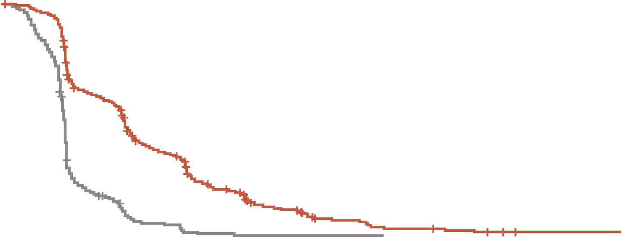
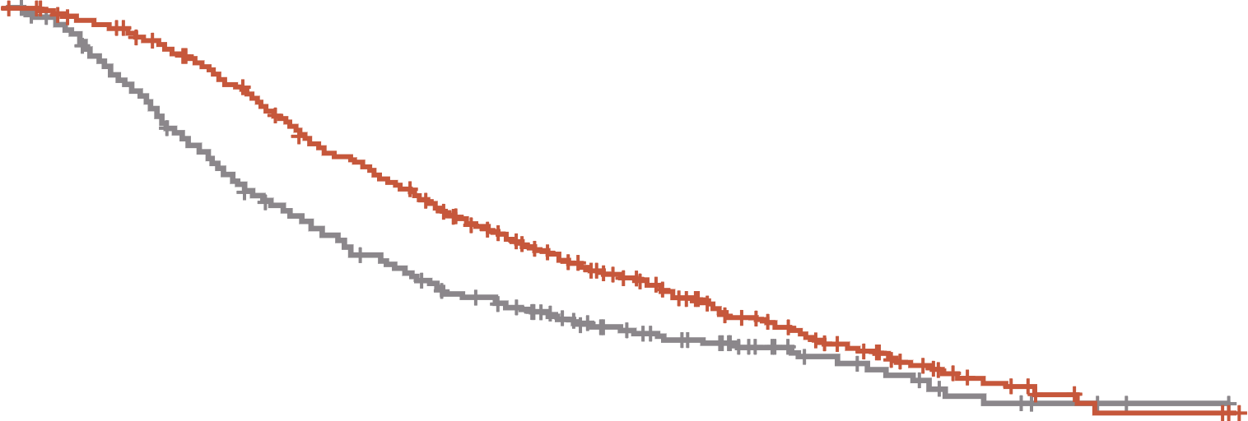
FRESCO-2: Fruquintinib prolonged OS and PFS in patients with refractory mCRC
PROGRESSION-FREE SURVIVAL
OVERALL SURVIVAL
 | Fruquintinib | Placebo
Events/patients (%) | 392/461 (85.0%) | 213/230 (92.6%)
Stratified p-value (log-rank) | <0.001
Stratified HR (95% CI) | 0.321 (0.267, 0.386)
Median (95% CI), months | 3.7 (3.5, 3.8) | 1.8 (1.8, 1.9)
Median PFS difference, months | 1.9
 | Fruquintinib | Placebo
Events/patients (%) | 317/461 (68.8%) | 173/230 (75.2%)
Stratified p-value (log-rank) | <0.001
Stratified HR (95% CI) | 0.662 (0.549, 0.800)
Median (95% CI), months | 7.4 (6.7, 8.2) | 4.8 (4.0, 5.8)
Median OS difference, months | 2.6
1.0
1.0
0.8
0.8
0.6
0.6
Probability of progression‑free survival (%)
Probability of overall survival (%)
Median follow-up:
Fruquintinib: 11.3 mo
Placebo: 11.2 mo
0.4
0.4
0.2
0.2
Fruquintinib + BSC
Placebo + BSC
Fruquintinib + BSC
Placebo + BSC
0
0
0
1
2
3
4
5
6
7
8
9
10
11
12
13
14
15
16
17
18
19
0
1
2
3
4
5
6
7
8
9
10
11
12
13
14
15
16
17
18
19
Time from randomisation (months)
Time from randomisation (months)
Patients at risk
Fruquintinib
Placebo
461
230
430
194
291
60
256
36
170
12
146
10
89
2
71
2
43
1
36
1
21
1
17
1
10
0
9
6
4
2
2
2
Patients at risk
Fruquintinib
Placebo
461
230
449
216
429
184
395
153
349
125
297
105
266
89
224
73
184
63
143
45
113
37
79
31
58
20
41
15
23
10
14
6
7
3
4
2
4
1
0
0
PFS: 3.7 mo vs. 1.8 mo (HR 0.32; p<0.001)
OS: 7.4 mo vs. 4.8 mo (HR 0.66; p<0.001)
Tumour response:
ORR: 1.5% vs. 0.0% (p=0.059)
DCR: 55.5% vs. 16.1% (p<0.001)
BSC, best supportive care; CI, confidence interval; DCR, disease control rate; HR, hazard ratio; mCRC, metastatic colorectal cancer; mo, months; ORR, objective response rate; OS, overall survival; PFS, progression-free survival
Dasari NA, et al. Ann Oncol. 2022;33(suppl_7):S808-S869 (ESMO 2022 oral presentation)

Slide 19
ASCO GI 2024
SELECT later-line
Real-World Data
FOR mCRC
mCRC, metastatic colorectal cancer

Slide 20
Real-world use and outcomes of regorafenib flexible dosing in patients with mCRC in Europe¹
Patients receiving REG flexible dosing regimens (ReDOS-like,² dose-adjusted) had longer DoT compared with a standard dosing regimen despite having a higher frequency of adverse prognostic factors
Study confirms flexible dosing strategies are viable options for optimising REG treatment and outcomes in patients with mCRC
 | Total (N=355) | ReDOS-like (n=173) | Dose-adjusted (n=67) | Standard (n=115)
Stage IVC, n (%) | 181 (51) | 77 (45) | 37 (55) | 67 (58)
ECOG PS 0-1, n (%) | 240 (68) | 112 (65) | 47 (70) | 81 (70)
Metastatic sites ≥3, n (%) | 169 (48) | 77 (45) | 43 (64) | 49 (43)
Liver metastases, n (%) | 302 (85) | 150 (87) | 63 (94) | 89 (77)
Lung metastases, n (%) | 198 (56) | 103 (60) | 39 (58) | 56 (49)
Line of REG = 2-3, n (%) | 294 (83) | 138 (80) | 55 (82) | 101 (88)
Line of REG = ≥4, n (%) | 60 (17) | 35 (20) | 12 (18) | 14 (12)
Median DoT,ª months | 1.4 | 1.4 | 1.9 | 1.0
REG cycles ≥3, n (%) | 252 (71) | 116 (67) | 62 (93) | 74 (64)
ª From REG initiation to last dose date prior to first >2-week gap in patients who were not censored
DoT, duration of treatment; ECOG PS, Eastern Cooperative Oncology Group performance status; mCRC, metastatic colorectal cancer; REG, regorafenib
1. Peeters A, et al. J Clin Oncol. 2024;42 (no. 3_Suppl):47 (Poster presentation); 2. Bekaii-Saab T, et al. Lancet Oncol. 2019;20:1070-1082

Slide 21
Real-world study in patients with mCRC with long‑term responses to regorafenib in the USA
Study used the Flatiron Health Electronic Health Record-derived database in the USA to evaluate characteristics of patients with a long-term response (LTR) to REG using DoT as a surrogate for
treatment response
Characteristics at index | LTR of ≥4 months (n=503) | LTR of ≥5 months (n=346)
Male sex, n (%) | 281 (56) | 185 (53)
ECOG PS 0-1, n (%) | 332 (66) | 237 (68)
Prior BEV, n (%) | 341 (68) | 221 (64)
Median CEA level (IQR), ng/mL | 40 (9, 152) | 35 (9, 139)
KRAS mutation, n (%)ª | 127/234 (54) | 84/164 (51)
BRAF mutation, n (%)ª | 18/319 (6) | 12/219 (5)
Median time from initial CRC diagnosis to index date (IQR), mos | 38.6 (24.8, 62.8) | 39.2 (25.1, 64.1)
Stage IV at initial CRC diagnosis, n (%)^{b} | 241 (48) | 160 (46)
ª Denominator is patients tested at index with available data; ^{b} at diagnosis not index
15% of REG treated patients received treatment for ≥5 months and 22% received treatment for ≥4 months. Patients with LTR5 and LTR4 had similar demographic and clinical characteristics, including favorable ECOG PS and similar biomarker status
BEV, bevacizumab; BRAF, proto-oncogene B-Raf; CEA, carcinoembryonic antigen; DoT, duration of treatment; ECOG PS, Eastern Cooperative Oncology Group performance status; IQR, interquartile range; (m)CRC, (metastatic) colorectal cancer; mos, months; REG, regorafenib; USA, United States of America
Kim RD, et al. J Clin Oncol. 2024;42 (no. 3_Suppl):48

Slide 22
Prospective observational study investigating the impact of treatment sequence using reg and FTD/TPI ± BEV for mCRC on overall survival (OSERO study)
Study demonstrates that OS are comparable regardless of whether REG, FTD/TPI, or FTD/TPI + BEV is administered firstª
Demography | Starting Regimen
 | Cohort A REG N=149 | Cohort B FTD/TPI N=80 | Cohort C FTD/TPI + BEV N=226
Median age, years | 64.0 | 65.5 | 67.0
Male, % | 53.0 | 52.5 | 55.3
ECOG PS 0, % | 52.3 | 31.3 | 48.7
Right-sided tumour, % | 33.6 | 27.5 | 20.4
RAS wild-type, % | 35.6 | 41.3 | 43.4
BRAF V600E mutant, % | 6.7 | 7.5 | 4.0
Outcomes | Starting Regimen
 | Cohort A REG N=149 | Cohort B FTD/TPI N=80 | Cohort C FTD/TPI + BEV N=226
Median OS, months | 11.8 | 7.1 | 10.3
HR (95% CI) p value (comparison with cohort A) |  | 0.72 (0.52-0.99) p=0.043 | 1.03 (0.79-1.33) p=0.828
Patients who received subsequent treatment with FTD/TPI+BEV in cohort A (62.4%), REG in
cohort B (37.5%), REG in cohort C (62.8%)
ª Patients were refractory or intolerant to standard chemotherapies, anti-VEGF or anti-EGFR and who were scheduled to receive REG or FTD/TPI +/- BEV first.
BEV, bevacizumab; BRAF, proto-oncogene B-Raf; CI, confidence interval; ECOG PS, Eastern Cooperative Oncology Group performance status; FTD/TPI, trifluridine/tipiracil; HR, hazard ratio; mCRC, metastatic colorectal cancer; OS, overall survival; REG, regorafenib
Chida A, et al. J Clin Oncol. 2024;42 (no. 3_Suppl):103 (Poster presentation)

Slide 23
Real-world analysis of patient characteristics and outcomes among mCRC patients receiving FTD/TPI plus bev versus FTD/TPI monotherapy
This real-world study supports the value of FTD/TPI+BEV combination therapy
vs FTD/TPI monotherapy as seen in the SUNLIGHT trial
Patients with FTD/TPI+BEV were treated for longer duration with improved OS and no difference in trends for HCRU and associated costs
Demography | FTD/TPI + BEV N=122 | FTD/TPI N=75
Mean age, years | 60.2 | 61.8
Male, % | 66 | 63
Mean Charlson Comorbidity Index | 8.9 | 8.5
Mean BMI, kg/m² | 26.9 | 27.3
Received treatment in 3L/4L setting, % | 65 | 75
Median follow-up, months | 5.3 | 4.6
Characteristic | FTD/TPI + BEV N=122 | FTD/TPI N=75
Mean length of treatment, mo | 3.7 | 2.7
Median OS, mo | 11.5 | 9.6
Mean outpatient visits, n | 20.5 | 13.9
Mean ER visits, n | 0.5 | 0.5
Mean hospitalisations, n | 1.1 | 1.2
Mean healthcare event costs, USD | 27,175 | 27,891
3L/4L, third-/fourth-line; BEV, bevacizumab; BMI, body mass index; ER, emergency room; FTD/TPI, trifluridine-tipiracil; HCRU, healthcare resource use;
mCRC, metastatic colorectal cancer; mo, months; OS, overall survival; USD, United States dollars
Hubbard J, et al. J Clin Oncol. 2024;42 (no. 3_Suppl):34

Slide 24
Summary
RWE is being increasingly used to assist decision-making for regulators, payers, HCPs and patients
Randomised controlled trials remain the ‘gold-standard’ to determine causal effect but RWE can provide complementary data in a patient population more representative of clinical practice
RWD can be collected from a variety of sources, including administrative claims databases, EHRs, registries, and multimodal data sources
Several limitations of RWE (e.g., risk of bias, data quality and confounding factors) must be considered and controlled through statistical and design methodology
Regulatory guidance on the use of RWE will improve the perception of RWE by various stakeholders
Real-world evidence on the use of regorafenib and trifluridine-tipiracil as later-line treatments for mCRC patients generally supports data from RCTs
Additional later-line treatments for molecularly unselected mCRC patients should also be considered, such as fruquintinib
RWE will provide useful information on the use of fruquintinib in routine clinical practice, as it becomes more widely available
EHR, electronic health record; HCP, healthcare professional; mCRC, metastatic colorectal cancer’ RCT, randomised-controlled trial; RWD, real-world data; RWE, real-world evidence

