Slide 2
chronic hypophosphatemia: differential diagnosis in children and adults
An independent hub session
13th May 2024

Slide 3

Developed by COR2ED
COR2ED, develops and implements high quality
Independent Medical Education programmes to
help improve the health of patients globally.
Acknowledgement and disclosures
This Rare Bone Disease ECE Hub session is supported through an independent educational grant from Kyowa Kirin. The programme is therefore independent, the content is not influenced by the supporter and is under the sole responsibility of the experts.
Please note: The views expressed within this programme are the personal opinions of the experts. They do not necessarily represent the views of the experts’ institution, employer, organisation or other group or individual. The patient cases and associated information are used for learning purposes and are a courtesy of the experts.
Expert disclosures:
Prof. Maria Luisa Brandi has received financial support/sponsorship for research support, consultation, or speaker fees from the following companies: Abiogen, Aboca, Alexion, Amgen, Amolyt, Amorphical, Ascendis, Bruno Farmaceutici, Calcilytix, CoGeDi, Echolight, Eli Lilly, Enterabio, Gedeon Richter, Italfarmaco, Kyowa Kirin International, Menarini, Monte Rosa, Personal Genomics, Smoke Free World Foundation, SPA, Takeda, Theramex, UCB.
Prof. Outi Mäkitie has received financial support/sponsorship for consultation or speaker fees from the following companies: Alexion, Ascendis Pharma, BridgeBio Pharma, Kyowa Kirin International, Merck, Sandoz, Ultragenyx Pharmaceutical Inc.

Slide 4


This programme has been developed by two experts
Prof. Maria Luisa Brandi
Endocrinologist
Vita-Salute University, Italy
Prof. Outi Mäkitie
Paediatric Endocrinologist
University of Helsinki, Finland

Slide 5
chronic hypophosphatemia: differential diagnosis in children and adults introduction and common challenges

Slide 6
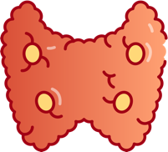
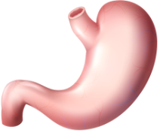
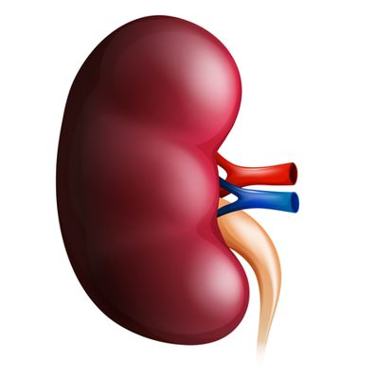
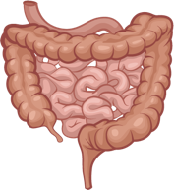

Phosphate homeostasis key players
Parathyroid
glands
Dietary
phosphate intake
1,500 mg/day
PTH
Kidney
Stimulates
PTH
secretion
Npt2a/2c
Extracellular
phosphate
Filtration
Phosphate
absorption
900 mg/day
Intestine
Reabsorption
Formation
Stimulates
FGF23
secretion
Urinary
phosphate
excretion
900 mg/day
Faecal
phosphate
600 mg/day
Bone
Resorption
FGF23
FGF23, fibroblast growth factor 23; Npt2a/2c, sodium-dependent phosphate transport protein 2a/2c; PTH, parathyroid hormone
Adapted from: Komaba H and Fukagawa M. Kidney Int. 2016;90:753-63

Slide 7
hypophosphatemia in children and adults understanding the condition
What is it?
A condition characterised by abnormally low levels of phosphate in the blood, resulting from impaired phosphate regulation, renal dysfunction or genetic disorders
Hypophosphatemia has broad origins:
  FGF23 mediated:
    X-linked hypophosphatemia (XLH): Genetic disorder leading to excessive FGF23 production
    Tumour-induced osteomalacia (TIO): Overproducing FGF23 leading to phosphate wasting
  Non-FGF23 mediated:
    Dietary: Inadequate phosphate intake or malnutrition
    Renal tubular effects: Causing phosphate wasting
    Soft tissue: Alkalosis leading to phosphate shifts
FGF23, fibroblast growth factor 23; TIO, tumour-induced osteomalacia; XLH, X-linked hypophosphatemia

Slide 8
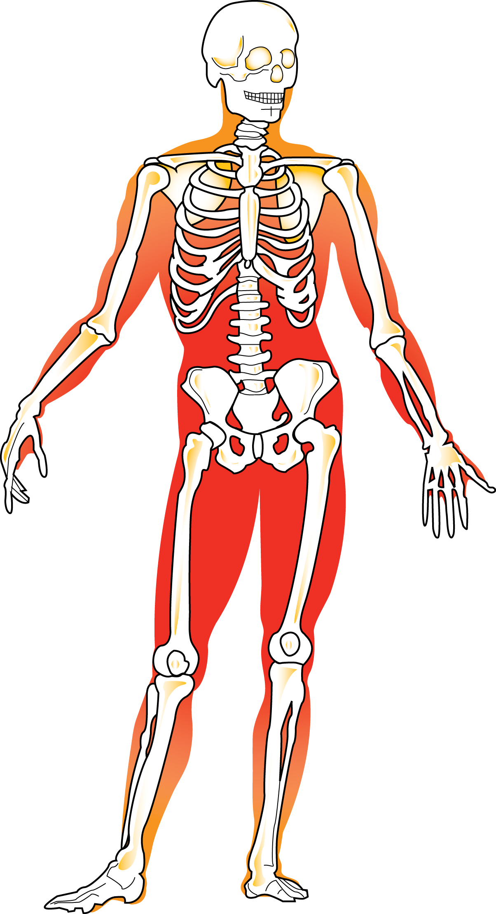

hypophosphatemia in children and adults understanding the condition
What is it?
A condition characterised by abnormally low levels of phosphate in the blood, resulting from impaired phosphate regulation, renal dysfunction or genetic disorders
Chronic hypophosphatemia has a
negative impact on^{1,2}:
  Bone growth and quality
  Muscle structure and function
  Dental mineralisation
1. Glorieux FH, et al. Orphanet J Rare Dis. 2022;17:30; 2. Larsson A, et al. Front Oral Health. 2023;4:1087761

Slide 9

Chronic hypophosphatemia in children and adults challenges in diagnosis
Diagnostic challenges
Chronic hypophosphatemia can be difficult
to diagnose¹:
  Non-specific symptoms
  Overlap with other metabolic disorders
Differential diagnosis is important²
To ensure accurate identification of the primary
aetiology and provide the best possible care for
the patient
Presentation of two patient cases, including polling questions
1. Villa-Suárez JM, et al. Int J Mol Sci. 2021;22:4303; 2. Goyal R and Jialal I. Treasure Island (FL): StatPearls Publishing; 2024 Jan-. Available at https://www.ncbi.nlm.nih.gov/books/NBK551586/

Slide 10
PATIENT CASE 1

Slide 11

Patient case 1
7-year-old girl
SYMPTOMS
Slow growth, otherwise healthy
Limping and difficulty in running
Several dental abscesses, 10 teeth extracted
LAB
Basic laboratory work normal, including complete blood
count and Ca, 25-OHD and PTH
Referred to diagnostic evaluation at 7 years
Ca, calcium; 25-OHD, 25-hydroxyvitamin D; PTH, parathyroid hormone
Information courtesy of Prof. Mäkitie

Slide 12

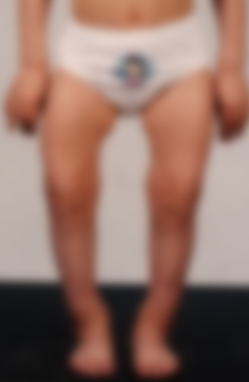
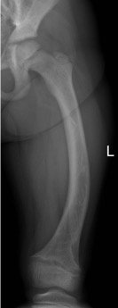
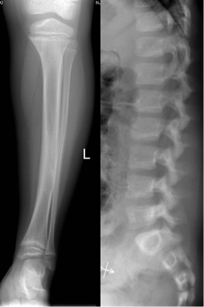
Patient case 1
Short stature (height – 2.9 SDS)
Lower limb deformities
Wide wrists and ankles
Rickets confirmed by radiography
SDS, standard deviation score
Information courtesy of Prof. Mäkitie

Slide 13
Laboratory work
Biochemistry
Normal S-Ca, 25-OHD
Low S-Pi, high U-Pi
High ALP
Normal PTH
Normal 1,25(OH)₂D
1,25(OH)₂D, 1,25-dihydroxyvitamin D; 25-OHD, 25-hydroxyvitamin D; ALP, alkaline phosphatase; PTH, parathyroid hormone; S-Ca, serum calcium;
S-Pi, serum phosphate; U-Pi, urinary phosphate
Information courtesy of Prof. Mäkitie

Slide 14

Polling question 1
Which laboratory parameter suggests that rickets is not caused by calcium or vitamin D deficiency?
Normal S-Ca
High ALP
Low S-Pi
Normal PTH
ALP, alkaline phosphatase; PTH, parathyroid hormone; S-Ca, serum calcium; S-Pi, serum phosphate
Notes:
D

Slide 15
Patient case 1 laboratory results
Biochemistry
Normal S-Ca, 25-OHD
Low S-Pi, high U-Pi
High ALP
Normal PTH
Normal 1,25(OH)₂D
Increased serum FGF23
Reduced
tubular
reabsorption
1,25(OH)2D, 1,25-dihydroxyvitamin D; 25-OHD, 25-hydroxyvitamin D; ALP, alkaline phosphatase; FGF23, fibroblast growth factor 23; PTH, parathyroid hormone; S-Ca, serum calcium; S-Pi, serum phosphate; U-Pi, urinary phosphate
Information courtesy of Prof. Mäkitie

Slide 16
Maintenance of normal phosphate balance
High serum or high dietary phosphate
CaSR
phosphate sensing
PiT1/PiT2
phosphate sensing
↑ PTH
↑ FGF23
FGF23
Klotho
↓ 1,25(OH)₂D
SLC34A1 (Npt2a)
SLC34A3 (Npt2c)
SLC34A2 (Npt2b)
↓ Reabsorption
↓ Serum phosphate
↓ Absorption
1,25(OH)₂D, 1,25-dihydroxyvitamin D; CaSR, calcium sensing receptor; FGF23, fibroblast growth factor 23; Npt2a/b/c, sodium-dependent phosphate transport protein 2a/b/c; PiT1/2, sodium-dependent phosphate transporter 1/2; PTH, parathyroid hormone
Adapted from: Hernando N, et al. Physiol Rev. 2021;101:1-35
Notes:
Text from ref:
under conditions of high serum or high dietary phosphate, calcium-sensing receptors in the parathyroid gland (blue ovals) increase production/release of PTH. PiT1/PiT2 cotransporters in bone contribute to increase the release of FGF23. The increased levels of PTH and the combination of FGF23 and Klotho (produced in the kidney) inhibit (solid arrows) the kidney and ‟signalˮ a decrease in phosphate reabsorption from glomerular filtrate by decreasing the expression/function of SLC34A1 (Npt2a) and SLC34A3 (Npt2c). The inhibitory effect of PTH/FGF23/Klotho also results in the kidney activating/releasing less 1,25(OH)₂D that in turn inhibits intestinal phosphate absorption from ingested food by decreasing the expression/function of SLC34A2 (Npt2b). The net effect of each pathway decreases circulating serum phosphate.

Slide 17
Genetic disorders leading to hypophosphatemia
CaSR
phosphate sensing
PiT1/PiT2
phosphate sensing
Disorders with:
Excessive FGF23
production
Inadequate urinary
Pi reabsorption
↑ PTH
↑ FGF23
FGF23
Klotho
↓ 1,25(OH)₂D
SLC34A1 (Npt2a)
SLC34A3 (Npt2c)
SLC34A2 (Npt2b)
↓ Reabsorption
↓ Serum phosphate
↓ Absorption
1,25(OH)2D, 1,25-dihydroxyvitamin D; CaSR, calcium sensing receptor; FGF23, fibroblast growth factor 23; Npt2a/b/c, sodium-dependent phosphate transport protein 2a/b/c; Pi, inorganic phosphate; PiT1/2, sodium-dependent phosphate transporter 1/2; PTH, parathyroid hormone
Adapted from: Hernando N, et al. Physiol Rev. 2021;101:1-35
Notes:
Text from ref:
under conditions of high serum or high dietary phosphate, calcium-sensing receptors in the parathyroid gland (blue ovals) increase production/release of PTH. PiT1/PiT2 cotransporters in bone contribute to increase the release of FGF23. The increased levels of PTH and the combination of FGF23 and Klotho (produced in the kidney) inhibit (solid arrows) the kidney and ‟signalˮ a decrease in phosphate reabsorption from glomerular filtrate by decreasing the expression/function of SLC34A1 (Npt2a) and SLC34A3 (Npt2c). The inhibitory effect of PTH/FGF23/Klotho also results in the kidney activating/releasing less 1,25(OH)₂D that in turn inhibits intestinal phosphate absorption from ingested food by decreasing the expression/function of SLC34A2 (Npt2b). The net effect of each pathway decreases circulating serum phosphate.

Slide 18
Patient case 1 patient was diagnosed with X-linked hypophosphatemia (XLH)
 | XLH | AD | AR
Prevalence | +++ | + | +
Genes | PHEX | FGF23 | DMP1, ENPP1, FAM20C
FGF23 | ⬆⬆ | ⬆⬆ | ⬆⬆
A gene panel including these genes and several others confirmed a heterozygous
PHEX mutation
No family history, the parents were mutation negative
AD, autosomal dominant; AR, autosomal recessive; DMP1, dentin matrix acidic phosphoprotein 1; ENPP1, ectonucleotide pyrophosphatase/phosphodiesterase 1; FAM20C, family with sequence similarity 20, member C; FGF23, fibroblast growth factor 23; PHEX, phosphate-regulating gene with homologies to endopeptidases on the X chromosome;

Slide 19
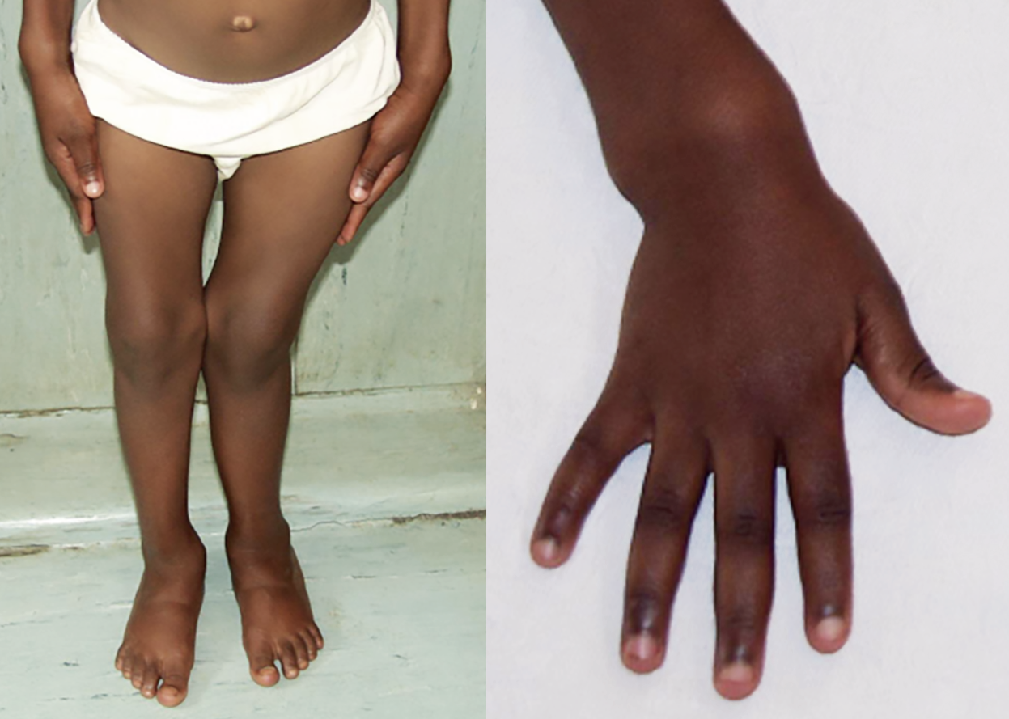
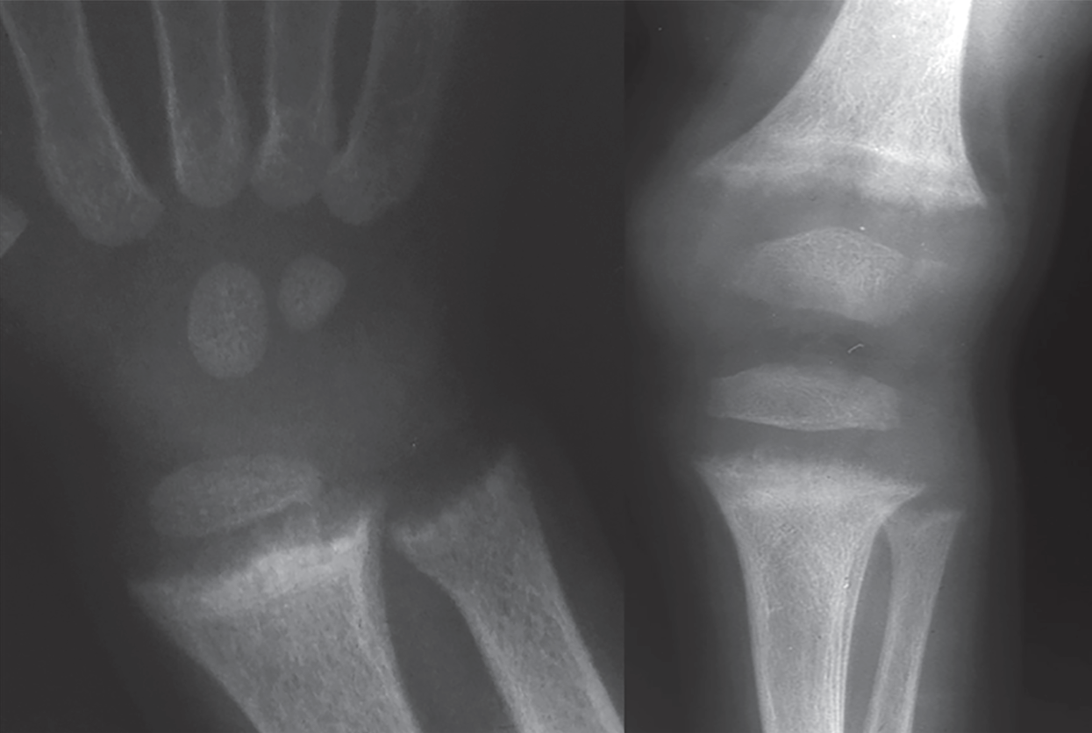
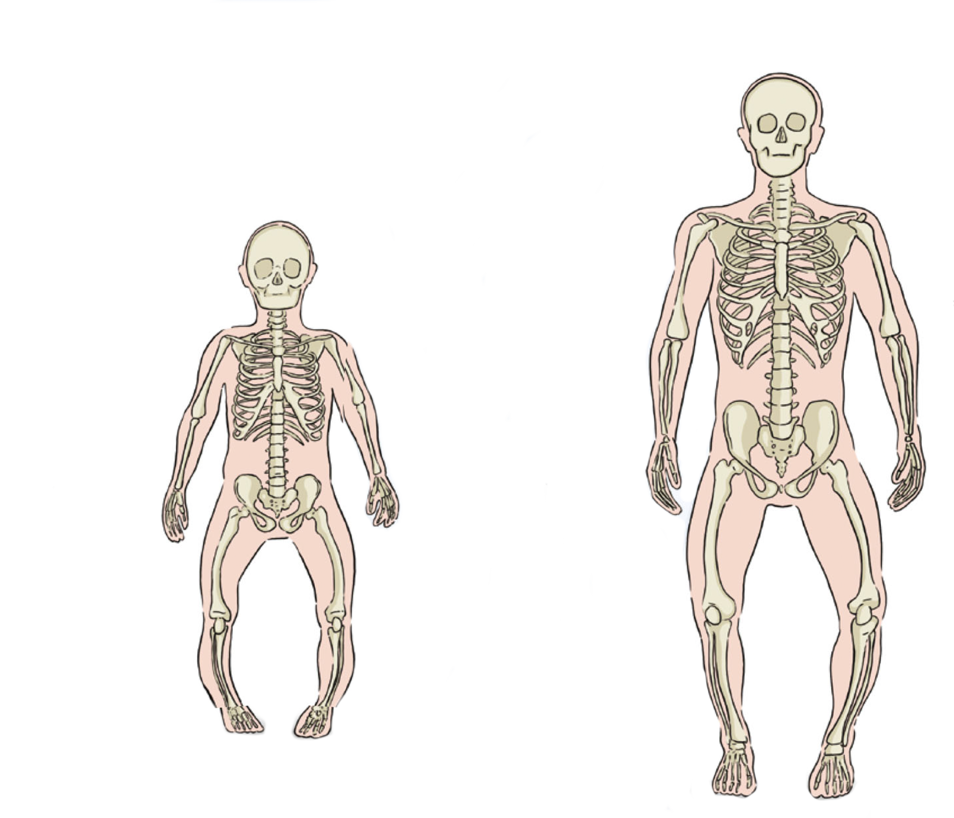
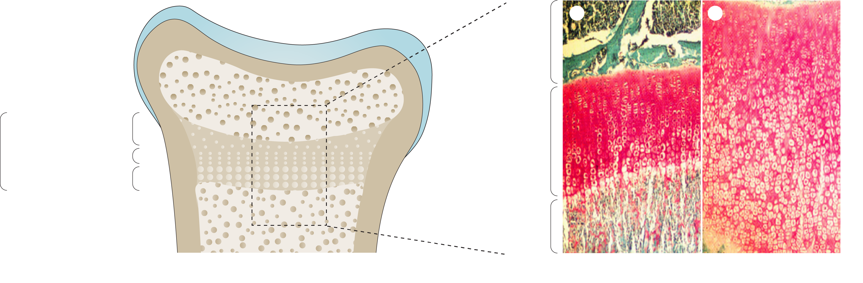
X-linked hypophosphatemia (XLH) symptomatology and pathophysiology in children
OVERVIEW¹
EXAMPLES²
PAEDIATRIC
Short stature
Deformity of weight-
bearing limbs
Tooth abscesses
Excessive dental caries
Osteomalacia
Bone and joint pain
Joint stiffness
Muscle pain and weakness
Chiari malformation
Gait abnormalities
Diminished quality
of life including
psychosocial
impact
Delayed and
disproportionate
growth
Craniosynostosis
Rickets
Delayed motor
development and
gait abnormalities
A
B
C
Growth
plate
Resting zone
Proliferating zone
Hypertrophic zone
Growth
plate
Metaphysis
Normal
Rickets
1. Beck-Nielsen SS, et al. Orphanet J Rare Dis. 2019;14:58; 2. Carpenter TO, et al. Nat Rev Dis Primers. 2017;3:17101

Slide 20
X-linked hypophosphatemia (XLH)
Conventional treatment: normaliSe mineralisation
Bone
Parathyroid
glands
PHEX
DMP1
ENPP1
FGF23
PTH
Oral phosphate¹:
20-60 mg/kg/d in 3-5 doses
FGFR1c and klotho
PTHR1
Dietary Pi
S-Pi
Kidneys
Gut
Npt2a/2c
FGFR1c and klotho
Active vitamin D¹:
alfacalcidol 30-50 ng/kg
1,25-OH₂D
U-Pi
1,25(OH)2D, 1,25-dihydroxyvitamin D; d, day; DMP1, dentin matrix acidic phosphoprotein 1; ENPP1, ectonucleotide pyrophosphatase/phosphodiesterase 1; FGF23, fibroblast growth factor 23; FGFR1c, fibroblast growth factor receptor 1 isoform c; Npt2a/2c, sodium-dependent phosphate transport protein 2a/2c; PHEX, phosphate-regulating gene with homologies to endopeptidases on the X chromosome; Pi, inorganic phosphate; PTH, parathyroid hormone; PTHR1, PTH receptor 1; S-Pi, serum phosphate; U-Pi, urinary phosphate
Figure adapted from Bergwitz C, et al. N Engl J Med. 2011;365:1625-35; 1. Haffner D, et al. Nat Rev Nephrol. 2019;15:435-455

Slide 21
Polling question 2
What is the main biochemical treatment goal with conventional treatment of XLH?
Normalise U-Pi
Normalise S-Pi
Normalise ALP
Normalise PTH
ALP, alkaline phosphatase; PTH, parathyroid hormone; S-Pi, serum phosphate; U-Pi, urinary phosphate; XLH, X-linked hypophosphatemia
Notes:
C

Slide 22

X-linked hypophosphatemia (XLH)
Conventional treatment: normalise mineralisation
Conventional treatment^{1,2}
Oral phosphate: 20–60 mg/kg/d in 3–5 doses
Active vitamin D: alfacalcidol 30–50 ng/d
Targets in biochemistry
Normalise ALP
Avoid:
  Secondary hyperparathyroidism
  Hypercalciuria
Accept hypophosphatemia
Impact of treatment^{3,4,5}
Conventional treatment is challenging
Complications
  Nephrocalcinosis
  Secondary and tertiary hyperparathyroidism
Incomplete treatment response
  Partial healing of rickets
  Often no catch-up growth
  Residual deformities
  Less frequent dental problems
ALP, alkaline phosphatase; d, day;
1. Bergwitz C, et al. N Engl J Med. 2011;365:1625-35; 2. Haffner D, et al. Nat Rev Nephrol. 2019;15:435-455; 3. Eddy MC, et al. Bone. 1997;21:515-20; 4. Park E and Kang HG. Clin Exp Pediatr. 2024;67:17-25; 5. Mao M, et al. J Clin Endocrinol Metab. 2020;105:3243-3249;

Slide 23
X-linked hypophosphatemia (XLH) treatment: normaliSe mineralisation
Bone
Parathyroid
glands
PHEX
DMP1
ENPP1
FGF23
PTH
FGF23 antibody:
Subcutaneous injection every two weeks
FGFR1c and klotho
PTHR1
Dietary Pi
S-Pi
Kidneys
Gut
Npt2a/2c
FGFR1c and klotho
1,25-OH₂D
U-Pi
1,25(OH)2D, 1,25-dihydroxyvitamin D; DMP1, dentin matrix acidic phosphoprotein 1; ENPP1, ectonucleotide pyrophosphatase/phosphodiesterase 1; FGF23, fibroblast growth factor 23;
FGFR1c, fibroblast growth factor receptor 1 isoform c; NaPi-IIa/c, sodium-phosphate cotransporter type IIa/c; PHEX, phosphate-regulating gene with homologies to endopeptidases on the X chromosome; Pi, inorganic phosphate; PTH, parathyroid hormone; PTHR1, PTH receptor 1; S-Pi, serum phosphate; U-Pi, urinary phosphate
Figure adapted from Bergwitz C, et al. N Engl J Med. 2011;365:1625-35

Slide 24
X-linked hypophosphatemia (XLH) a life-long disease
XLH disease burden progresses from childhood to adulthood¹
The symptoms of XLH accumulate over time
Adults transitioning from paediatric to adult health care are at risk of poor outcomes
  A well-supported transition is needed
ADULT
PAEDIATRIC
Short stature
Deformity of weight-
bearing limbs
Tooth abscesses
Excessive dental caries
Osteomalacia
Bone and joint pain
Joint stiffness
Muscle pain and weakness
Chiari malformation
Gait abnormalities
Diminished quality
of life including
psychosocial
impact
Fractures
(including
insufficiency
fractures
and looser zones)
Osteoarthritis
Extraosseous
calcification including:
Enthesiophytes
Enthesopathy
Spinal stenosis
Hearing loss
Disability that
impacts ability
to work
Delayed and
disproportionate
growth
Craniosynostosis
Rickets
Delayed motor
development and
gait abnormalities
Figure adapted from Beck-Nielsen et al.²
1. Giannini S, et al. Osteoporos Int. 2021;32:1937-1949; 2. Beck-Nielsen SS, et al. Orphanet J Rare Dis. 2019;14:58

Slide 25
Patient case 1
Summary and learning points
Phosphate homeostasis is tightly regulated
Genetic defects may lead to hypo- or hyperphosphatemia
  The hormone FGF23 is the main player in pathogenesis
XLH is the most common genetic form of hypophosphatemia
  Conventional treatment
  FGF23 antibody treatment
XLH is a life-long disease
FGF23, fibroblast growth factor 23 ; XLH, X-linked hypophosphatemia

Slide 26
PATIENT CASE 2

Slide 27
Polling question 1
What clinical history findings should prompt urgent referral to a metabolic bone specialist for further investigation in a patient suspected of having tumour-induced osteomalacia (TIO)?
History of recurrent infections
Sudden onset of bone abnormalities and fractures without history of trauma in a previously healthy individual
History of chronic back pain with no improvement despite conservative treatment
History of travel to endemic areas for bone diseases
Notes:
B

Slide 28

Patient case 2
55-year-old male
No family history of bone fragility
DISEASE PRESENTATION
Multiple vertebral and axial fragility fractures over the last 4 years
No apparent trauma
MEDICAL AND SOCIAL HISTORY
Healthy and physically active as a young man
No major clinical problems and surgeries prior to the last 4 years
Lawyer and father of two healthy children
Information courtesy of Prof. Brandi

Slide 29
Patient case 2
History of present illness
Age 51 years
Pain in left femur with
diagnosis of bone oedema
and recommendation to rest
Age 53 years
Fracture of left femoral
neck required an
osteosynthesis
December 2023:
Age 55 years
Presentation
2019
2020
2021
2022
2023
2024
Age 52 years
Extension of oedema to
right femur; injectable
bisphosphonates prescribed
2021-2023
  Fractures in right femur and nine vertebrae (with no trauma)
  13 cm loss in height
2019-2023
  Loss of 30 kg in weight, predominantly muscle mass
Information courtesy of Prof. Brandi

Slide 30
Patient case 2
Biochemical and bone assessments
Biochemistry at first examination: Dec 2018
Additional biochemistry at follow-up due
to abnormal serum and urine levels
Test, unit | Reference range | Value
Serum Ca, mg/dL | 8.2-10.6 | 9.7
24-hr urine Ca, mg/day | 100-300 | 45
Serum Pi, mg/dL | 2.5-4.5 | 1.69
24-hr urine Pi, mg/day | 400-1,300 | 2,256
25(OH)D, ng/mL | 30-100 | 42.5
PTH, pg/mL | 11-67 | 86.8
Bone ALP, µg/mL | 6-30 | 89
β-CTx, ng/mL | 0.115-0.748 | 1.280
Test, unit | Reference range | Value
1,25(OH)₂D, pg/mL | 15.2-90.1 | 8.9
FGF23, pg/mL | 23.2-95.4 | 312
Bone densitometry
DEXA: L1-L4 T-score = −3.5
Text in red indicates a value outside the reference range
1,25(OH)₂D, 1,25-dihydroxyvitamin D; 25(OH)D, 25-hydroxyvitamin D; β-CTx, carboxy-terminal cross-linked telopeptide of type I collagen ALP, alkaline phosphatase; Ca, calcium; DEXA, dual-energy X-ray absorptiometry; FGF23, fibroblast growth factor 23; hr, hour; L, lumbar; Pi, inorganic phosphate; PTH, parathyroid hormone
Information courtesy of Prof. Brandi

Slide 31
Patient case 2 initial treatment
Pharmacological therapy:
Oral phosphate
Calcitriol
Aminobisphosphonates
Clear suspicion of tumour-induced
osteomalacia (TIO):
No family history of bone fragility
Sudden onset of bone abnormalities and fractures without a history of trauma
Hypophosphatemia and elevated serum FGF23
Modest improvement in pain and muscle symptoms
How to localise the tumour?
FGF23, fibroblast growth factor 23; TIO, tumour-induced osteomalacia
Information courtesy of Prof. Brandi

Slide 32
Tumour-induced Osteomalacia (TIO) diagnostic algorithm
Patient presenting with generalised musculoskeletal pain,
muscle weakness, multiple fractures, and fatigue or
palpable localised mass
Medical history
Including medication and family history
Rare paraneoplastic syndrome
  Overproduction of phosphaturic hormones, as FGF23, by tumours (associated with tumours that are mesenchymal in nature)¹
Different than XLH, TIO is usually diagnosed in the adult patient²
Algorithm for its management has been published
Physical examination
Height
Body proportions
Limb deformity
Cranial anomalies (e.g., frontal bossing or craniosynostosis)
Dental and oral cavity examination
Palpate entire body for masses
Measure serum phosphate
Morning fasting blood specimen
Any patient presenting with chronic muscle pain or weakness and fragility fractures or bone pain
Biochemical workup
Second morning void urine phosphate and creatinine
Fasting morning serum phosphate and creatinine
Total or bone-specific ALP
PTH
25(OH)D
1,25(OH)₂D
FGF23 (if available)
Genetic testing
If clinical and biochemical suspicion of TIO,
refer to a specialist/specialist centre
Functional imaging
Genetic testing
Adapted from Jan de Beur et al. ³
Treatment
1,25(OH)2D, 1,25-dihydroxyvitamin D (calcitriol); 25(OH)D, 25-hydroxyvitamin D; ALP,
alkaline phosphatase; FGF23, fibroblast growth factor 23; XLH, X-linked hypophosphatemia
1. Alonso G and Varsavsky M. Endocrinología y Nutrición (English Edition). 2016;63:181-186; 2. Laurent MR, et al. GeneReviews® [Internet]. Adam MP, Feldman J, Mirzaa GM, et al., editors.
Seattle (WA): University of Washington, Seattle; 1993-2024. Available at https://www.ncbi.nlm.nih.gov/books/NBK83985/; 3. Jan de Beur, SM, et al. J Intern Med. 2023;293:309-328

Slide 33
Tumour localisation process (3 months) assessment results
Negative
CT scan
MRI scan
FDG-PET/CT scan
SPECT/CT (¹¹¹Indium-octreotde-scinti) scan
Positive
PET/CT (⁶⁸Gallium-DOTANOC) scan (X-ray negative) at
level of right femoral trochanter
Selective venous catheterisation revealed higher FGF23 at the level of the right common femoral vein compared with the left common femoral vein (644.6 pg/mL and 325.6 pg/mL, respectively)
Example of a positive PET/CT scan demonstrating marked tracer uptake¹
CT, computed tomography; FDG-PET/CT, fluorodeoxyglucose positron emission tomography/CT; FGF23, fibroblast growth factor 23; MRI, magnetic resonance imaging; PET, positron emission tomography; SPECT, single photon emission computed tomography
1. Chen DW, et al. Clin Diabetes Endocrinol. 2020;6:12
Information courtesy of Prof. Brandi

Slide 34
Polling question 2
What is the suggested next step after localisation of the
tumour in a patient with TIO?
Stop treatment with oral phosphate and calcitriol
Perform a biopsy of the localised tumour for histological diagnosis
Schedule the patient for surgical removal of the tumour
Conduct a follow-up imaging study to monitor tumour growth
TIO, tumour-induced osteomalacia
Notes:
C

Slide 35
Tumour-induced Osteomalacia treatment algorithm
Diagnosis
If tumour identified
If tumour not identified
Oral phosphate salts plus active vitamin D
Oral phosphate salts plus active vitamin D
Anatomical imaging
If tumour not resectable
OR
Venous
sampling
If tumour resectable
Burosumab
Surgical resection
Nonsurgical
ablation
If tumour not
resectable
Cure
Patient follow-up
Patient follow-up
Adapted figure
Jan de Beur, SM, et al. J Intern Med. 2023;293:309-328

Slide 36
Definitive management tumour removal
The tumour was successfully removed from the right femoral trochanter:
Histologically diagnosed as an osteoblastoma, positive for FGF23 peptide with staining
24 hours post-surgery, FGF23 values dropped to 16.4 pg/mL
Shortly after surgery, the patient was able to walk without help and went back to skiing
Following surgery, the patient made good clinical recovery
FGF23, fibroblast growth factor 23;
Information courtesy of Prof. Brandi

Slide 37
Patient case 2
Summary and learning points
This patient suffered multiple vertebral and axial fragility fractures without an apparent
cause for 4 years before being diagnosed and undergoing successful surgical treatment
A clinical history of sudden onset of bone abnormalities and fractures without history
of trauma in a previously healthy individual should prompt urgent referral to a metabolic
bone specialist for further investigation
A full clinical examination, biochemical investigation and specialised imaging may
be required to make a final diagnosis of TIO and to localise the tumour(s)
  Many patients suffer for years because their tumour is not localised, is not
  amenable to surgery or is in an inaccessible location
PET/CT (⁶⁸Gallium-DOTANOC) may reveal tumour(s) even if not detected by other
imaging techniques
CT, computed tomography; PET, positron emission tomography; TIO, tumour-induced osteomalacia; XLH, X-linked hypophosphatemia
Information courtesy of Prof. Brandi

Slide 38
Key clinical takeaways

Slide 39
Key clinical takeaways
Differential diagnosis of chronic hypophosphatemia in children and adults
Phosphate homeostasis is tightly regulated. FGF23 plays a key role in the
mechanisms involved in disorders linked to phosphate wasting
Hypophosphatemia can have genetic or physiological causes. Genetic causes continue throughout the life of the patient and transition of care from childhood to adulthood is crucial
Skeletal deformities in childhood and sudden onset of bone abnormalities and
fractures without a history of trauma in a previously healthy adult should prompt
suspicion of rare bone disorders, such as XLH and TIO
Several guidelines on the management of chronic hypophosphatemia exist (XLH and TIO). Updates are expected to be published soon
FGF23, fibroblast growth factor 23; TIO, tumour-induced osteomalacia; XLH, X-linked hypophosphatemia

