Slide 2
lung connect
Oncogene-addicted nsclc highlights from asco 2024
Prof. Nicolas Girard, MD
Institut Curie, Paris, France
June 2024

Slide 3

Developed by LUNG COnnect
This programme is developed by LUNG CONNECT,
an international group of experts in the field
of thoracic oncology.
Acknowledgement and disclosures
This LUNG CONNECT programme is supported through an independent educational grant from Bayer.
The programme is therefore independent, the content is not influenced by the supporter and is under
the sole responsibility of the experts.
Please note: The views expressed within this programme are the personal opinions of the experts. They do
not necessarily represent the views of the experts’ institutions, or the rest of the LUNG CONNECT group.
Expert disclosures:
Prof. Nicolas Girard
  has received financial support/sponsorship for research support, consultation, or speaker fees from the
  following companies: AbbVie, Amgen, AstraZeneca, Beigene, Boehringer Ingelheim, Bristol Myers Squibb,
  Daiichi-Sankyo, Gilead, Hoffmann-La Roche, Ipsen, Janssen, LeoPharma, Lilly, Merk Serono,
  Merck Sharp & Dohme, Mirati, Novartis, Pfizer, Pierre Fabre, Sanofi and Takeda
  has participated on a data safety monitoring board for Hoffmann-La Roche and has a family member
  employed with AstraZeneca

Slide 4
Clinical takeaways
EGFR:
PALOMA-2: provides evidence for the efficacy and safety of subcutaneous amivantamab + lazertinib and
suggests it could be suitable as a first-line option for patients with EGFR-mutant advanced NSCLC
PALOMA-3: subcutaneous amivantamab with lazertinib is noninferior to intravenous amivantamab plus lazertinib and has an improved safety profile and greater convenience
ALK:
CROWN: after 5 years of treatment, the median PFS of patients with advanced ALK-positive NSCLC treated
with lorlatinib has yet to be reached, corresponding with the longest PFS ever reported in advanced NSCLC
KRAS:
KRYSTAL-12: adagrasib demonstrated a statistically significant and clinically meaningful improvement in
PFS and ORR over docetaxel in patients with previously treated KRAS^{G12C}-mutated NSCLC
HER2:
SOHO-01: in patients with heavily pre-treated HER2-mutant NSCLC, treatment with BAY 2927088
resulted in rapid, substantial and durable responses
Beamion LUNG-1: zongertinib was well tolerated and demonstrated promising initial efficacy in
pre-treated patients with HER2-mutated NSCLC
ALK, anaplastic lymphoma kinase; EGFR, epidermal growth factor receptor; HER2, human epidermal growth factor receptor 2; KRAS, Kirsten rat sarcoma virus; NSCLC, non-small cell lung cancer; ORR, objective response rate; PFS, progression-free survival

Slide 5
Educational objectives
Understand the clinical trial data and emerging profile of targeted
therapies for the treatment of molecularly driven lung cancer

Slide 6
Subcutaneous amivantamab and lazertinib as first-line treatment in patients with EGFR-mutated, advanced NSCLC: Results from the phase 2 PALOMA-2 study
Lim S, et al. ASCO 2024. Abstract #LBA8612
Subcutaneous amivantamab vs intravenous amivantamab, both in combination with lazertinib, in refractory EGFR-mutated, advanced NSCLC: Primary results, including overall survival, from the global, phase 3, randomised controlled PALOMA-3 trial
Leighl N, et al. ASCO 2024. Abstract #LBA8505
EGFR, epidermal growth factor receptor; NSCLC, non-small cell lung cancer

Slide 7
PALOMA-2/-3: background
Amivantamab, an EGFR-MET bispecific antibody with immune cell-directing activity,
is approved as an IV formulation for first- and second-line treatment of patients with
EGFR exon 20 insertion-mutated advanced NSCLC
First-line amivantamab + lazertinib (3rd generation EGFR TKI) provided clinically meaningful improvements in PFS in EGFR-mutated advanced NSCLC patients versus osimertinib in the MARIPOSA study
A subcutaneous (SC) formulation of amivantamab is being developed to improve
patient experience and convenience for healthcare professionals
The recommended phase 2 dose and dosing schedule was determined in the
phase 1 PALOMA study
The efficacy and safety of the SC formulation is now being evaluated in the
PALOMA-2 and PALOMA-3 studies
NSCLC, non-small cell lung cancer; TKI, tyrosine kinase inhibitor
Lim S, et al. J Clin Oncol 2024;42(suppl 17; abstr LBA8612) (ASCO 2024 poster); Leighl N, et al. J Clin Oncol 2024;42(suppl 17; abstr LBA8505) (ASCO 2024 oral presentation); Cho BC, et al. Annals of Oncology (2023) 34 (suppl_2): S1254-S1335

Slide 8
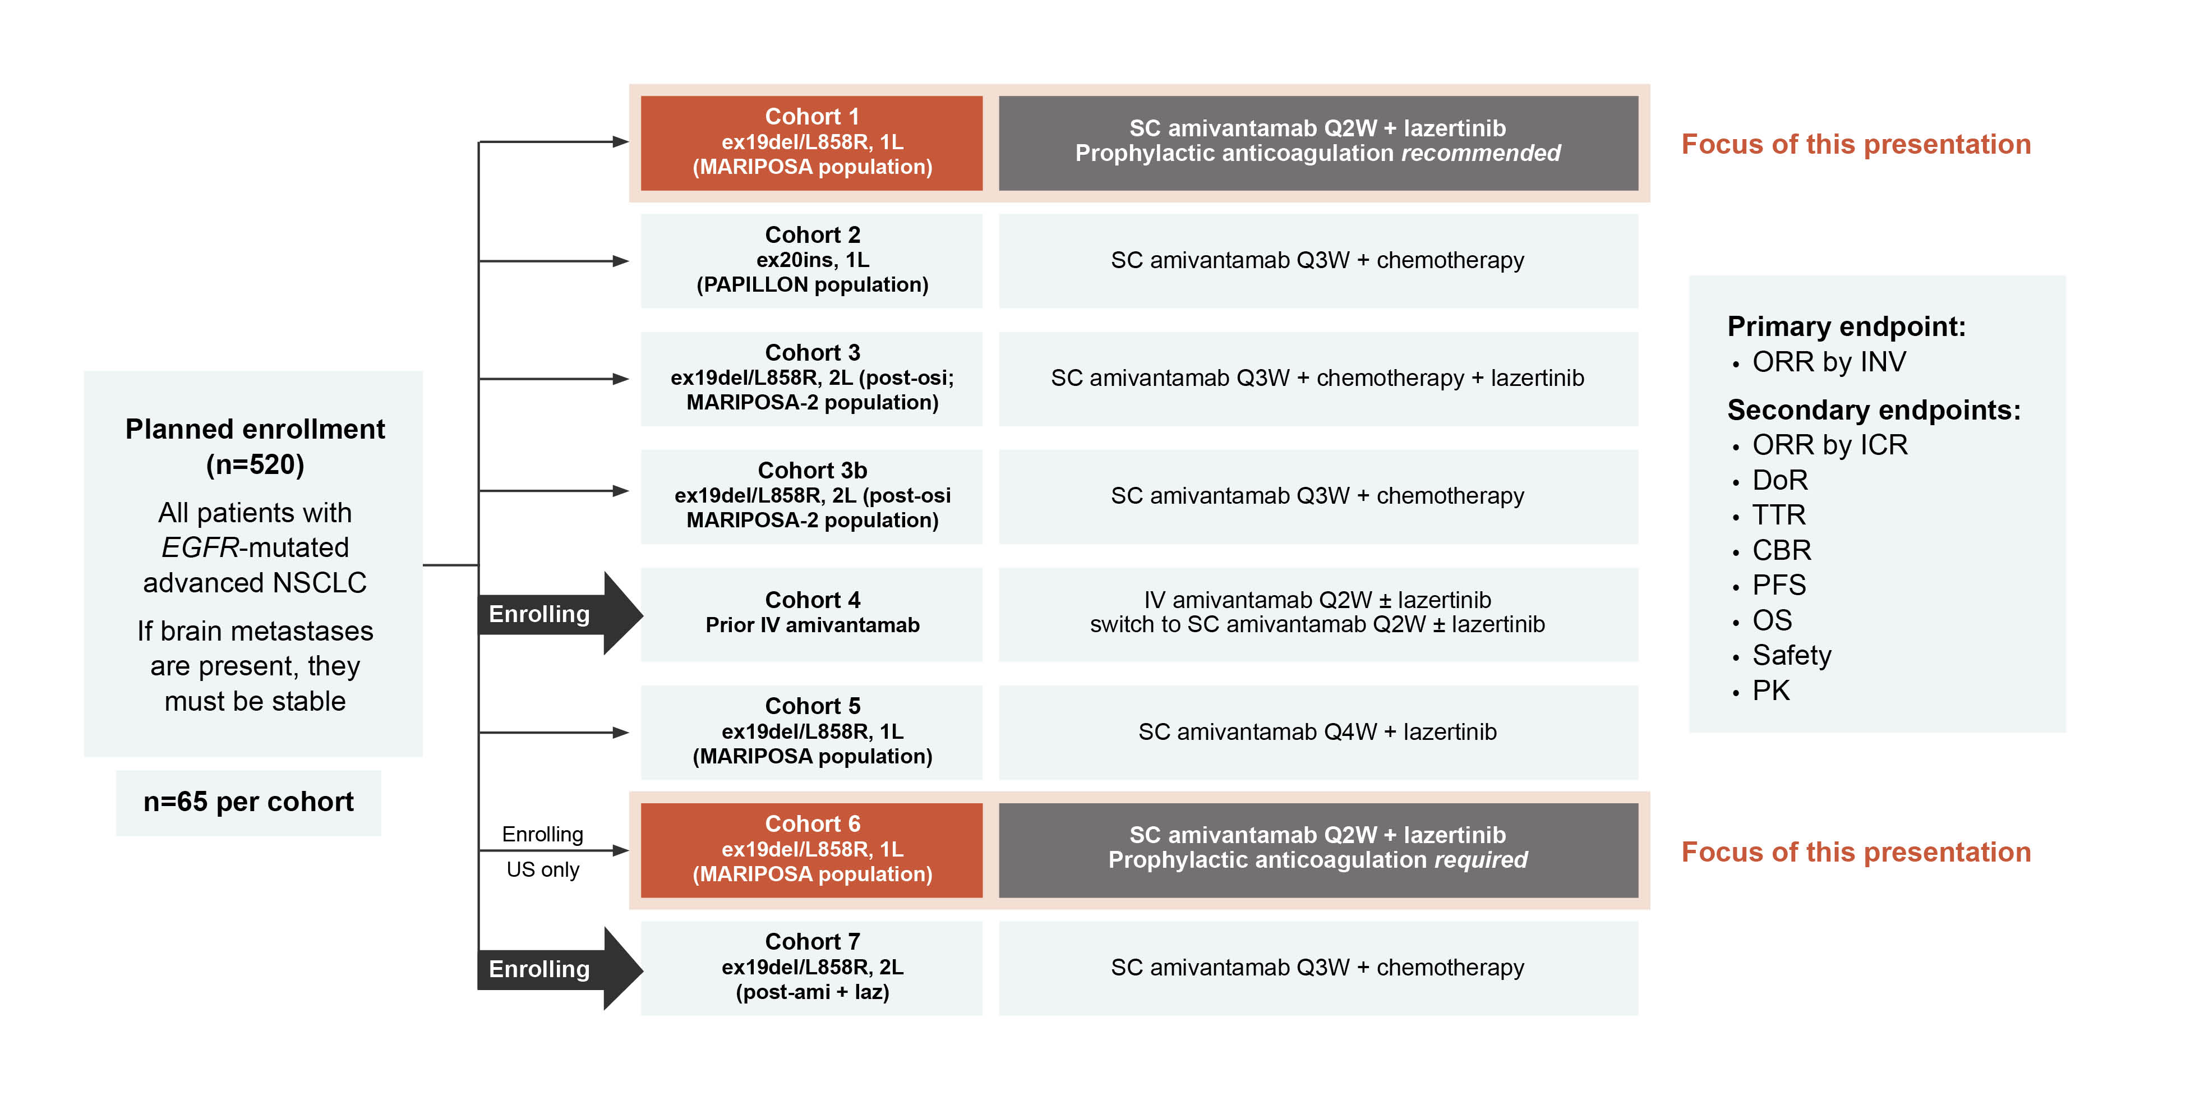
PALOMA-2: background and study design
PALOMA-2 is a phase 2 study evaluating the efficacy, safety and PK of first-line
SC amivantamab + lazertinib in EGFR-mutated advanced NSCLC
1L, first line; 2L, second line; ami, amivantamab; CBR, clinical benefit rate; DoR, duration of response; EGFR, epidermal growth factor receptor; ex19 del, exon 19 deletion; ex20ins, exon 20 insertion; ICR, independent central review; INV, investigator; IV, intravenous; laz, lazertinib; NSCLC, non-small cell lung cancer; ORR, objective response rate; OS, overall survival; osi, osimertinib; PFS, progression-free survival; PK, pharmacokinetics; Q2W, every 2 weeks; Q3W, every 3 weeks; Q4W, every 4 weeks; SC, subcutaneous; TTR, time to response; US, United States
Lim S, et al. J Clin Oncol 2024;42(suppl 17; abstr LBA8612) (ASCO 2024 poster)

Slide 9
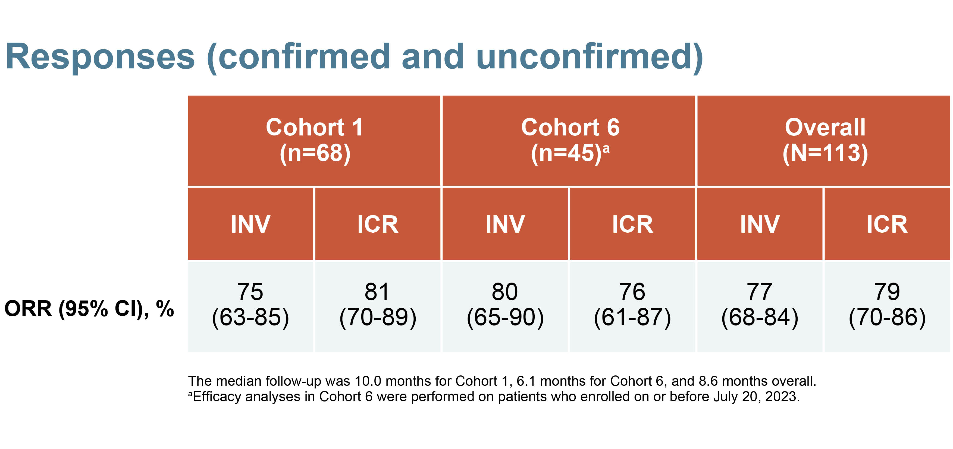
PALOMA-2: results
EFFICACY
SAFETY
The safety profile of SC amivantamab
+ lazertinib was consistent with previous reports of the IV formulation, with no new safety signals identified
However, markedly lower rates of ARRs and VTE were observed with the SC formulation
Discontinuation of all agents due to TRAEs occurred in 9% (11/125) of patients
Among the confirmed responders in both cohorts:
  Median TTR: 1.9 months (range, 1.4-5.3)
  Median DoR: not estimable
ARR, administration-related reaction; CI, confidence interval; DoR, duration of response; ICR, independent central review; INV, investigator; IV, intravenous; ORR, objective response rate; SC, subcutaneous; TRAE, treatment related adverse event; TTR, time to response; VTE, venous thromboembolism
Lim S, et al. J Clin Oncol 2024;42(suppl 17; abstr LBA8612) (ASCO 2024 poster)

Slide 10
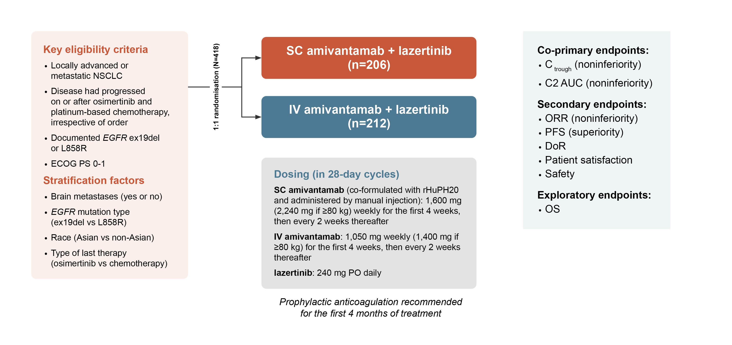
PALOMA-3: background and study design
PALOMA-3 (NCT05388669) is a phase 3 study which evaluated SC ami+laz vs IV ami+laz for pharmacokinetics (PK), efficacy, and safety among pts with EGFR ex19del or L858R-mutated advanced NSCLC and disease progression on osimertinib and platinum-based chemotherapy
ami, amivantamab; AUC, area under the curve; DoR, duration of response; ECOG PS, Eastern Cooperative Oncology Group performance status; Ex19 del, exon 19 deletion; IV, intravenous; laz, lazertinib; NSCLC, non-small cell lung cancer; ORR, objective response rate; OS, overall survival; PFS, progression-free survival; SC, subcutaneous
Leighl N, et al. J Clin Oncol 2024;42(suppl 17; abstr LBA8505) (ASCO 2024 oral presentation)

Slide 11
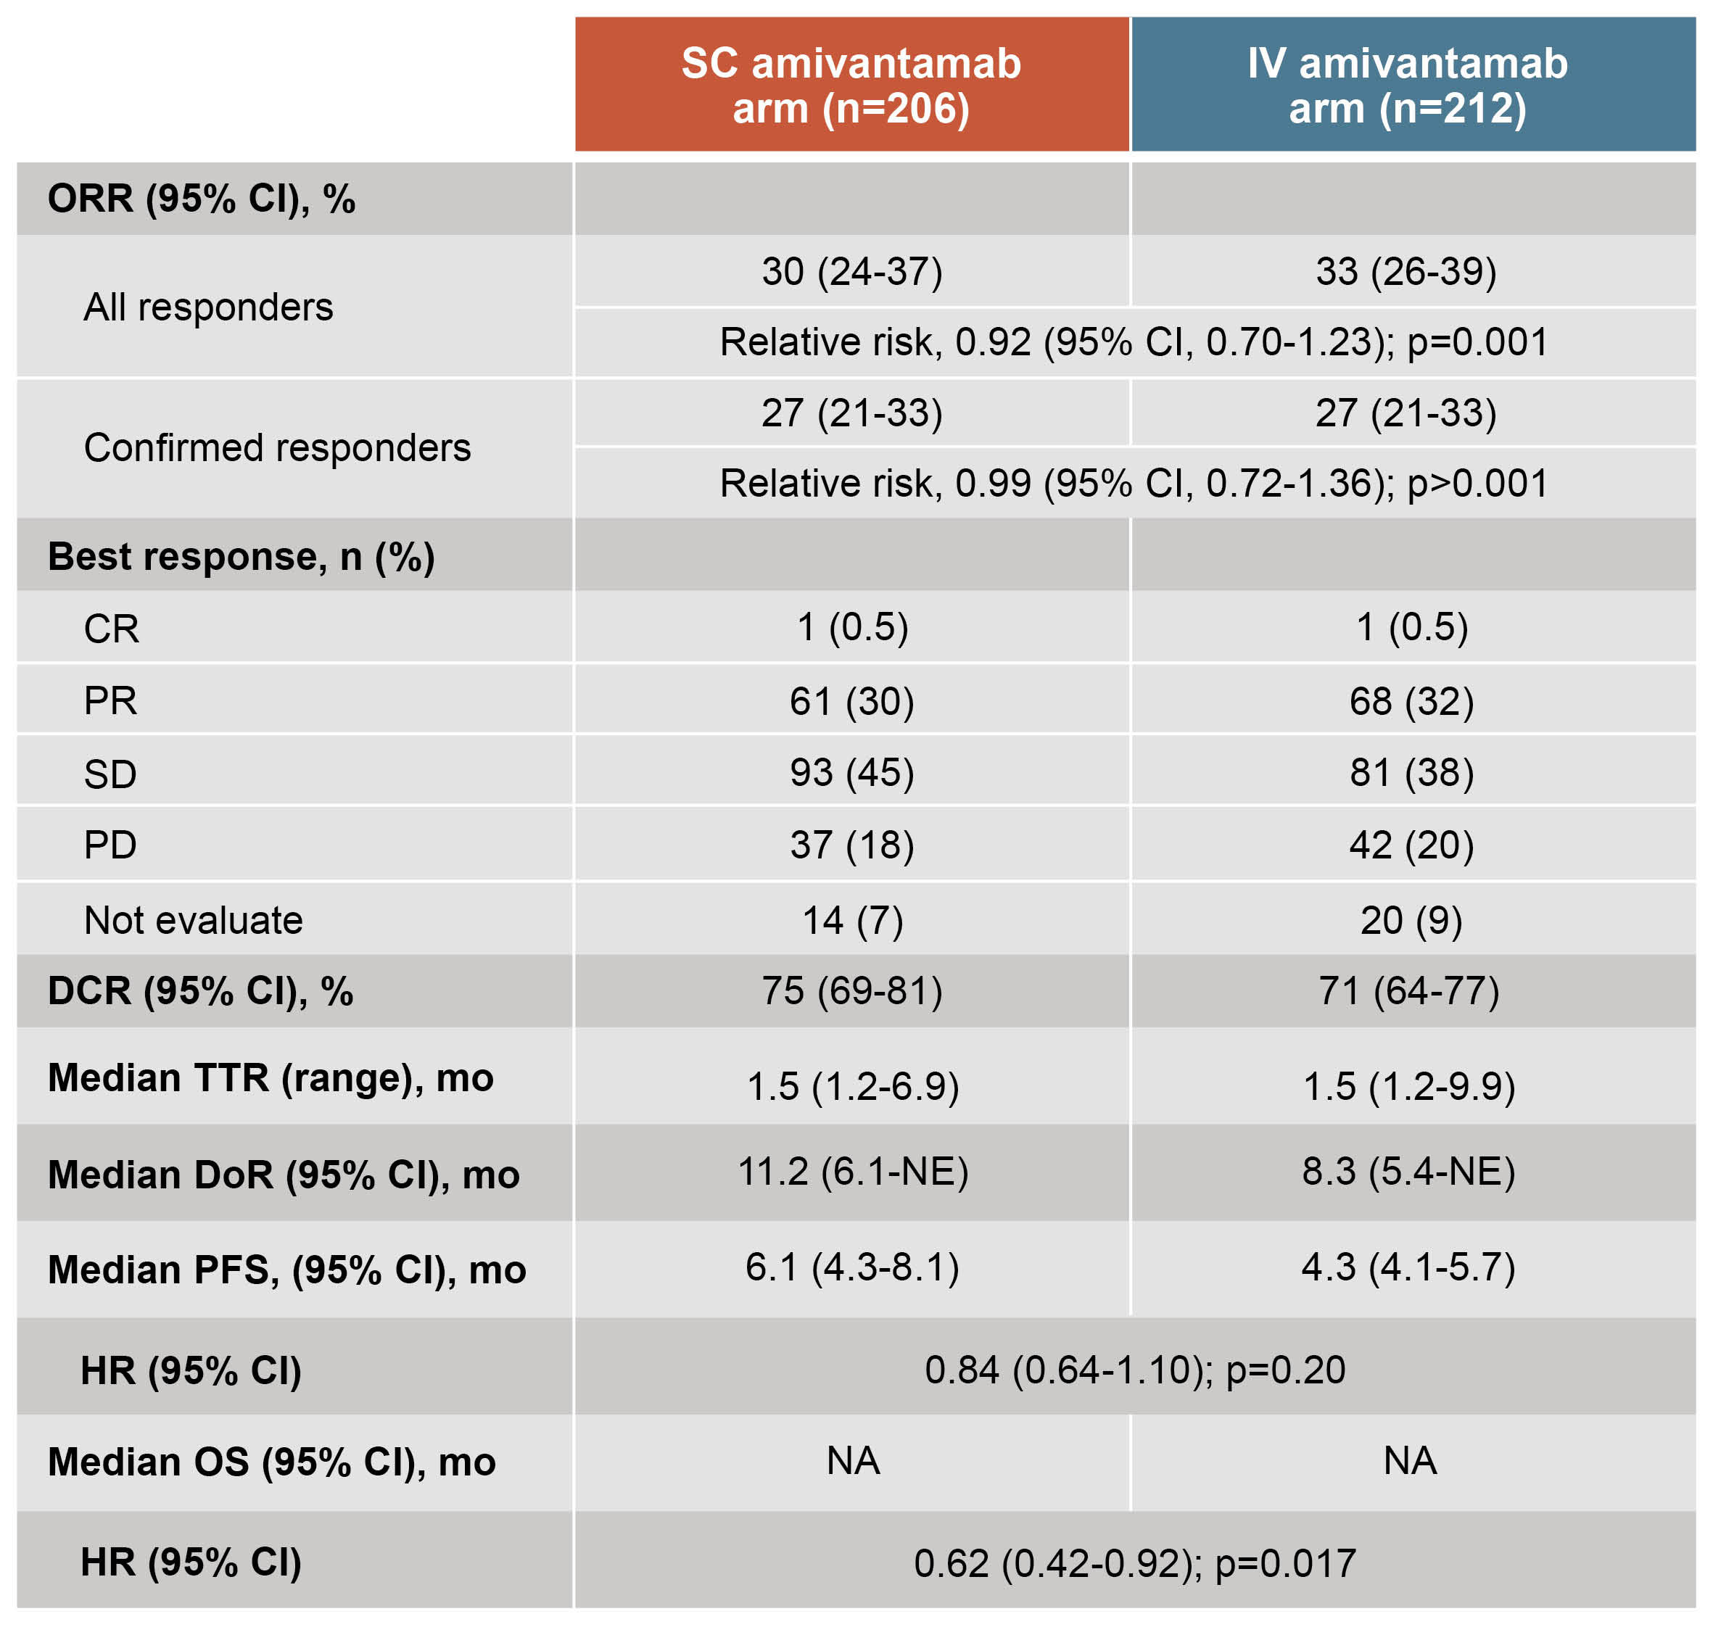
PALOMA-3: results
EFFICACY
SAFETY
TEAEs were consistent between arms
AEs leading to death were uncommon and
similar between arms
Treatment discontinuations: 9% in SC arm and
12% in IV arm
IRRs were ~5-fold lower in the SC arm:
13% vs 66% for IV
Prophylactic anticoagulants were administered
to 80% of patients in the SC arm and 81% for IV
Among all study patients, VTE was reported
by 9% in the SC arm vs 14% for IV.
Across both arms, VTE incidence was 10%
for pts who received prophylactic anticoagulants
vs 21% for pts who did not
AE, adverse event; CI, confidence interval; CR, complete response; DCR, disease control rate; DoR, duration of response; HR, hazard ratio; IRR, infusion-related reaction; IV, intravenous; mo, months; NE, not evaluable; ORR, objective response rate; OS, overall survival; PD, progressive disease; PFS, progression-free survival; PR, partial response; pts, patients; SC, subcutaneous; SD, stable disease; TEAE, treatment emergent adverse event; TTR, time to response; VTE, venous thromboembolism
Leighl N, et al. J Clin Oncol 2024;42(suppl 17; abstr LBA8505) (ASCO 2024 oral presentation)

Slide 12
PALOMA-2/-3: summary
PALOMA-2: SC amivantamab + lazertinib showed meaningful efficacy in 1L EGFR-mutated NSCLC
with an ORR comparable to that of the IV formulation
  The safety profile was as previously observed for the IV formulation, with the exception of VTE and ARR, which
  were markedly lower
PALOMA-3: SC amivantamab demonstrated noninferior PK and ORR compared to IV
  Unexpectedly, DoR, PFS, and OS were longer in the SC arm vs IV, suggesting that the route of administration or
  formulation may affect outcomes
  The safety profile was improved for SC amivantamab, with lower IRR and VTE rates
Clinical perspective
PALOMA-2
This study provides evidence for the efficacy and safety of SC amivantamab + lazertinib and suggests it could be suitable as a first-line option for patients with EGFR-mutant advanced NSCLC
PALOMA-3
Subcutaneous amivantamab with lazertinib is noninferior to the intravenous combination
and has an improved safety profile and greater convenience
1L, first-line; ARR, administration related reaction; DoR, duration of response; EGFR, epidermal growth factor receptor; IRR, infusion-related reaction; IV, intravenous; NSCLC, non-small cell lung cancer; ORR, objective response rate; OS, overall survival; PFS, progression-free survival; PK, pharmacokinetics; SC, subcutaneous; VTE, venous thromboembolism
Lim S, et al. J Clin Oncol 2024;42(suppl 17; abstr LBA8612) (ASCO 2024 poster); Leighl N, et al. J Clin Oncol 2024;42(suppl 17; abstr LBA8505) (ASCO 2024 oral presentation)

Slide 13
Lorlatinib vs crizotinib in treatment-naïve patients with advanced ALK+ NSCLC: 5-year progression-free survival and safety from the CROWN study
Solomon B, et al. ASCO 2024. Abstract #LBA8503
ALK, anaplastic lymphoma kinase; NSCLC, non-small cell lung cancer

Slide 14
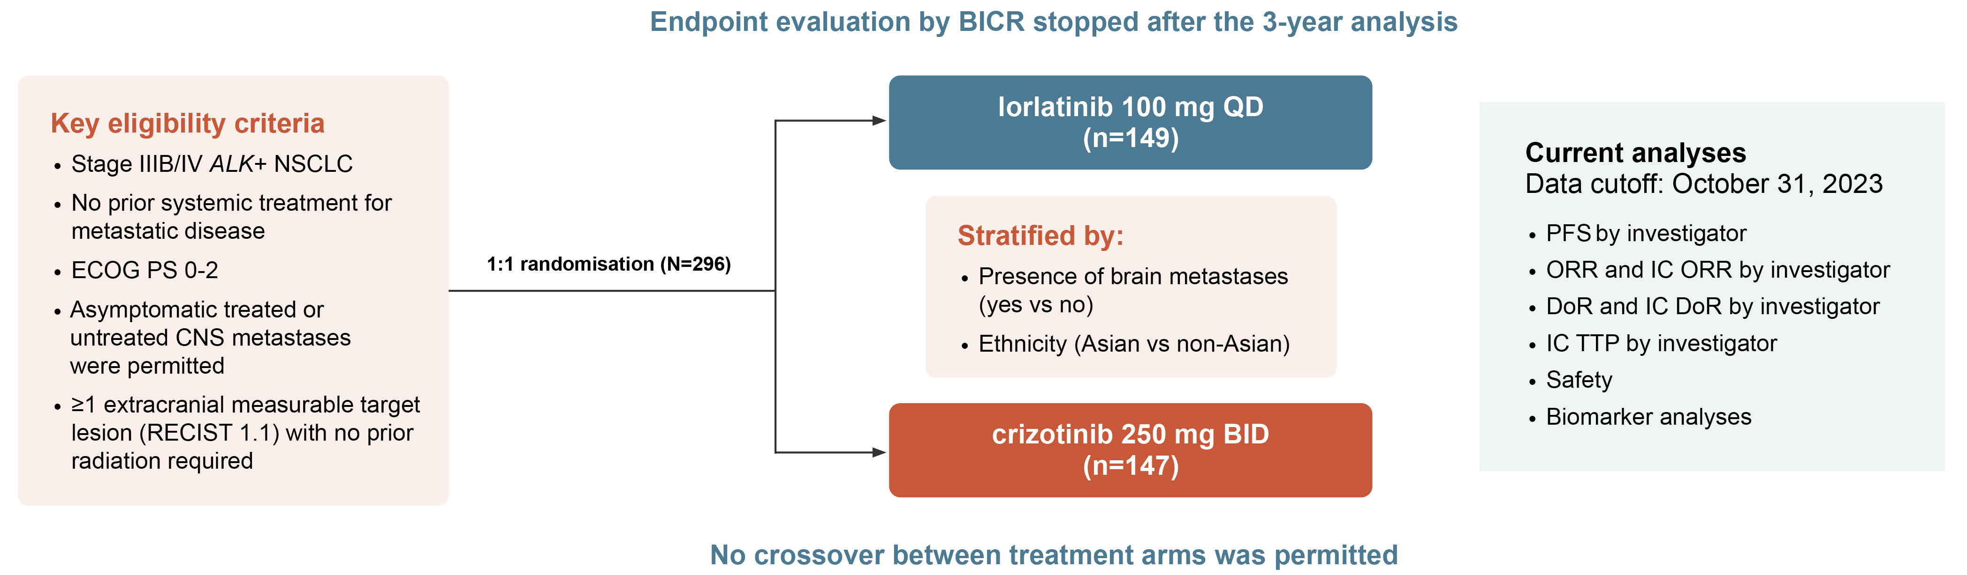
crown: background and study design
Lorlatinib, a brain-penetrant, 3rd-generation ALK TKI, demonstrated improved PFS and intracranial activity vs
crizotinib in the phase 3 CROWN study in previously untreated patients with advanced ALK+ NSCLC
In a previous analysis at 3-years follow-up, median PFS by BICR was still not reached
Long-term efficacy and safety outcomes from the CROWN study after 5 years of follow-up was reported at ASCO 2024
ALK, anaplastic lymphoma kinase; BICR, blinded independent central review; BID, twice daily; CNS, central nervous system; DoR, duration of response; ECOG, Eastern Cooperative Oncology Group; IC, intracranial; NSCLC, non-small cell lung cancer; ORR, objective response rate; PFS, progression-free survival; PS, performance status; QD, once daily; RECIST, Response Evaluation Criteria in Solid Tumours; TKI, tyrosine kinase inhibitor; TTP, time to tumour progression
Solomon B, et al. J Clin Oncol 2024;42(suppl 17; abstr LBA8503) (ASCO 2024 oral presentation); Solomon B, et al. J Clin Oncol 2024: https://doi.org/10.1200/JCO.24.005

Slide 15
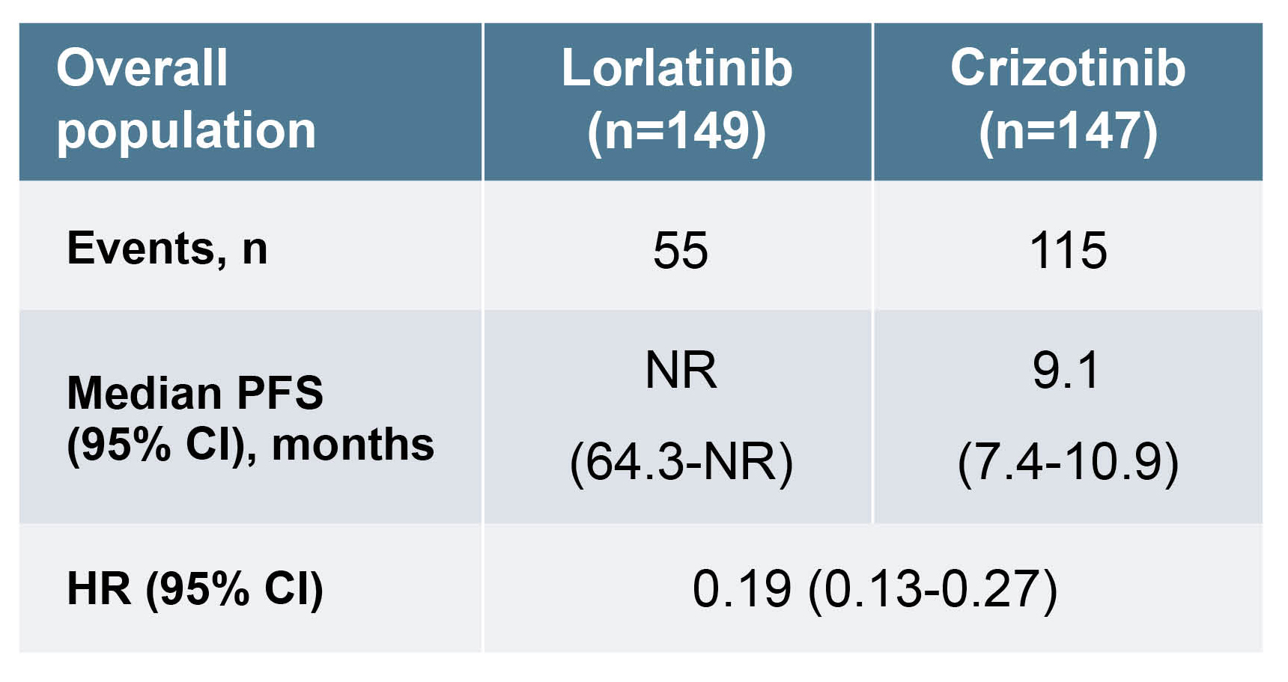
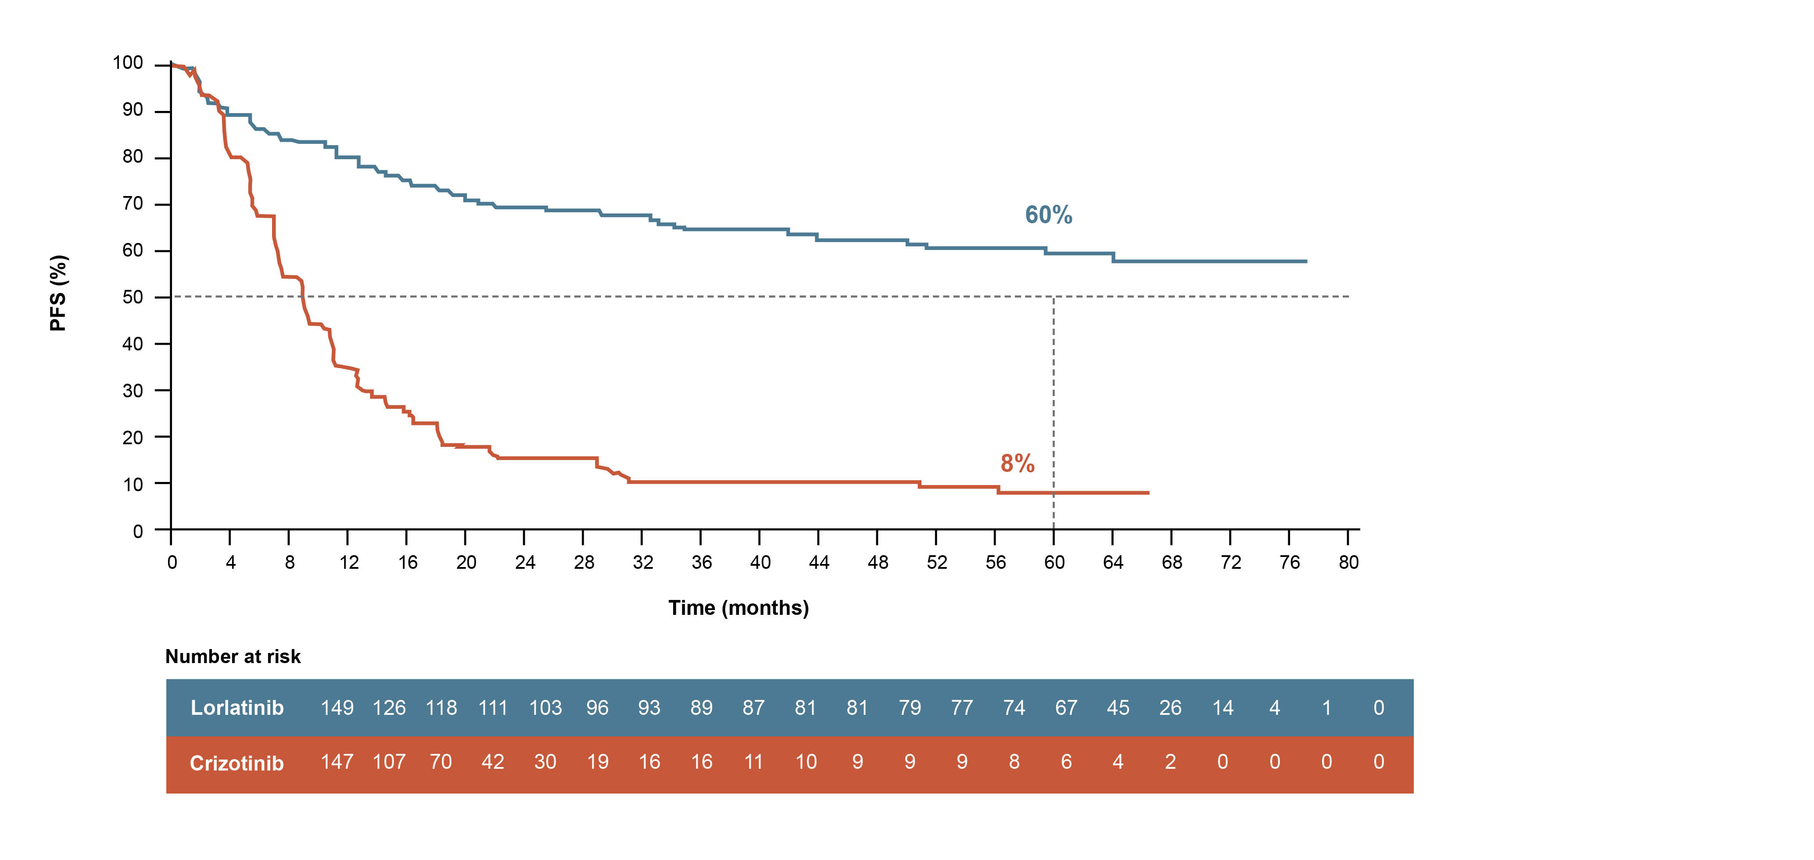
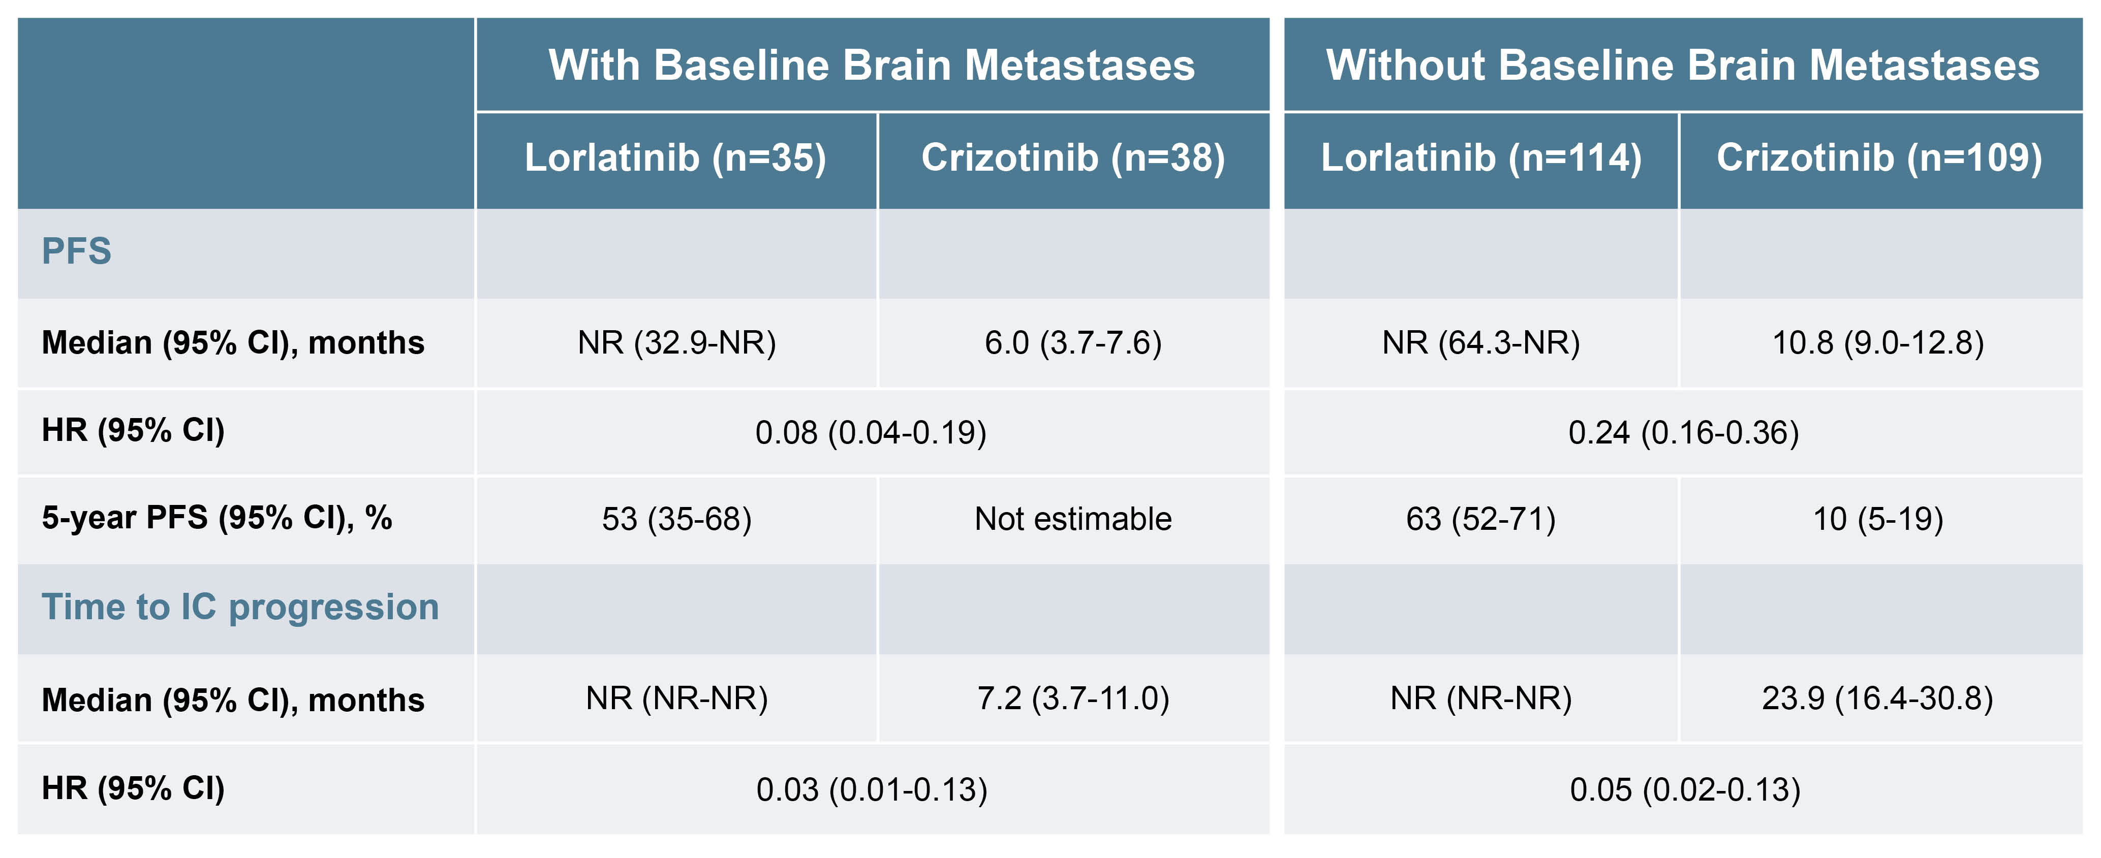
crown: results
Median follow-up for PFS: 60.2 months in the lorlatinib and 55.1 months in the crizotinib arm
Grade 3/4 AEs: 77% of pts with lorlatinib, 57% of pts with crizotinib
TRAEs led to treatment discontinuation in 5% and 6% of pts in the lorlatinib and crizotinib arms, respectively
Safety profile was consistent with that observed in prior analyses
No new ALK mutations detected in ctDNA collected at the end of lorlatinib treatment (n = 31)
AE, adverse events; ALK, anaplastic lymphoma kinase; CI, confidence interval; ctDNA, circulating tumour DNA; HR, hazard ratio; IC, intracranial; NR, not reached; PFS, progression-free survival; TRAE, treatment related adverse event;
Solomon B, et al. J Clin Oncol 2024;42(suppl 17; abstr LBA8503) (ASCO 2024 oral presentation); Solomon B, et al. J Clin Oncol 2024: https://doi.org/10.1200/JCO.24.005

Slide 16
crown: summary
After 5 years of follow up, median PFS in the lorlatinib arm has yet to be reached with 60% of patients being progression-free
92% of patients were intracranial progression-free
No new safety signals emerged
These results correspond to the longest PFS ever reported in advanced NSCLC and together with the absence
of new safety signals, indicate an unprecedented improvement in outcomes for pts with advanced ALK+ NSCLC
Clinical perspective
This is the longest PFS reported in ALK+ NSCLC, and of any targeted therapy
in lung cancer to date
The benefit of lorlatinib is not confined to patients with brain metastases
These results represent an unprecedented outcome for patients with advanced ALK+ NSCLC and set a new benchmark for targeted therapies in cancer
ALK, anaplastic lymphoma kinase; NSCLC, non-small cell lung cancer; PFS, progression-free survival
Solomon B, et al. J Clin Oncol 2024;42(suppl 17; abstr LBA8503) (ASCO 2024 oral presentation); Solomon B, et al. J Clin Oncol 2024: https://doi.org/10.1200/JCO.24.005

Slide 17
KRYSTAL-12: Phase 3 study of adagrasib versus docetaxel in patients with previously treated advanced/metastatic NSCLC harbouring a KRAS^{G12C} mutation
Mok T, et al. ASCO 2024. Abstract #LBA8509
KRAS, Kirsten rat sarcoma virus; NSCLC, non-small cell lung cancer

Slide 18
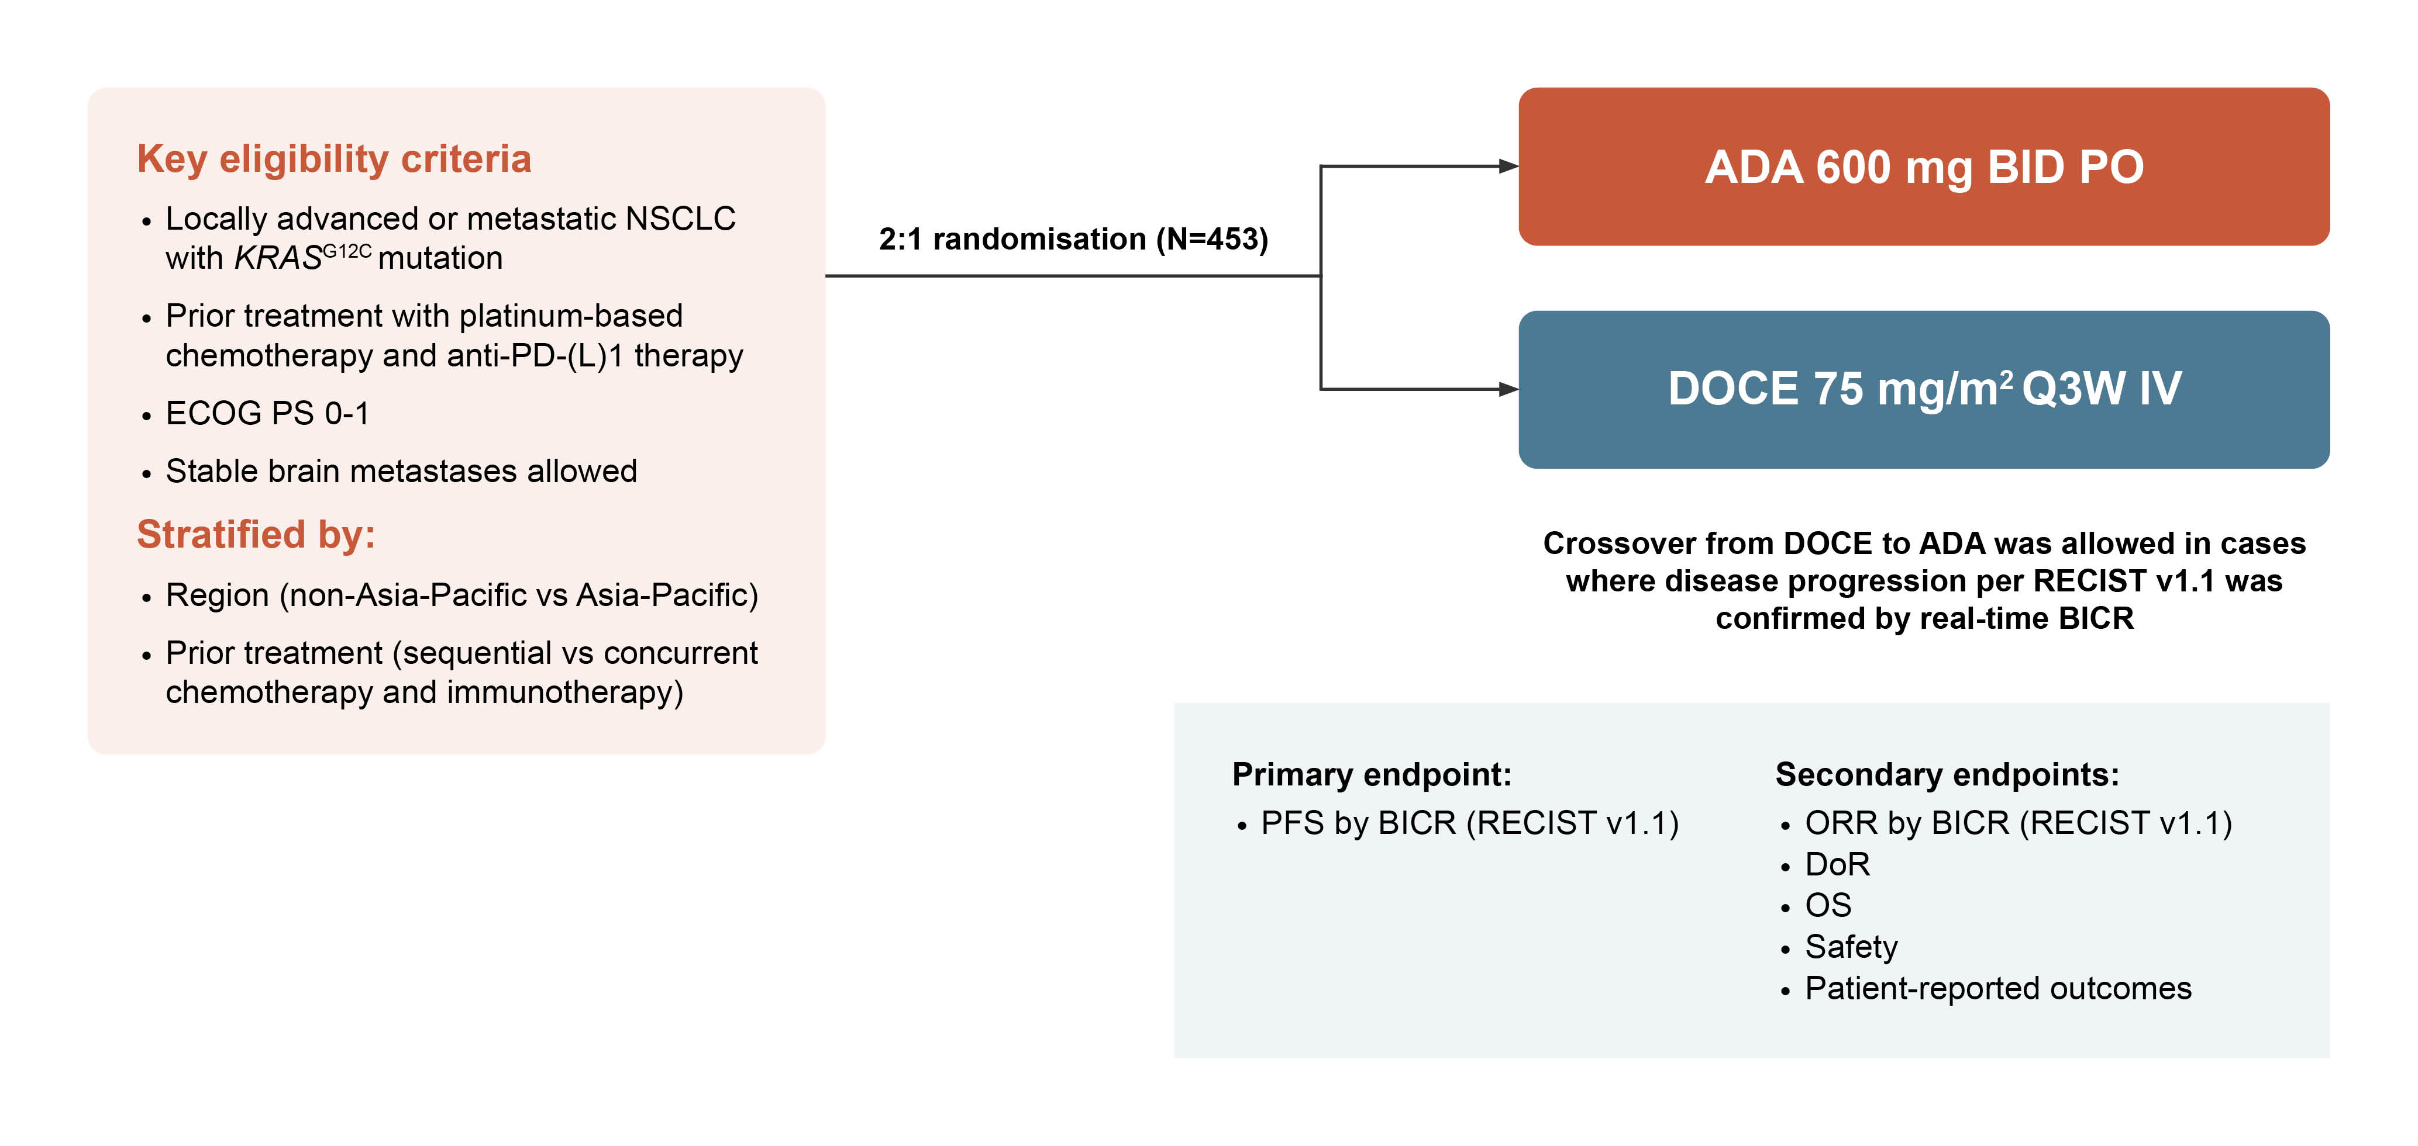
KRYSTAL-12: background and study design
Adagrasib (ADA), a potent covalent inhibitor of KRAS^{G12C}, demonstrated deep and durable responses with promising PFS and OS in patients with previously treated KRAS^{G12C}-mutated NSCLC in the phase 1/2 KRYSTAL-1 trial
KRYSTAL-12 (NCT04685135) is a randomised, open-label phase 3 trial of ADA compared with docetaxel (DOCE) in patients with KRAS^{G12C}-mutated locally advanced or metastatic NSCLC who had previously received a platinum-based chemotherapy, concurrently or sequentially with anti-PD-(L)1 therapy. The primary analysis was reported at ASCO 2024
AE, adverse event; BICR, blinded independent central review; BID, twice daily; DoR, duration of response; ECOG PS, Eastern Cooperative Oncology Group performance status; IV, intravenous; KRAS, Kirsten rat sarcoma virus; NSCLC, non-small cell lung cancer; ORR, objective response rate; OS, overall survival; PD-1, programmed cell death protein 1; PD-L1, programmed death-ligand 1; PFS, progression-free survival; PO, by mouth; Q3W, every 3 weeks; RECIST, Response Evaluation Criteria in Solid Tumours
Mok T, et al. J Clin Oncol 2024;42(suppl 17; abstr LBA8509) (ASCO 2024 oral presentation)

Slide 19
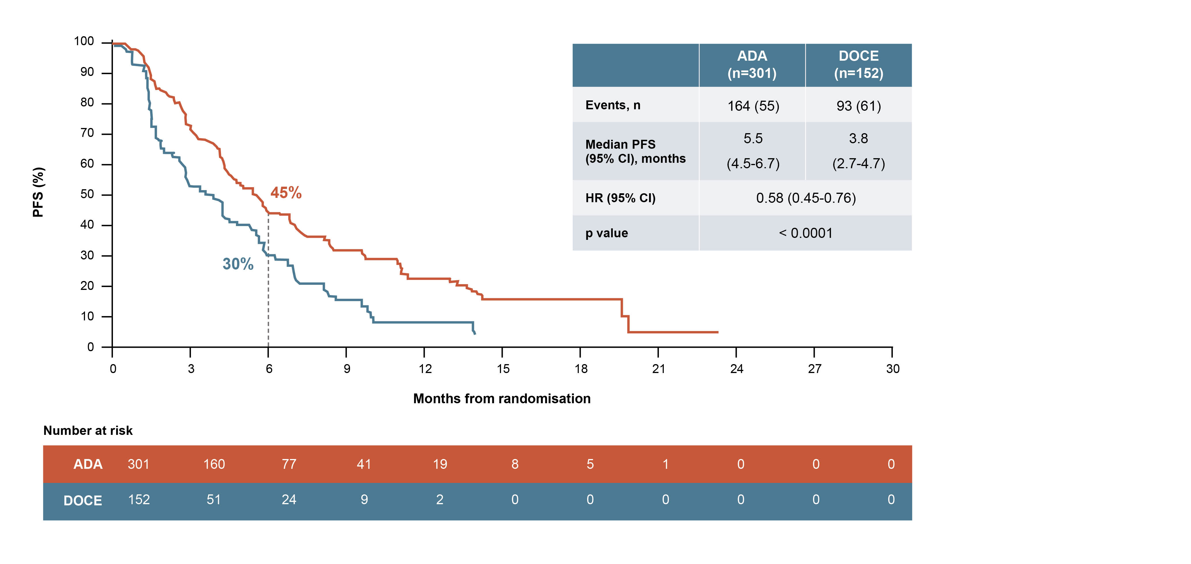
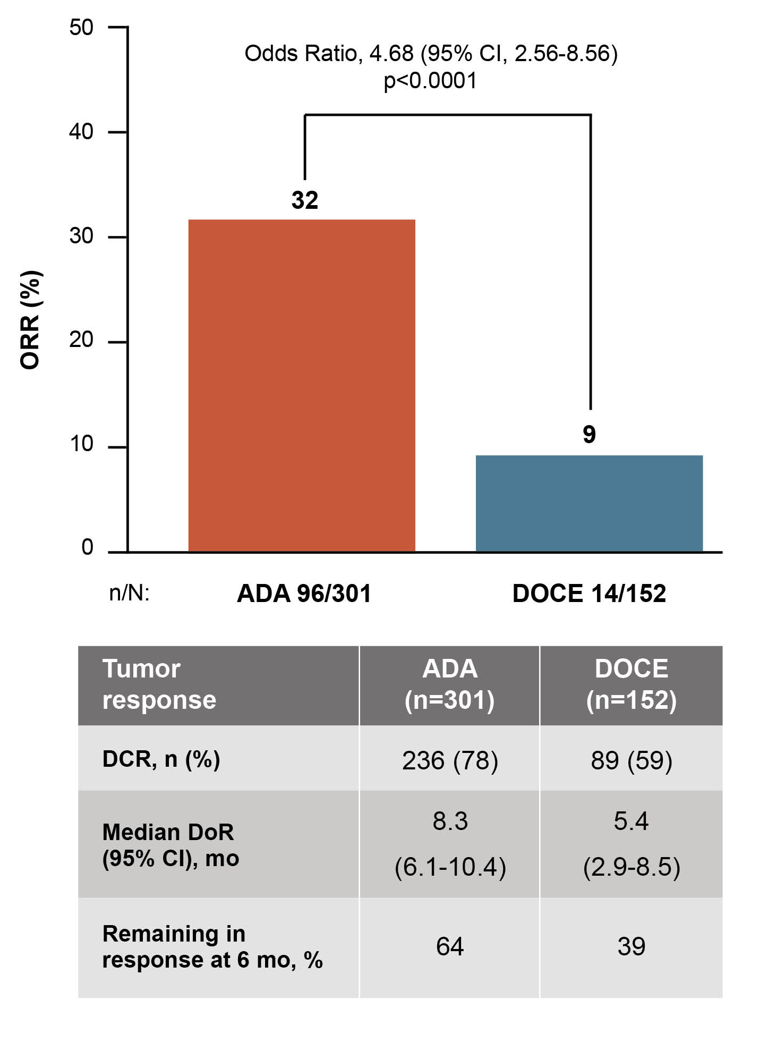
KRYSTAL-12: results
PFS (BICR)
TUMOUR REPONSE (BICR)
Median follow-up: 7.2 months
SAFETY
TRAEs were reported in 94% of pts treated with ADA and 86% with DOCE; grade ≥3 TRAEs occurred in 47% and 46% of pts, respectively
TRAEs led to discontinuation of ADA in 8% of pts and DOCE in 14%
ADA, adagrasib; BICR, blinded central independent review; CI, confidence interval; CR, complete response; DCR, disease control rate; DOCE, docetaxel; DoR, duration of response; HR, hazard ratio; mo, months; ORR, objective response rate; PFS, progression-free survival; PR, partial response; pts, patients; RECIST, Response Evaluation Criteria in Solid Tumours; SD, stable disease; TRAE, treatment-related adverse event
Mok T, et al. J Clin Oncol 2024;42(suppl 17; abstr LBA8509) (ASCO 2024 oral presentation)

Slide 20
KRYSTAL-12: summary
In KRYSTAL-12, ADA demonstrated a statistically significant and clinically meaningful improvement in PFS and ORR over DOCE in patients with previously treated KRAS^{G12C}-mutated NSCLC
The safety profile of ADA was consistent with previous reports and with no new safety signals
These results further support ADA as an efficacious treatment option for pts with previously treated KRAS^{G12C}-mutated locally advanced or metastatic NSCLC
Clinical perspective
Adagrasib has shown improved efficacy compared with the standard of practice of docetaxel, so the study is likely to be practice changing
Adagrasib is generally well-tolerated but there are some concerns about liver toxicity and GI side effects
The study supports early NGS testing rather than individual gene testing
ADA, adagrasib; DOCE, docetaxel; GI, gastrointestinal; KRAS, Kirsten rat sarcoma virus; NGS, next generation sequencing; NSCLC, non-small cell lung cancer; ORR, objective response rate; PFS, progression-free survival
Mok T, et al. J Clin Oncol 2024;42(suppl 17; abstr LBA8509) (ASCO 2024 oral presentation)

Slide 21
Safety and anti-tumour activity of BAY 2927088 in patients with HER2-mutant NSCLC: Results from an expansion cohort of the SOHO-01 phase 1/2 study
Girard N, et al. ASCO 2024. Abstract #LBA8598
HER2, human epidermal growth factor receptor 2; NSCLC, non-small cell lung cancer

Slide 22
Soho-01: background and study design
HER2 mutations have been reported in approximately 2-4% of patients with NSCLC, with exon 20 insertions
being the most common
BAY 2927088 is an oral, reversible tyrosine kinase inhibitor that potently inhibits HER2 and mutant EGFR in preclinical models
Encouraging objective responses were observed in patients with NSCLC harbouring a HER2 activating mutation treated with BAY 2927088 in the dose-escalation/backfill part of the Phase 1/2 SOHO-01 trial (NCT05099172)
The FDA has granted Breakthrough Therapy designation for BAY 2927088 for previously-treated patients with advanced NSCLC and activating HER2 mutations. Here we report the safety, anti-tumour activity, and longitudinal ctDNA data in a cohort of patients treated with BAY 2927088 from the expansion part of this trial
Overall eligibility:
Patients ≥ 18 yrs with advanced HER2-mutant or EGFR-mutant NSCLC who relapsed or were refractory to ≥ 1 systemic therapy
Expansion Cohort D:
Patients with advanced HER2m+ NSCLC (inc. ex20ins) naïve to therapies targeting HER2
Treatment:
BAY 2927088
orally
20 mg bid
Primary objectives:
Safety, tolerability, PK of BAY 2927088 at selected expansion dose
Secondary objectives:
Evaluation of anti-tumour activity
Association of ctDNA and efficacy outcomes
bid, twice daily; ctDNA, circulating tumour DNA; EGFR(m+), epidermal growth factor receptor (mutation positive); ex20ins, exon 20 insertion; FDA, Food and Drug Administration; HER2(m+), human epidermal growth factor receptor 2 (mutation positive); NSCLC, non-small cell lung cancer; PK, pharmacokinetics; yrs, years
Girard N, et al. J Clin Oncol 2024;42(suppl 17; abstr LBA8598) (ASCO 2024 poster)

Slide 23
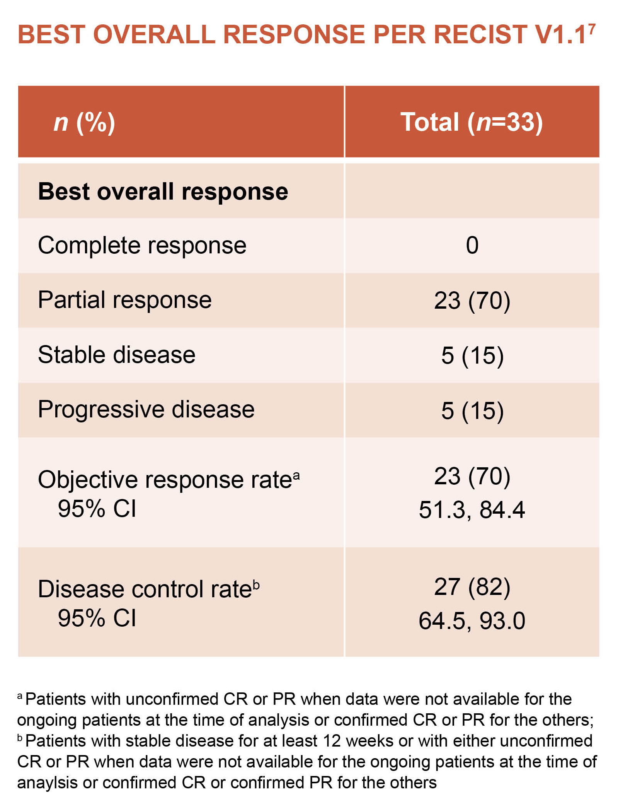
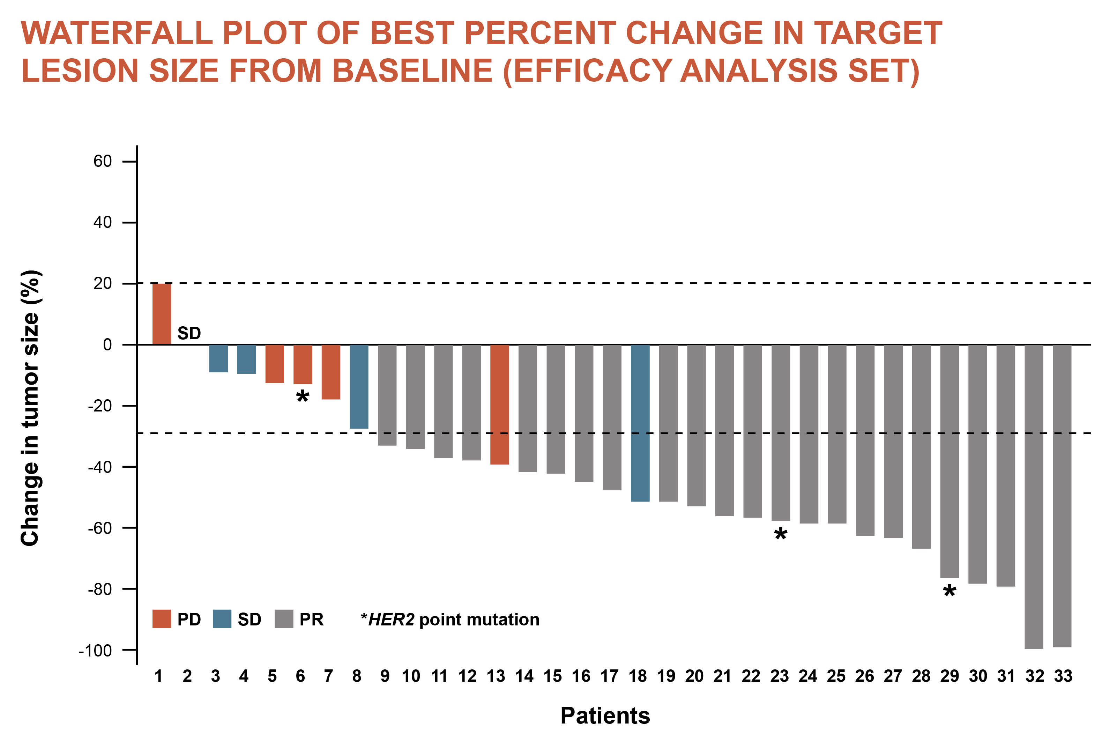
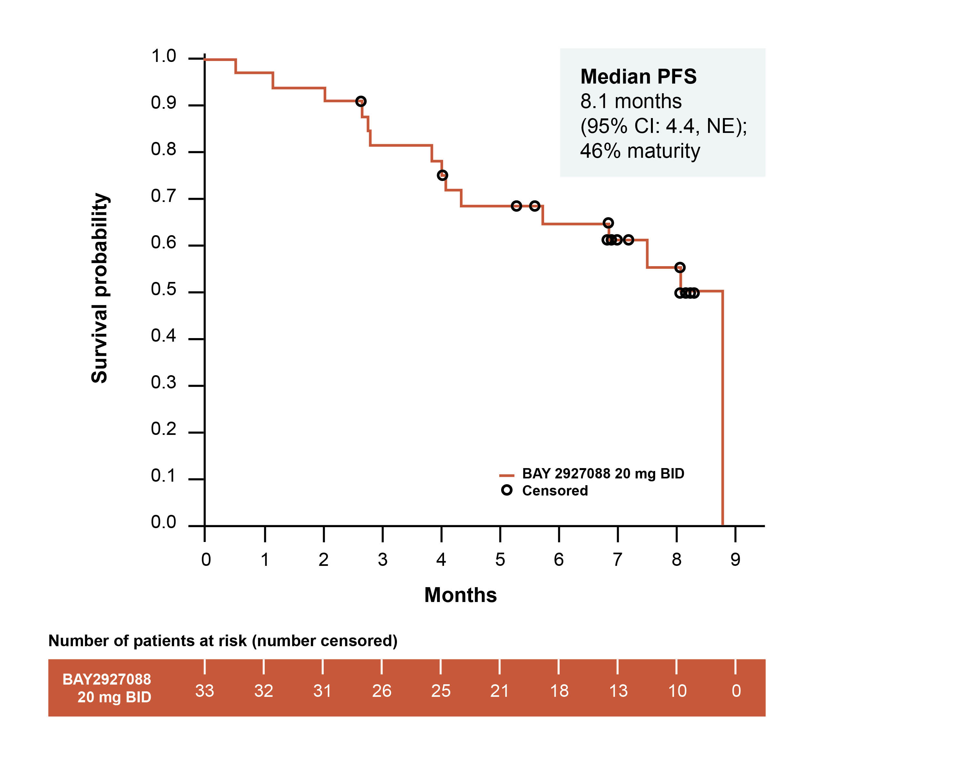
Soho-01: results
Median duration of treatment was 7.1 months (range 0.2-9.2). 34 patients were treated (33 evaluable for efficacy; treatment was ongoing in 17 pts (50%) at data cut-off
Responses were rapid (median TTR: 5.7 weeks) and durable (median DoR: NR)
Change in tumour size (%)
Ten patients had a dose reduction, eight had dose interruptions, and three discontinued study treatment due to a drug-related adverse event. Most common AEs were diarrhoea (85%; mainly grade 1-2) and rash (47%; grade 1-2).
AE, adverse event; bid, twice daily; CI, confidence interval; CR, complete response; DoR, duration of response; NE, not estimable; NR, not reached; PD, partial disease; PR, partial response; pts, patients; SD, stable disease TTR, time to response
Girard N, et al. J Clin Oncol 2024;42(suppl 17; abstr LBA8598) (ASCO 2024 poster)

Slide 24
Soho-01: summary
BAY 2927088 led to rapid, substantial, and durable responses in patients with pretreated HER2-mutant NSCLC
The safety profile was consistent with previously reported data
Changes in ctDNA levels may be an early indicator of clinical benefit
These data support the further clinical development of BAY 2927088 in pts with HER2-mutant NSCLC
ctDNA, circulating tumour DNA; HER2, human epidermal growth factor receptor 2; NSCLC, non-small cell lung cancer; pts, patients
Girard N, et al. J Clin Oncol 2024;42(suppl 17; abstr LBA8598) (ASCO 2024 poster)

Slide 25
Phase 1a/1b trial of zongertinib (BI 1810631), a HER2-specific TKI, in patients with HER2 aberration-positive solid tumours: Updated Phase 1a data from Beamion LUNG-1, including progression-free survival data
Heymach J, et al. ASCO 2024. Abstract #8514
HER2, human epidermal growth factor receptor 2; NSCLC, non-small cell lung cancer

Slide 26
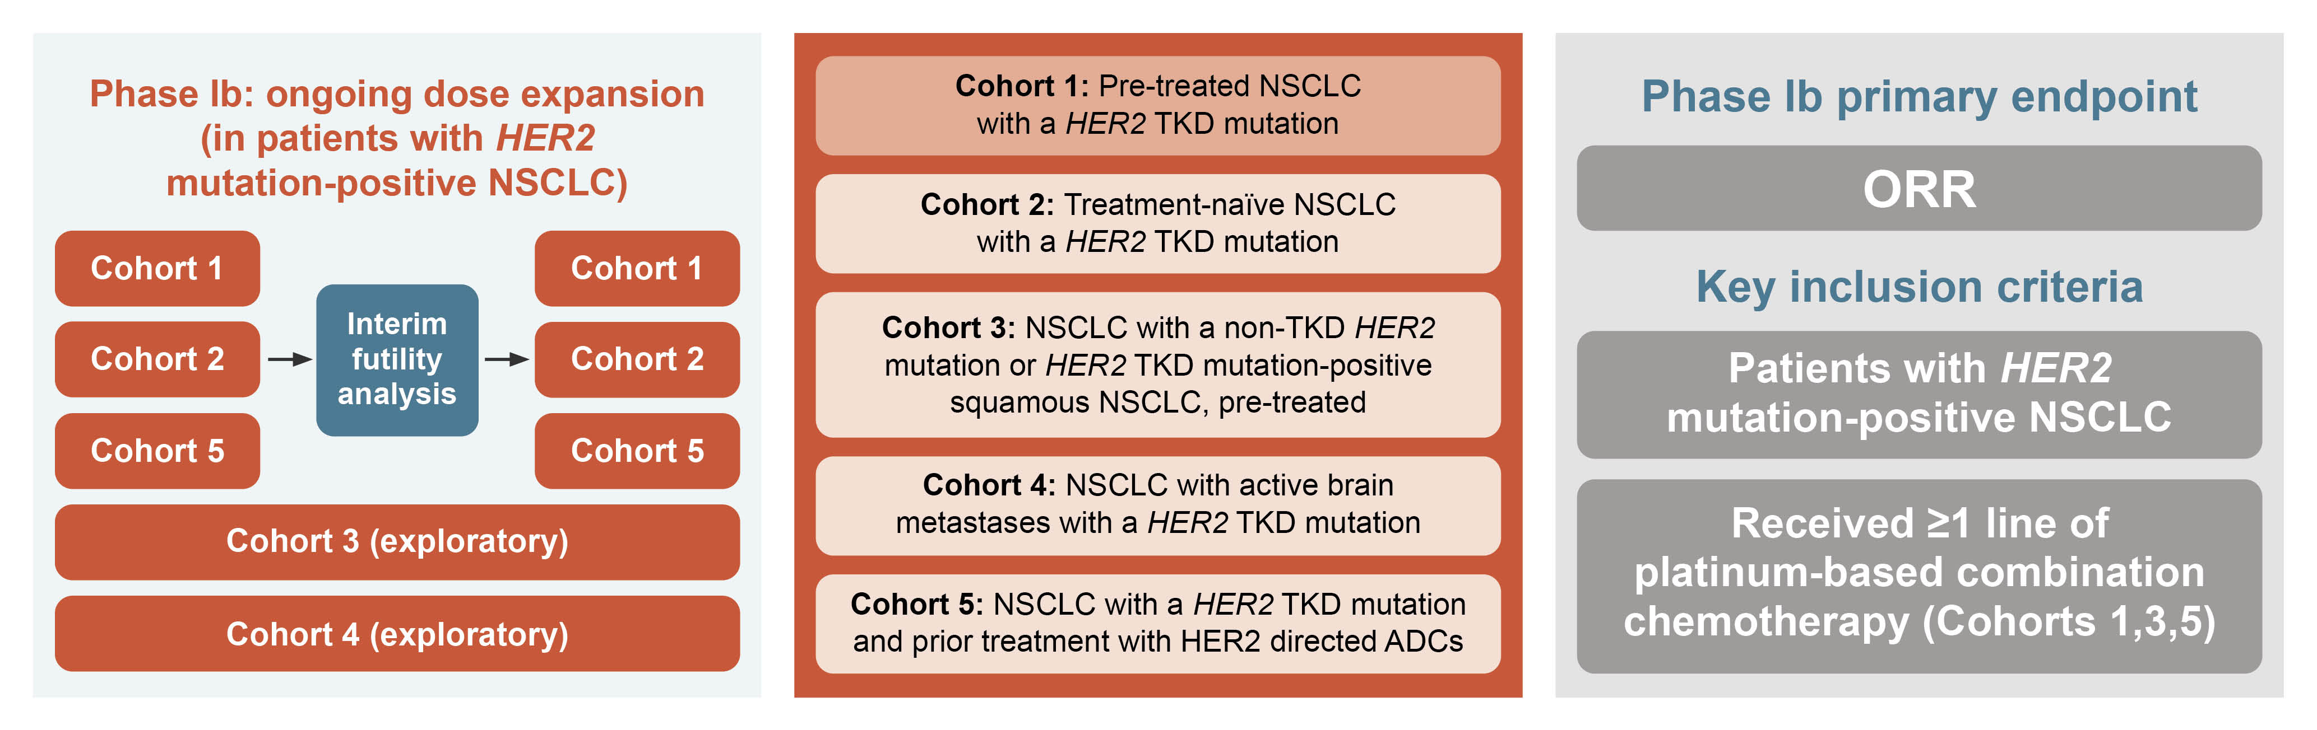
Beamion LUNG-1: background and study design
Zongertinib, a novel HER2-specific TKI, binds selectively and covalently to the HER2 tyrosine kinase domain
while sparing wild-type epidermal growth factor receptor
Beamion LUNG-1 (NCT04886804), a Phase 1a/1b, first-in-human, open-label trial, is evaluating the safety
and efficacy of zongertinib in patients with HER2 aberration-positive solid tumours (Phase 1a) and
HER2 mutation-positive(m+) NSCLC (Phase 1b). Here we report the findings from Phase 1b Cohort 1
ADC, antibody drug conjugate; HER2, human epidermal growth factor receptor 2; NSCLC, non-small cell lung cancer; ORR, objective response rate; TKD, tyrosine kinase domain; TKI, tyrosine kinase inhibitor
Heymach J, et al. J Clin Oncol 2024;42(suppl 16; abstr 8514) (ASCO 2024 oral presentation)

Slide 27
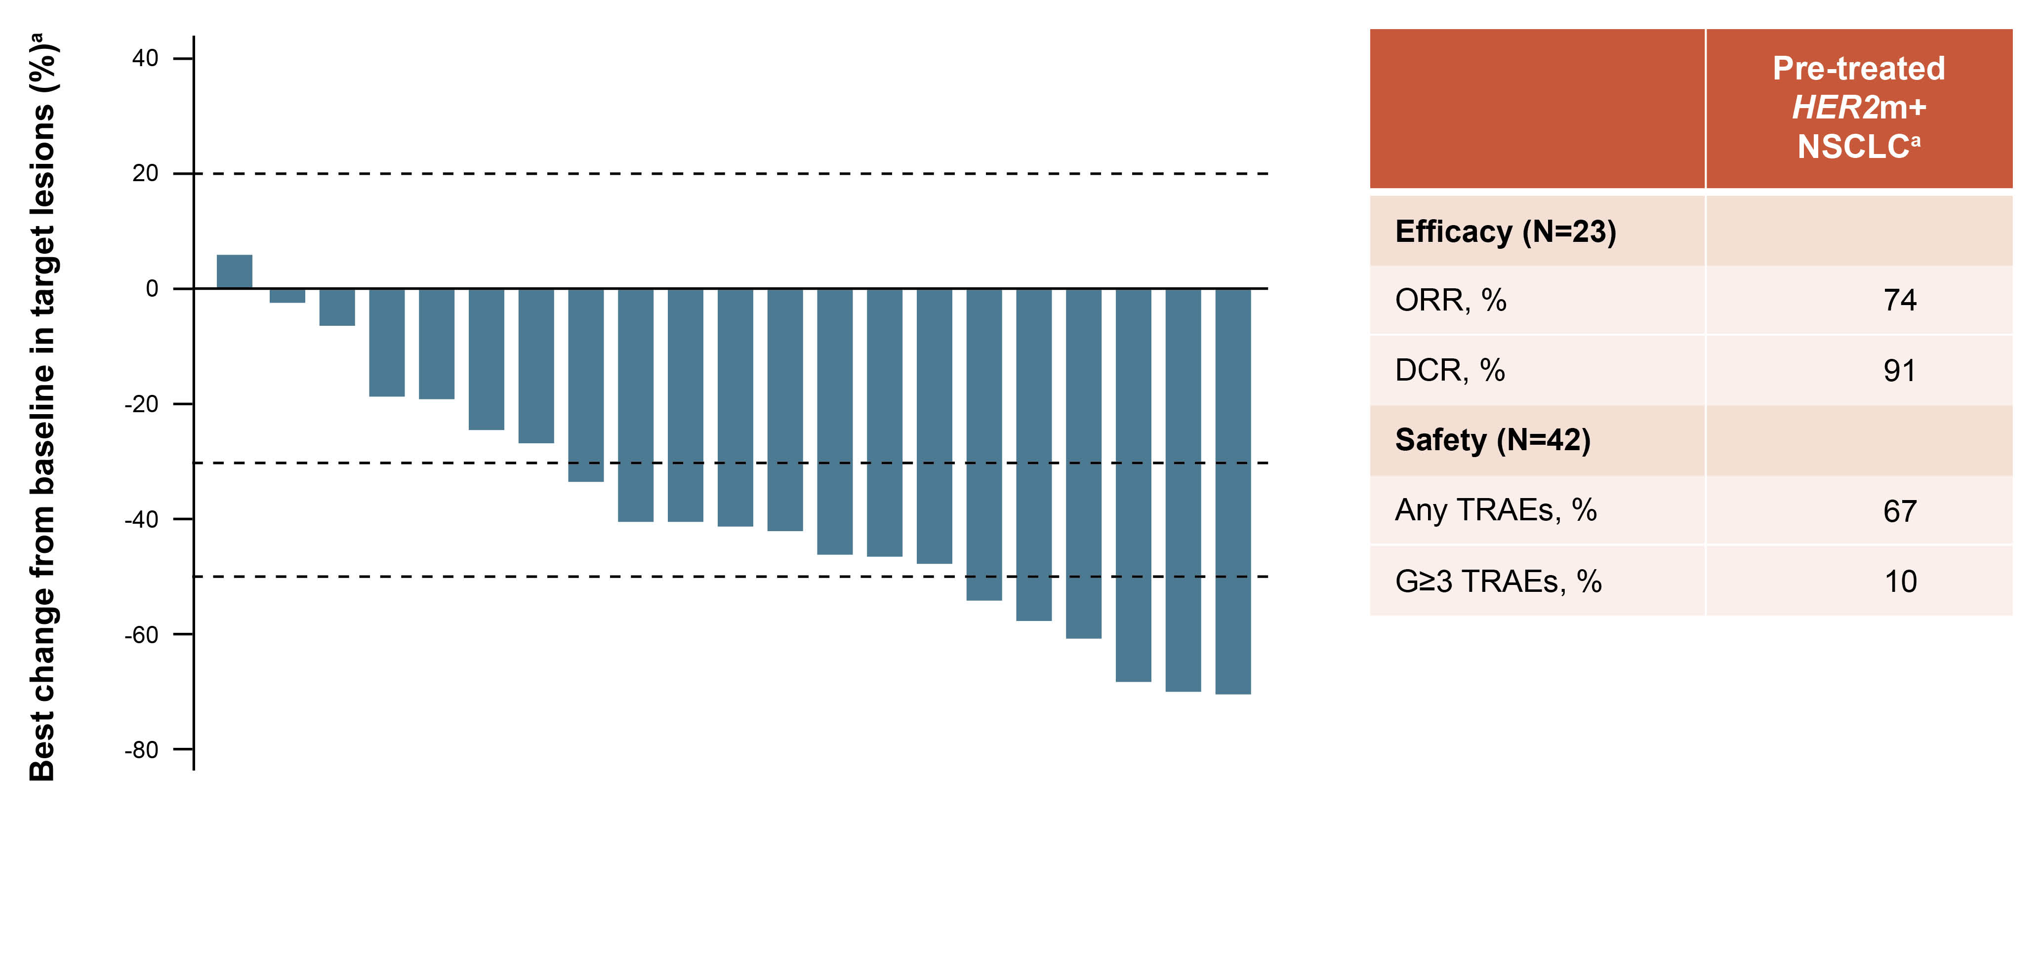
Beamion LUNG-1: results (Phase 1b, Cohort 1)
In a prespecified interim analysis of Phase 1b (July 31, 2023), 42 pts were treated in Cohort 1
(pretreated HER2m+ NSCLC randomised to 120/240 mg QD).
TRAEs (all/G3/G4/G5): 67/5/5/0%, most commonly diarrhoea (G1/G2/G≥3; 24/5/0%)
Serious TRAEs: 5% (n=2; G4 decreased neutrophils, G4 immune thrombocytopenia).
ª Anti-tumour response to zongertinib in 21 patients (with baseline and post-baseline tumour assessments available)
ª Excluding patients treated with ADCs; No AEs led to treatment discontinuation
AE, adverse event; DCR, disease control rate; G, grade; HER2m+, human epidermal growth factor receptor 2 mutation-positive; NSCLC, non-small cell lung cancer; ORR, objective response rate; pts, patients; QD, once daily; TRAE, treatment-related adverse event
Heymach J, et al. J Clin Oncol 2024;42(suppl 16; abstr 8514) (ASCO 2024 oral presentation)

Slide 28
Beamion LUNG-1: summary
The first futility analysis in Cohort 1 was passed
Zongertinib was well-tolerated and demonstrated promising initial efficacy in pre-treated patients
with HER2-mutated NSCLC
HER2, human epidermal growth factor receptor 2; NSCLC, non-small cell lung cancer
Heymach J, et al. J Clin Oncol 2024;42(suppl 16; abstr 8514) (ASCO 2024 oral presentation)

