Slide 2
HCC connect highlights from ESMO 2024
IO and IO based treatments in HCC
Dr Richard Finn, MD
Geffen School of Medicine, UCLA, Los Angeles, CA, USA
SEPTEMBER 2024
ESMO, European Society for Medical Oncology; HCC, hepatocellular carcinoma; IO, immunotherapy

Slide 3

Developed by HCC COnnect
This programme is developed by HCC CONNECT,
an international group of experts in the field of
hepatocellular carcinoma.
Acknowledgement and disclosures
AstraZeneca has provided a sponsorship grant towards this independent programme. The programme
is therefore independent, the content is not influenced by the supporter and is under the sole responsibility of the experts.
Please note: the views expressed within this programme are the personal opinions of the experts.
They do not necessarily represent the views of the experts’ institutions, or the rest of the
HCC CONNECT group.
Expert disclosures:
Dr Richard Finn has received financial support/sponsorship for research support, consultation,
or speaker fees from the following companies: AstraZeneca, Bayer, CStone, Eisai, Eli Lilly, Exelixis, Hengrui, Merck, Pfizer, Roche/Genentech

Slide 4
Clinical takeaways
Highlights from ESMO 2024 - hCC
ABSTRACT 1:
HIMALAYA: results from the extended follow-up set a new benchmark in unresectable
HCC, with one in five patients alive with single tremelimumab regular interval durvalumab (STRIDE) at 5 years
ABSTRACT 2:
CheckMate 9DW: further supports nivolumab + ipilimumab as a potential first-line
treatment option for patients with unresectable HCC
ABSTRACT 3:
LEAP-012: met its primary endpoint. Lenvatinib + pembrolizumab + TACE showed a statistically significant and clinically meaningful improvement in PFS and an early trend
towards improvement in OS versus placebo + TACE in patients with intermediate HCC
ABSTRACT 4:
IMbrave050: does not support atezolizumab + bevacizumab as an adjuvant therapy for all high-risk HCC
ESMO, European Society for Medical Oncology; HCC, hepatocellular carcinoma; OS, overall survival; PFS, progression-free survival; STRIDE, ; TACE, transarterial chemoembolisation

Slide 5
Educational objective
Understand the latest practice-changing HCC data on IO and IO-based treatments
from ESMO and how this could be implemented in clinical practice
ESMO, European Society for Medical Oncology; HCC, hepatocellular carcinoma; IO, immunotherapy

Slide 6
Five-year OS and OS by tumour response measures from the phase 3 HIMALAYA study of tremelimumab plus durvalumab in uHCC
Rimassa L, et al. ESMO 2024. Abstract #947MO. Oral presentation
OS, overall survival; uHCC, unresectable hepatocellular carcinoma

Slide 7
HIMALAYA
Background and study design
Phase 3 HIMALAYA study in unresectable HCC¹: STRIDE significantly improved OS versus sorafenib in the primary analysis² and demonstrated durable long-term survival with a 4-year OS rate of 25.2%³
At ESMO 2024⁴:
  The first 5-year OS analysis in uHCC was reported
  Survival by multiple tumour response measures was evaluated
Study population
Adults with confirmed uHCC
Child–Pugh A
BCLC B (not eligible for locoregional therapy) or C
No prior systemic therapy for HCC
ECOG PS 0 or 1
No main portal vein thrombosis
EGD was not required
Stratification factors
Aetiology of liver disease: HBV vs HCV vs non-viral
MVI: yes vs no
ECOG PS: 0 vs 1
STRIDE (n=393):
tremelimumab 300 mg × 1 dose
+ durvalumab 1500 mg Q4W
Key objectives
Primary:
OS superiority: STRIDE vs sorafenib
Secondary:
OS non-inferiority: durvalumab vs sorafenib
36-month OS rate
PFS, ORR, and DCR (investigator-assessed per RECIST v1.1)
Safety
R
Durvalumab (n=389):
durvalumab monotherapy
1500 mg Q4W
(N=1171)
Sorafenib (n=389):
sorafenib 400 mg BID
T75+D (n=153): arm closed to enrolmentª
tremelimumab 75 mg Q4W × 4 doses
+ durvalumab 1500 mg Q4W
Multiple testing procedure
OS superiority for
STRIDE vs sorafenib
OS non-inferiority for durvalumab vs sorafenib
Non-inferiority margin 1.08
OS superiority for
durvalumab vs sorafenib
36-month OS rate for STRIDE vs sorafenib
Treatment continued until unacceptable toxicity, or any discontinuation criteria were met. Participants with progressive disease who, in the investigator’s opinion, continued to benefit from treatment and met the criteria in the setting of progressive disease could continue treatment
ª The T75+D arm was closed following a preplanned analysis of a Phase 2 study. Participants randomised to this arm (n=153) could continue treatment following arm closure. Results from this arm are not reported in this presentation
BCLC, Barcelona Clinic Liver Cancer; BID, twice daily; DCR, disease control rate; ECOG PS, Eastern Cooperative Oncology Group performance status; EGD, esophagogastroduodenoscopy; ESMO, European Society for Medical Oncology; HBV, hepatitis B virus; HCC, hepatocellular carcinoma; HCV, hepatitis C virus; MVI, macrovascular invasion; ORR, objective response rate; OS, overall survival; PFS, progression-free survival; Q4W, every 4 weeks; R, randomised; RECIST, Response Evaluation Criteria in Solid Tumours; STRIDE, single tremelimumab regular interval durvalumab; uHCC, unresectable hepatocellular carcinoma
1. ClinicalTrials.gov: NCT03298451; 2. Abou-Alfa GK, et al. NEJM Evid. 2022;1:EVIDoa2100070; 3. Sangro B, et al. Ann Oncol. 2024;35:448-57; 4. Rimassa L, et al. ESMO 2024. Abstract #947MO. Oral presentation

Slide 8
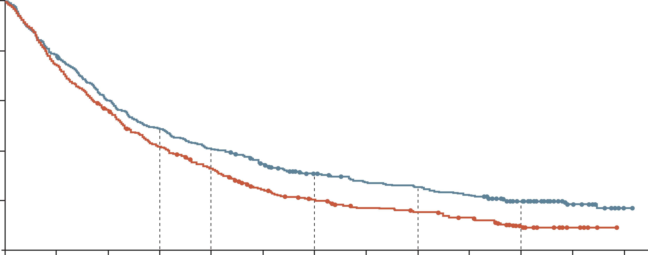
HIMALAYA
RESULTS: STRIDE Demonstrated a sustained OS benefit
STRIDE demonstrated a sustained OS benefit versus sorafenib at 5 years
1.0
0.8
OS rate
ratio: 1.17
18-mo OS:
48.7%
41.5%
 | STRIDE (n=393) | Sorafenib (n=389)
OS events, n (%) | 309 (78.6) | 332 (85.3)
Median OS (95% CI), mo | 16.43 (14.16-19.58( | 13.77 (12.25-16.13)
HR (95% CI) p value (2-sided) | 0.76 (0.65-0.89) 0.0008
Median follow-up duration (95% CI), mo | 62.49 (59.47-64.79) | 59.86 (58.32-61.54)
0.6
24-mo OS:
40.5%
32.6%
Probability of OS
36-mo OS:
30.7%
19.9%
0.4
OS rate
ratio: 1.17
48-mo OS:
25.2%
15.1%
60-mo OS:
19.6%
9.4%
OS rate
ratio: 1.24
0.2
OS rate
ratio: 1.54
OS data maturity
across the STRIDE and
sorafenib arms: 82.0%
OS rate
ratio: 1.67
0.0
OS rate
ratio: 2.09
0
6
12
18
24
30
36
42
48
54
60
66
72
No. at risk
STRIDE
Sorafenib
Time from randomisation (months)
393
389
308
283
235
211
190
155
158
121
131
84
104
66
89
51
83
45
72
37
46
18
20
6
2
0
There were no additional serious safety events
OS benefit with STRIDE was enhanced in participants experiencing disease control
(OS rates of 28.7% for STRIDE vs 12.7 for sorafenib at 5 years)
More participants treated with STRIDE than sorafenib had deep responses (>50%)
OS HRs and 95% CIs were calculated using a Cox proportional hazards model adjusting for treatment aetiology, ECOG PS, and MVI. Updated analysis data cutoff: March 1, 2024
CI, confidence interval; ECOG PS, Eastern Cooperative Oncology Group performance status; HR, hazard ratio; mo, month(s); MVI, macrovascular invasion; OS, overall survival; STRIDE, single tremelimumab regular interval durvalumab
Rimassa L, et al. ESMO 2024. Abstract #947MO. Oral presentation

Slide 9
HIMALAYA summary
STRIDE demonstrated an unprecedented 5-year survival rate
  There were no additional serious treatment-related adverse events (TRAEs) in the extended
  follow-up
The improved OS outcomes observed across multiple tumour response evaluations provide novel insights on the clinical benefit of dual immune checkpoint inhibition beyond conventional response measures
The results set a new benchmark in uHCC, with one in five patients alive with
STRIDE at 5 years
Clinical perspective
HIMALAYA presents the longest follow-up to date in Phase 3 studies in uHCC
Conventional response measures may not fully capture the benefits of STRIDE
Data support that STRIDE is a live-prolonging regimen
OS, overall survival; STRIDE, single tremelimumab regular interval durvalumab; uHCC, unresectable hepatocellular carcinoma
Rimassa L, et al. ESMO 2024. Abstract #947MO. Oral presentation; Harding J. ESMO 2024. Invited discussant for Abstracts #965MO and #947MO

Slide 10
Nivolumab plus ipilimumab vs lenvatinib or sorafenib as first-line treatment for uHCC: Expanded analyses from
CheckMate 9DW
Decaens T, et al. ESMO 2024. Abstract #965MO. Oral presentation
uHCC, unresectable hepatocellular carcinoma

Slide 11
CheckMate 9DW
Background and study design
Phase 3 CheckMate 9DW in uHCC¹: first-line nivolumab + ipilimumab demonstrated significant and clinically meaningful OS benefit versus lenvatinib/sorafenib
At ESMO 2024²: additional exploratory analyses from a preplanned interim analysis (IA) were presented
Key eligibility criteria
uHCCª
≥1 measurable lesion (RECIST v1.1)
Systemic therapy naive
Child–Pugh score 5 or 6
ECOG PS 0 or 1
No main portal vein invasion (Vp4)
NIVO 1 mg/kg IV + IPI 3 mg/kg IV Q3W (up to 4 cycles) then NIVO 480 mg Q4W^{c}
Primary endpoint
OS
Secondary endpoints
ORR and DOR by BICR per RECIST v1.1
Key exploratory endpoints
PFS by investigator per RECIST v1.1
PFS2 by investigator
Safety
n=335
N=668
R
1:1
Investigator’s choice of LEN 8 mg^{d} or
12 mg^{e} PO QD or SOR 400 mg PO BID
n=333
Stratification factors
Aetiology (HBV vs HCV vs uninfected)^{b}
MVI/EHS (present vs absent)
AFP (<400 vs ≥400 ng/mL)
Treatment until disease progression, unacceptable toxicity, withdrawal of consent (all arms), or a maximum treatment duration of 2 years (NIVO + IPI arm only)
Among 325 patients treated with LEN or SOR:
275 (85%) received LEN and 50 (15%) received SOR
At data cutoff (January 31, 2024), the median follow-upf was 35.2 months (range, 26.8-48.9)
ª Disease not eligible for, or progressive disease after, curative surgical and/or locoregional therapies; ^{b} Based on central lab serology results for stratification purpose;
^{c} Minimum of 1 dose of nivolumab + ipilimumab is required before proceeding to nivolumab monotherapy; ^{d} If body weight <60 kg; ^{e} If body weight ≥60 kg; ^{f} Time between randomisation date and cutoff date
AFP, alpha-fetoprotein; BICR, blinded independent central review; BID, twice daily; DOR, duration of response; ECOG PS, Eastern Cooperative Oncology Group performance status; EHS, extrahepatic spread; ESMO, European Society for Medical Oncology; HBV, hepatitis B virus; HCV, hepatitis C virus; IPI, ipilimumab; IV, intravenous; LEN, lenvatinib; MVI, macrovascular invasion; NIVO, nivolumab; ORR, objective response rate; OS, overall survival; PFS, progression-free survival; PFS2, second progression-free survival; PO, oral; Q3W, every 3 weeks; Q4W, every 4 weeks; QD, once daily; R, randomised; RECIST, Response Evaluation Criteria in Solid Tumours; SOR, sorafenib; uHCC, unresectable hepatocellular carcinoma
1. ClinicalTrials.gov: NCT04039607; 2. Decaens T, et al. ESMO 2024. Abstract #965MO. Oral presentation

Slide 12
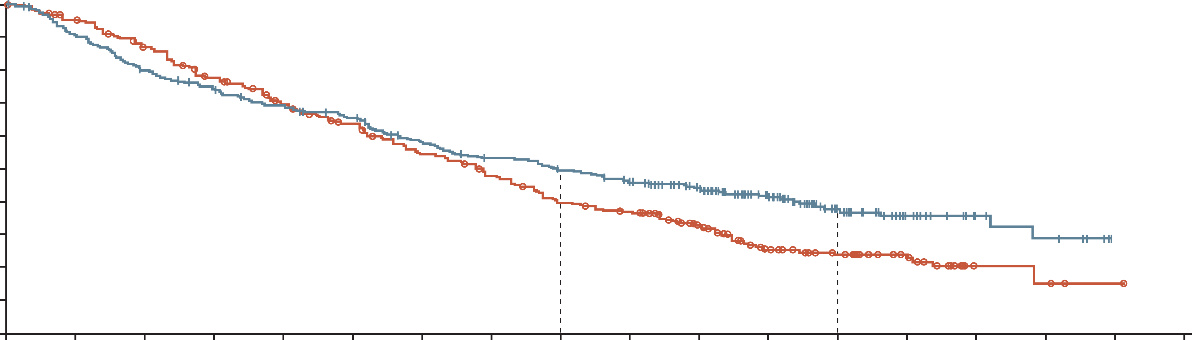
CheckMate 9DW
RESULTS: Primary endpoint was met
There was a statistically significant and clinically meaningful OS benefit with nivolumab + ipilimumab versus lenvatinib or sorafenib
OS
TRAEs
 | NIVO + IPI (n=335) | LEN or SOR (n=333)
Events | 194 | 228
Median OS (95% CI), mo | 23.7 (18.8-29.4) | 20.6 (17.5-22.5)
HR (95% CI) p valueª | 0.79 (0.65-0.96) 0.018
All treated patients, n (%) | Nivolumab + ipilimumab (n=332) |  |  | Lenvatinib or sorafenib (n=325)
 | Any grade | Grade 3 or 4 | Any grade leading to D/C | Any grade | Grade 3 or 4 | Any grade leading to D/C
Any TRAEs^{b} | 278 (84) | 137 (41) | 59 (18) | 297 (91) | 138 (42) | 34 (10)
Treatment-related hepatic events
Hepatobiliary disorders | 44 (13) | 35 (11) | 15 (5) | 15 (5) | 10 (3) | 4 (1)
Hepatobiliary investigations^{c} AST increased ALT increased Bilirubin increased | 65 (20) 63 (19) 14 (4) | 20 (6) 16 (5) 1 (<1) | 4 (1) 3 (<1) 1 (<1) | 27 (8) 19 (6) 23 (7) | 2 (<1) 3 (<1) 5 (2) | 1 (<1) 0 1 (<1)
Treatment-related deaths^{d} | 12 (4)^{e} |  |  | 3 (<1)^{f}
100
90
80
70
24-mo rate
60
49%
36-mo rate
OS (%)
50
40
38%
NIVO + IPI
30
39%
20
24%
10
LEN/SOR
0
0
3
6
9
12
15
18
21
24
27
30
33
36
39
42
45
48
51
Time (months)
No. at risk
NIVO + IPI
LEN/SOR
335
333
300
310
264
280
239
245
220
216
206
194
179
164
162
144
150
116
137
106
104
76
71
44
42
34
24
20
11
4
8
3
0
1
0
0
Median OS is estimated using Kaplan–Meier methodology. HR and 95% CI from stratified Cox proportional hazards model. HR is nivolumab + ipilimumab over lenvatinib or sorafenib. Symbols represent censored observations
ª Two-sided p value from stratified log-rank test. Boundary for statistical significance: p≤0.0257; ^{b} Includes events reported between first dose and 30 days after the last dose of study therapy; ^{c} Reported in ≥5% of patients; ^{d} Treatment-related deaths were reported irrespective of timeframe; ^{e} TRAEs leading to death included immune-mediated hepatitis (n=4), hepatic failure (n=3), and hepatic insufficiency, decompensated cirrhosis, diarrhoea-colitis, autoimmune haemolytic anaemia, and dysautonomia (n=1 each). In the nivolumab + ipilimumab arm, 2 patients with hepatic-related causes of death died at least 90 days after the last dose of study treatment. Furthermore, disease progression per BICR was confirmed in 1 patient (with hepatic failure as cause of death) and was suspected by imaging test in 3 additional patients (2 with immune-mediated hepatitis as cause of death and one with hepatic cirrhosis as cause of death); ^{f} TRAEs leading to death included hepatorenal syndrome, ischaemic stroke, and acute kidney injury (n = 1 each)
ALT, alanine aminotransferase; AST, aspartate aminotransferase; CI, confidence interval; D/C, discontinuation; HR, hazard ratio; IPI, ipilimumab; LEN, lenvatinib; NIVO, nivolumab;
mo, month(s); OS, overall survival; SOR, sorafenib; TRAE, treatment-related adverse event
Decaens T, et al. ESMO 2024. Abstract #965MO. Oral presentation

Slide 13
CheckMate 9DW summary
Nivolumab + ipilimumab demonstrated statistically significant OS benefit versus lenvatinib or sorafenib, with higher ORR and durable responses, in patients with previously untreated uHCC¹
Safety was manageable and consistent with the established safety profile of the regimen
Results further support nivolumab + ipilimumab as a potential first-line treatment option for patients with uHCC
Clinical perspective²
CheckMate 9DW confirms the efficacy of dual CTLA4 and PD1/PD-L-1 blockade in treatment-naive advanced HCC
Waiting for the 5-year follow-up data
Nivolumab + ipilimumab is likely to become a standard-of-care treatment option in the future
CTL4A, cytotoxic T-lymphocyte associated protein 4; HCC, hepatocellular carcinoma; ORR, objective response rate; OS, overall survival; PD1, programmed death 1; PD-L1, programmed death ligand 1; ORR, objective response rate; OS, overall survival; uHCC, unresectable HCC
1. Decaens T, et al. ESMO 2024. Abstract #965MO. Oral presentation; 2. Harding J. ESMO 2024. Invited discussant for Abstracts #965MO and #947MO

Slide 14
TACE With or Without Lenvatinib + Pembrolizumab for Intermediate-Stage HCC: Phase 3 LEAP-012 Study
Llovet J, et al. ESMO 2024. Abstract #LBA3. Oral presentation
HCC, hepatocellular carcinoma; TACE, transarterial chemoembolisation

Slide 15
LEAP-012
Background and study design^{1,2}
TACE remains standard of care for patients with intermediate-stage HCC
At ESMO 2024³: results from the Phase 3 LEAP-012 were presented, evaluating lenvatinib + pembrolizumab + TACE versus placebo + TACE in intermediate-stage HCC
Key eligibility criteria
Confirmed HCC not amenable to curative treatment
≥1 measurable HCC lesion per RECIST v1.1
All lesions treatable with TACE in 1 or 2 sessions
No portal vein thrombosis or extrahepatic disease
Child–Pugh liver class A
ECOG PS 0 or 1
Lenvatinib 12 mg (BW ≥60 kg) or
8 mg (BW <60 kg) PO QD
+
pembrolizumab 400 mg IV Q6W (up to 2 years)
+
TACE^{b}
Endpoints
Primary
PFS^{c} and OS
  IA1 is the final analysis for PFS
  Initial alpha of 0.025 (1-sided) allocated to PFS; passed to OS if PFS is statistically significant
Secondary
Secondary: ORR,^{c,d} DOR,^{c,d} TTP,^{c,d} PFS,^{d} and safety
R
1:1
Placebo PO QD +
placebo IV Q6W (up to 2 years)
+
TACE^{b}
Stratification factors
Study site
AFP (≤400 ng/mL vs >400 ng/mL)
ECOG PS (0 vs 1)
Albumin-bilirubin grade (1 vs 2 or 3)
Tumour burden score^{1,a} (≤6 vs >6 but ≤12 vs >12)
ª Largest tumour in cm + number of tumours; ^{b} 2-4 weeks after the start of systemic therapy with a maximum of 2 treatments per tumour (4 total) and no more than 1 treatment per month; ^{c} Per RECIST v1.1 by BICR; ^{d} Per mRECIST by BICR
AFP, alpha fetoprotein; BICR, blinded independent central review; BW, body weight; DOR, duration of response; ECOG PS, Eastern Cooperative Oncology Group performance status; ESMO, European Society for Medical Oncology; HCC, hepatocellular carcinoma; IA1, interim analysis 1; IV, intravenous; mRECIST, modified RECIST; ORR, objective response rate; OS, overall survival; PFS, progression-free survival; PO, oral; Q6W, every 6 weeks; QD, once daily; R, randomised; RECIST, Response Evaluation Criteria in Solid Tumours; TACE, transarterial chemoembolisation; TTP, time to progression
1. ClinicalTrials.gov: NCT04246177; 2. Wang Q, et al. J Hepatol. 2019;70:893-903; 3. Llovet J, et al. ESMO 2024. Abstract #LBA3. Oral presentation

Slide 16
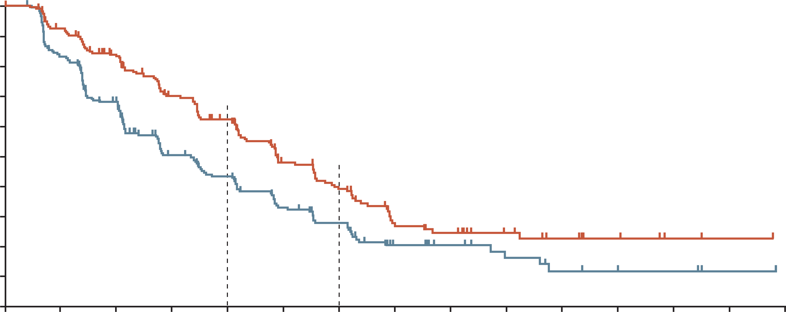
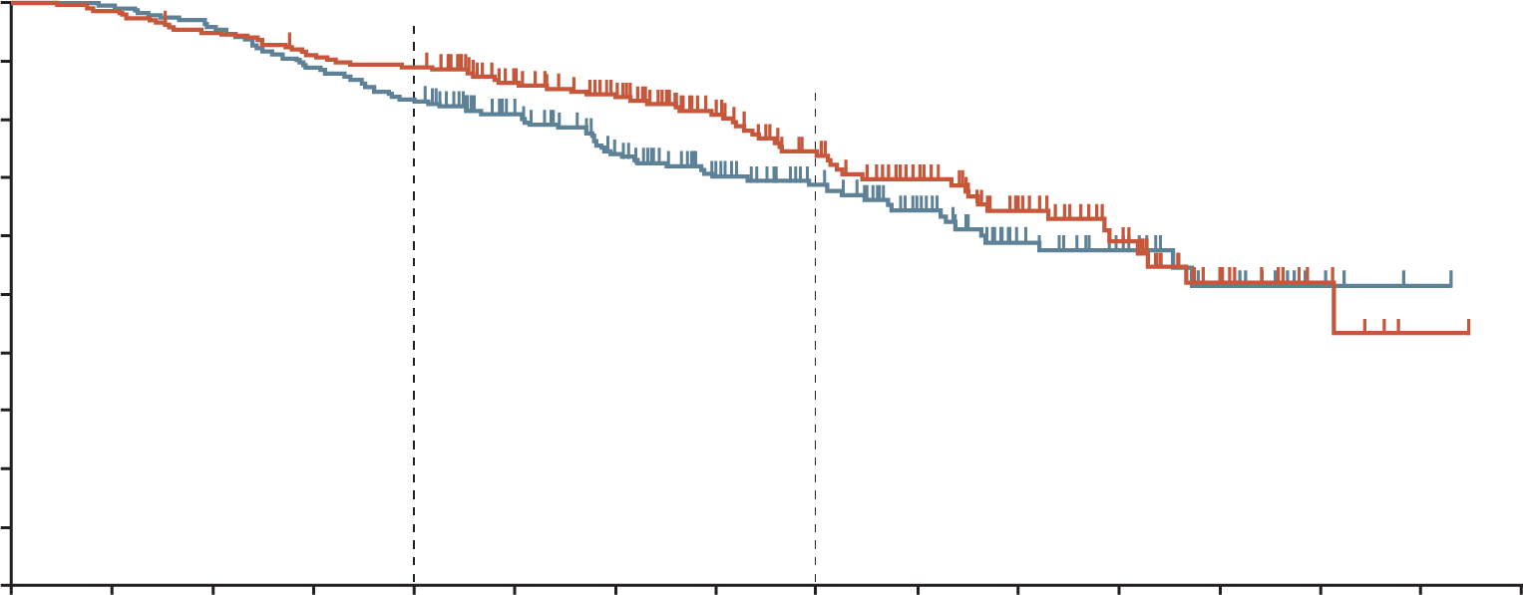
LEAP-012
RESULTS: Primary endpoint in PFS was met
There was a clinically meaningful and statistically significant improvement in PFS for patients with intermediate-stage HCC who received lenvatinib + pembrolizumab + TACE versus dual placebo + TACE
PFS PER RECIST V1.1 BY BICR
OS
 | Lenvatinib + pembrolizumab + TACE | Dual placebo + TACE
Events, n (%) | 69 (29.1) | 82 (33.7)
HR (95% CI) p value^{b} | 0.80 (0.57-1.11) 0.0867
100
 | Lenvatinib + pembrolizumab + TACE | Dual placebo + TACE
Events, n (%) | 132 (55.7) | 154 (63.4)
Median (95% CI), months | 14.6 (12.6-16.7) | 10.0 (8.1-12.2)
HR (95% CI) p valueª | 0.66 (0.51-0.84) 0.0002
100
89.0%
74.6%
90
90
68.6%
80
62.2%
80
83.1%
70
43.4%
70
60
39.1%
60
PFS (%)
27.9%
OS (%)
50
50
40
40
30
30
20
20
10
10
0
0
3
6
9
12
15
18
21
24
27
30
33
36
39
42
0
0
3
6
9
12
15
18
21
24
27
30
33
36
39
42
45
No. at risk
Time (months)
No. at risk
Time (months)
237
243
207
190
176
144
136
89
112
72
72
48
57
37
26
18
22
12
15
8
10
5
7
3
2
3
1
1
0
0
237
243
234
242
224
233
214
216
209
202
180
173
161
145
124
112
95
86
74
65
49
42
31
27
17
15
7
4
1
1
0
0
Although immature, a favourable OS trend was observed
The safety profile of lenvatinib + pembrolizumab, in combination with TACE, was manageable
and consistent with known safety profiles
Data cutoff date for IA1: January 30, 2024; ª One-sided p value from re-randomisation test; threshold p=0.025; ^{b} One-sided p from re-randomisation test; threshold p=0.0012
BICR, blinded independent central review; CI, confidence interval; HCC, hepatocellular carcinoma; HR, hazard ratio; IA1, interim analysis 1; OS, overall survival PFS, progression-free survival; RECIST, Response Evaluation Criteria in Solid Tumours; TACE, transarterial chemoembolisation
Llovet J, et al. ESMO 2024. Abstract #LBA3. Oral presentation

Slide 17
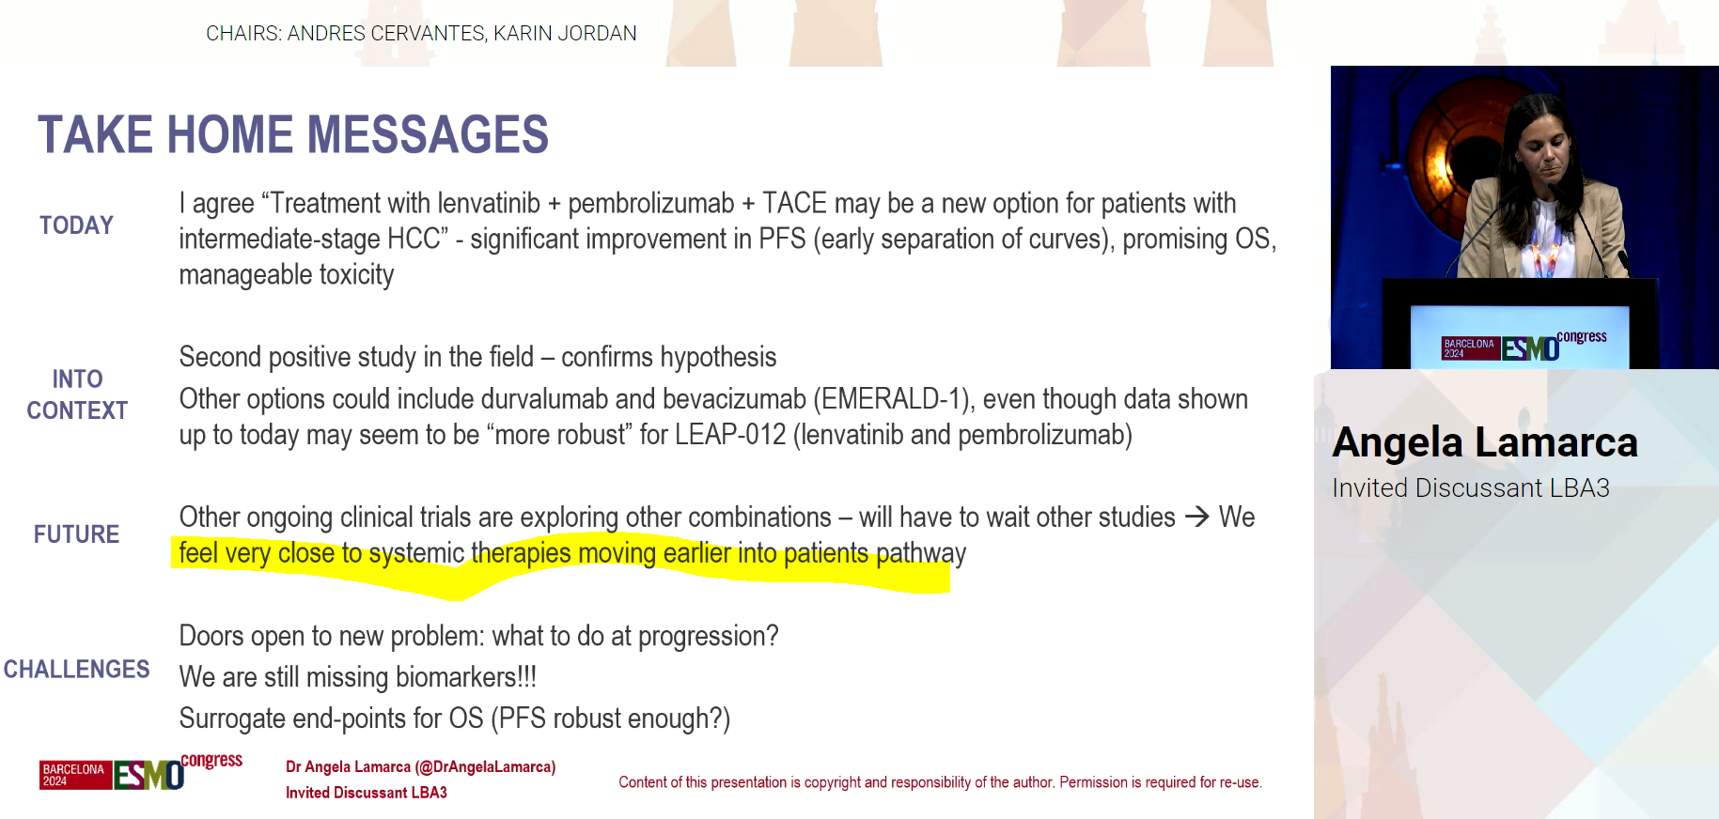
LEAP-012 summary¹
LEAP-012 met its primary endpoint
  Lenvatinib + pembrolizumab + TACE showed a statistically significant and clinically meaningful improvement in PFS versus double placebo + TACE in patients with intermediate-stage HCC
  There was an early trend toward improvement in OS versus placebo + TACE in patients with intermediate-stage HCC
    OS will be retested in future analyses
The adverse event profile was consistent with known safety profiles of lenvatinib, pembrolizumab, and TACE
Clinical perspective²
Lenvatinib + pembrolizumab + TACE may be accepted as a new standard of care in intermediate HCC
It is expected that systemic therapies will move to earlier disease stages shortly
HCC, hepatocellular carcinoma; OS, overall survival; PFS, progression free survival; TACE, transarterial chemoembolisation
1. Llovet J, et al. ESMO 2024. Abstract #LBA3. Oral presentation; 2. Lamarca A. ESMO 2024. Invited discussant for Abstract #LBA3

Slide 18
Updated efficacy and safety data from IMbrave050: Phase 3 study of adjuvant atezolizumab + bevacizumab versus active surveillance in patients with resected or ablated high-risk HCC
Yopp A, et al. ESMO 2024. Abstract #LBA39. Oral presentation
HCC, hepatocellular carcinoma

Slide 19
IMbrave050
Background and study design
Phase 3 IMbrave050¹: at the pre-specified IA IMbrave050 met its primary endpoint of improved independent review facility (IRF)-assessed recurrence-free survival (RFS) in patients with high-risk HCC. OS was immature
At ESMO 2024²: updated analyses were presented for atezolizumab + bevacizumab
versus active surveillance for patients with high-risk HCC
Patient population
Confirmed first diagnosis of HCC and had undergone curative resection or ablation
Disease free
Child–Pugh liver class A
High risk of recurrenceª
No extrahepatic disease or MVI (except Vp1/Vp2)
ECOG PS of 0 or 1
12 months or 17 cycles
Atezolizumab 1200 mg Q3W +
bevacizumab 15 mg/kg Q3W
(n=334)
4-12 weeks
R
1:1
Recurrence^{b} or
unacceptable toxicity
Survival follow-up
1 cycle of
TACE, If
indicated
Active surveillance
(n=334)
Stratification factors
Region (Asia–Pacific excluding Japan vs rest of world)
High-risk features and procedures:
  Ablation
  Resection, 1 risk feature, adjuvant TACE (yes vs no)
  Resection, ≥2 risk features, adjuvant TACE (yes vs no)
Primary endpoints
IRF-assessed RFS^{b}
(descriptive for this analysis)
Secondary endpoints
OS
Safety
Crossover permitted
ª High-risk features include: tumour >5 cm, >3 tumours, microvascular invasion, minor MVI Vp1/Vp2, or grade 3/4 pathology; ^{b} Intrahepatic recurrence defined by EASL criteria. Extrahepatic recurrence defined by RECIST 1.1
ClinicalTrials.gov: NCT04102098. EASL, European Association for the Study of the Liver; ECOG PS, Eastern Cooperative Oncology Group performance status;
ESMO, European Society for Medical Oncology; HCC, hepatocellular carcinoma; IA, interim analysis; MVI, macrovascular invasion; OS, overall survival; Q3W, every 3 weeks;
R, randomised; RECIST, Response Evaluation Criteria in Solid Tumours; TACE, transarterial chemoembolisation
1. Qin S, et al. Lancet. 2023;402:1835-47; 2. Yopp A, et al. ESMO 2024. Abstract #LBA39. Oral presentation

Slide 20
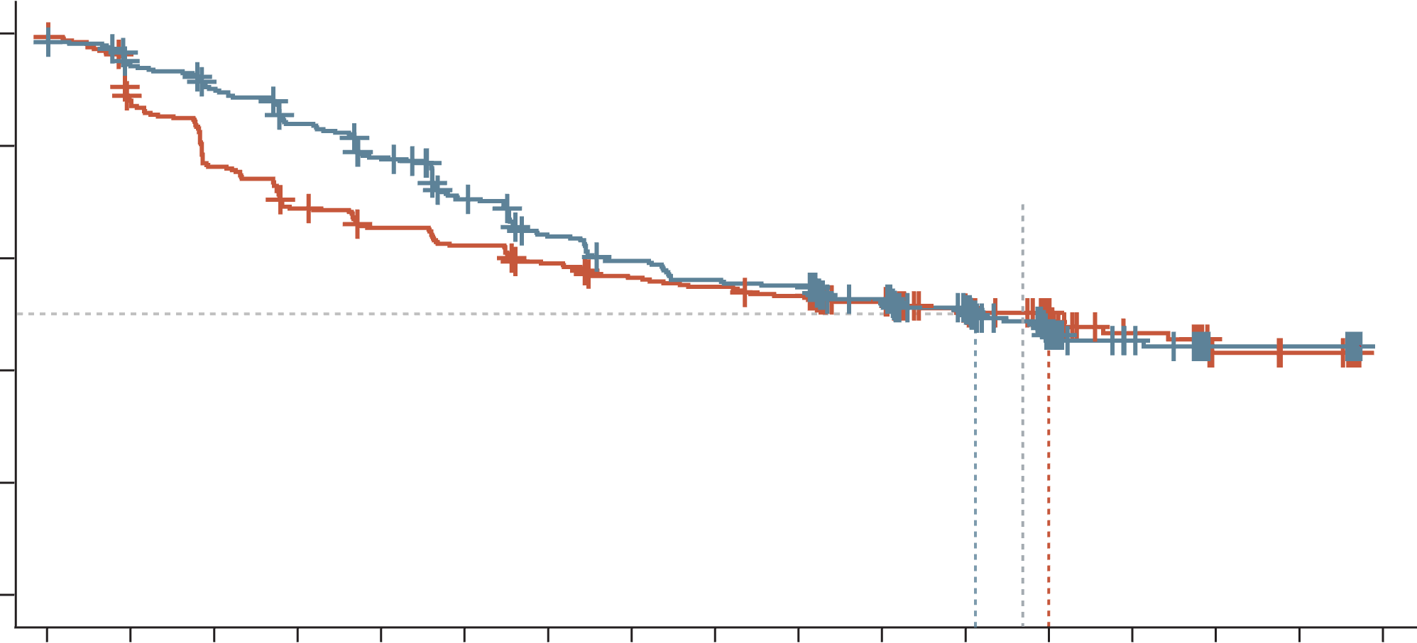
IMbrave050
RESULTS: Primary endpoint of RFS was not met
Early RFS benefit with atezolizumab + bevacizumab versus active surveillance was not maintained at follow-up¹
No new safety concerns were seen¹
100
Updated median RFS (95% CI), mo¹:
ATEZO + BEV 33.2 (24.3-NE)
Active surveillance 36.0 (22.7-NE)
HR (95% CI): 0.90 (0.72-1.12)
p=NA; descriptive
80
Median follow-up:
35.1 mo
60
RFS (%)
40
First IA median RFS (95% CI), mo^{2,3}:
ATEZO + BEV NE (22.1-NE)
Active surveillance NE (21.4-NE)
HR (95% CI): 0.72 (0.56-0.93)
p=0.012
20
0
0
3
6
9
12
15
18
21
24
27
30
33
36
39
42
45
48
No. at risk
ATEZO + BEV
Active surveillance
Time (months)
334
334
305
285
290
247
268
221
245
207
216
197
191
185
177
175
167
170
164
164
147
145
123
124
62
63
45
42
18
16
18
14
NE
NE
Clinical cutoff: May 3, 2024; median follow-up: 35.1 months. At clinical cutoff, 162 of 334 (49%) patients in the atezolizumab + bevacizumab arm and 164 of 334 (49%) in the active-surveillance arm experienced disease recurrence or death. HRs are stratified. p values are log rank
ATEZO, atezolizumab; BEV, bevacizumab; CI, confidence interval; HR, hazard ratio; IA, interim analysis; mo, months; NA, not applicable; NE, not estimable; RFS, recurrence-free survival; RFS, recurrence-free survival
1. Yopp A, et al. ESMO 2024. Abstract #LBA39. Oral presentation; 2. Qin S, et al. Lancet. 2023;402:1835-47; 3. Chow P, et al. AACR 2023. Abstract #CT003

Slide 21
IMbrave050 summary
Initial RFS benefit with atezolizumab + bevacizumab versus active surveillance was not sustained
Safety profile of atezolizumab + bevacizumab remained manageable and consistent with each agent and underlying HCC
Results do not support atezolizumab + bevacizumab as an adjuvant therapy for all high-risk HCC
  Efficacy follow-up for OS will continue
HCC, hepatocellular carcinoma; RFS, recurrence-free survival
Yopp A, et al. ESMO 2024. Abstract #LBA39. Oral presentation

