Slide 2
Precision ONCOLOGY
ANIMATED VIDEO sample collection, test request, guidelines, diagnostic modalities prostate cancer
Dr Alexander Wyatt
September 2024

Slide 3
Educational objectives
Know how to navigate pre-analytical phase challenges, including how to collect, store, process and prepare the samples
Be able to include all relevant biomarkers in the test request and tests
Understand the diagnostic modalities, and the role of biomarkers in oncology
Be able to implement or improve the leading role of the pathologist on the MDT
MDT, Multidisciplinary team

Slide 4
Clinical takeaways
It is important to consider that different types of samples are needed for somatic and germline testing
Genomic biomarker testing is required to help with treatment decision making and for understanding inherited cancer risk
Next-generation sequencing of multiple genes is the gold-standard method for both germline and tumour (somatic) testing in prostate cancer
Alterations in HRR genes and MMR pathway genes in advanced prostate cancer can predict response to targeted therapies
HHR, homologous recombination repair; MMR, mismatch repair

Slide 5

Developed by PRECISION ONCOLOGY COnnect
This programme is developed by PRECISION ONCOLOGY CONNECT,
an international group of experts in the field of oncology.
Acknowledgement and disclosures
This PRECISION ONCOLOGY CONNECT programme is supported through an independent educational grant from AstraZeneca and Amoy Diagnostics. The programme is therefore independent, the content is not influenced by the supporter and is under the sole responsibility of the experts.
Please note: The views expressed within this programme are the personal opinions of the experts. They do not necessarily represent the views of the experts’ institutions, or the rest of the PRECISION ONCOLOGY
CONNECT group.
Expert disclosures:
Dr Alexander Wyatt has received financial support/sponsorship for research support, consultation, or speaker fees from the following companies: A.W.W. has served on advisory boards and/or received honoraria from AstraZeneca, EMD Serono, Janssen, Genentech, Merck, and Pfizer. His laboratory has a contract research agreement with ESSA Pharma and Tyra Biosciences.

Slide 6
Prostate cancer precision oncology testing landscape

Slide 7

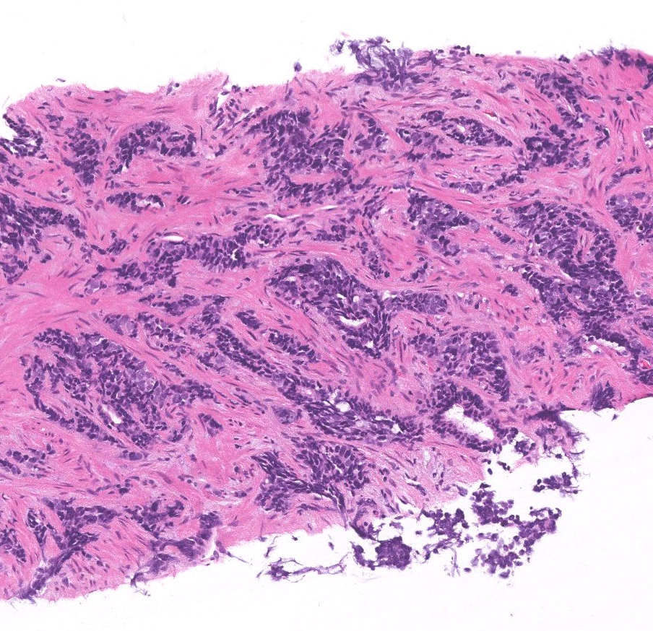

genomic testing
Germline versus Somatic testing
Genomic testing is a broad and non-specific term that describes multiple types of tests performed on part or all of the genome. Typically refers to somatic tests but may be used to describe some germline / genetic tests
Germline testing – DNA test looking for inherited alterations present in every cell in the body. Also called genetic testing
Somatic testing – DNA test looking for alterations in cancer DNA. Typically requires tumour tissue. Commonly called tumour testing
Genetic / germline testing
Somatic / tumour testing
Plasma
WBCs &
platelets
RBCs
Whole blood or saliva
Tumour tissue sample
Plasma cell-free DNA
Will not identify cancer only alterations
May not identify or discriminate all relevant germline alterations
DNA, deoxyribonucleic acid; RBC, red blood cell; WBC, white blood cell

Slide 8
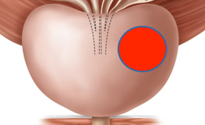
Common genomic alterations in prostate cancer
Relatively low mutation rate
Frequent copy number alterations and structural rearrangements
Most classes of alterations are more frequent in advanced disease than localised (e.g. DNA repair alterations)
AR gene alterations are only present in castration-resistant prostate cancer
Alterations get more frequent in advanced disease
Surveillance
Indolent
prostate
cancer
SPOP mut
Clinically localised
prostate cancer
Curable
prostate
cancer
Proportion of patients at diagnosis
Surgery +/-ADT
Radiation +/-ADT
Recurrent genomic aberrations beyond AR
TP53 loss
RB1 loss
PTEN loss
BRCA2 loss
CDK12 mutations
MYC amplification
Lethal
prostate
cancer
ERG
rearrangements
Metastatic
prostate cancer
Systemic therapy
ADT, androgen-deprivation therapy; AR, androgen receptor; BRCA1/2, breast cancer gene 1/2; CDK12, cyclin-dependent kinase 12; DNA, deoxyribonucleic acid; ERG, ETS family transcription factor ERG; ETS, erythroblast transformation-specific; MYC, MYC proto-oncogene; PTEN, phosphatase and tensin homologue; RB1, retinoblastoma protein; SPOP, speckle-type POZ; TP53, tumour protein p53
Adapted from Mateo J, et al. Nature Cancer. 2021;1(11):1041-53

Slide 9
BRCA2 and other DNA damage repair genes are frequently altered in metastatic prostate cancer
 | Germline |  | Somatic & Germline combined
 | Localised | Metastatic | Localised | Metastatic
All DDR genes | 2 - 4% | 6 - 12% | 8 - 12% | 20 - 25%
BRCA2 | 1 - 2% | 4 - 5% | 2 - 3% | 8 - 12%
ATM | 0.5 - 1% | 1 - 2% | 1 - 2% | 3 - 7%
BRCA1 | <1% | <1% | <1% | 1%
MMRd | <1% | ~1% | 1% | 3-5%
CDK12 | Only somatic | Only somatic | 1-2% | 5%
Overall, DNA damage repair gene alterations (germline and somatic, combined) are found in ~10% of localised prostate cancer but up to 25% of metastatic prostate cancer
ATM, ataxia telangiectasia mutated; BRCA1/2, breast cancer 1 and 2;DDR, DNA damage repair; DNA, deoxyribonucleic acid; MMRd, mismatch repair deficient
Darst B et al. J Natl Cancer Inst 2021 113(5):616-25; Lee D et al. Eur Urol 2022 81(6):559-67; Warner E et al. Clin Cancer Res 2021 27(6):1650-62;
Nicolosi P et al. JAMA Oncol. 2019 5(4):523-8; Pritchard C et al. N Engl J Med. 2016 375:443-53; Abida W et al, JCO Precis Oncol. 2017; Abida W et al, JAMA Oncol. 2019 5(4):471-478, Valsecchi AA et al, Cancers 2023, 15, 2435

Slide 10
Clinical implications of testing

Slide 11
BRCA2 alterations have clinical implications
Personal and familial risk of cancer (inherited germline alterations)¹
Poor outcomes on standard of care therapies (germline or somatic)²⁻⁴
Prognostic marker for aggressive disease (germline or somatic)^{5,6}
  Diagnosis = higher Gleason, advanced stage⁶
  Local = worse outcomes after RP/RT⁵
  Met = shorter PFS on systemic treatment²
  Predictive biomarker for PARP inhibitors⁷
    germline or somatic; bi-allelic loss³
Patients who developed metastases within 5 years (based on 5-year MFS in localised PC patients)⁶
P=0.0001
Proportion of patients (%)
gBRCAm
non-carrier
(n=1940)
gBRCAm
carrier
(n=78)
BRCA 2, breast cancer gene 2; met, metastasis; MFS, metastasis-free survival; PARP, poly-ADP ribose polymerase; PC, prostate cancer; PFS, Progression-free survival; RP, radical prostatectomy; RT, radiotherapy
Cheng HH, et al. J Natl Compr Cancer Netw. 2019;17(5):515-21; Castro E, et al. J Clin Oncol. 2019;6:490-503; Annala M, et al. Eur Urol. 2017;72:34-42;
Annala M, et al. Cancer Discov. 2018;8(4):444-57; Castro E, et al. Eur Urol. 2015;68:186-93; Castro E, et al. J Clin Oncol. 2013;31:1748-57; Lord CJ and Ashworth A. Nature. 2012;481:287-93

Slide 12
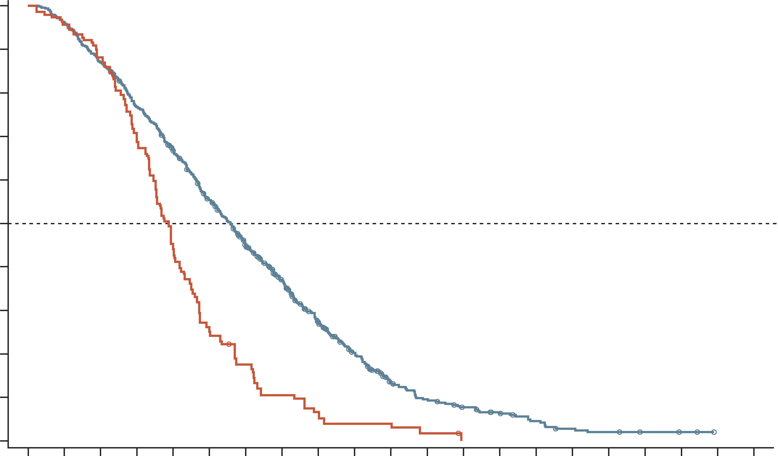
BRCA2 alterations have clinical implications: latest data
Confirmation of worse outcomes with
ARPI or taxanes
n=729 mCRPC, 1L Tx ARPI or taxane OS
13.2% with BRCA1/2 germline or somatic alterations
Poorer OS, rPFS, PFS2 for BRCA1/2 subgroup
100
 | BRCA | Non-BRCA
Median (95% CI) | 19.40 (16.80, 21.10) | 27.90 (25.80, 26.60)
HR (95% CI) | 1.95 (1.55, 2.45) p=<0.001
Non-HRR
n=506 (69.4%)
90
80
70
60
50
Patients without event (%)
40
Germline
BRCA
n=25 (3.4%)
Somatic HRR
non-BRCA
n=98 (13.4%)
30
20
10
Somatic
BRCA
n=71 (9.8%)
Germline HRR
non-BRCA
n=29 (4.0%)
0
0
5
10
15
20
25
30
35
40
45
50
55
60
65
70
75
80
85
90
95
100
Months since treatment initiation
96
633
90
610
83
551
67
483
43
417
25
340
16
267
9
203
6
139
4
94
4
52
2
37
0
27
20
13
7
5
3
2
0
1L, first-line; ARPI, androgen receptor pathway inhibitor; HR, hazard ratio; HRR, homologous recombination repair; mCRPC, metastatic castration-resistant prostate cancer; OS, overall survival; PFS, progression free survival; PFS2, second PFS; rPFS, radiographic PFS; Tx, treatment
Adapted from Olmos D et al. Ann Oncol. 2024;35(5):458-72

Slide 13
BRCA2 alterations have clinical implications: latest data
Confirmation of benefit from PARPi +/- ARPI
mCRPC, pooled analysis of PARPi trials
Gene mutation | End point | Arm | No. | No. of events | Median survival, months | HR (95% CI) | HR (95% CI)
ATMm (N=268) | rPFS (BICR) | PARPi + ARPI | 136 | 67 | 19 (16-28) | 1.05 (0.74-1.49) | 1.02 (0.71-1.45)
 |  | Placebo + ARPI | 132 | 59 | 19 (16-NE)
 | OS | PARPi + ARPI | 136 | 63 | 33 (26-NE) | 1.18 (0.82-1.71) | 1.12 (0.77-1.62)
 |  | Placebo + ARPI | 132 | 55 | 33 (28-NE)
BRCA1m (N=64) | rPFS (BICR) | PARPi + ARPI | 37 | 14 | 20 (14-NE) | 0.51 (0.23-1.1) | 0.52 (0.2-1.33)
 |  | Placebo + ARPI | 27 | 15 | 12 (4-NE)
 | OS | PARPi + ARPI | 37 | 16 | 29 (15-NE) | 0.74 (0.34-1.61) | 0.73 (0.28-1.89)
 |  | Placebo + ARPI | 27 | 13 | 26 (13-28)
BRCA2m (N=422) | rPFS (BICR) | PARPi + ARPI | 199 | 60 | NA (22-NE) | 0.31 (0.23-0.42) | 0.27 (0.19-0.37)
 |  | Placebo + ARPI | 223 | 144 | 10 (8-11)
 | OS | PARPi + ARPI | 199 | 77 | 33 (29-NE) | 0.66 (0.49-0.89) | 0.6 (0.44-0.82)
 |  | Placebo + ARPI | 223 | 112 | 24 (22-28)
CDK12m (N=146) | rPFS (BICR) | PARPi + ARPI | 73 | 32 | 17 (16-NE) | 0.5 (0.32-0.8) | 0.51 (0.32-0.82)
 |  | Placebo + ARPI | 73 | 44 | 14 (8-17)
 | OS | PARPi + ARPI | 73 | 32 | 36 (25-NE) | 0.63 (0.39-0.99) | 0.64 (0.4-1.03)
 |  | Placebo + ARPI | 73 | 44 | 27 (20-33)
CHEK2m (N=172) | rPFS (BICR) | PARPi + ARPI | 85 | 37 | 14 (14-25) | 1.06 (0.67-1.66) | 1.00 (0.63-1.59)
 |  | Placebo + ARPI | 87 | 43 | 18 (13-22)
 | OS | PARPi + ARPI | 85 | 39 | 26 (23-NE) | 1.53 (0.95-2.46) | 1.48 (0.92-2.4)
 |  | Placebo + ARPI | 87 | 32 | 34 (26-NE)
PALB2m (N=41) | rPFS (BICR) | PARPi + ARPI | 23 | 12 | 14 (8-NE) | 0.52 (0.23-1.17) | 0.43 (0.15-1.21)
 |  | Placebo + ARPI | 18 | 13 | 9 (2-20)
 | OS | PARPi + ARPI | 23 | 12 | 25 (15-NE) | 0.78 (0.34-1.8) | 0.59 (0.21-1.65)
 |  | Placebo + ARPI | 18 | 11 | 20 (11-NE)
ATM not strongly linked to outcomes
BRCA2
ARPI, androgen receptor pathway inhibitor; BICR, blinded independent central review; CI, confidence interval; HR, hazard ratio; m, mutation; mCRPC, metastatic castration-resistant prostate cancer; PARPi, poly-ADP ribose polymerase inhibitor; OS, overall survival PFS, progression free survival
Fallah J, et al. J Clin Oncol 2024;42:1687-98

Slide 14
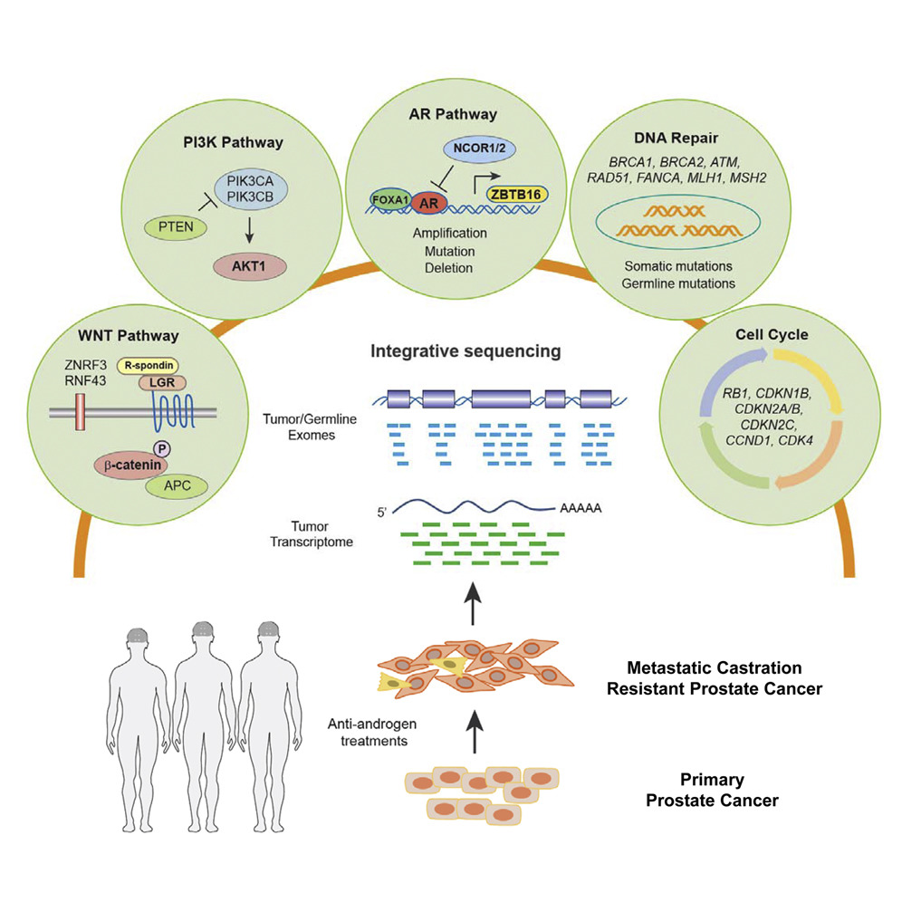
Clinically-relevant genomic alterations beyond DNA damage repair pathways
AR Pathway
DNA Repair
PI3K Pathway
NCOR1/2
BRCA1, BRCA2, ATM,
RAD51, FANCA, MLH1, MSH2
PIK3CA
PIK3CB
FOXA1
AR
ZBTB16
Correlative studies: non-DNA repair genomic alterations associate with different disease prognosis and may even predict outcomes in some contexts
SPOP, FOXA1
AR gene and enhancer
PTEN, PIK3CA, AKT1
TP53 and RB1
PTEN
Amplification
Mutation
Deletion
Clinical guidelines now recommend germline +/- somatic screening of
DNA repair genes
hereditary cancers
patient prognosis
treatment selection
AKT1
Somatic mutations
Germline mutations
WNT Pathway
Cell Cycle
ZNRF3
RNF43
R-spondin
Integrative sequencing
LGR
RB1, CDKN1B,
CDKN2A/B,
CDKN2C,
CCND1, CDK4
P
Tumour/Germline
Exomes
Β-catenin
APC
Tumour/
Transcriptome
5’
AAAAA
Metastatic castration
resistant prostate cancer
Anti-androgen
treatments
Primary
prostate cancer
Prospective trials are required to prove clinical utility of understanding genomic alterations beyond DNA damage repair defects
Annala M, et al. Cancer Discov. 2018;8(4):444-57; Herberts C, et al. Eur Urol. 2020;78(6):834-44; Annala M, et al. Annals Oncol. 2021;32(7):896-905; Image adapted from Robinson D et al. Cell 2015;161(5):1215-28; Abida W, et al. Proc Natl Acad Sci U S A. 2019;116(23):11428-36; van Dessel LF et al. Nat Commun. 2019;10:5251

Slide 15
when and who to order biomarker testing for

Slide 16
Who to test for DNA repair alterations?
Germline testing should be performed in all prostate cancer patients with metastatic disease
  Good practice point: perform testing as early as possible.
  Minimum genes: ATM, BRCA1, BRCA2, CHEK2, EPCAM, HOXB13, MLH1, MSH2, MSH6, PALB2, PMS2, TP53, and RAD51D
Germline testing should be performed in selected patients with localised prostate cancer (family or personal history of related cancers; high-risk or very-high risk disease)
Tumour/somatic testing should be performed in patients with mCRPC to inform the selection of therapy
Somatic-only testing is not adequate for germline conclusions
Good practice point: perform testing as early as possible (mCSPC, nmCRPC)
  Minimum genes: BRCA1, BRCA2, ATM (but ideally align with germline panels)
  Ensure all patients with de novo M1 disease have a tissue biopsy performed
  First choice of specimen for testing is tissue, second is ctDNA
ctDNA, circulating tumour DNA; DNA, deoxyribonucleic acid; mCRPC, metastatic castration-resistant prostate cancer; mCSPC, metastatic castration resistant prostate cancer; nmCRPC, non-metastatic CRPC
Rendon R, et al. Can Urol Assoc J. 2023;17(10):314-25

Slide 17
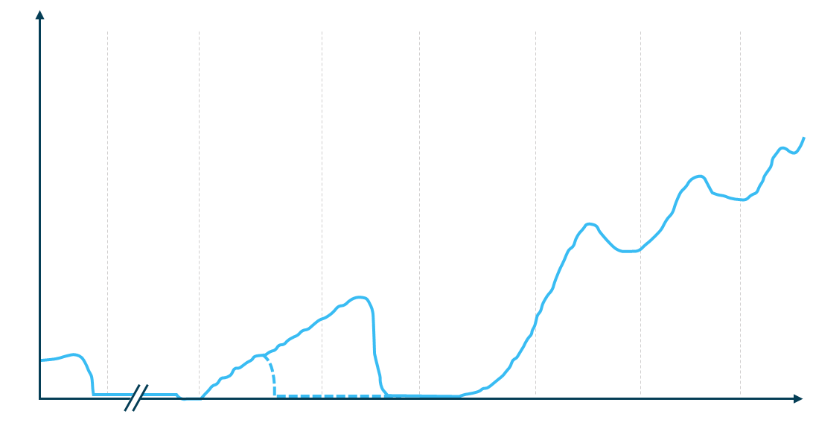
Considerations for when to test for HRRm are included in international guidelines
ESMO¹
Recommended for BRCA2 and other DDR genes associated with cancer predisposition in patients with family history of cancer
Should be considered in all patients with metastatic prostate cancer
Primary
Adjuvant
Biochemical recurrence
mHSPC
(inc. de novo)
1L
mCRPC
2L
mCRPC
3L
mCRPC
Consider HRRm and MSI dMRR testing in patients with mCRPC
Non-metastatic CRPC
EAU/EANM/ESTRO/ESUR/ISUP/SIOG²
Men with metastatic PCa;
Men with high-risk PCa and a family member diagnosed with PCa at age <60 years;
Men with multiple family members diagnosed with csPCa at age <60 years or a family member who died from PCa cancer;
Men with a family history of high-risk germline alterations or a family history of multiple cancers on the same side of the family.
Tumour testing
PSA
Consider HRRm and dMRR testing in all patients with mPC
Germline testing
NCCN³
Individuals where it is likely to impact the prostate cancer treatment and clinical trial options, management of risk of other cancers, and/or potential risk of cancer in family members.
Men with family history or known germline variants
Recommend HRRm testing in patients with mPC. Consider for regional PC
Recommend testing for MSI-H, dMMR for mCRPC. Consider for regional or CSPC
Consider TMB testing for mCRPC
AUA/SUO⁴
Based on Scher et al, 2016
Time
Testing for DDR, MSI dMMR, TMB and other potential alterations in mCRPC patients
Consider for mHSPC patients
Guidelines differ by jurisdiction:→ be aware of your local guidelines
Testing for DDR, MSI dMMR, TMB and other potential alterations in mCRPC patients
Consider for mHSPC patients
1L/2L/3L, first/second/third line; BRCA2, breast cancer gene 2; CRPC, castration-resistant prostate cancer; CSPC, castration-sensitive prostate cancer csPCa, clinically significant PCa; DDR, DNA damage repair; dMMR, mismatch repair damage; HRRm, homologous recombination repair mutation; mCRPC, metastatic CRPC; mHSPC, metastatic hormone-sensitive prostate cancer; mPC, metastatic prostate cancer; MSI(h), microsatellite instability (high); PCa, prostate cancer; PSA, prostate-specific antigen;
TMB, tumour mutational burden
1. Parker C, et al. Ann Oncol. 2020; 31(9): 1119-34; 2. Mottet N, et al. 2023 EAU - EANM - ESTRO - ESUR - ISUP - SIOG Guidelines on Prostate Cancer;
3. National Comprehensive Cancer Network. Prostate Cancer (Version 2024). prostate.pdf (nccn.org).; 4. Lowrance W, et al. J Urol. 2023; 209(6):1082-1090; 5. Scher HI, et al. J Clin Oncol 2016; 34 (12): 1402-1418

Slide 18
DNA damage repair genes, beyond BRCA2
(what additional genes should be tested)
DNA repair genes with Tier I/II alterations from genetic / germline testing
Rarely altered genes may not be covered at all by clinical tests, or may not be reported on even if covered
Somatic-only testing is not adequate for germline conclusions. Ideally, perform somatic and germline testing in parallel
It is difficult to predict the familial risk (germline alterations) or the functional / therapeutic / prognostic relevance (germline or somatic alterations)
Rare genes are more likely to be included in a germline
test than a somatic test
Remember that some genes are somatic-only mutated
(e.g. CDK12)
Germline testing panels should include genes associated
with Lynch syndrome (MLH1, MSH2, MSH6, PMS2) and homologous recombination genes (BRCA1/2, ATM,
PALB2, CHEK2)
RAD51D (2)
XPC (3)
RAD51C (4)
XRCC2 (4)
SLX4 (5)
NBN (6)
BRCA2 (59)
WRN (7)
PMS2 (7)
BRCA2
FANCL (7)
BRIP1 (7)
MSH6 (8)
MRE11A (8)
ATM
GEN1 (8)
FAM175A (8)
ATM (47)
MSH2 (9)
ATR (9)
MUTYH (10)
CHEK2 (16)
MLH1 (11)
PALB2 (16)
BRCA1 (15)
ERCC2 (13)
ATM, ataxia telangiectasia mutated; BRCA1/2, BReast Cancer gene 1/2; CDK12, cyclin-dependent kinase 12; CHEK2, checkpoint kinase 2; DNA, deoxyribonucleic acid; FANCA, Fanconi anaemia complementation group A protein; MLH1, mutL homologue 1; MSH2/6, mutS homologue 2/6; PALB2, partner and localiser of BRCA2
Darst B, et al. J Natl Cancer Inst. 2021 113(5):616-25

Slide 19
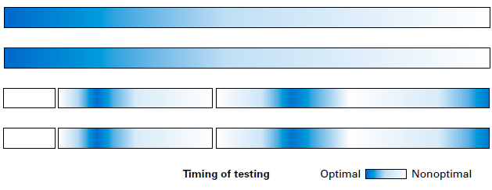
At what stage should a test be ordered?
Test as early as possible (once a patient is eligible)
As early as possible:
Germline
(whole blood or saliva)
Somatic (tumour tissue)
A
Radiation
Androgen-deprivation therapy (ADT)
B
Surgery
Considerations for each sample type
Tumour burden
Time
Frequent high tumour purity
Avoids spatial sampling bias
Reflects metastatic disease
Detects clonal hematopoiesis
Minimally invasive
Cost-effective
Local
Castration-sensitive (CSPC)
Castration-resistant (CRPC)
Only at disease progression:
Plasma cell-free DNA (ctDNA)
Sample types
 |  |  | ? | ✓ | ✓
✓ | ✗ | ✗ | ? | ✗ | ✗
✓ | ✗ | ✓ | ? | ✗ | ✗
✗ | ✓ | ✓ | ✓ | ✗ | ✓
Germline
Primary tissue
Plasma
Metastatic tissue
WBCs &
platelets
Plasma ctDNA
RBCs
Timing of testing
Optimal
Non-optimal
✓ Yes. ✗ No. ? Unknown
ctDNA, circulating tumour DNA; DNA, deoxyribonucleic acid; RBC, red blood cell; WBC, white blood cell
Image adapted from Vandekerkhove G, et al. JCO Precis Oncol. 2024;8: e2300654

Slide 20
Plasma free dna (ctdna)
ctDNA fraction is positively associated with progressive disease burden
The optimal time to order a ctDNA test for cancer genotyping is at times of clinical disease progression
If ctDNA tests are ordered while cancer is responding to treatment, there is unlikely to be ctDNA present (meaning that the cancer is not being tested)
A
Radiation
Androgen-deprivation therapy (ADT)
Surgery
Tumour burden
Time
Local
Castration-sensitive (CSPC)
Castration-resistant (CRPC)
Only at disease progression:
Plasma cell-free DNA (ctDNA)
Sample types
Germline
Primary tissue
Plasma
Metastatic tissue
WBCs &
platelets
Plasma ctDNA
RBCs
Timing of testing
Optimal
Non-optimal
ctDNA, circulating tumour DNA; DNA, deoxyribonucleic acid; RBC, red blood cell; WBC, white blood cell
Image adapted from Vandekerkhove G, et al. JCO Precis Oncol. 2024;8: e2300654

Slide 21
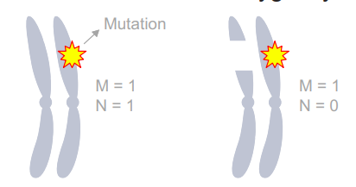
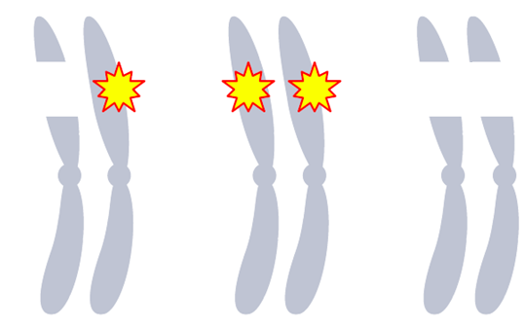
Mutations are just one mechanism of genomic alteration (copy losses are also important)
Most clinical tests will report a tumour suppressor gene mutation but not a copy number deletion (which can remove one or both parental alleles)
Key prostate cancer tumour suppressor genes BRCA2, RB1, TP53, MSH2/6,
PTEN can be disrupted by copy losses or complex structural rearrangements
Aim to use tests that report copy number variants in addition to mutations
mutation
BRCA2 only relevant if both alleles are lost (bi-allelic loss)
Case 1
Case 2
Case 3
BRCA2 gene
Rarely identified
by current tests;
up to 3% of mCRPC!
Copy loss (deletion)
Identified because a mutation is detected
BRCA2, breast cancer gene 2; mCRPC, metastatic castration-resistant prostate cancer; MSH2/6, mutS homologue 2/6; PTEN, phosphatase and tensin homologue; RB1, retinoblastoma protein; TP53, tumour protein p53
Herberts C and Wyatt A. Trends in Cancer. 2021;7(11):995-1009

Slide 22
Challenges, limitations and recommendations for prostate biomarker testing

Slide 23
Operational limitations of somatic testing
Tests do not cover all relevant genes / regions
  + huge variability between tests in performance
Tests cannot identify or report all possible deleterious alterations
  It can also be difficult to know if certain alterations are deleterious / pathogenic
Alteration detection is insufficiently sensitive for complex events
  Manual curation required even for standard mutations
Tumour fraction (purity) may be low, causing false negatives
Tumour heterogeneity (region to region) may cause false positives or negatives
Mutations can be sub-clonal (i.e. not present in all tumour cells)
… & many others!
Remember: tests generally flatten tumour biology into binary presence/absence, and do not
always capture/report other relevant biological context that may ultimately be informative for clinical
management decisions

Slide 24
Common challenges and recommendations in prostate cancer genomic testing: Test ordering
Access to tissue
Tumour tissue may not always be accessible
  Action: Source blocks early or consider re-biopsy
Insufficient tumour content within sample
Tissue tests have stringent minimum requirements (e.g. cellularity, DNA yield)
  Action: Involve a GU-specialist pathologist to help identify optimal tissue regions
  Action: Be ready to pivot to other test approaches
Insufficient breadth of genes tested
While all gene panels will include BRCA1 and BRCA2, rare or indirect HRR genes may not be present. Some panels may only report coding region alterations (and not copy number losses)
  Action: Understand your local panel design (may differ for germline vs somatic testing)
Uncertainty on need for tissue versus liquid biopsy testing
ctDNA tests can inform on alterations that arose later in disease progression (i.e. that would be missed by archival tissue tests), but can be unclear when a ctDNA test would be helpful
  Action: Only order ctDNA tests at times of disease clinical progression
  Action: Consult with the MDT or local clinical genomics staff
Uncertainty of need for germline versus somatic testing
ctDNA Optimal testing for metastatic prostate cancer involves somatic and germline testing but guidelines can differ especially for localized prostate cancer
  Action: Be aware of the guidelines relevant to local practice
  Action: Order both somatic and germline tests when appropriate (somatic testing does not replace the need for germline testing)
BRCA1.2, breast cancer gene 1/2; ctDNA, circulating tumour DNA; DNA, deoxyribonucleic acid; GU, genito-urinary; HRR, homologous recombination repair; MDT, multidisciplinary team

Slide 25
Common challenges and recommendations in prostate cancer genomic testing: Interpreting results
False negatives
Low tumour fraction can result in false negatives, particularly for copy number losses
  Action: Recognise the test-specific limits of detection for each type of alteration,
  and when you need to re-test
Allelic status
not reported
Tests may not report tumour allelic status of alterations (i.e. mono vs biallelic loss)
  Action: Be aware that most HRR genes require biallelic loss for inactivation
Unclear actionability of reported variants
Test reports can include technical jargon or be ambiguous on clinical actionability of each alteration
  Action: seek clarification from the group that operated the test and/or the local MDT
No discrimination between somatic and germline alterations
It can be difficult to resolve a germline variant from tumour tissue testing alone (i.e. without matched germline profiling
  Action: if HRR alterations are identified by tumour tissue testing (and the patient did not have prior or concurrent germline testing), the alteration may be germline in origin and patients should be referred for genetics counselling and germline testing
HRR, homologous recombination repair; MDT, multidisciplinary team; HRRm homologous recombination repair mutations

Slide 26
conclusions

Slide 27
Conclusions
Multi-gene germline and somatic testing is required for identification of HRR and MMR
gene alterations in advanced prostate cancer.
  Presence of HRR/MMR gene alterations can predict response to targeted therapies
  Germline alterations should trigger cascade family member testing
Both tumour tissue and plasma ctDNA can be used for somatic testing, but ctDNA tests
should only be ordered at times of clinical disease progression
Pre-analytical issues (e.g. tumour tissue availability, quality, and cellularity) and long
turn-around times for sourcing and testing tissue can be a barrier to accurate and
timely results
Multi-disciplinary team-based care including GU-cancer specialised pathologists and genomics experts are important for optimal precision oncology in prostate cancer
ctDNA, circulating tumour DNA; DNA, deoxyribonucleic acid; GU, genito-urinary; HRR, homologous recombination repair; MMR, mismatch repair

