Slide 2
Part 3
Multiple myeloma: current best practices in the treatment of early RRMM – an expert view
Dr Joseph Mikhael
Translational Genomics Research Institute (TGen)
City of Hope Cancer Center
September 2024
MM, multiple myeloma; RR, relapse/refractory

Slide 3
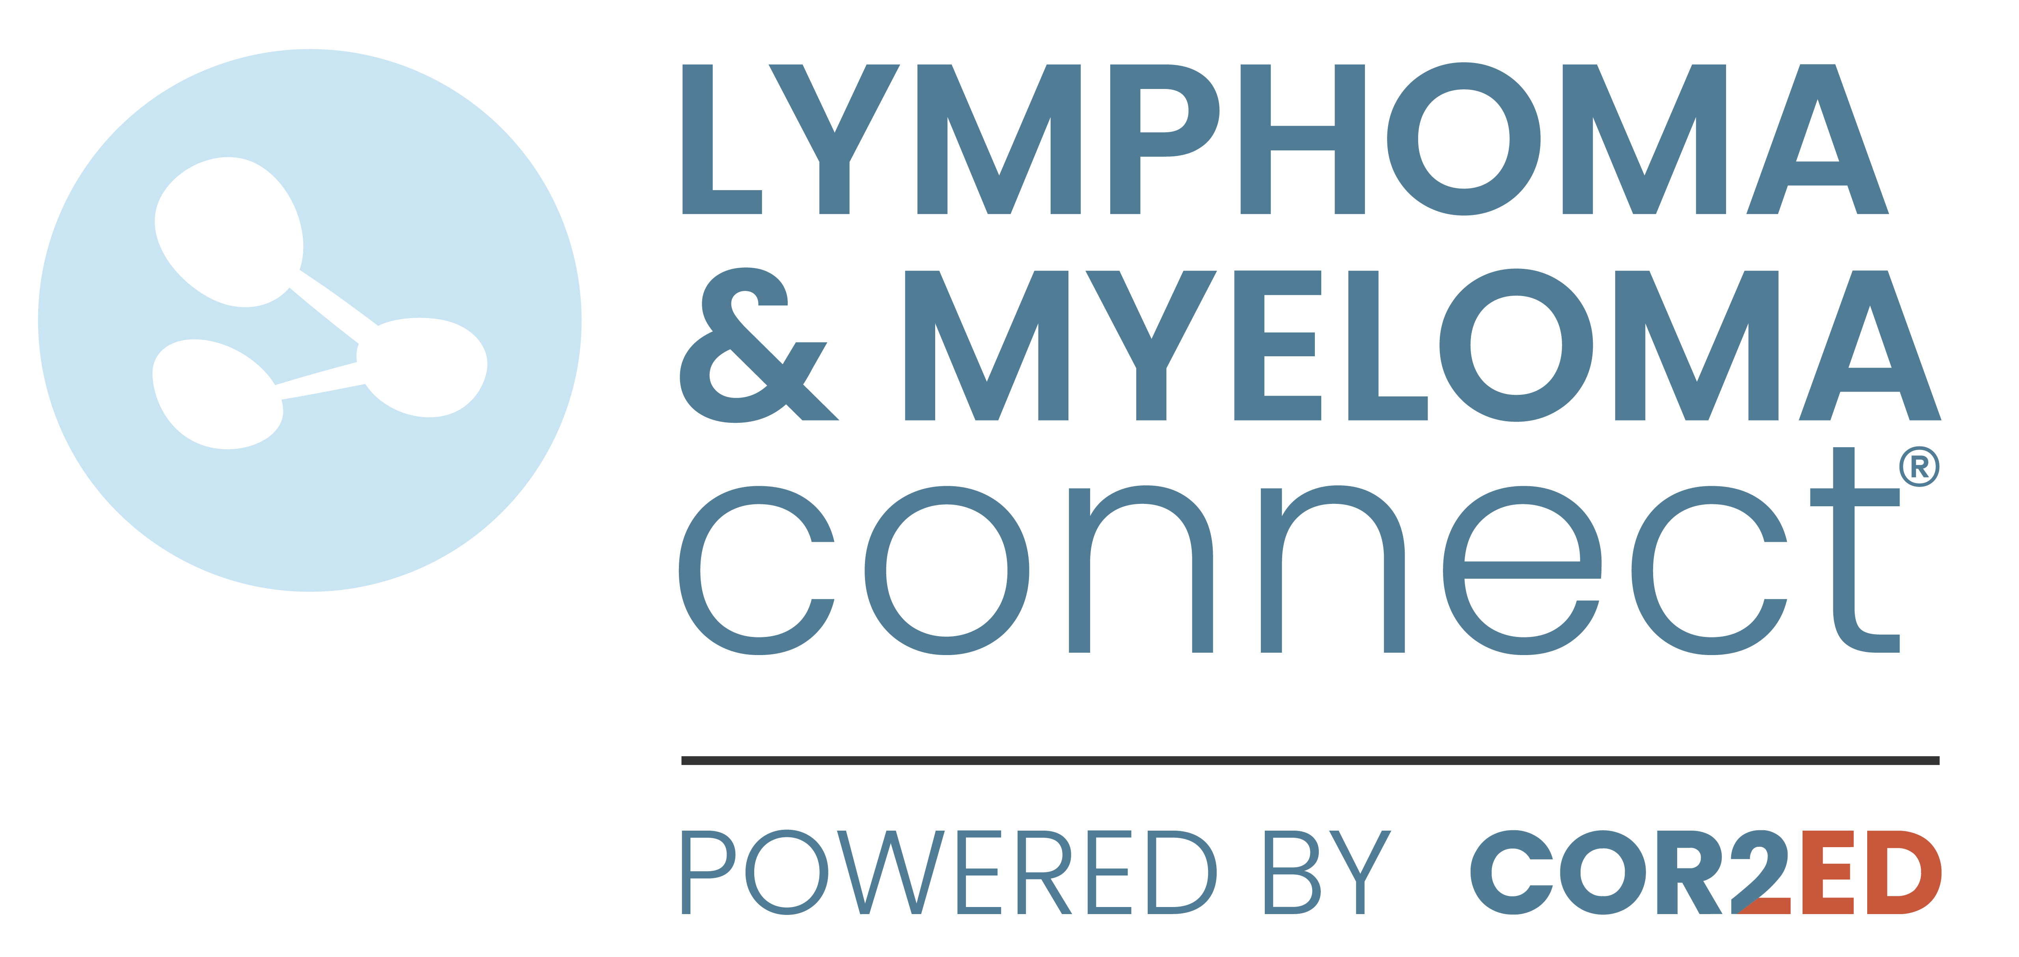
Developed by lymphoma & myeloma COnnect
This programme is developed by LYMPHOMA & MYELOMA CONNECT,
an international group of experts in the field of hematological malignancies.
Acknowledgement and disclosures
This LYMPHOMA & MYELOMA CONNECT programme is supported through an independent educational grant from Menarini Stemline Oncology. The programme is therefore independent, the content is not influenced by the supporter and is under the sole responsibility of the experts.
Please note: The views expressed within this programme are the personal opinions of the experts. They do not necessarily represent the views of the experts’ institutions, or the rest of the LYMPHOMA & MYELOMA CONNECT group.
Expert disclaimer:
Dr Joseph Mikhael has received financial support/sponsorship for research support, consultation, or speaker fees from the following companies: Amgen, BMS, Janssen, Sanofi

Slide 4
Educational objectives
Know how to incorporate the latest scientific and clinical insights on the treatment of MM into clinical practice, focusing on the relapsed/refractory setting
Knowing the MoA and how this translates into the efficacy profile of novel drugs
Learning from best practices on treatment sequencing, treatment combinations and dosing in MM
Knowing the safety profiles of novel drugs and what the best strategies are to prevent or act on side effects

Slide 5
Approach to relapsed MM drug classes, CAR-T and triplet combinations
MM, multiple myeloma

Slide 6
AN approach to relapsed MM
Not a simple algorithm of treatment #1, then #2, then #3…
Categories
1-3 prior lines AND ≥4 prior lines
Optimize the use of the 4 major classes of drugs in early relapse (recent incorporation of CAR-T):
  proteasome inhibitors
  immunomodulatory agents
  monoclonal antibodies
  XPO1 inhibitors
Principles
Depth of response matters…likely incorporate MRD soon
High risk vs. standard risk…more aggressive treatment in high-risk
Balance efficacy and toxicity…initially and constantly assess
Overcome drug resistance…change mechanism of action when possible
Expert view
MM, multiple myeloma; MRD, minimal residual disease; XPO1, exportin-1

Slide 7
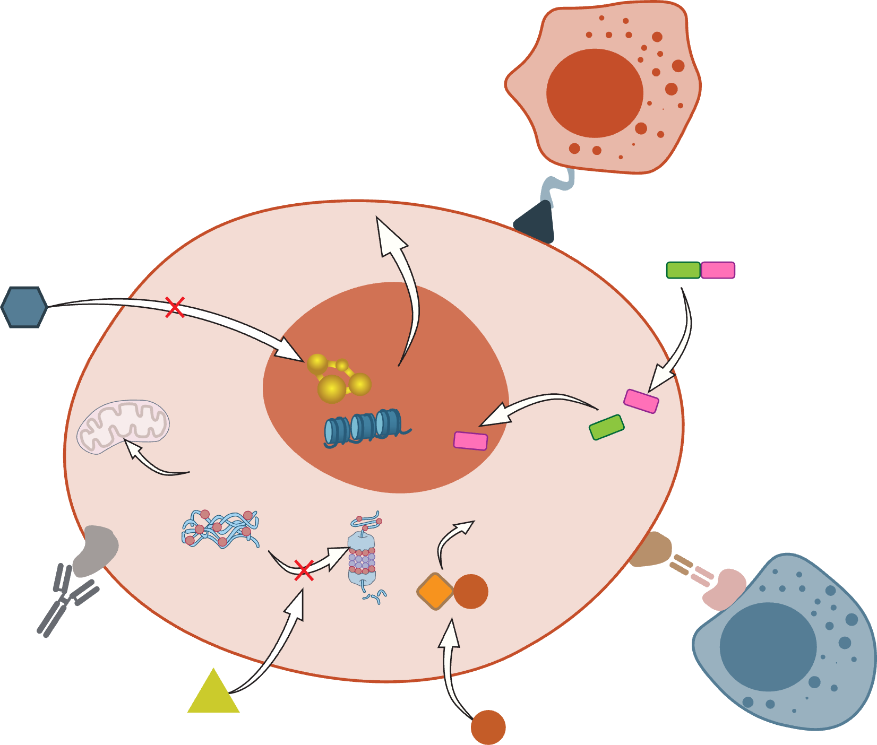
Drugs approved for the treatment of RRmm
Drugs approved by the EMA and FDA for the treatment of
early RRMM (1-3 prior therapies)^{1,2}
CAR-T
Ciltacabtagene autoleucel^{b}
Idecabtagene vicleucel^{c}
CAR-T
cell
Peptide-drug conjugate
Melphalan flufenamideª
HDAC inhibitor
Panobinostatª
XPO1 inhibitor
Selinexor
p53
Nucleus
Myeloma cell
Histones
Degradation of
transcription factors
and cell death
Ubiquitinated
protein aggregates
CRBN
Elranatamab
Talquetamab
Teclistamab
Protein
degradation
Bispecific antibodies
Elranatamab
Talquetamab
Teclistamab
Monoclonal antibody
Daratumumab (anti-CD38)
Elotuzumab (anti-SLAMF7)
Isatuximab (anti-CD38)
T cell
PI inhibitor
Bortezomib
Carfilzomib
Ixazomib
IMiD
Lenalidomide
Pomalidomide
Thalidomide
Figure adapted from Dimopoulos et al.³
ª No longer FDA-approved
^{b} Ciltacabtagene autoleucel has received a positive opinion from the CHMP to expand the indication to patients who have received ≥1 prior therapy.⁴
^{c} Idecabtagene vicleucel is approved for the treatment of patients who have received ≥2 prior therapies
CAR T, chimeric antigen receptor T cell; CD38, cluster of differentiation 38; CHMP, Committee for Medicinal Products for Human Use; EMA, European Medicines Agency; HDAC, histone deacetylase; IMiD, immunomodulatory drug; p53, tumour protein 53; PI, proteasome inhibitor; RRMM, relapsed/refractory multiple myeloma; SLAMF7, signalling lymphocyte activation molecule family 7; XPO1, exportin 1
1. Summary of Product Characteristics available from: https://www.ema.europa.eu/en/medicines. Last accessed 4 April 2024; 2. US Product Information available from: https://www.accessdata.fda.gov/scripts/cder/daf/index.cfm. Last accessed 12 June 2024; 3. Dimopoulos M-A, et al. Clin Lymphoma Myeloma Leuk. 2022;22:460-473; 4. https://www.ema.europa.eu/en/medicines/human/variation/carvykti. Last accessed 12 June 2024

Slide 8
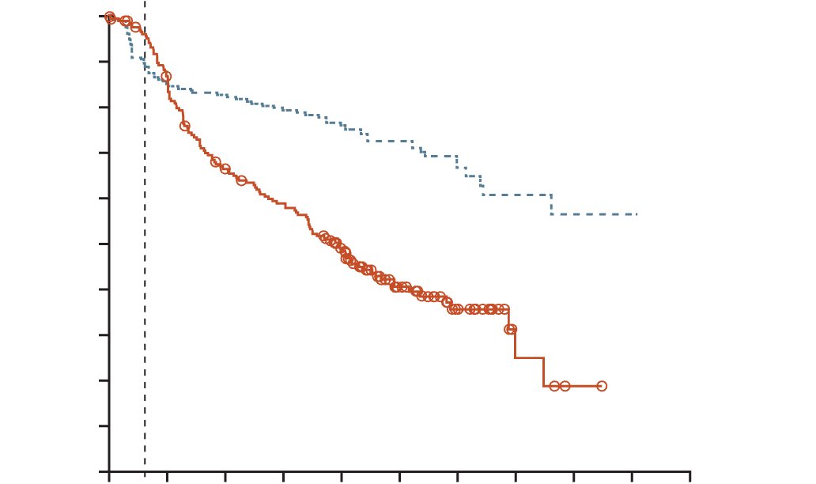
Cartitude-4: cilta-cel
Recently approved in all relapsed MM
Patients who had received 1-3 lines of therapy were randomised to cilta-cel (n=208) or standard care (n=211)ª
All patients were refractory to lenalidomide; 14.4% of cilta-cel group and 15.6% of standard care group were triple-class refractory
Cilta-cel resulted in a significantly lower risk of disease progression or death than standard care (HR, 0.26; 95% CI, 0.18 to 0.38; p<0.001)
ORRs were 84.6% in the cilta-cel group vs 67.3% in the standard care group
Overall, CAR-T–specific adverse events were manageable with appropriate supportive care
Cilta-cel may have a better side effect profile when used earlier in treatment
Progression-free survival
Wk 8
100
90
80
70
Cilta-cel group
60
Patients surviving without
disease progression (%)
50
40
30
20
10
Standard care group
0
0
3
6
9
12
15
18
21
24
27
30
Number at risk
Cilta-cel group
Standard-care
group
Months
208
211
177
176
172
133
166
116
146
88
94
46
45
20
22
4
9
1
1
0
0
0
ª 87% received daratumumab, pomalidomide and dexamethasone and 13% received pomalidomide, bortezomib and dexamethasone
CAR T, chimeric antigen receptor T cell; CI, confidence interval; cilta-cel, ciltacabtagene autoleucel; HR, hazard ratio; MM, multiple myeloma; ORR, overall response rate; Wk, week
San-Miguel J, et al. New Engl J Med. 2023;389:335-347

Slide 9
Patient outcomes in real-world practice
Only few patients with MM reach later lines of therapy
% of patients with multiple myeloma reaching the next line of therapy
1st line
95%
2nd line
61%
3rd line
38%
4th line
15%
5th line
1%
% attrition by line of therapy
34%
23%
23%
14%
Figure adapted from Yong et al.
In every new line of therapy, ~15-35% of patients are lost
MM, multiple myeloma
Yong K, et al. Br J Haematol. 2016;175:252-264

Slide 10
Early relapse
In real practice, most patients at first relapse will have one of the following:
Daratumumab + pomalidomide + dexamethasone (APOLLO)
Isatuximab + pomalidomide + dexamethasone (ICARIA)
Daratumumab + carfilzomib + dexamethasone (CANDOR)
Isatuximab + carfilzomib + dexamethasone (IKEMA)
Selinexor + bortezomib + dexamethasone (BOSTON)
Expert view

Slide 11
Anti-CD38 Triplet regimens
Improved PFS in patients with MM
CANDOR¹
DKd vs. Kd after ≥ PR to 1-3 prior lines
IKEMA²
Isa-Kd vs. Kd after 1-3 prior lines,
DKd
Isa-Kd
 | PFS HR
Len-refractory | 0.46
≥2 prior LOT | 0.55
High risk | 0.49
 | PFS HR
Len-refractory^{c} | 0.60
≥1 prior LOT^{c} | 0.48
High risk^{d} | 0.72
mPFS 29 vs. 15 mo
HR 0.59
mPFS 36 vs. 19 mo
HR 0.53
DKd was associated with a favourable benefit-risk profile
The safety profile was manageable and as expected
APOLLO³
Dara-Pd vs. Pd after ≥1 prior line with len and PI
ICARIA-MM⁴
Isa-Pd vs. Pd after ≥2 prior lines with len and PI
DPd
Isa-Pd
z | PFS HR
Len-refractory | 0.66
2-3 prior LOT | 0.66
High risk | 0.85
 | PFS HR
Len-refractory | 0.59
≥3 prior LOT | 0.59
High risk | 0.66
mPFS 12 vs. 7 mo
HR 0.63
mPFS 12 vs. 6 mo
HR 0.60
No new safety concerns were identified with the daratumumab combination
The addition of isatuximab to pomalidomide and dexamethasone
was well tolerated
CD38, cluster of differentiation 38; d, dexamethasone; D, daratumumab; HR, hazard ratio; Isa, isatuximab; len, lenalidomide; K, carfilzomib; LOT, line of therapy; MM, multiple myeloma; mo, months; (m)PFS, (median) progression-free survival; P, pomalidomide; PI, proteasome inhibitor; PR, partial response
1. Usmani SZ, et al. Lancet. Oncol. 2022;23:65-76; 2. Moreau P, et al. Lancet. 2021;397:2361-2371; 3. Dimopoulos MA, et al. Lancet Oncol. 2021;22:801-812;
4. Attal M, et al. Lancet. 2019;394:2096-2107

Slide 12
NCCN guidelines early relapse

Slide 13
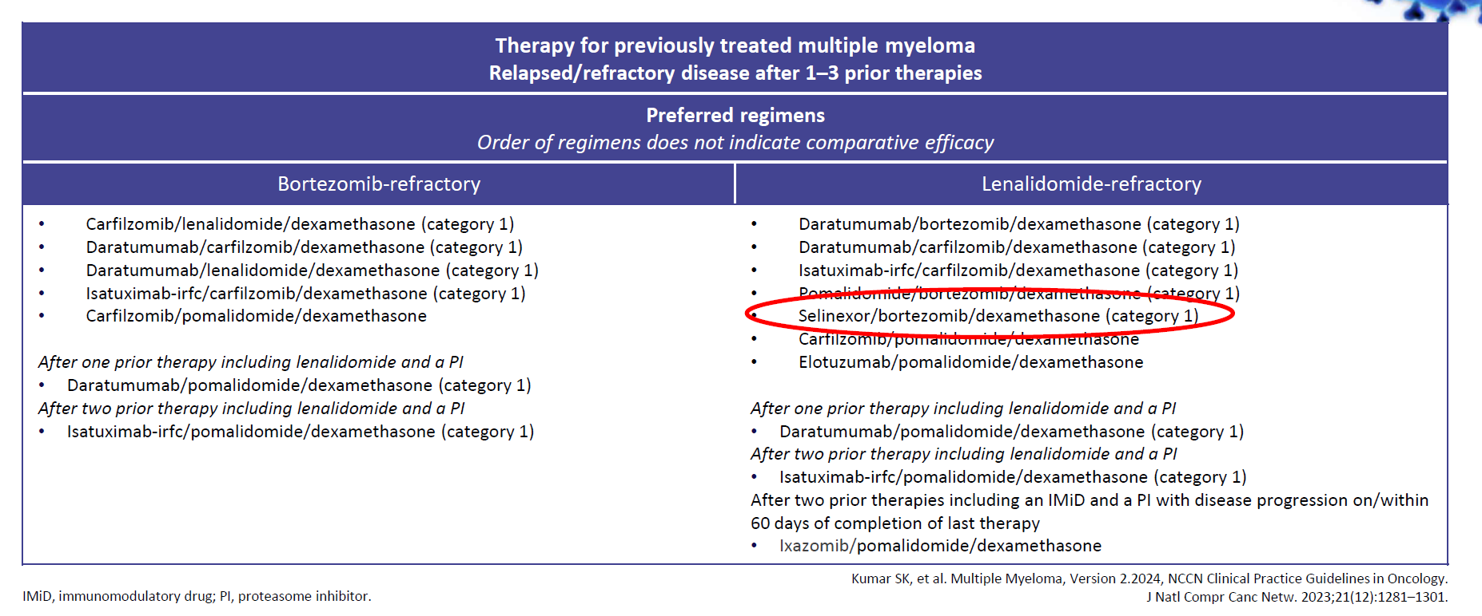
NCCN Guidelines
Early relapse
Therapy for previously treated multiple myeloma Relapsed/refractory disease after 1-3 prior therapies
Preferred regimens Order of regimens does not indicate comparative efficacy
Bortezomib-refractory | Lenalidomide-refractory
Carfilzomib/lenalidomide/dexamethasone (category 1) Daratumumab/carfilzomib/dexamethasone (category 1) Daratumumab/lenalidomide/dexamethasone (category 1) Isatuximab-irfc/carfilzomib/dexamethasone (category 1) Carfilzomib/pomalidomide/dexamethasone After one prior therapy including lenalidomide and a PI Daratumumab/pomalidomide/dexamethasone (category 1) After two prior therapy including lenalidomide and a PI Isatuximab-irfc/pomalidomide/dexamethasone (category 1) | Daratumumab/bortezomib/dexamethasone (category 1) Daratumumab/carfilzomib/dexamethasone (category 1) Isatuximab-irfc/carfilzomib/dexamethasone (category 1) Pomalidomide/bortezomib/dexamethasone (category 1) Selinexor/bortezomib/dexamethasone (category 1) Carfilzomib/pomalidomide/dexamethasone Elotuzumab/pomalidomide/dexamethasone After one prior therapy including lenalidomide and a PI Daratumumab/pomalidomide/dexamethasone (category 1) After two prior therapy including lenalidomide and a PI Isatuximab-irfc/pomalidomide/dexamethasone (category 1) After two prior therapies including an IMiD and a PI with disease progression on/within 60 days of completion of last therapy Ixazomib/pomalidomide/dexamethasone
IMiD, immunomodulatory drug; PI, proteasome inhibitor
Kumar SK, et al. Multiple Myeloma, Version 2.2024, NCCN Clinical Practice Guidelines in Oncology. J Natl Compr Canc Netw. 2023;21(12):1281-301

Slide 14
NCCN Guidelines
Early relapse
Therapy for previously treated multiple myeloma Relapsed/refractory disease after 1-3 prior therapies
Other recommended regimens
Carfilzomib (twice weekly)/dexamethasone (category 1) Elotuzumab/lenalidomide/dexamethasone (category 1) Bortezomib/cyclophosphamide/dexamethasone (category 1) Bortezomib/lenalidomide/dexamethasone Carfilzomib/cyclophosphamide/dexamethasone Daratumumab/cyclophosphamide/bortezomib/dexamethasone Elotuzumab/bortezomib/dexamethasone Ixazomib/cyclophosphamide/dexamethasone Lenalidomide/cyclophosphamide/dexamethasone | After two prior therapies including an IMiD and a PI with disease progression on/within 60 days of completion of last therapy Pomalidomide/cyclophosphamide/dexamethasone
Useful in certain circumstances
Bortezomib/dexamethasone (category 1) Bortezomib//liposomal doxorubicin/dexamethasone (category 1) Lenalidomide/dexamethasone (category 1) Carfilzomib/cyclophosphamide/thalidomide/dexamethasone Carfilzomib (weekly)/dexamethasone Selinexor/carfilzomib/dexamethasone Selinexor/daratumumab/dexamethasone Venetoclax/dexamethasone ± daratumumab or PI only for t(11;14 patients) | After two prior therapies including an IMiD and a PI with disease progression on/within 60 days of completion of last therapy Pomalidomide/dexamethasone (category 1) Ixazomib/pomalidomide/dexamethasone Selinexor/pomalidomide/dexamethasone For treatment of aggressive MM Dexamethasone/cyclophosphamide/etoposide/cisplatin Dexamethasone/thalidomide/cisplatin/doxorubicin/cyclophosphamide/ etoposide ± bortezomib After at least three prior therapies including a PI and an IMiD or are double-refractory to a PI and an IMiD Daratumumab
IMiD, immunomodulatory drug; MM, multiple myeloma; PI, proteasome inhibitor.
Kumar SK, et al. Multiple Myeloma, Version 2.2024, NCCN Clinical Practice Guidelines in Oncology. J Natl Compr Canc Netw. 2023;21(12):1281-301

Slide 15
XPO1 inhibitor
MoA, efficacy and safety, guidance on use
MoA, mechanism of action; XPO1, exportin-1

Slide 16


Selinexor is a first in class oral XPO1 inhibitor mechanism of action
XPO1:
XPO1 is a nuclear export protein that transports nuclear proteins to the cytoplasm via nuclear pore complexes
XPO1 is overexpressed in many tumour types, including MM
It exports TSPs to the cytoplasm, where they are unable to function and elevates cytosolic levels of pro-survival proteins
This results in dysregulation of growth signalling and increased anti-apoptotic signalling
Selinexor:
Blocks XPO1 so that it cannot carry cargo out of the nucleus
TSPs accumulate in the nucleus, causing cell cycle arrest and apoptosis
Traps oncoprotein mRNA in the nucleus, so they cannot be translated
MYELOMA CELL
Cytoplasm
Oncoprotein
mRNAs
Nucleus
XPO1
XPO1
Cargo
proteins
Cargo Proteins
(TSPs, oncoprotein
mRNAs, growth
regulators)
Nuclear Pore
MM, multiple myeloma; mRNA, messenger RNA; TSP, tumour suppressor protein; XPO1, exportin 1
Mo CC, et al. EJHaem. 2023;4:792-810

Slide 17
Selinexor is a first in class oral XPO1 inhibitor approvals, dosing, trials, outcomes and safety
 | Sd¹ | SVd² | SPd³ | SDd⁴ | SKd^{5,6} | SDVd⁷
FDA approval | ≥4 prior treatments and refractory to 2 PI, 2 IMiD, and anti-CD38 mAb | ≥1 prior therapy | N/A | N/A | N/A | N/A
Selinexor dosingª | 80 mg BIW | 100 mg QW | 60 mg QW; SPd (P: 4 mg QD) | 100 mg QW; SDd (D: 16 mg/kg) | 80 mg QW; SKd (K: 56 mg/m²) | 100 mg Q4W (pt 1) 60 mg Q5W (pt 2)
Clinical trial | STORM trial (N=122) Phase 2b, single-arm | BOSTON trial (N=402) Phase 3 | STOMP trial (N=65) Phase 1b/2 | STOMP trial (N=34/30^{b}) Phase 1/2b | STOMP trial (N=32) Phase 1b/2 | SELIBORDARA (N=57) Phase 2
Comparator | N/A (median seven treatment lines) | SVd vs. Vd (V: 1.3 mg/m²) | N/A (2+ lines of treatment) | N/A (≥3 lines of treatment) | N/A (1+ line of treatment) | N/A ( ≥3 lines of treatment [pt 1]; ≥1 lines of treatment [pt 2])
Outcomes (months) | mPFS = 3.7 mOS = 8.6 | mPFS = 13.9 vs. 9.5 | mPFS= 12.2 | mPFS = 12.5 | mPFS = 15/23.7^{triple-ref} | mPFS = 7.2 (pt 1); 25.1 (pt 2) mOS = 28.5 (pt 1); NR (pt 2)
Side effects | Thrombocytopenia, nausea, fatigue, anemia, neutropenia occurred across all trials |  |  | Thrombocytopenia, nausea, fatigue, anemia, neutropenia
Pearls^{1,5} | Optimize hydration, caloric intake, blood counts, and concomitant medications, and give with antiemetics
Safety: Side effects were consistent among studies. No new risks were identified for the combination therapies
ª Dexamethasone 20 mg in STORM and 40 mg in BOSTON and STOMP trials; ^{b} CD38 mAb naïve
BIW, twice weekly; CD38, cluster of differentiation 38; d, dexamethasone; D, daratumumab; FDA, Food and Drug Administration; IMiD, immunomodulatory drug; N/A, not applicable; K, carfilzomib; mOS, median overall survival; mPFS, median progression-free survival; P, pomalidomide; PI, proteasome inhibitor; QD, daily; QW, weekly; S, selinexor; triple-ref, refractory to three drug classes; V, bortezomib; XPO1, exportin 1
1. Chari A, et al. N Engl J Med. 2019;381:727-738; 2. Grosicki S, et al. Lancet. 2020;396:1563-73; 3. Chen CI, et al. Blood. 2020;136 (supplement 1):18-19 (Presented at ASH 2020); 4. Gasparetto C, et al. EJHaem. 2020;2:56-65; 5. Gasparetto C, et al. Br J Cancer. 2022;126:718-725; 6. Schiller GJ, et al. Blood. 2022;140 (supplement 1):10050-10053; 6. 7. González-Calle V, et al. Haematologica. 2024. Epub ahead of print. PMID: 38356463

Slide 18
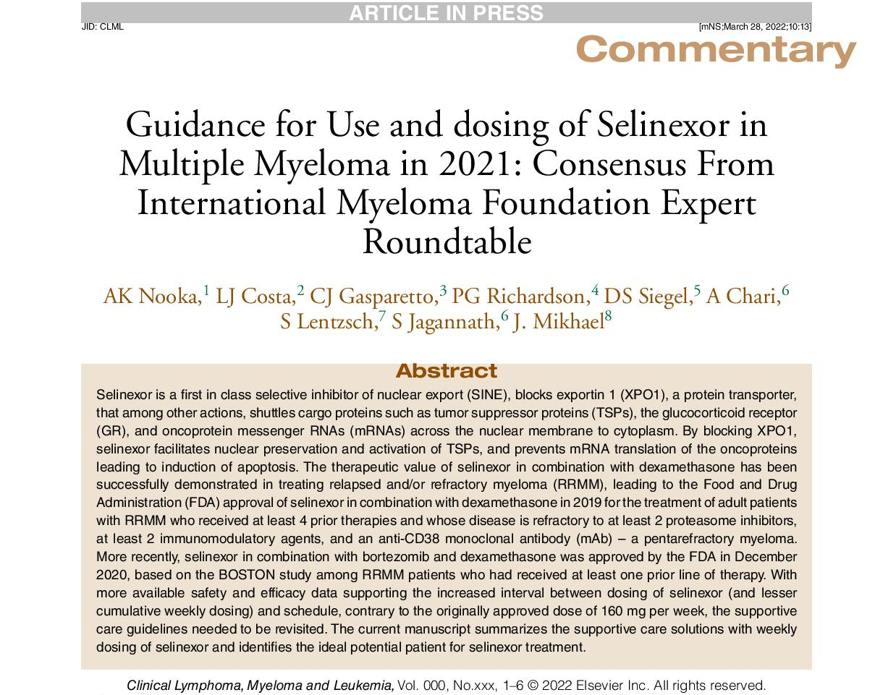
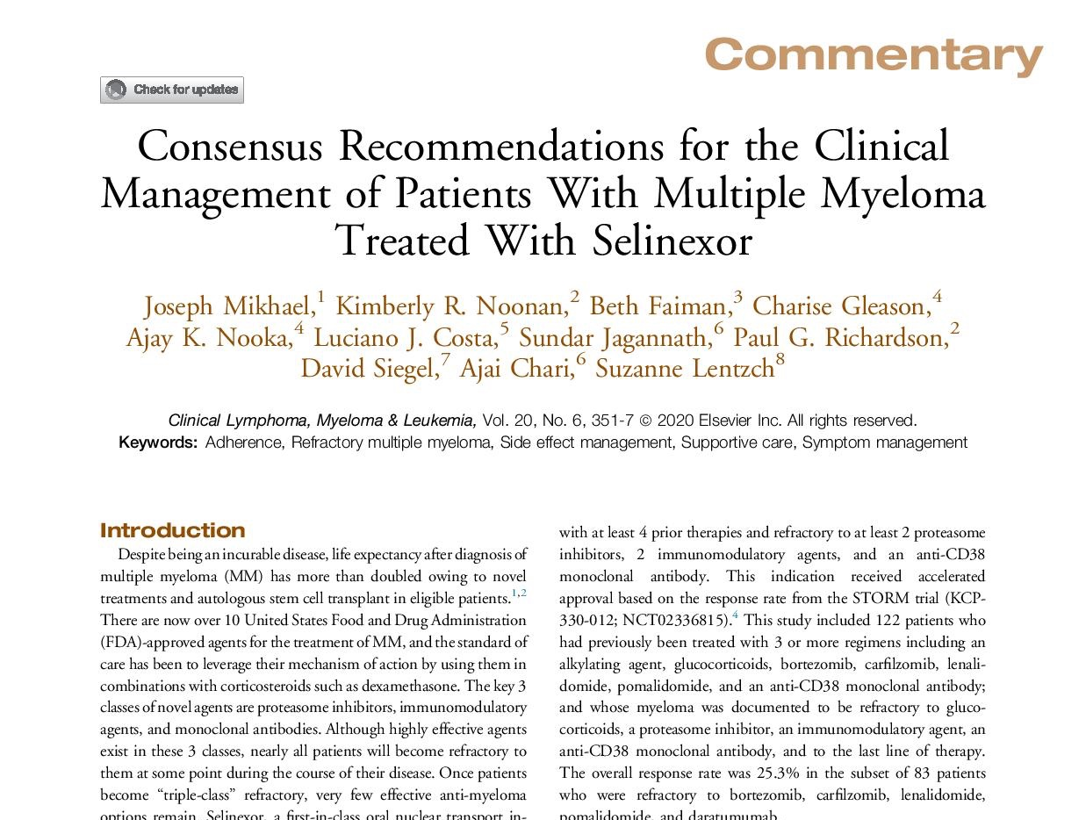
Selinexor is a first in class oral XPO1 inhibitor guidance and expert recommendations
Selinexor has to be administered carefully, especially in the first month
Expert recommendations – Dr Mikhael
PREVENT anorexia and nausea with two antiemetic agents (classic 5-HT3 antagonist AND olanzapine)
HYDRATE weekly for the first weeks
MONITOR food intake and possibly weight if meals missed
EDUCATE patients about the potential side effects
Expert view
5-HT3, 5-hydroxytryptamine type 3 (receptor); XPO1, exportin 1
Nooka AK, et al. Clin Lymphoma Myeloma Leuk. 2022;22:e526-e531; Mikhael J, et al. Lymphoma Myeloma Leuk. 2020;20:351-357

Slide 19
Selinexor is a first in class oral XPO1 inhibitor guidance and expert experience
Selinexor has to be administered carefully, especially in the first month
Expert experience – Dr Mikhael
Starting dose is 100 mg per US PI, but in my practice, I start with a lower dose
I tell every patient the worst month is the first month
I dose the 5-HT3 antagonist continuously the day prior, the day of and the day after each dose of selinexor for the first month
I dose the olanzapine (usually 2.5 mg) the night prior, the night of and the night after each dose of selinexor for the first month
Dose de-escalation of the antiemetics can then occur – most patients do not need them in the long-term
I arrange for an evaluation if they miss more than two meals in a row in the first month
I dose weekly dexamethasone on the same day as selinexor
I engage the patient’s care partner to be aware of the potential side effects
Expert view
5-HT3, 5-hydroxytryptamine type 3 (receptor); US PI, United States Product Information; XPO1, exportin 1
Nooka AK, et al. Clin Lymphoma Myeloma Leuk. 2022;22:e526-e531; Mikhael J, et al. Lymphoma Myeloma Leuk. 2020;20:351-357

Slide 20
SVd treatment-related nausea in BOSTON was transient with decreasing incidence after the first month of therapy
Percentage of Patients Experiencing Nausea Events per Month in the SVd Arm of BOSTON
In Month 1
94.2%
Patients with nausea resolved
In the SVd arm, nausea events were observed in 50% of patients
(% Grade 3).
The SVd trial protocol required a prophylactic 5-HT3 antagonist to address nausea but allowed for other interventions as required.
33.8
In Month 2
Patients with ≥1 nausea event by grade (%)
80.0%
Patients with nausea resolved
In Months 3, 4, 5 & 6
100%
Patients with nausea resolved
13.1
8.6
7.5
5.2
5.0
SVd, selinexor, bortezomib, dexamethasone
Nooka AK, et al. Clin Lymphoma Myeloma Leuk. 2022;7:e526-e531

Slide 21
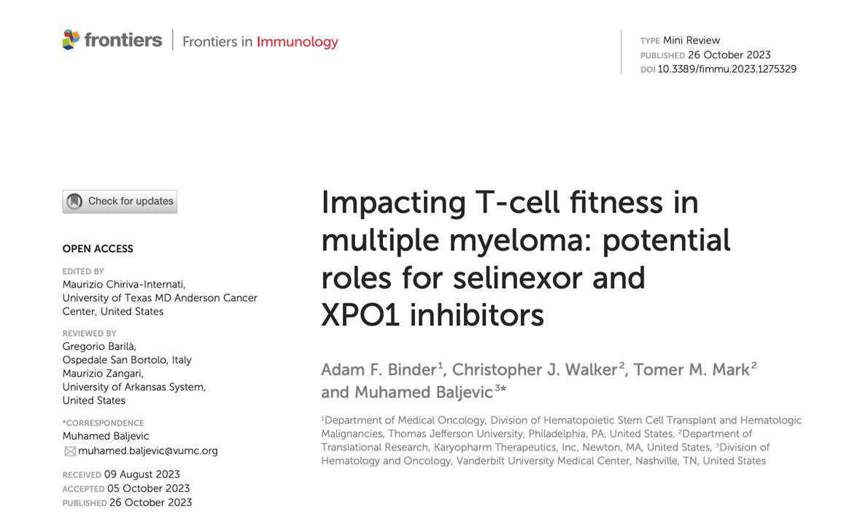
How does Selinexor fit into our use of CAR-T?
Emerging evidence that Selinexor does not impair T-cell health
CAR-T, chimeric antigen receptor T-cell;
Binder AF, et al. Front Immunol. 2023:14:1275329;

Slide 22
Key clinical takeaways
The treatment landscape for early relapsed multiple myeloma is expanding, including CAR-T cell therapies now available (prioritised for functional high-risk patients)
Early relapse management involves several drug classes:
  Immunomodulatory agents, proteasome inhibitors, monoclonal antibodies, XPO1 inhibitors
Selinexor is a first-in-class XPO1 inhibitor. Side effects can be managed through dose modifications and with the use of antiemetics
General principles of therapy selection include:
  Introducing a new mechanism of action
  Using a triplet combination
  Selecting the best combination based on patient, disease and treatment characteristics
There is no “perfect” sequence
CAR-T, chimeric antigen receptor T cell; XPO1, exportin-1

Slide 23
The evolution of myeloma therapy
Bortezomib
Lenalidomide
Carfilzomib
Pomalidomide
Selinexor
Panobinostat
Daratumumab
Ixazomib
Elotuzumab
Isatuximab
VTd
VRd
KRd
D-VMP
DRd
D-VRd
Lenalidomide
Bortezomib
Ixazomib
Lenalidomide + PI
Carfilzomib
Combinations
Idecabtagene autoleucel
Ciltacabtagene autoleucel
Teclistamab
Talquetamab
Elranatamab
Now
SCT +/- More induction
Front line treatment
Maintenance
Relapsed
Induction
Consolidation
Post consolidation
Rescue
New
Isa-VRd
Isa-KRd
D-KRd
CAR-T therapy or bispecifics?
Daratumumab?
Novel CAR-T therapies
Bispecific/trispecific antibodies
CelMod agents
Venetoclax?
Multiple small molecules
++++++++
Expert view
CAR-T, chimeric antigen receptor T-cell; Cy, cyclophosphamide; d, daratumumab; d, dexamethasone; Isa, isatuximab; K, carfilzomib; M, melphalan;
PI, proteasome inhibitor; R, lenalidomide; SCT, stem cell transplant; T, thalidomide; V, bortezomib

Slide 24
Find out more about RRMM in Parts 1 and 2 part 1: Unmet medical needs in early relapse
Part 2: the relevance of adding a new moa in treating RRMM – an expert view
MM, multiple myeloma; RR, relapsed/refractory;

