Slide 2
Part 2
Multiple myeloma: the relevance of adding a new moa in the treatment of RRMM – an expert view
Dr Fredrik Schjesvold
Oslo Myeloma Center, Norway
September 2024
MoA, mechanism of action; MM, multiple myeloma; RR, relapse/refractory

Slide 3

Developed by COR2ED
This programme is developed by LYMPHOMA & MYELOMA
CONNECT, an international group of experts working in the field
of hematological malignancies
Acknowledgement and disclosures
This clinical topic newsletter is supported through an independent educational grant from Menarini Stemline Oncology. The programme is therefore independent, the content is not influenced by the supporter and is under the sole responsibility of the expert.
Please note: The views expressed within this programme are the personal opinions of the experts. They do not necessarily represent the views of the experts’ institution, employer, organisation or other group or individual.
Expert disclosures:
Dr Fredrik Schjesvold has received financial support/sponsorship for research support, consultation, or speaker fees from the following companies: Targovax, Amgen, BMS, Takeda, Sanofi, Menarini, AbbVie, Janssen, Oncopeptides, GSK, Regeneron

Slide 4
Educational objectives
Know how to incorporate the latest scientific and clinical insights on the treatment of MM into clinical practice, focusing on the relapsed/refractory setting
Knowing the MoA and how this translates into the efficacy profile of novel drugs
Learning from best practices on treatment sequencing, treatment combinations and dosing in MM
Knowing the safety profiles of novel drugs and what the best strategies are to prevent or act on side effects

Slide 5
First line treatment
Usually contains
  Bortezomib
  Corticosteroids
  Lenalidomide
Today may contain
  Daratumumab
Dimopoulos MA, et al. Ann Oncol. 2021;32:309–322;

Slide 6
Multiple myeloma
Premise 1: At diagnosis the disease is already complex with multiple (sub)clones and genome aberrations^{1,2}
Premise 2: Genomic aberrations correlate to drug sensitivity/resistance^{3,4}
Premise 3: At relapse the cancer genome has changed^{5,6}
Summary of proteasome subunit mutations from different myeloma cohorts
Summarized findings from 28 patients with a sequential sample pair
2.5
Baseline/diagnosis (n=1241)
First relapse (n=194)
PI refractory MM (n=132)
First hit
Progenitor
Diagnosis
2.0
Relapse
1.5
Mutation frequency (%)
No changes (35.7%)
1-38 months (median 13)
1.0
0.5
Gains and losses (35.7%)
6-29 months (median 21)
9-61 changes (median 26)
Only new changes (28.6%)
3-65 months (median 18)
1-15 changes (median 5)
0
PSMA1
PSMB5
PSMB8
PSMB9
PSMD1
PSMG2
Relapse
Relapse
Proteasome related genes (M³P)
Coloured bars represent theoretical CNAs perceived to exist at a particular point in the evolution of the tumour
Figure adapted from Barrio et al.⁵
Figure adapted from Keats et al.⁶
M³P, multiple myeloma mutational panel; MM, multiple myeloma; PI, proteasome inhibitor; PSMA1, proteasome 20S subunit alpha 1; PSMB5/8/9, proteasome 20S subunit beta 5/8/9; PSMD1, proteasome 26S subunit, non-ATPase 1; PSMG2, proteasome assembly chaperone 2
1. Walker BA, et al. Blood. 2018;132:587-597; 2. Lohr JG, et al. Cancer Cell. 2014;25:91-101; 3. Marcotte R, et al. Cell. 2016;164:293-309; 4. Barrio S, et al. Leukemia. 2019;33:447-456; 5. Barrio S, et al. Leukemia. 2019;33:447-456 . 6. Keats JJ, et al. Blood. 2012;120:1067–1076

Slide 7
Changing + adding drug class
Clonal dynamics in a patient with high-risk MM
Len/Dex
Considerations at relapse¹
Remission
~2N
Len/Dex
Relapse 1
~2N
Carfilzomib
Therapy
Patient
Disease characteristics
Prior drug class
Age / frailty /
performance status
Early / late relapse
Clone 1.1
Clone 1.2
Clone 2.1
Clone 2.2
Misc
Biochemical /
symptomatic relapse
Diagnosis
~2N
Relapse 2
~2N
Prior efficacy
Patient preferences
Bortezomib
SGN-40
Duration of treatment
Comorbidities
Tumour burden
Relapse 3
~2N
Previous toxicities
Bone marrow reserve
Cytogenetics
cIg-high
66%
cIg-high
37%
Refractoriness
Quality of life
Aggressiveness
Plasma cell leukaemia
~3N
MPV
Expected toxicities
End organ function
M-protein level
Relapse 4
~3N
cIg-low
34%
cIg-low
63%
Figure adapted from Keats et al.¹
dex, dexamethasone; Len, lenalidomide; MM, multiple myeloma
1. Keats JJ, et al. Blood. 2012;120:1067-1076; 2. expert view

Slide 8
Strategy advice 1
Treat biochemical relapse/progression
Switch to or add new MoA
Treat continuously, if tolerated
Expert view

Slide 9
Strategy advice 2
How to choose a regimen?
If two regimens are “equally effective”
Aim for completely new MoAs, if not ➔
What gives the biggest change in MoA from the last treatment?
Aim for drugs that the patient has not received
MoA
(Think ahead)?
Consider the
next lines
Drugs with limited combinations
Studies
Expert view
MoA, mechanism of action;

Slide 10
Strategy advice 2
How to choose a regimen?
What drug groups should the patient receive first?
IMiDs
Pls
CD38 antibodies
First drug
classes
The rest
Later
Expert view
MoA, mechanism of action;

Slide 11
Relapse treatment overall response rate based on prior treatment history
In patients previously treated with bortezomib, randomized to DRd, the biggest increase in overall response rate is seen
Changing and adding drug class
 | # of patients in group |  | Overall response rate, n (%)ª
Subgroup | D-Rd | Rd | D-Rd | Rd | p value^{b}
ITT | 281 | 276 | 261 (92.9) | 211 (76.4) | <0.0001
Prior lines of therapy 1 2 to 3 1 to 3 | 147 120 267 | 142 115 257 | 137 (93.2) 114 (95.0) 251 (94.0) | 114 (80.3) 85 (73.9) 199 (77.4) | 0.0003 <0.0001 <0.0001
Prior therapy Bortezomib Lenalidomide Thalidomide | 237 50 119 | 232 47 123 | 218 (92.0) 42 (84.0) 109 (91.6) | 175 (75.4) 32 (64.0) 87 (70.7) | <0.0001 0.0233 <0.0001
Refractory to bortezomib | 57 | 56 | 50 (87.7) | 38 (67.9) | 0.0113
Changing drug class
Retreatment
Adding drug class
Data are based on computerised algorithm
ª Response-evaluable population; ^{b} p value was generated using the Cochran-Mantel-Haenszel χ² test;
(D-)Rd, (daratumumab), lenalidomide, dexamethasone; ITT, intent-to-treat
Dimopoulos MA, et al. Haematologica. 2018;103:2088-2096

Slide 12

Options for second line treatment
PI
IMiD
CD38 ab
After (V)Rd/Rd/ASCT-Len → Proteasome inhibitor-based treatment + CD38 ab
After D-VMP → IMiD-based treatment
After DRd → Proteasome inhibitor-based treatment
Expert view
ASCT, autologous stem cell transplant; CD38 ab, cluster of differentiation 38 antibody; D, daratumumab; IMiD, immunomodulatory drug; Len, lenalidomide; PI, proteasome inhibitor; Rd, lenalidomide plus dexamethasone; V, bortezomib; VMP, bortezomib, melphalan, and prednisone

Slide 13
Proteasome inhibitor-based SECOND-line treatment mPFS of different trials after Rd – or ASCT-Len
mPFS (months)
% | OPTIMISMM¹ |  | CASTOR² |  | BOSTON³ |  | ENDEAVOR⁴ |  | CANDOR⁵ |  | IKEMA^{6,7}
 | PVd (n=281) | Vd (n=278) | DVd (n=251) | Vd (n=247) | SVd (n=195) | Vd (n=247) | Kd (n=464) | Vd (n=465) | DKd (n=312) | Kd (n=154) | Isa-Kd (n=179) | Kd (n=123)
Prior lines of therapy
1 | 40 | 41 | 49 | 46 | 51 | 48 | 50 | 50 | 46 | 46 | 44 | 45
Prior therapies
Bortezomib | 72 | 73 | 65 | 66 | 69 | 70 | 54 | 54 | 92 | 87 | 93 | 85
Lenalidomide | 100 | 100 | 36 | 49 | 40 | 37 | 38 | 38 | 39 | 48 | 40 | 48
Head-to-head studies have not been conducted. Cross-trial comparisons are not appropriate.
ASCT, autologous stem cell transplant; DKd, daratumumab, carfilzomib, dexamethasone; DVd, daratumumab, bortezomib, dexamethasone; Isa-Kd, isatuximab, carfilzomib, dexamethasone; Kd, carfilzomib, dexamethasone; Len, lenalidomide; mPFS, median progression-free survival; NR, not reached; PVd, pomalidomide, bortezomib, dexamethasone; Rd, lenalidomide, dexamethasone; SVd, selinexor, bortezomib, dexamethasone; Vd, bortezomib, dexamethasone;
1. Richardson PG, et al. Lancet Oncol. 2019;20:781-794 (OPTIMISMM); 2. Mateos M-V, et al. 2020;20:509-518 (CASTOR); 3. Grosicki S, et al. Lancet. 2020;396:1563-1573 (BOSTON); 4. Dimopoulos MA, et al. Lancet Oncol. 2016.17:27-38 (ENDEAVOR); 5. Usmani SZ, et al. Lancet. Oncol. 2022;23:65-76 (CANDOR); 6. Moreau P, et al. Lancet. 2021;397:2361-2371 (IKEMA); 7. Martin T, et al. Blood Cancer J. 2023;13:72 (IKEMA)

Slide 14
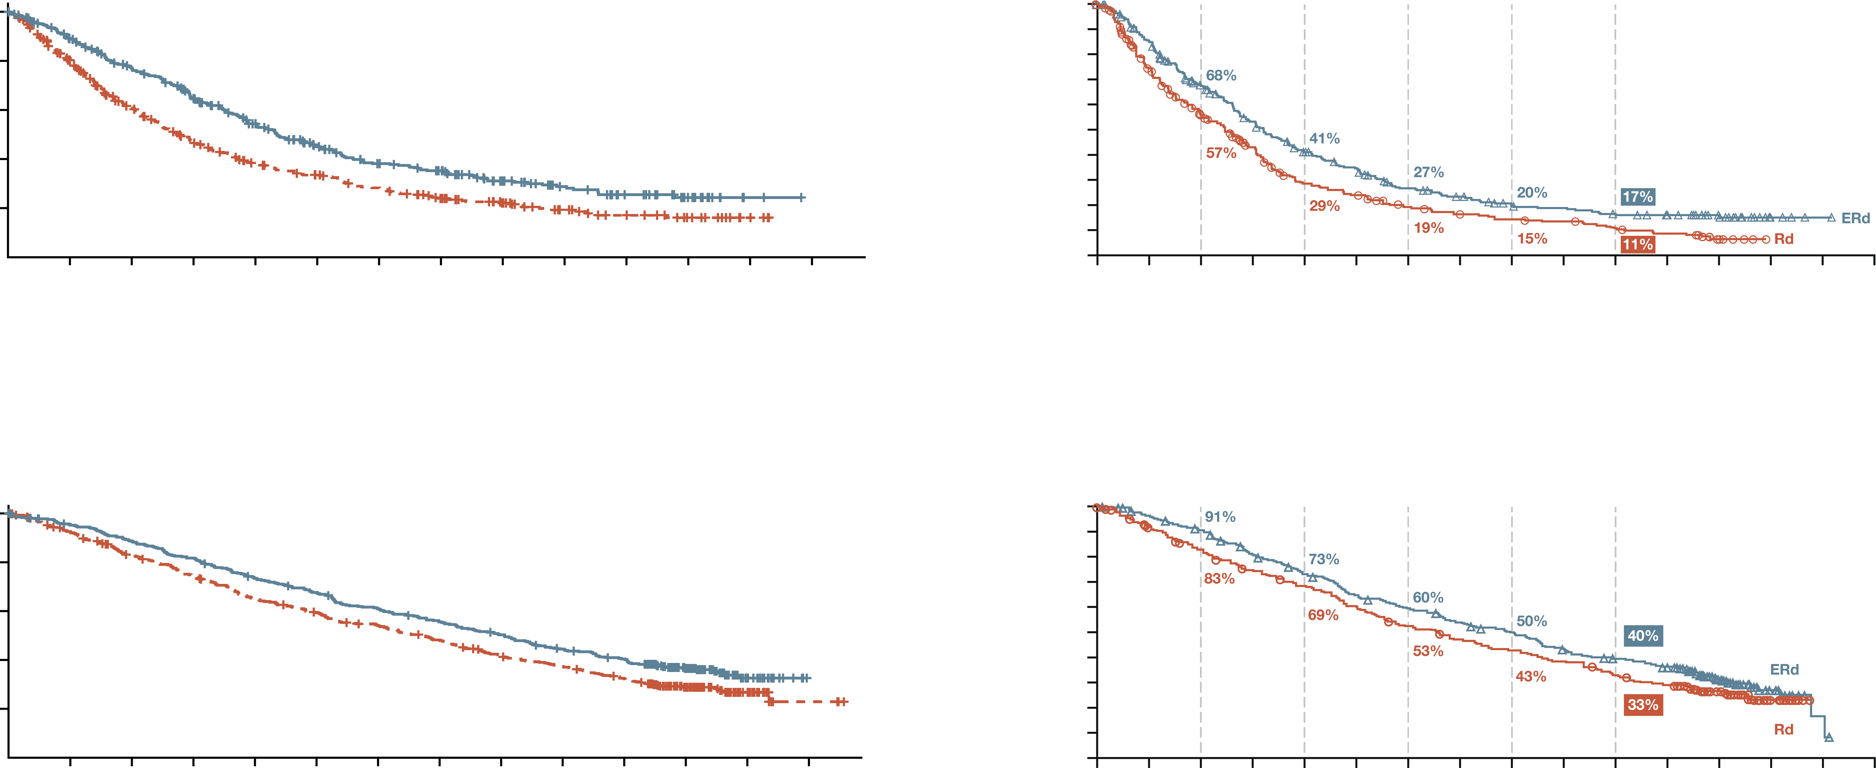
Second line after d-vmp: Imid-based
KRd vs Rd¹
EloRd vs Rd²
1-year
PFS
2-year
PFS
3-year
PFS
4-year
PFS
5-year
PFS
1.0
 | KRd (n=396) | Rd (n=396)
Death, No. (%) | 244 (61.6) | 272 (68.7)
Median PFS, months | 26.1 | 16.6
HR for KRd vs Rd (95% CI) | 0.659 (0.553-0.784)
One-sided p value | <0.001
1.0
 | ERd (n=321) | Rd (n=325)
Median PFS, months (95% CI) | 19.4 (16.6-22.3) | 14.9 (12.3-17.3)
HR for ERd vs Rd (95% CI) | 0.72 (0.60-0.87)
 | p=0.0005
0.9
0.8
0.8
19.4 vs 14.9 months
0.7
0.6
0.6
PFS (proportion)
PFS (probability)
0.5
0.4
0.4
0.3
0.2
26.1 vs 16.6 months
0.2
0.0
0.1
0
6
12
18
24
30
36
42
48
54
60
66
72
78
0.0
0
6
12
18
24
30
36
42
48
54
60
66
72
78
84
90
No. at risk:
KRd
Rd
Time since random assignment (months)
No. at risk:
KRd
Rd
Time (months)
396
396
337
291
282
211
227
154
178
118
136
99
109
81
94
61
65
45
45
30
32
21
17
13
2
4
0
0
321
325
261
217
196
159
149
109
113
69
92
58
67
42
56
35
44
30
41
27
34
21
31
16
18
6
4
0
1
0
0
0
 | KRd (n=396) | Rd (n=396)
Death, No. (%) | 246 (62.1) | 267 (67.4)
Median OS, months | 48.3 | 40.4
HR for KRd vs Rd (95% CI) | 0.794 (0.667-0.945)
One-sided p value | 0.0045
1-year
OS
2-year
OS
3-year
OS
4-year
OS
5-year
OS
1.0
1.0
 | ERd (n=321) | Rd (n=325)
Median OS, months (95% CI) | 48.3 (40.3-51.9) | 39.6 (33.3-45.3)
HR for ERd vs Rd (95% CI) | 95.4 (0.68-1.00)
 | p=0.0408
0.9
0.8
0.8
0.7
0.6
0.6
OS (proportion)
Probability alive
0.5
0.4
0.4
0.3
0.2
48.3 vs 40.4 months
0.2
48.3 vs 39.6 months
0.0
0.1
0
6
12
18
24
30
36
42
48
54
60
66
72
78
0.0
0
6
12
18
24
30
36
42
48
54
60
66
72
78
84
90
No. at risk:
KRd
Rd
Time since random assignment (months)
No. at risk:
KRd
Rd
Time (months)
396
396
369
356
343
313
316
281
282
243
259
220
232
199
211
176
190
149
166
133
149
113
88
69
22
20
0
3
321
325
303
287
283
255
250
228
224
208
197
184
181
159
163
142
149
128
129
116
115
98
105
86
57
47
15
9
2
0
0
0
Head-to-head studies have not been conducted. Cross-trial comparisons are not appropriate.
D-VMP, daratumumab, bortezomib, melphalan, prednisone; EloRd, elotuzumab, lenalidomide, dexamethasone; HR, hazard ratio; IMiD, immunomodulatory drug; KRd, carfilzomib, lenalidomide, dexamethasone; OS, overall survival; PFS, progression-free survival; Rd, lenalidomide, dexamethasone
1. Siegel DS, et al. J Clin Oncol. 2018;36:728-34; 2. Dimopoulos M, et al. Blood Cancer J. 2020;10:91

Slide 15
Second line after d-vmp: Imid-based
KRd or EloRd
Why not DPd ➔ Already daratumumab-refractory
Why not IxaRd ➔ No OS benefit
Why not PVd ➔ Re-use of bortezomib; studied in lenalidomide-exposed
KRd or EloRd?
For KRd:
  KRd best PFS HR (0.66 vs 0.72 for EloRd)^{1,2}
  EloRd may not be as good directly after daratumumab
EloRd:
  EloRd best tolerated
  Patient already exposed
  to PI
Expert view
DPd, daratumumab, pomalidomide; D-VMP, daratumumab, bortezomib, melphalan, prednisone; EloRd, elotuzumab, lenalidomide, dexamethasone;
HR, hazard ratio; IMiD, immunomodulatory drug; IxaRd, ixazomib, lenalidomide, dexamethasone; KRd, carfilzomib, lenalidomide, dexamethasone;
OS, overall survival; PI, proteasome inhibitor; PFS, progression-free survival; PVd, pomalidomide, bortezomib, dexamethasone
1. Siegel DS, et al. J Clin Oncol. 2018;36:728-34; 2. Dimopoulos M, et al. Blood Cancer J. 2020;10:91

Slide 16
Relapse treatment after drd?
No CD38 options
No lenalidomide options
Adamant to include a PI
As always, triplets are preferred
What options are there?
  PVd
  SVd
  Kd?
Expert view
CD38, cluster of differentiation 38; DRd, daratumumab, lenalidomed, dexamethasone; Kd, carfizomib, dexamethasone; PI, proteasome inhibitor; PVd, pomalidomide, bortezomib, dexamethasone; SVd, Selinexor bortezomib, dexamethasone;

Slide 17
Proteasome inhibitor-based SECOND-line treatment mPFS of different trials after Rd – or ASCT-Len
mPFS (months)
% | OPTIMISMM¹ |  | CASTOR² |  | BOSTON³ |  | ENDEAVOR⁴ |  | CANDOR⁵ |  | IKEMA^{6,7}
 | PVd (n=281) | Vd (n=278) | DVd (n=251) | Vd (n=247) | SVd (n=195) | Vd (n=247) | Kd (n=464) | Vd (n=465) | DKd (n=312) | Kd (n=154) | Isa-Kd (n=179) | Kd (n=123)
Prior lines of therapy
1 | 40 | 41 | 49 | 46 | 51 | 48 | 50 | 50 | 46 | 46 | 44 | 45
Prior therapies
Bortezomib | 72 | 73 | 65 | 66 | 69 | 70 | 54 | 54 | 92 | 87 | 93 | 85
Lenalidomide | 100 | 100 | 36 | 49 | 40 | 37 | 38 | 38 | 39 | 48 | 40 | 48
Head-to-head studies have not been conducted. Cross-trial comparisons are not appropriate.
ASCT, autologous stem cell transplant; DKd, daratumumab, carfilzomib, dexamethasone; DVd, daratumumab, bortezomib, dexamethasone; Isa-Kd, isatuximab, carfilzomib, dexamethasone; Kd, carfilzomib, dexamethasone; Len, lenalidomide; mPFS, median progression-free survival; NR, not reached; PVd, pomalidomide, bortezomib, dexamethasone; Rd, lenalidomide, dexamethasone; SVd, selinexor, bortezomib, dexamethasone; Vd, bortezomib, dexamethasone;
1. Richardson PG, et al. Lancet Oncol. 2019;20:781-794 (OPTIMISMM); 2. Mateos M-V, et al. 2020;20:509-518 (CASTOR); 3. Grosicki S, et al. Lancet. 2020;396:1563-1573 (BOSTON); 4. Dimopoulos MA, et al. Lancet Oncol. 2016.17:27-38 (ENDEAVOR); 5. Usmani SZ, et al. Lancet. Oncol. 2022;23:65-76 (CANDOR); 6. Moreau P, et al. Lancet. 2021;397:2361-2371 (IKEMA); 7. Martin T, et al. Blood Cancer J. 2023;13:72 (IKEMA)

Slide 18
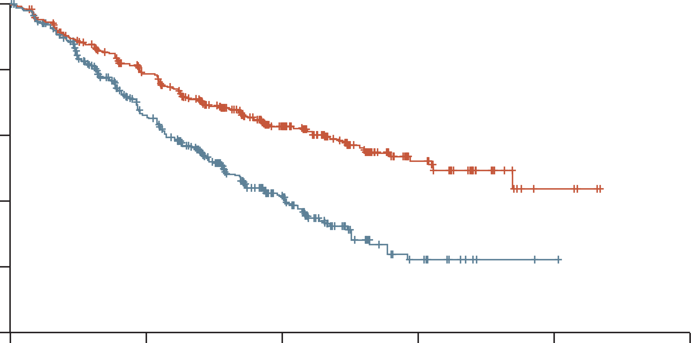
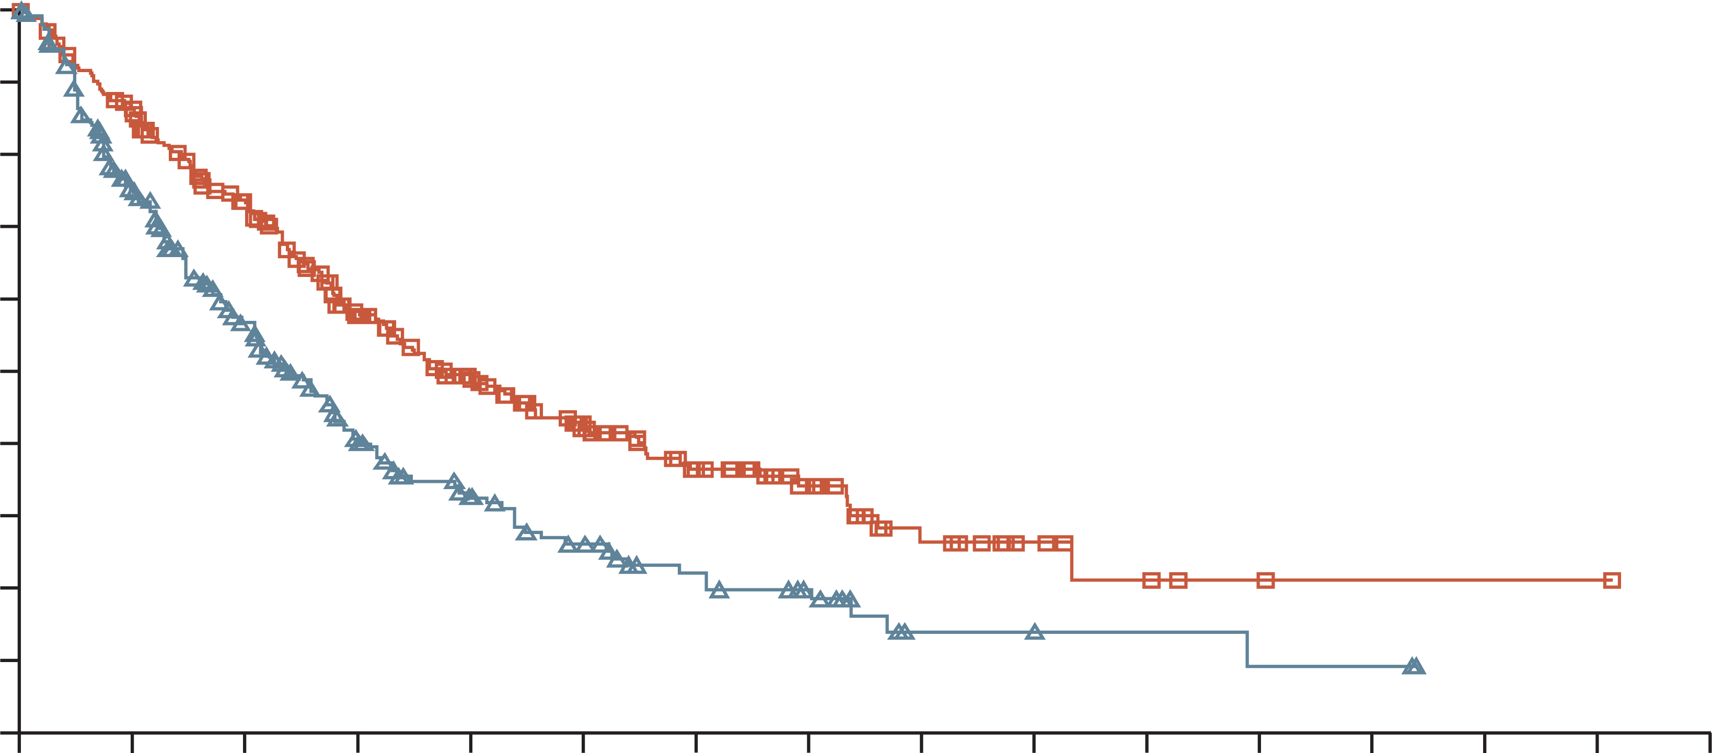
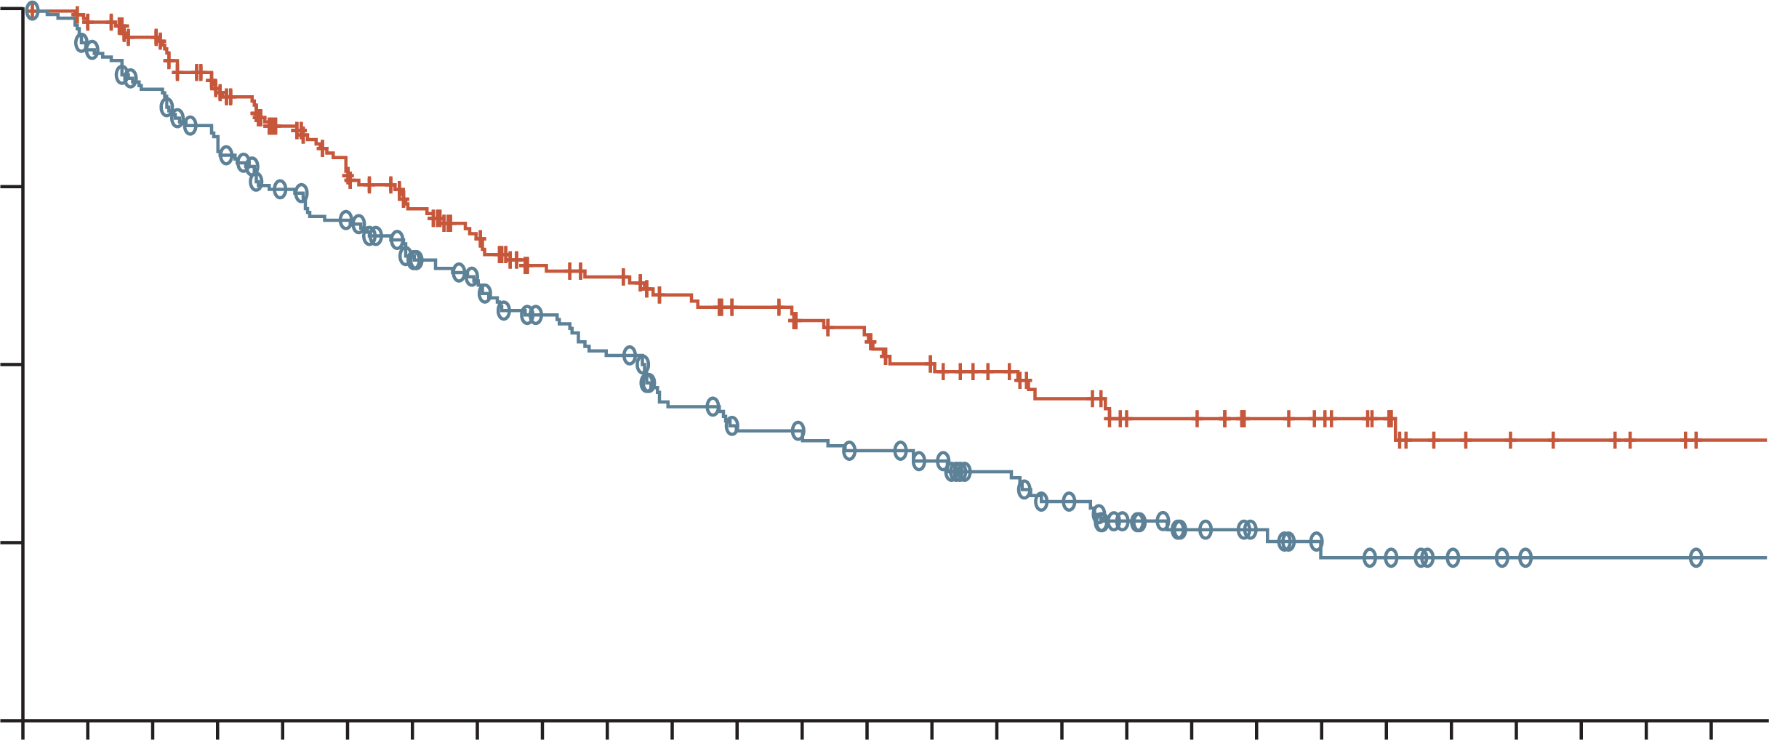
Relapse treatment after DRd
ENDEAVOR¹
1–3 prior lines of therapy
OPTIMISMM²
1–3 prior lines of therapy, received prior treatment
with a lenalidomide-containing regimen for
≥2 consecutive cycles, not bortezomib refractory
BOSTON³
1–3 prior lines of therapy
 | Carfilzomib group (n=464) | Bortezomib group (n=465)
Median progression-free survival (months) | 18.7 (95% CI 15.6-NE) | 9.4 (95% CI 8.4-10.4)
 | HR 0.53 (0.44-0.65); p<0.0001
100
100
Pomalidomide, bortezomib, and dexamethasone
Bortezomib and dexamethasone
HR 0.61 (95% CI 0·49–0.77); two-sided p<0.0001
1.00
Selinexor, bortezomib, and dexamethasone
Bortezomib and dexamethasone
90
80
80
0.75
Kd mPFS 18.7 months
70
60
60
PVd mPFS 11.2 months
SelVd mPFS 13.9 months
PFS (%)
Probability of PFS
PFS (%)
50
0.50
40
40
Selinexor, bortezomib, and dexamethasone:
median 13.93 months (95% CI 11.73-not evaluable)
Bortezomib and dexamethasone:
median 9.46 months (95% CI 8.11-10.78)
HR 0.70 (95% CI 0.53-0·93), p=0.0075
30
0.25
20
Bortezomib group
Carfilzomib group
Vd mPFS 9.4 months
20
Vd mPFS 7.1 months
Vd mPFS 9.5 months
10
0
0
6
12
18
24
30
0
0
3
6
9
12
15
18
21
24
27
30
33
36
39
42
45
0.00
0
1
2
3
4
5
6
7
8
9
10
11
12
13
14
15
16
17
18
19
20
21
22
23
24
25
26
Time (months)
Time (months)
Time (months)
Kd¹
  Doublet
  PI
  One different MoA
PVd²
  Triplet
  PI
  One different MoA
SelVd³
  Triplet
  PI
  Two different MoAs
Acceptable safety and tolerability profile of carfilzomib
Adverse events accorded with the individual profiles of pomalidomide, bortezomib, and dexamethasone
Safety results were consistent with the individual adverse event profiles of selinexor, bortezomib, and dexamethasone
CI, confidence interval; DRd, daratumumab, lenalidomide and dexamethasone; HR, hazard ratio; Kd, carfilzomib and dexamethasone; MoA, mechanism of action; (m)PFS, (median) progression-free survival; NE, not estimable; PI, proteasome inhibitor; PVd, pomalidomide, bortezomib, and dexamethasone; SelVd, selinexor, bortezomib, and dexamethasone; Vd, bortezomib and dexamethasone.
1. Dimopoulos MA, et al. Lancet Oncol. 2016.17:27-38; 2. Richardson PG, et al. Lancet Oncol. 2019;20:781-794; 3. Grosicki S, et al. Lancet. 2020;396:1563-1573

Slide 19
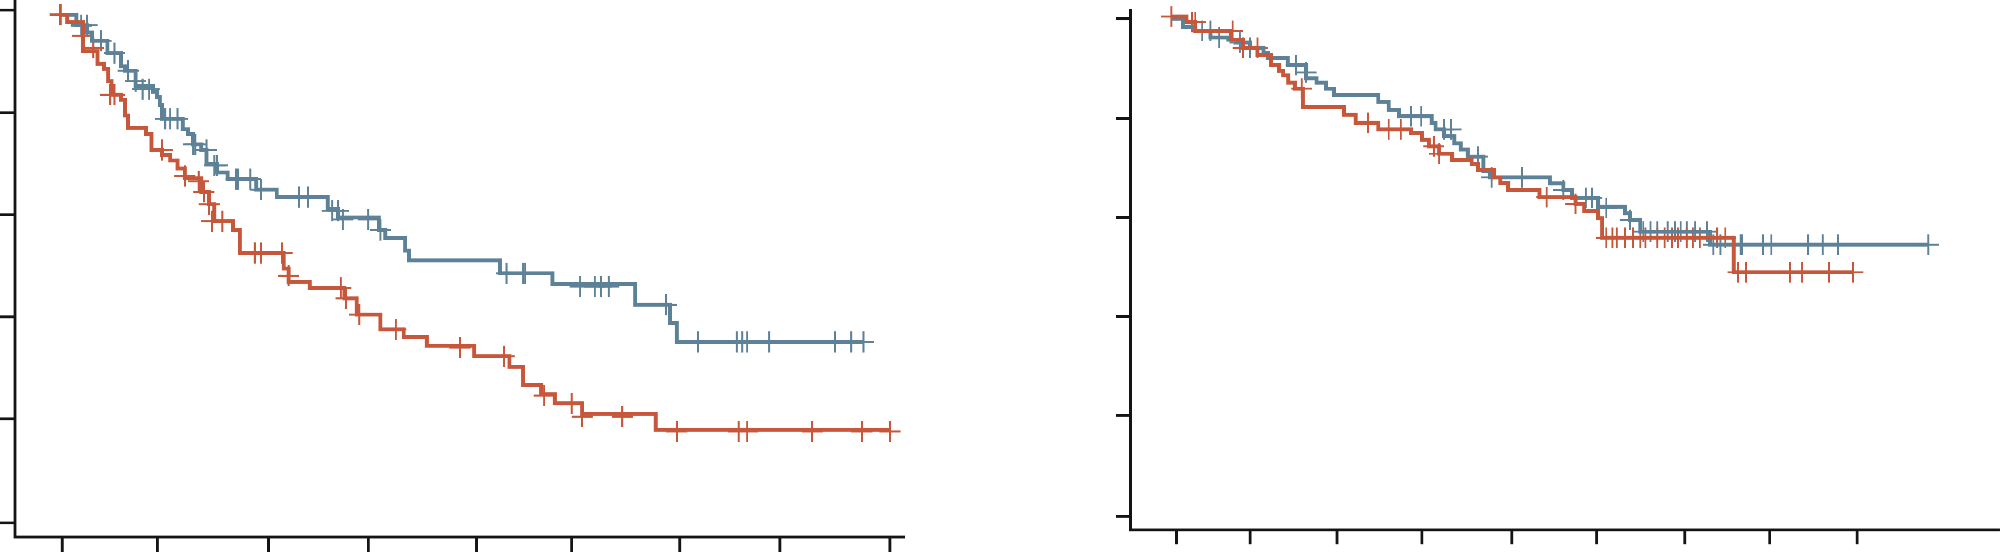
BOSTON subgroup analysis of patients with one prior line of therapy: Significant improvement in PFS with SVd vs Vd
PFS
OS
 | SVd | Vd
Median | 21.0 | 10.7
Hazard ratio (95% CI) | 0.62 (0.41, 0.95)
P value | 0.014
1.0
1.0
0.8
0.8
0.6
0.6
SVd
Progression-free
survival probability
Survival probability
0.4
SVd
0.4
 | SVd | Vd
Median | NR | 32.8
Hazard ratio (95% CI) | 0.91 (0.57, 1.45)
P value | 0.344
Vd
0.2
0.2
Vd
0.0
0.0
0
5
10
15
20
25
30
35
40
0
5
10
15
20
25
30
35
40
Months
Months
SVd
Vd
99
99
64
65
37
38
28
25
23
18
17
9
9
5
3
3
SVd
Vd
0
0
99
99
81
84
67
72
61
62
48
50
40
43
26
15
4
4
1
0
0
Higher ORR with SVd vs Vd (80.8% vs 66.7%; OR 2.40; p=0.005)
Higher ≥ VGPR with SVd vs Vd (52.5% vs 29.3%; OR 2.65; p<0.001)
CI, confidence intervals; NR, not reached; OR, odds ratio; ORR, overall response rate; OS, overall survival; PFS, progression-free survival;
SVd, selinexor, bortezomib, dexamethasone; Vd, bortezomib, dexamethasone; VGPR, very good partial response
Mateos MV, et al. Eur J Haematol. 2024;1-11

Slide 20
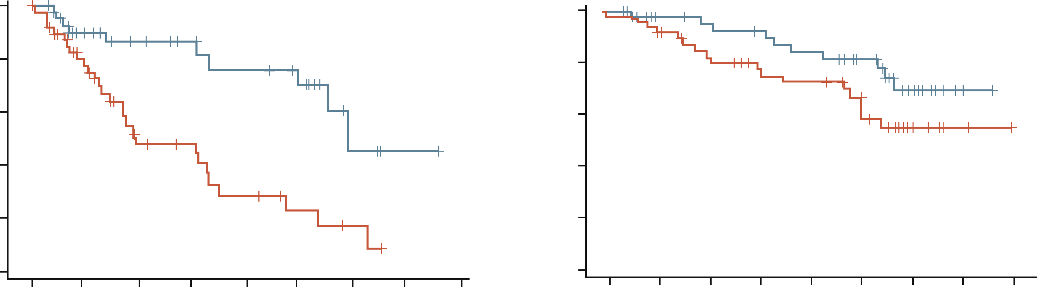
BOSTON subgroup analysis of patients with PI naïve MM: Significant improvement in PFS with SVd vs Vd
PFS
OS
 | SVd | Vd
Median | 29.5 | 9.7
Hazard ratio (95% CI) | 0.29 (0.14, 0.63)
P value | <0.001
1.0
1.0
0.8
0.8
SVd
0.6
0.6
Progression-free
survival probability
Survival probability
0.4
0.4
 | SVd | Vd
Median | NR | NR
Hazard ratio (95% CI) | 0.54 (0.25, 1.20)
P value | 0.062
Vd
SVd
0.2
0.2
Vd
0.0
0.0
0
5
10
15
20
25
30
35
40
0
5
10
15
20
25
30
35
40
Months
Months
SVd
Vd
47
48
28
31
22
14
18
12
15
7
12
4
3
2
1
0
SVd
Vd
0
47
48
39
44
35
37
33
31
30
28
25
24
12
11
2
2
0
0
Higher ORR with SVd vs Vd (67.9% vs 47.2%; OR 2.59 [95% CI, 1.17–5.77]; p=0.009)
Higher ≥ VGPR with SVd vs Vd (35.8% vs 24.5%; OR 1.74 [95% CI, 0.72–4.21]; p=0.109)
CI, confidence intervals; MM, multiple myeloma; NR, not reached; OR, odds ratio; ORR, overall response rate; OS, overall survival; PFS, progression-free survival; PI, proteasome inhibitor; SVd, selinexor, bortezomib, dexamethasone; Vd, bortezomib, dexamethasone; VGPR, very good partial response
Mateos MV, et al. Eur J Haematol. 2024;1-11

Slide 21
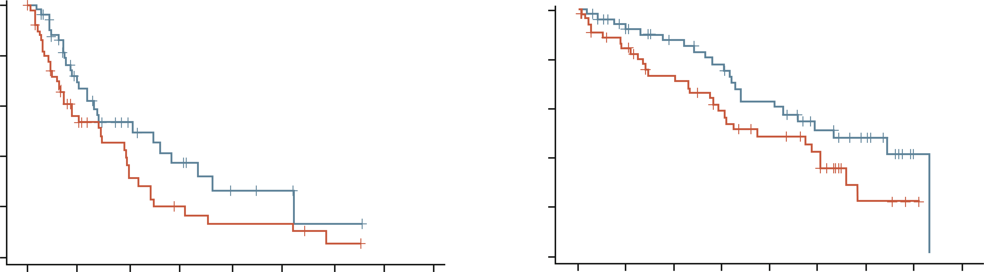
BOSTON subgroup analysis of patients with lenalidomide-refractory MM: Significant improvement in PFS and OS with SVd vs Vd
PFS
OS
 | SVd | Vd
Median | 10.2 | 7.1
Hazard ratio (95% CI) | 0.52 (0.31, 0.88)
P value | 0.006
 | SVd | Vd
Median | 26.7 | 18.6
Hazard ratio (95% CI) | 0.53 (0.30, 0.95)
P value | 0.015
1.0
1.0
0.8
0.8
0.6
0.6
Progression-free
survival probability
Survival probability
0.4
0.4
0.2
SVd
0.2
Vd
SVd
0.0
Vd
0.0
0
5
10
15
20
25
30
35
40
0
5
10
15
20
25
30
35
40
Months
Months
SVd
Vd
53
53
27
22
14
11
9
6
4
4
3
4
1
1
0
0
SVd
Vd
53
53
27
22
14
11
9
6
4
4
3
4
1
1
0
0
Higher ORR with SVd vs Vd (76.6% vs 70.8%; OR 1.30 [95% CI, 0.51–3.33]; p=0.290)
Higher ≥ VGPR with SVd vs Vd (53.2% vs 41.7%; OR 1.54 [95% CI, 0.68–3.48]; p=0.154)
CI, confidence intervals; MM, multiple myeloma; OR, odds ratio; ORR, overall response rate; OS, overall survival; PFS, progression-free survival;
SVd, selinexor, bortezomib, dexamethasone; Vd, bortezomib, dexamethasone; VGPR, very good partial response
Mateos MV, et al. Eur J Haematol. 2024;1-11

Slide 22
BOSTON subgroup analyses:
AEs were generally manageable and safety profiles were similar across the subgroups
Grade 3-4 TRAEs occurring in >5% of lenalidomide-refractory patients
Grade 3-4 TRAEs occurring in >5%
of patients with one prior LOT
Preferred term, n (%) | Lenalidomide-refractory
 | SVd (n=53) | Vd (n=52)
Haematological
Thrombocytopenia | 24 (45) | 16 (31)
Anaemia | 4 (8) | 2 (4)
Neutropenia | 2 (4) | 1 (2)
Non-haematological
Fatigue | 5 (9) | 0
Nausea | 5 (9) | 0
Diarrhoea | 6 (11) | 0
Peripheral neuropathy | 2 (4) | 4 (8)
Asthenia | 1 (2) | 1 (2)
Cataract | 7 (13) | 1 (2)
Vomiting | 4 (8) | 0
Preferred term, n (%) | One prior LOT
 | SVd (n=99) | Vd (n=99)
Haematological
Thrombocytopenia | 37 (37) | 16 (16)
Anaemia | 5 (5) | 2 (2)
Neutropenia | 9 (9) | 2 (2)
Non-haematological
Fatigue | 12 (12) | 0
Nausea | 8 (8) | 0
Diarrhoea | 3 (3) | 0
Peripheral neuropathy | 6 (6) | 9 (9)
Asthenia | 9 (9) | 2 (2)
Cataract | 8 (8) | 0
Vomiting | 5 (5) | 0
AE, adverse event; LOT, line of therapy; SVd, selinexor, bortezomib, dexamethasone; TRAEs, treatment-related adverse events; Vd, bortezomib, dexamethasone
Mateos MV, et al. Eur J Haematol. 2024;1-11

Slide 23
Conclusions
(V)Rd/ASCT-Len
D-VMP
DRd
DKd/IsaKd
KRd
ERd
SVd
EloPd
EloPd (DPd/IsaPd)
DKd/IsaKd
EloPd (DPd/IsaPd)
(Kd/DKd/IsaKd)
Expert view
ASCT, autologous stem cell transplant; DKd, daratumumab, carfilzomib, dexamethasone; DPd, daratumumab, pomalidomide; DRd, daratumumab, lenalidomide, dexamethasome; D-VMP, daratumumab, bortezomib, melphalan, prednisone; EloPd, elotuzumab, pomalidomide; ERd, elotuzumab, lenalidomide, dexamethasone; IsaKd, isatuximab, carfilzomib, dexamethasone; IsaPd, isatuximab, pomalidomide; Kd, carfilzomib, dexamethasone; KRd, carfilzomib, lenalidomide, dexamethasone; Len, lenalidomide; Pd, pomalidomide; PVd, pomalidomide, bortezomib, and dexamethasone; Rd, lenalidomide, dexamethasone; SVd, selinexor, bortezomib, dexamethasone; V, bortezomib

Slide 24
Key clinical takeaways
Multiple myeloma is a highly heterogeneous disease from diagnosis
The heterogeneic clones vary in their sensitivity to different treatments. Therefore, combinations are preferable
Each new treatment should preferably include drugs with novel mechanisms of action, which is more important when multiple myeloma becomes refractory rather than just exposed
USE
The best available treatment
Regimens from controlled clinical trials
PREFER
Treatments with OS benefit
Changing (adding) MoA
Triplets
TREAT
At biochemical relapse
Treatment approach should be continuous
Expert view
MoA, mechanisms of action; OS, overall survival

Slide 25
Find out more about RRMM IN Parts 1 and 3 part 1: Unmet medical needs in early relapse part 3: current best practices in the treatment of early RRMM – an expert view
MM, multiple myeloma; RR, relapsed/refractory;

