Slide 2
Part 1
Multiple myeloma:
Unmet medical needs in early relapse
Dr Elena Zamagni,
University of Bologna, Italy
September 2024

Slide 3

Developed by lymphoma & myeloma COnnect
This programme is developed by LYMPHOMA & MYELOMA CONNECT,
an international group of experts in the field of hematological malignancies.
Acknowledgement and disclosures
This LYMPHOMA & MYELOMA CONNECT programme is supported through an independent educational grant from Menarini Stemline Oncology. The programme is therefore independent, the content is not influenced by the supporter and is under the sole responsibility of the experts.
Please note: The views expressed within this programme are the personal opinions of the experts. They do not necessarily represent the views of the experts’ institutions, or the rest of the LYMPHOMA & MYELOMA CONNECT group.
Expert disclaimer:
Dr Elena Zamagni has received financial support/sponsorship for research support, consultation,
or speaker fees from the following companies: Janssen, BMS, Amgen, Pfizer, GSK and Sanofi

Slide 4
Educational objectives
Know how to incorporate the latest scientific and clinical insights on the treatment of MM into clinical practice, focusing on the relapsed/refractory setting
Knowing the MoA and how this translates into the efficacy profile of novel drugs
Learning from best practices on treatment sequencing, treatment combinations and dosing in MM
Knowing the safety profiles of novel drugs and what the best strategies are to prevent or act on side effects

Slide 5
multiple myeloma
Current treatment landscape and challenges
Current ESMO treatment guidelines recommend frontline regimens including anti-CD38 mAbs and proteasome inhibitors and/or immunomodulators agents for NDMM¹
However, with earlier use of triplet combinations in first-line, patients are now becoming
triple- or penta-exposed and even penta-refractory after very few lines of therapy^{1,2}
These include treatments containing the immunomodulator lenalidomide and the
anti-CD38 mAb daratumumab¹
CD38, cluster of differentiation 38; ESMO, European Society for Medical Oncology; mAb, monoclonal antibody; NDMM, newly diagnosed multiple myeloma
1. Dimopoulos MA, et al. Ann Oncol. 2021;32:309-322; 2. Morè S, et al. Cancers (Basel) 2023;15(8):2203.

Slide 6
EHA-ESMO MM guidelines – transplant-ineligible patients
The treatment paradigm in MM has changed
Induction:
4-drug regimens
DVTd
DVRd
200 mg/m² melphalan
followed by ASCT
Maintenance:
Lenalidomide (Daratumumab/Isatuximab)
Yes
Eligibility for ASCT
Option 1:
DaraRd, DaraVMP, VRd
Option 2:
VCd, MPT, VMP, Rd
Other options:
BP, CTd, MP
No
Figure adapted from Dimopoulos et al.
  Anti-CD38 mAbs, IMiDs or PIs are used as early as 1L
1L, first-line; ASCT, autologous stem cell transplantation; B, bendamustine; C, cyclophosphamide; CD38, cluster of differentiation 38; d, dexamethasone; D, daratumumab; EHA, European Hematology Association; ESMO, European Society for Medical Oncology; IMiD, immunomodulatory drug; M, melphalan; MM, multiple myeloma; P, prednisone; PI, proteasome inhibitor; R, lenalidomide; T, thalidomide; V, bortezomib
Dimopoulos MA, et al. Ann Oncol. 2021;32:309-322

Slide 7
multiple myeloma:
EHA-ESMO guidelines For initial relapse
Second-line options after VRd
Second-line options after DaraRd^{b,c}
Second-line options after
DaraVMP^{b,c} or DaraVTd^{b,c}
Lenalidomide-
sensitive
Lenalidomide-
refractory
Bortezomib-
sensitive
Lenalidomide
and bortezomib-
refractory
Lenalidomide-
sensitive
Lenalidomide-
refractory
Bortezomib-
sensitive
Bortezomib-
refractory
KRd [I, A]
DaraRd [I, A]
EloRd [I, A]
PomVd [I, A]
DaraKd [I, A]
IsaKd [I, A]
IxaRd [I, A]
SVd [I, A]
PomVd [I, A]
DaraKd [I, A]
IsaKd [I, A]
SVd [I, A]
KRd [I, A]
DaraRd [I, A]
EloRd [I, A]
PomVd [I, A]
DaraKd [I, A]
DaraVd [I, A]
IsaKd [I, A]
SVd [I, A]
VenVdª [I, A]
DaraKd [I, A]
IsaKd [I, A]
PomVd
Kd
EloRd
KRd
IxaRd
SVd
VenVdª
PomVd
Kd
SVd
VenVdª
EloRd
KRd
IxaRd
VRd
SVd
Kd
VenVdª
EloRd
Figure adapted from Dimopoulos et al.
ª Patients with t(11;14)
^{b} Patients who progress while on monthly daratumumab are considered as daratumumab-refractory
^{c} All recommendations for patients who receive front-line therapy with daratumumab-based therapies are based on panel consensus as there are no trials evaluating regimens in second-line therapy that include patients who are refractory or exposed to daratumumab
d, dexamethasone; Dara, daratumumab; EHA, European Hematology Association; Elo, elotuzumab; ESMO, European Society for Medical Oncology; Isa, isatuximab; Ixa, ixazomib; K, carfilzomib; M, melphalan; P, prednisone; Pom, pomalidomide; R, lenalidomide; S, selinexor; T, thalidomide; V, bortezomib; Ven, venetoclax
Dimopoulos MA, et al. Ann Oncol. 2021;32:309-322

Slide 8
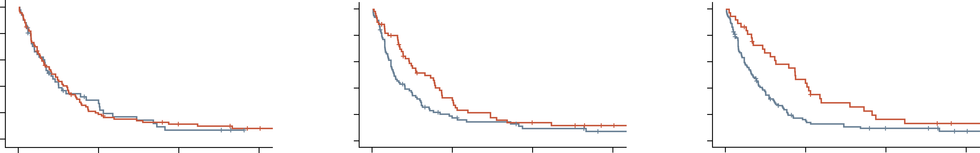
NDMM (transplant-eligible) patient journey: first relapse lenalidomide refractoriness
IMWG definition of refractoriness:
Progression during treatment or within 2 months of treatment discontinuation
PFS according to last LEN dose
(5–15 mg vs 25 mg)
PFS according to duration on
LEN therapy <12 vs ≥12 months
PFS according to IMiD free interval
(<18 months vs ≥18 months)
1.0
PomDex treated patients
PFS: 4.9 vs 5 months (p=0.929)
OS: 11.9 vs 12.8 months (p=0.194)
1.0
PomDex treated patients
PFS: 3.2 vs 7.8 months (p=0.023)
OS: 7.9 vs 16.5 months (p=0.005)
1.0
PomDex treated patients
PFS: 3.9 vs 10.3 months (p=0.003)
OS: 9.3 vs 27.1 months (p=0.008)
0.8
0.8
0.8
0.6
0.6
0.6
Cumulative survival
Cumulative survival
Cumulative survival
0.4
0.4
0.4
0.2
0.2
0.2
0.0
0.0
0.0
0
12
24
36
0
12
24
36
0
12
24
36
PFS (months)
PFS (months)
PFS (months)
LEN last dose 5-15 mg
LEN last dose 25 mg
52
95
11
17
3
8
4
LEN duration <12 mo
LEN duration >12 mo
86
61
12
16
5
6
2
2
IMiD free interval <18 mo
IMiD free interval >18 mo
110
37
13
15
6
5
2
2
How is lenalidomide resistance defined? What are the mechanisms?
What is the impact of lenalidomide dose?
Is the duration of prior lenalidomide exposure significant?
Are newer IMiDs (CELMoDs) able to overcome lenalidomide resistance more effectively?
CELMoD, cereblon E3 ligase modulatory drug; Dex, dexamethasone; IMiD, immunomodulatory drug; IMWG, International Myeloma Working Group; NDMM, newly diagnosed multiple myeloma; LEN, lenalidomide; mo, months; OS, overall survival; PFS, progression-free survival; Pom, pomalidomide
Kastritis E, et al. Blood Adv. 2019;3:4095-4103

Slide 9
EHA-ESMO MM guidelines second-line options after front-line daratumumab
There are limited second-line options for difficult-to-treat MM patients who are:
Anti-CD38-mAb-exposed/refractory
Lenalidomide-refractory
PI-naïve
Second-line options after DaraRd^{a,b}
Second-line options after
DaraVMP^{b,c} or DaraVTd^{a,b}
Lenalidomide-
sensitive
Lenalidomide-
refractory
Bortezomib-
sensitive
Bortezomib-
refractory
PomVd
Kd
EloRd
KRd
IxaRd
SVd
VenVd^{c}
PomVd
Kd
SVd
VenVd^{c}
EloRd
KRd
IxaRd
VRd
SVd
Kd
VenVd^{c}
EloRd
Second-line options recommended by ESMO suggest switching target may be beneficial
Figure adapted from Dimopoulos et al.
ª Patients who progress while on monthly daratumumab are considered as daratumumab-refractory
^{b} All recommendations for patients who receive front-line therapy with daratumumab-based therapies are based on panel consensus as there are no trials evaluating regimens in second-line therapy that include patients who are refractory or exposed to daratumumab
^{c} Patients with t(11;14)
CD38, cluster of differentiation 38; d, dexamethasone; Dara, daratumumab; EHA, European Hematology Association; Elo, elotuzumab; ESMO, European Society for Medical Oncology; Ixa, ixazomib; K, carfilzomib; M, melphalan; mAb, monoclonal antibody; MM, multiple myeloma; P, prednisone; PI, proteasome inhibitor; Pom, pomalidomide; R, lenalidomide; S, selinexor; T, thalidomide; V, bortezomib; Ven, venetoclax
Dimopoulos MA, et al. Ann Oncol. 2021;32:309-322

Slide 10
rechallenged with anti-CD38 mAbs
Outcomes are suboptimal in these patients
In the EMMY cohort analysis,ª 173 patients who initiated a second LOT with anti-CD38-based combinations after a first exposure to daratumumab or isatuximab were identified and described¹
Of these, 127 (73%) were anti-CD38 refractory
A single-centre analysis described 183 patients with RRMM who progressed during therapy with a daratumumab- or isatuximab-based regimen, then received further therapy²
Patients received anti-CD38 therapy after a median
of two prior LOTs (range, 1–10)
Median PFS and OS¹
Patient group | Median PFS (95% CI), months | Median OS (95% CI), months
All CD38-retreated (n=173) | 4.7 (3.8–6.5) | 16.5 (13.9–21.6)
Anti-CD38 non-refractory | 7.2 (3.4–NR) | N/A
Anti-CD38 refractory | 4.6 (3.7–6.0) | N/A
Anti-CD38-Rd (n=35) | 3.8 (1.8–7.2) | 25.1
Median PFS in post anti-CD38 treatment line by regimen^{2, b}
mPFS (months)
Regimen
ª The EMMY cohort is a non-interventional, prospective dynamic cohort study conducted by IFM group;
^{b} Only regimens received by ≥20% of ITT patient population.
CD38, cluster of differentiation 38; CI, confidence interval; IFM, Intergroupe Francophone du Myélome; ITT, intention to treat; LOT, line of therapy; mAb, monoclonal antibody; (m)PFS, (median) progression-free survival; N/A, not applicable; NR, not reached; OS, overall survival; PI, proteasome inhibitor; Rd, lenalidomide-dexamethasone; RRMM, relapsed/refractory multiple myeloma
1. Hulin C, et al. Blood. 2022;140 (supplement 1):7133-7135. Presented at the ASH Annual Meeting 2022 (Abstract #3174);
2. Kastritis E, et al. Blood. 2022;140 (supplement 1):7324-7325. Presented at the ASH Annual Meeting 2022 (Abstract #3256)

Slide 11
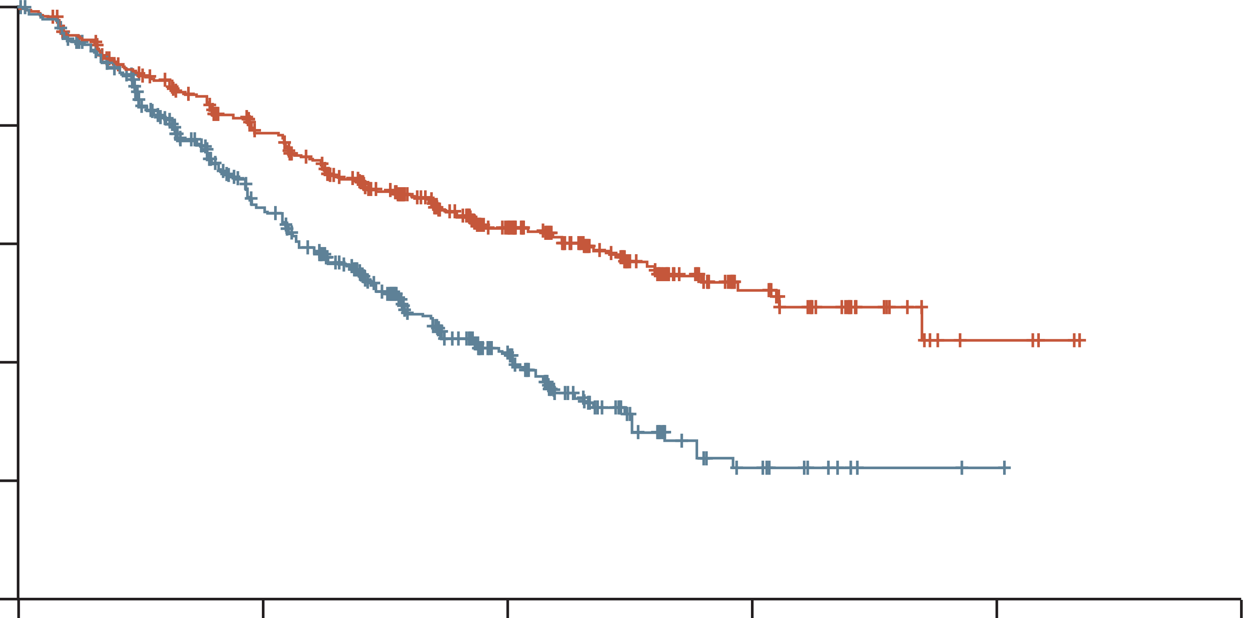
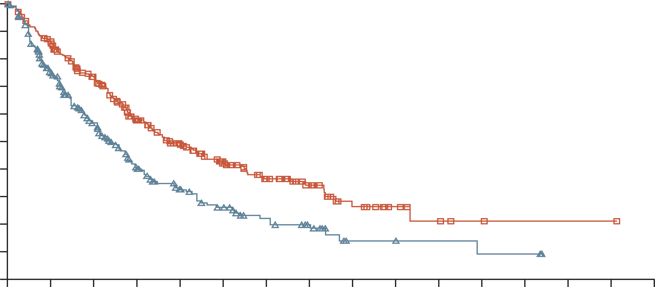
Relapse treatment after DRd
ENDEAVOR¹
1–3 prior lines of therapy
OPTIMISMM²
1–3 prior lines of therapy, received prior treatment
with a lenalidomide-containing regimen for
≥2 consecutive cycles, not bortezomib refractory
 | Carfilzomib group (n=464) | Bortezomib group (n=465)
Median progression-free survival (months) | 18.7 (95% CI 15.6-NE) | 9.4 (95% CI 8.4-10.4)
 | HR 0.53 (0.44-0.65); p<0.0001
100
100
Pomalidomide, bortezomib, and dexamethasone
Bortezomib and dexamethasone
HR 0.61 (95% CI 0·49–0.77); two-sided p<0.0001
90
80
80
Kd mPFS 18.7 months
70
60
60
PVd mPFS 11.2 months
PFS (%)
PFS (%)
50
40
40
30
20
Bortezomib group
Carfilzomib group
Vd mPFS 9.4 months
20
Vd mPFS 7.1 months
10
0
0
6
12
18
24
30
0
0
3
6
9
12
15
18
21
24
27
30
33
36
39
42
45
Time (months)
Time (months)
Kd¹
  Doublet
  PI
  One different MoA
PVd²
  Triplet
  PI
  One different MoA
Acceptable safety and tolerability profile of carfilzomib
Adverse events accorded with the individual profiles of pomalidomide, bortezomib, and dexamethasone
CI, confidence interval; DRd, daratumumab, lenalidomide and dexamethasone; HR, hazard ratio; Kd, carfilzomib and dexamethasone; MoA, mechanism of action; (m)PFS, (median) progression-free survival; NE, not estimable; PI, proteasome inhibitor; PVd, pomalidomide, bortezomib, and dexamethasone;
1. Dimopoulos MA, et al. Lancet Oncol. 2016.17:27-38; 2. Richardson PG, et al. Lancet Oncol. 2019;20:781-794;

Slide 12
EHA-ESMO MM guidelines subsequent relapse
At second or subsequent relapse
Lenalidomide and
bortezomib refractory
Lenalidomide refractory
and PI sensitive
Alternative
(less preferred) options
For triple-class refractory
patients (Pls, IMiDs and
mAbs against CD38)
DaraKd [I, A]
IsaPd [I, A]
EloPd [II, B]
IsaKd [I, A]
DaraPd [II, B]ª
DaraKd [I, A]
IsaPd [I, A]
EloPd [II, B]
IsaKd [I, A]
DaraPd [II, B]
DaraVd [I, A]
SVd [I, A]
VenVd [I, A]^{b}
PCd [II, B]
Daratumumab [I, A]
Sd [II, B]
Belantamab mafodotin [II, B]
Clinical trials
Figure adapted from Dimopoulos et al.
ª Only phase 1b data are published for DaraPd. Publication of phase 3 data are expected in 2021. ^{b} For patients with t(11;14) or high BCL-2 levels
BCL-2, B-cell lymphoma 2; CD38, cluster of differentiation 38; Dara, daratumumab; EHA, European Haematology Association; Elo, elotuzumab; ESMO, European Society for Medical Oncology; IMiD, immunomodulatory drug; Isa, isatuximab; Kd, carfilzomib-dexamethasone; mAb, monoclonal antibody; MM, multiple myeloma; PCd, pomalidomide-cyclophosphamide-dexamethasone; Pd, pomalidomide-dexamethasone; PI, proteasome inhibitor; S, selinexor; Sd, Selinexor-dexamethasone; Vd, bortezomib-dexamethasone; Ven, venetoclax
Dimopoulos MA, et al. Ann Oncol. 2021;32:309-322

Slide 13
Third-line treatment Poma-based:
Elo-Pd, Isa-Pd, Dara-Pd – STUDY RESULTS
 | Eloquent-3 Elo-Pd arm | ICARIA Isa-Pd arm | APOLLO Dara-Pd arm
Median prior lines of therapy | 3 | 3 | 2
Prior lenalidomide, % | 98 | 100 | 100
Lenalidomide refractory, % | 90 | 94 | 79
PI refractory, % | 78 | 77 | 47
Double refractory (lena + PI), % | 68 | 72 | 42
Median PFS, months | 10.3 | 11.5 | 12.4
HR for PFS | 0.54 (p=0.0078) | 0.60 (p=0.001) | 0.63 (p=0.0018)
Median PFS in len-refractory patients, months | 10.3 | 11.4 (HR 0.59) | 9.9 (HR 0.66)
Median PFS in double-refractory patients, months | 10.2 (HR 0.56) | 11.2 (HR 0.58) | 7.7 (HR 0.74)
HR for PFS in high-risk FISH | 0.52 | 0.66 | 0.85
ORR, % | 53 | 63 | 69
CR rate, % | 5 | 9 (MRD neg 5%) | 25 (MRD neg 9%)
Haematologic toxicity (gr 3–4), % Neutropaenia Thrombocytopaenia | 13 8 | 85 31 | 68 17
Non-hematological (gr 3–4), % IRR (all grades) Infections Pneumonia | 3 13 5 | 38 (3% gr 3–4) Not available 16 | 5 28 13
Treatment discontinuation due to Aes, % | 18 vs 24 | 7 vs 13 | 2 vs 3
AE, adverse event; CR, complete response; Dara-Pd, daratumumab, pomalidomide and dexamethasone; Elo-Pd, elotuzumab, pomalidomide and dexamethasone; FISH, fluorescent in-situ hybridisation; gr, grade; HR, hazard ratio; IRR, infusion-related reaction; Isa-Pd, isatuximab, pomalidomide and dexamethasone; lena, lenalidomide; MRD, minimal residual disease;
ORR, overall response rate; PFS, progression-free survival; PI proteosome inhibitor; Poma, pomalidomide
Dimopoulos MA, et al. N Engl J Med. 2018;379:1811-1822; Attal M, et al. Lancet. 2019;394:2096-2107; Dimopoulos MA, et al. Lancet Oncol. 2021;22:801-812

Slide 14
Current unmet needs in early R/R setting
Limited effective treatment options for early relapsed double- and triple-refractory patients¹
Due to patient attrition at each LoT, a substantial proportion of patients do not progress to third-line treatment²
Limited effective treatment options for transplant-ineligible patients relapsing during or after Dara-Rd, including disappointing results with Dara re-treatment^{3,4}
Lack of clear standard of care on the use, combination and sequencing of the growing number of MM treatment options, complicated by the heterogeneity of this population^{5,6}
Issues with access (approval and cost) to novel immunotherapies in many countries⁷
Dara, daratumumab; LoT, line of therapy; MM, multiple myeloma; Rd, lenalidomide and dexamethasone; R/R, relapsed/refractory
1. Kastritis E, et al. Blood 2022;139(19):2904–2917; 2. Fonseca R, et al. BMC Cancer 2020;20:1087; 3. Dimopoulos MA, et al. Ann Oncol 2021;32(3):309–322; 4. Kastritis E et al. Abstract #3256. ASH Annual Meeting 2022; 5. Mateos MV, et al. Leukemia 2022;36:1371‒1376; 6. Ntanasis-Stathopoulos I, et al. Clin Lymphoma Myeloma Leuk 2021;21(6):379–385. 7. Bhatt P, et al. Curr Oncol 2023;30(2):2322–2347; 8. Mateos MV, et al. Blood 2020:136(1):22–23; 9. Zamanillo I, et al. Blood 2024;143(20):2029–2036.

Slide 15
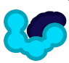



addressing the unmet needs in early RRMM selinexor is approved from second line onwards
Selective inhibitors of
nuclear export
(selinexor)
Bispecific antibodies
(▼ teclistamab, linvoseltamab,
(▼ elranatamab, talquetamab,
cevostamab)
Cellular therapy
(ide-cel,
cilta-cel)
Novel strategies for R/R MM
Cereblon E3 ligase modulators
(CELMoDs)
(iberdomide, CC-92480)
Antibody-drug conjugate
(belantamab mafodotin)
Alkylating Agent
(melflufen)
▼ This medicinal product is subject to additional monitoring. This will allow quick identification of new safety information. Healthcare professionals are asked to report any suspected adverse reactions.
MM, multiple myeloma; RR, relapsed/refractory
Hernández-Rivas JÁ, et al. Biomark Res. 2022:10(1)

Slide 16


Selinexor is a first in class oral XPO1 inhibitor mechanism of action¹
ESMO recommendations for daratumumab-pretreated patients include regimens containing selinexor in combination with bortezomib and dexamethasone, as well as carfilzomib and pomalidomide-based regimens²
XPO1:
XPO1 is a nuclear export protein that transports nuclear proteins to the cytoplasm via nuclear pore complexes
XPO1 is overexpressed in many tumour types, including MM
It exports TSPs to the cytoplasm, where they are unable to function and elevates cytosolic levels of pro-survival proteins
This results in dysregulation of growth signalling and increased anti-apoptotic signalling
Selinexor:
Blocks XPO1 so that it cannot carry cargo out of the nucleus
TSPs accumulate in the nucleus, causing cell cycle arrest and apoptosis
Traps oncoprotein mRNA in the nucleus, so they cannot be translated
MYELOMA CELL
Cytoplasm
Oncoprotein
mRNAs
Nucleus
XPO1
XPO1
Cargo
proteins
Cargo Proteins
(TSPs, oncoprotein
mRNAs, growth
regulators)
Nuclear Pore
ESMO, European Society for Medical Oncology; MM, multiple myeloma; mRNA, messenger RNA; TSP, tumour suppressor protein; XPO1, exportin 1
1. Mo CC, et al. EJHaem. 2023;4:792-810; 2. Dimopoulos MA, et al. Ann Oncol. 2021;32:309-322

Slide 17
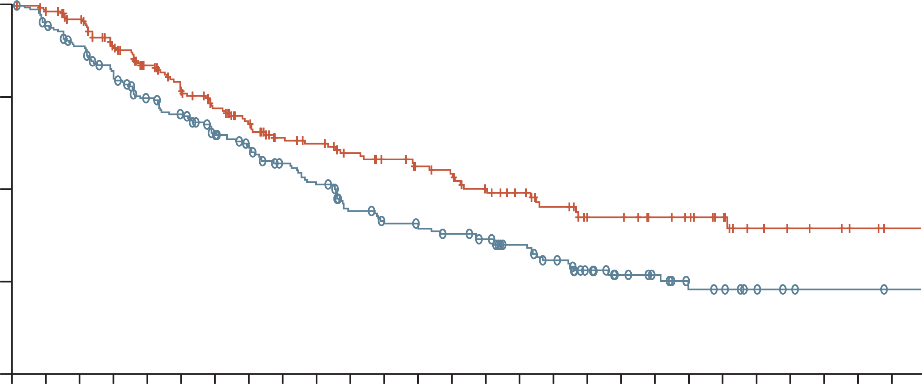
Relapse treatment after DRd
How does SVd fit with other treatments?
ENDEAVOR¹
1–3 prior lines of therapy
OPTIMISMM²
1–3 prior lines of therapy, received prior treatment
with a lenalidomide-containing regimen for
≥2 consecutive cycles, not bortezomib refractory
BOSTON³
1–3 prior lines of therapy
 | Carfilzomib group (n=464) | Bortezomib group (n=465)
Median progression-free survival (months) | 18.7 (95% CI 15.6-NE) | 9.4 (95% CI 8.4-10.4)
 | HR 0.53 (0.44-0.65); p<0.0001
100
100
Pomalidomide, bortezomib, and dexamethasone
Bortezomib and dexamethasone
HR 0.61 (95% CI 0·49–0.77); two-sided p<0.0001
1.00
Selinexor, bortezomib, and dexamethasone
Bortezomib and dexamethasone
90
80
80
0.75
Kd mPFS 18.7 months
70
60
60
PVd mPFS 11.2 months
SVd mPFS 13.9 months
PFS (%)
Probability of PFS
PFS (%)
50
0.50
40
40
Selinexor, bortezomib, and dexamethasone:
median 13.93 months (95% CI 11.73-not evaluable)
Bortezomib and dexamethasone:
median 9.46 months (95% CI 8.11-10.78)
HR 0.70 (95% CI 0.53-0·93), p=0.0075
30
0.25
20
Bortezomib group
Carfilzomib group
Vd mPFS 9.4 months
20
Vd mPFS 7.1 months
Vd mPFS 9.5 months
10
0
0
6
12
18
24
30
0
0
3
6
9
12
15
18
21
24
27
30
33
36
39
42
45
0.00
0
1
2
3
4
5
6
7
8
9
10
11
12
13
14
15
16
17
18
19
20
21
22
23
24
25
26
Time (months)
Time (months)
Time (months)
Kd¹
  Doublet
  PI
  One different MoA
PVd²
  Triplet
  PI
  One different MoA
SelVd³
  Triplet
  PI
  Two different MoAs
Acceptable safety and tolerability profile of carfilzomib
Adverse events accorded with the individual profiles of pomalidomide, bortezomib, and dexamethasone
Safety results were consistent with the individual adverse event profiles of selinexor, bortezomib, and dexamethasone
CI, confidence interval; DRd, daratumumab, lenalidomide and dexamethasone; HR, hazard ratio; Kd, carfilzomib and dexamethasone; MoA, mechanism of action; (m)PFS, (median) progression-free survival; NE, not estimable; PI, proteasome inhibitor; PVd, pomalidomide, bortezomib, and dexamethasone; SVd, selinexor, bortezomib, and dexamethasone; Vd, bortezomib and dexamethasone.
1. Dimopoulos MA, et al. Lancet Oncol. 2016.17:27-38; 2. Richardson PG, et al. Lancet Oncol. 2019;20:781-794; 3. Grosicki S, et al. Lancet. 2020;396:1563-1573

Slide 18
Key clinical takeaways
Current guidelines recommend lenalidomide-based treatment in the frontline setting
Non-transplant eligible patients may become anti-CD38 refractory after one
prior line of therapy
Although therapeutic advances in MM have improved outcomes, this has generated a
wide range of patient profiles at early relapse, many with substantial unmet needs
There is a need for new targets/new drugs with different mechanism of action
SVd may be a suitable treatment option for early relapsed patients previously treated with lenalidomide and daratumumab, as it offers a double MoA switch
CD38, cluster of differentiation 38; MM, multiple myeloma

Slide 19
Find out more about RRMM in Parts 2 and 3
Part 2: the relevance of adding a new moa in treating RRMM – an expert view part 3: current best practices in the treatment of early RRMM – an expert view
MM, multiple myeloma; RR, relapsed/refractory;

