Slide 2
Precision oncology connect
The emerging role of artificial intelligence in precision oncology
Prof. Albrecht Stenzinger, PhD
Pathologist, Heidelberg University Hospital,
Heidelberg, Germany
OCT 2024

Slide 3

Developed by PRECISION ONCOLOGY COnnect
This programme is developed by PRECISION ONCOLOGY CONNECT,
an international group of experts in the field of oncology.
Acknowledgement and disclosures
This PRECISION ONCOLOGY CONNECT programme is supported through an independent educational grant from Bayer. The programme is therefore independent, the content is not influenced by the supporter and is under the sole responsibility of the experts.
Please note: The views expressed within this programme are the personal opinions of the experts. They do not necessarily represent the views of the experts’ institutions, or the rest of the PRECISION ONCOLOGY
CONNECT group.
Expert disclosures:
Prof. Albrecht Stenzinger has received financial support/sponsorship for research support, consultation, or speaker fees from the following companies: Aignostics, Amgen, Astellas, Astra Zeneca, Bayer, BMS, Chugai, Eli Lilly, Illumina, Incyte, Janssen, MSD, Novartis, Pfizer, Qlucore, Roche, Sanofi, Servier, Takeda, Thermo Fisher

Slide 4
Educational objectives
Upon completion of this activity, the learner will:
Have a deeper awareness and understanding of the current and future role of artificial intelligence in precision oncology

Slide 5
Clinical takeaways
AI technologies have the potential to support cancer diagnostics and therapy prediction by integrating complex clinical, imaging and genetic data
Explainable AI is paramount for implementation in diagnostics
Generalisability of AI is critical for widespread use
Addressing regulatory and ethical issues, such as ensuring transparency in AI decision-making and maintaining patient data privacy, is essential for the widespread adoption of AI in precision oncology
AI, artificial intelligence

Slide 6
Development, requirements for successful use and core concepts of ai
AI, artificial intelligence

Slide 7
introduction
Artificial intelligence (AI) has transformed various fields, including healthcare and has the potential to improve patient care^{1,2}
AI technologies can assist physicians with accurate diagnosis via oncology image-recognition
algorithms and can help clinicians estimate the patient’s prognosis by predicting drug response, the
tumour recurrence rate after surgery, radiotherapy response, and side effects^{1,2}
AI’s role in
healthcare¹
Clinical
decision-making
Hospital operations and management
Medical imaging and diagnosis
Patient care
and monitoring
Methodologies
for assessing AI
Ethical considerations
and challenges
Future of AI in
healthcare
Algorithms
Logistics and
management
Radiology and
pathology
Wearable
devices
Validation
Ethical
implications
Personalised applications
Case studies
Administrative
tasks
Enhancing
accuracy
Virtual
nursing
Interpretability
and usability
Challenges in
integrating AI
Treatment technologies
Personalised
medicine
Patient flow
and scheduling
Hardware
acceleration
Telemedicine
Sociability and continuous
improvement
Regulatory and compliance issues
Healthcare system optimisation
Case studies
Data management
Ethical considerations and trust building
1. Varnosfaderani SM and Forouzanfar M. Bioengineering (Basel). 2024;11:337; 2. Gandhi Z, et al. Cancers (Basel). 2023; 15:5236

Slide 8
Pathology becomes digital
Molecular Pathology
  Acquisition of images of molecular features such as specific tagged proteins or RNA or full
  metabolic, proteomic, or transcriptomic imaging. Digital pathology methods can be applied to molecular pathology imaging
Histopathology/surgical pathology
  Digital slide scanning and the use of AI
  Virtual microscopy on the computer, with multiple tools using artificial intelligence and
  machine learning to support pathologists in their work
AI, artificial intelligence; RNA, ribonucleic acid
Stenzinger A, et al. Seminars in Cancer 2021: https://doi.org/10.1016/j.semcancer.2021.02.011; Dexter A, et al. J Mol Pathol. 2022;3:168-81

Slide 9
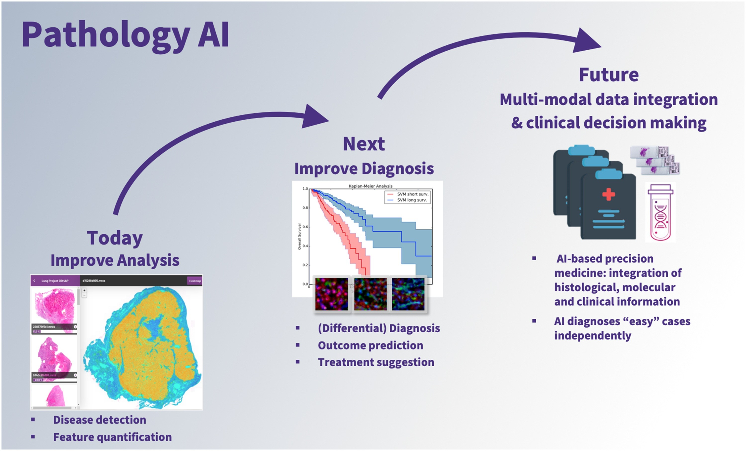
AI-based support systems
Support tool in the framework of diagnostics – “Copilot“ supporting:
  Diagnosis¹
  Prognosis^{1,2}
  Enrichment of mutational profiles¹
PATHOLOGY AI¹
Future
Multi-modal data integration
& clinical decision-making
Next
Improve diagnosis
Today
Improve analysis
AI-based precision
medicine: integration of
histological, molecular
and clinical information
Independent AI diagnosis of ‟easy” cases
(Differential) diagnosis
Outcome prediction
Treatment suggestion
Disease detection
Feature quantification
AI, artificial intelligence
1. Stenzinger A, et al. Semin Cancer Biol. 2022; 84:129-143; 2. Gandhi Z, et al. Cancers (Basel). 2023; 15:5236

Slide 10
A scalable Set-Up
A scalable set-up is required for AI to be successful:
Hardware (scanner and IT infrastructure)
Experts familiar with the systems
Critical Mass
Significant investments in short innovation cycles
AI, artificial intelligence; IT, information technology
How To Scale AI In Your Organization | IBM (Accessed Oct 2024)

Slide 11
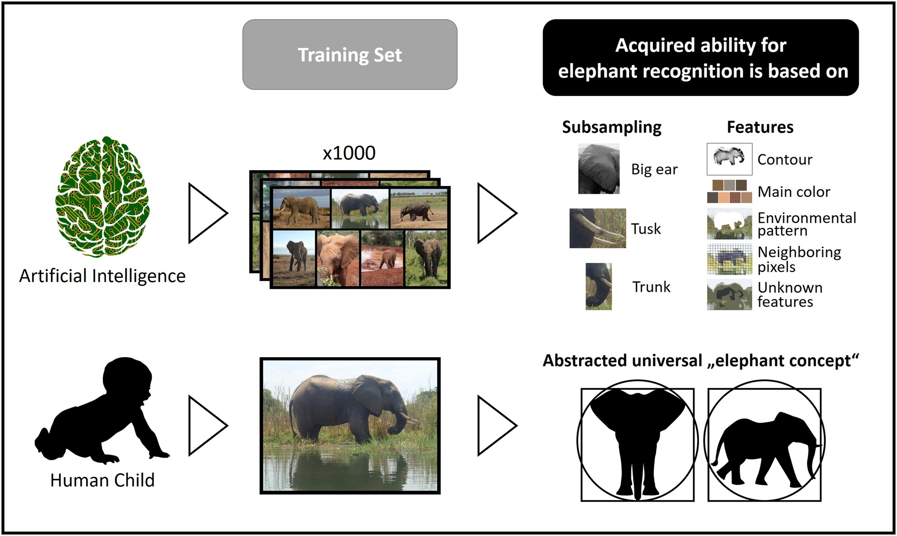
Development of AI
Strength in numbers/training sets
Machine learning tools require large amounts of high-quality data for training purposes and are only able to interpolate the acquired information for a new task
Human beings can extract highly complex concepts from limited amounts of data to apply it to new tasks beyond the one originally learned
Further development of AI tools
Human features like cognition and extrapolation are core examples of
AI-based approaches that still require enormous scientific advancements
AI, artificial intelligence
Stenzinger A, et al. Semin Cancer Biol. 2022; 84:129-143

Slide 12
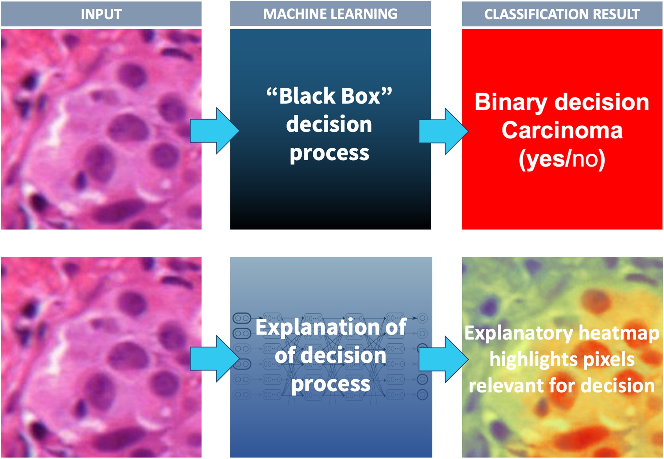
Implementation of AI
Generalisability
  The data generated in one dataset need to be transferable to another dataset/institution
Explainability
  Conventional AI leaves the decision process intransparent (“black box”) and provides a binary decision without “explaining” why
  Explainable AI uses layer-wise-relevance propagation to open the black box and provide pixel-wise scores that contribute to the decision “carcinoma”
Conventional AI approach
H&E-stained breast cancer
Explainable AI approach
AI, artificial intelligence; H&E, haematoxylin and eosin stain
Stenzinger A, et al. Semin Cancer Biol. 2022; 84:129-143

Slide 13
Considerations for clinical implementation
Barriers:
Lack of quality medical data can result in inaccurate outcomes¹
Lack of large clinical datasets to train the model²
Data privacy, availability and security issues¹
Determining relevant clinical metrics and methodology¹
Lack of human expertise¹
Alowais SA, et al. BMC Medical Education 2023; 23:689: doi.org/10.1186/s12909-023-04698-z; Gandhi Z, et al. Cancers 2023; 15: 5236: doi.org/10.3390/cancers15215236
Solutions:
Multidisciplinary approach¹
Innovative data annotation methods¹
Development of more rigorous AI techniques and models¹
Data sharing between multiple health care settings^{1,2}
Training and education of students and healthcare professionals¹
AI, artificial intelligence
1. Alowais SA, et al. BMC Med Educ. 2023;23:689; 2. Gandhi Z, et al. Cancers (Basel). 2023;15:5236

Slide 14
Ethical, legal and regulatory aspects of AI
IVDR and other regulations¹
  applies to in vitro diagnostics containing AI/ML-based software
  Validation of any AI approach requires careful standardisation of datasets in a highly controlled environment
Acceptable error margin¹
  Defining an error margin that we
  would be willing to accept when
  applying AI
  What is the human error rate in comparison
Liability of the AI report provider¹
Ethical considerations
in AI healthcare²
Ethical implications
of AI
Challenges in
integrating AI
Regulatory and
compliance issues
Privacy
concerns
Data security
concerns
Approval
processes
Informed
consent
Interoperability between systems
Ethical
standards and patient safety
Bias and
fairness
Integration with existing clinical workflows
Data protection and privacy
laws
Transparency
and
accountability
Data quality
and quantity
Continual monitoring and reporting
AI, artificial intelligence; IVDR, in-vitro diagnostic regulation; ML, machine learning
1. Stenzinger A, et al. Semin Cancer Biol. 2022; 84:129-143; 2. Varnosfaderani SM and Forouzanfar M. Bioengineering (Basel). 2024;11:337;

Slide 15
Clinical application of ai
AI, artificial intelligence

Slide 16
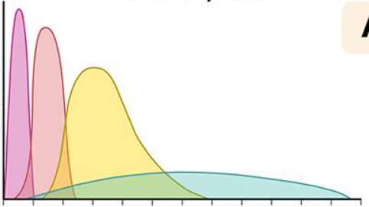

Ai-powered predictive analysis in clinical practice
Insulin activity chart
Analyses both historical and current data
100
Low risk
80
Intermediate risk
60
Insulin effect
Survival
40
High risk
0
Time
Injection
6
12
18
24
Duration (hours)
It requires:
Quality data
Technological infrastructure
Human supervision
Beneficial outcomes
Improve patient outcomes | Identifying patients at risk and target interventions to prevent or treat them
Predicting hospital readmissions | Reduce healthcare costs
AI, artificial intelligence
Alowais SA, et al. BMC Med Educ. 2023;23:689;

Slide 17
Clinical application of ai in oncology
AI Applications in Cancer Genomics
  Analysing large-volume multiomics data (exome, transcriptome, and epigenome) combined with clinically annotated datasets has led to the identification of drug-susceptibility genes, variant detection, new cancer biology insights, and prediction of RNA splice sites
AI Applications in Cancer-related Image Analysis
  AI-based models are now routinely part of breast imaging
  Software program allows comprehensive detection and tracking of pulmonary nodules,
  prediction of lung malignancy among detected lesions on low-dose CT images
  Deep neural networks have been developed to detect enlarged lymph nodes or colonic
  polyps in CT images and to enhance colon polyp detection during colonoscopy with a
  real-time DL computer-aided detection system
  Augmented interpretation of endoscopic images using AI consistently improves accuracy
  in the detection of oesophageal cancer
  Analysis of pathologic images for diagnosis, grading, and prognostic biomarker interpretation
AI, artificial intelligence; CT, computed tomography; DL, deep learning; RNA, ribonucleic acid
Shreve J, et al. Am Soc Clin Oncol Educ Book. 2022;42:1-10

Slide 18
Application of AI in Lung cancer
Use of AI in lung cancer
Lung cancer screening
Lung cancer diagnosis
Lung cancer staging
Lung cancer treatment
Imaging
techniques
Non-imaging
techniques
Imaging
Histopathology
With use of CT/PET for
TNM staging
Treatment
regimen protocols
Predicting treatment outcomes/survival
Nodule
detection
Biomarkers (serum proteins, DNA and miRNA markers, incorporation of clinical parameters)
CT scan, experimental CXR studies noted
Biomarkers (Rb,
KRAS, EGFR,
c-MET, TP53,
ALK, and PDL1)
Nodule
characterisation
Nodule
segmentation
AI, artificial intelligence; ALK, anaplastic lymphoma kinase; c-MET, mesenchymal-epithelial transition factor; CT, computed tomography; CXR, chest x-ray; DNA, deoxyribonucleic acid; EGFR, epidermal growth factor receptor; KRAS, Kirsten rat sarcoma viral oncogene homolog; miRNA, microRNA; PD-L1, programmed death-ligand 1; PET, positron emission tomography; Rb, retinoblastoma protein; RNA, ribonucleic acid; TNM, tumour, node, metastasis; TP53, p53 protein
Gandhi Z, et al. Cancers (Basel). 2023; 15:5236

Slide 19
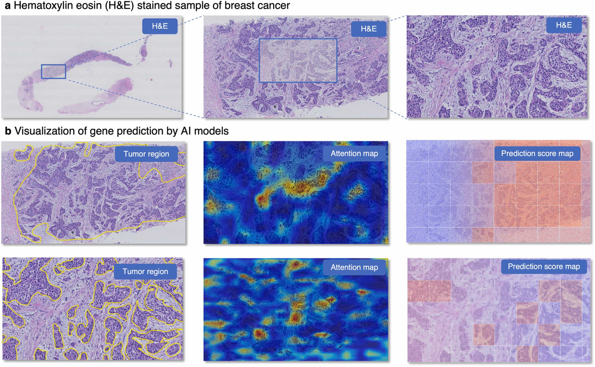
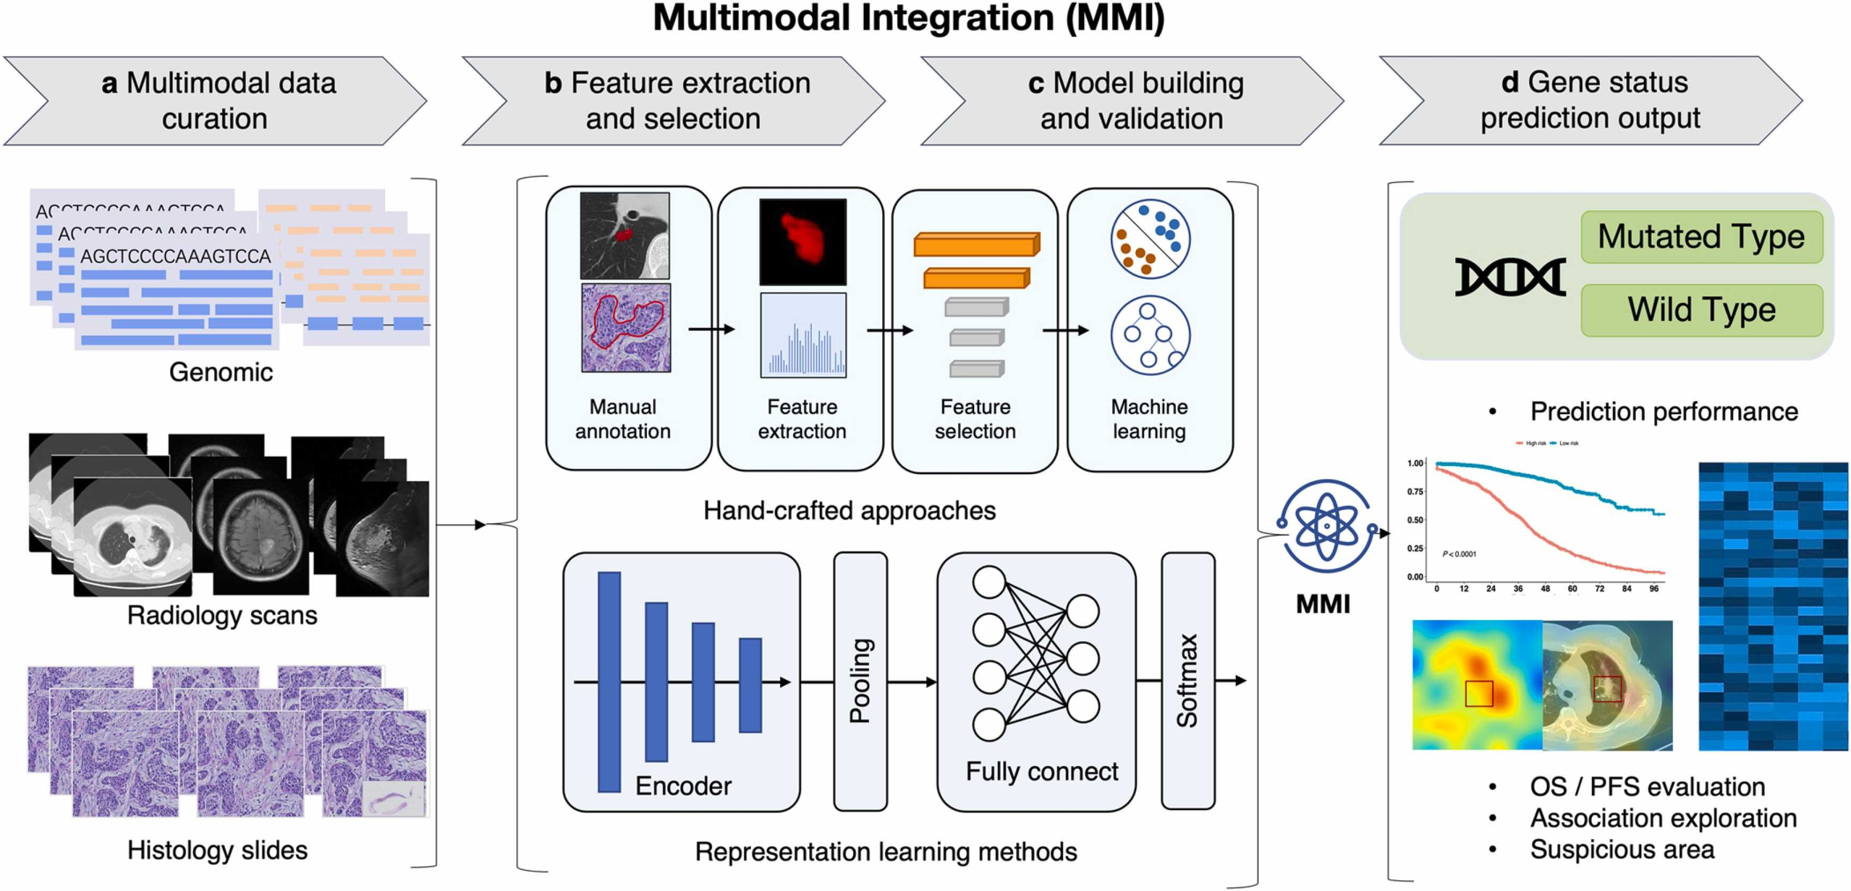
Examples of AI Use (I)
Workflow for Predicting gene states
AI, artificial intelligence; OS, overall survival; PFS, progression-free survival
Shao J, et al. Semin Cancer Biol. 2023; 91:1-15

Slide 20
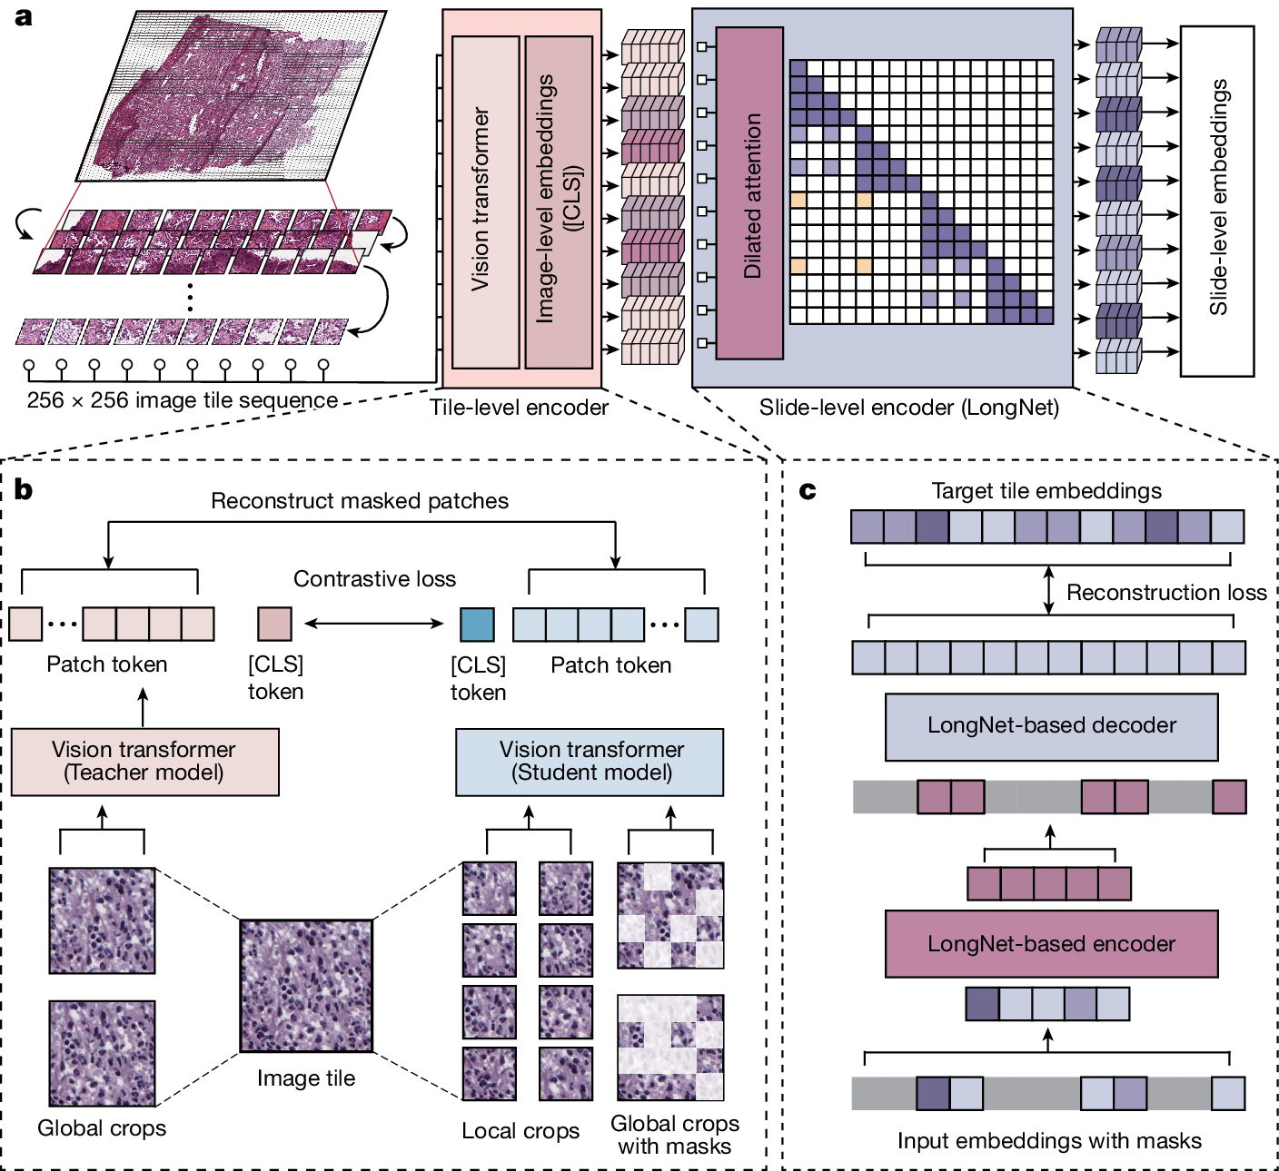
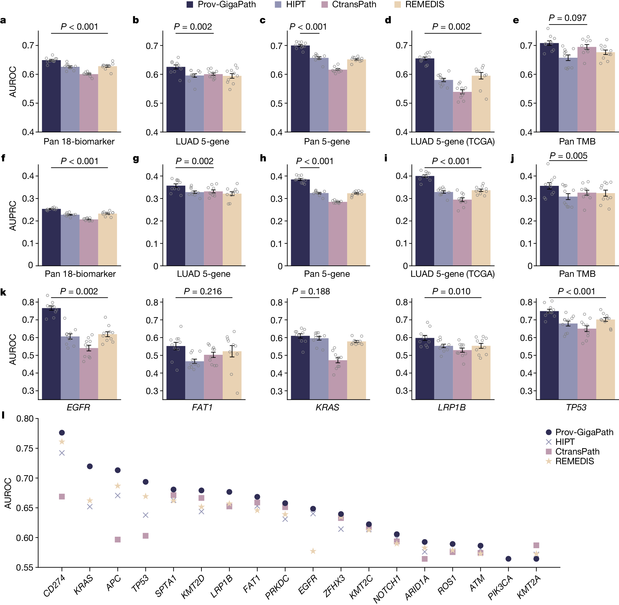
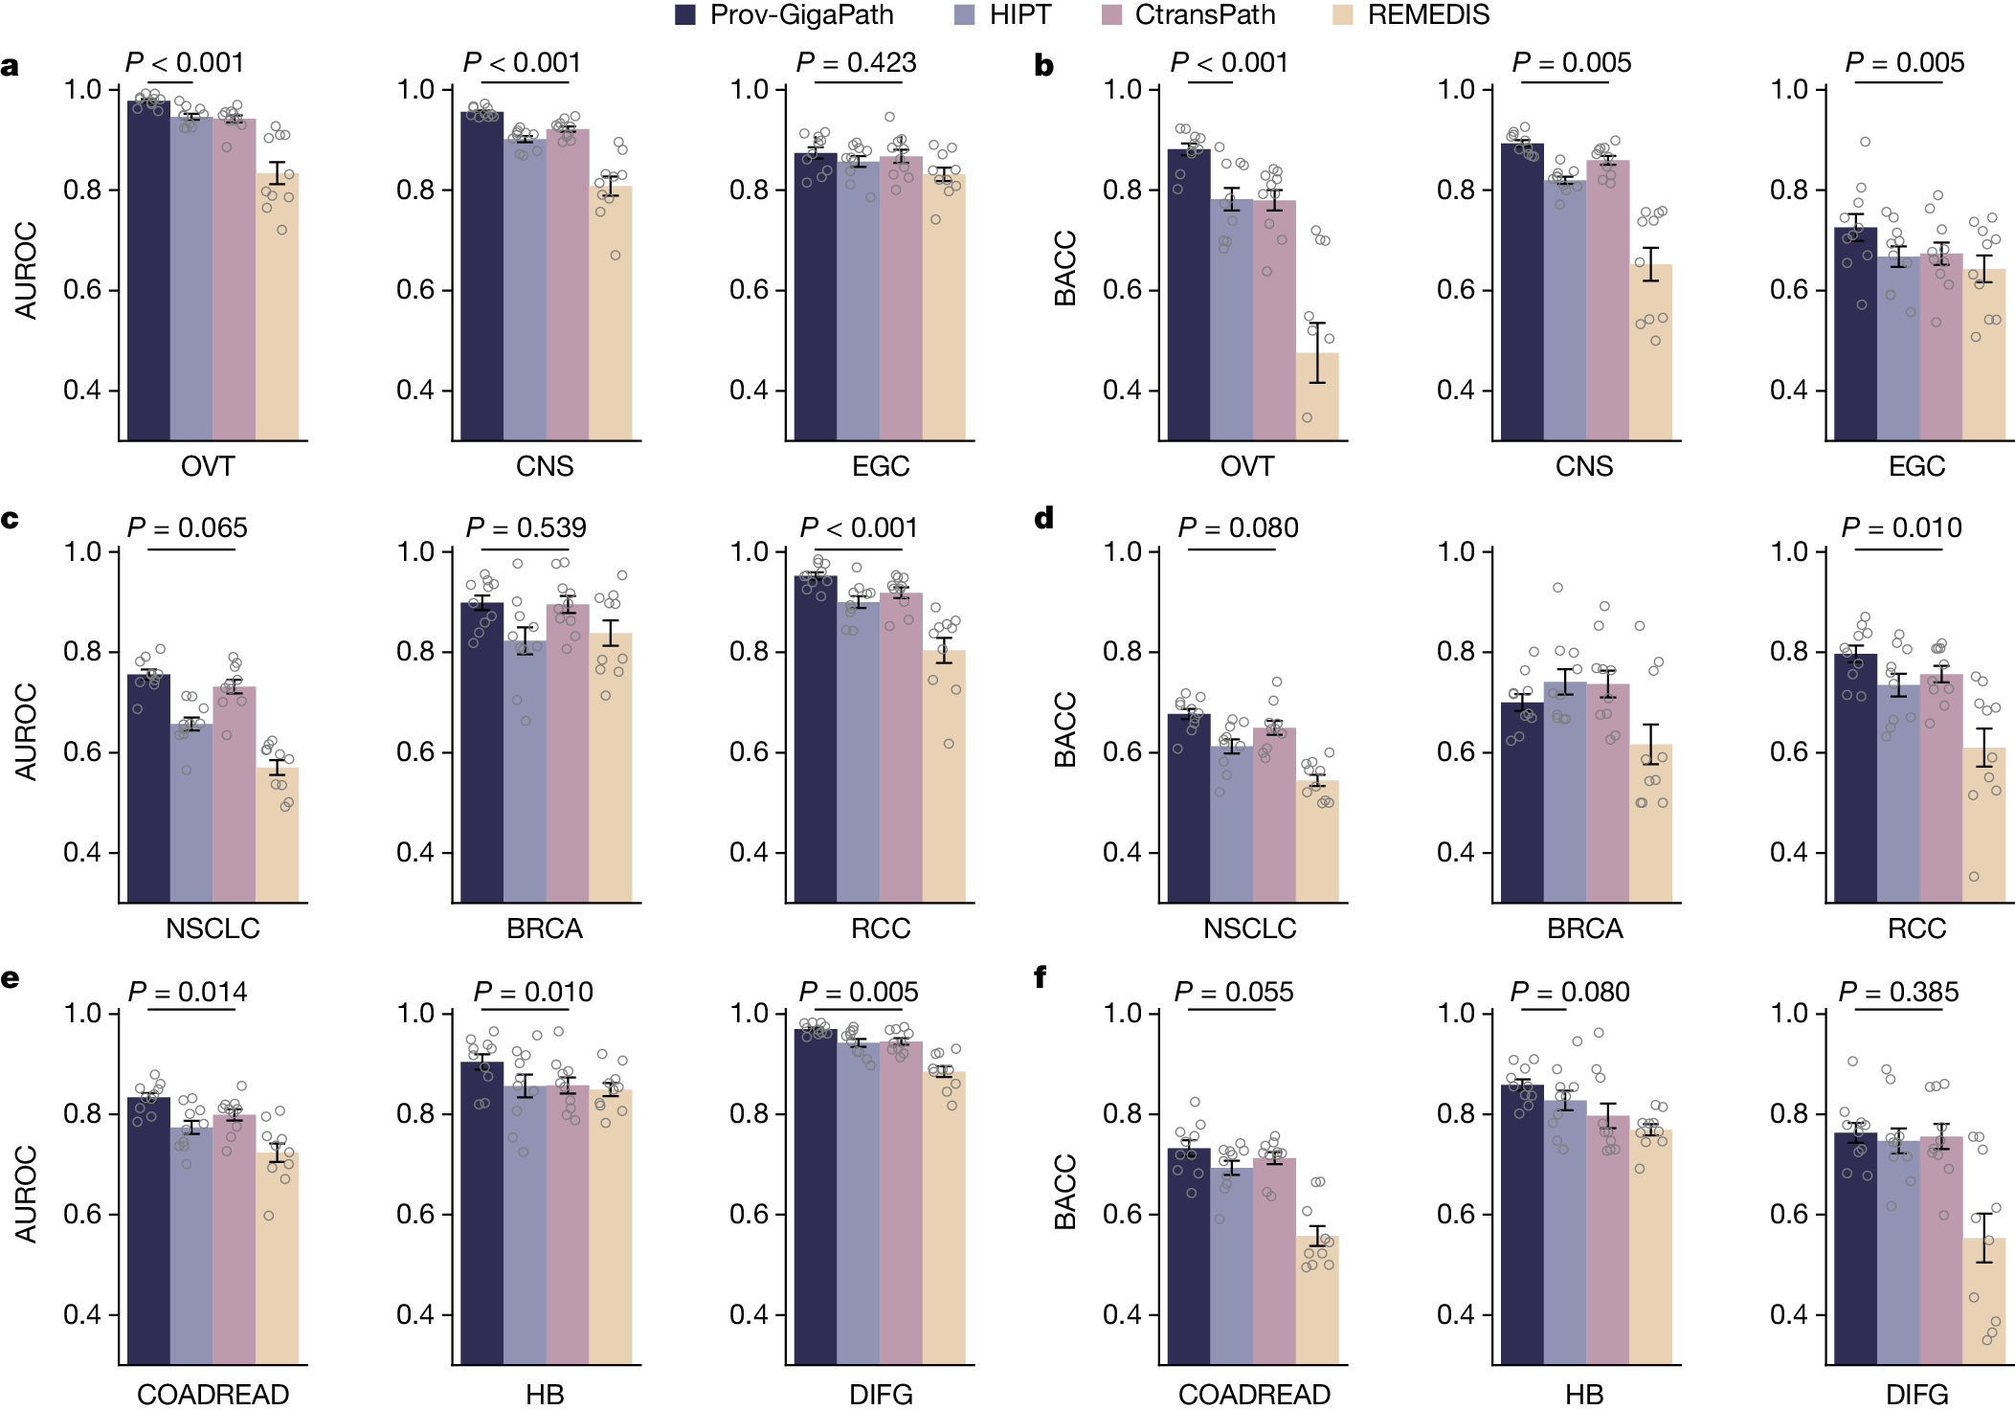
Examples of AI Use (II)
Overview of Prov-GigaPath
Prediction of mutations
Comparison of cancer subtyping
[CLS], “classification” token; APC, adenomatous polyposis coli; ARID1A, AT-rich interactive domain-containing protein 1A; ATM, ataxia-telangiectasia mutated; AUROC, area under the receiver operating characteristic curve; BRCA, breast invasive carcinoma; CD274, programmed death-ligand 1 (PD-L1); CNS, central nervous system; COADREAD, colorectal adenocarcinoma; DIFG, diffuse intrinsic pontine glioma; EGC, early gastric cancer; EGFR, epidermal growth factor receptor; FAT1, FAT atypical cadherin 1; HB, hepatobiliary; HIPT, hierarchical image pyramid transformer; KMT2A/C/D, lysine methyltransferase 2A/C/D; KRAS, Kirsten rat sarcoma viral oncogene homolog; LRP1B, low-density lipoprotein receptor-related protein 1B; LUAD, lung squamous cell carcinoma; NOTCH1, neurogenic locus notch homolog protein 1; NSCLC, non-small cell lung cancer; OVT, ovarian cancer; PIK3CA, phosphatidylinositol-4,5-bisphosphate 3-kinase catalytic subunit alpha; RCC, renal cell cancer; ROS1, ROS proto-oncogene 1; SPTA1, spectrin alpha, erythrocytic 1; TCGA, The Cancer Genome Atlas; TMB, tumour mutational burden; TP53, p53 protein; ZFHX3, zinc finger homeobox 3
Xu H, et al. Nature 2024;630:181-188

Slide 21
Future use of ai
Widescale adoption and application of AI in healthcare
Timeline | Connected/ augmented care | Precision diagnostics | Precision therapeutics | Precision medicine | Summary
Short-term: 0-5 years | Internet of things in healthcare Virtual assistants Augmented telehealth Personalised mental health support | Precision imaging (e.g. diabetic retinopathy and radiotherapy planning) | CRISPR (increasing use) | Digital and AI enabled research hospitals | AI automates time consuming, high-volume repetitive tasks, especially within precision imaging
Medium-term: 5-10 years | Ambient intelligence in healthcare | Large-scale adoption and scale-up of precision imaging | Synthetic biology Immunomics | Customisation of healthcare Robotic assisted therapies | AI uses multi-modal datasets to drive precision therapeutics
Long-term: >10 years | Autonomous virtual health assistants, delivering predictive and anticipatory care Networked and connected care organisations (single digital infrastructure) | Holographic and hybrid imaging Holomics (integrated genomic/radiomic/ proteomic/clinical/ immunohistochemical data) | Genomics medicine AI driven drug discovery | New curative treatments AI empowered healthcare professionals | AI enables healthcare systems to achieve a state of precision medicine through AI-augmented healthcare and connected care
Timings are illustrative to widescale adoption of the proposed innovation taking into account challenges/regulatory environment/use at scale
AI, artificial intelligence; CRISPR, clustered regularly interspaced short palindromic repeats
Bajwa J, et al. Future Healthc J. 2021;8:e188-e194

Slide 22
summary

Slide 23
summary
AI can be used to diagnose diseases,¹ develop personalised treatment plans,² and assist clinicians with decision-making²
Rather than simply automating tasks, AI is about developing technologies that can
enhance patient care across healthcare settings^{2,3}
However, challenges related to data privacy, bias, and the need for human expertise
must be addressed for the responsible and effective implementation of AI in healthcare^{2,4}
Collaboration amongst stakeholders is vital for robust AI systems,⁴ ethical guidelines,²
and patient and provider trust²
The future of precision oncology, in which databases of multimodal datatypes are recursively used to improve clinical models,⁵⁻⁷ may have beneficial outcomes across wide-ranging aspects of healthcare in oncology⁴
AI, artificial intelligence
1. Gandhi Z, et al. Cancers (Basel). 2023; 15:5236; 2. Varnosfaderani SM and Forouzanfar M. Bioengineering (Basel). 2024;11:337; 3. Shreve J, et al. Am Soc Clin Oncol Educ Book. 2022;42:1-10; 4. Alowais SA, et al. BMC Med Educ. 2023;23:689; 5. Bajwa J, et al. Future Healthc J. 2021;8:e188-e194; 6. Stenzinger A, et al. Semin Cancer Biol. 2022; 84:129-143; 7. Shao J, et al. Semin Cancer Biol. 2023; 91:1-15

