Slide 2
Precision oncology connect
Recent advances in precision oncology and future implications
Prof. David Hong, MD
MD Anderson Cancer Center, Houston, United States
DECEMBER 2024

Slide 3

Developed by PRECISION ONCOLOGY COnnect
This programme is developed by PRECISION ONCOLOGY CONNECT,
an international group of experts in the field of oncology.
Acknowledgement and disclosures
This PRECISION ONCOLOGY CONNECT programme is supported through an independent educational grant from Bayer. The programme is therefore independent, the content is not influenced by the supporter and is under the sole responsibility of the experts.
Please note: The views expressed within this programme are the personal opinions of the experts. They do not necessarily represent the views of the experts’ institutions, or the rest of the PRECISION ONCOLOGY
CONNECT group.
Expert disclosures:
Dr David S Hong has received financial support/sponsorship for research support, consultation, or speaker fees from the following companies: 280Bio, AACR, AbbVie, Acuta, Adaptimmune, Adlai-Nortye, Alaunos Therapeutics; Alkermes, Alpha Insights, Amgen, Affini-T, ASCO, Astellas, AstraZeneca, Aumbiosciences, Axiom, Baxter, Bayer, Biomea, Blackstone, Boxer Capital, BridgeBio, Bristol-Myers Squibb, CARSgen, Children’s Oncology Group, COR2ED, TD Cowen, CrossBridge Bio, Daiichi-Sankyo, Deciphera, EcoR1 Capital, EDDC, Eisai, Eli Lilly, Endeavor BioMedicines, Erasca, Exelixis, Fate Therapeutics, Genentech, Genmab, Gennao Bio, Gilead, GLG Pharma, Group H, Guidepoint, HCW Precision Oncology, Immunogenesis, Incyte Inc, Inhibrix Inc, InduPro, Infinity, Innovent, Janssen, Jounce Therapeutics Inc, Kyowa Kirin, LianBio, MEDACorp, Medscape, Merck, Mirati, Molecular Match, Navier, NCI-CTEP, Novartis, Northwestern, Numab, Oncologia Brasil, OncoResponse, ORI Capital, Pfizer, Pharma Intelligence, POET Congress, prIME Oncology, Projects in Knowledge, Pyramid Bio, Quanta Therapeutics, RAIN Oncology, Ridgeline Therapeutics, Revolution Medicine, Roche, SeaGen, SITC, Stanford, STCube, STOP Cancer, Takeda, Tavistock, Telperian, TCR2, Trieza Therapeutics, T-Knife, Turning Point Therapeutics, UNC, VM Oncology, WebMD, Yingli Pharma

Slide 4
Educational objectives
Drive a deeper awareness and understanding of current and future developments in precision oncology and the future clinical implications
Enhance knowledge of precision oncology and biomarker testing across patient, caregiver and HCP communities
HCP, healthcare professionals

Slide 5
Clinical takeaways
Ongoing research is uncovering new, precise, and reliable tumour biomarkers. This has improved advanced precision medicine, promising better outcomes for people with cancer
Inhibitors for KRAS mutations (e.g. sotorasib/adagrasib) have provided new treatment options for cancer in certain subpopulations (i.e. KRAS^{G12C} mutated); other agents targeting specific patient subsets (e.g. those with MTAP loss) may expand targeted therapy options
Evolving targets like NTRK and HER2 are benefiting multiple cancer types
The expansion of new biomarkers and targeted therapies highlights the importance of molecular profiling using NGS and knowing which treatment option is best suited to individual patients
HER2, human epidermal growth factor receptor 2; KRAS, Kirsten rat sarcoma virus; MTAP, methylthioadenosine phosphorylase; NGS, next-generation sequencing; NTRK, neurotrophic tyrosine receptor kinase

Slide 6
introduction
As research continues to evolve, identifying key molecular targets plays a critical role in the development of effective therapies for cancer.¹ New precision targets and therapies continue to emerge,² and more established targets are expanding their indications²
New and emerging targets:
  RAS (KRAS, NRAS and HRAS) is the most frequently mutated gene family in cancers, and researchers have sought an effective RAS inhibitor for more than 30 years.³ Two KRAS^{G12C} inhibitors, sotorasib⁴ and adagrasib,⁵ are now FDA approved for NSCLC and a number of RAS(ON) inhibitors are in development targeting variants of RAS proteins including KRAS^{G12D6,7,8}
  Protein arginine methyltransferase 5 (PRMT5) inhibitors have emerged as a promising treatment for solid tumours with methylthioadenosine phosphorylase (MTAP) deficiency⁹
Older, established targets:
  HER2: long-established as a key target in breast cancer¹⁰ and recently gained a histology-agnostic approval of the anti‑HER2 antibody–drug conjugate trastuzumab deruxtecan for patients with HER2-overexpressing solid tumours¹¹
  NTRK: targeting NTRK gene fusions with tyrosine kinase inhibitors has provided significant benefits in precision oncology.¹² New data continues to emerge for the first generation TRK inhibitors¹² and novel second-generation TRK inhibitors are in development¹³
FDA, Food and Drug Administration; HER2, human epidermal growth factor receptor 2; HRAS, Harvey RAS; KRAS, Kirsten RAS; NRAS, Neuroblastoma RAS; NSCLC, non-small cell lung cancer; NTRK, neurotrophic tyrosine receptor kinase; RAS, rat sarcoma virus; TRK, tropomyosin receptor kinase
1. Min HY and Lee HY. Exp Mol Med. 2022;54:1670-1694; 2. Malone ER, et al. Genome Med. 2020;12:8; 3. CAS. Emerging trends in targeting “undruggable” RAS protein for cancer treatment. Available here (accessed December 2024); 4. FDA grants accelerated approval to sotorasib for KRAS G12C mutated NSCLC. Available here (accessed December 2024); 5. FDA grants accelerated approval to adagrasib for KRAS G12C-mutated NSCLC. Available here (accessed December 2024); 6. Nokin M-J, et al. Nat Commun. 2024; 15: 7554; 7. Akhave NS, et al. Mol Cancer Ther. 2022;21:1645-1651; 8. Arbour KC, et al. Ann Oncol. 2023;34(Supplement 2):S458-S497. Presented at ESMO 2023. Abstr 6520, oral presentation; 9. Rodon J, et al. Eur J Cancer. 2024;211 (suppl 1):114981. Presented at ENA 2024 (EORTC NCI AACR 36th Symposium). 503LBA (oral presentation); 10. Meric-Bernstam F, et al. J Clin Oncol. 2023;42:47-58; 11. Yoon J, et al. Nat Rev Clin Oncol. 2024; 21:675-700; 12. Hong DS, et al. Ann Oncol. 34 (supplement 2):S469. Presented at ESMO 2023 (Poster 667P); 13. Sheng J, et al. NPJ Precis Oncol. 2024;8:198

Slide 7
New targets: kras
KRAS, Kirsten rat sarcoma virus

Slide 8
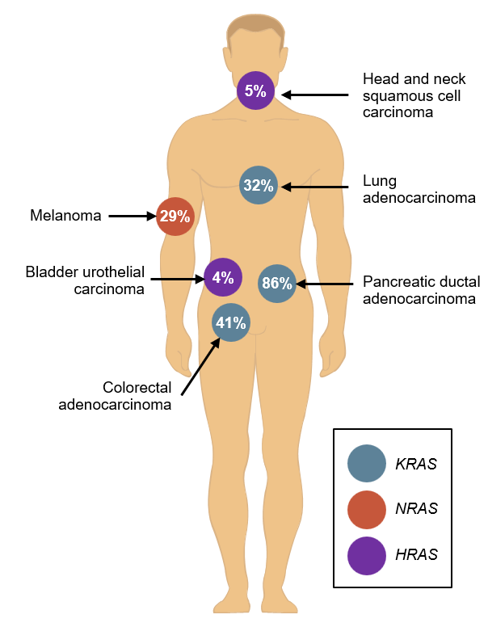
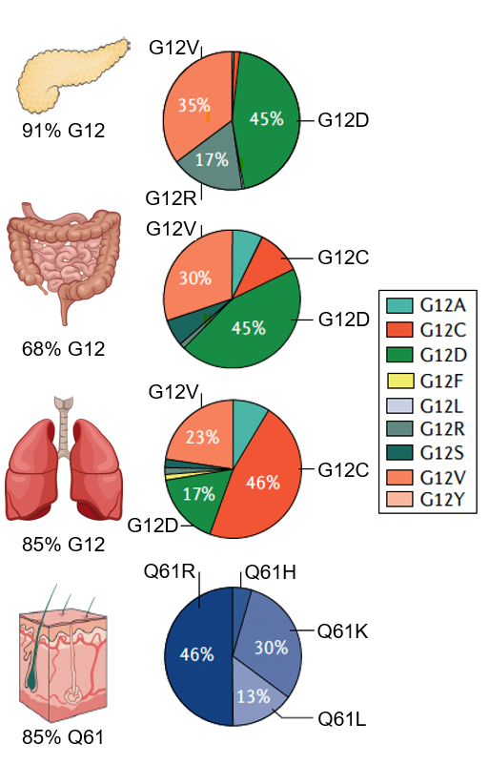
RAS mutant cancers: targets for precision oncology?
Different mutant alleles are found in different cancer types. Pancreatic cancer has the most KRAS mutations
PAN-TUMOUR
Distribution and frequency of RAS isoform across tumour types
Percentages of KRAS mutations in codon 12 by tissue and tumour type
RAS mutation isoforms
KRAS mutation codons
N
Other
HRAS, Harvey RAS; KRAS, Kirsten RAS; NRAS, Neuroblastoma RAS; RAS, rat sarcoma virus
Moore A, et al. Nat Rev Drug Discovery. 2020;19:553-552

Slide 9
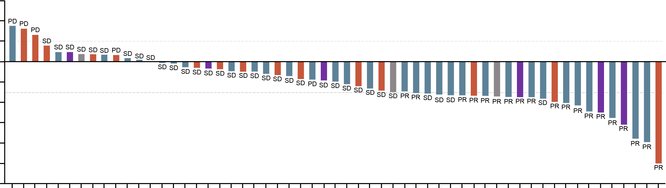
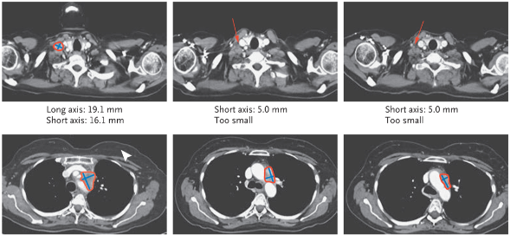
KRAS^{G12C} Inhibition with Sotorasib in Advanced Solid Tumours (efficacy)
CHANGE FROM BASELINE IN TUMOUR BURDEN
60
Planned dose:
180 mg
360 mg
720 mg
960 mg
40
20
EFFICACY OF SOTORASIB IN ALL TUMOUR TYPES
0
 | NSCLC (N=59) | Colorectal cancer (N=42) | Other (N=28)
Best overall response, n (%)
Confirmed CR | 0 | 0 | 0
Confirmed PR | 19 (32.2) | 3 (7.1) | 4 (14.3)
SD | 33 (55.9) | 28 (66.7) | 17 (60.7)
PD | 5 (8.5) | 10 (23.8) | 4 (14.3)
Could not be evaluated | 1 (1.7) | 0 | 1 (3.6)
No assessmentª | 1 (1.7) | 1 (2.4) | 2 (7.1)
Objective response, %^{b} (95% CI) | 32.2 (20.62-45.64) | 7.1 (1.50-19.48) | 14.3 (4.03-32.67)
Disease control, %^{c} (95% CI) | 88.1 (77.07-95.09) | 73.8 (57.96-86.14) | 75.0 (55.13-89.31)
-20
Best percent change from baseline
-40
-60
-80
-100
-120
Patients with NSCLC receiving sotorasib
EFFECT OF SOTORASIB IN A PATIENT WITH NSCLC
Baseline
Week 10
Week 16
Lymph node cervical
deep lower right
Long axis: 19.1 mm
Short axis: 16.1 mm
Short axis: 5.0 mm
Too small
Short axis: 5.0 mm
Too small
Mediastinum
Long axis: 39.3 mm
Short axis: 30.2 mm
Long axis: 30.8 mm
Short axis: 17.9 mm
Long axis: 28.0 mm
Short axis: 12.8 mm
ª One patient with NSCLC withdrew consent before tumour assessment. One patient with colorectal cancer and two patients with other tumour types had clinical progression
^{b} Objective response was defined as a complete or partial response
^{c} Disease control was defined as a complete response, a partial response, or stable disease
CI, confidence interval; CR, complete response; KRAS, Kirsten rat sarcoma virus; NSCLC, non-small cell lung cancer; PD, progressive disease; PR, partial response; SD, stable disease
Hong DS, et al. N Engl J Med. 2020;383:1207-1217

Slide 10
KRAS^{G12C} Inhibition with Sotorasib in Advanced Solid Tumours (safety)
Events | Any Grade | Grade ≥3 | Grade ≥4 | Grade 5: Fatal
Adverse events of any cause that occurred during treatment, n (%)
Any | 125 (96.9) | 68 (52.7) | 26 (20.2) | 22 (17.1)
Serious | 58 (45.0) | 51 (39.5) | 25 (19.4) | 22 (17.1)
Resulting in discontinuation of treatmentª | 9 (7.0) | 9 (7.0) | 4 (3.1) | 4 (3.1)
Adverse events of any cause that occurred during treatment ≥10% of patients, n (%)
Diarrhoea | 38 (29.5) | 5 (3.9) | 0 | 0
Fatigue | 30 (23.3) | 3 (2.3) | 0 | 0
Nausea | 27 (20.9) | 2 (1.6) | 0 | 0
Vomiting | 23 (17.8) | 5 (3.9) | 0 | 0
Abdominal pain | 23 (17.8) | 4 (3.1) | 0 | 0
Dyspnoea | 21 (16.3) | 3 (2.3) | 1 (0.8) | 1 (0.8)
Cough | 20 (15.5) | 0 | 0 | 0
Back pain | 19 (14.7) | 2 (1.6) | 0 | 0
Decreased appetite | 19 (14.7) | 1 (0.8) | 0 | 0
Headache | 18 (14.0) | 0 | 0 | 0
Aspartate aminotransferase increase | 17 (13.2) | 3 (2.3) | 0 | 0
Anaemia | 17 (13.2) | 6 (4.7) | 0 | 0
Dizziness | 17 (13.2) | 0 | 0 | 0
Alanine aminotransferase increase | 15 (11.6) | 6 (4.7) | 1 (0.8) | 0
Constipation | 15 (11.6) | 0 | 0 | 0
Pyrexia | 14 (10.9) | 0 | 0 | 0
Insomnia | 14 (10.9) | 0 | 0 | 0
Myalgia | 13 (10.1) | 0 | 0 | 0
Peripheral oedema | 13 (10.1) | 0 | 0 | 0
Arthralgia | 13 (10.1) | 2 (1.6) | 0 | 0
ª Among the 22 patients who had fatal adverse events of any cause during treatment, four patients discontinued treatment directly because of those adverse events. The remaining patients discontinued treatment before the fatal adverse event occurred, and therefore the fatal adverse event was not recorded as the reason for treatment discontinuation for those patients.
CI, confidence interval; KRAS, Kirsten rat sarcoma virus; NSCLC, non-small cell lung cancer
Hong DS, et al. N Engl J Med. 2020;383:1207-1217

Slide 11
KRAS^{G12C} allele specific inhibitors – single arm studies
Agent | Sotorasib¹ 960 mg daily | Adagrasib² 600 mg BID | Fulzerasib³ (IBI351) 600 mg BID | Divarasib⁴ (GDC-6036) 50-400 mg QD | Garsorasib⁵ (D-1553) 600 mg BID | Opnurasib⁶ (JDQ443) 200 mg BID | Glecirasib⁷ (JAB-81822) 800 mg QD | Olomorasib⁸ (LY3537982) 50-200 mg BID
N | 124 | 112 | 116 | 60ª | 123 | 14ª | 119 | 39ª
Confirmed ORR, % | 37.1 | 43 | 49.1 | 53.4 | 52.0 | 57.1 | 47.9 | 41
Median DoR, months | 11.1 | 8.5 | NR | 14.0 | 12.5 | – | – | –
Median PFS, months | 6.8 | 6.5 | 9.7 | 13.1 | 9.1 | – | 8.2 | 8.1
Grade 3-4 TRAE, % | 20.6 | 43 | 33.6 | 18 | 51.2 | 5.9 | 38.7 | 7
Dose reduction for TRAE, % | – | 52 | 6.9 | 14 | 30.1 | 2.9 | – | 5
Dose modification/ Interruption, % | 22.2 | 61 | 33.6 | 50 | 41.5 | – | – | 13
Discontinued for TRAE, % | 7.1 | 7 | 6.0 | 3 | 0 | – | 5.0 | 1
ªNSCLC cohort for efficacy and full dataset for safety
BID, twice a day; DoR, duration of response; KRAS, Kirsten rat sarcoma virus; ORR, objective response rate; PFS, progression-free survival; QD, once daily; RP2D, recommended phase 2 dose; TRAE, treatment-related adverse event
1. Skoulidis F, et al. N Engl J Med 2021; 384: 2371-81; 2. Spira AI, et al. J Clin Oncol. 2022;40 (16 suppl):9002. (ASCO 2022 oral presentation); 3. Zhou Q, et al. Journal of Thoracic Oncology 2024; 19: 1630-1639; 4. Sacher A, et al N Engl J Med. 2023;389:710-721; 5. Li Z, et al. J Thorac Oncol. 2024;19(10 Suppl):S40-S41 (WCLC 2024 oral presentation); 6. Cassier P, et al. J. Clin Oncol 2023; 41 (16_suppl): 9007 (Miguel M, ASCO 2023 oral presentation); 7. Shi Y, et al. J Clin Oncol. 2024;42(36 Suppl):468214 (ASCO 2024 oral presentation); 8. Heist RS, et al. J Clin Oncol 2024;42 (16_suppl):3007 (ASCO 2024 oral presentation)
Modified from Leighl NB, 2024. Slides presented at ESMO 2024

Slide 12
Do the lessons from KRAS^{G12C} apply to the next generation of inhibitors?
Spectrum of therapeutic approaches to target KRAS
RAS(off)
RAS(on)
GDP
GTP
Mutation-specific direct KRAS therapies
Advantages:
Wide therapeutic index supporting
combination trials
Disadvantages:
Narrow target population for each agent
Unclear efficacy/safety of
non-covalent inhibitors
Beyond KRAS^{G12C} inhibitors, all other
inhibitors remain in pre-clinical testing
Indirect Pan-RAS therapies
Advantages:
Large patient population, including ability to target other RAS
proteins (e.g. HRAS, NRAS) or non-mutated oncogenic
alterations (e.g. KRAS amplification)
Bypass acquired resistance mechanisms to KRAS^{G12C} inhibitors
Disadvantages:
Possibility for unanticipated off-target or on-target effects that
could narrow therapeutic index
Mutation-independent direct KRAS therapies
GDP, guanosine diphosphate; GTP, guanosine triphosphate; HRAS, Harvey RAS; KRAS, Kirsten RAS; NRAS, Neuroblastoma RAS; RAS, rat sarcoma virus
Akhave NS, et al. Mol Cancer Ther. 2022;21:1645-1651

Slide 13
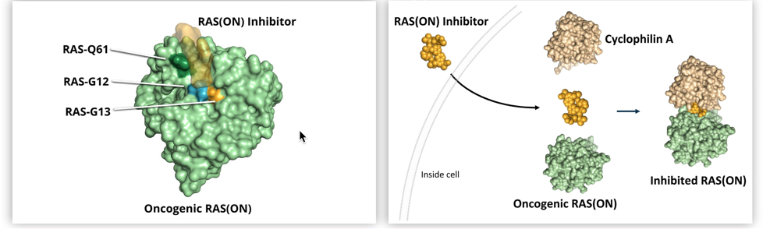
Do the lessons from KRAS^{G12C} apply to the next generation of inhibitors?
First-in-class RAS(ON) inhibitors, including
RAS(ON) G12D-Selective and RAS(ON) Multi-Selective Inhibitors^{1,2}
Bind²
Suppress^{1,3}
Amino acid positions that, according to mutation, determine potential for inhibitor interaction
Preclinical studies have demonstrated deep and sustained regressions across multiple RAS^{MUT} tumour types, particularly PDAC and NSCLC harbouring KRAS G12X mutations²
KRAS, Kirsten RAS; MUT, mutated; NSCLC, non-small cell lung cancer; PDAC, pancreatic ductal adenocarcinoma; RAS, rat sarcoma virus
1. On Target to Outsmart Cancer. Revolution Medicines. Available at: https://ir.revmed.com/static-files/1980f6ca-cb1d-4568-94a7-623ccc8c0cf2 (accessed December 2024); 2. Arbour KC, et al. Ann Oncol. 2023;34(Supplement 2):S458-S497. Presented at ESMO 2023 (oral presentation) 3. Koltun E, et al. Presented at AACR 2022. Available at: https://www.revmed.com/wp-content/uploads/2023/09/AACR_2022_Koltun.pdf (accessed December 2024);

Slide 14
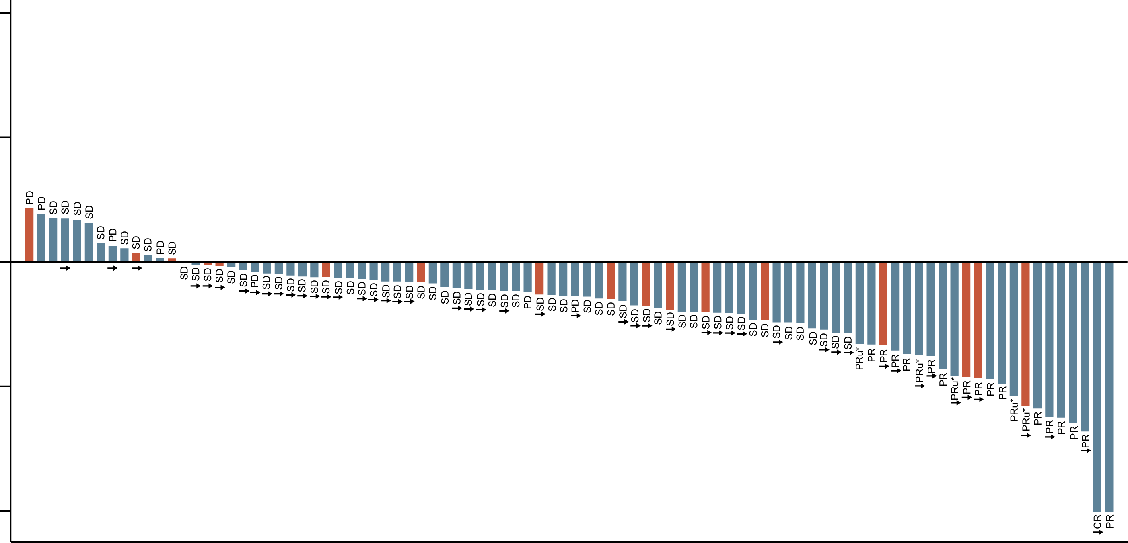
Best Percentage Change in Tumour Size from Baseline and Objective Response Rate in 2L+ PDAC (RMC-6236 160-300 mg)
100
 | ORR 14+ weekª | ORR 20+ weekª | DCR 14+ weekª
KRAS G12X, % (n/N) | 20 (16/79) | 27 (13/48) | 87 (69/79)
RAS mutant, % (n/N)^{b} | 21 (20/97) | 26 (16/61) | 88 (85/97)
Benchmark, %^{c} | 9 |  | NA
Best % change in SOD from baseline
In target tumour burden
50
0
-50
KRAS G12X
RAS other
on treatment
-100
Unconfirmed PRs (PRu) with treatment discontinued (will never confirm) are not considered responders but remain in the denominator (n=5)
ª “ORR 14+ week” and “DCR 14+ week” analyses include all patients who received first dose of RMC-6236 at least 14 weeks prior to data cutoff date (to allow two potential scans). “ORR 20+ week” analysis is similarly defined to allow three potential scans. Five patients included in the denominator of the ‘14+ week’ analyses are not displayed on waterfall due to lack of post-baseline target lesion assessment (four patients discontinued treatment without post-baseline scans: three due to death, one due to subject request to withdraw from treatment, and one patient had documented PD due to new lesion without target lesion assessment); ORR (by RECISTv1.1) includes confirmed CRs/PRs and unconfirmed CRs/PRs who are still on treatment and may yet confirm; 2L in the metastatic setting includes patients who progressed on prior therapy in an earlier setting within 6 months of last dose
^{b} RAS mutant defined as patients with G12X, G13X or Q61X PDAC
^{c} Benchmark mean ORR derived from published reports
2L, second line; CR, complete response; DCR, disease control rate; KRAS, Kirsten rat sarcoma virus; NA, not available; ORR, objective response rate; PD, progressive disease; PDAC, pancreatic ductal adenocarcinoma; PR(u), (unconfirmed) partial response; RAS, rat sarcoma virus; RECIST, Response Evaluation Criteria in Solid Tumours; SD, stable disease; SOD, sum of diameters
RMC-6236: Pancreatic Cancer Update to Support Pivotal Phase 3 Trial. Revolution Medicines. Available at: https://ir.revmed.com/static-files/eeeb0690-0ef4-44b8-b5fe-8d11d8df3c9a (accessed December 2024)

Slide 15
ORR and DCR in Patients with KRAS G12D PDAC Treated with RMC-9805
100
Tumour Response for PDAC Patients Treated with 1200 mg Daily Dose (QD, N=20 or BID, N=20)ª
ORR (confirmed or pending)^{b}, % (n) | 30 (12)
DCR (CR+PR+SD), % (n) | 80 (32)
PD
Best % change from baseline
for sum of diameters
PD
50
PD
ª per RECIST v1.1
^{b} Includes confirmed PRs and unconfirmed PRs who were still on treatment and may yet be confirmed
PD
PD
PD
SD
SD
NE
SD
PD
PD
PD
SD
NE
SD
NE
SD
SD
0
SD
SD
SD
SD
SD
SD
SD
SD
SD
SD
NE
SD
SD
SD
SD
SD
SD
SD
SD
SD
SD
SD
SD
SD
SD
SD
SD
SD
SD
SD
PR*
PR*
PR*
PR
PR*
PR*
PR*
PR
PR*
PR*
PR
PR*
PR
PR
PR
PR*
PR*
PR*
-50
PR*
PR
PR
1200 mg Daily (QD or BID)
PR
˂1200 mg Daily (QD or BID)
on treatment
-100
PR*, unconfirmed partial response
1
3
3
2
1
1
1
1
2
1
2
1
1
3
1
1
2
4
2
1
2
2
4
4
2
2
1
4
2
3
1
2
2
1
4
4
1
2
2
2
4
2
2
2
3
3
5
2
1
4
3
2
4
2
2
3
1
3
3
6
4
3
3
3
4
2
2
2
2
2
Number of Post
Baseline Scans
2
Data cutoff: 02 Sep 2024; All treated patients with PDAC who received a first daily dose at least 14 weeks prior to data cutoff date (applies to Waterfall plot and ORR table); three additional patients (N=2 at 1200 mg daily; N=1 at <1200 mg daily) are not displayed on the Waterfall plot due to withdrawal of consent or clinical progression. Among patients with a response (confirmed or unconfirmed), 55% of first response occurred after 2 months of RMC-9805 treatment (all dose levels)
BID, twice a day; CR, complete response; DCR, disease control rate; KRAS, Kirsten rat sarcoma virus; NE, not evaluable; ORR, objective response rate; PD, progressive disease; PDAC, pancreatic ductal adenocarcinoma; PR, partial response; QD, once daily; RECIST, Response Evaluation Criteria in Solid Tumours; SD, stable disease
Hong DS, et al. Presented at ENA 2024 (EORTC NCI AACR 36th Symposium): Available at: https://www.revmed.com/wp-content/uploads/2024/10/ENA-LBA514-Hong-etal-FINAL-2024_1018.pdf (accessed December 2024)

Slide 16
New targets:
MTAP
MTAP, methylthioadenosine phosphorylase

Slide 17
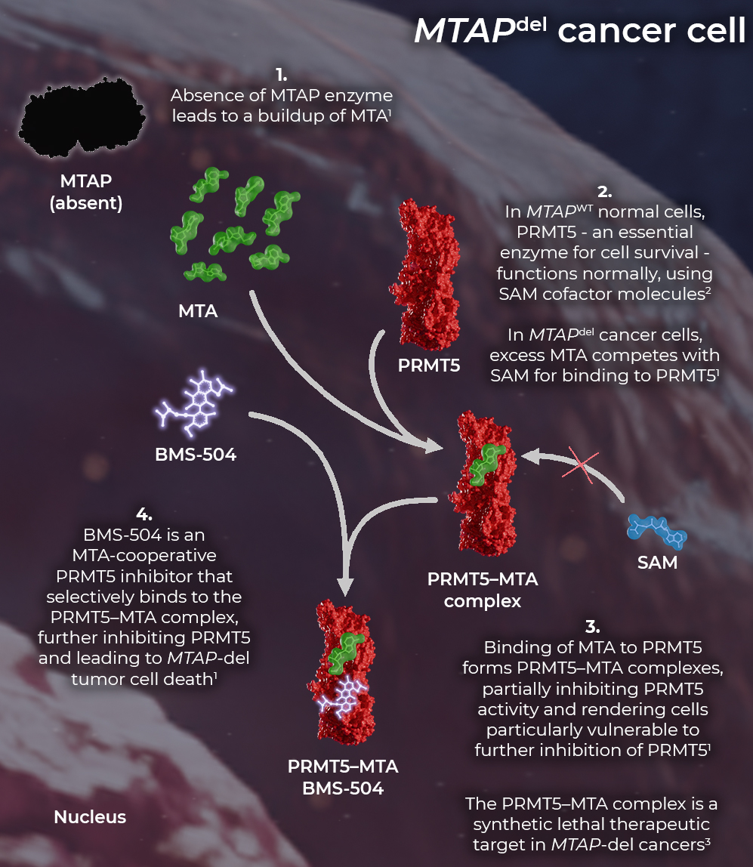
Background
MTAP-del CANCER CELL
Homozygous MTAP-del occurs in 10–15% of all cancers,¹ and in up to 50% of tumours such as GBM² and mesothelioma³
Patients with homozygous MTAP-del have a poorer prognosis⁴
BMS-986504 (MRTX1719) is a first-in-class MTA-cooperative PRMT5 inhibitor^{5,6} that selectively binds to the PRMT5-MTA complex⁶
The PRMT5-MTA complex is a synthetic lethal target in
MTAP-del cancer cells, but not in MTAP–wild-type cells⁷
CA240-0007 is a phase 1/2 study of BMS-986504 in patients with advanced solid tumours with homozygous MTAP-del^{5,8}
  Early clinical activity has been reported across a range of doses and tumour types⁵
del, deleted; GBM, glioblastoma multiforme; (MTA)P, (methylthioadenosine) phosphorylase; PRMT5, protein arginine methyltransferase 5; SAM, S-adenosylmethionine
1. Rodon J, et al. Ann Oncol. 2024;35:1138-1147; 2. Barekatain Y, et al. Nature Commun. 2021;12:4228; 3. Sharkey A, et al. J Thorac Oncol. 2017;12(no. 15):P3.03-005; 4. Han G, et al. Nat Commun 2021;12:5606; 5. Engstrom LD, et al. Cancer Discov. 2023;13:2412-2431; 6. Smith CR, et al. Mol Cancer Ther. 2021;20 (12_Supplement): P165; 7. Smith CR, et al. J Med Chem. 2022;65:1749-1766; 8. ClinicalTrials.gov identifier: NCT05245500. Available at: https://clinicaltrials.gov/study/NCT05245500 (accessed December 2024)
Rodon J, et al. Eur J Cancer. 2024; 211 (suppl 1):114981. Presented at ENA 2024 (EORTC NCI AACR 36th Symposium). 503LBA (oral presentation)

Slide 18
CA240-0007ª phase 1 first-in-human study of BMS-986504
(PRMT5 inhibitor)
Key eligibility criteria
Advanced, unresectable, or
metastatic solid tumours with homozygous MTAP-del^{b}
Measurable or evaluable
disease^{c}
Disease progression on or after the most recent treatment
No available treatment with curative intent
Phase 1 dose escalation^{e}
Phase 1b dose expansion^{f}
400 mg BID
600 mg QD
800 mg QD
600 mg QD
400 mg QD
400 mg QD
Tumour types assessed
200 mg QD
NSCLC
PDAC
CCA
Meso
MPNST
HNSCC
BC
MEL
Other^{d}
200 mg QD
100 mg QD
50 mg QD
Endpoints: safety, pharmacokinetics, and clinical activity/efficacy
Data cutoff date: September 19, 2024; median follow-up (95% CI): 7.6 (6.8–8.3) months.
ª NCT05245500. ^{b} Dose escalation only: patients with tumours with homozygous CDKN2A-del per a sponsor-approved test were eligible if MTAP-del was unknown or present but assessed using a test not approved by the sponsor and MTAP-wild type was not present on the test establishing CDKN2A-del. ^{c} Patients with evaluable disease were eligible only in dose escalation. ^{d} Included acinic cell carcinoma, acinic cell carcinoma of the parotid gland, ampulla of the vater cancer, apocrine carcinoma, chondrosarcoma, esophageal adenocarcinoma, gallbladder cancer, GIST, GBM, large cell neuroendocrine tumour, malignant TGCT, metastatic ampullary adenocarcinoma, neuroendocrine cancer, osteosarcoma, pancreatic cancer (invasive carcinoma with adenosquamous features and neuroendocrine), pleomorphic adenoma of parotid gland, RCC, rectal cancer, spindle cell sarcoma, undifferentiated pleomorphic sarcoma, and UC. ^{e} Doses increased by 100% increments until ≥1 DLTs occurred and then in increments of 40–50% afterwards. Depending on safety observations, smaller dose increments were used. In the event the MTD was exceeded, dose levels below the MTD but above the previous dose level would be evaluated using smaller dose increments. n ≥ 3 per cohort. ^{f} Enrolment to dose expansion cohorts is ongoing.
BC, breast cancer; BID, twice daily; CCA, cholangiocarcinoma; CDKN2A, cyclin-dependent kinase inhibitor 2A; CI, confidence interval; del, deleted; DLT, dose-limiting toxicity; GBM, glioblastoma multiforme; GIST, gastrointestinal stromal tumour; HNSCC, head and neck squamous cell carcinoma; MEL, melanoma; meso, mesothelioma; MPNST, malignant peripheral nerve sheath tumour; MTAP, methylthioadenosine phosphorylase; MTD, maximum tolerated dose; NSCLC, non-small cell lung cancer; PDAC, pancreatic ductal adenocarcinoma; PRMT5, protein arginine methyltransferase 5; QD, once daily; RCC, renal cell carcinoma; TGCT, tenosynovial giant cell tumour; UC, uterine carcinosarcoma
Rodon J, et al. Eur J Cancer. 2024; 211 (suppl 1):114981. Presented at ENA 2024 (EORTC NCI AACR 36th Symposium). 503LBA (oral presentation)

Slide 19
Best percent change in sum of target lesion measurements
80
Clinical activity-evaluable population
70
60
23 patients with PR as BOR had SD at first on-treatment scan
50
BOR
40
CR
PR
SD
PD
30
►
* Improvement in response from
first on-treatment scan
20
►
10
►
►
# Unconfirmed PR
0
►
►
Best percentage change from baseline
−10
►
►
−20
►
►
►
►
►
−30
►
►
►
►
►
►
►
►
►
►
*
►
*
−40
*
*
►
►
*
#
*
*
*
►
►
►
*
*
►
−50
*
*
*
*
►
*
►
*
*
−60
►
*
*
*
−70
►
−80
*
►
−90
*
►
*
Tumour type
Post-baseline scans
Previous LoT
BMS-986504 dose
Tumour type
Post-baseline scans
BMS-986504 dose
NSCLC
PDAC
CCA
Meso
MPNST
1
2–4
> 4
50 mg QD
100 mg QD
200 mg QD
400 mg QD
HNSCC
BC
MEL
Other
Previous LoT
600 mg QD
800 mg QD
400 mg BID
Prior surgery only
1–2
>2
► Ongoing treatment
Median follow-up (95% CI): 7.6 (6.8–8.3) months.
Clinical activity-evaluable population (n = 124): patients who received ≥1 dose of BMS-986504 in this study, had homozygous MTAP-del confirmed by a sponsor-approved assay, and had ≥ 1 on-study disease assessment prior to discontinuation, any subsequent anti-cancer therapies, or death. Patients with NE as BOR or for which change of baseline is missing due to lack of post-baseline measurement (n = 8) were not included.
BC, breast cancer; BID, twice daily; BOR, best overall response; CCA, cholangiocarcinoma; CR, complete response; del, deleted; HNSCC, head and neck squamous cell carcinomas; LoT, line of therapy; MEL, melanoma;
meso, mesothelioma; MPNST, malignant peripheral nerve sheath tumour; MTAP, methylthioadenosine phosphorylase; NE, not evaluable; NSCLC, non-small cell lung cancer; PD, progressive disease; PDAC, pancreatic ductal adenocarcinoma; PR, partial response; QD, once daily; SD, stable disease
Rodon J, et al. Eur J Cancer. 2024; 211 (suppl 1):114981. Presented at ENA 2024 (EORTC NCI AACR 36th Symposium). 503LBA (oral presentation)

Slide 20
Established targets

Slide 21





Tumour agnostic precision medicine
May 2017
Nov 2018
Aug 2019
Jun 2020
Aug 2021
Jun 2022
Sep 2022
RX
RX
Pembrolizumab
in dMMR/MSI-H
cancers
Larotrectinib
in NTRK fusion
positive cancers
Entrectinib
in NTRK fusion
positive cancers
Pembrolizumab
in TMB-high
cancers
Dostarlimab
in dMMR/MSI-H
cancers
Dabrafenib/
trametinib
in BRAF^{V600E}
mutant cancers
Selpercatinib
in RET fusion
positive cancers
6 medicines US FDA approved for 7 tumour-agnostic indications
BRAF, proto-oncogene B-Raf; dMMR, deficient DNA mismatch repair; FDA, Food and Drug Administration; MSI-H, microsatellite instability high;
NTRK, neurotrophic tropomyosin-receptor kinase; RET, rearranged during transfection; TMB, tumour mutational burden
Gouda M, et al. Clin Can Res. 2023;29:2753-2760

Slide 22
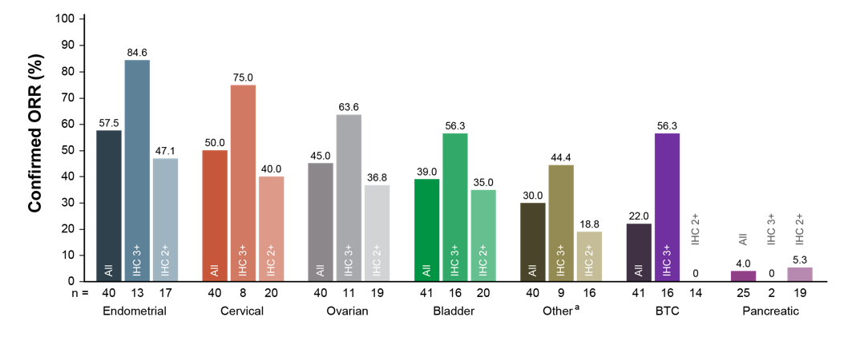
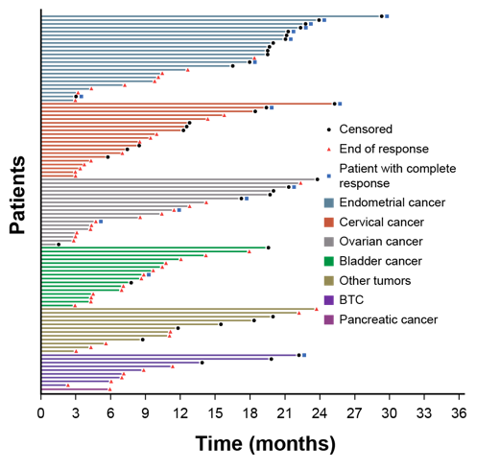
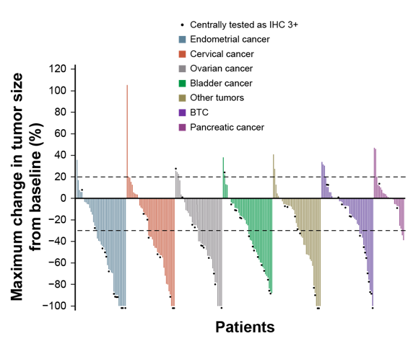
Efficacy and Safety of T-DXd in HER2-Expressing Solid Tumours
ORR across tumour cohorts, according to HER2 status
DOR in patients with objective response
Maximum change in tumour size
ª Responses in the other tumours cohort include responses in extramammary Paget disease, oropharyngeal neoplasm, head and neck cancer, and salivary gland cancer
Led to approval of T-DXd for HER2-expressing solid tumours
BTC, biliary tract cancer; DOR, duration of response; HER2, human epidermal growth factor receptor 2; IHC, immunohistochemistry; ORR, objective response rate; RECIST, Response Evaluation Criteria in Solid Tumours; T-DXd, trastuzumab deruxtecan
Meric-Bernstam F, et al. J Clin Oncol. 2023;42:47-58

Slide 23
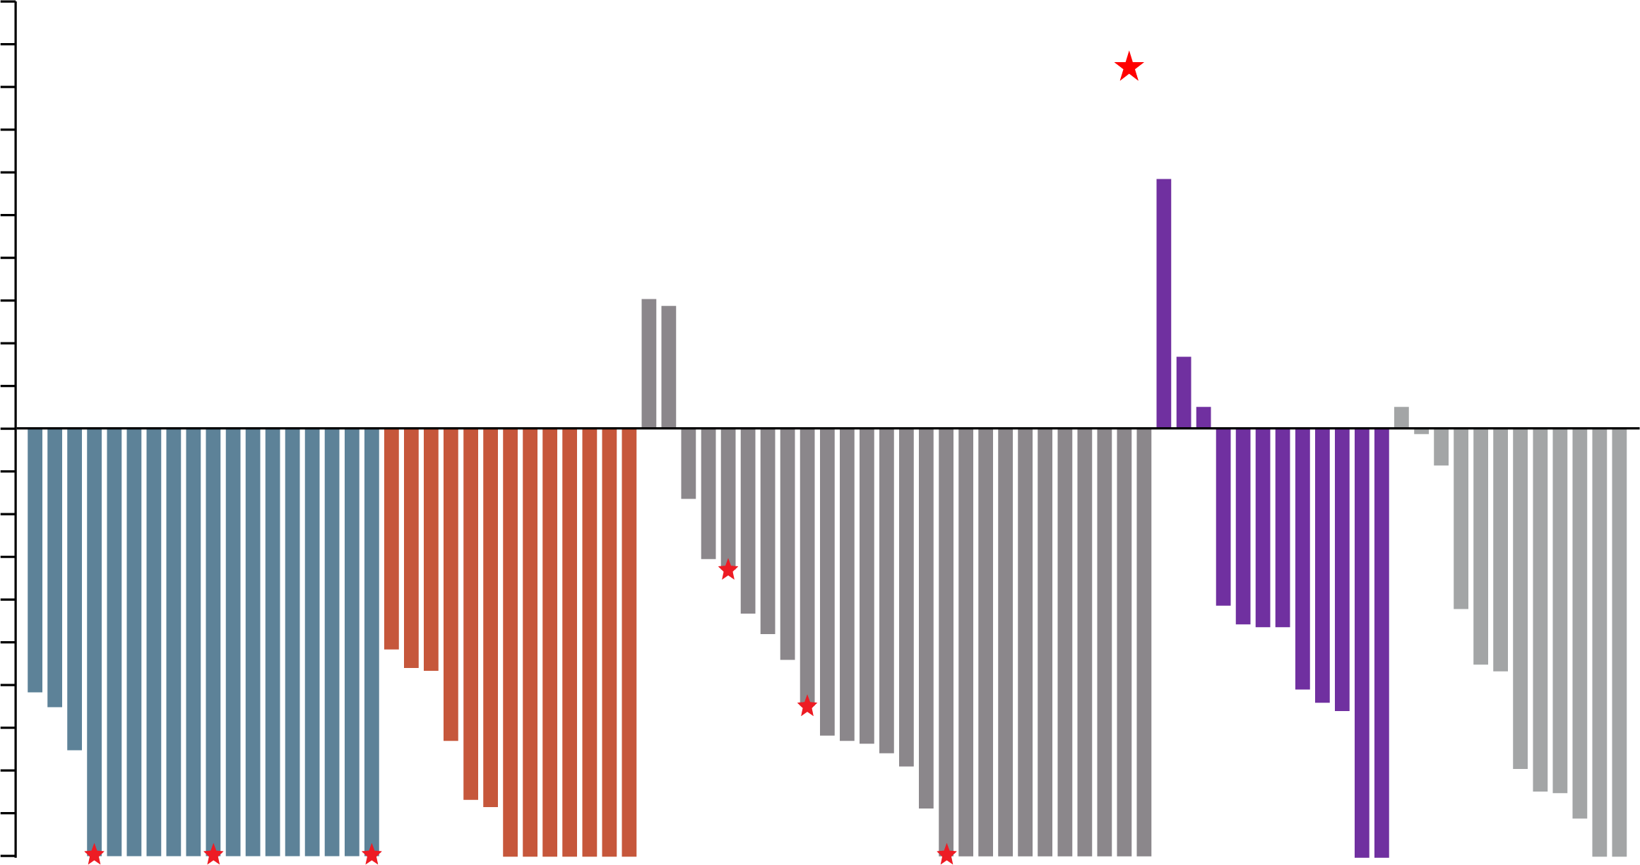
Efficacy and safety of larotrectinib as first-line treatment for patients with TRK fusion cancer
Maximum change in target lesion size in patients with TRK fusion cancer (N=92)
100
Efficacy
IRC-eligible patients, n | 92
ORR (95% CI), % | 78 (68-86)
Best overall response, n (%) Complete response Pathological complete response Partial response Stable disease Progressive disease Not evaluable | 38 (41) 6 (7) 28 (30) 11 (12) 7 (8) 2 (2)
90
Pathological complete response
80
70
60
50
40
30
20
10
IFS
Salivary gland
Soft tissue sarcoma
Thyroidª
Other^{b}
Maximum change in target lesion size (%)
0
−10
−20
−30
−40
−50
−60
−70
−80
−90
−100
Not including one patient who was not eligible for IRC assessment. ª The three patients with thyroid cancer that did not experience tumour shrinkage had anaplastic thyroid cancer. ^{b} Other includes two congenital mesoblastic nephroma and one each of bone sarcoma, cervix, cholangiocarcinoma, external auditory canal and lung
CI, confidence interval; IFS, infantile fibrosarcoma; IRC, independent review committee; ORR, overall response rate; TRK, tropomyosin receptor kinase
Hong DS, et al. Ann Oncol. 34 (supplement 2):S469. Presented at ESMO 2023 (Poster 667P)

Slide 24
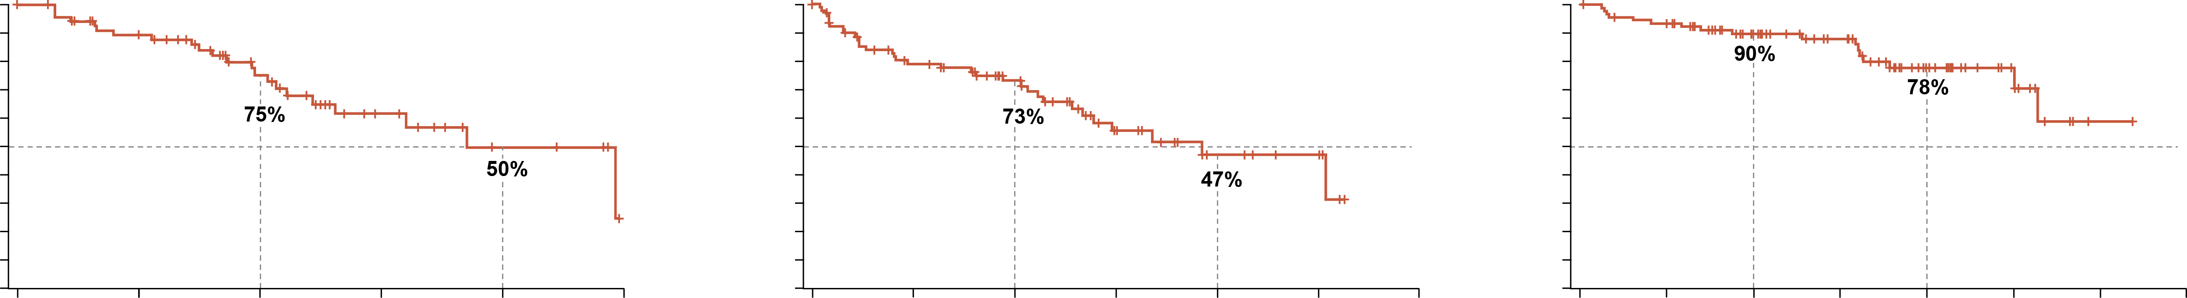
Efficacy and safety of larotrectinib as first-line treatment for patients with TRK fusion cancer
DoR, PFS and OS in patients with TRK fusion cancer
DoR
Median DoR, months (95% CI) | 44.5 (29.2-NE)
Median follow-up, months | 28.6
24-month DoR, % (95% CI) | 75 (64-87)
48-month DoR, % (95% CI) | 50 (31-69)
PFS
Median PFS, months (95% CI) | 46.2 (32.0-NE)
Median follow-up, months | 30.3
24-month PFS, % (95% CI) | 73 (63-83)
48-month PFS, % (95% CI) | 47 (31-62)
OS
Median OS, months (95% CI) | Not reached (63.4-NE)
Median follow-up, months | 41.3
24-month OS, % (95% CI) | 90 (83-96)
48-month OS, % (95% CI) | 78 (67-88)
100
90
80
70
60
50
40
30
20
10
0
100
90
80
70
60
50
40
30
20
10
0
100
90
80
70
60
50
40
30
20
10
0
DoR (%)
PFS (%)
OS (%)
0
12
24
36
48
60
0
12
24
36
48
60
72
0
12
24
36
48
60
72
84
Months from start of response
Months from start of treatment
Months from start of treatment
No. at risk
72
54
32
14
6
0
92
60
42
19
8
5
0
92
84
63
47
23
11
1
0
CI, confidence interval; DoR, duration of response; NE, not estimable; OS, overall survival; PFS, progression-free survival; TRK, tropomyosin receptor kinase
Hong DS, et al. Ann Oncol. 34 (supplement 2):S469. Presented at ESMO 2023 (Poster 667P)

Slide 25
summary
The field of precision medicine continues to evolve with the identification of new biomarkers and targeted treatments^{1,2}
Development of inhibitors such as sotorasib and adagrasib which target the KRAS G12C mutations have improved outcomes for NSCLC patients^{3,4,5}
Inhibitors for other KRAS mutations, such as KRAS G12D could expand treatment options for other cancers like pancreatic cancer^{6,7,8}
Other agents targeting specific patient subsets (e.g. those with MTAP loss) may expand targeted therapy options⁹
Tumour agnostic targets such as NTRK^{10,11} and HER2^{12,13} continue to evolve and provide significant clinical benefit across a number of tumour types
Molecular profiling by next generation sequencing is critical to ensure patients receive the most appropriate targeted therapy to improve outcomes^{1,2}
KRAS, Kirsten rat sarcoma virus; MTAP, methylthioadenosine phosphorylase; NSCLC, non-small cell lung cancer; NTRK, neurotrophic tyrosine receptor kinase; PRMT5, protein arginine methyltransferase 5
1. Min HY and Lee HY. Exp Mol Med. 2022;54:1670-1694; 2. Malone ER, et al. Genome Med. 2020;12:8; 3. Boumelha J, et al. Clin Cancer Res. 2023;29:5012-5020; 4. FDA grants accelerated approval to sotorasib for KRAS G12C mutated NSCLC. Available here (accessed December 2024); 5. FDA grants accelerated approval to adagrasib for KRAS G12C-mutated NSCLC. Available here (accessed December 2024); 6. Nokin M-J, et al. Nat Commun. 2024; 15: 7554; 7. Akhave NS, et al. Mol Cancer Ther. 2022;21:1645-1651; 8. Arbour KC, et al. Ann Oncol. 2023;34(Supplement 2):S458-S497. Presented at ESMO 2023. Abstr 6520, oral presentation; 9. Rodon J, et al. Eur J Cancer. 2024;211 (suppl 1):114981. Presented at ENA 2024 (EORTC NCI AACR 36th Symposium). 503LBA (oral presentation); 10. Hong DS, et al. Ann Oncol. 34 (supplement 2):S469. Presented at ESMO 2023 (Poster 667P); 11. Sheng J, et al. NPJ Precis Oncol. 2024;8:198; 12. Meric-Bernstam F, et al. J Clin Oncol. 2023;42:47-58; 13. Yoon J, et al. Nat Rev Clin Oncol. 2024; 21:675-700

