Slide 1
metastatic pancreatic ductal adenocarcinoma (mPDAC): from diagnosis to treatment micro learning module two chemotherapy strategies for mpdac
Prof. Efrat Dotan
Penn Medicine, Ann B. Barshinger Cancer Institute, PA, USA
Prof. Shubham Pant
MD Anderson Cancer Center, TX, USA
DECEMBER 2024

Slide 2

Developed by GI COnnect
This programme is developed by GI CONNECT,
an international group of experts in the field
of gastrointestinal oncology.
Acknowledgement and disclosures
This GI CONNECT programme is supported through an independent educational grant from Ipsen USA. The programme is therefore independent, the content is not influenced by the supporter and is under the sole responsibility of the experts.
Please note: The views expressed within this programme are the personal opinions of the experts. They do not necessarily represent the views of the experts’ institutions, or the rest of the GI CONNECT group.
Expert disclosures:
Prof. Efrat Dotan has received financial support/sponsorship for research support, consultation, or speaker fees from the following companies: Amgen, Dragonfly, Gilead, Incyte, Ipsen, Kinnate, Leap therapeutics, Lutris, MedImmune, Merck, MERUS, Olympus, Pfizer, Relay, TME biopharmaceuticals, Zymeworks
Prof. Shubham Pant has received financial support/sponsorship for research support, consultation, or speaker fees from the following companies: Alligator Bioscience, Amal Therapeutics, Arcus, AskGene Pharma, Astellas, AstraZeneca, BioNTech, Boehringer Ingelheim, BPGBio, Bristol-Myers Squibb, Elicio, Framewave, Immuneering, ImmunoMET, Ipsen, Janssen, Jazz, Lilly, Mirati Therapeutics, NGM Pharmaceuticals, Nihon Medi-Physics Co, Ltd, Novartis, Pfizer, Revolution Medicine, Theriva Biosciences, USWorldmeds, Zymeworks

Slide 3


This programme has been developed by experts
Prof. Efrat Dotan
Penn Medicine, Ann B. Barshinger Institute, USA
Prof. Shubham Pant
MD Anderson Cancer Center, USA

Slide 4
Educational objectives
Educational objectives
Understand the different mechanisms of action (MoA) of chemotherapies for mPDAC
Be able to differentiate the efficacy and safety profiles of chemotherapies for mPDAC
Recognise how to optimise chemotherapies for patients with mPDAC, and understand the optimal combination of treatments
Be able to recognise the cause of toxicities and have an awareness of strategies that can be used to improve tolerability and manage side effects whilst maintaining optimal efficacy

Slide 5
Clinical takeaways
Pancreatic ductal adenocarcinoma (PDAC) is usually diagnosed at an advanced, incurable stage and has an extremely poor prognosis
Systemic chemotherapy is the standard treatment for metastatic PDAC (mPDAC) but molecularly targeted treatments and immunotherapies may have a role for specific patients
Treatment selection depends on several factors, including patients' performance status and co-morbidities. These should be considered alongside the efficacy and safety profiles of the different chemotherapy regimens
Treatment strategies can be implemented to manage toxicities associated with the different chemotherapy regimens to enable a patient to stay on treatment for optimal efficacy

Slide 6
First-line treatment options

Slide 7
Overview of treatment for mpdac
Chemotherapy is the mainstay of treatment for mPDAC patients
Enrolment in clinical trials should always be encouraged
<50% eligible
First-line treatment
Olaparib Maintenance (only for gBRCAm pts)
Progression
Second-line treatment
Progression
Third-line treatment
mPFS:
7.4 months
mPFS:
6 months
NALIRIFOX
FOLFIRINOX
Gem + Nab-paclitaxel
Nal-IRI
FOLFOX
FOLFIRINOX
Gem + Nab-paclitaxel
Targeted therapies if
molecular alteration identified
Progression
mPFS = 5.5-6.4 months
Figure adapted from Casolino 2022
gBRCAm, germline BRCA mutation; FOLFIRINOX, folinic acid (leucovorin calcium), fluorouracil, irinotecan, and oxaliplatin; FOLFOX, folinic acid (leucovorin calcium), fluorouracil, and oxaliplatin; gem, gemcitabine; mPDAC, metastatic pancreatic adenocarcinoma; mPFS, median progression-free survival; Nab, nanoparticle albumin-bound; Nal-IRI, nanoliposomal irinotecan; NALIRIFOX; Nal-IRI, fluorouracil/folinic acid (leucovorin calcium), and oxaliplatin
Casolino R, Biankin AV. Camb Prism Precis Med. 2023;1:e14

Slide 8
chemotherapy agents used in the treatment of mpdac
Mechanism of action
Drug class | Mechanism of action | mPDAC chemotherapy agents
Alkylating agents | Inducing DNA damage by transferring alkyl groups to DNA, generating covalent adducts that induce single or double stranded DNA breaks. Intercalating with DNA | Cisplatin Carboplatin Oxaliplatin
Antimetabolites | Incorporated into DNA instead of regular nucleotides or molecules, which inhibits of DNA synthesis and causes premature chain termination. Gemcitabine, cytarabine and fludarabine also inhibit DNA polymerase and ribonucleotide reductase to halt DNA replication, chain elongation and DNA repair | Fluorouracil (5-FU) Leucovorin Capecitabine Gemcitabine
Antimicrotubule agents | Binding to interior surface of microtubules, impeding movement and function | Cabazitaxel Nab-paclitaxel Paclitaxel
Topoisomerase inhibitors | Binding to topoisomerase by intercalating DNA to create a drug/enzyme complex. When the replication fork reaches this complex the collision causes double stranded DNA breaks | Irinotecan Nanoliposomal irinotecan
mPDAC, metatstatic pancreatic ductal adenocarcinoma; Nab-Paclitaxel, nanoparticle albumin-bound paclitaxel
Pavlidis N, et al. https://oncologypro.esmo.org/content/download/233711/3944768/file/2019-ESMO-ESO-Course-Valencia-Chemotherapy-Nicholas-Pavlidis.pdf. Accessed: November 2024; Tilsed C, et al. Frontiers in Oncology 2022; 12:960317

Slide 9
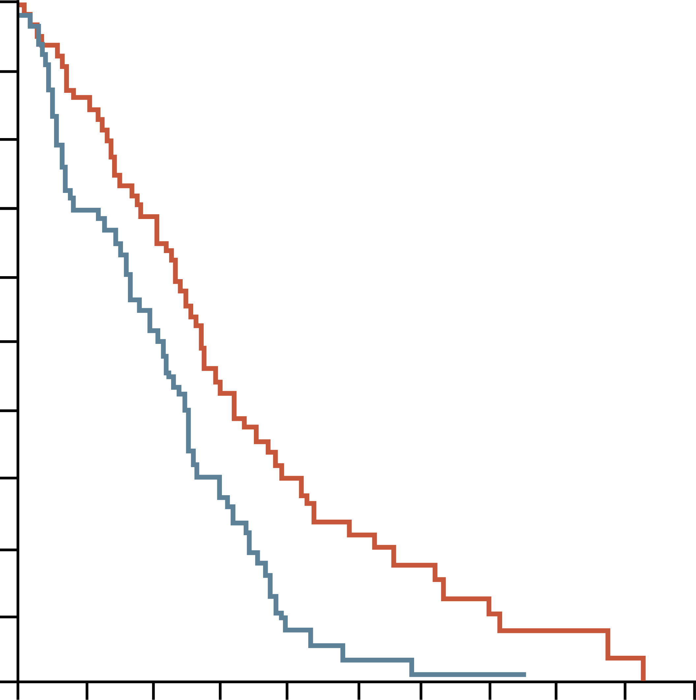
1L Gemcitabine was standard of care for many years
Gemcitabine was approved in 1996 for first-line treatment of advanced pancreatic cancer
100
 | Gemcitabine n=63, 12.7% censored | 5-FU n=63, 4.8% censored
Median survival (months) | 5.65 | 4.41
Survival duration (%) 6 months 9 months 12 months | 46 24 18 | 31 6 2
90
80
70
Clinical benefit:
23.8% gemcitabine
vs 4.8% 5-FU
60
50
Patients surviving (%)
40
30
Gemcitabine
20
Log-rank test
P=0.0025
10
5-FU
0
0
2
4
6
8
10
12
14
16
18
20
Survival time (months)
1L, first-line; 5-FU, fluorouracil
Burris HA, et al. J Clin Oncol. 1997 Jun;15(6):2403-13; Barton-Burke M. Cancer Nurs. 1999; 22: 176-83

Slide 10
PRODIGE4/ACCORD11: STUDY DESIGN
Folfirinox vs gemcitabine as 1l therapy
FOLFIRINOX (n=171)
Oxaliplatin 85 mg/m²
Irinotecan 180 mg/m²
Leucovorin 400 mg/m²
5-FU bolus 400 mg/m², then 2,400 mg/m²
infusional over 46 hours, every 2 weeks
Metastatic
Pancreatic Cancer
Gemcitabine (n=171)
1,000 mg/m² weekly × 7 of 8 (cycle 1),
then weekly × 3 of 4 (cycle 2 and subsequent cycles)
1L, first-line; 5-FU, fluorouracil; FOLFIRINOX, folinic acid (leucovorin calcium), fluorouracil, irinotecan, and oxaliplatin
Conroy T, et al. N Engl J Med. 2011;364:1817-25

Slide 11
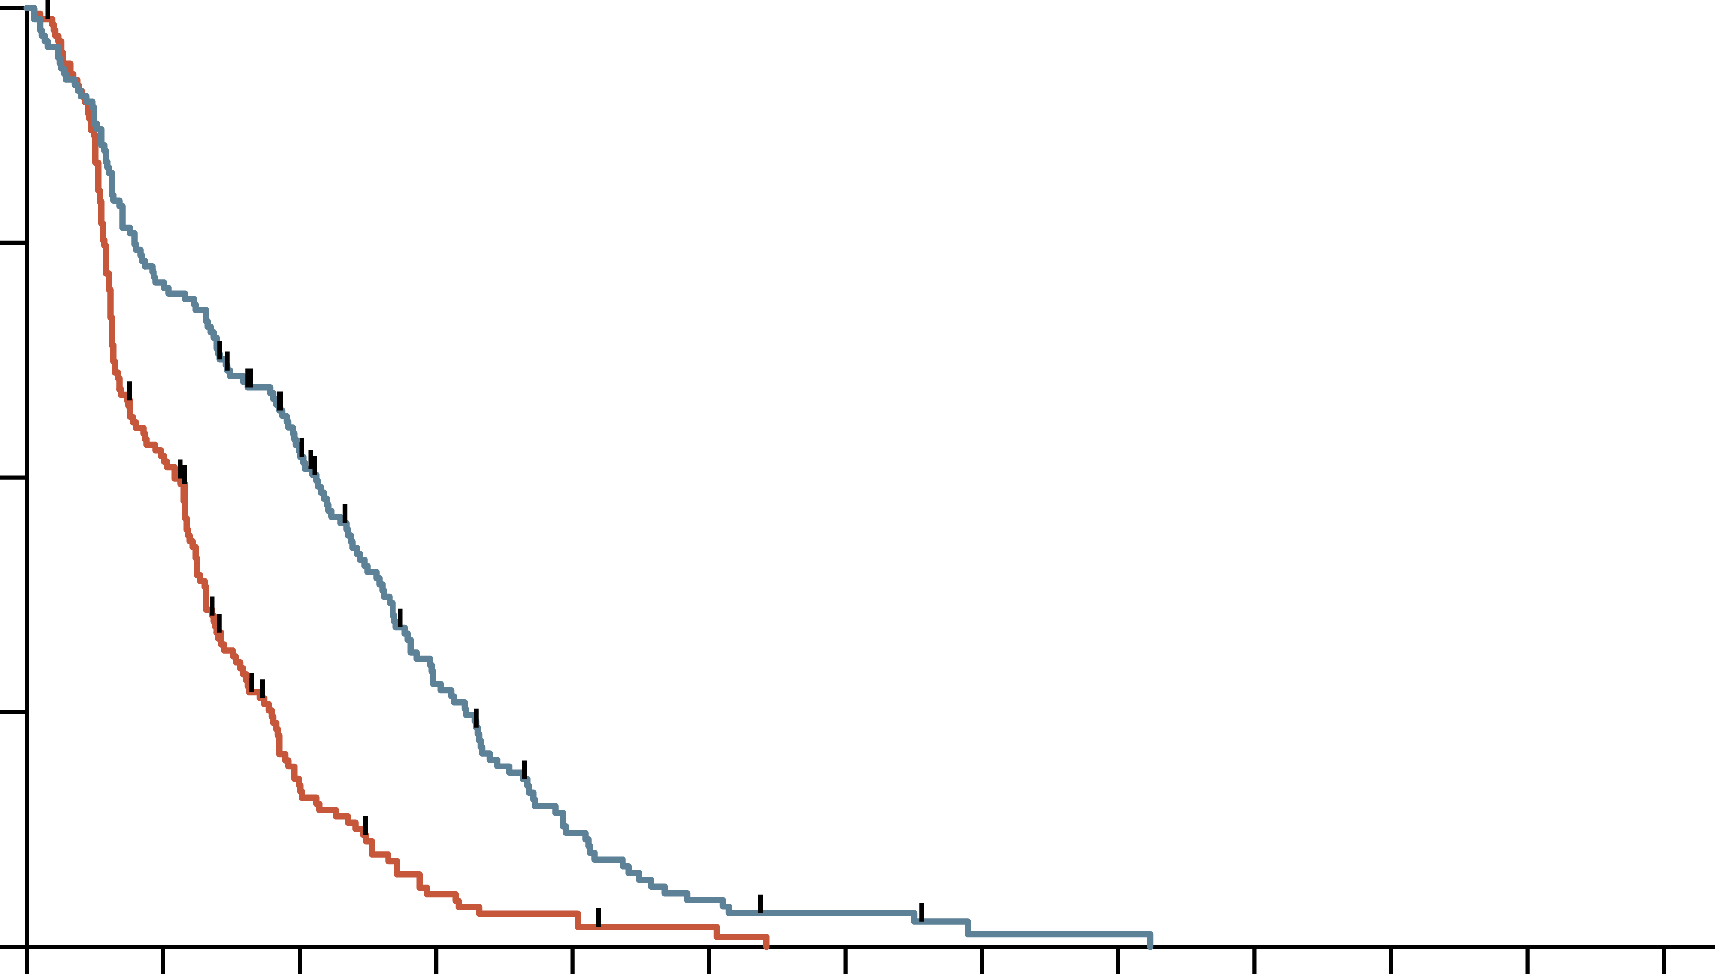
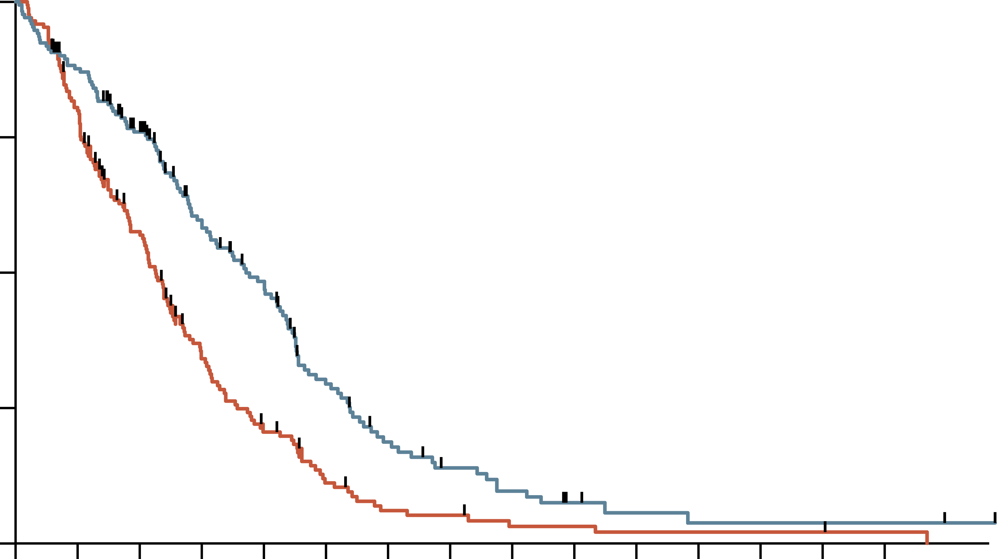
PRODIGE4/ACCORD11: FOLFIRINOX emerged as a 1l option
Progression-free survival
overall survival
100
100
Hazard ratio, 0.47 (95% CI, 0.37-0.59)
P<0.001
Hazard ratio, 0.57 (95% CI, 0.45-0.73)
P<0.001 by stratified log-rank test
75
75
Probability (%)
Probability (%)
50
FOLFIRINOX
50
FOLFIRINOX
25
25
0
Gemcitabine
0
Gemcitabine
0
3
6
9
12
15
18
21
24
27
30
33
36
0
3
6
9
12
15
18
21
24
27
30
33
36
39
42
Time (months)
Time (months)
No. at risk
Gemcitabine
FOLFIRINOX
No. at risk
Gemcitabine
FOLFIRINOX
171
171
88
121
26
85
8
42
5
17
2
7
0
4
0
1
0
1
0
0
0
0
0
0
0
0
171
171
134
146
89
116
48
81
28
62
14
34
7
20
6
13
3
9
3
5
2
3
2
2
2
2
2
2
1
2
Median PFS: 6.4 mo FOLFIRINOX vs 3.3 mo gemcitabine
Median OS: 11.1 mo FOLFIRINOX vs 6.8 mo gemcitabine
1L, first-line; CI, confidence interval; FOLFIRINOX, folinic acid (leucovorin calcium), fluorouracil, irinotecan, and oxaliplatin; mo, months; OS, overall survival; PFS, progression-free survival
Conroy T, et al. N Engl J Med. 2011;364:1817-25

Slide 12
PRODIGE4/ACCORD11: SAFETY
MOST COMMON GRADE 3 OR 4 ADVERSE EVENTS OCCURRING IN MORE THAN 5% OF PATIENTS IN THE SAFETY POPULATIONª
Event | FOLFIRINOX (N=171) | Gemcitabine (N=171) | P value
Hematologic, n/N (%)
Neutropenia | 75/164 (47.5) | 35/167 (21.0) | <0.001
Febrile neutropenia | 9/166 (5.4) | 2/169 (1.2) | 0.03
Thrombocytopenia | 15/165 (9.1) | 6/168 (3.6) | 0.04
Anaemia | 13/166 (7.8) | 10/168 (6.0) | NS
Non-hematologic, n/N (%)
Fatigue | 39/165 (23.6) | 30/169 (17.8) | NS
Vomiting | 24/166 (14.5) | 14/169 (8.3) | NS
Diarrhoea | 21/165 (12.7) | 3/169 (1.8) | <0.001
Sensory neuropathy | 15/166 (9.0) | 0/169 | <0.001
Elevated level of alanine aminotransferase | 12/165 (7.3) | 35/168 (20.8) | <0.001
Thromboembolism | 11/166 (6.6) | 7/169 (4.1) | NS
ªEvents listed are those that occurred in more than 5% of patients in either group. NS denotes not significant
FOLFIRINOX, folinic acid (leucovorin calcium), fluorouracil, irinotecan, and oxaliplatin
Conroy T, et al. N Engl J Med. 2011;364:1817-25

Slide 13
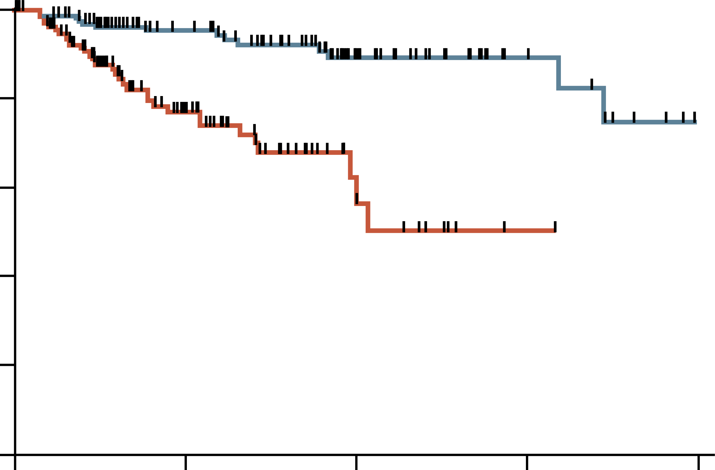
PRODIGE4/ACCORD11 trial: QOL prolonged with FOLFIRINOX
Time until definitive deterioration >20 points, EORTC-C30 global health
status/QoL questionnaire
1.0
Prolongation of QoL in patients treated with FOLFIRINOX compared to gemcitabine, despite greater toxicity – longer time to deterioration in:
  Global health score
  Physical, cognitive, and social functioning
  Symptoms such as fatigue, nausea
  and vomiting, pain, and anorexia
0.8
FOLFIRINOX
0.6
Deterioration (probability)
0.4
Gemcitabine
0.2
P<0.001
0
0
3
6
9
12
Time (months)
No. at risk
Gemcitabine
FOLFIRINOX
157
163
55
97
11
40
1
14
0
4
EORTC, European Organisation for the Research and Treatment of Cancer Core 30; FOLFIRINOX, folinic acid (leucovorin calcium), fluorouracil, irinotecan, and oxaliplatin; QoL, quality of life
Gourgou-Bourgade S, et al. J Clin Oncol. 2013;31:23-9

Slide 14
MPACT: study design
nab-paclitaxel plus gemcitabine as 1l therapy
Pancreatic cancer
(metastatic adenocarcinoma)
N=861
Gemcitabine
1,000 mg/m²
weekly × 7 of 8 (cycle 1),
then weekly × 3 of 4 (cycle 2 and subsequent cycles)
Gemcitabine
1,000 mg/m²
plus
Nab-paclitaxel 125 mg/m²
weekly × 3 of 4
1L, first-line; Nab, nanoparticle albumin-bound
Von Hoff D, et al. N Engl J Med. 2013;369:1691-703

Slide 15
MPACT: Efficacy
 | GEM + NabP (n=431) | GEM (n=430) | Hazard ratio
Overall survival, months | 8.5 | 6.7 | 0.72 (p<0.001)
One-year survival, % | 35 | 22
Progression-free survival, months | 5.5 | 3.7 | 0.69 (p<0.001)
6-month PFS, % | 44 | 25
Response rate, % | 23 | 7 | p<0.001
Median treatment duration (range), months | 3.9 (0.1-21.9) | 2.8 (0.1-21.5)
% protocol doseª Nab-paclitaxel Gemcitabine | 80.6 75.2 | – 84.6%
ªProportion of administered cumulative dose relative to the planned cumulative dose
GEM, gemcitabine; HR, hazard ratio; NabP, nanoparticle albumin-bound paclitaxel; PFS, progression-free survival
Von Hoff D, et al. N Engl J Med. 2013;369:1691-703

Slide 16
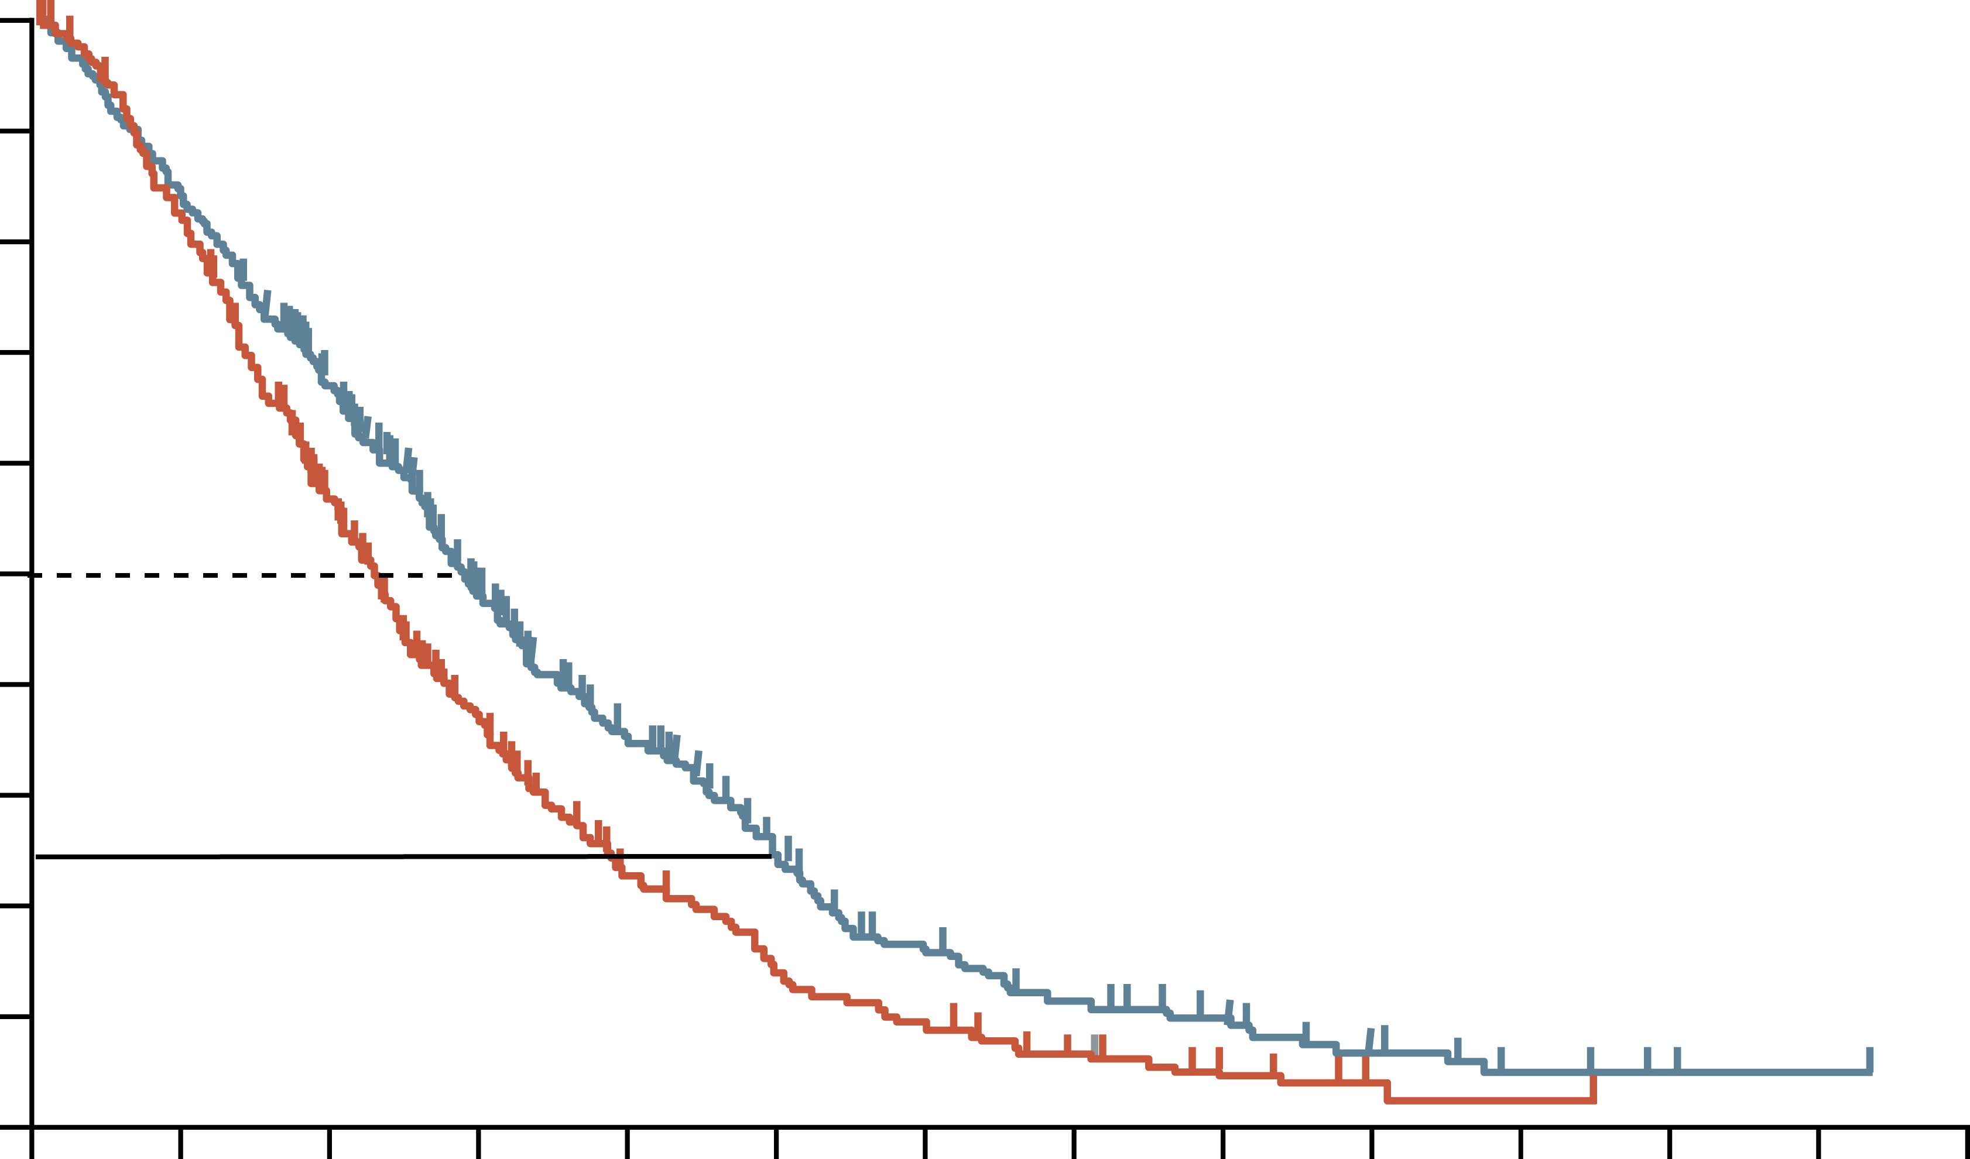
MPACT: the addition of Nabp to gem improves
Overall Survival
100
90
Hazard ratio for death, 0.72 (95% CI, 0.62-0.83)
P<0.001 by stratified log-rank test
80
70
60
Patients who were alive (%)
50
40
GEM + NabP
30
20
10
GEM
0
0
3
6
9
12
15
18
21
24
27
30
33
36
39
Time (months)
No. at risk
GEM + NabP
GEM
431
430
357
340
269
220
169
124
108
69
67
40
40
26
27
15
16
7
9
3
4
1
1
0
1
0
0
0
CI, confidence interval; GEM, gemcitabine; HR, hazard ratio; NabP, nanoparticle albumin-bound paclitaxel
Von Hoff D, et al. N Engl J Med. 2013;369:1691-703

Slide 17
MPACT: Pre-specified subgroup analysis
Overall Survival
Subgroup | GEM + NabP | GEM | Hazard Ratio for death (95% CI)
 | No. of events/no. of patients
All patients | 333/431 | 359/430 |  | 0.72 (0.62-0.83)
Age
<65 yr | 188/254 | 209/242 |  | 0.65 (0.53-0.79)
≥65 yr | 145/177 | 150/188 |  | 0.81 (0.63-1.03)
Sex
Female | 138/186 | 141/173 |  | 0.72 (0.57-0.93)
Male | 195/245 | 218/257 |  | 0.72 (0.59-0.88)
Karnofsky performance-status score
70-80 | 142/179 | 146/161 |  | 0.61 (0.48-0.78)
90-100 | 187/248 | 212/268 |  | 0.75 (0.62-0.92)
Primary tumour location
Head | 142/191 | 155/180 |  | 0.59 (0.46-0.75)
Other | 188/237 | 201/246 |  | 0.80 (0.65-0.98)
Liver metastases
Yes | 290/365 | 309/360 |  | 0.69 (0.59-0.81)
No | 43/66 | 50/70 |  | 0.86 (0.56-1.33)
No. of metastatic sites
1 | 21/33 | 16/21 |  | 0.41 (0.19-0.88)
2 | 159/202 | 163/206 |  | 0.75 (0.60-0.95)
3 | 104/136 | 121/140 |  | 0.79 (0.61-1.04)
>3 | 49/60 | 59/63 |  | 0.50 (0.33-0.76)
Level of CA19-9
Normal | 47/60 | 43/56 |  | 1.07 (0.69-1.66)
<59x ULN | 96/122 | 95/120 |  | 0.83 (0.61-1.12)
≥59x ULN | 151/197 | 171/195 |  | 0.61 (0.48-0.77)
Region
Australia | 50/61 | 53/59 |  | 0.67 (0.44-1.01)
Eastern Europe | 62/64 | 59/62 |  | 0.84 (0.58-1.23)
Western Europe | 14/38 | 17/38 |  | 0.72 (0.35-1.47)
North America | 207/268 | 230/271 |  | 0.68 (0.56-0.82)
0.125
0.25
0.50
1.00
2.00
GEM + NabP Better
GEM Better
CA19-9, carbohydrate antigen 19-9; CI, confidence interval; GEM, gemcitabine; NabP, nanoparticle albumin-bound paclitaxel; ULN, upper limit of normal; yr, year
Von Hoff D, et al. N Engl J Med. 2013;369:1691-703

Slide 18
MPACT: Safety
Preferred Term | GEM + NabP (n=421) | GEM (n=402)
Grade ≥3 Hematologic AEª, % Neutropenia Leukopenia Thrombocytopenia Anaemia | 38 31 13 13 | 27 16 9 12
Patients who received growth factors, % | 26 | 15
Febrile Neutropenia,^{b} % | 3 | 1
Grade ≥3 Non-hematologic AE^{b} in >5% patients, % Fatigue Peripheral Neuropathy^{c} Diarrhoea | 17 17 6 | 7 <1 <1
Grade ≥3 Neuropathy Median time to Onset, median days Median time to Improvement by 1 Grade, median days Median time to Improvement to Grade ≤1, median days Patients who resumed NabP, % | 140 21 29 44 | 113 29 NR NA
GEM + NabP group:
  High levels of neutropenia, and thrombocytopenia
  Significant percentage of patients with peripheral neuropathy
ª Based on lab values; ^{b} Based on investigator assessment of treatment-related events; ^{c} grouped term
AE, adverse event; GEM, gemcitabine; NabP, nanoparticle albumin-bound paclitaxel; NA, not applicable; NR, not reached
Von Hoff D, et al. N Engl J Med. 2013;369:1691-703
18
Notes:
18

Slide 19
Modified Gemcitabine plus Nab-paclitaxel
A modified regimen of biweekly mGEM + NabP in metastatic pancreatic cancer patients is tolerable and effective
Variable | mGEM + NabP | MPACT trial
Median PFS, months | 5.4, N=57 | 5.5, N=431
Median OS, months | 10, N=57 | 8.5, N=431
Grade 3 or 4 toxicity, hematological, n/N(%)
Anaemia | 8/57 (14%) | 53/405 (13%)
Neutropenia | 11/57 (19%) | 153/405 (38%)
Thrombocytopenia | 1/57 (2%) | 52/405 (13%)
Growth factor support | 7/57 (12%) | 110/431 (26%)
Grade 3 or 4 neurotoxicity | 1/57 (2%) | 70/421 (17%)
Dose reduction, (%): Nab-paclitaxel Gemcitabine | 20% 16% | 41% 47%
mGEM + NabP, modified regimen of gemcitabine and nanoparticle albumin-bound paclitaxel; OS, overall survival; PFS, progression-free survival
Ahn D, et al. Therapeutic Advances in Medical Oncology 2017; 9(2):75-8

Slide 20
two-week low dose GEM-NabP dosing manages toxicity and maintains efficacy
Outcome | First-line GEM + NabP efficacy
Median OS (95% CI), mo | 7.5 (6.51-10.33)
Median OS (95% CI) stratified by ECOG PS, mo
0 | 12.7 (8.49-18.49)
1 | 9.6 (6.48-12.04)
2 | 5.3 (4.41-10.2)
3 | 1.6 (NE)
 | P value <0.0001
Median PFS (95% CI), mo | 2.8 (2.3-3.68)
Median PFS (95% CI) stratified by ECOG PS, mo
0 | 5.3 (2.73-9.11)
1 | 2.8 (2.24-4.34)
2 | 1.8 (1.41-3.59)
3 | 1.4 (NE)
 | P value = 0.0072
Outcome | Second-line GEM + NabP efficacy
Median OS (95% CI), mo | 7.6 (6.12-8.26)
Median OS (95% CI) stratified by ECOG PS, mo
0 | 8 (6.22-12.99)
1 | 7.3 (5.33-9.14)
2 | 6.1 (4.61 - NE)
 | P value = 0.581
Median PFS (95% CI), mo | 2.5 (2.14-3.85)
Median PFS (95% CI) stratified by ECOG PS, mo
0 | 3.5 (2.07-7.24)
1 | 2.4 (2.07-2.99)
2 | 2.6 (1.74 - NE)
 | P value = 0.362
Median dosing was 600 mg/m² at fixed dose rate for GEM and 125 mg/m² for NabP given predominantly (~90%) every two weeks
CI, confidence interval; ECOG PS, Eastern Cooperative Oncology Group Performance Status; GEM-NabP, gemcitabine + nanoparticle albumin-bound paclitaxel; mo, months; NE, not estimable; OS, overall survival; PFS, progression-free survival
Rogers J, et al. Cancer Med. 2020;9:5406-15

Slide 21
NAPOLI-3: Study design
A randomised, open-label phase 3 study of liposomal irinotecan +
5-fluorouracil/leucovorin + oxaliplatin (NALIRIFOX) versus gemcitabine + Nab-paclitaxel in treatment-naïve patients with metastatic pancreatic ductal adenocarcinoma
Lower dose of oxaliplatin and liposomal irinotecan than FOLFIRINOX
Primary endpoint: OS
Secondary endpoints: PFS, ORR
Exploratory endpoints: QOL, biomarker analyses
Key inclusion criteria
Aged ≥18 years
Confirmed PDAC not previously treated in the metastatic setting
Metastatic disease diagnosed
≤6 weeks prior to screening
≥1 metastatic lesions measurable by CT/MRI according to RECIST v1.1
ECOG PS 0 or 1
NALIRIFOX
Liposomal irinotecan 50 mg/m^{2a}
+ 5-FU 2400 mg/m²
+ LV 400 mg/m²
+ oxaliplatin 60 mg/m²
Days 1 and 15 of a 28-day cycle^{b}
Tumour assessment every
8 weeks per RECIST v1.1^{c}
Treatment until disease progression, unacceptable toxicity or study withdrawal
AEs recorded and coded using MedDRA (v24.0); severity graded by NCI-CTCAE (v5.0)
Follow-up every 8 weeks until death or study end^{d}
R
1:1
GEM + NabP
GEM 1000 mg/m²
+ NabP 125 mg/m²
Days 1, 8 and 15 of a 28-day cycle
Stratification
ECOG PS 0/1
Region
Liver metastases
ª Dose expressed as irinotecan free base equivalent; ^{b} Administered sequentially as a continuous infusion over 46 hours beginning on days 1 and 15 of a 28-day cycle (dose delays and oxaliplatin discontinuation were permitted); ^{c} Until progressive disease; ^{d} The study was completed once all patients had discontinued the study treatment and at least 543 events had occurred in randomised patients
5-FU, fluorouracil; AE, adverse event; CT, computed tomography; ECOG PS, Eastern Cooperative Oncology Group performance status; FOLFIRINOX, folinic acid (leucovorin calcium), fluorouracil, irinotecan, and oxaliplatin; GEM, gemcitabine; LV, leucovorin calcium (folinic acid); MedDRA, Medical Dictionary for Regulatory Activities; MRI magnetic resonance imaging; NabP, nanoparticle albumin-bound paclitaxel; Nal-IRI, nanoliposomal irinotecan; NALIRIFOX; Nal-IRI, fluorouracil/folinic acid (leucovorin calcium), and oxaliplatin; NCI-CTCAE, National Cancer Institute Common Terminology Criteria for Adverse Events; ORR, objective response rate; OS, overall survival; PDAC, pancreatic ductal adenocarcinoma; PFS, progression-free survival; QoL, quality of life; R, randomisation; RECIST, Response Evaluation Criteria in Solid Tumours
O’Reilly E, et al. J. Clin Oncol. 2023;41;16_suppl:4006 (ASCO 2023 oral presentation); Jung K, et al. Ther Adv Med Oncol 2023; 15: 1-15

Slide 22
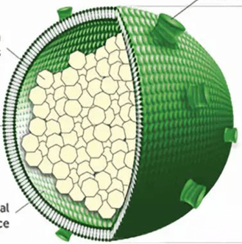
How is Nanoliposomal irinotecan (Nal-iri) different to irinotecan?
Liposomal irinotecan⁵
Nanoliposomal irinotecan: irinotecan encapsulated in liposome nanoparticles¹
Liposome shelters irinotecan from
conversion to its active metabolite
(SN-38) thereby remaining in the circulation for longer than free (unencapsulated) irinotecan¹⁻³
Leads to increases and prolonged intratumoural levels of both irinotecan and SN-38 compared with free irinotecan¹
Median OS of 5·2 months for Nal-IRI in a phase 2 study of gemcitabine-refractory metastatic pancreatic cancer^{1,4}
PEG-DSPE
~80,000 irinotecan
salt molecules
Lipid
membrane
~110nm
Internal
aqueous space
Nal-IRI, nanoliposomal irinotecan; OS, overall survival; PEG-DSPE, polyethylene glycol-distearoylphosphatidylethanolamine
1. Wang-Gillam A, et al. Lancet 2016;387:545-57; 2. Kalra AV, et al. Cancer Res. 2014;74:7003-13; 3. Roy AC, et al. Ann Oncol. 2013;24: 1567-73;
4. Ko AH, et al. Br J Cancer. 2013;109:920-25; 5. Image: Camptothecin & Its Derivatives for Cancer Therapy | Biopharma PEG. Available at: https://www.biochempeg.com/article/310.html. Accessed July 2024

Slide 23
NAPOLI-3: baseline characteristics
 | NALIRIFOX (n=383) | GEM + NabP (n=387)
Age, years Mean (SD) Median (range; IQR) | 62.8 (9.7) 64.0 (20-85; 57-70) | 64.0 (8.3) 65.0 (36.82; 59-70)
Sex, n (%) Female Male | 179 (47%) 204 (53%) | 157 (41%) 230 (59%)
Race, n (%) White Asian Black or African American Other Multiple American Indian or Alaska Native Native Hawaiian or other Pacific Islander Not reported | 315 (82%) 20 (5%) 12 (3%) 7 (2%) 3 (1%) 0 0 26 (7%) | 324 (84%) 18 (5%) 7 (2%) 6 (2%) 0 2 (1%) 1 (<1%) 29 (7%)
ECOG performance status score, n (%) 0 1 2 | 160 (42%) 222 (58%) 1 (<1%)ª | 168 (43%) 219 (57%) 0
Metastatic sites, n (%) 1 2 ≥3 | 114 (30%) 120 (31%) 149 (39%) | 138 (36%) 108 (28%) 141 (36%)
Liver metastases, n (%) | 307 (80%) | 311 (80%)
 | NALIRIFOX (n=383) | GEM + NabP (n=387)
Geographical region, n (%) North America East Asia Rest of world | 120 (31%) 11 (3%) 252 (66%) | 122 (32%) 11 (3%) 254 (66%)
Main pancreatic tumour location, n (%) Head Other^{b} | 147 (38%) 236 (62%) | 156 940%) 231 (60%)
Baseline CA 19-9^{c} <37 U/mL, n (%) ≥37 U/mL, n (%) Median (range; IQR), U/mL | 60 (16%) 321 (84%) 1856.0 (0.6-8000.0; 178.0-8000.0) | 71 (18%) 316 (82%) 1544.0 (0.6-8000.0; 93.7-8000.0)
Any previous anti-cancer therapy, n (%) Chemotherapy Radiotherapy Surgical procedure | 22 (6%) 14 (4%) 10 (3%) 18 (5%) | 27 (7%) 16 (4%) 6 (2%) 25 (7%)
Time from diagnosis of metastatic disease at study entry to randomisation, weeks Mean (SD) Median (range; IQR) | 3.6 (2%) 3.0 (0.6-9.1; 2.1-4.7) | 3.9 (2%) 3.6 (0.4-10.9; 2.4-5.1)
Data are based on the intention-to-treat population.
ª One patient was considered to have an ECOG performance status score of 2 after randomisation and continued to receive treatment.
^{b} Body, tail, or unknown location.
^{c} Baseline values were missing for two patients (1%) in the NALIRIFOX arm. The upper limit of detection was 8000 U/mL.
CA 19-9, carbohydrate antigen 19-9; ECOG, Eastern Cooperative Oncology Group; GEM, gemcitabine; IQR, inter-quartile range; NabP, nanoparticle albumin-bound paclitaxel; Nal-IRI, nanoliposomal irinotecan; NALIRIFOX; Nal-IRI, fluorouracil/folinic acid (leucovorin calcium), and oxaliplatin; SD, standard deviation
Wainberg Z, et al. Lancet 2023;402:1272-81

Slide 24
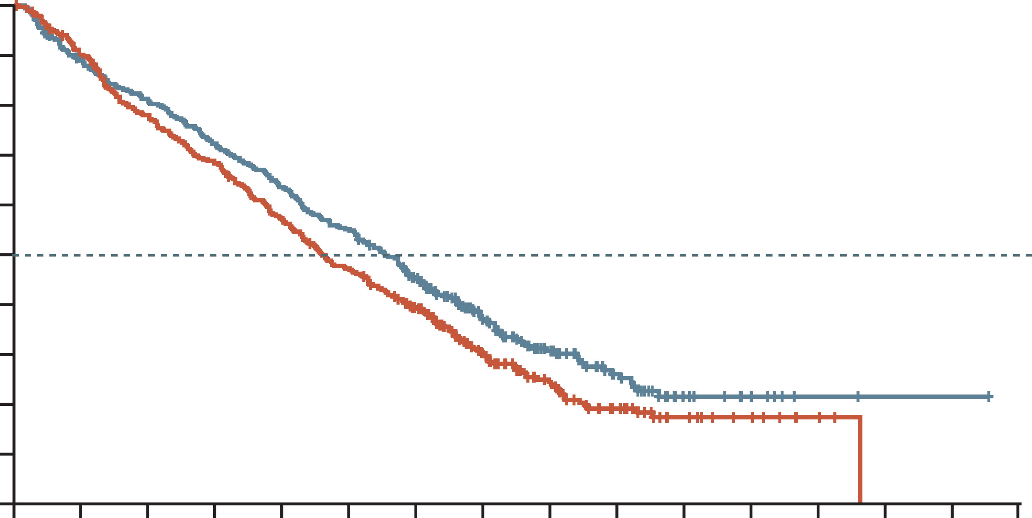
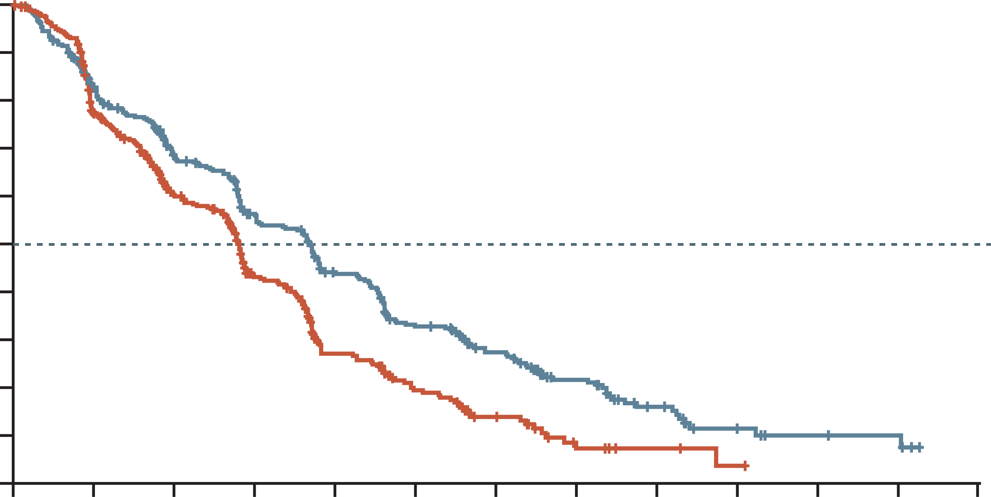
Napoli-3: nalirifox more effective than nabp/gem
OVERALL SURVIVAL
Progression-free SURVIVAL
 | NALIRIFOX | GEM + NabP
Median (95% CI), mo | 11.1 (10.0-12.1) | 9.2 (8.3-10.6)
Hazard ratio (95% CI) | 0.83 (0.70-0.99)
P value | 0.036
 | NALIRIFOX | GEM + NabP
Median (95% CI), mo | 7.4 (6.0-7.7) | 5.6 (5.3-5.8)
Hazard ratio (95% CI) | 0.69 (0.58-0.83)
P value | P<0.0001
100
100
90
90
80
80
70
70
60
60
Overall survival (%)
Progression-free
survival (%)
50
50
40
40
30
30
20
20
10
10
0
0
2
4
6
8
10
12
14
16
18
20
22
24
26
28
30
0
0
2
4
6
8
10
12
14
16
18
20
22
24
Number at risk
(number censored)
NALIRIFOX
GEM + NabP
Time (months)
Number at risk
(number censored)
NALIRIFOX
GEM + NabP
Time (months)
383
(0)
387
(0)
337
(4)
345
(4)
308
(4)
298
(5)
274
(4)
261
(5)
241
(4)
218
(6)
209
(4)
179
(7)
162
(15)
140
(17)
98
(53)
80
(48)
59
(77)
50
(65)
32
(97)
28
(77)
13
(111)
15
(88)
7
(117)
10
(93)
2
(122)
3
(100)
1
(123)
0
(102)
1
(123)
0
(102)
0
(124)
0
(102)
383
(0)
387
(0)
271
(52)
267
(40)
210
(68)
182
(68)
164
(77)
112
(89)
122
(84)
60
(102)
87
(88)
38
(108)
61
(101)
19
(117)
39
(111)
6
(123)
20
(121)
3
(126)
9
(127)
1
(127)
5
(130)
0
(128)
4
(131)
0
(128)
0
(134)
0
(128)
CI, confidence interval; GEM, gemcitabine; mo, months; NabP, nanoparticle albumin-bound paclitaxel; Nal-IRI, nanoliposomal irinotecan; NALIRIFOX; Nal-IRI, fluorouracil/folinic acid (leucovorin calcium), and oxaliplatin
Wainberg Z, et al. Lancet 2023;402:1272-81

Slide 25
NAPOLI-3: OS subgroup analyses (ITT population)
 | Events/patients |  | NALIRIFOX, median (months) | GEM + NabP, median (months) |  | Hazard ratio (95% CI)
Age | NALIRIFOX | GEM + NabP
Presence of liver metastases at baseline
Yes | 220/309 | 242/309 | 10.3 | 8.6 |  | 0.82 (0.68-0.98)
No | 39/74 | 43/78 | 15.0 | 13.8 |  | 0.89 (0.57-1.37)
Number of metastatic sites
1 | 75/114 | 92/138 | 11.5 | 11.3 |  | 0.98 (0.72-1.32)
2 | 87/120 | 83/108 | 11.5 | 10.1 |  | 0.89 (0.65-1.20)
≥3 | 97/149 | 110/141 | 10.9 | 7.7 |  | 0.69 (0.52-0.90)
Baseline ECOG performance status
0 | 97/168 | 112/171 | 13.9 | 11.4 |  | 0.75 (0.57-0.98)
1 | 162/215 | 173/216 | 8.5 | 7.6 |  | 0.91 (0.73-1.13)
Region
North America | 85/120 | 94/122 | 11.2 | 9.1 |  | 0.79 (0.59-1.06)
Rest of the world | 174/263 | 191/265 | 11.1 | 9.3 |  | 0.86 (0.70-1.05)
Main pancreatic tumour location
Head | 97/147 | 116/156 | 10.2 | 9.1 |  | 0.86 (0.65-1.12)
Other | 162/236 | 169/231 | 11.7 | 9.2 |  | 0.83 (0.67-1.02)
Baseline CA 19-9
<37 U/mL | 34/60 | 45/71 | 13.2 | 10.9 |  | 0.75 (0.48-1.17)
≥37 U/mL | 223/321 | 240/316 | 11.1 | 9.1 |  | 0.84 (0.70-1.01)
Race
White | 218/315 | 240/324 | 10.7 | 9.0 |  | 0.84 (0.70-1.01)
Sex
Male | 139/204 | 175/230 | 10.9 | 9.0 |  | 0.82 (0.66-1.02)
Female | 120/179 | 110/157 | 11.6 | 9.5 |  | 0.88 (0.68-1.14)
Age, years
<65 | 127/193 | 130/191 | 11.5 | 9.9 |  | 0.92 (0.72-1.17)
≥65 | 132/190 | 155/196 | 11.0 | 9.0 |  | 0.77 (0.61-0.97)
Overall | 259/383 | 285/387 | 11.1 | 9.2 |  | 0.83 (0.70-0.99)
0
0.5
1.0
1.5
2.0
NALIRIFOX Better
GEM + NabP Better
CA19-9, carbohydrate antigen 19-9; CI, confidence interval; ECOG, Eastern Cooperative Oncology Group; GEM, gemcitabine; ITT, intention-to-treat; NabP, nanoparticle albumin-bound paclitaxel; Nal-IRI, nanoliposomal irinotecan; NALIRIFOX; Nal-IRI, fluorouracil/folinic acid (leucovorin calcium), and oxaliplatin; OS, overall survival
Wainberg Z, et al. Lancet 2023;402:1272-81

Slide 26
NAPOLI-3: RESULTS
Tumour response
 | NALIRIFOX (N=383) | GEM + NabP (N=387)
Objective response rate (95% CI), % | 41.8 (36.8-46.9) | 36.2 (31.4-41.2)
Best overall response, % Complete response Partial response Stable disease Progressive disease Not evaluable | 0.3 41.5 25.8 9.9 22.5 | 0.3 35.9 26.1 14.5 23.3
Disease control rate, % | 67.6 | 62.3
Median duration of response (95% CI), months | 7.3 (5.8-7.6) | 5.0 (3.8-5.6)
Subsequent anti-cancer treatment
 | NALIRIFOX (N=370) | GEM + NabP (N=379)
Any further subsequent anti-cancer therapy, % Systemic anti-neoplastic therapy Surgery Radiotherapy | 50.5 50.5 0.3 0.5 | 54.4 54.1 0.5 1.1
CI, confidence interval; GEM, gemcitabine; NabP, nanoparticle albumin-bound paclitaxel; Nal-IRI, nanoliposomal irinotecan; NALIRIFOX; Nal-IRI, fluorouracil/folinic acid (leucovorin calcium), and oxaliplatin
Wainberg Z, et al. Lancet. 2023;402:1272-81 (appendix); O’Reilly E, et al. J. Clin Oncol. 2023;41;16_suppl:4006 (ASCO 2023 oral presentation)

Slide 27
Napoli-3: overall summary of adverse events
 | NALIRIFOX (N=370) | GEM + NabP (N=379)
Median duration of treatment (range; IQR), weeks | 24.3 (0.4-100.9; 8.4-42.1) | 17.6 90.7-81.7; 8.1-30.1)
Median number of treatment cycles (range; IQR) | 5.0 (1-24; 2-10) | 4.0 (1-20; 2-7)
Any dose reductions, n (%) | 220 (60%) | 204 (54%)
TEAEs, n (%)
Any TEAE | 369 (≥99%) | 376 (99%)
Any treatment-related TEAE | 352 (95%) | 352 (93%)
Grade ≥3 TEAE | 322 (87%) | 326 (86%)
Grade ≥3 treatment-related TEAE | 262 (71%) | 258 (68%)
Any TEAE leading to discontinuation | 118 (32%) | 112 (30%)
Any treatment-related TEAE leading to discontinuation | 94 (25%) | 88 (23%)
Any TEAE leading to dose reduction | 208 (56%) | 190 (50%)
Any treatment-related TEAE leading to dose reduction | 198 (54%) | 184 (49%)
Any serious TEAEs | 201 (54%) | 195 (52%)
Any treatment-related serious TEAEs | 98 (27%) | 72 (19%)
TEAEs leading to death | 22 (6%) | 23 (6%)
Treatment-related TEAEs leading to death | 6 (2%) | 8 (2%)
GEM, gemcitabine; NabP, nanoparticle albumin-bound paclitaxel; Nal-IRI, nanoliposomal irinotecan; NALIRIFOX; Nal-IRI, fluorouracil/folinic acid (leucovorin calcium), and oxaliplatin; TEAE, treatment emergent adverse events
Wainberg Z, et al. Lancet. 2023;402:1272-81

Slide 28
NAPOLI-3: overview of TEAEs in safety population
More hematologic toxicity observed with GEM + NabP
More diarrhoea, nausea, and vomiting observed with NALIRIFOX
TEAEs of grade 3-4 occurring in ≥5% of patients in either treatment arm | NALIRIFOX (N=370) | GEM + NabP (N=379)
Diarrhoea | 75 (20%) | 17 (5%)
Nausea | 44 (12%) | 10 (3%)
Vomiting | 26 (7%) | 8 (2%)
Decreased appetite | 32 (9%) | 10 (3%)
Hypokalaemia | 56 (15%) | 15 (4%)
Fatigue | 23 (6%) | 20 (5%)
Asthenia | 33 (9%) | 19 (5%)
Neutropenia | 52 (14%) | 93 (25%)
Neutrophil count decreased | 36 (10%) | 51 (14%)
Anaemia | 39 (11%) | 66 (17%)
Peripheral neuropathy | 12 (3%) | 22 (6%)
Increased 𝛾-glutamyltransferase | 23 (6%) | 21 (6%)
Data are median (range; IQR) or n (%)
GEM, gemcitabine; NabP, nanoparticle albumin-bound paclitaxel; Nal-IRI, nanoliposomal irinotecan; NALIRIFOX; Nal-IRI, fluorouracil/folinic acid
(leucovorin calcium), and oxaliplatin; TEAE, treatment-emergent adverse event
Wainberg Z, et al. Lancet. 2023;402:1272-81

Slide 29
Summary of Efficacy and safety of NALIRIFOX and FOLFIRINOX
 | NALIRIFOX¹ N=370 | FOLFIRINOX² N=171
Efficacy Results
Median OS, months | 11.1 | 11.1
OS at 12 months, % | 45.6 | 48.4
OS at 18 months, % | 26.2 | 18.6
Median PFS, months | 7.4 | 6.4
ORR, % | 41.8 | 31.6
Safety Results
Grade 3-4 diarrhoea, % | 20.3 | 12.7
Grade 3-4 vomiting, % | 7.0 | 14.5
Grade 3-4 neuropathy, % | 3.2 | 9.0
Grade 3-4 neutropenia, % | 14.1 | 45.7
Data presented for information purposes. Cross-trial comparison is not intended
FOLFIRINOX, folinic acid (leucovorin calcium), fluorouracil, irinotecan, and oxaliplatin; Nal-IRI, nanoliposomal irinotecan; NALIRIFOX; Nal-IRI, fluorouracil/folinic acid (leucovorin calcium), and oxaliplatin; ORR, objective response rate; OS, overall survival; PFS, progression-free survival
1. Wainberg Z, et al. Lancet 2023; 402:1272-81; 2. Conroy T, et al. N Engl J Med. 2011;364:1817-25

Slide 30
Managing vulnerable patients during first-line treatment

Slide 31
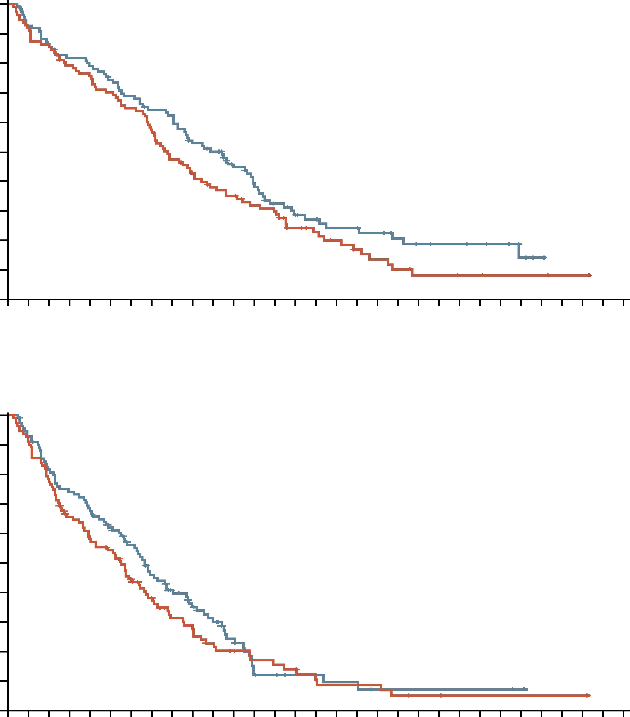
Gem + NabP is effective for patients with a Poor
Performance Status
1.0
0.9
Arm
B
D
B, censored
D, censored
0.8
0.7
0.6
Cumulative OS (probability)
0.5
Patients enrolled and
randomly assigned
(n=221)
0.4
0.3
0.2
0.1
Assigned to arm B
(NabP 100 mg/m² +
GEM 1000 mg/m²; n=111)
Assigned to arm D
(NabP 125 mg/m² +
GEM 1000 mg/m²; n=110)
0
0
1
2
3
4
5
6
7
8
9
10
11
12
13
14
15
16
17
18
19
20
21
22
23
24
25
26
27
28
29
30
No. at risk
Arm B
Arm D
Follow-up time (months)
110
109
101
101
95
93
86
88
82
85
76
79
70
73
62
67
51
65
44
54
38
50
35
40
29
33
27
25
19
20
15
18
12
18
9
15
7
13
5
10
4
8
3
8
3
7
2
6
2
5
2
2
1
0
1
1
0
Schedule 3 weeks on 1 week off
Median age 71 and 68 (range 35-89)
mPFS 5.4 vs 6.6 months (P=0.28)
Free of disease progression at 6 months: 44% vs 58%
mOS 7.7m vs 9.8m (P=0.11)
No significant differences in AEs between the two
dose regimens
1.0
0.9
Arm
B
D
B, censored
D, censored
0.8
0.7
0.6
Cumulative PFS (probability)
0.5
0.4
0.3
0.2
0.1
0
0
1
2
3
4
5
6
7
8
9
10
11
12
13
14
15
16
17
18
19
20
21
22
23
24
25
26
27
28
29
30
No. at risk
Arm B
Arm D
Follow-up time (months)
111
110
100
100
85
87
69
79
61
72
56
64
43
55
35
44
25
36
22
29
17
23
14
16
10
7
9
7
8
6
6
4
5
4
5
3
4
2
3
2
2
2
1
2
1
2
1
2
1
1
1
1
1
0
1
1
0
AEs, adverse events; GEM, gemcitabine; (m)OS, (median) overall survival;
(m)PFS, (median) progression-free survival; NabP, nanoparticle albumin-bound paclitaxel
Maccarulla T, et al. J Clin Oncol. 2019;37:230-238

Slide 32

EA2186 (GIANT) – Study Design
Study designed to determine whether elderly patients gain benefit from chemotherapy
Fit
No GA abnormalities
Standard of care treatment off study
Study patients
Untreated metastatic pancreatic
cancer
Age ≥70
ECOG PS: 0-2
Stratification
ECOG PS
0-1 vs 2
Age 70-74
vs ≥75
Arm A
(control): Modified Gemcitabine + Nab-Paclitaxel every 2 weeks
Disease evaluation + repeat modified GA + QOL assessment every 8 weeks
Treatment until disease progression or intolerance
Vulnerable
Mild-moderate GA abnormalities
Complete Geriatric & Quality of Life (QOL) Assessment
Screening Geriatric Assessment (GA)
1:1 Randomisation
Arm B (experimental): Dose-reduced 5-FU, leucovorin + liposomal irinotecan
every 2 weeks
Frail
Severe GA abnormalities
Supportive care off study
Primary Endpoint: Overall Survival (OS)
Key Secondary Endpoints: Progression Free Survival (PFS), Objective Response Rate (ORR)
Additional Secondary Endpoints: QOL, Toxicities of Interest to Older Adults
5-FU, fluorouracil; ECOG PS, Eastern Cooperative Oncology Group performance status; Nab, nanoparticle albumin-bound; ORR, objective response rate; OS, overall survival; PFS, progression-free survival
Dotan E, et al. J Clin Oncol. 2024;42(16_suppl):4003 (oral presentation)

Slide 33
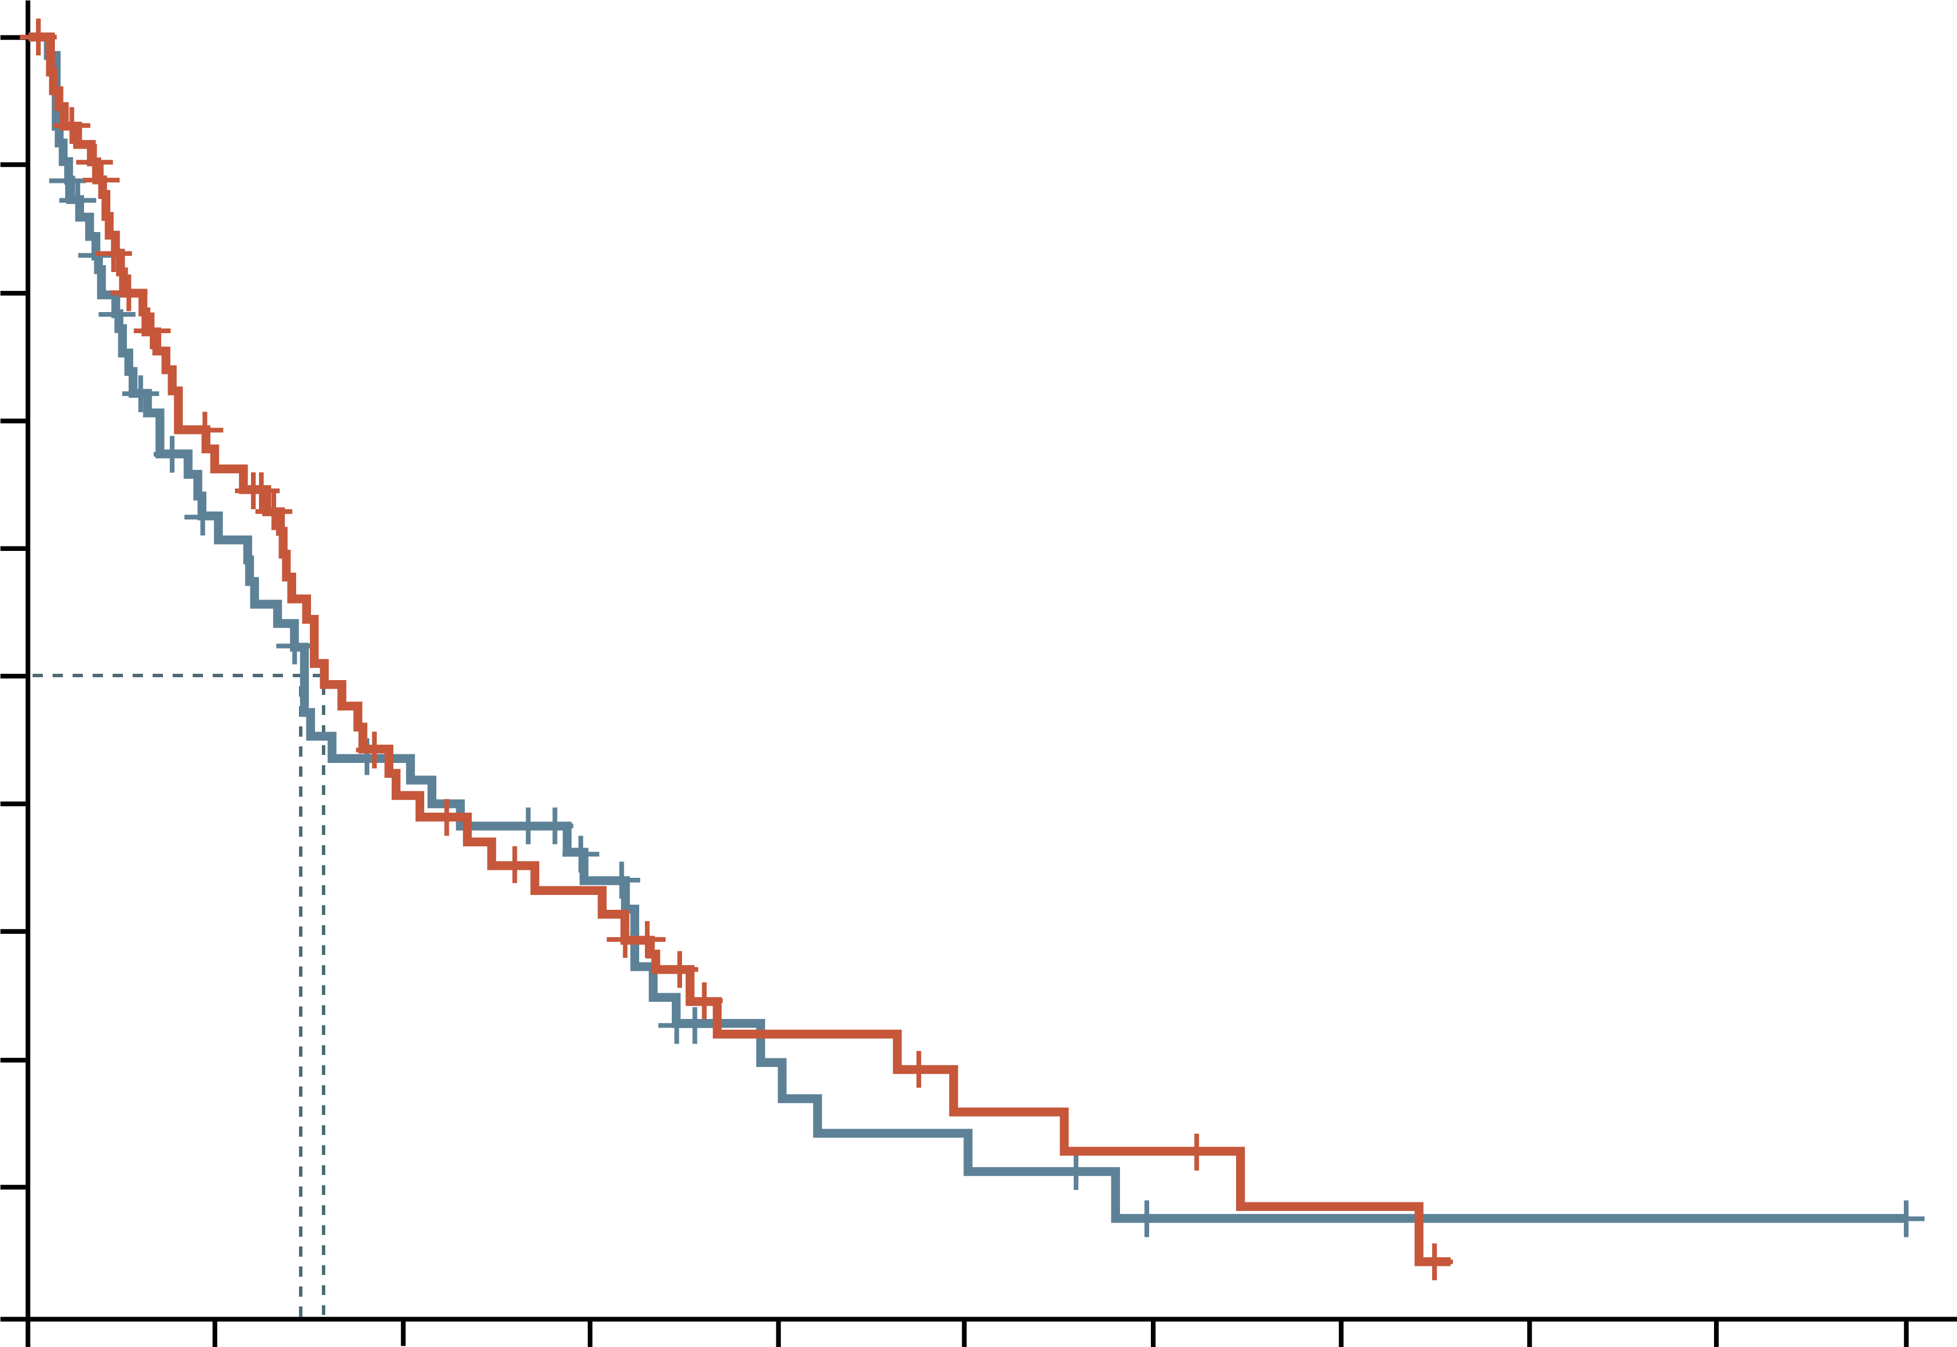
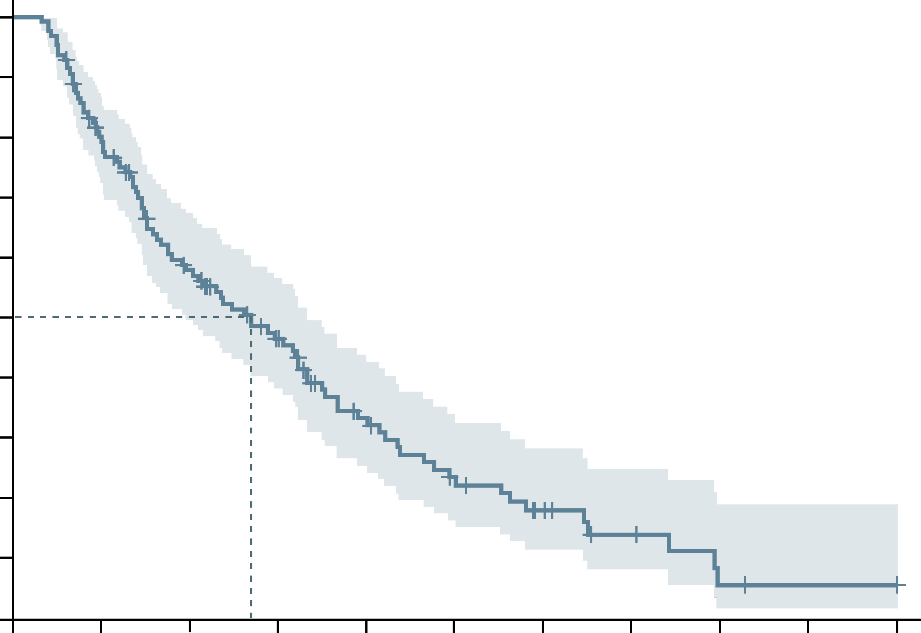
Elderly patients benefit from Dose reduced chemotherapy
Primary endpoint OS – ITT
OS analysis of patients who received ≥ 4 weeks of treatment
100
GEM + NabP mOS: 4.7 months (95% CI: 4.1-7.4)
5FU/LI mOS: 4.4 months (95% CI: 3.1-8.9)
HR: 1.12 (0.76-1.66)
P=0.72
100
Events/Total: 90/27
mOS: 8.0 months (95% CI: 5.9-10.0)
90
90
80
80
70
70
60
60
50
50
Percent alive
Percent alive
40
40
30
30
20
20
10
10
0
0
0
3
6
9
12
15
18
21
24
27
30
0
3
6
9
12
15
18
21
24
27
30
No. at risk
GEM+NabP
5FU/LI
Time (months)
No. at risk
Time (months)
76
78
42
37
23
24
17
16
8
7
5
5
4
1
2
1
0
1
1
1
127
96
66
46
28
18
11
6
2
1
1
5-FU, fluorouracil; CI, confidence interval; GEM, gemcitabine; HR, hazard ratio; ITT, intention-to-treat; LI, liposomal irinotecan; (m)OS, (median) overall survival; NabP, nanoparticle albumin-bound paclitaxel
Dotan E, et al. J Clin Oncol. 2024;42(16_suppl):4003 (oral presentation)

Slide 34
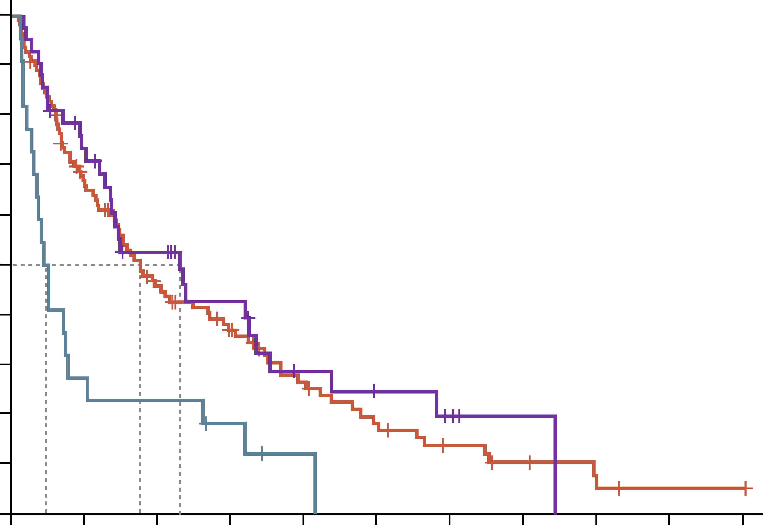
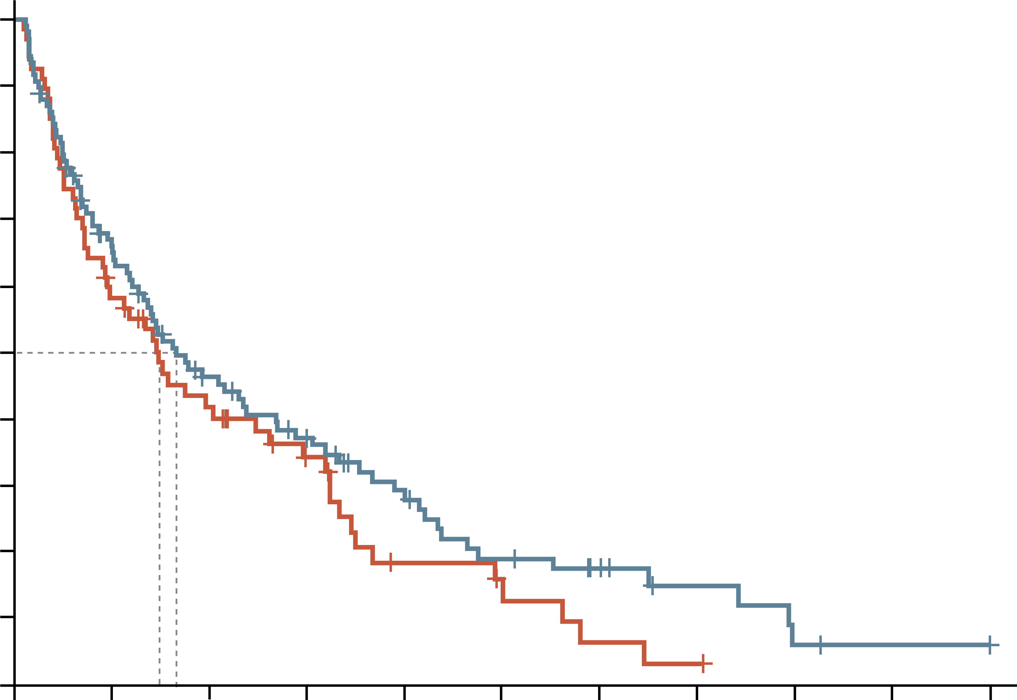
elderly patients with a poor performance status do not benefit from chemotherapy
MEDIAN OS STRATIFIED BY ECOG PS
MEDIAN OS STRATIFIED BY Age
100
PS0: 6.9m (95% CI: 4.0-10.6) (Ref)
PS1: 5.3m (95%CI: 4.3-8.6) HR: 1.13
PS2: 1.4m (95%CI: 1.1-3.1) HR: 2.77
P<0.001
100
Age 70-74: 4.4m (95% CI: 2.9-8.9) (Ref)
Age ≥75: 5.0m (95%CI: 4.0-8.1) HR: 0.80
P<0.217
90
90
80
80
70
70
60
60
50
50
Percent alive
Percent alive
40
40
30
30
20
20
10
10
0
0
0
3
6
9
12
15
18
21
24
27
30
0
3
6
9
12
15
18
21
24
27
30
No. at risk
PS0
PS1
PS2
Time (months)
No. at risk
Age 70-74
Age 75+
Time (months)
42
112
22
29
68
6
19
43
5
13
31
3
7
20
1
5
13
0
3
8
1
5
0
2
1
1
67
109
38
65
25
42
16
31
7
21
5
13
2
9
1
5
0
2
1
1
CI, confidence interval; HR, hazard ratio; m, months; PS, performance status; Ref, reference
Dotan E, et al. J Clin Oncol. 2024;42(16_suppl):4003 (oral presentation)

Slide 35
Maintenance therapy

Slide 36
POLO: PARPi as Maintenance therapy for brcam mpdac patients post-platinum chemotherapy
Global, randomised, double-blind phase 3 trial
Patients with metastatic pancreatic cancer and deleterious/suspected deleterious germline BRCA1/2 mutation, ≥16 wks of first-line platinum-based therapy without progression
(4-8 wks from last dose)
(N=154)
Olaparib 300 mg BID
(n=92)
Continue until PD or unacceptable toxicity
Placebo
(n=62)
Primary endpoint: PFS by blinded independent central review
Key secondary endpoints: safety/tolerability, PFS2,
ORR, OS, HRQoL
1L, first-line; BID, twice daily; BRCA, BReast CAncer 1/2 gene; HRQoL, health-related quality of life; ORR, objective response rate; OS, overall survival; PD, progressive disease; PFS(2), (second) progression-free survival; wks, weeks
Golan T, et al. N Engl J Med. 2019;381:317-27; Kindler H, et al. J Clin Oncol. 2022;40:3929-39

Slide 37
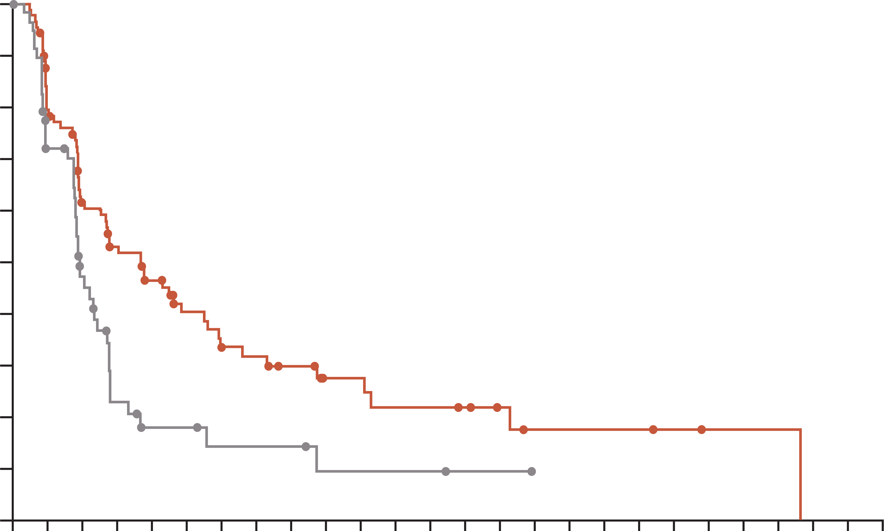
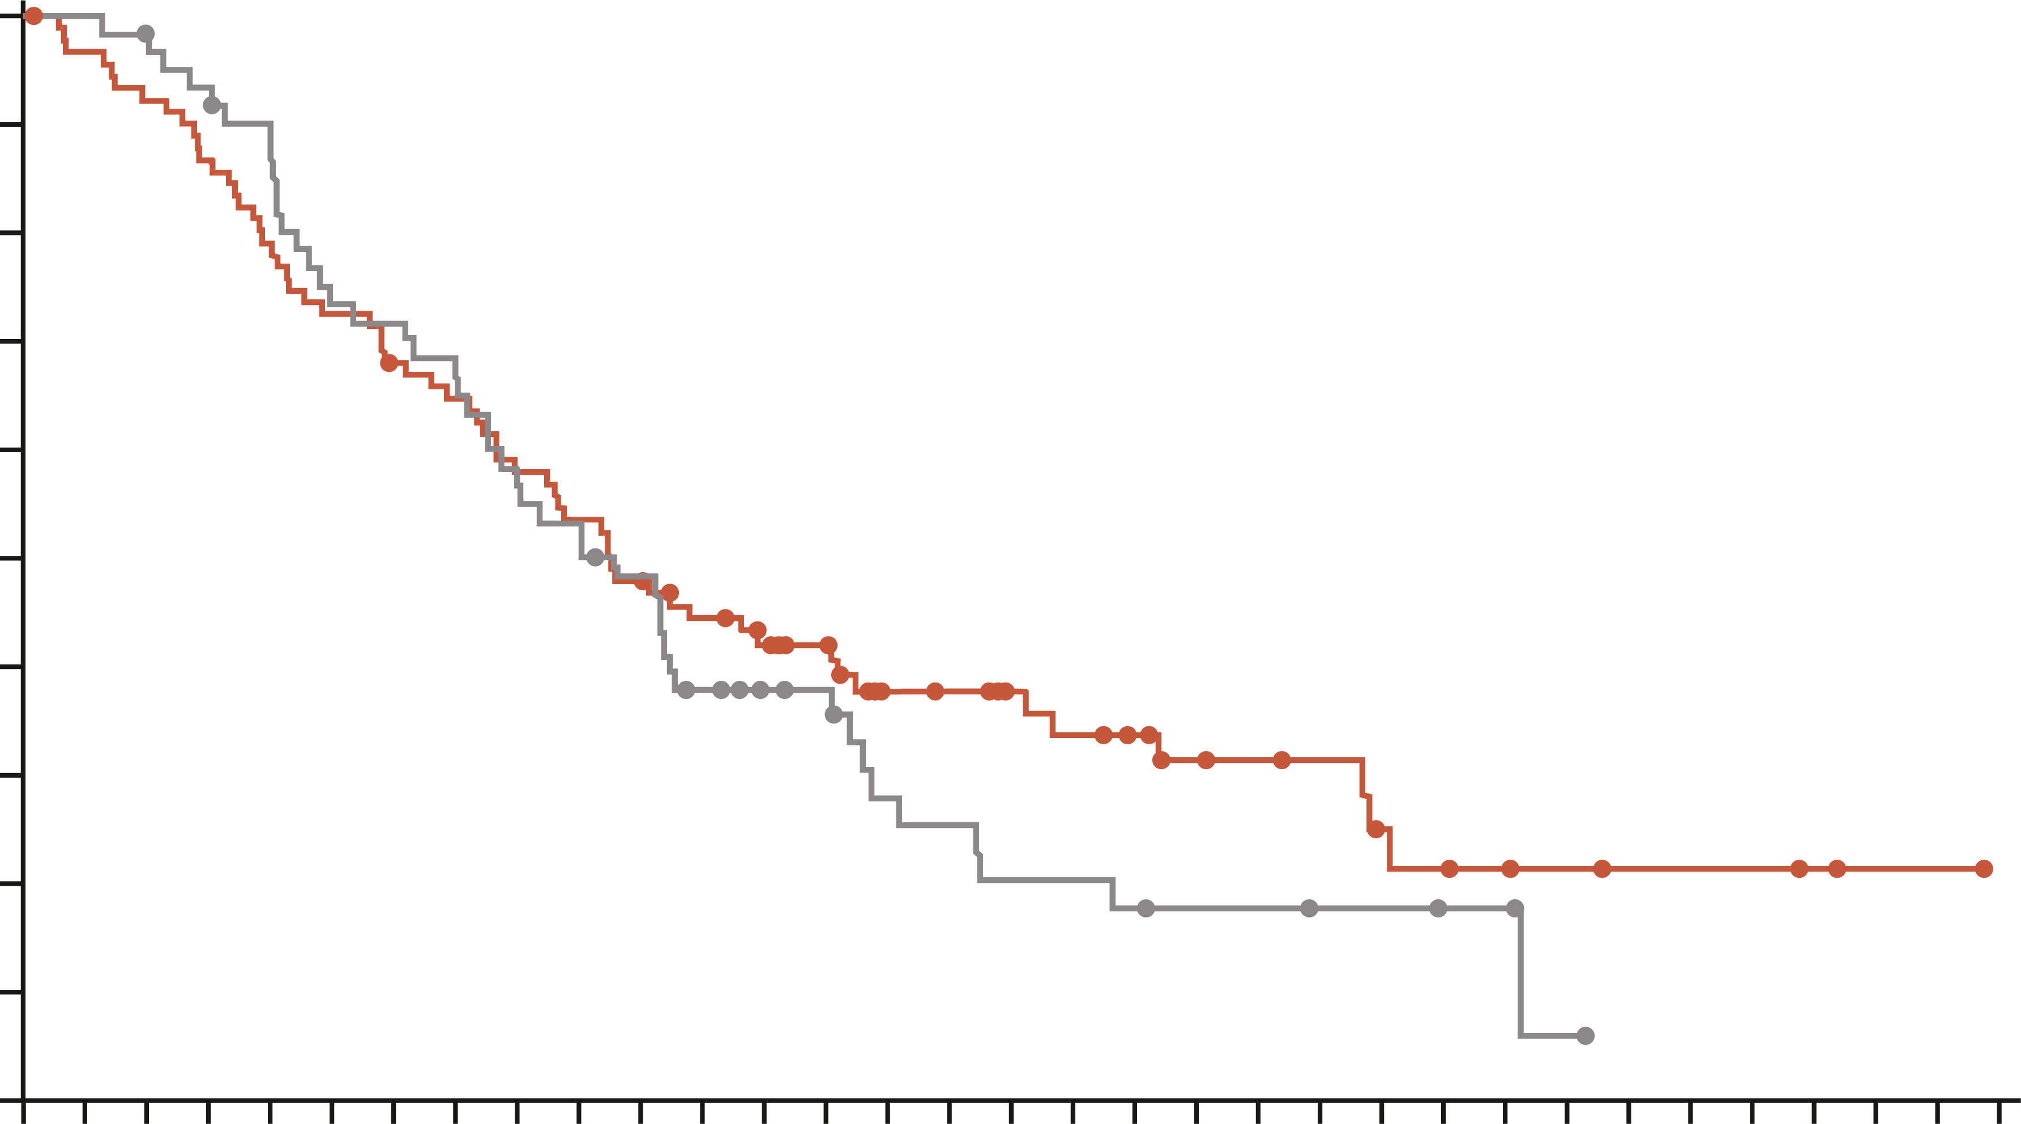
POLO: pfs LONGER WITH MAINTENANCE OLAPARIB THAN PLACEBO
Progression-free survival¹
overall survival²
1.0
Progression-free survival (%) | Olaparib (n=92) | Placebo (n=62)
Month 6 Month 12 Month 18 Month 24 | 53.0% 33.7% 27.6% 22.1% | 23.0% 14.5% 9.6% 9.6%
Median, 7.4 mo vs. 3.8 mo Hazard ratio, 0.53 (95% CI, 0.35-0.82 P=0.004
 | Olaparib (n=92) | Placebo (n=62)
Events, n (%) | 61 (66.3) | 47 (75.8)
Median OS, months | 19.0 | 19.2
HR (95% CI) P value | 0.83 (0.56-1.22) 0.3487
Ongoing investigational treatment at DCO, n (%) | 13 (14.1) | 2 (3.2)
1.0
0.9
0.9
0.8
0.8
0.7
0.7
0.6
0.6
PFS (probability)
OS (probability)
0.5
0.5
0.4
0.4
0.3
0.3
0.2
0.2
0.1
0.1
0.0
0.0
0
2
4
6
8
10
12
14
16
18
20
22
24
26
28
30
32
34
36
38
40
42
44
46
48
50
0
2
4
6
8
10
12
14
16
18
20
22
24
26
28
30
32
34
36
38
40
42
44
46
48
50
52
54
56
58
60
62
64
No. at risk
Olaparib
Placebo
Time since random assignment (months)
No. at risk
Olaparib
Placebo
Time since random assignment (months)
92
62
69
39
50
23
41
10
34
6
24
6
18
4
17
4
14
4
10
2
10
2
8
2
8
2
7
1
5
1
3
0
3
3
3
2
1
1
1
0
92
62
88
62
84
60
79
57
72
53
66
44
61
43
58
40
52
34
48
32
43
28
38
21
34
17
31
16
23
11
22
10
19
8
17
8
15
7
12
6
11
6
10
5
7
5
6
4
5
4
4
1
3
0
3
3
2
1
1
0
CI, confidence interval; BRCA, BReast CAncer gene mutation; DCO, data cut-off; HR, hazard ratio; mo, months; mPDAC, metastatic pancreatic ductal adenocarcinoma; OS, overall survival; PARPi, poly(ADP-ribose) polymerase inhibitor; PFS, progression-free survival
1. Golan T, et al. N Engl J Med. 2019;381:317-27; 2. Kindler H, et al. J Clin Oncol. 2022;40:3929-39

Slide 38
Polo: safety summary
AEs IN ≥ 15% OF STUDY POPULATION
 | Olaparib (N=90) |  | Placebo (N=61)
Event, n (%) | Any grade | Grade ≥3 | Any grade | Grade ≥3
Any AE | 89 (98.9) | 44 (48.9) | 56 (91.8) | 15 (24.6)
Nausea | 44 (48.9) | 1 (1.1) | 15 (24.6) | 1 (1.6)
Fatigue | 42 (46.7) | 5 (5.6) | 16 (26.2) | 0 (0.0)
Diarrhoea | 34 (37.8) | 1 (1.1) | 10 (16.4) | 0 (0.0)
Abdominal pain | 29 (32.2) | 3 (3.3) | 16 (26.2) | 1 (1.6)
Anaemia | 29 (32.2) | 11 (12.2) | 10 (16.4) | 2 (3.3)
Constipation | 25 (27.8) | 0 (0.0) | 7 (11.5) | 0 (0.0)
Decreased appetite | 25 (27.8) | 3 (3.3) | 4 (6.6) | 0 (0.0)
Vomiting | 23 (25.6) | 2 (2.2) | 10 (16.4) | 1 (1.6)
Back pain | 22 (24.4) | 0 (0.0) | 13 (21.3) | 1 (1.6)
Arthralgia | 16 (17.8) | 1 (1.1) | 7 (11.5) | 0 (0.0)
Asthenia | 16 (17.8) | 1 (1.1) | 6 (9.8) | 1 (1.6)
Pyrexia | 16 (17.8) | 0 (0.0) | 6 (9.8) | 0 (0.0)
Causally related to study treatmentª | 75 (83.3) | 22 (24.4) | 37 (60.7) | 2 (3.3)
Serious AE | 28 (31.1) | NA | 10 (16.4) | NA
Death | 1 (1.1) | NA | 0 (0.0) | NA
Interruption of intervention because of AE | 37 (41.1) | NA | 4 (6.6) | NA
Dose reduction because of AE | 16 (17.8) | NA | 3 (4.9) | NA
Discontinuation of intervention because of AE | 8 (8.9) | NA | 1 (1.6) | NA
ª As assessed by the investigator
AE, adverse event; NA, not applicable
Kindler H, et al. J Clin Oncol. 2022;40:3929-39

Slide 39
Second-line treatment options

Slide 40
Oxaliplatin phase 3 second-line studies
CONKO-003¹
FF (5-FU and Folinic acid)
(n=91)
Patients with advanced pancreatic cancer previously treated with gemcitabine, with a
KPS ≥ 70%
N=168
Continue until progression or unacceptable toxicity
R
OFF (5-FU, Folinic acid + oxaliplatin
(n=77)
Primary endpoint: OS
PANCREOX²
mFOLFOX6
(n=54)
Patients with advanced pancreatic cancer previously treated with gemcitabine, with an ECOG PS 0-2
N=108
Continue until progression or unacceptable toxicity
R
5-FU/LV
(n=54)
Primary endpoint: PFS
5-FU, fluorouracil; ECOG PS, Eastern Cooperative Oncology Group performance status; FF, folinic acid (leucovorin calcium) and fluorouracil; KPS, Karnofsky performance status; LV, leucovorin calcium (folinic acid); mFOLFOX6, modified FOLFOX6: folinic acid (leucovorin calcium), fluorouracil, and oxaliplatin; OFF, oxaliplatin and FF; OS, overall survival; PFS, progression-free survival
1. Oettle H, et al. J Clin Oncol. 2014 Aug 10;32:2423-9; 2. Gill S, et al. J Clin Oncol. 2016;10;3914-20

Slide 41
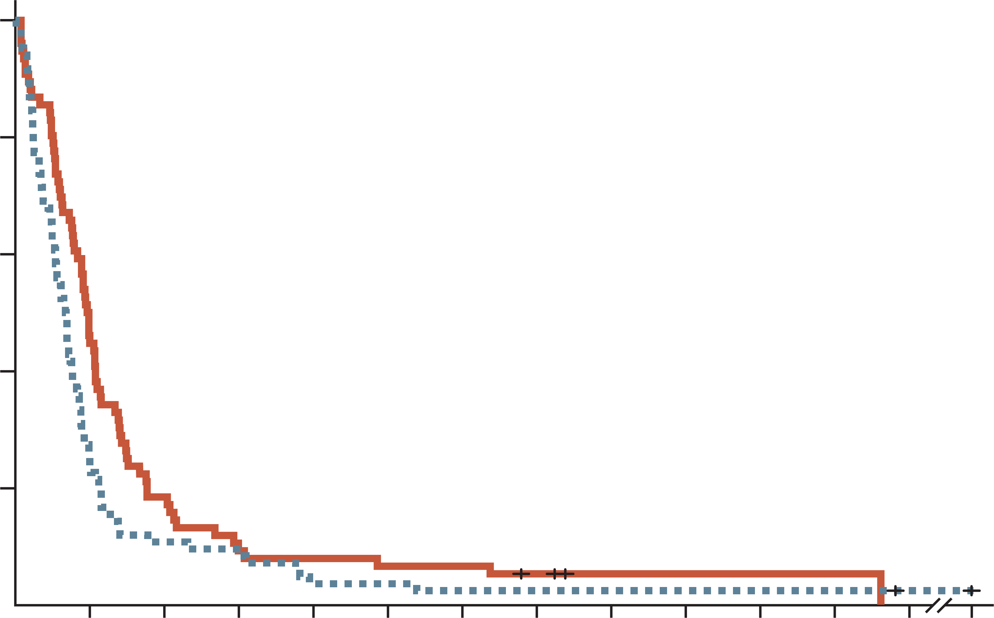
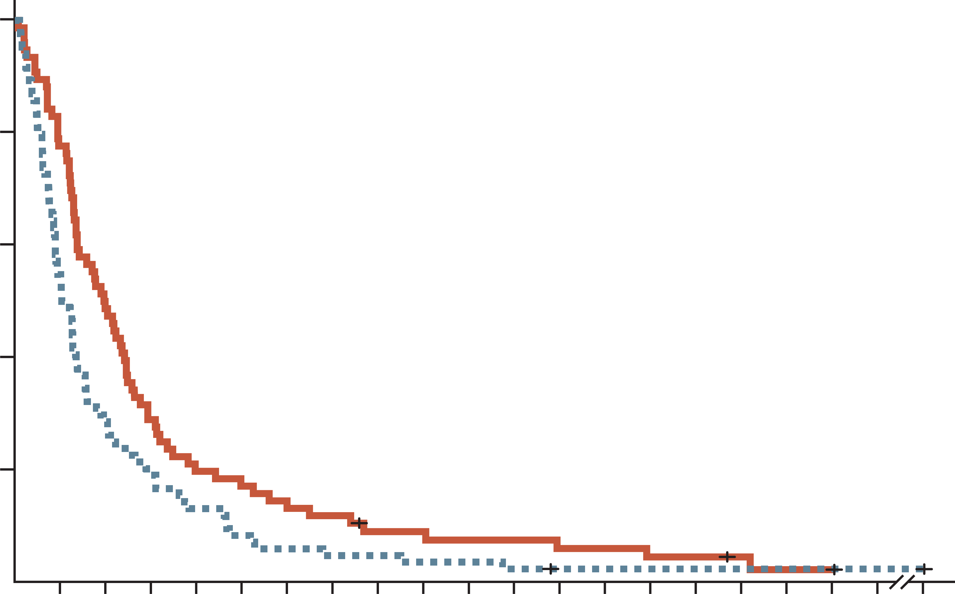
CONKO-003: 5FU+ Folinic Acid +/- Oxaliplatin (off) efficacy
progression-free survival
Overall survival
100
 | OFF | FF
Median (95% CI), months | 2.9 (2.4-3.2) | 2.0 (1.6-2.3)
Log-rank | P=0.019
HR (95% CI) | 0.68 (0.50-0.94)
100
 | OFF | FF
Median (95% CI), months | 5.9 (4.1-7.4) | 3.3 (2.7-4.0)
Log-rank | P=0.010
HR (95% CI) | 0.66 (0.48-0.91)
80
80
60
60
Progression-free survival (%)
Overall survival (%)
40
40
20
20
0
0
3
6
9
12
15
18
21
24
27
30
33
36
86
0
0
3
6
9
12
18
24
30
36
42
48
54
86
No. at risk
OFF
FF
Time (months)
No. at risk
OFF
FF
Time (months)
76
84
34
20
14
9
7
7
6
3
5
3
5
2
3
2
1
2
1
2
1
2
1
2
0
1
0
1
76
84
59
46
37
24
22
16
15
11
10
5
6
4
5
3
4
1
3
1
2
1
1
1
0
1
Rates of adverse events were similar between treatment arms, except for grades 1 to 2 neurotoxicity, which were reported in 29 patients (38.2%) and six patients (7.1%) in the OFF
and FF groups, respectively (P<0.001)
1L, first-line; 5-FU, fluorouracil; CI, confidence interval; FF, folinic acid (leucovorin calcium) and fluorouracil; HR, hazard ratio; OFF oxaliplatin and FF
Oettle H, et al. J Clin Oncol. 2014 Aug 10;32:2423-9

Slide 42
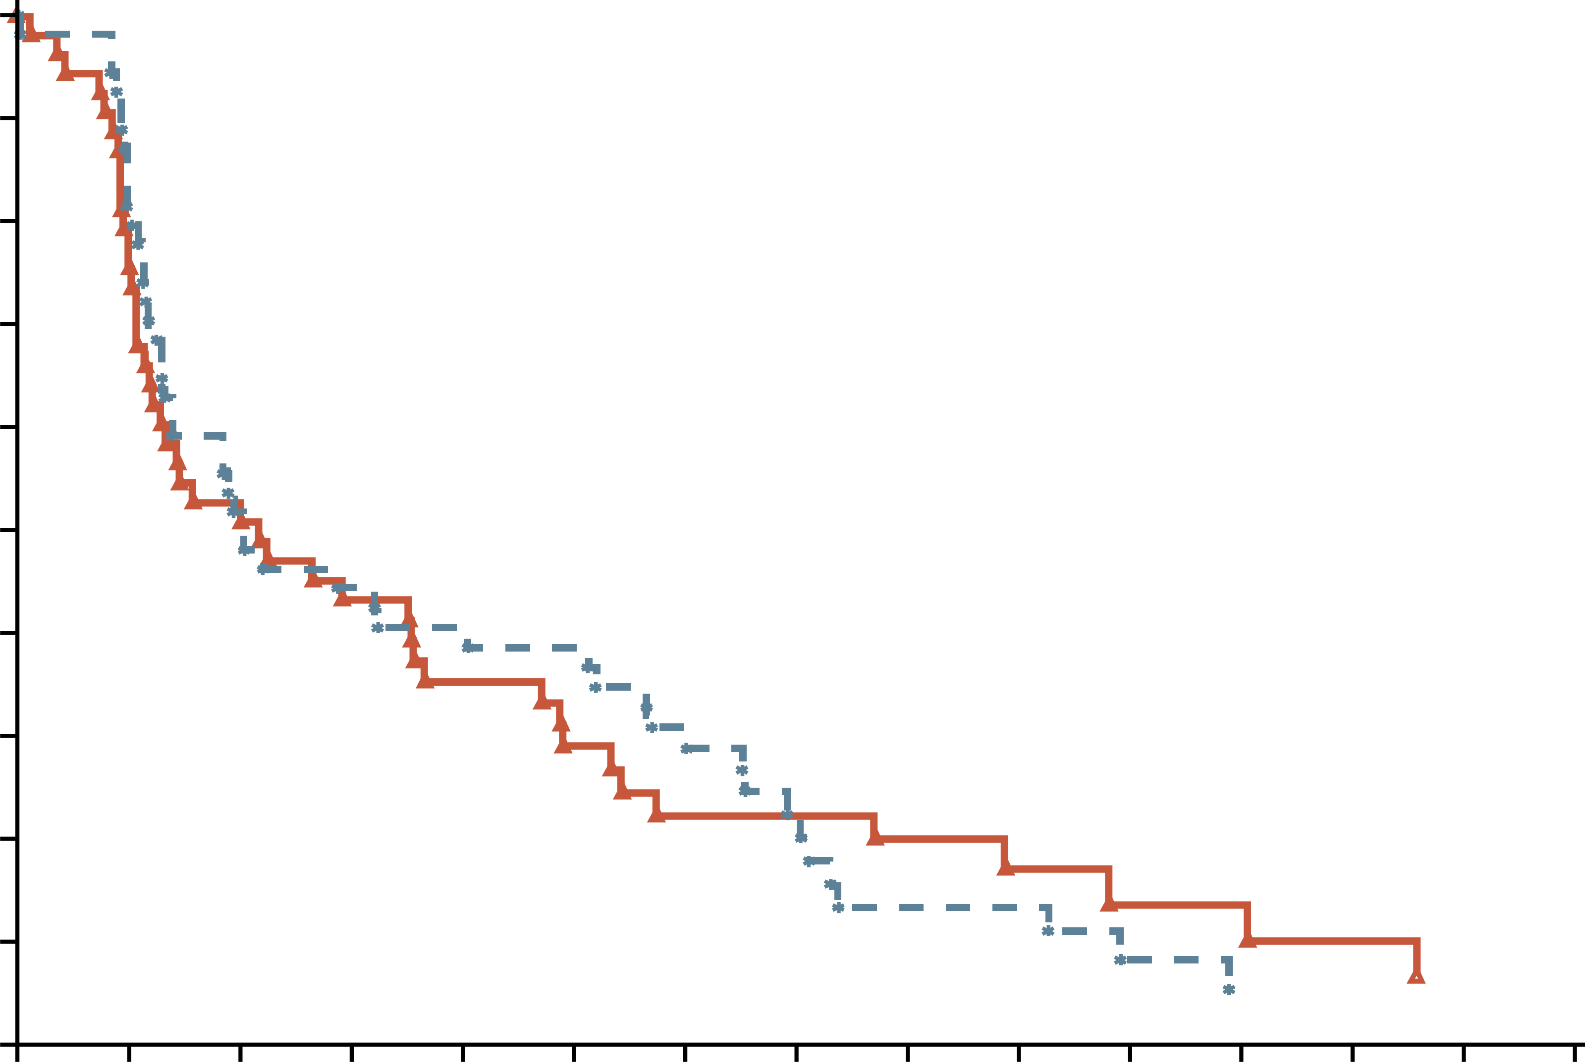
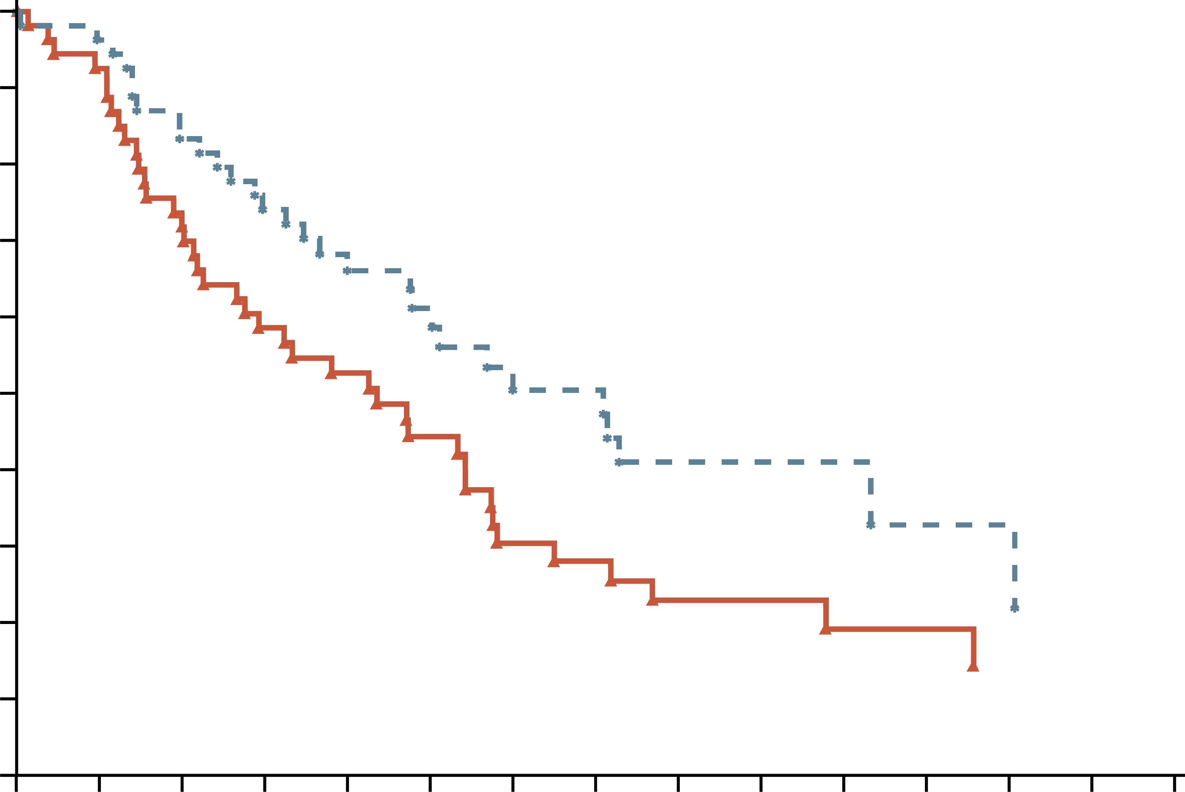
PANCREOX: addition of oxaliplatin to 5-Fu in 2L
WAS detrimental
PROGRESSION-FREE SURVIVAL
Overall survival
 | mFOLFOX6 | 5-FU/LV
No. of patients | 54 | 54
Event, n (%) | 41 (75.9%) | 29 (53.7%)
Censored, n (%) | 13 (24.1%) | 25 (46.3%)
Median OS (95% CI), d | 183 days (95, 241) | 298 days (200, 507)
Log-rank | 0.0355
Hazard ratio | 1.6819
p-value (hazard ratio) | 0.0334
1.0
 | mFOLFOX6 | 5-FU/LV
No. of patients | 54 | 54
Event, n (%) | 47 (87.0%) | 49 (90.7%)
Censored, n (%) | 7 (13.0%) | 5 (9.3%)
Median PFS (95% CI), d | 92 days (51, 154) | 86 days (56, 215)
Log-rank | 0.8897
Hazard ratio | 0.9754
p-value (hazard ratio) | 0.9051
0.9
0.9
0.9
0.8
0.8
0.7
0.7
0.6
0.6
Progression-free survival (probability)
Overall survival (probability)
0.5
0.5
0.4
0.4
0.3
0.3
0.2
0.2
0.1
0.1
0.0
0.0
0
42
84
126
168
210
252
294
336
378
420
462
504
546
588
0
42
84
126
168
210
252
294
336
378
420
462
504
546
588
No. at risk
Oxaliplatin
No Oxaliplatin
Time (days)
No. at risk
Oxaliplatin
No Oxaliplatin
Time (days)
54
54
42
47
28
28
23
24
18
21
13
20
10
15
10
10
7
6
6
6
4
3
4
2
3
1
2
1
2
1
54
54
49
52
39
45
31
40
26
32
20
24
13
18
12
16
7
13
7
11
5
5
5
4
3
3
3
2
3
1
Grade 3 or 4 toxicity: 63% on mFOLFOX6; 11% on 5-FU/LV
2L, second-line; 5-FU, fluorouracil; CI, confidence interval; d, days; LV, leucovorin calcium (folinic acid); mFOLFOX6, modified infusional fluorouracil, leucovorin (folinic acid), and oxaliplatin; PFS, progression-free survival
Gill S, et al. J Clin Oncol. 2016;10;3914-20

Slide 43
Phase 3 experience in 2L with OXALIPLATIN
Contradicting results observed with second-line oxaliplatin regimens in the CONKO-003 and PANCREOX trials
 | CONKO-003¹ N=160 |  | PANCREOX² N=108
Treatment | OFF | 5-FU/LV | mFOLFOX6 | 5-FU/LV
Median OS, mo | 5.9 | 3.3 | 6.1 | 9.9
HR | 0.66, P=0.01 |  | 1.78, P=0.02
Median PFS, mo | 2.9 | 2.0 | 3.0 | 2.8
HR | 0.68, P=0.02 |  | 0.98, P=0.91
Data presented for information purposes. Cross-trial comparison is not intended
2L, second-line; 5-FU, fluorouracil; HR, hazard ratio; LV, leucovorin calcium (folinic acid); mFOLFOX6, modified infusional fluorouracil, leucovorin, and oxaliplatin; mo, months; OS, overall survival; PFS, progression-free survival; OFF, folinic acid (leucovorin calcium), fluorouracil and oxaliplatin
1. Oettle H, et al. J Clin Oncol. 2014;32: doi.org/10.1200/JCO.2013.53.6995; 2. Gill S, et al. J Clin Oncol. 2016;10; 3914-20

Slide 44
Napoli-1: study design
Nal-iri alone and in combination with 5-fu/lv as 2l therapy
Initial
design
After
amendmentª
Total
Nal-IRI
120 mg/m², q3w
N=33
N=118
N=151
Inclusion criteria
Metastatic pancreatic cancer
Received prior gemcitabine-based therapy
R
5-FU/LV
2000/200 mg/m²
weekly × 4, q6w
N=30
N=119
N=149
Nal-IRI + 5-FU/LV
80 mg/m² + 2400/400 mg/m², q2w
N=117
N=117
Stratification factors: Albumin, KPS and ethnicity
Primary endpoint: Overall survival
Secondary endpoints: PFS, ORR, TTTF, CA19-9 response safety
ª Study was amended to add the Nal-IRI + 5-FU/LV arm once safety data on the combination became available. Only those patients enrolled in the 5FU/LV arm after the amendment (N=119), were used as the control for the combination arm
2L, second-line; 5-FU, fluorouracil; CA19-9; carbohydrate antigen 19-9; KPS, Karnofsky performance status; LV, leucovorin calcium (folinic acid); Nal‑IRI, nanoliposomal irinotecan; ORR, overall response rate; PFS, progression-free survival; q2w/q3w/q6/w, every 2/3/6 weeks; R, randomised; TTTF, time to treatment failure
Wang-Gillam A, et al. Lancet. 2016;387:545-57

Slide 45
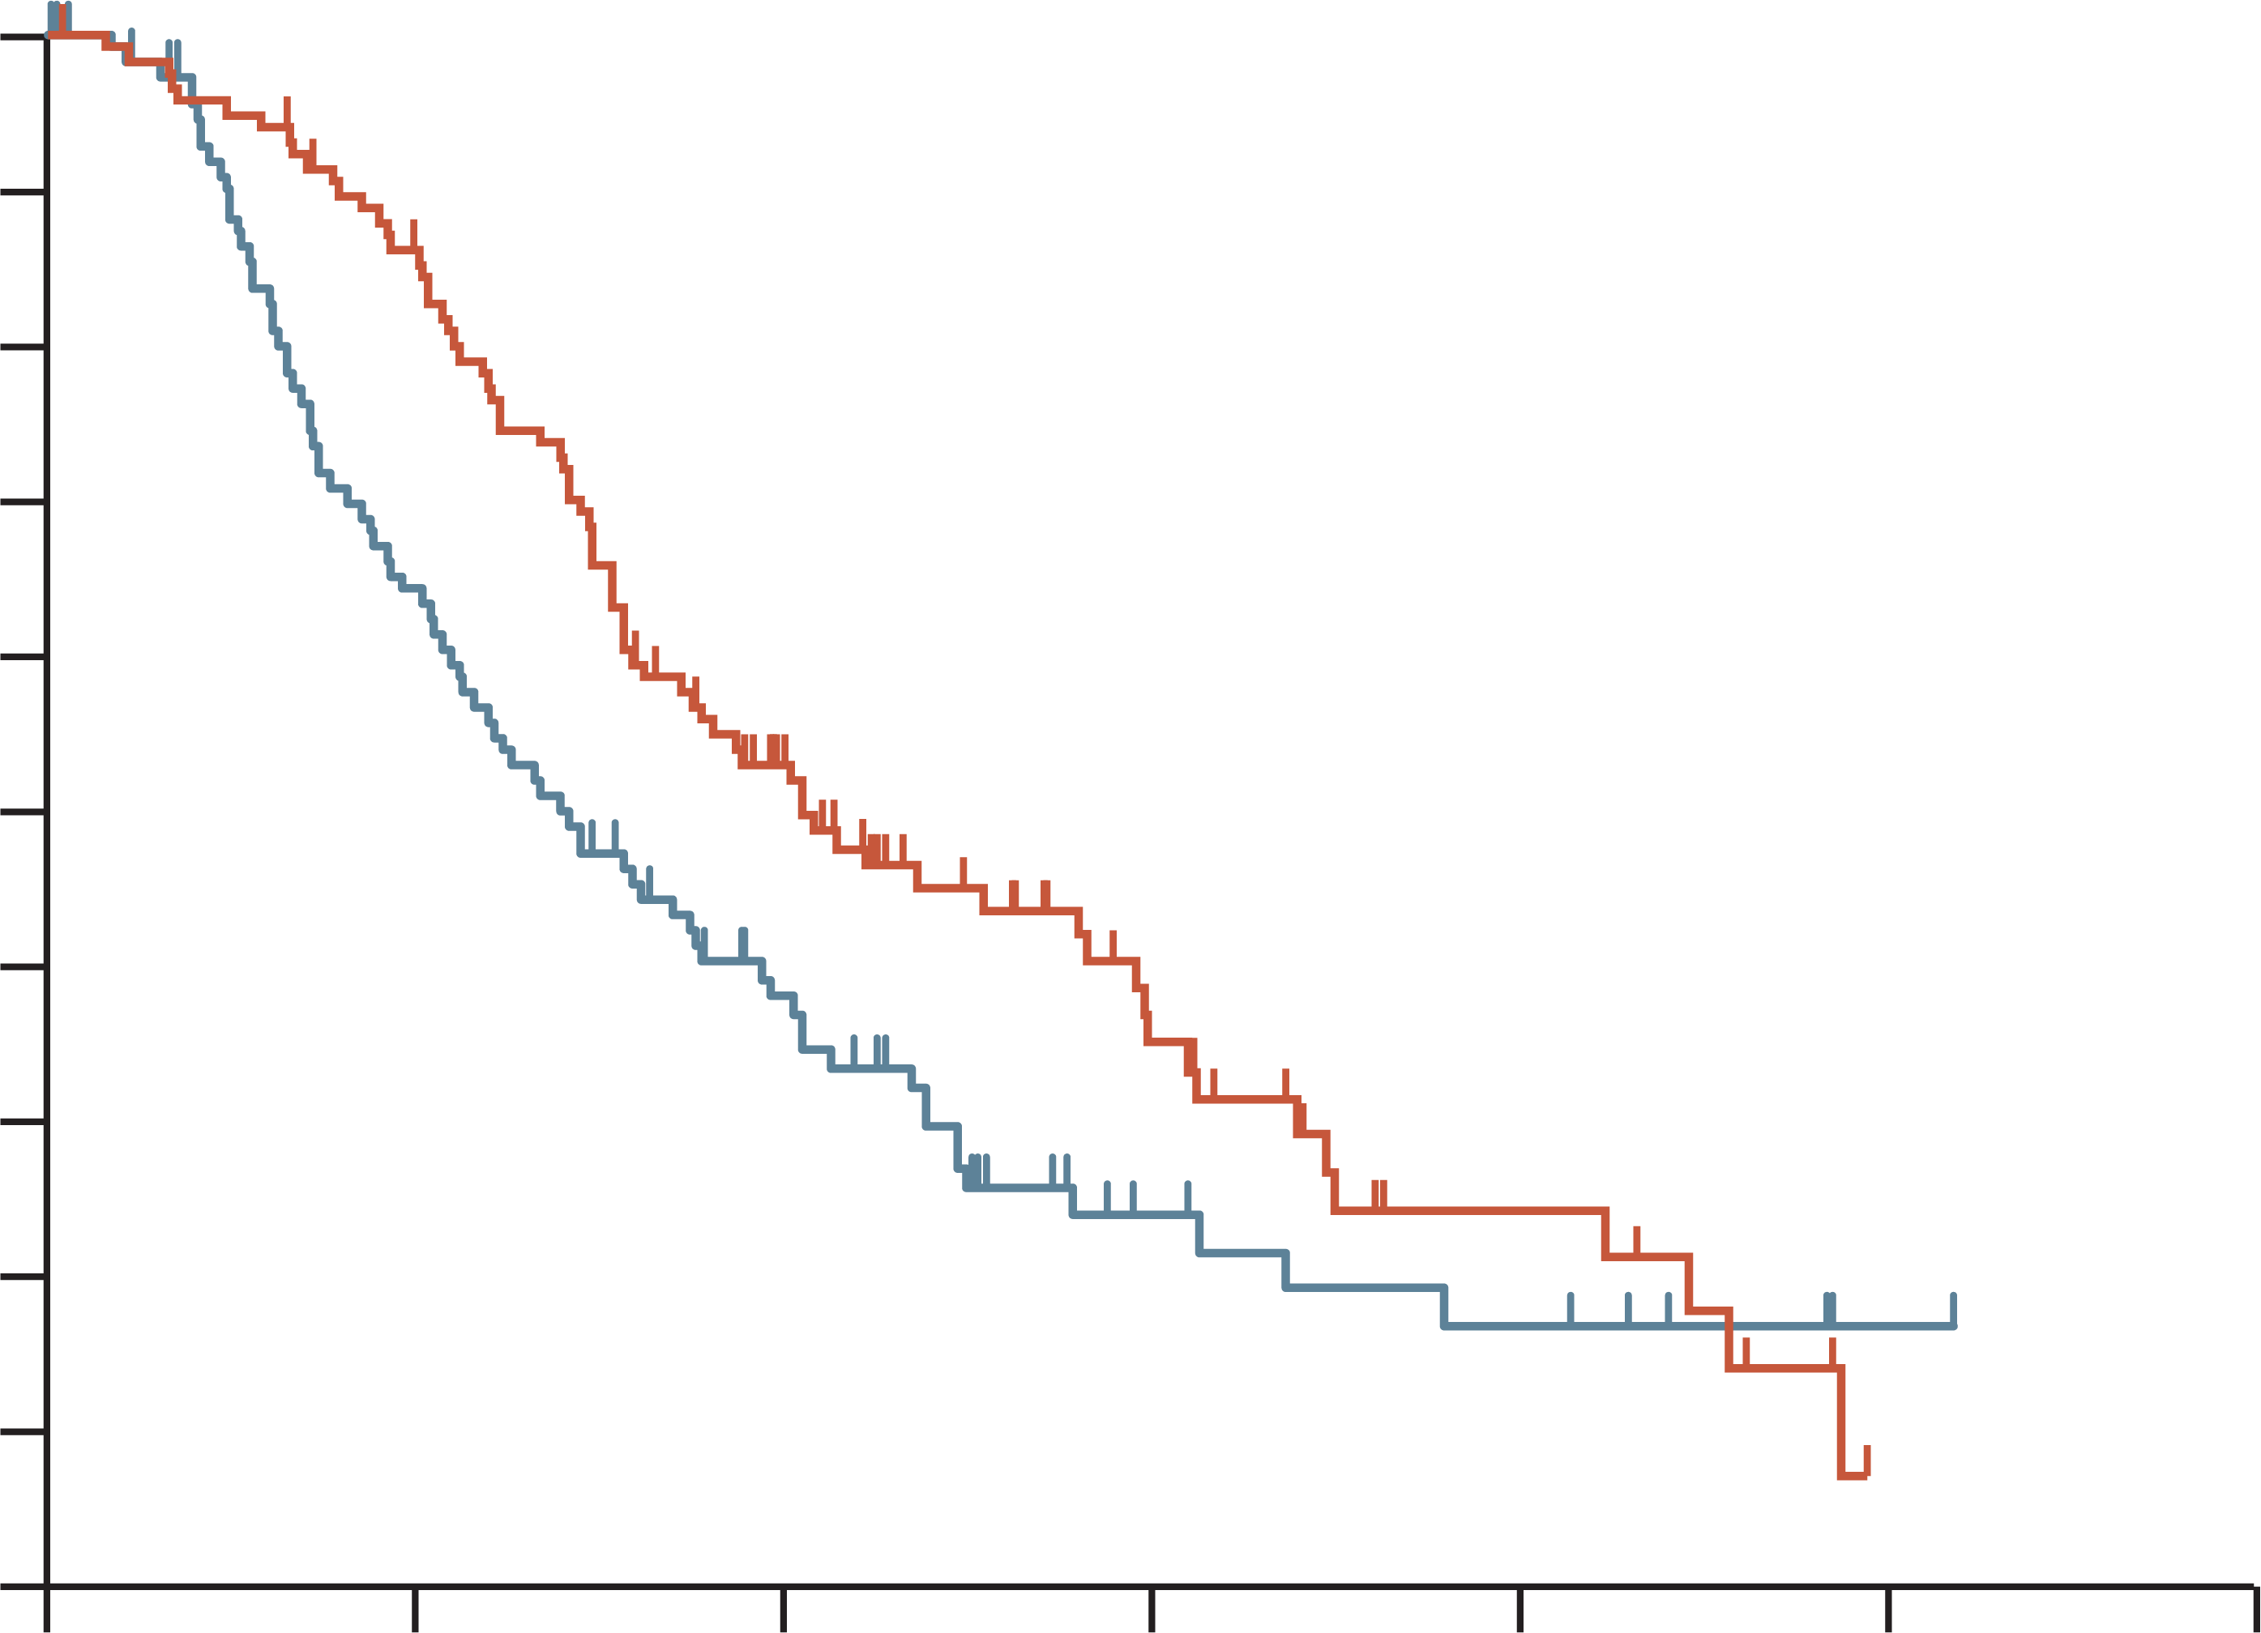
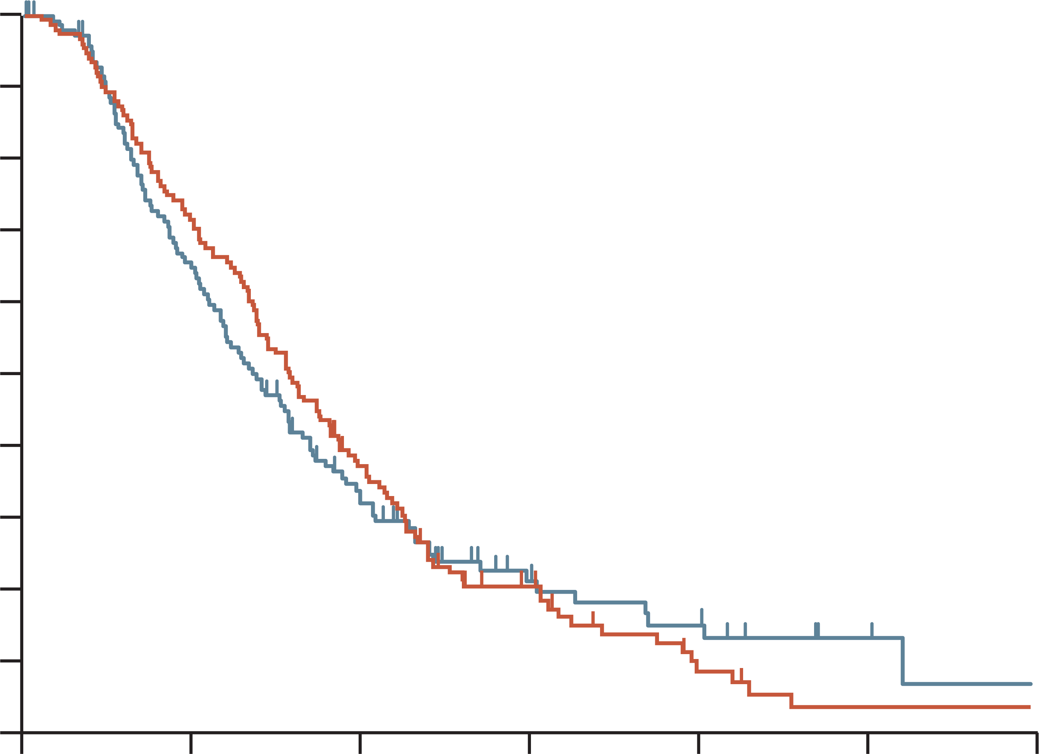
Napoli-1: overall survival (ITT)
 | Nal-IRI + 5-FU/LV | 5-FU/LV
Median OS (95% CI), months | 6.1 (4.8-8.9) | 4.2 (3.3-5.3)
Unstratified HR (95% CI): | 0.67 (0.49-0.92) P=0.012
 | Nal-IRI monotherapy | 5-FU/LV
Median OS (95% CI), months | 4.9 (4.2-5.6) | 4.2 (3.6-4.9)
Unstratified HR (95% CI): | 0.99 (0.77-1.28) P=0.94
1.0
1.0
0.9
0.9
0.8
0.8
0.7
0.7
0.6
0.6
Overall survival proportion
Overall survival proportion
0.5
0.5
0.4
0.4
0.3
0.3
0.2
0.2
0.1
0.1
0.0
0.0
0
3
6
9
12
15
18
0
3
6
9
12
15
18
Time from randomisation (months)
Time from randomisation (months)
No. at risk
117
119
97
68
51
34
20
11
8
6
0
1
0
1
No. at risk
151
149
109
89
23
41
21
16
10
9
2
3
2
1
Protocol-defined primary analysis data cut (14 February 2014, after 305 events)
5-FU, fluorouracil; CI, confidence interval; HR, hazard ratio; ITT, intention-to-treat; LV, leucovorin calcium (folinic acid); Nal-IRI, nanoliposomal irinotecan; OS, overall survival
Wang-Gillam A, et al. Lancet. 2016;387:545-57

Slide 46
Napoli-1: safety
Adverse event, n (%) | Nal-IRI + 5-FU/LV (N=117) |  | Nal-IRI monotherapy (N=147) |  | 5-FU/LV (N=134)
 | Any grade | Grades 3-4 | Any grade | Grades 3-4 | Any grade | Grades 3-4
Diarrhoea | 69 (59%) | 15 (13%) | 103 (70%) | 31 (21%) | 35 (26%) | 6 (4%)
Vomiting | 61 (52%) | 13 (11%) | 80 (54%) | 20 (14%) | 25 (26%) | 4 (3%)
Nausea | 60 (51%) | 9 (8%) | 89 (61%) | 8 (5%) | 46 (34%) | 4 (3%)
Decreased appetite | 52 (44%) | 5 (4%) | 72 (49%) | 13 (19%) | 43 (32%) | 3 (2%)
Fatigue | 47 (40%) | 16 (14%) | 54 (37%) | 9 (6%) | 37 (28%) | 5 (4%)
Neutropeniaª | 46 (39%) | 32 (27%) | 37 (25%) | 22 (15%) | 7 (5%) | 2 (1%)
Anaemia | 44 (38%) | 11 (9%) | 48 (33%) | 16 (11%) | 31 (23%) | 9 (7%)
Hypokalaemia | 14 (12%) | 4 (3%) | 32 (22%) | 17 (12%) | 12 (9%) | 3 (2%)
Data are number of patients (%). The table shows grade 3 and 4 adverse events reported in ≥5% of patients whose treatment included nanoliposomal irinotecan with ≥2% incidence versus fluorouracil and folinic acid. ª includes agranulocytosis, febrile neutropenia, granulocytopenia, neutropenia, neutropenic sepsis, decreased neutrophil count, and pancytopenia
5-FU, fluorouracil; LV, leucovorin calcium (folinic acid); Nal-IRI, nanoliposomal irinotecan
Wang-Gillam A, et al. Lancet 2016;387:545-57

Slide 47
Napoli-1: Dose modifications of nal-iri + 5-fu/lv
POST HOC ANALYSIS: IMPACT of dose modifications or delays ON EFFICACY
 | Nal-IRI + 5-FU/LV | 5-FU/LV
 | Nal-IRI dose delay
Median overall survival, mos | 8.4 (N=49) | 4.2 (N=105)
Hazard ratio (95% CI) | 0.66 (0.46, 0.94)
 | Nal-IRI dose reduction
Median overall survival, mos | 9.4 (N=34) | 4.2 (N=105)
Hazard ratio (95% CI) | 0.58 (0.38, 0.88)
5-FU, fluorouracil; CI, confidence interval; LV, leucovorin calcium (folinic acid); mos, months; Nal‑IRI, nanoliposomal irinotecan; OS, overall survival
Wang-Gillam A, et al. J. Clin. Oncol. 2018; 36(4_suppl):388

Slide 48

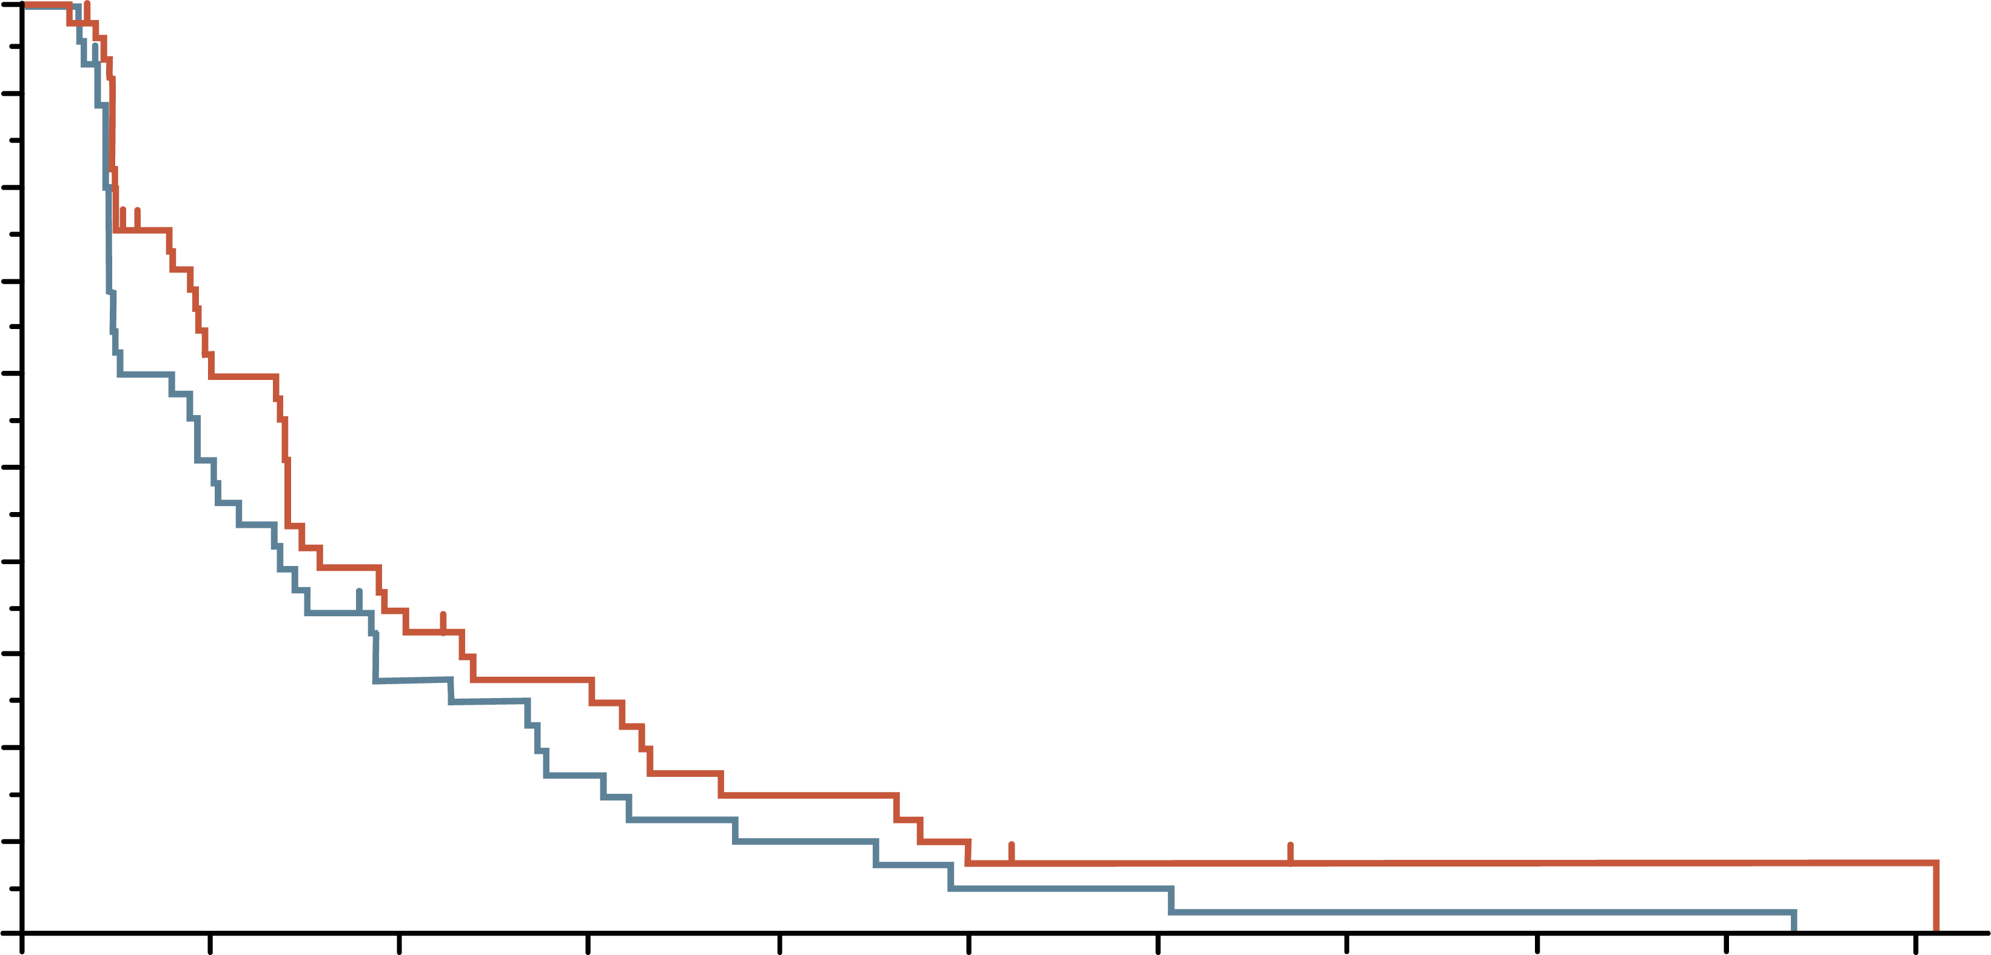
Napoli-1: Dose modifications of nal-iri + 5-fu/lv
POST HOC ANALYSIS: IMPACT ON EFFICACY
100
 | Nal-IRI + 5-FU/LV, early modification | Nal-IRI + 5-FU/LV, no modification
Median OS, months (95% CI) | 8.44 (5.26-11.04) | 6.67 (4.70-8.87)
HR | 0.89 (0.59-1.35)
100
 | Nal-IRI + 5-FU/LV, early modification | Nal-IRI + 5-FU/LV, no modification
Median PFS, months (95% CI) | 4.21 (2.79-5.72) | 3.06 (1.45-4.53)
HR | 0.74 (0.48-1.13)
90
90
80
80
70
70
60
60
Overall survival
Progression-free survival
50
50
40
40
30
30
20
20
10
10
0
0
0
3
6
9
12
15
18
21
24
27
30
0
3
6
9
12
15
18
21
24
27
30
Time from randomisation (months)
Time from randomisation (months)
No. at risk
53
49
48
41
31
27
25
14
19
10
13
8
7
7
4
5
4
3
1
3
1
1
No. at risk
53
49
26
22
15
11
11
7
6
4
3
2
2
2
1
1
1
1
1
1
1
0
Tolerability-guided dose modification of liposomal irinotecan does not adversely affect efficacy outcomes
5-FU, fluorouracil; CI, confidence interval; HR, hazard ratio; LV, leucovorin calcium (folinic acid); Nal‑IRI, nanoliposomal irinotecan; OS, overall survival; PFS, progression-free survival
Chen L-T, et al. Pancreatology. 2021;21:192-199

Slide 49
summary

Slide 50
summary
Cytotoxic chemotherapy remains the cornerstone of systemic therapy for advanced or metastatic pancreatic cancer
NALIRIFOX is a possible new option for frontline therapy based on the NAPOLI-3 clinical trial
Maintenance therapy after a period of chemotherapy is an option for patients with BRCA
or PALB2 alterations
Treatment selection depends on several factors, including patients' performance
status and co-morbidities. These should be considered alongside the efficacy and
safety profiles of the different chemotherapy regimens
Treatment strategies can be implemented to manage toxicities associated with the
different chemotherapy regimens to enable a patient to stay on treatment for
optimal efficacy
BRCA1/2, BReast CAncer 1/2 gene; Nal‑IRI, nanoliposomal irinotecan; NALIRIFOX; Nal-IRI, fluorouracil/folinic acid (leucovorin calcium), and oxaliplatin; PALB2, partner and localiser of BRCA2
NCCN Guidelines Version 3.2024. Available at: https://www.nccn.org/guidelines/guidelines-detail?category=1&id=1455. Accessed October 2024

