Slide 2

DEVELOPED BY OBSTETRICS & GYNECOLOGY CONNECT
This programme is developed by OBSTETRICS & GYNECOLOGY
CONNECT, an international group of experts in the field of
obstetrics and gynecology.
Acknowledgement and disclosures
This OBSTETRICS & GYNECOLOGY CONNECT programme has been sponsored by Eisai Europe Limited ("Eisai"). Eisai has had no input on the educational content of or speakers involved in this programme.
Please note:
This educational programme is intended for healthcare professionals only
The views expressed within this programme are the personal opinions of the expert. They do not necessarily represent the views of the expert’s academic institutions, organisations, or other group or individual
Expert Disclosures:
Prof. Christian Marth has received financial support/sponsorship for research support,
consultation, or speaker fees from the following companies: EU, FWF, AstraZeneca, Roche,
Novartis, MSD, Pharmamar, GSK, Pfizer, ImmunoGen, Daiichi Sankyo, BioNTech, Novocure, Eisai

Slide 3
OBSTETRICS & GYNECOLOGY CONNECT
Animated Video
Current treatment options in advanced/recurrent endometrial cancer:
Exploring the impact of molecular subtypes
Prof. Christian Marth
Innsbruck Medical University, Austria
January 2025

Slide 4
Educational Objectives
Understand current treatment options for advanced or recurrent endometrial cancer and their place in the treatment landscape
Explore treatment decisions in advanced or recurrent endometrial cancer based on molecular subtypes
Embrace the importance of clear communication with patients and agreement on the end goal of the treatment

Slide 5
CLINICAL TAKEAWAYS
Molecular classification is crucial not only for prognosis but also for guiding personalised treatment decisions
ICI and ChT combination, including with maintenance olaparib, demonstrates PFS benefits and manageable safety in patients with non-dMMR advanced/recurrent endometrial cancer, with greater efficacy observed in dMMR populations
Lenvatinib plus pembrolizumab is a viable option not only as 2nd line therapy but also as 1st line treatment for patients with non-dMMR advanced/recurrent endometrial cancer who have progressed after prior systemic therapy in any setting
Shared decision-making, supported by patient education, is essential for optimising
treatment outcomes
ChT, chemotherapy; ICI, immune checkpoint inhibitor; PFS, progression-free survival; p/dMMR, proficient/deficient mismatch repair

Slide 6
ENDOMETRIAL CANCER EPIDEMIOLOGY & Current treatment guidelines

Slide 7
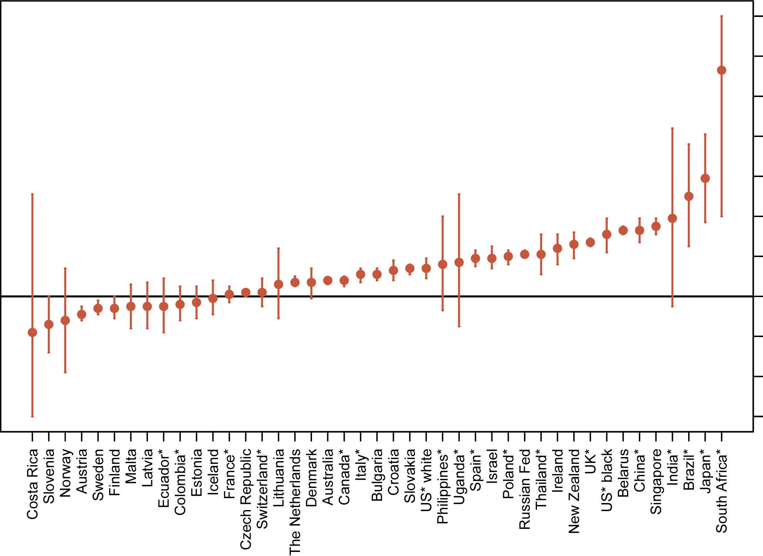
ENDOMETRIAL CANCER: EPIDEMIOLOGY
Endometrial cancer (EC) is the most common gynecologic cancer and the fourth most common cancer among women in the
United States^{1,2}
The majority of EC (66%) is diagnosed in early stages²
However, 15% to 20% of these carcinomas will recur with unfavourable prognosis^{3,4}
AVERAGE ANNUAL PERCENT CHANGE IN AGE-STANDARDISED
ENDOMETRIAL CANCER INCIDENCE RATES⁵
Please redraw graph currently a bit blurry add COR2ED colors
14
10
6
Average annual percent change
in incidence rate
2
−2
−6
1. Liu L, et al. JNCI Cancer Spect. 2023;7:pkad001; 2. Cancer Facts and Figures 2022. American Cancer Society (2022). Available at: https://www.cancer.org/content/dam/cancer-org/research/cancer-facts-and-statistics/annual-cancer-facts-and-figures/2022/2022-cancer-facts-and-figures.pdf (accessed October 2024); 3. Beavis AL and Fader AN. J Clin Oncol. 2022;40:3790-3795; 4. van den Heerik ASVM, et al. Int J Gynecol Cancer. 2021:31:594-604; 5. Lortet-Tieulent J, et al. J Natl Cancer Inst. 2018;110:354-361

Slide 8
ENDOMETRiaL CANCER: SURVIVAL BY CANCER STAGE
Overall, 5-year survival rate for endometrial cancer is 81.1%
Survival rate varies significantly by stage: Patients with distant metastases have five times lower chances of 5-year survival compared to those with localized EC
PERCENT OF CASES BY STAGE AT DIAGNOSIS
5-YEAR RELATIVE SURVIVAL
Localised
Confined to primary site
Regional
Spread to regional
lymph nodes
Distant
Cancer has metastasised
Unknown
Unstaged
Stage
EC, endometrial cancer
Cancer stat facts: Uterine Cancer. National Cancer Institute. 2022. https://seer.cancer.gov/statfacts/html/corp.html (accessed in November 2024)

Slide 9
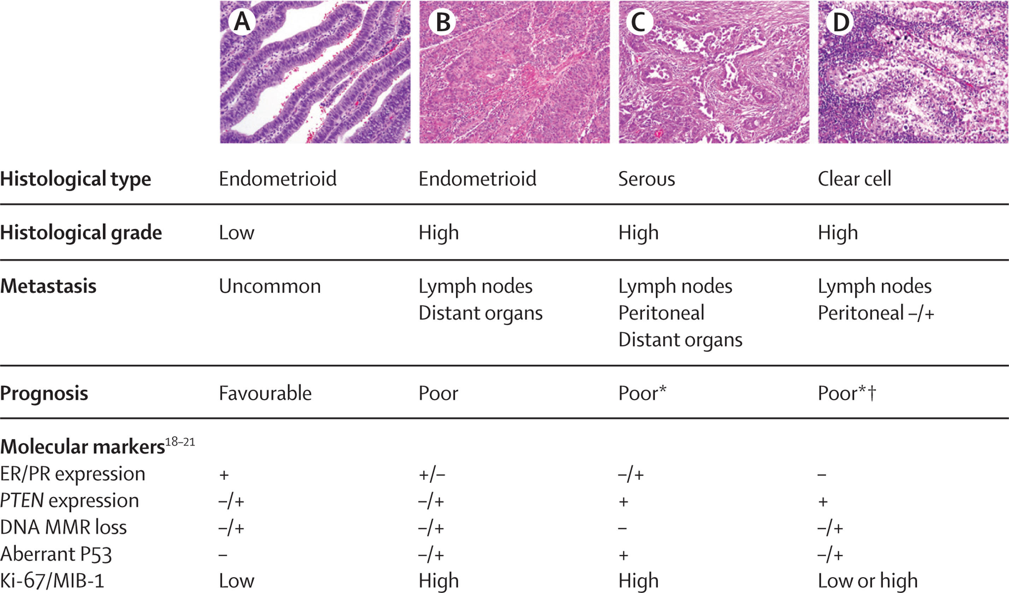
ENDOMETRIAL CANCER GENOMIC AND HISTOPAHTOLOGICAL FEATURES
Histological type | Endometrioid | Endometrioid | Serous | Clear cell
Histological grade | Low | High | High | High
Metastasis | Uncommon | Lymph nodes Distant organs | Lymph nodes Peritoneal Distant organs | Lymph nodes Peritoneal −/+
Prognosis | Favourable | Poor | Poor | Poor
Molecular markers ER/PR expression PTEN expression DNA MMR loss Aberrant P53 Ki-67/MIB-1 | + −/+ −/+ − Low | +/− −/+ −/+ −/+ High | −/+ + − + High | − + −/+ −/+ Low or high
DNA, deoxyribonucleic acid; ER, estrogen receptor; Ki-67, marker of proliferation Kiel-67; MIB-1, mindbomb e3 ubiquitin protein ligase 1; MMR, mismatch repair; P53, tumour protein p53; PR, progesterone receptor; PTEN, phosphatase and tensin homolog
Murali R, et al. Lancet Oncol. 2014;15:e268-e278

Slide 10
MOLECULAR CLASSIFICATION AND TREATMENT IMPLICATIONS
Molecular classification not only provides prognostic value but also serves as a
factor in selecting appropriate treatments
Molecular Group | Identifying features | Predominant Hystotypes | Prognosis (PFS at 5 yrs) | Treatment Implications
POLEmut | Mutational load | All expect serous carcinomas | 92-100% | Adjuvant treatment may not be required
dMMR | Mutational load | Endometroid carcinomas | 80-90% | Limited ChT benefit, improved response to IO
p53abn | Mutational load CNV | Serous, high grade endometroid carcinomas | 50% | Benefit from ChT + radiotherapy, PARPi or IO²
NSMP | Mutational load CNV | Low grade endometroid | 75%-80% | May benefit from hormonal therapy
ChT, chemotherapy; CNV, copy number variation; dMMR, deficient mismatch repair; IO, immuno-oncology; NSMP, no specific molecular profile; p53abn, p53 abnormal; PARPi, poly (ADP-ribose) polymerase inhibitor; PFS, progression-free survival; POLEmut, polymerase epsilon mutation; yrs, years
1.Baker-Rand H and Kitson SJ. Cancers (Basel). 2024;16:1028; 2. Yang Y, et al. Int J Gynaecol Obstet. 2024 Feb;164(2):436-459

Slide 11
METASTATIC EC: CURRENT 1L TREATMENT GUIDELINES
The latest ESMO guidelines (2022) recommend hormonal therapy or ChT as the 1st line treatment for metastatic EC¹
Recent research has focused on precision medicine, leading to the development of various targeted therapies, including Immune checkpoint inhibitors (ICI),^{2,3} tyrosine kinase inhibitors (TKIs)⁴ and PARP inhibitors (PARPis)^{5,6}
Many of these therapies have now received EMA and/or FDA approval, with expectations of their integration
into clinical guidelines in the near future⁷⁻¹¹
Recurrent/metastatic EC
ICI
TKI
Low-grade carcinomas with endometroid histology
Low-volume/indolent disease
Targeted Therapies
Hormonal therapy
Progestins (II, A)
AIs (III, C)
Tamoxifen (III, C)
Fulvestrant (III, C)
ChT
Carboplatin AUC 5-6 + paclitaxel 175 mg/m² every 21 days for 6 cycles (I, A)
Precision medicine
PARPi
1L, first-line; AI, aromatase inhibitor; AUC, area under the curve; ChT, chemotherapy; EC, endometrial cancer; EMA, European Medicines Agency; ESMO, European Society for Medical Oncology; FDA, United States Food and Drug Administration
1. Oaknin A, et al. Ann Oncol. 2022;33:860-77; 2. Mirza MR, et al. N Engl J Med. 2023;388(23):2145-2158; 3. Eskander RN, et al. N Engl J Med. 2023;388:2159-2170; 4. Marth C, et al. Int J Gynecol Cancer. 2022;32(1):93-100; 5. Westin SN, et al. J Clin Oncol. 2024;42:283-299; 6. Westin SN, et al. J Clin Oncol. 2024;42:3262; 7. GSK press release (December 2023). Available here (accessed November 2024). 8. GSK press release (August 2024). Available here (accessed November 2024); 9. Merck press release (October 2024). Available here (accessed November 2024); 10. Flaherty C (August 2024). Available at: https://www.onclive.com/view/durvalumab-based-combos-win-eu-approval-for-advanced-recurrent-endometrial-cancer (accessed November 2024); 11. Ryan C (June 2024). Available at: https://www.onclive.com/view/fda-approves-durvalumab-plus-chemotherapy-for-dmmr-primary-advanced-or-recurrent-endometrial-cancer (accessed November 2024)

Slide 12
CLINICAL SCENARIO

Slide 13
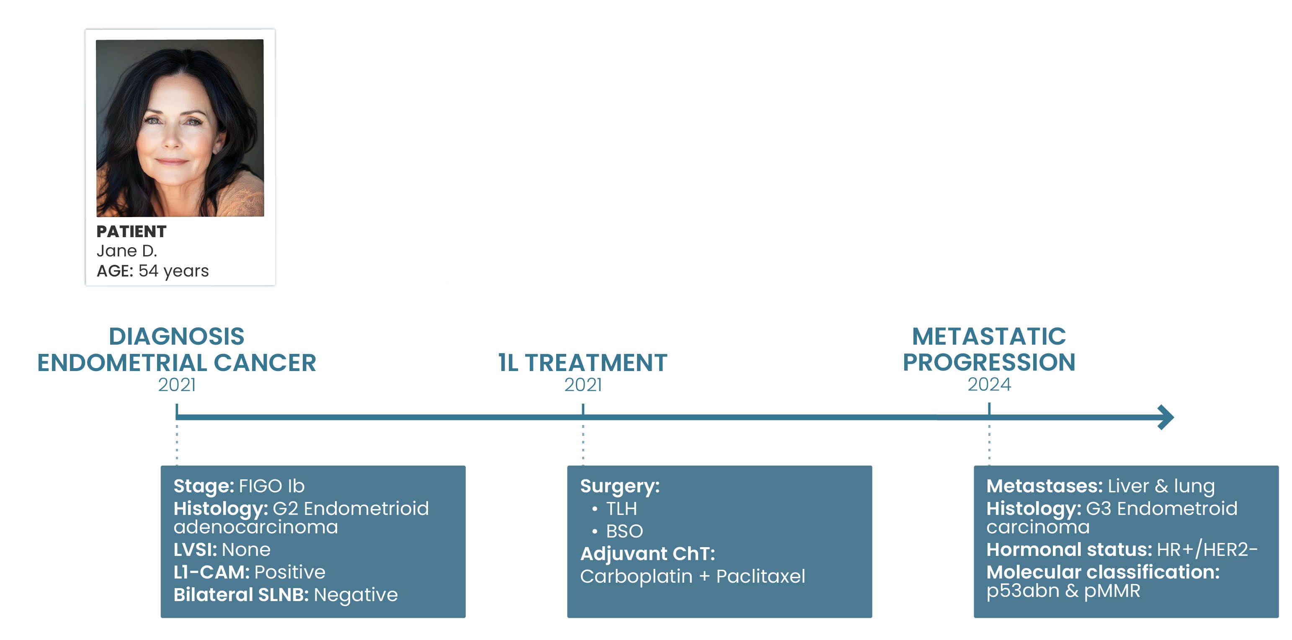
PATIENT CASE: p53abn & pMMR METASTATIC EC
Which first-line targeted therapy options are available to patients like Jane?
1L, first line; BSO, bilateral salpingo-oophorectomy; ChT, chemotherapy; EC, endometrial cancer; FIGO Ib, International Federation of Gynecology and Obstetrics stage Ib; G2/3, grade 2/3; HER2, human epidermal growth factor receptor 2; HR, hormone receptor; L1-CAM, L1 cell adhesion molecule; LVSI, lymphovascular space invasion; p53abn, p53 abnormality; pMMR, proficient mismatch repair; SNLB, sentinel lymph node biopsy; TLH, total laparoscopic hysterectomy

Slide 14
IMMUNO CHECKPOINT INHIBITORS

Slide 15
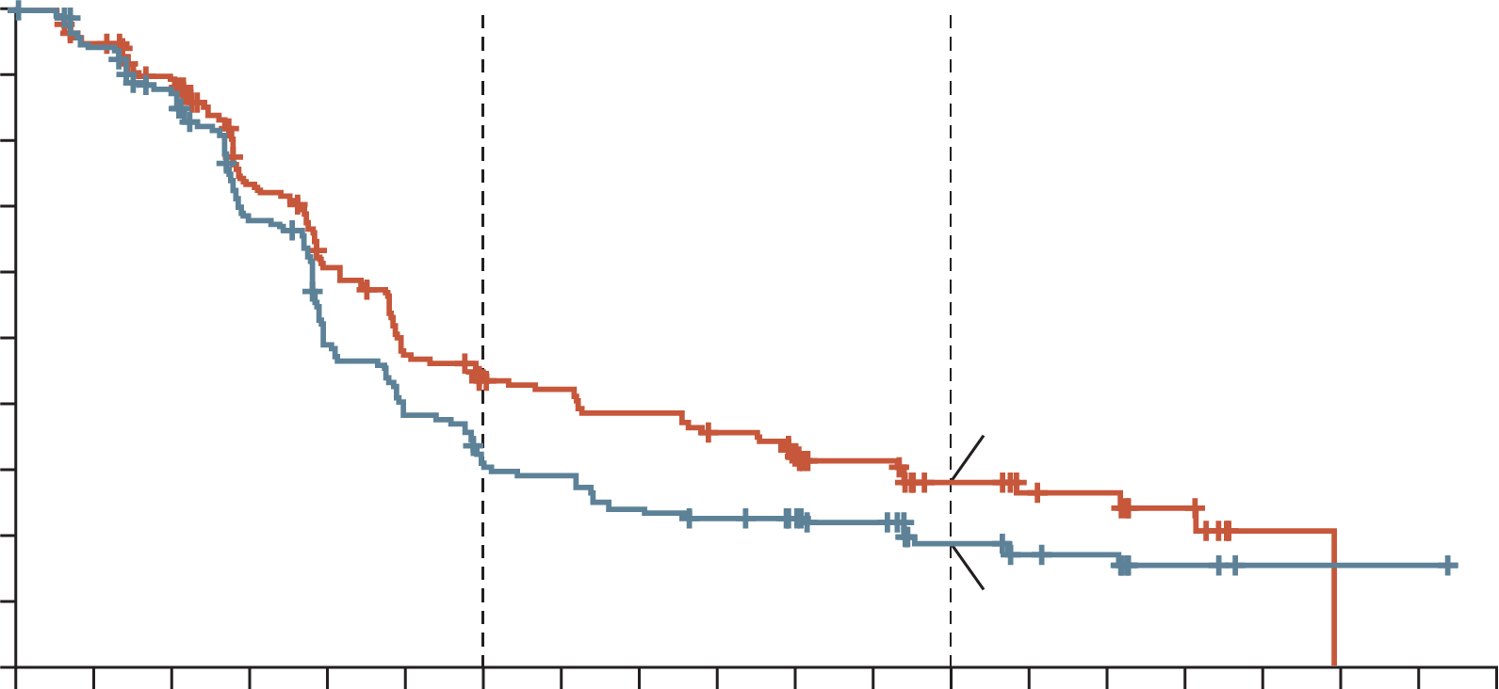
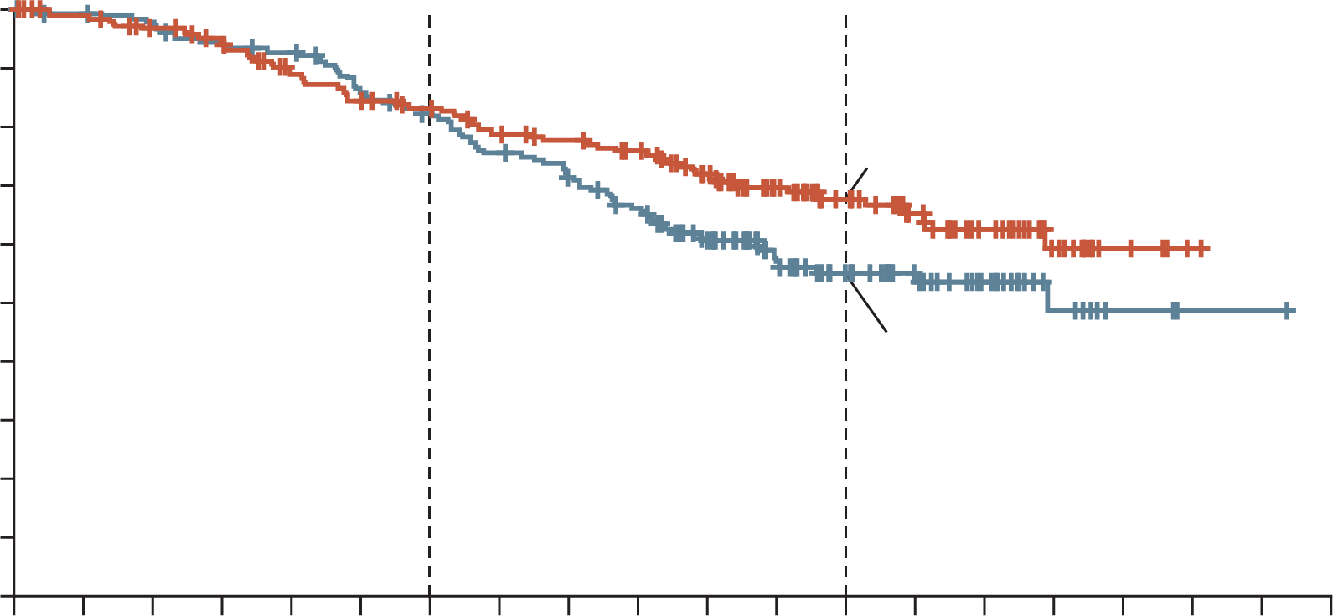
RUBY TRIAL: DOSTARLIMAB + ChT SHOWED IMPROVED PFS & OS RESULTS IN pMMR POPULATION VS ChT ALONE
Dostarlimab benefit in pMMR–MSS population: Although less pronounced than in the dMMR–MSI-H group, efficacy was consistent for progression-free and overall survival
PFS RESULTS
OS RESULTS
HR 0.76
HR 0.73
100
(95% CI, 0.59 to 0.98)
100
(95% CI, 0.52 to 1.02)
90
90
Dostarlimab group
80
80
67.7 (95% CI, 59.8-74.4)
70
70
60
60
Placebo group
Progression-free survival (%)
Dostarlimab group
Overall survival (%)
50
50
40
28.4 (95% CI, 21.2-36.0)
40
55.1 (95% CI, 46.8-62.5)
30
30
20
Placebo group
20
10
18.8 (95% CI,
12.8-25.7)
10
0
0
0
2
4
6
8
10
12
14
16
18
20
22
24
26
28
30
32
34
36
38
0
2
4
6
8
10
12
14
16
18
20
22
24
26
28
30
32
34
36
38
Months since randomisation
Months since randomisation
Safety analysis in the overall population showed a 10% higher incidence of grade ≥3 AEs with dostarlimab,
while chemotherapy discontinuation rates and QoL remained similar between the two groups
Aes, adverse events; ChT, chemotherapy; CI, confidence interval; dMMR, deficient mismatch repair; HR, hazard ratio; MSI-H, microsatellite instability-high; MSS, microsatellite stable; OS, overall survival; pMMR, proficient mismatch repair; PFS, progression-free survival; QoL, quality of life
Mirza MR, et al. N Engl J Med. 2023;388(23):2145-2158

Slide 16
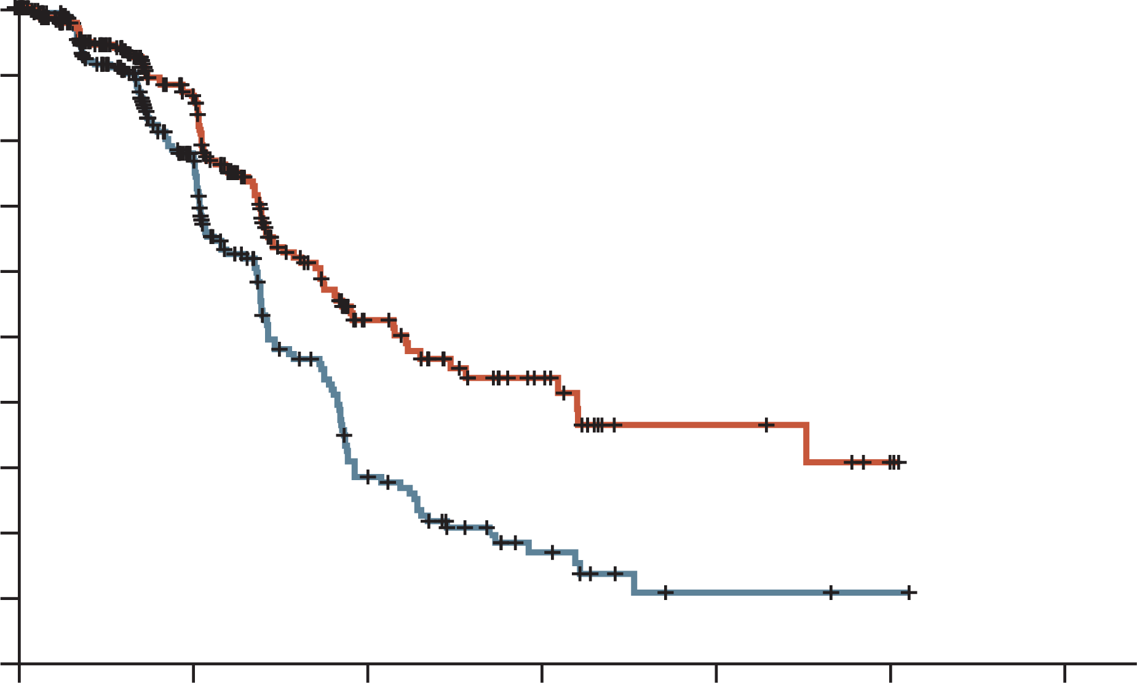
NRG-GY018 TRIAL: SUBGROUP ANALYSIS OF PFS IN pMMR POPULATION FAVORS PEMBROLIZUMAB + ChT vs ChT ALONE
PEMBRO + ChT was associated with longer PFS compared to placebo in patients with pMMR endometrial cancers, although greater benefits were observed in dMMR population
PFS RESULTS
GRADE ≥3 ADVERSE EVENTS
1.0
0.9
HR 0.54
(95% CI, 0.41 to 0.71)
0.8
0.7
0.6
Probability of progression-free
survival
Paclitaxel–carboplatin+
pembrolizumab
0.5
Percentage of patients
0.4
0.3
0.2
Paclitaxel–carboplatin+
placebo
0.1
0.0
0
6
12
18
24
30
36
Months
pMMR cohort
Frequency of grade ≥3 AEs increased with the addition of pembrolizumab to combination chemotherapy
AE, adverse event; ChT, chemotherapy; HR, hazard ratio; PEMBRO, pembrolizumab; PFS, progression-free survival; p/dMMR, proficient mismatch repair
Eskander RN, et al. N Engl J Med. 2023;388:2159-2170

Slide 17
TYROSINE KINASE INHIBITORS

Slide 18
ENGOT-en9/LEAP-001 TRIAL DESIGN: PEMBROLIZUMAB + LENVATINIB IN 1L TREATMENT OF ENDOMETRIAL CANCER^{1,2}
Key eligibility criteria
Stage III, Stage IV or recurrent endometrial carcinomaª
Radiographically apparent disease – either measurable or non-measurable
No prior chemotherapy except in the neo/adjuvant setting^{b}
ECOG PS 0-1
Tumour tissue sample for MMR testing
Lenvatinib 20 mg orally QD until PD
+
Pembrolizumab 200 mg IV Q3W
until PD or ×35 cycles
R (1:1)
N=842²
Paclitaxel 175 mg/m² IV Q3W
+
Carboplatin AUC 6 IV Q3W
×7 cycles^{c}
Stratification factors
MMR status (pMMR vs dMMR)
If pMMR
  ECOG PS (0 vs 1)
  Measurable disease (yes vs no)
  Prior chemotherapy and/or chemoradiation (yes vs no)
Endpoints
Dual primary: PFS per RECIST v1.1 by BICR and OS
Secondary: ORR per RECIST v1.1 by BICR, safety, and HRQoL
Exploratory: Included DoR per RECIST v1.1 by BICR
ª Carcinosarcoma (malignant mixed Müllerian tumour), endometrial leiomyosarcoma or other high-grade sarcomas, or endometrial stromal sarcomas excluded
^{b} 1 prior line of neoadjuvant and/or adjuvant chemotherapy in the setting of curative-intent resection was permitted if recurrence occurred ≥6 months after last dose; prior radiotherapy with or without chemotherapy, or prior hormonal therapy were also permitted
^{c} Patients with ongoing clinical benefit could continue chemotherapy beyond 7 cycles if approved by sponsor
1L, first-line; AUC, area under the curve; BICR, blinded independent central review; DoR, duration of response; ECOG PS, Eastern Cooperative Oncology Group performance status; HRQoL, health-related quality of life; IV, intravenous; ORR, objective response rate; OS, overall survival; PD, progressive disease; (p/d)MMR, (proficient/deficient) mismatch repair; PFS, progression-free survival; QD, once daily; Q3W, every 3 weeks; R, randomised; RECIST, Response Evaluation Criteria In Solid Tumours
1. Marth C, et al. Int J Gynecol Cancer. 2022;32:93-100; 2. Marth C, et al. Gynecol Oncol. 2024;190 (suppl. 1):S63-S64. Presented at SGO Annual Meeting on Women’s Cancer 2024 (22 [LBA])

Slide 19
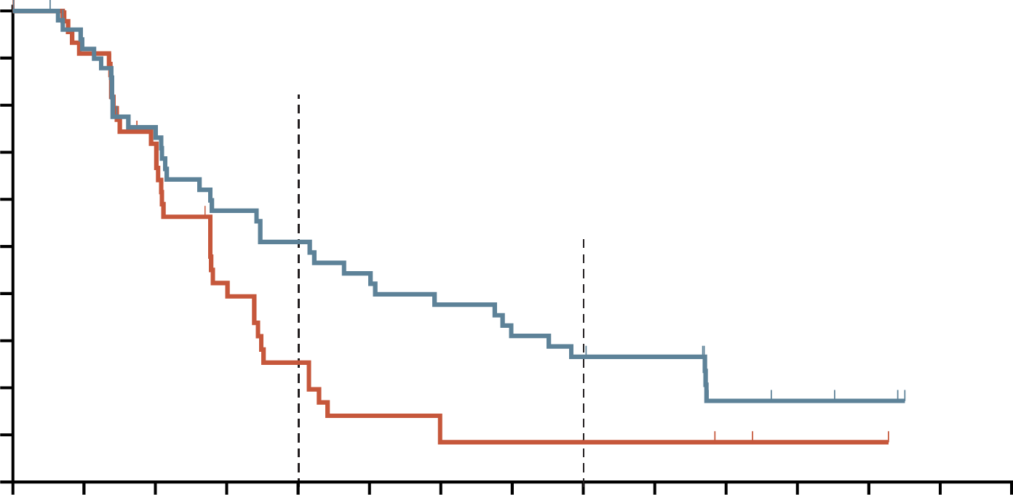
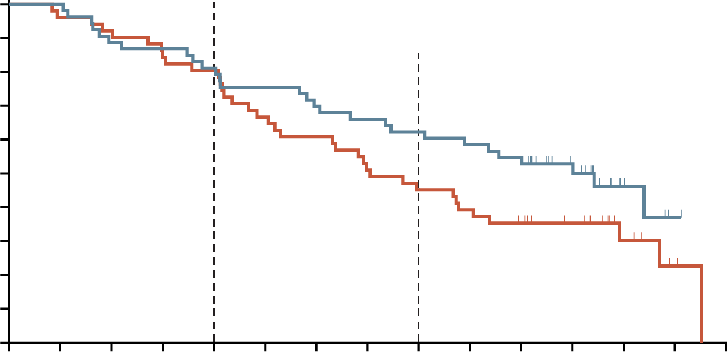
ENGOT-en9/LEAP-001 TRIAL: PFS & OS IMPROVED WITH LEN/PEMBRO VS TPC IN PRIOR (NEO)ADJUVANT ChT pMMR SUBGROUP
LEN/PEMBRO was approved based on the KEYNOTE-775 trial for aEC (non-MSI-H/dMMR) after prior systemic therapy in any setting.¹ The ENGOT-en9/LEAP-001 trial further confirms its effectiveness as a 1st line option in this population
PFS RESULTS²
OS RESULTS²
100
100
81.1%
80.4%
90
90
80
51.0%
25.4%
80
62.3%
45.1%
70
70
60
60
Progression-free
survival (%)
50
26.6%
8.5%
50
Overall survival (%)
40
40
30
30
20
20
10
10
0
0
0
3
6
9
12
15
18
21
24
27
30
33
36
39
42
0
3
6
9
12
15
18
21
24
27
30
33
36
39
42
Number at risk
LEN/PEMBRO
TC
Time (months)
Number at risk
LEN/PEMBRO
TC
Time (months)
53
51
45
40
34
28
26
15
23
9
20
5
17
3
14
3
12
3
11
3
4
2
3
1
2
1
0
0
0
0
53
51
53
49
47
47
46
43
43
41
40
34
37
31
35
26
33
23
31
20
28
17
18
13
6
6
1
2
0
0
 | LEN/PEMBRO | TPC
Events, n/N | 37/53 | 35/51
Median PFS (95% CI), mo | 12.5 (6.5-20.3) | 8.3 (6.1-10.2)
HR (95% CI) | 0.60 (0.37-0.97)
 | LEN/PEMBRO | TPC
Events, n/N | 28/53 | 36/51
Median OS (95% CI), mo | 34.2 (22.0-NR) | 21.1 (15.1-28.1)
HR (95% CI) | 0.67 (0.41-1.11)
ChT, chemotherapy;CI, confidence interval; HR, hazard ratio; LEN, lenvatinib; mo, months; MSI-H, microsatellite instability-high; NR, not reached; OS, overall survival; p/dMMR, proficient/deficient mismatch repair; PEMBRO, pembrolizumab; PFS, progression-free survival; TPC, treatment of physician’s choice
1. FDA grants regular approval to pembrolizumab and lenvatinib for advanced endometrial carcinoma. Available here (accessed November 2024); 2. Marth C, et al. Gynecol Oncol. 2024;190 (suppl. 1):S63-S64. Presented at SGO Annual Meeting on Women’s Cancer 2024 (22 [LBA])

Slide 20
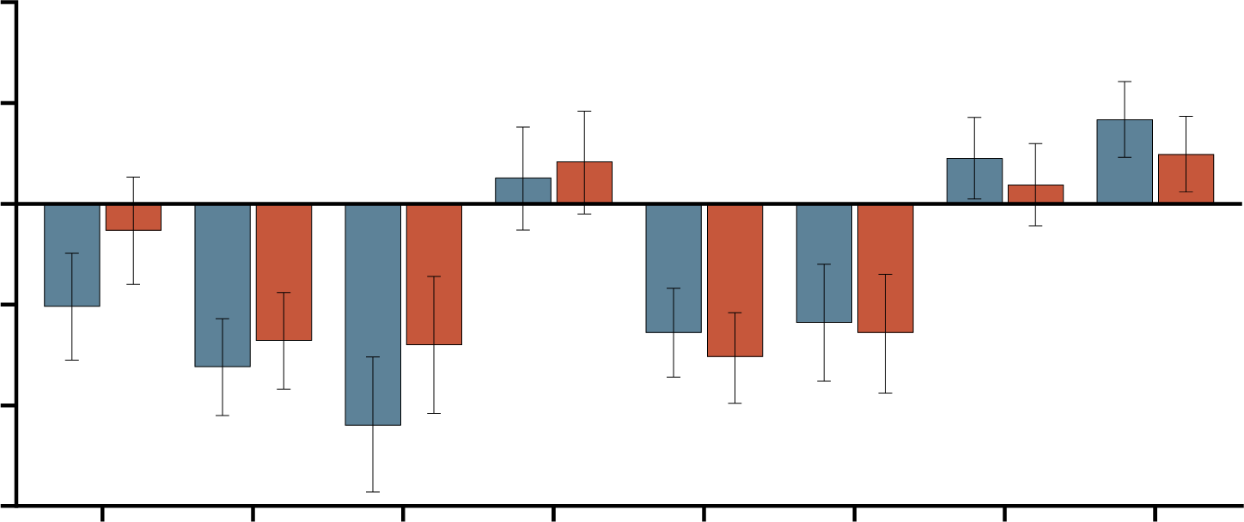
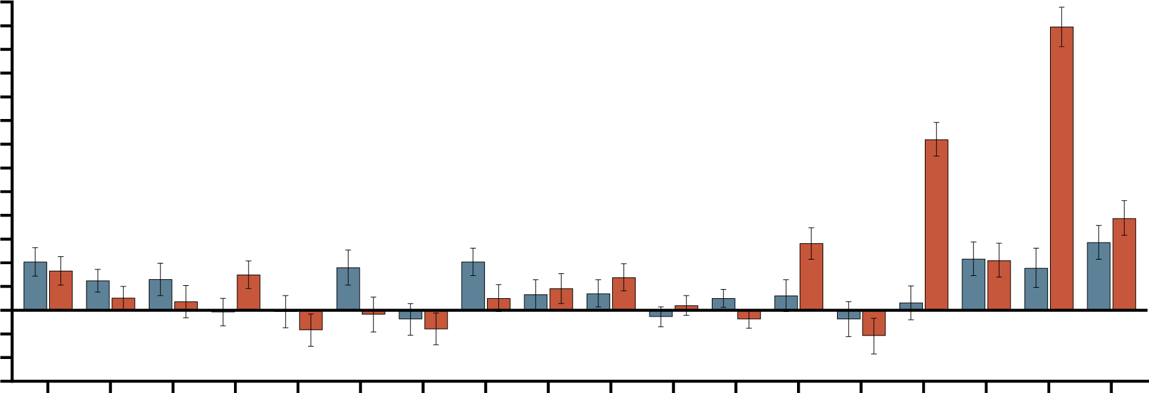
ENGOT-en9/LEAP-001 TRIAL: CHANGES IN EORTC QLQ-C30 & QLQ‑EN24 SCALE SCORES FROM BASELINE TO WEEK 18 IN pMMR COHORT
HRQoL outcomes were similar between LEN/PEMBRO and TPC across most QoL scales; however, LEN/PEMBRO was associated with lower incidences of neuropathy and alopecia compared to TPC
10
EORTC QLQ-C30
QLQ-EN24
LEN/PEMBRO
TPC
65
60
55
45
40
35
30
25
20
15
10
5
0
−5
−10
−15
LEN/PEMBRO
TPC
5
0
LS Mean Score Change
From Baseline (95% CI)
LS Mean Score Change
From Baseline (95% CI)
−5
−10
−15
Sexual
interest
Sexual
activity
Fatigue
Pain
Insomnia
Hair loss
GHS/QoL
Physical
functioning
Role
functioning
Emotional
functioning
Cognitive
functioning
Social
functioning
Dyspnoea
Diarrhoea
Constipation
Appetite loss
Lymphoedema
GI symptoms
Muscular pain
Taste change
Poor body image
Financial difficulties
Tingling/numbness
Nausea and vomiting
Urological symptoms
Pain in back and pelvis
AEs of interest were generally consistent with those observed for pembrolizumab monotherapy
with exception of increased rates of thyroid abnormalities (hypo/hyperthyroidism) and colitis
AE, adverse event; CI, confidence interval; EORTC, European Organisation for Research and Treatment of Cancer; GHS, global health status; HRQoL, health-related quality of life; LEN, lenvatinib; LS, least squares; PEMBRO, pembrolizumab; pMMR, proficient mismatch repair; QLQ-C30, quality of life questionnaire core 30; QLQ-EN24, quality of life questionnaire endometrial cancer module 24; QoL, quality of life; TPC, treatment of physician’s choice
Marth C, et al. Gynecol Oncol. 2024;190 (suppl. 1):S63-S64. Presented at SGO Annual Meeting on Women’s Cancer 2024 (22 [LBA])

Slide 21
PARP inhibitors
PARP, poly (ADP-ribose) polymerase

Slide 22
DUO-E TRIAL DESIGN: DURVALUMAB + ChT FOLLOWED BY DURVALUMAB +/- OLAPARIB AS 1L TREATMENT FOR aEC
Chemotherapy phase
6 cycles
Maintenance phase
Patients
Newly diagnosed FIGO stage III/IV or recurrent endometrial cancer
Known MMR status
Naïve to first-line systemic anticancer treatment
Naïve to PARP inhibitors and immune-mediated therapy
Adjuvant chemotherapy allowed if ≥12 months from last treatment to relapse
All histologies except sarcomas
Paclitaxel-carboplatin q3w
+
durvalumab placebo IV q3w
Durvalumab placebo IV q4w
+
olaparib placebo tablets bid
Control
R
1:1:1
Paclitaxel-carboplatin q3w
+
Durvalumab 1,120 mg IV q3w
Durvalumab 1,500 mg IV q4w
+
olaparib placebo tablets bid
Durvalumab
Patients without disease progression
Stratified by:
MMR status (proficient vs deficient)
Disease status (recurrent vs newly diagnosed)
Geographic region (Asia vs RoW)
Durvalumab
+ olaparib
Paclitaxel-carboplatin q3w
+
Durvalumab 1,120 mg IV q3w
Durvalumab 1,500 mg IV q4w
+
olaparib 300 mg tablets bid
Maintenance therapy continued until disease progression, unacceptable toxicity, or other discontinuation criteria were met
1L, first-line; aEC, advanced endometrial cancer; bid, twice daily; ChT, chemotherapy; FIGO, International Federation of Gynecology and Obstetrics; IV, intravenous; MMR, mismatch repair; PARP, poly (ADP-ribose) polymerase; q3/4w, every 3/4 weeks; R, randomised; RoW, rest of world
Westin SN, et al. J Clin Oncol. 2024;42:283-299 (including supplement); Westin SN, et al. J Clin Oncol. 2024;42:3262

Slide 23
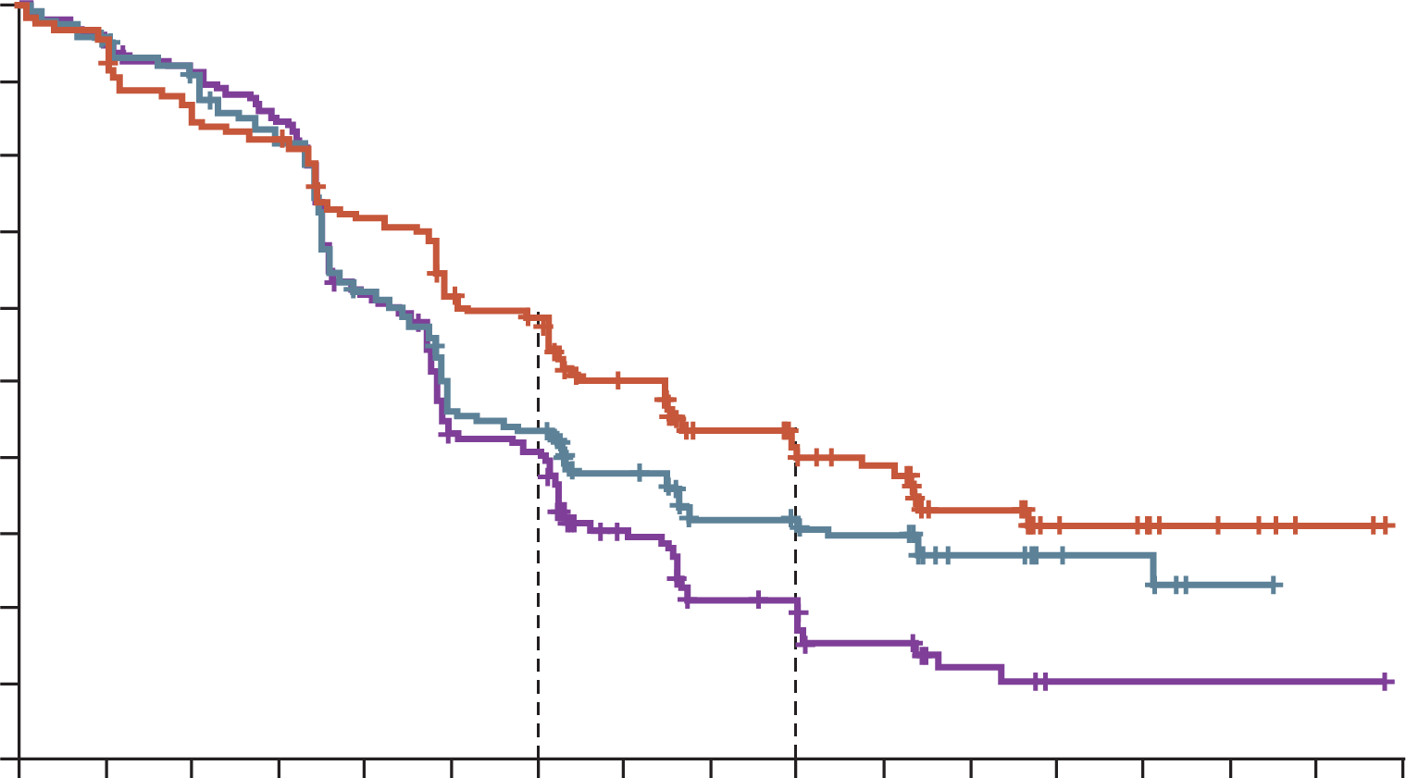
DUO-E TRIAL: DURVALUMAB IMPROVED PFS VS CONTROL IN pMMR SUBGROUP WITH ADDED BENEFIT FROM MAINTENANCE OLAPARIB
PFS benefit was observed for durvalumab + olaparib arm versus control in pMMR subgroup, although the greatest benefit was seen in the dMMR subgroup
100
HR 0.57 (CP+D+O arm)
Summary of AEs in the overall population
90
12 months
59.4%
44.4%
40.8%
(95% CI, 0.44 to 0.73)
80
 | Overallª |  |  | Maintenance Phase
 | D + O (n=238) | D (n=235) | CP (n=236) | D + O (n=192) | D (n=183) | CP (n=169)
Grade ≥3 AE (%) | 67.2 | 54.9 | 56.4 | 41.1 | 16.4 | 16.6
AE leading to death (%) | 2.1 | 1.7 | 3.4 | 1.6 | 0 | 1.2
Immune-mediated AEs (%) | 23.5 | 28.1 | 6.8 | 14.1 | 14.8 | 3.6
AEs leading to discontinuation (%) | 24.4 | 20.9 | 18.6 | 14.1 | 6.0 | 4.1
70
18 months
42.0%
31.3%
20.0%
60
Progression-free survival (%)
50
40
CP+D+O arm
30
20
CP+D arm
10
CP arm
0
0
2
4
6
8
10
12
14
16
18
20
22
24
26
28
30
32
Months
In the overall population, although there was a higher rate of grade ≥3 AEs in the durvalumab + olaparib arm, the safety profiles of each arm were generally consistent with the known profiles of individual components of the regimen
ª ChT Phase + Maintenance Phase
AE, adverse events; CP, carboplatin; D, durvalumab; O, olaparib; PFS, progression-free survival; p/dMMR, proficient/deficient mismatch repair; HR, hazard ratio
Westin SN, et al. J Clin Oncol. 2024;42:283-299

Slide 24
PATIENT COMMUNICATION &
SHARED DECISION-MAKING

Slide 25
THE SHARE APPROACH—ESSENTIAL STEPS OF SHARED DECISION-MAKING (SDM)
The SHARE Model guides effective SDM in clinical practice, with patient education as the core focus. Key topics for patients with aEC includeª:
  Molecular Classification
  Simplify the explanation of molecular subtypes and their impact on treatment options to empower informed decisions and build trust
  Risks and Benefits of Combination Therapy
  Explain targeted combinations (e.g. DURV/OLA, LEN/PEMBRO) and their side effects transparently. Discuss QoL outcomes to help patients weigh pros and cons and engage in SDM
STEP 1
Seek your
patient’s
participation
STEP 2
Help your
patient
explore
& compare
treatment
options
STEP 3
Communicate
that a choice
exists and
encourage
your
patient to
become
involved in the
conversation
Asses your
patient’s
values &
preferences
STEP 4
Reach a
decision
with your
patient
STEP 5
Discuss the
benefits and
risks of
each option
Evaluate your
patient’s
decision
Take into
account what
matters most
to your patient
Decide
together
on the
best option
Is the
decision
reasonable?
Any concerns?
ªExpert input
aEC, advanced endometrial cancer, DUR, durvalumab; LEN, lenvatinib; OLA, olaparib; PEMBRO, pembrolizumab; QoL, quality of life
SHARE approach. AHRQ. 2020. Available at: https://www.ahrq.gov/health-literacy/professional-training/shared-decision/tool/resource-2.html#ref1 (accessed October 2024)

Slide 26
CONCLUSION

Slide 27
CONCLUSION
Molecular classification is essential for both prognosis and guiding personalised treatment decisions¹
The combination of an ICI and ChT has demonstrated benefits for patients with pMMR status, including with maintenance olaparib. However, the greatest benefit for this combination is seen in the dMMR population²⁻⁵
Lenvatinib plus pembrolizumab is a viable option for advanced or recurrent endometrial cancer, particularly for pMMR patients who have progressed after any prior systemic
therapy, including (neo)adjuvant treatments⁶
Shared decision-making, reinforced by patient education, is crucial for optimising
treatment outcomes⁷
aEC, advanced endometrial cancer; ChT, chemotherapy; ICI, immune checkpoint inhibitor; p/dMMR, proficient/deficient mismatch repair
1. Baker-Rand H and Kitson SJ. Cancers (Basel). 2024;16:1028; 2. Mirza MR, et al. N Engl J Med. 2023;388(23):2145-2158; 3. Eskander RN, et al. N Engl J Med. 2023;388(23):2159-2170; 4. Westin SN, et al. J Clin Oncol. 2024;42:283-299; 5. Westin SN, et al. J Clin Oncol. 2024;42:3262; 6. Marth C, et al. Int J Gynecol Cancer. 2022;32:93-100; 7. SHARE approach. AHRQ. 2020. available from: https://www.ahrq.gov/health-literacy/professional-training/shared-decision/tool/resource-2.html#ref1 (accessed October 2024)

