Slide 2
Virtual experts knowledge share
HER2 testing: The evolving role of IHC - best practices and interpretation of results in lung and ovarian cancer
Tuesday 11th March 2025

Slide 3

Developed by PRECISION ONCOLOGY COnnect
This programme is developed by PRECISION ONCOLOGY CONNECT,
an international group of experts in the field of oncology.
Acknowledgement and disclosures
This PRECISION ONCOLOGY CONNECT programme is supported through an independent educational grant from AstraZeneca. The programme is therefore independent, the content is not influenced by the supporter and is under the sole responsibility of the experts.
Please note:
This educational programme is intended for healthcare professionals only.
The views expressed within this programme are the personal opinions of the experts. They do not necessarily represent the views of the experts’ academic institutions, organisations, or other group or individual.
Expert disclosures:
Prof. Fernando López-Ríos has received financial support/sponsorship for research support, consultation, or speaker fees from the following companies: AbbVie, AstraZeneca, Bayer, BMS, Daiichi Sankyo, Janssen, Lilly Merck, MSD, Novartis, Pfizer, Roche, Takeda and Thermo Fisher.
Prof. Christian Rolfo has received financial support/sponsorship for research support, consultation, or speaker fees from the following companies: ArcherDx, AstraZeneca, BMS, Boston Pharmaceuticals, Blueprint, Eisai, Inivata, Guardant Health, MD Serono, Mirati, MSD, Novartis, Pfizer and Roche.
Prof. Charlie Gourley has received financial support/sponsorship for research support, consultation, or speaker fees from the following companies: AstraZeneca, Apera, Clovis, MSD, NuCana, Novartis, Roche, Sierra Oncology and Tesaro.

Slide 4



MEETING OBJECTIVES
Provide Expert Opinion on HER2 immunohistochemistry in lung and ovarian cancer
focusing on best practices, which guidelines exist and scoring criteria to follow
Understand best practices in HER2 immunohistochemistry
Be able to implement optimal immunohistochemistry testing and scoring of staining
for HER2 expression
Recognise the appropriate placement of therapies targeting HER2 alterations
(including antibody-drug conjugates) across the patient journey in lung and ovarian cancers

Slide 5
Agenda: Tuesday 11th March 2025
HER2 testing: The evolving role of IHC - best practices and interpretation of results in lung and ovarian cancer
Topic | Facilitator | Timings
Welcome and introductions | COR2ED | 5 mins
1. Scene setting: an overview of challenges related to HER2 immunohistochemistry, guidance and interpretation of the results | Fernando López-Ríos | 10 mins
Q&A |  | 5 mins
2. Targeting HER2 in lung cancer: where does IHC fit in? | Christian Rolfo | 20 mins
Q&A | Fernando López-Ríos | 5 mins
3. Ovarian cancer: Challenges and considerations for HER2 IHC testing Including a patient case and polling questions | Charlie Gourley | 20 mins
Q&A | Fernando López-Ríos | 5 mins
Panel discussion and audience questions | All | 15 mins
Future perspectives and summary | Fernando López-Ríos | 5 mins

Slide 6



Introducing the scientific committee
Prof. Fernando López-Ríos
Pathologist
12 de Octubre University Hospital,
Madrid, Spain
Prof. Christian Rolfo
Medical Oncologist
The James, The Ohio State University, USA
Prof. Charlie Gourley
Medical Oncologist
CRUK Edinburgh Centre, Nicola Murray Centre for Ovarian Cancer Research, UK

Slide 7

An overview of challenges related to
HER2 immunohistochemistry
A CALL TO PROVE SOMETHING
Fernando López-Ríos MD, PhD
Pathologist
12 de Octubre University Hospital
Madrid, Spain
Notes:
And now it gives me great pleasure to hand you over to the chair of this session, Professor Fernando Lopez-rios for the first presentation

Slide 8
POLLING question
WHEN WOULD YOU ORDER HER2 IMMUNOHISTOCHEMISTRY AS A PREDICTIVE BIOMARKER IN A NEW PAN-TUMOUR PERSPECTIVE?
At diagnosis, simultaneously to diagnostic immunohistochemistry
After discussion at the clinical/molecular tumour board
After I receive the NGS report
I leave this decision to the pathologists

Slide 9
Contents
The challenge
The tool
The workflow
Further reading

Slide 10
Contents
The challenge
The tool
The workflow
Further reading

Slide 11
The challenge: a her2 (r)evolution
a pan-tumour perspective of her2 protein overexpression
Salivary gland cancer
Lung cancer
10-30%
15-20%
15-37%
40%
1-5%
15-30%
15%
3%
2%
1-3%
Breast cancer
Pancreatic cancer
28%
20%
10%
20%
2%
24%
8%
2-5%
2%
<1%
Biliary tract cancer
Gastric and gastroesophageal junction cancer
25-40%
15-20%
5-7%
5-15%
2%
18-20%
11-13%
11-14%
11-16%
3%
Uterine cancer
Colorectal cancer
8%
39%
13%
13%
2%
13-21%
4-8%
3%
5%
2%
Ovarian cancer
Urinary tract cancer
13%
20%
5%
15%
1%
4-18%
5-28%
22%
9%
10%
Cervical cancer
Prostate cancer
7%
14%
14%
1-3%
2%
13-35%
10-18%
5%
5%
<1%
HER2
IHC 1+
HER2
IHC 2+
HER2
IHC 3+
ERBB2
amplification
ERBB2
mutation
IHC, immunohistochemistry
Yoon J, Oh DY. Nat Rev Clin Oncol. 2024;21:675-700

Slide 12
Contents
The challenge
The tool
The workflow
Further reading

Slide 13
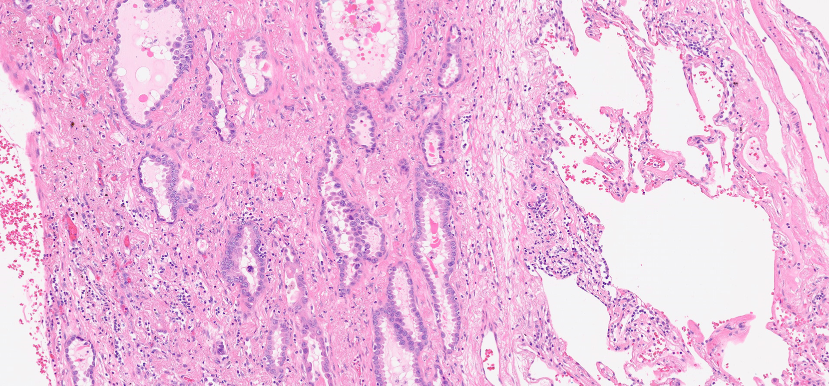
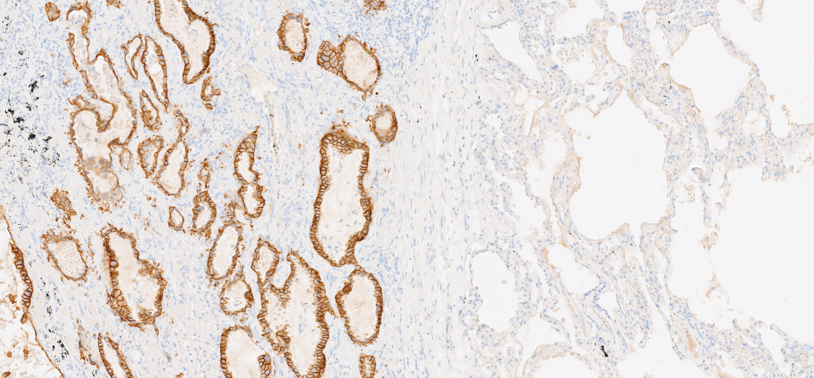

The tool
Her2 overexpression can be identified with immunohistochemistry
Image: Lung adenocarcinoma stained with the 4B5 clone (VENTANA), ×10 magnification. HERMES 196
Image provided by the presenter. Refer to the QR code for the full image

Slide 14
Contents
The challenge
The tool
The workflow
Further reading

Slide 15
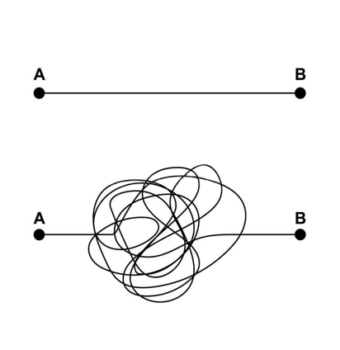
The workflow
how can I implement a high-quality her2 immunohistochemistry assay?
How long can my patients wait for the results?
Reflex testing at diagnosis
Remember Gall′s Law
If you want to build
a complex system that works,
build a simpler system first,
and then improve it over time
The reality?

Slide 16
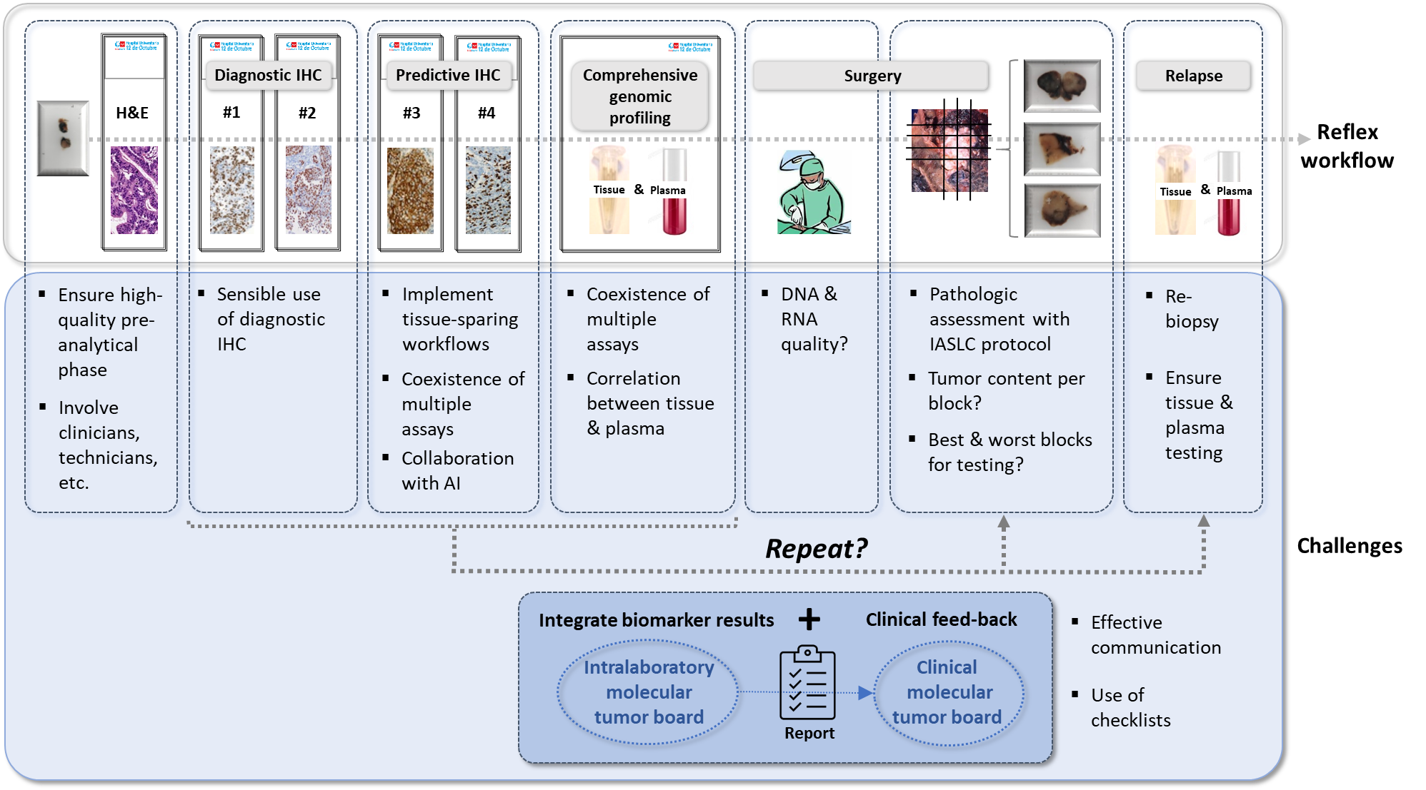


A patient-centred universal workflow for predictive biomarker testing
Diagnostic IHC
Predictive IHC
Comprehensive
genomic
profiling
Surgery
Relapse
H&E
#1
#2
#3
#4
Reflex
workflow
Tissue & Plasma
Tissue & Plasma
Ensure high-
quality pre-
analytical
phase
Involve
clinicians,
technicians,
etc.
Sensible use
of diagnostic
IHC
Implement
tissue-sparing
workflows
Coexistence
of multiple
assays
Collaboration
with AI
Coexistence
of multiple
assays
Correlation
between tissue
& plasma
DNA &
RNA
quality?
Pathologic
assessment with
IASLC protocol
Tumour content per
block?
Best & worst blocks
for testing?
Re-
biopsy
Ensure
tissue &
plasma
testing
Repeat?
Challenges
+
Effective
communication
Use of
checklists
Integrate biomarker results
Clinical feed-back
Clinical feed-back
Intra-laboratory
molecular
tumour board
Clinical
molecular
tumour board
Report
AI, artificial intelligence; H&E, hematoxylin and eosin; IASLC, International Association for the Study of Lung Cancer; IHC, immunohistochemistry
Figure adapted from Conde E, et al. Mod Pathol. 2022;35:1754-1756

Slide 17






Top SIX Pre-analytical factors for tissue quality
involve clinicians and technicianS
Time to stabilisation (cold ischemia time)
1 hour or less
Tissue processor variables
Processor maintenance daily per manufacturer’s recommendations
Quality of processing fluids rigorously maintained
  Maintenance of formalin purity and pH
  Attention to water (i.e. formalin) contamination of alcohol baths
Type of paraffin
  Low-melt paraffin (melts at <60⁰C)
Method of stabilisation
Fixative: 10% phosphate-buffered formalin, pH 7.0
Total time in formalin: at least 6 h, not more than 24-36 h (tissue with high fat content may require 48 h)
Acid decalcification, before or during stabilisation, is contraindicated for nucleic acid analyses
Storage conditions
Dry, pest-free conditions at room temperature
(defined as 18-25 ⁰C)
Method of processing
Specimen thickness not to exceed 4-5 mm
Volume to mass ratio 4:1 at a minimum, preferably 10:1, with tissue completely submerged
Documentation data for the aforementioned factors and/or deviations from the recommendations
Note: Tissue specimens considered unacceptable for molecular testing include desiccated tissues or those known to have been improperly collected or stored
h, hours
Compton CC, et al. Arch Pathol Lab Med. 2019;143:1346-1363

Slide 18

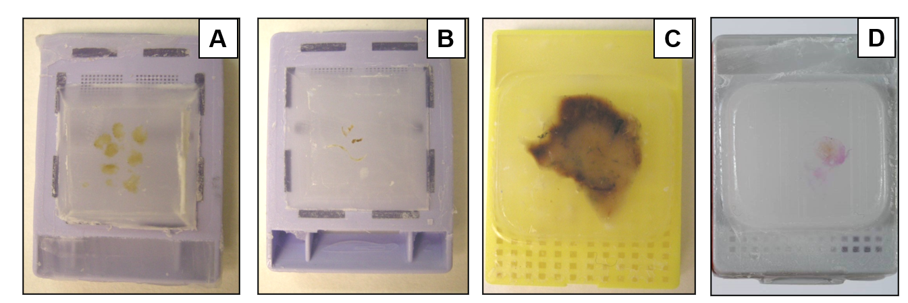
Pre-analytical phase
Choose wisely: adequate tumour cellularity
  Biopsy
  Core needle biopsy
  Surgical specimen
  Cell block
Formalin
fixed paraffin embedded (FFPE)
Tissue
Cytology
Personal communication, López-Ríos, F

Slide 19
Pre-analytical phase
less is more: sensible use of diagnostic ihc
Key questions and recommendations for diagnostic immunohistochemistry in lung cancer
Key questions | Short answers
What is the best combination of markers to use in daily practice? | When IHC is needed for the subtyping of NSCC, TTF1 and p40 are the criterion standard, and these two markers are usually sufficient in clinical practice if there are no morphologic features of NE differentiation. p40 is preferable to p63 to identify squamous cell carcinoma
What extent of TTF1- and p40-positive reactions should we consider to be positive? | Focal positivity for TTF1 is considered a positive reaction indicating pulmonary adenocarcinoma in the proper clinical context, whereas for p40 the cut-off rate should be positivity in more than 50% of tumour nuclei. Focal or weak positivity for p40 is not diagnostic or squamous cell carcinoma
Are there any staining differences in lung adenocarcinoma among TTF1 clones (SPT24, SP141 and 8G7G3/1)? | The staining performance of TTF1 varies among the clones. Among the most commonly used antibodies, 8G7G3/1 is the most specific antibody to identify lung adenocarcinoma
Should an NSCC that is diffusely positive for CK7 but negative for TTF1 and p40 be regarded as probably adenocarcinoma? | CK7 is not specific for adenocarcinoma; the marker can be seen in squamous cell carcinoma. The use of CK7 is discouraged for subtyping of NSCC
When should NE markers be applied to an NSCC? | NE markers should be applied only in support of NE morphology
What is the best antibody panel to differentiate NE tumours from other types of NSCC and which one is the most reliable? | A panel of chromogranin A, synaptophysin and CD56 is the best combination to identify NE tumours. The staining significance of each antibody varies among the sample types, histologic subtypes and extent and/or intensity of positive reactions
When should a proliferation marker be used in diagnosis? | The main established role of Ki-67 in lung carcinomas is to help distinguish carcinoids from high-grade NE carcinomas (large cell NE carcinoma and small cell carcinomas), especially in small or crushed biopsy or cytologic samples. The role of Ki-67 in separating typical from atypical carcinoids is not established and needs more investigation
IHC, immunohistochemistry; NE, neuroendocrine; NSCC, non-small cell carcinoma
Yatabe Y, et al. J Thorac Oncol. 2019;14:377-407

Slide 20
analytical phase
coexistence of multiple assays: follow the manufacturer’s protocols
Clinical trial | Assay | Scoring algorithm | Cut-off
DESTINY-Lung01¹ | VENTANA PATHWAY anti-HER-2/neu (4B5) | Gastric | IHC 2+ and 3+
 |  |  | ≥10% cut-off
DESTINY-Lung03² | Dako HercepTest mAb pharmDx (Dako Omnis) | Novel lung algorithm | IHC 2+ and 3+
 |  |  | ≥25% cut-off
DESTINY-PanTumor02³ | Dako HercepTest mAb pharmDx (Dako Omnis) | Gastric | IHC 2+ and 3+
 |  |  | ≥10% cut-off
IHC, immunohistochemistry; mAb, monoclonal antibody
1. Smit EF, et al. Lancet Oncol 2024;25:439-454; 2. Planchard D, et al. Abstract OA16.05, WCLC 2024 (oral presentation); 3. Meric-Bernstam F, et al. J Clin Oncol 2024;42:47-58

Slide 21
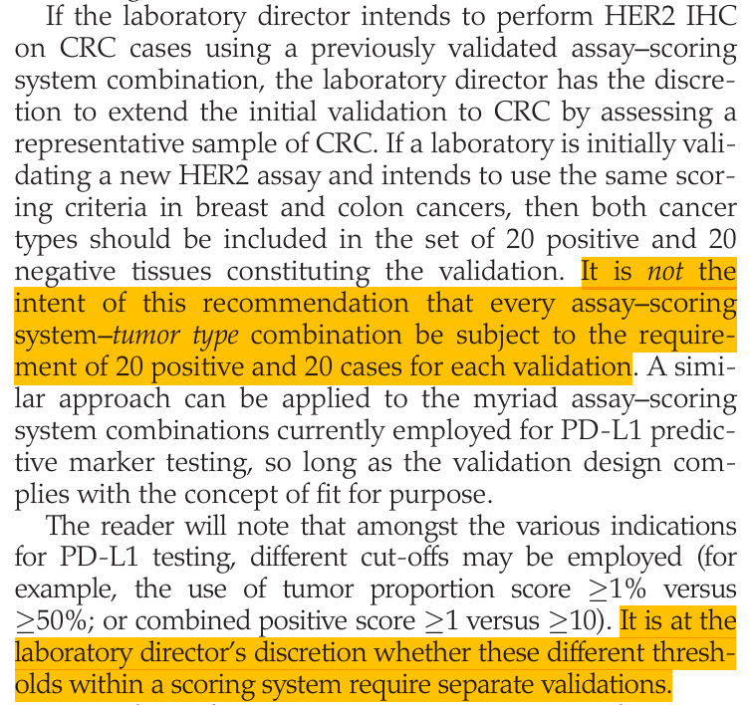
analytical phase
coexistence of multiple assays: avoid decision paralysis
Principles of analytic validation of immunohistochemical assays – Guideline update¹
CRC, colorectal carcinoma; IHC, immunohistochemistry
1. Goldsmith JD, et al. Arch Pathol Lab Med. 2024;148:e111-e153

Slide 22
interpretation
only definitive linear membrane staining should be scored
Reporting results of HER2 testing by immunohistochemistry (IHC) for trastuzumab-deruxtecan use based on the enrolment criteria for the DESTINY-PanTumor02 trial (NCT04482309)¹
Result | Criteria for surgical specimens | Criteria for biopsy specimens
Negative (Score 0) | No staining or membrane staining in less than 10% of tumour cells | No staining in any tumour cells
Negative (Score 1+) | Faint/barely perceptible incomplete membrane staining in greater than or equal to 10% tumour cells | Tumour cell clusterª with a faint/barely perceptible membrane staining irrespective of percentage of positive tumour cells
Equivocal (Score 2+) | Weak to moderate, complete, basolateral or lateral membrane staining in greater than or equal to 10% of tumour cells | Tumour cell clusterª with a weak to moderate, complete, basolateral or lateral membrane staining irrespective of percentage of positive tumour cells
Positive (Score 3+) | Strong, complete, basolateral or lateral membrane staining in greater than or equal to 10% of tumour cells | Tumour cell clusterª with a strong, complete basolateral or lateral membrane staining irrespective of percentage of positive tumour cells
ª Tumour cell cluster denotes five or more tumour cells
1. College of American Pathologists, Template for reporting results, December 2024. Available at: https://documents.cap.org/protocols/Gynecologic.Bmk_1.2.0.0.-REL.CAPCP.pdf (accessed February 2025)

Slide 23
interpretation
The magnification rule might be helpful
HER2 scores correlated with the size of the precipitates
Magnification | 40× | 20× | 10× | 5×
Consensus intensity-score | ‘1+’ | ‘2+’ |  | ‘3+’
Num. aperture | 0.65-0.75 | 0.40-0.50 | 0.25-0.30 | 0.12-0.15
Resolution (µm) | 0.40-0.46 | 0.60-0.75 | 1.0-1.20 | 2.0-2.50
DAB-precipitate width ± SD (µm) | 0.64 ± 0.1 | 1.0 ± 0.23 |  | 2.14 ± 0.4
40×
20×
10×
5×
1+
2+
3+
(µm)
0.0
0.5
1.0
1.5
2.0
2.5
3.0
3.5
100
80
60
Frequency
40
20
0
0.0
0.5
1.0
1.5
2.0
2.5
3.0
3.5
(µm)
DAB, diaminobenzidine; SD, standard deviation
Scheel AH, et al. Diagn Pathol. 2018;13:19

Slide 24
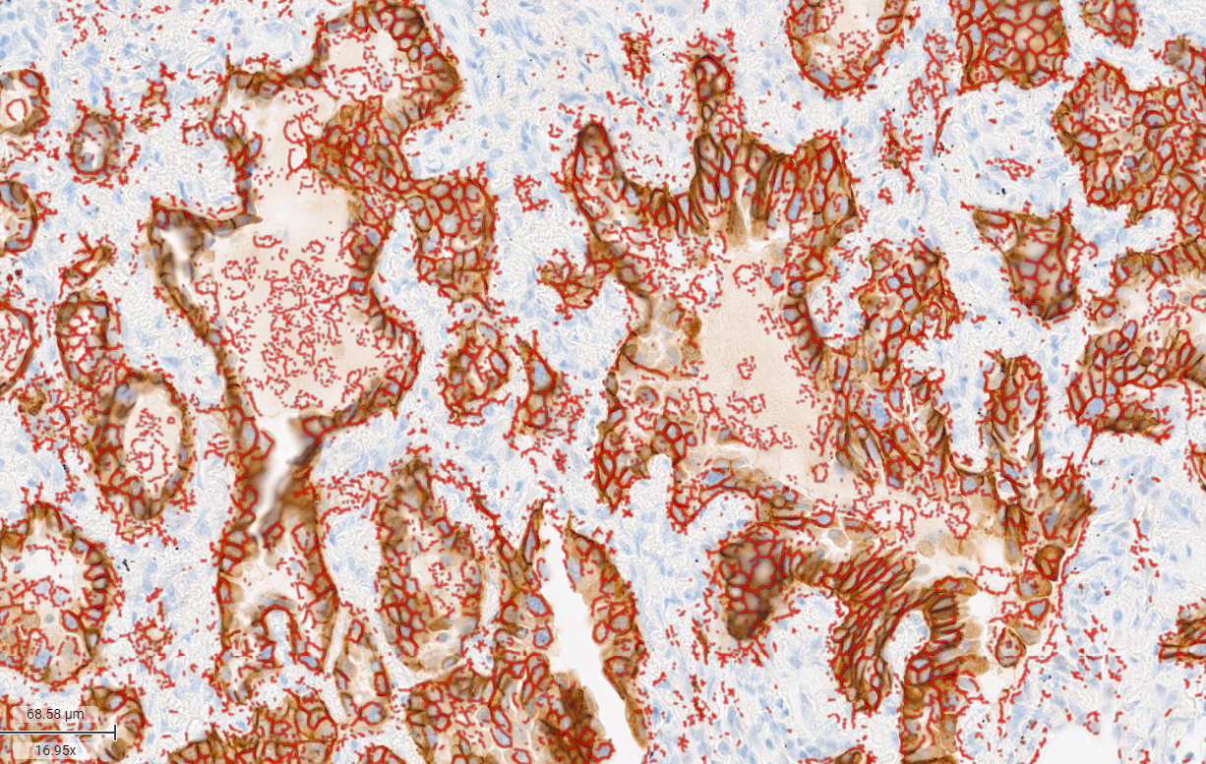
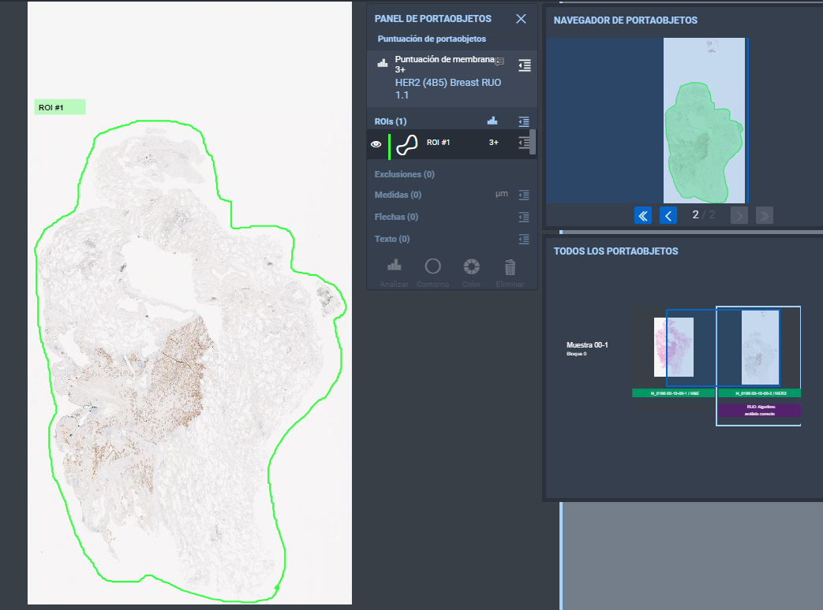
interpretation
Collaboration with AI
AI-powered HER2 analyzers may have the potential to:
Improve turnaround times
Enhance interobserver reproducibility by reducing variability in interpretation
AI, artificial intelligence;
Navify Digital Pathology (NDP)

Slide 25
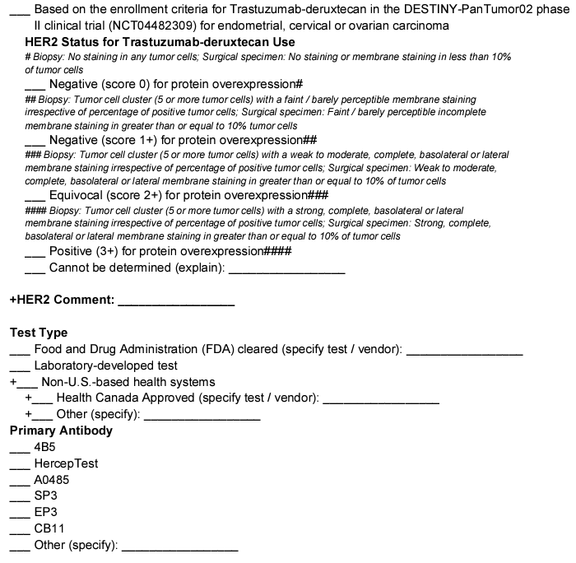
interpretation
checklist for ovarian carcinomas: Avoid being lost in translation
College of American Pathologists, Template for reporting results, December 2024. Available at: https://documents.cap.org/protocols/Gynecologic.Bmk_1.2.0.0.-REL.CAPCP.pdf (accessed February 2025)

Slide 26
interpretation
checklist for carcinomas: Avoid being lost in translation
Given the potential need for rescoring the HER2 expression depending on the clinical indication, the percentage of tumour cells with strong complete or basolateral/lateral membrane staining may be reported, in addition to the overall HER2 IHC result.
IHC, immunohistochemistry
College of American Pathologists, Template for reporting results, September 2023. Available at: https://documents.cap.org/protocols/IHC.Bmk_1.1.0.1.REL_CAPCP.pdf (accessed February 2025); College of American Pathologists, Template for reporting results, December 2024. Available at: https://documents.cap.org/protocols/Gynecologic.Bmk_1.2.0.0.-REL.CAPCP.pdf (accessed February 2025)

Slide 27
interpretation
checklist for carcinomas: Avoid being lost in translation
IHC, immunohistochemistry
College of American Pathologists, Template for reporting results, September 2023. Available at: https://documents.cap.org/protocols/IHC.Bmk_1.1.0.1.REL_CAPCP.pdf (accessed February 2025);

Slide 28
Contents
The challenge
The tool
The workflow
Further reading

Slide 29
Further reading
Compton CC, et al., Preanalytics and Precision Pathology: Pathology Practices to Ensure Molecular Integrity of Cancer Patient Biospecimens for Precision Medicine. Arch Pathol Lab Med. 2019 Nov;143(11):1346-1363
Goldsmith JD, et al., Principles of Analytic Validation of Immunohistochemical Assays: Guideline Update. Arch Pathol Lab Med. 2024 Jun 1;148(6):e111-e153
Yoon J, Oh DY. HER2-targeted therapies beyond breast cancer - an update. Nat Rev Clin Oncol. 2024 Sep;21(9):675-700

Slide 30
An overview of challenges related to HER2 immunohistochemistry
Q&A Session

Slide 31

Targeting her2 in lung cancer: where does THE Ihc TESTING fit in?
Prof. Christian Rolfo
Medical Oncologist
The James, The Ohio State University, USA

Slide 32


Her2 family and targets
Non-small cell lung cancer HER2 tumorigenesis pathways and targeted therapy mechanisms
TKIs block phosphorylation of the tyrosine kinase residues, inhibiting cell proliferation
Monoclonal antibodies bind to the extracellular domain of HER2 to block homo and heterodimerisation
ADCs incorporate the HER2-targeted actions of trastuzumab with a cytotoxic component (microtubule inhibitor or topoisomerase I inhibitor) connected by a cleavable tetrapeptide-based linker
afatinib
dacomitinib
pyrotinib
poziotinib
Tarloxotinib
neratinib
mobocertinib
lapatinib
trastuzumab
pertuzumab
T-DM1
T-DXd
HER2
HER3
2
HER1/EFGR
HER4
3
dimerization
1
PI3K
RAS
T-DM1
T-DXd
HER2
AKT
RAF
Endosome/lysosome
mTOR
MEK
DM1
(microtubule inhibition and
DNA damage)
ERK
DXd
(topoisomerase inhibition and
bystander antitumour effect)
nucleus
ADC, antibody-drug conjugate; T-DM1, trastuzumab emtansine; T-DXd, trastuzumab deruxtecan; TKI, tyrosine kinase inhibitor
Uy NF, et al. Cancers (Basel). 2022;14:4155

Slide 33
Actionable HER2 mutations in NSCLC
Frequency and location of HER2 mutations found in NSCLC¹
S310F
(5.1%)
Y772dupYVMA
(33.9%)
G776delinsVC
(5.7%)
Extracellular
Exon 18
Exon 19
Exon 20
Exon 21
Exon 22-
Exon 31
Transmembrane
G778dupGSP
(3.4%)
NCCN and ESMO guidelines recommend broad molecular profiling of
patients with NSCLC, including HER2 mutation testing^{2,3}
ESMO, European Society for Medical Oncology; NCCN, National Comprehensive Cancer Network; NSCLC, non small cell lung cancer;
1. Robichaux JP, et al. Cancer Cell. 2019:14;36:444-457; 2. Ettinger DS, et al. J Natl Compr Canc Netw. 2022;20:497-530;
3. Hendriks LE, et al. Ann Oncol. 2023;34:339-357

Slide 34
Types of HER2 alterations in NSCLC¹⁻⁵
Type | ERBB2 mutations | ERBB2 amplification | HER2 overexpression
Frequency (%) | 1-4¹ | 2-22⁵ | 7.7-23%⁵
Detection method | NGS, PCR¹ | FISH^{1,2} | IHC⁵
Different types of alterations seem to originate from different
mechanisms and induce different biological and clinical consequences¹⁻⁴
IHC, immunohistochemistry; NGS, next-generation sequencing; NSCLC, non-small cell lung cancer; PCR, polymerase chain reaction; FISH, fluorescence in‑situ hybridisation
1. Yu Y, et al. Cancer Treat Rev. 2023;114:102520; 2. Ricciardi GRR, et al. J Thorac Oncol. 2014;9:1750-1762; 3. Lai WV, et al. Eur J Cancer. 2019;109:28-35;
4. Peters S and Zimmermann S. Transl Lung Cancer Res. 2014;3:84-88; Mar N, et al. Lung Cancer. 2015;87:220-225; 5. Ren S, et al. ESMO Open. 2022;7:100395; Sholl LM., et al. J Thorac Oncol. 2015;10:768-777

Slide 35
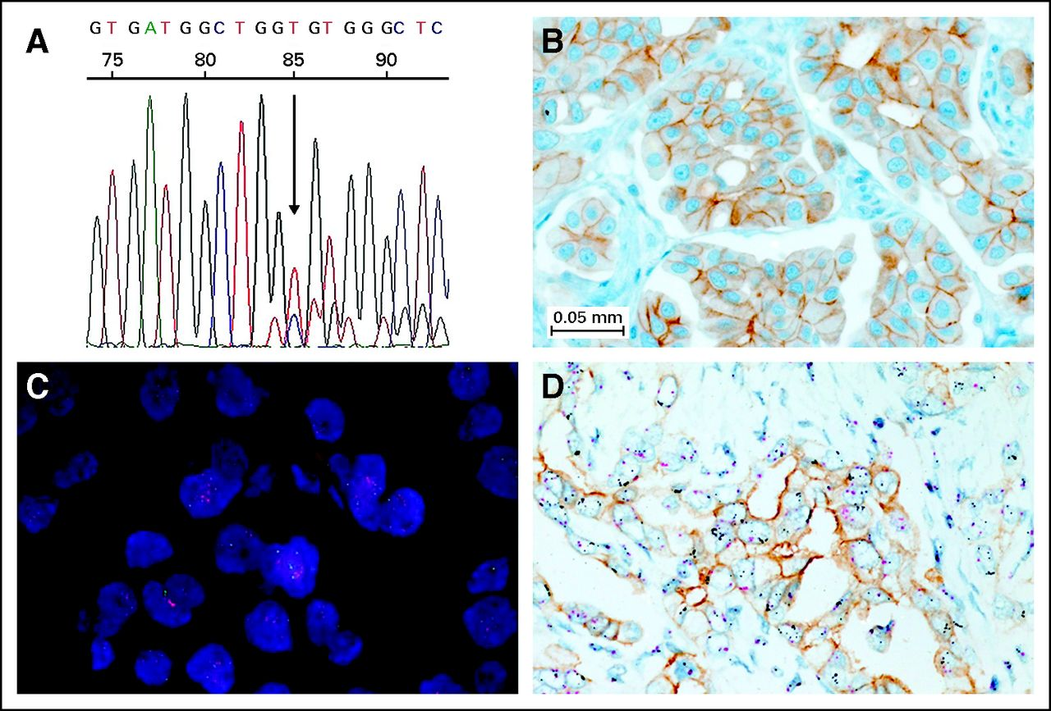
HER2 mutations in NSCLC methodology for detection
Sanger sequencing read with heterozygous HER2 exon 20 insertion
HER2 IHC with score 2+
FISH with HER2 amplification (HER2 in red; centromere 17 in green)
Tricolour visualisation of HER2 protein (in brown), HER2 gene (in black), and centromere 17 (in red)
FISH, fluorescence in situ hybridisation; IHC, immunohistochemistry; NSCLC, non-small cell lung cancer
Mazières J, et al. J Clin Oncol. 2013;31:1997-2003

Slide 36
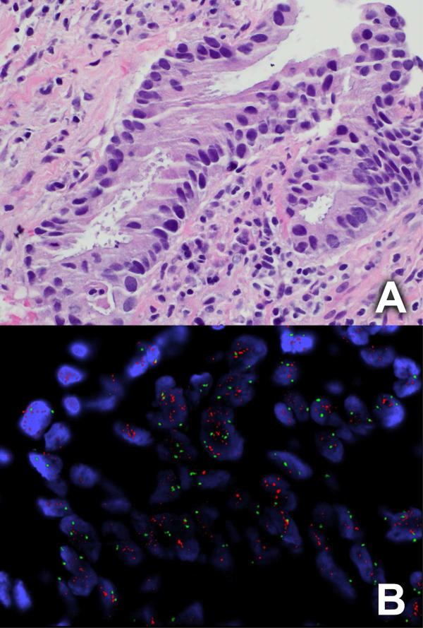
HER2 amplification in NSCLC
Diagnostic
Hematoxylin and eosin
FISH
Representative images of lung adenocarcinoma with HER2 gene amplification
FISH, fluorescence in-situ hybridisation; NSCLC, non-small cell lung cancer
Li BT, et al. J Thorac Oncol. 2016;11:414-419

Slide 37
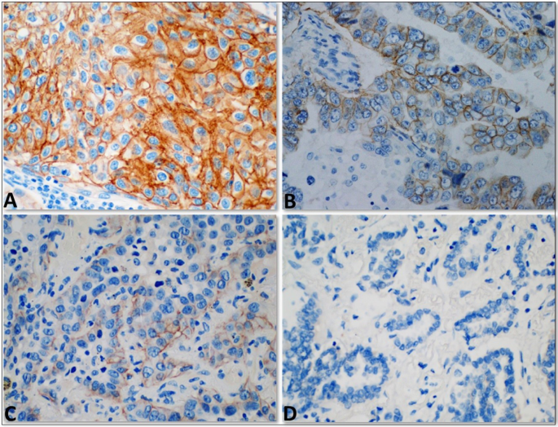
HER2 overexpression in NSCLC using IHC
Diagnostic
HER2 3+
HER2 2+
HER2 1+
HER2 0
Representative images of HER2 IHC
IHC, immunohistochemistry; NSCLC, non small cell lung cancer
Abu Al Karsaneh O, et al. Diagn Pathol. 2023;18:75

Slide 38
evaluation of HER2 protein expression by IHC assay an algorithm¹
HER2 testing (invasive component) by validated IHC assay
Batch controls and on-slide controls show appropriate staining
Circumferential membrane staining that is complete, intense, and in >10% of tumour cells
Weak or moderate complete membrane staining observed in >10% of tumour cells
Incomplete membrane staining that is faint/barely perceptible and in >10% of tumour cells
No staining is observed
or
Membrane staining is incomplete and is faint/barely perceptible and in ≤10% of tumour cells
IHC 3+
positive
IHC 2+
equivocal
IHC 1+
negative
IHC 0
negative
Must order reflex test (same specimen using ISH) or order a new test
(new specimen if available, using IHC or ISH)
There is no consensus on the definition of HER2 protein overexpression in lung cancer
ASCO/CAP breast cancer guidelines are used to guide diagnosis²
ASCO, American Society of Clinical Oncology; CAP, College of American Pathologists; IHC, immunohistochemistry; ISH, in-situ hybridisation
1. Wolff AC, et al. Arch Pathol Lab Med. 2023;147:993-1000; 2. Uy NF, et al. Cancers (Basel). 2022;14:4155

Slide 39
ASCO/CAP HER2 scoring and interpretation guidelines gastric cancer has specific cut-offs to determine each IHC score
Staining patterns required for IHC3+
IHC scoring for breast cancer¹ | IHC scoring for gastric cancer
Extent: >10% | Surgical specimen: ≥10% of tumour cells
 | Biopsy specimen: Tumour cell cluster (≥5 tumour cells)
Circularity: a must in IHC 2+/3+ | Circularity: mostly missing (often only lateral in IHC 2+/3+)
Control
Breast scoring
Gastric scoring
Slide Courtesy of Dr. Bruna Pellini
ASCO, American Society of Clinical Oncology; CAP, College of American Pathologists; IHC, immunohistochemistry
Rüschoff J, et al. Mod Pathol. 2012;25:637-650

Slide 40
breast and gastric cancer interpretation guidelines
HER2 IHC scores were concordant for 87% samples
Comparison of HER2 IHC assessment in breast cancer (BC) vs gastroesophageal adenocarcinoma (GEA) across all samples
HER2 IHC score |  |  |  | Total
Breast cancer | Gastroesophageal adenocarcinoma
 | 3+ | 2+ | 0 or 1+
3+ | 15 (7.9%) | 0 (0%) | 0 (0%) | 15 (7.9%)
2+ | 5 (2.6%) | 18 (9.4%) | 0 (0%) | 23 (12%)
0 or 1+ | 0 (0%) | 20 (10%) | 133 (70%) | 153 (80%)
Total | 20 (10%) | 38 (20%) | 133 (70%) | 191 (100%)
IHC, immunohistochemistry
Courtesy of Pellini B. Submitted for publication

Slide 41
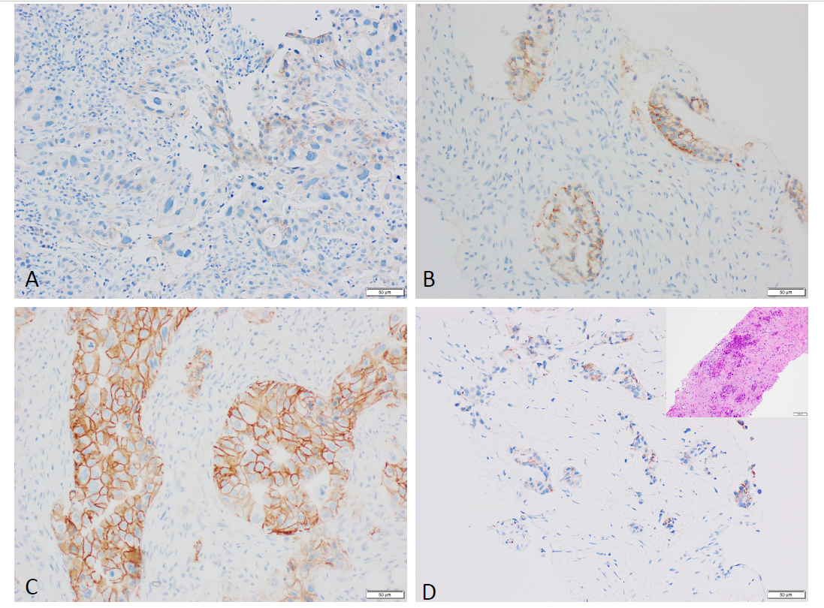
ASCO/CAP BC vs Gastric/gastroesophageal ADK guidelines
HER2 IHC scoring discrepancies
IHC-stained section revealing a 2+ IHC score based on the ASCO/CAP guideline for gastric/gastroesophageal adenocarcinoma, but score is 0 when using the guideline for breast cancer
(clone: 4B5,x20).
ASCO, American Society of Clinical Oncology; CAP, College of American Pathologists; IHC, immunohistochemistry
Courtesy of Pellini B. Submitted for publication

Slide 42
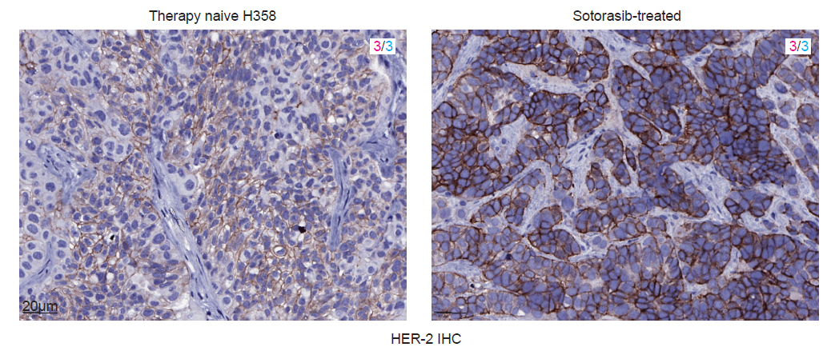
Asco/cap her2 ihc guidelines for gastric/gej cancer
HER2 IHC differences in staining in nsclc xenograft models
Even when the score is 3+
Therapy naïve H358
Sotorasib-treated
HER2 IHC
ASCO, American Society of Clinical Oncology; CAP, College of American Pathologists; IHC, immunohistochemistry
Courtesy of Pellini B. Submitted for publication

Slide 43
her2-positive ncslc treatment approaches
NSCLC, non-small cell lung cancer

Slide 44
POLLING QUESTION
Which statement about her2 alterations in lung cancer is correct?
Only HER2 mutations are relevant in lung cancer
Only HER2 overexpression is relevant in lung cancer
HER2 mutations in lung cancer are most commonly found in squamous cell carcinoma
HER2-targeted therapies have shown clinical activity in patients with HER2-mutant and HER2 IHC3+ non-small cell lung cancer (NSCLC)
NSCLC; non-small cell lung cancer;

Slide 45
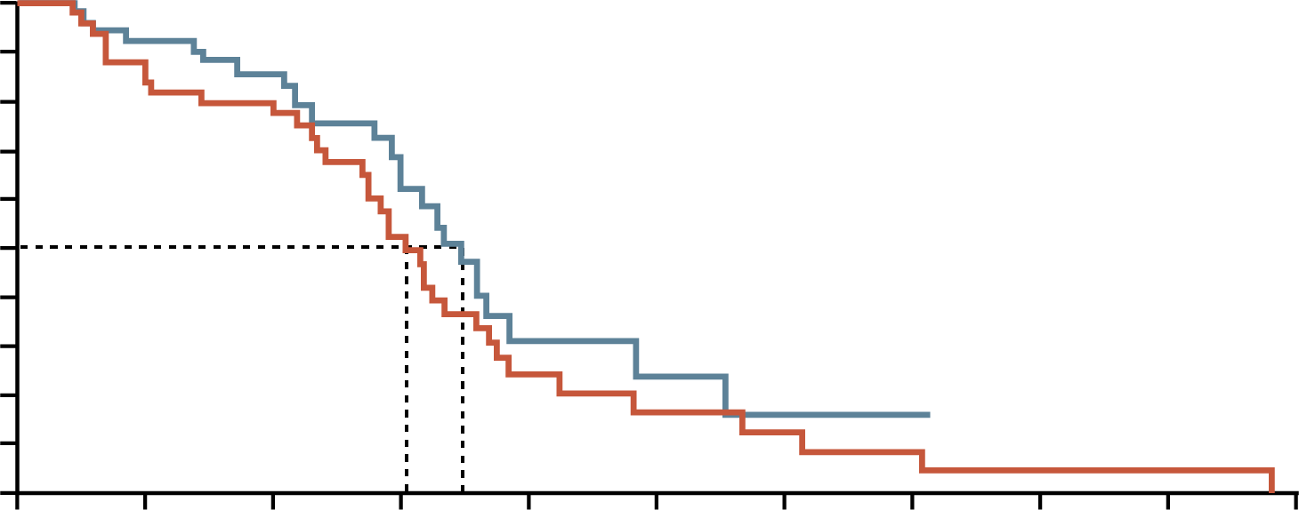
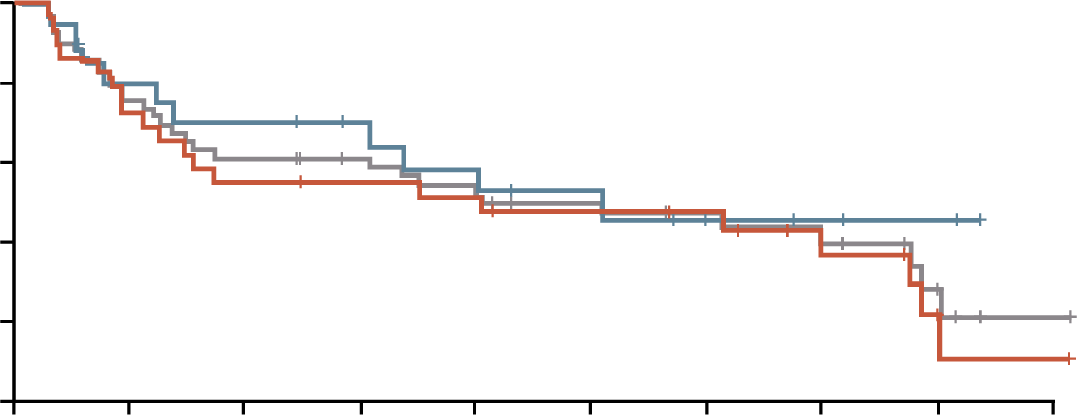
HER2-positive lung cancer treated with anti-HER2 drugs
PFS of gemcitabine–cisplatin with or without
trastuzumab in HER2-positive NSCLC¹
T-DM1 in metastatic NSCLC²
IHC status | Patients with OS event, n (%) | Median time to OS event, months (95% CI)
IHC 2+ | 20 (69) | 12.2 (3.8-23.3)
IHC 3+ | 10 (50) | 15.3 (4.1-NE)
All patients | 30 (61) | 12.2 (4.7-23.6)
1.0
100
0.9
Gemcitabine-cisplatin
Trastuzumab + gemcitabine-cisplatin
0.8
80
0.7
0.6
60
Probability of remaining
progression free
0.5
OS (%)
0.4
40
IHC 2+ (n=29)
IHC 3+ (n=20)
All patients (N=49)
Censored
0.3
0.2
20
0.1
6.1
7.0
0.0
0
0
2
4
6
8
10
12
14
16
18
20
0
3
6
9
12
15
18
21
24
27
Time (months)
Time (months)
NO BENEFIT
MINIMUM BENEFIT
Contrary to breast cancer, where HER2 overexpression often occurs concurrently with HER2 amplification, this co-occurrence has been less consistently observed in lung cancer
Mutations in the HER2 gene are also not clearly associated with increased levels of HER2 amplification
CI, confidence interval; IHC, immunohistochemistry; NE, not evaluable; NSCLC, non-small cell lung cancer; OS, overall survival; PFS, progression-free survival; T-DM1, trastuzumab emtansine
1. Gatzemeier U, et al. Ann Oncol. 2004;15:19-27; 2. Peters S, et al. Clin Cancer Res. 2019;25:64-72

Slide 46
Can ADCs be the turning point for HER2 treatment in NSCLC?
ADC Characteristic differences between T-DXd and T-DM1
HER2-targeting ADCs with similar mAb backbone
Next generation ADCs
Trastuzumab
deruxtecan
(T-DXd)¹
T-DXd^{1-4,a} | ADC attributes | T-DM1³⁻⁵
Topoisomerase I inhibitor | Payload MoA | Anti- microtubule
~8:1 | Drug-to-antibody ratio | ~3.5:1
Yes | Tumour-selective cleavable linker? | No
Yes | Evidence of bystander anti-tumour effect? | No
First-generation ADCs
Trastuzumab
emtansine
(T-DM1)⁵
ADC, antibody-drug conjugate; mAb, monoclonal antibody; MoA, mechanism of action; NSCLC, non-small cell lung cancer; T-DM1, trastuzumab emtansine;
T-DXd, trastuzumab deruxtecan
1. Azar I, et al. Lung Cancer (Auck). 2021;12:103-113; 2. Ogitani Y, et al. Clin Cancer Res. 2016;22:5097-108;
3. Trail PA, et al. Pharmacol Ther. 2018;181:126-142; 4. Ogitani Y, et al. Cancer Sci. 2016;107:1039-1046; 5. LoRusso PM, et al. Clin Cancer Res. 2011;17:6437-6447

Slide 47
DESTINY-Lung01 - phase 2 – her2 mutant trial design
Key eligibility criteria^{1,2}
Unresectable/metastatic non-squamous NSCLC
Relapsed following or is refractory to standard treatment
Measurable disease by RECIST v1.1
Asymptomatic CNS metastases allowed
ECOG PS 0 or 1
Locally reported HER2 mutant (for Cohort 2)
Cohort 1:³
HER2 overexpressing
(IHC 3+ or IHC 2+)
T-DXd 6.4 mg/kg q3w
N=49
Cohort 1a:³
HER2 overexpressing
(IHC 3+ or IHC 2+)
T-DXd 5.4 mg/kg q3w
N=41
Primary endpoint¹
Confirmed ORR by ICR
Secondary endpoints¹
Confirmed ORR by INV
DoR by ICR and INV
DCR by ICR and INV
PFS by ICR and INV
OS
Safety
Exploratory endpoint¹
Biomarkers of response
Cohort 2:²
HER2 mutant
T-DXd 6.4 mg/kg q3w
N=42
Cohort 2 expansion:²
HER2 mutant
T-DXd 6.4 mg/kg q3w
N=49
HER2 mutant
CNS, central nervous system; DCR, disease control rate; DoR, duration of response; ECOG, Eastern Cooperative Oncology Group; ICR, independent central review; IHC, immunohistochemistry; INV, investigator assessment; NSCLC, non-small cell lung cancer; ORR, objective response rate; OS, overall survival; PFS, progression-free survival; q3w, every 3 weeks; RECIST, Response Evaluation Criteria in Solid Tumours; T-DXd, trastuzumab deruxtecan
1. Li BT, et al. N Engl J Med. 2022;386:241-251 (including protocol); 2. Li B, et al. Ann Oncol. 2023;34 (suppl_2):S755-S851 (presented at ESMO 2023);
3. Smit EF, et al. Lancet Oncol. 2024;25:439-454

Slide 48
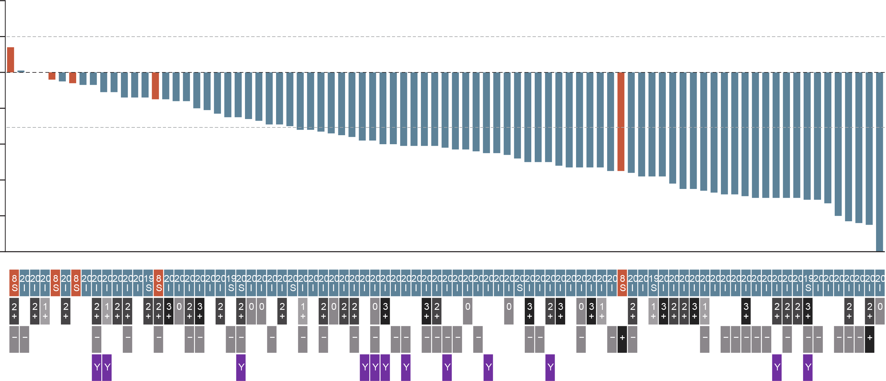
DESTINY-Lung01 – phase 2 – her2 mutant trastuzumab deruxtecan showed durable anticancer activity in patients with previously treated HER2-mutated NSCLC
ORR (95% CI): 55% (44-65)
N=91
40
20
0
Best percent change from
baseline in sum of largest diameters
-20
-40
-60
HER2 mutation domain location
Kinase domain
Extracellular domain
-80
-100
HER2 mutation
HER2 protein expression
HER2 gene amplification
Prior HER2 TKI therapy
CI, confidence interval; NSCLC, non-small cell lung cancer; ORR, objective response rate
Li BT, et al. N Engl J Med. 2022;386:241-251

Slide 49
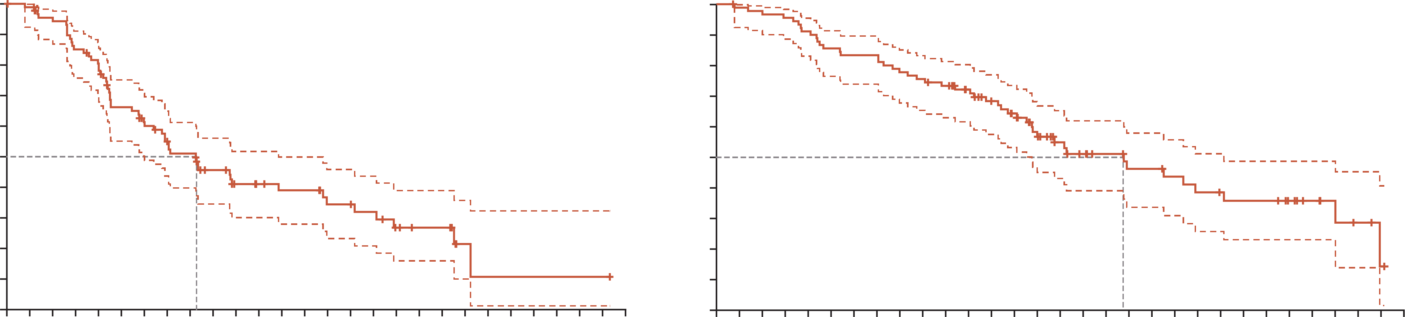
DESTINY-Lung01 – phase 2 – her2 mutant pfs and os
PFSª
OSª
Median (95% CI), months: 8.2 (6.0-11.9)
Median (95% CI), months: 17.8 (13.8-22.1)
100
100
90
90
80
80
70
70
60
60
50
50
Patients (%)
Patients (%)
40
40
30
30
20
20
10
10
0
0
0
1
2
3
4
5
6
7
8
9
10
11
12
13
14
15
16
17
18
19
20
21
22
23
24
25
26
27
0
1
2
3
4
5
6
7
8
9
10
11
12
13
14
15
16
17
18
19
20
21
22
23
24
25
26
27
28
29
30
No. at
risk
Time (months)
No. at
risk
Time (months)
91
89
83
74
69
55
49
42
39
31
25
21
19
19
15
15
13
9
7
7
2
1
1
1
1
1
1
0
91
89
88
86
82
77
75
75
70
68
65
58
51
46
36
29
25
22
19
19
17
15
14
13
13
10
7
5
3
1
0
Safety profile included interstitial lung disease that was fatal in 2 cases
Observed toxic effects were generally consistent with those in previously reported studies
ª Dashed lines indicate 95% confidence intervals
OS, overall survival; PFS, progression-free survival;
Li BT, et al. N Engl J Med. 2022;386:241-251

Slide 50
HER2-mutant and HER2‑Overexpression: same disease but different results

Slide 51
DESTINY-Lung01 – phase 2 – her2-overexpressing study design
(IHC 3+ or IHC 2+)
Key eligibility criteria
Unresectable metastatic non-squamous NSCLC
Relapsed from or is refractory to standard treatment
Measurable disease by RECIST v1.1
ECOG PS of 0 or 1
Cohort 1:
HER2-overexpressing
(IHC 3+ or IHC 2+)
T-DXd 6.4 mg/kg q3w
n=49
Cohort 1a:
HER2-overexpressing
(IHC 3+ or IHC 2+)
T-DXd 5.4 mg/kg q3w
n=41
Primary endpoint
ORR
Secondary endpoints
PFS
OS
DoR
DCR
Safety and tolerability
Cohort 2: HER2-mutated
T-DXd 6.4 mg/kg q3w
n=78
(Encore to be presented at WCLC: abstract 1419)
Cohort 2 expansion:
HER2-mutated
T-DXd 6.4 mg/kg q3w
n=50
DCR, disease control rate; DoR, duration of response; ECOG PS, Eastern Cooperative Oncology Group performance status; IHC, immunohistochemistry; NSCLC, non-small cell lung cancer; ORR, overall response rate; OS, overall survival; PFS, progression-free survival; q3w, every 3 weeks; RECIST, Response Evaluation Criteria in Solid Tumours; T-DXd, trastuzumab deruxtecan
Smit EF, et al. Lancet Oncol. 2024;25:439-454

Slide 52
DESTINY-Lung01 – phase 2 – her2-overexpressing results
Cohort 1
Trastuzumab deruxtecan 6.4 mg/kg, N=49
Cohort 1a
Trastuzumab deruxtecan 5.4 mg/kg, N=41
100
100
Baseline HER2 IHC status
IHC 2+ (n=17)
IHC 3+ (n=17)
80
80
60
60
40
ORR (95% CI): 26.5% (15.0-41.1)
40
ORR (95% CI): 34.1% (20.1-50.6)
20
20
Best percentage change in
sum of diameters from baseline (%)
Best percentage change in
sum of diameters from baseline (%)
0
0
-20
-20
-40
-40
-60
-60
-80
Baseline HER2 IHC status
IHC 2+ (n=35)
IHC 3+ (n=9)
-80
-100
-100
Cohort 1a (all patients | 14/41 | 34.1 (20.1-50.6)
HER2 IHC 3+ | 9/17 | 52.9 (27.8-77.0)
HER2 IHC 2+ | 5/24 | 20.8 (7.1-42.2)
52.9%
20.8%
0
10
20
30
40
50
50
70
80
ORR (%)
CI, confidence interval; IHC, immunohistochemistry; ORR, overall response rate;
Smit EF, et al. Lancet Oncol. 2024;25:439-454

Slide 53
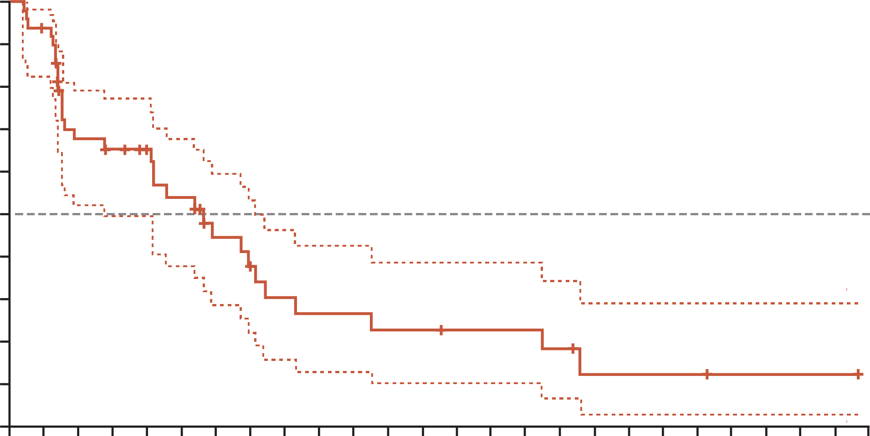
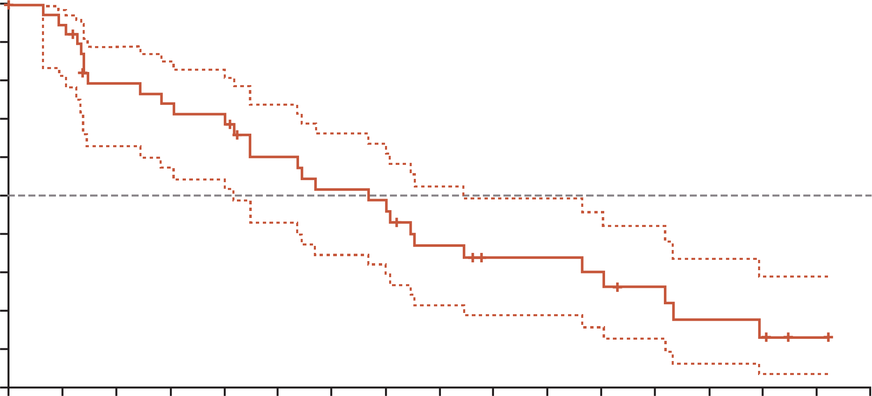
DESTINY-Lung01 - phase 2 - her2-overexpressing results – Progression free survival
PFS in Cohort 1
Trastuzumab deruxtecan 6.4 mg/kg, N=49
PFS in Cohort 1a
Trastuzumab deruxtecan 5.4 mg/kg, N=41
N=41
1.0
1.0
0.9
0.9
0.8
mPFS (95% CI):
5.7 months (2.8-7.2)
0.8
mPFS (95% CI):
6.7 months (4.2-8.4)
0.7
0.7
0.6
0.6
0.5
0.5
Probability of PFS
Probability of PFS
0.4
0.4
0.3
0.3
0.2
0.2
0.1
0.1
0.0
0.0
0
1
2
3
4
5
6
7
8
9
10
11
12
13
14
15
16
17
18
19
20
21
22
23
24
25
0
1
2
3
4
5
6
7
8
9
10
11
12
13
14
15
16
No. at
risk
Time (months)
Time (months)
49
45
29
26
23
19
13
10
8
7
7
6
6
5
5
5
4
2
2
2
2
1
1
1
1
0
41
38
30
28
27
21
18
16
12
9
9
8
6
4
3
1
0
CI, confidence interval; (m)PFS, (median) progression free survival
Smit EF, et al. Lancet Oncol. 2024;25:439-454

Slide 54
DESTINY-Lung02 – phase 2 study design
Primary endpoint
Confirmed ORR by BICR
Secondary endpoints
Confirmed ORR by INV
DoR by BICR and INV
DCR by BICR and INV
PFS by BICR and INV
OS
Exploratory
PROs:
  EQ-5D-5L
  EORTC QLQ-C30
  EORTC QLQ-LC13
  NSCLC-SAQ
Key eligibility criteria
Metastatic HERm NSCLC
≥1 prior anticancer therapy (2L+), including platinum-based chemotherapy
Measurable disease per RECIST v1.1
ECOG PS of 0 or 1
Stratification factor:
Prior anti–PD-(L)1 treatment
T-DXd 5.4 mg/kg
q3w
N=102
R
2:1
N=152
T-DXd 6.4 mg/kg
q3w
N=50
Patients and investigators
were blinded to the dose level
Final analysis data
cutoff: August 25, 2023
2L+, second line of treatment or later; BICR, blinded independent central review; ORR, objective response rate; DCR, disease control rate; DoR, duration of response; ECOG PS, Eastern Cooperative Oncology Group performance status; EORTC QLQ-C30, European Organisation for Research and Treatment of Cancer Quality of Life Questionnaire Core 30; EORTC QLQ-LC13, EORTC Lung Cancer Specific Quality of Life Questionnaire; EQ-5D-5L, EuroQol 5-Dimension, 5-Level Cancer Specific Core Quality of Life Questionnaire; INV, investigator assessment; NSCLC, non–small cell lung cancer; ORR, objective response rate; OS, overall survival; PD-1, programmed cell death protein 1; PD-L1, programmed death ligand-1; PFS, progression-free survival; PR, partial response; PRO, patient-reported outcome; q3w, every 3 weeks; R, randomisation; RECIST v1.1, Response Evaluation Criteria in Solid Tumours, version 1.1; SAQ, Symptom Assessment Questionnaire; T-DXd, trastuzumab deruxtecan
Janne P, et al. J Clin Oncol. 2024;42(no. 16_suppl):8543 (presented at ASCO Annual Meeting I, 2024)

Slide 55
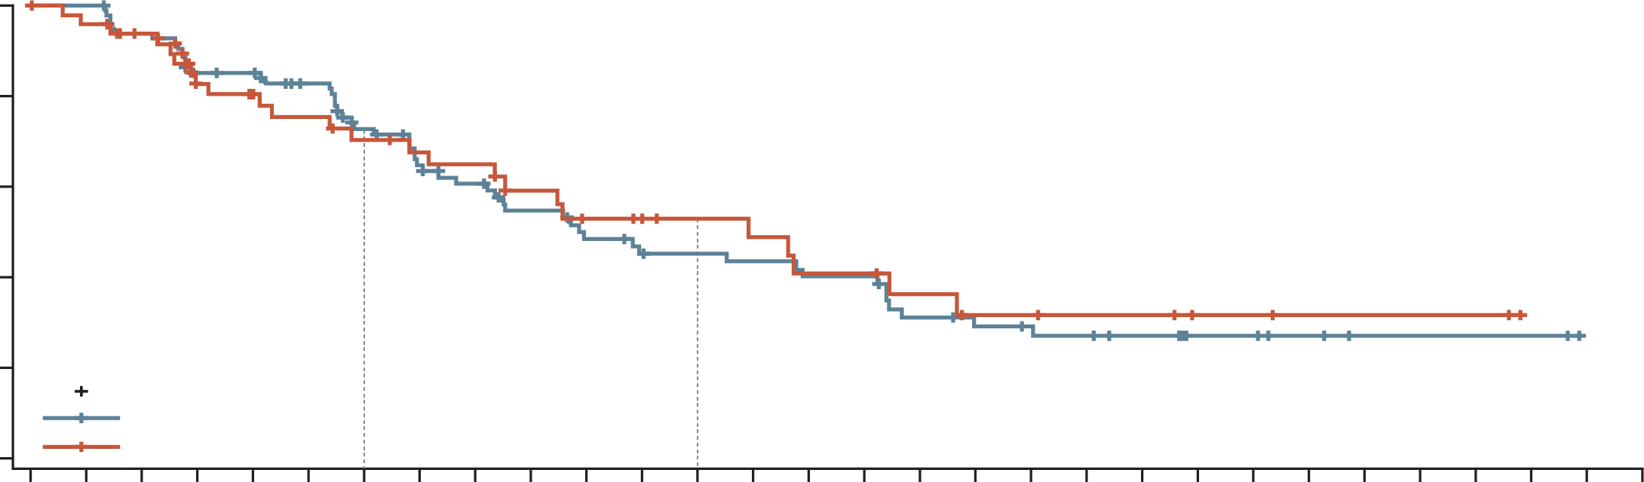
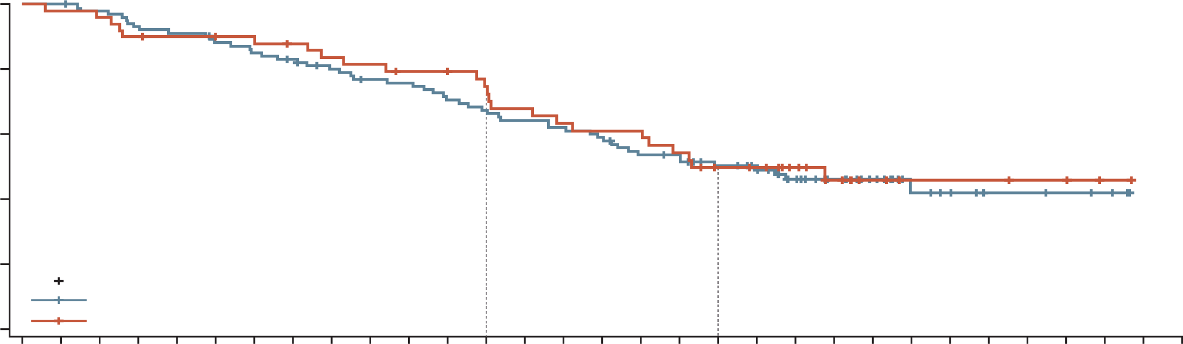
DESTINY-Lung02 – phase 2
T-DXd also demonstrated an ORR of 50% (5.4 mg/kg) and 56% (6.4 mg/kg) in 2L+ HER2-mutated NSCLC
PFS by BICR
OS by BICR
 | T-DXd 5.4 mg/kg n=102 | T-DXd 6.4 mg/kg n=50
Median PFS (95% CI), months | 10.0 (7.7-15.2) | 12.9 (7.2-16.7)
 | T-DXd 5.4 mg/kg n=102 | T-DXd 6.4 mg/kg n=50
Median OS (95% CI), months | 19.0 (14.7-NE) | 17.3 (13.8-NE)
100
100
80
70% (95% CI, 54%-82%)
80
67% (95% CI, 57%-76%)
75% (95% CI, 60%-85%)
60
45% (95% CI, 34%-56%)
53% (95% CI, 36%-67%)
60
50% (95% CI, 40%-60%)
50% (95% CI, 35%-63%)
Progression-free
survival probability (%)
Overall survival
probability (%)
40
40
20
Censored
T-DXd 5.4 mg/kg
T-DXd 6.4 mg/kg
20
Censored
T-DXd 5.4 mg/kg
T-DXd 6.4 mg/kg
0
0
0 | 1 | 2 | 3 | 4 | 5 | 6 | 7 | 8 | 9 | 10 | 11 | 12 | 13 | 14 | 15 | 16 | 17 | 18 | 19 | 20 | 21 | 22 | 23 | 24 | 25 | 26 | 27 | 28 | 29
0 | 1 | 2 | 3 | 4 | 5 | 6 | 7 | 8 | 9 | 10 | 11 | 12 | 13 | 14 | 15 | 16 | 17 | 18 | 19 | 20 | 21 | 22 | 23 | 24 | 25 | 26 | 27 | 28 | 29 | 30
Time (months)
Time (months)
No. of patients at risk
T-DXd 5.4 mg/kg:
T-DXd 6.4 mg/kg:
No. of events
T-DXd 5.4 mg/kg:
T-DXd 6.4 mg/kg:
102 | 100 | 89 | 76 | 75 | 68 | 56 | 48 | 43 | 36 | 31 | 28 | 27 | 26 | 24 | 24 | 17 | 15 | 14 | 13 | 10 | 6 | 6 | 4 | 2 | 2 | 2 | 2 | 0 | 0
50 | 47 | 44 | 36 | 33 | 30 | 27 | 25 | 24 | 19 | 16 | 15 | 13 | 12 | 10 | 10 | 8 | 6 | 6 | 5 | 5 | 3 | 3 | 2 | 2 | 2 | 2 | 0 | 0 | 0
0 | 0 | 6 | 14 | 14 | 16 | 24 | 30 | 33 | 37 | 41 | 43 | 43 | 44 | 46 | 46 | 51 | 52 | 52 | 53 | 53 | 53 | 53 | 53 | 53 | 53 | 53 | 53 | 53 | 0
0 | 2 | 3 | 8 | 9 | 11 | 13 | 14 | 15 | 17 | 19 | 19 | 19 | 20 | 22 | 22 | 23 | 24 | 24 | 24 | 24 | 24 | 24 | 24 | 24 | 24 | 24 | 24 | 0 | 0
No. of patients at risk
T-DXd 5.4 mg/kg:
T-DXd 6.4 mg/kg:
No. of events
T-DXd 5.4 mg/kg:
T-DXd 6.4 mg/kg:
102 | 102 | 99 | 94 | 92 | 88 | 85 | 82 | 77 | 73 | 72 | 67 | 64 | 61 | 59 | 56 | 50 | 49 | 43 | 40 | 30 | 23 | 17 | 10 | 8 | 5 | 5 | 4 | 3 | 0 | 0
50 | 49 | 48 | 45 | 44 | 43 | 43 | 41 | 39 | 38 | 36 | 36 | 33 | 30 | 28 | 27 | 27 | 24 | 20 | 19 | 15 | 11 | 6 | 4 | 4 | 4 | 3 | 3 | 1 | 0 | 0
0 | 0 | 2 | 7 | 9 | 12 | 15 | 17 | 20 | 23 | 24 | 29 | 32 | 35 | 37 | 40 | 45 | 45 | 48 | 48 | 51 | 51 | 51 | 52 | 52 | 52 | 52 | 52 | 52 | 52 | 0
0 | 1 | 2 | 5 | 5 | 5 | 5 | 6 | 8 | 9 | 10 | 10 | 12 | 15 | 17 | 18 | 18 | 21 | 23 | 23 | 23 | 24 | 24 | 24 | 24 | 24 | 24 | 24 | 24 | 24 | 0
2L+, second line of treatment or later; BICR, blinded independent central review; CI, confidence interval; NSCLC, non–small cell lung cancer; ORR, objective response rate; OS, overall survival; PFS, progression-free survival; T-DXd, trastuzumab deruxtecan;
Janne P, et al. J Clin Oncol. 2024;42(no. 16_suppl):8543 (presented at ASCO Annual Meeting I, 2024)

Slide 56
Safety profile of T-DXd
Results from Destiny-lung01 and destiny-lung02
DESTINY-Lung01¹ (N=91)¹ | TRAEs, n (%)
 | Any grade | Grade ≥3
Nausea | 66 (73) | 8 (9)
Fatigue | 48 (53) | 6 (7)
Alopecia | 42 (46) | 0
Vomiting | 36 (40) | 3 (3)
Neutropenia | 32 (35) | 17 (19)
Anaemia | 30 (33) | 9 (10)
Diarrhoea | 29 (32) | 3 (3)
Decreased appetite | 27 (30) | 0
Interstitial lung disease | 24 (26) | 6 (7)
Leukopenia | 21 (23) | 4 (4)
Constipation | 20 (22) | 0
DESTINY-Lung02² | TEAEs, n (%)
 | Any grade | Grade ≥3
5.4 mg/kg (N=101)
Nausea | 66 (65) | NR
Neutropenia | 43 (43) | 19 (19)
Fatigue | 38 (38) | NR
Interstitial lung disease | 15 (15) | 2 (2)
6.4 mg/kg (N=50)
Nausea | 39 (78) | NR
Neutropenia | 28 (56) | 19 (38)
Fatigue | 23 (46) | NR
Decreased appetite | 23 (46) | NR
Interstitial lung disease | 16 (32) | 2 (4)
T‑DXd, trastuzumab deruxtecan; TEAE, treatment-emergent adverse event; TRAE, treatment-related adverse event
1. Li BT, et al. N Engl J Med. 2022;386:241-251; 2. Janne P, et al. J Clin Oncol. 2024;42(no. 16_suppl):8543 (presented at ASCO Annual Meeting I, 2024)

Slide 57
DESTINY-Lung03 – phase 1B – multicentre, open label, dose escalation
IHC her2 3+/2+
Patient population
Aged ≥18 years
Centrally assessed HER2-OE
(IHC 3+/2+)ª unresectable,
locally advanced or metastatic
non-squamous NSCLC
Measurable disease per
RECIST v1.1
WHO/ECOG performance
status 0-1
Patients in Part 1 had 1 or 2
prior lines of therapy; patients
with therapy-targetable
alterations must have had prior
appropriate targeted therapy
Part 1: dose escalation^{b} (enrolment complete)
Arm 1A: T-DXd + durvalumab + cisplatin q3w
Arm 1B: T-DXd + durvalumab + carboplatin q3w
Key endpoints
for the T-DXd
monotherapy arm
ORR
DoR
DCR
PFS
OS
Safety and
tolerability
Part 1: T-DXd monotherapy (enrolment complete)
Arm 1D: T-DXd 5.4 mg/kg IV q3w (N=36)
Investigator
assessed
Part 3: dose confirmation and expansion (currently recruiting)
T-DXd + volrustomig ± carboplatin
Part 4: safety run-in and expansion (currently recruiting)
T-DXd + rilvegostomig ± carboplatin
Data cutoff for the Part 1 T-DXd monotherapy arm results: April 1, 2024
Data cutoff for the Part 1 T-DXd monotherapy arm results was April 1, 2024. Part 2 of the study was not initiated owing to a strategic decision by the study sponsor.
ª HER2 overexpression was defined as ≥25% of tumour cells with IHC 3+ or 2+ by central testing using the Dako HER2-low IHC assay
^{b} Arm 1C: T-DXd + durvalumab + pemetrexed treatment was planned but not initiated
DoR, duration of response; ECOG, Eastern Cooperative Oncology Group; HER2-OE, HER2-overexpressing; IHC, immunohistochemistry; IV, intravenous; NSCLC, non-small cell lung cancer; ORR, objective response rate; OS, overall survival; PFS, progression-free survival; q3w, every 3 weeks; RECIST v1.1, Response Evaluation Criteria in Solid Tumours version 1.1; T-DXd, trastuzumab deruxtecan; WHO, World Health Organization
Planchard D, et al. J Thorac Oncol. 19 (Issue 10, supplement):S46-S47 (presented at WCLC 2024)

Slide 58
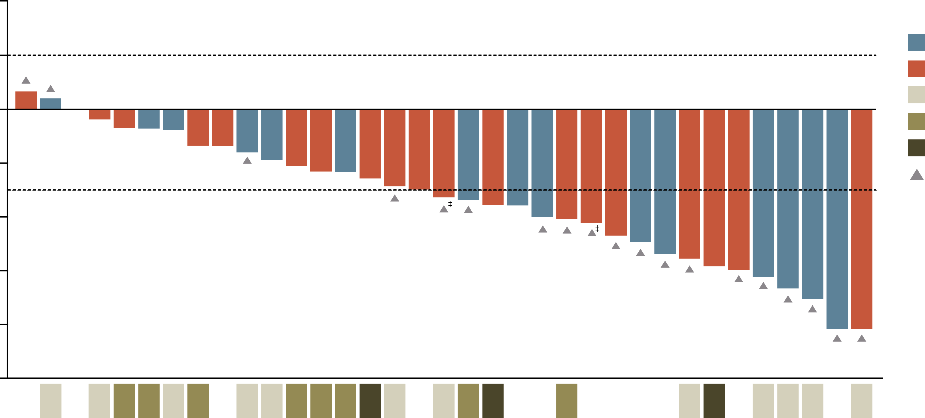
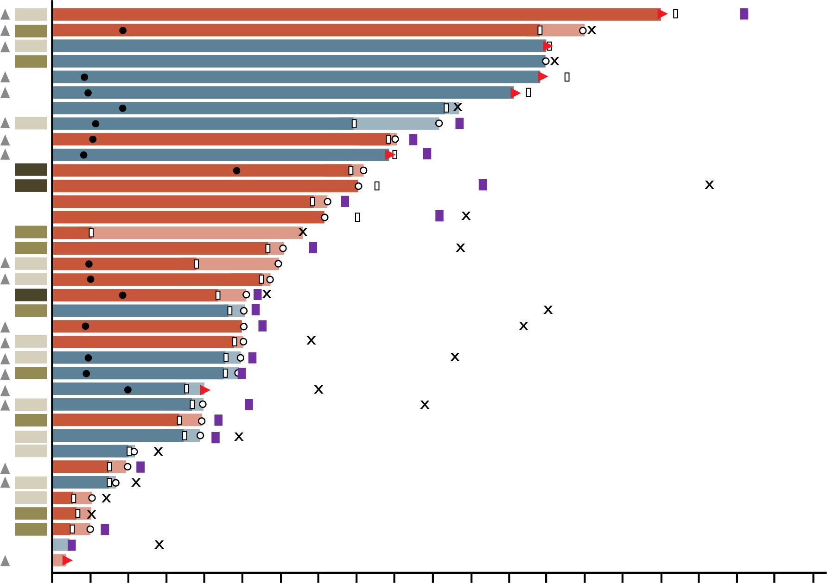
DESTINY-Lung03 - phase 1B
Best percentage change from baseline in target lesion size and TTP
Howard, in the WCLC presentation I can find the first graph, but not the TTP. Can you find it?
Part 1: T-DXd monotherapy arm, N=36ª
Part 1: T-DXd monotherapy arm, N=36
20
PD-L1
Status
ORR: 44.4% (27.9-61.9)
HER2 IHC 3+
HER2 IHC 2+
PD-L1 <1%
PD-L1 1-49%
PD-L1 ≥50%
Prior EGFR TKI
Confirmed PR
Death
PD
Censored at last
evaluable scan
On study, post
treatment
Start of subsequent
therapy
Last dose of T-DXd
40
0
-20
Best change from baseline in target lesion size(%)
-40
-60
HER2 IHC 3+
HER2 IHC 2+
PD-L1 <1%
PD-L1 1-49%
PD-L1 ≥50%
Prior EGFR TKI
-80
mDoR: 11.0% (5.5-16.7)
-100
PD-L1
Status^{b}
0
6
12
18
24
30
36
42
48
54
60
66
72
78
84
90
96
102
108
114
120
Time from first dose (weeks)
ª One patient not evaluable
^{b} Patients with unknown PD-L1 status represented by white spaces
‡ Unconfirmed response
IHC, immunohistochemistry; mDoR, median duration of response; PD-L1, programmed death ligand-1; PR, partial response; ORR, objective response rate; T‑DXd, trastuzumab deruxtecan; TKI, tyrosine kinase inhibitor; TTP, time to progression;
Planchard D, et al. J Thorac Oncol. 19 (Issue 10, supplement):S46-S47 (presented at WCLC 2024)

Slide 59
DESTINY-Lung03 – phase 1B orr: Overall and by HER2 IHC status and prior EFGR TKI exposure
T-DXd monotherapy, N=36 pts
100
Overall ORR
ORR by HER2 IHC status
ORR by EGFR TKI status
90
68.4
(43.5, 87.4)
80
70
56.3
(29.9, 80.3)
60
44.4
(27.9, 61.9)
50
35.0
(15.4, 59.2)
Patients (95% CI), %
40
30
17.6
(3.8, 43.4)
20
10
0
n/N
16/36
9/16
7/20
13/19
3/17
 | Overall | HER2 IHC 3+ | HER2 IHC 2+ | Prior EGFR TKI | EGFR TKI naïve
Median DoR (95% CI), months | 11.0 (5.5, 16.7) | 12.5 (5.5, NE) | 6.6 (4.5, 11.0) | 11.7 (5.5, NE) | 4.6 (4.5, NE)
DCR at 12 weeks (95% CI), % | 77.8 (60.9, 89.9) | 81.3 (54.4, 96.0) | 75.0 (50.9, 91.3) | 84.2 (60.4, 96.6) | 70.6 (44.0, 89.7)
There were no new safety signals identified, and the safety profile was consistent with the known profile of T-DXd
CI, confidence interval; DCR, disease control rate; DoR, duration of response; IHC, immunohistochemistry; ORR, objective response rate; T‑DXd, trastuzumab deruxtecan; TKI, tyrosine kinase inhibitor
Planchard D, et al. J Thorac Oncol. 19 (Issue 10, supplement):S46-S47 (presented at WCLC 2024)

Slide 60
Exploratory pooled brain metastases analyses
Study designs DESTINY-Lung01 and DESTINY-Lung02
Post hoc analysis
Small number of patients
Lack of a comparator arm
DESTINY-Lung01ª
Unresectable/metastatic non-squamous NSCLC
Relapsed from or is refractory to standard treatment
Measurable disease by RECIST v1.1
ECOG PS of 0 or 1
Locally reported HERm (Cohort 2)
Asymptomatic BM allowed
Cohort 1: HER2-OE
(IHC 3+ or IHC 2+)
T-DXd 6.4 mg/kg q3w
N=49
Cohort 1a: HER2-OE
(IHC 3+ or IHC 2+)
T-DXd 5.4 mg/kg q3w
N=41
Endpoints
In patients with and without baseline BM:
Systemic cORR per BICR
Systemic DoR per BICR
Sites of progression per BICR
TEAEs
In patients with measurable baseline BM:
IC-cORR per BICR
IC-DCR per BICR
IC-DoR per BICR
Cohort 2: HER2m
T-DXd 6.4 mg/kg q3w
N=42
Cohort 2: expansion: HER2m
T-DXd 6.4 mg/kg q3w N=49
T-DXd 5.4 mg/kg
DL-02
BM (N=32)
Non-BM (N=70)
DESTINY-Lung02^{b}
Metastatic HER2-mutated NSCLC
≥1 prior anticancer therapy (2L+), including platinum-based chemotherapy
Measurable disease per RECIST v1.1
ECOG PS of 0 or 1
Locally reported HER2 mutation
Asymptomatic BM allowed​
Stratified by
Prior anti-PD-(L)1 treatment
Pooled T-DXd 6.4 mg/kg
DL-01 HER2m/DL-02
BM (N=54)
Non-BM (N=87)
T-DXd 5.4 mg/kg
q3w
N=102
R
2:1
T-DXd 6.4 mg/kg
q3w
N=50
ª Data cutoff: December 3, 2021. ^{b} Data cutoff: December 23, 2022.
2L+, second line of treatment or later; BICR, blinded independent central review; BM, brain metastases, cORR , confirmed objective response rate; DCR, disease control rate; DoR , duration of response; ECOG PS, Eastern Cooperative Oncology Group performance status; IHC, immunohistochemistry; NSCLC, non-small cell lung cancer; OE, overexpressing; q3w, every 3 weeks; R, randomisation; RECIST v1.1, Response Evaluation Criteria in Solid Tumours, version 1.1; T DXd , trastuzumab deruxtecan; TEAE, treatment emergent adverse event
Li B, et al. Ann Oncol. 2023;34 (suppl_2):S755-S851 (presented at ESMO 2023).

Slide 61
Exploratory pooled brain metastases analyses
DESTINY-Lung01 and DESTINY-Lung02: ORR and Best overall response
Responses in patients with measurable BM at baseline
T-DXd 5.4 mg/kg
(N=14)
 | T-DXd 5.4 mg/kg DL-02 BM (N=14) | Pooled T-DXd 6.4 mg/kg DL-01 HER2m/DL-02 BM (N=30)
IC-cORR, n (%)ª | 7 (50) | 9 (30)
95% CI^{b} | 23-77 | 14.7-49.4
CR | 3 (21.4) | 0
PR | 4 (28.6) | 9 (30)
SD | 6 (42.9) | 13 (43.3)
PD | 1 (7.1) | 4 (13.3)
NE^{c} | 0 | 2 (6.7)
Missing | 0 | 2 (6.7)
IC-DCR, n (%)ª | 13 (92.9) | 22 (73.3)
95% CI^{b} | 66.1-99.8 | 54.1-87.7
IC-DoR, mo^{d}
Median (95% CI)^{e} | 9.5 (3.6-NE) | 4.4 (2.9-10.2)
25
Progressive
disease
0
-25
Partial
response
Best change in SoD
from baseline (%)
-50
-75
Without prior treatment
With prior treatment
* Indicates surgery
*
-100
Pooled T-DXd 6.4 mg/kg
(N=27^{c})
25
Progressive
disease
0
-25
*
Partial
response
Best change in SoD
from baseline (%)
12/14 (86%) patients with measurable BM receiving T-DXd
5.4 mg/kg and 21/27 (78%) in the pooled 6.4-mg/kg group experienced a reduction in brain lesion size from baseline as their best overall response
-50
-75
Without prior treatment
With prior treatment
* Indicates surgery
-100
Systemic responses to T-DXd were similar in patients with and without BM at baseline
Patients with and without BM showed similar safety outcomes overall
ª Denominator for percentage is the number of patients in the full analysis set who have at least one target lesion at baseline, per BICR. ^{b} Based on Clopper Pearson method for single proportion. ^{c} For one patient deemed NE in the 6.4 mg/kg group, it was not possible to derive objective response due to missing data of one target lesion; the patient’s best over all response however was calculated from available target lesion assessments and included the waterfall plot. ^{d} Calculated as time from first response in brain until progression in brain. ^{e} Based on Kaplan-Meier analysis and computed with the Brookmeyer-Crowley method.
BICR, blinded independent central review; BM, brain metastases; CI, confidence interval; cORR, confirmed objective response rate; CR, complete response; DCR, disease control rate; DL, DESTINY Lung (trial); DoR , duration of response; HER2m, HER2 mutant; IC, intracranial; mo, months; NE, not evaluable; PD, progressive disease; PR, partial response; SD, stable disease; SoD, sum of diameters; T DXd , trastuzumab deruxtecan
1. Li B, et al. Ann Oncol. 2023;34 (suppl_2):S755-S851 (presented at ESMO 2023)

Slide 62


Her2 targeted therapy in lung cancer approvals AND UPCOMING TRIAL
On August 11, 2022, the FDA granted accelerated approval to fam-trastuzumab deruxtecan-nxki for adult patients with unresectable or metastatic non-small cell lung cancer (NSCLC) whose tumours have activating HER2 (ERBB2) mutations, as detected by an FDA-approved test, and who have received a prior systemic therapy. This is the first drug approved for HER2-mutant NSCLC.
On April 5, 2024, the FDA granted accelerated approval to fam-trastuzumab deruxtecan-nxki for adult patients with unresectable or metastatic HER2-positive (IHC3+) solid tumours who have received prior systemic treatment and have no satisfactory alternative treatment options.
FDA^{1,2}
In September 2023, the EMA recommended trastuzumab deruxtecan for approval as monotherapy for the treatment of adult patients with advanced NSCLC whose tumours have an activating HER2 (ERBB2) mutation and who require systemic therapy following platinum-based chemotherapy with or without immunotherapy
EMA³
DESTINY-Lung04⁴
First-line advanced NSCLC
HER2 ex19 or ex20 mutations
(Estimated enrolment = 450)
T-DXd
R
Endpoint: PFS
Pembrolizumab +
pemetrexed + platinum
EMA, European Medicines Agency; FDA, Food and Drug Administration; NSCLC, non-small cell lung cancer; PFS, progression-free survival; T‑DXd, trastuzumab deruxtecan
1. FDA grants accelerated approval to fam-trastuzumab deruxtecan-nxki for HER2-mutant non-small cell lung cancer. Available here (accessed Feb 2025);
2. FDA grants accelerated approval to fam-trastuzumab deruxtecan-nxki for unresectable or metastatic HER2-positive solid tumors. Available here (accessed March 2025); 3. EMA Recommends Extending Indications for Trastuzumab Deruxtecan to Include Treatment of Advanced HER2-mutated NSCLC. Available here (accessed Feb 2025); 4. ClinicalTrials.gov, NCT05048797

Slide 63
Conclusions
HER2 alterations are different in NSCLC compared to other cancer types such as breast cancer
There is variability in HER2 IHC scoring (guidelines, antibody clones, clinical vs. autopsy samples)
  There is a need to standardize HER2 IHC testing for NSCLC
HER2-driven NSCLC is a challenging target with limited therapeutic options for patients
Different alteration types require different diagnostic techniques and may have different predictive effect
The safety profiles of novel anti-HER2 treatments are acceptable and manageable
  No significant toxicities were reported in longer follow-up
IHC, immunohistochemistry; NSCLC, non small cell lung cancer

Slide 64
Targeting her2 in lung cancer: where does THE Ihc TESTING fit in?
Q&A Session

Slide 65
Panel discussion and audience questions

Slide 66
Ovarian cancer: challenges and considerations for her2 ihc testing
Prof. Charlie Gourley
Medical Oncologist
CRUK Edinburgh Centre, Nicola Murray Centre for Ovarian Cancer Research, UK

Slide 67
Her2 testing in ovarian cancer key challenges
Lack of consistency around HER2 scoring systems
Staining issues
Inadequate consideration of histological subtype
to date
Lack of reimbursement for downstream therapies
Doubt in routine pathology laboratory about merits
of testing
Intra-tumoral heterogeneity
of HER2 expression
underexplored
Inadequate understanding of stability of HER2 expression through the patient journey

Slide 68
Her2 testing in ovarian cancer key challenges
Lack of consistency around HER2 scoring systems
Staining issues
Inadequate consideration of histological subtype
to date
Lack of reimbursement for downstream therapies
Doubt in routine pathology laboratory about merits
of testing
Intra-tumoural heterogeneity
of HER2 expression
under explored
Inadequate understanding of stability of HER2 expression through the patient journey

Slide 69
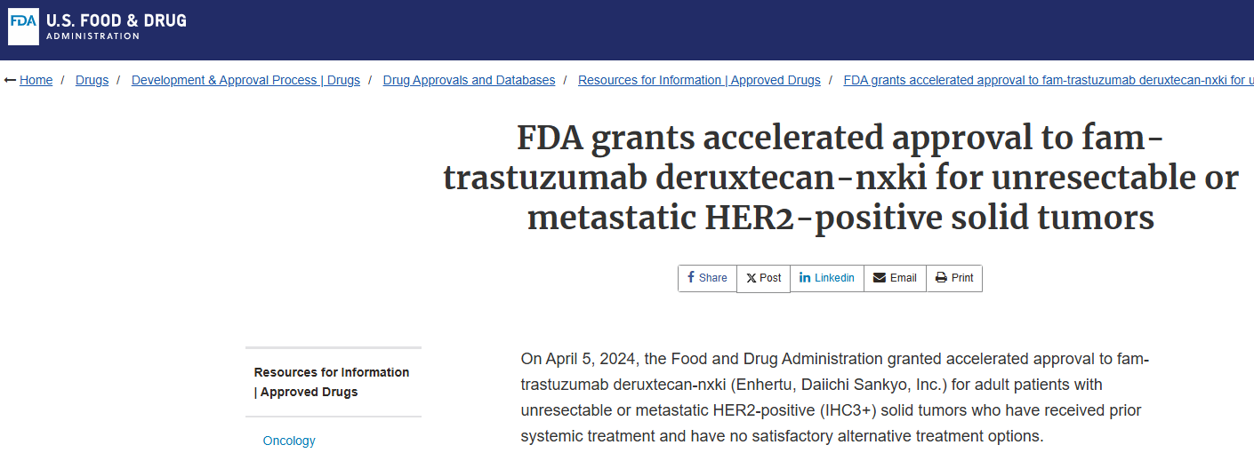
Her2 targeted therapy in ovarian cancer approvals^{1,2}
No approval³
1. Mehta GU, et al. Oncologist. 2024;29:667-671
2. FDA grants accelerated approval to fam-trastuzumab deruxtecan-nxki for unresectable or metastatic HER2-positive solid tumors. Available here (accessed Feb 2025)
3. The promises of antibody-drug conjugates for ovarian cancer. Available here (accessed Feb 2025)

Slide 70
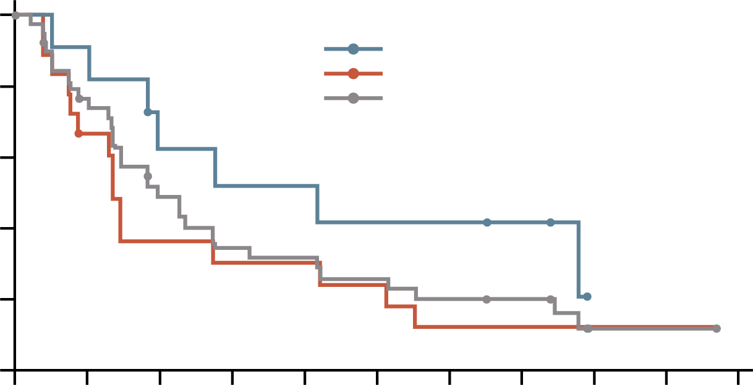
Her2-targeted therapy on the horizon for ovarian cancer
Destiny-pantumor02 phase 2 trial of trastuzumab deruxtecan
ORR across tumour cohorts according to
HER2 status
HER2 expression (2+ or 3+ by IHC) required
PFS for ovarian cancer according to type
1.0
Median PFS in months (95% CI)
IHC 3+ 12.5 (3.1-NR)
IHC 2+ 4.1 (2.3-12.6)
Total 5.9 (4.0-8.3)
0.8
0.6
PFS (probability)
Confirmed ORR (%)
0.4
0.2
0.0
0
3
6
9
12
15
18
21
24
27
30
40
No. at risk
IHC 3+
IHC 2+
Total
Time since first dose (months)
11
19
40
10
11
28
6
6
17
5
5
12
5
5
11
4
4
9
4
2
7
3
2
6
0
1
1
1
1
0
0
N =
40
13
17
40
8
20
40
11
19
Endometrial
Cervical
Ovarian
IHC, immunohistochemistry; NR, not reached; ORR, objective response rate; PFS, progression free survival
Meric-Bernstam F, et al, J Clin Oncol. 2024;42:47-58

Slide 71
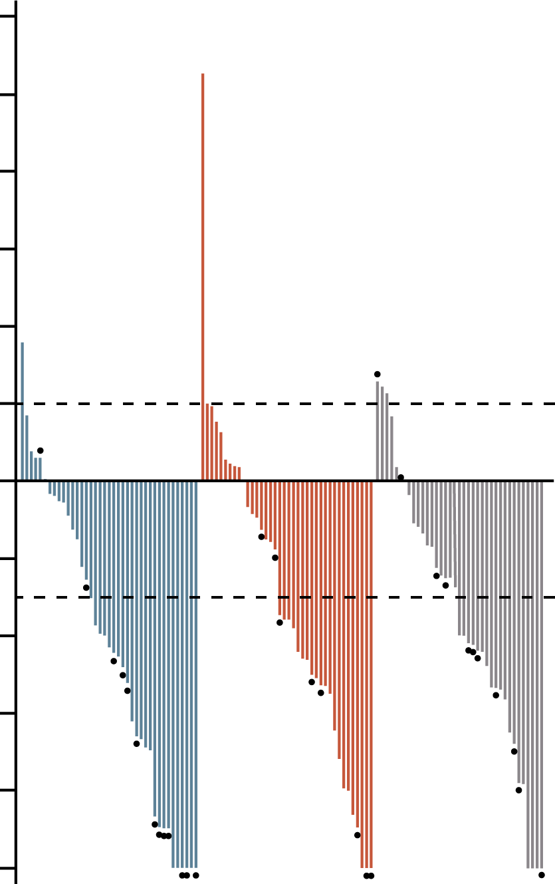
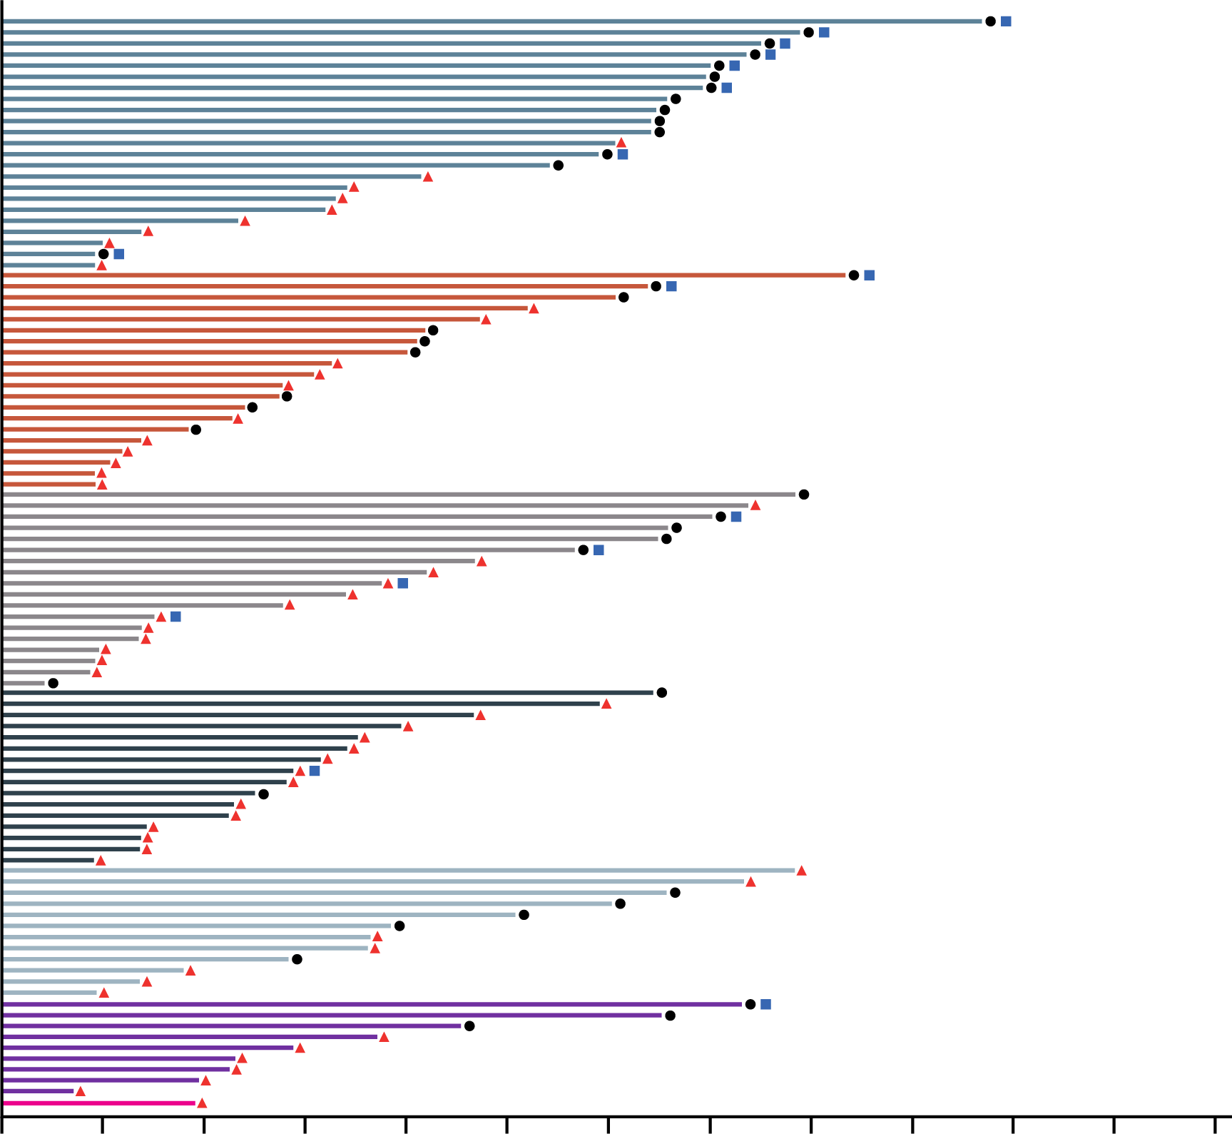
Her2-targeted therapy on the horizon for ovarian cancer
Destiny-pantumor02 phase 2 trial of trastuzumab deruxtecan
HER2 expression (2+ or 3+ by IHC) required
Maximum change in tumour size across tumour cohorts
DoR in patients with an objective response
120
100
Centrally tested as IHC 3+
Endometrial cancer
Cervical cancer
Ovarian cancer
80
60
Censored
End of response
Patient with complete response
40
20
Patients
Maximum change in tumour size
from baseline (%)
Endometrial cancer
Cervical cancer
Ovarian cancer
Bladder cancer
Other tumours
BTC
Pancreatic cancer
0
-20
-40
-60
-80
-100
0
3
6
9
12
15
18
21
24
27
30
33
36
Patients
Time (months)
BTC, biliary tract cancer; DoR, duration of response; IHC, immunohistochemistry;
Meric-Bernstam F, et al, J Clin Oncol. 2024;42:47-58

Slide 72
Her2-targeted therapy on the horizon for ovarian cancer
IBI354 phase 1 study – study design¹ trastuzumab conjugated to NT3, a topoisomerase1 inhibitor
Dose escalation
(DLT window: 21 days)
Dose expansion
Locally advanced/ unresectable or metastatic solid tumour that is refractory to or intolerable with standard treatment
HER2 alteration (IHCª 1+, IHC 2+, IHC 3+ and/or ISH+ and/or NGS mutation or amplification
At least one measurable lesion
ECOG PS 0 or 1
Breast cancer
Ovarian cancer
Endometrial cancer
12 mg/kg Q3W
Dose levels
0.8 ~ 18 mg/kg Q3W
Cervical cancer
9 mg/kg Q3W
Colorectal cancer
6 mg/kg Q3W
Biliary tract cancer
Other solid tumours
Primary endpoints: Safety, dose-limiting toxicities
Secondary endpoints: Pharmacokinetics, anti-drug antibody, efficacy
Over 65% of patients had tumours with HER2 intensity 1+ by IHC
ª HER2 expression by immunohistochemistry (IHC) was tested via local lab or central lab according to PATHWAY HER2 (4B5) if local test not feasible (ASCO/CAP gastric cancer guideline²). All enrolled patients were required to provide the most recent pre-enrolment tumour samples for central test
DLT, dose-limiting toxicity; ECOG PS, Eastern Cooperative Oncology Group performance status; IHC, immunohistochemistry; ISH, in-situ hybridisation; NGS, next-generation sequencing; Q3W, every 3 weeks
1. Shu J, et al. Ann Oncol. 2024;35 (suppl 2):S551 (presented at ESMO 2024); 2. Bartley AN, et al. J Clin Oncol. 2017;35:446-464

Slide 73
Her2-targeted therapy on the horizon for ovarian cancer
IBI354 phase 1 study – safety trastuzumab conjugated to NT3, a topoisomerase1 inhibitor
AE, n (%) | Overall (N=132)
 | Any grade | Grade ≥3
Any TEAE | 127 (96.2) | 52 (39.4)
Any TRAE | 114 (86.4) | 31 (23.5)
ILDª | 2 (1.5) | 0 (0.0)
Common TRAEs (≥10% or G3+ >1%)
Grade ≥3 TRAEs occurred in 23.5% of patients. Low incidences of Grade ≥3 myelosuppression (including WBC decreased, anaemia, neutrophil count decreased, and platelet count decreased), vomiting (1.5%) and diarrhoea (0.8%).
No Grade ≥3 nausea, fatigue and alopecia
No Grade 5 TRAE
Low incidence of ILD
(Grade 1 in both patients)
Patients (%)
Data cutoff: 2024-7-24
ª ILD, pneumonitis or interstitial lung disease related to IBI354 considered by the investigator
AE, adverse event; G, grade; ILD, interstitial lung disease; TEAE, treatment-emergent AE; TRAE, treatment-related AE; WBC, white blood cell (count)
Shu J, et al. Ann Oncol. 2024;35 (suppl 2):S551 (presented at ESMO 2024)

Slide 74
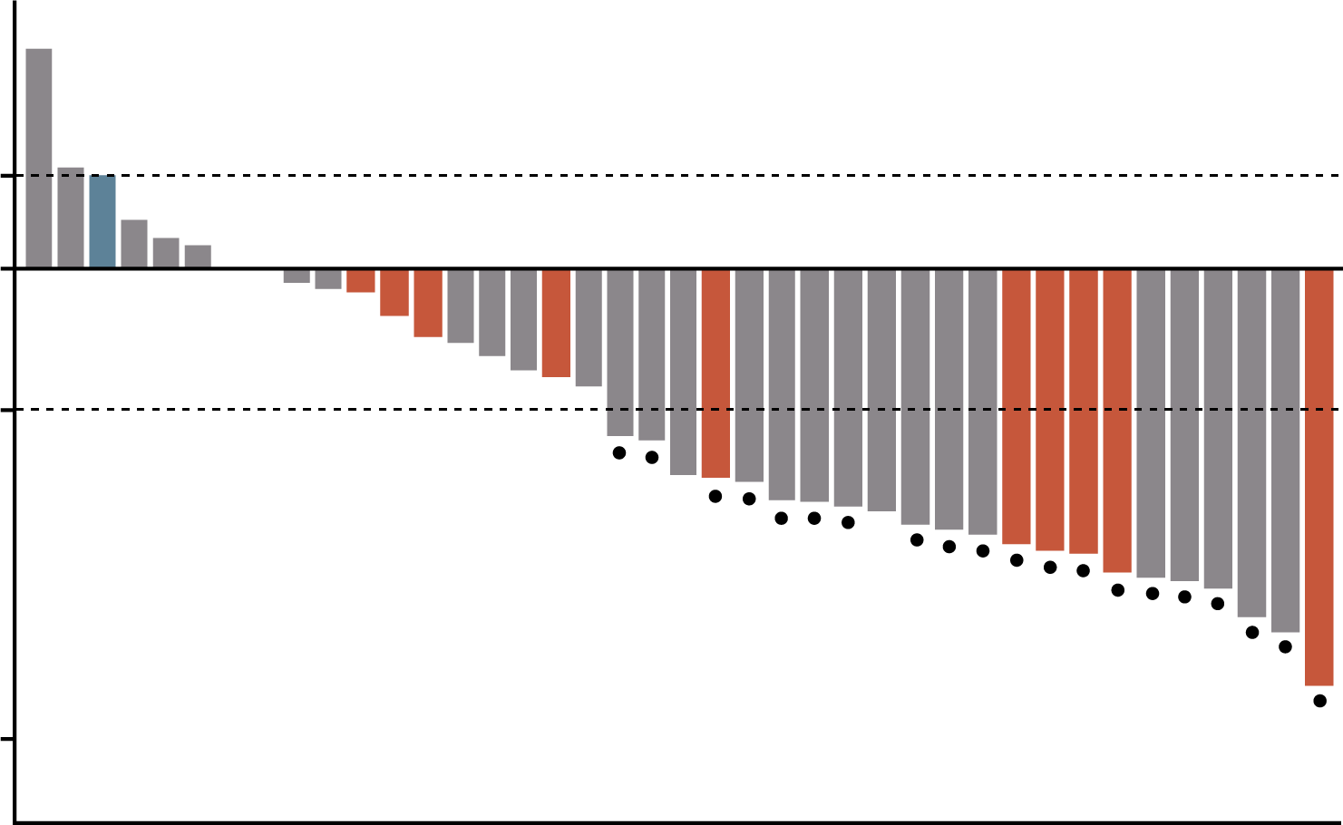
Her2-targeted therapy on the horizon for ovarian cancer
IBI354 phase 1 study - efficacy trastuzumab conjugated to NT3, a topoisomerase1 inhibitor
Ovarian cancer, n (%) | 12 mg/kg Q3W (N=40) | Total (N=87)ª
Prior treatment regimens ≥3 | 40 (100.0) | 87 (100.0)
Prior platinum | 40 (100.0) | 87 (100.0)
Platinum-free interval <6 months | 35 (87.5) | 78 (89.7)
Prior taxanes | 39 (97.5) | 84 (96.6)
Prior bevacizumab | 33 (80.5) | 70 (77.8)
Best response cPR SD PD | 21 (52.5) 15 (37.5) 4 (10.0) | 35 (40.2) 36 (41.4) 16 (18.4)
cORR 95% CI | 21 (52.5) 36.1-68.5 | 35 (40.2) 29.9-51.3
DCR 95% CI | 36 (90.0) 76.3-97.2 | 71 (81.6) 71.9-89.1
Patients with ovarian cancer at 12 mg/kg Q3W dose
HER2 expression
IHC 1+
IHC 2+
IHC 3+
20%
0%
Maximum change in tumour size
from baseline
-30%
-100%
Confirmed response
n (%) | Ovarian cancer in 12 mg/kg Q3W dose group (N=40)
 | HER2 IHC 1+ (N=27) | HER2 IHC 2+ (N=12) | HER2 IHC 3+ (N=1)
cORR 95% CI | 15 (55.6) 35.3-74.5 | 6 (50.0) 21.1-78.9 | 0 (0.0) 0-97.5
DCR 95% CI | 24 (88.9) 70.8-97.6 | 12 (100.0) 73.5-100 | 0 (0.0) 0-97.5
In 12 mg/kg Q3W dose group, the confirmed ORR reached 52.5% with a DCR of 90.0% in ovarian cancer
In 27 (67.5%) patients with HER2 IHC 1+:
ORR of 55.6% and DCR of 88.9%
Data cutoff: 2024-7-24
ª For patients with HER2 IHC 1+, 2+ or 3+ via local lab, who received 6 mg/kg or above, with at least one post-baseline tumour assessment
CI, confidence interval; (c)ORR, (confirmed) objective response rate; cPR, confirmed partial response; DCR, disease control rate; IHC, immunohistochemistry; Q3W, every 3 weeks; PD, progressive disease; SD, stable disease
Shu J, et al. Ann Oncol. 2024;35 (suppl 2):S551 (presented at ESMO 2024)

Slide 75
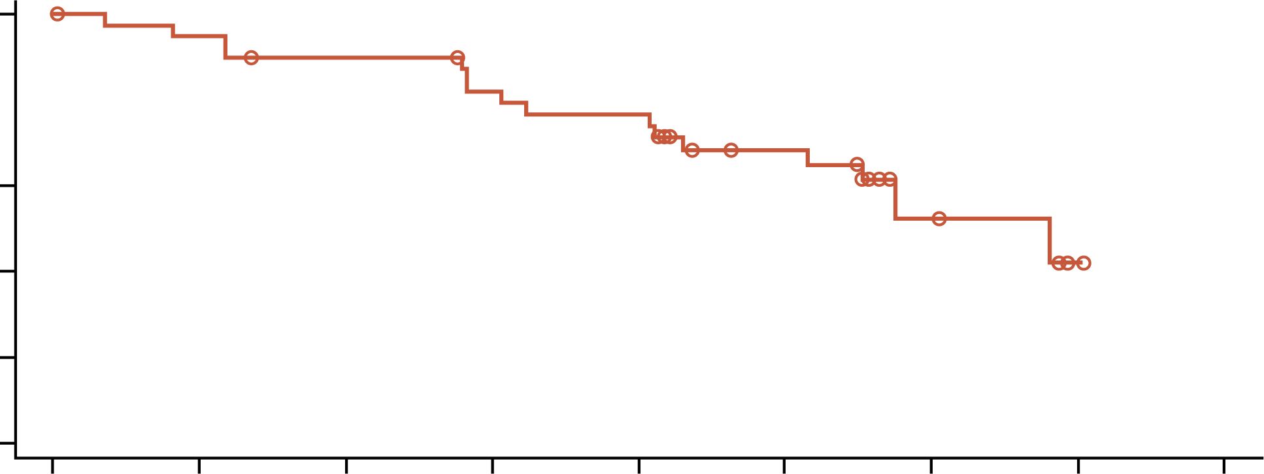
Her2-targeted therapy on the horizon for ovarian cancer
IBI354 phase 1 study - durability of clinical benefit trastuzumab conjugated to NT3, a topoisomerase1 inhibitor
PFS in individuals with ovarian cancer at 12 mg/kg
Q3W dose (N=41)
1.0
0.8
0.6
PFS (probability)
Median PFS (95% CI), months | 6.8 (5.2-NR)
Pts with events, n (%) | 16 (39.0)
6-month PFS rate (95% CI), % | 52.4 (29.9-70.8)
Circles indicate censoring
0.4
0.2
0.0
0
1
2
3
4
5
6
7
8
No. of patients at risk
(censoring)
Study months
41 (0)
38 (1)
35 (2)
31 (3)
29 (3)
20 (9)
6 (20)
1 (24)
0 (25)
As of July 24, 2024, with a median follow-up of 6.5 (range: 4.4-10.2) months in 12 mg/kg Q3W dose group
The median DoR was not reached, with events in 3 (14.3%) patients
The median PFS was 6.8 (95% CI: 5.2-NR) months, with events in 16 (39.0%) patients
HER2-targeting therapies appear safe and effective and will be with us soon in HER2
expressing ovarian cancer
CI, confidence interval; DoR, duration of response; NR, not reached; PFS, progression-free survival; Q3W, every 3 weeks
Shu J, et al. Ann Oncol. 2024;35 (suppl 2):S551 (presented at ESMO 2024)

Slide 76
Her2 testing in ovarian cancer key challenges
Lack of consistency around HER2 scoring systems
Staining issues
Inadequate consideration of histological subtype
to date
Lack of reimbursement for downstream therapies
Doubt in routine pathology laboratory about merits
of testing
Intra-tumoral heterogeneity
of HER2 expression
under explored
Inadequate understanding of stability of HER2 expression through the patient journey

Slide 77
intra-tumoral heterogeneity of HER2 expression underexplored
Serous endometrial cancer study¹
Paired endometrial curetting/biopsy and hysterectomy
40 pairs
HER2 IHC (Abcam EP3 clone) and/or FISH
HER2 IHC in curettage and hysterectomy identical in 26/40 (65%) cases
When FISH included, concordance for HER2 status increased to 31/37 (84%)
Of the six discordant cases, four were HER2 positive in the biopsy/curettage and negative in the hysterectomy; the other two went in the opposite direction
Proposed HER2 scoring system for endometrial serous carcinoma based on the recent clinical
trial patient enrolment criteria²
HER2 score | Staining pattern
0 | No staining
1+ | Faint/barely perceptible, incomplete membrane staining in any proportion, or weak complete staining in <10% of tumour cells
2+ | Intense complete or basolateral/lateral membrane staining in ≤30%, or weak to moderate in ≥10% of tumour cells
3+ | Intense complete or basolateral/lateral membrane staining in >30% of tumour cells
FISH, fluorescence; ISH, in-situ hybridisation
1. Rottman D, et al. Int J Gynecol Pathol. 2021;40:263-271; 2. Fader AN, et al. J Clin Oncol 2018;36:2044–51

Slide 78
Her2 testing in ovarian cancer key challenges
Lack of consistency around HER2 scoring systems
Staining issues
Inadequate consideration of histological subtype
to date
Lack of reimbursement for downstream therapies
Doubt in routine pathology laboratory about merits
of testing
Intra-tumoural heterogeneity
of HER2 expression
under explored
Inadequate understanding of stability of HER2 expression through the patient journey

Slide 79
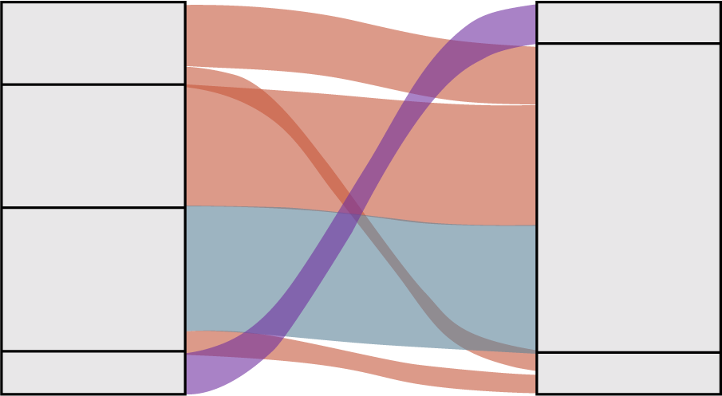
stability of HER2 expression through the patient journey poorly characterised¹
HER2 score² | Expression pattern | Assessment
0 | No reactivity or membranous reactivity in <10% of cancer cells | Negative
1+ | Faint or barely perceptible membranous reactivity in ≥10% of cancer cells; cells are reactive only in part of their membrane | Negative
2+ | Weak or moderate complete, basolateral, or lateral membranous reactivity in ≥10% of cancer cells | Equivocal
3+ | Strong complete, basolateral, or lateral membranous reactivity in ≥10% of cancer cells | Positive
HER2 immunohistochemistry performed on specimens from 200 individuals with ovarian cancer¹
Ventana Discovery platform;
DAKO antibody¹
28% 2+ and 6% 3+¹
By histology:¹
  Mucinous 23% 3+
  Endometrioid 11% 3+
  Clear cell 9% 3+
  High grade serous 5% 3+
19 patients underwent multiple biopsies: of these, 11 showed increased HER2 expression in later biopsies¹
Changes in HER2 expression among patients with time-lagged biopsies¹
Trend
Increased
Not changed
Decreased
0
0
15
1
10
Frequency
2
5
2
0
3
3
HER2 initial
HER2 later
Main caveat: this study included all histologies
1. Kim YN, et al. Sci Rep. 2024;14:7992; 2. Kim KM, et al. Asia Pac J Clin Oncol. 2014;10:297-307

Slide 80
stability of HER2 expression through the patient journey impact of neoadjuvant chemotherapy unknown in ovarian
Possible causes for change in HER2 expression include:
↑ protein internalisation
↑protein degradation
Loss of gene amplification
Using breast cancer as a better explored comparator¹
Changes do occur following neoadjuvant chemotherapy²⁻⁴
More common with IHC than with FISH^{2,3}
Of 12 studies investigating IHC before and after neoadjuvant chemo, six showed a change in HER2 IHC in 1-30% of cases; 1-16% were positive to negative and 4-20% were negative to positive^{2,3}
Of seven studies investigating FISH before and after neoadjuvant chemotherapy, only one identified a change (6% positive to negative; 3.5% negative to positive)^{2,3}
Studies need to be repeated in ovarian cancer
FISH, fluorescence in-situ hybridisation; IHC, immunohistochemistry
1. Kim YN, et al. Sci Rep. 2024;14:7992; 2. Shaaban Am and Provenzano E. Pathobiology. 2022;89:297-308; 3. van de Ven S, et al. Cancer Treat Rev. 2011;37:422-430; 4. Jabbour MN, et al, Breast Cancer Res Treat. 2012;135:29-37;

Slide 81
Ovarian cancer: challenges and considerations for her2 ihc testing patient case
IHC, immunohistochemistry

Slide 82
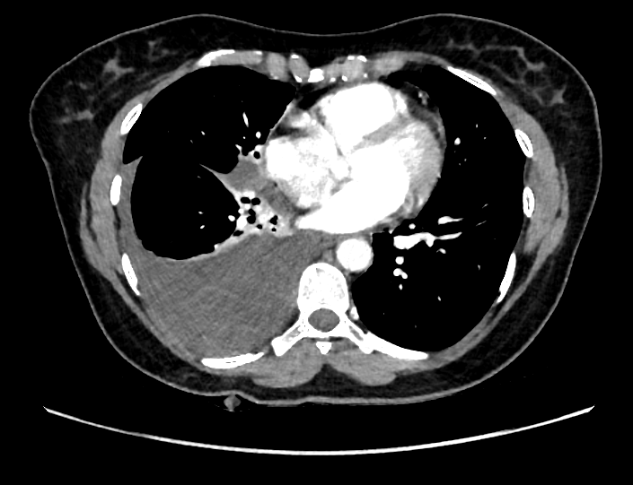
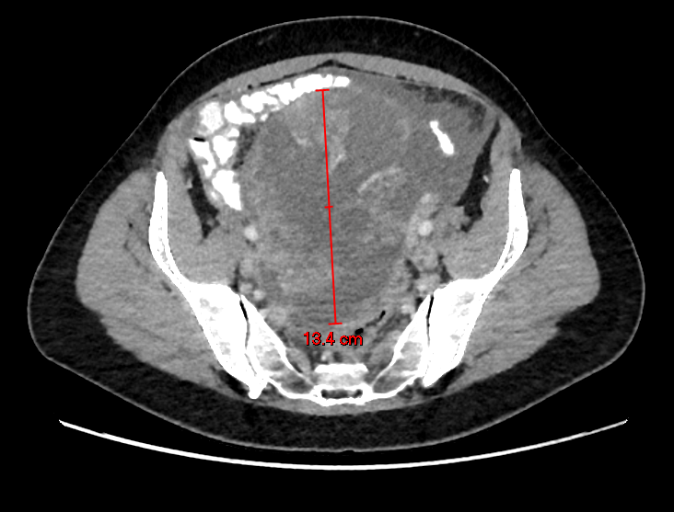
Patient case ovarian cancer
Clinical history
47-year-old patient
Presented to her GP in UK country (not Scotland)
1 year history of tightness around her bra and change in her breathing
Found to have a right pleural effusion
CA125 496ª
Initial intervention
Pleural drainage (1350 mL)
Cytology: no malignant cells
Surgical intervention
Total abdominal hysterectomy, bilateral salpingo-oophorectomy, omentectomy and appendicectomy
Pathology: Grade 1 stage 1C2 mucinous carcinoma of the left ovary, expansile pattern of invasion
CT: right pleural effusion and left complex ovarian mass with ascites, peritoneal enhancement and omental stranding.
ª CA125 496 U/mL
CA125, cancer antigen 125; CT, computed tomography; GP, general practitioner
Patient case and images provided by Prof. C Gourley

Slide 83
POLLING QUESTION
What other molecular tests would you routinely request
in this situation?
Nine gene germ-line panel (BRCA1, BRCA2, RAD51C, RAD51D, BRIP1, PALB2, MLH1, MSH2, MSH6)
Homologous Recombination Deficiency (HRD) testing of tumour
KRAS sequencing and HER2 immunohistochemistry
No additional routine testing indicated at this time

Slide 84
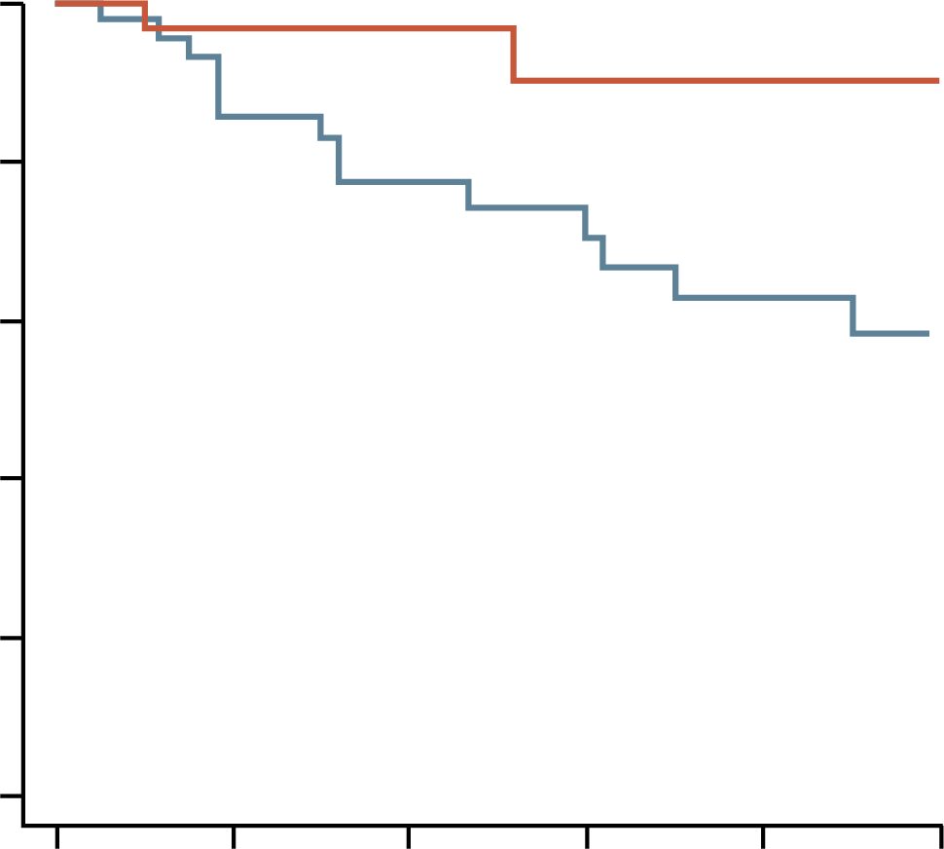
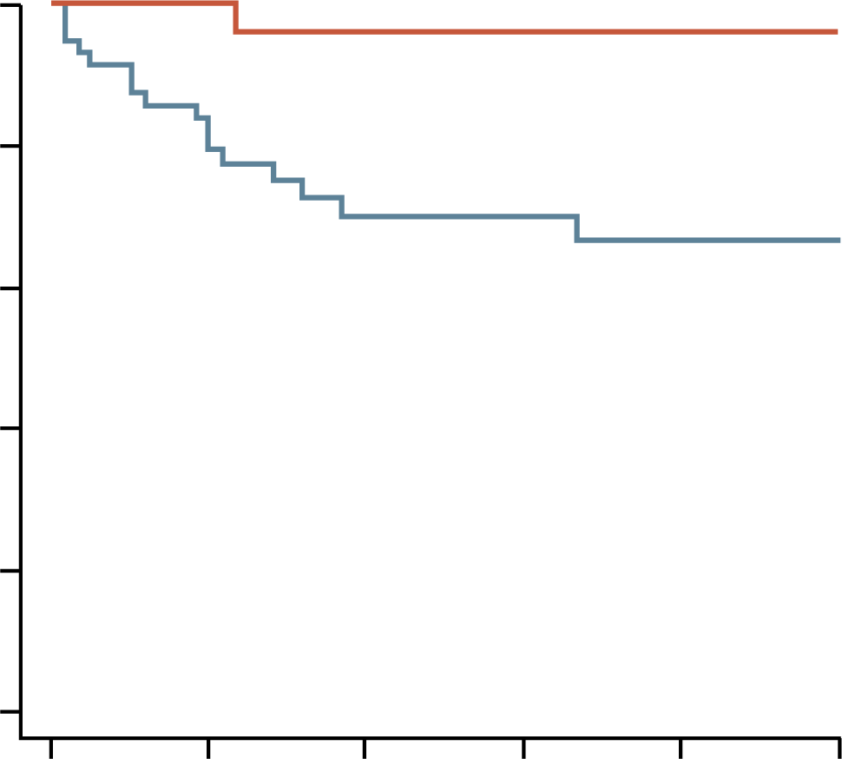
Risk of relapse of expansile mucinous ovarian cancer is low
Recurrence Free Survival
Overall survival
1.0
Mucinous ovarian
carcinomas with
expansile invasion
1.0
Mucinous ovarian
carcinomas with
expansile invasion
0.8
0.8
Mucinous ovarian
carcinomas with
infiltrative invasion
Mucinous ovarian
carcinomas with
infiltrative invasion
0.6
0.6
Probability
Probability
0.4
p=0.02
0.4
p=0.004
0.2
0.2
0.0
0.0
0
12
24
36
48
60
0
12
24
36
48
60
Time (months)
Time (months)
94 cases of mucinous ovarian cancer diagnosed in 13 French centres between Jan 01 2001 and Dec 31 2019
35 (37%) expansile and 59 (63%) infiltrative
Huin M, et al, J Clin Med. 2022;11:6120

Slide 85
POLLING QUESTION
What would be recommended in this situation?
Carboplatin and paclitaxel
Capecitabine and oxaliplatin
Follow-up only
Any of the above

Slide 86
Adjuvant chemotherapy for patients with early-stage mucinous ovarian cancer (Stage I-IIA)
ESMO–ESGO consensus conference recommendations
Mucinous histology
Stage IA
Stage IB/IC1
Stage IC2-IC3
Stage IIA
Expansile
Grade 1-2
Infiltrative
Expansile
Grade 1-2
Infiltrative
Expansile
Grade 1-2
Infiltrative
No adjuvant
chemotherapy
Adjuvant
chemotherapy
(optional)ª
Adjuvant
chemotherapy
(optional)ª
Adjuvant
chemotherapy
Adjuvant
chemotherapy
(optional)ª
Adjuvant
chemotherapy
Adjuvant
chemotherapy
ª Considered no adjuvant chemotherapy only for patients with complete surgical staging
ESGO, European Society of Gynaecological Oncology; ESMO, European Society for Medical Oncology
Colombo N, et al, Ann Oncol. 2019;30:672-705

Slide 87
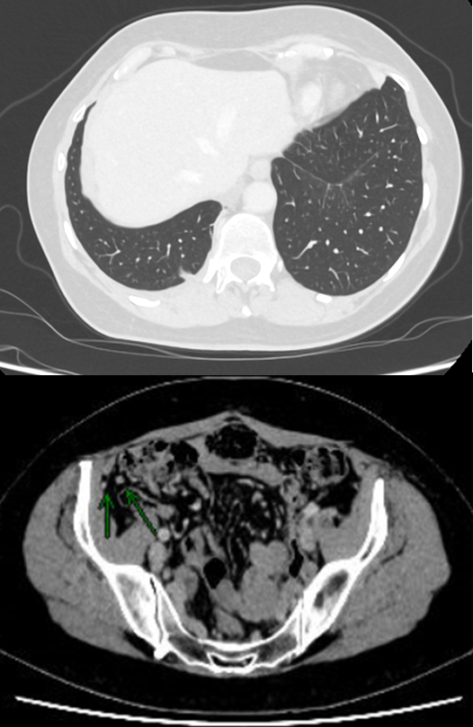
Patient case ovarian cancer
Immediate post-operative management plan
No adjuvant therapy recommended
Regular follow-up by the gynaecological oncology team
During subsequent follow-up
CA125 started to rise 2 years post-diagnosis (55 U/mL)
CT scan at this time showed no recurrent disease
Moved to Edinburgh and care transferred here
CA125 level: 91 U/mL
CT scan showed relapsed disease
CT: progressive right-sided pleural disease, thickened right hemidiaphragm and enlarged nodules close to the caecum
CA125, cancer antigen 125; CT, computed tomography
Patient case and images provided by Gourley C

Slide 88
Patient case ovarian cancer
Right video-assisted thoracoscopic biopsy performed:
Suspicious nodules seen throughout the parietal pleura
Talc pleurodesis performed
Pathology showed metastatic mucinous ovarian adenocarcinoma
Patient case and images provided by Gourley C

Slide 89
POLLING QUESTION
Which molecular abnormality is not associated with mucinous ovarian cancer?
BRCA1 mutation
TP53 mutation
KRAS mutation
HER2 amplification

Slide 90
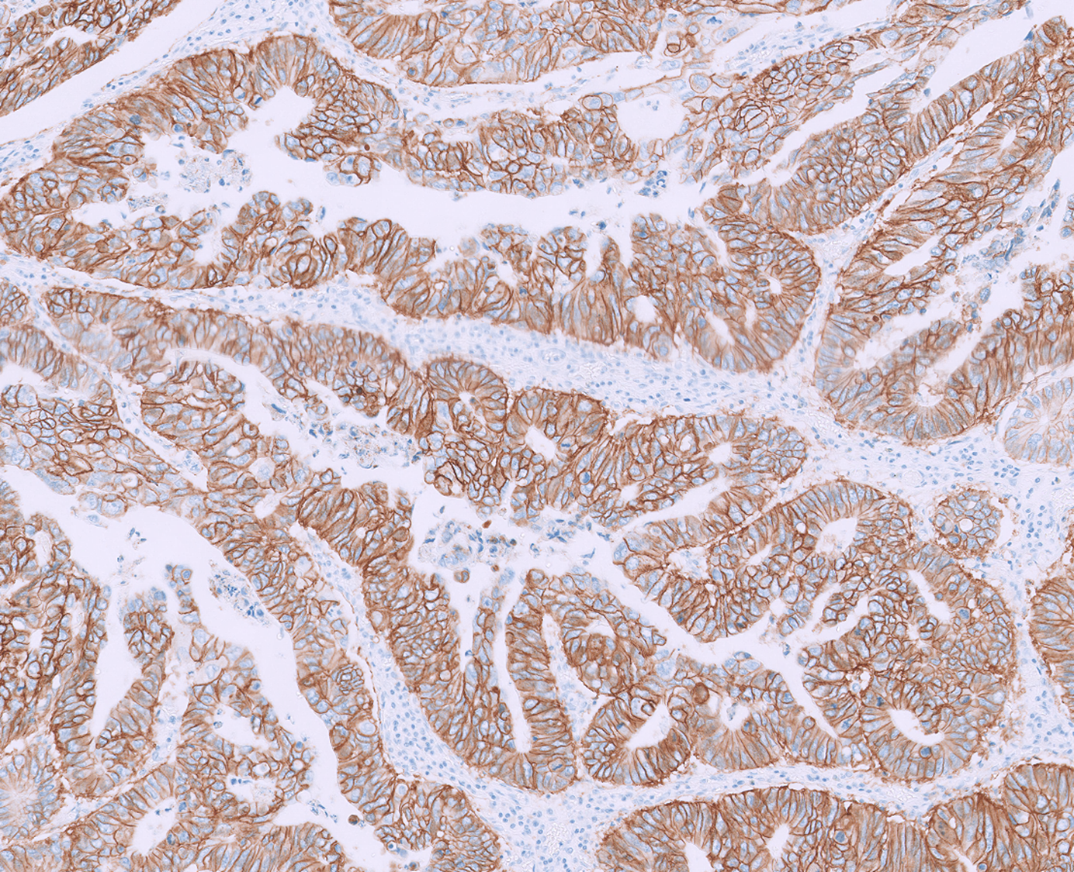
Patient case ovarian cancer
Right video-assisted thoracoscopic biopsy performed:
Suspicious nodules seen throughout the parietal pleura
Talc pleurodesis performed
Pathology showed metastatic mucinous ovarian adenocarcinoma
KRAS testing on primary tumour revealed no activating mutations
HER2 staining on primary tumour suggested over-expression
Patient case and images provided by Gourley C

Slide 91
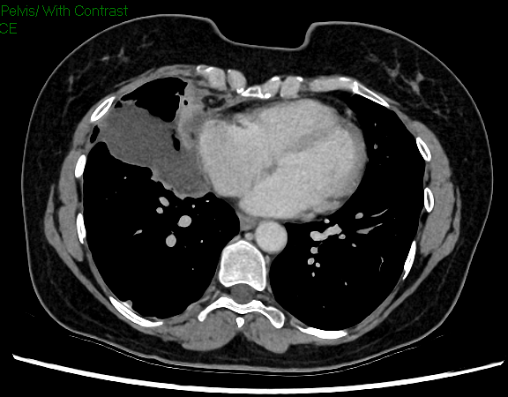
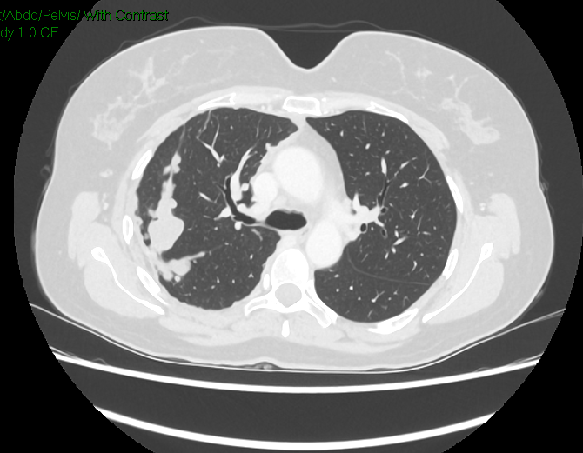
Patient case ovarian cancer
Commenced palliative capecitabine and oxaliplatin (CAPOX) chemotherapy
CT scan after three cycles showed stable disease
Some response on the basis of CA125
Chemotherapy discontinued after 4 cycles because of angina
(treatment-induced coronary artery spasm)
CT scan performed two months later showed progression of right
pleural disease
CA125
50
45
40
30
CA125 level (U/mL)
20
17
17
20
14
15
13
12
12
10
11
10
0
Time
CT: Progression in right pleural disease with enlarging solid component extending along fissures and anterior mediastinal pleura with new loculated anterior right pleural effusion. Invasion of right epiphrenic/epicardial fat and suspicion of pericardial involvement
CA125, cancer antigen 125; CT, computed tomography
Patient case and images provided by Gourley C

Slide 92
Patient case – ovarian cancer bouquet study discussed with patient
Platform study for multiple rare ovarian cancers; endometrioid, clear cell, low grade serous etc
Arm decided by Foundation Medicine testing and ER staining
PTENLOF alteration and/or PIK3CA-
or AKT1-activating mutation
Measurable persistent or recurrent platinum-resistant rare eOC (LGSOC, clear-cell, mucinous, undifferentiated or grade 1/2 endometrioid carcinoma, carcinosarcoma, malignant Brenner tumour or mesonephric-like adenocarcinoma)
One to four prior lines of non‑hormonal systemic therapy
ECOG PS 0 or 1
Tumour sample if available
Ipatasertib + paclitaxel
n=20 per arm, with potential to expand to n=50
BRAF/KRAS/NRAS-activating
mutation and/or NF1LOF alteration
Cobimetinib
ERBB2-amplified and/or mutated
Trastuzumab emtansine
Prescreening: Biomarker testing (F1CDx and ER IHC) and pathology
Non-matched
Atezolizumab + bevacizumab
General and arm-specific screening
ER+
Giredestrant + ademaciclib
PIK3CA-activating mutation
Inavolisib + palbociclib
ER+ and PIK3CA-activating mutation
Inavolisib + palbociclib + letrozole
Non-matched
Inavolisib + olaparib
ER+ and PIK3CA-activating mutation
Inavolisib + giredestrant
PIK3CA-activating mutation
Inavolisib + bevacizumab
Primary efficacy endpoint:
investigator-assessed cORR per RECIST v1.1
Non-matched
Atezolizumab + bevacizumab
cyclophosphamide
ECOG PS, Eastern Cooperative Oncology Group performance status; eOC, epithelial ovarian cancer; ER, estrogen receptor; IHC, immunohistochemistry; LGSOC, low-grade serous ovarian cancer; LOF, loss of function; RECIST, response Evaluation Criteria in Solid Tumours
https://clinicaltrials.gov/study/NCT04931342

Slide 93
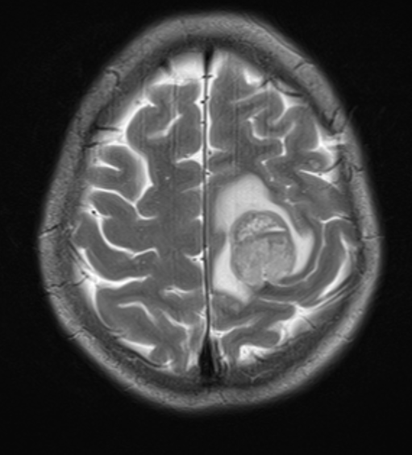
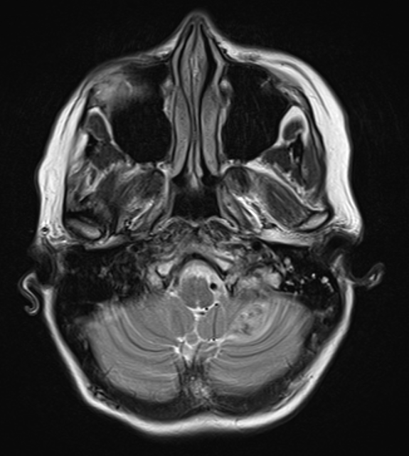
Patient case ovarian cancer
Patient received 17 cycles of 3-weekly trastuzumab emtansine
Only toxicity was Grade 1 nausea
Ejection fraction was satisfactory throughout
Best response on trial was a partial response after 16 cycles
Tumour markers normalised
Unfortunately, shortly after the scan suggesting partial response suffered an acute right-sided weakness
Imaging and MRI showed multiple bilateral cerebral and cerebellar metastases
Treated with palliative whole brain radiotherapy (3000 cGy in five fractions)
Returned to her home country for end-of-life care
cGy, centigray; MRI, magnetic resonance imaging
Patient case and images provided by Gourley C

Slide 94
Ovarian cancer: challenges and considerations for her2 ihc testing conclusions
IHC, immunohistochemistry

Slide 95
Conclusions her2-targeting therapies for ovarian cancer are on the horizon
Initially, HER2-targeting therapies will be used in relapsed disease in the palliative setting
  There is a high chance they will be moved earlier in the patient journey, in particular for certain ovarian cancer histological subtypes and specific molecular subgroups
Uncertainty remains regarding whether sensitivity to these agents will differ between ovarian cancer histological subtypes for a given level of HER2 expression
For ovarian cancer, uncertainties remain regarding:
  Intra-tumoral heterogeneity of HER2 expression
  How expression changes during the patient journey
  The extent to which this is impacted by previous therapy

Slide 96
Ovarian cancer: challenges and considerations for her2 ihc testing
Q&A Session
IHC, immunohistochemistry

Slide 97
Panel discussion and audience questions

Slide 98
Future perspectives and key clinical takeaways
Fernando López-Ríos MD, PhD
Pathologist
12 de Octubre University Hospital
Madrid, Spain

Slide 99
future perspectives her2 testing: the evolving role of IHC in lung and ovarian cancer
Comprehensive genomic profiling and HER2 IHC for all patients with lung and ovarian carcinomas to better understand HER2 alterations and guide personalized treatment strategies
  Integration of ultrafast NGS and AI-powered HER2 scoring
  AI algorithms: a new member of the clinical/ molecular tumor board

Slide 100
Key clinical takeaways her2 testing: the evolving role of IHC in lung and ovarian cancer
Standardise HER2 IHC for lung and ovarian carcinoma patients to ensure consistent and reliable results
Implement high-quality HER2 IHC testing by:
  Engaging in pre-analytical processes
  Using validated IHC assays
  Adopting scoring and reporting guidelines (e.g., 3+ with a 10% cut-off)
HER2 alterations in lung carcinoma encompass both amplifications and mutations, highlighting the importance of comprehensive testing for accurate diagnosis and treatment planning
Incorporate HER2 testing earlier in the patient journey for ovarian carcinoma, to guide timely and informed treatment decisions
Emerging HER2-targeted therapies with antibody-drug conjugates are showing promise in the treatment of HER2-altered ovarian and lung cancers
IHC, immunohistochemistry

