Slide 2
Lung connect
The evolving treatment landscape in BRAF^{V600E} mutated NSCLC
Prof. Amanda Tufman, MD
Ludwig-Maximilians-University of Munich, München, Germany
MARCH 2025

Slide 3


Developed by LUNG COnnect
This programme is developed by LUNG CONNECT, an international group of experts in the field of thoracic oncology and brought to you alongside PRECISION ONCOLOGY CONNECT, an international group of experts in the field of detection and treatment of targetable genetic/genomic alterations in various cancers
Acknowledgement and disclosures
LUNG CONNECT programme is supported through an independent educational grant from Pierre Fabre Laboratories.
The programme is therefore independent; the content is not influenced by the supporter and is under the
sole responsibility of the experts.
Please note:
This educational programme is intended for healthcare professionals outside the UK and ROI only
The views expressed within this programme are the personal opinions of the experts. They do not
necessarily represent the views of the experts’ academic institutions, organisations,
Pierre Fabre Laboratories, or another group or individual
Expert disclosures:
Prof. Amanda Tufman has received financial support/sponsorship for research support, consultation, or
speaker fees from the following companies: Amgen, AstraZeneca, Boehringer Ingelheim, BMS, Celgene,
Lilly, MSD, Novartis, Pierre Fabre Laboratories, Roche and Takeda

Slide 4
Clinical takeaways
BRAF^{V600E} is an actionable mutation for metastatic NSCLC with effective and well-tolerated treatment options available
The BRAF mutation should be tested for at the time of first diagnosis for all patients with advanced NSCLC
Only around half of patients with metastatic NSCLC receive a second-line treatment, so the most appropriate, efficacious treatments should be used in the first-line setting
BRAF-targeted treatment combinations are approved for first-line treatment of NSCLC
NSCLC, non-small cell lung cancer

Slide 5
Educational objectives
Understand the clinical trial data and emerging profile (efficacy and potential toxicities) of therapies for the treatment of BRAF^{V600E} mutated NSCLC
Recognise the appropriate placement of therapies for the treatment of BRAF^{V600E} mutated NSCLC across the patient journey
NSCLC, non-small cell lung cancer

Slide 6
Driver mutations in nsclc
NTRK rearrangement (0.23%)
Targetable oncogenic driver molecular alterations in NSCLC²
RET rearrangement (1.7%)
Non-small cell lung cancer (NSCLC), which constitutes >80% of all lung cancers, remains a leading cause of cancer-related deaths worldwide¹
Numerous oncogenic driver mutations that contribute to the molecular pathogenesis of lung cancers have been characterised, leading to the development of targeted therapies for NSCLC patients²
BRAF V600E mutation (2.1%)
HER2 exon 20 insertion mutation (2.3%)
ROS1 rearrangement (2.6%)
◼︎ No actionable
alteration
MET exon 14 mutation (3.0%)
ALK rearrangement (3.8%)
◼︎ Other KRAS mutation
◼︎ KRAS G12C mutation
◼︎ Other EGFR mutation
◼︎ EGFR exon
20 insertion
mutation
Outer circle: Asian populations
Inner circle: Western populations
◼︎ EGFR exon 19 deletion and L858R mutation
BRAF, B-Raf proto-oncogene; EGFR, epidermal growth factor receptor; HER2, human epidermal growth factor receptor 2; KRAS, Kirsten ras oncogene; MET, MET proto-oncogene; NTRK, neurotrophic tyrosine receptor kinase; RET, RET proto-oncogene; ROS1, ROS proto-oncogene 1 receptor tyrosine kinase
1. Zhen D, et al. Oncotarget. 2016;7:41691-41702; 2. Tan AC and Tan DSW. J Clin Oncol. 2022;40:611-25

Slide 7
Overview of braf mutations
Mutations in the v-Raf murine sarcoma viral oncogene homolog B (BRAF) gene are found in approximately
4–8% of all cancers, with the greatest number found in colorectal cancer, melanoma, and non-small cell lung cancer (NSCLC)¹
The most common BRAF mutation is a point mutation (T1799A) resulting in an amino acid substitution at
codon 600 (V600E), which confers constitutive BRAF kinase activity¹
BRAF V600E accounts for ~1–2% of NSCLCs, making it an actionable therapeutic target¹
BRAF mutations are classified into three different classes based on their biological characteristics:
  Class 1: kinase activated, codon 600, e.g. V600E, V600K, V600D¹⁻³
  Class 2: kinase activated, non-codon 600, e.g. K601E, L597V/Q/R, G469V/S/R/E/A, G464V¹⁻³
  Class 3: kinase impaired, e.g. G596R, D594Y/N/G/E, N581Y/S/I, G466V/L/E/ A, D287Y¹⁻³
Currently approved BRAF inhibitors effectively inhibit only class 1 mutant proteins and show substantially less efficacy against BRAF-mutant dimers¹
NSCLC, non-small cell lung cancer
1. Planchard D, et al. NPJ Precis Oncol. 2024;8:90; 2. Tabbò F, et al. Cancer Treat Rev. 2022;103:102335; 3. Guaitoli G, et al. Drugs Context. 2023;12: 2022-11-3

Slide 8
Clinical characteristics
BRAF mutations are predominantly found in adenocarcinomas (>85%). However, there is no clear association of BRAF mutation status with other patient characteristics, such as age, ethnicity, and sex¹
The majority of patients with BRAF mutated NSCLC are current or former smokers:²
  20-30% of patients harbouring V600E mutations are never smokers
  almost all patients with non-V600E alterations are heavy smokers
Metastatic spread to the central nervous system appears to be frequent in patients with BRAF mutated NSCLC,³ similar to other molecularly driven lung cancers⁴. The incidence of brain metastases at diagnosis is significantly lower for patients with class 1 alterations compared with class 2 and 3⁵
NSCLC, non-small cell lung cancer
1. Planchard D, et al. NPJ Precis Oncol. 2024;8:90; 2. Tabbò F, et al. Cancer Treat Rev. 2022;103:102335; 3. Guaitoli G, et al. Drugs Context. 2023;12: 2022-11-3;
4. Weller M, et al. Cancer Treat Rev. 2024;130102807; 5. Dagogo-Jack I, et al. Clin Cancer Res. 2019; 25: 158-65

Slide 9
Combination of braf inhibitors and mek inhibitors
Despite effective anti-tumour activity of BRAF inhibitors (vemurafenib, dabrafenib, encorafenib) in mutated cancers, resistance eventually develops, mostly due to MAPK pathway reactivation, leading to subsequent disease progression¹
It was hypothesised that dual MAPK pathway inhibition with BRAF and MEK inhibitors in BRAF^{V600E}-mutant NSCLC might improve efficacy over BRAF inhibitor monotherapy based on observations in BRAF^{V600}-mutant melanoma and delay the onset of resistance²
A number of BRAF inhibitor + MEK inhibitor combinations have shown efficacy in
BRAF-mutant NSCLC^{1,3}
BRAF inhibitor | MEK inhibitor
Dabrafenib | Trametinib
Encorafenib | Binimetinib
NSCLC, non-small cell lung cancer
1. Tabbò F, et al. Cancer Treat Rev. 2022;103:102335; 2. Planchard D, et al. Lancet Oncol. 2016;17:984-93; 3. Riely GJ, et al. J Clin Oncol. 2023;41:3700-11

Slide 10
timeline of treatment advancements for braf mutated nsclc
The identification of BRAF mutations, especially V600E, and their role in cancer led to the development of highly-selective BRAF inhibitors such as vemurafenib, dabrafenib, and encorafenib¹
Both vemurafenib and dabrafenib have confirmed activity against V600E, V600K, V600R, and V600D BRAF mutations¹
Encorafenib has confirmed activity against BRAF^{V600E} and BRAF^{V600K} mutants and BRAF^{WT 1}
EC approval of encorafenibª + binimetinib^{b} for BRAF^{V600E}‑mutant NSCLC⁵
Dabrafenibª + trametinib^{b}
EC & FDA approval for BRAF^{V600E}‑mutant NSCLC^{2,3}
Vemurafenibª
Encorafenibª + binimetinib^{b}
2015
2016
2017
2018
2019
2020
2021
2022
2023
2024
Dabrafenibª
FDA approval of encorafenibª + binimetinib^{b} for BRAF^{V600E}‑mutant NSCLC⁴
Dabrafenibª + trametinib^{b}
Positive data readout in BRAF-mutant NSCLC
Figure adapted from: Planchard D, et al.¹
Approved for BRAF^{V600E}-mutant NSCLC
ª BRAF inhibitors. ^{b} MEK inhibitors.
EC, European Commission; FDA, Food and Drug Administration; NSCLC, non-small cell lung cancer; WT, wild-type
1. Planchard D, et al. NPJ Precis Oncol. 2024;8:90; 2. Novartis’ lung cancer drug combination receives EU approval. Available here. 3. FDA grants regular approval to dabrafenib and trametinib combination for metastatic NSCLC with BRAF V600E mutation. Available here. 4. FDA approves encorafenib with binimetinib for metastatic non-small cell lung cancer with a BRAF V600E mutation. Available here. 5. EMA Recommends Extension of Therapeutic Indications for Encorafenib and Binimetinib. Available here. All accessed Feb 2025

Slide 11
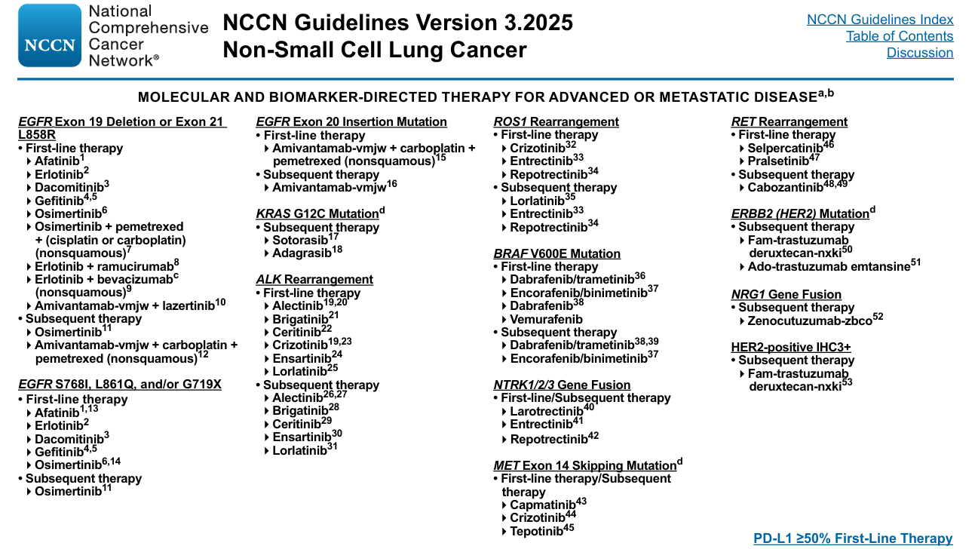
NCCN: Driver mutations in nsclc and targeted therapy options
NCCN, National Comprehensive Cancer Network; NSCLC, non-small cell lung cancer
NCCN Guidelines Version 3.2025. Non-Small Cell Lung Cancer. Available at: https://www.nccn.org/professionals/physician_gls/pdf/nscl.pdf (accessed Feb 2025)

Slide 12
ESMO: Driver mutations in nsclc and targeted therapy options¹
Stage IV mNSCLC, molecular tests positive (EGFR/ALK/ROS1/BRAF/RET/NTRK/MET/HER2/EGFRex20ins/KRAS G12C)
EGFR mutation
ALK translocation
ROS1 translocation
BRAF V600 mutation
RET translocation
NTRK/HER2/
EGFR ex20ins
MET ex14 skipping mutation
KRAS G12C
mutation
Osimertinib
[I, A; MCBS 4; ESCAT I-A]
Gefitinib
[I, B; MCBS 4; ESCAT I-A]
Erlotinib
[I, B; MCBS 4; ESCAT I-A]
Erlotinib–bevacizumab
[I, B; MCBS 2; ESCAT I-A]
Erlotinib–ramucirumab
[I, B; MCBS 3; ESCAT I-A]
Afatinib
[I, B; MCBS 5; ESCAT I-A]
Dacomitinib
[I, B; MCBS 3; ESCAT I-A]
Gefitinib–carboplatin–
pemetrexed [I, B]
Alectinib [I, A;
MCBS 4; ESCAT I-A]
Brigatinib [I, A;
MCBS 4; ESCAT I-A]
Lorlatinib [I, A;
MCBS 4; ESCAT I-A]
Crizotinib [I, B;
MCBS 4; ESCAT I-A]
Ceritinib [I, B;
MCBS 4; ESCAT I-A]
Crizotinib [III, A;
MCBS 3; ESCAT I-B]
Entrectinib [III, A;
MCBS 3; ESCAT I-B]
Alternative:
Repotrectinib
[III, B; ESCAT I-B]
Dabrafenib–trametinib [III, A; MCBS 2;
ESCAT I-B]
Pralsetinib [III, A;
MCBS 3; ESCAT I-C]
Selpercatinib [III, A;
MCBS 3; ESCAT I-C]
Platinum-doublet
ChT ± ICI [IV, B]
Platinum-doublet ChT ± ICI [IV, B]
Capmatinib [III, A; MCBS 3; ESCAT I-B] Tepotinib [III, A; MCBS 3; ESCAT I-B]
Refer to ESMO
CPG on non-
oncogene-addicted
mNSCLC [III, A]
EMA approval in 2024 of encorafenib + binimetinibª
NTRK translocation
HER2
mutation
EGFR ex20ins
mutation
Entrectinib [III, A;
MCBS 3; ESCAT I-C]
Larotrectinib [III, A;
MCBS 3; ESCAT I-C]
Trastuzumab–deruxtecan
[III, B; ESCAT II-B]
Amivantamab [III, B;
MCBS 3; ESCAT I-B]
Mobocertinib [III, C;
MCBS 2; ESCAT I-B]
Capmatinib [III, A;
MCBS 3; ESCAT I-B]
Tepotinib [III, A;
MCBS 3; ESCAT I-B]
Sotorasib [I, B;
MCBS 3; ESCAT I-B]
Adagrasib [III, B;
MCBS 2; ESCAT I-B]
Alternative: if ICI monotherapy given in first-line: platinum-doublet ChT [III, A]
ª Encorafenib + binimetinib received EMA approval for the treatment of adult patients with advanced NSCLC with a BRAF V600E mutation in August 2024 – awaiting next update of ESMO guidelines²
ChT, chemotherapy, CPG, clinical practice guidelines; ESCAT, ESMO Scale for Clinical Actionability of Molecular Targets; ESMO, European Medical Society for Oncology; ex20ins, exon 20 insertion; ICI, immune checkpoint inhibitor; MCBS, ESMO‑Magnitude of Clinical Benefit Scale; (m)NSCLC, (metastatic) non-small cell lung cancer
1. Hendriks LE, et al. Ann Oncol. 2023;34:339-57; 2. EMA Recommends Extension of Therapeutic Indications for Encorafenib and Binimetinib. Available here (accessed Feb 2025)

Slide 13
Dabrafenib plus Trametinib: efficacy
IN PREVIOUSLY TREATED BRAF^{V600E}-MUTANT mNSCLC (COHORT B)
Anti-tumour activityª | Primary analysis (DCO Oct 7th 2015)¹ n=57 | 5-year analysis (DCO Feb 24th 2021)² n=57
Best response, n (%)
CR | 2 (4) | 3 (5)
PR | 34 (60) | 36 (63)
SD | 9 (16) | 7 (12)
PD | 7 (12) | 7 (12)
NE | 5 (9) | 4 (7)
ORR (CR + PR), n (%); [95% CI] | 36 (63.2); [49.3-75.6] | 39 (68.4); [54.8-80.1]
DCR (CR + PR + SD), n (%); [95% CI] | 45 (78.9); [66.1-88.6] | 46 (80.7); [68.1-90.0]
Median PFS [95% CI], months | 9.7 [6.9-19.6] | 10.2 [6.9-16.7]
Median OS [95% CI], months | – | 18.2 [14.3-28.6]
Median duration of response [95% CI], months | 9.0 [6.9-18.3] | 9.8 [6.9-18.3]
ª Investigator assessed
CI, confidence interval; CR, complete response; DCO, data cutoff; DCR, disease control rate; mNSCLC, metastatic non-small cell lung cancer; NE, not evaluable; ORR, objective response rate; OS, overall survival; PD, progressive disease; PFS, progression-free survival; PR, partial response; SD, stable disease
1. Planchard D, et al. Lancet Oncol. 2016;17:984-93; 2. Planchard D, et al. J Thorac Oncol. 2022;17:103-15

Slide 14
Dabrafenib plus Trametinib: tumour responses
TREATMENT-NAÏVE PATIENTS¹
PREVIOUSLY TREATED PATIENTS²
10
Dashed line at 20 represents the RECIST version 1.1 definition for progressive disease and the line at −30 represents the definition for partial response
40
0
-10
20
-20
0
-30
-40
-20
Maximum reduction from
baseline measurement (%)ª
Maximum reduction from
baseline measurement (%)ª
-50
-40
-60
-70
Best confirmed response
Complete response
Partial response
Stable disease
Progressive disease
Not evaluable
-60
Best confirmed response
Complete response
Partial response
Stable disease
Progressive disease
Not evaluable
-80
-80
-90
-100
-100
Patient
Patient
Dashed line at −30% represents the threshold for partial response, according to RECIST version 1.1.
ªBy best confirmed response
RECIST, Response Evaluation Criteria In Solid Tumours
1. Planchard D, et al. Lancet Oncol. 2017;18:1307-16; 2. Planchard D, et al. Lancet Oncol. 2016;17:984-93

Slide 15
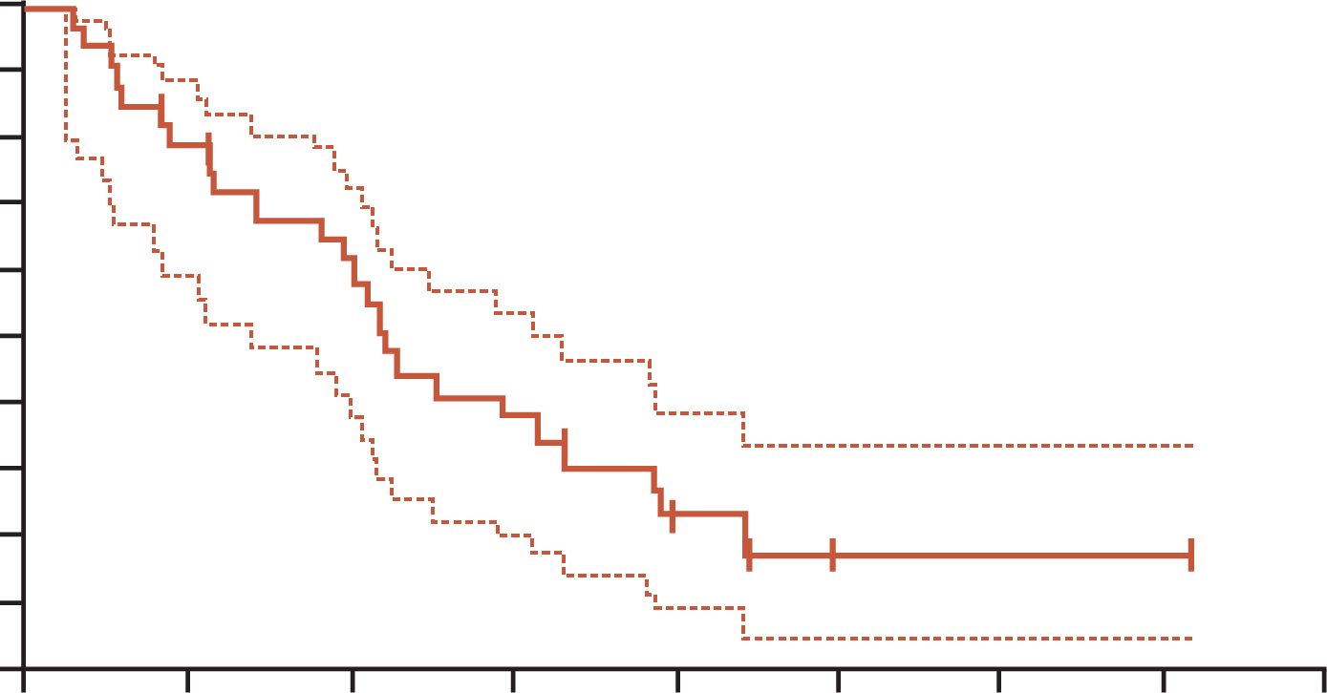
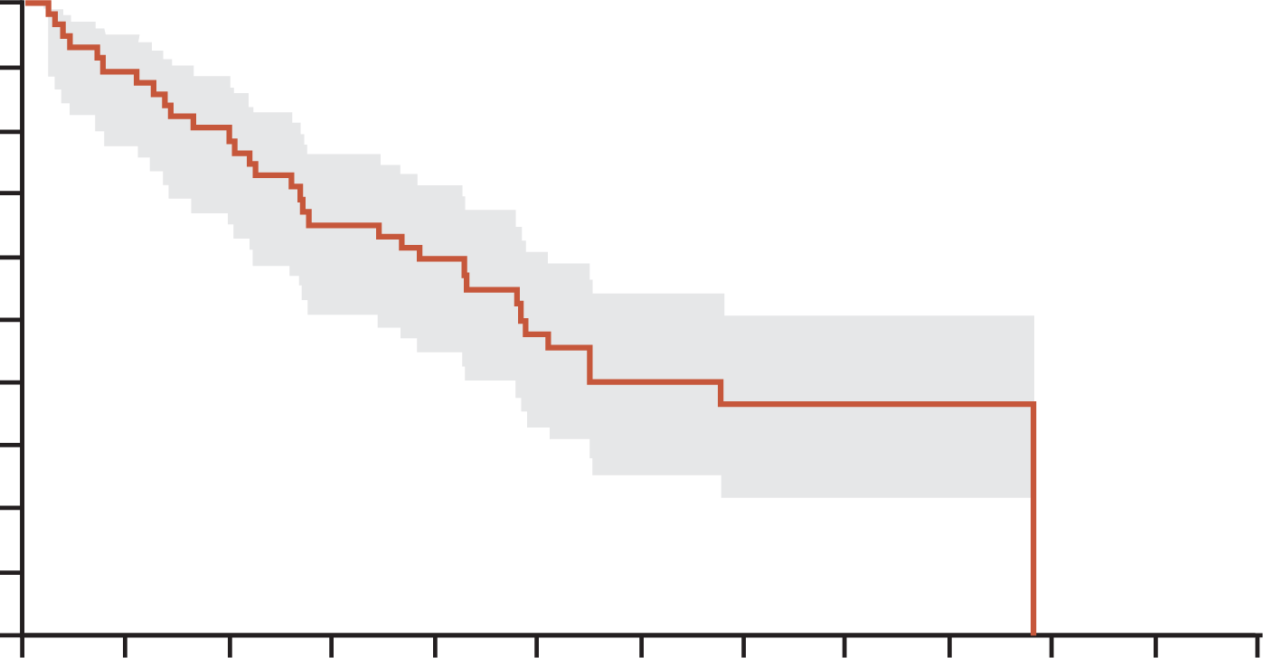
Dabrafenib plus Trametinib: progression-free survival
TREATMENT-NAÏVE PATIENTS¹
PREVIOUSLY TREATED PATIENTS²
100
100
90
90
80
80
70
70
60
60
50
50
Progression-free survival (%)
Progression-free survival (%)
40
40
30
30
20
20
10
10
0
0
0
5
10
15
20
25
30
35
40
0
2
4
6
8
10
12
14
16
18
20
22
24
Time from first dose (months)
Time from first dose (months)
No. at risk
No. censored
36
0
25
4
18
6
11
6
4
9
1
11
1
11
1
11
0
12
No. at risk
No. censored
57
0
49
2
43
3
34
4
31
4
20
10
13
14
7
19
6
20
2
24
0
25
0
25
0
25
Tick marks represent censored patients. Dotted lines in Kaplan-Meier estimated curves represent 95% CIs.
Kaplan-Meier curve of investigator-assessed progression-free survival in patients receiving second-line or later treatment
Shaded area represents 95% CI. Number of patients censored represent cumulative totals
CI, confidence interval
1. Planchard D, et al. Lancet Oncol. 2017;18:1307-16; 2. Planchard D, et al. Lancet Oncol. 2016;17:984-93

Slide 16








Trametinib plus dabrafenib: safety
Adverse events (%) in ≥10% of patientsª
CNS | Grade 1/2 | Grade ≥3
Dizziness Headache | 17 16 | 0 0
 | Systemic | Grade 1/2 | Grade ≥3
 | Pyrexia Chills Fatigue Asthenia Hypotension Hyponatremia Peripheral oedema | 47 23 24 20 12 4 28 | 5 1 1 3 2 6 0
Respiratory | Grade 1/2 | Grade ≥3
Dyspnoea Cough Chest pain^{b} | 13 22 11 | 4 0 0
Haematological | Grade 1/2 | Grade ≥3
Anaemia Neutropenia ALP increased | 12 6 10 | 4 6 0
 | Dermatological | Grade 1/2 | Grade ≥3
 | Rash Dry skin Pruritus | 19 28 12 | 2 1 2
Musculoskeletal | Grade 1/2 | Grade ≥3
Arthralgia Back pain Myalgia | 16 11 12 | 1 1 0
 | Gastrointestinal | Grade 1/2 | Grade ≥3
 | Nausea Diarrhoea Vomiting Constipation Decreased appetite Decreased weight Abdominal pain Increased weight | 46 32 31 16 31 14 12 8 | 0 2 3 0 0 1 1 2
AEs led to dose modifications
Dose reduction Dose interruption | 37 67
Permanent discontinuation | 16
ª AEs shown for dabrafenib plus trametinib occurred in at least 10% of patients in combined data from interim analysis of treatment-naive and previously treated patients.
^{b} Chest pain includes musculoskeletal chest pain
AE, adverse event; ALP alkaline phosphatase, CNS central nervous system
Adapted from Planchard D, et al. NPJ Precis Oncol. 2024;8:90

Slide 17
Encorafenib plus binimetinib: efficacy
IN TREATMENT-NAÏVE AND PREVIOUSLY TREATED BRAF^{V600E}-MUTANT mNSCLC
 | Primary analysis (data cutoff: Sep 22, 2022)¹ |  | Current analysis (data cutoff: Apr 1, 2024)²
 | Treatment naïve n=59 | Previously treated n=39 | Treatment naïve N=59 | Previously treated N=39
Objective response rate (95% CI), %ª | 75 (62, 85) | 46 (30, 63) | 75 (62, 85) | 46 (30, 63)
Complete response, n (%) | 9 (15) | 4 (10) | 9 (15) | 4 (10)
Partial response, n (%) | 35 (59) | 14 (36) | 35 (59) | 14 (36)
Stable disease, n (%) | 10 (17) | 13 (33) | 10 (17) | 13 (33)
Progressive disease, n (%) | 2 (3) | 3 (8) | 2 (3) | 3 (8)
Disease control rate at 24 weeks (95% CI), % | 64 (51, 76) | 41 (26, 58) | 64 (51, 76) | 44 (28, 60)
Median time to response (range), months | 1.9 (1.1-19.1) | 1.7 (1.2-7.3) | 1.9 (1.1-19.1) | 1.7 (1.2-7.3)
Median duration of response (95% CI), months | NE (23.1, NE) | 16.7 (7.4, NE) | 40.0 (23.1, NE) | 16.7 (7.4, NE)
Median PFS (95% CI), months | NE (15.7, NE) | 9.3 (6.2, NE) | 30.2 (15.7, NE) | 9.3 (6.2, 24.8)
Median OS (95% CI), months | NE (26.7, NE) | NE (14.7, NE) | NE (31.3, NE) | 22.7 (14.1, 32.2)
ª Independent radiological review
CI, confidence interval; mNSCLC, metastatic non-small cell lung cancer; NE, not evaluable; OS, overall survival; PFS, progression-free survival
1. Riely GJ, et al. J Clin Oncol. 2023;41:3700-11; 2. Riely GJ, et al. Ann Oncol. 2024;35 (suppl 2):S1246-S1247 (ESMO 2024 oral presentation)

Slide 18
Encorafenib plus binimetinib: tumour responses
TREATMENT-NAÏVE PATIENTS
PREVIOUSLY TREATED PATIENTS
100
160
80
140
Complete response
Partial response
Stable disease
Progressive disease
Not evaluable
120
Complete response
Partial response
Stable disease
Progressive disease
60
100
40
80
20
60
40
0
Change from baseline (%)
Change from baseline (%)
20
-20
0
-40
-20
-60
-40
-60
-80
-80
-100
-100
Patient
Patient
Patients for whom an assessment response was not evaluable at all tumour assessments were not included in this analysis
1. Riely GJ, et al. J Clin Oncol. 2023;41:3700-11

Slide 19
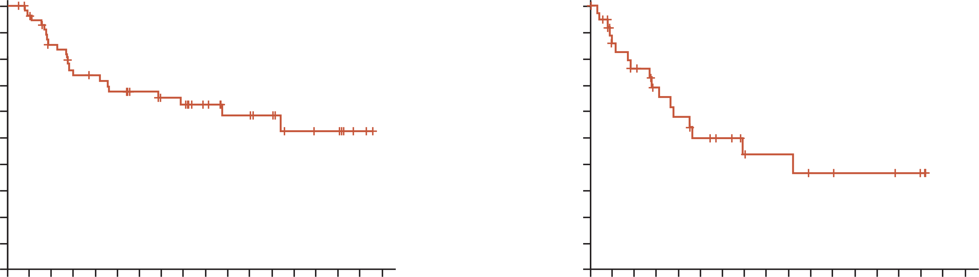
Encorafenib plus binimetinib: progression-free survival
TREATMENT-NAÏVE PATIENTS
PREVIOUSLY TREATED PATIENTS
100
100
90
90
80
80
70
70
60
60
50
50
Progression-free survival (%)
Progression-free survival (%)
40
40
30
30
20
20
10
10
0
0
0
2
4
6
8
10
12
14
16
18
20
22
24
26
28
30
32
34
0
2
4
6
8
10
12
14
16
18
20
22
24
26
28
30
32
34
No. at risk
Treatment-naïve
Time (months)
No. at risk
Previously treated
Time (months)
59
54
45
38
36
33
30
26
25
19
14
14
12
8
7
7
2
0
39
27
23
18
15
12
10
7
6
6
4
4
3
3
2
2
0
0
PFS by independent radiology review
PFS, progression-free survival
1. Riely GJ, et al. J Clin Oncol. 2023;41:3700-11

Slide 20








Encorafenib plus binimetinib: safety
Treatment-related aes (%) in ≥10% of patients
 | Systemic | Grade 1/2 | Grade ≥3
 | Fatigue Asthenia | 30 7 | 2 3
 | Peripheral oedema | 11 | 0
Ocular | Grade 1/2 | Grade ≥3
Blurred vision | 16 | 1
 | Hepatological | Grade 1/2 | Grade ≥3
 | ALT increased AST increased | 7 5 | 5 7
Haematological | Grade 1/2 | Grade ≥3
Anaemia | 15 | 3
Musculoskeletal | Grade 1/2 | Grade ≥3
Blood CPK increased | 11 | 0
 | Dermatological | Grade 1/2 | Grade ≥3
 | Pruritus Dry skin Alopecia | 12 10 10 | 0 0 0
TRAEs led to dose modifications
Dose reduction Dose interruption | 24 44
Permanent discontinuation | 15
 | Gastrointestinal | Grade 1/2 | Grade ≥3
 | Nausea Diarrhoea Vomiting Constipation Abdominal pain | 47 39 28 13 10 | 3 4 1 0 0
AE, adverse event; ALT, alanine aminotransferase; AST, aspartate aminotransferase; CPK, creatine phosphokinase; TRAE, treatment-related AE
Adapted from Planchard D, et al. NPJ Precis Oncol. 2024;8:90

Slide 21
Braf-targeted treatments available – test nsclc patients before treatment!
All patients with advanced NSCLC, irrespective of smoking history, should undergo comprehensive molecular testing to identify molecular drivers— including but not
limited to BRAF^{V600} mutations¹⁻³
Tissue biopsy is the standard for molecular testing.² Liquid biopsy can be a complementary approach,^{2.3} but negative results should be confirmed by tissue testing.²
Broad panel testing using NGS is preferable²
Real-time PCR and NGS using DNA sequencing are the most used methodologies
for examining BRAF mutation status^{1,3}
While an anti-BRAF p.V600E-specific monoclonal antibody is commercially available,
and some studies have examined utilising this approach, it should only be deployed
after extensive validation³
NGS, next-generation sequencing; NSCLC, non-small cell lung cancer; PCR, polymerase chain reaction
1. Planchard D, et al. NPJ Precis Oncol. 2024;8:90; 2. Hendriks LE, et al. Ann Oncol. 2023;34:339-57 (including Supplementary appendix);
3. NCCN Guidelines Version 3.2025. Non-Small Cell Lung Cancer. Available at: https://www.nccn.org/professionals/physician_gls/pdf/nscl.pdf (accessed Feb 2025)

Slide 22
What next? Progression on braf / mek inhibition
NCCN GUIDELINES²
ESMO GUIDELINES¹
Stage IV mNSCLC with BRAF^{V600} mutation
BRAF^{V600E} mutation
First-line therapy
  Dabrafenib/trametinib
  Encorafenib/binimetinib
  Dabrafenib
  Vemurafenib
Subsequent therapy
  Dabrafenib/trametinib
  Encorafenib/binimetinib
Dabrafenib–trametinib
[III, A; MCBS 2; ESCAT I-B]
Encorafenib/binimetinib first-line option based on data from the PHAROS trial^{3,4,a}
Disease progression
Oligoprogression
Systemic progression
Local treatment (surgery or RT)
and continue targeted systemic treatment
Systemic progression
If no smoking history: platinum-based ChT ± immunotherapy [IV, A]
If smoking history: immunotherapy ± platinum-based ChT [IV, B]
Dabrafenib–trametinib if not
received in first-line
[III, A; MCBS 2; ESCAT I-B]
At progression:¹
Consider mechanisms of resistance
Local treatment for oligoprogression
Re-biopsy if feasible
ª Encorafenib + binimetinib received EMA approval for the treatment of adult patients with advanced NSCLC with a BRAF V600E mutation in August 2024 – awaiting next update of ESMO guidelines⁴
Encorafenib/binimetinib as a subsequent treatment based on data from the PHAROS trial^{3,4,a} if a BRAFi not received first-line
BRAFi, BRAF inhibitor; ChT, chemotherapy; ESCAT, ESMO Scale for Clinical Actionability of Molecular Targets; ESMO, European Medical Society for Oncology;
MCBS, ESMO-Magnitude of Clinical Benefit Scale; mNSCLC, metastatic non-small cell lung cancer; NCCN, National Comprehensive Cancer Network; RT, radiotherapy
1. Hendriks LE, et al. Ann Oncol. 2023;34:339-357; 2. NCCN Guidelines Version 3.2025. Non-Small Cell Lung Cancer. Available at: https://www.nccn.org/professionals/physician_gls/pdf/nscl.pdf (accessed Feb 2025); 3. Riely GJ, et al. J Clin Oncol. 2023;41:3700-3711; 4. EMA Recommends Extension of Therapeutic Indications for Encorafenib and Binimetinib. Available here (accessed Feb 2025)

Slide 23
Potential later line treatment options for braf-mutated nsclc
Chemotherapy remains a second-line recommendation for patients with a BRAFV600 mutation
Immunotherapy-based treatments are an option for patients with BRAFV600E-mutant advanced NSCLC
Treatment | Patients, n (BRAF mutation) | Treatment status | Median follow-up, mo | ORR, % | Median PFS, mo | Median OS, mo
Platinum-based doublet chemotherapy | 7 (V600E) | Treatment-naïve | 13.7 | 29 | 4.1 | 10.8
 | 7 (non-V600E) |  | 13.7 | 71 | 8.9 | 15.2
Platinum-based doublet chemotherapy | 23 (V600E and non-V600E) | Treatment-naïve | NA | NA | 6.4 | 18.4
Immunotherapy | 12 (V600E) | Treatment-naïve and previously treated | 5.5 | 25 | 3.7 | NE
 | 10 (non-V600E) |  |  | 33 | 4.1 | NE
Immunotherapy | 17 (V600E) | Treatment-naïve and previously treated | 16.1 | 24 | 1.8 | 8.2
 | 18 (non-V600E) |  |  |  | 4.1 | 17.2
Immunotherapy | 26 (V600) | Treatment-naïve and previously treated | 9.2 | 26 | 5.3 | 22.5
 | 18 (non-V600) |  |  | 35 | 4.9 | 12.0
Immunotherapy | 8 (V600E) | Treatment-naïve | NA | 38 | 10.5 | NA
 | 7 (non-V600E) |  |  | 43 | 10.8 | NA
Immunotherapy as monotherapy or in combination | 43 (V600E) | Treatment-naïve and previously treated | 16.2 | 51.7 | 10.0 | 18.5
 | 16 (non-V600E) |  |  | 31.1 | 8.0 | 16.0
Immunotherapy-combined chemotherapy | 9 (V600E) | Treatment-naïve | NA | 56 | 18.5 | NA
 | 7 (V600E) | Previously treated | NA | 29 | 1.9 | NA
mo, months; NA, not available; NSCLC, non-small cell lung cancer; NE, not estimable; ORR, objective response rate; OS, overall survival; PD-1, programmed cell death protein 1; PD‑L1, programmed death ligand 1; PFS, progression-free survival
Planchard D, et al. NPJ Precis Oncol. 2024;8:90

Slide 24
Future treatment options?
Possible combinations of immune checkpoint inhibitors with BRAF-targeted therapies¹
  Synergistic tumour effect but tolerability will be a consideration¹
  Triple combination therapies (BRAFi + MEKi + IO therapy) investigated in melanoma²
Next-generation BRAF inhibitors²
  First-generation BRAF inhibitors only effective in patients with class 1 BRAF^{V600E} mutations
  Next-generation BRAF inhibitors designed to inhibit class 1-3
BRAFi, BRAF inhibitor; IO, immuno-oncology; MEKi, MEK inhibitor
1. Planchard D, et al. NPJ Precis Oncol. 2024;8:90; 2. Abdayem P and Planchard D. Clin Adv Hematol Oncol. 2022;20:662-72

Slide 25
summary
BRAF mutated NSCLC occurs in smokers and non-smokers¹
Treat patients with BRAF^{V600E} mutated NSCLC with BRAFi plus MEKi combination^{2,3}
  Two combinations available, perhaps differing toxicity, similar efficacy
    Trametinib plus dabrafenib
    Encorafenib plus binimetinib
Disease progression is inevitable and only approximately 50% of mNSCLC patients receive
second-line treatment⁴
Test before commencing first-line treatment - use the most efficacious agents in the first-line setting based on the patient's molecular profile⁴
Reassess at progression, treat oligoprogression with local treatments, re-biopsy if feasible⁵
Second-line treatment options include chemotherapy + IO therapy,⁵ or BRAFi plus MEKi combination if not used for first-line⁶
BRAFi, BRAF inhibitor; IO, immuno-oncology; MEKi, MEK inhibitor; (m)NSCLC, (metastatic) non-small cell lung cancer
1. Zhen D, et al. Oncotarget. 2016;7:41691-702; 2. Tabbò F, et al. Cancer Treat Rev. 2022;103:102335; 3. Riely GJ, et al. J Clin Oncol. 2023;41:3700-11;
4. Planchard D, et al. NPJ Precis Oncol. 2024;8:90; 5. Hendriks LE, et al. Ann Oncol. 2023;34:339-57; 6. NCCN Guidelines Version 3.2025. Non-Small Cell Lung Cancer. Available at: https://www.nccn.org/professionals/physician_gls/pdf/nscl.pdf (accessed Feb 2025)

